Slide 1
Hedging Against Uncertainty with Multiple Diverse Predictions
Dhruv Batra
Virginia Tech
Joint work with:
Students: Aishwarya Agrawal (VT), Harsh Agrawal (VT), Neelima Chavali (VT), Michael Cogswell
(VT), Gordon Christie (VT), Abner Guzman-Rivera (UIUC), Ankit Laddha (CMU),
Adarsh Prasad (UT-Austin), Xiao Lin (VT), Clint Solomon (VT), Qing Sun (VT),
Payman Yadollahpour (TTIC)
Colleagues: Chris Dyer (CMU), Kevin Gimpel (TTIC), Stefanie Jegelka (UC Berekely),
Pushmeet Kohli (MSRC), Greg Shakhnarovich (TTIC), Danny Tarlow (MSRC).

Slide 2
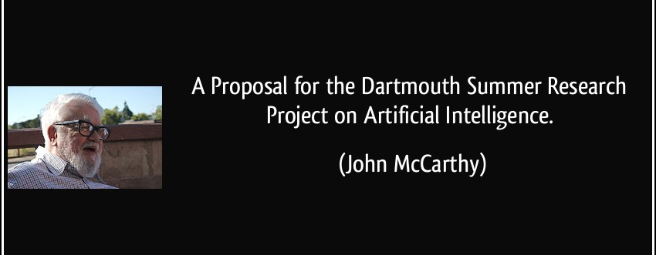
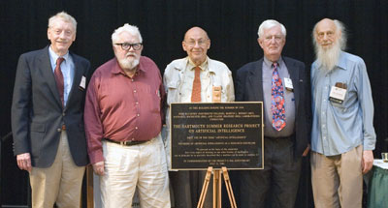
A Brief History of AI
Image Credit: Joseph Mehling; AI@50; http://www.dartmouth.edu/~vox/0607/0724/ai50.html

Slide 3
A Brief History of AI
“We propose that a 2 month, 10 man study of artificial intelligence be carried out during the summer of 1956 at Dartmouth College in Hanover, New Hampshire.”
… [Our] conjecture is that
every aspect of learning or intelligence can
be so precisely described that
a machine can be made to simulate it.
An attempt will be made …
to make machines use language,
form abstractions and concepts,
solve kinds of problems now reserved for humans.
We think that a significant advance can be made
in one or more of these problems if a carefully selected group of scientists work on it together for a summer.”

Slide 4
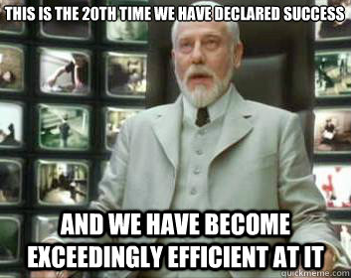
Note of Caution

Slide 5
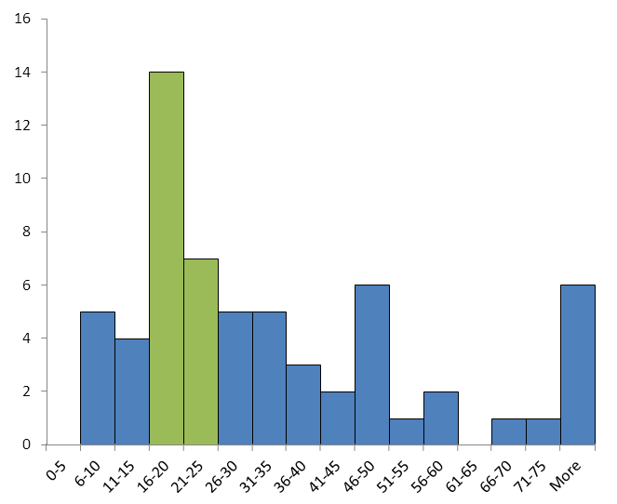
AI Predictions: Experts
Image Credit: http://intelligence.org/files/PredictingAI.pdf

Slide 6
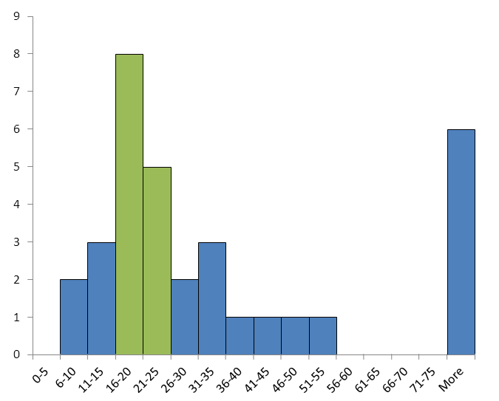
AI Predictions: Non-Experts
Image Credit: http://intelligence.org/files/PredictingAI.pdf

Slide 7
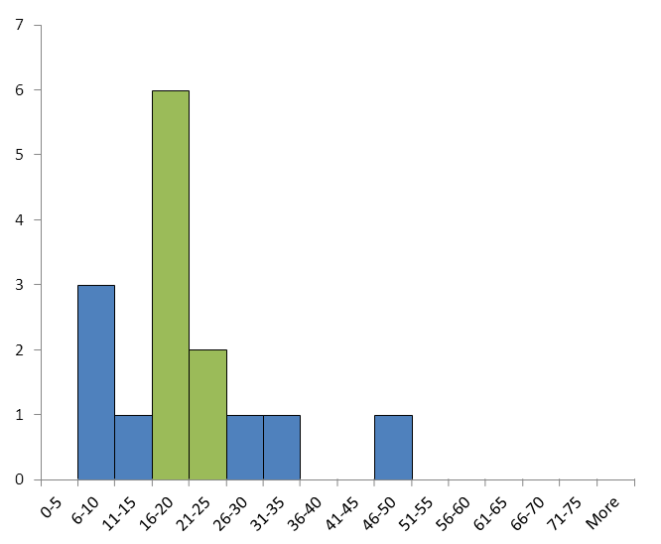
AI Predictions: Failed
Image Credit: http://intelligence.org/files/PredictingAI.pdf

Slide 8
Why is AI hard?
“The three biggest challenges to a computer
being able to build knowledge from data are
Ambiguity, Ambiguity, Ambiguity.”
-- Ray Mooney, CS, UT-Austin,
(quote in reference to IBM Watson).

Slide 9
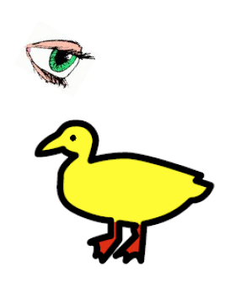
“I saw her duck”
Linguistic Ambiguity
Image Credit: Liang Huang

Slide 10
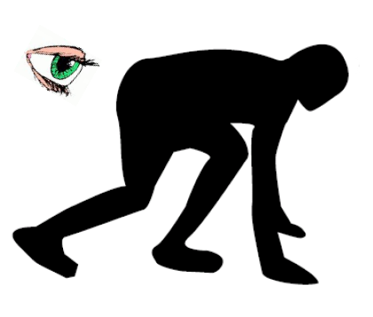
“I saw her duck”
Linguistic Ambiguity
Image Credit: Liang Huang

Slide 11
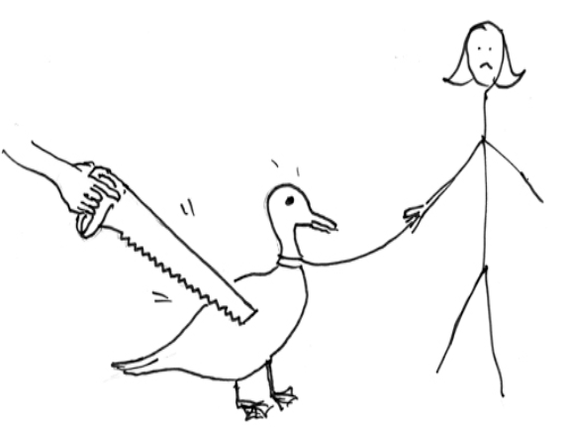
“I saw her duck”
Linguistic Ambiguity
Image Credit: Liang Huang

Slide 12
“I saw her duck with a telescope…”
Linguistic Ambiguity
Image Credit: Liang Huang

Slide 13


Visual Ambiguity
slide credit: Fei-Fei Li, Rob Fergus, & Antonio Torralba

Slide 14
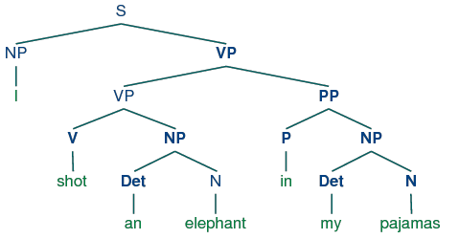
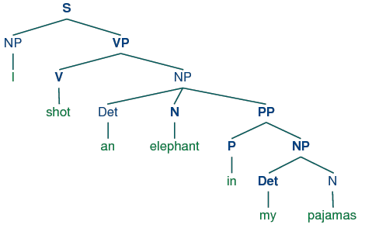
Global Ambiguity
“While hunting in Africa, I shot an elephant in my pajamas.
How an elephant got into my pajamas, I’ll never know!”
  Groucho Marx (1930)

Slide 15
Uncertainty in AI
“uncertainty arises because of
limitations in our ability to observe the world,
limitations in our ability to model it,
and possibly even because of innate non-determinism.”
-- Koller & Friedman

Slide 16
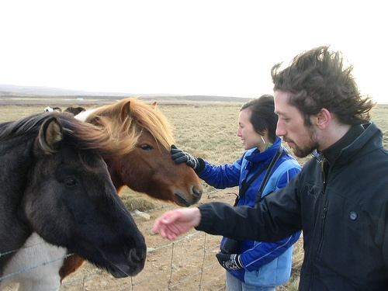
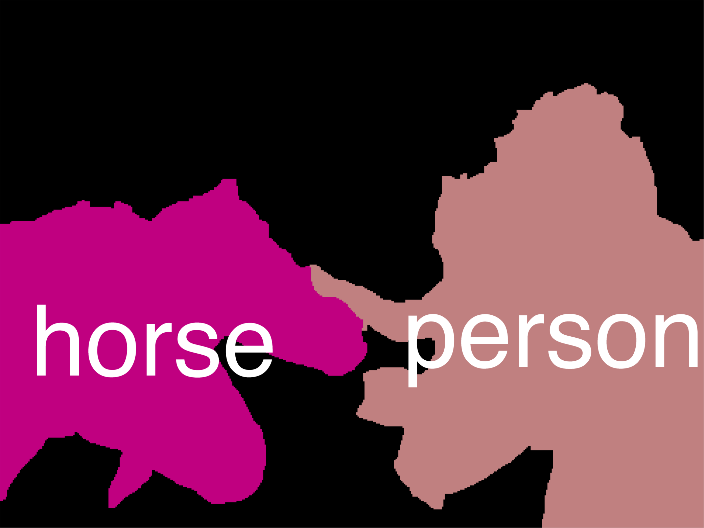
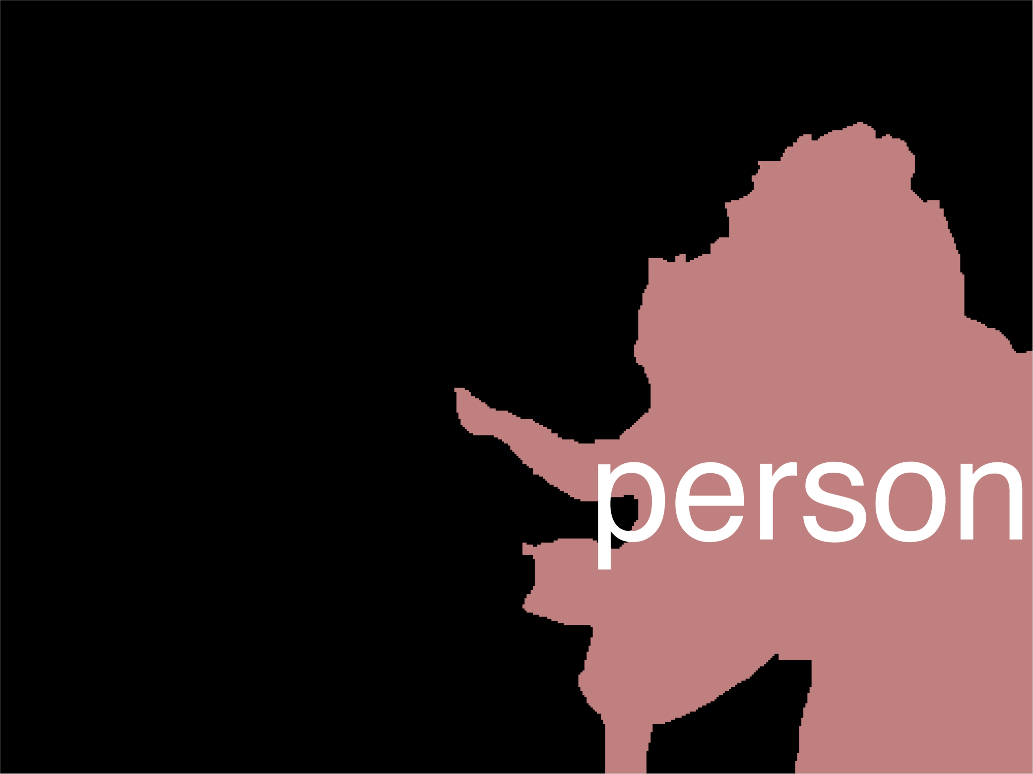
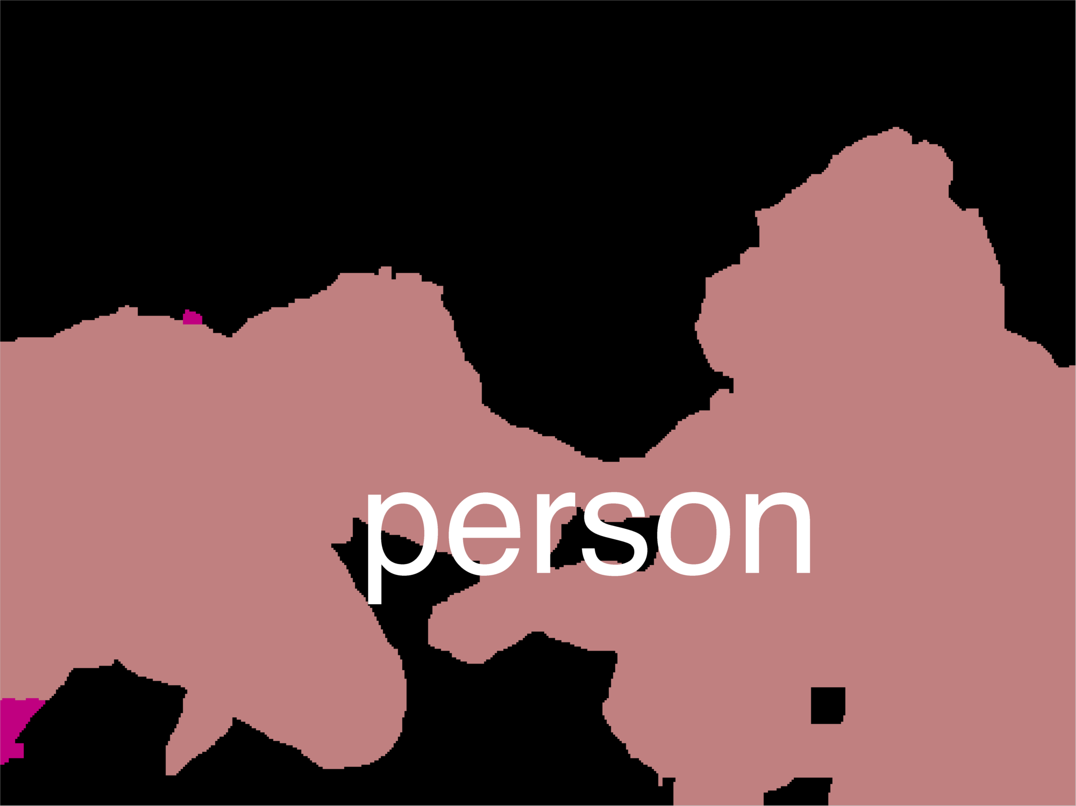
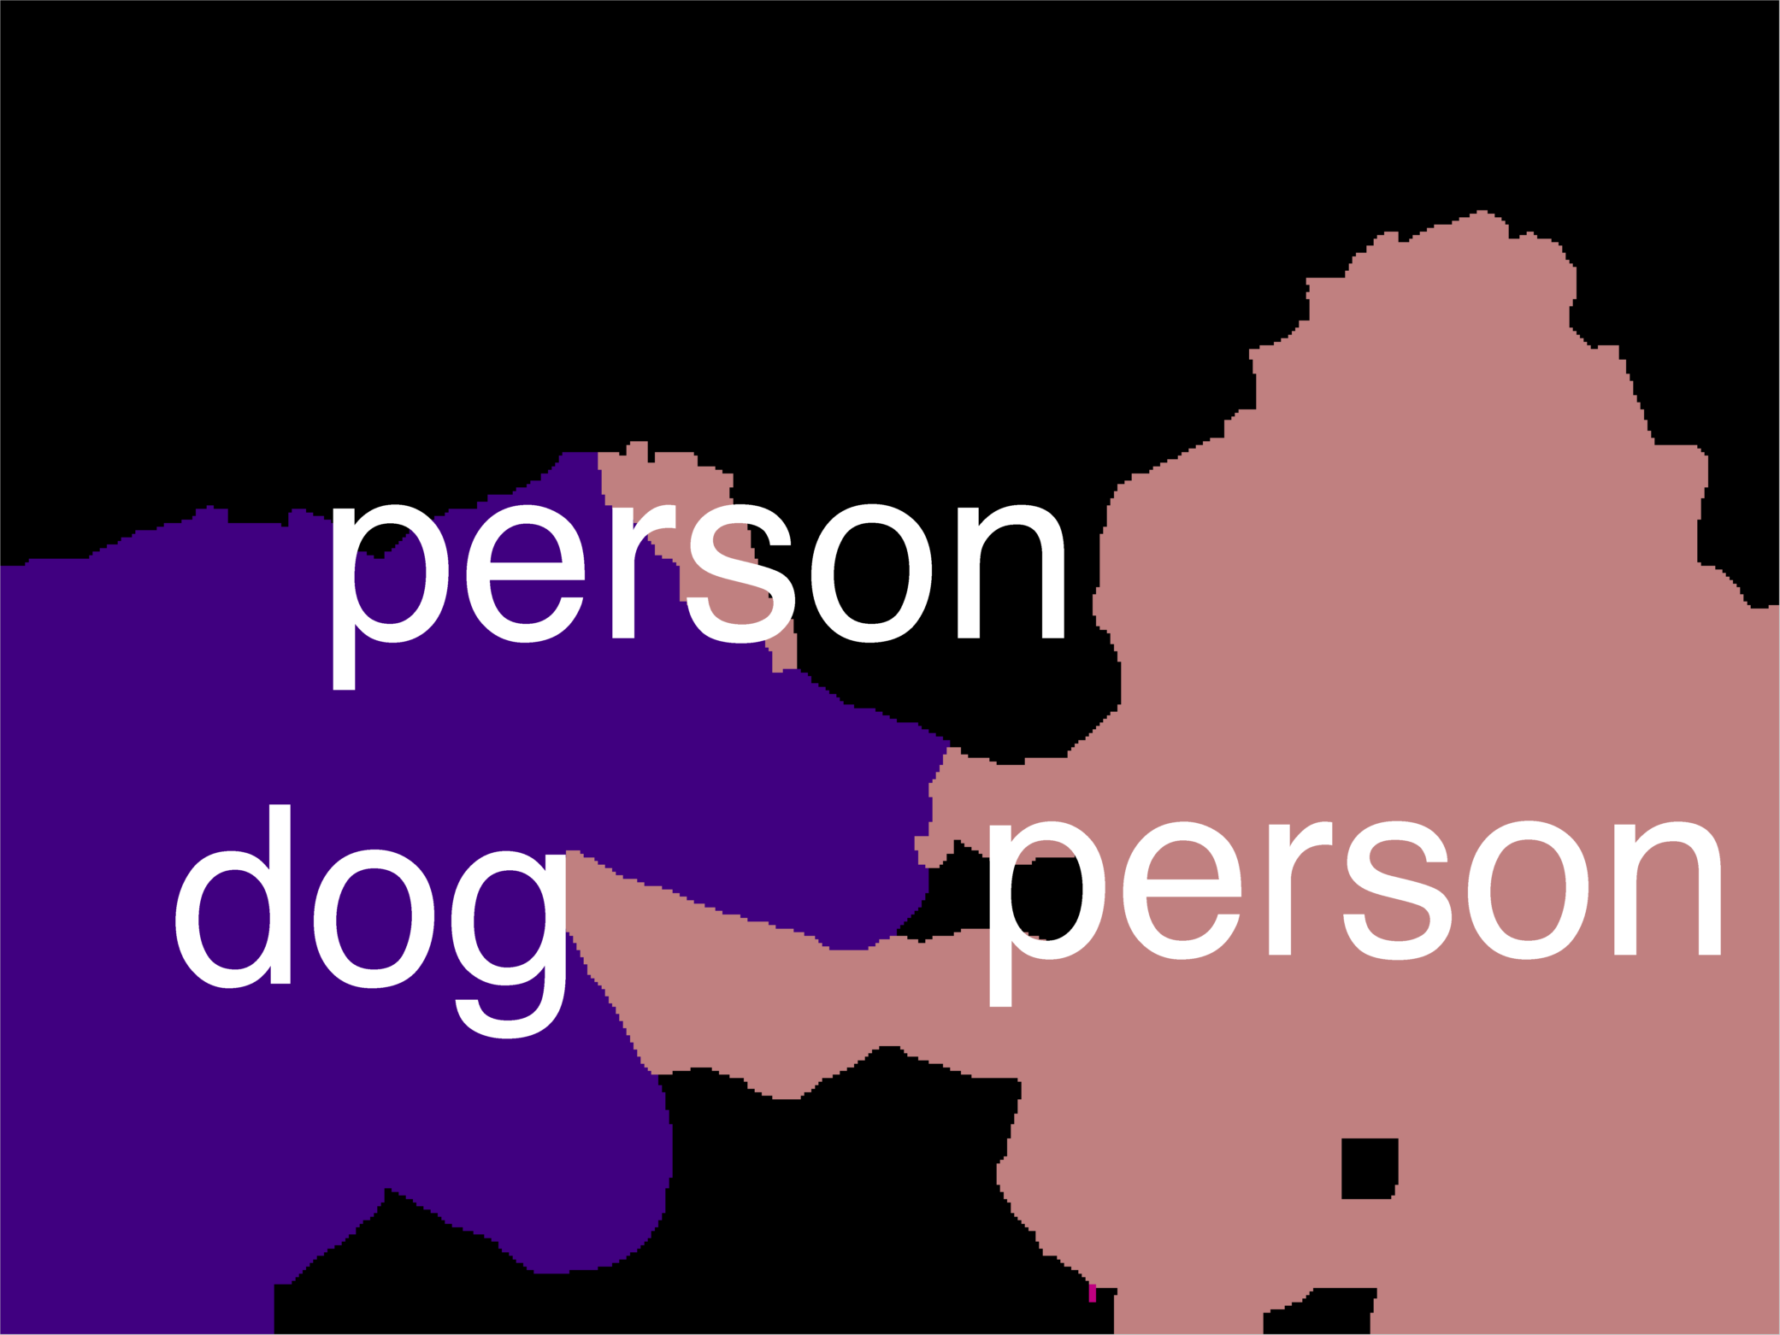
Notation + MAP
y₁
1 1 10 0
kx1
y₂
10
MAP
Inference
0
…
10
10
0
10
y_{n}
kxk
Most Likely Assignment
Node Scores /
Local Rewards
Edge Scores /
Distributed Prior

Slide 17

Vision in 2000s

Slide 18
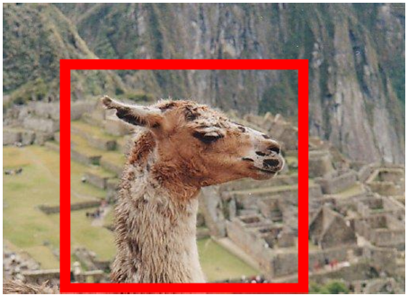
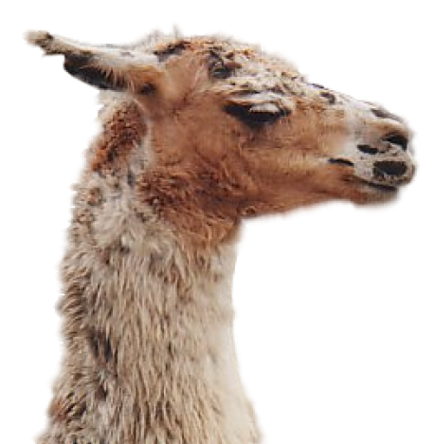
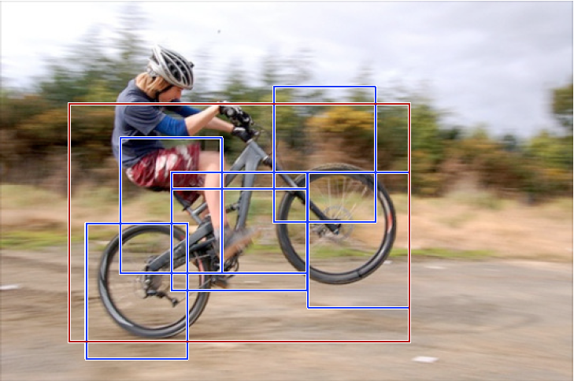
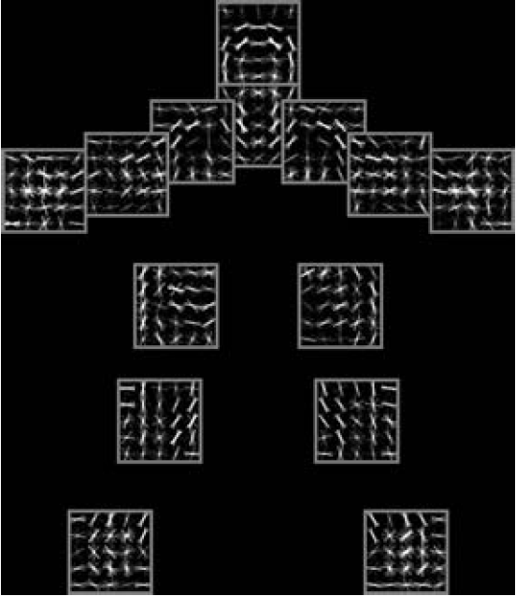
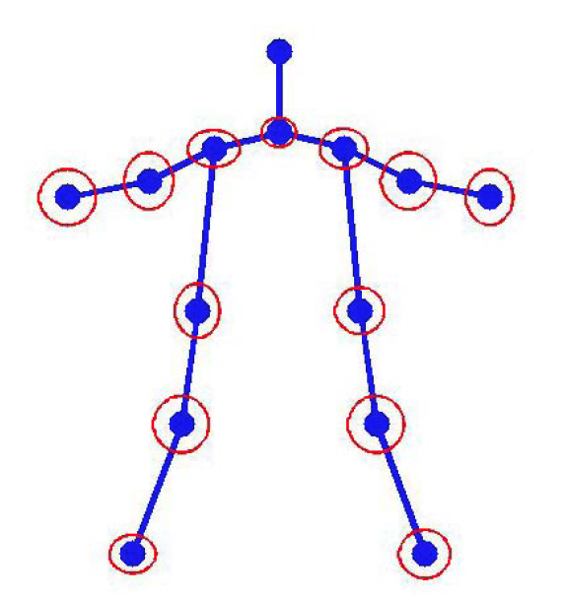
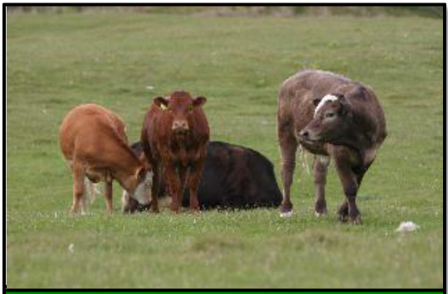
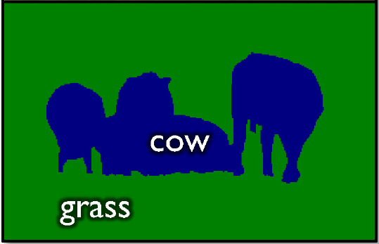
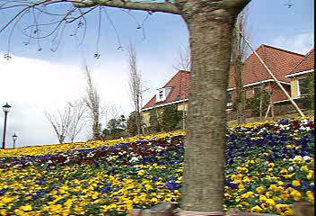
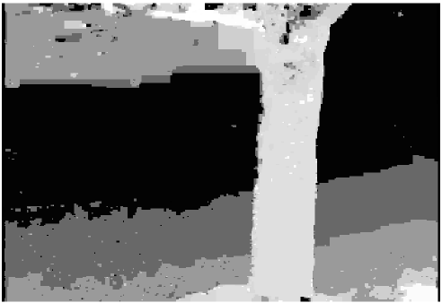
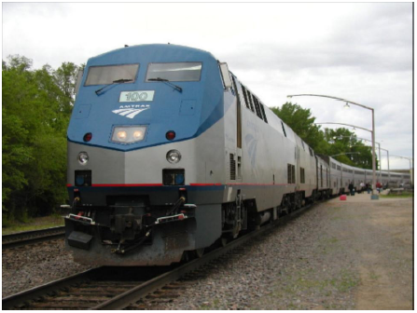
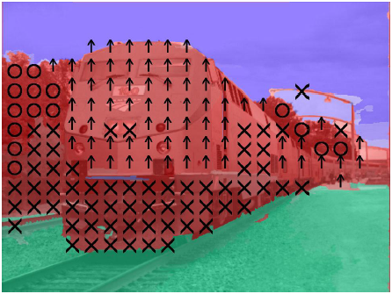
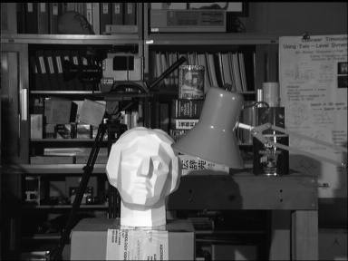
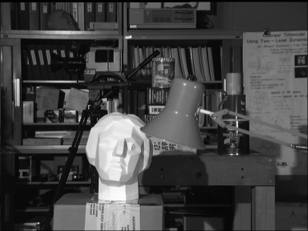

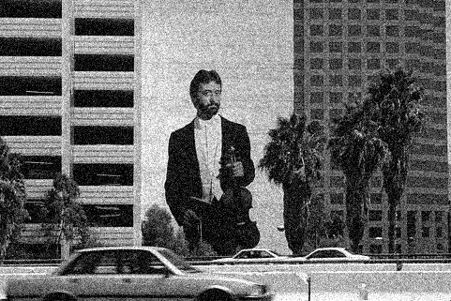

Graphical Models in Vision
Segmentation
Object Recognition / Pose Estimation
Motion Flow
Geometric Labelling
Stereo
Denoising
Left image
Right image
Disparity map

Slide 19

Yadollahpour et al., CVPR 2013

Slide 20
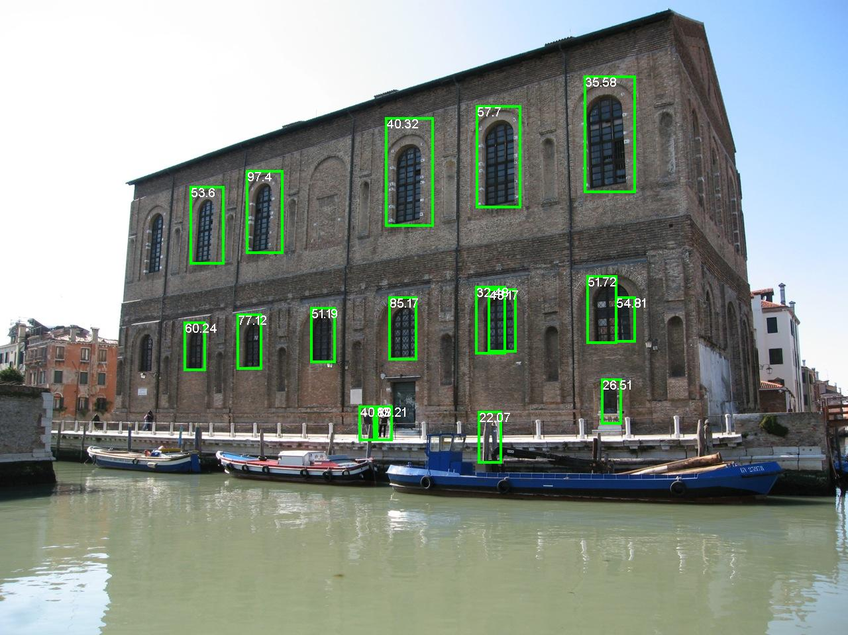
Slide Credit: Larry Zitnick
Dollar et al., BMVC 2009

Slide 21


Slide 22
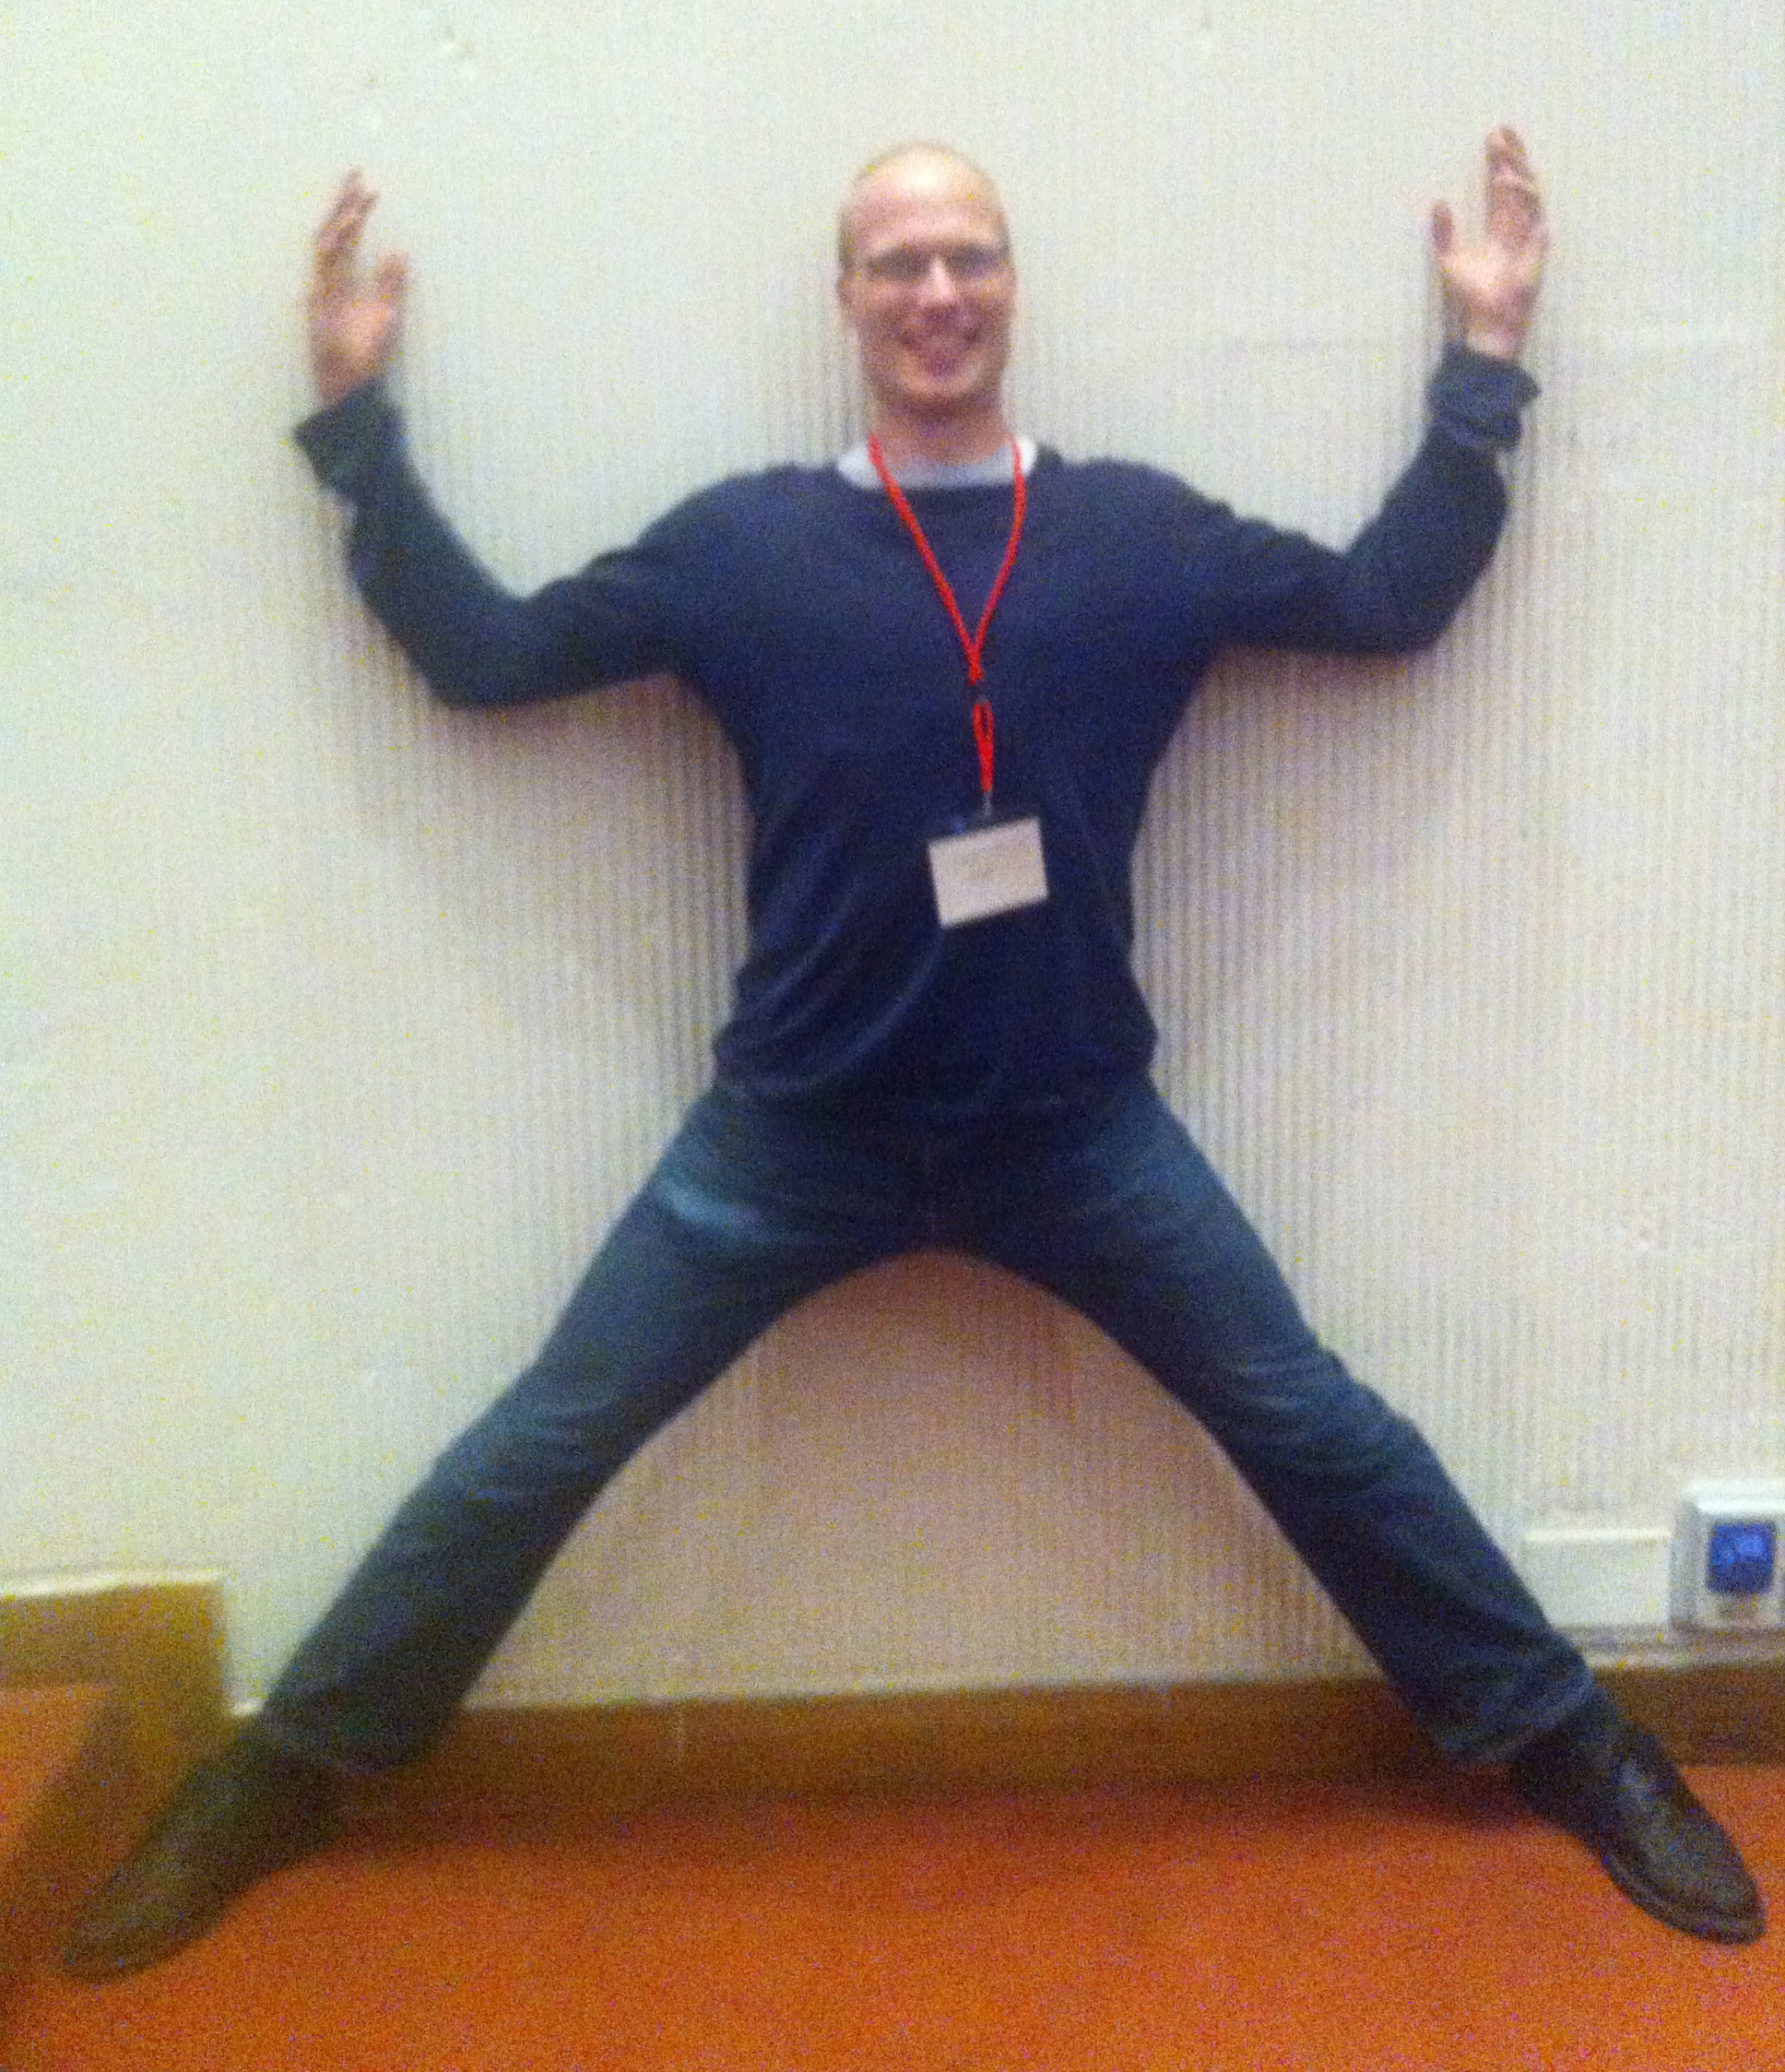
Problems
Model-Class is Wrong!
-- Approximation Error
  Human Body ≠ Tree
Figure Courtesy: [Yang & Ramanan ICCV ‘11]
Notes:
Unfortunately, we often run into a number of problems with MAP.
Most often, our model is simply wrong. So even if we predict the most probable state from our model, it could be very far from ground-truth.
For example, a tree model assumes that we walk around like this, with our limbs always un-occluded.

Slide 23
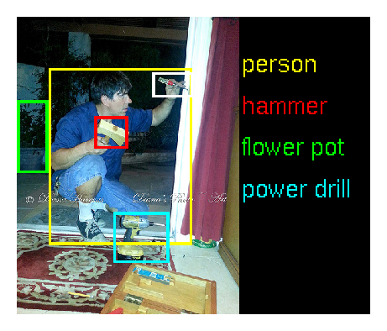
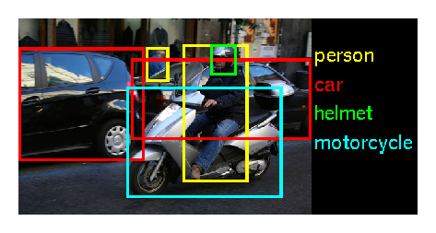
Problems
Model-Class is Wrong!
Not Enough Training Data!
-- Approximation Error
-- Estimation Error
Notes:
Even if your model is rich enough, you may not have enough training data to learn the correct parameters.

Slide 24
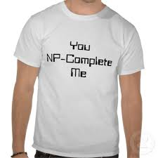
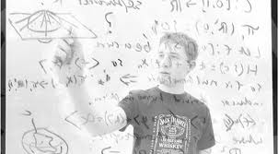
Problems
Model-Class is Wrong!
Not Enough Training Data!
MAP is NP-Hard
-- Approximation Error
-- Estimation Error
-- Optimization Error
Notes:
Even if you have enough training data, actually computing MAP may be NP-hard.

Slide 25
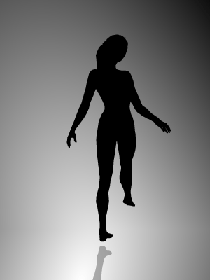
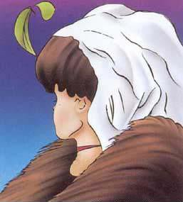
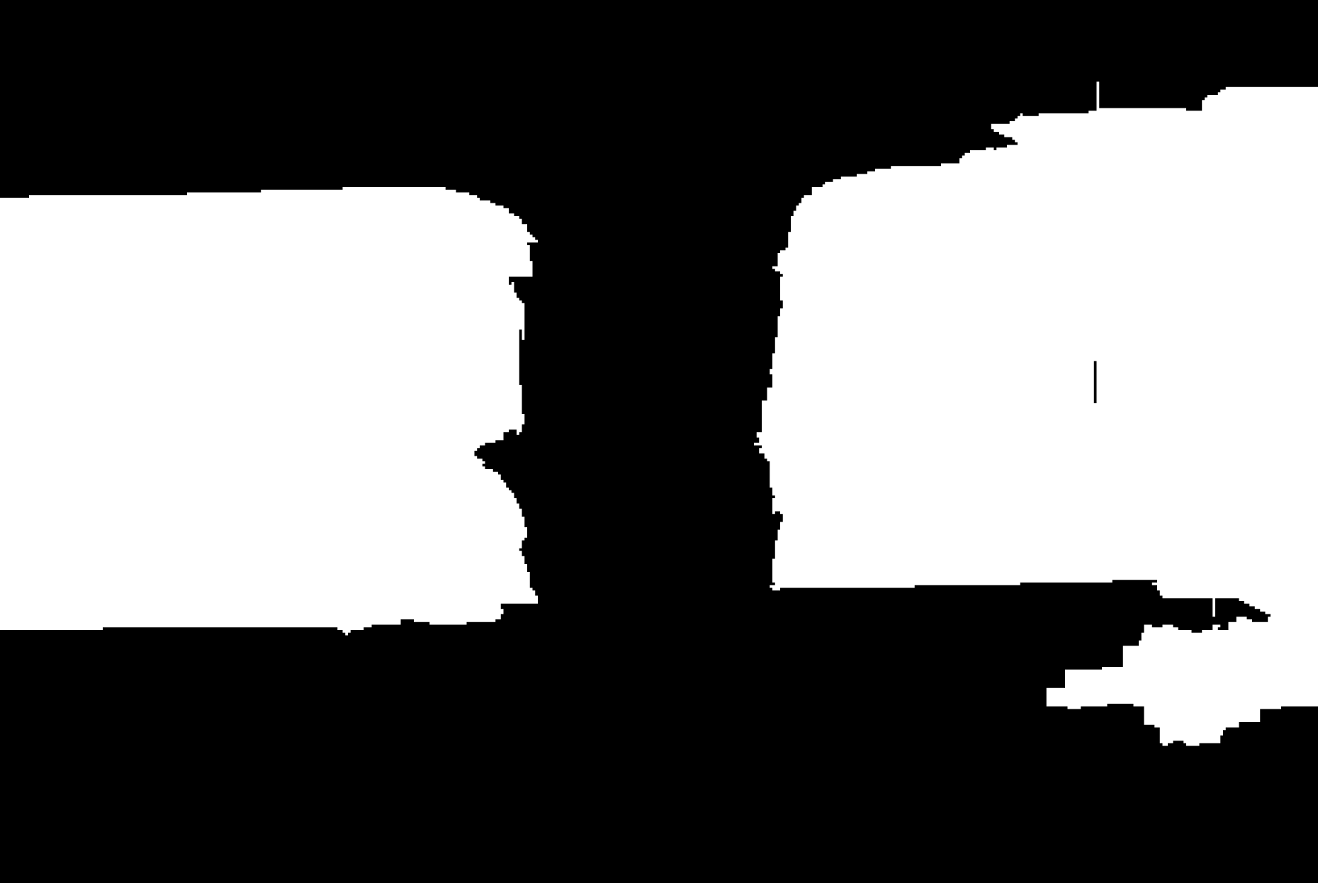

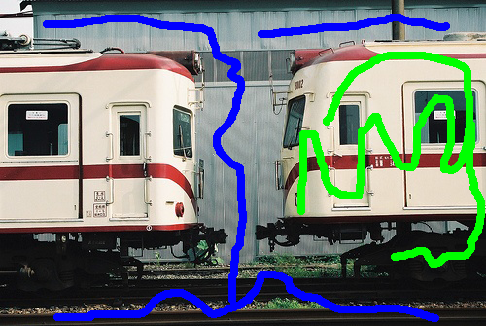
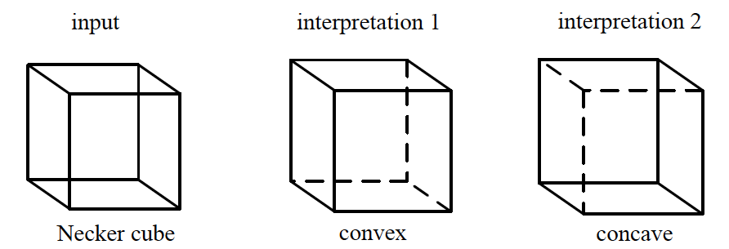
Biggest Problem
Model-Class is Wrong!
Not Enough Training Data!
MAP is NP-Hard
Inherent Ambiguity
-- Approximation Error
-- Estimation Error
-- Optimization Error
-- Bayes Error
?
?
Rotating clockwise /
anti-clockwise?
Old Lady looking left /
Young woman looking away?
One instance /
Two instances?
Notes:
Even if you can compute MAP, there may simply be multiple acceptable answers.
For example, this woman could be rotating left or rotating right.
This could be a young woman looking away or an old lady looking left.
When we have a user-in-the-loop, different users may expect different outputs from the same input.

Slide 26
Problems
Model-Class is Wrong!
Not Enough Training Data!
MAP is NP-Hard
Inherent Ambiguity
-- Approximation Error
-- Estimation Error
-- Optimization Error
-- Bayes Error
Notes:
So where does that leave us?
When your model is wrong, your data is insufficient, you can’t compute the optimal MAP and you’re not sure which answer the user wanted anyway, making a single best prediction is simply inadequate. What we need to do is to make multiple plausible predictions!

Slide 27
Problems
Model-Class is Wrong!
Single Prediction = Uncertainty Mismanagement
Not Enough Training Data!
MAP is NP-Hard
Inherent Ambiguity
-- Approximation Error
-- Estimation Error
-- Optimization Error
Need: Better Representation of Uncertainty
-- Bayes Error
Notes:
So where does that leave us?
When your model is wrong, your data is insufficient, you can’t compute the optimal MAP and you’re not sure which answer the user wanted anyway, making a single best prediction is simply inadequate. What we need to do is to make multiple plausible predictions!

Slide 28
Representation of Uncertainty
MAP = Most Likely Soln.
Marginal Beliefs
No Uncertainty
No Structure
This line of work

Slide 29
Example Result

Slide 30


Multiple Predictions
x
x
x
x
x
x
x
x
x
x
x
x
x
Sampling
Porway & Zhu, 2011
TU & Zhu, 2002
Rich History
Notes:
So how can we make multiple predictions.
Well, it’s a probabilistic model. We could sample from the distribution. Unfortunately, sampling is rather wasteful since we observe the same modes of the distribution over and over again. And if there is a low-probability mode, we will have to wait a long time to observe a sample from it.

Slide 31
Multiple Predictions
✓
Sampling
M-Best MAP
Ideally:
M-Best Modes
Porway & Zhu, 2011
TU & Zhu, 2002
Rich History
Flerova et al., 2011
Fromer et al., 2009
Yanover et al., 2003
Notes:
We could ask for the top M most probably states from the model, called the M Best MAPs. Unfortunately, these solutions are typically minor perturbations of each other.
What we’d like to extract are the top M /modes/ of this distribution, i.e. solve the M-Best Mode problem.
However, there are technical challenges because this is a discrete distribution, and we have to deal with combinatorial optimization.

Slide 32
Exponentially-Large Item Set
Semantic Segmentation

Slide 33
Exponentially-Large Item Set
Pose Estimation

Slide 34
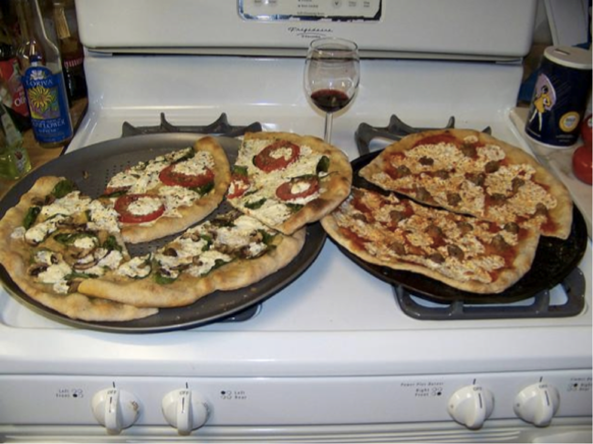
Exponentially-Large Item Set
Image Captioning
Two pizzas sitting
on top of a stove
top oven.
A pizza sitting on
top of a pan on
top of a stove.
there is a man
sitting in a
dish pizza
A wine glass and
three pizzas
on top of an oven.

Slide 35
Quality/Score of Items

Slide 36
Diverse Subset Selection

Slide 37
Diverse Subset Selection
Our work: [ECCV ’12; NIPS ‘14]
Diverse Subset Selection =
Submodular Maximization on a Structured-Output Space
NP-Hard, but Greedy Algorithm = (1-1/e)-approx guarantee*
[Nemhauser et al. ‘ 78]
Greedy = “for loop” around a MAP / 1-best algorithm
*Some restrictions apply; See store for details.

Slide 38
Objective = Score + Diversity

Slide 39
(Modular) Score + (Submodular) Diversity
radius = r
radius = r
radius = r
radius = r

Slide 40
Submodularity in a slide

Slide 41
Submodularity in a slide

Slide 42
Greedy Submodular Maximization
Score
Marginal Gain in Diversity

Slide 43
Greedy Submodular Maximization

Slide 44
Greedy Submodular Maximization

Slide 45
Greedy Submodular Maximization
radius = r
radius = r
radius = r
radius = r

Slide 46
Greedy Submodular Maximization
Exponentially Large Space!
Can’t enumerate

Slide 47
Score = Factor Graph
y₁
1 1 10 0
kx1
y₂
10
MAP
Inference
0
…
10
10
0
10
y_{n}
kxk
Most Likely Assignment
Node Scores /
Local Rewards
Edge Scores /
Distributed Prior

Slide 48
Where do parameters come from?
y₁
y₂
…
y_{n}

Slide 49
BK (Before Krizhevsky)
HOG
y₁
y₂
…
y_{n}

Slide 50
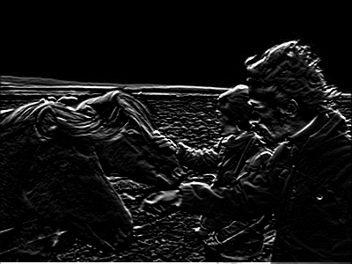
AK (After Krizhevsky)
Deep CNN
y₁
y₂
…
y_{n}

Slide 51
Greedy Submodular Maximization
Exponentially Large Space!
Can’t enumerate

Slide 52
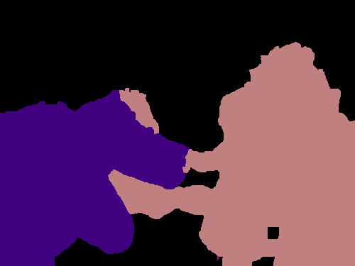


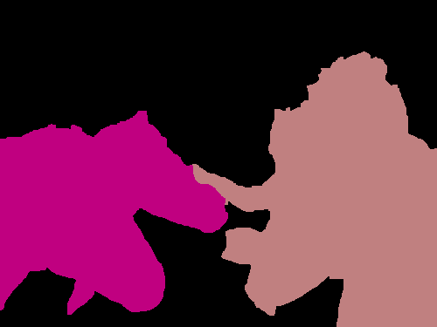


Diversity via Groups
person
dog
person
dog
horse
person
horse
dog
horse

Slide 53
Diversity = Coverage of Groups
person
dog
person
dog
horse
person
horse
dog
horse

Slide 54
Diversity = (Soft) Coverage of Groups
person
dog
person
dog
horse
person
horse
dog
horse

Slide 55
Diversity = Coverage of Groups
person
dog
person
dog
horse
person
horse
dog
horse

Slide 56
Marginal Gain = Label Score
0
+1
0
+1
0
1
1
person
dog
person
dog
1
2
horse
person
horse
dog
1
horse

Slide 57
Greedy Submodular Maximization
+
Just a modified MAP call!

Slide 58
Diversity = High-Order Potential (HOP)
Diversity HOP
Label Occurrence Label Costs [Delong et al. CVPR10]
Label Transitions Cooperative Cuts [Jegelga et al. CVPR 11;
Kohli et al. CVPR13]
Hamming Ball Cardinality Potential [Tarlow et al AISTATS10]
DivMBest Node Potential Perturb [Batra et al ECCV12]

Slide 59
Diverse M-Best
Notes:
The extension from 2nd best to M best is fairly straightforward. We simply add more inequalities incrementally to further restrict the search space.

Slide 60
Diverse 2nd-Best
Diversity-Augmented Score
Dualize
Notes:
The extension from 2nd best to M best is fairly straightforward. We simply add more inequalities incrementally to further restrict the search space.

Slide 61
Diverse 2nd-Best
Diversity-Augmented Score
Notes:
The extension from 2nd best to M best is fairly straightforward. We simply add more inequalities incrementally to further restrict the search space.

Slide 62
Diverse 2nd-Best
Diversity-Augmented Score
Lagrangian Relaxation
Dual
Subgradient Descent
Concave (Non-smooth)
Upper-Bound on Div2Best Score
Div2Best score

Slide 63
Diverse 2nd-Best
Diversity-Augmented Score
Lagrangian Relaxation
Many ways to solve:
Subgradient Descent. Optimal. Slow.
See Paper for Details
2. Binary Search. Optimal for M=2. Faster.
3. Grid-search on lambda. Sub-optimal. Fastest.
Notes:
The extension from 2nd best to M best is fairly straightforward. We simply add more inequalities incrementally to further restrict the search space.

Slide 64
Diversity
[Special Case] 0-1 Diversity M-Best MAP
  [Yanover NIPS03; Fromer NIPS09; Flerova Soft11]
[Special Case] Max Diversity [Park & Ramanan ICCV11]
Hamming Diversity
Cardinality Diversity
Any Diversity
Notes:
Our formulation allows several kinds of diversity functions.
With a 0-1 diversity, we get the special case of M-Best MAP.
With a max-diversity, we get the formulation of Park & Ramanan from last year.
We can use hamming diversity, cardinality diversity, basically any diversity function that allows efficient inference with diversity-augmented-energy.
In this talk, I am going to describe the simplest diversity – Hamming diversity; and details of the others can be found in the paper.

Slide 65
Hamming Diversity
Diversity Augmented Inference:
Notes:
Hamming Diversity has the property that it factorizes with the node energies, so we can think of diversity augmented score as having perturbed node energies, that absorb the previous solutions vectors.

Slide 66
Hamming Diversity
Diversity Augmented Inference:
Unchanged.
Can still use graph-cuts!
Simply edit node-terms. Reuse MAP machinery!
Notes:
This can be implemented with these 4 lines of pseudo-code. Simply write a for loop over the variables, increment the unary costs of the labels seen in MAP and run MAP again.
That’s it!
Thus we can reuse all the existing MAP machinery.
Another interesting thing is that we did not modify the edge energies, so there was some structure in the edge terms, it is preserved. For instance, if they were submodular, they continue to be submodular and we can use graph-cuts for the second best problem.

Slide 67
Example Result
Now what?
[Batra et al. ECCV12], [Guzman-Rivera et al. NIPS12], [Yadollahpour et al. CVPR13],
[Gimpel et al. EMNLP13], [Guzman-Rivera AISTATS13], [Premachandran et al. CVPR14]
[Prasad et a. NIPS14], [Guzman-Rivera et al. AISTATS14], [Sun et al. CVPR15]

Slide 68
Your Options
Nothing: User-in-the-loop [ECCV12]
  Additional Information: None
Tracking [ECCV12]
  Additional Information: Time
(Approximate) Min Bayes Risk [CVPR14]
  Additional Information: Loss function
Re-ranking [CVPR13]
  Additional Information: higher-order constraints
Holistic Scene Understanding [Under Review]
Increasing Side Information

Slide 69
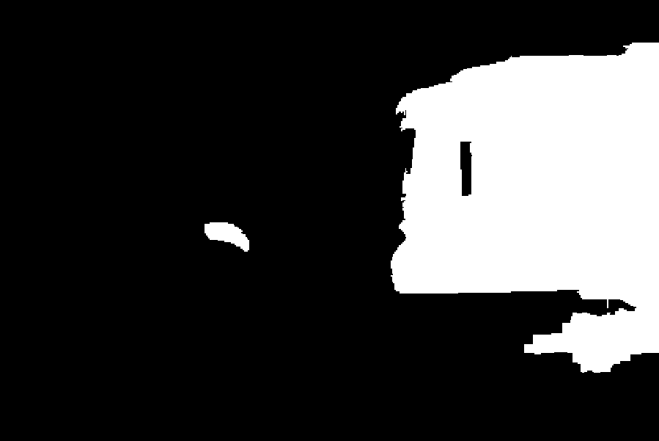

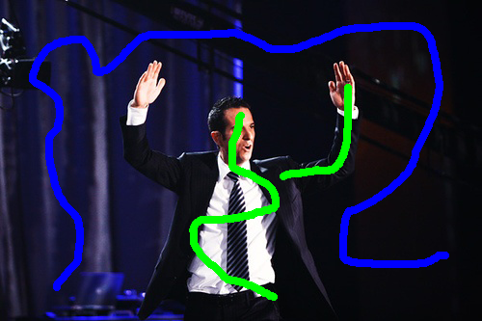



Interactive Segmentation
Setup
  Model: Color/Texture + Potts Grid CRF
  Inference: Graph-cuts
  Dataset: 50 train/val/test images from PASCAL
Image + Scribbles
MAP
2nd Best MAP
Diverse 2nd Best
1-2 Nodes Flipped
100-500 Nodes Flipped
[Batra, Yadollahpour, Guzman-Rivera, Shakhnarovich, ECCV12]
Notes:
The first experiment is interactive segmentation, where a user provides scribbles on images and we use graph-cuts for inference.
This is the second-best solution without diversity. We can see that it is nearly identical to MAP with a few nodes flipped.
This is the second-best solutions with diversity. We can see that these solutions are significantly different. In one case, we found another instance of the object, and in another, we completed a thin long structure.

Slide 70
Your Options
Nothing: User-in-the-loop [ECCV12]
  Additional Information: None
Tracking [ECCV12]
  Additional Information: Time
(Approximate) Min Bayes Risk [CVPR14]
  Additional Information: Loss function
Re-ranking [CVPR13]
  Additional Information: higher-order constraints
Holistic Scene Understanding [Under Review]
Increasing Side Information

Slide 71
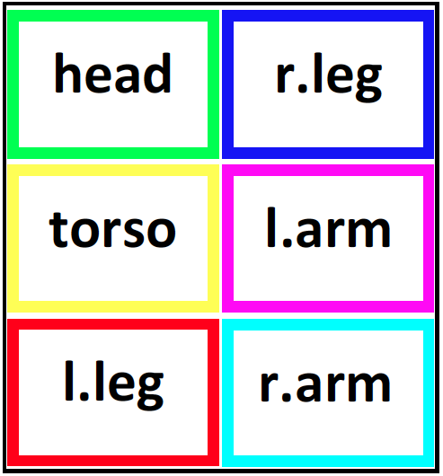
Pose Estimation
Setup
  Model: Mixture of Parts Tree [Park & Ramanan, ICCV ‘11]
  Inference: Dynamic Programming
  Dataset: PARSE
Image Credit: [Yang & Ramanan, ICCV ‘11]
Notes:
Next, we applied our approach to pose-tracking in videos.
We replicated the setup of Park & Ramanan who use a mixture of parts tree model. Exact inference can be performed by dynamic programming.

Slide 72
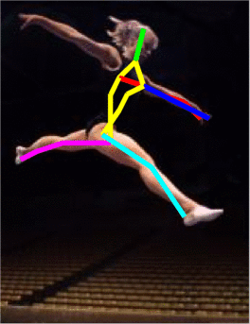
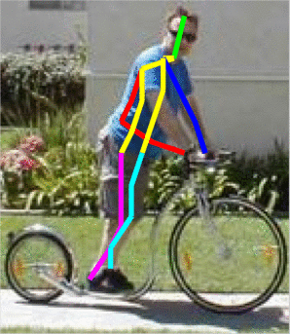






Pose Estimation: 10 guesses/frame
a
[Premachandran, Tarlow, Batra, CVPR14]

Slide 73

Pose Tracking
Chain CRF with M states at each frame
DivMBest
Solutions
Image Credit: [Yang & Ramanan, ICCV ‘11]
Notes:
We compute M solutions in each frame of the video, and then choose a smooth trajectory using the Viterbi algorithm.

Slide 74

Pose Tracking
MAP / 1-Best
DivMBest + Viterbi
[Batra, Yadollahpour, Guzman-Rivera, Shakhnarovich, ECCV12]
Notes:
Here, on the left, I am showing you the MAP pose on each frame. We can see that is quite noisy and jumps around, while the DivMBest solution is smooth.

Slide 75
Your Options
Nothing: User-in-the-loop [ECCV12]
  Additional Information: None
Tracking [ECCV12]
  Additional Information: Time
(Approximate) Min Bayes Risk [CVPR14]
  Additional Information: Loss function
Re-ranking [CVPR13]
  Additional Information: higher-order constraints
Holistic Scene Understanding [Under Review]

Slide 76
Pose Estimation: 10 guesses/frame
a
[Premachandran, Tarlow, Batra, CVPR14]

Slide 77
Statistics 101
Loss
  Hamming, Jaccard Index, …
“True” Distribution
Expected Loss:
Min Bayes Risk
Fit model (CRF, etc) to mimic

Slide 78
DivMBest for MBR
Min Bayes Risk
Two Problems
Approximate MBR:
Intractable
Intractable

Slide 79




DivMBest for MBR
,
MxM

Slide 80
DivMBest for MBR
,
MxM
Mx1

Slide 81
DivMBest for MBR
Diversity Augmented Inference with Hamming:
Empircal MBR prediction

Slide 82
Pose Estimation
Better
DivMBest (Oracle)
22%-gain possible
Same Features
Same Model
~7% Gain
Same Model
No new information!
MBR [PTB, CVPR14]
State of art
[Yang & Ramanan PAMI12]
#Solutions / Frame
[Premachandran, Tarlow, Batra, CVPR14]

Slide 83
Your Options
Nothing: User-in-the-loop [ECCV12]
  Additional Information: None
Tracking [ECCV12]
  Additional Information: Time
(Approximate) Min Bayes Risk [CVPR14]
  Additional Information: Loss function
Re-ranking [CVPR13]
  Additional Information: higher-order constraints
Holistic Scene Understanding [Under Review]

Slide 84




Semantic Segmentation
Setup
  Models: Second-Order Pooling Flat CRF [Carreira ECCV12]
  Inference: Greedy Pasting
  Dataset: Pascal Segmentation Challenge (VOC 2012)
    20 categories + background; ~1500 train/val/test images
Notes:
Finally, we applied DivMBest to Semantic Segmentation on the PASCAL 2010 dataset.
We use the model of Ladicky et al., where approximate inference is performed with alpha-expansion.

Slide 85









Semantic Segmentation
Input
MAP
Best of 10-Div
[Yadollahpour, Batra, Shakhnarovich, CVPR13]
Notes:
Here are some example results.
We can see that for the first image, the MAP solution is wrong.
But if we compute 10 diverse solutions, one of them does in fact have the correct answer.

Slide 86
Large-Margin Re-ranking
[Yadollahpour, Batra, Shakhnarovich, CVPR13]

Slide 87
Large-Margin Re-ranking
[Yadollahpour, Batra, Shakhnarovich, CVPR13]

Slide 88
Large-Margin Re-ranking
[Yadollahpour, Batra, Shakhnarovich, CVPR13]

Slide 89
Large-Margin Re-ranking
[Yadollahpour, Batra, Shakhnarovich, CVPR13]

Slide 90
PASCAL VOC Semantic Segmentation
Better
DivMBest (Oracle)
15%-gain possible
Same Features
Same Model
PACAL Accuracy
Deep SegNet [Under Review]
+Deep Features
[CVPR14 workshop]
[Hariharan ECCV14]
Re-ranking [CVPR13]
MBR [CVPR14]
MAP
[Carriera ECCV12]
Previous state of art
#Solutions / Image

Slide 91


My history with PASCAL Leaderboard
Better
PACAL Accuracy
20%-gain possible
Same Features
Same Model
ALE-DivMBest (Oracle)
ALE-Re-ranking [CVPR13]
ALE
[Ladicky ICCV09]
VOC10
#Solutions / Image

Slide 92
My history with PASCAL Leaderboard
Better
15%-gain possible
Same Features
Same Model
O2P-DivMBest (Oracle)
PACAL Accuracy
O2P-Re-ranking [CVPR13 + CVPR14workshop]
O2P
[Carriera ECCV12]
Winner of VOC12
ALE-DivMBest (Oracle)
ALE-Re-ranking [CVPR13]
ALE
[Ladicky ICCV09]
VOC10
#Solutions / Image

Slide 93
My history with PASCAL Leaderboard
Better
[DeepLab-CRF ICLR15]
[TTIC-Zoomout CVPR15]
O2P-DivMBest (Oracle)
[Hypercolumns” CVPR15]
PACAL Accuracy
O2P-Re-ranking [CVPR13 + CVPR14workshop]
O2P
[Carriera ECCV12]
Winner of VOC12
ALE-DivMBest (Oracle)
ALE-Re-ranking [CVPR13]
ALE
[Ladicky ICCV09]
VOC10
#Solutions / Image

Slide 94
Your Options
Nothing: User-in-the-loop [ECCV12]
  Additional Information: None
Tracking [ECCV12]
  Additional Information: Time
(Approximate) Min Bayes Risk [CVPR14]
  Additional Information: Loss function
Re-ranking [CVPR13]
  Additional Information: higher-order constraints
Holistic Scene Understanding [Under Review]

Slide 95




Pose Estimation
Coarse 3D Layout
Object Segmentation
Scene Recognition
Street
Hypothesis
#1
Inside City
Hypothesis
#2
Consistent
Consistent
Consistent
Construction
Hypothesis
#M

Slide 96





PASCAL
Sentence Dataset
“A dog is standing next to a woman
on a couch”
Ambiguity:
(dog next to woman) on couch
vs dog next to (woman on couch)
Vision: Semantic Segmentation
NLP: Sentence Parsing
Labels: Chairs, desks, etc
Output: Parse Tree
Hypothesis
#1
Person
Couch
Dog
Consistent
Person
Hypothesis
#M
Couch

Slide 97

Joint Re-Ranking
prep_on(woman, couch)
Person
Couch
Dog

Slide 98
Joint Re-Ranking
Person
Couch
Dog
Person
Couch

Slide 99



Joint Re-Ranking
with
on
by

Slide 100

Joint Re-Ranking
Vision-alone
~9% Gain
Language-alone
Vision+Language

Slide 101






NYU-v2 RGBD Dataset
Semantic Segmentation
3D Support Estimation
Labels: Chairs, desks, etc
Supported from below, behind, etc
Hypothesis
#1
Other Structure
Wall
Wall
Other Prop
Table
Other Structure
Wall
Hypothesis
#M
Television
Chair
Table

Slide 102
NYU-v2 RGBD Dataset
Semantic Segmentation
3D Support Estimation
Labels: Chairs, desks, etc
Supported from below, behind, etc
Hypothesis
#1
Other Structure
Wall
Wall
Other Prop
Table
Other Structure
Wall
Hypothesis
#M
Television
Chair
Table

Slide 103


Slide 106
NYU-v2 RGBD Dataset
Semantic Segmentation
3D Support Estimation
Labels: Chairs, desks, etc
Supported from below, behind, etc
Hypothesis
#1
Other Structure
Wall
Wall
Other Prop
Table
Other Structure
Wall
Hypothesis
#M
Television
Chair
Table

Slide 107
NYU-v2 RGBD Dataset
Semantic Segmentation
3D Support Estimation
Labels: Chairs, desks, etc
Supported from below, behind, etc
Hypothesis
#1
Other Structure
Wall
Wall
Other Prop
Table
Consistent
Other Structure
Wall
Hypothesis
#M
Television
Chair
Table

Slide 108


Interpretation: Projected Message Passing
Vision: Semantic Segmentation
NLP: Sentence Parsing
Vision: Human Body Pose
Vision: 3D Layout

Slide 109
DivMBest as a Sampler!
Intractable Quantities
  Bayes Risk [CVPR14]
  Partition Function & Marginals [POS, NIPS13]
  Entropy [CVPR15]
  …
Delta
Approximation

Slide 110



Active Learning
Labeled Data
CRF
Unlabeled Data
Train
Query
Pick images
to annotate
Diverse solutions for each unlabeled image
Sort by
(approx.) entropy
Delta
Approximation
[Sun, Laddha, Batra, CVPR15]

Slide 111







Active Learning
High Entropy, Accurate MAP
y¹
y³
y⁵
y⁷
y⁹

Slide 112







Active Learning
Low Entropy, Accurate MAP
y¹
y³
y⁵
y⁷
y⁹

Slide 113
Active Learning
Better
Accuracy
#Image Annotated
[Sun, Laddha, Batra, CVPR15]

Slide 114
Improved Learning
Classical Setup

Slide 115
How to update?
Structured SVMs
  Subgradient of Hinge Loss
CRFs
  Gradient of log-liklihood
[Meier, Sha, Globerson]

Slide 116

Structured SVM
Training SSVMs
Standard Approach, M=1
Exponential number of constraints.
Cutting-Plane!
[Guzman-Rivera, Kohli, Batra, AISTATS12]

Slide 117
Structured SVM
Training of SSVM with Diverse M-Best Cutting Planes
Training Objective
MAP
Better
DivMBest
[Guzman-Rivera, Kohli, Batra, AISTATS12]

Slide 118
Machine Translation
Input:
Die Regierung will die Folter von “Hexen” unterbinden und gab eine Broschüre heraus
5-Best Translations:
The government wants the torture of ‘witch’ and gave out a booklet
The government wants the torture of “witch” and gave out a booklet
The government wants the torture of ‘witch’ and gave out a brochure
The government wants the torture of ‘witch’ and gave out a leaflet
The government wants the torture of “witch” and gave out a brochure
[Gimpel, Batra, Dyer, Shakhnarovich, EMNLP13]

Slide 119
Machine Translation
Input:
Die Regierung will die Folter von “Hexen” unterbinden und gab eine Broschüre heraus
Diverse 5-Best Translations:
The government wants the torture of ‘witch’ and gave out a booklet
The government wants to stop torture of “witch” and issued a leaflet issued
The government wants to “stop the torture of” witches and gave out a brochure
The government intends to the torture of “witchcraft” and were issued a leaflet
The government is the torture of “witches” stamp out and gave a brochure
[Gimpel, Batra, Dyer, Shakhnarovich, EMNLP13]

Slide 120
Machine Translation
Input:
Die Regierung will die Folter von “Hexen” unterbinden und gab eine Broschüre heraus
Diverse 5-Best Translations:
The government wants the torture of ‘witch’ and gave out a booklet
The government wants to stop torture of “witch” and issued a leaflet issued
The government wants to “stop the torture of” witches and gave out a brochure
The government intends to the torture of “witchcraft” and were issued a leaflet
The government is the torture of “witches” stamp out and gave a brochure
Correct Translation:
The government wants to limit the torture of “witches,” a brochure was released
[Gimpel, Batra, Dyer, Shakhnarovich, EMNLP13]

Slide 121
Arabic-English Reranking Results
BLEU

Slide 122
Summary
All models are wrong
Some beliefs are useful
Focus on optimization error is unhelpful
  The goal is low generalization error
Diverse Multiple Solutions
  A way to get useful beliefs out.
DivMBest +
MBR / Reranking / Active-Learning / Faster Training
  Big impact on many applications!
Notes:
In summary, not matter what the problem, all models are wrong, but some of their beliefs might be useful.
Our proposed algorithm give you a wait to exploit these beliefs by producing diverse M-Best solutions in discrete models.
It’s an efficient algorithm that re-uses existing MAP machinery.
And we believe there is a big impact possible on many applications.

Slide 123
Summary
What does my model believe?
Posterior Summary

Slide 124



Acknowledgements
Students
  Virginia Tech
    Aishwarya Agrawal, Harsh Agrawal, Neelima Chavali, Michael Cogswell, Gordon Christie, Xiao Lin, Clint Solomon, Qing Sun
  External
    Abner Guzman-Rivera (UIUC), Ankit Laddha (CMU), Adarsh Prasad (UT-Austin), Payman Yadollahpour (TTIC)
Collaborators
  Stefanie Jegelka (UC Berkeley), Pushmeet Kohli (MSR) Greg Shakhnarovich (TTIC), Danny Tarlow (MSR)
Sponsors

Slide 125
Thanks!

Slide 126
Interactive Segmentation
Better
+3.62%
+1.61%
Segmentation Accuracy
+0.05%
(Oracle)
(Oracle)
(Oracle)
M=6
Notes:
Quantitatively, here is the how well MAP performs on our dataset.
And these are the oracle accuracy for different methods. We can see that DivMBest outperforms both baselines.

Slide 127
Pose Tracking
Better
DivMBest (Re-ranked)
13% Gain
Same Features
Same Model
[Park & Ramanan, ICCV ‘11] (Re-ranked)
PCP Accuracy
Confidence-based Perturbation (Re-ranked)
#Solutions / Frame
Notes:
Here are quantitative results. On the x axis are the no. of solutions per frame. On the Y axis is PCP accuracy of the trajectory.
The confidence based baseline does not benefit from multiple solutions.
This is the result from Park & Ramanan. And this is our approach.
We can see that we get an improvement of 13 PCP points with the same model and exactly the same features, just a different way of computing multiple solutions.

Slide 128
MAP Integer Program
kx1
Notes:
Let me begin by writing the MAP problem, which involves minimizing an energy composed of node terms & edge terms.
Instead of each variable being an integer between 1 and k, we will represent them as indicator vectors of length k.

Slide 129
MAP Integer Program
1
0
0
0
kx1
Notes:
So this is xi = 1.

Slide 130
MAP Integer Program
0
1
0
0
kx1
Notes:
So this is xi = 2.

Slide 131
MAP Integer Program
0
0
1
0
kx1
Notes:
This is xi = 3.

Slide 132
MAP Integer Program
0
0
0
1
kx1
Notes:
And this is xi = 4.

Slide 133
MAP Integer Program
0
0
0
1
kx1
k²x1
Notes:
We can do the same thing at edges, where the indicator vector is of length k^2

Slide 134
MAP Integer Program
0
0
0
1
kx1
k²x1
Notes:
So this is the Linear Integer program whose solution in the MAP state.

Slide 135
MAP Integer Program
Graphcuts, BP, Expansion, etc
Notes:
We typically solve this with algorithms like graph-cuts, BP, alpha-expansion. Etc.

Slide 136
Multiple Predictions
✓
Our work: Diverse M-Best in MRFs [ECCV ‘12]
Sampling
M-Best MAP
Don’t hope for diversity. Explicitly encode it.
Not guaranteed to be modes.
Ideally:
M-Best Modes
Porway & Zhu, 2011
TU & Zhu, 2002
Rich History
Flerova et al., 2011
Fromer et al., 2009
Yanover et al., 2003
Notes:
In this paper we present an algorithm to find a set of diverse M-Best solutions from discrete probabilistic models.
We elevate diversity to a first-class citizen by explicitly encoding it into our approach, rather than post-processing for diversity.
Our solutions are not guaranteed to be modes, but are often very useful for applications.

Slide 137
Diverse 2nd-Best
Diversity
MAP
Notes:
So now, how can we find a diverse 2nd best solution?
We present a fairly general formulation, that simply adds this inequality to the problem. There is task-specific diversity function Delta that measures the dissimilarity or distance between two full configurations, and we force the 2nd best solution to be at least k distance away from MAP.

Slide 138
Diverse M-Best
Notes:
The extension from 2nd best to M best is fairly straightforward. We simply add more inequalities incrementally to further restrict the search space.

Slide 139
Diverse 2nd-Best
Q1: How do we solve DivMBest?
Q2: What kind of diversity functions are allowed?
Q3: How much diversity?
Notes:
In order to keep things simple, I’ll focus on the 2nd best problem in this talk and everything I describe will naturally extend to the M-Best case.
Now, given this general formulation, there are a few different questions we can ask.
In this talk, I will answer the first question, partially answer the second, and not answer the third. I encourage you to see the paper for details.
So let’s look at the first question.

Slide 140
Diverse 2nd-Best
Diversity-Augmented Score
Primal
Dualize
Notes:
We do not solve this problem in the “Primal” form. Instead, we dualize the diversity constraint, ie add it as a penalty to the objective. So whenever we find a solution that is less than k distance away, we pay a penalty of lambda.
This is known as the Lagrangian relaxation. It has an interesting interpretation as the diversity augmented energy, which involves finding low-energy high-diversity solutions.
The Lagrangian function is known to provide a concave lower-bound to the Primal solution; and the tightest lower-bound can be found by maximizing this function.
There are several ways to solve this Lagrangian dual problem.
We can use 1) supergradient ascent 2) binary search or 3) grid search.
For our experiments, we use grid search over lambda, which is suboptimal but the fastest.

Slide 141
Diverse 2nd-Best
Lagrangian Relaxation
Diversity-Augmented Score
Dual
Subgradient Descent
Concave (Non-smooth)
Upper-Bound on Div2Best Score
Div2Best score

Slide 142
Diverse 2nd-Best
Lagrangian Relaxation
Many ways to solve:
Diversity-Augmented Energy
Subgradient Ascent. Optimal. Slow.
2. Binary Search. Optimal for M=2. Faster.
3. Grid-search on lambda. Sub-optimal. Fastest.
Dualize

Slide 143
Theorem Statement
Theorem [Batra et al ’12]: Lagrangian Dual corresponds to solving the Relaxed Primal:
    Based on result from [Geoffrion ‘74]
Dual
Relaxed Primal

Slide 144

Effect of Lagrangian Relaxation

Slide 145
Effect of Lagrangian Relaxation

Slide 146


Effect of Lagrangian Relaxation
[Mezuman et al. UAI13]
Pairwise Potential Strength
Pairwise Potential Strength

Slide 147
Diverse 2nd-Best
Q1: How do we solve DivMBest?
Q2: What kind of diversity functions are allowed?
Q3: How much diversity?
Notes:
So now let’s look at how we measure diversity.

Slide 148
Diversity
[Special Case] 0-1 Diversity M-Best MAP
  [Yanover NIPS03; Fromer NIPS09; Flerova Soft11]
[Special Case] Max Diversity [Park & Ramanan ICCV11]
Hamming Diversity
Cardinality Diversity
Any Diversity
Notes:
Our formulation allows several kinds of diversity functions.
With a 0-1 diversity, we get the special case of M-Best MAP.
With a max-diversity, we get the formulation of Park & Ramanan from last year.
We can use hamming diversity, cardinality diversity, basically any diversity function that allows efficient inference with diversity-augmented-energy.
In this talk, I am going to describe the simplest diversity – Hamming diversity; and details of the others can be found in the paper.

Slide 149
Hamming Diversity
0
1
0
0
0
1
0
0
0 1 0 0
1 0 0 0
Notes:
Hamming Diversity can be expressed with a sum of dot-products of indicator vectors.
If the vectors are the same, their dot-product is 1, and if they are different, their dot-product is 0. Thus this sum counts the no. of variables that have the same label as MAP.

Slide 150
Hamming Diversity
Diversity Augmented Inference:
Notes:
Hamming Diversity has the property that it factorizes with the node energies, so we can think of diversity augmented score as having perturbed node energies, that absorb the previous solutions vectors.

Slide 151
Hamming Diversity
Diversity Augmented Inference:
Unchanged.
Can still use graph-cuts!
Simply edit node-terms. Reuse MAP machinery!
Notes:
This can be implemented with these 4 lines of pseudo-code. Simply write a for loop over the variables, increment the unary costs of the labels seen in MAP and run MAP again.
That’s it!
Thus we can reuse all the existing MAP machinery.
Another interesting thing is that we did not modify the edge energies, so there was some structure in the edge terms, it is preserved. For instance, if they were submodular, they continue to be submodular and we can use graph-cuts for the second best problem.

Slide 152
Diverse 2nd-Best
Q1: How do we solve DivMBest?
Q2: What kind of diversity functions are allowed?
Q3: How much diversity?
Notes:
So now let’s look at how we measure diversity.

Slide 153
How Much Diversity?
Empirical Solution: Cross-Val for
More Efficient: Cross-Val for

Slide 154


Qualitative Results: Success

Slide 155

Qualitative Results: Success

Slide 156

Qualitative Results: Success

Slide 157


Qualitative Results: Failures

Slide 158


Qualitative Results: Failures

Slide 159


Qualitative Results: Failures

Slide 160
Higher-Order Dissimilarity
Cardinality Potential
Efficient Inference
  Cardinality [Tarlow ‘10]
  Lower Linear envelop [Kohli ‘10]
  Pattern Potentials [Rother ‘10]

Slide 161

Example Results

Slide 162
Linear Structured Models
Linear Scoring Model

Slide 163
Graphical Models to the Rescue!
y₁
1 1 10 0
kx1
y₂
10
MAP
Inference
0
…
10
Person
10
0
10
y_{n}
kxk
Table
Plate
Most Likely Assignment
Node Scores /
Local Rewards
Edge Scores /
Distributed Prior
Notes:
The visual perception problem have a lot of local ambiguity. If I ask you to recognize this patch, you probably won’t be able to.
Graphical models are useful tools that allow us to model all variables of interest, write down local beliefs in terms of node & edge energies, and then use these to make a global prediction by jointly minimizing this energy function, also called MAP inference.

