Slide 1
BASS: A Resource Orchestrator to Account for Vagaries in Network Conditions in Community WiFi Mesh
Manasvini Sethuraman, Anirudh Sarma, Netra Ghaisas, Adwait Bauskar, Ashutosh Dhekne, Anand Sivasubramaniam*, Umakishore Ramachandran
Georgia Tech and *Penn State University

Slide 2
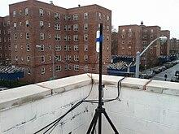
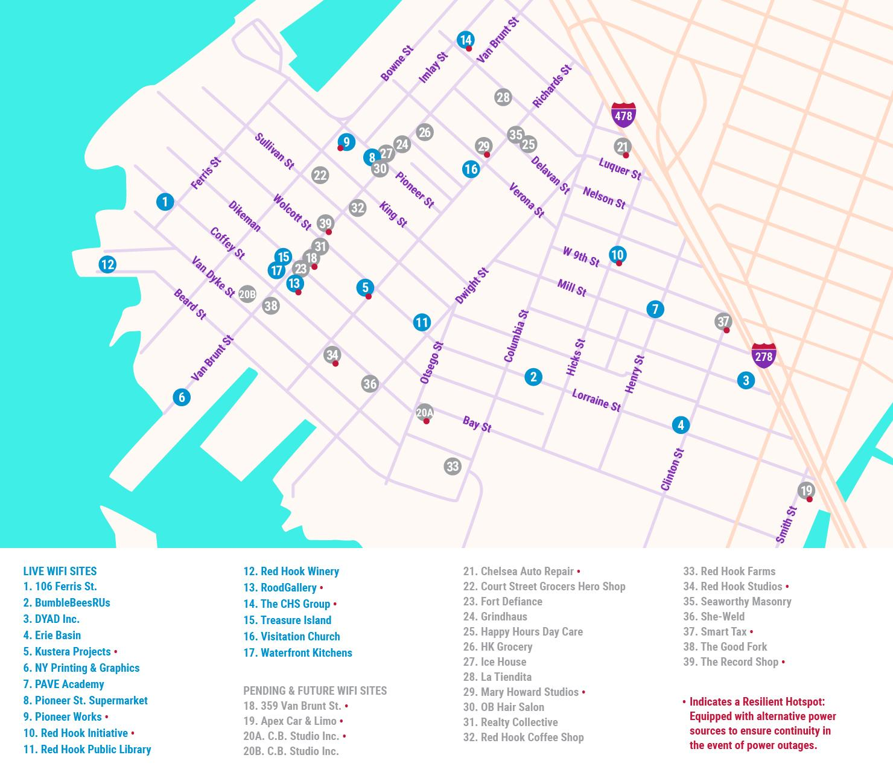
Community Wifi Mesh Networks
Red Hook Wifi | New York^{[1,2]}
Mesh networks provide essential IT services to communities in the absence of internet access.
In times of calamity, mesh can support critical operations like Search & Rescue
Aftermath of Hurricane Sandy - Red Hook mesh network was the only operational network!
[1] https://en.wikipedia.org/wiki/Red_Hook_Wi-Fi
[2] https://redhookwifi.org/

Slide 3
Services on Community Wifi Mesh Networks
Wireless mesh networks as communication infrastructure.

Slide 4
Services on Community Wifi Mesh Networks
Traditionally, wireless mesh was a communication infrastructure.
Now, Components of critical services can be deployed across the Mesh
E.g., Video conferencing servers on Guifi.net, Spain
Linked CCTV cameras on NYC Mesh

Slide 5
Services on Community Wifi Mesh Networks
K3s is a popular lightweight orchestrator to deploy these component parts of the service

Slide 6
Challenges with deploying services on the Mesh
Challenge 1: Wireless link capacities could vary.
Notes:
Recall that the links between the resource nodes are wireless. Their link capacities could vary!
Be it trees or a truck occluding the communication path.
Environmental conditions cause bandwidth fluctuations

Slide 7
Do Bandwidth links vary in reality?
10% STD
27% STD
Real Time monitoring of links in the CityLab test bed (Antwerp, Belgium)
Notes:
Here’s some data to help me prove our point. We monitored links of a real world mesh network called the CityLab Testbed in Antwerp, Belgium and found that while Link 1 was fairly stable with 10% standard deviation from mean, Link 2 on the other hand varied with a 27% std from mean.

Slide 8
Challenges with deploying services on the Mesh
Challenge 2: SoTA resource orchestrators do not react to bandwidth fluctuations
Notes:
Coupled with this fact of varying wireless link capacities, SoTA resource orchestrators

Slide 9
Can k3s react to changes in bandwidth?
End to End Latency of a Social Network Application
Notes:
Let’s look at what happens to the end-to-end latency of a social network application which was deployed using k3s (the popular choice for lightweight orchestrator) I’d like you to focus on the cyan line, which shows the case WHEN the b/w remains stable.
However,
Once we reduce the bandwidth from 30 to 25mbps, the navy lines starts to creep up in latency (Note the y-axis is exponential!)

Slide 10
Can k3s react to changes in bandwidth?
100 -> 25 Mbps
End to End Latency of a Social Network Application
Notes:
Let’s look at what happens to the end-to-end latency of a social network application which was deployed using k3s (the popular choice for lightweight orchestrator) I’d like you to focus on the cyan line, which shows the case WHEN the b/w remains stable.
However,
Once we reduce the bandwidth from 30 to 25mbps, the navy lines starts to creep up in latency (Note the y-axis is exponential!)

Slide 11
Can k3s react to changes in bandwidth?
100 -> 25 Mbps
End to End Latency of a Social Network Application
Notes:
Let’s look at what happens to the end-to-end latency of a social network application which was deployed using k3s (the popular choice for lightweight orchestrator) I’d like you to focus on the cyan line, which shows the case WHEN the b/w remains stable.
However,
Once we reduce the bandwidth from 30 to 25mbps, the navy lines starts to creep up in latency (Note the y-axis is exponential!)

Slide 12
Requirements of a good Solution
Prevention is better than cure - Deploy application components such that data movement between nodes is minimized
Low cost probing to detect changes to link capacity
Migrating application components when link capacity falls below component’s required data rate

Slide 13
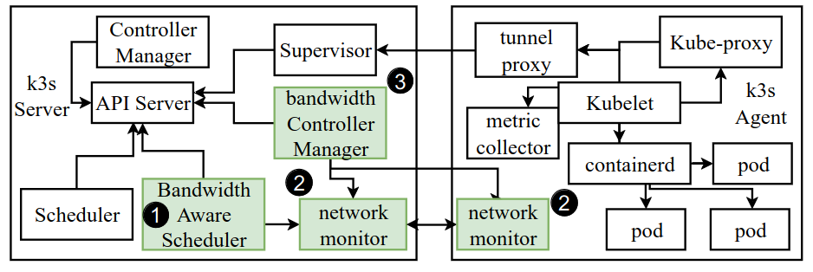
Our Solution: Bandwidth Aware Scheduling System (BASS)
Set of extensions to k3s
3 components
Bandwidth aware scheduler
Decentralised network monitoring
Bandwidth controller for determining if migration is necessary
Bandwidth Controller Manager
Network
Monitor
Network
Monitor

Slide 14
Our Solution: Bandwidth Aware Scheduling System (BASS)
1. Prevention is better than cure - Deploy application components such that data movement between nodes is minimized
Key Idea:
Model application components as a DAG with data rates expressed as edge weights
Using a path based heuristic to colocate components to minimize data transfer
Notes:
Minimizing data transfer makes it immune to bandwidth fluctuations

Slide 15
BASS: Heuristic for component placement
Set of application components
Components form a directed acyclic graph (DAG) representing the data flow between components (G)
Edge weights represent the data rate between two DAG nodes
CPU: 1
mem: 100
G
CPU: 4
mem: 100
2
2
1
1
1
4
5
CPU: 1
mem: 100
2
3
2
3
CPU: 1
mem: 100
CPU: 1
mem: 100
?
R
B
CPU: 4
mem: 2000
Resources available in the system form an undirected graph (R )
How to map G onto R?
2
C
A
CPU: 4
mem: 1000
12
CPU: 4
mem: 2000
2
4
CPU: 4
mem: 1000
D
Notes:
CPU and memory available on a node are node properties
bandwidth available between nodes is an edge property

Slide 16
BASS: Heuristic for component placement
CPU: 1
mem: 100
Sort compute nodes by CPU, memory and bandwidth capacity
G
CPU: 4
mem: 100
2
2
1
1
1
4
5
CPU: 1
mem: 100
2
3
2
3
CPU: 1
mem: 100
CPU: 1
mem: 100
?
R
B
CPU: 4
mem: 2000
Node | Rank
C | 1
B | 2
A | 3
D | 4
2
C
A
CPU: 4
mem: 1000
12
CPU: 4
mem: 2000
2
4
CPU: 4
mem: 1000
D
Notes:
CPU and memory available on a node are node properties
bandwidth available between nodes is an edge property

Slide 17
BASS: Heuristic for component placement
CPU: 1
mem: 100
Minimize data movement between nodes
Find data intensive paths in the DAG
Front end server -> cache -> database
G
CPU: 4
mem: 100
2
2
1
1
1
4
5
CPU: 1
mem: 100
2
3
2
3
CPU: 1
mem: 100
CPU: 1
mem: 100
?
R
B
CPU: 4
mem: 2000
Node | Rank
C | 1
B | 2
A | 3
D | 4
2
C
A
CPU: 4
mem: 1000
12
CPU: 4
mem: 2000
2
4
CPU: 4
mem: 1000
D
Notes:
CPU and memory available on a node are node properties
bandwidth available between nodes is an edge property

Slide 18
BASS: Heuristic for component placement
CPU: 1
mem: 100
Pack as many components along the path on a single node as possible
G
CPU: 4
mem: 100
2
2
1
1
1
4
5
CPU: 1
mem: 100
2
3
2
3
CPU: 1
mem: 100
CPU: 1
mem: 100
?
R
B
CPU: 4
mem: 2000
Node | Rank
C | 1
B | 2
A | 3
D | 4
2
C
A
CPU: 4
mem: 1000
12
CPU: 4
mem: 2000
2
4
CPU: 4
mem: 1000
D
Notes:
CPU and memory available on a node are node properties
bandwidth available between nodes is an edge property

Slide 19
BASS: Heuristic for component placement
CPU: 1
mem: 100
Pack as many components along the path on a single node as possible
G
CPU: 4
mem: 100
2
2
1
1
1
4
5
CPU: 1
mem: 100
2
3
2
3
CPU: 1
mem: 100
CPU: 1
mem: 100
?
R
B
CPU: 4
mem: 2000
Node | Rank
C | 1
B | 2
A | 3
D | 4
2
C
1
A
CPU: 4
mem: 1000
12
CPU: 3/4
mem: 1.9/2k
2
4
CPU: 4
mem: 1000
D
Notes:
CPU and memory available on a node are node properties
bandwidth available between nodes is an edge property

Slide 20
BASS: Heuristic for component placement
CPU: 1
mem: 100
Pack as many components along the path on a single node as possible
G
CPU: 4
mem: 100
2
2
1
1
1
4
5
CPU: 1
mem: 100
2
3
2
3
CPU: 1
mem: 100
CPU: 1
mem: 100
?
R
B
CPU: 4
mem: 2000
Node | Rank
C | 1
B | 2
A | 3
D | 4
2
C
1
A
CPU: 4
mem: 1000
12
CPU: 3/4
mem: 1.9/2k
2
4
CPU: 4
mem: 1000
D
Notes:
CPU and memory available on a node are node properties
bandwidth available between nodes is an edge property

Slide 21
BASS: Heuristic for component placement
CPU: 1
mem: 100
Pack as many components along the path on a single node as possible
G
CPU: 4
mem: 100
2
2
1
1
1
4
5
CPU: 1
mem: 100
2
3
2
3
CPU: 1
mem: 100
CPU: 1
mem: 100
?
R
B
CPU: 4
mem: 2000
Node | Rank
C | 1
B | 2
A | 3
D | 4
2
C
1
3
A
CPU: 4
mem: 1000
12
CPU: 2/4
mem: 1.8/2k
2
4
CPU: 4
mem: 1000
D
Notes:
CPU and memory available on a node are node properties
bandwidth available between nodes is an edge property

Slide 22
BASS: Heuristic for component placement
CPU: 1
mem: 100
Pack as many components along the path on a single node as possible
G
CPU: 4
mem: 100
2
2
1
1
1
4
5
CPU: 1
mem: 100
2
3
2
3
CPU: 1
mem: 100
CPU: 1
mem: 100
?
R
B
CPU: 4
mem: 2000
x
Node | Rank
C | 1
B | 2
A | 3
D | 4
2
C
1
3
A
CPU: 4
mem: 1000
12
CPU: 2/4
mem: 1.8/2k
2
4
CPU: 4
mem: 1000
D
Notes:
CPU and memory available on a node are node properties
bandwidth available between nodes is an edge property

Slide 23
BASS: Heuristic for component placement
CPU: 1
mem: 100
Pack as many components along the path on a single node as possible
G
CPU: 4
mem: 100
2
2
1
1
1
4
5
CPU: 1
mem: 100
2
3
2
3
CPU: 1
mem: 100
CPU: 1
mem: 100
?
R
B
CPU: 4
mem: 2000
Node | Rank
C | -
B | 1
A | 2
D | 3
2
C
1
3
A
x
CPU: 4
mem: 1000
12
CPU: 2/4
mem: 1.8/2k
2
4
CPU: 4
mem: 1000
D
Notes:
CPU and memory available on a node are node properties
bandwidth available between nodes is an edge property

Slide 24
BASS: Heuristic for component placement
CPU: 1
mem: 100
Pack as many components along the path on a single node as possible
G
CPU: 4
mem: 100
2
2
1
1
1
4
5
CPU: 1
mem: 100
2
3
2
3
CPU: 1
mem: 100
CPU: 1
mem: 100
?
R
B
CPU: 4
mem: 2000
Node | Rank
C | -
B | 1
A | 2
D | 3
2
C
1
3
A
CPU: 4
mem: 1000
12
CPU: 2/4
mem: 1.8/2k
2
4
CPU: 4
mem: 1000
D
Notes:
CPU and memory available on a node are node properties
bandwidth available between nodes is an edge property

Slide 25
BASS: Heuristic for component placement
CPU: 1
mem: 100
Pack as many components along the path on a single node as possible
G
CPU: 4
mem: 100
2
2
1
1
1
4
5
CPU: 1
mem: 100
2
3
2
3
CPU: 1
mem: 100
CPU: 1
mem: 100
?
R
B
CPU: 4
mem: 2000
Node | Rank
C | -
B | 1
A | 2
D | 3
4
2
C
1
3
A
CPU: 0/4
mem: .9/1k
9/12
CPU: 2/4
mem: 1.8/2k
2
4
CPU: 4
mem: 1000
D
Notes:
CPU and memory available on a node are node properties
bandwidth available between nodes is an edge property

Slide 26
BASS: Heuristic for component placement
CPU: 1
mem: 100
Pack as many components along the path on a single node as possible
G
CPU: 4
mem: 100
2
2
1
1
1
4
5
CPU: 1
mem: 100
2
3
2
3
CPU: 1
mem: 100
CPU: 1
mem: 100
?
R
5
B
CPU: 4
mem: 2000
Node | Rank
C | 3
B | 1
A | -
D | 2
4
2
C
1
3
A
CPU: 0/4
mem: .9/1k
6/12
CPU: 2/4
mem: 1.8/2k
0/2
3/4
2
CPU: 3/4
mem: .9/1K
D
Notes:
CPU and memory available on a node are node properties
bandwidth available between nodes is an edge property

Slide 27
Our Solution: Bandwidth Aware Scheduling System (BASS)
2. Low cost probing to detect changes to link capacity
Key Idea:
Headroom probing coupled with application traffic monitoring to gauge available spare capacity

Slide 28
BASS: Probing to detect link capacity changes
Passive Operation
Passively observe component data rates
2
1
CPU: 3/4
mem: 0.9K/1K
CPU: 1/4
mem: 1.7K/2K
Active Operation
Headroom accommodates spikes in application traffic
Probe types:
Headroom probe: Periodically check if link has sufficient headroom
Capacity probe: Use iPerf3 to determine link capacity
4
initial capacity = 4
required = 1
headroom = 0.5
link cap.
b/w
headroom
app usage
time
Capacity probe needed only when headroom shrinks and app data rate falls!
Notes:
Headroom - Link specific property decided by the system administrator

Slide 29
Our Solution: Bandwidth Aware Scheduling System (BASS)
3. Migrating application components when link capacity falls below component’s required data rate
Key Idea:
Migration to nodes with already deployed dependencies
Timeout period before successive migrations

Slide 30
BASS: Evaluations
Are BASS’s deployment and migration strategies effective?
Can we quantify the improvement in application performance?
What are the overheads associated with BASS?
< 1% overheads!
Other questions answered in the paper -
How do we tune thresholds for migration in BASS?
Does BASS work generally across various applications?

Slide 31
BASS: Evaluation Setup
Node 1
Cloudlab VMs
Linux tc mimics bandwidth traces from CityLab testbed for 5 nodes
Node 5
Node 2
Node 4
Node 3

Slide 32
BASS: Evaluation Results
With migration
Migrating services result in higher bitrates at node 2
K3s no migration
Node 1
Video Conferencing Service
Timely migrations preserve bitrates at node 2
Node 5
Node 2
Node 4
Node 3

Slide 33
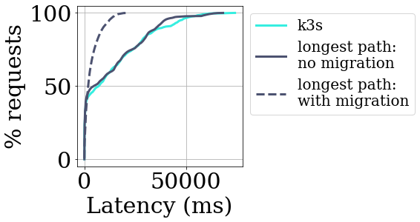
BASS: Evaluations
DeathStarBench - Social Network Application
Mean Latencies
K3s: 13.4 ms
longest path: 12.6 ms
longest path with migration: 7.1 ms
Cuts p99 latency from 60 seconds to 28 seconds
Notes:
Using longest path heuristic improves p90 latency in comparison to k3s
Real benefit comes from monitoring the network and performing migration

Slide 34
Summary
Key Insights
Wireless Link capacities fluctuate
SoTA Schedulers are not equipped to react to fluctuations
Our solution BASS treats bandwidth as a first-class citizen and leverages
Path based heuristics to minimize data movement
Low cost probing
Timely migrations
Results
Reduces end to end latencies by upto 50%
Improves QoS for bandwidth-heavy applications by improving bitrates.
Does not impose significant overheads over the baseline K3s orchestrator

