Slide 1
uFindMe: A UWB-Based Robotic Package Finder
Nicholas Cich
Rishabh Singhal
Georgia Tech / Amazon Robotics
Georgia Tech / Synopsys
Ashutosh Dhekne
Georgia Tech

Slide 2
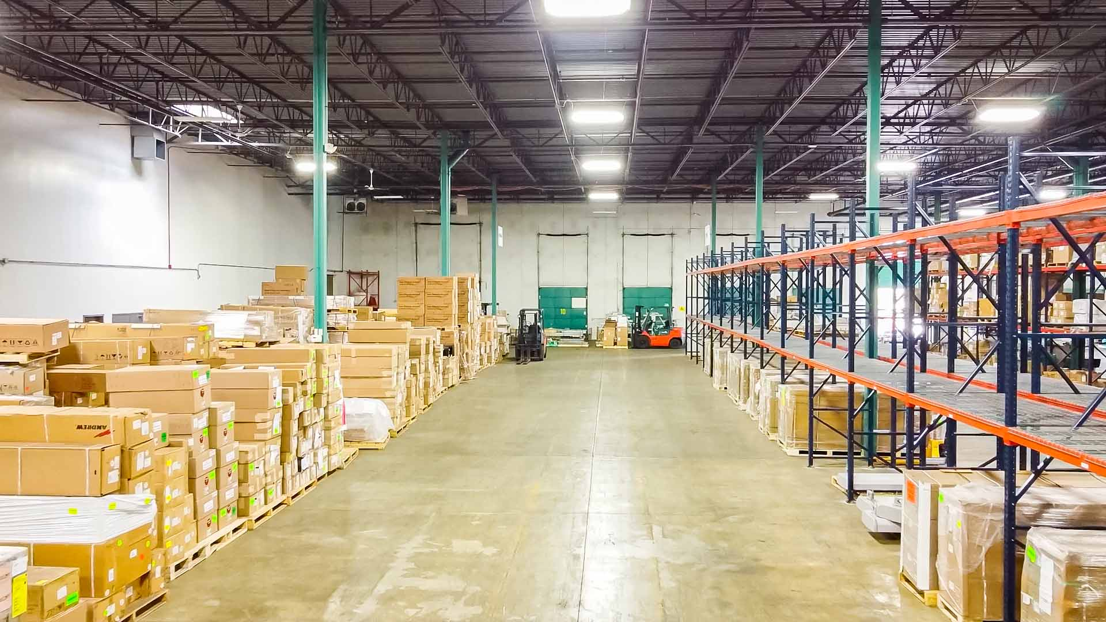
Losing Packages During Shipping Is Not New!
This is how to reduce losses caused by lost or stolen packaging
Warehouse Shipping Mistakes – How to Avoid and Correct Them
Notes:
Losing high-value or sentimental packages can cause financial loss or distress. Lost-and-found cases occur when standard tracking fails, but the package's location is often known to the warehouse level. Embedding a tracking device can help locate it without needing global positioning or communication. However, locating a package within a warehouse or shipping dock can be challenging. A dedicated robot, using UWB signals to autonomously find the package, offers a generic solution independent of existing infrastructure.

Slide 3
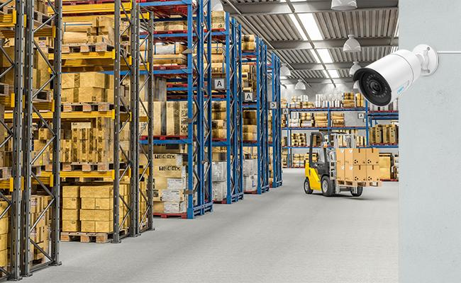
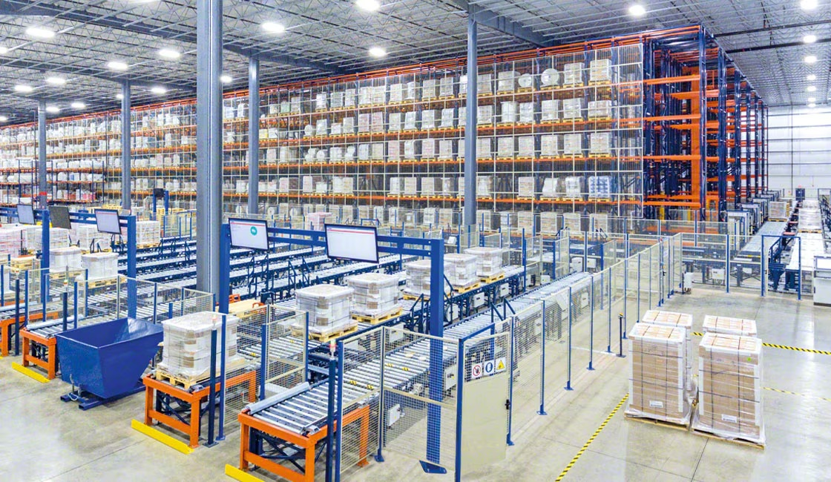
Why UWBs?
Camera limitations: Blocked labels and limited range. Unobstructed line-of-sight required.
RFID issues: Weak signal and poor localization accuracy over distance.
WiFi limitations: Significantly affected by multi-path effect, particularly in cluttered environments.
In contrast to the above three solutions, Ultra-Wideband radios provide right combination of accuracy (10-20 cm), range (30-40m), and power consumption

Slide 4
This Paper: New Modalities
Single UWB Pair Platform
Package Seeking
Infrastructure Free
Online Course Correction
Real-time target location estimation
Joint Obstacle Avoidance and Navigation
UWB-aided LiDAR Navigation System

Slide 5
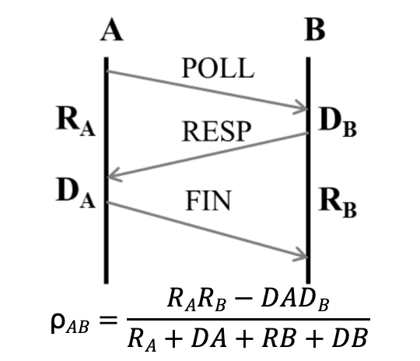
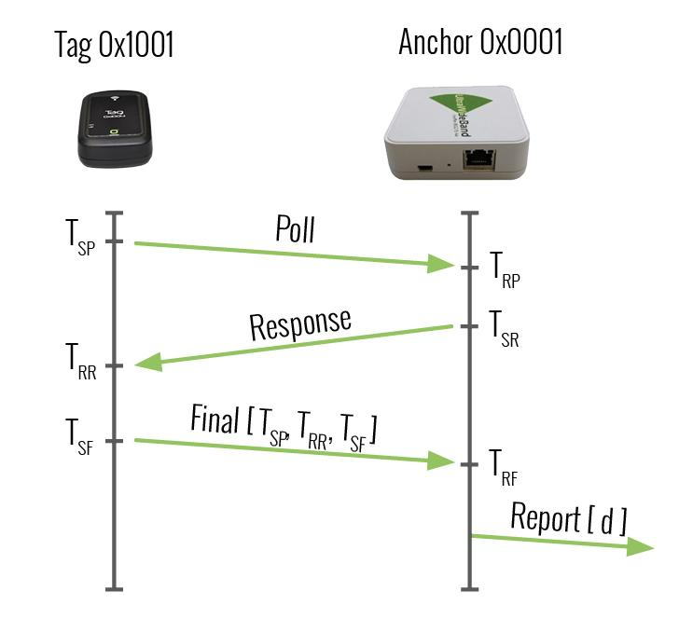
Single UWB Pair Platform
UWB two-way ranging (TWR) measurements:
Calculates Time of Flight (ToF) of UWB RF signal by exchanging messages between Tag and an Anchor.
Only one Anchor participates in the TWR process at a time to avoid interference

Slide 6
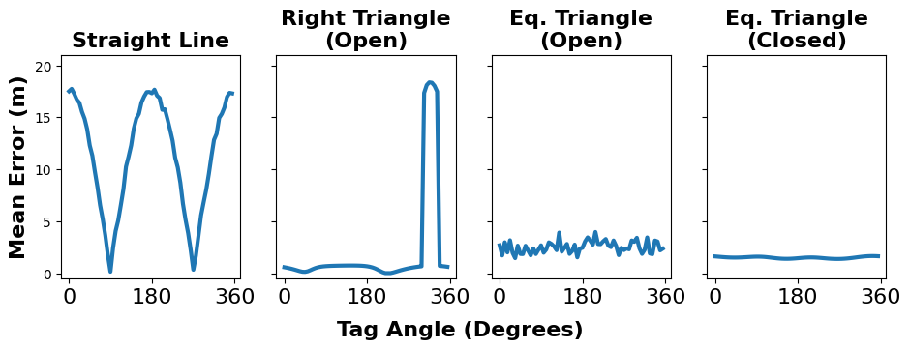
Synthetic Aperture Optimization
To make initial estimate of package location, the robot travels in a predefined path known as a “synthetic aperture”
The shape and size of this synthetic aperture can significantly affect performance

Slide 7
Course Correction
Sensor data fused using factor graph
Robot’s positions + static package position are set as variables
Odometer reading and package robot distance estimates are set as factors
Package location estimation updated online as new data is collected

Slide 8
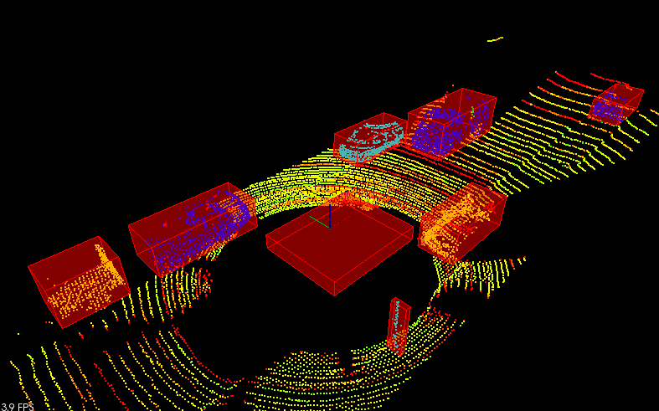
Joint Obstacle Avoidance and Navigation
No prior knowledge of environment
Robot detects obstacles using on-board LiDAR sensor

Slide 9
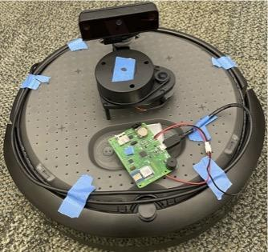
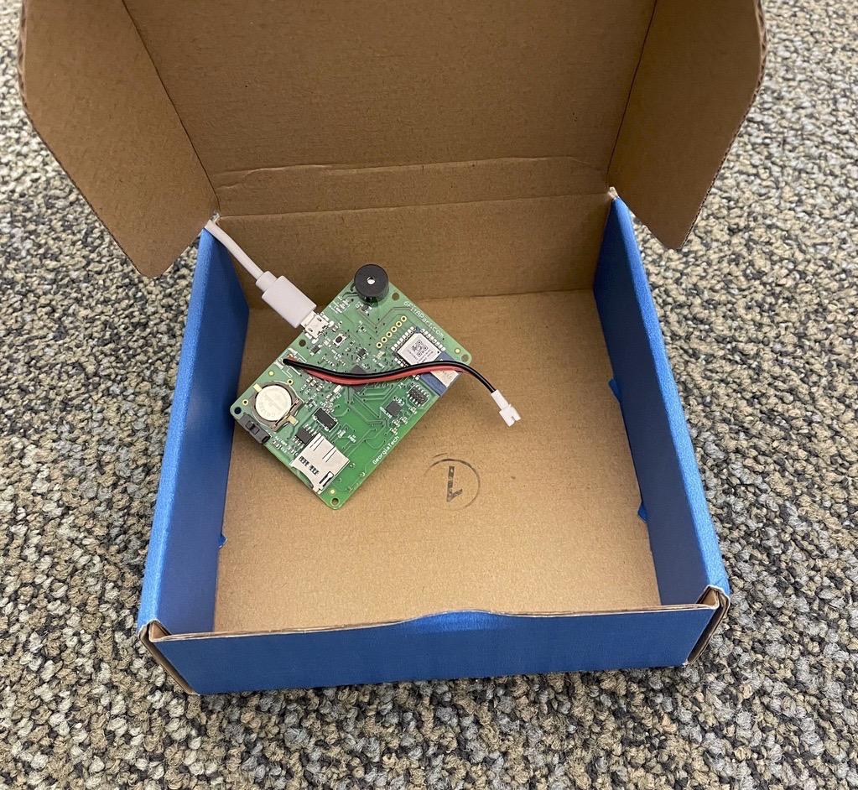
Implementation

Slide 10
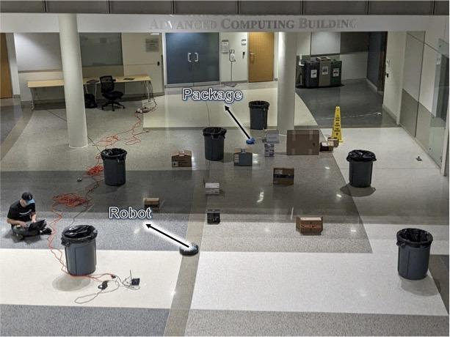
Experimental Setup

Slide 11
Results (4 Illustrative Trials)

Slide 12
Distance Calculations
 | Trial 1 | Trial 2 | Trial 3 | Trial 4
Our Approach | 0.03m | 0.42m | 0.53m | 0.77m
Infrastructure-Based | 0.12m | 0.06m | 0.13m | 0.08m
Distance Between Final Location of Robot and Target Package
 | Trial 1 | Trial 2 | Trial 3 | Trial 4
Our Approach No Synthetic Aperture | 12.6m | 12.5m | 13.2m | 21.1m
Our Approach | 6.4m | 6.2m | 6.2m | 14.3m
Infrastructure-Based | 6.4m | 6.5m | 6.1m | 7.2m
Oracle | 5.8m | 5.9m | 5.9m | 6.7m
Total Distance Traveled to Find Target Package

Slide 13
LiDAR Scans

Slide 14
Future Work
Analyze the size of the synthetic aperture in addition to the shape with respect to localization error
Explore how a dynamic environment can affect performance
Address test bed size constraints
Investigate how some domain knowledge of surroundings may improve exploration
Try avoiding clutter rather than directly approaching the target

Slide 15
Concluding Remarks
uFindMe introduces a novel autonomous package-seeking system in a cluttered environments
First of it’s kind robotic system that combines LiDAR data with continuous two-way ranging from UWB sensors to track objects
Encourages exploration of new UWB sensor applications within the mobile computing and robotics ecosystems

