Slide 1
IntruSense: An Enhanced Physical Security System using UWB
Shrenik Changede, Ashutosh Dhekne
HotMobile 2022

Slide 2
Physical Security is a Multi-Billion Dollar Industry
https://www.prnewswire.com/news-releases/physical-security-market-worth-140-0-billion-by-2026--exclusive-research-by-marketsandmarkets-301467445.html
We forecast the market will reach $56.76Bn in 2024.
https://www.researchandmarkets.com/reports/4858655/the-physical-security-business-2019-to-2024
https://www.researchandmarkets.com/reports/5302516/home-security-systems-global-market-trajectory

Slide 3
Physical Security is a Multi-Billion Dollar Industry
https://www.prnewswire.com/news-releases/physical-security-market-worth-140-0-billion-by-2026--exclusive-research-by-marketsandmarkets-301467445.html
We forecast the market will reach $56.76Bn in 2024.
https://www.researchandmarkets.com/reports/4858655/the-physical-security-business-2019-to-2024
https://www.researchandmarkets.com/reports/5302516/home-security-systems-global-market-trajectory

Slide 4
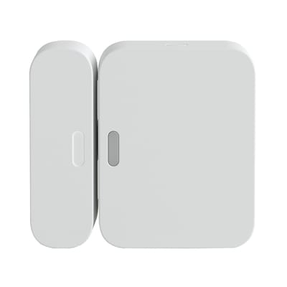
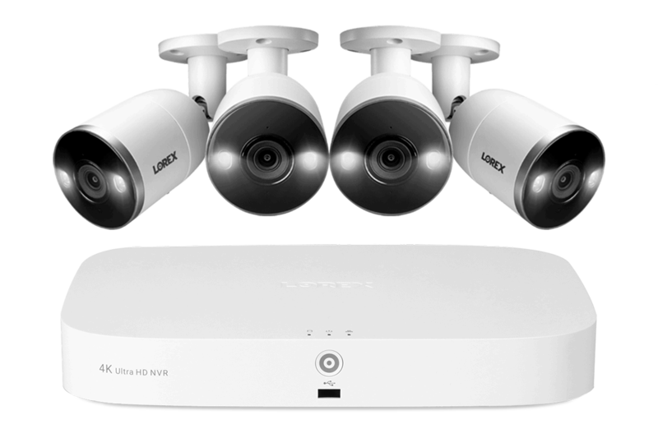
Tools at our Disposal
Magnetic Ingress-Egress Sensors
Cameras
IR Motion Sensors

Slide 5
Tools at our Disposal
Issues
Room-level coverage
Multiple expensive devices
Triggered by friendlies
Large data processing
Large bandwidth needs
Magnetic Ingress-Egress Sensors
Cameras
IR Motion Sensors

Slide 6
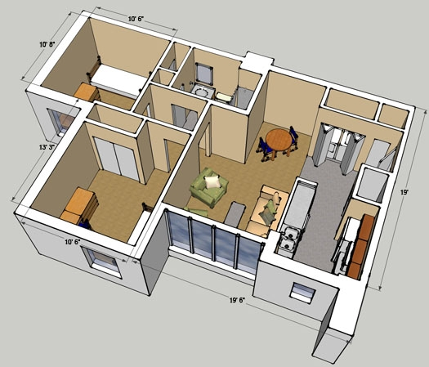
Our Goal
Beyond a room – cover a large indoor space
Inexpensive, easy to deploy
Low data and bandwidth overhead
Allow presence of friendly entities
http://www.tyler-morgan.com/#/smile-train/
https://housing.gatech.edu/building/tenth-and-home-bldg-f

Slide 7
Through a wireless sensing approach to physical security

Slide 8
IntruSense:
An Enhanced Physical Security System using UWB

Slide 9
Core Intuition

Slide 10
Core Intuition

Slide 11
Core Intuition
A static reflection pattern is observed
The reflections describe the wireless channel’s impulse response

Slide 12
Core Intuition
An occupied space shows a different reflection pattern

Slide 13
Core Intuition
Movement causes this pattern to change over time
https://www.pinterest.com.au/pin/361836151311622239/

Slide 14
We use the changes in channel impulse response (CIR) to detect intrusion

Slide 15
Sounds Simple, But…
Wireless signals travel at speed of light
Distinguishing reflections requires nanosecond level precision (a billionth of a second)
Need a technology that covers a rather large indoor space
mmWave vs WiFi vs UWB tradeoffs
How to ignore disturbances of known entities?
Need a localization-based solution

Slide 16
Sounds Simple, But…
Wireless signals travel at speed of light
Distinguishing reflections requires nanosecond level precision (a billionth of a second)
Need a technology that covers a rather large indoor space
mmWave vs WiFi vs UWB tradeoffs
How to ignore disturbances of known entities?
Need a localization-based solution
Wide-bandwidth provides nanosecond CIR
Large coverage
Allows robust localization

Slide 17
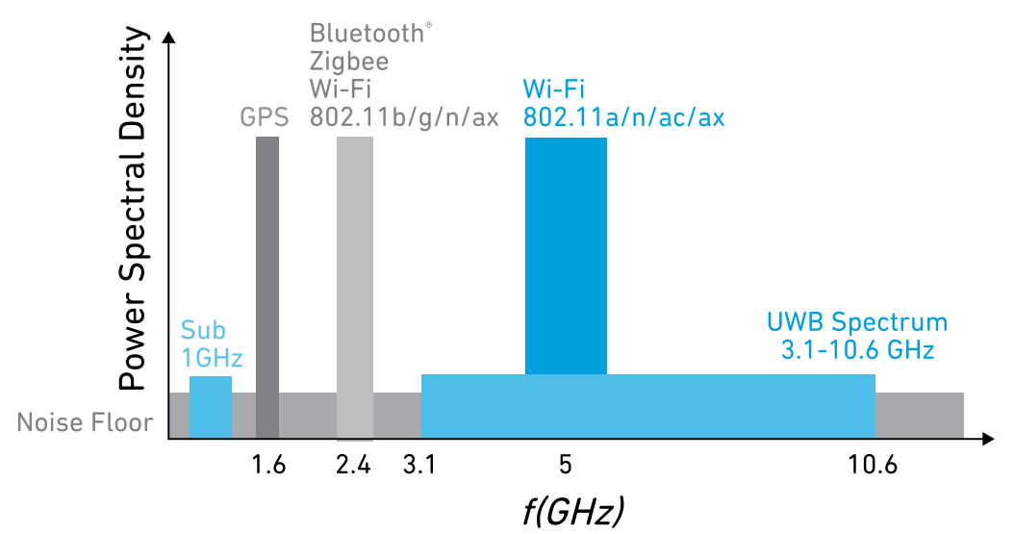
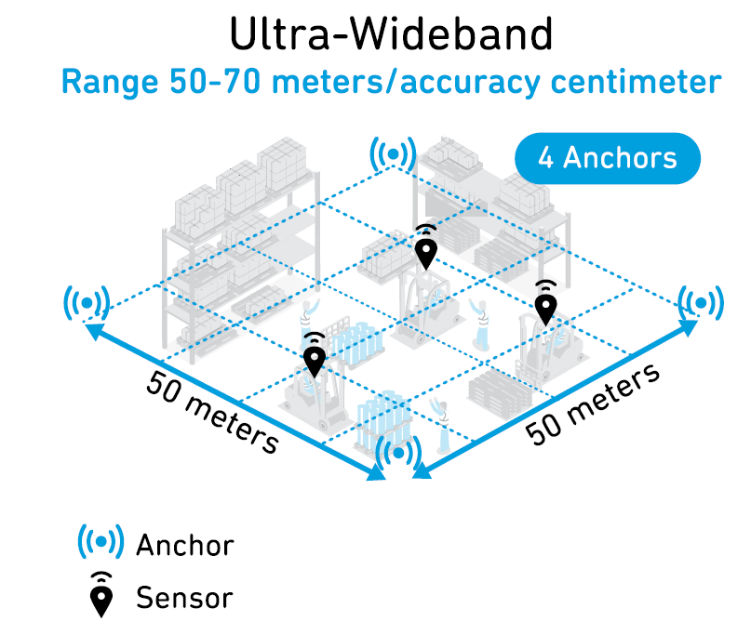
What is Ultra-wideband (UWB)?
Ultra wide-band is the technology ratified by 802.15.4a and 802.15.4z standards
500MHz or 1GHz bands in the 3.1–10.6 GHz range
Very low power -41.3dBm/Hz
UWB
3.1-10.6GHz
Very low data rates 110kbps/850kbps/6.8Mbps
Long Range Indoors 50-70 meters
Receiver sensitivity at -106dB/500MHz (1% err)
https://www.decawave.com/wp-content/uploads/2020/04/DW1000_Datasheet.pdf
https://www.qorvo.com/design-hub/ebooks/ultra-wideband-for-dummies

Slide 18
What is Ultra-wideband (UWB)?
Ultra wide-band is the technology ratified by 802.15.4a and 802.15.4z standards
500MHz or 1GHz bands in the 3.1–10.6 GHz range
Very low power -41.3dBm/Hz
UWB
3.1-10.6GHz
Very low data rates 110kbps/850kbps/6.8Mbps
Long Range Indoors 50-70 meters
Receiver sensitivity at -106dB/500MHz (1% err)
https://www.decawave.com/wp-content/uploads/2020/04/DW1000_Datasheet.pdf
https://www.qorvo.com/design-hub/ebooks/ultra-wideband-for-dummies

Slide 19
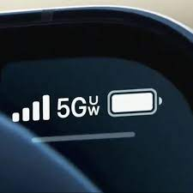
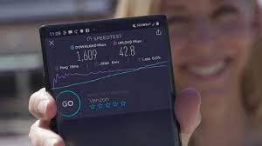
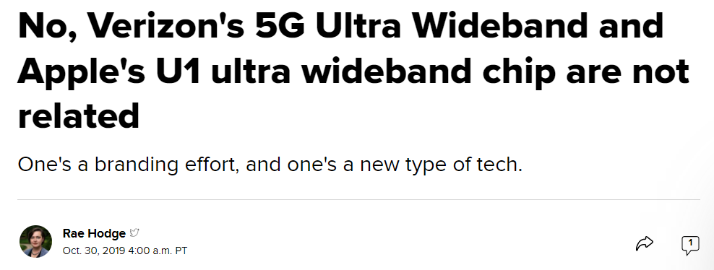
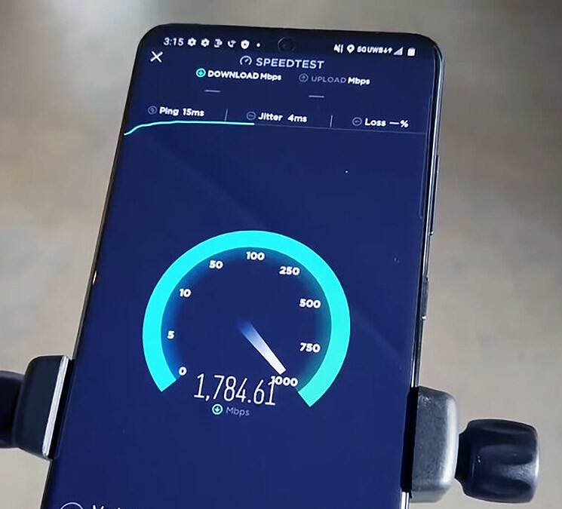
What is Ultra-wideband (UWB)?
not
^
Ultra wide-band is the technology ratified by 802.15.4a and 802.15.4z standards
500MHz or 1GHz bands in the 3.1–10.6 GHz range
Very low power -41.3dBm/Hz
X
X
UWB
3.1-10.6GHz
X
X
Very low data rates 110kbps/850kbps/6.8Mbps
Long Range Indoors 50-70 meters
Receiver sensitivity at -106dB/500MHz (1% err)
X
https://www.cnet.com/tech/services-and-software/verizon-apple-u1-ultra-wideband-not-related/
https://www.decawave.com/wp-content/uploads/2020/04/DW1000_Datasheet.pdf
https://www.qorvo.com/design-hub/ebooks/ultra-wideband-for-dummies

Slide 20
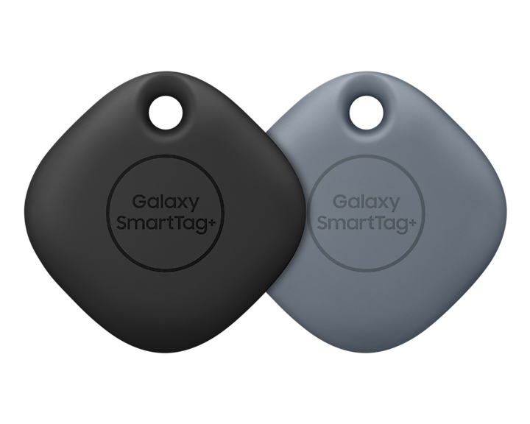
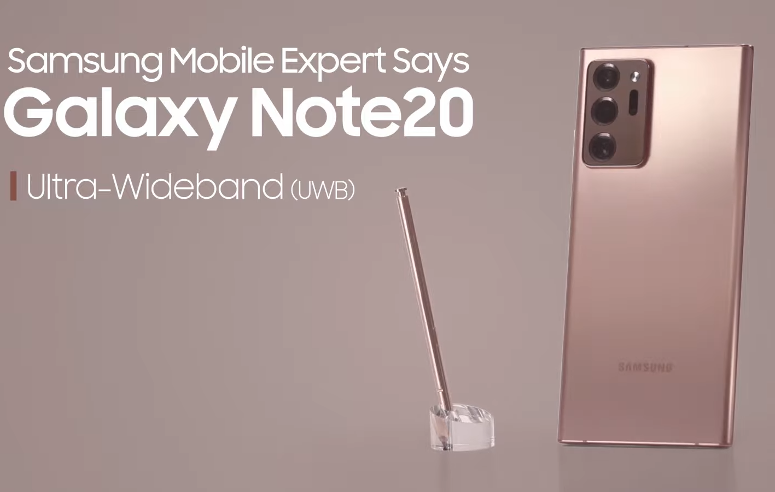
Where is UWB used?

Slide 21
Innovations in IntruSense
We develop 4 models of security systems
Each uses progressively more complex wireless sensing logic.

Slide 22
Sneak Preview
We develop 4 models of security systems
Each uses progressively more complex wireless sensing logic.
IntruSense Model 1
Detects line-of-sight obstruction
IntruSense Model 2
Detects disturbances to reflection patterns
IntruSense Model 3
Ignore movements of friendlies
IntruSense Model 4
Single central RADAR system

Slide 23
Innovations in IntruSense
We develop 4 models of security systems
Each uses progressively more complex wireless sensing logic.
IntruSense Model 1
Detects line-of-sight obstruction

Slide 24
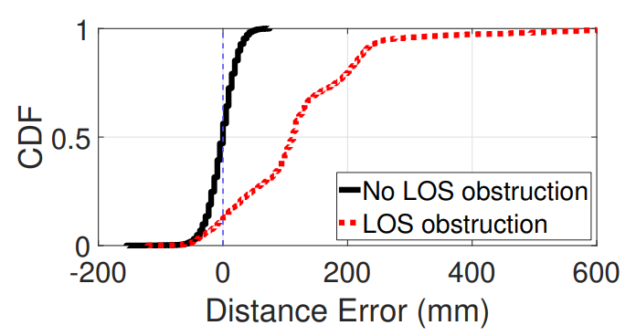
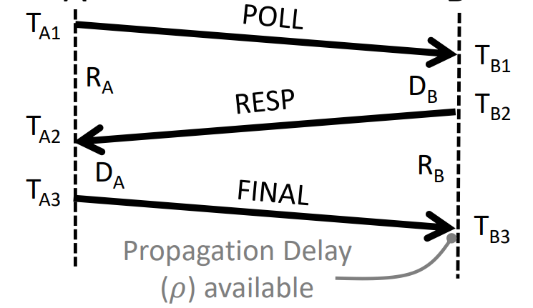
IntruSense Model 1
Detects line-of-sight obstruction
UWB 1
Line of sight
UWB 2
UWB performs two-way ranging
Calculates distance between two devices
Across Doorway
Ingress/egress points
UWB 1
UWB 2

Slide 25
IntruSense Model 1
Detects line-of-sight obstruction
UWB 1
Line of sight
UWB 2
Measured distance changes due to LOS blockage.
Across Doorway
Ingress/egress points

Slide 26
IntruSense Model 1
Detects line-of-sight obstruction
UWB 1
Line of sight
UWB 2
Measured distance changes due to LOS blockage.
Across Doorway
Ingress/egress points

Slide 27
IntruSense Model 2
Detects disturbances to reflection patterns

Slide 28
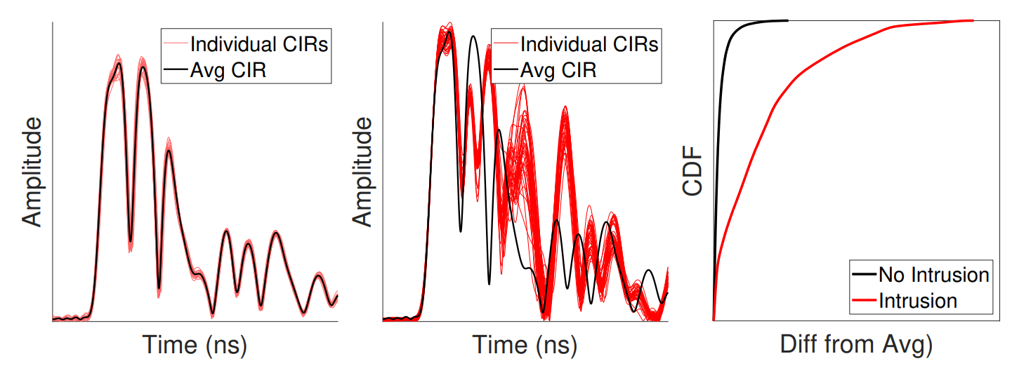
IntruSense Model 2
Detects disturbances to reflection patterns
UWB 2
Measure unoccupied indoor space’s CIR using multiple UWB
UWB 1
UWB 3

Slide 29
IntruSense Model 2
Detects disturbances to reflection patterns
UWB 2
Reflection
Intruder disturbs NLOS
Measured disturbances to the observed CIR
UWB 1
UWB 3

Slide 30
IntruSense Model 3
Ignore movements of friendlies

Slide 31
IntruSense Model 3
Ignore movements of friendlies
Can we arm the security system even when the space is occupied?

Slide 32
IntruSense Model 3
Ignore movements of friendlies
Can we arm the security system even when the space is occupied?
Pets
Elderly
Guards

Slide 33
IntruSense Model 3
Ignore movements of friendlies
Can we arm the security system even when the space is occupied?
Pets
Elderly
Guards
Not possible using IR motion detectors, cameras, etc.
False alarms are frequent

Slide 34
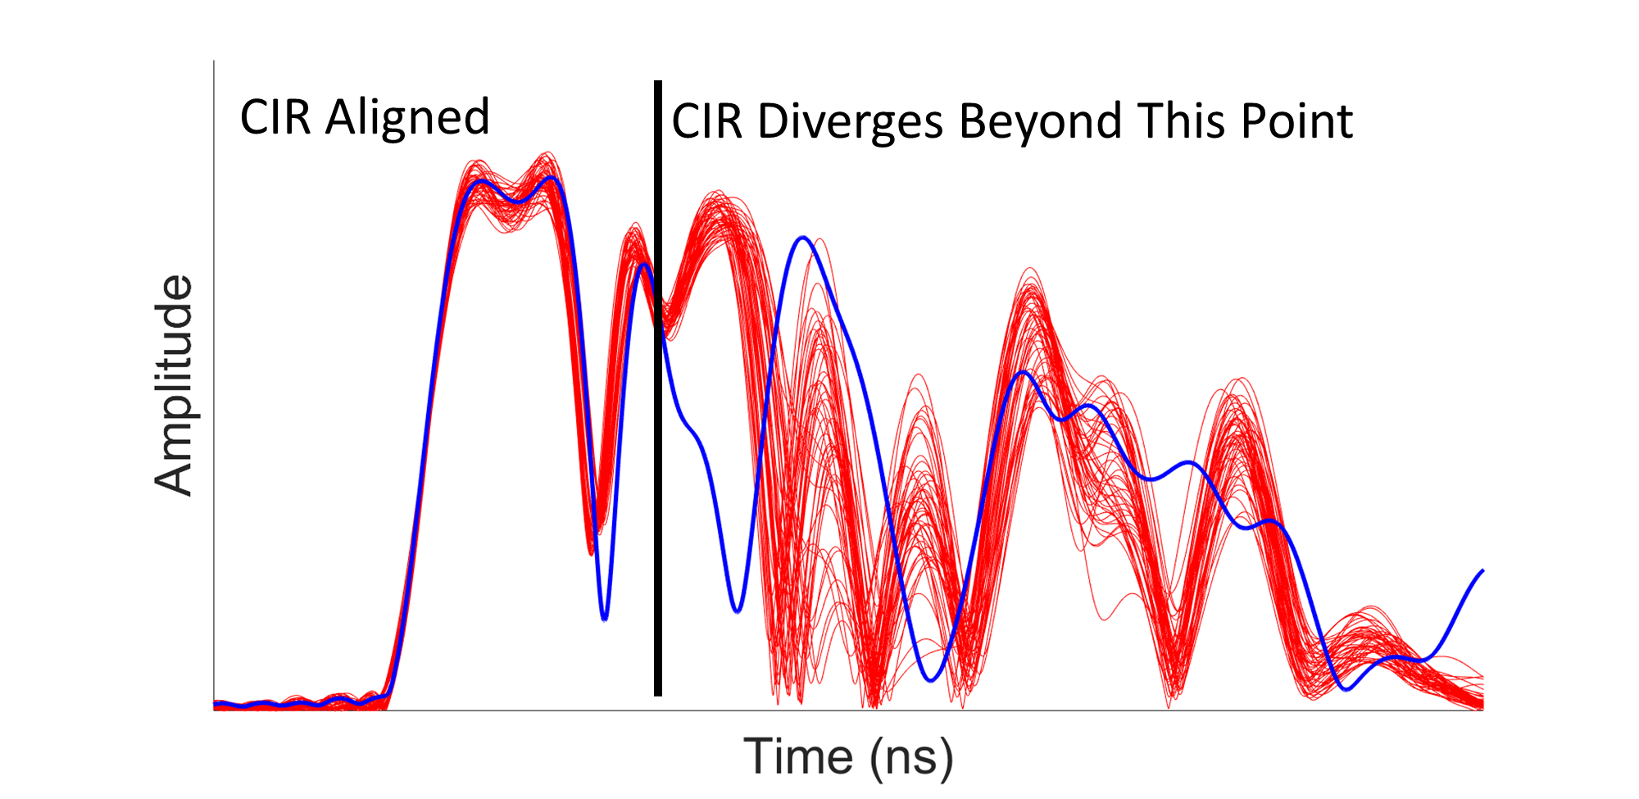
IntruSense Model 3
Ignore movements of friendlies
Friendlies wear a UWB device
IntruSense localizes this friendly device
Ignores CIR changes in those locations
UWB
Collar
Pets
Detected Pet Location

Slide 35
IntruSense Model 3
Ignore movements of friendlies
Active Localization
UWB 2
UWB 1
UWB 3
Reflection matches known location
Unmatched Reflection
Friendly UWB device performs active localization with the security system
Security system ignores CIR changes in the vicinity of expected location
Raises alarm when unmatched reflections occur

Slide 36
IntruSense Model 4
Single central RADAR system

Slide 37
IntruSense Model 4
Single central RADAR system
Model 3 requires multiple UWB devices.
Can we create a single central system, instead?
3
Active Localization
1
Ignored
2
Reflection raises alarm

Slide 38
IntruSense Model 4
Single central RADAR system
Model 3 requires multiple UWB devices.
Can we create a single central system, instead?
Future Work
3
Active Localization
3
Receivers saturate, need to ignore direct signal.
1
Ignored
1
2
2
Reflection raises alarm

Slide 39
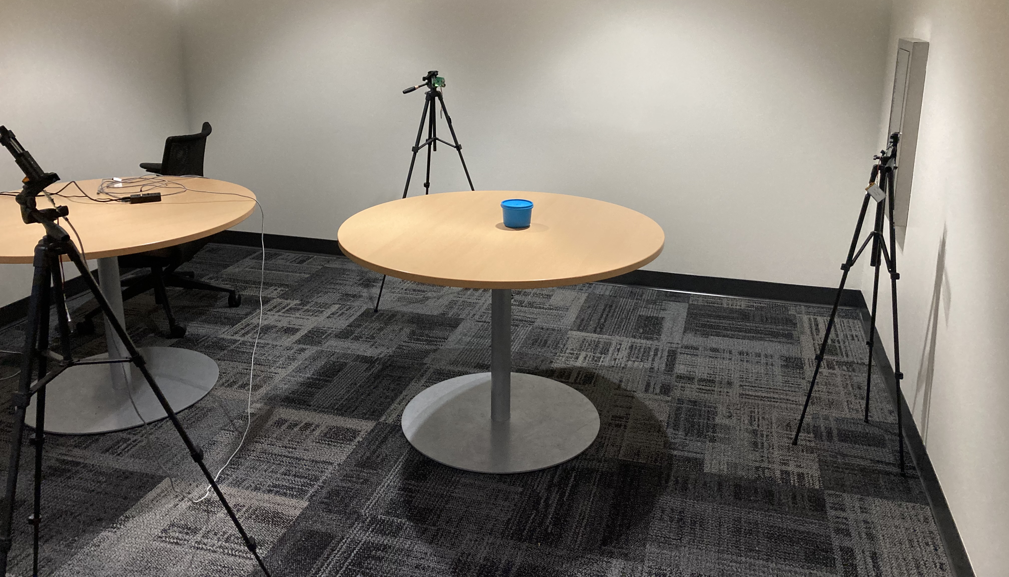
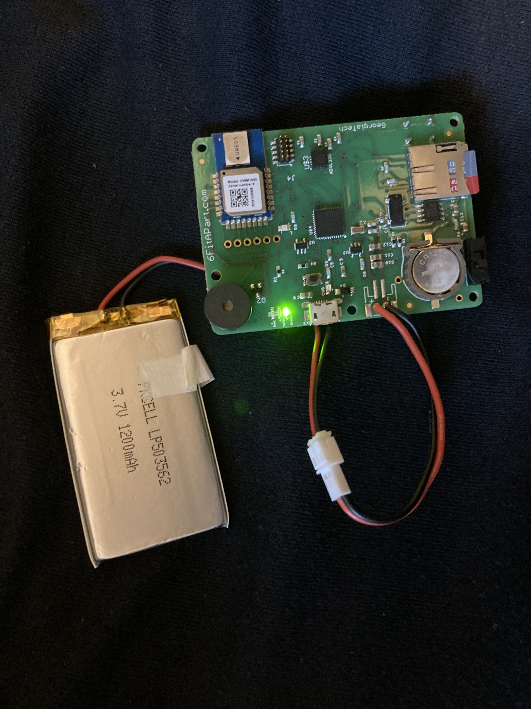
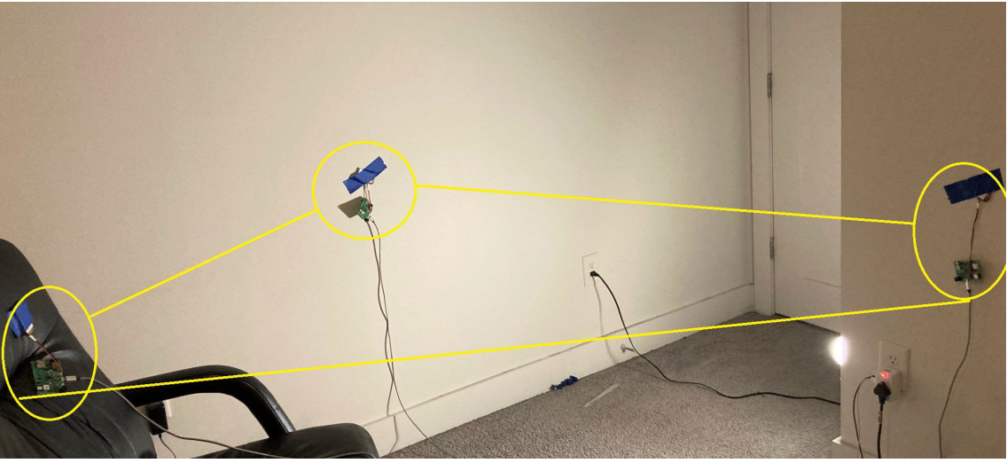
Implementation
Object to be protected
Decawave DWM1000 UWB
Buzzer
\
Attempting to steal an object demo
At home preliminary tests

Slide 40
Short Demo Video of IntruSense

Slide 41
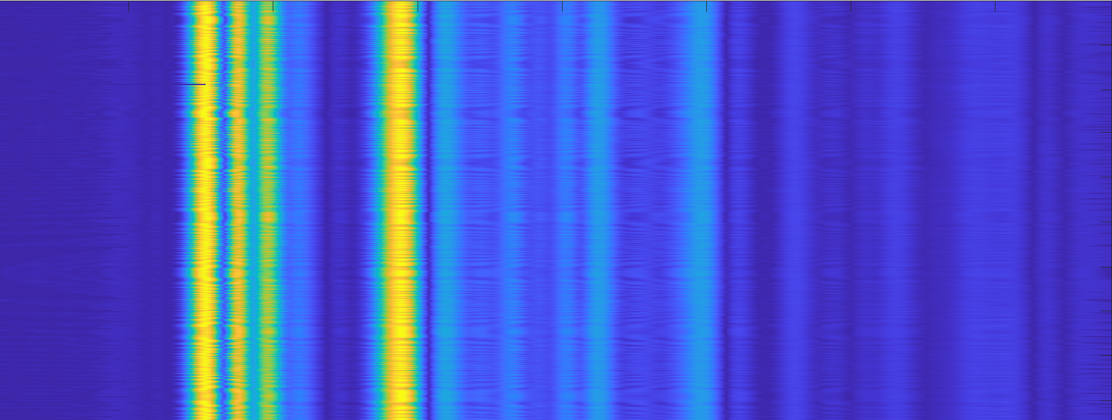
A Potential Solution to the UWB Radar problem
Strong direct-path signal
Other reflections appear weak
High Amplitude
1-antenna system
$λ$/2
Weaker direct-path signal
Other reflections appear stronger
2-antenna system
Low Amplitude
Time in nanoseconds (within a packet) →
Work in Progress

Slide 42
Summary
IntruSense Model 1
Detects line-of-sight obstruction
IntruSense Model 2
Detects disturbances to reflection patterns
IntruSense Model 3
Ignore movements of friendlies
IntruSense Model 4
Single central RADAR system

Slide 43
Conclusion
We are just getting started.
Perimeter fencing, home security, safeguarding valuables at a museum, etc. could all benefit from IntruSense.
IntruSense ignores friendlies while still monitoring an indoor space
We see a promise in using wireless sensing approach for physical security problems

