Slide 1
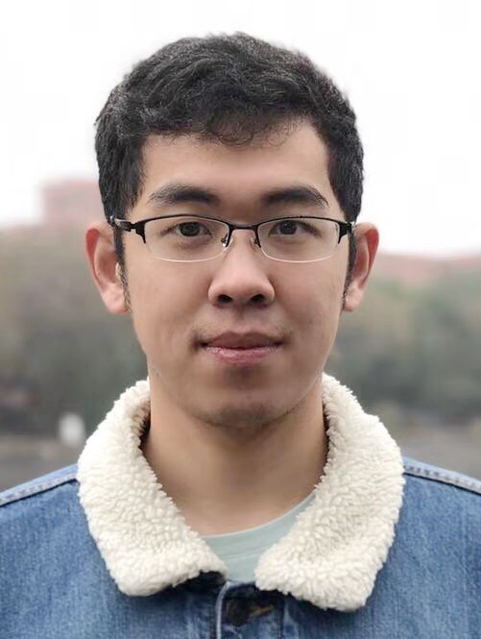
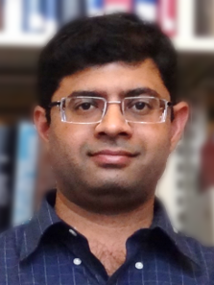
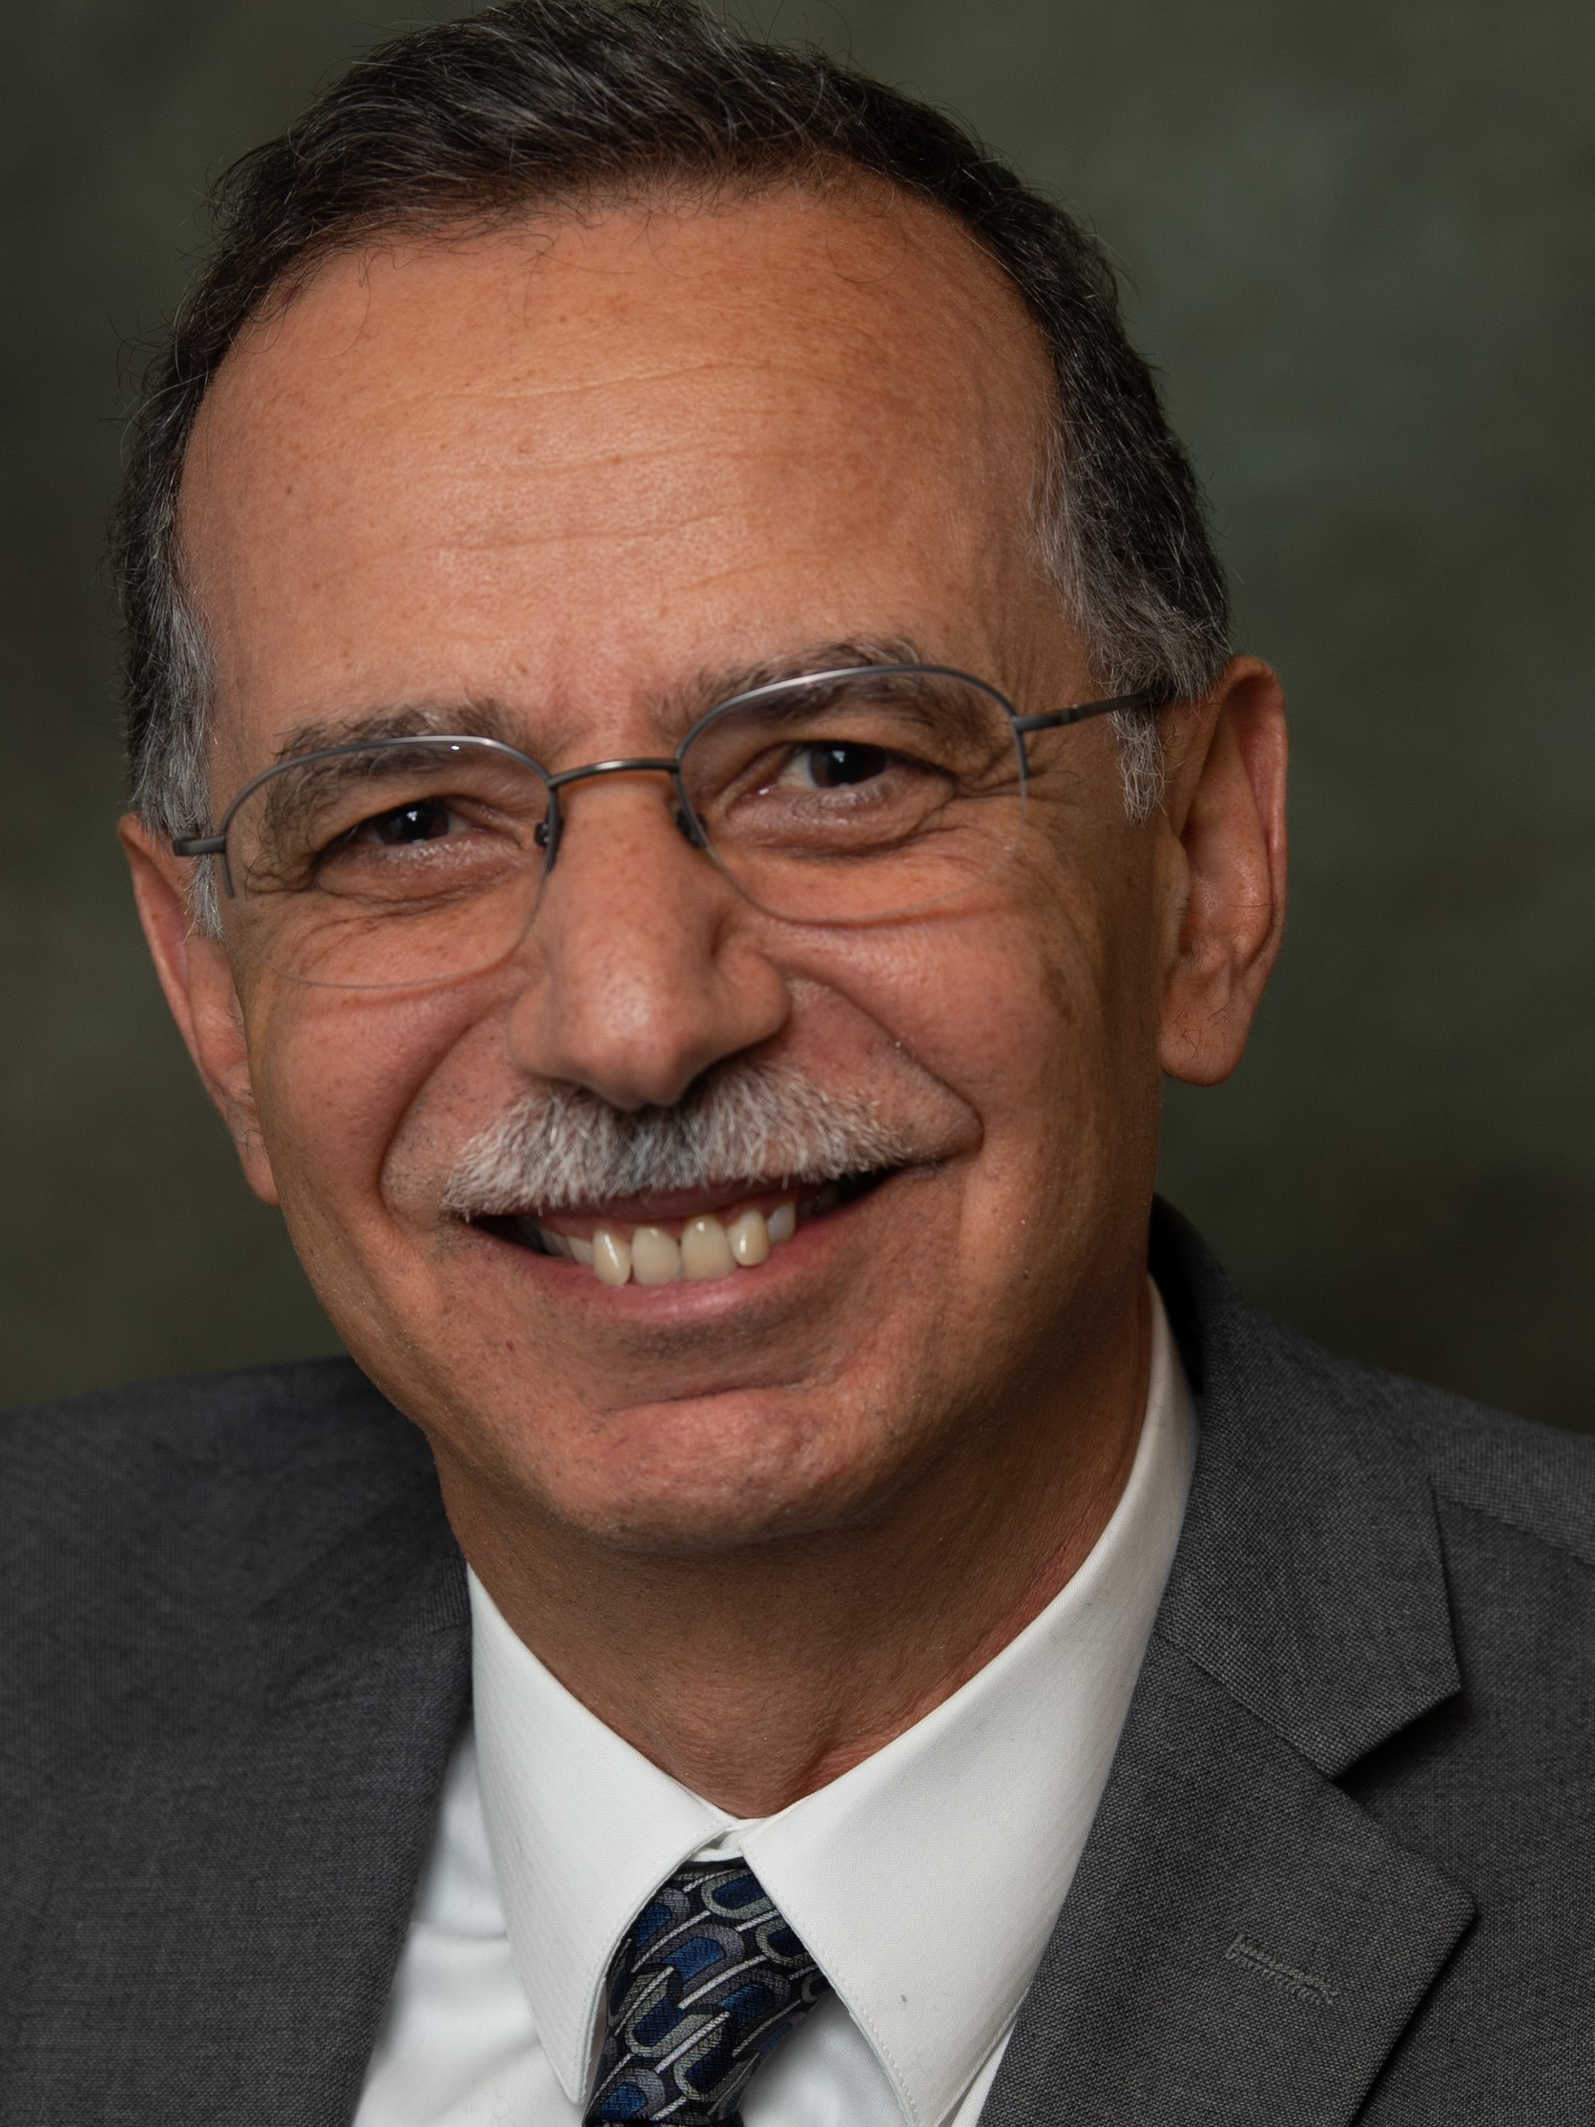
ViSig: Automatic Interpretation of Visual Body Signals Using On-Body Sensors
Yifeng Cao
Ashutosh Dhekne
Mostafa Ammar
ycao361@gatech.edu
dhekne@gatech.edu
ammar@cc.gatech.edu
Presenter: Ashutosh Dhekne
Notes:
3min + 10min + 10min + 25min + 5min

Slide 2
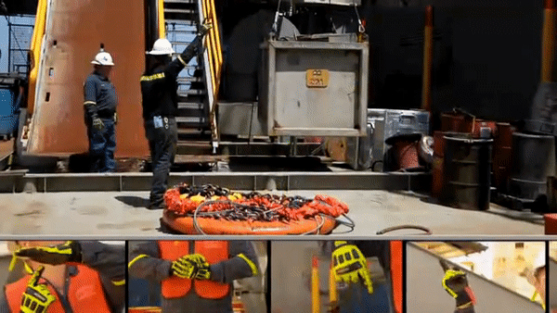
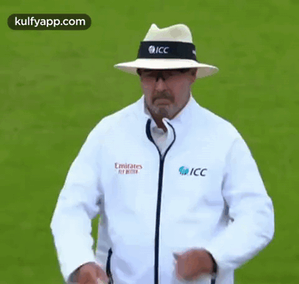
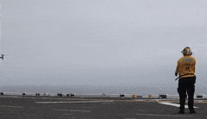
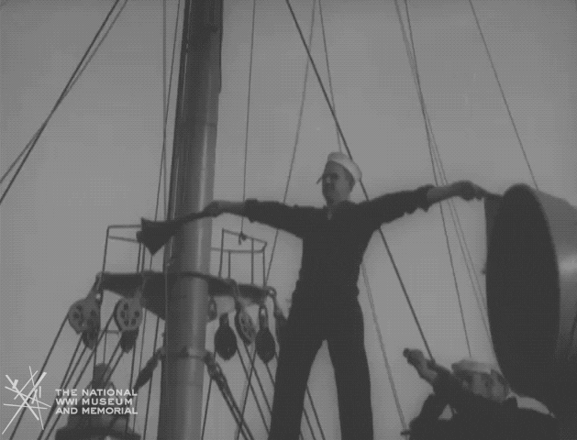
Visual Body Signals Are Everywhere
Crane Signal
Umpire Signal
>600,000 people use body signals
Billions of dollars worth equipment
Aircraft Marshalling
Flag Semaphore
Notes:
Visual body signals are widely used in our life. Some of them are designed for the safety purpose like crane signal, aircraft marshalling, and some of them are designed in a certain domain as a practice, like umpire signals. But All of them are designed for the ease of communication in the case when audio communication is not available. According to the report from BLS, there are six hundred thousand people who are actively using body signals in more than 10 occupations

Slide 3
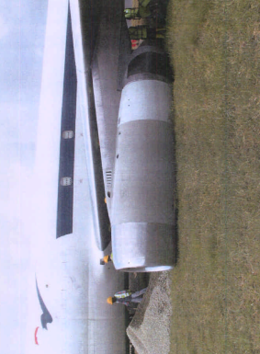
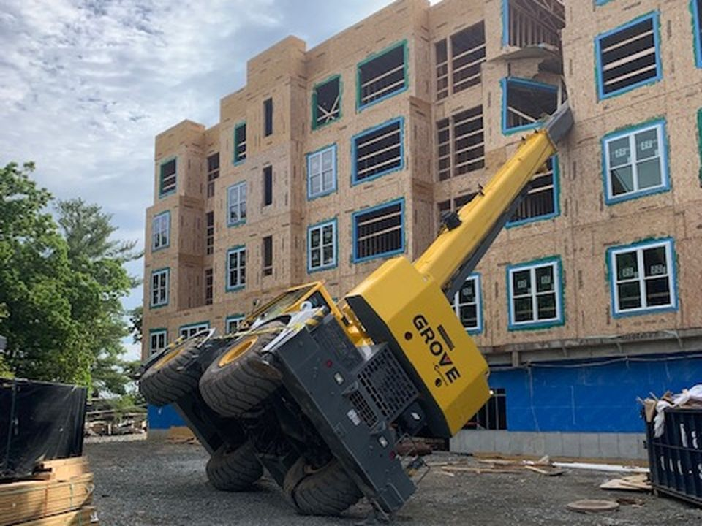
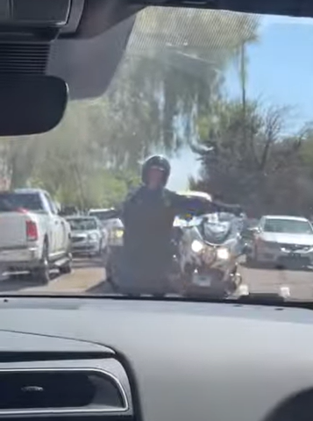
Why is Body-Signal Interpretation Important?
Notes:
In scenarios where body signals are designed for safety, if the signal is not given, or understood correctly, it will lead to severe consequence. For example, if a crane signal, or an aircraft marshaller signal is mis-interpreted, it would be an accident at a loss of billions of dollars, or even at cost of human lives. In this case applications, automatic interpretation is very helpful in providing a feedback to the signalman and those who needs to read signals, or simply keep a record for auditing in the future.
(Mention an immediate feedback, record keeping, audit (who’s duty))
Crane signal should be replaced (it is not mechanical ), put static images costly
Airplane
Red color

Slide 4
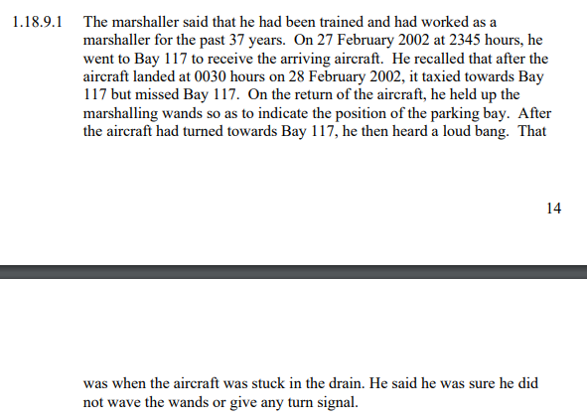
Why is Body-Signal Interpretation Important?
Notes:
In scenarios where body signals are designed for safety, if the signal is not given, or understood correctly, it will lead to severe consequence. For example, if a crane signal, or an aircraft marshaller signal is mis-interpreted, it would be an accident at a loss of billions of dollars, or even at cost of human lives. In this case applications, automatic interpretation is very helpful in providing a feedback to the signalman and those who needs to read signals, or simply keep a record for auditing in the future.
(Mention an immediate feedback, record keeping, audit (who’s duty))
Crane signal should be replaced (it is not mechanical ), put static images costly
Airplane
Red color

Slide 5
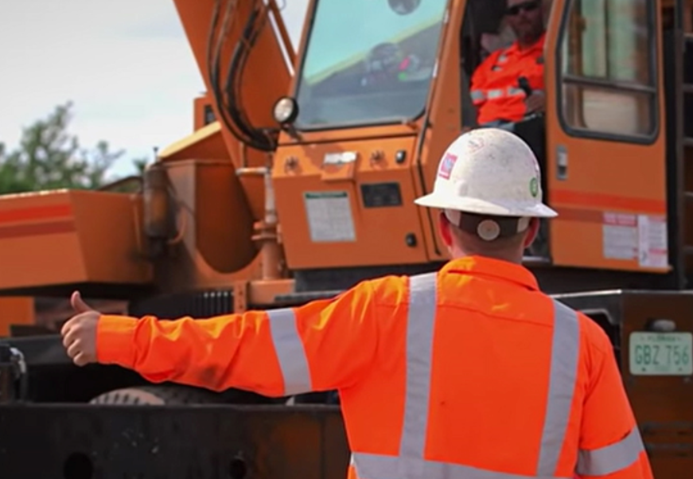
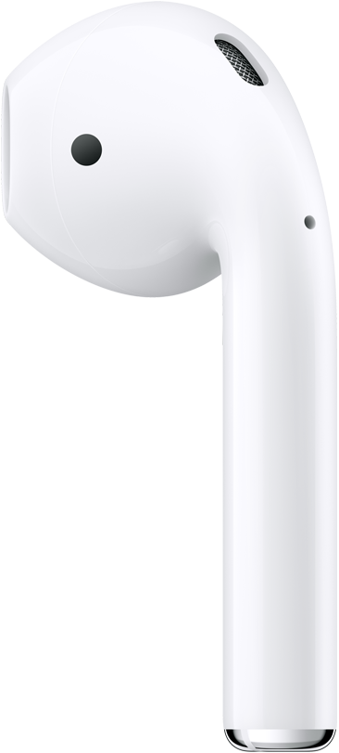
Why is Body-Signal Interpretation Important?
You are giving a “raise boom” signal!
Notes:
In scenarios where body signals are designed for safety, if the signal is not given, or understood correctly, it will lead to severe consequence. For example, if a crane signal, or an aircraft marshaller signal is mis-interpreted, it would be an accident at a loss of billions of dollars, or even at cost of human lives. In this case applications, automatic interpretation is very helpful in providing a feedback to the signalman and those who needs to read signals, or simply keep a record for auditing in the future.
(Mention an immediate feedback, record keeping, audit (who’s duty))
Crane signal should be replaced (it is not mechanical ), put static images costly
Airplane
Red color

Slide 6
Why is Body-Signal Interpretation Important?
Feedback
Record-keeping
Auditing
Communication with autonomous systems
Notes:
In scenarios where body signals are designed for safety, if the signal is not given, or understood correctly, it will lead to severe consequence. For example, if a crane signal, or an aircraft marshaller signal is mis-interpreted, it would be an accident at a loss of billions of dollars, or even at cost of human lives. In this case applications, automatic interpretation is very helpful in providing a feedback to the signalman and those who needs to read signals, or simply keep a record for auditing in the future.
(Mention an immediate feedback, record keeping, audit (who’s duty))
Crane signal should be replaced (it is not mechanical ), put static images costly
Airplane
Red color

Slide 7
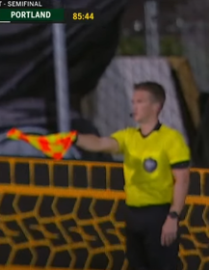
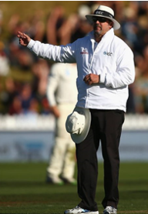
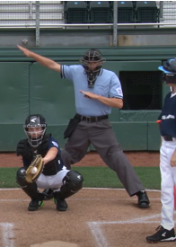
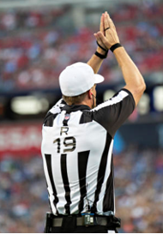
Even Labeling of Events in Video Streams
Foul Tip
Offside
No Ball
Safety
Notes:
Of course, even in other domains where body signals are not designed for safety, an automatic interpretation system will be very useful. For example, we can realize more automation in a ball game if we can automatically interpret the umpire’s signal. The umpire’s actions can be captioned for audience to better understand what is going on in the game. Also, the umpire’s judgement can be automatically reviewed by a decision review system to check if it is reasonable. Some other functions can also be available with automatic interpretation like record keeping, umpire training, statistics analysis, etc. So we believe an end-to-end body signal interpretation system is in high demand.

Slide 8
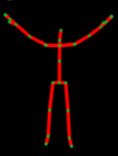
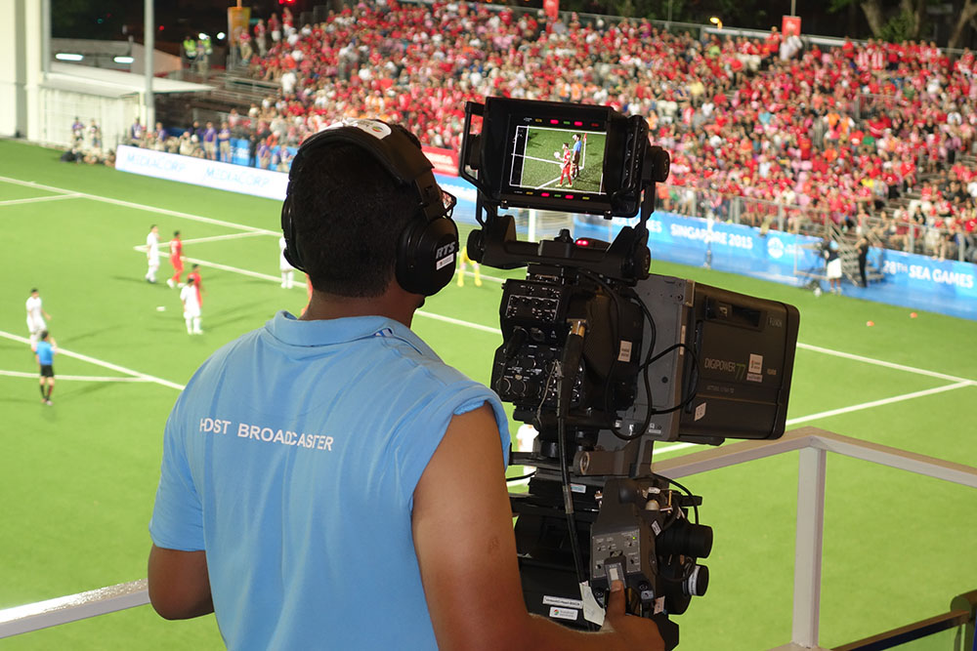
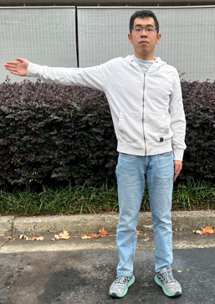
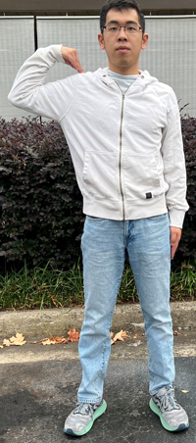
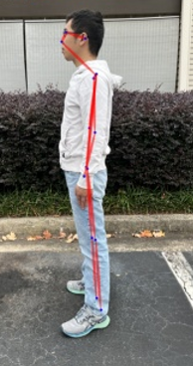
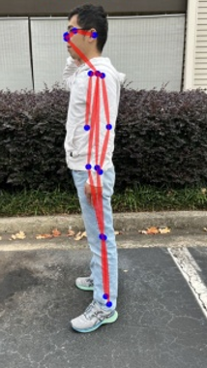

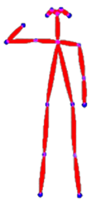
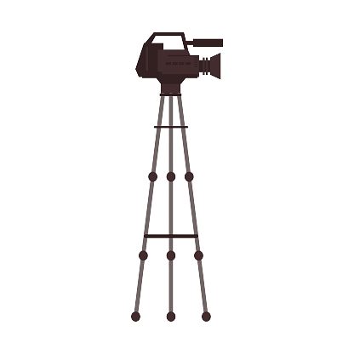
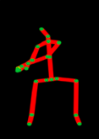

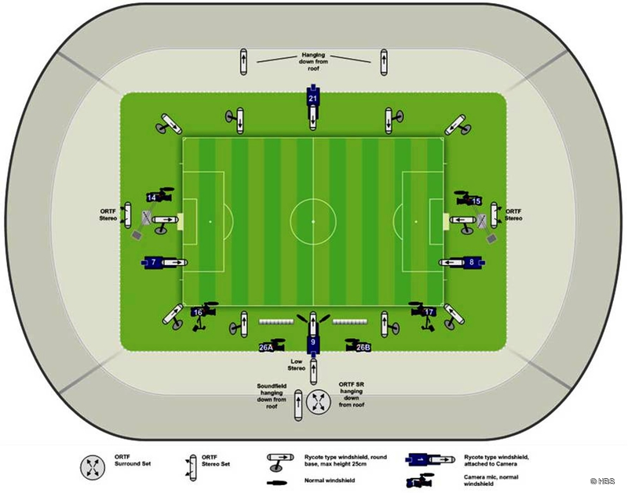
Viewer-Centered Solutions: Camera
Traditional Approach
Single Camera
Method Overview
Problems
Classifier
Camera Group
Method Overview
Problems
Input 1
Camera-denied scenario
Deployment cost
Memory usage
Architecture complexity
…
Classifier
Deciding Module
Input 2
Classifier
Viewer
…
Input 3
…
Classifier
Notes:
Traditionally, this problem is treated as a sub-problem of human action recognition. It is solved from the viewer perspective. The natural solution is to take a picture, extract skeletons and sends the skeleton to a classifier for interpretation. But with a single camera, the issue is also very prominent. Its interpretation quality heavily depend on the camera’s position, perspective, occlusion, etc. In the example I give here, when viewing from the side, two different signals cannot be distinguished by a single camera. So the actual commercial solution is to use camera group with a lot of cameras distributed in a scenario. They jointly interpret the signal by taking pictures from different angles. Of course, this system is not always a good idea. In a construction site, even if we deploy a camera group, there will still be a lot of blindspot. This solution also brings large deployment cost, memory usage, and need complicated architecture.
Obvious solution is to solve the problem from the viewer side. (before you show anything) View-center approach
Occlusion

Slide 9
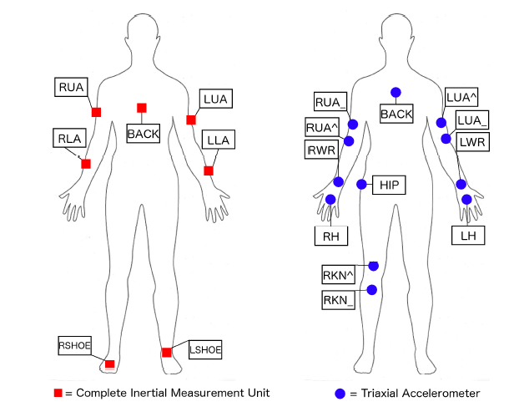
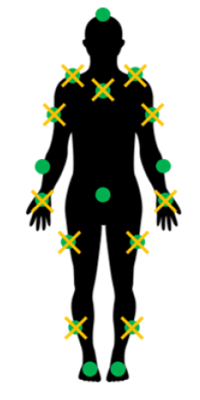
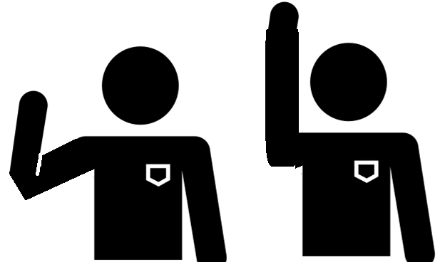
Signaler-centered Solutions: Wearable Sensors
Nagaraj et al. (2020)
Hand-down
Hand-up
IMU measures:
Acceleration
Angular velocity
Orientation
Notes:
We think a more promising solution is signalman-centered solution using wearable sensors. Some research work place only IMU to measure the acceleration and the angular velocity of key joints of signalman’s body. The downside of such solution is, to comprehensively understand the action of the signalman, we need to place more than 20 IMU sensors on body, which is not very user-friendly. There are also a few works studying how to recognize human action with only sparse sensors, for example, only putting IMU on wrists and ankles. But we observe that sparse IMU sensors can’t distinguish signals like hand-down and hand-up because they have the same IMU measurements. So an IMU-only system will not work well.
Shouldn’t say on a blank slide for long
Imu-alone
Contrast

Slide 10
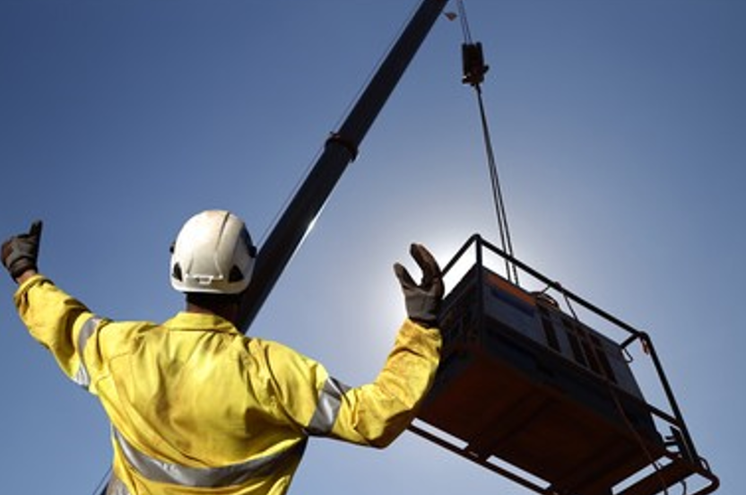
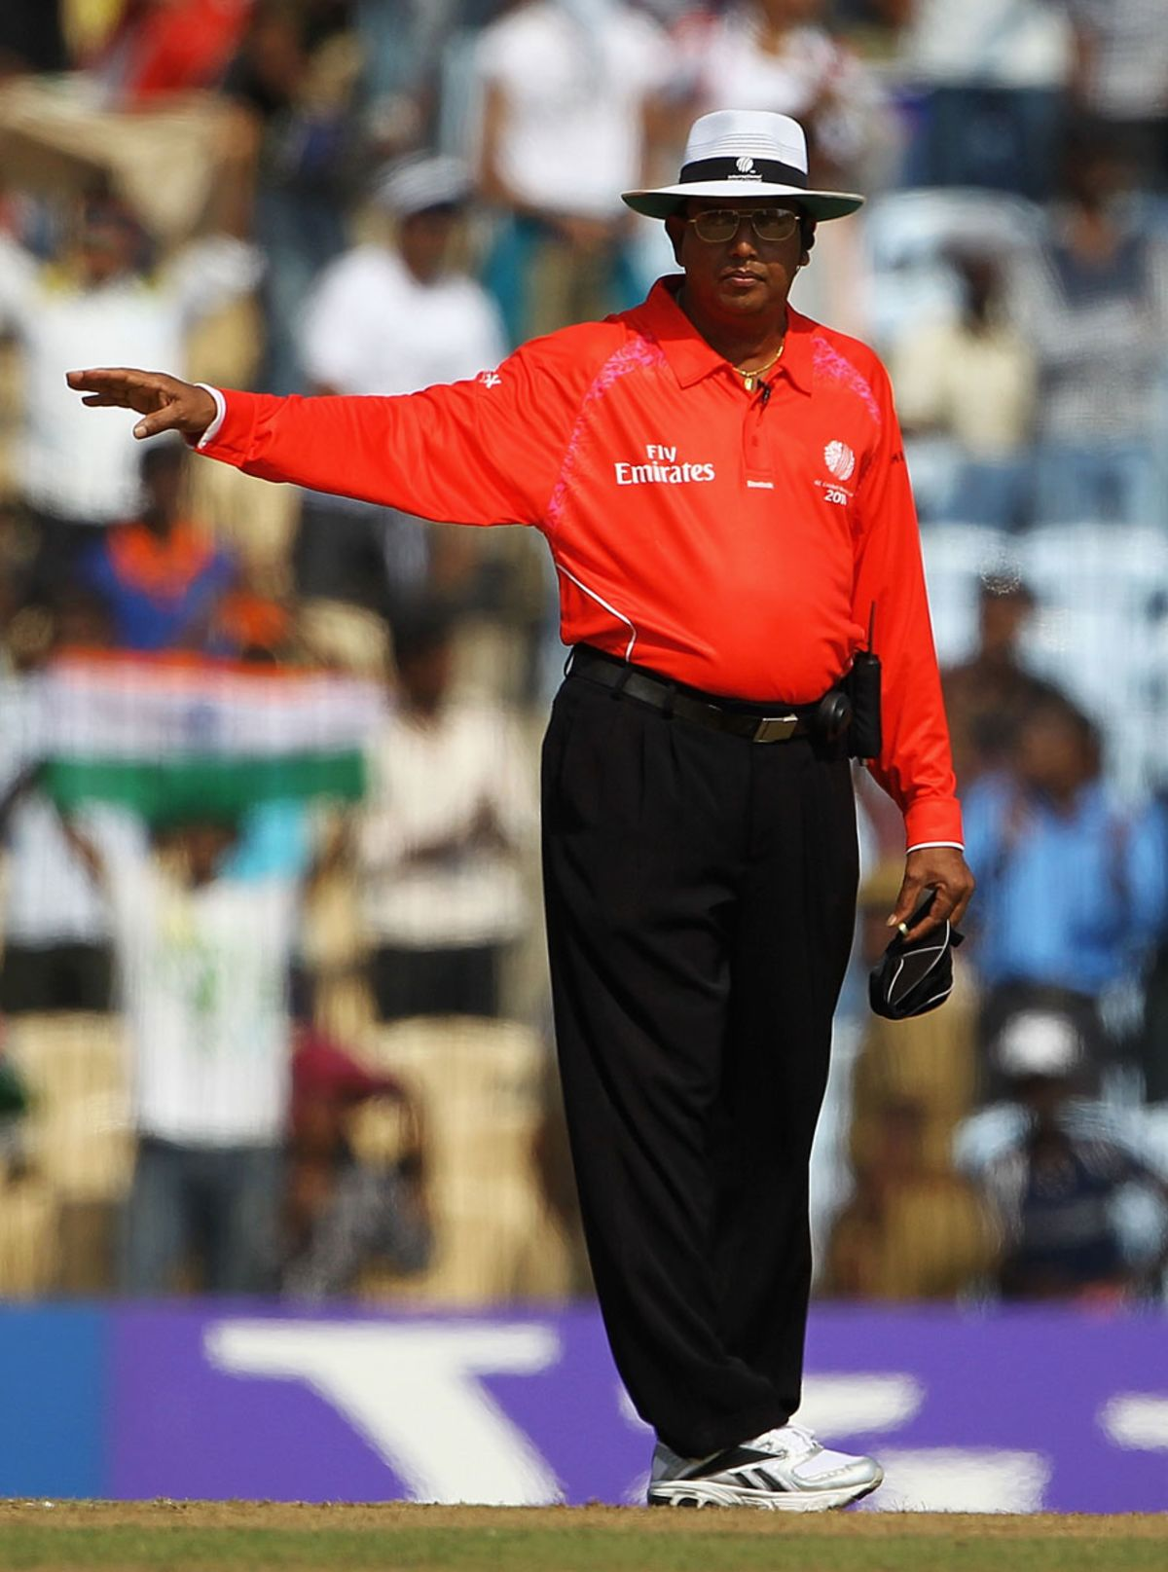
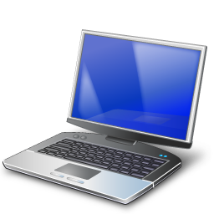
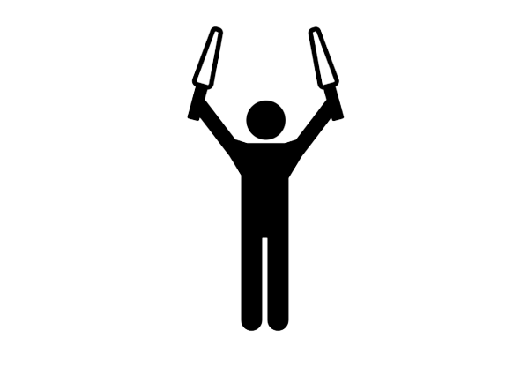
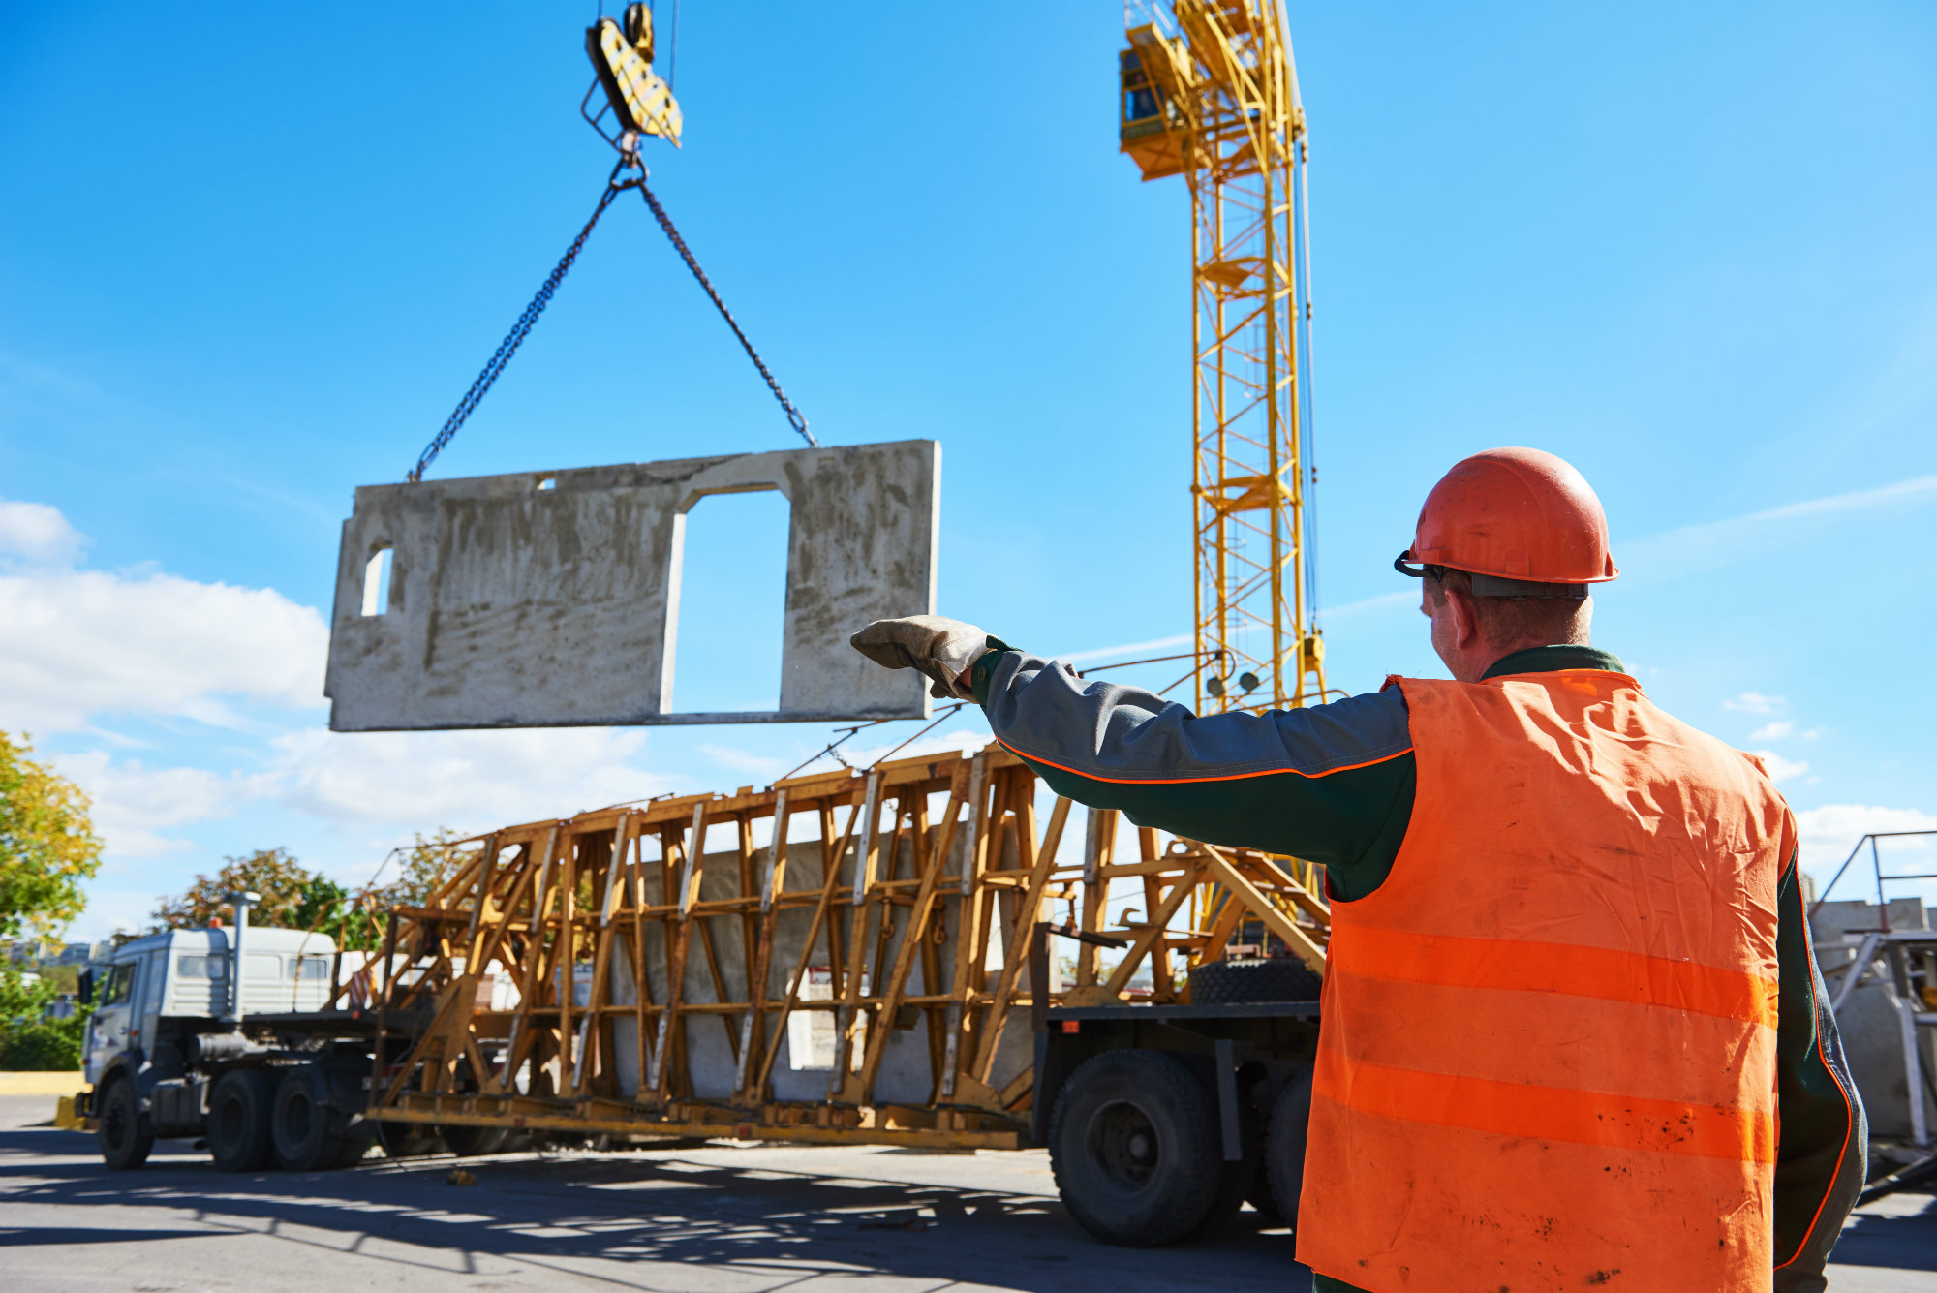
Goal
Accurate interpretation
OK! Raise boom!
Raise boom!
Real-time interpretation
2-3 seconds
No ball
Data efficiency
99% pixels are irrelevant
Small number of sensors
Notes:
So it is natural to ask, what is the best solution for automatic body signal interpretation? For the best solution, we believe it should firstly interpret the body signals accurately with little confusion. This system will be used in areas involving safety, so the accuracy is a fundamental. We also hope this system able to provide a real-time feedback. For example, when an umpire gives a judgement, this system will quickly review this decision. Then we hope the data can be efficiently used. We think camera is not a good option from this end because using a camera can record a lot of irrelevant information, but what really matters is only the human skeleton joints. Finally, we want to find a small set of sensors to reduce the cost of the system.
Remainder -> feedback
Use “Body signal”
======
Bandwidth (data efficiency)
Show the whole page, bold in turn
For data efficiency, have a picture

Slide 11
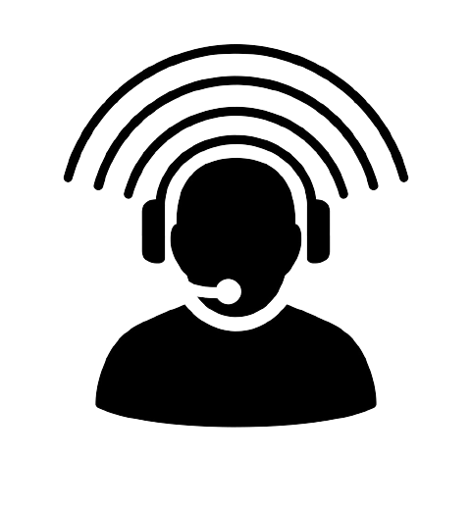

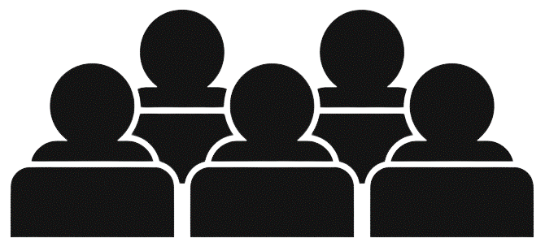
ViSig: Automatic Interpretation of Visual Body Signals
Wearable System
Records
Media
Audience
Feedback
Signaling
Client-end applications
On-body sensors transmit raw data
Automatic body signal interpretation system
Notes:
Based on these design principles, we propose our solution ViSig. Visig is an end-to-end wearable system for body signal interpretation. The sensors are sparsely distributed over the key joints of the signalman’s body. These sensors will collect raw data and sent the raw data via wireless communication to some edge device for signal interpretation. The interpreted signal will feed a lot of client-end applications, records, media, showing to audience, or providing a feedback.

Slide 12
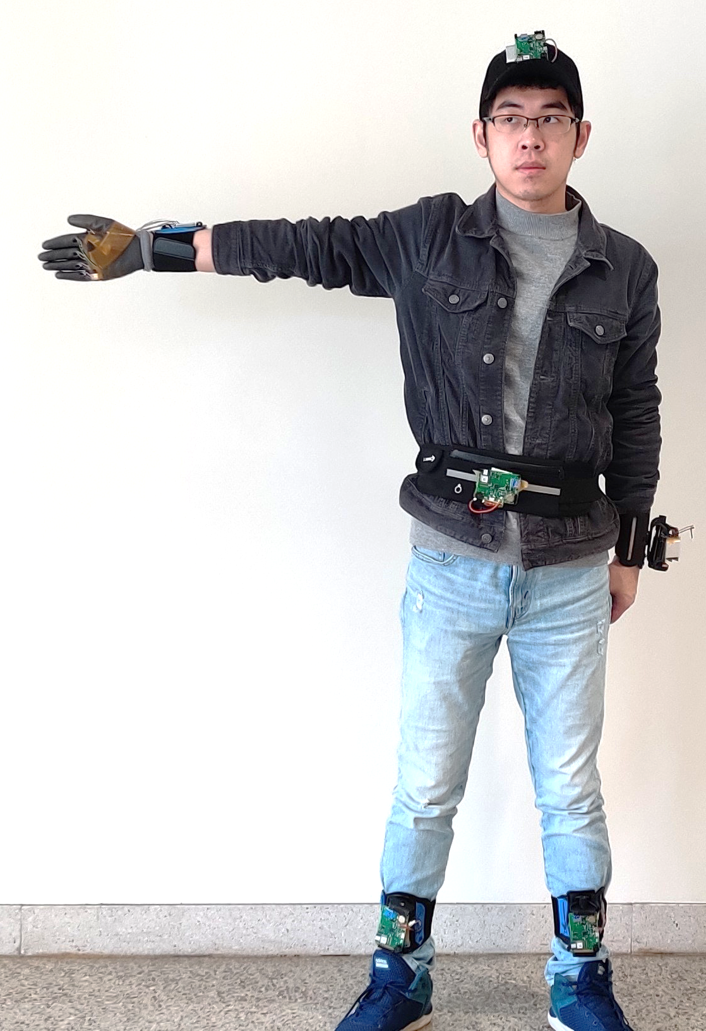
ViSig: Key Innovation – Wearable System with UWB
Notes:
This is the overall design of the ViSig sensor system. We place on 6 key joints on the body, waist, two wrists, two ankles, and the head. We choose those key joints because most of the body signals can be inferred from the motion, and the state of these 6 joints. The sensors on each of these 6 joints have an IMU chip. The IMU sensor provides acceleration, and angular velocity, with which we can get the motion state and orientation of each joint. Of course, just as I mentioned before, an IMU-only system cannot distinguish signals with the same IMU readings, like hand-up, hand-down. Obviously, some degree of freedom is not captured or constrained by an IMU-only system. This is why we believe UWB can provide a good complement here. In our system, apart from Imu, we additionally put a UWB chip which can measure the distance with UWB chips placed on other key joints. In this way, we can get a distance matrix which measures the distance between every pair of joints. This distance turns out to be very important information because it removes the confusion of hands-up and hands-down-like signal. At this point, current setup can be enough for many applications, but depend on the codebook, some body signals use finger states to represent some special meaning, like indicating a number. To detect the finger state, we additionally put 5 photodiodes on hand. The light intensity collected by each photodiode can help us judge if each finger is closed or stretched out. All these collected data, the distance matrix, IMU data, light intensity will be sent over a UWB channel, to a UWB eavesdropper for signal interpretation.
Bring numbers out when you say “waist”, “wrist”…
Bring the photodiode
===========

Slide 13
ViSig: Key Innovation – Wearable System with UWB
Notes:
This is the overall design of the ViSig sensor system. We place on 6 key joints on the body, waist, two wrists, two ankles, and the head. We choose those key joints because most of the body signals can be inferred from the motion, and the state of these 6 joints. The sensors on each of these 6 joints have an IMU chip. The IMU sensor provides acceleration, and angular velocity, with which we can get the motion state and orientation of each joint. Of course, just as I mentioned before, an IMU-only system cannot distinguish signals with the same IMU readings, like hand-up, hand-down. Obviously, some degree of freedom is not captured or constrained by an IMU-only system. This is why we believe UWB can provide a good complement here. In our system, apart from Imu, we additionally put a UWB chip which can measure the distance with UWB chips placed on other key joints. In this way, we can get a distance matrix which measures the distance between every pair of joints. This distance turns out to be very important information because it removes the confusion of hands-up and hands-down-like signal. At this point, current setup can be enough for many applications, but depend on the codebook, some body signals use finger states to represent some special meaning, like indicating a number. To detect the finger state, we additionally put 5 photodiodes on hand. The light intensity collected by each photodiode can help us judge if each finger is closed or stretched out. All these collected data, the distance matrix, IMU data, light intensity will be sent over a UWB channel, to a UWB eavesdropper for signal interpretation.
Bring numbers out when you say “waist”, “wrist”…
Bring the photodiode
===========

Slide 14
ViSig: Key Innovation – Wearable System with UWB
Notes:
This is the overall design of the ViSig sensor system. We place on 6 key joints on the body, waist, two wrists, two ankles, and the head. We choose those key joints because most of the body signals can be inferred from the motion, and the state of these 6 joints. The sensors on each of these 6 joints have an IMU chip. The IMU sensor provides acceleration, and angular velocity, with which we can get the motion state and orientation of each joint. Of course, just as I mentioned before, an IMU-only system cannot distinguish signals with the same IMU readings, like hand-up, hand-down. Obviously, some degree of freedom is not captured or constrained by an IMU-only system. This is why we believe UWB can provide a good complement here. In our system, apart from Imu, we additionally put a UWB chip which can measure the distance with UWB chips placed on other key joints. In this way, we can get a distance matrix which measures the distance between every pair of joints. This distance turns out to be very important information because it removes the confusion of hands-up and hands-down-like signal. At this point, current setup can be enough for many applications, but depend on the codebook, some body signals use finger states to represent some special meaning, like indicating a number. To detect the finger state, we additionally put 5 photodiodes on hand. The light intensity collected by each photodiode can help us judge if each finger is closed or stretched out. All these collected data, the distance matrix, IMU data, light intensity will be sent over a UWB channel, to a UWB eavesdropper for signal interpretation.
Bring numbers out when you say “waist”, “wrist”…
Bring the photodiode
===========

Slide 15
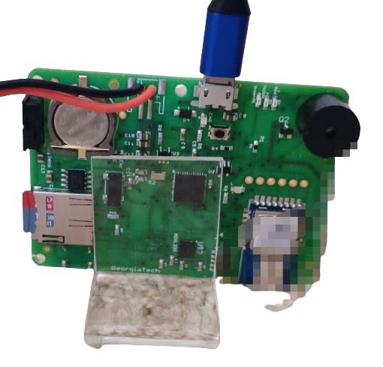
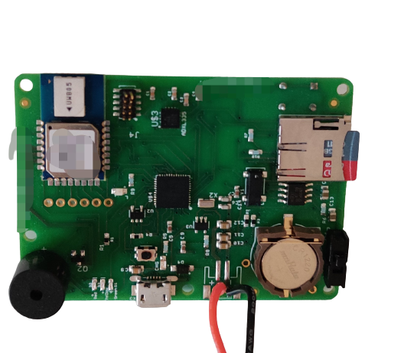
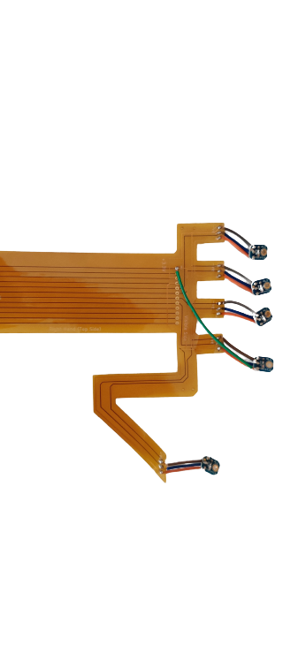
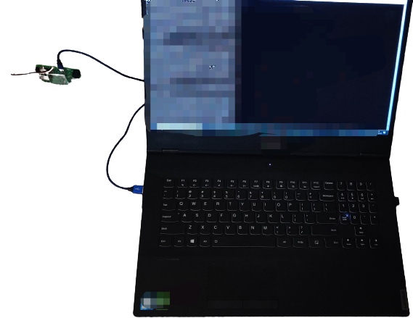

ViSig: Automatic Interpretation of Visual Body Signals
Data Streaming
Edge Eavesdropper
UWB+IMU
6
Pairwise Distance
1
2
3
4
5
6
6
$$\left[\begin{matrix}d_{11} & ⋯ & d_{16} \\ ⋮ & ⋱ & ⋮ \\ d_{61} & ⋯ & d_{66}\end{matrix}\right]$$
3
3
2
1
5
4
2
IMU Data
1
1
Photodiode
2
3
3
…
4
5
6
5
4
Light Intensity
UWB Communication
Notes:
This is the overall design of the ViSig sensor system. We place on 6 key joints on the body, waist, two wrists, two ankles, and the head. We choose those key joints because most of the body signals can be inferred from the motion, and the state of these 6 joints. The sensors on each of these 6 joints have an IMU chip. The IMU sensor provides acceleration, and angular velocity, with which we can get the motion state and orientation of each joint. Of course, just as I mentioned before, an IMU-only system cannot distinguish signals with the same IMU readings, like hand-up, hand-down. Obviously, some degree of freedom is not captured or constrained by an IMU-only system. This is why we believe UWB can provide a good complement here. In our system, apart from Imu, we additionally put a UWB chip which can measure the distance with UWB chips placed on other key joints. In this way, we can get a distance matrix which measures the distance between every pair of joints. This distance turns out to be very important information because it removes the confusion of hands-up and hands-down-like signal. At this point, current setup can be enough for many applications, but depend on the codebook, some body signals use finger states to represent some special meaning, like indicating a number. To detect the finger state, we additionally put 5 photodiodes on hand. The light intensity collected by each photodiode can help us judge if each finger is closed or stretched out. All these collected data, the distance matrix, IMU data, light intensity will be sent over a UWB channel, to a UWB eavesdropper for signal interpretation.
Bring numbers out when you say “waist”, “wrist”…
Bring the photodiode
===========

Slide 16
ViSig: Automatic Interpretation of Visual Body Signals
Data Streaming
Data Processing
UWB + IMU
6
1
2
3
4
5
6
Distances
3
Edge Eavesdropper
Distance and IMU
2
1
IMU Data
Detection
Interpretation
Photodiode
3
Light Intensity
Finger State Detection
5
4
Notes:
In the edge device, the distances and IMU data will firstly stream to a detection module, in which an algorithm is run to judge if there is a signal in the current data stream. If a signal is detected, the IMU data, the distance and the detected finger state will be fed into the interpretation module for signal interpretation. So from this overview page, we can clearly see, as an end-to-end solution, our design is divided into two main parts: data streaming and signal interpretation. There are a few challenges in each part so next we will dive into a bit to discuss them.
Say “distance measurements”
Potential question:
1. Why not put detection and interpretation into one module

Slide 17
ViSig: Automatic Interpretation of Visual Body Signals
Data Streaming
Data Processing
UWB + IMU
6
1
2
3
4
5
6
Distances
3
Edge Eavesdropper
Distance and IMU
2
1
IMU Data
Detection
Interpretation
Photodiode
3
Light Intensity
Finger State Detection
5
4
Notes:
I will start with the data streaming part.

Slide 18




Data Streaming: Data Rate
IMU data and light intensity
1
2
3
4
5
6
Directly readable from sensor
High data rate
Communicate over UWB
1
2
UWB Pairwise distances
Need message communication for ranging
Low data rate
3
4
Device 1
Device 2
5
Poll
$$R_{1}$$
Resp
$$D_{2}$$
6
$$D_{1}$$
Final
$$R_{2}$$
Time complexity: O(n²)
Notes:
In this part, the main questions we are concerned about: With sensor data of three modalities, How can we synchronize them? Can we collect a fair size of data a short time so they can be used for interpretation? For photodiodes and IMU sensor, the answers will be Yes because these data are directly read from sensor via SPI. They have a very high data rate. But for UWB distances, we will encounter a similar problem in 6Fit-a-part: which is UWB relies on Two way ranging message communication to measure the distance. To get a full 6x6 distance matrix, each node has to perform two way ranging with every other node, which is eventually a n square complexity. This process turns out to be very slow. The distance matrix updating rate is only 3Hz. This updating rate cannot capture body signals which involve some quick motion of the hand.
Check: Will this animation show normally in online meeting?
Potential question:
What signal can’t be captured by a 3Hz updating rate: emergency
IMU has high data rate, why not use IMU to detection the motion?
SPI bus

Slide 19





Data Streaming: N-Way Time Transfer (NWTT)
Broadcasting nature of wireless signal
Msg 1
Msg 2
Msg 1
1
2
3
4
5
6
Node 1
Msg 1
Msg 2
Msg 1
Node 2
1
Msg 1
Msg 2
…
Msg 1
Node 3
Identical function of Poll, Resp, Final
…
Msg 1
Msg 2
…
Msg 1
Device 1
Device 2
Poll
Node 6
Msg(seq=1, src=1)
Resp
$$D_{2}$$
Everyone has distance from Node 1
$$R_{1}$$
Msg(seq=1, src=2)
$$D_{1}$$
Final
$$R_{2}$$
Msg(seq=2, src=1)
Time complexity: O(n)
$$ToF=\frac{R_{1}R_{2}−D_{1}D_{2}}{R_{1}+R_{2}+D_{1}+D_{2}}$$
Updating rate: 16Hz
Notes:
To speed up the ranging process, we propose to do two way ranging in a N-way time transfer way. This protocol makes a few improvements on top of original two way ranging.
Firstly, we again use the broadcasting nature of the wireless signal. When one node sends a signal, other nodes in the vicinity will all receive this message. No need to repeat sending messages to other nodes.
Apart from the broadcasting nature, there is still room for improvement. Originally, two way ranging needs to exchange 3 messages, POLL, Response, and FINAL between two devices. But we can see, what really matters is the sending and receiving timestamps of each message, not content. From this end, the function of these three different messages are the same in nature.
In the communication, we now use the same message to represent POLL, RESP and FINAL in the standard protocol. Different messages only differ in sequence number and the source ID. With this conceptual change, we can actually design a much more efficient ranging protocol. Here is how it works. Node 1 will initialize a POLL, which is received by other nodes. Then ndoe 2 initializes the poll. And then node 3, node 4, mode 5 and node 6. When the node 1 polls again, we can see the part bounded by the black box, which is exactly the two way ranging process we have seen on the left. In this protocol, what each node needs to do is only send poll in turn, which makes the all-to-all ranging having a linear complexity. The theoretical updating rat is 45Hz which is sufficient to describe the motion of the joints.
With this protocol, we can send sufficient distance, IMU and photodiode data to the edge device. So the edge device can start the data processing.
“stop for a while. Ask if there is any question.”
The contents of the message is less important than the timestamps.
Use msg instead of poll

Slide 20
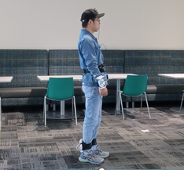
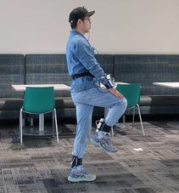
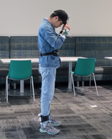
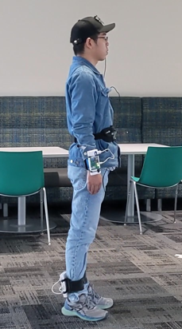
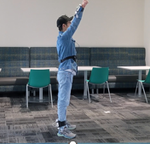
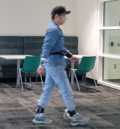
Data Processing: Detection
Goal: Determine whether a valid signal is incorporated in the current data stream
X
Valid Signal
X
Valid Signal
X
Threshold
Notes:
Once we got distances, IMU data. The first step for a signal interpretation system is to determine if a valid signal is in the current stream.

Slide 21
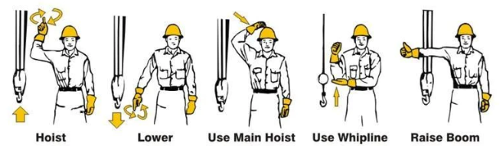

Data Processing: Detection
Distances
Detection Model (ML)
Signal?
IMU Data
Class imbalance: The space of non-signals >> The space of signals
Small Finite Number of Crane Signals
An Example
…
Infinite Irrelevant Actions Possible
…
Notes:
We wish to build a machine learning model, it takes distances and IMU data as input, and outputs a 0/1 binary mask indicating if a valid signal is included in a given time-window. We take some considerations when designing the machine learning model. The first issue is class imbalance, the number of non-signal data, has a much much larger space than the space of body signals. It is almost impossible for our data collection to enumerate every possible irrelevant action. So from this sense, if we, for example, simply build a neural network, followed by a softmax classifier, we will find a significant part of non-signal data will be mis-intepretated as signal data.

Slide 22
Data Processing: Detection
Distances
Detection Model (ML)
Signal?
IMU Data
Domain-specific signal variance
- Some body signals (e.g., football signals) have large variance
Notes:
Another fact we are considering is some body signals have larger variance than others, it is also very difficult to enumerate all the potential possibilities for these signals, just like non-signal data. For example, the football official signals typically have much larger variance than flag semaphore. If we ignore this variance, a lot of signal samples will be mis-interpreted as irrelevant signals.
% ButLearning such variance of the football signals needs a very large dataset, which is out of our data collection capability.
Bright takeaway larger box

Slide 23

Data Processing: Detection
Neural network architecture + Soft-boundary based loss function
Training Phase
Detection Phase
Feature space
Signal
Non-signal
Input
Flag Semaphore
Football Signal
R_{O}
Distances
R_{I}
IMU Data
Small detection threshold
Large detection threshold
Customized shell-like soft boundary
Notes:
Based on these considerations, we employ a neural network architecture that trained with a soft boundary as our detection module. The input data are distances and IMU measurements. They are fed into a neural network for feature encoding. In the feature space, we will create a shell-like soft boundary. Of course, in 2D, a shell is a ring for the ease of visualization. All the non-signals should be outside of the outer circle of the shell, and all the signals should lie in the inner circle of the shell. Any signal lying out of the inner circle, and non-signals lying in the outer circle will be punished with a loss. This loss will be backpropagated to train the network.
In the detection stage, we need a hard threshold with which we determine whether current data stream include a meaningful signal. And in this stage, we can have some insight in the threshold selection. For a body signal application with small variance, like flag semaphore, we can use a small threshold because the flag semaphore signal samples are expected to be compact in the inner circle. For body signals like football official signals which can have large variance, we choose a larger threshold to allow some freedom in performing the signal. We can say the soft boundary in training phase, and an application-specific threshold in detection phase to solve the class imbalance and application-specific signal variance.

Slide 24



Data Processing: Interpretation
Distances
IMU Data
…
LSTM + MLP + Softmax
Notes:
Once the system judges that a valid signal in included, the distances and IMU data will be sent to another network for signal interpretation. To extract both temporal and space features, we employ an architecture consisting of long short term memory and multi-layer perceptron. A softmax layer is added to classify the body signal.

Slide 25














Data Processing: Finger State Detection
Signals can use fingers to transfer special messages
Out
Bye
Common Finger Signs
Detect stretch-out/closeness with on-finger photodiodes
0
0
0
0
0
0
0
1
1
0
1
1
1
1
1
Ref
Notes:
Finally, some signals body will need finger state detection for distinguishment. For example, in cricket, umpire signal out and bye are only different in how many fingers are stretched out. We use our photodiodes to detect the finger state. The intuition is that if a finger is closed, the photodiode on this finger will receive less light than others. This turns out to be very useful and we observe a quite good accuracy of this scheme to judge the state of the finger. Of course, in this project, the on-finger sensor is only a complement, or extension of on-body sensors. It is open research that maybe we can have more sophisticated sensors like IMU to detect more complicated finger signs.

Slide 26

Notes:
This video shows the process of body signal interpretation process. After the user gives a signal, the end device should quickly interpret the signal in a few seconds.

Slide 27

ViSig
11 Volunteers
Signal Set | # of Signals
Cricket | 11
Cricket Umpire Signals

Slide 28

ViSig
11 Volunteers
Signal Set | # of Signals
Cricket | 11
Baseball | 13
Baseball Umpire Signals
…

Slide 29

ViSig
11 Volunteers
Signal Set | # of Signals
Cricket | 11
Baseball | 13
Crane | 20
Crane Signals
…

Slide 30

ViSig
11 Volunteers
Signal Set | # of Signals
Cricket | 11
Baseball | 13
Crane | 20
Flag | 30
Flag Semaphore
…

Slide 31

ViSig
11 Volunteers
Signal Set | # of Signals
Cricket | 11
Baseball | 13
Crane | 20
Flag | 30
Football | 47
Football Umpire Signals
…

Slide 32
Evaluation: Detection Accuracy
Softmax
Deep SVDD
ViSig
Baseline
Input
- Softmax binary classifier
Body signal
Not a body signal
- One-class model: Deep SVDD (Ruff et.al, 2018 )
p=0.6
p=0.4
Signals
Non-Signals
 | Softmax (%) | Deep SVDD (%) | ViSig (%)
Cricket | 79.7 | 85.7 | 91.9
Baseball | 99.1 | 88.9 | 99.3
Crane | 96.7 | 90.7 | 97.3
Flag Semaphore | 85.4 | 75 | 95.1
Football | 88 | 88.2 | 88.7
Notes:
We compare ViSig’s detection accuracy with a simple binary softmax classifier and deep SVDD. Softmax binary classifier can be assumed as a special case of ViSig when the inner circle equals the outer circle. It is an one-class classifier proposed in 2018. The pictures in top-right corner shows the difference of these three models. Softmax classifier directly outputs the probability that an input is a signal sample or non-signal sample. We can clearly observe that ViSig is better than these two baselines. This out-performance comes from the soft-boundary we use to punish in training, and also the application-specific threshold in detection.

Slide 33
Evaluation: Interpretation Accuracy
Ablation study: UWB-Only, IMU-Only, UWB + IMU
Method
- Single-user evaluation: Train and test using the same user’s data (forming user-specific model)
- Cross-user evaluation: Train users and test users are separated (forming general model)
Single-User Accuracy
Cross-User Accuracy
 | UWB-Only (%) | IMU-Only (%) | ViSig (%)
Cricket | 91.4 | 93.9 | 98.5
Baseball | 85.8 | 92.4 | 98.0
Crane | 82.9 | 97.4 | 98.7
Flag Semaphore | 64.2 | 89.6 | 95.7
Football | 78.9 | 93.9 | 94.7
 | UWB-Only (%) | IMU-Only (%) | ViSig (%)
Cricket | 90.9 | 88.0 | 97.6
Baseball | 83.7 | 87.9 | 97.1
Crane | 80.9 | 92.2 | 97.7
Flag Semaphore | 64.5 | 80.8 | 92.2
Football | 61.5 | 84.7 | 90.7
Notes:
For the interpretation accuracy, we evaluate in an ablation study manner. We try to remove UWB or IMU to see whether the performance will drop. We divide our evaluation on interpretation accuracy into single user evaluation and cross user evaluation. Both of them have practical sense. For single user evaluation, the same wearable setup will only be worn by the same user, so it forms a user-specific model for one user. We will collect training data and test data from the same user in single-user evaluation. On the other hand, cross-user evaluation gives the generality of the model. We collect data from several users, and test on a group of different users. From the two tables in this page, we can see the power of fusing IMU with UWB. The fusion clears the ambiguity encountered by a single-modality, and thereby can have a much better performance.
Bring tables later
========================
p

Slide 34


Final Thoughts
UWB can help simplify gesture-detection and activity-recognition models
Sensor fusion helps
Domain-specific knowledge helps
ViSig significantly reduces storage/network-bandwidth needs
Dataset is open-sourced:
https://faculty.cc.gatech.edu/~dhekne/visig_body_signal_data.zip
Embed these sensors in clothing?
How to reduce energy needs or harvest energy from human actions?

Slide 35

Glimpse into what Construction Workers Wear
Embed UWB sensors in some of these?

