Slide 1
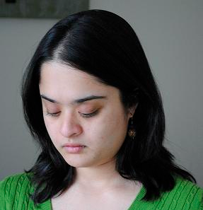
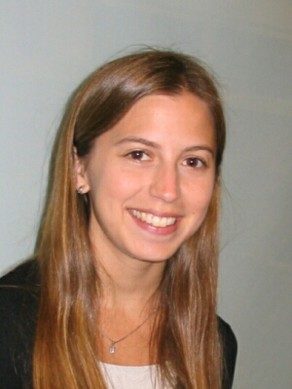
Interactively Discovery of Attributes Vocabulary
Devi Parikh and Kristen Grauman

Slide 2
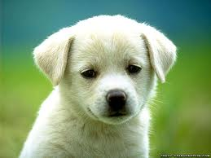
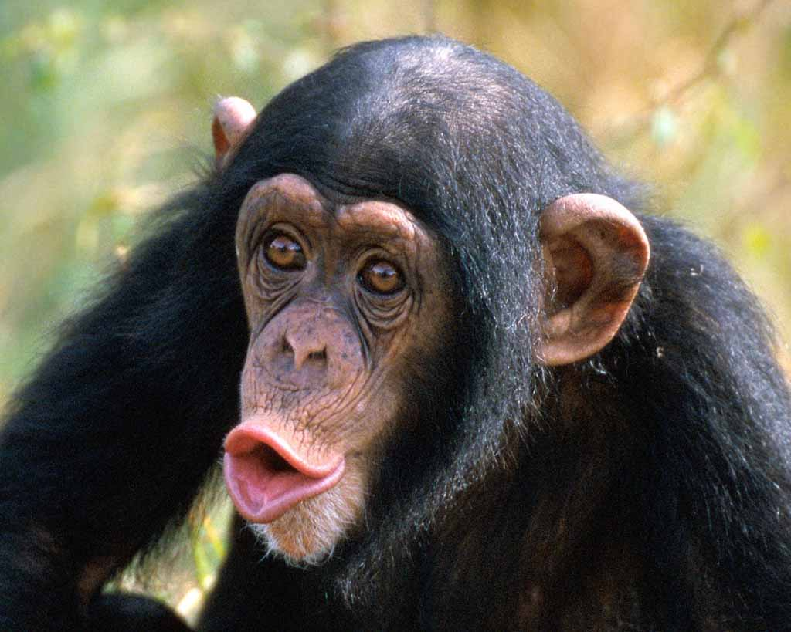
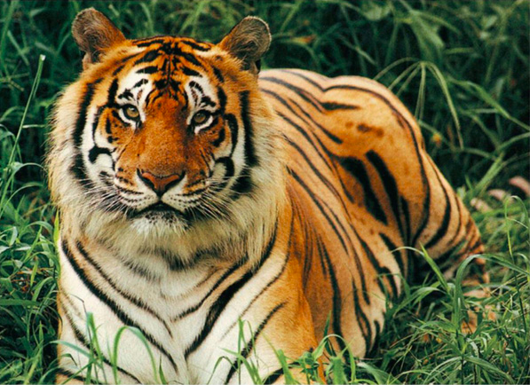
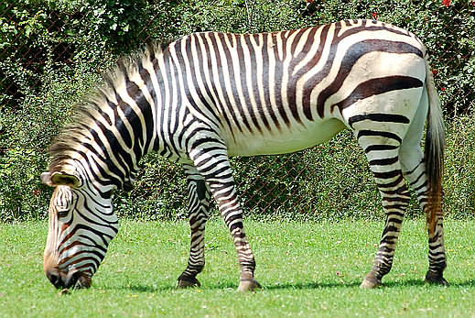
Traditional Recognition
Dog
Chimpanzee
Tiger
???

Slide 3
Attributes-based Recognition
Furry
White
Black
Big
Stripped
Yellow
Stripped
Black
White
Big
Dog
Chimpanzee
Tiger

Slide 4
Applications
Zero-shot learning
Attributes provide a mode of communication between humans and machines!
A Zebra is…
White
Black
Stripped
Zebra
Image description
Stripped
Black
White
Big

Slide 5
Attributes
Attributes are most useful if they are
Discriminative
Nameable
Approaches | Discriminative | Nameable

Slide 6
Attributes
Attributes are most useful if they are
Discriminative
Nameable
Approaches | Discriminative | Nameable
Hand-generated | Maybe not | Yes

Slide 7
Attributes
Attributes are most useful if they are
Discriminative
Nameable
Approaches | Discriminative | Nameable
Hand-generated | Maybe not | Yes
Mining the web | Maybe not | Yes

Slide 8
Attributes
Attributes are most useful if they are
Discriminative
Nameable
Approaches | Discriminative | Nameable
Hand-generated | Maybe not | Yes
Mining the web | Maybe not | Yes
Automatic splits | Yes | Maybe not

Slide 9
Attributes
Attributes are most useful if they are
Discriminative
Nameable
Approaches | Discriminative | Nameable
Hand-generated | Maybe not | Yes
Mining the web | Maybe not | Yes
Automatic splits | Yes | Maybe not
Proposed | Yes | Yes

Slide 10
Interactive System
1. Name: Fluffy
2. Name: x
3. Name: Metal
…
How do we show the user a candidate-attribute?
How do we ensure proposals are discriminative?
How do we ensure proposals are nameable?

Slide 11
Attribute Visualization

Slide 12
Attribute Visualization

Slide 13
Ensure Discriminability
Normalized cuts
Max Margin Clustering

Slide 14
Ensure Nameability
1. Name: Fluffy
2. Name: x
3. Name: Metal
…

Slide 15
Ensure Nameability
1. Name: Fluffy
2. Name: x
3. Name: Metal
…
Mixture of Probabilistic PCA

Slide 16
Interactive System

Slide 17
Evaluation
Outdoor Scenes
Animals with Attributes
Public Figures Face
Gist and Color features (LDA)

Slide 18
Interactive System

Slide 19
Evaluation
Annotate all candidates off-line
“Black”
… ~25000 responses

Slide 20
Evaluation
Annotate all candidates off-line
“Spotted”
… ~25000 responses

Slide 21
Evaluation
Annotate all candidates off-line
Unnameable
… ~25000 responses

Slide 22
Evaluation
Annotate all candidates off-line
“Green”
… ~25000 responses

Slide 23
Evaluation
Annotate all candidates off-line
“Congested”
… ~25000 responses

Slide 24
Evaluation
Annotate all candidates off-line
“Smiling”
… ~25000 responses

Slide 25
Results
Our active approach discovers more discriminative splits than baselines
Structure exists in nameability space allowing for prediction

Slide 26
Results
Comparing to discriminative-only baseline

Slide 27
Results
Comparing to descriptive-only baseline

Slide 28
Results
Automatically generated descriptions

Slide 29
Summary
Machines need to understand us
Attributes need to be detectable & discriminative
We need to understand machines
Attributes need to be nameable
Interactive system for discovering attributes

Slide 30
Thank you.

