Slide 2
source
Notes:
From https://www.reddit.com/r/illusionporn/comments/sz7nnx/i_meticulously_sculpted_my_face_in_snow_it_took_6/

Slide 3
Deep Learning Neural Net Basics
Computer Vision
James Hays
Many slides by Marc’Aurelio Ranzato

Slide 4
Outline
Neural Networks
Convolutional Neural Networks
Variants
Detection
Segmentation
Siamese Networks
Visualization of Deep Networks

Slide 8
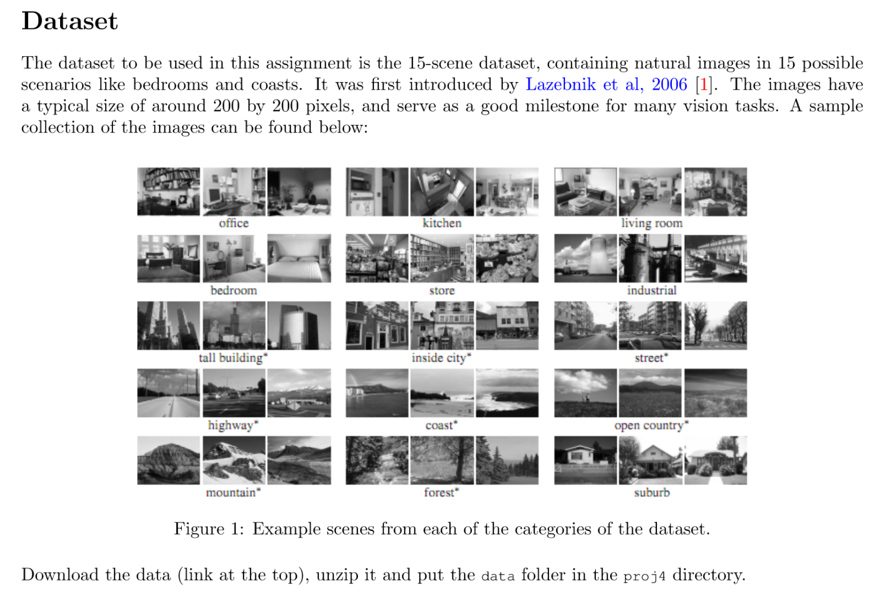
Project 4: Scene Classification with Deep Nets

Slide 10
Outline
Neural Networks
Convolutional Neural Networks
Variants
Detection
Segmentation
Siamese Networks
Visualization of Deep Networks

Slide 13
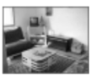

Slide 18
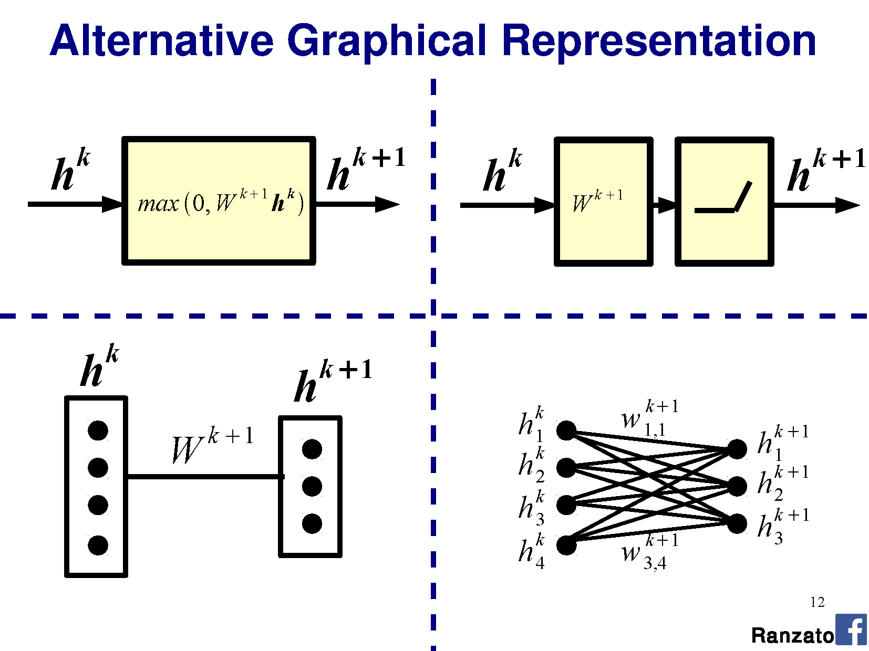

Slide 32
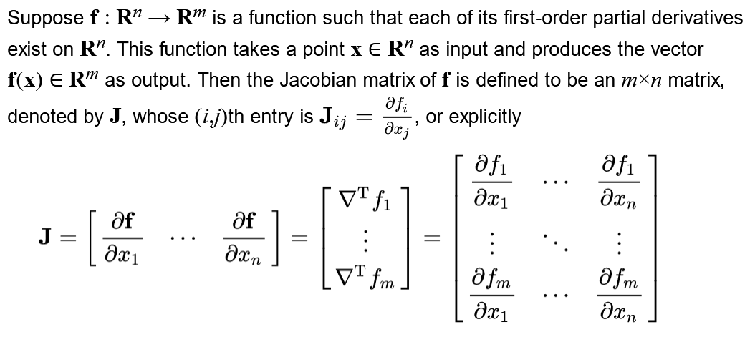

Slide 45
This all seems pretty complicated. Why are we using Neural Networks? James’s rough assessment:
Learning method | Ease of configuration
Neural Network | 1
Nearest Neighbor | 10
Linear SVM | 10
Non-linear SVM | 5
Decision Tree or Random Forest | 4

Slide 46
This all seems pretty complicated. Why are we using Neural Networks? James’s rough assessment:
Learning method | Ease of configuration | Ease of interpretation
Neural Network | 1 | 1
Nearest Neighbor | 10 | 10
Linear SVM | 10 | 9
Non-linear SVM | 5 | 4
Decision Tree or Random Forest | 4 | 4

Slide 47
This all seems pretty complicated. Why are we using Neural Networks? James’s rough assessment:
Learning method | Ease of configuration | Ease of interpretation | Speed / memory when training
Neural Network | 1 | 1 | 1
Nearest Neighbor | 10 | 10 | 8
Linear SVM | 10 | 9 | 10
Non-linear SVM | 5 | 4 | 2
Decision Tree or Random Forest | 4 | 4 | 4

Slide 48
This all seems pretty complicated. Why are we using Neural Networks? James’s rough assessment:
Learning method | Ease of configuration | Ease of interpretation | Speed / memory when training | Speed / memory at test time
Neural Network | 1 | 1 | 1 | 6
Nearest Neighbor | 10 | 10 | 8 | 4
Linear SVM | 10 | 9 | 10 | 10
Non-linear SVM | 5 | 4 | 2 | 2
Decision Tree or Random Forest | 4 | 4 | 4 | 8

Slide 49
This all seems pretty complicated. Why are we using Neural Networks? James’s rough assessment:
Learning method | Ease of configuration | Ease of interpretation | Speed / memory when training | Speed / memory at test time | Accuracy w/ lots of data
Neural Network | 1 | 1 | 1 | 6 | 10
Nearest Neighbor | 10 | 10 | 8 | 4 | 7
Linear SVM | 10 | 9 | 10 | 10 | 5
Non-linear SVM | 5 | 4 | 2 | 2 | 8
Decision Tree or Random Forest | 4 | 4 | 4 | 8 | 7

Slide 50
This all seems pretty complicated. Why are we using Neural Networks? James’s rough assessment:
Learning method | Ease of configuration | Ease of interpretation | Speed / memory when training | Speed / memory at test time | Accuracy w/ lots of data
Neural Network | 1 | 1 | 1 | 6 | 10
Nearest Neighbor | 10 | 10 | 8 | 4 | 7
Linear SVM | 10 | 9 | 10 | 10 | 5
Non-linear SVM | 5 | 4 | 2 | 2 | 8
Decision Tree or Random Forest | 4 | 4 | 4 | 8 | 7
Representation design matters more for all of these

