Slide 1
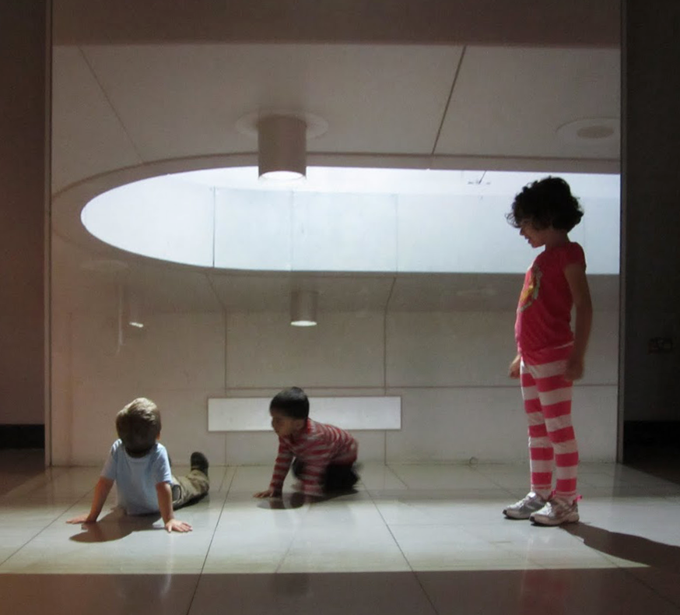
Image Filtering
Computer Vision
James Hays
Many slides by Derek Hoiem

Slide 2
Recap: Light and Sensors

Slide 3

Pinhole camera
f
c
f = focal length
c = center of the camera
Figure from Forsyth

Slide 4
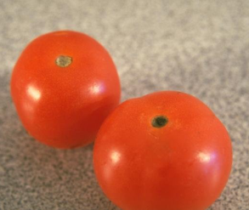
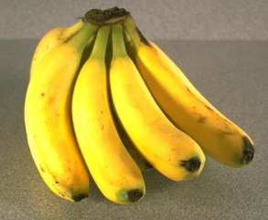
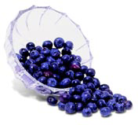
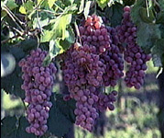
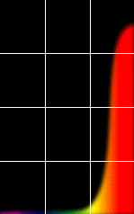
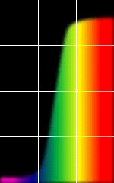
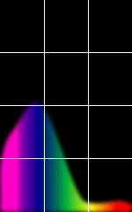
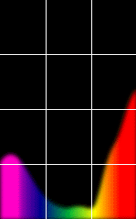
The Physics of Light
Some examples of the reflectance spectra of surfaces
Red
Yellow
Blue
Purple
% Photons Reflected
400 700
400 700
400 700
400 700
Wavelength (nm)
© Stephen E. Palmer, 2002

Slide 5
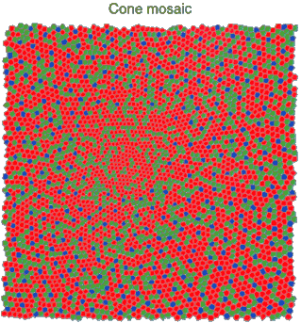
Physiology of Color Vision
Three kinds of cones:
Why are M and L cones so close?
Why are there 3?
© Stephen E. Palmer, 2002

Slide 6
The Retina

Slide 7


Practical Color Sensing: Bayer Grid
Estimate RGB
at ‘G’ cells from neighboring values
Slide by Steve Seitz

Slide 8
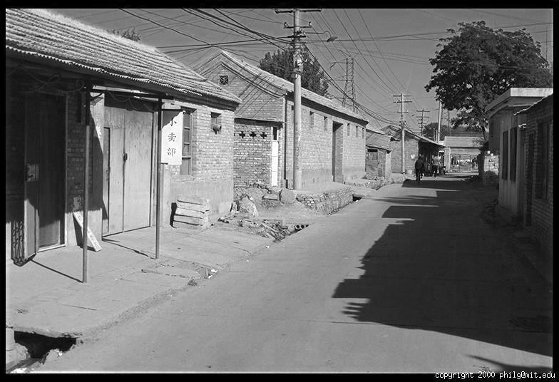
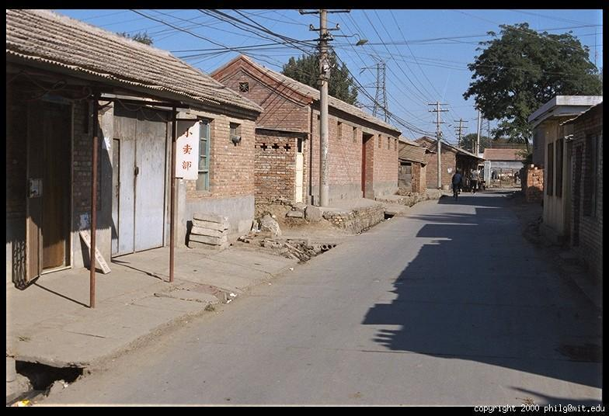
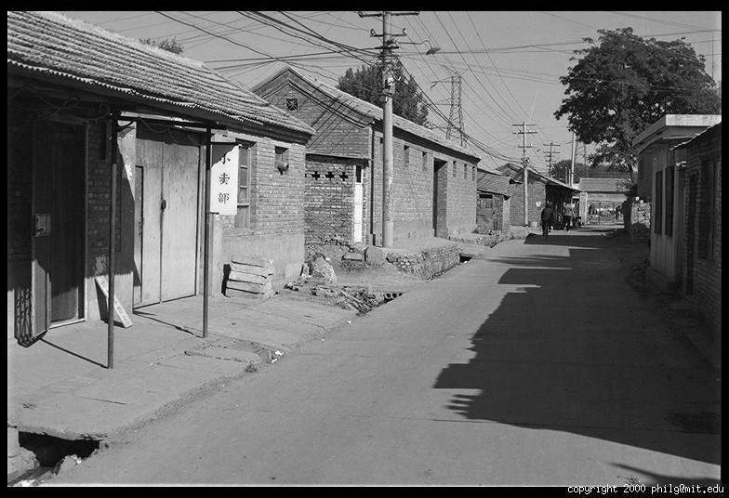
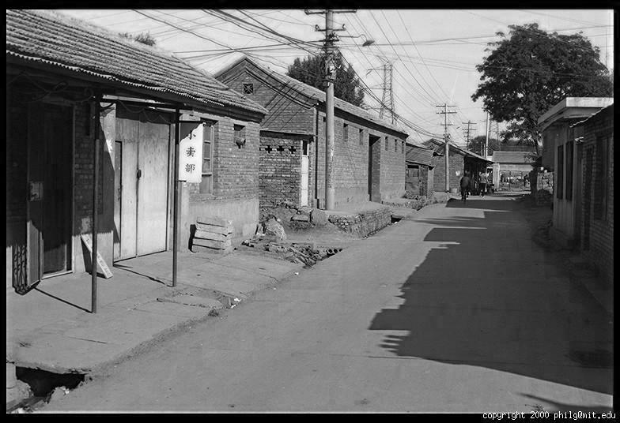
Color Image
R
G
B

Slide 9
Images in Matlab
Images represented as a matrix
Suppose we have a NxM RGB image called “im”
  im(1,1,1) = top-left pixel value in R-channel
  im(y, x, b) = y pixels down, x pixels to right in the b^{th} channel
  im(N, M, 3) = bottom-right pixel in B-channel
imread(filename) returns a uint8 image (values 0 to 255)
  Convert to double format (values 0 to 1) with im2double
column
row
R
0.92 | 0.93 | 0.94 | 0.97 | 0.62 | 0.37 | 0.85 | 0.97 | 0.93 | 0.92 | 0.99
0.95 | 0.89 | 0.82 | 0.89 | 0.56 | 0.31 | 0.75 | 0.92 | 0.81 | 0.95 | 0.91
0.89 | 0.72 | 0.51 | 0.55 | 0.51 | 0.42 | 0.57 | 0.41 | 0.49 | 0.91 | 0.92
0.96 | 0.95 | 0.88 | 0.94 | 0.56 | 0.46 | 0.91 | 0.87 | 0.90 | 0.97 | 0.95
0.71 | 0.81 | 0.81 | 0.87 | 0.57 | 0.37 | 0.80 | 0.88 | 0.89 | 0.79 | 0.85
0.49 | 0.62 | 0.60 | 0.58 | 0.50 | 0.60 | 0.58 | 0.50 | 0.61 | 0.45 | 0.33
0.86 | 0.84 | 0.74 | 0.58 | 0.51 | 0.39 | 0.73 | 0.92 | 0.91 | 0.49 | 0.74
0.96 | 0.67 | 0.54 | 0.85 | 0.48 | 0.37 | 0.88 | 0.90 | 0.94 | 0.82 | 0.93
0.69 | 0.49 | 0.56 | 0.66 | 0.43 | 0.42 | 0.77 | 0.73 | 0.71 | 0.90 | 0.99
0.79 | 0.73 | 0.90 | 0.67 | 0.33 | 0.61 | 0.69 | 0.79 | 0.73 | 0.93 | 0.97
0.91 | 0.94 | 0.89 | 0.49 | 0.41 | 0.78 | 0.78 | 0.77 | 0.89 | 0.99 | 0.93
G
0.92 | 0.93 | 0.94 | 0.97 | 0.62 | 0.37 | 0.85 | 0.97 | 0.93 | 0.92 | 0.99
0.95 | 0.89 | 0.82 | 0.89 | 0.56 | 0.31 | 0.75 | 0.92 | 0.81 | 0.95 | 0.91
0.89 | 0.72 | 0.51 | 0.55 | 0.51 | 0.42 | 0.57 | 0.41 | 0.49 | 0.91 | 0.92
0.96 | 0.95 | 0.88 | 0.94 | 0.56 | 0.46 | 0.91 | 0.87 | 0.90 | 0.97 | 0.95
0.71 | 0.81 | 0.81 | 0.87 | 0.57 | 0.37 | 0.80 | 0.88 | 0.89 | 0.79 | 0.85
0.49 | 0.62 | 0.60 | 0.58 | 0.50 | 0.60 | 0.58 | 0.50 | 0.61 | 0.45 | 0.33
0.86 | 0.84 | 0.74 | 0.58 | 0.51 | 0.39 | 0.73 | 0.92 | 0.91 | 0.49 | 0.74
0.96 | 0.67 | 0.54 | 0.85 | 0.48 | 0.37 | 0.88 | 0.90 | 0.94 | 0.82 | 0.93
0.69 | 0.49 | 0.56 | 0.66 | 0.43 | 0.42 | 0.77 | 0.73 | 0.71 | 0.90 | 0.99
0.79 | 0.73 | 0.90 | 0.67 | 0.33 | 0.61 | 0.69 | 0.79 | 0.73 | 0.93 | 0.97
0.91 | 0.94 | 0.89 | 0.49 | 0.41 | 0.78 | 0.78 | 0.77 | 0.89 | 0.99 | 0.93
B
0.92 | 0.93 | 0.94 | 0.97 | 0.62 | 0.37 | 0.85 | 0.97 | 0.93 | 0.92 | 0.99
0.95 | 0.89 | 0.82 | 0.89 | 0.56 | 0.31 | 0.75 | 0.92 | 0.81 | 0.95 | 0.91
0.89 | 0.72 | 0.51 | 0.55 | 0.51 | 0.42 | 0.57 | 0.41 | 0.49 | 0.91 | 0.92
0.96 | 0.95 | 0.88 | 0.94 | 0.56 | 0.46 | 0.91 | 0.87 | 0.90 | 0.97 | 0.95
0.71 | 0.81 | 0.81 | 0.87 | 0.57 | 0.37 | 0.80 | 0.88 | 0.89 | 0.79 | 0.85
0.49 | 0.62 | 0.60 | 0.58 | 0.50 | 0.60 | 0.58 | 0.50 | 0.61 | 0.45 | 0.33
0.86 | 0.84 | 0.74 | 0.58 | 0.51 | 0.39 | 0.73 | 0.92 | 0.91 | 0.49 | 0.74
0.96 | 0.67 | 0.54 | 0.85 | 0.48 | 0.37 | 0.88 | 0.90 | 0.94 | 0.82 | 0.93
0.69 | 0.49 | 0.56 | 0.66 | 0.43 | 0.42 | 0.77 | 0.73 | 0.71 | 0.90 | 0.99
0.79 | 0.73 | 0.90 | 0.67 | 0.33 | 0.61 | 0.69 | 0.79 | 0.73 | 0.93 | 0.97
0.91 | 0.94 | 0.89 | 0.49 | 0.41 | 0.78 | 0.78 | 0.77 | 0.89 | 0.99 | 0.93

Slide 10
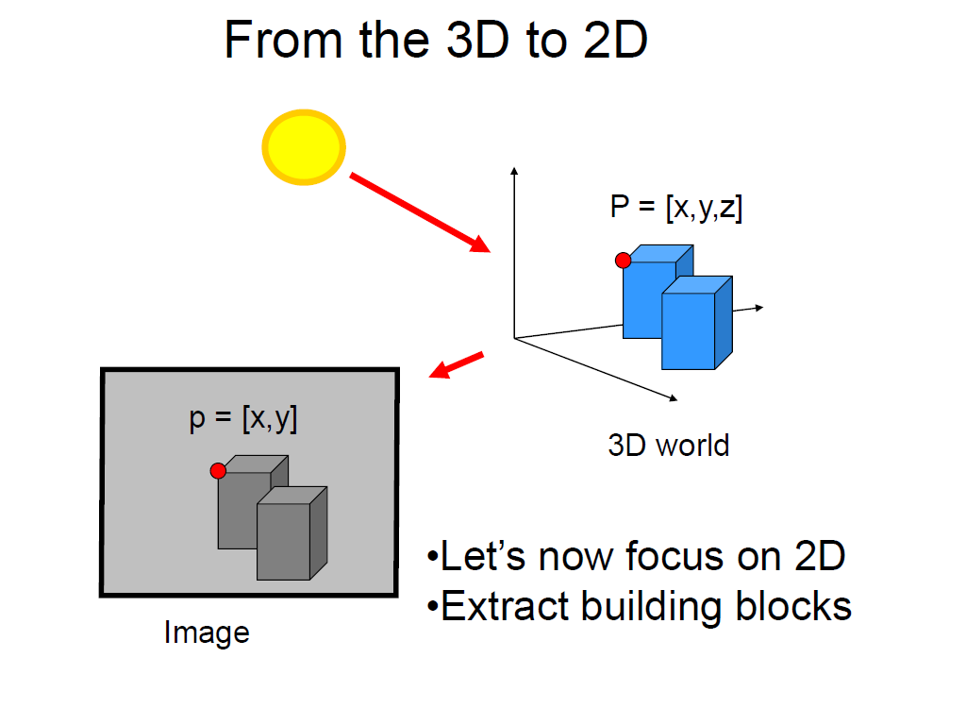
Slide credit Fei Fei Li

Slide 11
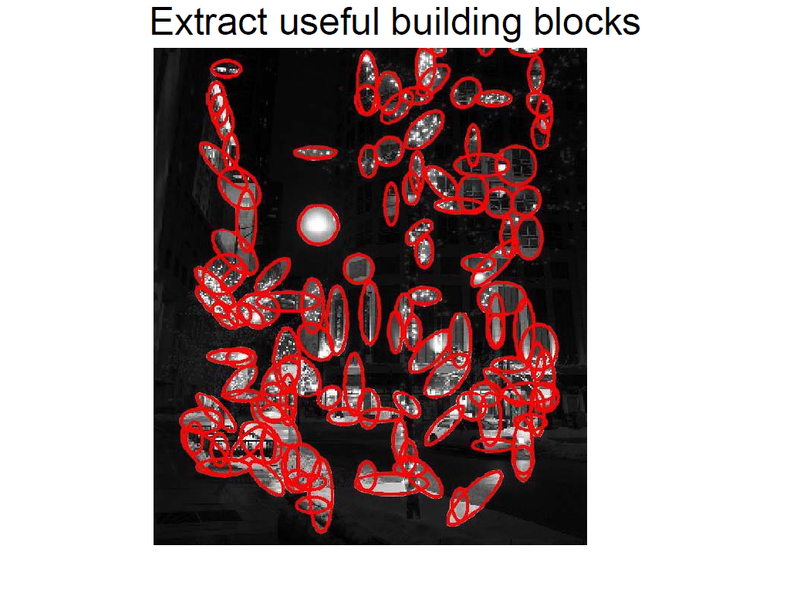
Slide credit Fei Fei Li

Slide 12
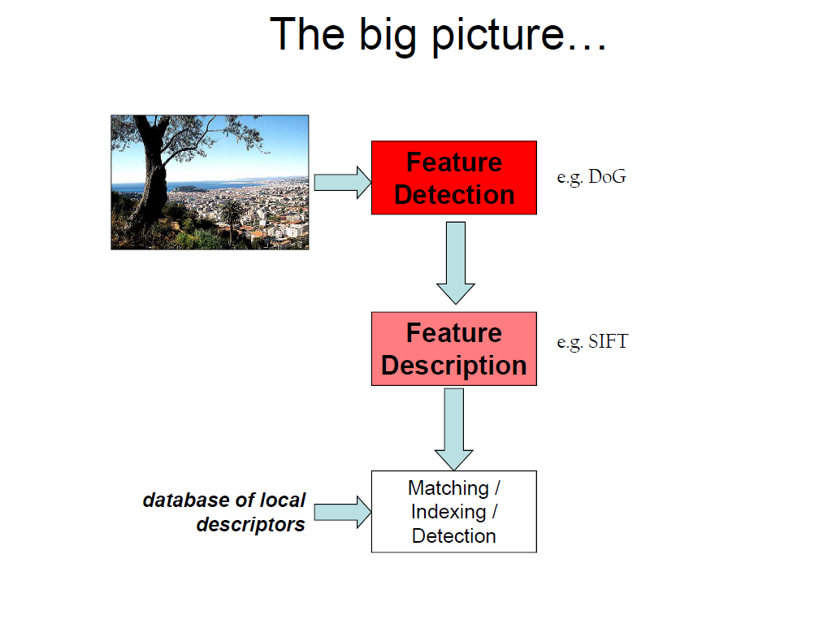
Slide credit Fei Fei Li

Slide 13
Image Filtering
Computer Vision
James Hays
Many slides by Derek Hoiem

Slide 14
Upcoming classes: three views of filtering
Image filters in spatial domain
  Filter is a mathematical operation of a grid of numbers
  Smoothing, sharpening, measuring texture
Image filters in the frequency domain
  Filtering is a way to modify the frequencies of images
  Denoising, sampling, image compression
Templates and Image Pyramids
  Filtering is a way to match a template to the image
  Detection, coarse-to-fine registration

Slide 15
Image filtering
Image filtering: compute function of local neighborhood at each position
Really important!
  Enhance images
    Denoise, resize, increase contrast, etc.
  Extract information from images
    Texture, edges, distinctive points, etc.
  Detect patterns
    Template matching
  Deep Convolutional Networks

Slide 16

Example: box filter
1
1
1
1
1
1
1
1
1
Slide credit: David Lowe (UBC)

Slide 17
Image filtering
1
1
1
1
1
1
1
1
1
0 | 0 | 0 | 0 | 0 | 0 | 0 | 0 | 0 | 0
0 | 0 | 0 | 0 | 0 | 0 | 0 | 0 | 0 | 0
0 | 0 | 0 | 90 | 90 | 90 | 90 | 90 | 0 | 0
0 | 0 | 0 | 90 | 90 | 90 | 90 | 90 | 0 | 0
0 | 0 | 0 | 90 | 90 | 90 | 90 | 90 | 0 | 0
0 | 0 | 0 | 90 | 0 | 90 | 90 | 90 | 0 | 0
0 | 0 | 0 | 90 | 90 | 90 | 90 | 90 | 0 | 0
0 | 0 | 0 | 0 | 0 | 0 | 0 | 0 | 0 | 0
0 | 0 | 90 | 0 | 0 | 0 | 0 | 0 | 0 | 0
0 | 0 | 0 | 0 | 0 | 0 | 0 | 0 | 0 | 0
 | 0
0 | 0 | 0 | 0 | 0 | 0 | 0 | 0 | 0 | 0
0 | 0 | 0 | 0 | 0 | 0 | 0 | 0 | 0 | 0
0 | 0 | 0 | 90 | 90 | 90 | 90 | 90 | 0 | 0
0 | 0 | 0 | 90 | 90 | 90 | 90 | 90 | 0 | 0
0 | 0 | 0 | 90 | 90 | 90 | 90 | 90 | 0 | 0
0 | 0 | 0 | 90 | 0 | 90 | 90 | 90 | 0 | 0
0 | 0 | 0 | 90 | 90 | 90 | 90 | 90 | 0 | 0
0 | 0 | 0 | 0 | 0 | 0 | 0 | 0 | 0 | 0
0 | 0 | 90 | 0 | 0 | 0 | 0 | 0 | 0 | 0
0 | 0 | 0 | 0 | 0 | 0 | 0 | 0 | 0 | 0
Credit: S. Seitz
Notes:
ones, divide by 9

Slide 18
Image filtering
1
1
1
1
1
1
1
1
1
0 | 0 | 0 | 0 | 0 | 0 | 0 | 0 | 0 | 0
0 | 0 | 0 | 0 | 0 | 0 | 0 | 0 | 0 | 0
0 | 0 | 0 | 90 | 90 | 90 | 90 | 90 | 0 | 0
0 | 0 | 0 | 90 | 90 | 90 | 90 | 90 | 0 | 0
0 | 0 | 0 | 90 | 90 | 90 | 90 | 90 | 0 | 0
0 | 0 | 0 | 90 | 0 | 90 | 90 | 90 | 0 | 0
0 | 0 | 0 | 90 | 90 | 90 | 90 | 90 | 0 | 0
0 | 0 | 0 | 0 | 0 | 0 | 0 | 0 | 0 | 0
0 | 0 | 90 | 0 | 0 | 0 | 0 | 0 | 0 | 0
0 | 0 | 0 | 0 | 0 | 0 | 0 | 0 | 0 | 0
 | 0 | 10
0 | 0 | 0 | 0 | 0 | 0 | 0 | 0 | 0 | 0
0 | 0 | 0 | 0 | 0 | 0 | 0 | 0 | 0 | 0
0 | 0 | 0 | 90 | 90 | 90 | 90 | 90 | 0 | 0
0 | 0 | 0 | 90 | 90 | 90 | 90 | 90 | 0 | 0
0 | 0 | 0 | 90 | 90 | 90 | 90 | 90 | 0 | 0
0 | 0 | 0 | 90 | 0 | 90 | 90 | 90 | 0 | 0
0 | 0 | 0 | 90 | 90 | 90 | 90 | 90 | 0 | 0
0 | 0 | 0 | 0 | 0 | 0 | 0 | 0 | 0 | 0
0 | 0 | 90 | 0 | 0 | 0 | 0 | 0 | 0 | 0
0 | 0 | 0 | 0 | 0 | 0 | 0 | 0 | 0 | 0
Credit: S. Seitz
Notes:
ones, divide by 9

Slide 19
Image filtering
1
1
1
1
1
1
1
1
1
0 | 0 | 0 | 0 | 0 | 0 | 0 | 0 | 0 | 0
0 | 0 | 0 | 0 | 0 | 0 | 0 | 0 | 0 | 0
0 | 0 | 0 | 90 | 90 | 90 | 90 | 90 | 0 | 0
0 | 0 | 0 | 90 | 90 | 90 | 90 | 90 | 0 | 0
0 | 0 | 0 | 90 | 90 | 90 | 90 | 90 | 0 | 0
0 | 0 | 0 | 90 | 0 | 90 | 90 | 90 | 0 | 0
0 | 0 | 0 | 90 | 90 | 90 | 90 | 90 | 0 | 0
0 | 0 | 0 | 0 | 0 | 0 | 0 | 0 | 0 | 0
0 | 0 | 90 | 0 | 0 | 0 | 0 | 0 | 0 | 0
0 | 0 | 0 | 0 | 0 | 0 | 0 | 0 | 0 | 0
 | 0 | 10 | 20
0 | 0 | 0 | 0 | 0 | 0 | 0 | 0 | 0 | 0
0 | 0 | 0 | 0 | 0 | 0 | 0 | 0 | 0 | 0
0 | 0 | 0 | 90 | 90 | 90 | 90 | 90 | 0 | 0
0 | 0 | 0 | 90 | 90 | 90 | 90 | 90 | 0 | 0
0 | 0 | 0 | 90 | 90 | 90 | 90 | 90 | 0 | 0
0 | 0 | 0 | 90 | 0 | 90 | 90 | 90 | 0 | 0
0 | 0 | 0 | 90 | 90 | 90 | 90 | 90 | 0 | 0
0 | 0 | 0 | 0 | 0 | 0 | 0 | 0 | 0 | 0
0 | 0 | 90 | 0 | 0 | 0 | 0 | 0 | 0 | 0
0 | 0 | 0 | 0 | 0 | 0 | 0 | 0 | 0 | 0
Credit: S. Seitz
Notes:
ones, divide by 9

Slide 20
Image filtering
1
1
1
1
1
1
1
1
1
0 | 0 | 0 | 0 | 0 | 0 | 0 | 0 | 0 | 0
0 | 0 | 0 | 0 | 0 | 0 | 0 | 0 | 0 | 0
0 | 0 | 0 | 90 | 90 | 90 | 90 | 90 | 0 | 0
0 | 0 | 0 | 90 | 90 | 90 | 90 | 90 | 0 | 0
0 | 0 | 0 | 90 | 90 | 90 | 90 | 90 | 0 | 0
0 | 0 | 0 | 90 | 0 | 90 | 90 | 90 | 0 | 0
0 | 0 | 0 | 90 | 90 | 90 | 90 | 90 | 0 | 0
0 | 0 | 0 | 0 | 0 | 0 | 0 | 0 | 0 | 0
0 | 0 | 90 | 0 | 0 | 0 | 0 | 0 | 0 | 0
0 | 0 | 0 | 0 | 0 | 0 | 0 | 0 | 0 | 0
 | 0 | 10 | 20 | 30
0 | 0 | 0 | 0 | 0 | 0 | 0 | 0 | 0 | 0
0 | 0 | 0 | 0 | 0 | 0 | 0 | 0 | 0 | 0
0 | 0 | 0 | 90 | 90 | 90 | 90 | 90 | 0 | 0
0 | 0 | 0 | 90 | 90 | 90 | 90 | 90 | 0 | 0
0 | 0 | 0 | 90 | 90 | 90 | 90 | 90 | 0 | 0
0 | 0 | 0 | 90 | 0 | 90 | 90 | 90 | 0 | 0
0 | 0 | 0 | 90 | 90 | 90 | 90 | 90 | 0 | 0
0 | 0 | 0 | 0 | 0 | 0 | 0 | 0 | 0 | 0
0 | 0 | 90 | 0 | 0 | 0 | 0 | 0 | 0 | 0
0 | 0 | 0 | 0 | 0 | 0 | 0 | 0 | 0 | 0
Credit: S. Seitz
Notes:
ones, divide by 9

Slide 21
Image filtering
1
1
1
1
1
1
1
1
1
0 | 0 | 0 | 0 | 0 | 0 | 0 | 0 | 0 | 0
0 | 0 | 0 | 0 | 0 | 0 | 0 | 0 | 0 | 0
0 | 0 | 0 | 90 | 90 | 90 | 90 | 90 | 0 | 0
0 | 0 | 0 | 90 | 90 | 90 | 90 | 90 | 0 | 0
0 | 0 | 0 | 90 | 90 | 90 | 90 | 90 | 0 | 0
0 | 0 | 0 | 90 | 0 | 90 | 90 | 90 | 0 | 0
0 | 0 | 0 | 90 | 90 | 90 | 90 | 90 | 0 | 0
0 | 0 | 0 | 0 | 0 | 0 | 0 | 0 | 0 | 0
0 | 0 | 90 | 0 | 0 | 0 | 0 | 0 | 0 | 0
0 | 0 | 0 | 0 | 0 | 0 | 0 | 0 | 0 | 0
 | 0 | 10 | 20 | 30 | 30
Credit: S. Seitz
Notes:
ones, divide by 9

Slide 22
Image filtering
1
1
1
1
1
1
1
1
1
0 | 0 | 0 | 0 | 0 | 0 | 0 | 0 | 0 | 0
0 | 0 | 0 | 0 | 0 | 0 | 0 | 0 | 0 | 0
0 | 0 | 0 | 90 | 90 | 90 | 90 | 90 | 0 | 0
0 | 0 | 0 | 90 | 90 | 90 | 90 | 90 | 0 | 0
0 | 0 | 0 | 90 | 90 | 90 | 90 | 90 | 0 | 0
0 | 0 | 0 | 90 | 0 | 90 | 90 | 90 | 0 | 0
0 | 0 | 0 | 90 | 90 | 90 | 90 | 90 | 0 | 0
0 | 0 | 0 | 0 | 0 | 0 | 0 | 0 | 0 | 0
0 | 0 | 90 | 0 | 0 | 0 | 0 | 0 | 0 | 0
0 | 0 | 0 | 0 | 0 | 0 | 0 | 0 | 0 | 0
 | 0 | 10 | 20 | 30 | 30
?
Credit: S. Seitz
Notes:
ones, divide by 9

Slide 23
Image filtering
1
1
1
1
1
1
1
1
1
0 | 0 | 0 | 0 | 0 | 0 | 0 | 0 | 0 | 0
0 | 0 | 0 | 0 | 0 | 0 | 0 | 0 | 0 | 0
0 | 0 | 0 | 90 | 90 | 90 | 90 | 90 | 0 | 0
0 | 0 | 0 | 90 | 90 | 90 | 90 | 90 | 0 | 0
0 | 0 | 0 | 90 | 90 | 90 | 90 | 90 | 0 | 0
0 | 0 | 0 | 90 | 0 | 90 | 90 | 90 | 0 | 0
0 | 0 | 0 | 90 | 90 | 90 | 90 | 90 | 0 | 0
0 | 0 | 0 | 0 | 0 | 0 | 0 | 0 | 0 | 0
0 | 0 | 90 | 0 | 0 | 0 | 0 | 0 | 0 | 0
0 | 0 | 0 | 0 | 0 | 0 | 0 | 0 | 0 | 0
 | 0 | 10 | 20 | 30 | 30
 |  |  |  | 50
?
Credit: S. Seitz
Notes:
ones, divide by 9

Slide 24
Image filtering
1
1
1
1
1
1
1
1
1
0 | 0 | 0 | 0 | 0 | 0 | 0 | 0 | 0 | 0
0 | 0 | 0 | 0 | 0 | 0 | 0 | 0 | 0 | 0
0 | 0 | 0 | 90 | 90 | 90 | 90 | 90 | 0 | 0
0 | 0 | 0 | 90 | 90 | 90 | 90 | 90 | 0 | 0
0 | 0 | 0 | 90 | 90 | 90 | 90 | 90 | 0 | 0
0 | 0 | 0 | 90 | 0 | 90 | 90 | 90 | 0 | 0
0 | 0 | 0 | 90 | 90 | 90 | 90 | 90 | 0 | 0
0 | 0 | 0 | 0 | 0 | 0 | 0 | 0 | 0 | 0
0 | 0 | 90 | 0 | 0 | 0 | 0 | 0 | 0 | 0
0 | 0 | 0 | 0 | 0 | 0 | 0 | 0 | 0 | 0
 | 0 | 10 | 20 | 30 | 30 | 30 | 20 | 10
 | 0 | 20 | 40 | 60 | 60 | 60 | 40 | 20
 | 0 | 30 | 60 | 90 | 90 | 90 | 60 | 30
 | 0 | 30 | 50 | 80 | 80 | 90 | 60 | 30
 | 0 | 30 | 50 | 80 | 80 | 90 | 60 | 30
 | 0 | 20 | 30 | 50 | 50 | 60 | 40 | 20
 | 10 | 20 | 30 | 30 | 30 | 30 | 20 | 10
 | 10 | 10 | 10 | 0 | 0 | 0 | 0 | 0
Credit: S. Seitz

Slide 25
Box Filter
What does it do?
Replaces each pixel with an average of its neighborhood
Achieve smoothing effect (remove sharp features)
1
1
1
1
1
1
1
1
1
Slide credit: David Lowe (UBC)

Slide 26


Smoothing with box filter

Slide 27
One more on board…

Slide 28

Practice with linear filters
0
0
0
?
0
1
0
0
0
0
Original
Source: D. Lowe

Slide 29
Practice with linear filters
0
0
0
0
1
0
0
0
0
Original
Filtered
(no change)
Source: D. Lowe

Slide 30
Practice with linear filters
0
0
0
?
0
0
1
0
0
0
Original
Source: D. Lowe

Slide 31
Practice with linear filters
0
0
0
0
0
1
0
0
0
Original
Shifted left
By 1 pixel
Source: D. Lowe

Slide 32

Practice with linear filters
0
0
0
-
1
1
1
?
0
2
0
1
1
1
0
0
0
1
1
1
(Note that filter sums to 1)
Original
Source: D. Lowe

Slide 33
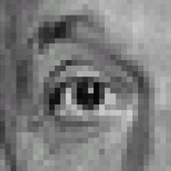
Practice with linear filters
0
0
0
-
1
1
1
0
2
0
1
1
1
0
0
0
1
1
1
Original
Sharpening filter
  Accentuates differences with local average
Source: D. Lowe

Slide 34

Sharpening
Source: D. Lowe

Slide 35


Other filters
1
0
-1
2
0
-2
1
0
-1
Sobel
Vertical Edge
(absolute value)

Slide 36

Other filters
1
2
1
0
0
0
-1
-2
-1
Sobel
Horizontal Edge
(absolute value)
Notes:
Questions at this point?

Slide 37
How could we synthesize motion blur?
theta = 30; len = 20;
fil = imrotate(ones(1, len), theta, 'bilinear');
fil = fil / sum(fil(:));
figure(2), imshow(imfilter(im, fil));

Slide 38
Filtering vs. Convolution
f=filter
I=image
2d filtering
  h=filter2(f,I); or h=imfilter(I,f);
2d convolution
  h=conv2(f,I);

Slide 39
Key properties of linear filters
Linearity:
imfilter(I, f₁ + f₂) =
imfilter(I,f₁) + imfilter(I,f₂)
Shift invariance: same behavior regardless of pixel location
imfilter(I,shift(f)) = shift(imfilter(I,f))
Any linear, shift-invariant operator can be represented as a convolution
Source: S. Lazebnik
Notes:
f is image

Slide 40
More properties
Commutative: a * b = b * a
  Conceptually no difference between filter and signal
  But particular filtering implementations might break this equality
Associative: a * (b * c) = (a * b) * c
  Often apply several filters one after another: (((a * b₁) * b₂) * b₃)
  This is equivalent to applying one filter: a * (b₁ * b₂ * b₃)
Distributes over addition: a * (b + c) = (a * b) + (a * c)
Scalars factor out: ka * b = a * kb = k (a * b)
Identity: unit impulse e = [0, 0, 1, 0, 0],
a * e = a
Source: S. Lazebnik

Slide 42

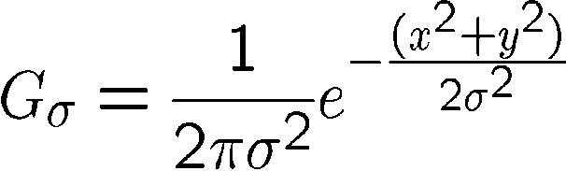
Important filter: Gaussian
Weight contributions of neighboring pixels by nearness
0.003 0.013 0.022 0.013 0.003
0.013 0.059 0.097 0.059 0.013
0.022 0.097 0.159 0.097 0.022
0.013 0.059 0.097 0.059 0.013
0.003 0.013 0.022 0.013 0.003
5 x 5, σ = 1
Slide credit: Christopher Rasmussen
Notes:
e^0 = 1, e^-1 = .37, e^-2 = .14, etc.

Slide 43

Smoothing with Gaussian filter

Slide 44
Smoothing with box filter

Slide 45
Gaussian filters
Remove “high-frequency” components from the image (low-pass filter)
  Images become more smooth
Convolution with self is another Gaussian
  So can smooth with small-width kernel, repeat, and get same result as larger-width kernel would have
  Convolving two times with Gaussian kernel of width σ is same as convolving once with kernel of width σ√2
Separable kernel
  Factors into product of two 1D Gaussians
Source: K. Grauman
Notes:
Linear vs. quadratic in mask size

Slide 46
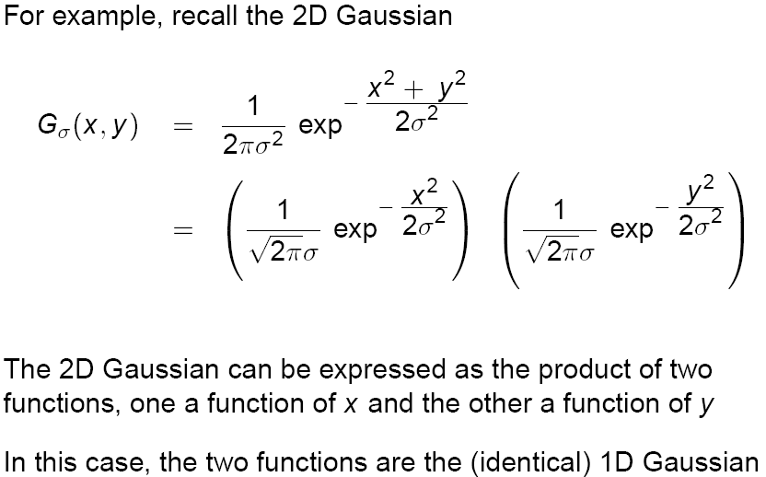
Separability of the Gaussian filter
Source: D. Lowe

Slide 47
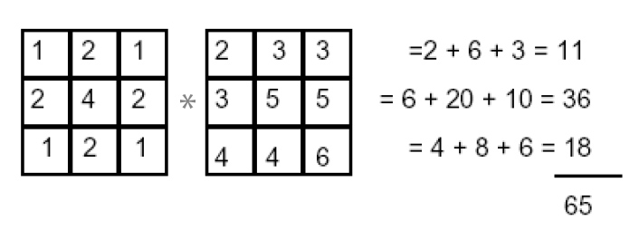
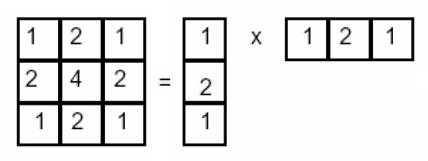
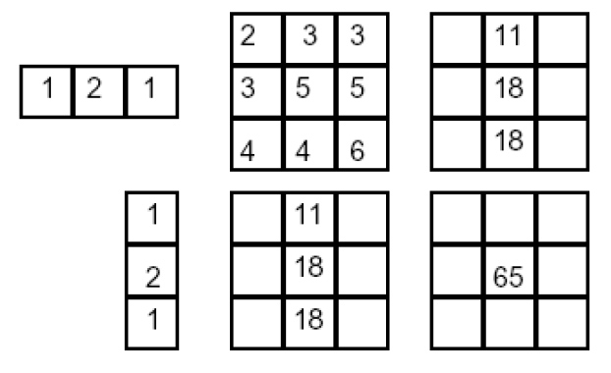
Separability example
2D convolution
(center location only)
The filter factors
into a product of 1D
filters:
Perform convolution
along rows:
*
=
Followed by convolution
along the remaining column:
*
=
Source: K. Grauman
Notes:
Convolution vs filtering doesn’t matter here because the filter is symmetric

Slide 48
Separability
Why is separability useful in practice?

Slide 49
Some practical matters

Slide 50
Practical matters
How big should the filter be?
Values at edges should be near zero
Rule of thumb for Gaussian: set filter half-width to about 3 σ

Slide 51
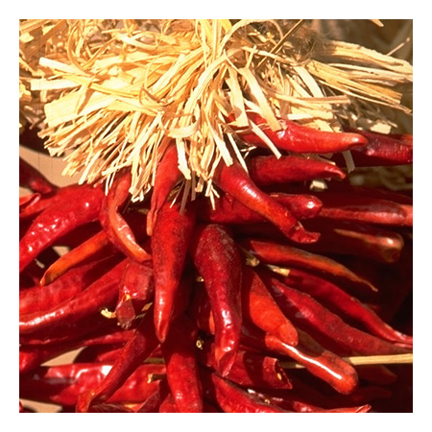
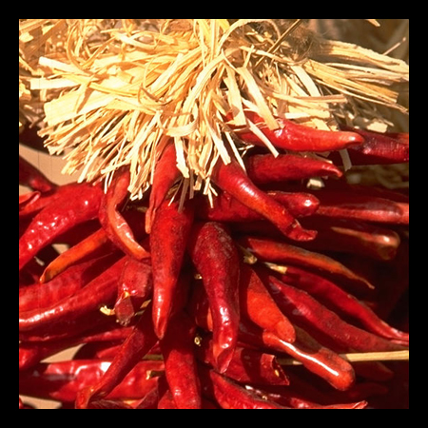


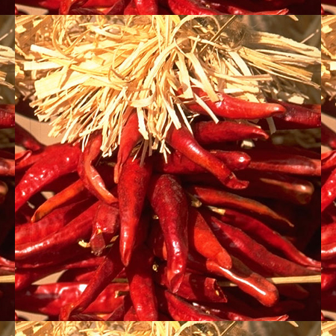





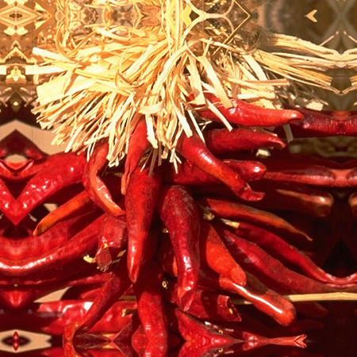


Practical matters
What about near the edge?
  the filter window falls off the edge of the image
  need to extrapolate
  methods:
    clip filter (black)
    wrap around
    copy edge
    reflect across edge
Source: S. Marschner

Slide 52
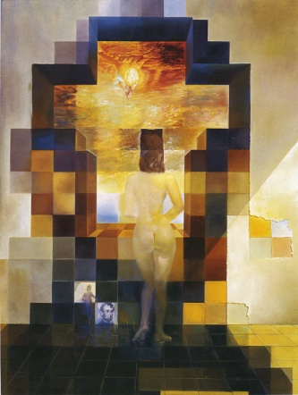
Next class: Thinking in Frequency

