Slide 1
Large-scale Instance Retrieval
Computer Vision
James Hays
Many slides from Derek Hoiem and Kristen Grauman

Slide 2
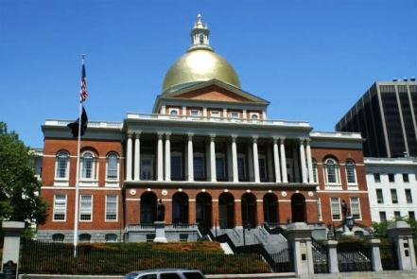
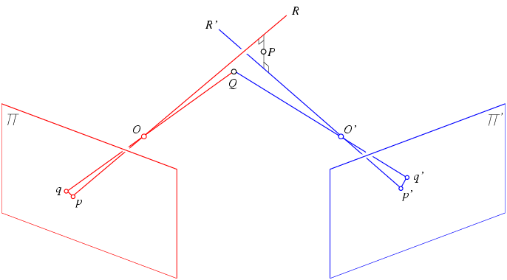
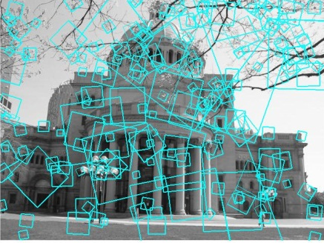
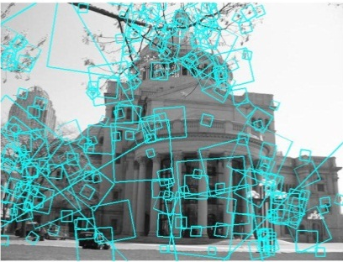

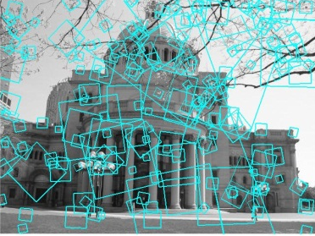
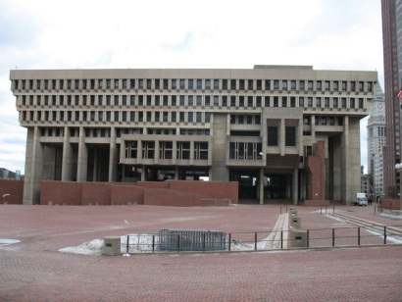
Multi-view matching
?
vs
…
Matching two given views for depth
Search for a matching view for recognition
Kristen Grauman

Slide 3
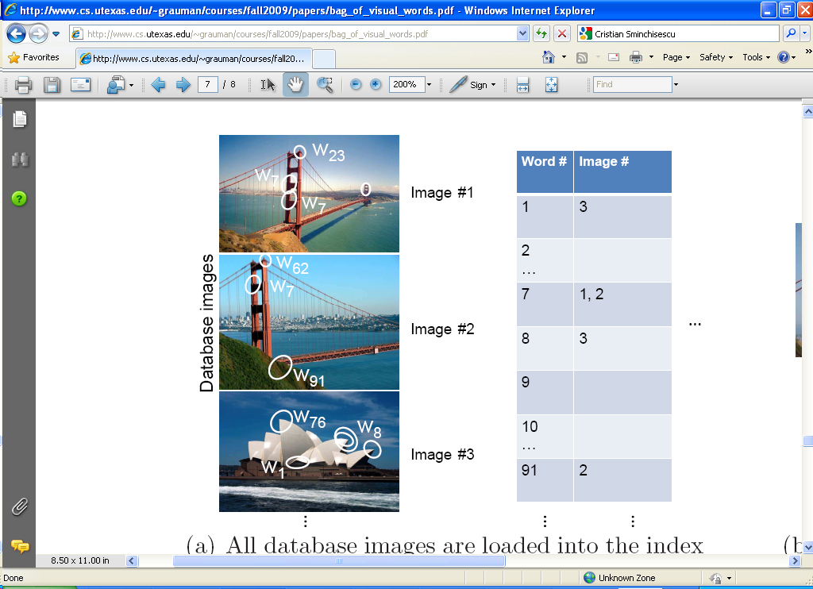
Inverted file index
Database images are loaded into the index mapping words to image numbers
Kristen Grauman

Slide 4
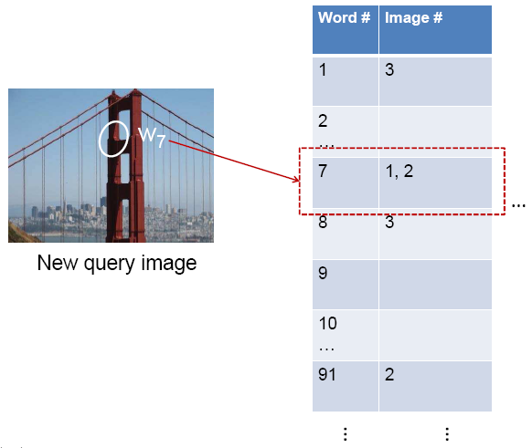
Inverted file index
New query image is mapped to indices of database images that share a word.
Kristen Grauman

Slide 5
Inverted file index
Key requirement for inverted file index to be efficient: sparsity
If most pages/images contain most words then you’re no better off than exhaustive search.
  Exhaustive search would mean comparing the word distribution of a query versus every page.

Slide 6
Instance recognition: remaining issues
How to summarize the content of an entire image? And gauge overall similarity?
How large should the vocabulary be? How to perform quantization efficiently?
Is having the same set of visual words enough to identify the object/scene? How to verify spatial agreement?
How to score the retrieval results?
Kristen Grauman

Slide 7

Analogy to documents
Of all the sensory impressions proceeding to the brain, the visual experiences are the dominant ones. Our perception of the world around us is based essentially on the messages that reach the brain from our eyes. For a long time it was thought that the retinal image was transmitted point by point to visual centers in the brain; the cerebral cortex was a movie screen, so to speak, upon which the image in the eye was projected. Through the discoveries of Hubel and Wiesel we now know that behind the origin of the visual perception in the brain there is a considerably more complicated course of events. By following the visual impulses along their path to the various cell layers of the optical cortex, Hubel and Wiesel have been able to demonstrate that the message about the image falling on the retina undergoes a step-wise analysis in a system of nerve cells stored in columns. In this system each cell has its specific function and is responsible for a specific detail in the pattern of the retinal image.
China is forecasting a trade surplus of $90bn (£51bn) to $100bn this year, a threefold increase on 2004's $32bn. The Commerce Ministry said the surplus would be created by a predicted 30% jump in exports to $750bn, compared with a 18% rise in imports to $660bn. The figures are likely to further annoy the US, which has long argued that China's exports are unfairly helped by a deliberately undervalued yuan. Beijing agrees the surplus is too high, but says the yuan is only one factor. Bank of China governor Zhou Xiaochuan said the country also needed to do more to boost domestic demand so more goods stayed within the country. China increased the value of the yuan against the dollar by 2.1% in July and permitted it to trade within a narrow band, but the US wants the yuan to be allowed to trade freely. However, Beijing has made it clear that it will take its time and tread carefully before allowing the yuan to rise further in value.
sensory, brain,
visual, perception,
retinal, cerebral cortex,
eye, cell, optical
nerve, image
Hubel, Wiesel
China, trade,
surplus, commerce,
exports, imports, US,
yuan, bank, domestic,
foreign, increase,
trade, value
ICCV 2005 short course, L. Fei-Fei

Slide 8





Slide 9







Bags of visual words
Summarize entire image based on its distribution (histogram) of word occurrences.
Analogous to bag of words representation commonly used for documents.
Notes:
9

Slide 10
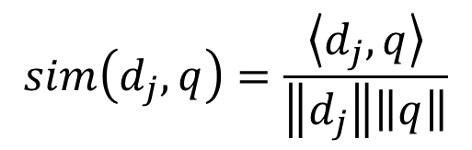





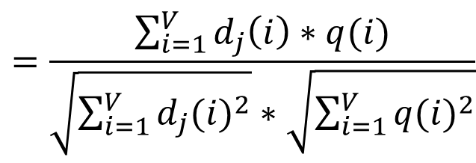
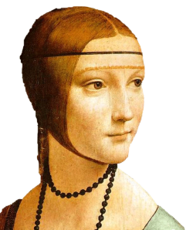
Comparing bags of words
Rank frames by normalized scalar product between their (possibly weighted) occurrence counts---nearest neighbor search for similar images.
[1 8 1 4]
[5 1 1 0]
for vocabulary of V words
Kristen Grauman

Slide 11
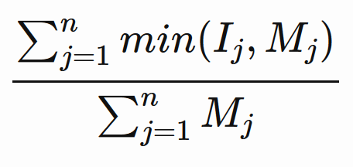
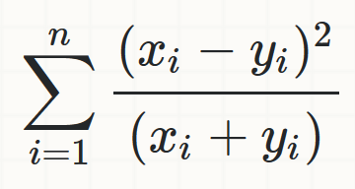
Comparing bags of words
Other common histogram comparisons:
  Histogram intersection
  Chi squared
[1 8 1 4]
[5 1 1 0]
Kristen Grauman

Slide 12
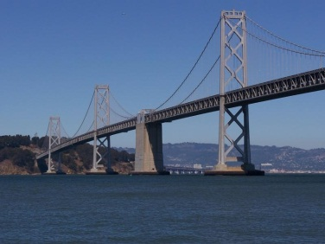
Inverted file index and
bags of words similarity
w₉₁
Extract words in query
Inverted file index to find relevant frames
Compare word counts
Kristen Grauman

Slide 13
Instance recognition: remaining issues
How to summarize the content of an entire image? And gauge overall similarity?
How large should the vocabulary be? How to perform quantization efficiently?
Is having the same set of visual words enough to identify the object/scene? How to verify spatial agreement?
How to score the retrieval results?
Kristen Grauman

Slide 14
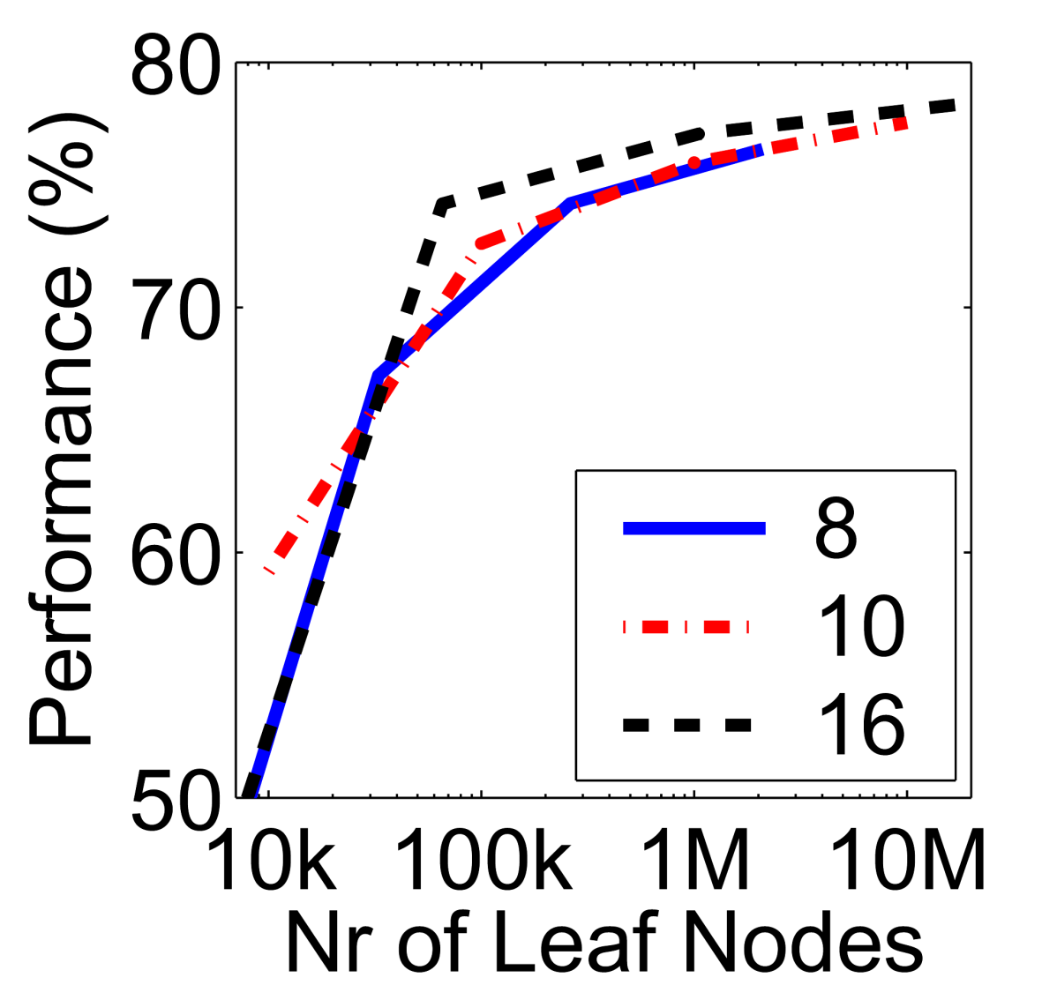
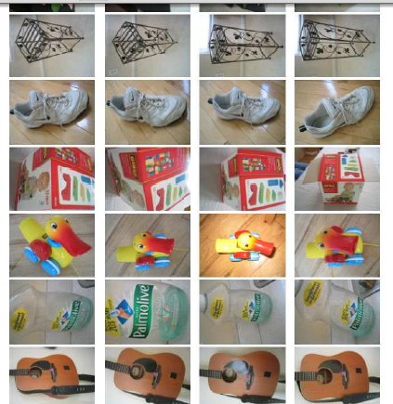
Vocabulary size
Results for recognition task with 6347 images
Branching factors
Influence on performance, sparsity
Nister & Stewenius, CVPR 2006
Kristen Grauman

Slide 15
Recognition with K-tree
Following slides by David Nister (CVPR 2006)

Slide 16
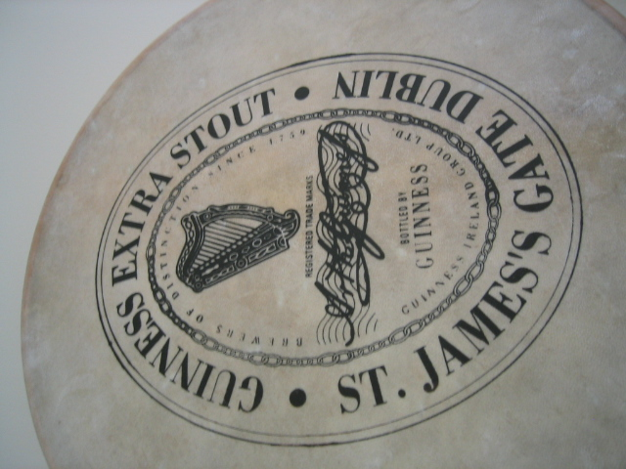
Notes:
I will now try to describe the approach with an animation.
The first, offline phase, is to train the vocabulary tree.
We use Maximally Stable Extremal Regions by Matas et al. and then we extract SIFT descriptors from the MSER regions.
Regarding the feature extraction, we are not really claiming anything other than down-in-the-trenches nose-to-the-grindstone hard work to get good implementations of the state-of-the-art, and since we are all obsessed with novelty I will not spend any time talking about the feature extraction.
We believe that the vocabulary tree approach will work well on any of your favorite descriptors.

Slide 17
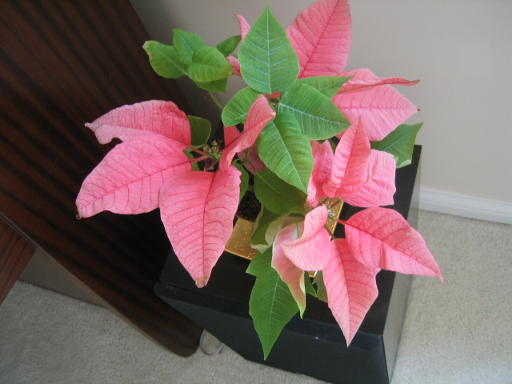
Notes:
All the descriptor vectors are thrown into a common space.
This is done for many images, the goal being to acquire enough statistics on how natural images distribute points in the descriptor space.

Slide 18
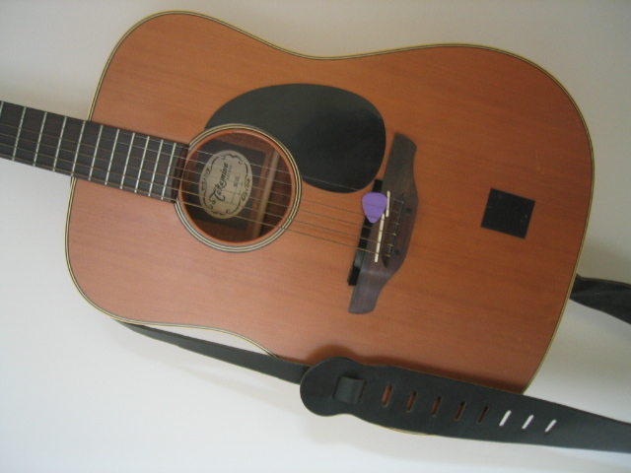

Slide 19
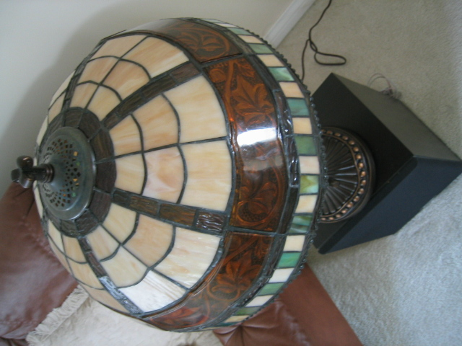

Slide 20


Slide 21
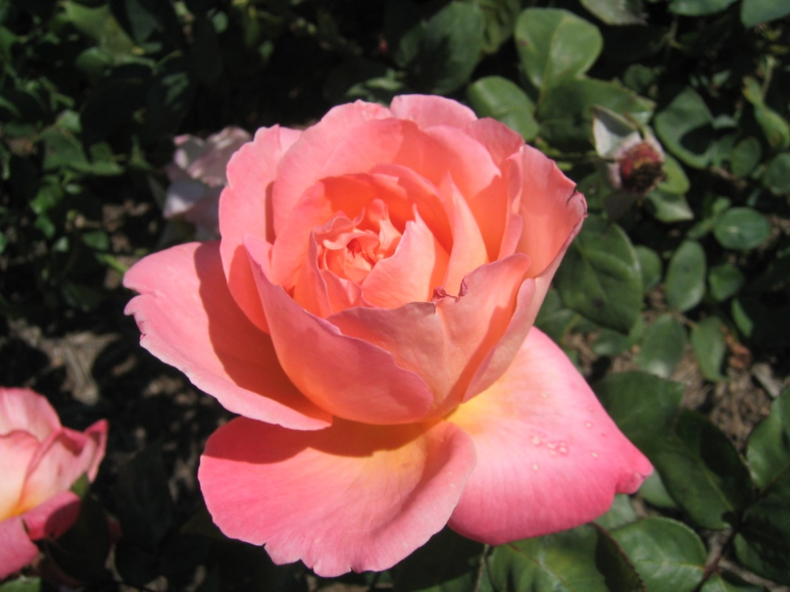

Slide 23
Notes:
We then run k-means on the descriptor space. In this setting, k defines what we call the branch-factor of the tree, which indicates how fast the tree branches.
In this illustration, k is three. We then run k-means again, recursively on each of the resulting quantization cells.
This defines the vocabulary tree, which is essentially a hierarchical set of cluster centers and their corresponding Voronoi regions.
We typically use a branch-factor of 10 and six levels, resulting in a million leaf nodes. We lovingly call this the Mega-Voc.

Slide 33
Notes:
We now have the vocabulary tree, and the online phase can begin.
In order to add an image to the database, we perform feature extraction. Each descriptor vector is now dropped down from the root of the tree and quantized very efficiently into a path down the tree, encoded by a single integer.
Each node in the vocabulary tree has an associated inverted file index.
Indecies back to the new image are then added to the relevant inverted files.
This is a very efficient operation that is carried out whenever we want to add an image.

Slide 34
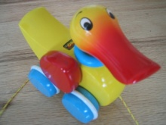


Slide 35
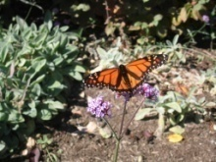


Slide 36



Slide 37



Slide 38
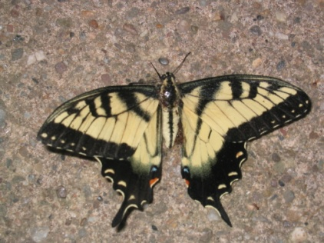
Notes:
When we then wish to query on an input image, we quantize the descriptor vectors of the input image in a similar way, and accumulate scores for the images in the database with so called term frequency inverse document frequency (tf-idf). This is effectively an entropy weighting of the information. The winner is the image in the database with the most common information with the input image.

Slide 39
Vocabulary trees: complexity
Number of words given tree parameters: branching factor and number of levels
branching_factor^^{number_of_levels}
Word assignment cost vs. flat vocabulary
O(k) for flat
O(log_{branching_factor}(k) * branching_factor)
Is this like a kd-tree?
Yes, but with better partitioning and defeatist search.
This hierarchical data structure is lossy – you might not find your true nearest cluster.
Notes:
Number of words = (branching_factor)^(number_of_levels)
Assignment cost for flat hierarchy O(k), for tree O(log(base branching_factor)(k) * branching_factor)

Slide 40
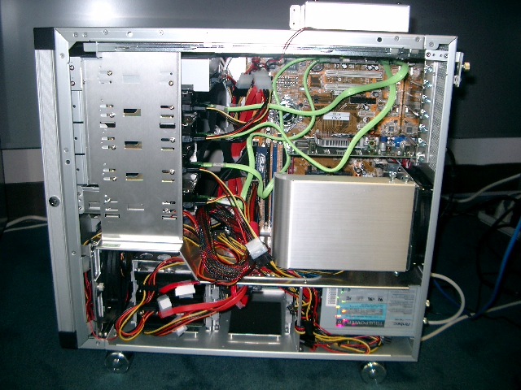
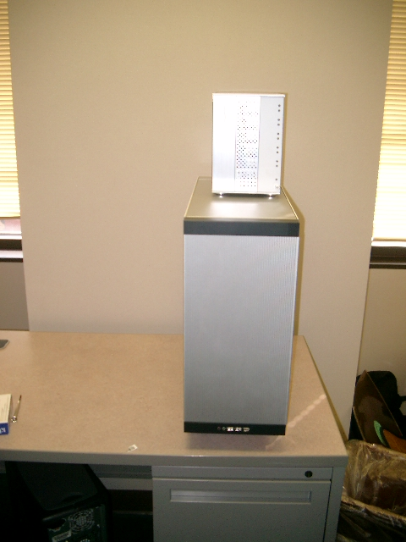
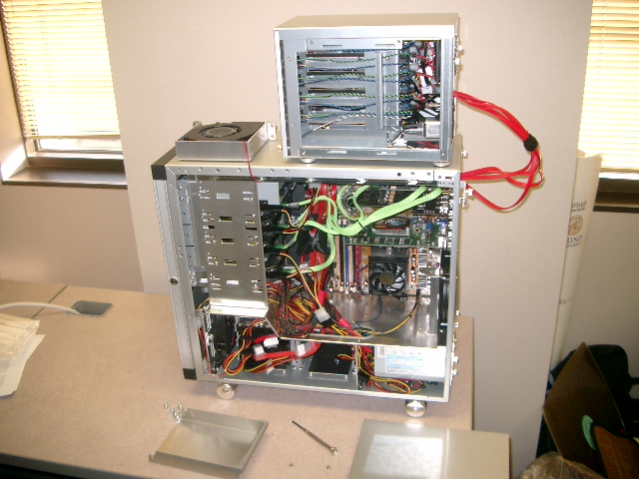
110,000,000
Images in
5.8 Seconds
Slide
Slide Credit: Nister
Notes:
Very recently, we have scaled the system even further.
The system we just demo’d searches a 50 thousand image index in the RAM of this laptop at real-time rates.
We have built and programmed a desktop system at home in which we currently have 12 hard drives. We bypass the operating system and
read and write the disk surfaces directly.
Last week this system clocked in on 110 Million images in 5.8 seconds, so roughly 20Million images per second and machine.
The images consist of around 10 days of four TV channels, so more than a month of TV.
Soon we don’t have to watch TV, because we’ll have machines doing it for us.

Slide 41
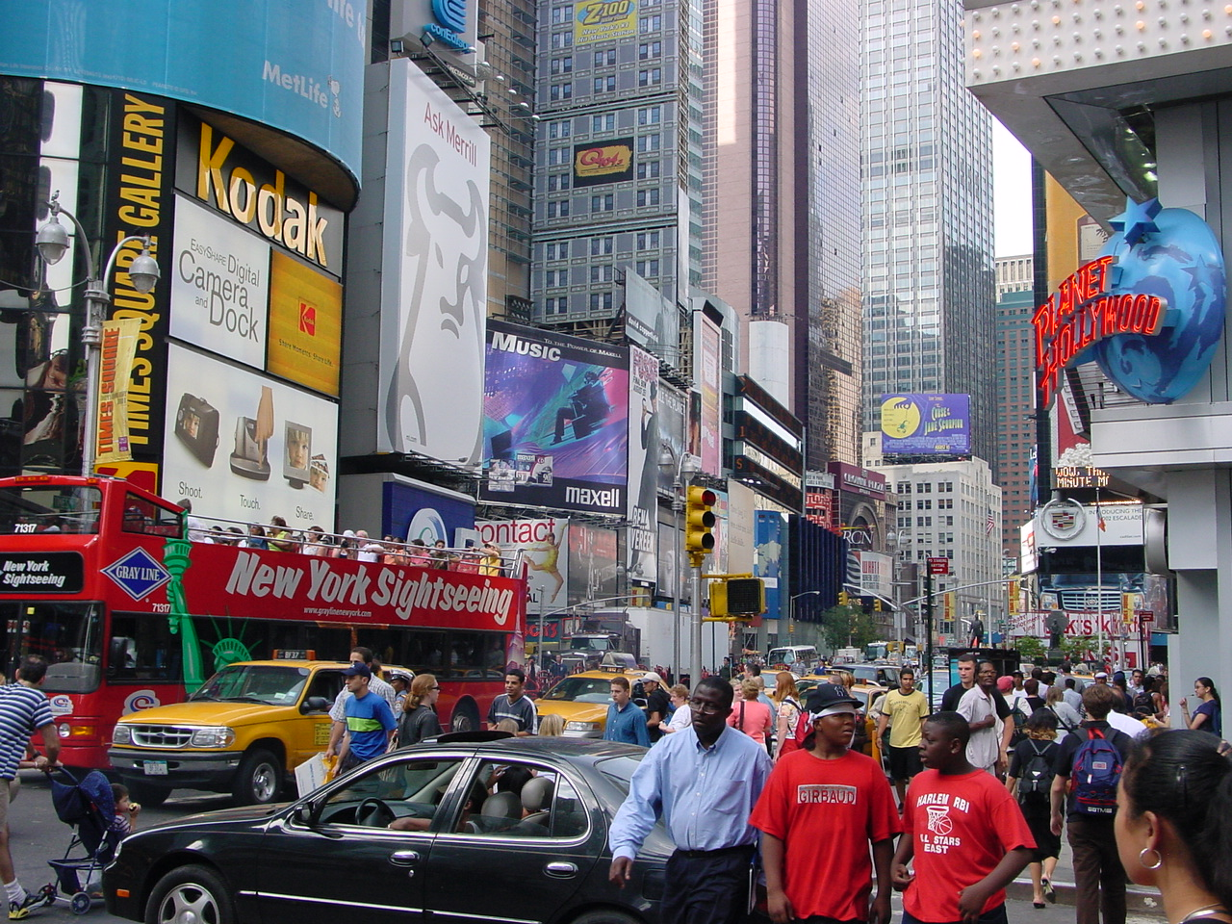


Slide
Slide Credit: Nister
Notes:
To continue the analogy, if we printed all these images on paper, and stacked them,

Slide 42
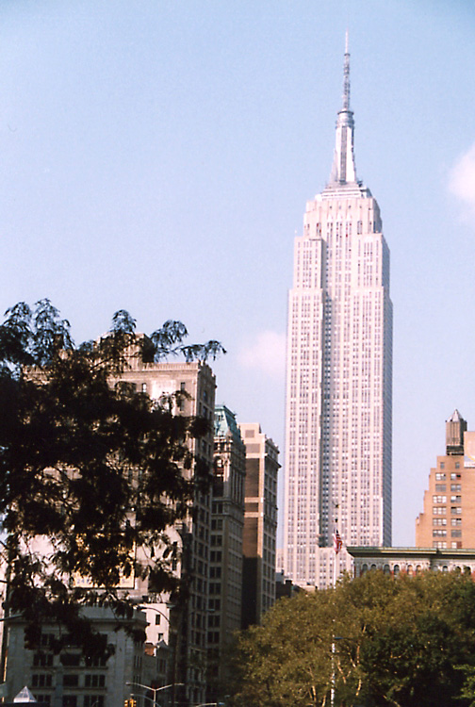
Slide
Slide Credit: Nister
Notes:
The pile would stack, as high as

Slide 43
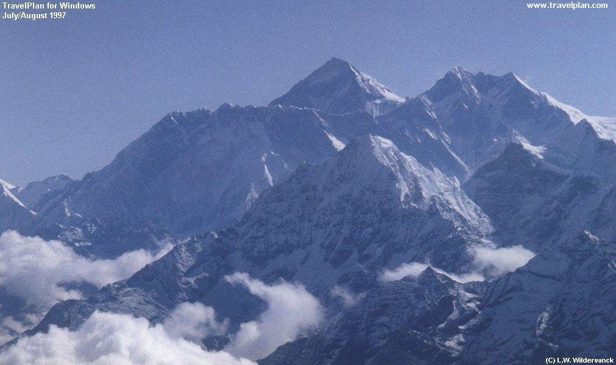
Slide
Slide Credit: Nister
Notes:
Mount Everest.
Another way to put perspective on this is, Google image search not too long ago claimed to index 2 billion images,
although based on meta-data, while we do it based on image content.
So, with about 20 desktop systems like the one I just showed, it seems that it may be possible to build a web-scale content-based image search engine,
and we are sort of hoping that this paper will fuel the race for the first such search engine.
So, that is some motivation.
Let me now move to the contribution of the paper.
As you can guess by now, it is about scalability of recognition and retrieval.

Slide 44
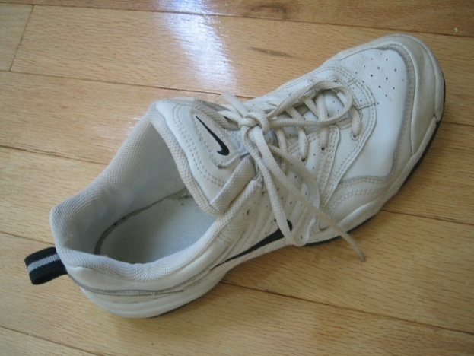
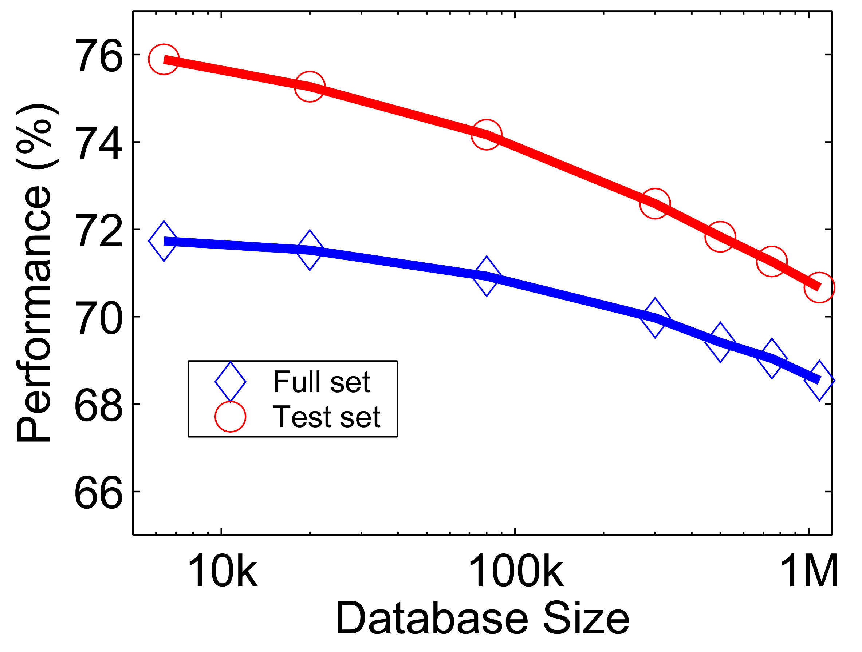










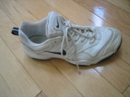
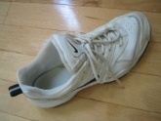
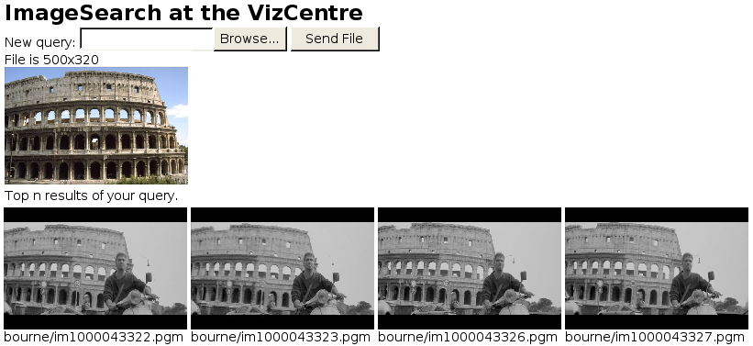












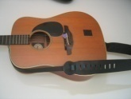

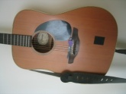
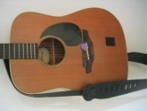
Performance
Notes:
One of the reasons we managed to take the system this far is that we have worked with rigorous performance testing against a database with ground truth.
We now have a benchmark database with over 10000 images grouped in sets of four images of the same object. We query on one of the images in the group and see how many of the other images in the group make it to the top of the query.
In the paper, we have tested this up to a million images, by embedding the ground truth database into a database encompassing all the frames of 10 feature length movies.

Slide 45
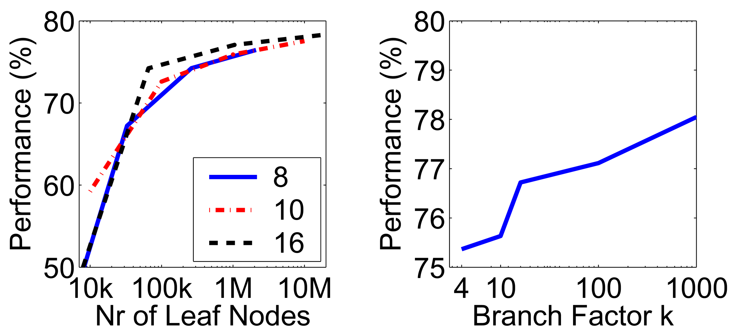
Higher branch factor works better (but slower)
Notes:
We also find that performance improves with the branch factor.
This improvement is not dramatic, but it is interesting to note that very low branch factors are somewhat weak, and a branch factor of two results in partitioning the space with planes.

Slide 46
Visual words/bags of words
+ flexible to geometry / deformations / viewpoint
+ compact summary of image content
+ provides fixed dimensional vector representation for sets
+ very good results in practice
background and foreground mixed when bag covers whole image
optimal vocabulary formation remains unclear
basic model ignores geometry – must verify afterwards, or encode via features
Kristen Grauman
Notes:
46

Slide 47
Instance recognition: remaining issues
How to summarize the content of an entire image? And gauge overall similarity?
How large should the vocabulary be? How to perform quantization efficiently?
Is having the same set of visual words enough to identify the object/scene? How to verify spatial agreement?
How to score the retrieval results?
Kristen Grauman

Slide 48
Can we be more accurate?
So far, we treat each image as containing a “bag of words”, with no spatial information
Which matches better?
e
h
a
f
e
e
z
a
f
e
h
a
f
e
e

