Slide 1
Object Detection
Overview
Viola-Jones
Dalal-Triggs
Deformable models
Deep learning

Slide 2
https://en.wikipedia.org/wiki/The_dress

Slide 3
Lit part of blue dress and shadowed part of white dress are the same color

Slide 4
Recap: Viola-Jones sliding window detector
Fast detection through two mechanisms
Quickly eliminate unlikely windows
Use features that are fast to compute
Viola and Jones. Rapid Object Detection using a Boosted Cascade of Simple Features (2001).

Slide 5
Cascade for Fast Detection
Choose threshold for low false negative rate
Fast classifiers early in cascade
Slow classifiers later, but most examples don’t get there
Stage 1
H₁(x) > t₁?
Yes
Stage 2
H₂(x) > t₂?
Stage N
H_{N}(x) > t_{N}?
Yes
…
Pass
No
No
No
Examples
Reject
Reject
Reject

Slide 6
Features that are fast to compute
“Haar-like features”
Differences of sums of intensity
Thousands, computed at various positions and scales within detection window
-1
+1
Two-rectangle features
Three-rectangle features
Etc.

Slide 7
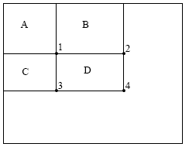
Integral Images
ii = cumsum(cumsum(im, 1), 2)
x, y
ii(x,y) = Sum of the values in the grey region
SUM within Rectangle D is ii(4) - ii(2) - ii(3) + ii(1)

Slide 8
Feature selection with Adaboost
Create a large pool of features (180K)
Select features that are discriminative and work well together
“Weak learner” = feature + threshold + parity
Choose weak learner that minimizes error on the weighted training set
Reweight

Slide 9
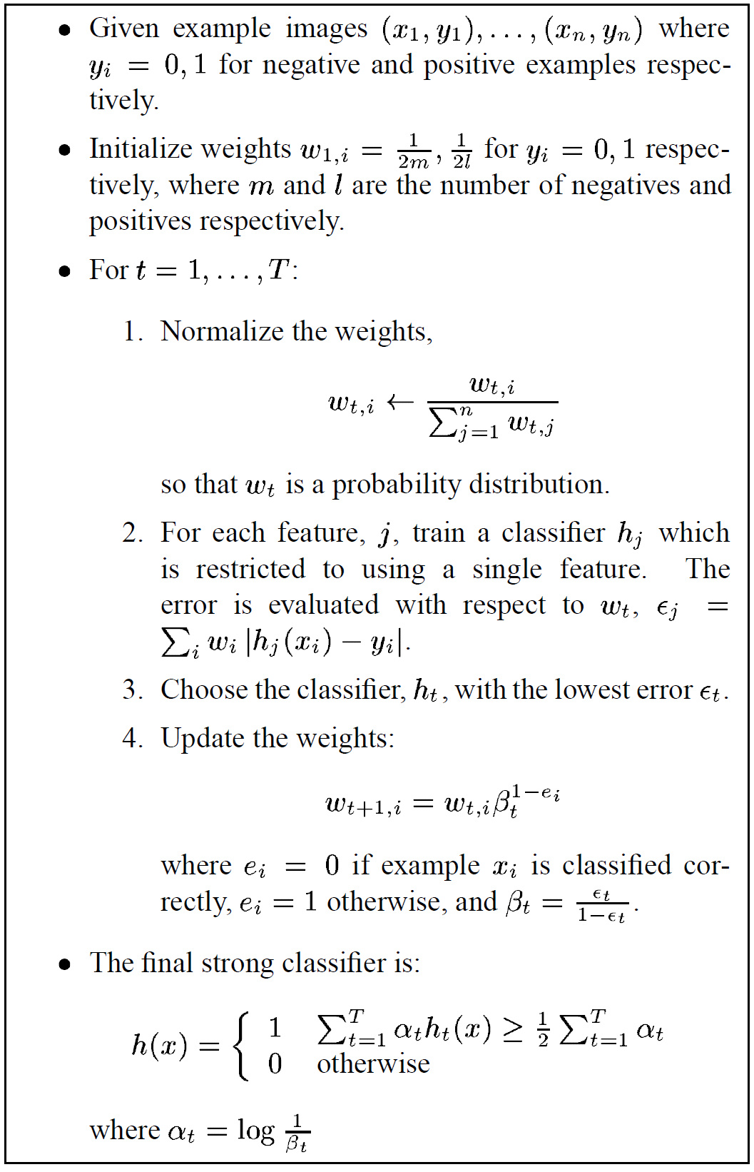
Adaboost

Slide 10
Viola-Jones details
38 stages with 1, 10, 25, 50 … features
6061 total used out of 180K candidates
10 features evaluated on average
Training Examples
4916 positive examples
10000 negative examples collected after each stage
Scanning
Scale detector rather than image
Scale steps = 1.25 (factor between two consecutive scales)
Translation 1*scale (# pixels between two consecutive windows)
Non-max suppression: average coordinates of overlapping boxes
Train 3 classifiers and take vote

Slide 11
Viola Jones Results
Speed = 15 FPS (in 2001)
MIT + CMU face dataset

Slide 12
Object Detection
Overview
Viola-Jones
Dalal-Triggs
Deformable models
Deep learning

Slide 13
Statistical Template
Object model = sum of scores of features at fixed positions
?
+3
+2
-2
-1
-2.5
= -0.5
> 7.5
Non-object
?
+4
+1
+0.5
+3
+0.5
= 10.5
> 7.5
Object

Slide 14
Design challenges
How to efficiently search for likely objects
Even simple models require searching hundreds of thousands of positions and scales
Feature design and scoring
How should appearance be modeled? What features correspond to the object?
How to deal with different viewpoints?
Often train different models for a few different viewpoints
Implementation details
Window size
Aspect ratio
Translation/scale step size
Non-maxima suppression

Slide 15
Example: Dalal-Triggs pedestrian detector
Extract fixed-sized (64x128 pixel) window at each position and scale
Compute HOG (histogram of gradient) features within each window
Score the window with a linear SVM classifier
Perform non-maxima suppression to remove overlapping detections with lower scores
Navneet Dalal and Bill Triggs, Histograms of Oriented Gradients for Human Detection, CVPR05
Notes:
6000+ citations, another of the most influential papers in computer vision!

Slide 16
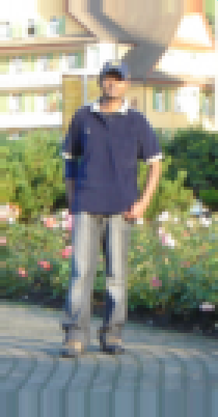
Slides by Pete Barnum
Navneet Dalal and Bill Triggs, Histograms of Oriented Gradients for Human Detection, CVPR05

Slide 17
Tested with
RGB
LAB
Grayscale
Gamma Normalization and Compression
Square root
Log
Slightly better performance vs. grayscale
Very slightly better performance vs. no adjustment

Slide 18
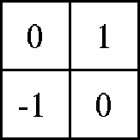
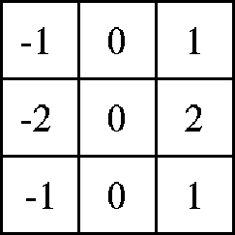
Outperforms
centered
diagonal
uncentered
cubic-corrected
Sobel
Slides by Pete Barnum
Navneet Dalal and Bill Triggs, Histograms of Oriented Gradients for Human Detection, CVPR05

Slide 19
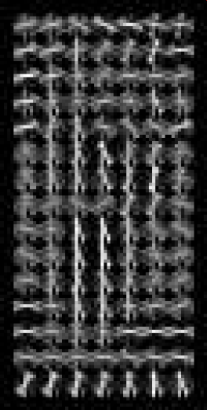
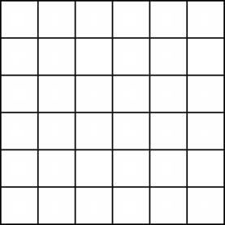
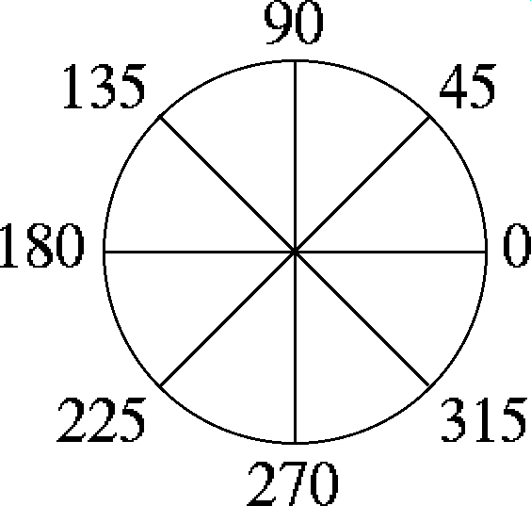
Histogram of gradient orientations
Votes weighted by magnitude
Bilinear interpolation between cells
Orientation: 9 bins (for unsigned angles 0 -180)
Histograms in k x k pixel cells
Slides by Pete Barnum
Navneet Dalal and Bill Triggs, Histograms of Oriented Gradients for Human Detection, CVPR05

Slide 20
Normalize with respect to surrounding cells
Slides by Pete Barnum
Navneet Dalal and Bill Triggs, Histograms of Oriented Gradients for Human Detection, CVPR05

Slide 21
Original Formulation
# orientations
# features = 15 x 7 x 9 x 4 = 3780
X=
# cells
# normalizations by neighboring cells
Slides by Pete Barnum
Navneet Dalal and Bill Triggs, Histograms of Oriented Gradients for Human Detection, CVPR05
Notes:
Note – this is not a “bag of features”, these gradient measurements have fixed spatial positions

Slide 22
Original Formulation
# orientations
# features = 15 x 7 x 9 x 4 = 3780
# cells
# normalizations by neighboring cells
X=
UoCTTI variant
# orientations
# features = 15 x 7 x (3 x 9) + 4 = 3780
# cells
magnitude of neighbor cells
Slides by Pete Barnum
Navneet Dalal and Bill Triggs, Histograms of Oriented Gradients for Human Detection, CVPR05
Notes:
Note – this is not a “bag of features”, these gradient measurements have fixed spatial positions

Slide 23
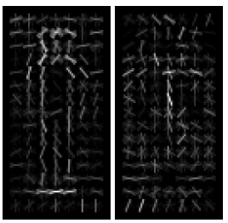
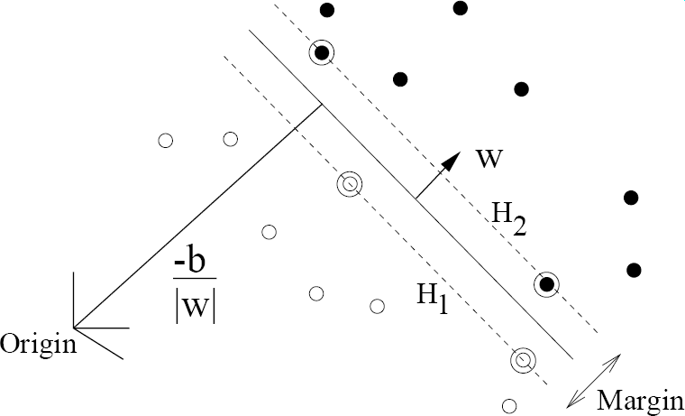
pos w
neg w
Slides by Pete Barnum
Navneet Dalal and Bill Triggs, Histograms of Oriented Gradients for Human Detection, CVPR05

Slide 24
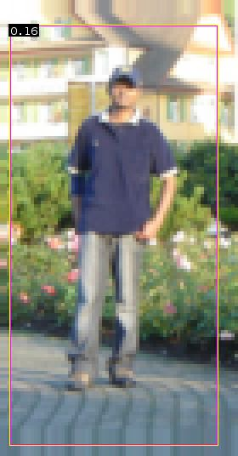
pedestrian
Slides by Pete Barnum
Navneet Dalal and Bill Triggs, Histograms of Oriented Gradients for Human Detection, CVPR05

Slide 25
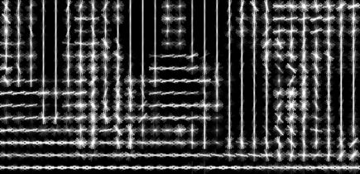
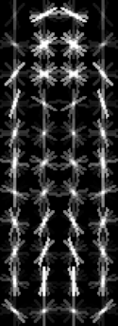
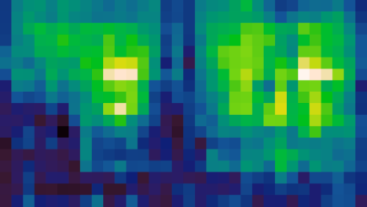
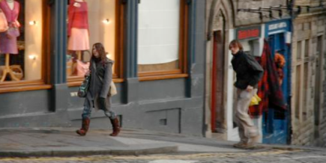
Pedestrian detection with HOG
Train a pedestrian template using a linear support vector machine
At test time, convolve feature map with template
Find local maxima of response
For multi-scale detection, repeat over multiple levels of a HOG pyramid
HOG feature map
Template
Detector response map
N. Dalal and B. Triggs, Histograms of Oriented Gradients for Human Detection, CVPR 2005

Slide 26
Something to think about…
Sliding window detectors work
very well for faces
fairly well for cars and pedestrians
badly for cats and dogs
Why are some classes easier than others?

Slide 27
Strengths and Weaknesses of Statistical Template Approach
Strengths
Works very well for non-deformable objects with canonical orientations: faces, cars, pedestrians
Fast detection
Weaknesses
Not so well for highly deformable objects or “stuff”
Not robust to occlusion
Requires lots of training data

Slide 28
Tricks of the trade
Details in feature computation really matter
E.g., normalization in Dalal-Triggs improves detection rate by 27% at fixed false positive rate
Template size
Typical choice is size of smallest detectable object
“Jittering” to create synthetic positive examples
Create slightly rotated, translated, scaled, mirrored versions as extra positive examples
Bootstrapping to get hard negative examples
Randomly sample negative examples
Train detector
Sample negative examples that score > -1
Repeat until all high-scoring negative examples fit in memory

Slide 29
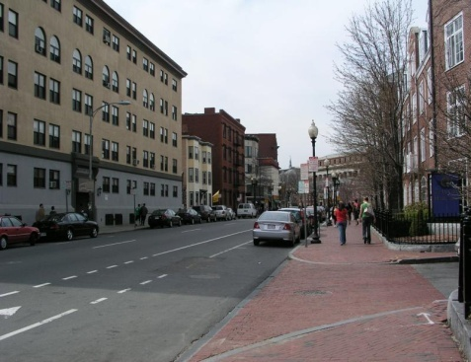
Things to remember
Sliding window for search
Features based on differences of intensity (gradient, wavelet, etc.)
Excellent results require careful feature design
Boosting for feature selection
Integral images, cascade for speed
Bootstrapping to deal with many, many negative examples
Stage 1
H₁(x) > t₁?
Yes
Stage 2
H₂(x) > t₂?
…
Stage N
H_{N}(x) > t_{N}?
Yes
Pass
Examples
No
No
No
Reject
Reject
Reject

