Slide 1
“Fovea Detector”
https://www.shadertoy.com/view/4dsXzM

Slide 2
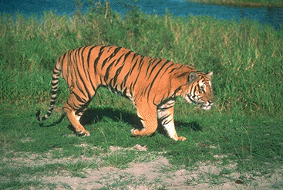
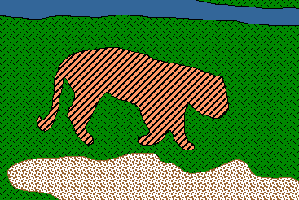
From Images to Objects
"I stand at the window and see a house, trees, sky. Theoretically I
might say there were 327 brightnesses and nuances of colour. Do
I have "327"? No. I have sky, house, and trees." --Max Wertheimer, 1923
Notes:
https://simple.wikipedia.org/wiki/Gestalt_psychology

Slide 3
Recap
Segmentation vs Boundary Detection vs semantic segmentation / scene parsing
Why boundaries / Grouping?
Recap: Canny Edge Detection
The Berkeley Segmentation Data Set
pB boundary detector ~2001
Sketch Tokens 2013

Slide 4
Recap: modern boundary detection
Learn from humans where image boundaries are.
Boundaries aren’t super well defined.
  Depth discontinuities
  Semantic boundaries
  Texture boundaries
  Illumination boundaries

Slide 5
Today: Scene Parsing / Semantic Segmentation
Label every pixel of an image with a category label (usually with the help of contextual reasoning).
Well known example: TextonBoost
Detailed look at the “non parametric” approach of Tighe and Lazebnik

Slide 6
Object Recognition and Segmentation are Coupled
People Present
No Segmentation
Approximate Segmentation
Good Segmentation
Images from [Leibe et al. 2005]

Slide 7
The Three Approaches
Segment → Detect
Detect → Segment
Segment ←→ Detect

Slide 8
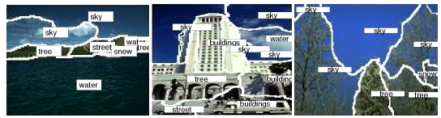
Segment first and ask questions later.
Reduces possible locations for objects
Allows use of shape information and makes long-range cues more effective
But what if segmentation is wrong?
[Duygulu et al ECCV 2002]

Slide 9
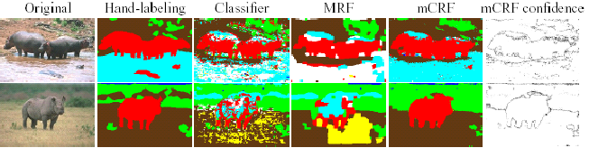
Object recognition + data-driven smoothing
Object recognition drives segmentation
Segmentation gives little back
He et al. 2004
TextonBoost

Slide 10
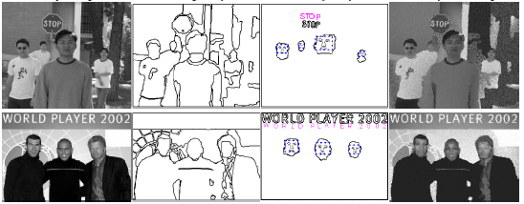
Is there a better way?
Integrated segmentation and recognition
Generalized Swendsen-Wang
[Tu et al. 2003]
[Barba Wu 2005]

Slide 11
TextonBoost: Joint Appearance, Shape and Context Modeling for Multi-Class Object Recognition and Segmentation
J. Shotton ; University of Cambridge
J. Jinn, C. Rother, A. Criminisi ; MSR Cambridge
Slides modified from Derek Hoiem

Slide 12
The Ideas in TextonBoost
Textons from Universal Visual Dictionary paper [Winn Criminisi Minka ICCV 2005]
Color models and GC from “Foreground Extraction using Graph Cuts” [Rother Kolmogorov Blake SG 2004]
Boosting + Integral Image from Viola-Jones
Joint Boosting from [Torralba Murphy Freeman CVPR 2004]

Slide 13
What’s good about this paper
Provides recognition + segmentation for many classes (for the time it was published)
Combines several good ideas
Very thorough evaluation

Slide 14
What’s bad about this paper
A bit hacky
Does not beat past work (in terms of quantitative recognition results)
No modeling of “everything else” class

Slide 15

TextonBoost Overview
Shape-texture: localized textons
Color: mixture of Gaussians
Location: normalized x-y coordinates
Edges: contrast-sensitive Pott’s model

Slide 16
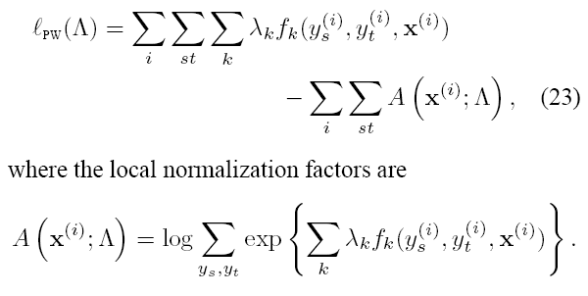
Learning the CRF Params
The authors claim to be using piecewise training …
[Sutton McCallum UAI 2005]

Slide 17
Learning the CRF Params
But it’s really just piecewise hacking
  Learn params for different potential functions independently
  Raise potentials to some exponent to reduce overcounting

Slide 18
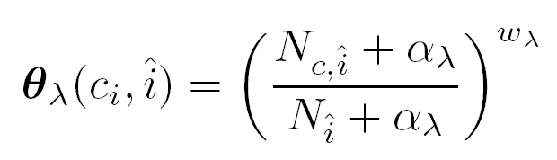
Location Term
Counts for each normalized position over training images for each class
from Validation

Slide 19
Color Term
Mixture of Gaussian learned over image
Mixture coefficients determined separately for each class
Iterate between class labeling and parameter-estimation
Manual: 3

Slide 20
Edge Term
Parameters learned using validation data

Slide 21
Texture-Shape
17 filters (oriented gaus/lap + dots)
Cluster responses to form textons
Count textons within white box (relative to position i)
Feature = texton + rectangle

Slide 22
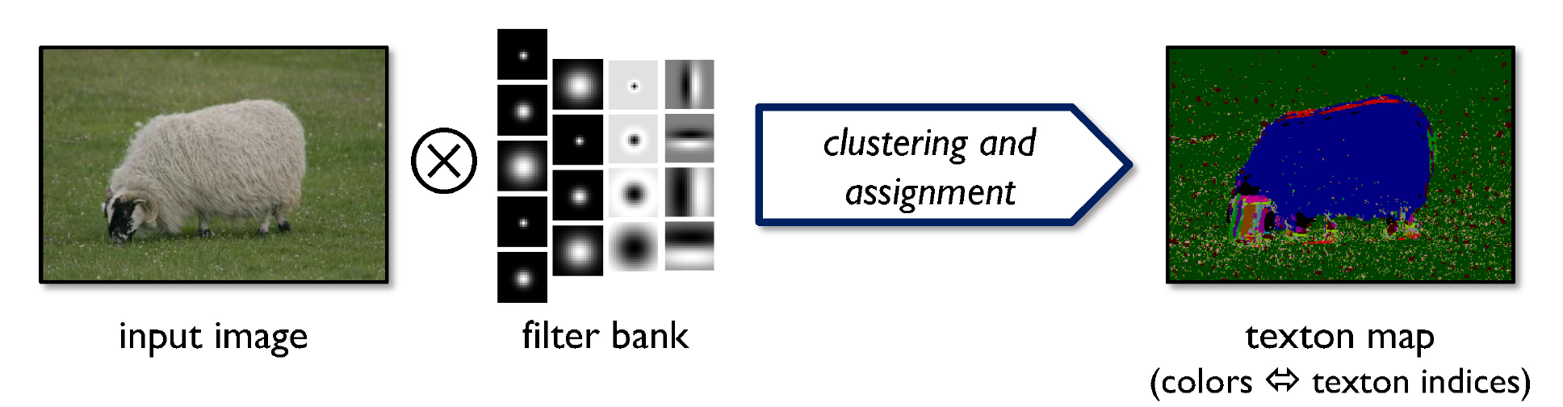
Texton Visualization

Slide 23
Boosting Textons
Use “Joint Boosting” [Torralba Murphy Freeman CVPR 2004]
  Different classes share features
  Weak learners: decision stumps on texton count within rectangle
To speed training:
  Randomly select 0.3% of possible features from large set
  Downsample texton maps for training images

Slide 24
“Shape Context”
Toy example

Slide 25
Random Feature Selection
Toy example (training on ten images)

Slide 26
Results on Boosted Textons
Boosted shape-textons in isolation
  Training time: 42 hrs for 5000 rounds on 21-class training set of 276 images

Slide 27
Parameters Learned from Validation
Number of Adaboost rounds (when to stop)
Number of textons
Edge potential parameters
Location potential exponent

Slide 28
Qualitative (Good) Results

Slide 29
Qualitative (Bad) Results
But notice good segmentation, even with bad labeling

Slide 30
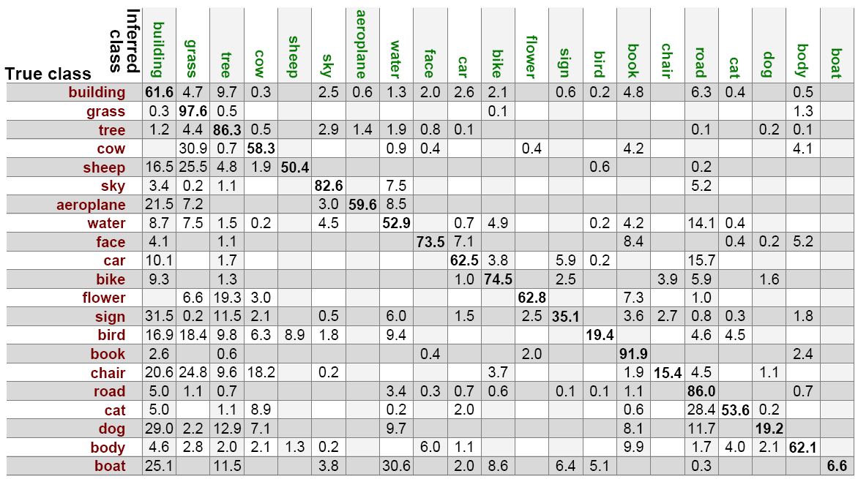
Quantitative Results

Slide 31
Effect of Different Model Potentials
Boosted textons only
No color modeling
Full CRF model

Slide 32
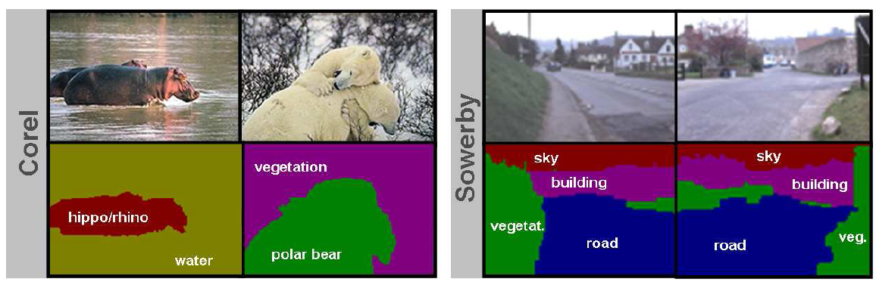
Corel/Sowerby

Slide 33
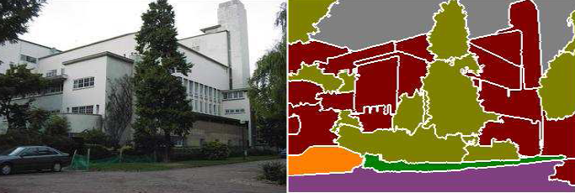




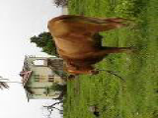

Closed-universe recognition
Fixed, pre-defined set of classes
Test image
Fixed, static training set
Models
Learning
Inference
(offline)
Output
Notes:
In a closed-universe setting, we would begin by making a short list of all the possible classes we can expect to see at test time, and learn a separate model for each class. [Explain about possible types of models] If we wanted to add new classes or new examples for existing classes to the database, we would have to re-train all the models from scratch. So, the challenge is to have an approach that can very easily accommodate evolving datasets and annotations.

Slide 34
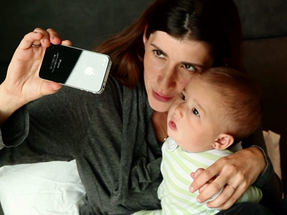


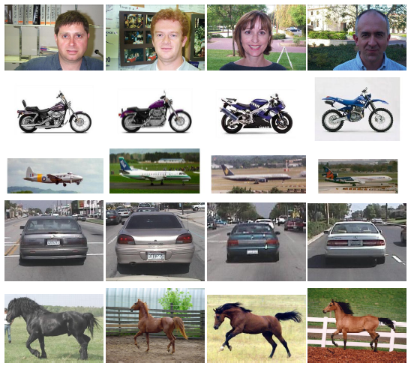


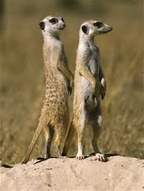

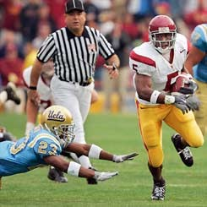
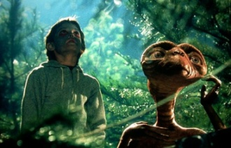






Closed-universe datasets
Open-universe datasets
  Small amount of data
  Static datasets
  Limited variation
  Full annotation
  Large amount of data
  Evolving datasets
  Wide variation
  Incomplete annotation

Slide 35
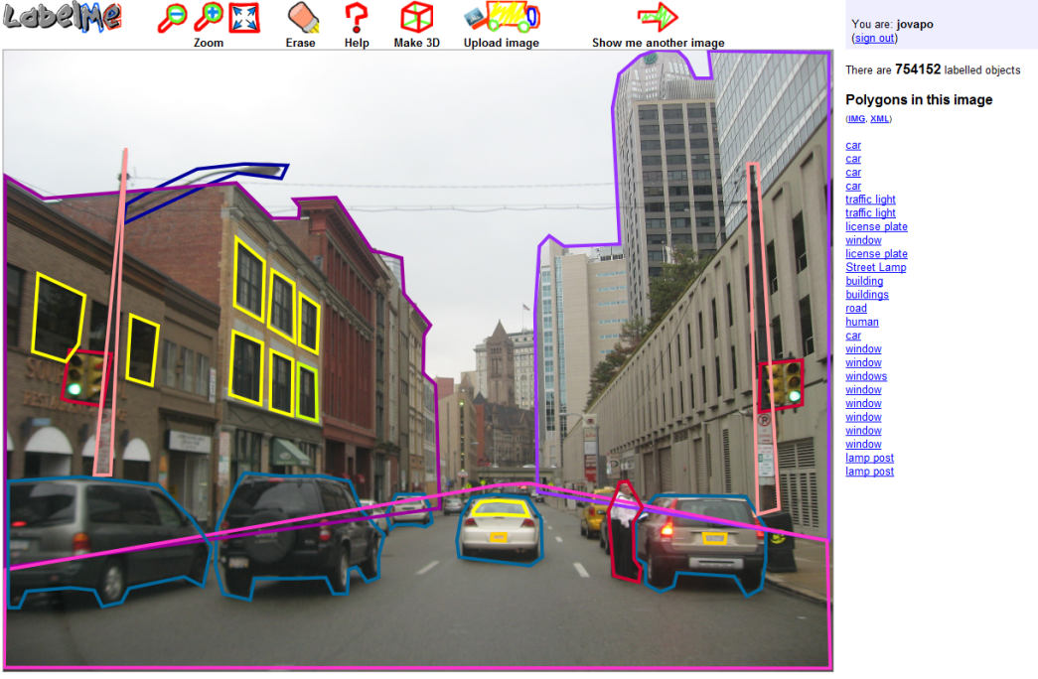
Open-universe recognition
Evolving training set
http://labelme.csail.mit.edu/

Slide 36
Open-universe recognition
Very large/open-ended set of classes
…

Slide 37
Open-universe recognition
Very large/open-ended set of classes
…
Unbalanced data distribution

Slide 38
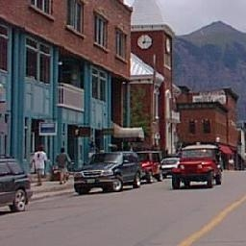
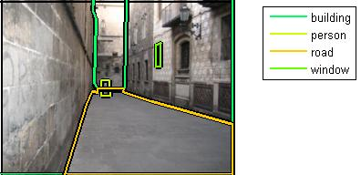
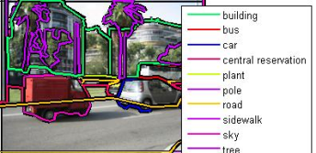
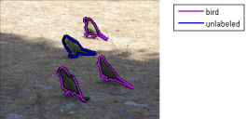
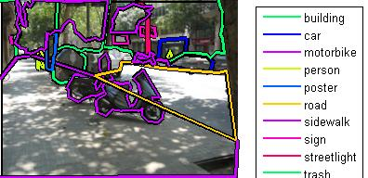
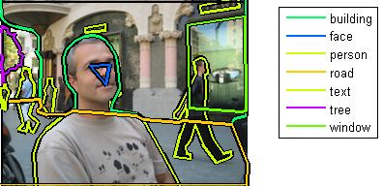
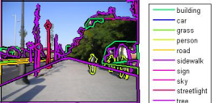
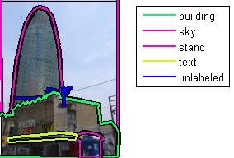
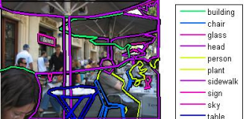
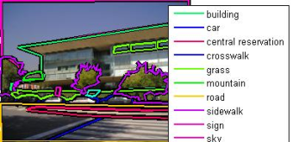
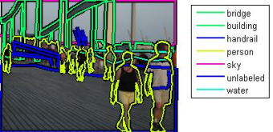
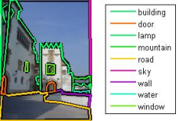
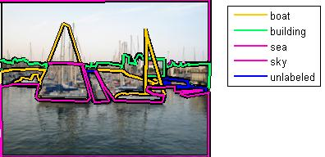
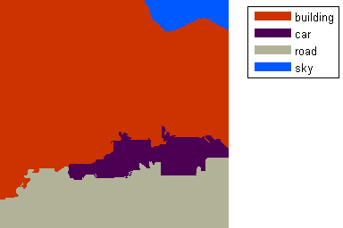
Potential solution: Lazy learning
Test image
On-the-fly inference
sky
building
Training set
car
road

Slide 39

Large-Scale Nonparametric Image Parsing
Joseph Tighe and Svetlana Lazebnik
ECCV 2010
sky
building
car
road

Slide 40
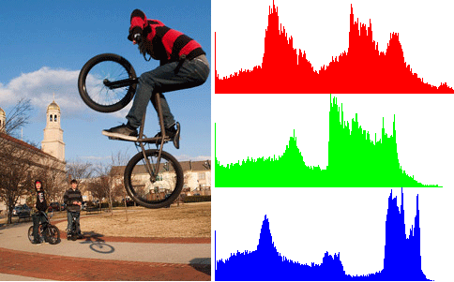
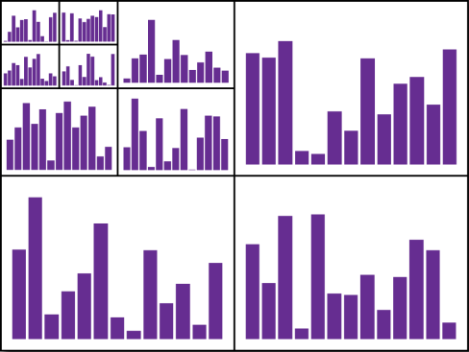
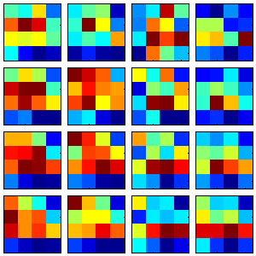
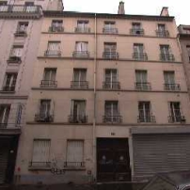
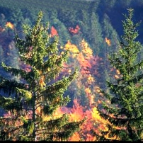
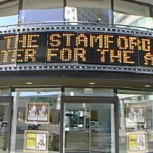
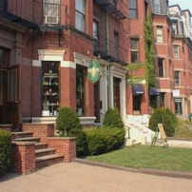
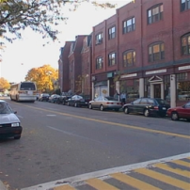
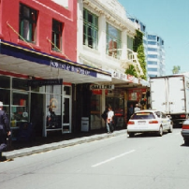
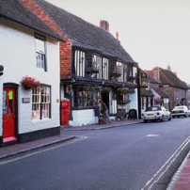
Step 1: Scene-level matching
Color Histogram
Spatial Pyramid
(Lazebnik et al., 2006)
Gist
(Oliva & Torralba, 2001)
Notes:
Retrieval set:
Source of possible labels
Source of region-level matches

Slide 41
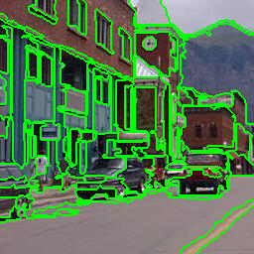
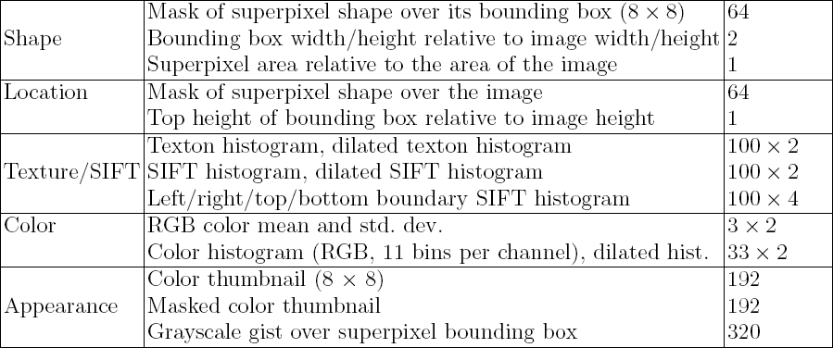
Step 2: Region-level matching
Superpixel features
Superpixels
(Felzenszwalb & Huttenlocher, 2004)

Slide 42



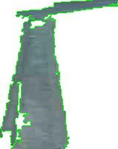





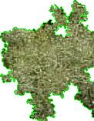

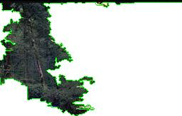
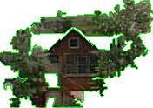

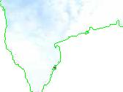
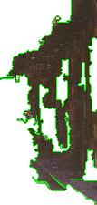




Step 2: Region-level matching
Road
Tree
Pixel Area (size)
Sky
Building
Snow

Slide 43
















Step 2: Region-level matching
Road
Absolute mask
(location)
Sidewalk

Slide 44
















Step 2: Region-level matching
Road
Texture
Sidewalk
Snow
Sky

Slide 45






Step 2: Region-level matching
Road
Sidewalk
Color histogram
Building

Slide 46
Region-level likelihoods
Nonparametric estimate of class-conditional densities for each class c and feature type k:
Per-feature likelihoods combined via Naïve Bayes:
Features of class c within some radius of r_{i}
Total features of class c in the dataset
kth feature type
of ith region

Slide 47







Region-level likelihoods
Building
Car
Crosswalk
Road
Window
Sky

Slide 48

Step 3: Global image labeling
Compute a global image labeling by optimizing a Markov random field (MRF) energy function:
Vector of region labels
Regions
Likelihood score for
region r_{i} and label c_{i}
Neighboring regions
Smoothing penalty
Co-occurrence penalty
Efficient approximate minimization using α-expansion (Boykov et al., 2002)
r_{i}
r_{j}

Slide 49
Step 3: Global image labeling
Compute a global image labeling by optimizing a Markov random field (MRF) energy function:
Vector of region labels
Regions
Likelihood score for
region r_{i} and label c_{i}
Neighboring regions
Smoothing penalty
Co-occurrence penalty

Slide 50



Step 3: Global image labeling
Compute a global image labeling by optimizing a Markov random field (MRF) energy function:
Vector of region labels
Regions
Likelihood score for
region r_{i} and label c_{i}
Neighboring regions
Smoothing penalty
Co-occurrence penalty
Maximum likelihood labeling
Edge penalties
Final labeling
Final edge penalties
sky
sky
building
building
window
car
car
road
road

Slide 51




Step 3: Global image labeling
Compute a global image labeling by optimizing a Markov random field (MRF) energy function:
Vector of region labels
Regions
Likelihood score for
region r_{i} and label c_{i}
Neighboring regions
Smoothing penalty
Co-occurrence penalty
Maximum likelihood labeling
Original image
Edge penalties
MRF labeling
sky
sky
road
tree
sea
sea
road
sand
sand

Slide 52
Datasets
 | Training images | Test images | Labels
SIFT Flow (Liu et al., 2009) | 2,488 | 200 | 33
Barcelona | 14,871 | 279 | 170
LabelMe+SUN | 50,424 | 300 | 232
Notes:
I constructed the LM+SUN dataset by taking the data from the Sun dataset and all the available data from LabelMe. I then did manual synonym correction on both datasets to make 232 unique labels that both datasets share. I then added any image that had at least 10% of the pixels labeled. Finally I removed approximately 15k images of video surveillance sequences from the LabelMe image set that were very repetitive and not very interesting (mostly just people walking on the street).
The LM+SUN dataset is approximately 1/3 indoor 2/3 outdoor. The test set is 84 indoor images and 216 outdoor images. The test set is taken at random from all the images that have at least 90% of their pixels labeled.

Slide 53

Overall performance

Slide 54
Overall performance
 | SIFT Flow |  | Barcelona |  | LabelMe + SUN
 | Semantic | Geom. | Semantic | Geom. | Semantic | Geom.
Base | 73.2 (29.1) | 89.8 | 62.5 (8.0) | 89.9 | 46.8 (10.7) | 81.5
MRF | 76.3 (28.8) | 89.9 | 66.6 (7.6) | 90.2 | 50.0 (9.1) | 81.0
MRF + Joint | 76.9 (29.4) | 90.8 | 66.9 (7.6) | 90.7 | 50.2 (10.5) | 82.2
*SIFT Flow: 74.75
 | LabelMe + SUN Indoor |  | LabelMe + SUN Outdoor
 | Semantic | Geom. | Semantic | Geom.
Base | 22.4 (9.5) | 76.1 | 53.8 (11.0) | 83.1
MRF | 27.5 (6.5) | 76.4 | 56.4 (8.6) | 82.3
MRF + Joint | 27.8 (9.0) | 78.2 | 56.6 (10.8) | 84.1
Notes:
The average class rate is higher on LM+Sun because there is a larger diversity of test images. There are 169 of the 232 unique labels present in the test images whereas there are only 83 of the 170 in Barcelona. This happened because while there are indoor and nature scenes in the Barcelona training set there aren't any in the test set. So in some ways Barcelona is harder because it has a greater number of rare classes in the testset because the test set is only street scenes. LM+Sun has a range of indoor and even some object images as well as street, highway, and nature outdoor scenes. That gives is a greater number of 'easy' classes.

Slide 55
Per-class classification rates

Slide 56

Effect of spatial support

Slide 57


Results on SIFT Flow dataset

Slide 58

Results on LM+SUN dataset

Slide 59

Running times
Barcelona dataset
SIFT Flow

Slide 60
Summary so far
A lazy learning method for image parsing:
  Global scene matching
  Superpixel-level matching
  MRF optimization
Challenges
  Indoor images are hard!
  We do well on “stuff” but not on “things”

Slide 61


We get the “stuff” but not the “things”
sky
building
ceiling
boat
statue
sea
sand

Slide 62



Finding Things: Image Parsing with Regions and Per-Exemplar Detectors
Joseph Tighe and Svetlana Lazebnik
CVPR 2013
Superparsing Result
Detector Based Parsing Result
Sign
Bus
Wheel
Notes:
. Joseph Tighe and Svetlana Lazebnik, CVPR 2013 (Oral)

Slide 63

To get the “things” use detectors
Ladicky et al. used detector output coupled with bounding box based foreground/background segmentation to improve performance on things
Result without detections
Set of detections
Final Result
Ľubor Ladický, Paul Sturgess, Karteek Alahari, Chris Russell, Philip H.S. Torr
What, Where & How Many? Combining Object Detectors and CRFs, ECCV 2010

Slide 64






Problems with this approach
The mask for bounding boxes is obtained by an automatic segmentation, which can fail
The models must be pre-trained and cannot adapt to new data easily
There is little flexibility for objects that take many forms

Slide 65

Per-exemplar detectors
For each instance of a class: train SVM based on HOG features
Negative examples are taken from all images that do not contain the class
Tomasz Malisiewicz, Abhinav Gupta, Alexei A. Efros. Ensemble of Exemplar-SVMs for Object Detection and Beyond. In ICCV, 2011

Slide 66

Tomasz Malisiewicz, Abhinav Gupta, Alexei A. Efros. Ensemble of Exemplar-SVMs for Object Detection and Beyond . In ICCV, 2011

Slide 67
Per-exemplar detectors for parsing
Retrieve a set of similar images using global image descriptors
Train per-exemplar detectors for “things” in retrieval set
Run trained detectors on query and transfer weighted masked for all positive detections

Slide 68

Retrieval set for

Slide 69
Retrieval set for

Slide 70
Per-exemplar detectors for parsing
Retrieve a set of similar images using global image descriptors
Train per-exemplar detectors for each object in retrieval set
Run trained detectors on query and transfer weighted masked for all positive detections

Slide 71
Per-exemplar detectors for parsing

Slide 72


Per-exemplar detectors for parsing

Slide 73


Slide 74


Slide 75
Per-exemplar detectors for parsing
Retrieve a set of similar images using global image descriptors
Train per-exemplar detectors for “things” in retrieval set
Run trained detectors on query and transfer weighted masks for all positive detections

Slide 76

Per-exemplar detectors for parsing

Slide 77

Superparsing Result
Detector-based Parsing Result
Sign
Some bus
Building
Bus
Car
Wheel
55% (23%)
45% (26%)

Slide 78
How do we combine these?
Learn which labels to trust. If there are c classes, there are 2c predictions at each pixel (one from super-parsing, one from the object detectors).
Learn an SVM to predict the best category from those 2c confidences.
Then smooth with an MRF

Slide 79
Superparsing Result
Detector Based Parsing Result
55% (23%)
45% (26%)
Sign
Bus
Wheel
61% (31%)

Slide 80


Superparsing Result
Detector Based Parsing Result
Building
Church
Boat
Ceiling
Statue
Boat
52% (31%)
19% (25%)

Slide 81

Superparsing Result
Detector Based Parsing Result
52% (31%)
19% (25%)
Sky
Boat
Sea
62% (46%)

Slide 82




Superparsing Result
Detector Based Parsing Result
Ceiling
Window
Building
Wall
Washing Machine
Cupboard
12% (7%)
20% (9%)
Dishwasher

Slide 83

Superparsing Result
Detector Based Parsing Result
Ceiling
Window
Building
Wall
Washing Machine
Cupboard
12% (7%)
20% (9%)
Dish Washer
24% (10%)

Slide 84
Timing
10-15 seconds to train each exemplar
2-4k exemplars per query
5-17 hours per query training time
That’s too slow!
.1 seconds to run trained detector
200-400 seconds per query

Slide 85
Next Steps
Determine which detectors to run
  Manually select the “thing” classes
  Use context from parsing
Find better methods for integrating image parsing and detectors

Slide 86
SuperParsing Conclusion
Image parsing with superpixels
  Scene-level matching
  Superpixel-level matching
  MRF optimization
Getting “things” with detectors
  Use per-exemplar detectors of Malisiewicz et al.

Slide 87
Summary
There are several ways to generate semantic segmentations.
  Segment then classify
  Detect then segment
  Various things in between
Not clear what is correct.
Expect to see more research in this area as PASCAL VOC fades and MS COCO gets more attention.

