Slide 1
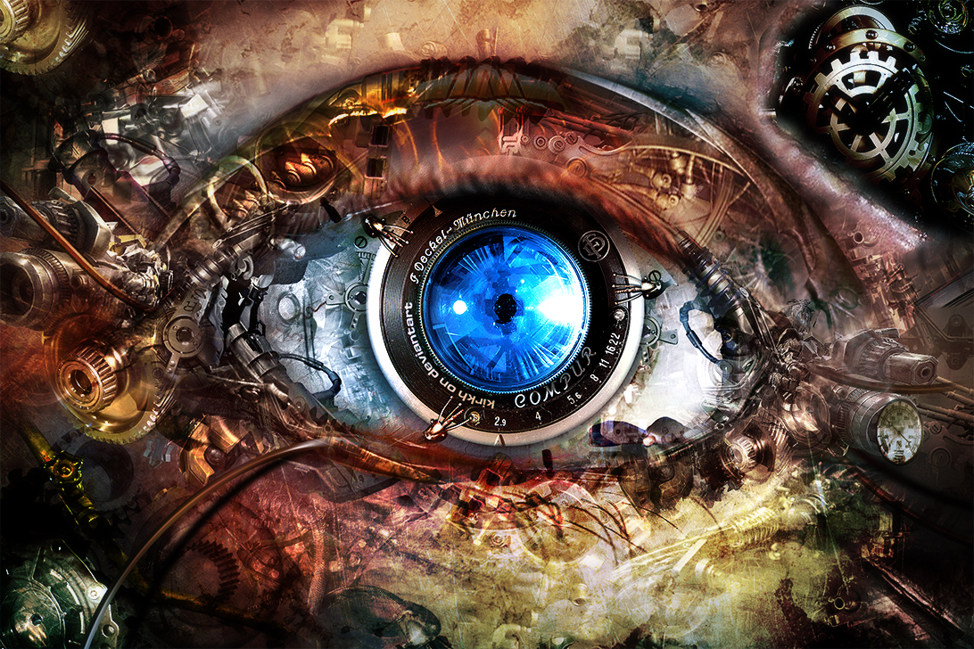
CS 6476:
Computer Vision
Instructor: James Hays
Tas: Cusuh Ham (head TA), Sean Foley, Jianan Gao, John Lambert, (more to come)
Image by kirkh.deviantart.com

Slide 2
Today’s Class
Course enrollment
Who am I?
What is Computer Vision?
Specifics of this course
Geometry of Image Formation
Questions

Slide 3
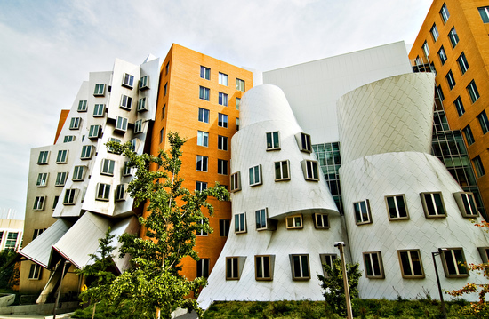
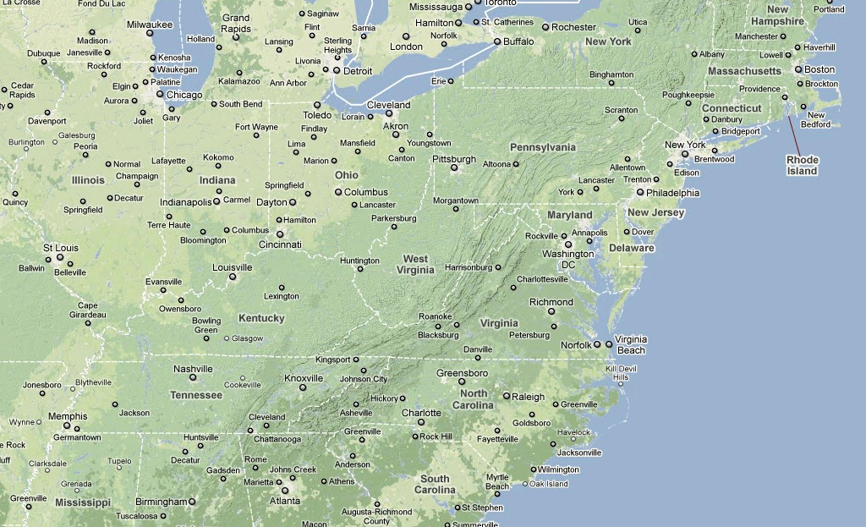
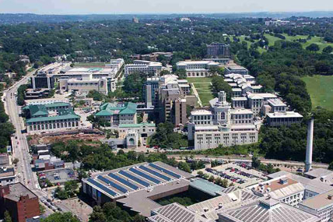
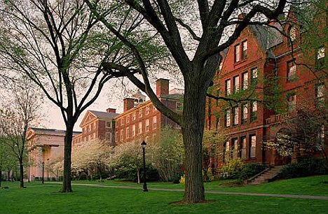
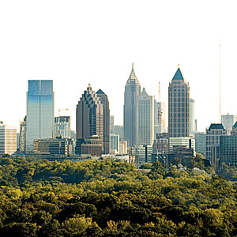
A bit about me

Slide 4

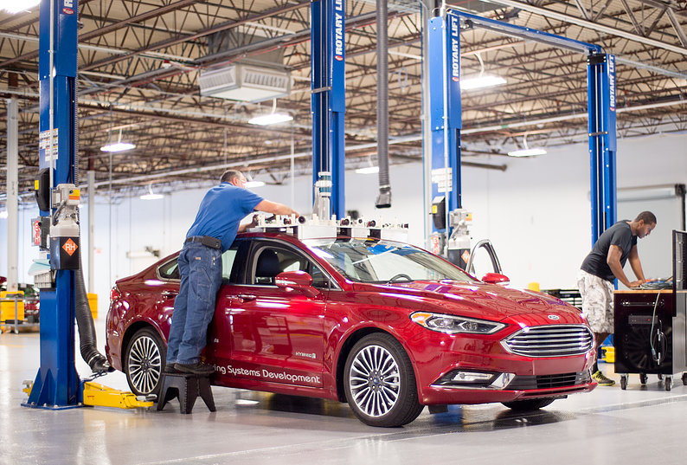

Slide 5
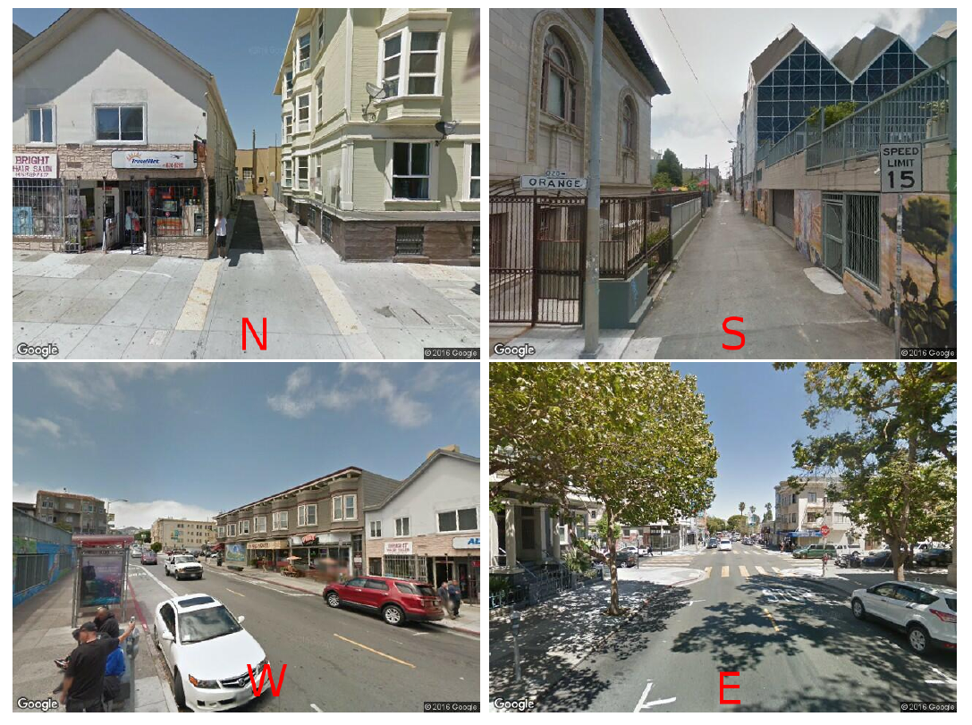
DeepNav
DeepNav: Learning to Navigate Large Cities
Samarth Brahmbhatt and James Hays. CVPR 2017
Notes:
These street-view images are taken from roughly
the same location. Which direction do you think the nearest
gas station is in?
Correct answer: west

Slide 6
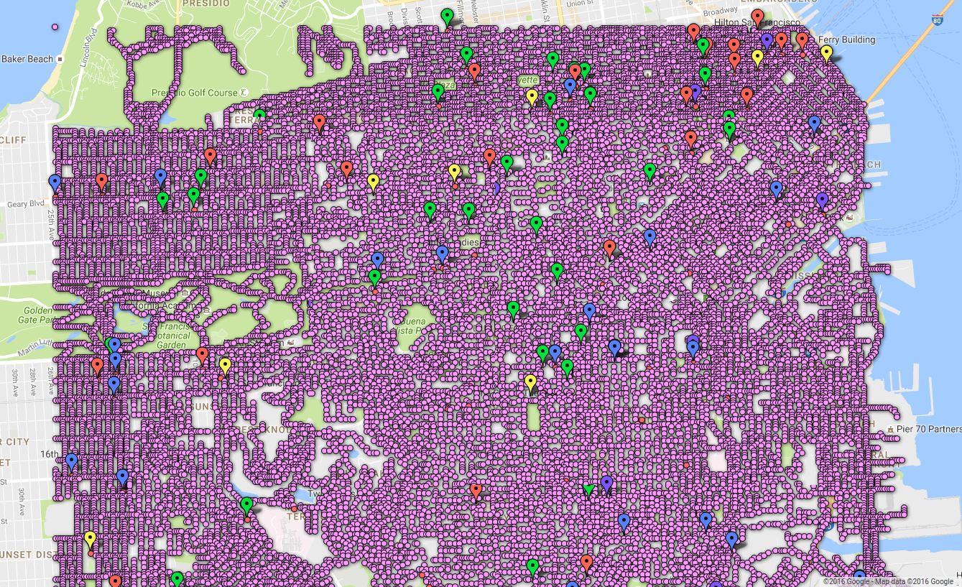
Notes:
San Francisco graph locations and destinations
(red: Bank of America, green: church, blue: gas station,
yellow: high school, purple: McDonald’s)

Slide 7
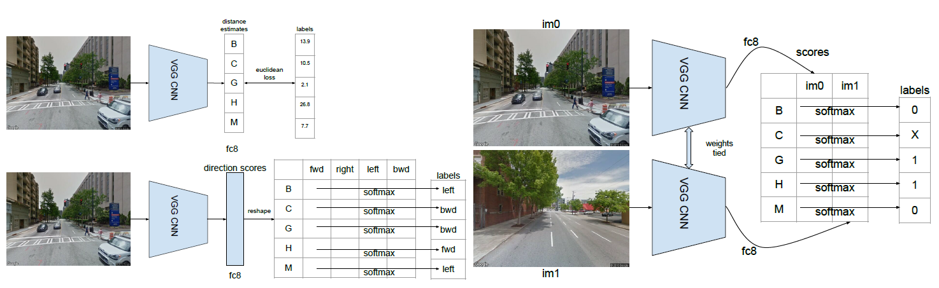
Network Architectures
Notes:
(a) DeepNav-distance (top), DeepNav-direction (bottom)
(b) DeepNav-pair
Figure 4: DeepNav CNN architectures. Abbreviations for destinations: B = Bank of America, C = Church, G = Gas station,
H = High school, M = McDonald’s.

Slide 8
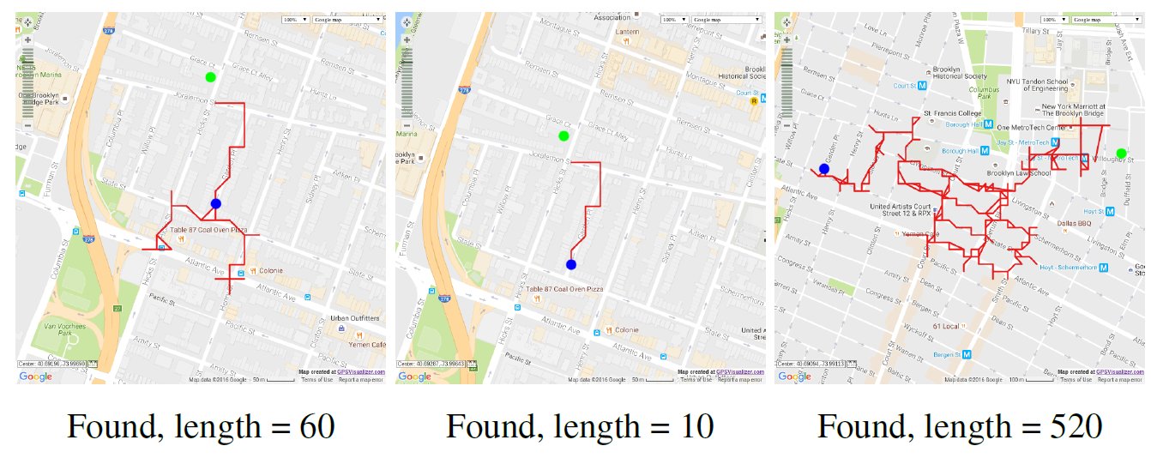
Qualitative Results
Notes:
Finding a church in NYC

Slide 9
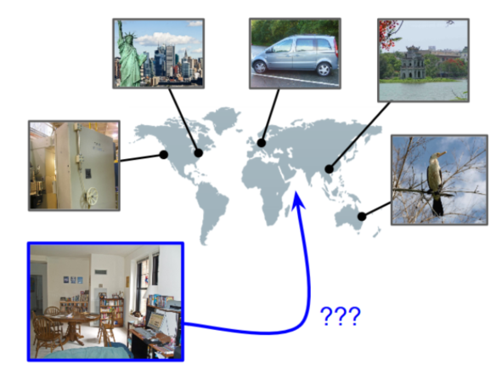
Revisiting IM2GPS in the Deep Learning Era
Nam Vo, Nathan Jacobs, James Hays. ICCV 2017
The problem set up:
Give a large set of GPS-tagged images.
Learn to infer GPS coordinate of query images with unknown location.
Approaches:
Image retrieval
Image classification

Slide 10
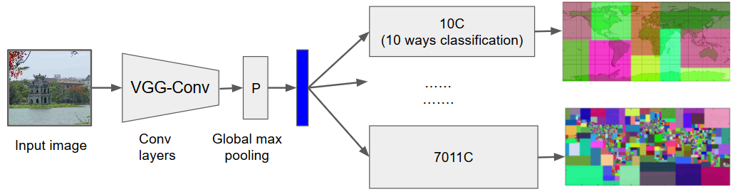
Geolocalization at planet scale
Caffe library, Vgg-16 imagenet initialization, training data: Im2GPS (~6m images)
Model [M]: 6 outputs
Model [L]: 7011C only
Model [L2]: 359C only
Model [R]: finetuned from [M] with ranking loss
Notes:
Some implementation detail
We implement this in caffe

Slide 11
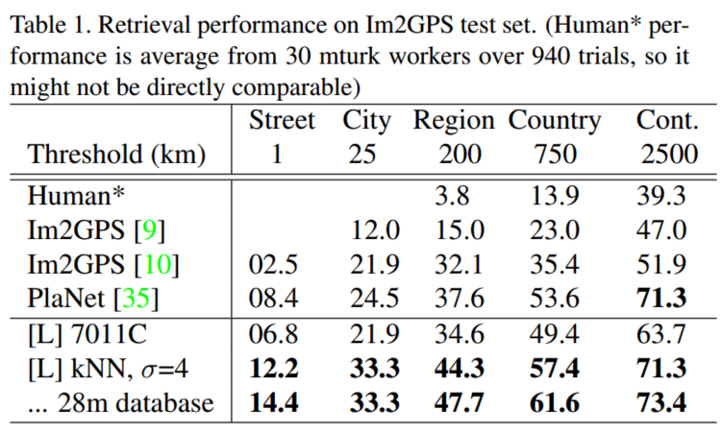
Geolocalization at planet scale, Quantitative result
Notes:
20minutes

Slide 12
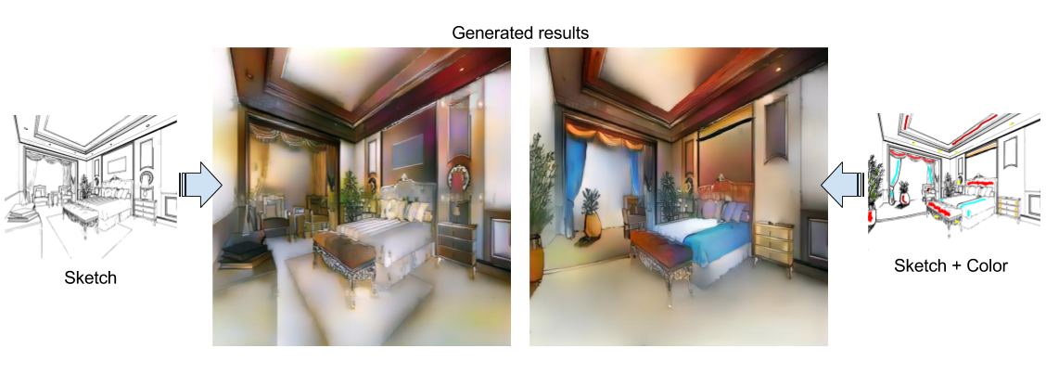
Scribbler: Controlling Deep Image Synthesis with Sketch and Color
Patsorn Sangkloy, Jingwan Lu, Chen Fang , Fisher Yu, and James Hays. CVPR 2017

Slide 13
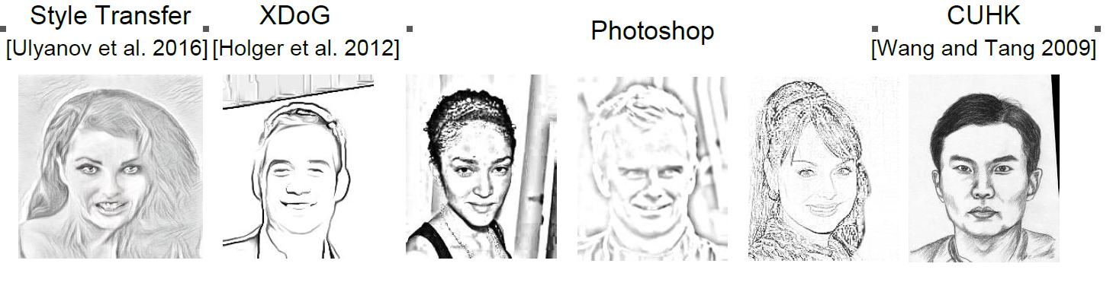
Training Data – (Mostly) Synthetic Sketches
Notes:
Unfortunately, most of the training data is “synthetic”. We don’t have real, hand-drawn sketches paired with photos, except for the small CUHK data set

Slide 14
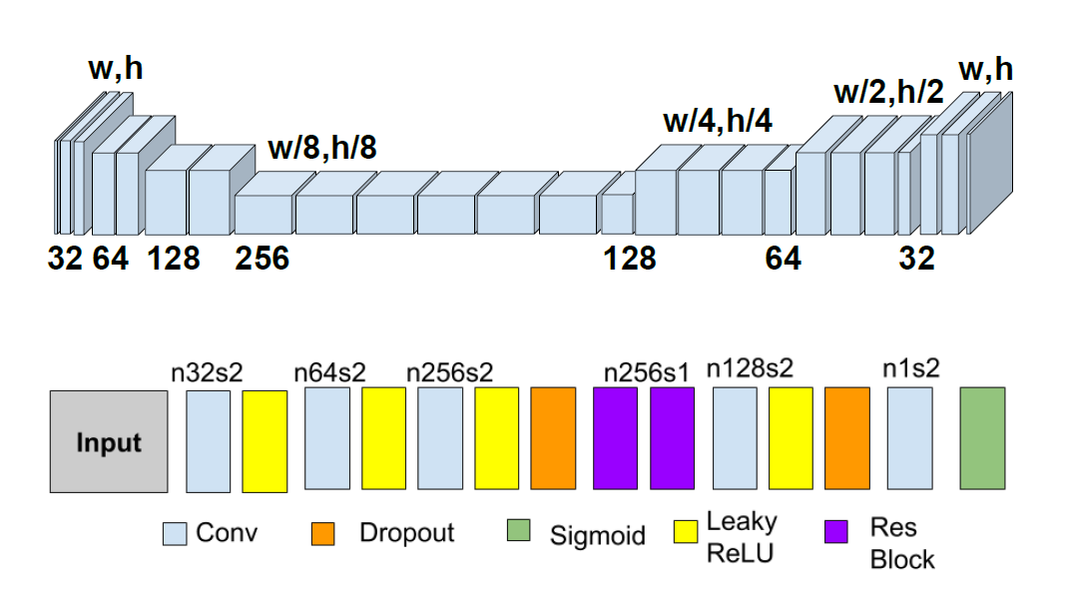
Network Architecture – Adversarial Learning

Slide 15
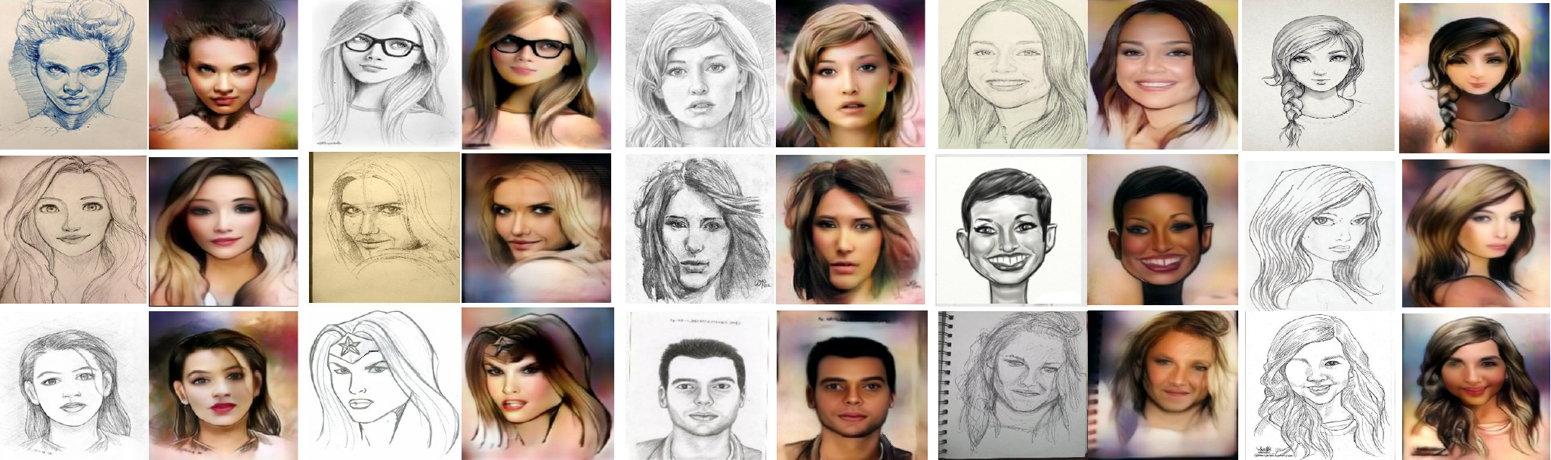
Results on held out sketches

Slide 16
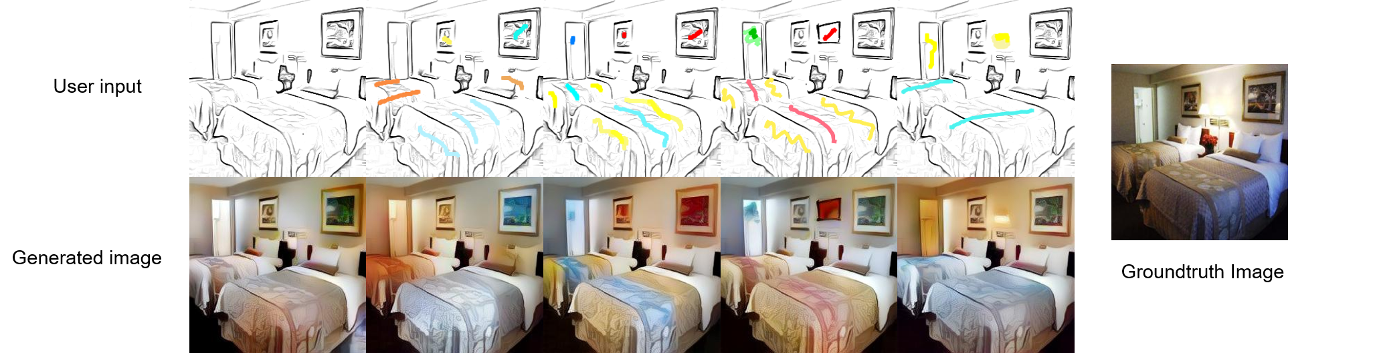
Results on held out sketchesc

Slide 17
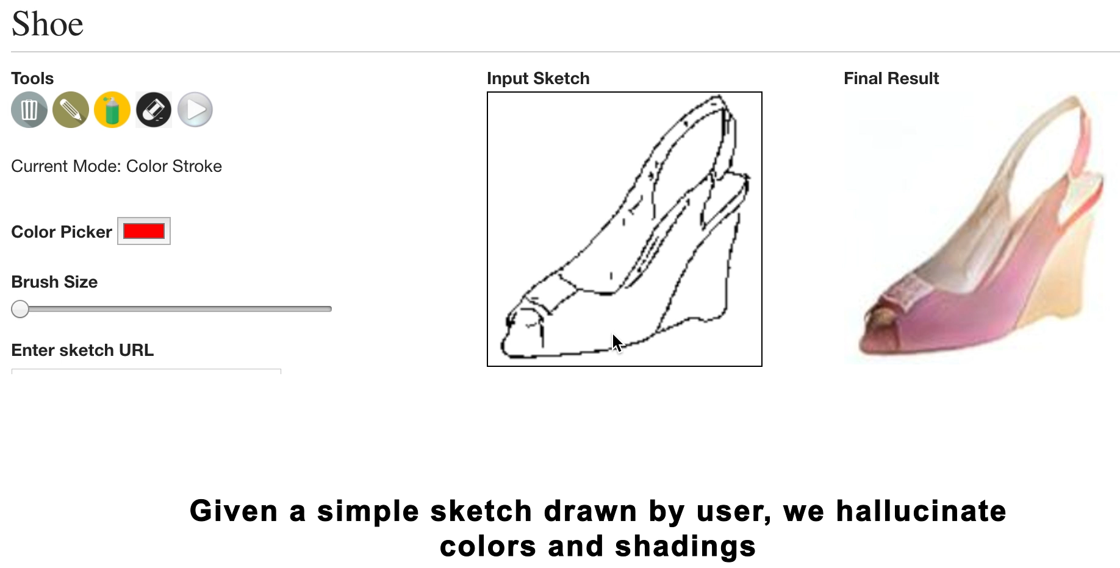

Slide 18
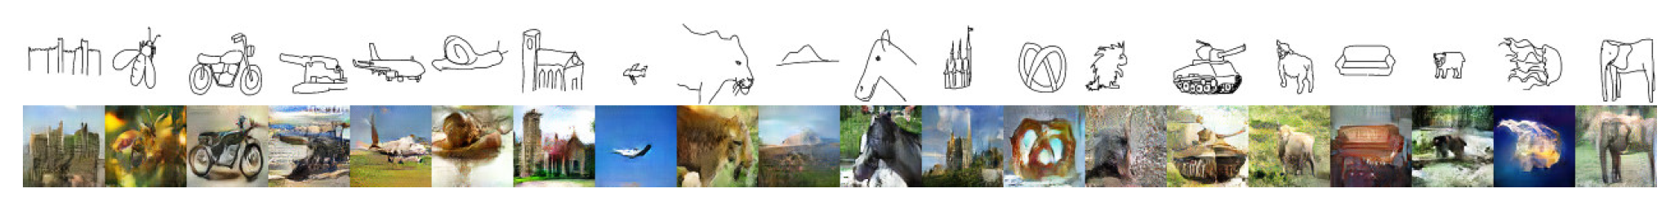
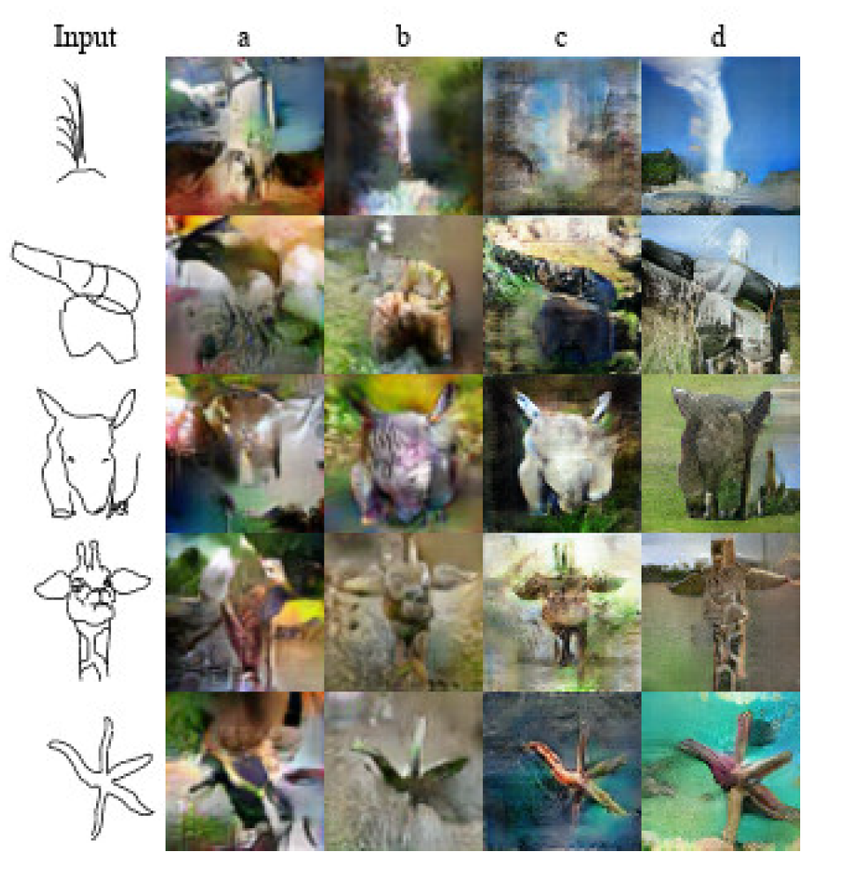
SketchyGAN.
Wengling Chen and
James Hays.
CVPR 2018.

Slide 19
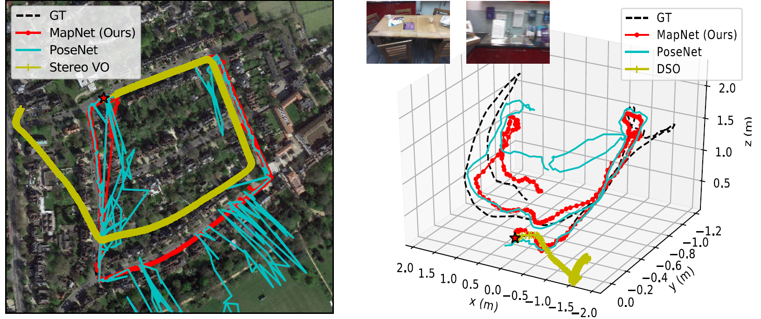
MapNet.
Samarth Brahmbhatt, Jinwei Gu, Kihwan Kim,
James Hays, and Jan Kautz.
CVPR 2018.

Slide 20
What is Computer Vision?

Slide 21
Computer Vision and Nearby Fields
Computer Graphics: Models to Images
Comp. Photography: Images to Images
Computer Vision: Images to Models
Derogatory summary of computer vision:
Machine learning applied to visual data

Slide 22
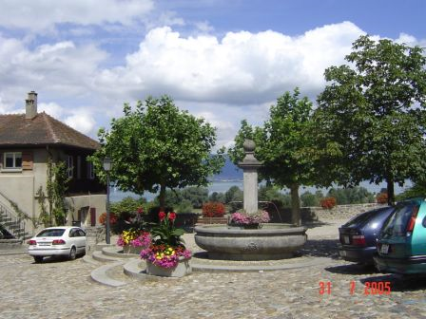
Computer Vision
Make computers understand images and video or any visual data.
What kind of scene?
Where are the cars?
How far is the building?
…

Slide 23
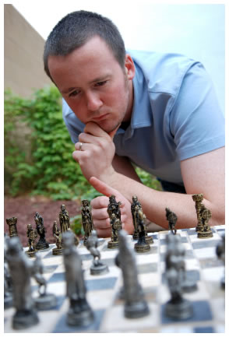
Vision is really hard
Vision is an amazing feat of natural intelligence
  Visual cortex occupies about 50% of Macaque brain
  One third of human brain devoted to vision (more than anything else)
Is that a queen or a bishop?

Slide 24
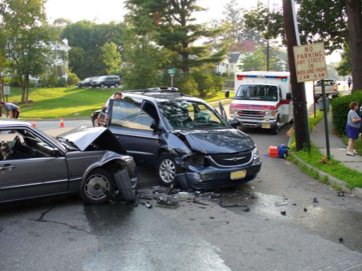
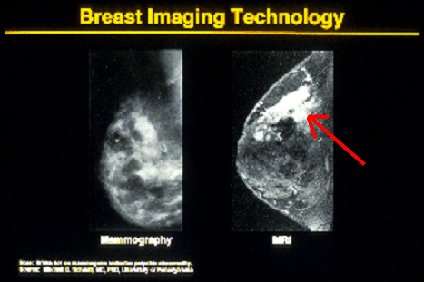
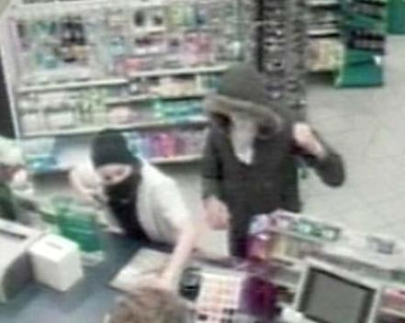
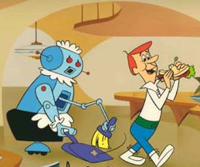
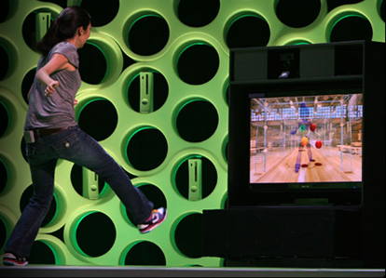
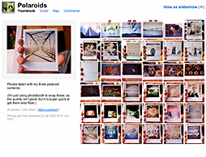
Why computer vision matters
Safety
Health
Security
Comfort
Fun
Access

Slide 25
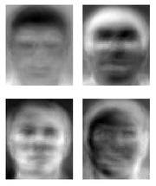
Ridiculously brief history of computer vision
1966: Minsky assigns computer vision as an undergrad summer project
1960’s: interpretation of synthetic worlds
1970’s: some progress on interpreting selected images
1980’s: ANNs come and go; shift toward geometry and increased mathematical rigor
1990’s: face recognition; statistical analysis in vogue
2000’s: broader recognition; large annotated datasets available; video processing starts
2010’s: Deep learning with ConvNets
2020’s: Widespread autonomous vehicles?
2030’s: robot uprising?
Guzman ‘68
Ohta Kanade ‘78
Turk and Pentland ‘91

Slide 26
How vision is used now
Examples of real world applications
Some of the following slides by Steve Seitz

Slide 27
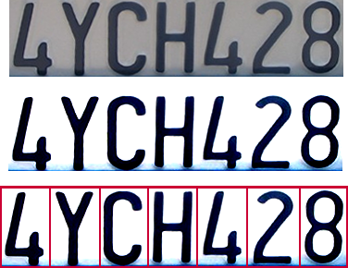
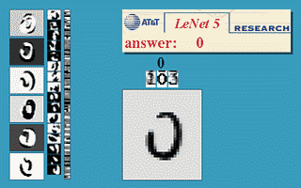
Optical character recognition (OCR)
Technology to convert scanned docs to text
  If you have a scanner, it probably came with OCR software
Digit recognition, AT&T labs
http://www.research.att.com/~yann/
License plate readers
http://en.wikipedia.org/wiki/Automatic_number_plate_recognition

Slide 28
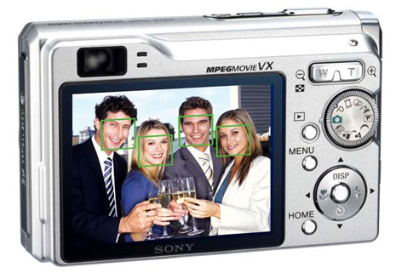
Face detection
Digital cameras detect faces
Notes:
Why would this be useful? Main reason is focus. Also enables “smart” cropping.

Slide 29
Smile detection
Sony Cyber-shot® T70 Digital Still Camera

Slide 30
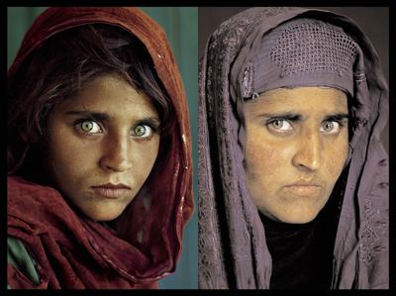
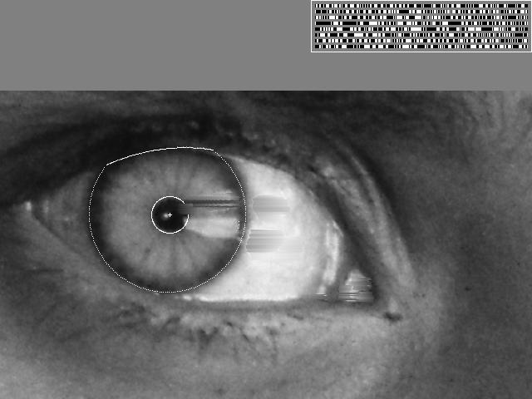
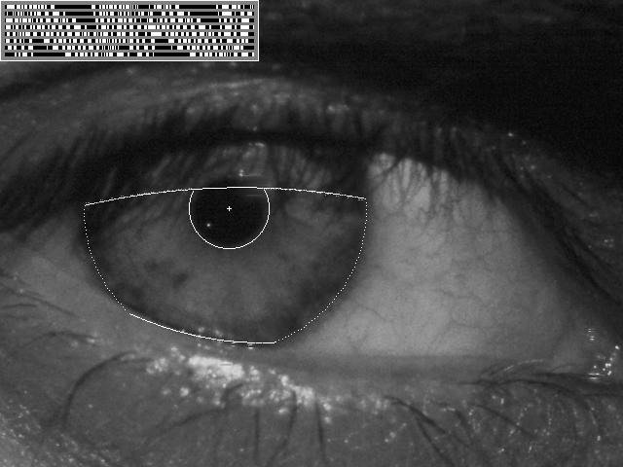
Vision-based biometrics
“How the Afghan Girl was Identified by Her Iris Patterns” Read the story
wikipedia
Notes:
Age 12, Age 30

Slide 31
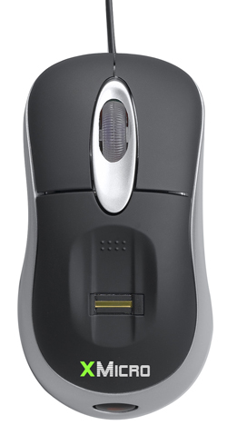

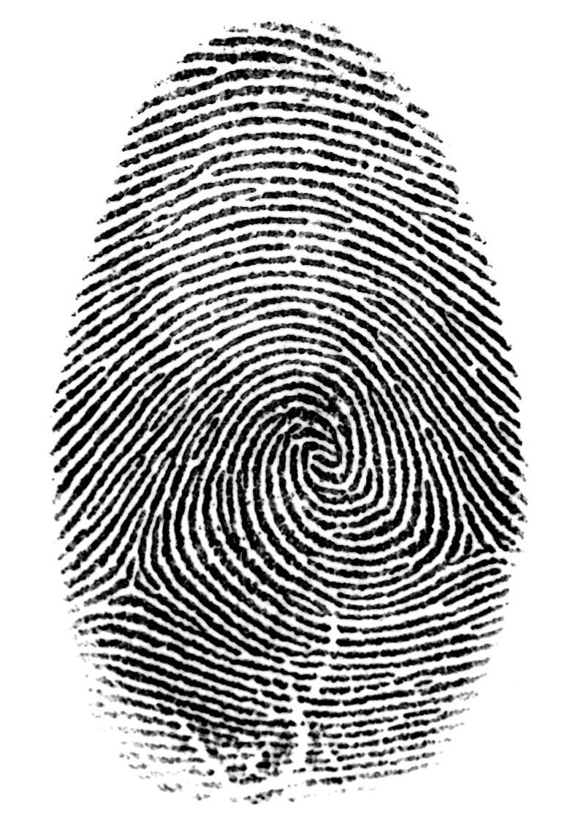

Login without a password…
Fingerprint scanners on many new laptops,
other devices
Face recognition systems now beginning to appear more widely
http://www.sensiblevision.com/

Slide 32
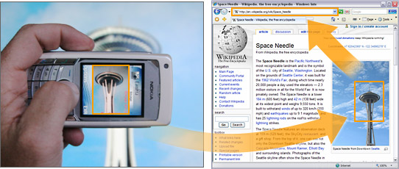
Object recognition (in mobile phones)
  Point & Find, Nokia
  Google Goggles

Slide 33
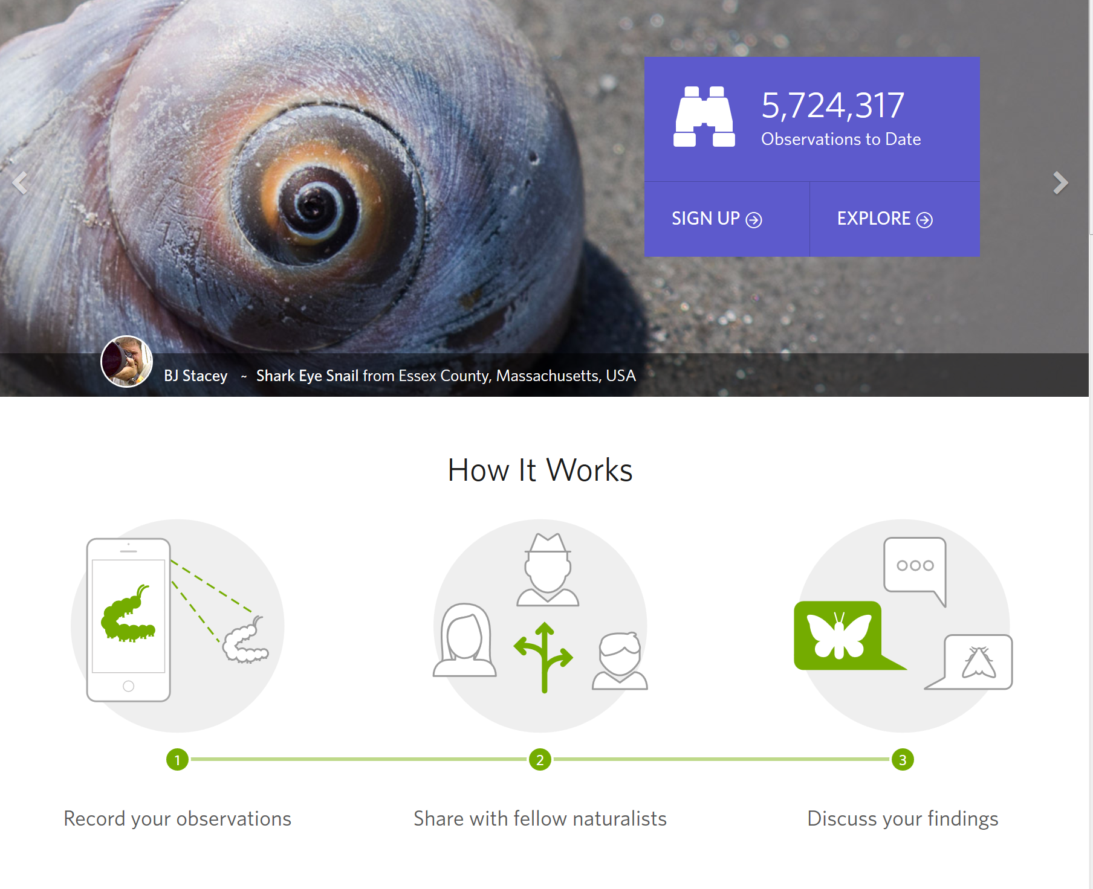
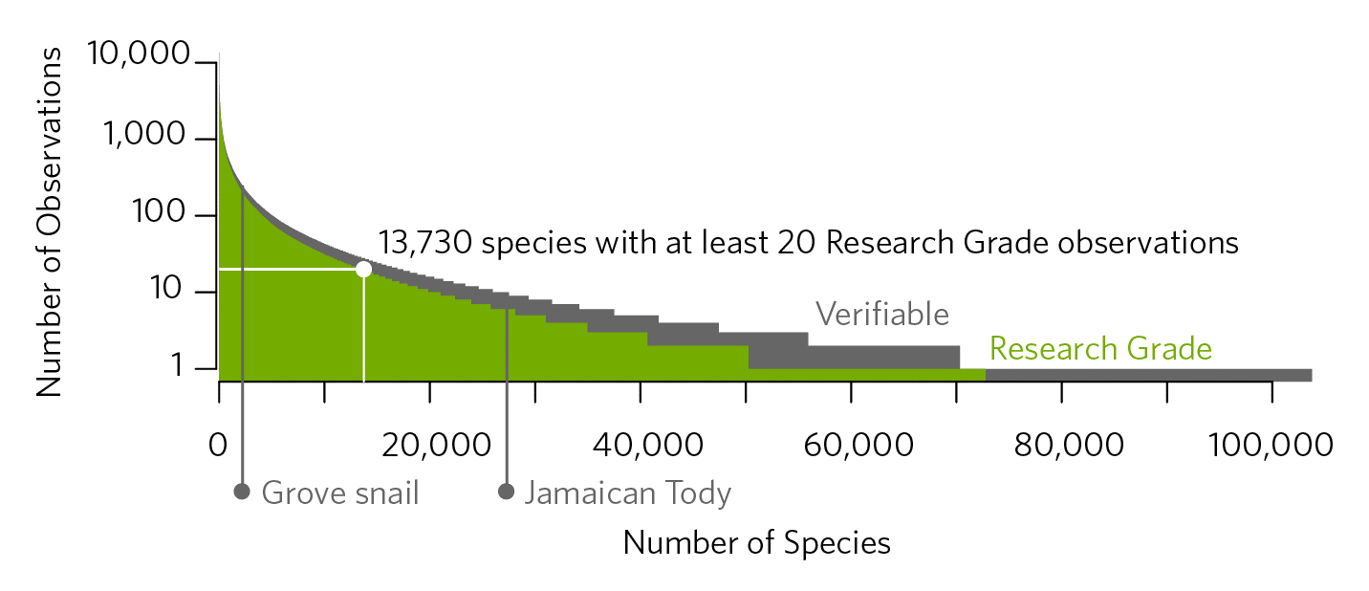
iNaturalist
https://www.inaturalist.org/pages/computer_vision_demo
Notes:
https://www.inaturalist.org/pages/computer_vision_demo

Slide 34
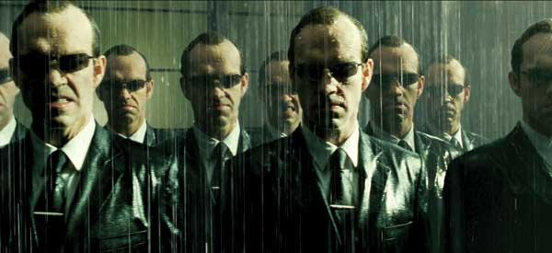
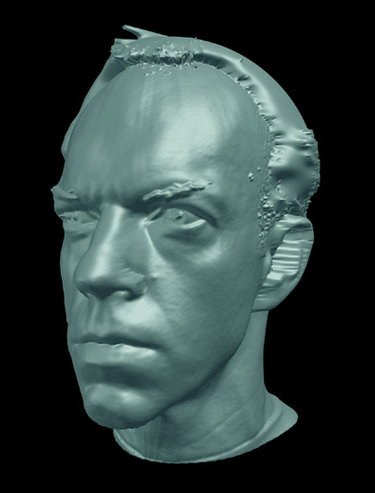
Special effects: shape capture
The Matrix movies, ESC Entertainment, XYZRGB, NRC

Slide 35

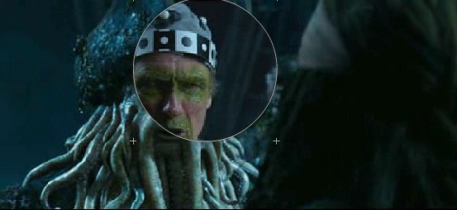
Special effects: motion capture
Pirates of the Carribean, Industrial Light and Magic

Slide 36
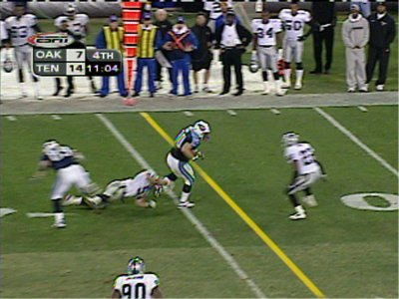
Sports
Sportvision first down line
Nice explanation on www.howstuffworks.com
http://www.sportvision.com/video.html

Slide 37
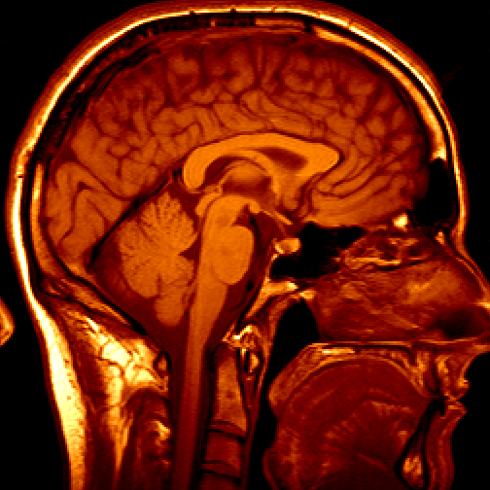
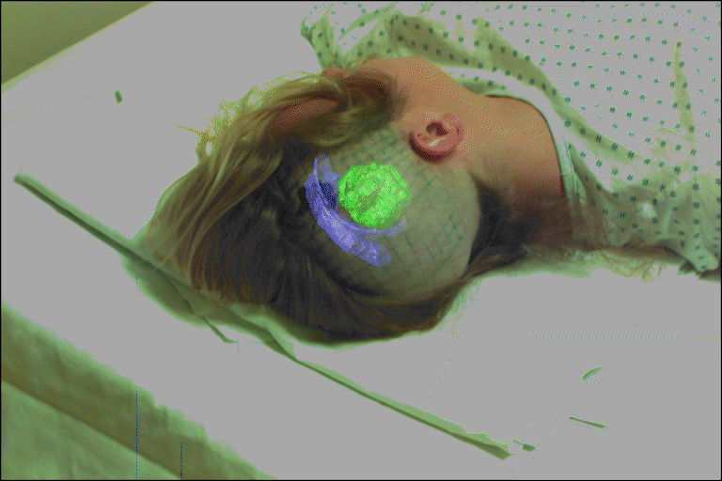
Medical imaging
3D imaging
MRI, CT
Image guided surgery
Grimson et al., MIT

Slide 38
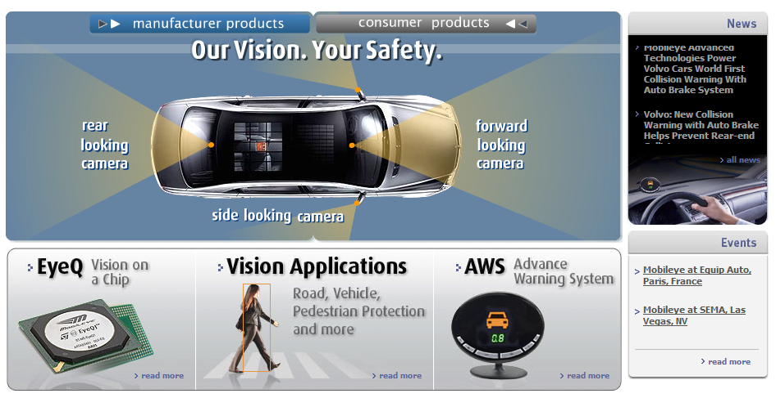
Smart cars
Slide content courtesy of Amnon Shashua
Mobileye
  Market Capitalization: 11 Billion dollars
  Bought by Intel for 15 Billion dollars

Slide 39

Google cars
Oct 9, 2010. "Google Cars Drive Themselves, in Traffic". The New York Times. John Markoff
June 24, 2011. "Nevada state law paves the way for driverless cars". Financial Post. Christine Dobby
Aug 9, 2011, "Human error blamed after Google's driverless car sparks five-vehicle crash". The Star (Toronto)

Slide 40


Interactive Games: Kinect
Object Recognition: http://www.youtube.com/watch?feature=iv&v=fQ59dXOo63o
Mario: http://www.youtube.com/watch?v=8CTJL5lUjHg
3D: http://www.youtube.com/watch?v=7QrnwoO1-8A
Robot: http://www.youtube.com/watch?v=w8BmgtMKFbY

Slide 41

Augmented Reality and Virtual Reality
Magic Leap, Oculus, Hololens, etc.

Slide 42


Industrial robots
Vision-guided robots position nut runners on wheels

Slide 43

Vision in space
NASA'S Mars Exploration Rover Spirit captured this westward view from atop
a low plateau where Spirit spent the closing months of 2007.
Vision systems (JPL) used for several tasks
  Panorama stitching
  3D terrain modeling
  Obstacle detection, position tracking
  For more, read “Computer Vision on Mars” by Matthies et al.

Slide 44



Mobile robots
NASA’s Mars Spirit Rover
http://en.wikipedia.org/wiki/Spirit_rover
http://www.robocup.org/
Saxena et al. 2008
STAIR at Stanford

Slide 45
Amazon Prime Air
https://www.amazon.com/b?node=8037720011

Slide 46
Skydio
https://www.skydio.com/

Slide 47
State of the art today?
With enough training data, computer vision nearly matches human vision at most recognition tasks
Deep learning has been an enormous disruption to the field. More and more techniques are being “deepified”.

Slide 48


Slide 49


Slide 50


Slide 51


Slide 52


Slide 53


Slide 54
Course Syllabus (tentative)
http://www.cc.gatech.edu/~hays/compvision

Slide 55
Grading
80% programming projects (6 total)
20% quizzes (2 total)

Slide 56
Scope of CS 4476
Computer Vision
Robotics
Machine Learning
Human Computer Interaction
Image Processing
Geometric Reasoning
Recognition
Deep Learning
Graphics
Medical Imaging
Computational Photography
Neuroscience
Optics

Slide 57
Course Topics
Interpreting Intensities
  What determines the brightness and color of a pixel?
  How can we use image filters to extract meaningful information from the image?
Correspondence and Alignment
  How can we find corresponding points in objects or scenes?
  How can we estimate the transformation between them?
Grouping and Segmentation
  How can we group pixels into meaningful regions?
Categorization and Object Recognition
  How can we represent images and categorize them?
  How can we recognize categories of objects?
Advanced Topics
  Action recognition, 3D scenes and context, human-in-the-loop vision…

Slide 58

Textbook
http://szeliski.org/Book/

Slide 59
Prerequisites
Linear algebra, basic calculus, and probability
Experience with image processing will help but is not necessary
Experience with Python or Python-like languages will help

Slide 60
Projects
Image Filtering and Hybrid Images
Local Feature Matching
Camera Calibration and Fundamental Matrix Estimation with RANSAC
Scene Recognition with Bag of Words
Object Detection with a Sliding Window
Recognition with Deep Learning

Slide 61

Proj1: Image Filtering and Hybrid Images
Implement image filtering to separate high and low frequencies
Combine high frequencies and low frequencies from different images to create an image with scale-dependent interpretation

Slide 62

Proj2: Local Feature Matching
Implement interest point detector, SIFT-like local feature descriptor, and simple matching algorithm.

Slide 63

Proj4: Scene Recognition with Bag of Words
Quantize local features into a “vocabulary”, describe images as histograms of “visual words”, train classifiers to recognize scenes based on these histograms.

Slide 64

Proj5: Object Detection with a Sliding Window
Train a face detector based on positive examples and “mined” hard negatives, detect faces at multiple scales and suppress duplicate detections.

Slide 65
Course Syllabus (tentative)
http://www.cc.gatech.edu/~hays/compvision

