Slide 1
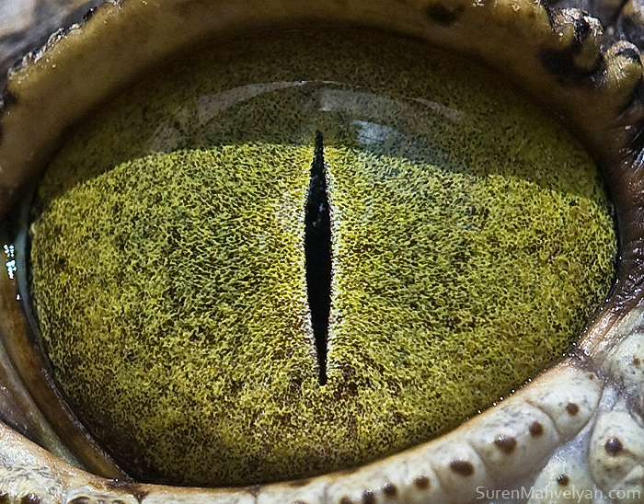
By Suren Manvelyan, http://www.surenmanvelyan.com/gallery/7116
Notes:
http://www.surenmanvelyan.com/gallery/7116
Crocodile (nile crocodile?)

Slide 2
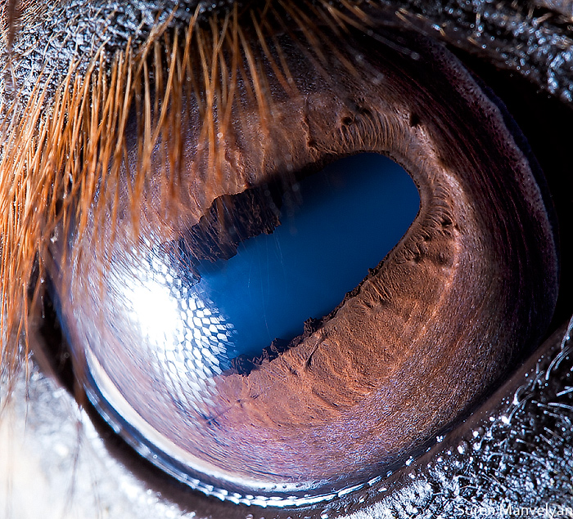
By Suren Manvelyan, http://www.surenmanvelyan.com/gallery/7116
Notes:
http://www.surenmanvelyan.com/gallery/7116
horse

Slide 3
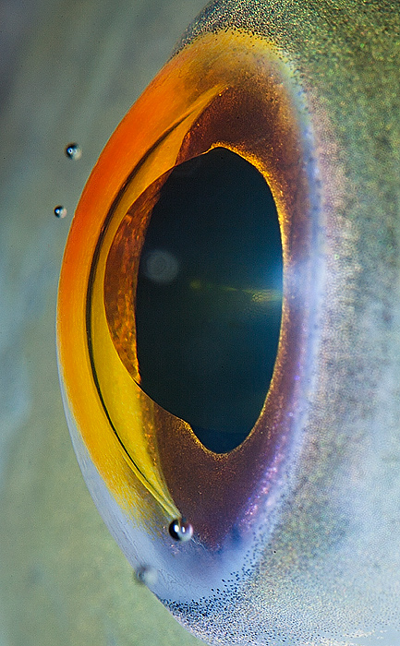
By Suren Manvelyan, http://www.surenmanvelyan.com/gallery/7116
Notes:
http://www.surenmanvelyan.com/gallery/7116
fish

Slide 4
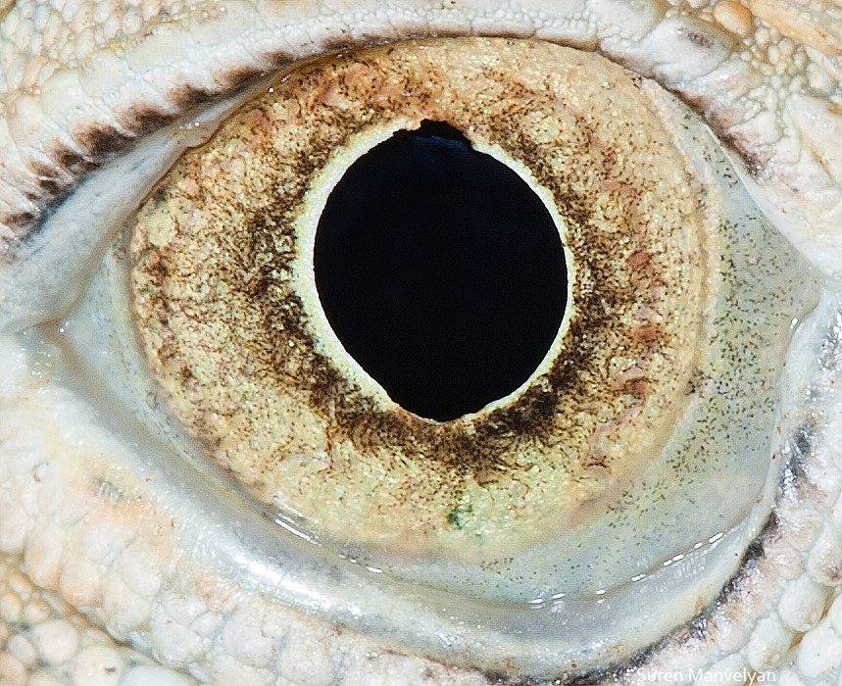
By Suren Manvelyan, http://www.surenmanvelyan.com/gallery/7116
Notes:
http://www.surenmanvelyan.com/gallery/7116
iguana

Slide 5
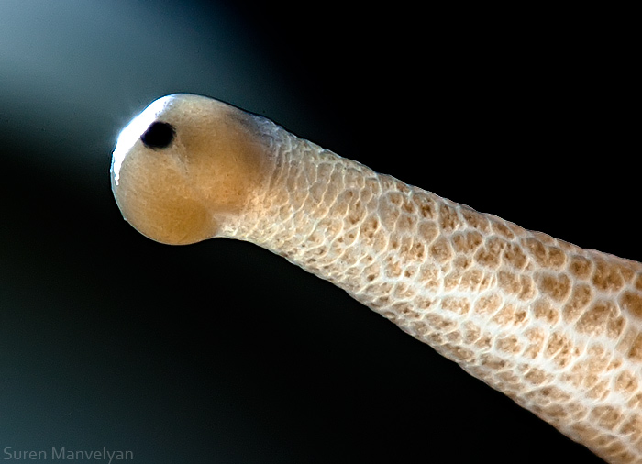
By Suren Manvelyan, http://www.surenmanvelyan.com/gallery/7116
Notes:
http://www.surenmanvelyan.com/gallery/7116
snail

Slide 6
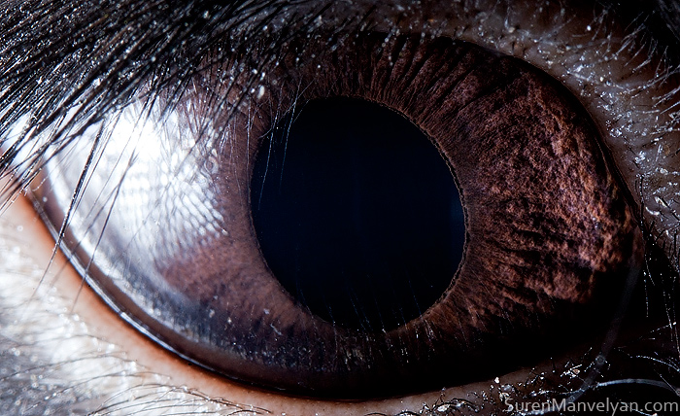
By Suren Manvelyan, http://www.surenmanvelyan.com/gallery/7116
Notes:
http://www.surenmanvelyan.com/gallery/7116
rabbit

Slide 7
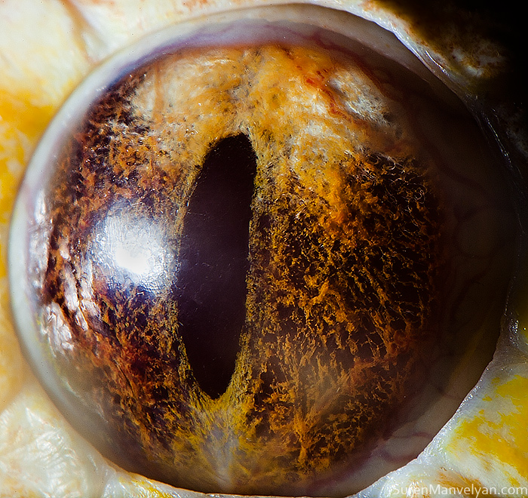
By Suren Manvelyan, http://www.surenmanvelyan.com/gallery/7116
Notes:
http://www.surenmanvelyan.com/gallery/7116
Tiger python

Slide 8
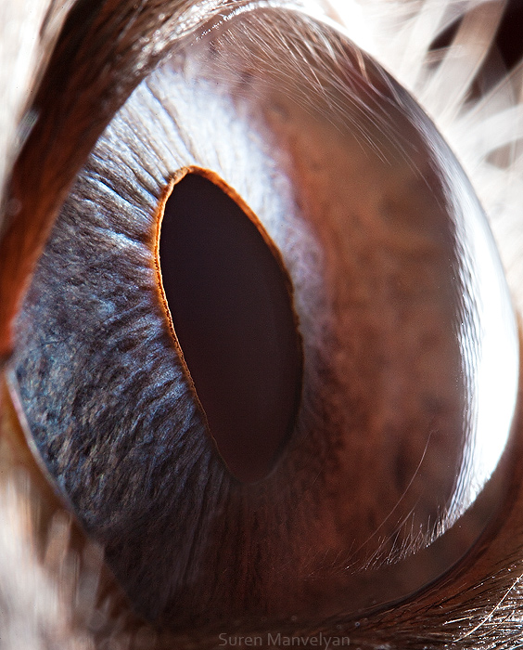
By Suren Manvelyan, http://www.surenmanvelyan.com/gallery/7116
Notes:
http://www.surenmanvelyan.com/gallery/7116
Siam cat

Slide 9
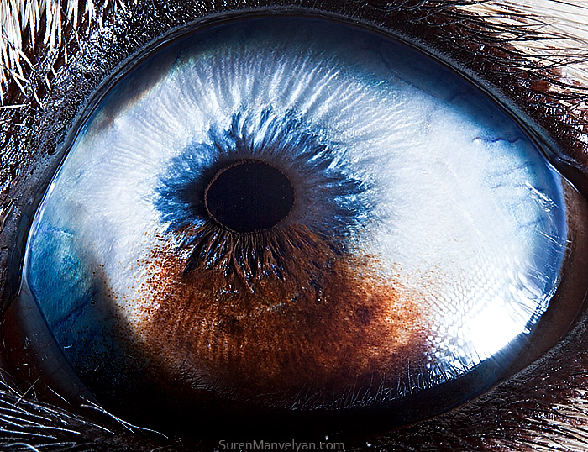
By Suren Manvelyan, http://www.surenmanvelyan.com/gallery/7116
Notes:
http://www.surenmanvelyan.com/gallery/7116
Husky with heterochromia

Slide 10
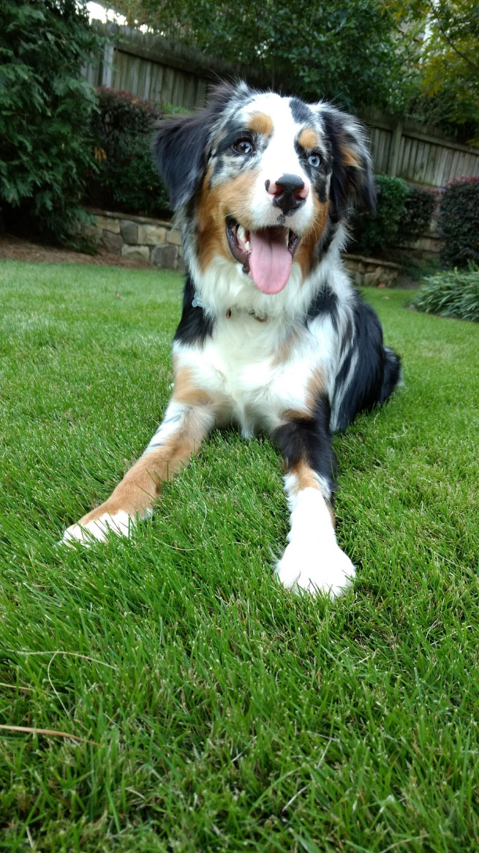
Indy
Notes:
http://www.surenmanvelyan.com/gallery/7116
Crocodile (nile crocodile?)

Slide 11

Indy
Notes:
http://www.surenmanvelyan.com/gallery/7116
Crocodile (nile crocodile?)

Slide 12
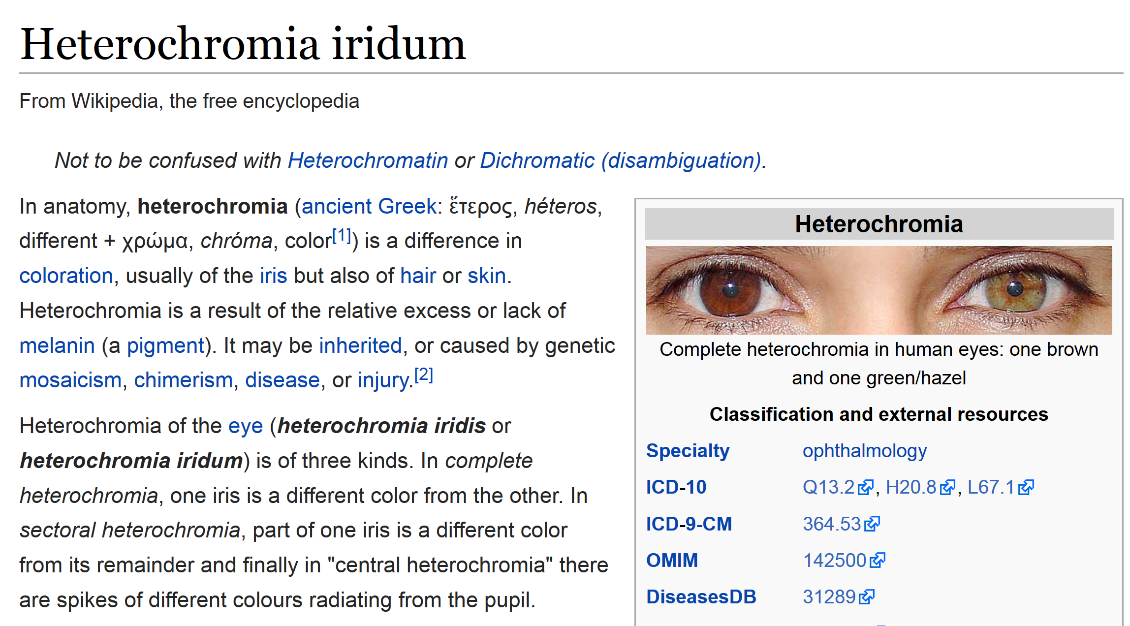

Slide 13


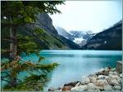


Image Categorization
Training
Training Labels
Training Images
Image Features
Classifier Training
Trained Classifier
Testing
Image Features
Trained Classifier
Prediction
Outdoor
Test Image

Slide 14
History of ideas in recognition
1960s – early 1990s: the geometric era
1990s: appearance-based models
Mid-1990s: sliding window approaches
Late 1990s: local features
Early 2000s: parts-and-shape models
Mid-2000s: bags of features
Svetlana Lazebnik

Slide 15
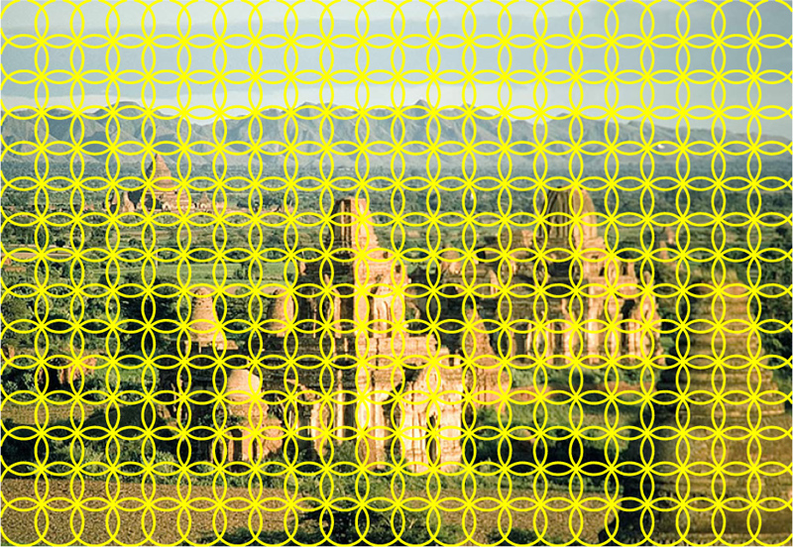
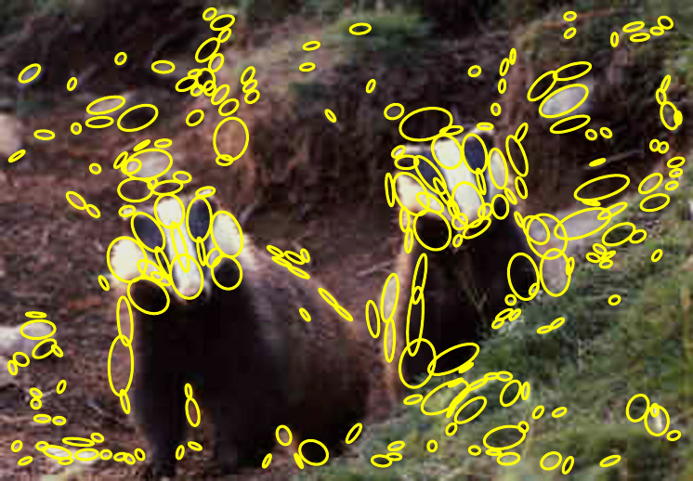
1. Feature extraction
Regular grid or interest regions

Slide 16
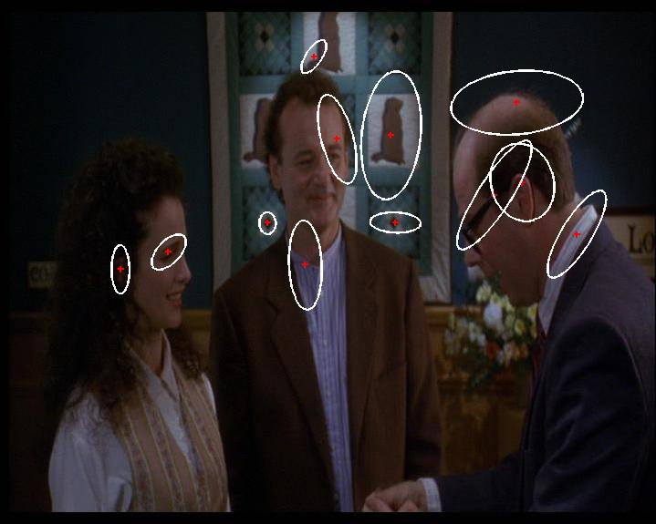
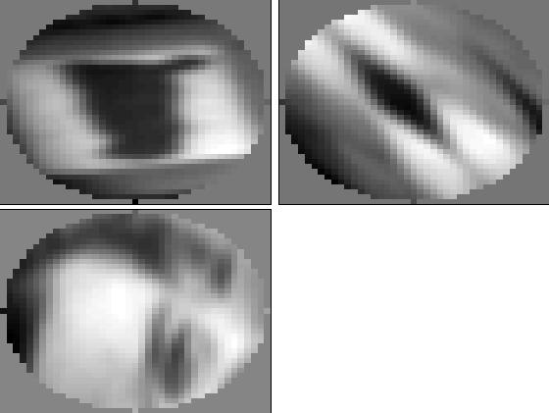
1. Feature extraction
Compute descriptor
Normalize patch
Detect patches
Slide credit: Josef Sivic

Slide 17
1. Feature extraction
…
Slide credit: Josef Sivic

Slide 18
2. Learning the visual vocabulary
…
Slide credit: Josef Sivic

Slide 19
2. Learning the visual vocabulary
…
Clustering
Slide credit: Josef Sivic

Slide 20
2. Learning the visual vocabulary
Visual vocabulary
…
Clustering
Slide credit: Josef Sivic

Slide 21
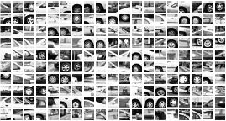
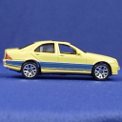
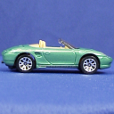
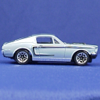
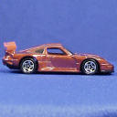
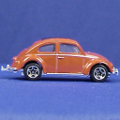
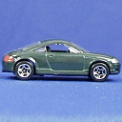
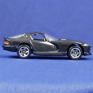
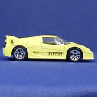
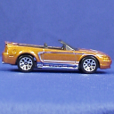
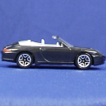






Example codebook
…
Appearance codebook
Source: B. Leibe

Slide 22
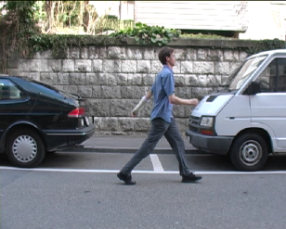
Another codebook
…
…
…
…
…
Appearance codebook
Source: B. Leibe

Slide 23
Visual vocabularies: Issues
How to choose vocabulary size?
  Too small: visual words not representative of all patches
  Too large: quantization artifacts, overfitting
Computational efficiency
  Vocabulary trees
  (Nister & Stewenius, 2006)

Slide 24
History of ideas in recognition
1960s – early 1990s: the geometric era
1990s: appearance-based models
Mid-1990s: sliding window approaches
Late 1990s: local features
Early 2000s: parts-and-shape models
Mid-2000s: bags of features
Present trends: combination of local and global methods, context, deep learning
Svetlana Lazebnik

Slide 25
Large-scale Instance Retrieval
Computer Vision
James Hays
Many slides from Derek Hoiem and Kristen Grauman

Slide 26
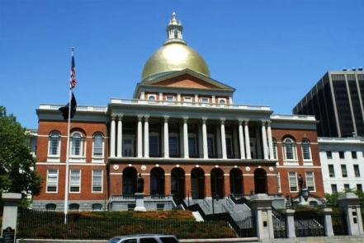
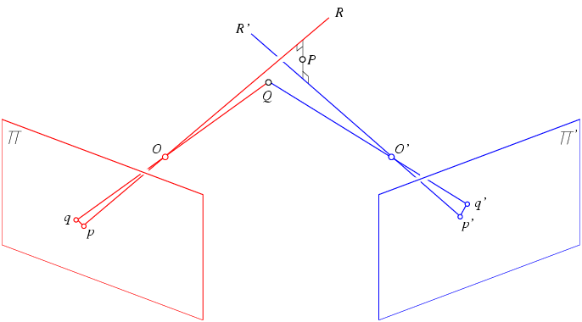
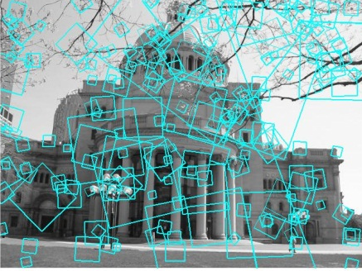
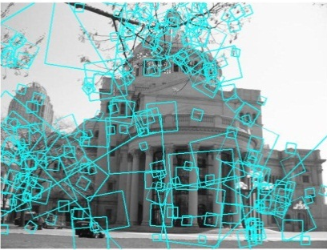

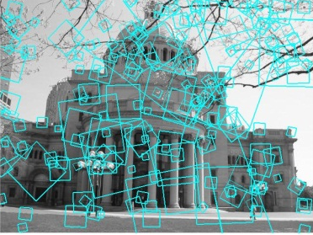
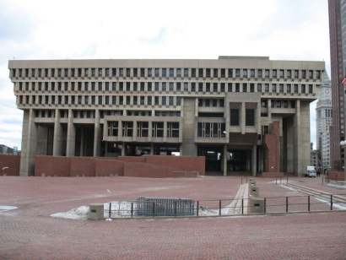
Multi-view matching
?
vs
…
Matching two given views for depth
Search for a matching view for recognition
Kristen Grauman

Slide 27
Demo

Slide 28
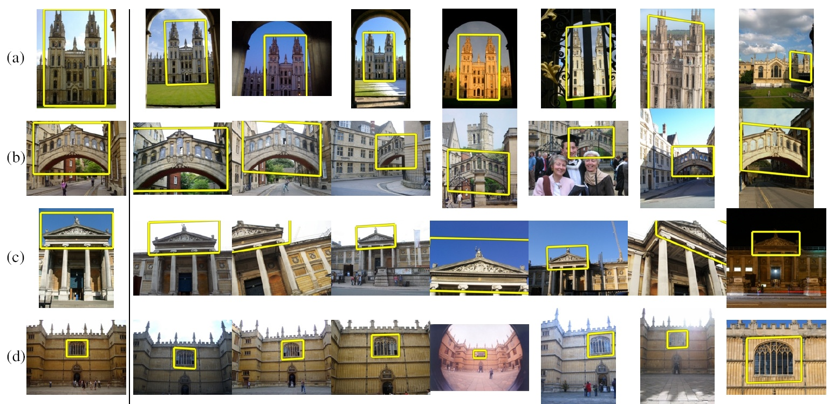
How to quickly find images in a large database that match a given image region?

Slide 29

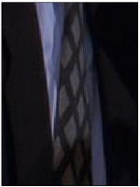
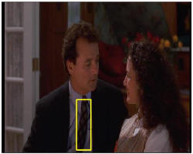
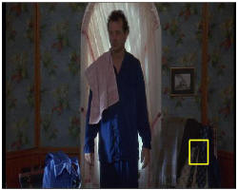
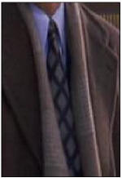
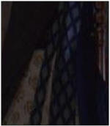
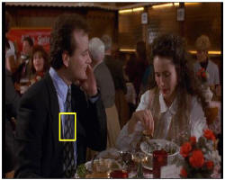
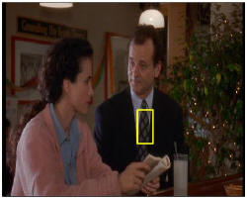

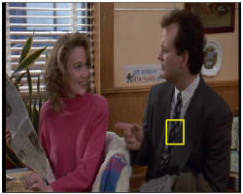
Video Google System
Query region
Collect all words within query region
Inverted file index to find relevant frames
Compare word counts
Spatial verification
Sivic & Zisserman, ICCV 2003
Demo online at : http://www.robots.ox.ac.uk/~vgg/research/vgoogle/index.html
Retrieved frames
Kristen Grauman
Notes:
29

Slide 30
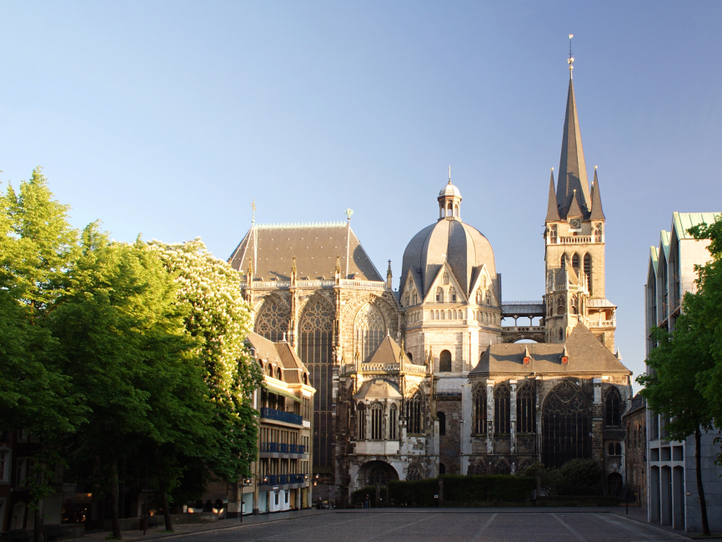
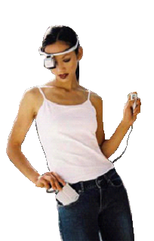
Example Applications
Aachen Cathedral
Mobile tourist guide
Self-localization
Object/building recognition
Photo/video augmentation
[Quack, Leibe, Van Gool, CIVR’08]

Slide 31

Application: Large-Scale Retrieval
Query
Results from 5k Flickr images (demo available for 100k set)
[Philbin CVPR’07]

Slide 32

Web Demo: Movie Poster Recognition
50’000 movie
posters indexed
Query-by-image
from mobile phone
available in Switzer-
land
http://www.kooaba.com/en/products_engine.html#

Slide 33
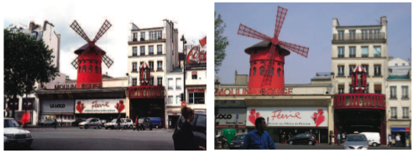
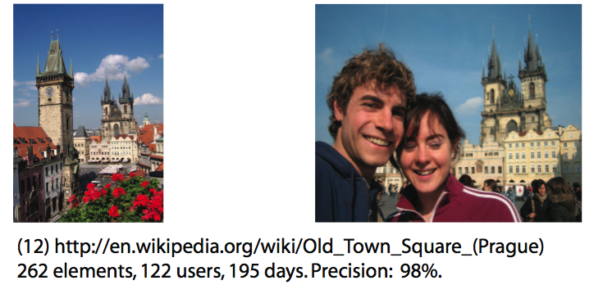
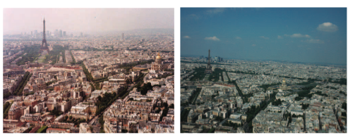
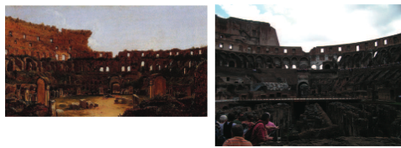
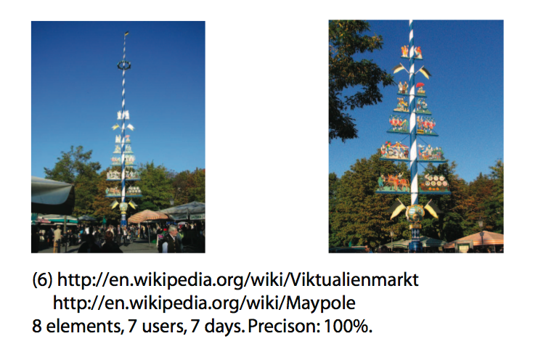
Application: Image Auto-Annotation
Moulin Rouge
Old Town Square (Prague)
Tour Montparnasse
Colosseum
Viktualienmarkt
Maypole
Left: Wikipedia image
Right: closest match from Flickr
[Quack CIVR’08]

Slide 34


Notes:
http://www.google.com/mobile/goggles

Slide 35


Simple idea
See how many keypoints are close to keypoints in each other image
Lots of Matches
Few or No Matches
But this will be really, really slow!

Slide 36
Indexing local features
Each patch / region has a descriptor, which is a point in some high-dimensional feature space (e.g., SIFT)
Descriptor’s feature space
Kristen Grauman
Notes:
36

Slide 37
Indexing local features
When we see close points in feature space, we have similar descriptors, which indicates similar local content.
Query image
Descriptor’s feature space
Database images
Easily can have millions of features to search!
Kristen Grauman

Slide 38

Indexing local features: inverted file index
For text documents, an efficient way to find all pages on which a word occurs is to use an index…
We want to find all images in which a feature occurs.
To use this idea, we’ll need to map our features to “visual words”.
Kristen Grauman

Slide 39
Visual words
Map high-dimensional descriptors to tokens/words by quantizing the feature space
Quantize via clustering, let cluster centers be the prototype “words”
Word #2
Determine which word to assign to each new image region by finding the closest cluster center.
Descriptor’s feature space
Kristen Grauman

Slide 40

Visual words
Example: each group of patches belongs to the same visual word
Figure from Sivic & Zisserman, ICCV 2003
Kristen Grauman

Slide 41
Visual vocabulary formation
Issues:
Vocabulary size, number of words
Sampling strategy: where to extract features?
Clustering / quantization algorithm
Unsupervised vs. supervised
What corpus provides features (universal vocabulary?)
Kristen Grauman

Slide 42



Sampling strategies
Sparse, at interest points
Dense, uniformly
Randomly
To find specific, textured objects, sparse sampling from interest points often more reliable.
Multiple complementary interest operators offer more image coverage.
For object categorization, dense sampling offers better coverage.
[See Nowak, Jurie & Triggs, ECCV 2006]
Multiple interest operators
Image credits: F-F. Li, E. Nowak, J. Sivic

Slide 43

Inverted file index
Database images are loaded into the index mapping words to image numbers
Kristen Grauman

Slide 44

Inverted file index
New query image is mapped to indices of database images that share a word.
Kristen Grauman

Slide 45
Inverted file index
Key requirement for inverted file index to be efficient: sparsity
If most pages/images contain most words then you’re no better off than exhaustive search.
  Exhaustive search would mean comparing the word distribution of a query versus every page.

Slide 46
Instance recognition: remaining issues
How to summarize the content of an entire image? And gauge overall similarity?
How large should the vocabulary be? How to perform quantization efficiently?
Is having the same set of visual words enough to identify the object/scene? How to verify spatial agreement?
How to score the retrieval results?
Kristen Grauman

Slide 47

Analogy to documents
Of all the sensory impressions proceeding to the brain, the visual experiences are the dominant ones. Our perception of the world around us is based essentially on the messages that reach the brain from our eyes. For a long time it was thought that the retinal image was transmitted point by point to visual centers in the brain; the cerebral cortex was a movie screen, so to speak, upon which the image in the eye was projected. Through the discoveries of Hubel and Wiesel we now know that behind the origin of the visual perception in the brain there is a considerably more complicated course of events. By following the visual impulses along their path to the various cell layers of the optical cortex, Hubel and Wiesel have been able to demonstrate that the message about the image falling on the retina undergoes a step-wise analysis in a system of nerve cells stored in columns. In this system each cell has its specific function and is responsible for a specific detail in the pattern of the retinal image.
China is forecasting a trade surplus of $90bn (£51bn) to $100bn this year, a threefold increase on 2004's $32bn. The Commerce Ministry said the surplus would be created by a predicted 30% jump in exports to $750bn, compared with a 18% rise in imports to $660bn. The figures are likely to further annoy the US, which has long argued that China's exports are unfairly helped by a deliberately undervalued yuan. Beijing agrees the surplus is too high, but says the yuan is only one factor. Bank of China governor Zhou Xiaochuan said the country also needed to do more to boost domestic demand so more goods stayed within the country. China increased the value of the yuan against the dollar by 2.1% in July and permitted it to trade within a narrow band, but the US wants the yuan to be allowed to trade freely. However, Beijing has made it clear that it will take its time and tread carefully before allowing the yuan to rise further in value.
sensory, brain,
visual, perception,
retinal, cerebral cortex,
eye, cell, optical
nerve, image
Hubel, Wiesel
China, trade,
surplus, commerce,
exports, imports, US,
yuan, bank, domestic,
foreign, increase,
trade, value
ICCV 2005 short course, L. Fei-Fei

Slide 48





Slide 49







Bags of visual words
Summarize entire image based on its distribution (histogram) of word occurrences.
Analogous to bag of words representation commonly used for documents.
Notes:
49

Slide 50








Comparing bags of words
Rank frames by normalized scalar product between their (possibly weighted) occurrence counts---nearest neighbor search for similar images.
[1 8 1 4]
[5 1 1 0]
for vocabulary of V words
Kristen Grauman

Slide 51

Inverted file index and
bags of words similarity
w₉₁
Extract words in query
Inverted file index to find relevant frames
Compare word counts
Kristen Grauman

Slide 52
Instance recognition: remaining issues
How to summarize the content of an entire image? And gauge overall similarity?
How large should the vocabulary be? How to perform quantization efficiently?
Is having the same set of visual words enough to identify the object/scene? How to verify spatial agreement?
How to score the retrieval results?
Kristen Grauman

Slide 53


Vocabulary size
Results for recognition task with 6347 images
Branching factors
Influence on performance, sparsity
Nister & Stewenius, CVPR 2006
Kristen Grauman

Slide 54
Recognition with K-tree
Following slides by David Nister (CVPR 2006)

Slide 55

Notes:
I will now try to describe the approach with an animation.
The first, offline phase, is to train the vocabulary tree.
We use Maximally Stable Extremal Regions by Matas et al. and then we extract SIFT descriptors from the MSER regions.
Regarding the feature extraction, we are not really claiming anything other than down-in-the-trenches nose-to-the-grindstone hard work to get good implementations of the state-of-the-art, and since we are all obsessed with novelty I will not spend any time talking about the feature extraction.
We believe that the vocabulary tree approach will work well on any of your favorite descriptors.

Slide 56

Notes:
All the descriptor vectors are thrown into a common space.
This is done for many images, the goal being to acquire enough statistics on how natural images distribute points in the descriptor space.

Slide 57


Slide 58


Slide 59


Slide 60


Slide 62
Notes:
We then run k-means on the descriptor space. In this setting, k defines what we call the branch-factor of the tree, which indicates how fast the tree branches.
In this illustration, k is three. We then run k-means again, recursively on each of the resulting quantization cells.
This defines the vocabulary tree, which is essentially a hierarchical set of cluster centers and their corresponding Voronoi regions.
We typically use a branch-factor of 10 and six levels, resulting in a million leaf nodes. We lovingly call this the Mega-Voc.

Slide 72
Notes:
We now have the vocabulary tree, and the online phase can begin.
In order to add an image to the database, we perform feature extraction. Each descriptor vector is now dropped down from the root of the tree and quantized very efficiently into a path down the tree, encoded by a single integer.
Each node in the vocabulary tree has an associated inverted file index.
Indecies back to the new image are then added to the relevant inverted files.
This is a very efficient operation that is carried out whenever we want to add an image.

Slide 73



Slide 74



Slide 75



Slide 76



Slide 77

Notes:
When we then wish to query on an input image, we quantize the descriptor vectors of the input image in a similar way, and accumulate scores for the images in the database with so called term frequency inverse document frequency (tf-idf). This is effectively an entropy weighting of the information. The winner is the image in the database with the most common information with the input image.

Slide 78
Vocabulary trees: complexity
Number of words given tree parameters: branching factor and number of levels
branching_factor^^{number_of_levels}
Word assignment cost vs. flat vocabulary
O(k) for flat
O(log_{branching_factor}(k) * branching_factor)
Is this like a kd-tree?
Yes, but with better partitioning and defeatist search.
This hierarchical data structure is lossy – you might not find your true nearest cluster.
Notes:
Number of words = (branching_factor)^(number_of_levels)
Assignment cost for flat hierarchy O(k), for tree O(log(base branching_factor)(k) * branching_factor)

Slide 79



110,000,000
Images in
5.8 Seconds
Slide
Slide Credit: Nister
Notes:
Very recently, we have scaled the system even further.
The system we just demo’d searches a 50 thousand image index in the RAM of this laptop at real-time rates.
We have built and programmed a desktop system at home in which we currently have 12 hard drives. We bypass the operating system and
read and write the disk surfaces directly.
Last week this system clocked in on 110 Million images in 5.8 seconds, so roughly 20Million images per second and machine.
The images consist of around 10 days of four TV channels, so more than a month of TV.
Soon we don’t have to watch TV, because we’ll have machines doing it for us.

Slide 80



Slide
Slide Credit: Nister
Notes:
To continue the analogy, if we printed all these images on paper, and stacked them,

Slide 81

Slide
Slide Credit: Nister
Notes:
The pile would stack, as high as

Slide 82

Slide
Slide Credit: Nister
Notes:
Mount Everest.
Another way to put perspective on this is, Google image search not too long ago claimed to index 2 billion images,
although based on meta-data, while we do it based on image content.
So, with about 20 desktop systems like the one I just showed, it seems that it may be possible to build a web-scale content-based image search engine,
and we are sort of hoping that this paper will fuel the race for the first such search engine.
So, that is some motivation.
Let me now move to the contribution of the paper.
As you can guess by now, it is about scalability of recognition and retrieval.

Slide 83































Performance
Notes:
One of the reasons we managed to take the system this far is that we have worked with rigorous performance testing against a database with ground truth.
We now have a benchmark database with over 10000 images grouped in sets of four images of the same object. We query on one of the images in the group and see how many of the other images in the group make it to the top of the query.
In the paper, we have tested this up to a million images, by embedding the ground truth database into a database encompassing all the frames of 10 feature length movies.

Slide 84

Higher branch factor works better (but slower)
Notes:
We also find that performance improves with the branch factor.
This improvement is not dramatic, but it is interesting to note that very low branch factors are somewhat weak, and a branch factor of two results in partitioning the space with planes.

Slide 85
Visual words/bags of words
+ flexible to geometry / deformations / viewpoint
+ compact summary of image content
+ provides fixed dimensional vector representation for sets
+ very good results in practice
background and foreground mixed when bag covers whole image
optimal vocabulary formation remains unclear
basic model ignores geometry – must verify afterwards, or encode via features
Kristen Grauman
Notes:
85

Slide 86
Instance recognition: remaining issues
How to summarize the content of an entire image? And gauge overall similarity?
How large should the vocabulary be? How to perform quantization efficiently?
Is having the same set of visual words enough to identify the object/scene? How to verify spatial agreement?
How to score the retrieval results?
Kristen Grauman

Slide 87
Can we be more accurate?
So far, we treat each image as containing a “bag of words”, with no spatial information
Which matches better?
e
h
a
f
e
e
z
a
f
e
h
a
f
e
e

Slide 88
Can we be more accurate?
So far, we treat each image as containing a “bag of words”, with no spatial information
Real objects have consistent geometry

Slide 89


Spatial Verification
Query
Query
DB image with high BoW similarity
DB image with high BoW similarity
Both image pairs have many visual words in common.
Slide credit: Ondrej Chum

Slide 90


Spatial Verification
Query
Query
DB image with high BoW similarity
DB image with high BoW similarity
Only some of the matches are mutually consistent
Slide credit: Ondrej Chum

Slide 91
Spatial Verification: two basic strategies
RANSAC
  Typically sort by BoW similarity as initial filter
  Verify by checking support (inliers) for possible transformations
    e.g., “success” if find a transformation with > N inlier correspondences
Generalized Hough Transform
  Let each matched feature cast a vote on location, scale, orientation of the model object
  Verify parameters with enough votes
Kristen Grauman

Slide 92
RANSAC verification

Slide 93
Recall: Fitting an affine transformation
Approximates viewpoint changes for roughly planar objects and roughly orthographic cameras.

Slide 94
RANSAC verification

Slide 95
Instance recognition: remaining issues
How to summarize the content of an entire image? And gauge overall similarity?
How large should the vocabulary be? How to perform quantization efficiently?
Is having the same set of visual words enough to identify the object/scene? How to verify spatial agreement?
How to score the retrieval results?
Kristen Grauman

Slide 96











Scoring retrieval quality
Results (ordered):
Database size: 10 images
Relevant (total): 5 images
Query
precision = #relevant / #returned
recall = #relevant / #total relevant
1
0.8
0.6
precision
0.4
0.2
0
0
0.2
0.4
0.6
0.8
1
recall
Slide credit: Ondrej Chum

Slide 97
What else can we borrow from text retrieval?
China is forecasting a trade surplus of $90bn (£51bn) to $100bn this year, a threefold increase on 2004's $32bn. The Commerce Ministry said the surplus would be created by a predicted 30% jump in exports to $750bn, compared with a 18% rise in imports to $660bn. The figures are likely to further annoy the US, which has long argued that China's exports are unfairly helped by a deliberately undervalued yuan. Beijing agrees the surplus is too high, but says the yuan is only one factor. Bank of China governor Zhou Xiaochuan said the country also needed to do more to boost domestic demand so more goods stayed within the country. China increased the value of the yuan against the dollar by 2.1% in July and permitted it to trade within a narrow band, but the US wants the yuan to be allowed to trade freely. However, Beijing has made it clear that it will take its time and tread carefully before allowing the yuan to rise further in value.
China, trade,
surplus, commerce,
exports, imports, US,
yuan, bank, domestic,
foreign, increase,
trade, value

Slide 98

tf-idf weighting
Term frequency – inverse document frequency
Describe frame by frequency of each word within it, downweight words that appear often in the database
(Standard weighting for text retrieval)
Number of occurrences of word i in document d
Total number of documents in database
Number of documents word i occurs in, in whole database
Number of words in document d
Kristen Grauman

Slide 99
Query expansion
Query: golf green
Results:
- How can the grass on the greens at a golf course be so perfect?
For example, a skilled golfer expects to reach the green on a par-four hole in ...
- Manufactures and sells synthetic golf putting greens and mats.
Irrelevant result can cause a `topic drift’:
Volkswagen Golf, 1999, Green, 2000cc, petrol, manual, , hatchback, 94000miles, 2.0 GTi, 2 Registered Keepers, HPI Checked, Air-Conditioning, Front and Rear Parking Sensors, ABS, Alarm, Alloy
Slide credit: Ondrej Chum
Notes:
Query expansion is a technique to increase recall, possibly at the expense of precision.

Slide 100















Query Expansion
Results
…
Spatial verification
Query image
New results
New query
Chum, Philbin, Sivic, Isard, Zisserman: Total Recall…, ICCV 2007
Slide credit: Ondrej Chum

Slide 101
Recognition via alignment
  Pros:
    Effective when we are able to find reliable features within clutter
    Great results for matching specific instances
  Cons:
    Scaling with number of models
    Spatial verification as post-processing – not seamless, expensive for large-scale problems
    Not suited for category recognition.
Kristen Grauman

Slide 102
Summary
Matching local invariant features
  Useful not only to provide matches for multi-view geometry, but also to find objects and scenes.
Bag of words representation: quantize feature space to make discrete set of visual words
  Summarize image by distribution of words
  Index individual words
Inverted index: pre-compute index to enable faster search at query time
Recognition of instances via alignment: matching local features followed by spatial verification
  Robust fitting : RANSAC, GHT
Kristen Grauman

Slide 103
Lessons from a Decade Later
For Category recognition (project 4)
  Bag of Feature models remained the state of the art until Deep Learning.
  Spatial layout either isn't that important or its too difficult to encode.
  Quantization error is, in fact, the bigger problem. Advanced feature encoding methods address this.
  Bag of feature models are nearly obsolete. At best they seem to be inspiring tweaks to deep models e.g. NetVLAD.
James Hays

Slide 104
Lessons from a Decade Later
For instance retrieval (this lecture)
  deep learning is taking over.
  learn better local features (replace SIFT) e.g. MatchNet
  or learn better image embeddings (replace the histograms of visual features) e.g. Vo and Hays 2016.
  or learn to do spatial verification e.g. DeTone, Malisiewicz, and Rabinovich 2016.
  or learn a monolithic deep network to recognition all locations e.g. Google’s PlaNet 2016.
James Hays

Slide 105






Things to remember
Object instance recognition
  Find keypoints, compute descriptors
  Match descriptors
  Vote for / fit affine parameters
  Return object if # inliers > T
Keys to efficiency
  Visual words
    Used for many applications
  Inverse document file
    Used for web-scale search

