Slide 1
Visualizing CNNs and Deeper Deep Architectures

Slide 2
Visualizing Deep Networks
See slides here: http://places.csail.mit.edu/slide_iclr2015.pdf

Slide 3
Beyond AlexNet

Slide 4
VERY DEEP CONVOLUTIONAL NETWORKS FOR LARGE-SCALE IMAGE RECOGNITION
Karen Simonyan & Andrew Zisserman 2015
These are the “VGG” networks. Including what you use in Project 6

Slide 5
Notes:
Compared to Alex-Net – Deeper, smaller convolutions, more parameters

Slide 6
Notes:
Compared to Alex-Net – Deeper, smaller convolutions, more parameters

Slide 7
Going Deeper with Convolutions
Christian Szegedy, Wei Liu, Yangqing Jia, Pierre Sermanet, Scott Reed,
Dragomir Anguelov, Dumitru Erhan, Vincent Vanhoucke, Andrew Rabinovich 2015
This is the “Inception” architecture or “GoogLeNet”
*The architecture blocks are called “Inception” modules and the collection of them into a particular net is “GoogLeNet”

Slide 9
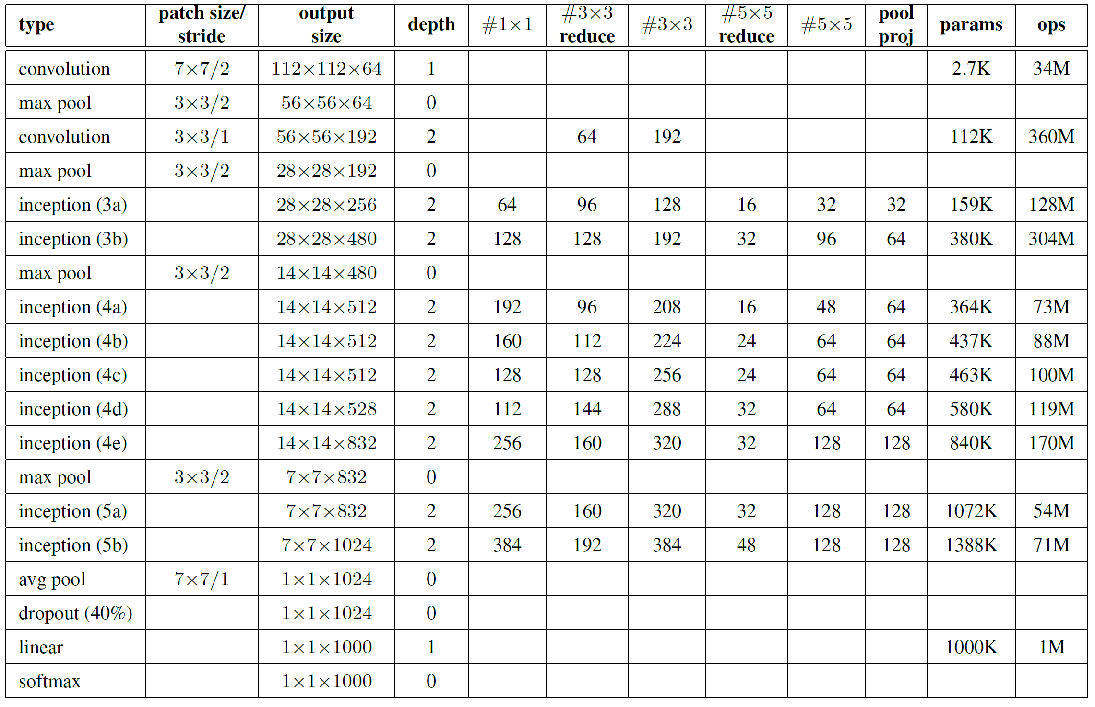
Only 6.8 million parameters. AlexNet ~60 million, VGG up to 138 million

Slide 12
Surely it would be ridiculous to go any deeper…
ResNet

Slide 13
Surely it would be ridiculous to go any deeper…
ResNet
See the following slides: http://kaiminghe.com/cvpr16resnet/cvpr2016_deep_residual_learning_kaiminghe.pdf

