Slide 1
Welcome back!
Project 0 will be out today
Project 1 will be out soon
Read Szeliski 2.1, especially 2.1.4
Today
  Image projection
  Filtering

Slide 2
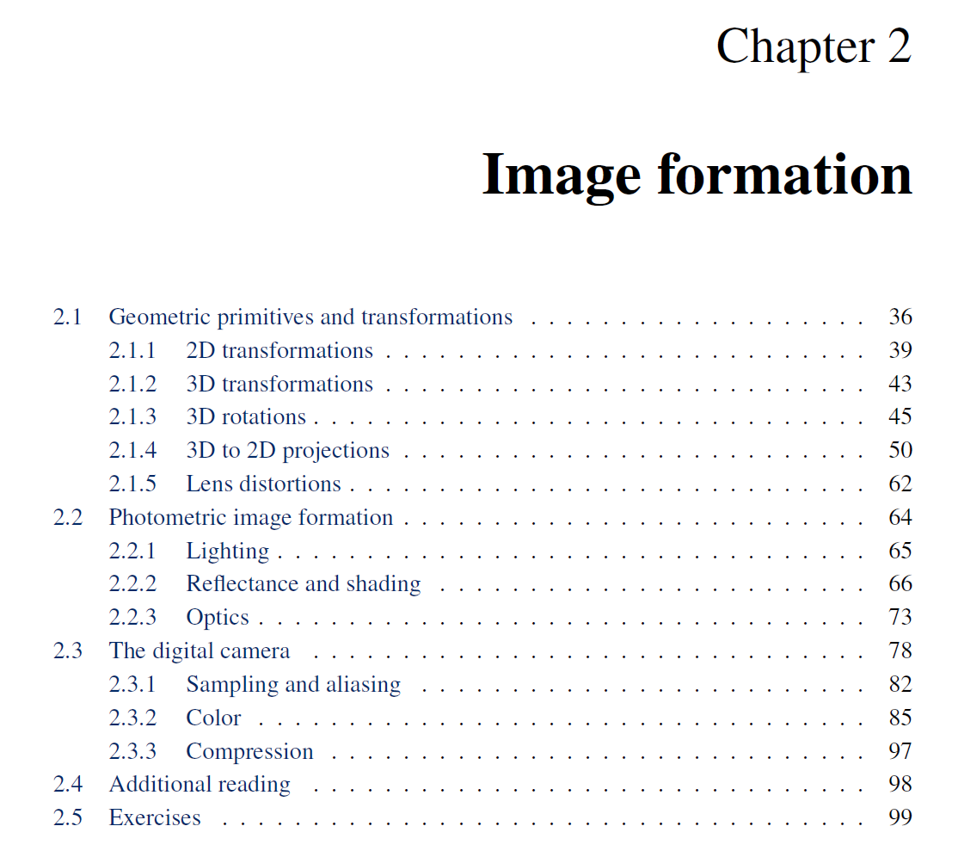

Slide 3
Projection: world coordinates→image coordinates
.
.
.
3
f
5
y
2
z
v’
?
.
Camera Center (0, 0, 0)
u’
If x = 2, y = 3,
z = 5, and f = 2
What are u’ and v’?
Notes:
Being a little loose about coordinates vs lengths
u and v prime because they are in the same coordinate system as x, y, and z but in later slides u and v will be –u’ and –v’ because they are in their own coordinate system which is mirrored

Slide 4
Projection: world coordinates→image coordinates
.
Optical Center (u₀, v₀)
.
.
f
Z
Y
.
v
Camera Center (t_{x}, t_{y}, t_{z})
u
How do we handle the general case?

Slide 5
Interlude: why does this matter?

Slide 6
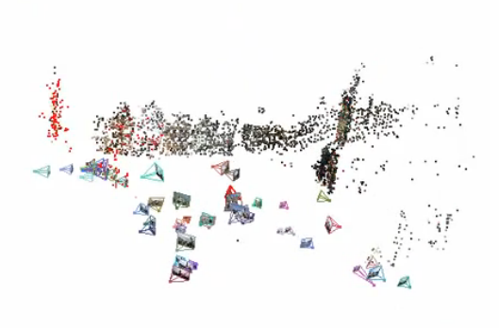
Relating multiple views

Slide 7


Slide 8
Projection: world coordinates→image coordinates
.
Optical Center (u₀, v₀)
.
.
f
Z
Y
.
v
Camera Center (t_{x}, t_{y}, t_{z})
u
How do we handle the general case?

Slide 9




Homogeneous coordinates
Conversion
Converting to homogeneous coordinates
homogeneous image
coordinates
homogeneous scene
coordinates
Converting from homogeneous coordinates
Notes:
Append coordinate with value 1; proportional coordinate system

Slide 10
Homogeneous coordinates
Invariant to scaling
Point in Cartesian is ray in Homogeneous
Homogeneous Coordinates
Cartesian Coordinates
Notes:
Q: Suppose we have a point in Cartesian coordinates. What is that in homogeneous coordinates? A: a ray

Slide 11
Basic geometry in homogeneous coordinates
Line equation: ax + by + c = 0
Append 1 to pixel coordinate to get homogeneous coordinate
Line given by cross product of two points
Intersection of two lines given by cross product of the lines

Slide 12
Another problem solved by homogeneous coordinates
Intersection of parallel lines
  Cartesian: (Inf, Inf)
  Homogeneous: (1, 1, 0)
  Cartesian: (Inf, Inf)
Homogeneous: (1, 2, 0)
Notes:
Parallel lines intersect at different infinities

Slide 13

Projection matrix
Slide Credit: Savarese
R,t
j_{w}
X
k_{w}
O_{w}
x
i_{w}
x: Image Coordinates: (u,v,1)
K: Intrinsic Matrix (3x3)
R: Rotation (3x3)
t: Translation (3x1)
X: World Coordinates: (X,Y,Z,1)
Notes:
We can use homogeneous coordinates to write camera matrix in linear form.

Slide 14
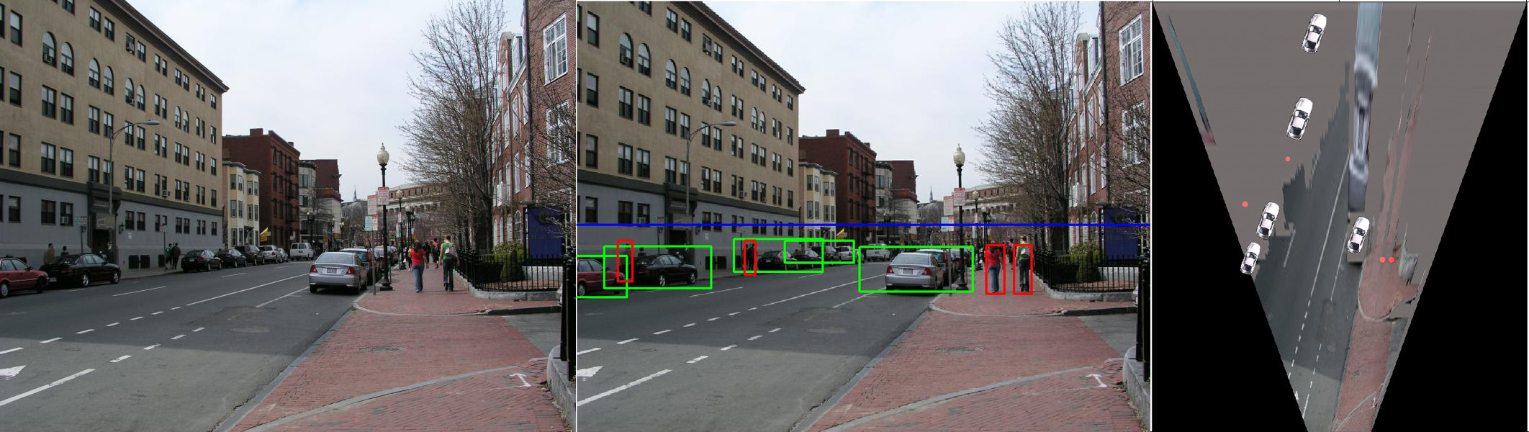
Object Recognition (CVPR 2006)

Slide 15
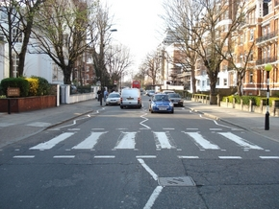
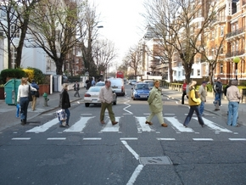
Inserting photographed objects into images (SIGGRAPH 2007)
Original
Created

Slide 16
Pinhole Camera Model
x: Image Coordinates: (u,v,1)
K: Intrinsic Matrix (3x3)
R: Rotation (3x3)
t: Translation (3x1)
X: World Coordinates: (X,Y,Z,1)

Slide 17
Projection matrix
X
x
Intrinsic Assumptions
Unit aspect ratio
Optical center at (0,0)
No skew
Extrinsic Assumptions
No rotation
Camera at (0,0,0)
K
Slide Credit: Savarese
Notes:
Work through equations for u and v on board

Slide 18
Projection matrix
X
x
Intrinsic Assumptions
Unit aspect ratio
Optical center at (0,0)
No skew
Extrinsic Assumptions
No rotation
Camera at (0,0,0)
Slide Credit: Savarese
Notes:
Work through equations for u and v on board

Slide 19
Remove assumption: known optical center
Intrinsic Assumptions
Unit aspect ratio
No skew
Extrinsic Assumptions
No rotation
Camera at (0,0,0)

Slide 20
Remove assumption: square pixels
Intrinsic Assumptions
No skew
Extrinsic Assumptions
No rotation
Camera at (0,0,0)

Slide 21
Remove assumption: non-skewed pixels
Intrinsic Assumptions
Extrinsic Assumptions
No rotation
Camera at (0,0,0)
Note: different books use different notation for parameters

Slide 22
Oriented and Translated Camera
R
j_{w}
X
t
k_{w}
O_{w}
x
i_{w}

Slide 23
Allow camera translation
Intrinsic Assumptions
Extrinsic Assumptions
No rotation

Slide 24
3D Rotation of Points
Slide Credit: Saverese
Rotation around the coordinate axes, counter-clockwise:
p’
γ
y
p
z

Slide 25
Allow camera rotation

Slide 26
Degrees of freedom
5
6
Notes:
How many known points are needed to estimate this?

Slide 27
Vanishing Point = Projection from Infinity

Slide 28
Orthographic Projection
Special case of perspective projection
  Distance from the COP to the image plane is infinite
  Also called “parallel projection”
  What’s the projection matrix?
Image
World
Slide by Steve Seitz

Slide 29
Scaled Orthographic Projection
Special case of perspective projection
  Object dimensions are small compared to distance to camera
  Also called “weak perspective”
  What’s the projection matrix?
Image
World
Slide by Steve Seitz

Slide 30
Field of View (Zoom, focal length)

Slide 31
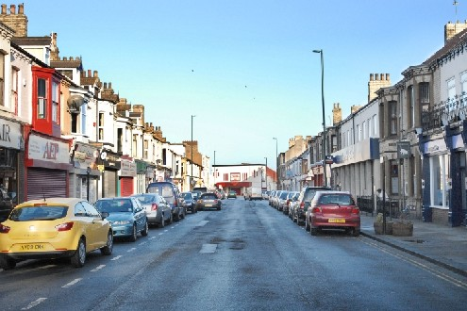
Suppose we have two 3D cubes on the ground facing the viewer, one near, one far.
What would they look like in perspective?
What would they look like in weak perspective?
Photo credit: GazetteLive.co.uk

Slide 32
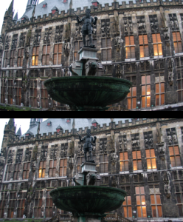
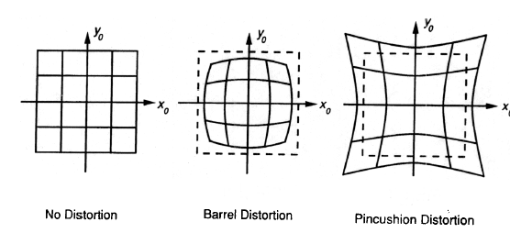
Beyond Pinholes: Radial Distortion
Corrected Barrel Distortion
Image from Martin Habbecke

Slide 33


Things to remember
Vertical vanishing
point
(at infinity)
Vanishing points and vanishing lines
Pinhole camera model and camera projection matrix
Homogeneous coordinates
Vanishing
line
Vanishing
point
Vanishing
point

Slide 34
Reminder: read your book
Lectures have assigned readings
Szeliski 2.1 and especially 2.1.4 cover the geometry of image formation

Slide 35
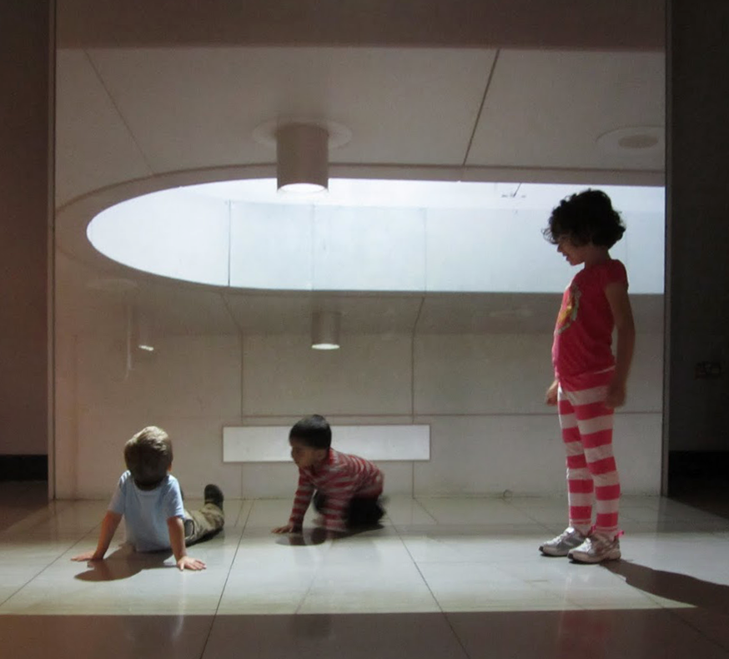
Image Filtering
Computer Vision
James Hays
Many slides by Derek Hoiem

Slide 36
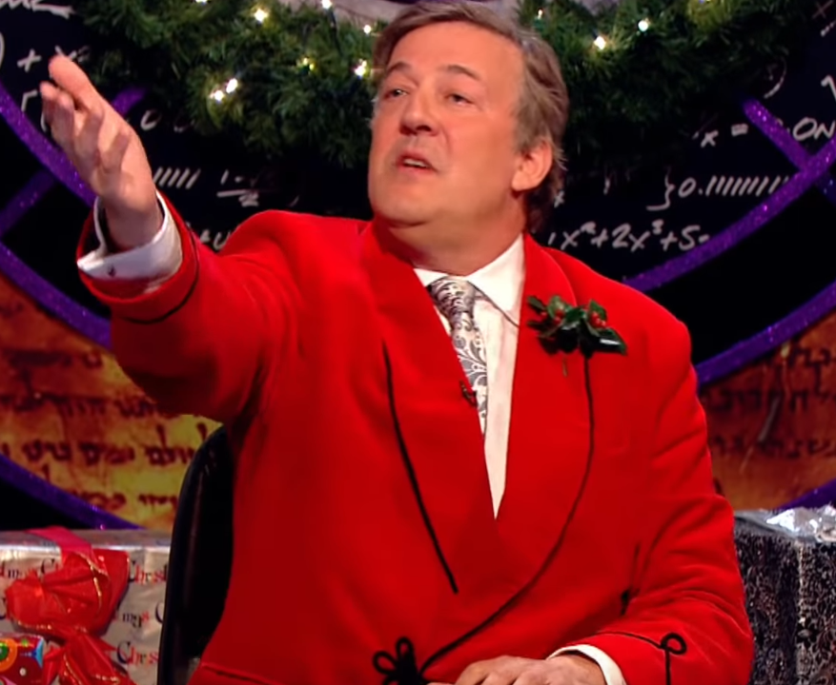
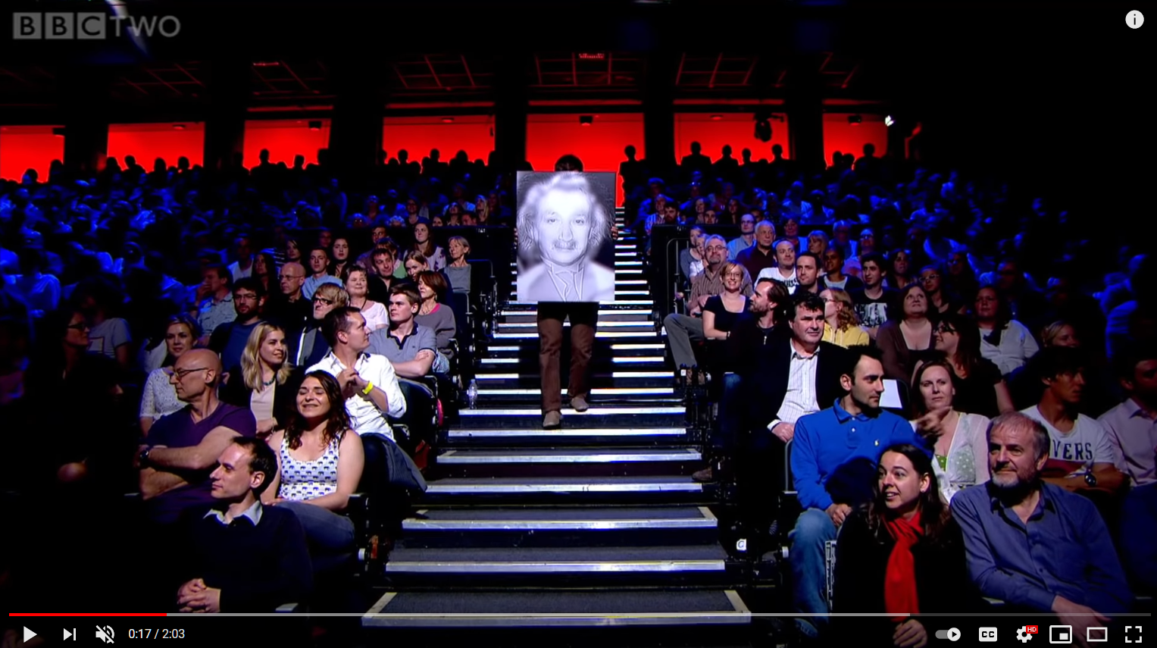
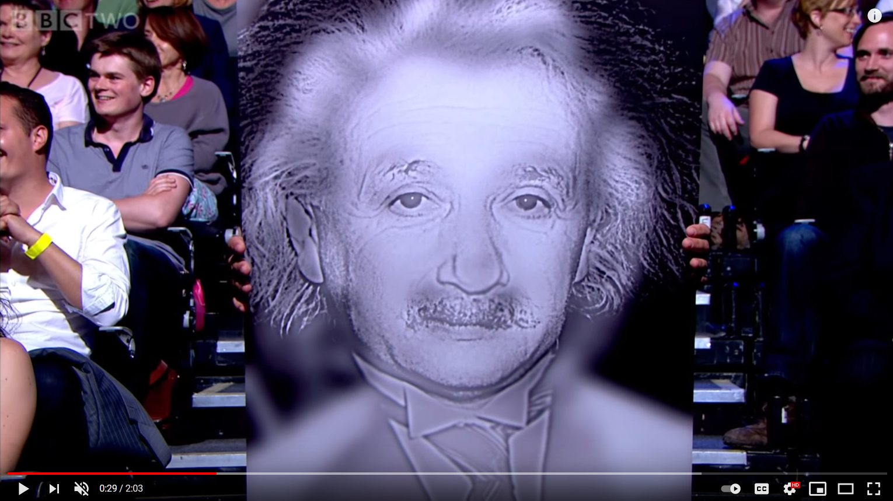
Project 1
BBC Clip: https://www.youtube.com/watch/OlumoQ05gS8

Slide 37
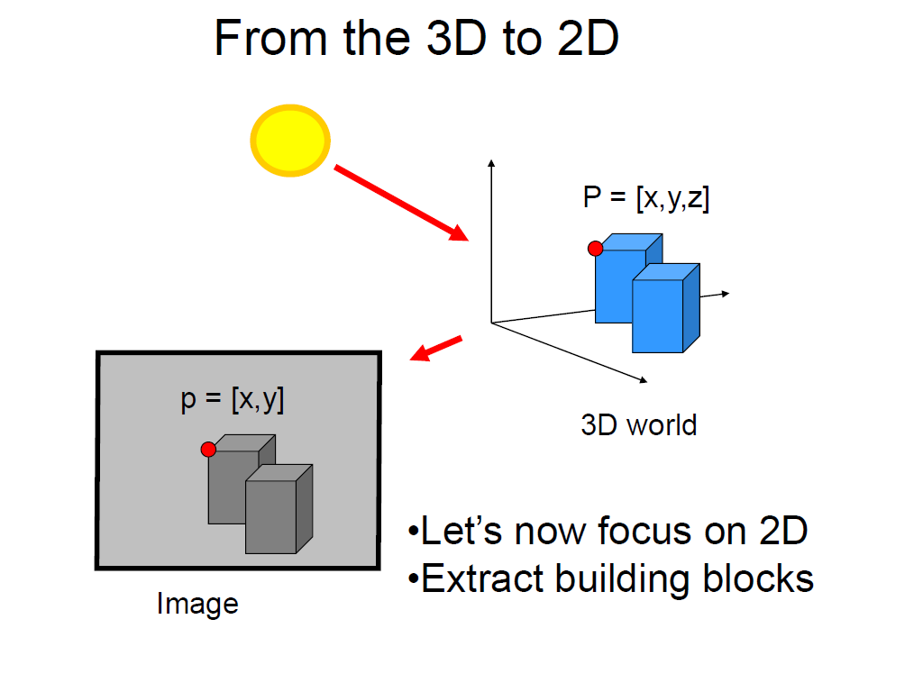
Slide credit Fei Fei Li

Slide 38
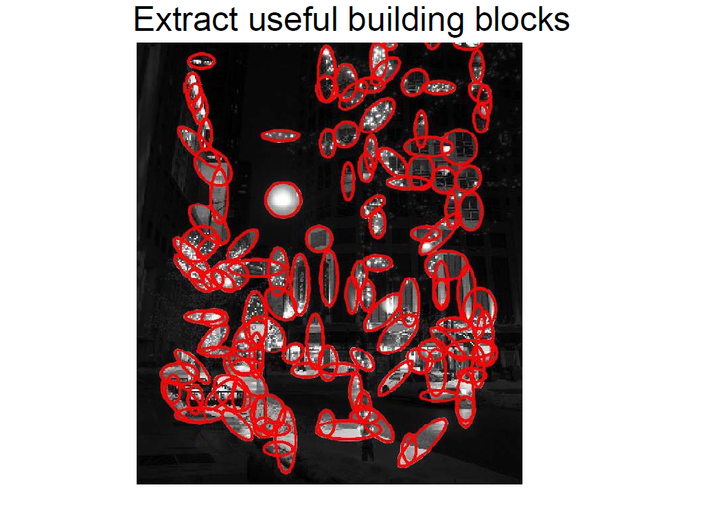
Slide credit Fei Fei Li

Slide 39
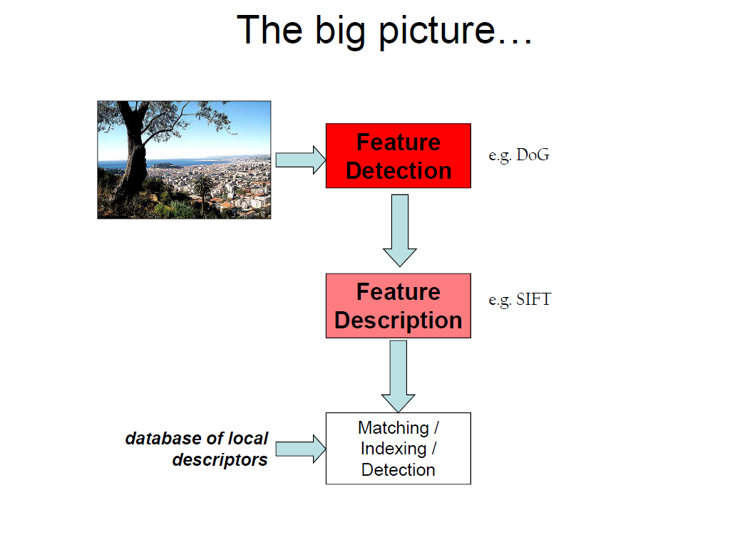
Slide credit Fei Fei Li

Slide 40

Hybrid Images
A. Oliva, A. Torralba, P.G. Schyns,
“Hybrid Images,” SIGGRAPH 2006

Slide 41
Upcoming classes: two views of filtering
Image filters in spatial domain
  Filter is a mathematical operation of a grid of numbers
  Smoothing, sharpening, measuring texture
Image filters in the frequency domain
  Filtering is a way to modify the frequencies of images
  Denoising, sampling, image compression

Slide 42
Image filtering
Image filtering: compute function of local neighborhood at each position
Really important!
  Enhance images
    Denoise, resize, increase contrast, etc.
  Extract information from images
    Texture, edges, distinctive points, etc.
  Detect patterns
    Template matching
  Deep Convolutional Networks

Slide 43

Example: box filter
1
1
1
1
1
1
1
1
1
Slide credit: David Lowe (UBC)

Slide 44
Image filtering
1
1
1
1
1
1
1
1
1
0 | 0 | 0 | 0 | 0 | 0 | 0 | 0 | 0 | 0
0 | 0 | 0 | 0 | 0 | 0 | 0 | 0 | 0 | 0
0 | 0 | 0 | 90 | 90 | 90 | 90 | 90 | 0 | 0
0 | 0 | 0 | 90 | 90 | 90 | 90 | 90 | 0 | 0
0 | 0 | 0 | 90 | 90 | 90 | 90 | 90 | 0 | 0
0 | 0 | 0 | 90 | 0 | 90 | 90 | 90 | 0 | 0
0 | 0 | 0 | 90 | 90 | 90 | 90 | 90 | 0 | 0
0 | 0 | 0 | 0 | 0 | 0 | 0 | 0 | 0 | 0
0 | 0 | 90 | 0 | 0 | 0 | 0 | 0 | 0 | 0
0 | 0 | 0 | 0 | 0 | 0 | 0 | 0 | 0 | 0
 | 0
0 | 0 | 0 | 0 | 0 | 0 | 0 | 0 | 0 | 0
0 | 0 | 0 | 0 | 0 | 0 | 0 | 0 | 0 | 0
0 | 0 | 0 | 90 | 90 | 90 | 90 | 90 | 0 | 0
0 | 0 | 0 | 90 | 90 | 90 | 90 | 90 | 0 | 0
0 | 0 | 0 | 90 | 90 | 90 | 90 | 90 | 0 | 0
0 | 0 | 0 | 90 | 0 | 90 | 90 | 90 | 0 | 0
0 | 0 | 0 | 90 | 90 | 90 | 90 | 90 | 0 | 0
0 | 0 | 0 | 0 | 0 | 0 | 0 | 0 | 0 | 0
0 | 0 | 90 | 0 | 0 | 0 | 0 | 0 | 0 | 0
0 | 0 | 0 | 0 | 0 | 0 | 0 | 0 | 0 | 0
Credit: S. Seitz
Notes:
ones, divide by 9

Slide 45
Image filtering
1
1
1
1
1
1
1
1
1
0 | 0 | 0 | 0 | 0 | 0 | 0 | 0 | 0 | 0
0 | 0 | 0 | 0 | 0 | 0 | 0 | 0 | 0 | 0
0 | 0 | 0 | 90 | 90 | 90 | 90 | 90 | 0 | 0
0 | 0 | 0 | 90 | 90 | 90 | 90 | 90 | 0 | 0
0 | 0 | 0 | 90 | 90 | 90 | 90 | 90 | 0 | 0
0 | 0 | 0 | 90 | 0 | 90 | 90 | 90 | 0 | 0
0 | 0 | 0 | 90 | 90 | 90 | 90 | 90 | 0 | 0
0 | 0 | 0 | 0 | 0 | 0 | 0 | 0 | 0 | 0
0 | 0 | 90 | 0 | 0 | 0 | 0 | 0 | 0 | 0
0 | 0 | 0 | 0 | 0 | 0 | 0 | 0 | 0 | 0
 | 0 | 10
0 | 0 | 0 | 0 | 0 | 0 | 0 | 0 | 0 | 0
0 | 0 | 0 | 0 | 0 | 0 | 0 | 0 | 0 | 0
0 | 0 | 0 | 90 | 90 | 90 | 90 | 90 | 0 | 0
0 | 0 | 0 | 90 | 90 | 90 | 90 | 90 | 0 | 0
0 | 0 | 0 | 90 | 90 | 90 | 90 | 90 | 0 | 0
0 | 0 | 0 | 90 | 0 | 90 | 90 | 90 | 0 | 0
0 | 0 | 0 | 90 | 90 | 90 | 90 | 90 | 0 | 0
0 | 0 | 0 | 0 | 0 | 0 | 0 | 0 | 0 | 0
0 | 0 | 90 | 0 | 0 | 0 | 0 | 0 | 0 | 0
0 | 0 | 0 | 0 | 0 | 0 | 0 | 0 | 0 | 0
Credit: S. Seitz
Notes:
ones, divide by 9

Slide 46
Image filtering
1
1
1
1
1
1
1
1
1
0 | 0 | 0 | 0 | 0 | 0 | 0 | 0 | 0 | 0
0 | 0 | 0 | 0 | 0 | 0 | 0 | 0 | 0 | 0
0 | 0 | 0 | 90 | 90 | 90 | 90 | 90 | 0 | 0
0 | 0 | 0 | 90 | 90 | 90 | 90 | 90 | 0 | 0
0 | 0 | 0 | 90 | 90 | 90 | 90 | 90 | 0 | 0
0 | 0 | 0 | 90 | 0 | 90 | 90 | 90 | 0 | 0
0 | 0 | 0 | 90 | 90 | 90 | 90 | 90 | 0 | 0
0 | 0 | 0 | 0 | 0 | 0 | 0 | 0 | 0 | 0
0 | 0 | 90 | 0 | 0 | 0 | 0 | 0 | 0 | 0
0 | 0 | 0 | 0 | 0 | 0 | 0 | 0 | 0 | 0
 | 0 | 10 | 20
0 | 0 | 0 | 0 | 0 | 0 | 0 | 0 | 0 | 0
0 | 0 | 0 | 0 | 0 | 0 | 0 | 0 | 0 | 0
0 | 0 | 0 | 90 | 90 | 90 | 90 | 90 | 0 | 0
0 | 0 | 0 | 90 | 90 | 90 | 90 | 90 | 0 | 0
0 | 0 | 0 | 90 | 90 | 90 | 90 | 90 | 0 | 0
0 | 0 | 0 | 90 | 0 | 90 | 90 | 90 | 0 | 0
0 | 0 | 0 | 90 | 90 | 90 | 90 | 90 | 0 | 0
0 | 0 | 0 | 0 | 0 | 0 | 0 | 0 | 0 | 0
0 | 0 | 90 | 0 | 0 | 0 | 0 | 0 | 0 | 0
0 | 0 | 0 | 0 | 0 | 0 | 0 | 0 | 0 | 0
Credit: S. Seitz
Notes:
ones, divide by 9

Slide 47
Image filtering
1
1
1
1
1
1
1
1
1
0 | 0 | 0 | 0 | 0 | 0 | 0 | 0 | 0 | 0
0 | 0 | 0 | 0 | 0 | 0 | 0 | 0 | 0 | 0
0 | 0 | 0 | 90 | 90 | 90 | 90 | 90 | 0 | 0
0 | 0 | 0 | 90 | 90 | 90 | 90 | 90 | 0 | 0
0 | 0 | 0 | 90 | 90 | 90 | 90 | 90 | 0 | 0
0 | 0 | 0 | 90 | 0 | 90 | 90 | 90 | 0 | 0
0 | 0 | 0 | 90 | 90 | 90 | 90 | 90 | 0 | 0
0 | 0 | 0 | 0 | 0 | 0 | 0 | 0 | 0 | 0
0 | 0 | 90 | 0 | 0 | 0 | 0 | 0 | 0 | 0
0 | 0 | 0 | 0 | 0 | 0 | 0 | 0 | 0 | 0
 | 0 | 10 | 20 | 30
0 | 0 | 0 | 0 | 0 | 0 | 0 | 0 | 0 | 0
0 | 0 | 0 | 0 | 0 | 0 | 0 | 0 | 0 | 0
0 | 0 | 0 | 90 | 90 | 90 | 90 | 90 | 0 | 0
0 | 0 | 0 | 90 | 90 | 90 | 90 | 90 | 0 | 0
0 | 0 | 0 | 90 | 90 | 90 | 90 | 90 | 0 | 0
0 | 0 | 0 | 90 | 0 | 90 | 90 | 90 | 0 | 0
0 | 0 | 0 | 90 | 90 | 90 | 90 | 90 | 0 | 0
0 | 0 | 0 | 0 | 0 | 0 | 0 | 0 | 0 | 0
0 | 0 | 90 | 0 | 0 | 0 | 0 | 0 | 0 | 0
0 | 0 | 0 | 0 | 0 | 0 | 0 | 0 | 0 | 0
Credit: S. Seitz
Notes:
ones, divide by 9

Slide 48
Image filtering
1
1
1
1
1
1
1
1
1
0 | 0 | 0 | 0 | 0 | 0 | 0 | 0 | 0 | 0
0 | 0 | 0 | 0 | 0 | 0 | 0 | 0 | 0 | 0
0 | 0 | 0 | 90 | 90 | 90 | 90 | 90 | 0 | 0
0 | 0 | 0 | 90 | 90 | 90 | 90 | 90 | 0 | 0
0 | 0 | 0 | 90 | 90 | 90 | 90 | 90 | 0 | 0
0 | 0 | 0 | 90 | 0 | 90 | 90 | 90 | 0 | 0
0 | 0 | 0 | 90 | 90 | 90 | 90 | 90 | 0 | 0
0 | 0 | 0 | 0 | 0 | 0 | 0 | 0 | 0 | 0
0 | 0 | 90 | 0 | 0 | 0 | 0 | 0 | 0 | 0
0 | 0 | 0 | 0 | 0 | 0 | 0 | 0 | 0 | 0
 | 0 | 10 | 20 | 30 | 30
Credit: S. Seitz
Notes:
ones, divide by 9

Slide 49
Image filtering
1
1
1
1
1
1
1
1
1
0 | 0 | 0 | 0 | 0 | 0 | 0 | 0 | 0 | 0
0 | 0 | 0 | 0 | 0 | 0 | 0 | 0 | 0 | 0
0 | 0 | 0 | 90 | 90 | 90 | 90 | 90 | 0 | 0
0 | 0 | 0 | 90 | 90 | 90 | 90 | 90 | 0 | 0
0 | 0 | 0 | 90 | 90 | 90 | 90 | 90 | 0 | 0
0 | 0 | 0 | 90 | 0 | 90 | 90 | 90 | 0 | 0
0 | 0 | 0 | 90 | 90 | 90 | 90 | 90 | 0 | 0
0 | 0 | 0 | 0 | 0 | 0 | 0 | 0 | 0 | 0
0 | 0 | 90 | 0 | 0 | 0 | 0 | 0 | 0 | 0
0 | 0 | 0 | 0 | 0 | 0 | 0 | 0 | 0 | 0
 | 0 | 10 | 20 | 30 | 30
?
Credit: S. Seitz
Notes:
ones, divide by 9

Slide 50
Image filtering
1
1
1
1
1
1
1
1
1
0 | 0 | 0 | 0 | 0 | 0 | 0 | 0 | 0 | 0
0 | 0 | 0 | 0 | 0 | 0 | 0 | 0 | 0 | 0
0 | 0 | 0 | 90 | 90 | 90 | 90 | 90 | 0 | 0
0 | 0 | 0 | 90 | 90 | 90 | 90 | 90 | 0 | 0
0 | 0 | 0 | 90 | 90 | 90 | 90 | 90 | 0 | 0
0 | 0 | 0 | 90 | 0 | 90 | 90 | 90 | 0 | 0
0 | 0 | 0 | 90 | 90 | 90 | 90 | 90 | 0 | 0
0 | 0 | 0 | 0 | 0 | 0 | 0 | 0 | 0 | 0
0 | 0 | 90 | 0 | 0 | 0 | 0 | 0 | 0 | 0
0 | 0 | 0 | 0 | 0 | 0 | 0 | 0 | 0 | 0
 | 0 | 10 | 20 | 30 | 30
 |  |  |  | 50
?
Credit: S. Seitz
Notes:
ones, divide by 9

Slide 51
Image filtering
1
1
1
1
1
1
1
1
1
0 | 0 | 0 | 0 | 0 | 0 | 0 | 0 | 0 | 0
0 | 0 | 0 | 0 | 0 | 0 | 0 | 0 | 0 | 0
0 | 0 | 0 | 90 | 90 | 90 | 90 | 90 | 0 | 0
0 | 0 | 0 | 90 | 90 | 90 | 90 | 90 | 0 | 0
0 | 0 | 0 | 90 | 90 | 90 | 90 | 90 | 0 | 0
0 | 0 | 0 | 90 | 0 | 90 | 90 | 90 | 0 | 0
0 | 0 | 0 | 90 | 90 | 90 | 90 | 90 | 0 | 0
0 | 0 | 0 | 0 | 0 | 0 | 0 | 0 | 0 | 0
0 | 0 | 90 | 0 | 0 | 0 | 0 | 0 | 0 | 0
0 | 0 | 0 | 0 | 0 | 0 | 0 | 0 | 0 | 0
 | 0 | 10 | 20 | 30 | 30 | 30 | 20 | 10
 | 0 | 20 | 40 | 60 | 60 | 60 | 40 | 20
 | 0 | 30 | 60 | 90 | 90 | 90 | 60 | 30
 | 0 | 30 | 50 | 80 | 80 | 90 | 60 | 30
 | 0 | 30 | 50 | 80 | 80 | 90 | 60 | 30
 | 0 | 20 | 30 | 50 | 50 | 60 | 40 | 20
 | 10 | 20 | 30 | 30 | 30 | 30 | 20 | 10
 | 10 | 10 | 10 | 0 | 0 | 0 | 0 | 0
Credit: S. Seitz

Slide 52
Box Filter
What does it do?
Replaces each pixel with an average of its neighborhood
Achieve smoothing effect (remove sharp features)
1
1
1
1
1
1
1
1
1
Slide credit: David Lowe (UBC)

Slide 53


Smoothing with box filter

Slide 54
One more on board…

Slide 55

Practice with linear filters
0
0
0
?
0
1
0
0
0
0
Original
Source: D. Lowe

Slide 56
Practice with linear filters
0
0
0
0
1
0
0
0
0
Original
Filtered
(no change)
Source: D. Lowe

Slide 57
Practice with linear filters
0
0
0
?
0
0
1
0
0
0
Original
Source: D. Lowe

Slide 58
Practice with linear filters
0
0
0
0
0
1
0
0
0
Original
Shifted left
By 1 pixel
Source: D. Lowe

Slide 59

Practice with linear filters
0
0
0
-
1
1
1
?
0
2
0
1
1
1
0
0
0
1
1
1
(Note that filter sums to 1)
Original
Source: D. Lowe

Slide 60
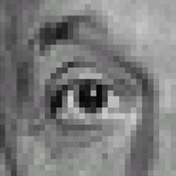
Practice with linear filters
0
0
0
-
1
1
1
0
2
0
1
1
1
0
0
0
1
1
1
Original
Sharpening filter
  Accentuates differences with local average
Source: D. Lowe

Slide 61

Sharpening
Source: D. Lowe

Slide 62


Other filters
1
0
-1
2
0
-2
1
0
-1
Sobel
Vertical Edge
(absolute value)

Slide 63

Other filters
1
2
1
0
0
0
-1
-2
-1
Sobel
Horizontal Edge
(absolute value)
Notes:
Questions at this point?

Slide 64
How could we synthesize motion blur?
theta = 30; len = 20;
fil = imrotate(ones(1, len), theta, 'bilinear');
fil = fil / sum(fil(:));
figure(2), imshow(imfilter(im, fil));

Slide 65
Filtering vs. Convolution
f=filter, size k x l
I=image, size m x n
2d filtering
2d convolution
In Python you can use https://docs.scipy.org/doc/scipy/reference/generated/scipy.signal.convolve2d.html

Slide 66
Key properties of linear filters
Linearity:
imfilter(I, f₁ + f₂) =
imfilter(I,f₁) + imfilter(I,f₂)
Shift invariance: same behavior regardless of pixel location
imfilter(I,shift(f)) = shift(imfilter(I,f))
Any linear, shift-invariant operator can be represented as a convolution
Source: S. Lazebnik
Notes:
f is image

Slide 67
More properties
Commutative: a * b = b * a
  Conceptually no difference between filter and signal
  But particular filtering implementations might break this equality
Associative: a * (b * c) = (a * b) * c
  Often apply several filters one after another: (((a * b₁) * b₂) * b₃)
  This is equivalent to applying one filter: a * (b₁ * b₂ * b₃)
Distributes over addition: a * (b + c) = (a * b) + (a * c)
Scalars factor out: ka * b = a * kb = k (a * b)
Identity: unit impulse e = [0, 0, 1, 0, 0],
a * e = a
Source: S. Lazebnik

Slide 68

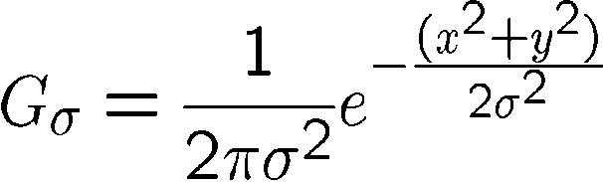
Important filter: Gaussian
Weight contributions of neighboring pixels by nearness
0.003 0.013 0.022 0.013 0.003
0.013 0.059 0.097 0.059 0.013
0.022 0.097 0.159 0.097 0.022
0.013 0.059 0.097 0.059 0.013
0.003 0.013 0.022 0.013 0.003
5 x 5, σ = 1
Slide credit: Christopher Rasmussen
Notes:
e^0 = 1, e^-1 = .37, e^-2 = .14, etc.

Slide 69

Smoothing with Gaussian filter

Slide 70
Smoothing with box filter

Slide 71
Gaussian filters
Remove “high-frequency” components from the image (low-pass filter)
  Images become more smooth
Convolution with self is another Gaussian
  So can smooth with small-width kernel, repeat, and get same result as larger-width kernel would have
  Convolving two times with Gaussian kernel of width σ is same as convolving once with kernel of width σ√2
Separable kernel
  Factors into product of two 1D Gaussians
Source: K. Grauman
Notes:
Linear vs. quadratic in mask size

Slide 72
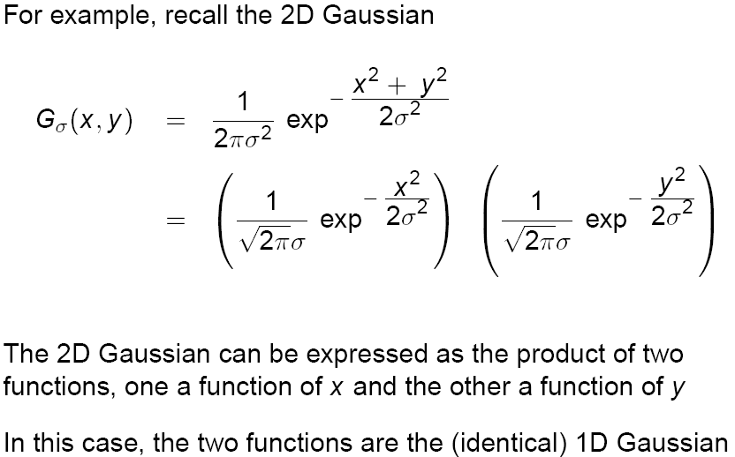
Separability of the Gaussian filter
Source: D. Lowe

Slide 73
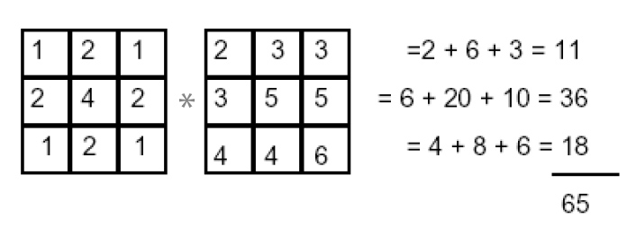
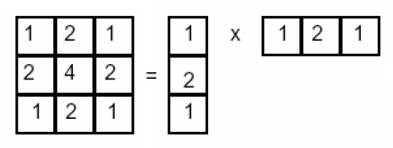
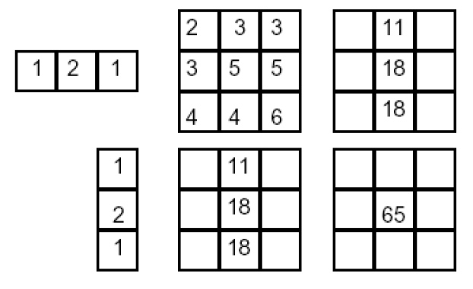
Separability example
2D convolution
(center location only)
The filter factors
into a product of 1D
filters:
Perform convolution
along rows:
*
=
Followed by convolution
along the remaining column:
*
=
Source: K. Grauman
Notes:
Convolution vs filtering doesn’t matter here because the filter is symmetric

Slide 74
Separability
Why is separability useful in practice?

Slide 75
Some practical matters

Slide 76
Practical matters
How big should the filter be?
Values at edges should be near zero
Rule of thumb for Gaussian: set filter half-width to about 3 σ

Slide 77













Practical matters
What about near the edge?
  the filter window falls off the edge of the image
  need to extrapolate
  methods:
    clip filter (black)
    wrap around
    copy edge
    reflect across edge
Source: S. Marschner

Slide 78
To be continued…

Slide 79
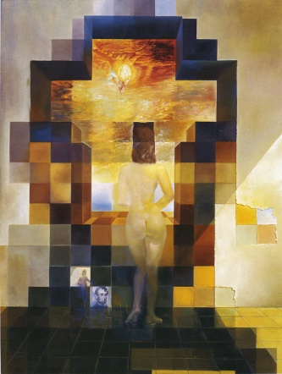
Next class: Light and Color and
Thinking in Frequency

