Slide 1
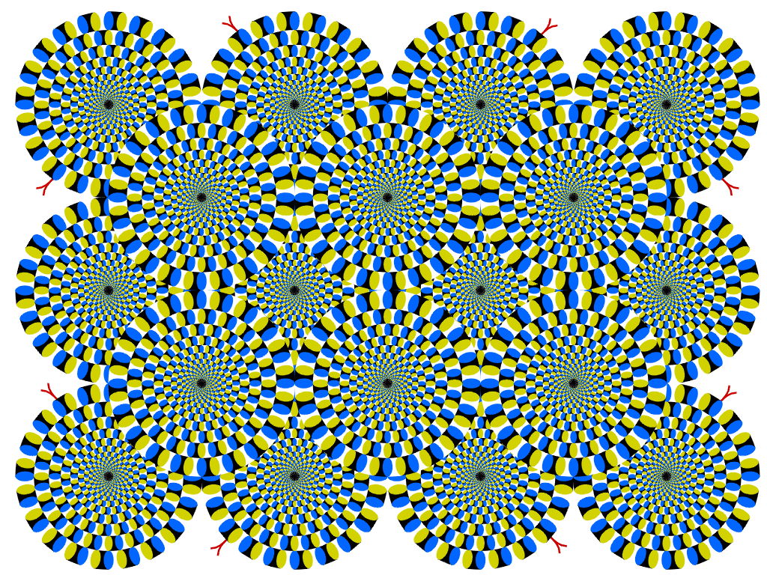

Slide 2

Recap: projection
X
x

Slide 3
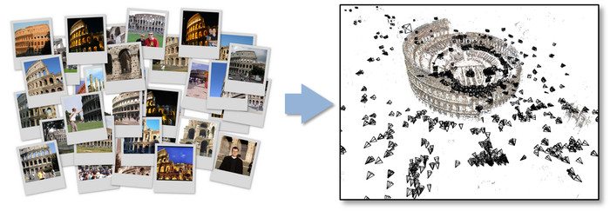
Relating multiple views
Figure Credit: Bundler: Structure from Motion (SfM) for Unordered Image Collections

Slide 4
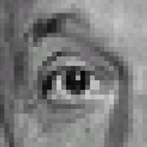

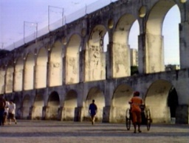
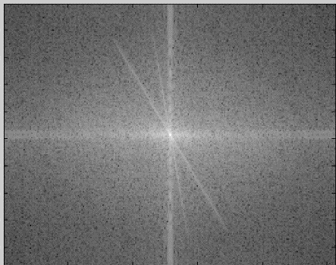
Recap of Filtering
Linear filtering is dot product at each position
  Not a matrix multiplication
  Can smooth, sharpen, translate (among many other uses)
We can use the Fourier transform to represent images in the frequency domain.
  Filtering in the spatial domain is multiplication in the frequency domain.
1
1
1
1
1
1
1
1
1

Slide 5
This lecture
Image Formation
Biological Vision
Light and Color

Slide 6
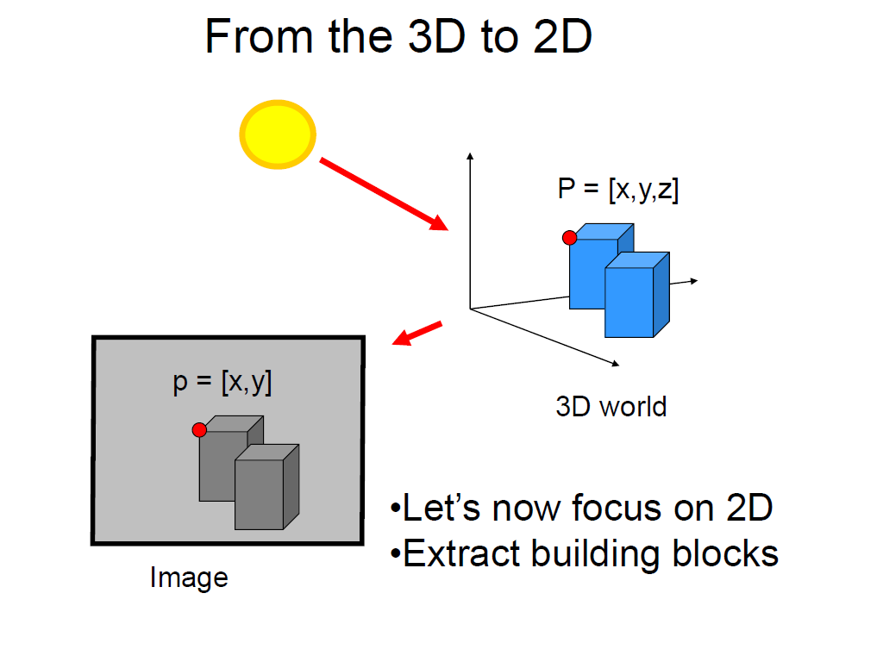
Slide credit Fei Fei Li

Slide 7


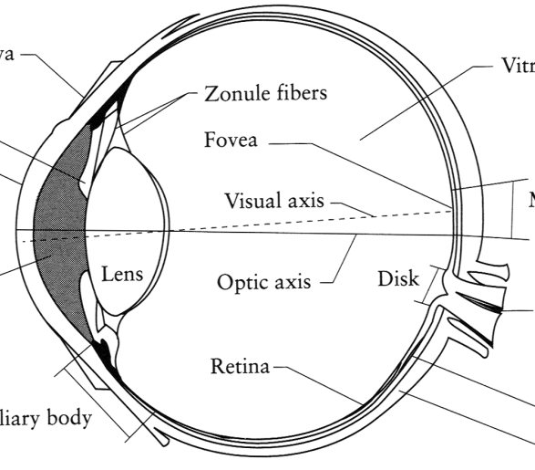
Image Formation
Digital Camera
Film
The Eye

Slide 8
A photon’s life choices
Absorption
Diffusion
Reflection
Transparency
Refraction
Fluorescence
Subsurface scattering
Phosphorescence
Interreflection
light source
λ
?

Slide 9
A photon’s life choices
Absorption
Diffusion
Reflection
Transparency
Refraction
Fluorescence
Subsurface scattering
Phosphorescence
Interreflection
light source
λ

Slide 10
A photon’s life choices
Absorption
Diffuse Reflection
Reflection
Transparency
Refraction
Fluorescence
Subsurface scattering
Phosphorescence
Interreflection
light source
λ

Slide 11
A photon’s life choices
Absorption
Diffusion
Specular Reflection
Transparency
Refraction
Fluorescence
Subsurface scattering
Phosphorescence
Interreflection
light source
λ

Slide 12
A photon’s life choices
Absorption
Diffusion
Reflection
Transparency
Refraction
Fluorescence
Subsurface scattering
Phosphorescence
Interreflection
light source
λ

Slide 13
A photon’s life choices
Absorption
Diffusion
Reflection
Transparency
Refraction
Fluorescence
Subsurface scattering
Phosphorescence
Interreflection
light source
λ

Slide 14
A photon’s life choices
Absorption
Diffusion
Reflection
Transparency
Refraction
Fluorescence
Subsurface scattering
Phosphorescence
Interreflection
light source
λ₁
λ₂

Slide 15
A photon’s life choices
Absorption
Diffusion
Reflection
Transparency
Refraction
Fluorescence
Subsurface scattering
Phosphorescence
Interreflection
light source
λ

Slide 16
A photon’s life choices
Absorption
Diffusion
Reflection
Transparency
Refraction
Fluorescence
Subsurface scattering
Phosphorescence
Interreflection
light source
t=1
t=n

Slide 17
A photon’s life choices
Absorption
Diffusion
Reflection
Transparency
Refraction
Fluorescence
Subsurface scattering
Phosphorescence
Interreflection
light source
λ
(Specular Interreflection)

Slide 18
Lambertian Reflectance
In computer vision, the complexity of light transport is mostly ignored.
Surfaces are often assumed to be ideal diffuse reflectors with no dependence on viewing direction.

Slide 19

Digital camera
A digital camera replaces film with a sensor array
  Each cell in the array is light-sensitive diode that converts photons to electrons
  Two common types
    Charge Coupled Device (CCD)
    CMOS
  http://electronics.howstuffworks.com/digital-camera.htm
Slide by Steve Seitz

Slide 20
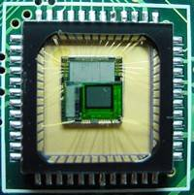
Sensor Array
CMOS sensor

Slide 21
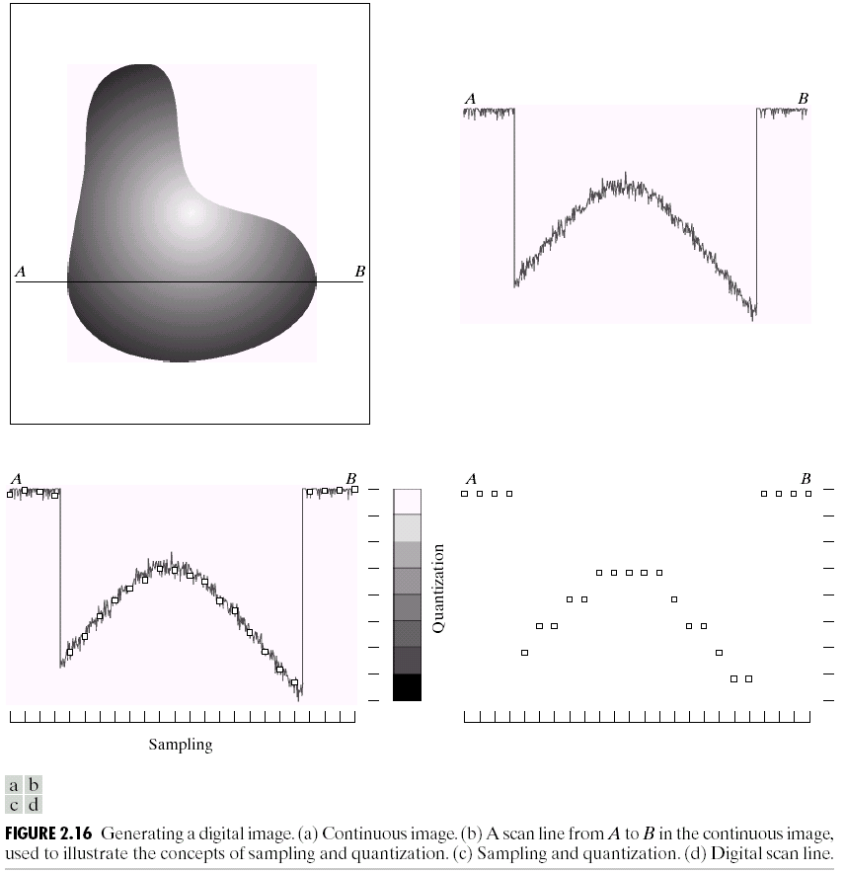
Sampling and Quantization

Slide 22
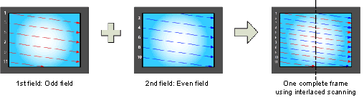
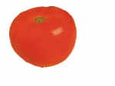
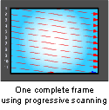
Interlace vs. progressive scan
http://www.axis.com/products/video/camera/progressive_scan.htm
Slide by Steve Seitz

Slide 23
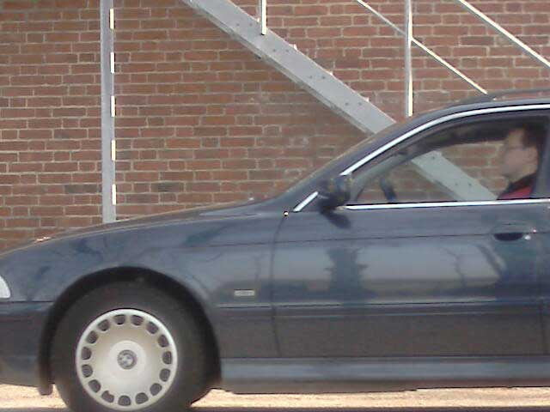
Progressive scan or Global shutter
http://www.axis.com/products/video/camera/progressive_scan.htm
Slide by Steve Seitz

Slide 24
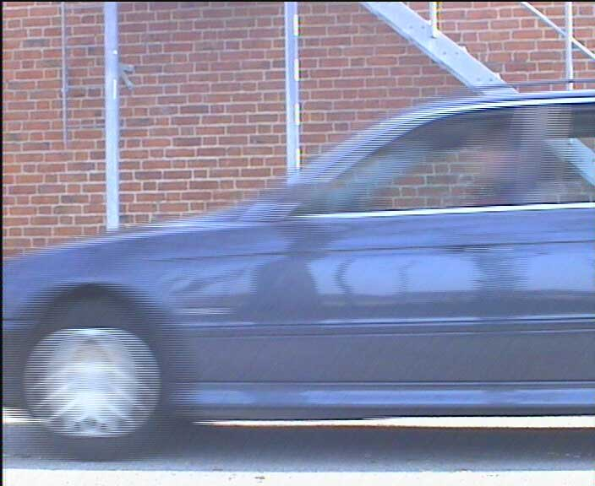
Interlaced
http://www.axis.com/products/video/camera/progressive_scan.htm
Slide by Steve Seitz

Slide 25
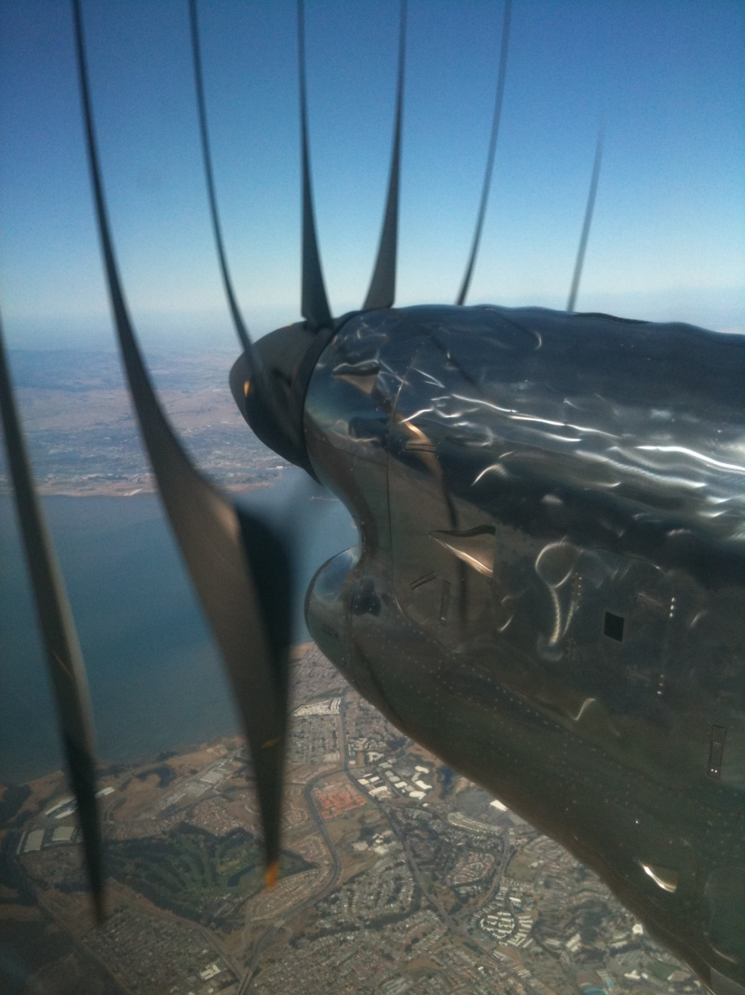
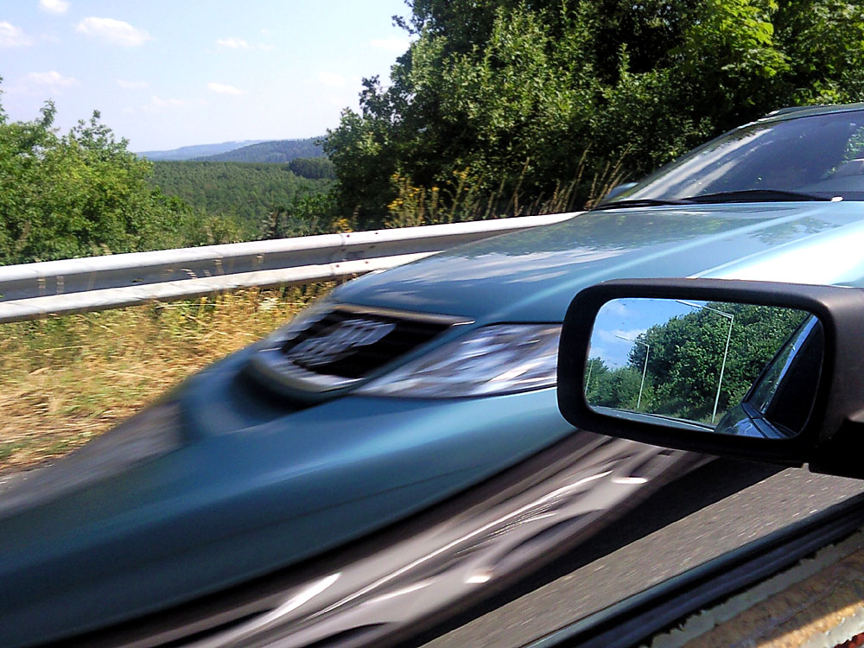
Rolling Shutter
Notes:
http://en.wikipedia.org/wiki/Rolling_shutter
Even DSLRs have this problem.

Slide 26

The Eye
The human eye is a camera!
  Iris - colored annulus with radial muscles
  Pupil - the hole (aperture) whose size is controlled by the iris
  What’s the “film”?
    photoreceptor cells (rods and cones) in the retina
Slide by Steve Seitz

Slide 27
Aside: why do we care about human vision in this class?
We don’t, necessarily.

Slide 28
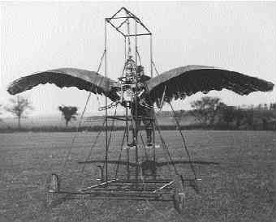
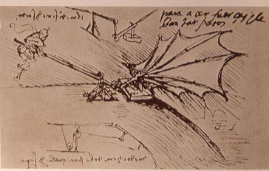
Ornithopters

Slide 29
Why do we care about human vision?
We don’t, necessarily.
But cameras necessarily imitate the frequency response of the human eye, so we should know that much.
Also, computer vision probably wouldn’t get as much scrutiny if biological vision (especially human vision) hadn’t proved that it was possible to make important judgements from 2d images.

Slide 30
Does computer vision “understand” images?
"Can machines fly?" The answer is yes, because airplanes fly.
"Can machines swim?" The answer is no, because submarines don't swim.
"Can machines think?" Is this question like the first, or like the second?
Source: Norvig

Slide 31
The Retina

Slide 32
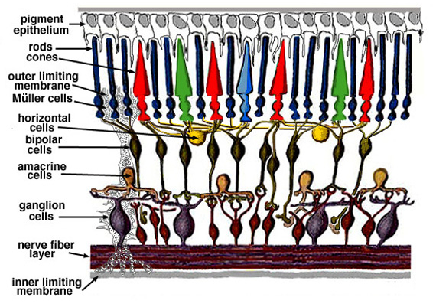
Retina up-close
Light
Notes:
Tapetum lucidum

Slide 33
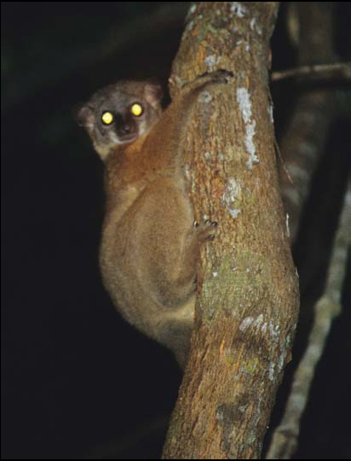
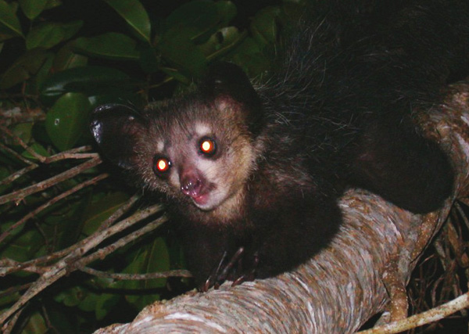
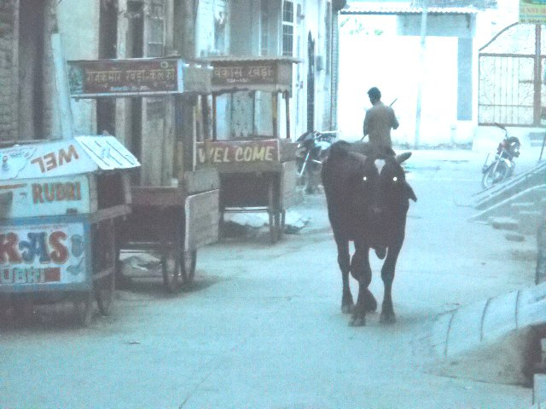
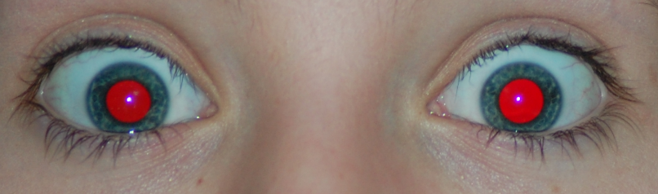
What humans don’t have: tapetum lucidum
Human eyes can reflect a tiny bit and blood in the retina makes this reflection red.
Notes:
Animals with Tapetum Lucidum also have RPE, just not in the same part of the eye.

Slide 34
Two types of light-sensitive receptors
Cones
cone-shaped
less sensitive
operate in high light
color vision
Rods
rod-shaped
highly sensitive
operate at night
gray-scale vision
© Stephen E. Palmer, 2002

Slide 35
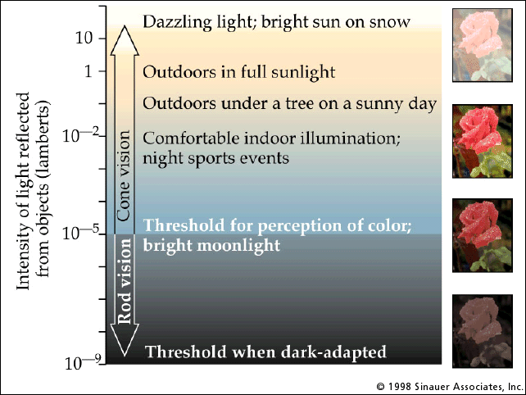
Rod / Cone sensitivity

Slide 36
Distribution of Rods and Cones
Night Sky: why are there more stars off-center?
Averted vision: http://en.wikipedia.org/wiki/Averted_vision
© Stephen E. Palmer, 2002

Slide 37
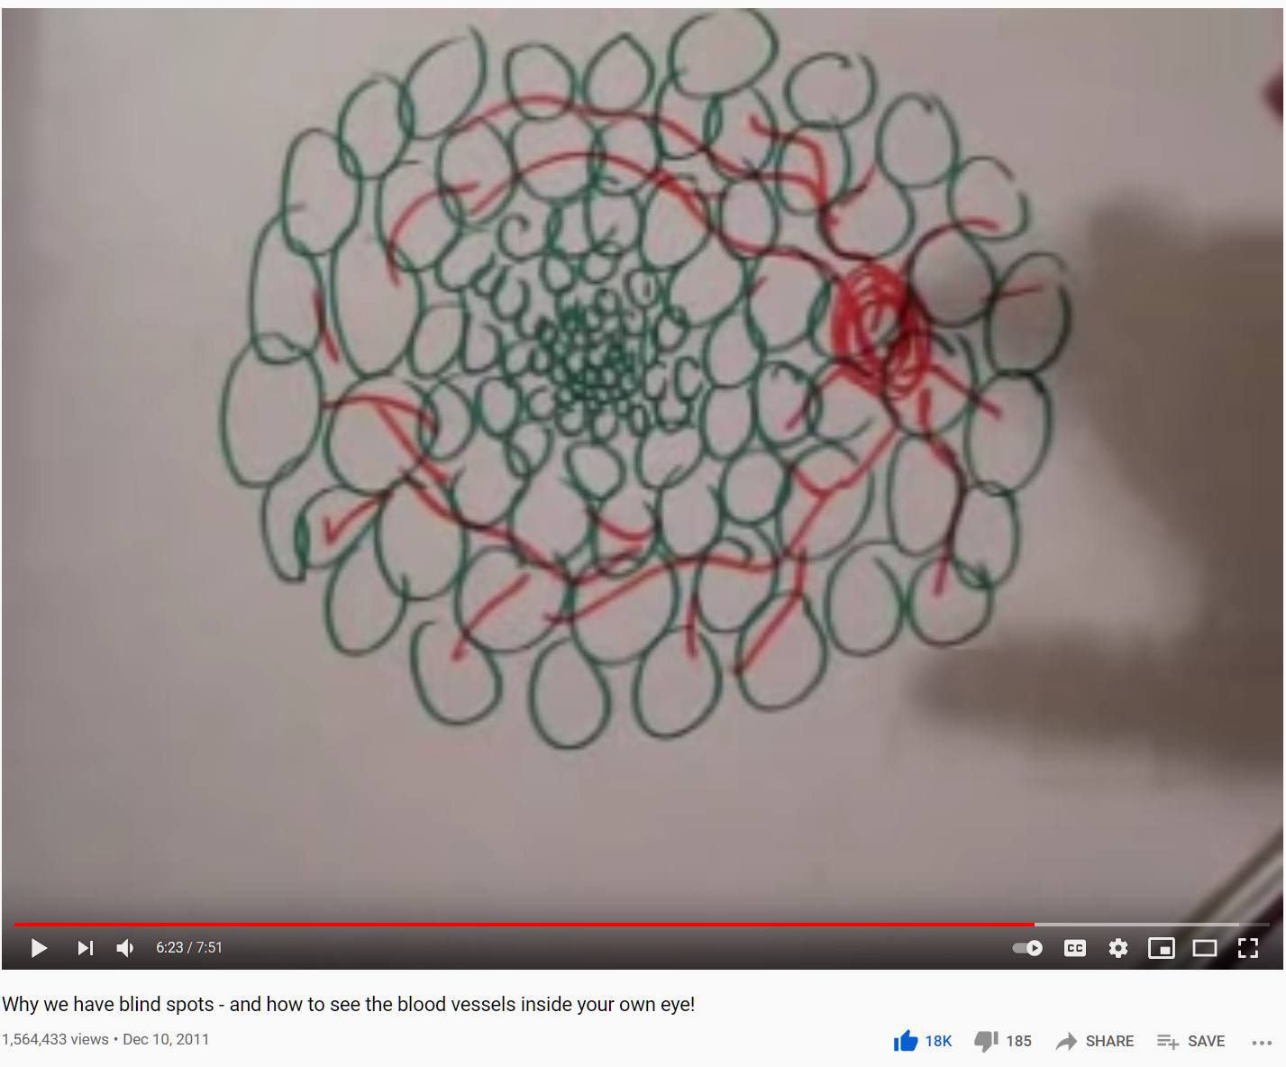
Wait, the blood vessels are in front of the photoreceptors??
https://www.youtube.com/watch?v=L_W-IXqoxHA
Notes:
Yes, and you can see them!

Slide 39
Eye Movements
Saccades
Can be consciously controlled. Related to perceptual attention.
200ms to initiation, 20 to 200ms to carry out. Large amplitude.
Microsaccades
Involuntary. Smaller amplitude. Especially evident during prolonged fixation. Function debated.
Ocular microtremor (OMT)
Involuntary. high frequency (up to 80Hz), small amplitude.
Smooth pursuit – tracking an object

Slide 40
Slow mo guys – Saccades and CRTs
https://youtu.be/Fmg9ZOHESgQ?t=21s
https://youtu.be/3BJU2drrtCM

Slide 41
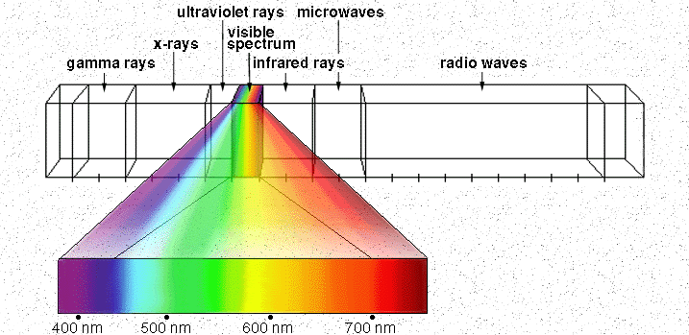

Electromagnetic Spectrum
Human Luminance Sensitivity Function
http://www.yorku.ca/eye/photopik.htm
Notes:
At least 3 spectral bands required (e.g. R,G,B)

