Slide 1
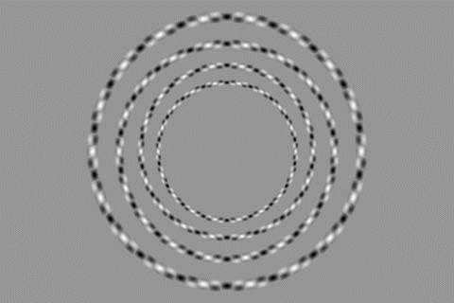

Slide 2
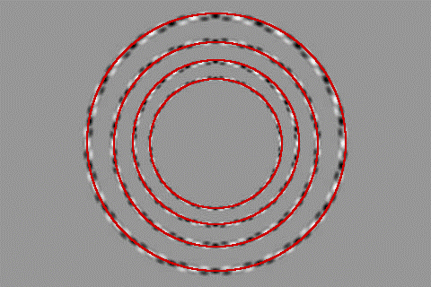

Slide 3
Recap: Frequency Domain

Slide 4
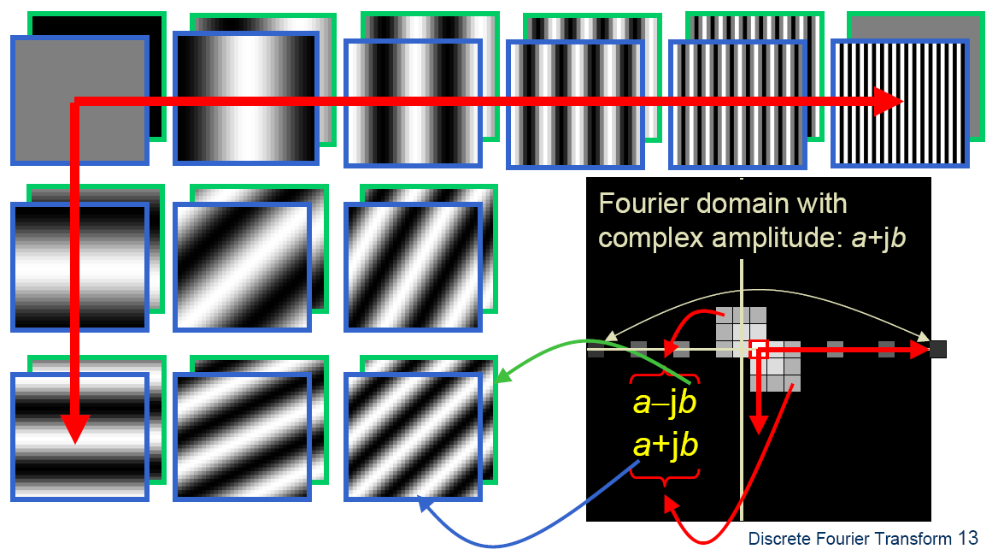
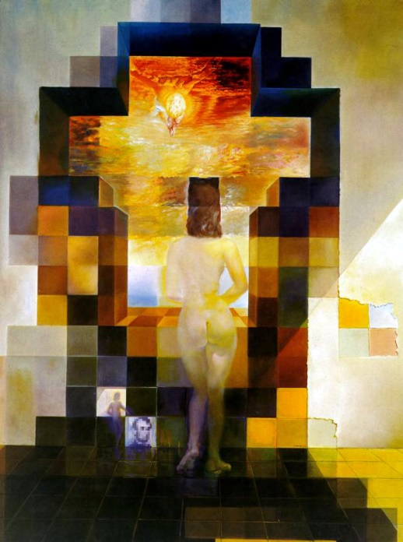
Fourier Bases
Teases away fast vs. slow changes in the image.
This change of basis is the Fourier Transform

Slide 5
Fourier Bases
in Matlab, check out: imagesc(log(abs(fftshift(fft2(im)))));

Slide 6
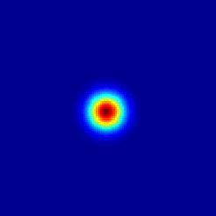
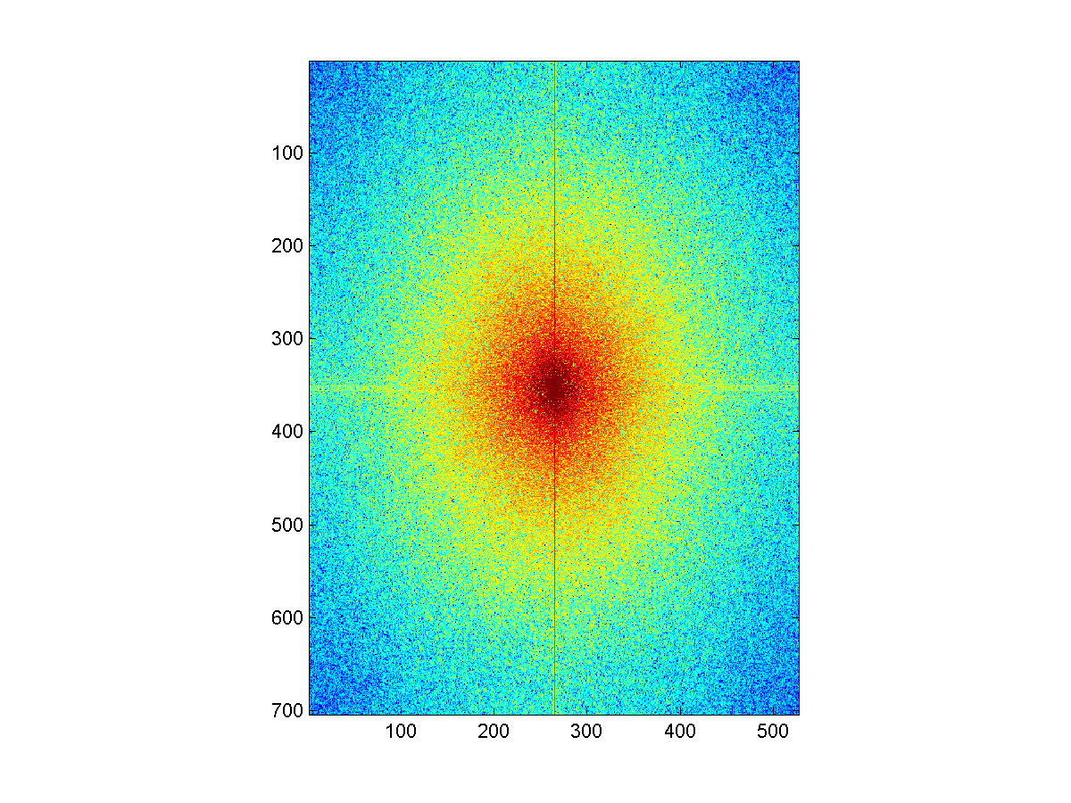
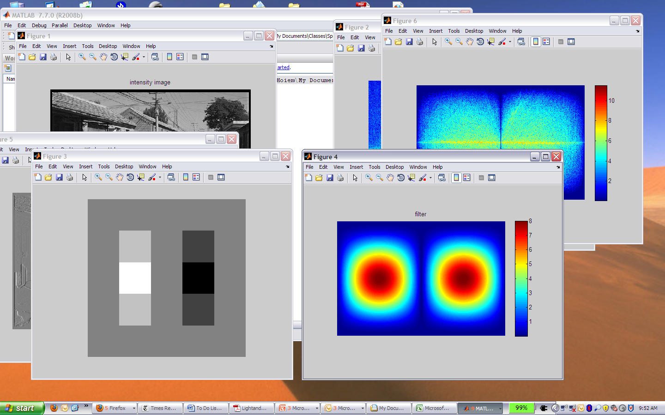
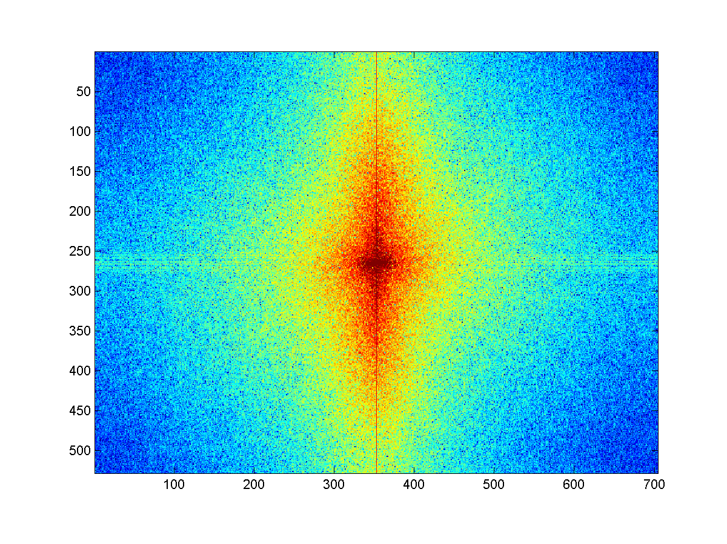
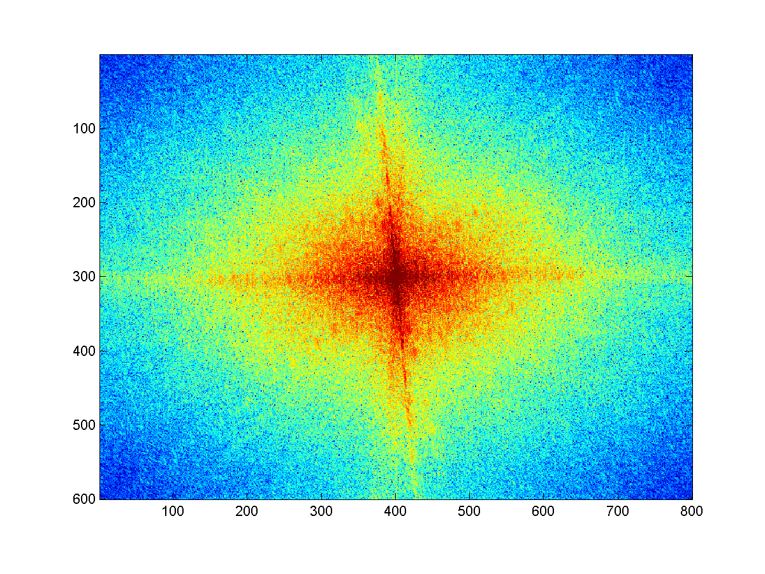
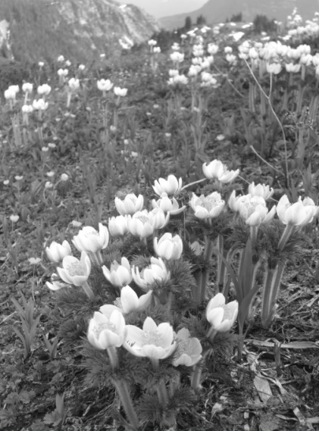
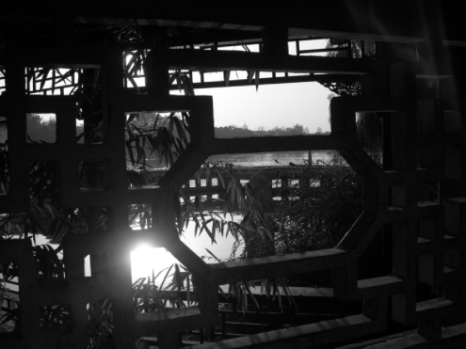
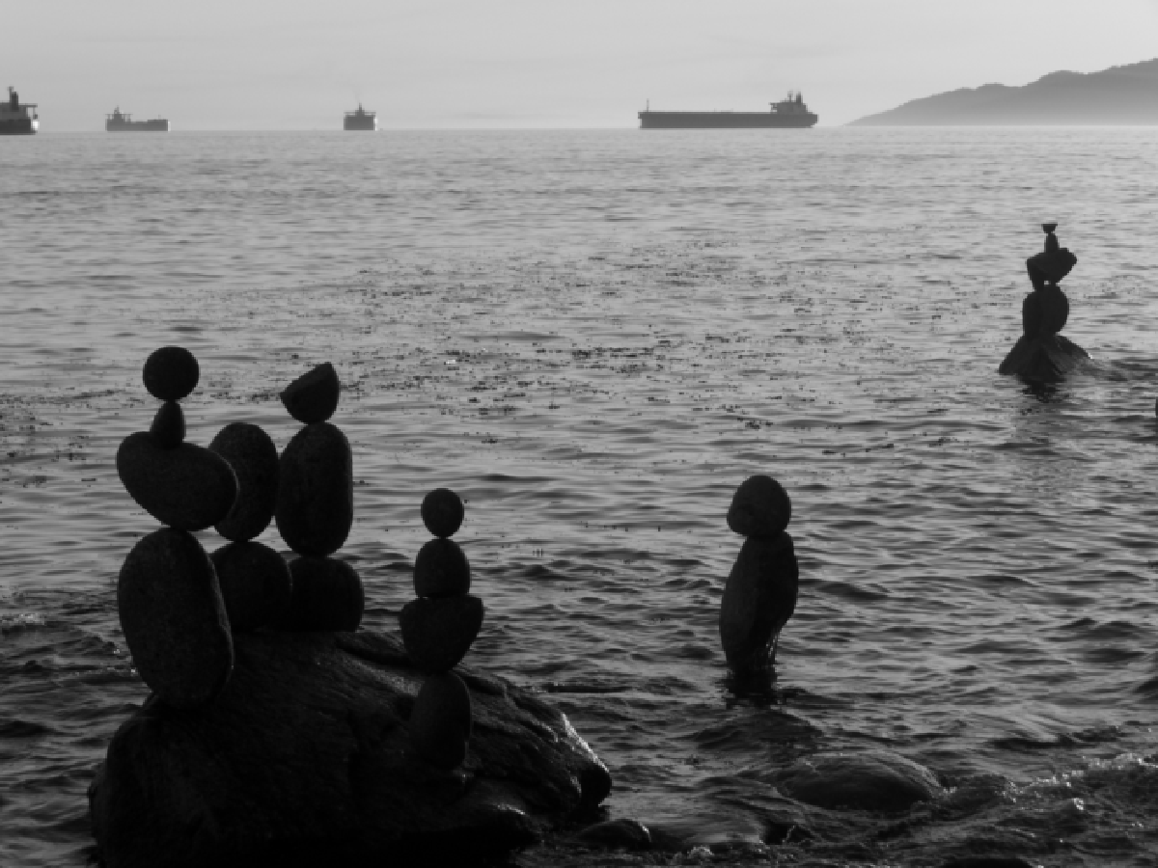


Review
Match the spatial domain image to the Fourier magnitude image
1
2
3
4
5
B
A
C
E
D
Notes:
1 - D
2 – B
3 – A
4 - E
5 - C

Slide 7
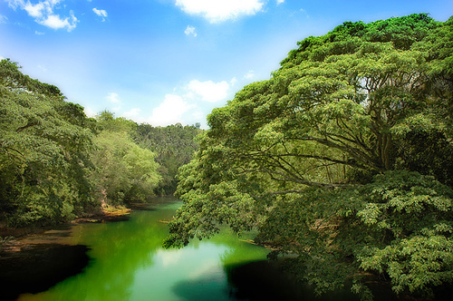
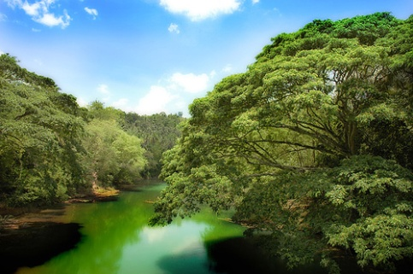
Sampling
Why does a lower resolution image still make sense to us? What do we lose?
Image: http://www.flickr.com/photos/igorms/136916757/

Slide 8
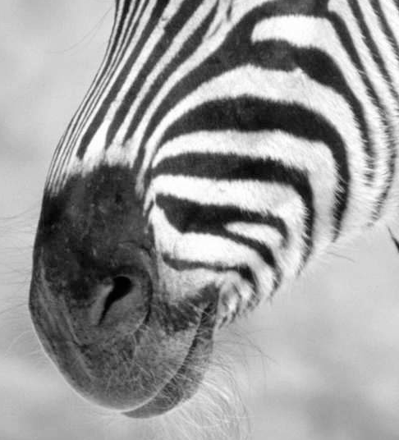
Subsampling by a factor of 2
Throw away every other row and column to create a 1/2 size image

Slide 9
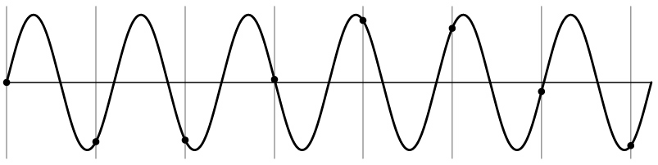
Aliasing problem
1D example (sinewave):
Source: S. Marschner

Slide 10
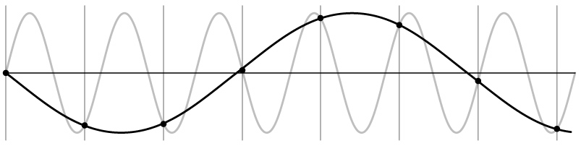
Aliasing problem
1D example (sinewave):
Source: S. Marschner

Slide 11
Aliasing problem
Sub-sampling may be dangerous….
Characteristic errors may appear:
  “car wheels rolling the wrong way in movies”
  “Checkerboards disintegrate in ray tracing”
  “Striped shirts look funny on color television”
Source: D. Forsyth

Slide 12
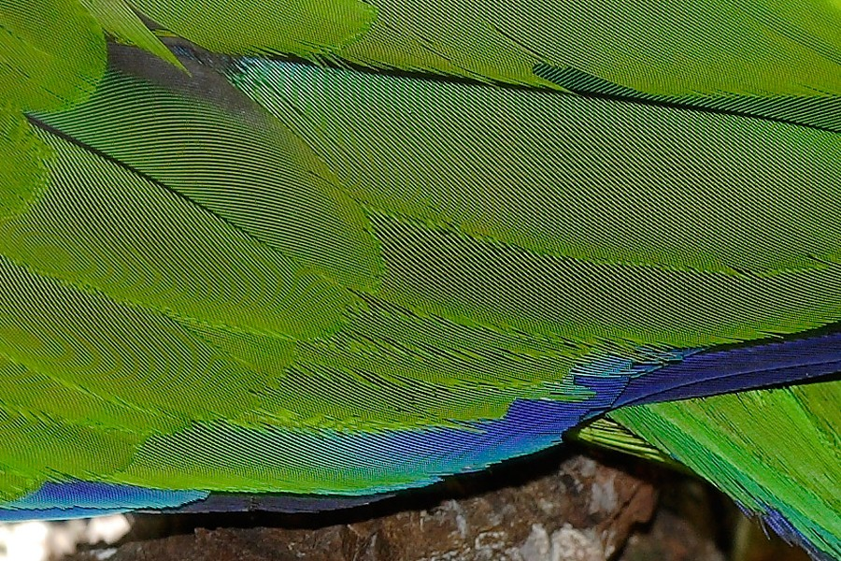
A form of spatial aliasing: Moire Pattern
https://en.wikipedia.org/wiki/Moir%C3%A9_pattern

Slide 13
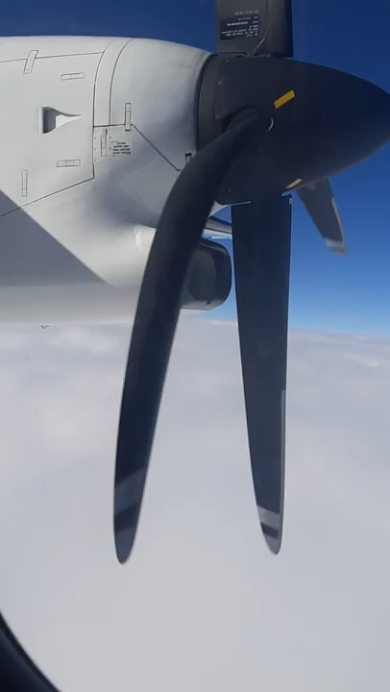
Notes:
https://www.youtube.com/watch?v=dNVtMmLlnoE

Slide 14
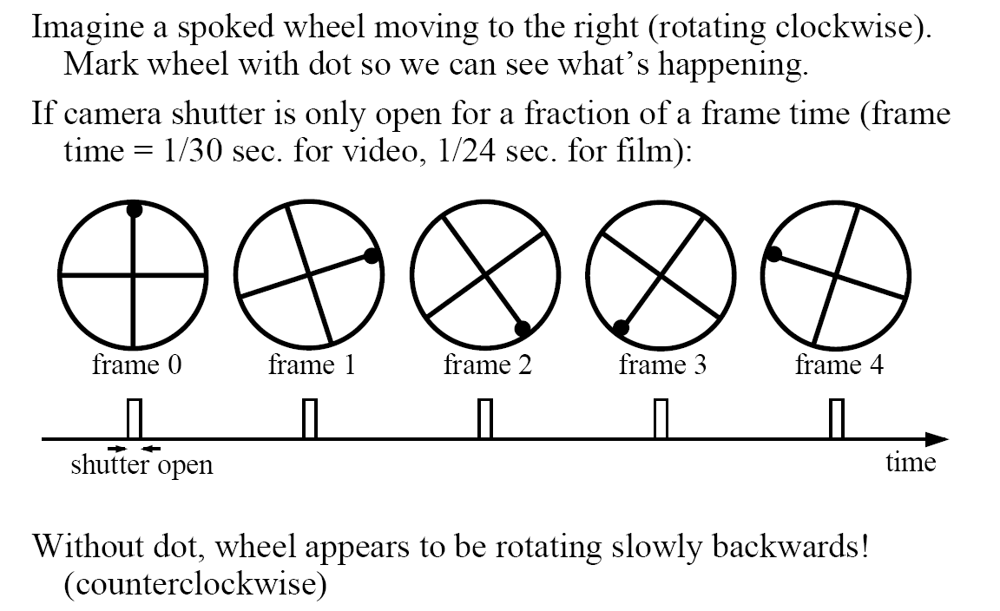
Aliasing in video
Slide by Steve Seitz

Slide 15
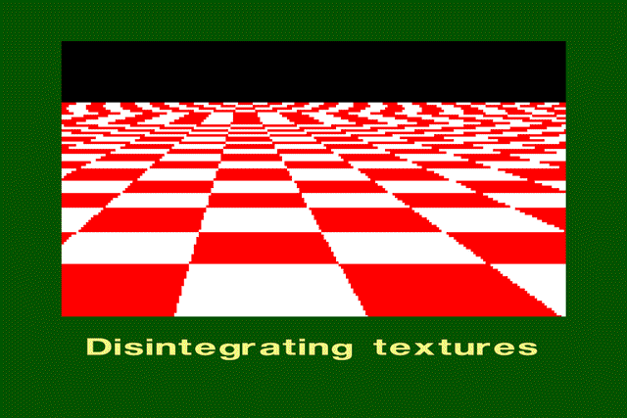
Aliasing in graphics
Source: A. Efros

Slide 16
Sampling and aliasing

Slide 17
Nyquist-Shannon Sampling Theorem
When sampling a signal at discrete intervals, the sampling frequency must be ≥ 2 × f_{max}
f_{max} = max frequency of the input signal
This will allows to reconstruct the original perfectly from the sampled version
v
v
v
good
bad

Slide 18
Anti-aliasing
Solutions:
Sample more often
Get rid of all frequencies that are greater than half the new sampling frequency
  Will lose information
  But it’s better than aliasing
  Apply a smoothing filter

Slide 19
Algorithm for downsampling by factor of 2
Start with image(h, w)
Apply low-pass filter
  im_blur = imfilter(image, fspecial(‘gaussian’, 7, 1))
Sample every other pixel
  im_small = im_blur(1:2:end, 1:2:end);

Slide 20
Anti-aliasing
Forsyth and Ponce 2002

Slide 21



Subsampling without pre-filtering
1/2
1/4 (2x zoom)
1/8 (4x zoom)
Slide by Steve Seitz

Slide 22



Subsampling with Gaussian pre-filtering
Gaussian 1/2
G 1/4
G 1/8
Slide by Steve Seitz

Slide 23

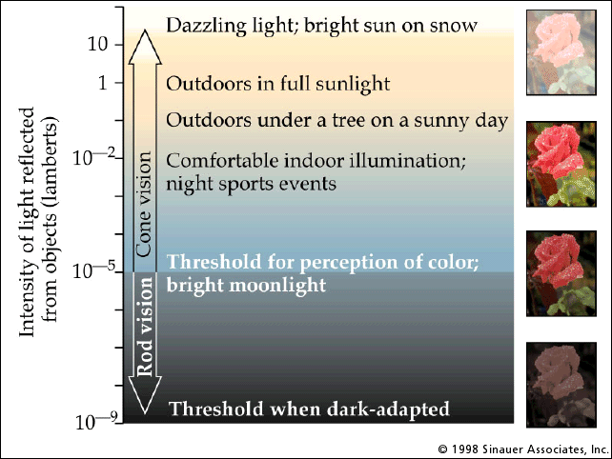
Recap – Light, Cameras, Eyes
λ
light source
?

Slide 24
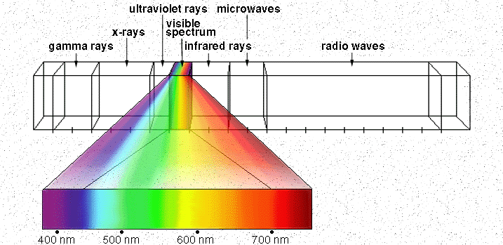

Electromagnetic Spectrum
Human Luminance Sensitivity Function
http://www.yorku.ca/eye/photopik.htm
Notes:
At least 3 spectral bands required (e.g. R,G,B)

Slide 25
Visible Light
Why do we see light of these wavelengths?
…because that’s where the
Sun radiates EM energy
© Stephen E. Palmer, 2002
Notes:
Because that’s where the Sun’s peak radiation was
Because the atmosphere is fairly transparent in that range
Because biology has many important markers in that range (but that’s because of the previous two reasons)

Slide 26
The Physics of Light
Any patch of light can be completely described
physically by its spectrum: the number of photons
(per time unit) at each wavelength 400 - 700 nm.
© Stephen E. Palmer, 2002

Slide 27
The Physics of Light
Some examples of the spectra of light sources
© Stephen E. Palmer, 2002

Slide 28
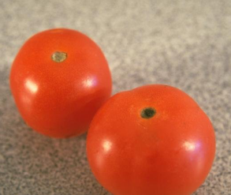
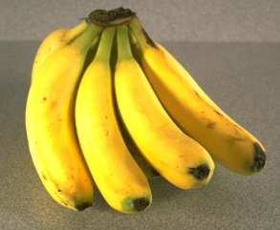
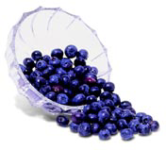
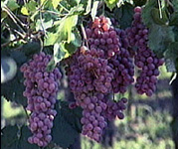
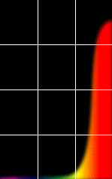
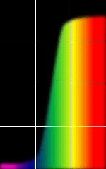
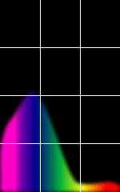
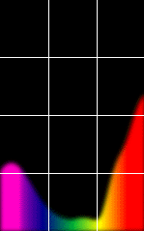
The Physics of Light
Some examples of the reflectance spectra of surfaces
Red
Yellow
Blue
Purple
% Photons Reflected
400 700
400 700
400 700
400 700
Wavelength (nm)
© Stephen E. Palmer, 2002

Slide 29
The Psychophysical Correspondence
There is no simple functional description for the perceived
color of all lights under all viewing conditions, but …...
A helpful constraint:
Consider only physical spectra with normal distributions
mean
area
variance
© Stephen E. Palmer, 2002

Slide 30
The Psychophysical Correspondence
Mean
Hue
# Photons
Wavelength
© Stephen E. Palmer, 2002

Slide 31
The Psychophysical Correspondence
Variance
Saturation
# Photons
Wavelength
© Stephen E. Palmer, 2002

Slide 32
The Psychophysical Correspondence
Area
Brightness
# Photons
Wavelength
© Stephen E. Palmer, 2002

Slide 33
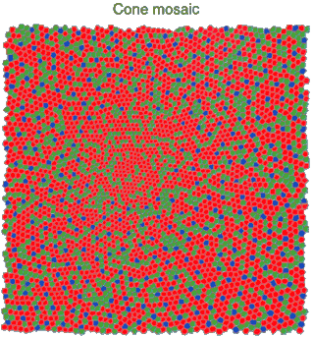
Physiology of Color Vision
Three kinds of cones:
Why are M and L cones so close?
Why are there 3?
© Stephen E. Palmer, 2002

Slide 34


Impossible Colors
Can you make the cones respond in ways that typical light spectra never would?
http://en.wikipedia.org/wiki/Impossible_colors

Slide 35
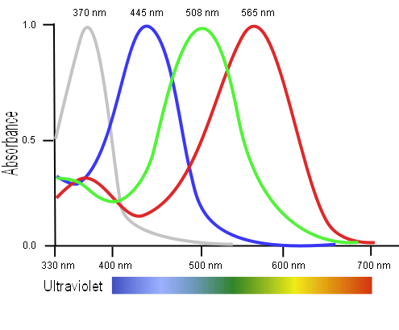
Tetrachromacy
Bird cone responses
Most birds, and many other animals, have cones for ultraviolet light.
Some humans, mostly female, seem to have slight tetrachromatism.

Slide 36
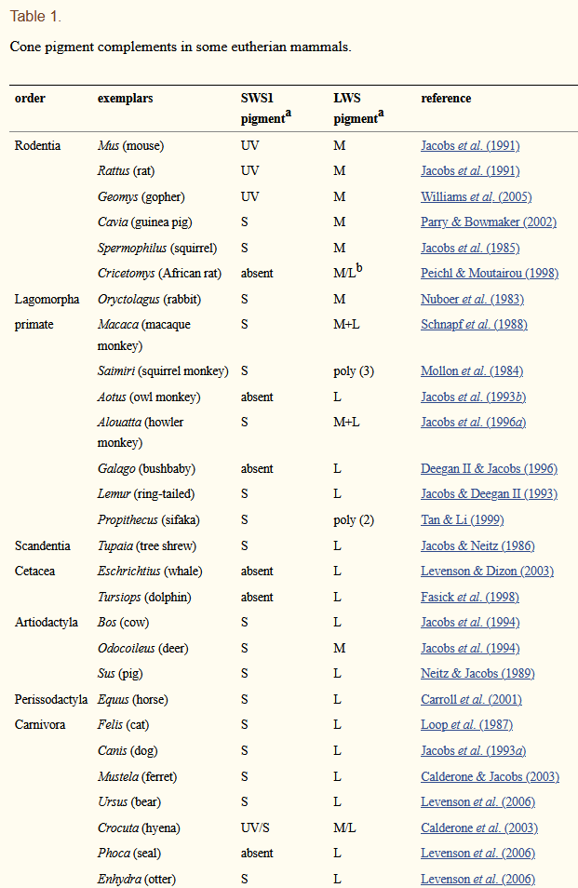
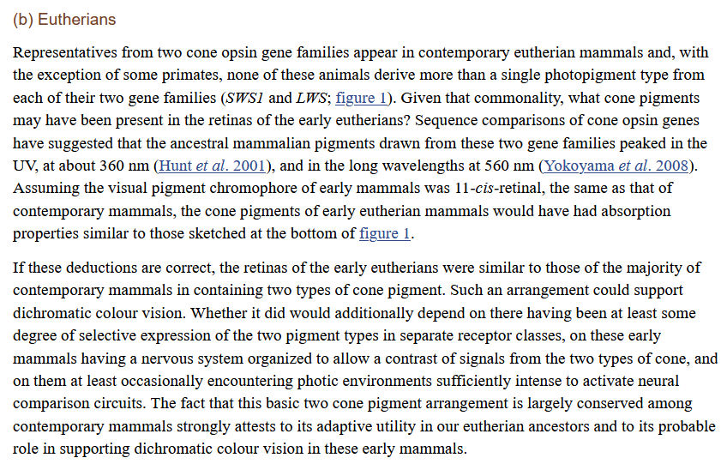
Jacobs GH. Evolution of colour vision in mammals. Philos Trans R Soc Lond B Biol Sci. 2009;364(1531):2957-2967. doi:10.1098/rstb.2009.0039

Slide 37
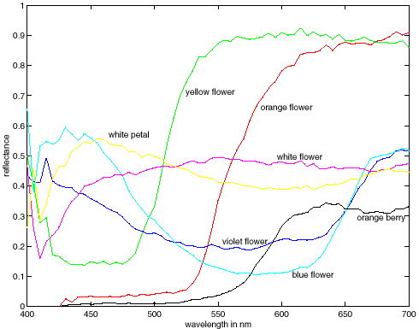
More Spectra
metamers
Notes:
Metamerism can be illuminant based or observer based. Color blindness produced well known instances of metamerism.

Slide 38
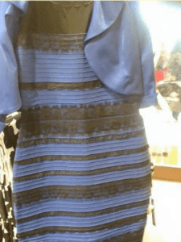
Color can be ambiguous

Slide 39
Color can be ambiguous

Slide 40
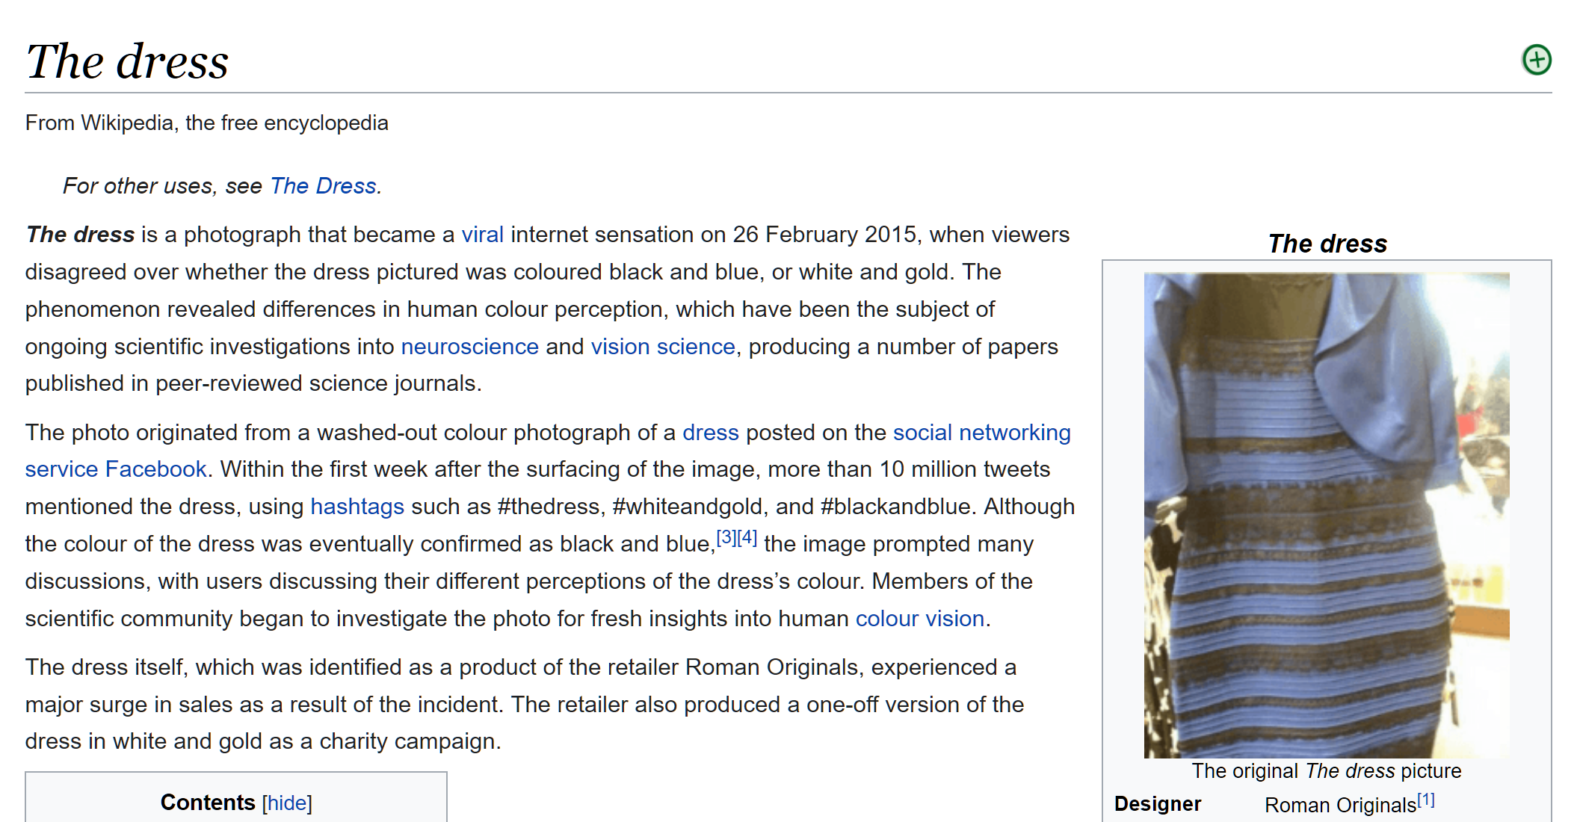
https://en.wikipedia.org/wiki/The_dress

Slide 41
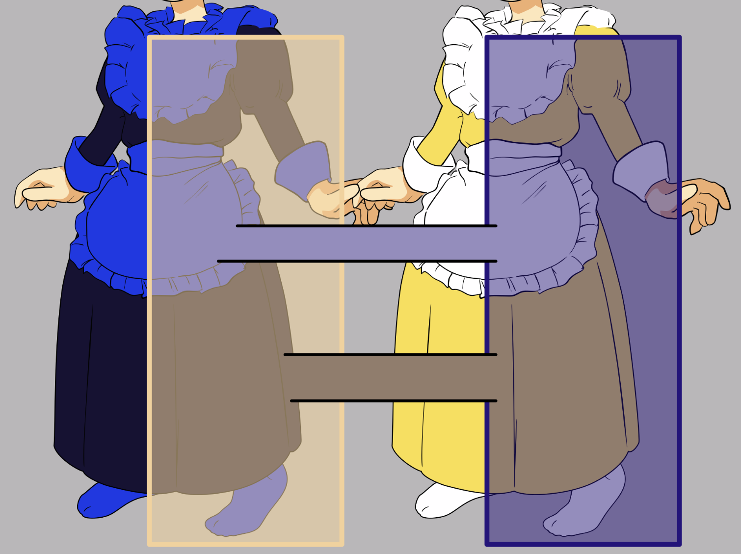
https://en.wikipedia.org/wiki/The_dress
Notes:
https://en.wikipedia.org/wiki/The_dress

Slide 42
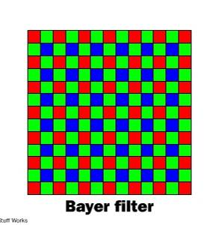
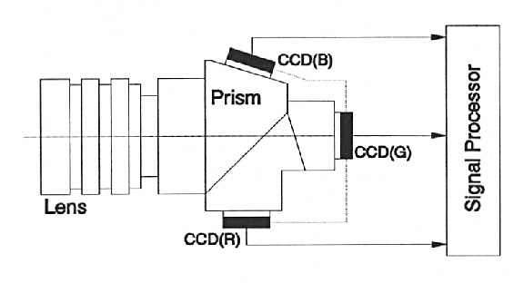
Color Sensing in Camera (RGB)
3-chip vs. 1-chip: quality vs. cost
Why more green?
Why 3 colors?
http://www.cooldictionary.com/words/Bayer-filter.wikipedia
Slide by Steve Seitz

Slide 43


Practical Color Sensing: Bayer Grid
Estimate RGB
at ‘G’ cells from neighboring values
Slide by Steve Seitz

Slide 44
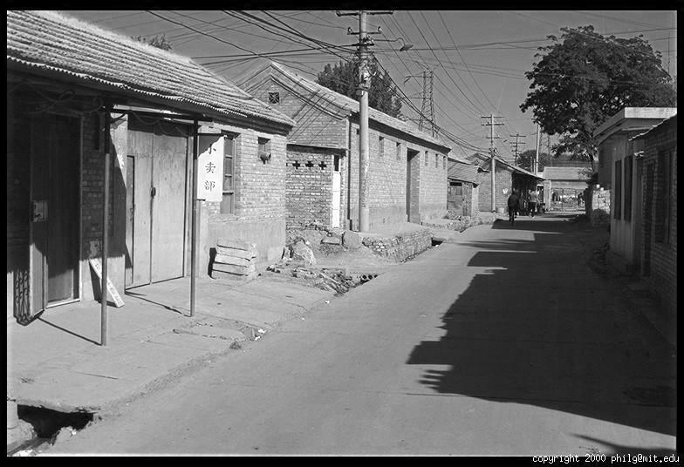
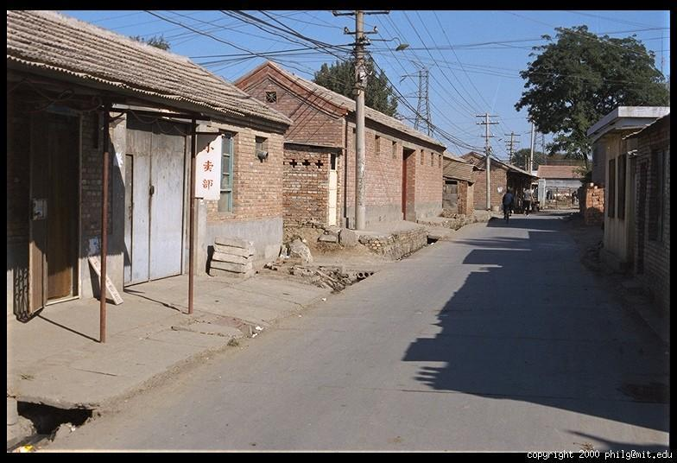
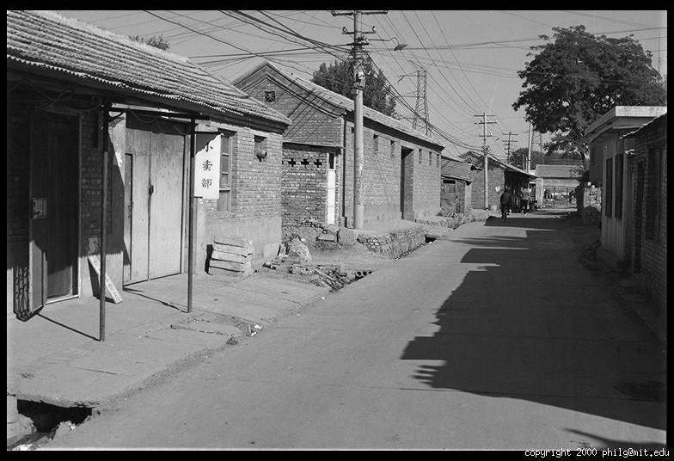
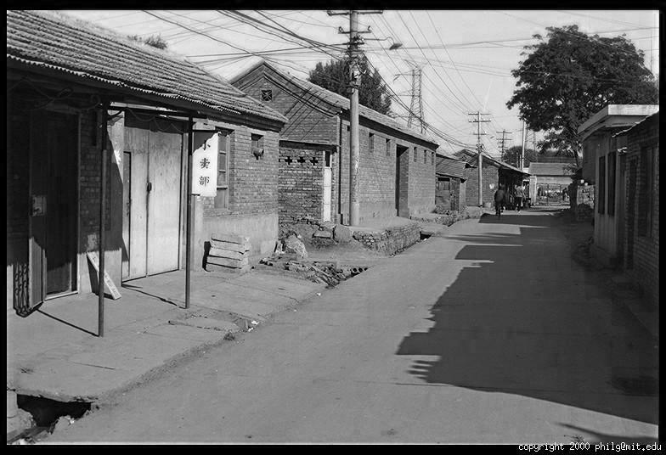
Color Image
R
G
B

Slide 45
Images in Matlab
Images represented as a matrix
Suppose we have a NxM RGB image called “im”
  im(1,1,1) = top-left pixel value in R-channel
  im(y, x, b) = y pixels down, x pixels to right in the b^{th} channel
  im(N, M, 3) = bottom-right pixel in B-channel
column
row
R
0.92 | 0.93 | 0.94 | 0.97 | 0.62 | 0.37 | 0.85 | 0.97 | 0.93 | 0.92 | 0.99
0.95 | 0.89 | 0.82 | 0.89 | 0.56 | 0.31 | 0.75 | 0.92 | 0.81 | 0.95 | 0.91
0.89 | 0.72 | 0.51 | 0.55 | 0.51 | 0.42 | 0.57 | 0.41 | 0.49 | 0.91 | 0.92
0.96 | 0.95 | 0.88 | 0.94 | 0.56 | 0.46 | 0.91 | 0.87 | 0.90 | 0.97 | 0.95
0.71 | 0.81 | 0.81 | 0.87 | 0.57 | 0.37 | 0.80 | 0.88 | 0.89 | 0.79 | 0.85
0.49 | 0.62 | 0.60 | 0.58 | 0.50 | 0.60 | 0.58 | 0.50 | 0.61 | 0.45 | 0.33
0.86 | 0.84 | 0.74 | 0.58 | 0.51 | 0.39 | 0.73 | 0.92 | 0.91 | 0.49 | 0.74
0.96 | 0.67 | 0.54 | 0.85 | 0.48 | 0.37 | 0.88 | 0.90 | 0.94 | 0.82 | 0.93
0.69 | 0.49 | 0.56 | 0.66 | 0.43 | 0.42 | 0.77 | 0.73 | 0.71 | 0.90 | 0.99
0.79 | 0.73 | 0.90 | 0.67 | 0.33 | 0.61 | 0.69 | 0.79 | 0.73 | 0.93 | 0.97
0.91 | 0.94 | 0.89 | 0.49 | 0.41 | 0.78 | 0.78 | 0.77 | 0.89 | 0.99 | 0.93
G
0.92 | 0.93 | 0.94 | 0.97 | 0.62 | 0.37 | 0.85 | 0.97 | 0.93 | 0.92 | 0.99
0.95 | 0.89 | 0.82 | 0.89 | 0.56 | 0.31 | 0.75 | 0.92 | 0.81 | 0.95 | 0.91
0.89 | 0.72 | 0.51 | 0.55 | 0.51 | 0.42 | 0.57 | 0.41 | 0.49 | 0.91 | 0.92
0.96 | 0.95 | 0.88 | 0.94 | 0.56 | 0.46 | 0.91 | 0.87 | 0.90 | 0.97 | 0.95
0.71 | 0.81 | 0.81 | 0.87 | 0.57 | 0.37 | 0.80 | 0.88 | 0.89 | 0.79 | 0.85
0.49 | 0.62 | 0.60 | 0.58 | 0.50 | 0.60 | 0.58 | 0.50 | 0.61 | 0.45 | 0.33
0.86 | 0.84 | 0.74 | 0.58 | 0.51 | 0.39 | 0.73 | 0.92 | 0.91 | 0.49 | 0.74
0.96 | 0.67 | 0.54 | 0.85 | 0.48 | 0.37 | 0.88 | 0.90 | 0.94 | 0.82 | 0.93
0.69 | 0.49 | 0.56 | 0.66 | 0.43 | 0.42 | 0.77 | 0.73 | 0.71 | 0.90 | 0.99
0.79 | 0.73 | 0.90 | 0.67 | 0.33 | 0.61 | 0.69 | 0.79 | 0.73 | 0.93 | 0.97
0.91 | 0.94 | 0.89 | 0.49 | 0.41 | 0.78 | 0.78 | 0.77 | 0.89 | 0.99 | 0.93
B
0.92 | 0.93 | 0.94 | 0.97 | 0.62 | 0.37 | 0.85 | 0.97 | 0.93 | 0.92 | 0.99
0.95 | 0.89 | 0.82 | 0.89 | 0.56 | 0.31 | 0.75 | 0.92 | 0.81 | 0.95 | 0.91
0.89 | 0.72 | 0.51 | 0.55 | 0.51 | 0.42 | 0.57 | 0.41 | 0.49 | 0.91 | 0.92
0.96 | 0.95 | 0.88 | 0.94 | 0.56 | 0.46 | 0.91 | 0.87 | 0.90 | 0.97 | 0.95
0.71 | 0.81 | 0.81 | 0.87 | 0.57 | 0.37 | 0.80 | 0.88 | 0.89 | 0.79 | 0.85
0.49 | 0.62 | 0.60 | 0.58 | 0.50 | 0.60 | 0.58 | 0.50 | 0.61 | 0.45 | 0.33
0.86 | 0.84 | 0.74 | 0.58 | 0.51 | 0.39 | 0.73 | 0.92 | 0.91 | 0.49 | 0.74
0.96 | 0.67 | 0.54 | 0.85 | 0.48 | 0.37 | 0.88 | 0.90 | 0.94 | 0.82 | 0.93
0.69 | 0.49 | 0.56 | 0.66 | 0.43 | 0.42 | 0.77 | 0.73 | 0.71 | 0.90 | 0.99
0.79 | 0.73 | 0.90 | 0.67 | 0.33 | 0.61 | 0.69 | 0.79 | 0.73 | 0.93 | 0.97
0.91 | 0.94 | 0.89 | 0.49 | 0.41 | 0.78 | 0.78 | 0.77 | 0.89 | 0.99 | 0.93

Slide 46
Images in Matlab Python
Images represented as a matrix
Suppose we have a NxM RGB image called “im”
  im(0,0,0) = top-left pixel value in R-channel
  im(y, x, b) = y pixels down, x pixels to right in the b^{th} channel
  im(N-1, M-1, 2) = bottom-right pixel in B-channel
column
row
R
0.92 | 0.93 | 0.94 | 0.97 | 0.62 | 0.37 | 0.85 | 0.97 | 0.93 | 0.92 | 0.99
0.95 | 0.89 | 0.82 | 0.89 | 0.56 | 0.31 | 0.75 | 0.92 | 0.81 | 0.95 | 0.91
0.89 | 0.72 | 0.51 | 0.55 | 0.51 | 0.42 | 0.57 | 0.41 | 0.49 | 0.91 | 0.92
0.96 | 0.95 | 0.88 | 0.94 | 0.56 | 0.46 | 0.91 | 0.87 | 0.90 | 0.97 | 0.95
0.71 | 0.81 | 0.81 | 0.87 | 0.57 | 0.37 | 0.80 | 0.88 | 0.89 | 0.79 | 0.85
0.49 | 0.62 | 0.60 | 0.58 | 0.50 | 0.60 | 0.58 | 0.50 | 0.61 | 0.45 | 0.33
0.86 | 0.84 | 0.74 | 0.58 | 0.51 | 0.39 | 0.73 | 0.92 | 0.91 | 0.49 | 0.74
0.96 | 0.67 | 0.54 | 0.85 | 0.48 | 0.37 | 0.88 | 0.90 | 0.94 | 0.82 | 0.93
0.69 | 0.49 | 0.56 | 0.66 | 0.43 | 0.42 | 0.77 | 0.73 | 0.71 | 0.90 | 0.99
0.79 | 0.73 | 0.90 | 0.67 | 0.33 | 0.61 | 0.69 | 0.79 | 0.73 | 0.93 | 0.97
0.91 | 0.94 | 0.89 | 0.49 | 0.41 | 0.78 | 0.78 | 0.77 | 0.89 | 0.99 | 0.93
G
0.92 | 0.93 | 0.94 | 0.97 | 0.62 | 0.37 | 0.85 | 0.97 | 0.93 | 0.92 | 0.99
0.95 | 0.89 | 0.82 | 0.89 | 0.56 | 0.31 | 0.75 | 0.92 | 0.81 | 0.95 | 0.91
0.89 | 0.72 | 0.51 | 0.55 | 0.51 | 0.42 | 0.57 | 0.41 | 0.49 | 0.91 | 0.92
0.96 | 0.95 | 0.88 | 0.94 | 0.56 | 0.46 | 0.91 | 0.87 | 0.90 | 0.97 | 0.95
0.71 | 0.81 | 0.81 | 0.87 | 0.57 | 0.37 | 0.80 | 0.88 | 0.89 | 0.79 | 0.85
0.49 | 0.62 | 0.60 | 0.58 | 0.50 | 0.60 | 0.58 | 0.50 | 0.61 | 0.45 | 0.33
0.86 | 0.84 | 0.74 | 0.58 | 0.51 | 0.39 | 0.73 | 0.92 | 0.91 | 0.49 | 0.74
0.96 | 0.67 | 0.54 | 0.85 | 0.48 | 0.37 | 0.88 | 0.90 | 0.94 | 0.82 | 0.93
0.69 | 0.49 | 0.56 | 0.66 | 0.43 | 0.42 | 0.77 | 0.73 | 0.71 | 0.90 | 0.99
0.79 | 0.73 | 0.90 | 0.67 | 0.33 | 0.61 | 0.69 | 0.79 | 0.73 | 0.93 | 0.97
0.91 | 0.94 | 0.89 | 0.49 | 0.41 | 0.78 | 0.78 | 0.77 | 0.89 | 0.99 | 0.93
B
0.92 | 0.93 | 0.94 | 0.97 | 0.62 | 0.37 | 0.85 | 0.97 | 0.93 | 0.92 | 0.99
0.95 | 0.89 | 0.82 | 0.89 | 0.56 | 0.31 | 0.75 | 0.92 | 0.81 | 0.95 | 0.91
0.89 | 0.72 | 0.51 | 0.55 | 0.51 | 0.42 | 0.57 | 0.41 | 0.49 | 0.91 | 0.92
0.96 | 0.95 | 0.88 | 0.94 | 0.56 | 0.46 | 0.91 | 0.87 | 0.90 | 0.97 | 0.95
0.71 | 0.81 | 0.81 | 0.87 | 0.57 | 0.37 | 0.80 | 0.88 | 0.89 | 0.79 | 0.85
0.49 | 0.62 | 0.60 | 0.58 | 0.50 | 0.60 | 0.58 | 0.50 | 0.61 | 0.45 | 0.33
0.86 | 0.84 | 0.74 | 0.58 | 0.51 | 0.39 | 0.73 | 0.92 | 0.91 | 0.49 | 0.74
0.96 | 0.67 | 0.54 | 0.85 | 0.48 | 0.37 | 0.88 | 0.90 | 0.94 | 0.82 | 0.93
0.69 | 0.49 | 0.56 | 0.66 | 0.43 | 0.42 | 0.77 | 0.73 | 0.71 | 0.90 | 0.99
0.79 | 0.73 | 0.90 | 0.67 | 0.33 | 0.61 | 0.69 | 0.79 | 0.73 | 0.93 | 0.97
0.91 | 0.94 | 0.89 | 0.49 | 0.41 | 0.78 | 0.78 | 0.77 | 0.89 | 0.99 | 0.93

Slide 47
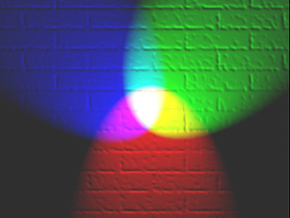
Color spaces
How can we represent color?
http://en.wikipedia.org/wiki/File:RGB_illumination.jpg

Slide 48

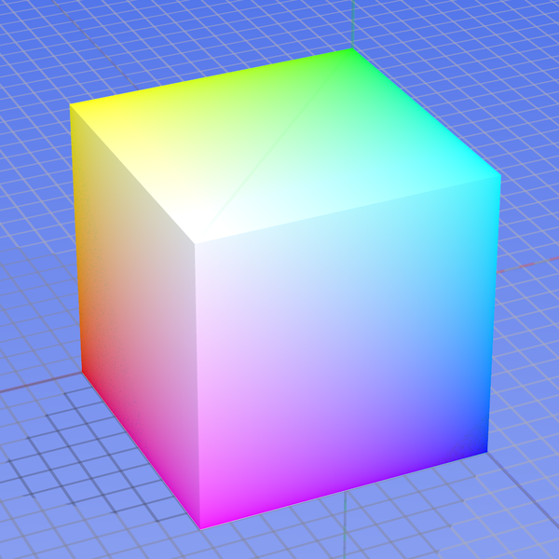
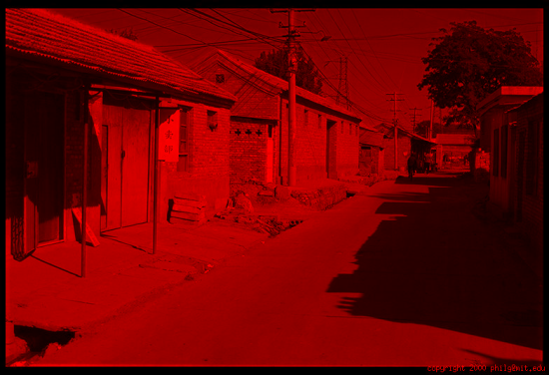
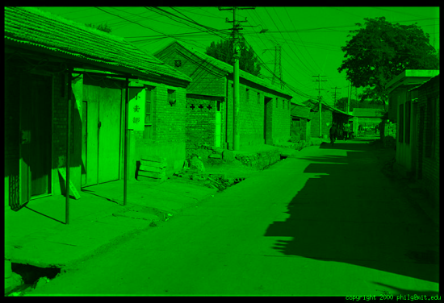
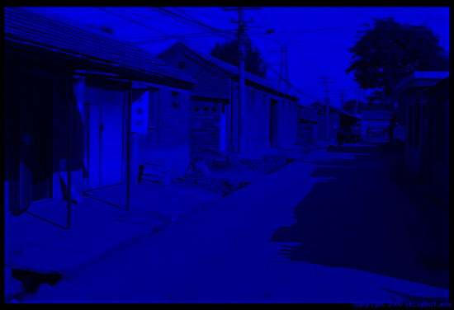
Color spaces: RGB
Default color space
0,1,0
R
(G=0,B=0)
1,0,0
G
(R=0,B=0)
0,0,1
B
(R=0,G=0)
Some drawbacks
Strongly correlated channels
Non-perceptual
Image from: http://en.wikipedia.org/wiki/File:RGB_color_solid_cube.png

Slide 49




Color spaces: HSV
Intuitive color space
H
(S=1,V=1)
S
(H=1,V=1)
V
(H=1,S=0)

Slide 50






Color spaces: YCbCr
Fast to compute, good for compression, used by TV
Y=0
Y=0.5
Y
(Cb=0.5,Cr=0.5)
Cr
Cb
(Y=0.5,Cr=0.5)
Cb
Y=1
Cr
(Y=0.5,Cb=05)

Slide 51




Color spaces: L*a*b*
“Perceptually uniform”* color space
L
(a=0,b=0)
a
(L=65,b=0)
b
(L=65,a=0)

Slide 52
If you had to choose, would you rather go without luminance or chrominance?

Slide 53
If you had to choose, would you rather go without luminance or chrominance?

Slide 54

Most information in intensity
Only color shown – constant intensity

Slide 55

Most information in intensity
Only intensity shown – constant color

Slide 56
Most information in intensity
Original image

Slide 57

Back to grayscale intensity
0.92 | 0.93 | 0.94 | 0.97 | 0.62 | 0.37 | 0.85 | 0.97 | 0.93 | 0.92 | 0.99
0.95 | 0.89 | 0.82 | 0.89 | 0.56 | 0.31 | 0.75 | 0.92 | 0.81 | 0.95 | 0.91
0.89 | 0.72 | 0.51 | 0.55 | 0.51 | 0.42 | 0.57 | 0.41 | 0.49 | 0.91 | 0.92
0.96 | 0.95 | 0.88 | 0.94 | 0.56 | 0.46 | 0.91 | 0.87 | 0.90 | 0.97 | 0.95
0.71 | 0.81 | 0.81 | 0.87 | 0.57 | 0.37 | 0.80 | 0.88 | 0.89 | 0.79 | 0.85
0.49 | 0.62 | 0.60 | 0.58 | 0.50 | 0.60 | 0.58 | 0.50 | 0.61 | 0.45 | 0.33
0.86 | 0.84 | 0.74 | 0.58 | 0.51 | 0.39 | 0.73 | 0.92 | 0.91 | 0.49 | 0.74
0.96 | 0.67 | 0.54 | 0.85 | 0.48 | 0.37 | 0.88 | 0.90 | 0.94 | 0.82 | 0.93
0.69 | 0.49 | 0.56 | 0.66 | 0.43 | 0.42 | 0.77 | 0.73 | 0.71 | 0.90 | 0.99
0.79 | 0.73 | 0.90 | 0.67 | 0.33 | 0.61 | 0.69 | 0.79 | 0.73 | 0.93 | 0.97
0.91 | 0.94 | 0.89 | 0.49 | 0.41 | 0.78 | 0.78 | 0.77 | 0.89 | 0.99 | 0.93

Slide 58
Wrap up: Why do we care about cameras and eyes?
Notes:
December 6th, 2021 New York Times

Slide 59

Notes:
December 6th, 2021 New York Times

Slide 60


Slide 61


Slide 62

Another driving system with human level eyesight

Slide 63

https://twitter.com/JordanTeslaTech/status/1418413307862585344

Slide 64

https://www.reddit.com/r/teslamotors/comments/nrs8kf/you_think_ice_cream_truck_stop_signs_are_a_problem/

Slide 65
On the whole, cameras are a reasonable analogy for eyes. They do capture sufficient information for safe driving 99.9% of the time.

Slide 66

https://www.youtube.com/watch?v=s1eTBMYEs-Y
Notes:
But maybe some cameras don’t have enough dynamic range at the moment

Slide 67
On the whole, cameras are a reasonable analogy for eyes. They do capture sufficient information for safe driving 99.9% of the time.
  Imagine remote controlling a vehicle based on a camera feed.
But the computer vision and machine learning methods that interpret the camera images are not yet a reasonable analogy for the human brain.

Slide 68
Next class: Interest points and corners
Slides: Hoiem, Efros, and others

