Slide 1
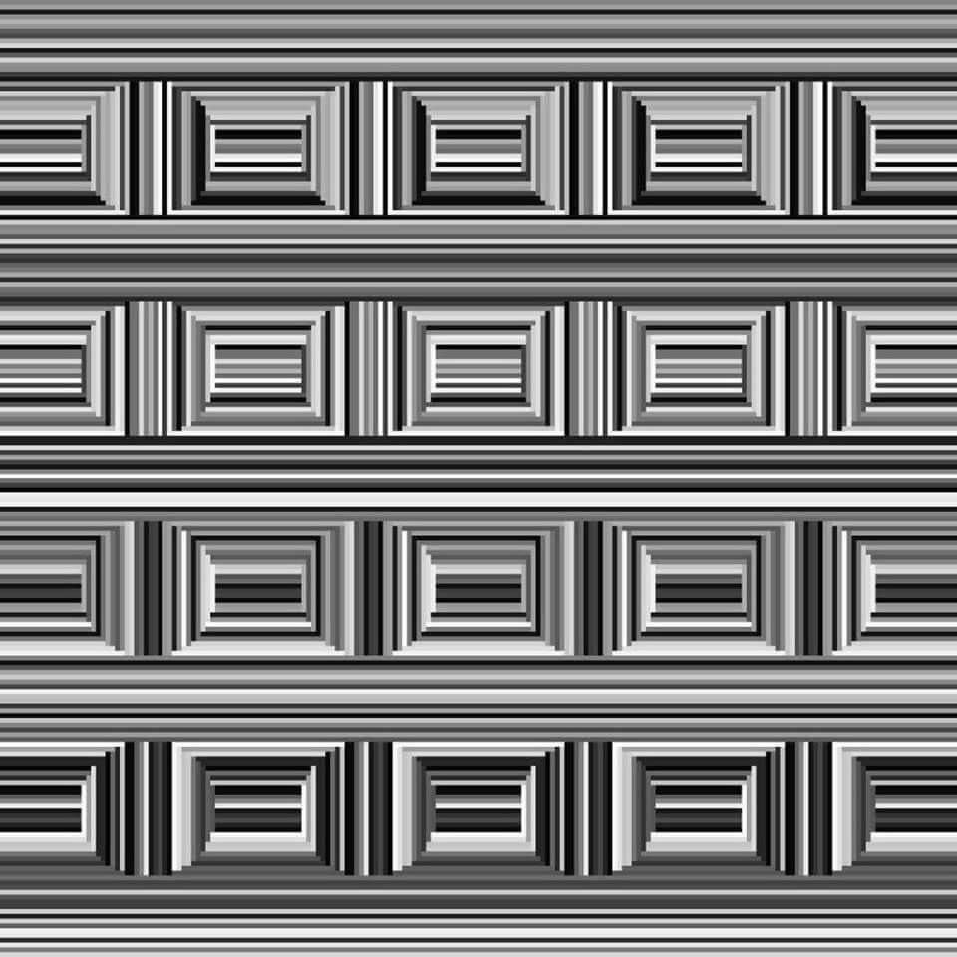

Slide 2
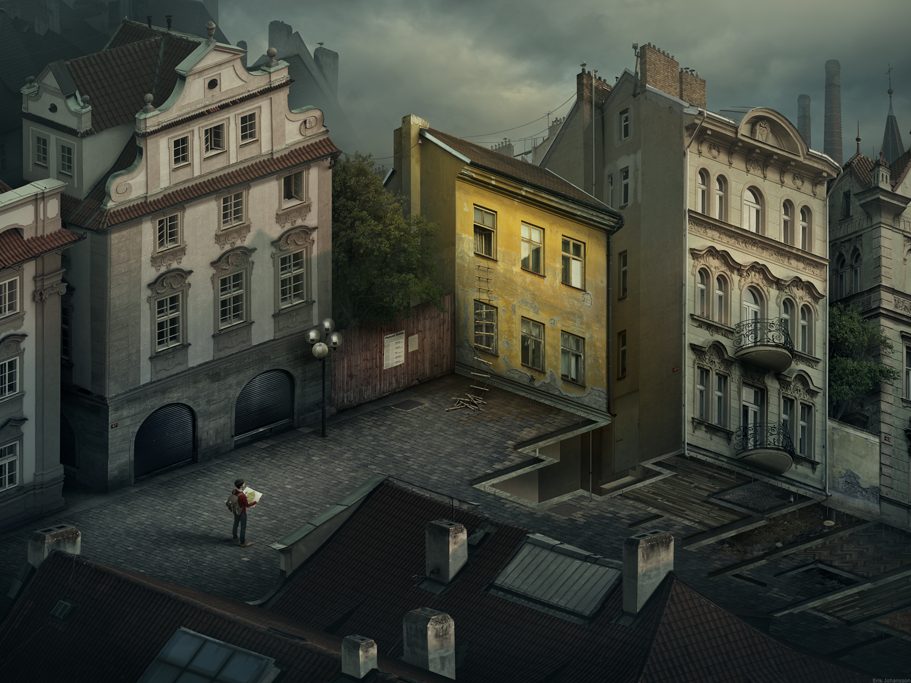
Notes:
http://www.erikjohanssonphoto.com/

Slide 3
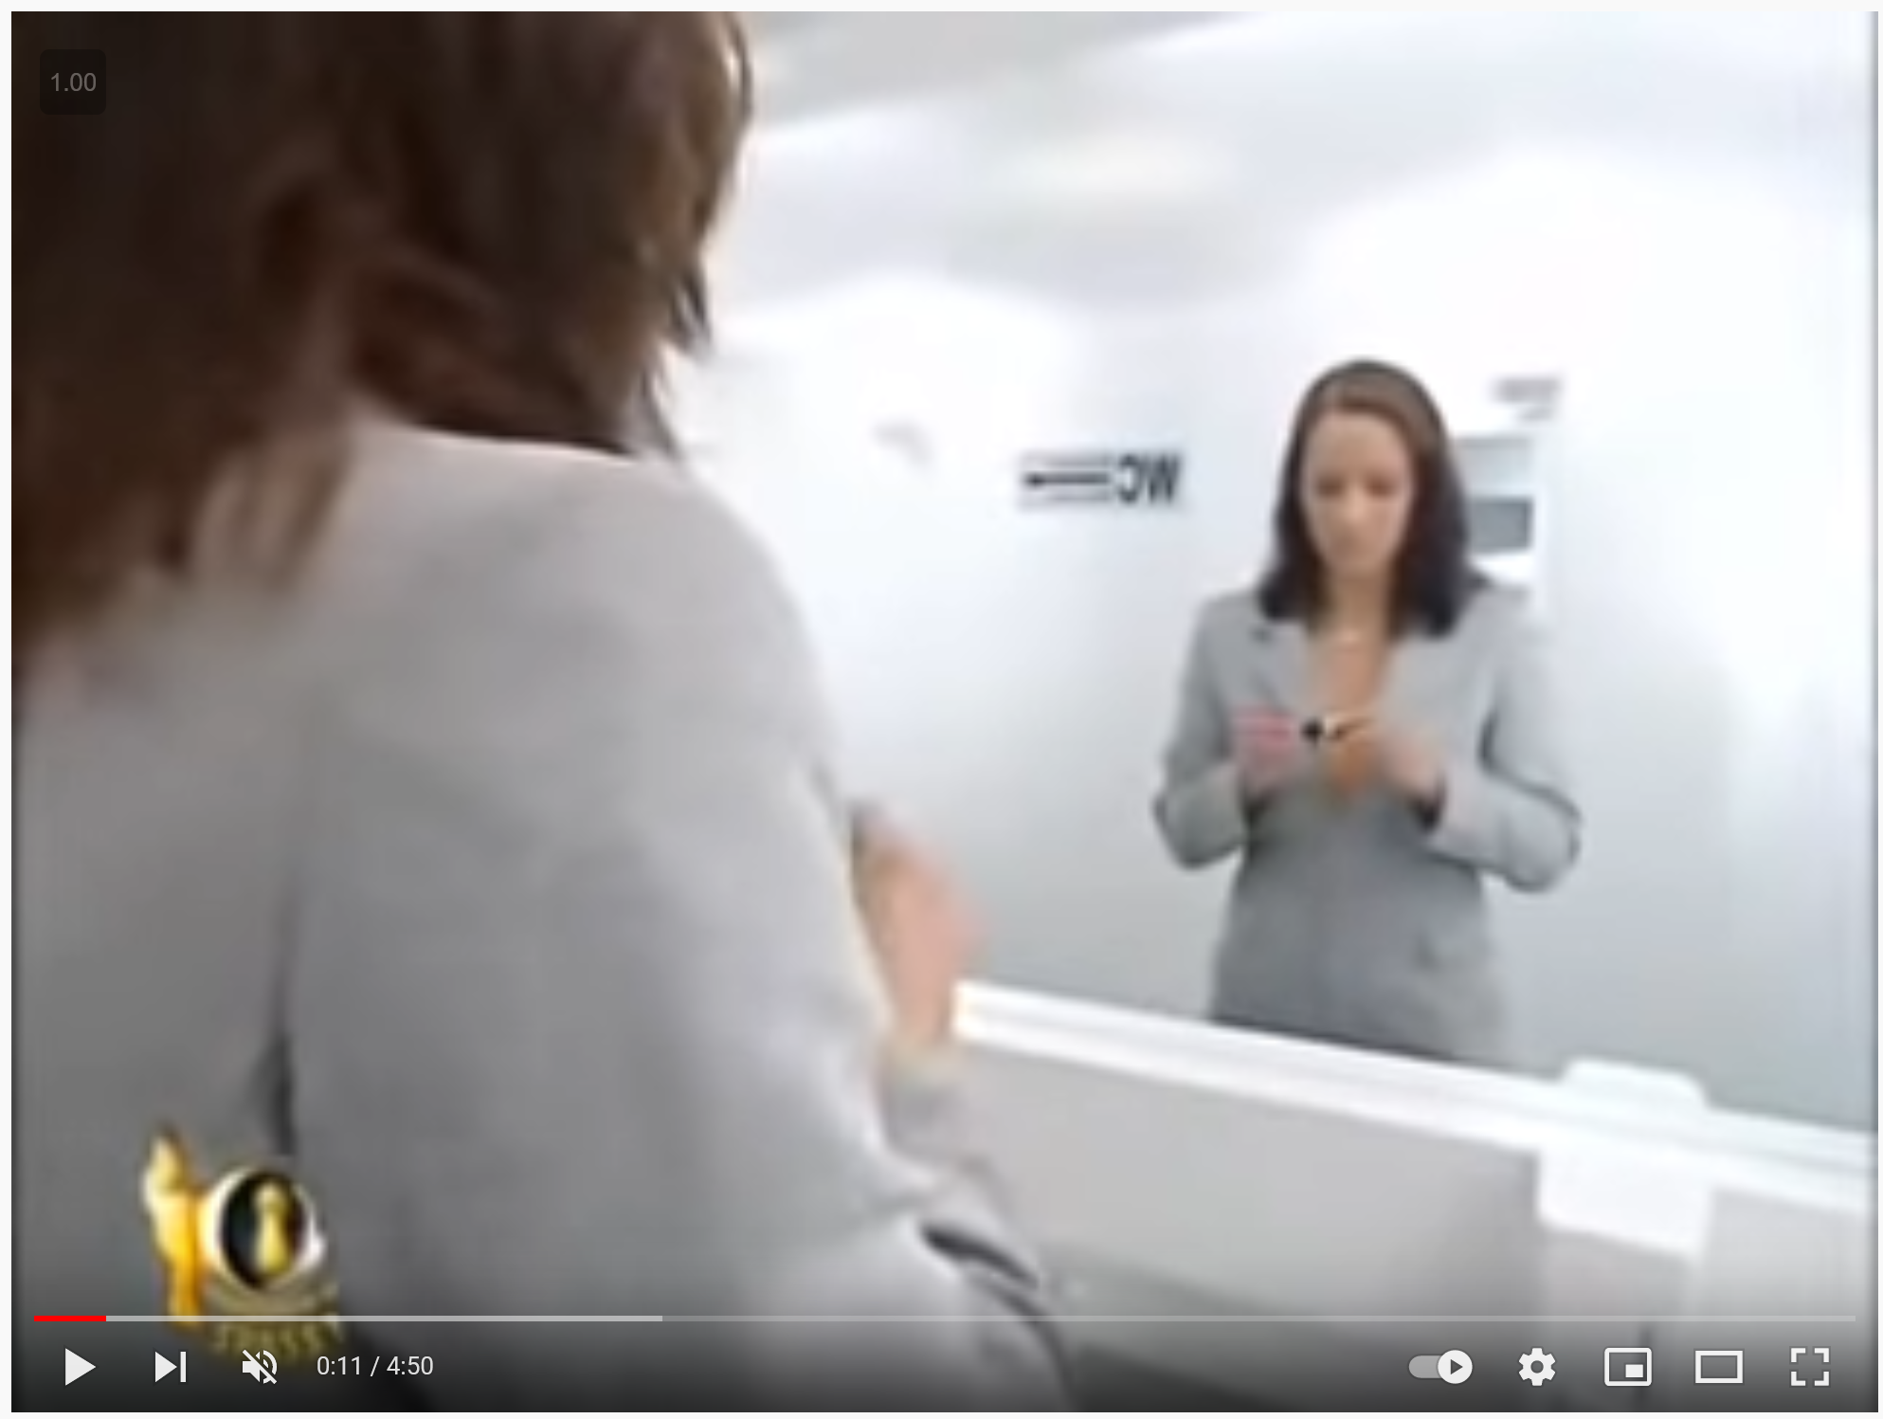
From last lecture
Stereo and lidar can fall victim to mirrors?
Yes, there’s no easy way around that
https://youtu.be/pBzU8TD1iks

Slide 4
Outline
Camera calibration
Epipolar Geometry

Slide 5
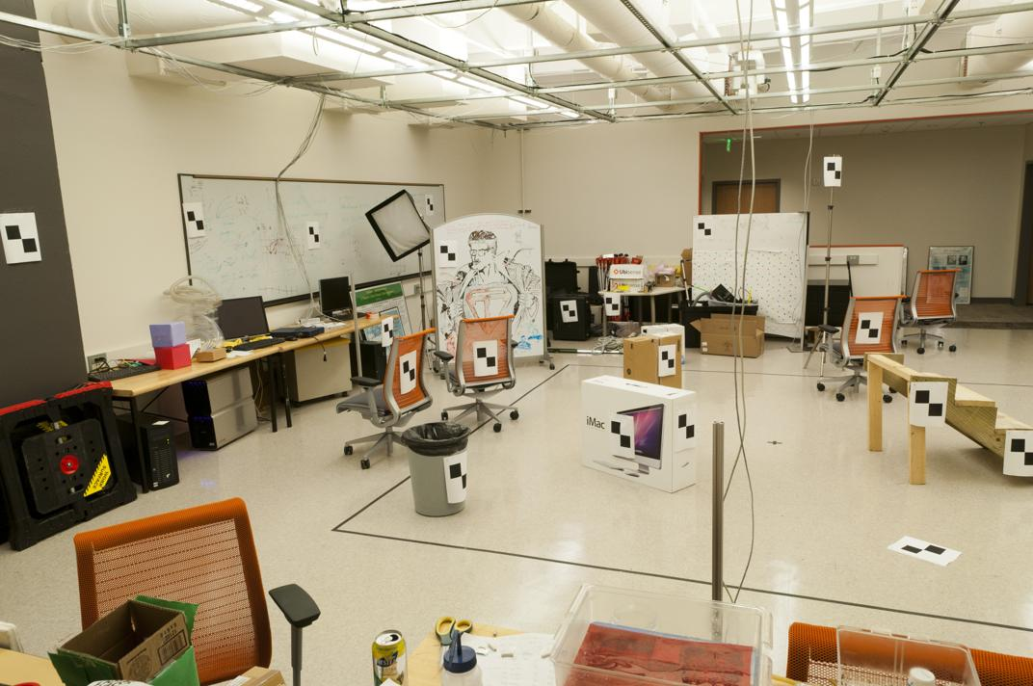
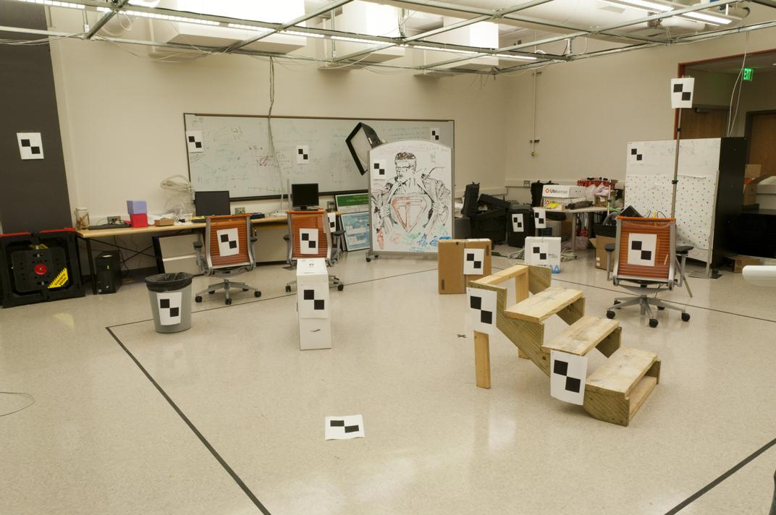
Where do we need to search?

Slide 6
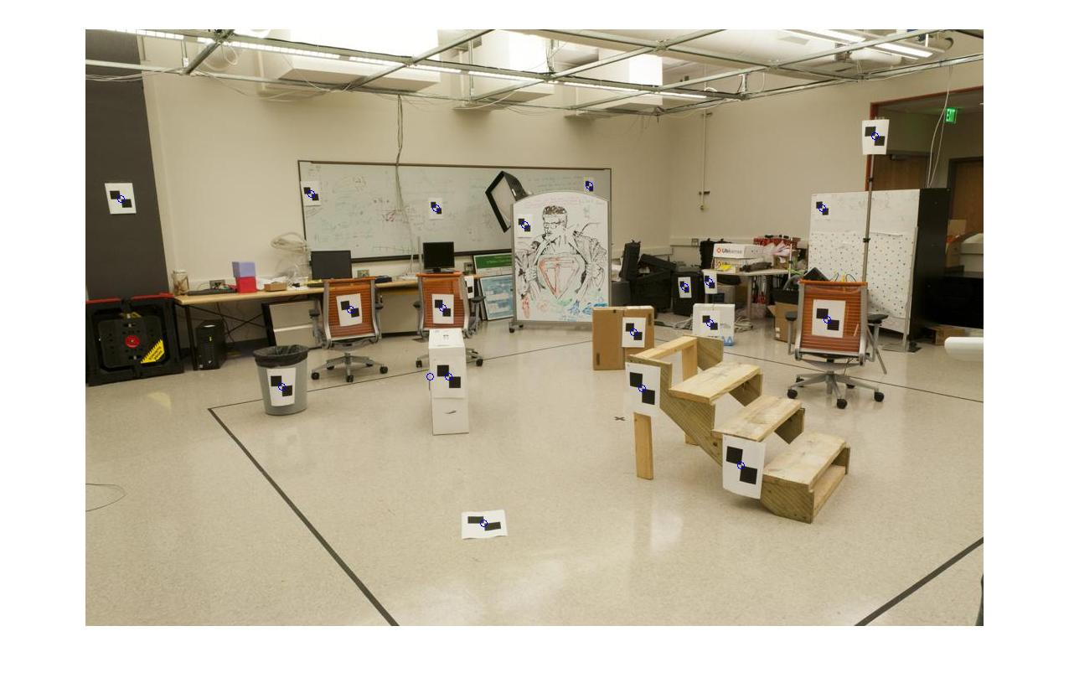
How do we calibrate a camera?
880 214
43 203
270 197
886 347
745 302
943 128
476 590
419 214
317 335
783 521
235 427
665 429
655 362
427 333
412 415
746 351
434 415
525 234
716 308
602 187
312.747 309.140 30.086
305.796 311.649 30.356
307.694 312.358 30.418
310.149 307.186 29.298
311.937 310.105 29.216
311.202 307.572 30.682
307.106 306.876 28.660
309.317 312.490 30.230
307.435 310.151 29.318
308.253 306.300 28.881
306.650 309.301 28.905
308.069 306.831 29.189
309.671 308.834 29.029
308.255 309.955 29.267
307.546 308.613 28.963
311.036 309.206 28.913
307.518 308.175 29.069
309.950 311.262 29.990
312.160 310.772 29.080
311.988 312.709 30.514

Slide 7
World vs Camera coordinates

Slide 8
Image formation
Let’s design a camera
  Idea 1: put a piece of film in front of an object
  Do we get a reasonable image?
Slide source: Seitz

Slide 9
Pinhole camera
Idea 2: add a barrier to block off most of the rays
  This reduces blurring
  The opening known as the aperture
Slide source: Seitz
Notes:
Q: How does this transform the image? A: It gets inverted

Slide 10

Pinhole camera
f
c
f = focal length
c = center of the camera
Figure from Forsyth

Slide 11
Projection: world coordinates→image coordinates
.
Optical Center (u₀, v₀)
.
.
Y
f
Z
X
.
v
Camera Center (t_{x}, t_{y}, t_{z})
u

Slide 12




Homogeneous coordinates
Conversion
Converting to homogeneous coordinates
homogeneous image
coordinates
homogeneous scene
coordinates
Converting from homogeneous coordinates
Notes:
Append coordinate with value 1; proportional coordinate system

Slide 13
World vs Camera coordinates

Slide 14

Projection matrix
Slide Credit: Saverese
R,T
j_{w}
k_{w}
O_{w}
i_{w}
x: Image Coordinates: (u,v,1)
K: Intrinsic Matrix (3x3)
R: Rotation (3x3)
t: Translation (3x1)
X: World Coordinates: (X,Y,Z,1)
Notes:
We can use homogeneous coordinates to write camera matrix in linear form.

Slide 15
Pinhole Camera Model
x: Image Coordinates: (u,v,1)
K: Intrinsic Matrix (3x3)
R: Rotation (3x3)
t: Translation (3x1)
X: World Coordinates: (X,Y,Z,1)

Slide 16
Projection matrix
Intrinsic Assumptions
Unit aspect ratio
Optical center at (0,0)
No skew
Extrinsic Assumptions
No rotation
Camera at (0,0,0)
K
Slide Credit: Saverese
Notes:
Work through equations for u and v on board

Slide 17
Remove assumption: known optical center
Intrinsic Assumptions
Unit aspect ratio
No skew
Extrinsic Assumptions
No rotation
Camera at (0,0,0)

Slide 18
Remove assumption: square pixels
Intrinsic Assumptions
No skew
Extrinsic Assumptions
No rotation
Camera at (0,0,0)

Slide 19
Remove assumption: non-skewed pixels
Intrinsic Assumptions
Extrinsic Assumptions
No rotation
Camera at (0,0,0)
Note: different books use different notation for parameters

Slide 20
Oriented and Translated Camera
R
j_{w}
t
k_{w}
O_{w}
i_{w}

Slide 21
Allow camera translation
Intrinsic Assumptions
Extrinsic Assumptions
No rotation

Slide 22
3D Rotation of Points
Slide Credit: Saverese
Rotation around the coordinate axes, counter-clockwise:
p’
γ
y
p
z

Slide 23
Allow camera rotation

Slide 24
Degrees of freedom
5
6
Notes:
How many known points are needed to estimate this?

Slide 25
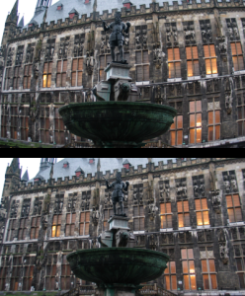
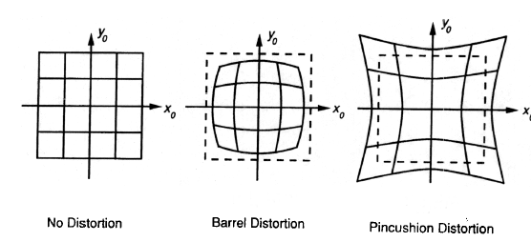
Beyond Pinholes: Radial Distortion
Common in wide-angle lenses or for special applications (e.g., security)
Creates non-linear terms in projection
Usually handled by through solving for non-linear terms and then correcting image
Corrected Barrel Distortion
Image from Martin Habbecke

Slide 26
How to calibrate the camera?
(also called “camera resectioning”)

Slide 27

Calibrating the Camera
Use an scene with known geometry
  Correspond image points to 3d points
  Get least squares solution (or non-linear solution)
Known 2d image coords
Known 3d locations
Unknown Camera Parameters

Slide 28
How do we calibrate a camera?
Known 2d image coords
Known 3d locations
880 214
43 203
270 197
886 347
745 302
943 128
476 590
419 214
317 335
783 521
235 427
665 429
655 362
427 333
412 415
746 351
434 415
525 234
716 308
602 187
312.747 309.140 30.086
305.796 311.649 30.356
307.694 312.358 30.418
310.149 307.186 29.298
311.937 310.105 29.216
311.202 307.572 30.682
307.106 306.876 28.660
309.317 312.490 30.230
307.435 310.151 29.318
308.253 306.300 28.881
306.650 309.301 28.905
308.069 306.831 29.189
309.671 308.834 29.029
308.255 309.955 29.267
307.546 308.613 28.963
311.036 309.206 28.913
307.518 308.175 29.069
309.950 311.262 29.990
312.160 310.772 29.080
311.988 312.709 30.514

Slide 29
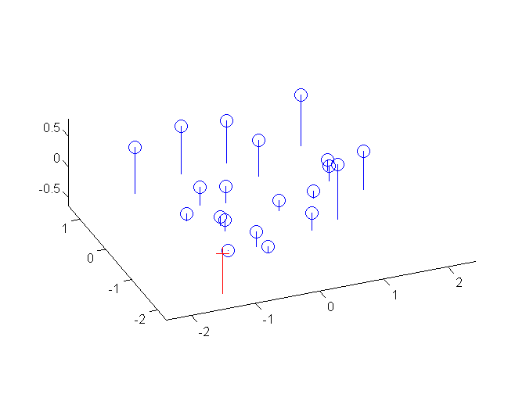
Estimate of camera center
1.0486 -0.3645
-1.6851 -0.4004
-0.9437 -0.4200
1.0682 0.0699
0.6077 -0.0771
1.2543 -0.6454
-0.2709 0.8635
-0.4571 -0.3645
-0.7902 0.0307
0.7318 0.6382
-1.0580 0.3312
0.3464 0.3377
0.3137 0.1189
-0.4310 0.0242
-0.4799 0.2920
0.6109 0.0830
-0.4081 0.2920
-0.1109 -0.2992
0.5129 -0.0575
0.1406 -0.4527
1.5706 -0.1490 0.2598
-1.5282 0.9695 0.3802
-0.6821 1.2856 0.4078
0.4124 -1.0201 -0.0915
1.2095 0.2812 -0.1280
0.8819 -0.8481 0.5255
-0.9442 -1.1583 -0.3759
0.0415 1.3445 0.3240
-0.7975 0.3017 -0.0826
-0.4329 -1.4151 -0.2774
-1.1475 -0.0772 -0.2667
-0.5149 -1.1784 -0.1401
0.1993 -0.2854 -0.2114
-0.4320 0.2143 -0.1053
-0.7481 -0.3840 -0.2408
0.8078 -0.1196 -0.2631
-0.7605 -0.5792 -0.1936
0.3237 0.7970 0.2170
1.3089 0.5786 -0.1887
1.2323 1.4421 0.4506

Slide 30
Unknown Camera Parameters
Known 2d image coords
Known 3d locations

Slide 31
Unknown Camera Parameters
Known 2d image coords
Known 3d locations

Slide 32
Unknown Camera Parameters
Known 2d image coords
Known 3d locations
Method 1 – homogeneous linear system. Solve for m’s entries using linear least squares
[U, S, V] = svd(A);
M = V(:,end);
M = reshape(M,[],3)';
For python, see
numpy.linalg.svd

Slide 33
Unknown Camera Parameters
Known 2d image coords
Known 3d locations
Method 2 – nonhomogeneous linear system. Solve for m’s entries using linear least squares
Ax=b form
M = A\Y;
M = [M;1];
M = reshape(M,[],3)';
For python, see
numpy.linalg.lstsq

Slide 34
Calibration with linear method
Advantages
  Easy to formulate and solve
  Provides initialization for non-linear methods
Disadvantages
  Doesn’t directly give you camera parameters
  Doesn’t model radial distortion
  Can’t impose constraints, such as known focal length
Non-linear methods are preferred
  Define error as difference between projected points and measured points
  Minimize error using Newton’s method or other non-linear optimization

Slide 35
Can we factorize M back to K [R | T]?
Yes!
You can use RQ factorization (note – not the more familiar QR factorization). R (right diagonal) is K, and Q (orthogonal basis) is R. T, the last column of [R | T], is inv(K) * last column of M.
  But you need to do a bit of post-processing to make sure that the matrices are valid. See http://ksimek.github.io/2012/08/14/decompose/

Slide 36
Can we factorize M back to K [R | T]?
Yes!
You can use RQ factorization (note – not the more familiar QR factorization). R (right diagonal) is K, and Q (orthogonal basis) is R. T, the last column of [R | T], is inv(K) * last column of M.
  But you need to do a bit of post-processing to make sure that the matrices are valid. See http://ksimek.github.io/2012/08/14/decompose/

Slide 37
For project 3, we want the camera center

Slide 38
Estimate of camera center
1.0486 -0.3645
-1.6851 -0.4004
-0.9437 -0.4200
1.0682 0.0699
0.6077 -0.0771
1.2543 -0.6454
-0.2709 0.8635
-0.4571 -0.3645
-0.7902 0.0307
0.7318 0.6382
-1.0580 0.3312
0.3464 0.3377
0.3137 0.1189
-0.4310 0.0242
-0.4799 0.2920
0.6109 0.0830
-0.4081 0.2920
-0.1109 -0.2992
0.5129 -0.0575
0.1406 -0.4527
1.5706 -0.1490 0.2598
-1.5282 0.9695 0.3802
-0.6821 1.2856 0.4078
0.4124 -1.0201 -0.0915
1.2095 0.2812 -0.1280
0.8819 -0.8481 0.5255
-0.9442 -1.1583 -0.3759
0.0415 1.3445 0.3240
-0.7975 0.3017 -0.0826
-0.4329 -1.4151 -0.2774
-1.1475 -0.0772 -0.2667
-0.5149 -1.1784 -0.1401
0.1993 -0.2854 -0.2114
-0.4320 0.2143 -0.1053
-0.7481 -0.3840 -0.2408
0.8078 -0.1196 -0.2631
-0.7605 -0.5792 -0.1936
0.3237 0.7970 0.2170
1.3089 0.5786 -0.1887
1.2323 1.4421 0.4506

Slide 39
Oriented and Translated Camera
R
j_{w}
t
k_{w}
O_{w}
i_{w}

Slide 40
Recovering the camera center
This is not the camera center -C. It is –RC
(because a point will be rotated before t_{x}, t_{y}, and t_{z} are added)
This, m_{4,} is K * t
So K⁻¹ m₄ is t
So we need
-R⁻¹ K⁻¹ m₄ to get C
Q is K * R. So we just need -Q⁻¹ m₄
Q

Slide 41
Estimate of camera center
1.0486 -0.3645
-1.6851 -0.4004
-0.9437 -0.4200
1.0682 0.0699
0.6077 -0.0771
1.2543 -0.6454
-0.2709 0.8635
-0.4571 -0.3645
-0.7902 0.0307
0.7318 0.6382
-1.0580 0.3312
0.3464 0.3377
0.3137 0.1189
-0.4310 0.0242
-0.4799 0.2920
0.6109 0.0830
-0.4081 0.2920
-0.1109 -0.2992
0.5129 -0.0575
0.1406 -0.4527
1.5706 -0.1490 0.2598
-1.5282 0.9695 0.3802
-0.6821 1.2856 0.4078
0.4124 -1.0201 -0.0915
1.2095 0.2812 -0.1280
0.8819 -0.8481 0.5255
-0.9442 -1.1583 -0.3759
0.0415 1.3445 0.3240
-0.7975 0.3017 -0.0826
-0.4329 -1.4151 -0.2774
-1.1475 -0.0772 -0.2667
-0.5149 -1.1784 -0.1401
0.1993 -0.2854 -0.2114
-0.4320 0.2143 -0.1053
-0.7481 -0.3840 -0.2408
0.8078 -0.1196 -0.2631
-0.7605 -0.5792 -0.1936
0.3237 0.7970 0.2170
1.3089 0.5786 -0.1887
1.2323 1.4421 0.4506

Slide 42
Epipolar Geometry and Stereo Vision
Chapter 11.2 in Szeliski
Many slides adapted from Derek Hoiem, Lana Lazebnik, Silvio Saverese, Steve Seitz, many figures from Hartley & Zisserman

Slide 43
Epipolar geometry
  Relates cameras from two positions

Slide 44
Depth from Stereo
Goal: recover depth by finding image coordinate x’ that corresponds to x
X
X
x
z
x
x’
x'
f
f
C
Baseline
B
C’

Slide 45
Depth from Stereo
Goal: recover depth by finding image coordinate x’ that corresponds to x
Sub-Problems
  Calibration: How do we recover the relation of the cameras (if not already known)?
  Correspondence: How do we search for the matching point x’?
X
x
x'

Slide 46


Correspondence Problem
x
?
We have two images taken from cameras with different intrinsic and extrinsic parameters
How do we match a point in the first image to a point in the second? How can we constrain our search?

Slide 47
Where do we need to search?

Slide 48
Key idea: Epipolar constraint

Slide 49

Key idea: Epipolar constraint
X
X
X
x
x’
x’
x’
Potential matches for x have to lie on the corresponding line l’.
Potential matches for x’ have to lie on the corresponding line l.

Slide 50
Wouldn’t it be nice to know where matches can live? To constrain our 2d search to 1d.

Slide 51
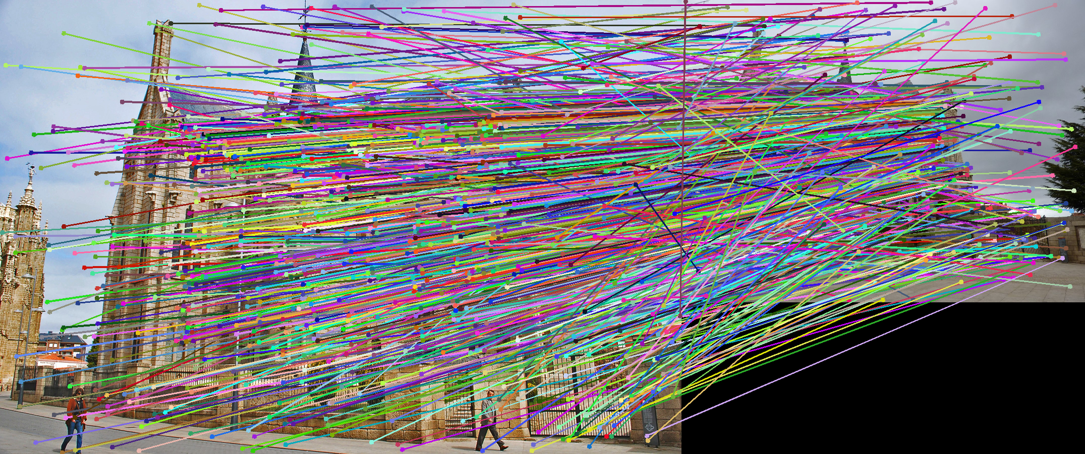
VLFeat’s 800 most confident matches among 10,000+ local features.

Slide 52

Epipolar geometry: notation
X
x
x’
Baseline – line connecting the two camera centers
Epipoles
= intersections of baseline with image planes
= projections of the other camera center
Epipolar Plane – plane containing baseline (1D family)

Slide 53
Epipolar geometry: notation
X
x
x’
Baseline – line connecting the two camera centers
Epipoles
= intersections of baseline with image planes
= projections of the other camera center
Epipolar Plane – plane containing baseline (1D family)
Epipolar Lines - intersections of epipolar plane with image
planes (always come in corresponding pairs)

Slide 54



Example: Converging cameras

Slide 55



Example: Motion parallel to image plane

Slide 56
Example: Forward motion
What would the epipolar lines look like if the camera moves directly forward?

Slide 57
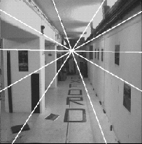
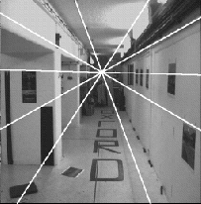
Example: Forward motion
e’
e
Epipole has same coordinates in both images.
Points move along lines radiating from e: “Focus of expansion”

Slide 58
Epipolar constraint: Calibrated case
X
x
x’
Given the intrinsic parameters of the cameras:
  Convert to normalized coordinates by pre-multiplying all points with the inverse of the calibration matrix; set first camera’s coordinate system to world coordinates
3D scene point
Homogeneous 2d point (3D ray towards X)
2D pixel coordinate (homogeneous)
3D scene point in 2nd camera’s 3D coordinates

Slide 59
Epipolar constraint: Calibrated case
X
x
x’
Given the intrinsic parameters of the cameras:
  Convert to normalized coordinates by pre-multiplying all points with the inverse of the calibration matrix; set first camera’s coordinate system to world coordinates
  Define some R and t that relate X to X’ as below
for some scale factor

Slide 60



Epipolar constraint: Calibrated case
X
x
x’
$$\hat{x}$$
$${\hat{x}}^{′}$$
(because $\hat{x}, R{\hat{x}}^{′},$ and $t$ are co-planar)
Notes:
X’ is X in the second camera’s coordinate system
We can identify the non-homogeneous 3D vectors X and X’ with the homogeneous coordinate vectors x and x’ of the projections of the two points into the two respective images

Slide 61
Essential matrix
X
x
x’
Essential Matrix
(Longuet-Higgins, 1981)
Notes:
[t]_{x} is the skew symmetric matrix of t

Slide 62
Properties of the Essential matrix
X
x
x’
Drop ^ below to simplify notation
Skew-symmetric matrix
E x’ is the epipolar line associated with x’ (l = E x’)
E^{T}x is the epipolar line associated with x (l’ = E^{T}x)
E e’ = 0 and E^{T}e = 0
E is singular (rank two)
E has five degrees of freedom
  (3 for R, 2 for t because it’s up to a scale)

Slide 63
Epipolar constraint: Uncalibrated case
X
x
x’
If we don’t know K and K’, then we can write the epipolar constraint in terms of unknown normalized coordinates:

Slide 64
The Fundamental Matrix
Without knowing K and K’, we can define a similar relation using unknown normalized coordinates
Fundamental Matrix
(Faugeras and Luong, 1992)

Slide 65
Properties of the Fundamental matrix
X
x
x’
F x’ = 0 is the epipolar line associated with x’
F^{T}x = 0 is the epipolar line associated with x
F e’ = 0 and F^{T}e = 0
F is singular (rank two): det(F)=0
F has seven degrees of freedom: 9 entries but defined up to scale, det(F)=0

Slide 66
Estimating the Fundamental Matrix
8-point algorithm
  Least squares solution using SVD on equations from 8 pairs of correspondences
  Enforce det(F)=0 constraint using SVD on F
7-point algorithm
  Use least squares to solve for null space (two vectors) using SVD and 7 pairs of correspondences
  Solve for linear combination of null space vectors that satisfies det(F)=0
Minimize reprojection error
  Non-linear least squares
Note: estimation of F (or E) is degenerate for a planar scene.

Slide 67
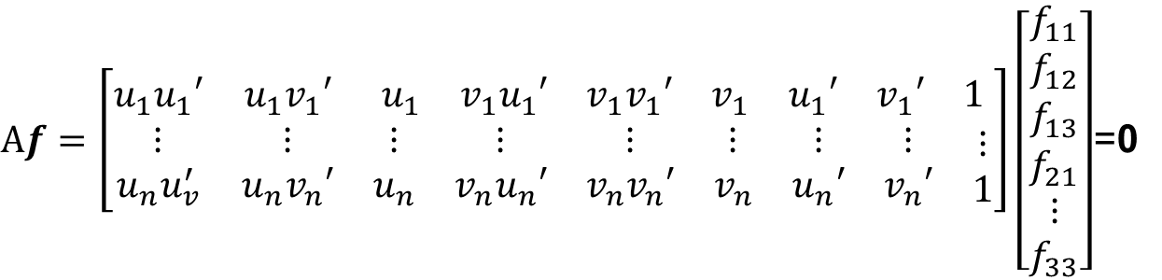
8-point algorithm
Solve a system of homogeneous linear equations
  Write down the system of equations
$$uu^{′}f_{11}+uv^{′}f_{12}+uf_{13}+vu^{′}f_{21}+vv^{′}f_{22}+vf_{23}+u^{′}f_{31}+v^{′}f_{32}+f_{33}=0$$
$Af=\left[\begin{matrix}u_{1}u_{1}′ & u_{1}v_{1}′ & \begin{matrix}u_{1} & v_{1}u_{1}′ & \begin{matrix}v_{1}v_{1}′ & v_{1} & \begin{matrix}u_{1}′ & v_{1}′ & 1\end{matrix}\end{matrix}\end{matrix} \\ \begin{matrix}⋮ \\ u_{n}u_{v}^{′}\end{matrix} & \begin{matrix}⋮ \\ u_{n}v_{n}′\end{matrix} & \begin{matrix}\begin{matrix}⋮ \\ u_{n}\end{matrix} & \begin{matrix}⋮ \\ v_{n}u_{n}′\end{matrix} & \begin{matrix}\begin{matrix}⋮ \\ v_{n}v_{n}′\end{matrix} & \begin{matrix}⋮ \\ v_{n}\end{matrix} & \begin{matrix}\begin{matrix}⋮ \\ u_{n}′\end{matrix} & \begin{matrix}⋮ \\ v_{n}′\end{matrix} & \begin{matrix}⋮ \\ 1\end{matrix}\end{matrix}\end{matrix}\end{matrix}\end{matrix}\right]\left[\begin{matrix}f_{11} \\ f_{12} \\ \begin{aligned}f_{13} \\ f_{21} \\ ⋮ \\ f_{33}\end{aligned}\end{matrix}\right]$=0

Slide 68
8-point algorithm
Solve a system of homogeneous linear equations
  Write down the system of equations
  Solve f from Af=0 using SVD
Matlab:
[U, S, V] = svd(A);
f = V(:, end);
F = reshape(f, [3 3])’;
For python, see
numpy.linalg.svd

Slide 69
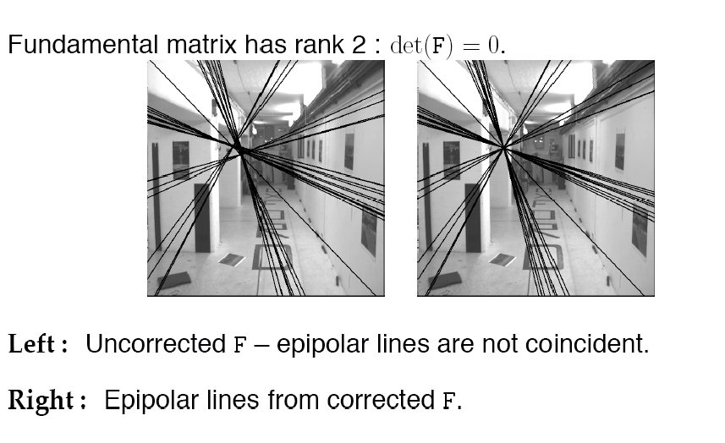
Need to enforce singularity constraint

Slide 70
8-point algorithm
Solve a system of homogeneous linear equations
  Write down the system of equations
  Solve f from Af=0 using SVD
Resolve det(F) = 0 constraint using SVD
Matlab:
[U, S, V] = svd(A);
f = V(:, end);
F = reshape(f, [3 3])’;
Matlab:
[U, S, V] = svd(F);
S(3,3) = 0;
F = U*S*V’;
For python, see
numpy.linalg.svd

Slide 71
8-point algorithm
Solve a system of homogeneous linear equations
  Write down the system of equations
  Solve f from Af=0 using SVD
Resolve det(F) = 0 constraint by SVD
Notes:
Use RANSAC to deal with outliers (sample 8 points)
  How to test for outliers?
Notes:
Test for outliers by computing distance from epipolar line to corresponding point (NOT by taking square of x^{T}Fx’)

Slide 72
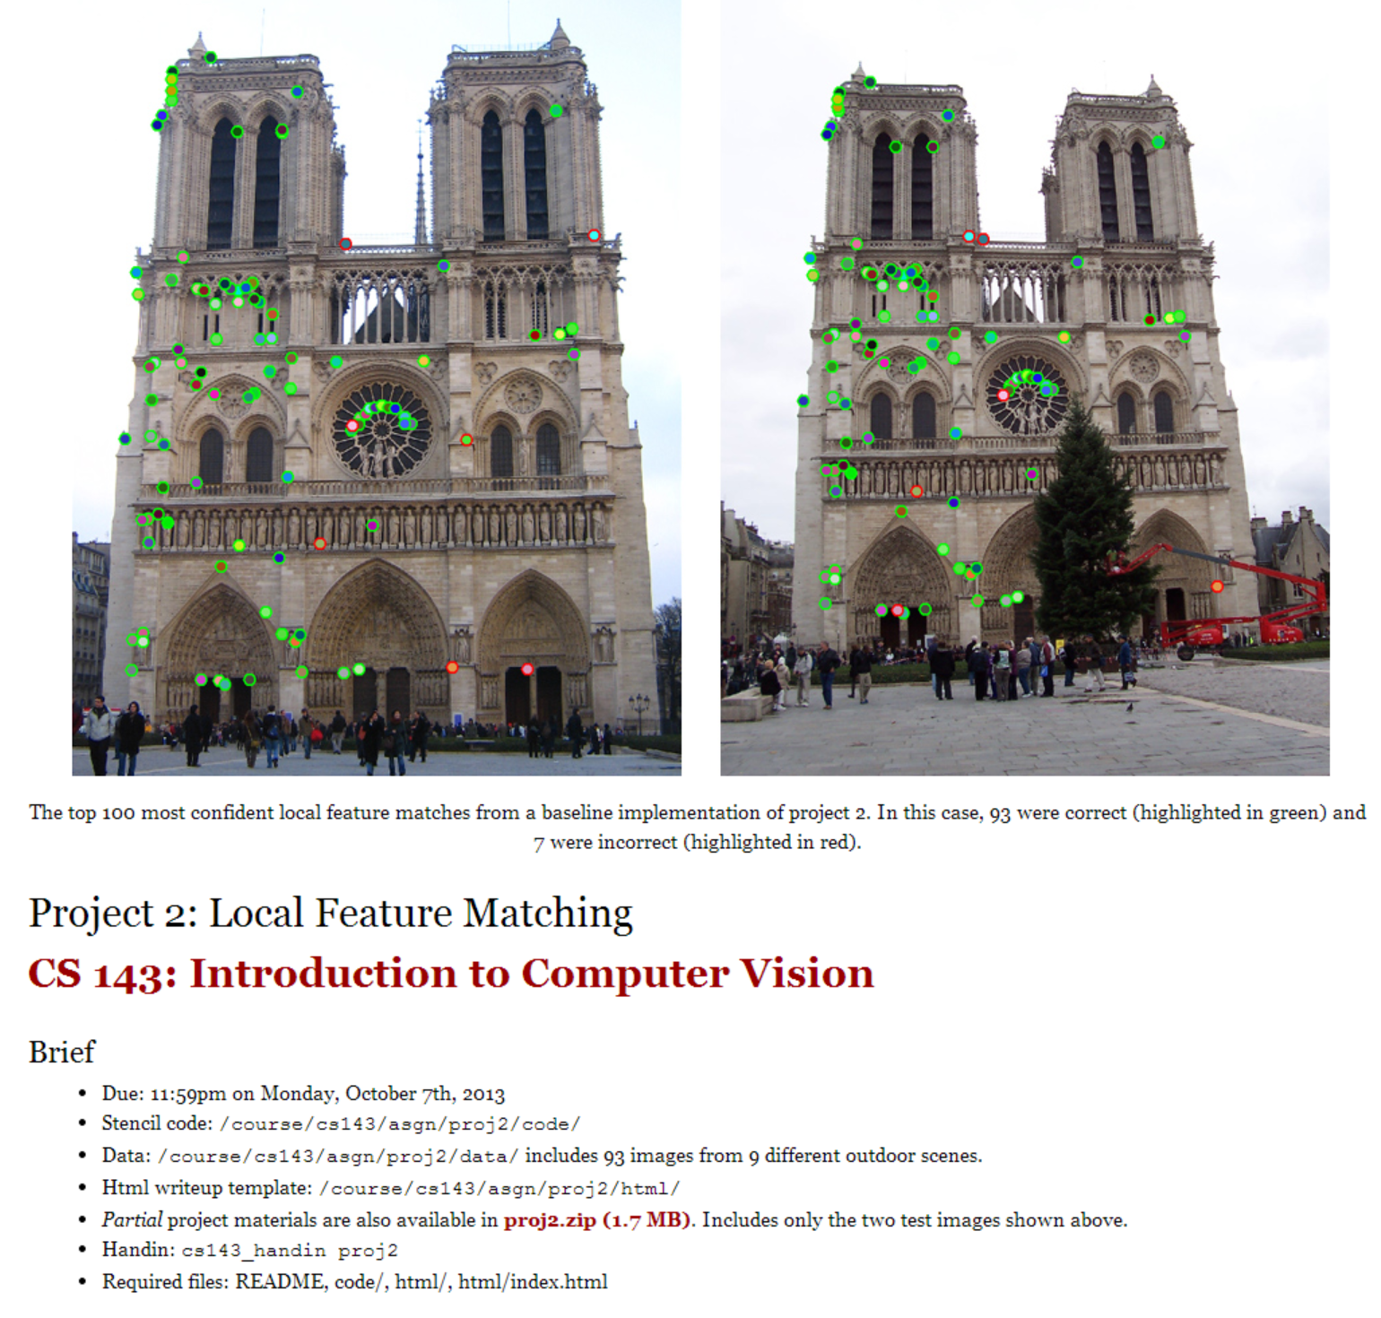
  How to test for outliers?

Slide 73
Problem with eight-point algorithm

Slide 74
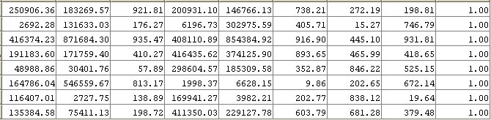
Problem with eight-point algorithm
Poor numerical conditioning
Can be fixed by rescaling the data

Slide 75
The normalized eight-point algorithm
(Hartley, 1995)
Center the image data at the origin, and scale it so the mean squared distance between the origin and the data points is 2 pixels
Use the eight-point algorithm to compute F from the normalized points
Enforce the rank-2 constraint (for example, take SVD of F and throw out the smallest singular value)
Transform fundamental matrix back to original units: if T and T’ are the normalizing transformations in the two images, than the fundamental matrix in original coordinates is T’^{T} F T

Slide 76
VLFeat’s 800 most confident matches among 10,000+ local features.

Slide 77
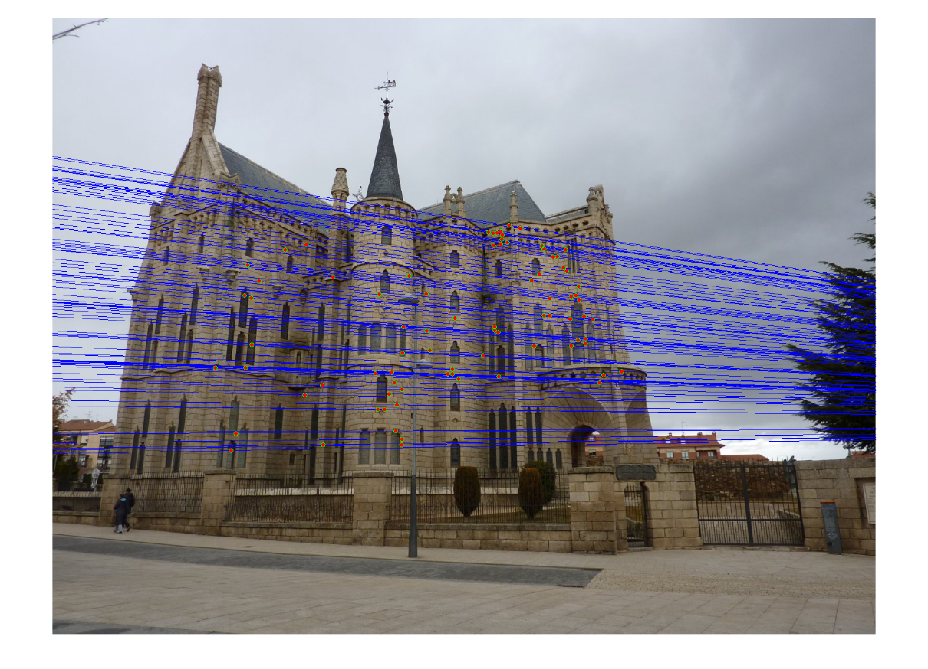
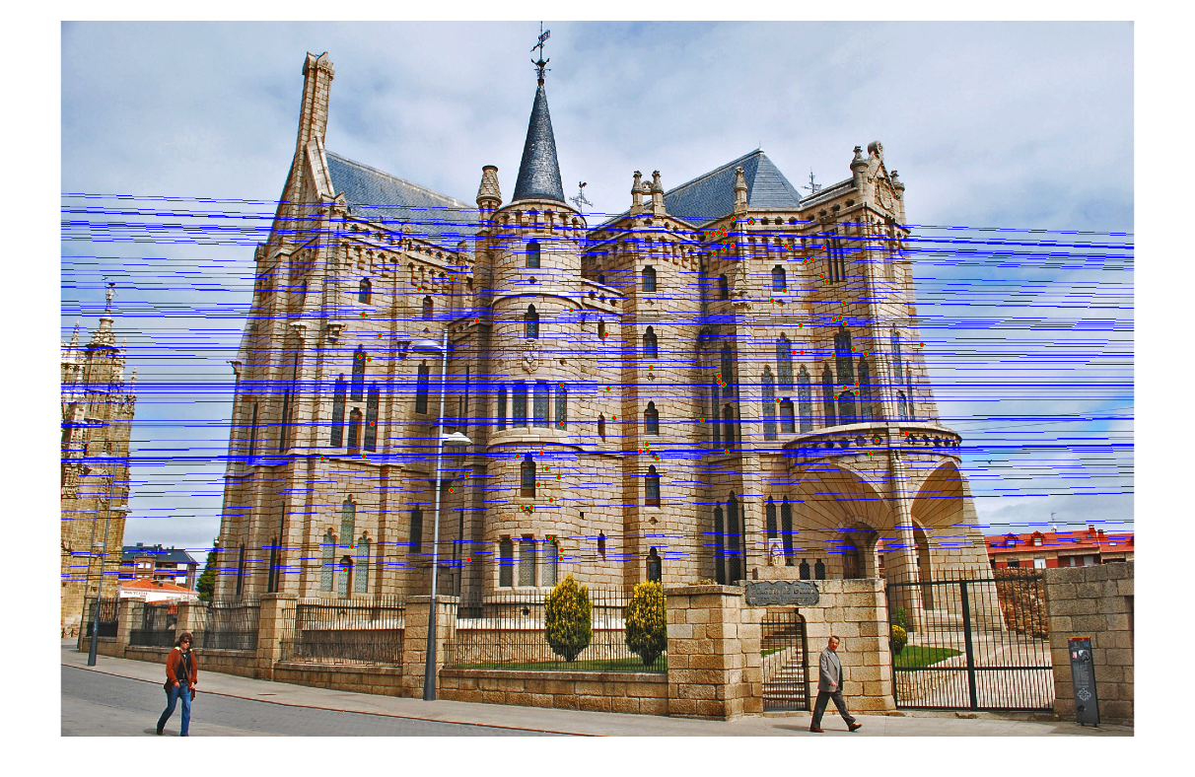
Epipolar lines

Slide 78
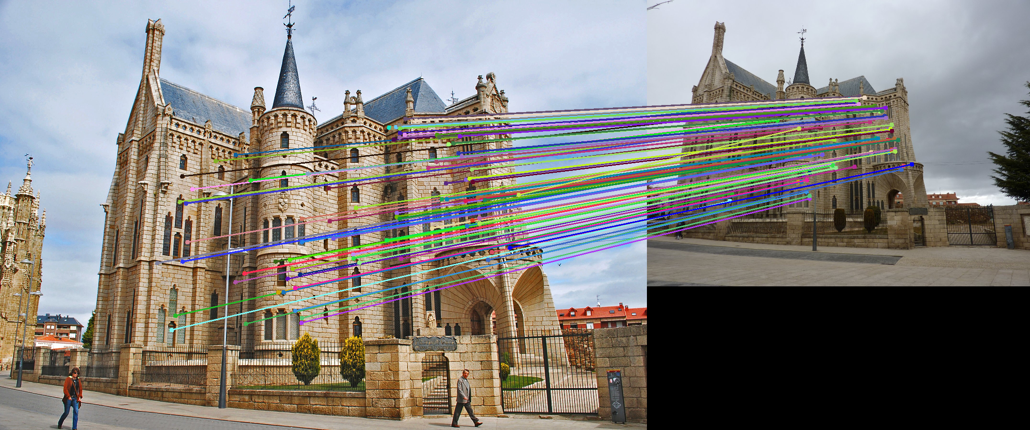
Keep only the matches at are “inliers” with respect to the “best” fundamental matrix

Slide 79
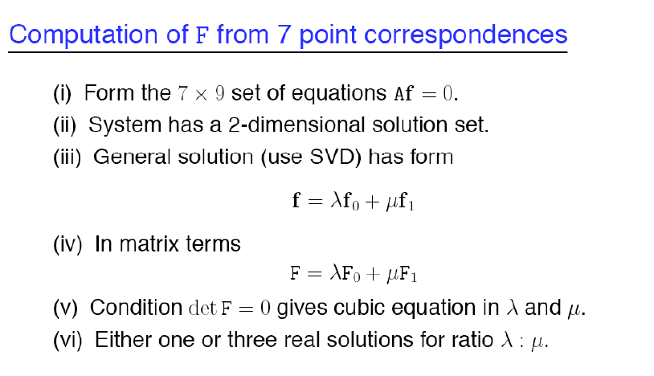
7-point algorithm
Faster (need fewer points) and could be more robust (fewer points), but also need to check for degenerate cases

Slide 80
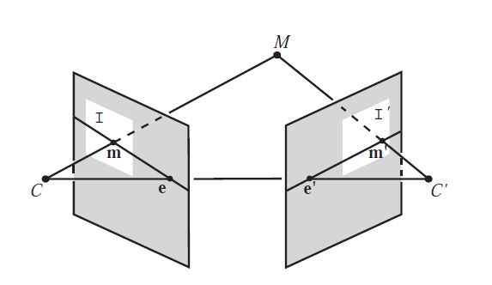
“Gold standard” algorithm
Use 8-point algorithm to get initial value of F
Use F to solve for P and P’ (discussed later)
Jointly solve for 3d points X and F that minimize the squared re-projection error
X
x
x'
See Algorithm 11.2 and Algorithm 11.3 in HZ (pages 284-285) for details

Slide 81

Comparison of estimation algorithms
 | 8-point | Normalized 8-point | Nonlinear least squares
Av. Dist. 1 | 2.33 pixels | 0.92 pixel | 0.86 pixel
Av. Dist. 2 | 2.18 pixels | 0.85 pixel | 0.80 pixel

Slide 82
We can get projection matrices P and P’ up to a projective ambiguity
Code:
function P = vgg_P_from_F(F)
[U,S,V] = svd(F);
e = U(:,3);
P = [-vgg_contreps(e)*F e];
K’*rotation
K’*translation
See HZ p. 255-256
If we know the intrinsic matrices (K and K’), we can resolve the ambiguity

Slide 83
From epipolar geometry to camera calibration
Estimating the fundamental matrix is known as “weak calibration”
We cIf we know the calibration matrices of the two cameras, we can estimate the essential matrix: E = K^{T}FK’
The essential matrix gives us the relative rotation and translation between the cameras, or their extrinsic parameters

Slide 84
Let’s recap…
Fundamental matrix song

