Slide 1
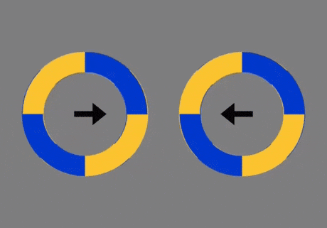

Slide 2
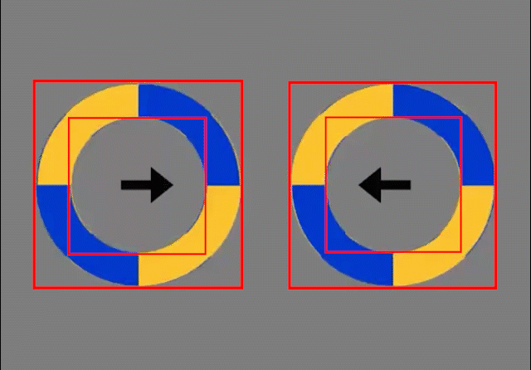

Slide 4
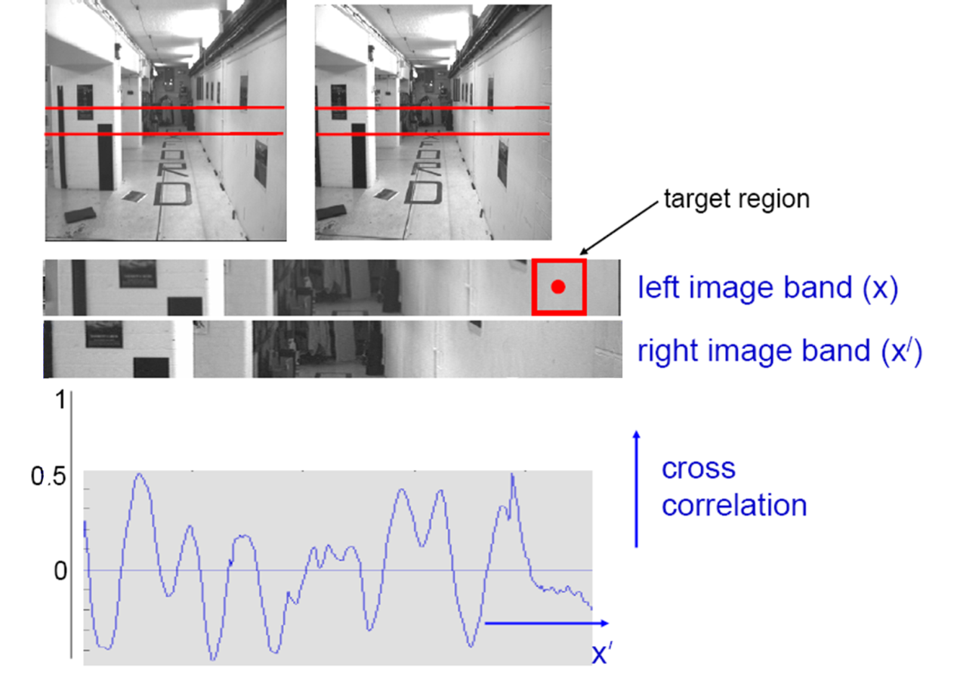
Reminder: last lecture on stereo matching
???
Textureless regions are non-distinct; high ambiguity for matches.
Notes:
We get this corrleation.
[a] And where the peak is located is hard to tell.
How could we fix that? Well…

Slide 5
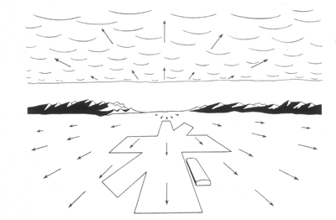
Computer Vision
Motion and Optical Flow
Many slides adapted from S. Seitz, R. Szeliski, M. Pollefeys, K. Grauman and others…

Slide 6
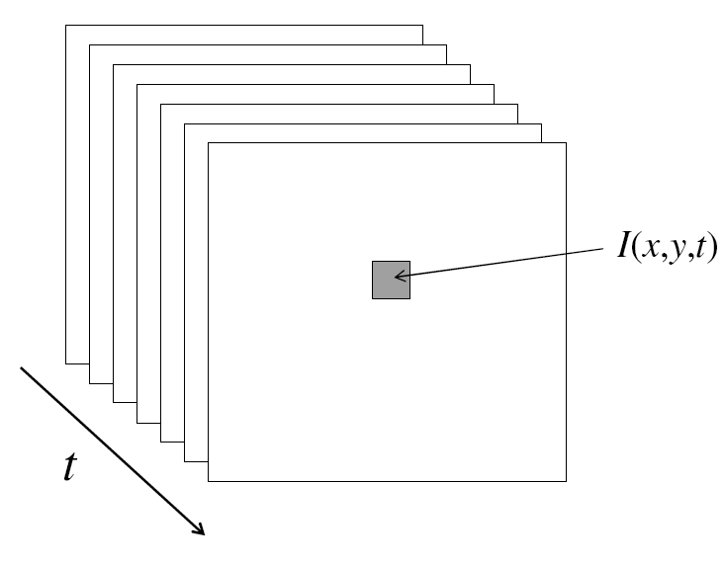
Video
A video is a sequence of frames captured over time
Now our image data is a function of space
(x, y) and time (t)

Slide 7
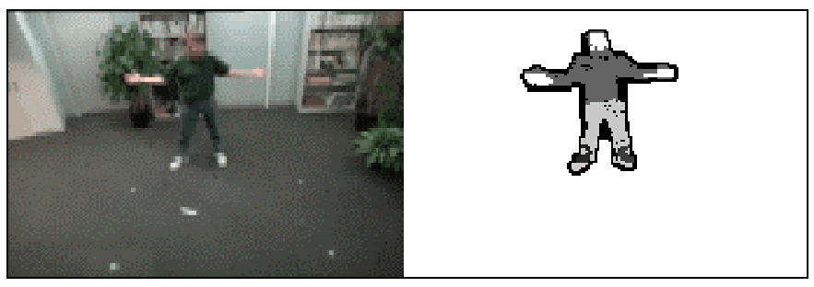
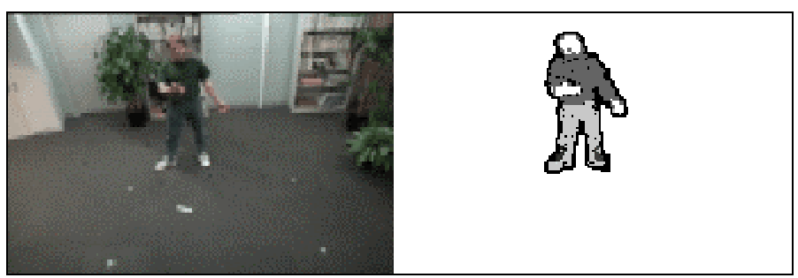
Motion Applications: Segmentation of video
Background subtraction
  A static camera is observing a scene
  Goal: separate the static background from the moving foreground

Slide 8
Applications of segmentation to video
Background subtraction
  Form an initial background estimate
  For each frame:
    Update estimate using a moving average
    Subtract the background estimate from the frame
    Label as foreground each pixel where the magnitude of the difference is greater than some threshold
    Use median filtering to “clean up” the results

Slide 9
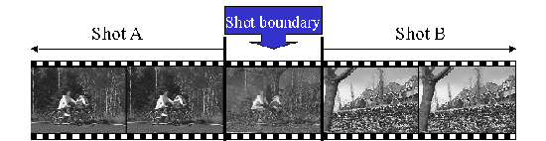
Motion Applications: Segmentation of video
Background subtraction
Shot boundary detection
  Commercial video is usually composed of shots or sequences showing the same objects or scene
  Goal: segment video into shots for summarization and browsing (each shot can be represented by a single keyframe in a user interface)
  Difference from background subtraction: the camera is not necessarily stationary

Slide 10
Applications of segmentation to video
Background subtraction
Shot boundary detection
  For each frame
    Compute the distance between the current frame and the previous one
      Pixel-by-pixel differences
      Differences of color histograms
      Block comparison
    If the distance is greater than some threshold, classify the frame as a shot boundary

Slide 11
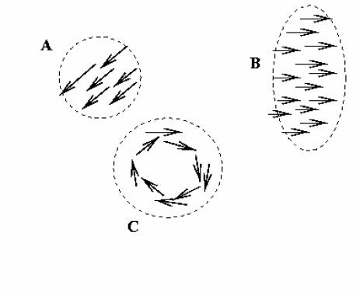
Motion Applications: Segmentation of video
Background subtraction
Shot boundary detection
Motion segmentation
  Segment the video into multiple coherently moving objects

Slide 12
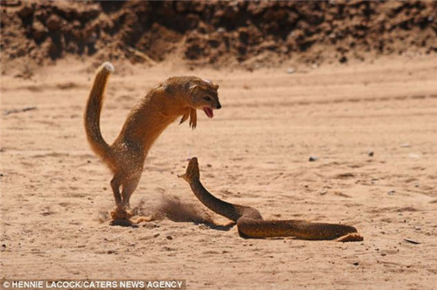
Motion Applications: Segmentation of video
Background subtraction
Shot boundary detection
Motion segmentation
  Segment the video into multiple coherently moving objects

Slide 13
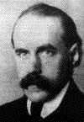
Motion and perceptual organization
Gestalt psychology (Max Wertheimer, 1880-1943)

Slide 14
Motion and perceptual organization
Sometimes, motion is the only cue
Gestalt psychology (Max Wertheimer, 1880-1943)

Slide 15
Motion and perceptual organization
Sometimes, motion is the only cue
Notes:
Now take it away. And count to 3…

Slide 16
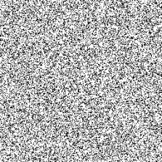
Motion and perceptual organization
Sometimes, motion is the only cue
Notes:
Now put another one. You probably don’t see anything special.

Slide 17
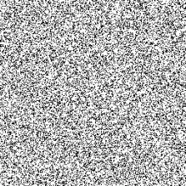
Motion and perceptual organization
Sometimes, motion is the only cue
Notes:
But put them in sequence…. And you see the moving square. The only indication of the square is the common motion.

Slide 18
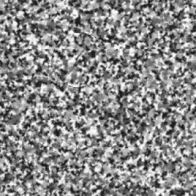
Motion and perceptual organization
Sometimes, motion is the only cue http://www.youtube.com/watch?v=aEoxO_RdGhE

Slide 19
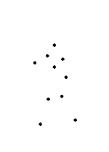
Motion and perceptual organization
Even “impoverished” motion data can evoke a strong percept
G. Johansson, “Visual Perception of Biological Motion and a Model For Its Analysis", Perception and Psychophysics 14, 201-211, 1973.

Slide 20
Motion and perceptual organization
Even “impoverished” motion data can evoke a strong percept
G. Johansson, “Visual Perception of Biological Motion and a Model For Its Analysis", Perception and Psychophysics 14, 201-211, 1973.

Slide 21
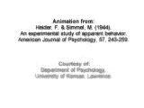
Motion and perceptual organization
Experimental study of apparent behavior.
Fritz Heider & Marianne Simmel. 1944

Slide 22
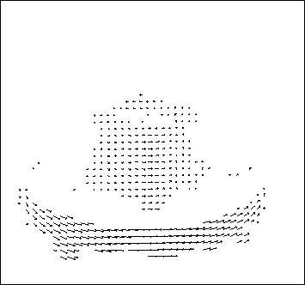
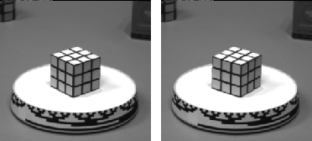
Motion estimation: Optical flow
Optical flow is the apparent motion of objects or surfaces
Will start by estimating motion of each pixel separately
Then will consider motion of entire image
The term “scene flow” is used to describe 3d motion estimation

Slide 23
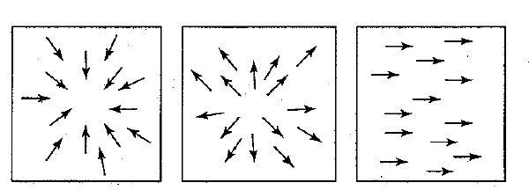
Motion field + camera motion
Zoom out
Zoom in
Pan right to left

Slide 24
Problem definition: optical flow
How to estimate pixel motion from image I(x,y,t) to I(x,y,t+1) ?
  Solve pixel correspondence problem
    given a pixel in I(x,y,t), look for nearby pixels of the same color in I(x,y,t+1)
Key assumptions
  color constancy: a point in I(x,y,t) looks the same in I(x,y,t+1)
    For grayscale images, this is brightness constancy
  small motion: points do not move very far
This is called the optical flow problem

Slide 25


Optical flow constraints (grayscale images)
Let’s look at these constraints more closely
  brightness constancy constraint (equation)
  small motion: (u and v are less than 1 pixel, or smooth) Taylor series expansion of the spatial changes of I:
Notes:
A: H(x,y) = I(x+u, y+v)

Slide 26
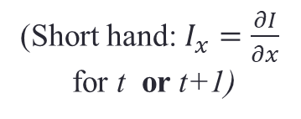
Optical flow equation
Combining these two equations
(Short hand: $I_{x}=\frac{∂I}{∂x}$
for t or t+1)

Slide 27
Optical flow equation
Combining these two equations
(Short hand: $I_{x}=\frac{∂I}{∂x}$
for t or t+1)

Slide 28
Optical flow equation
Combining these two equations
(Short hand: $I_{x}=\frac{∂I}{∂x}$
for t or t+1)
In the limit as u and v go to zero, this becomes exact
  Brightness constancy constraint equation

Slide 29
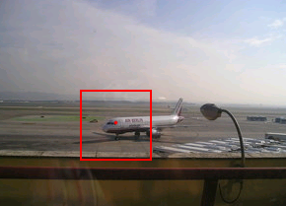
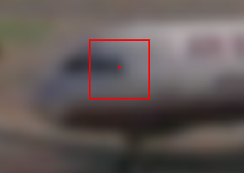
How does this make sense?
  Brightness constancy constraint equation
What do the static image gradients have to do with motion estimation?
If I told you I_{t} is -5
I_{x} is 2.5
I_{y} is 0
What was the pixel shift (u,v)?

Slide 30
How does this make sense?
  Brightness constancy constraint equation
What do the static image gradients have to do with motion estimation?
If I told you I_{t} is -5
I_{x} is 2
I_{y} is 1
What was the pixel shift (u,v)?

Slide 31
The brightness constancy constraint
Can we use this equation to recover image motion (u,v) at each pixel?
or
How many equations and unknowns per pixel?
  One equation (this is a scalar equation!), two unknowns (u,v)
The component of the motion perpendicular to the gradient (i.e., parallel to the edge) cannot be measured
  If (u, v) satisfies the equation,
  so does (u+u’, v+v’ ) if
gradient
(u,v)
(u’,v’)
(u+u’,v+v’)
edge
Notes:
A: u and v are unknown, 1 equation

Slide 32
Aperture problem

Slide 33
Aperture problem

Slide 34
Aperture problem

Slide 35
Apparently an aperture problem

Slide 36

The barber pole illusion
http://en.wikipedia.org/wiki/Barberpole_illusion

Slide 37


The barber pole illusion
http://en.wikipedia.org/wiki/Barberpole_illusion

Slide 38
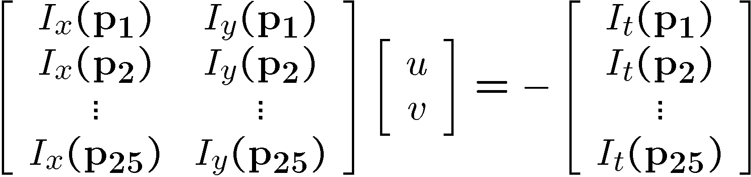
Solving the ambiguity…
B. Lucas and T. Kanade. An iterative image registration technique with an application to stereo vision. In Proceedings of the International Joint Conference on Artificial Intelligence, pp. 674–679, 1981.
How to get more equations for a pixel?
Spatial coherence constraint
Assume the pixel’s neighbors have the same (u,v)
  If we use a 5x5 window, that gives us 25 equations per pixel

Slide 39




Solving the ambiguity…
Least squares problem:

Slide 40

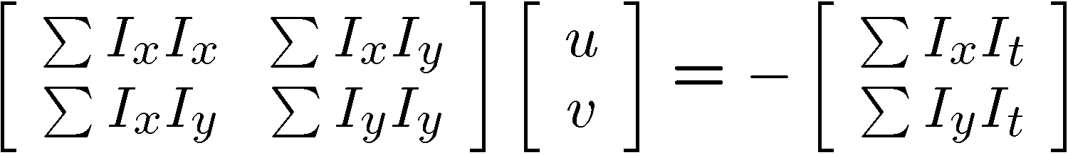


Matching patches across images
Overconstrained linear system
Least squares solution for d given by
  The summations are over all pixels in the K x K window

Slide 41


Conditions for solvability
  Optimal (u, v) satisfies Lucas-Kanade equation
When is this solvable? I.e., what are good points to track?
  A^{T}A should be invertible
  A^{T}A should not be too small due to noise
    eigenvalues λ₁ and λ ₂ of A^{T}A should not be too small
  A^{T}A should be well-conditioned
    λ ₁/ λ ₂ should not be too large (λ ₁ = larger eigenvalue)
Does this remind you of anything?
Criteria for Harris corner detector
Notes:
http://en.wikipedia.org/wiki/Invertible_matrix

Slide 42
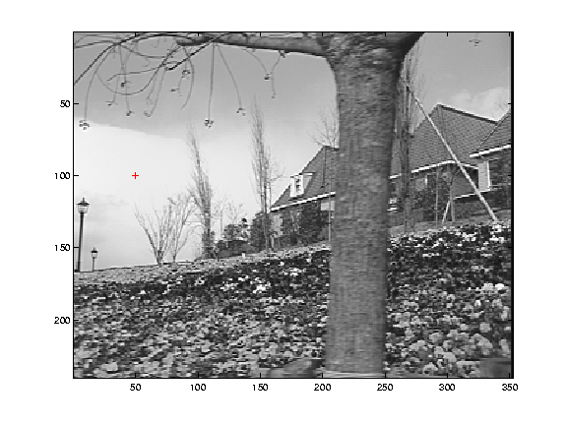
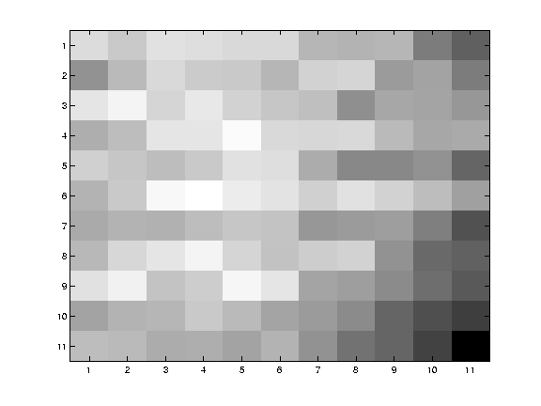
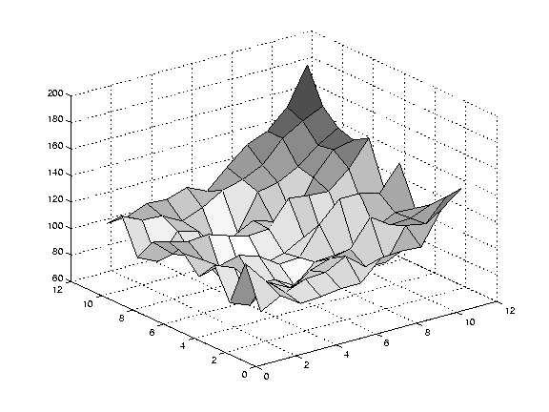
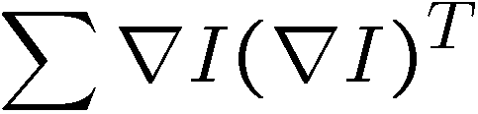
Low texture region
gradients have small magnitude
small λ₁, small λ₂
Notes:
Can’t estimate motion here…nothing you can see moving.

Slide 43
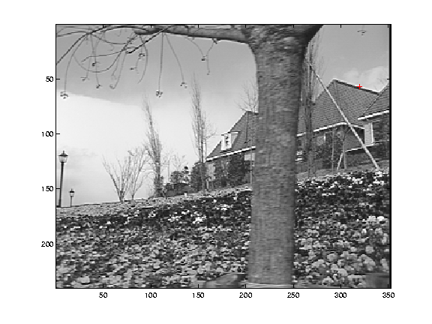
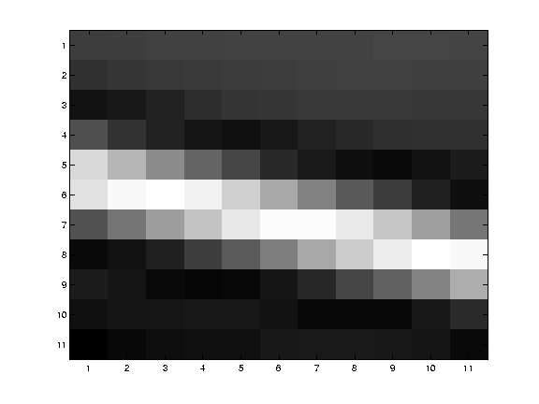
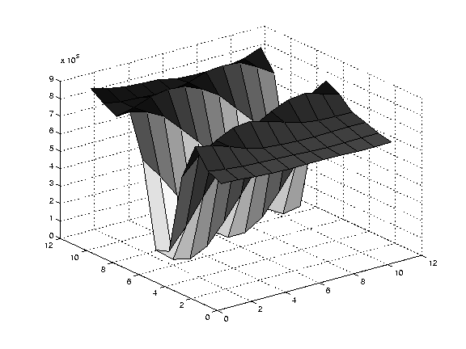
Edge
large gradients, all the same
large λ₁, small λ₂
Notes:
On an edge you can estimate motion perpendicular to the edge but not along it.

Slide 44
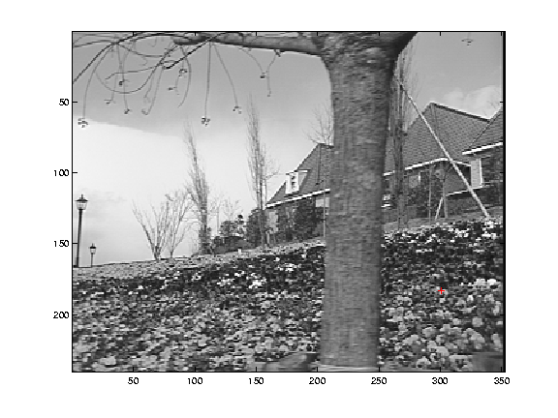
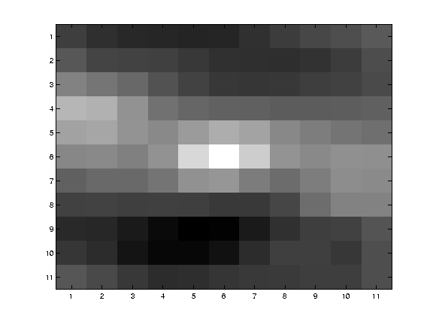
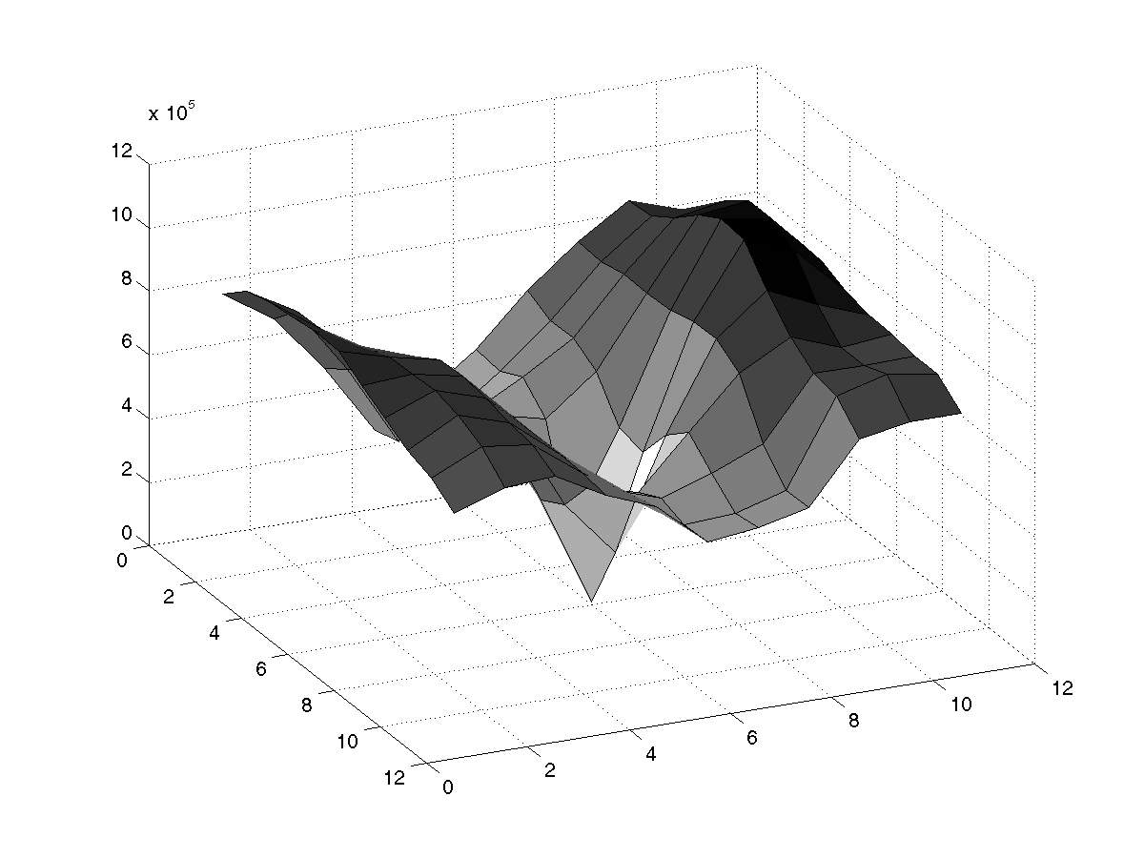
High textured region
gradients are different, large magnitudes
large λ₁, large λ₂
Notes:
But on nice textured regions motion is well estimated because the gradient varies over the window.

Slide 45
The aperture problem resolved
Actual motion

Slide 46
The aperture problem resolved
Perceived motion

Slide 47
Errors in Lucas-Kanade
A point does not move like its neighbors
  Motion segmentation
Brightness constancy does not hold
  Do exhaustive neighborhood search with normalized correlation - tracking features – maybe SIFT – more later….
The motion is large (larger than a pixel)
  Not-linear: Iterative refinement
  Local minima: coarse-to-fine estimation

Slide 48
Not tangent: Iterative Refinement
Iterative Lukas-Kanade Algorithm
  Estimate velocity at each pixel by solving Lucas-Kanade equations
  Warp I_{t} towards I_{t+1} using the estimated flow field
    - use image warping techniques
  Repeat until convergence

Slide 49
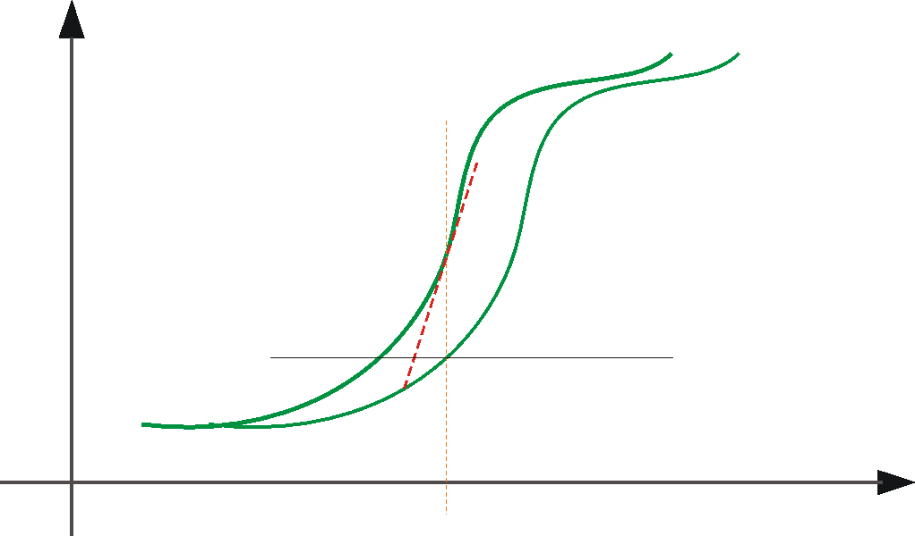





Optical Flow: Iterative Estimation
estimate update
Initial guess:
Estimate:
x₀
x
(using d for displacement here instead of u)

Slide 50
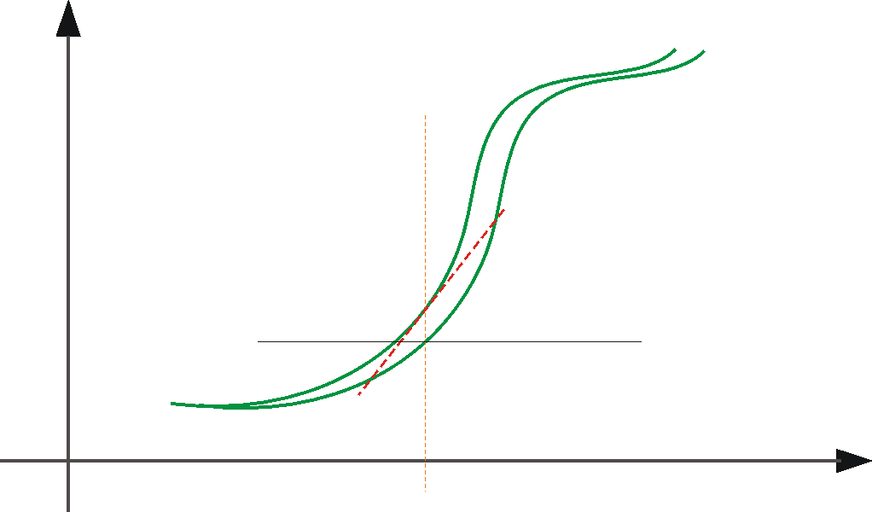



Optical Flow: Iterative Estimation
estimate update
Initial guess:
Estimate:
x₀
x

Slide 51
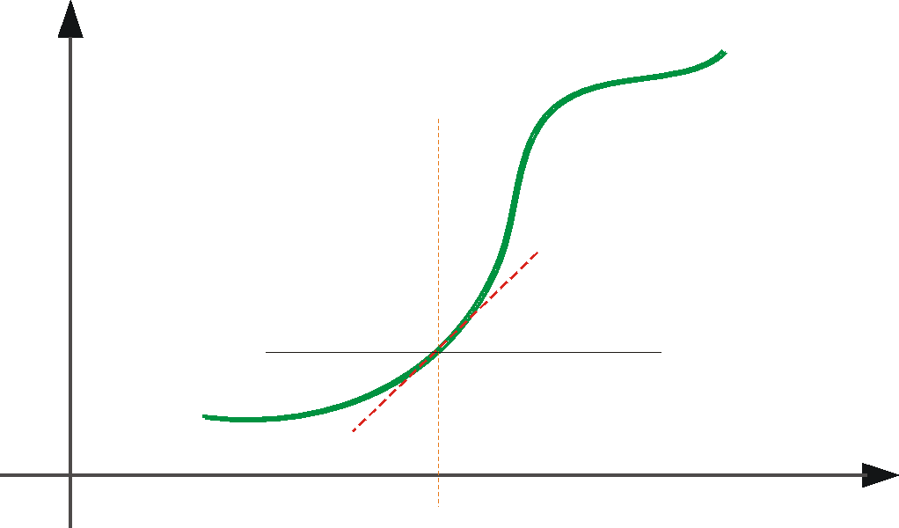



Optical Flow: Iterative Estimation
estimate update
Initial guess:
Estimate:
Initial guess:
Estimate:
x₀
x

Slide 52
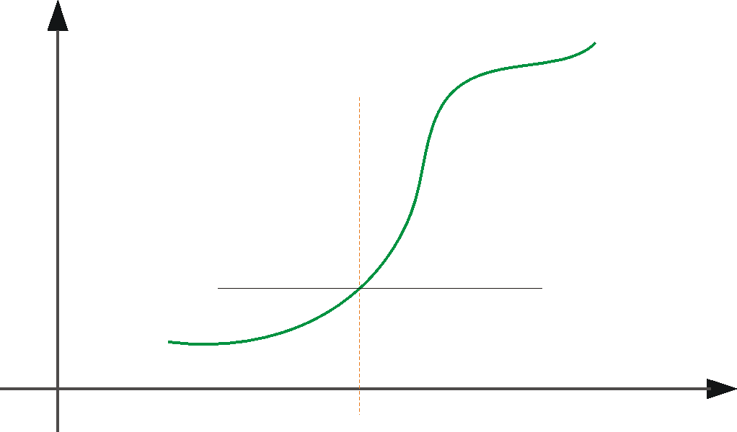

Optical Flow: Iterative Estimation
x₀
x

Slide 53
Optical Flow: Iterative Estimation
Some Implementation Issues:
  Warping is not easy (ensure that errors in warping are smaller than the estimate refinement) – but it is in MATLAB!
  Often useful to low-pass filter the images before motion estimation (for better derivative estimation, and linear approximations to image intensity)

Slide 54
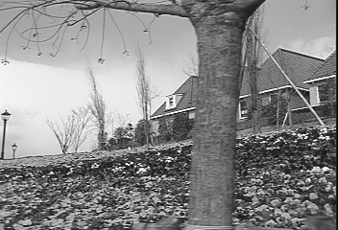
Revisiting the small motion assumption
Is this motion small enough?
  Probably not—it’s much larger than one pixel
  How might we solve this problem?

Slide 55


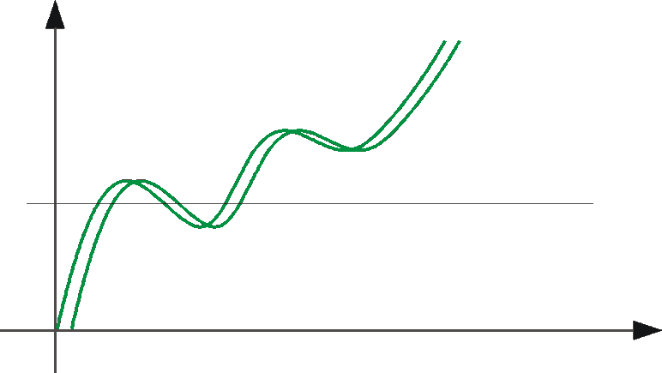
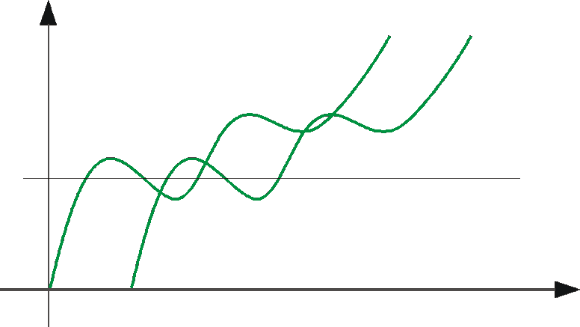
Optical Flow: Aliasing
Temporal aliasing causes ambiguities in optical flow because images can have many pixels with the same intensity.
I.e., how do we know which ‘correspondence’ is correct?
actual shift
estimated shift
nearest match is correct (no aliasing)
nearest match is incorrect (aliasing)
To overcome aliasing: coarse-to-fine estimation.

Slide 56
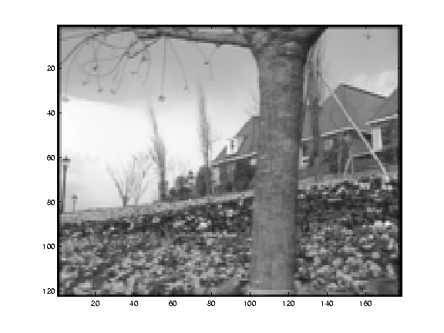
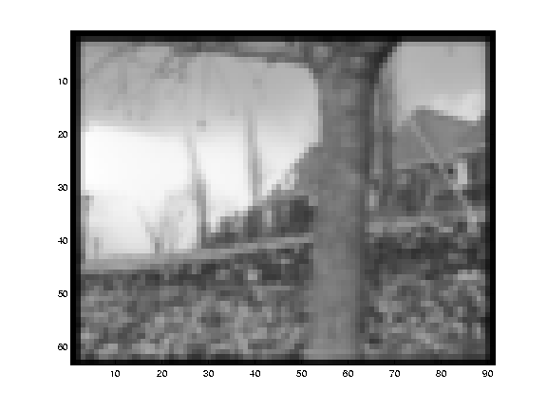
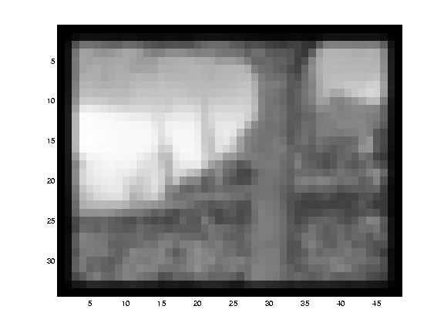
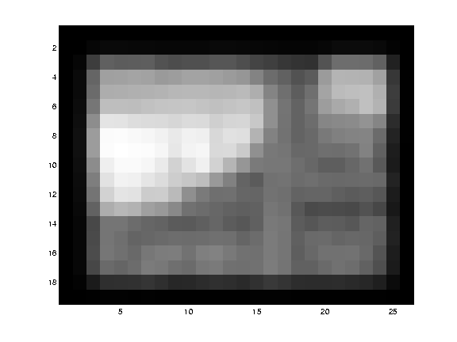
Reduce the resolution!

Slide 57
Coarse-to-fine optical flow estimation
u=1.25 pixels
u=2.5 pixels
u=5 pixels
image 1
u=10 pixels
image 2
image 1
image 2
Gaussian pyramid of image 1
Gaussian pyramid of image 2

Slide 58
Coarse-to-fine optical flow estimation
run iterative L-K
warp & upsample
run iterative L-K
.
.
.
image J
image I
image 1
image 2
Gaussian pyramid of image 1
Gaussian pyramid of image 2
Notes:
Far more details: http://robots.stanford.edu/cs223b04/algo_tracking.pdf

Slide 59
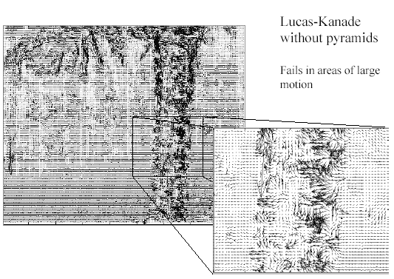
Optical Flow Results
* From Khurram Hassan-Shafique CAP5415 Computer Vision 2003

Slide 60
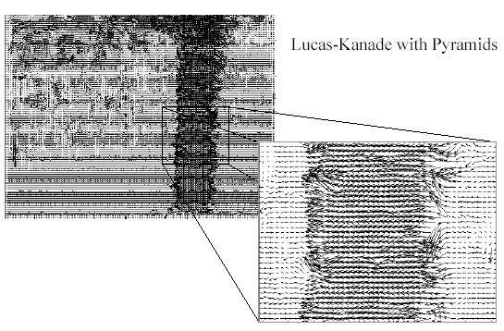
Optical Flow Results
* From Khurram Hassan-Shafique CAP5415 Computer Vision 2003

Slide 61
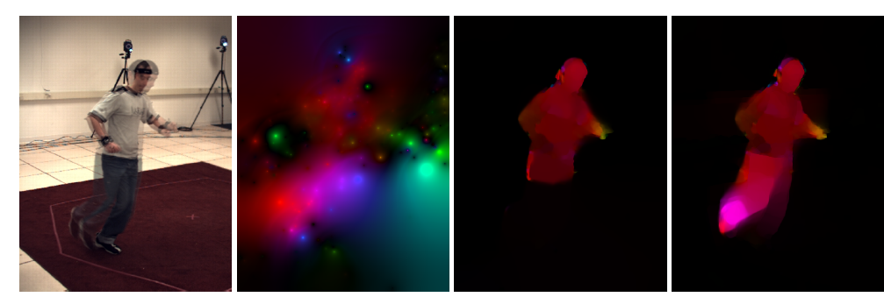
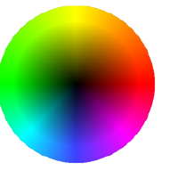
State-of-the-art optical flow in 2009
Start with something similar to Lucas-Kanade
+ gradient constancy
+ energy minimization with smoothing term
+ region matching
+ keypoint matching (long-range)
Region-based
+Pixel-based
+Keypoint-based
Large displacement optical flow, Brox et al., CVPR 2009

Slide 62
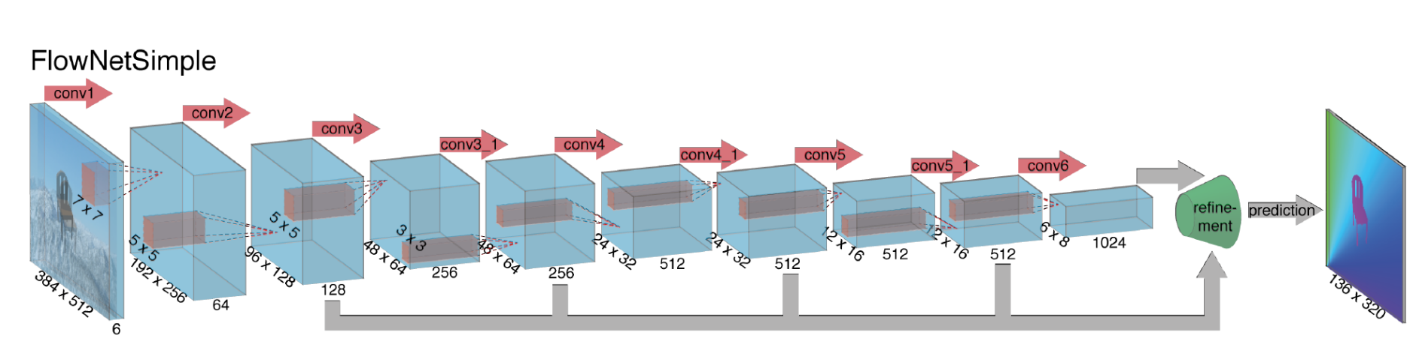
State-of-the-art optical flow in 2015
Deep convolutional network which accepts a pair of input frames and upsamples the estimated flow back to input resolution. Very fast because of deep network, near the state-of-the-art in terms of end-point-error.
Fischer et al. 2015. https://arxiv.org/abs/1504.06852
Notes:
Optical flow as supervised learning

Slide 63

Deep optical flow, 2015
Synthetic Training data
Fischer et al. 2015. https://arxiv.org/abs/1504.06852

Slide 64

Deep optical flow, 2015
Results on Sintel
Fischer et al. 2015. https://arxiv.org/abs/1504.06852

Slide 65
Optical flow
Definition: optical flow is the apparent motion of brightness patterns in the image
Ideally, optical flow would be the same as the motion field
Have to be careful: apparent motion can be caused by lighting changes without any actual motion
  Think of a uniform rotating sphere under fixed lighting vs. a stationary sphere under moving illumination

