Slide 2
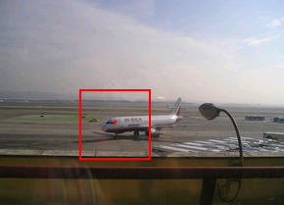
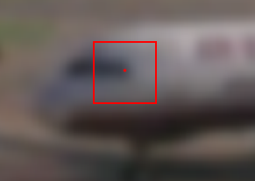
Recap: Optical Flow
Brightness constancy constraint equation
What do the static image gradients have to do with motion estimation?
If I told you I_{t} is -5 I_{x} is 2
I_{y} is 1
What was the pixel shift (u,v)?

Slide 3
Recap: Conditions for solvability
Optimal (u, v) satisfies Lucas-Kanade equation
When is this solvable? I.e., what are good points to track?
A^{T}A should be invertible
A^{T}A should not be too small due to noise
eigenvalues λ₁ and λ ₂ of A^{T}A should not be too small
A^{T}A should be well-conditioned
λ ₁/ λ ₂ should not be too large (λ ₁ = larger eigenvalue)
Does this remind you of anything?
Criteria for Harris corner detector
Notes:
http://en.wikipedia.org/wiki/Invertible_matrix

Slide 4
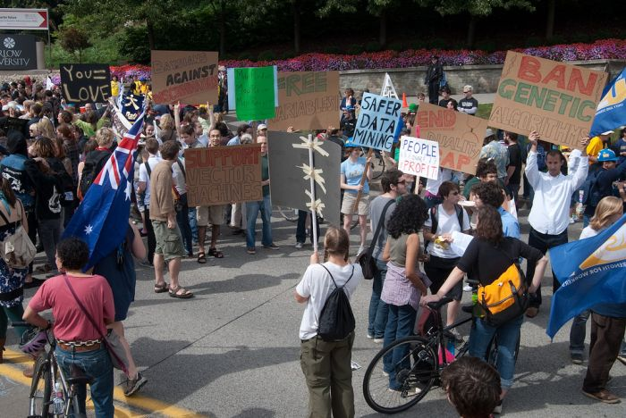
Machine Learning Crash Course
Computer Vision
James Hays
Slides: Isabelle Guyon, Erik Sudderth, Mark Johnson, Derek Hoiem
Photo: CMU Machine Learning Department protests G20

Slide 6
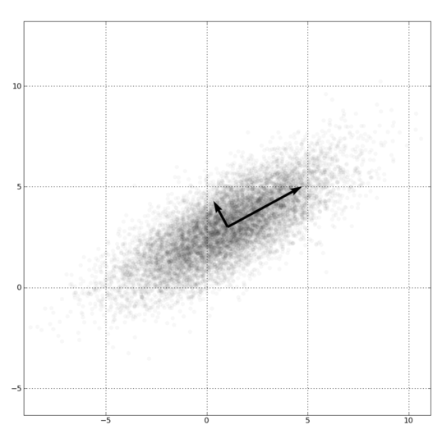
Dimensionality Reduction
PCA, ICA, LLE, Isomap, Autoencoder
PCA is the most important technique to know. It takes advantage of correlations in data dimensions to produce the best possible lower dimensional representation based on linear projections (minimizes reconstruction error).
PCA should be used for dimensionality reduction, not for discovering patterns or making predictions. Don't try to assign semantic meaning to the bases.

Slide 8
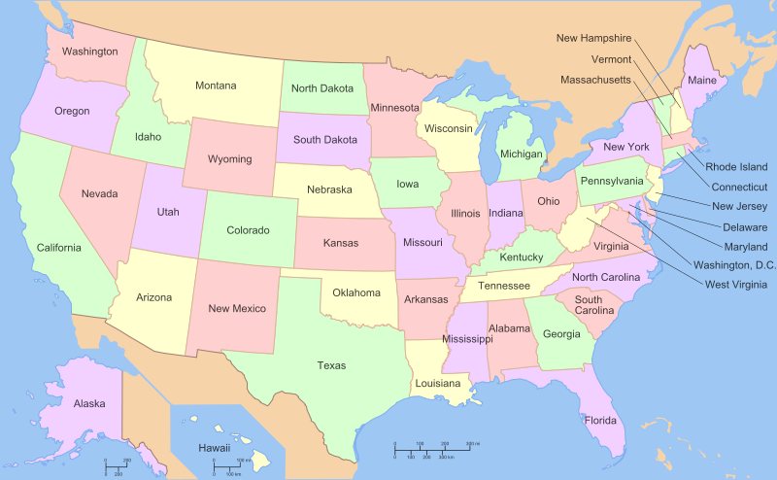

Slide 9
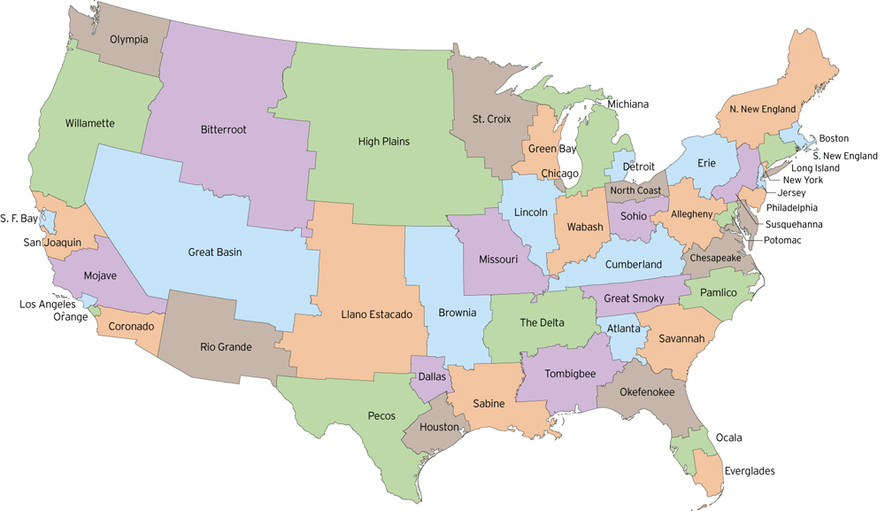
http://fakeisthenewreal.org/reform/
Notes:
~5,617,000 population in each state

Slide 10
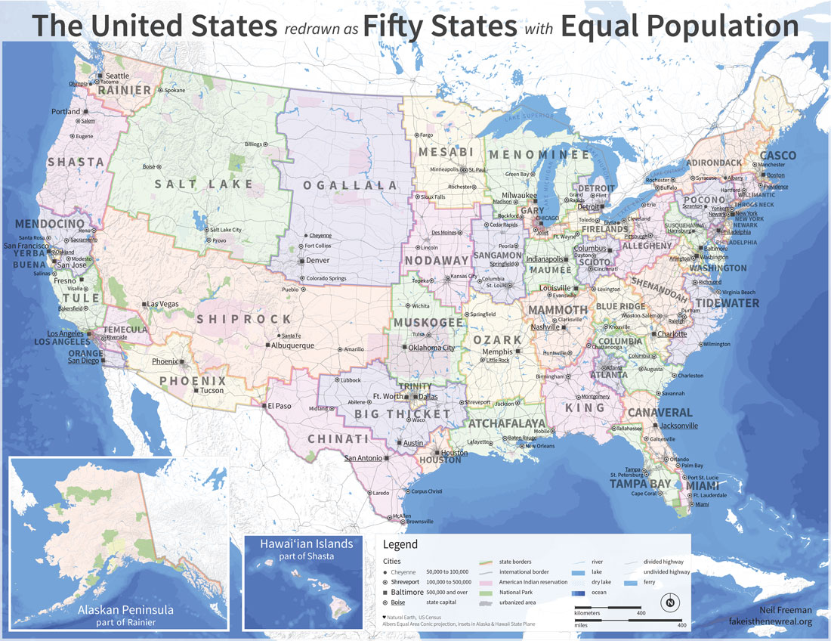
http://fakeisthenewreal.org/reform/
Notes:
~5,617,000 population in each state

Slide 11
Clustering example: image segmentation
Goal: Break up the image into meaningful or perceptually similar regions

Slide 12
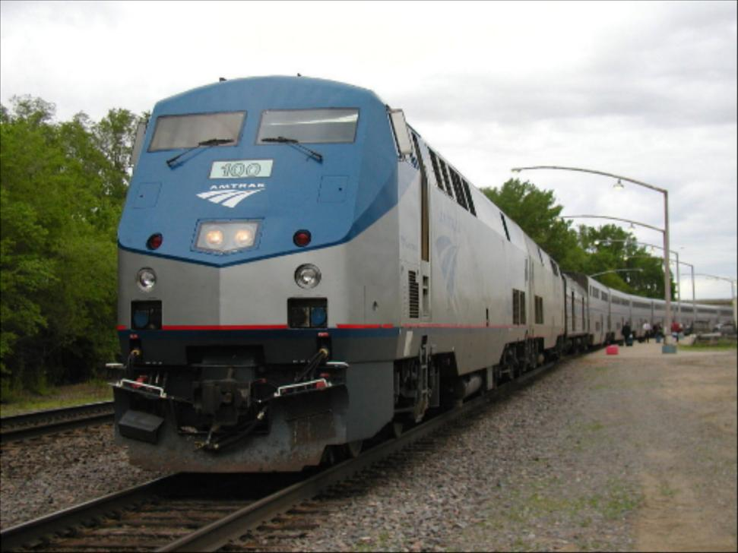
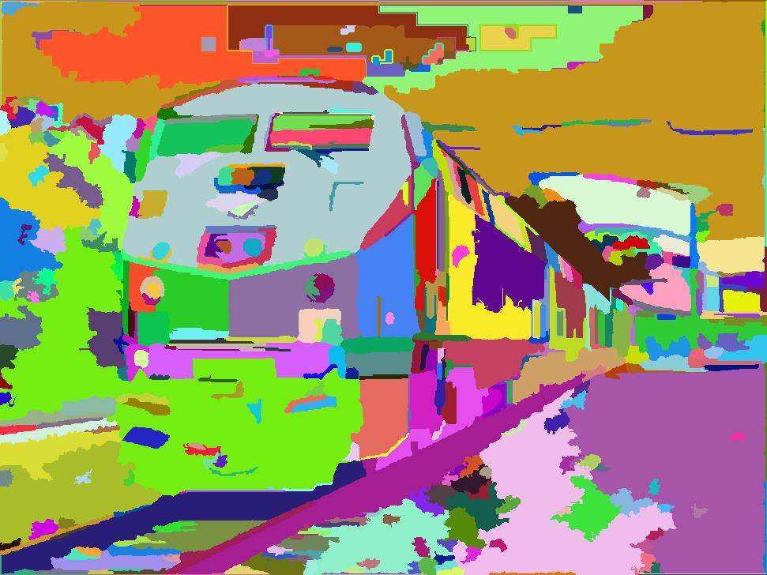
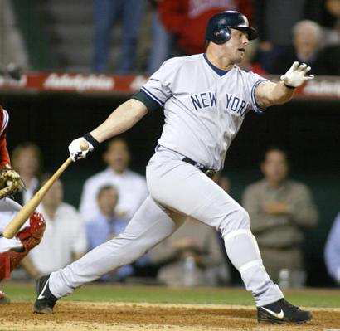
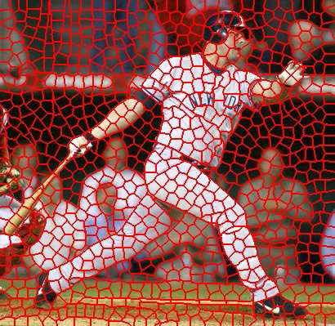
Segmentation for feature support or efficiency
50x50 Patch
50x50 Patch
[Felzenszwalb and Huttenlocher 2004]
[Shi and Malik 2001]
Slide: Derek Hoiem
[Hoiem et al. 2005, Mori 2005]

Slide 13
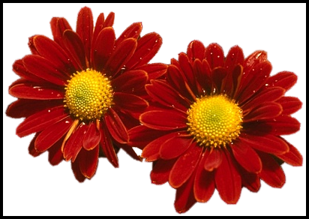
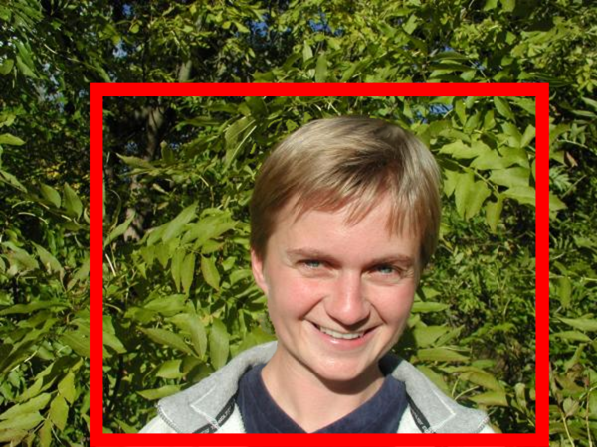
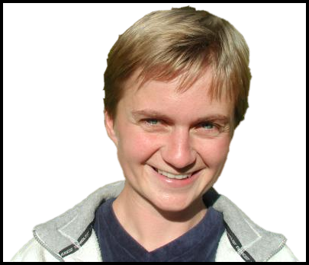
Segmentation as a result
Rother et al. 2004

Slide 14
Types of segmentations
Oversegmentation
Undersegmentation
Multiple Segmentations

Slide 15
Major processes for segmentation
Bottom-up: group tokens with similar features
Top-down: group tokens that likely belong to the same object
[Levin and Weiss 2006]

Slide 16
Clustering: group together similar points and represent them with a single token
Key Challenges:
1) What makes two points/images/patches similar?
2) How do we compute an overall grouping from pairwise similarities?
Slide: Derek Hoiem

Slide 17
Why do we cluster?
Summarizing data
Look at large amounts of data
Patch-based compression or denoising
Represent a large continuous vector with the cluster number
Counting
Histograms of texture, color, SIFT vectors
Segmentation
Separate the image into different regions
Prediction
Images in the same cluster may have the same labels
Slide: Derek Hoiem

Slide 18
How do we cluster?
K-means
Iteratively re-assign points to the nearest cluster center
Agglomerative clustering
Start with each point as its own cluster and iteratively merge the closest clusters
Mean-shift clustering
Estimate modes of pdf
Spectral clustering
Split the nodes in a graph based on assigned links with similarity weights

Slide 19
Clustering for Summarization
Goal: cluster to minimize variance in data given clusters
Preserve information
Cluster center
Data
Whether x_{j} is assigned to c_{i}
Slide: Derek Hoiem

Slide 20
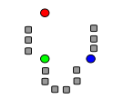
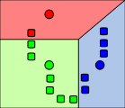
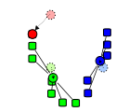
K-means algorithm
1. Randomly select K centers
2. Assign each point to nearest center
3. Compute new center (mean) for each cluster
Illustration: http://en.wikipedia.org/wiki/K-means_clustering

Slide 21
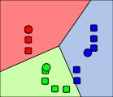
K-means algorithm
1. Randomly select K centers
2. Assign each point to nearest center
Back to 2
3. Compute new center (mean) for each cluster
Illustration: http://en.wikipedia.org/wiki/K-means_clustering

Slide 22
K-means
Initialize cluster centers: c⁰ ; t=0
Assign each point to the closest center
Update cluster centers as the mean of the points
Repeat 2-3 until no points are re-assigned (t=t+1)
Slide: Derek Hoiem

Slide 23
K-means converges to a local minimum

Slide 24
K-means: design choices
Initialization
Randomly select K points as initial cluster center
Or greedily choose K points to minimize residual
Distance measures
Traditionally Euclidean, could be others
Optimization
Will converge to a local minimum
May want to perform multiple restarts

Slide 25
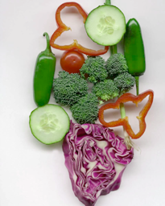
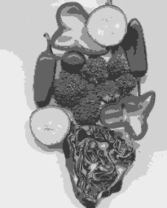
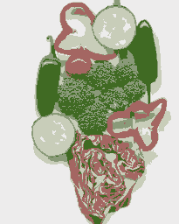
K-means clustering using intensity or color
Image
Clusters on intensity
Clusters on color
Notes:
I gave each pixel the mean intensity or mean color of its cluster --- this is basically just vector quantizing the image intensities/colors. Notice that there is no requirement that clusters be spatially localized and they’re not.

Slide 26
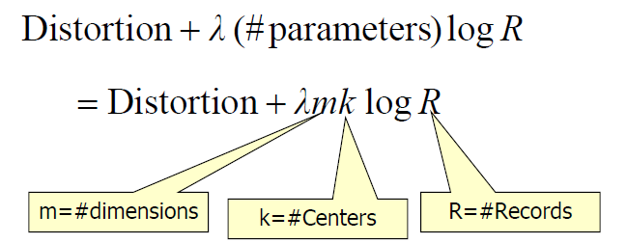
How to choose the number of clusters?
Minimum Description Length (MDL) principal for model comparison
Minimize Schwarz Criterion
also called Bayes Information Criteria (BIC)

Slide 27
How to evaluate clusters?
Generative
How well are points reconstructed from the clusters?
Discriminative
How well do the clusters correspond to labels?
Purity
Note: unsupervised clustering does not aim to be discriminative
Slide: Derek Hoiem

Slide 28
How to choose the number of clusters?
Validation set
Try different numbers of clusters and look at performance
When building dictionaries (discussed later), more clusters typically work better
Slide: Derek Hoiem

Slide 29
K-means demos
General
http://home.dei.polimi.it/matteucc/Clustering/tutorial_html/AppletKM.html
http://www.cs.washington.edu/research/imagedatabase/demo/kmcluster/
Color clustering

Slide 30
K-Means pros and cons
Pros
Finds cluster centers that minimize conditional variance (good representation of data)
Simple and fast*
Easy to implement
Cons
Need to choose K
Sensitive to outliers
Prone to local minima
All clusters have the same parameters (e.g., distance measure is non-adaptive)
*Can be slow: each iteration is O(KNd) for N d-dimensional points
Usage
Rarely used for pixel segmentation

Slide 31
Building Visual Dictionaries
Sample patches from a database
E.g., 128 dimensional SIFT vectors
Cluster the patches
Cluster centers are the dictionary
Assign a codeword (number) to each new patch, according to the nearest cluster

Slide 32
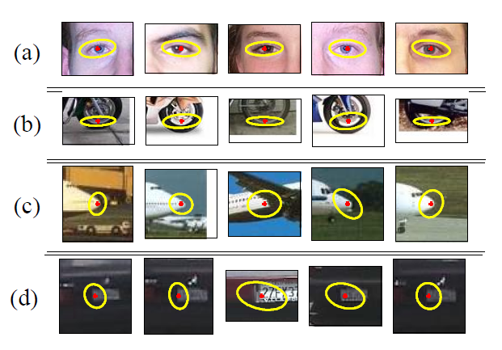
Examples of learned codewords
Most likely codewords for 4 learned “topics”
http://www.robots.ox.ac.uk/~vgg/publications/papers/sivic05b.pdf
Sivic et al. ICCV 2005

Slide 33
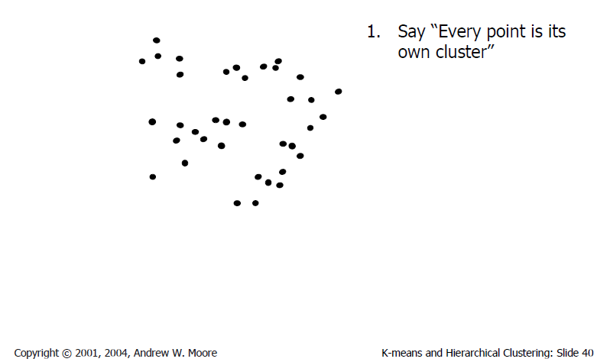
Agglomerative clustering

Slide 34
Agglomerative clustering

Slide 35
Agglomerative clustering

Slide 36
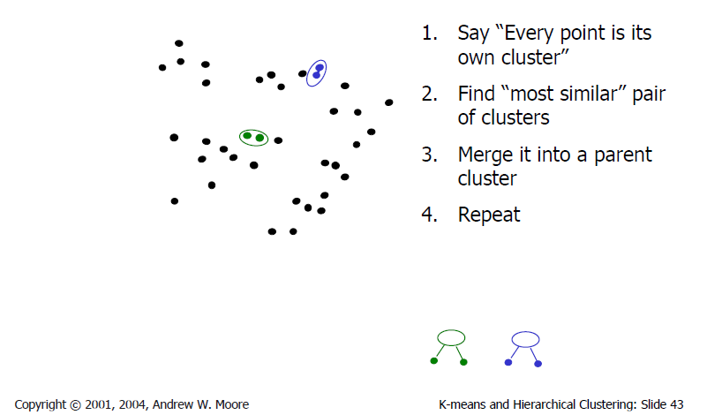
Agglomerative clustering

Slide 37
Agglomerative clustering

Slide 38
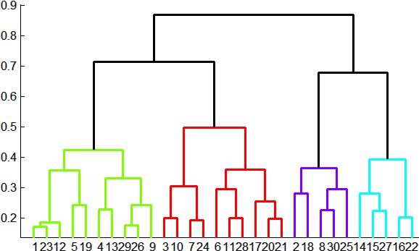
Agglomerative clustering
How to define cluster similarity?
Average distance between points, maximum distance, minimum distance
Distance between means or medoids
How many clusters?
Clustering creates a dendrogram (a tree)
Threshold based on max number of clusters or based on distance between merges
distance

Slide 39
Agglomerative clustering demo
http://home.dei.polimi.it/matteucc/Clustering/tutorial_html/AppletH.html

Slide 40
Conclusions: Agglomerative Clustering
Good
Simple to implement, widespread application
Clusters have adaptive shapes
Provides a hierarchy of clusters
Bad
May have imbalanced clusters
Still have to choose number of clusters or threshold
Need to use an “ultrametric” to get a meaningful hierarchy
Notes:
Ultrametric – stronger requirement than triangle inequality. Distance between two points must be at least a large as the distance of connecting those two points through any intermediate point.

Slide 41
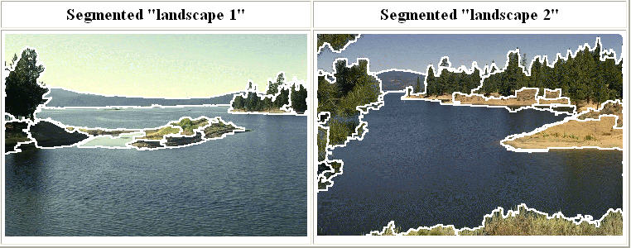
Mean shift segmentation
D. Comaniciu and P. Meer, Mean Shift: A Robust Approach toward Feature Space Analysis, PAMI 2002.
Versatile technique for clustering-based segmentation

Slide 42
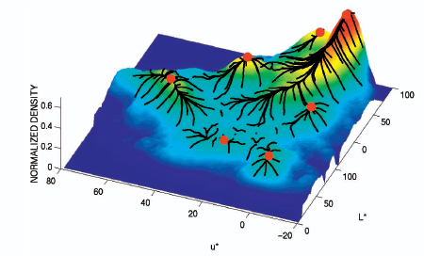
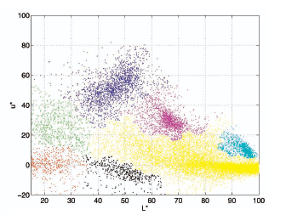
Mean shift algorithm
Try to find modes of this non-parametric density

Slide 43
Kernel density estimation
Kernel density estimation function
Gaussian kernel

Slide 44
Mean shift
Region of
interest
Center of
mass
Mean Shift
vector
Slide by Y. Ukrainitz & B. Sarel

Slide 45
Mean shift
Region of
interest
Center of
mass
Mean Shift
vector
Slide by Y. Ukrainitz & B. Sarel

Slide 46
Mean shift
Region of
interest
Center of
mass
Mean Shift
vector
Slide by Y. Ukrainitz & B. Sarel

Slide 47
Mean shift
Region of
interest
Center of
mass
Mean Shift
vector
Slide by Y. Ukrainitz & B. Sarel

Slide 48
Mean shift
Region of
interest
Center of
mass
Mean Shift
vector
Slide by Y. Ukrainitz & B. Sarel

Slide 49
Mean shift
Region of
interest
Center of
mass
Mean Shift
vector
Slide by Y. Ukrainitz & B. Sarel

Slide 50
Mean shift
Region of
interest
Center of
mass
Slide by Y. Ukrainitz & B. Sarel

Slide 51
Computing the Mean Shift
Simple Mean Shift procedure:
Compute mean shift vector
Translate the Kernel window by m(x)
Slide by Y. Ukrainitz & B. Sarel

Slide 52
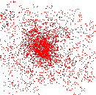
Attraction basin
Attraction basin: the region for which all trajectories lead to the same mode
Cluster: all data points in the attraction basin of a mode
Slide by Y. Ukrainitz & B. Sarel

Slide 53
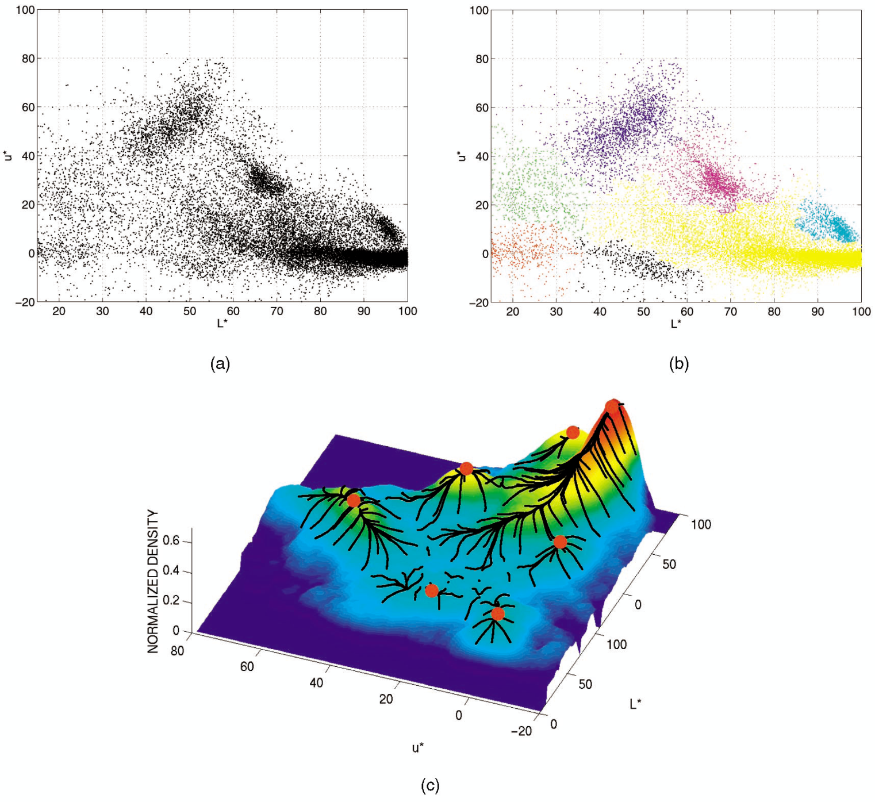
Attraction basin

Slide 54
Mean shift clustering
The mean shift algorithm seeks modes of the given set of points
Choose kernel and bandwidth
For each point:
Center a window on that point
Compute the mean of the data in the search window
Center the search window at the new mean location
Repeat (b,c) until convergence
Assign points that lead to nearby modes to the same cluster

Slide 55
Segmentation by Mean Shift
Compute features for each pixel (color, gradients, texture, etc)
Set kernel size for features K_{f} and position K_{s}
Initialize windows at individual pixel locations
Perform mean shift for each window until convergence
Merge windows that are within width of K_{f} and K_{s}

Slide 56
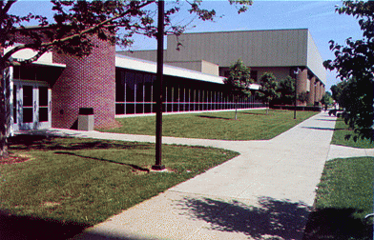
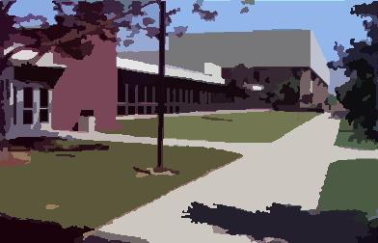
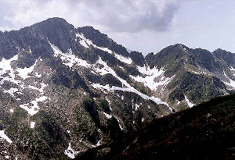
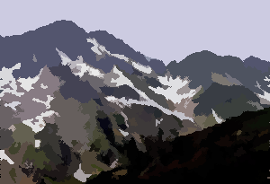
Mean shift segmentation results
Comaniciu and Meer 2002
Notes:
Clustering based on feature (LUV colors), location (x y coordinates), and eliminating small clusters

Slide 57
Comaniciu and Meer 2002

Slide 58
Mean-shift: other issues
Speedups
Binned estimation
Fast search of neighbors
Update each window in each iteration (faster convergence)
Other tricks
Use kNN to determine window sizes adaptively
Lots of theoretical support
D. Comaniciu and P. Meer, Mean Shift: A Robust Approach toward Feature Space Analysis, PAMI 2002.

Slide 59
Mean shift pros and cons
Pros
Good general-practice segmentation
Flexible in number and shape of regions
Robust to outliers
Cons
Have to choose kernel size in advance
Not suitable for high-dimensional features
When to use it
Oversegmentatoin
Multiple segmentations
Tracking, clustering, filtering applications

Slide 60
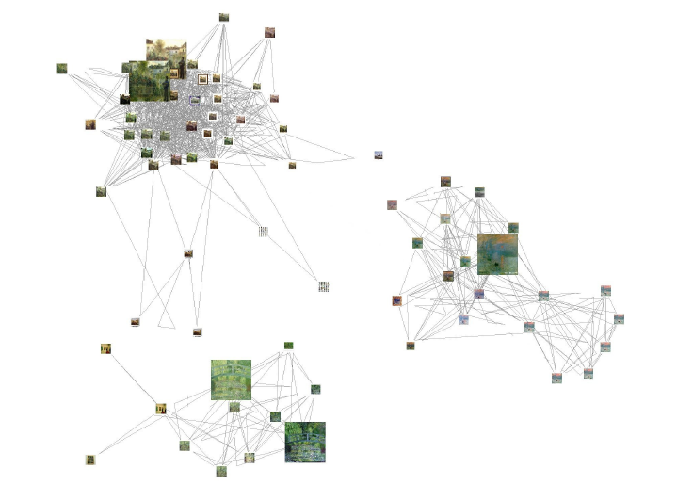
Spectral clustering
Group points based on links in a graph
B
A

Slide 61
Cuts in a graph
B
A
Normalized Cut
a cut penalizes large segments
fix by normalizing for size of segments
volume(A) = sum of costs of all edges that touch A
Source: Seitz

Slide 62
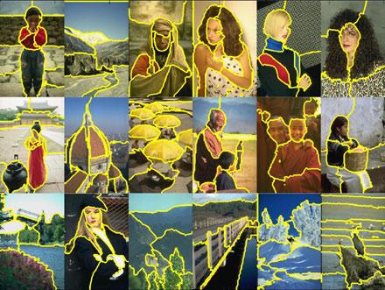
Normalized cuts for segmentation

Slide 63
Visual PageRank
Determining importance by random walk
What’s the probability that you will randomly walk to a given node?
Create adjacency matrix based on visual similarity
Edge weights determine probability of transition
Jing Baluja 2008

Slide 64
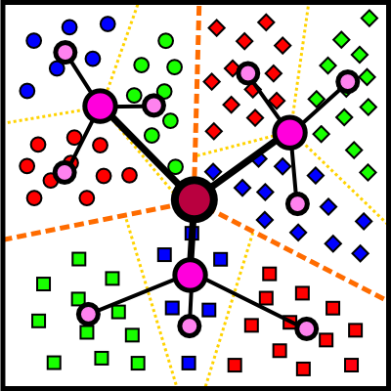
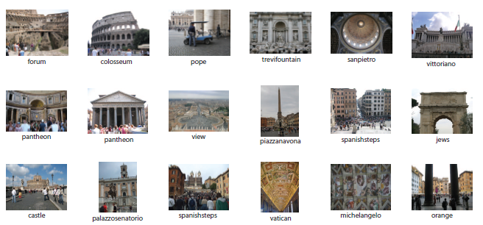
Which algorithm to try first?
Quantization/Summarization: K-means
Aims to preserve variance of original data
Can easily assign new point to a cluster
Summary of 20,000 photos of Rome using “greedy k-means”
http://grail.cs.washington.edu/projects/canonview/
Quantization for computing histograms

Slide 65
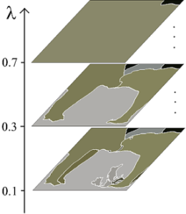
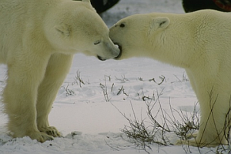
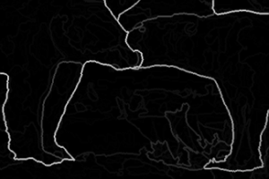
Which algorithm to use?
Image segmentation: agglomerative clustering
More flexible with distance measures (e.g., can be based on boundary prediction)
Adapts better to specific data
Hierarchy can be useful
http://www.cs.berkeley.edu/~arbelaez/UCM.html

Slide 66
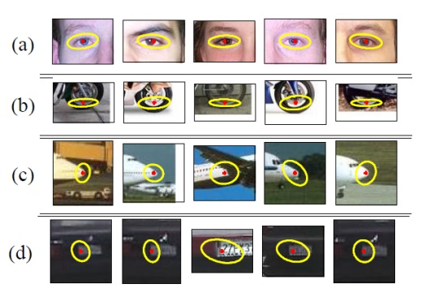
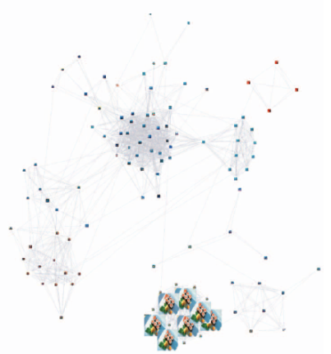
Things to remember
K-means useful for summarization, building dictionaries of patches, general clustering
Agglomerative clustering useful for segmentation, general clustering
Spectral clustering useful for determining relevance, summarization, segmentation

Slide 67
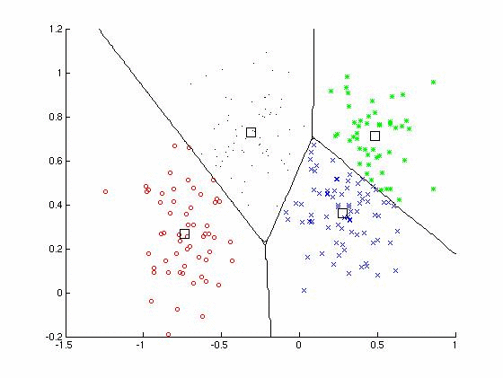
Clustering
Key algorithm
K-means

Slide 69
The machine learning framework
Apply a prediction function to a feature representation of the image to get the desired output:
f( ) = “apple”
f( ) = “tomato”
f( ) = “cow”
Slide credit: L. Lazebnik

Slide 70
The machine learning framework
y = f(x)
Training: given a training set of labeled examples {(x₁,y₁), …, (x_{N},y_{N})}, estimate the prediction function f by minimizing the prediction error on the training set
Testing: apply f to a never before seen test example x and output the predicted value y = f(x)
output
prediction function
Image feature
Slide credit: L. Lazebnik

Slide 71
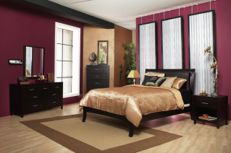
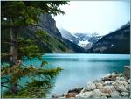
Image Categorization
Training
Training Labels
Training Images
Image Features
Classifier Training
Trained Classifier

Slide 72
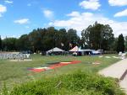
Image Categorization
Training
Training Labels
Training Images
Image Features
Classifier Training
Trained Classifier
Testing
Image Features
Trained Classifier
Prediction
Outdoor
Test Image

Slide 73
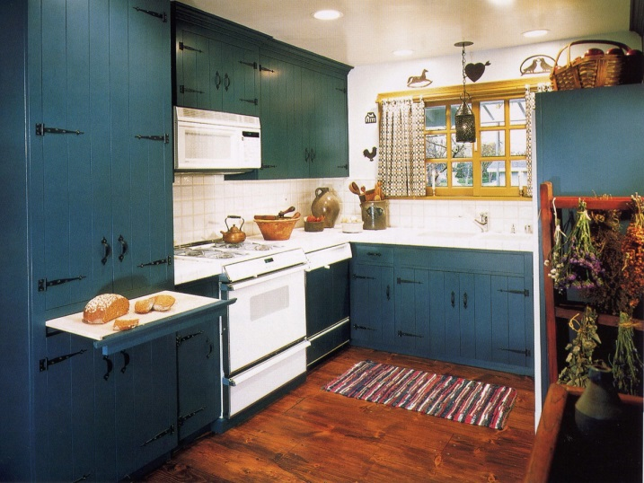
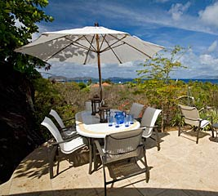
Example: Scene Categorization
Is this a kitchen?

Slide 74
Image features
Training
Training Labels
Training Images
Image Features
Classifier Training
Trained Classifier

Slide 75
General Principles of Representation
Coverage
Ensure that all relevant info is captured
Concision
Minimize number of features without sacrificing coverage
Directness
Ideal features are independently useful for prediction

Slide 76
Image representations
Templates
Intensity, gradients, etc.
Histograms
Color, texture, SIFT descriptors, etc.

Slide 77
Classifiers
Training
Training Labels
Training Images
Image Features
Classifier Training
Trained Classifier

Slide 78
Learning a classifier
Given some set of features with corresponding labels, learn a function to predict the labels from the features
x
x
x
x
x
x
o
x
x
o
o
o
o
x2
x1

Slide 79
Steps
Training
Training Labels
Training Images
Image Features
Training
Learned model
Testing
Image Features
Learned model
Prediction
Test Image
Slide credit: D. Hoiem and L. Lazebnik

Slide 80
Features
Raw pixels
Histograms
GIST descriptors
…
Slide credit: L. Lazebnik

Slide 81
One way to think about it…
Training labels dictate that two examples are the same or different, in some sense
Features and distance measures define visual similarity
Classifiers try to learn weights or parameters for features and distance measures so that visual similarity predicts label similarity

Slide 82
Many classifiers to choose from
SVM
Neural networks
Naïve Bayes
Bayesian network
Logistic regression
Randomized Forests
Boosted Decision Trees
K-nearest neighbor
RBMs
Deep Convolutional Network
Etc.
Which is the best one?

Slide 83
Claim:
The decision to use machine learning is more important than the choice of a particular learning method.
*Deep learning seems to be an exception to this, at the moment, probably because it is learning the feature representation.

Slide 84
Classifiers: Nearest neighbor
Test example
Training examples from class 2
Training examples from class 1
f(x) = label of the training example nearest to x
All we need is a distance function for our inputs
No training required!
Slide credit: L. Lazebnik

Slide 85
Classifiers: Linear
Find a linear function to separate the classes:
f(x) = sgn(w ⋅ x + b)
Slide credit: L. Lazebnik

Slide 86
Recognition task and supervision
Images in the training set must be annotated with the “correct answer” that the model is expected to produce
Contains a motorbike
Slide credit: L. Lazebnik

Slide 87
Unsupervised
“Weakly” supervised
Fully supervised
Definition depends on task
Slide credit: L. Lazebnik

Slide 88
Generalization
Training set (labels known)
Test set (labels unknown)
How well does a learned model generalize from the data it was trained on to a new test set?
Slide credit: L. Lazebnik

Slide 89
Generalization
Components of generalization error
Bias: how much the average model over all training sets differ from the true model?
Error due to inaccurate assumptions/simplifications made by the model. “Bias” sounds negative. “Regularization” sounds nicer.
Variance: how much models estimated from different training sets differ from each other.
Underfitting: model is too “simple” to represent all the relevant class characteristics
High bias (few degrees of freedom) and low variance
High training error and high test error
Overfitting: model is too “complex” and fits irrelevant characteristics (noise) in the data
Low bias (many degrees of freedom) and high variance
Low training error and high test error
Slide credit: L. Lazebnik

Slide 90
No Free Lunch Theorem
Slide credit: D. Hoiem
Notes:
You can only get generalization through assumptions.

Slide 91
Bias-Variance Trade-off
Models with too few parameters are inaccurate because of a large bias (not enough flexibility).
Models with too many parameters are inaccurate because of a large variance (too much sensitivity to the sample).
Slide credit: D. Hoiem
Notes:
http://www.aiaccess.net/English/Glossaries/GlosMod/e_gm_bias_variance.htm

Slide 92
Bias-Variance Trade-off
E(MSE) = noise² + bias² + variance
Error due to variance of training samples
Unavoidable error
Error due to incorrect assumptions
See the following for explanations of bias-variance (also Bishop’s “Neural Networks” book):
http://www.inf.ed.ac.uk/teaching/courses/mlsc/Notes/Lecture4/BiasVariance.pdf
Slide credit: D. Hoiem
Notes:
From the link above:
You can only get generalization through assumptions.
Thus in order to minimize the MSE, we need to minimize both
the bias and the variance. However, this is not trivial to do this. For instance, just
neglecting the input data and predicting the output somehow (e.g., just a constant), would definitely minimize the variance of our predictions: they would be
always the same, thus the variance would be zero—but the bias of our estimate
(i.e., the amount we are off the real function) would be tremendously large. On
the other hand, the neural network could perfectly interpolate the training data,
i.e., it predict y=t for every data point. This will make the bias term vanish entirely, since the E(y)=f (insert this above into the squared bias term to verify this),
but the variance term will become equal to the variance of the noise, which may
be significant (see also Bishop Chapter 9 and the Geman et al. Paper). In general,
finding an optimal bias-variance tradeoff is hard, but acceptable solutions can be
found, e.g., by means of cross validation or regularization.

Slide 93
Bias-variance tradeoff
Underfitting
Overfitting
Error
Test error
Training error
High Bias
Low Variance
Complexity
Low Bias
High Variance
Slide credit: D. Hoiem

Slide 94
Bias-variance tradeoff
Few training examples
Test Error
Many training examples
High Bias
Low Variance
Complexity
Low Bias
High Variance
Slide credit: D. Hoiem
Notes:
Note: these figures don’t work in pdf

Slide 95
Effect of Training Size
Fixed prediction model
Error
Testing
Generalization Error
Training
Number of Training Examples
Slide credit: D. Hoiem

Slide 96
The perfect classification algorithm
Objective function: encodes the right loss for the problem
Parameterization: makes assumptions that fit the problem
Regularization: right level of regularization for amount of training data
Training algorithm: can find parameters that maximize objective on training set
Inference algorithm: can solve for objective function in evaluation
Slide credit: D. Hoiem

Slide 97
Remember…
No classifier is inherently better than any other: you need to make assumptions to generalize
Three kinds of error
Inherent: unavoidable
Bias: due to over-simplifications
Variance: due to inability to perfectly estimate parameters from limited data
Slide credit: D. Hoiem
Notes:
You can only get generalization through assumptions.

Slide 98
How to reduce variance?
Choose a simpler classifier
Regularize the parameters
Get more training data
How to reduce bias?
Choose a more complex, more expressive classifier
Remove regularization
(These might not be safe to do unless you get more training data)
Slide credit: D. Hoiem
Notes:
The simpler classifier or regularization could increase bias and lead to more error.

Slide 99
To be continued…

