Slide 2
source
Notes:
From https://www.reddit.com/r/illusionporn/comments/sz7nnx/i_meticulously_sculpted_my_face_in_snow_it_took_6/

Slide 3
Deep Learning Neural Net Basics
Computer Vision
James Hays
Many slides by Marc’Aurelio Ranzato

Slide 4
Outline
Neural Networks
Convolutional Neural Networks
Variants
Detection
Segmentation
Siamese Networks
Visualization of Deep Networks

Slide 15
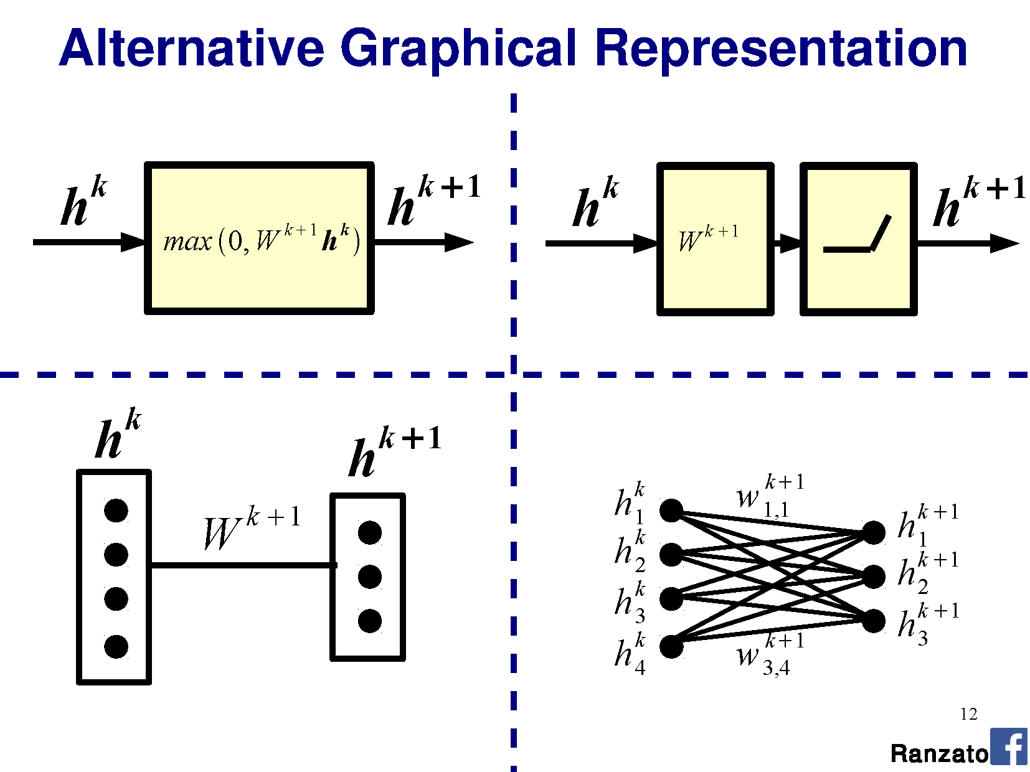

Slide 36
This all seems pretty complicated. Why are we using Neural Networks? James’s rough assessment:
Learning method | Ease of configuration
Neural Network | 1
Nearest Neighbor | 10
Linear SVM | 10
Non-linear SVM | 5
Decision Tree or Random Forest | 4

Slide 37
This all seems pretty complicated. Why are we using Neural Networks? James’s rough assessment:
Learning method | Ease of configuration | Ease of interpretation
Neural Network | 1 | 1
Nearest Neighbor | 10 | 10
Linear SVM | 10 | 9
Non-linear SVM | 5 | 4
Decision Tree or Random Forest | 4 | 4

Slide 38
This all seems pretty complicated. Why are we using Neural Networks? James’s rough assessment:
Learning method | Ease of configuration | Ease of interpretation | Speed / memory when training
Neural Network | 1 | 1 | 1
Nearest Neighbor | 10 | 10 | 8
Linear SVM | 10 | 9 | 10
Non-linear SVM | 5 | 4 | 2
Decision Tree or Random Forest | 4 | 4 | 4

Slide 39
This all seems pretty complicated. Why are we using Neural Networks? James’s rough assessment:
Learning method | Ease of configuration | Ease of interpretation | Speed / memory when training | Speed / memory at test time
Neural Network | 1 | 1 | 1 | 6
Nearest Neighbor | 10 | 10 | 8 | 4
Linear SVM | 10 | 9 | 10 | 10
Non-linear SVM | 5 | 4 | 2 | 2
Decision Tree or Random Forest | 4 | 4 | 4 | 8

Slide 40
This all seems pretty complicated. Why are we using Neural Networks? James’s rough assessment:
Learning method | Ease of configuration | Ease of interpretation | Speed / memory when training | Speed / memory at test time | Accuracy w/ lots of data
Neural Network | 1 | 1 | 1 | 6 | 10
Nearest Neighbor | 10 | 10 | 8 | 4 | 7
Linear SVM | 10 | 9 | 10 | 10 | 5
Non-linear SVM | 5 | 4 | 2 | 2 | 8
Decision Tree or Random Forest | 4 | 4 | 4 | 8 | 7

Slide 41
This all seems pretty complicated. Why are we using Neural Networks? James’s rough assessment:
Learning method | Ease of configuration | Ease of interpretation | Speed / memory when training | Speed / memory at test time | Accuracy w/ lots of data
Neural Network | 1 | 1 | 1 | 6 | 10
Nearest Neighbor | 10 | 10 | 8 | 4 | 7
Linear SVM | 10 | 9 | 10 | 10 | 5
Non-linear SVM | 5 | 4 | 2 | 2 | 8
Decision Tree or Random Forest | 4 | 4 | 4 | 8 | 7
Representation design matters more for all of these

