Slide 1
Convolutional Neural Networks
Computer Vision
James Hays
Many slides by Marc’Aurelio Ranzato

Slide 2
Outline
Neural Networks (covered in previous lecture)
Convolutional Neural Networks
Visualization and interpretation of Deep Networks

Slide 61
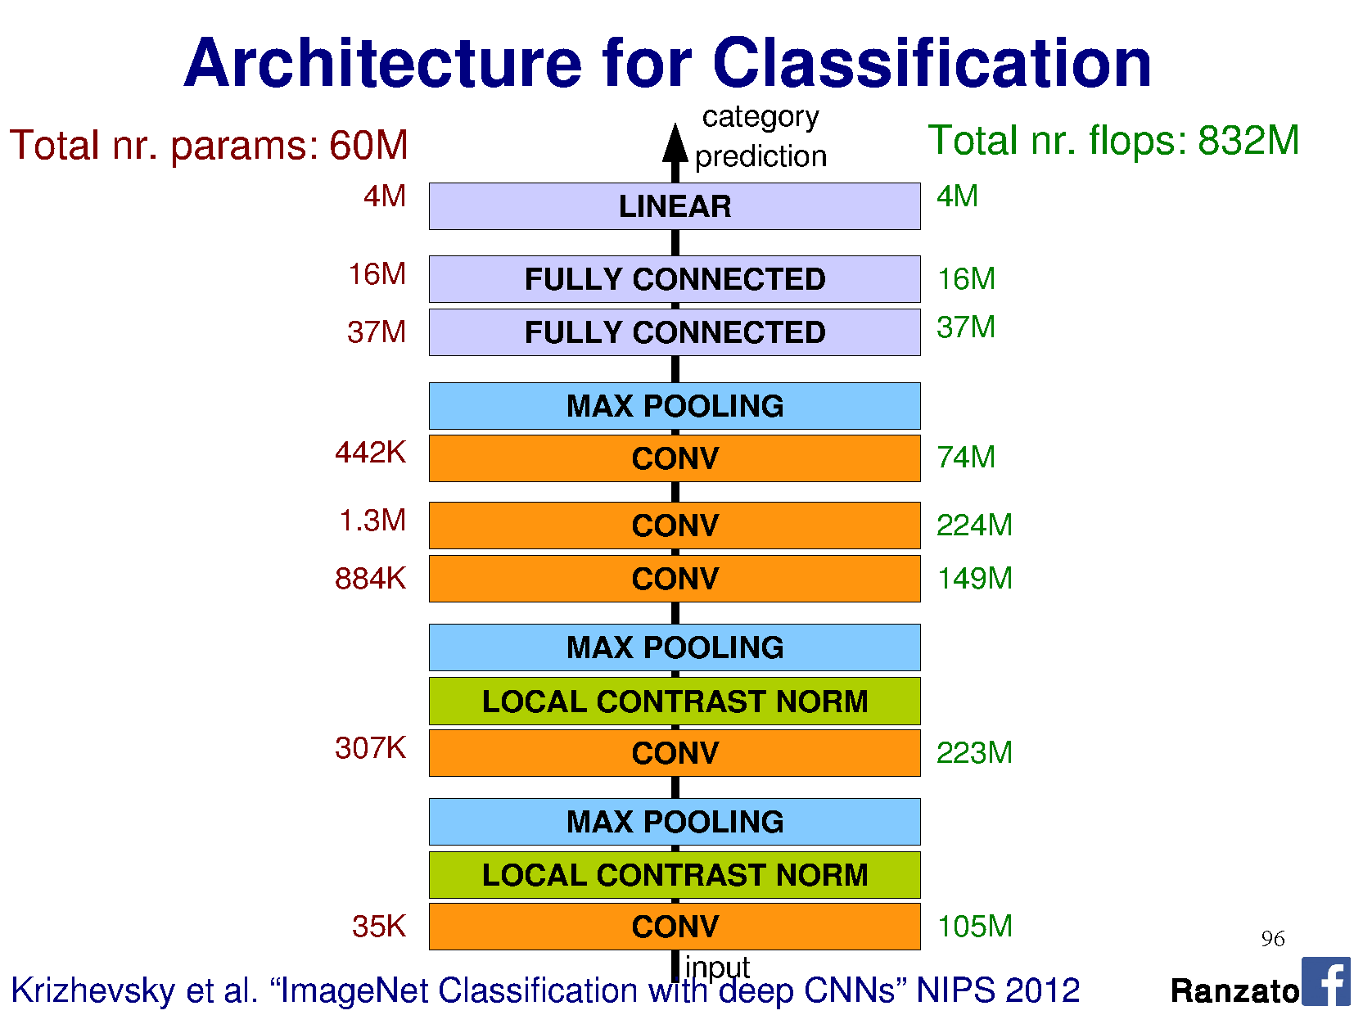

Slide 63
Notes:
This is top 5 error

Slide 64
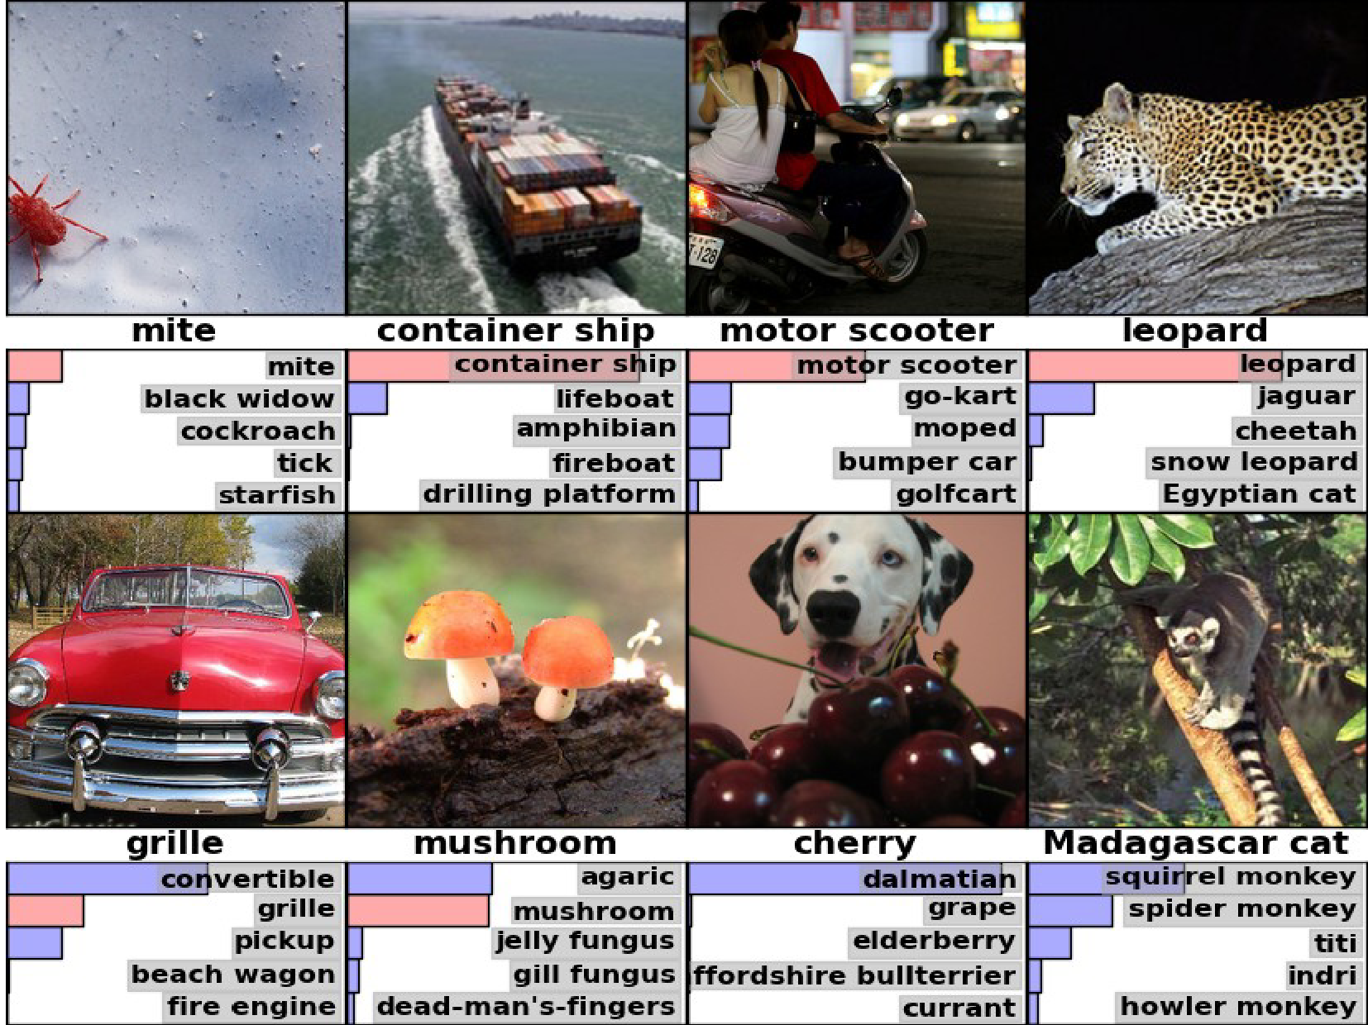

Slide 67
Object Detectors Emerge in Deep Scene CNNs
Bolei Zhou, Aditya Khosla, Agata Lapedriza, Aude Oliva, Antonio Torralba
Massachusetts Institute of Technology

Slide 68
CNN for Object Recognition
Large-scale image classification result on ImageNet
CNN methods
Figure from Olga Russakovsky ECCV'14 workshop

Slide 69
How Objects are Represented in CNN?
Conv1
Conv2
Conv3
Conv4 Pool5
DrawCNN: visualizing the units' connections

Slide 70
How Objects are Represented in CNN?
Deconvolution
Zeiler, M. et al. Visualizing and Understanding Convolutional Networks,ECCV 2014.
Strong activation image
Girshick, R., Donahue, J., Darrell, T., Malik, J.: Rich feature hierarchies for accu-rate object detection and semantic segmentation. CVPR 2014
Back-propagation
Simonyan, K. et al. Deep inside convolutional networks: Visualising image classification models and saliency maps. ICLR workshop, 2014

Slide 71
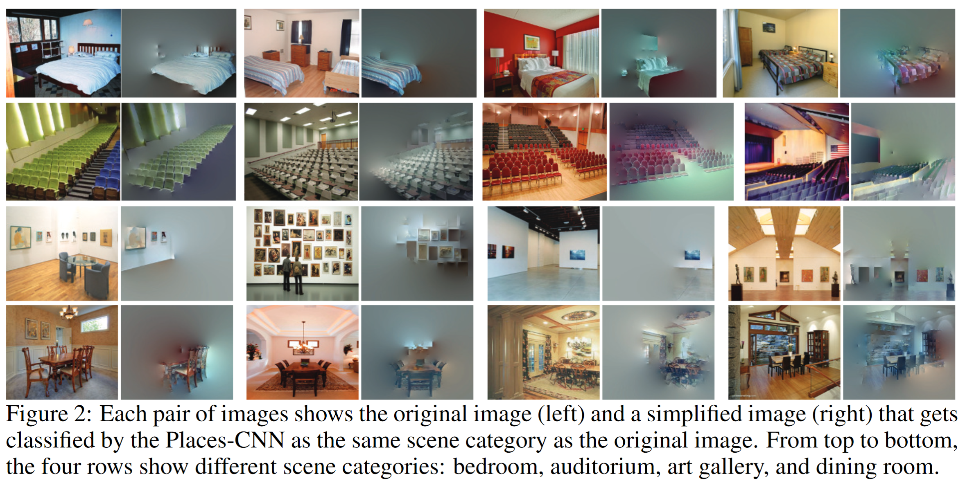
Another CNN interpretation method: Simplifying Scenes While Maintaining Classifier Decision

Slide 72
Object Representations in Computer Vision
Part-based models are used to represent objects and visual patterns.
-Object as a set of parts
-Relative locations between parts
Figure from Fischler & Elschlager (1973)

Slide 73
Object Representations in Computer Vision
Constellation model
Deformable Part model
Weber, Welling & Perona (2000), Fergus, Perona & Zisserman (2003)
P. Felzenszwalb, R. Girshick, D. McAllester, D. Ramanan (2010)
Bag-of-word model
Class-specific graph model
Lazebnik, Schmid & Ponce(2003), Fei-Fei Perona (2005)
Kumar, Torr and Zisserman (2005), Felzenszwalb & Huttenlocher (2005)

Slide 74
Learning to Recognize Objects
brambling
terrier
Possible internal representations:
Object parts
Textures
Attributes

Slide 75
How Objects are Represented in CNN?
CNN uses distributed code to represent objects.
Conv1
Conv2
Conv3
Conv4 Pool5
Agrawal, et al. Analyzing the performance of multilayer neural networks for object recognition. ECCV, 2014 Szegedy, et al. Intriguing properties of neural networks.arXiv preprint arXiv:1312.6199, 2013.
Zeiler, M. et al. Visualizing and Understanding Convolutional Networks, ECCV 2014.

Slide 76
Scene Recognition
Given an image, predict which place we are in.
Bedroom
Harbor

Slide 77
Learning to Recognize Scenes
bedroom
mountain
Possible internal representations:
Objects (scene parts?)
Scene attributes
Object parts
Textures

Slide 78
CNN for Scene Recognition
Places Database: 7 million images from 400 scene categories
#
scene category
Places-CNN: AlexNet CNN on 2.5 million images from 205 scene categories.
Scene Recognition Demo: 78% top-5 recognition accuracy in the wild
http://places.csail.mit.edu
Zhou, et al. NIPS, 2014.

Slide 79
ImageNet CNN and Places CNN
ImageNet CNN for Object Classification
Same architecture: AlexNet
Places CNN for Scene Classification
Places

Slide 80
Data-Driven Approach to Study CNN
Neuroscientists study brain
d
ImageNet CNN Places CNN
200,000 image stimuli of objects and scene categories (ImageNet TestSet+SUN database)

Slide 81
Estimating the Receptive Fields
Estimated receptive fields
pool1
Actual size of RF is much smaller than the theoretic size
conv3 pool5
Segmentation using the RF of Units
More semantically meaningful

Slide 82
Annotating the Semantics of Units
Top ranked segmented images are cropped and sent to Amazon Turk for annotation.

Slide 83
Annotating the Semantics of Units
Pool5, unit 76; Label: ocean; Type: scene; Precision: 93%

Slide 84
Annotating the Semantics of Units
Pool5, unit 13; Label: Lamps; Type: object; Precision: 84%

Slide 85
Annotating the Semantics of Units
Pool5, unit 77; Label:legs; Type: object part; Precision: 96%

Slide 86
Annotating the Semantics of Units
Pool5, unit 112; Label: pool table; Type: object; Precision: 70%

Slide 87
Annotating the Semantics of Units
Pool5, unit 22; Label: dinner table; Type: scene; Precision: 60%

Slide 88
Distribution of Semantic Types at Each Layer
1
Object detectors emerge within CNN trained to classify scenes, without any object supervision!

Slide 89
Histogram of Emerged Objects in Pool5
ImageNet-CNN (59/256)

Slide 90
Histogram of Emerged Objects in Pool5
Places-CNN (151/256)

Slide 92
Evaluation on SUN Database
Evaluate the performance of the emerged object detectors

Slide 93
Evaluation on SUN Database
Correlation:0.53
Correlation:0.84

Slide 94
Conclusion
We show that object detectors emerge inside a CNN trained to classify scenes, without any object supervision.
Places database, Places CNN, and unit annotations could be downloaded at
http://places.csail.mit.edu

