Slide 1
Classical and Modern Recognition Techniques

Slide 2
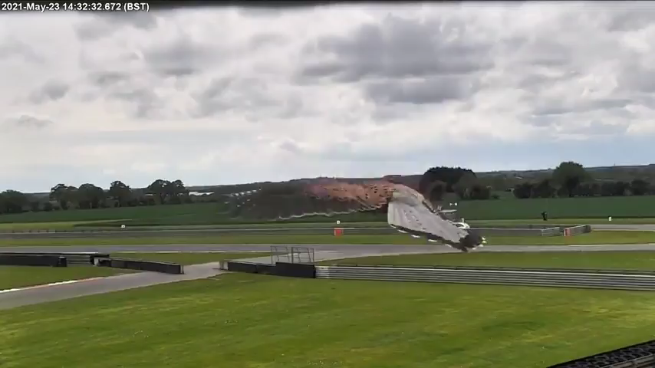

Slide 3
Today’s outline
We’ve covered Deep Convolutional Networks. But what did recognition techniques look like before AlexNet?
  Bag of words models
  Sliding window models
What do more recent deep learning architectures look like?

Slide 4
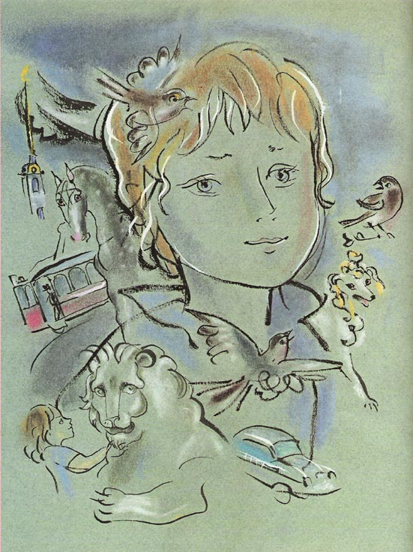
Recognition: Overview and History
Slides from Lana Lazebnik, Fei-Fei Li, Rob Fergus, Antonio Torralba, and Jean Ponce

Slide 5
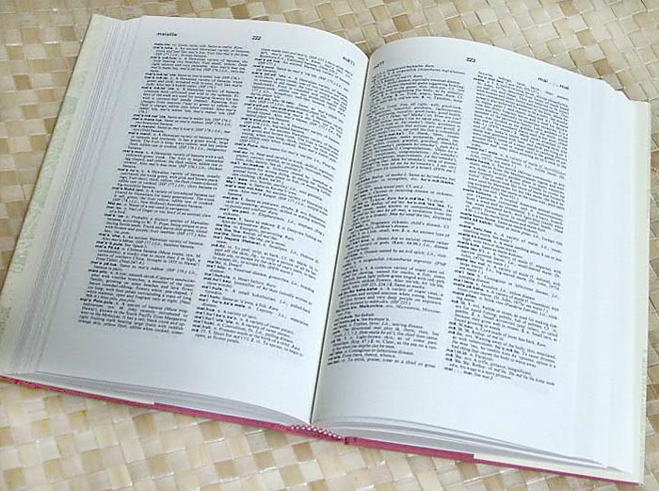

How many visual object categories are there?
~10,000 to 30,000
Biederman 1987
Notes:
1500-3000 basic-level nouns, ~10 types per basic-level category
Alternative explanation (Perona): ~1000 names per domain (broad scene category), 20-30 domains

Slide 6
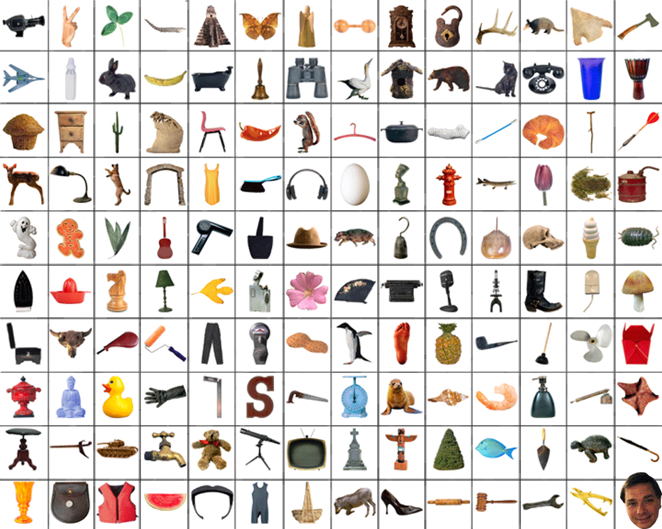
~10,000 to 30,000

Slide 7
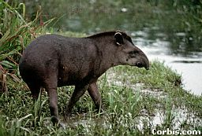
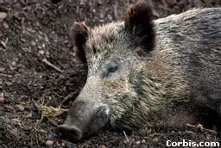
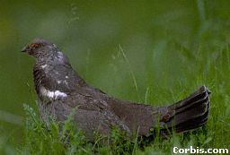
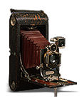
OBJECTS
ANIMALS
PLANTS
INANIMATE
NATURAL
MAN-MADE
…..
VERTEBRATE
MAMMALS
BIRDS
TAPIR
BOAR
GROUSE
CAMERA

Slide 8
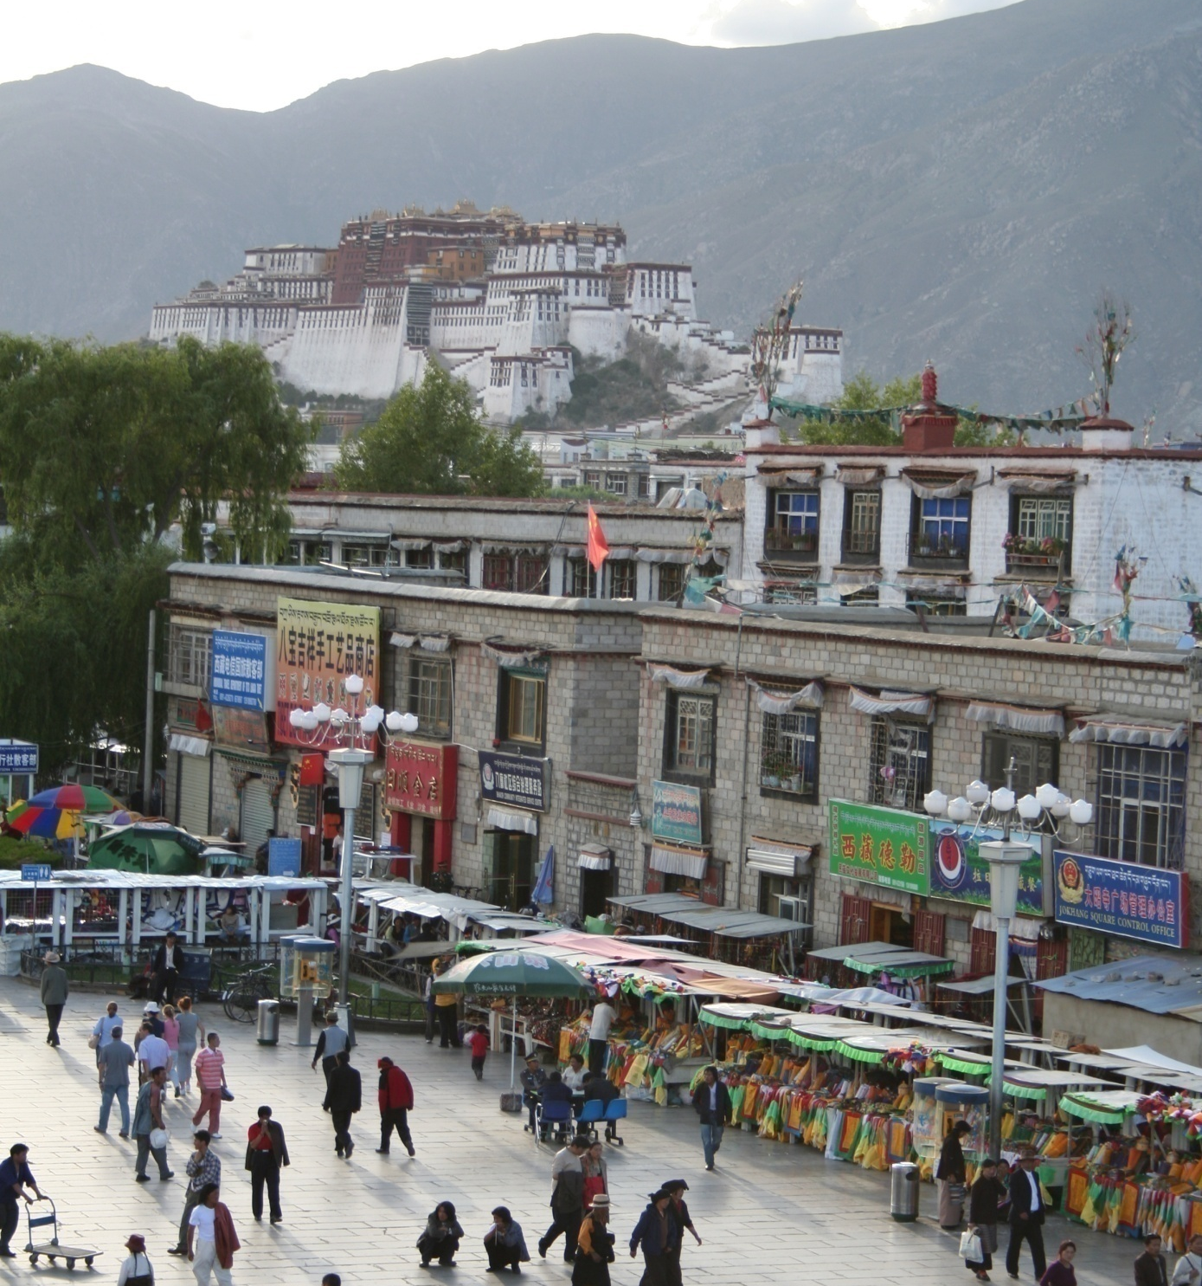
Specific recognition tasks
Svetlana Lazebnik

Slide 9
Scene categorization or classification
outdoor/indoor
city/forest/factory/etc.
Svetlana Lazebnik

Slide 10
Image annotation / tagging / attributes
street
people
building
mountain
tourism
cloudy
brick
…
Svetlana Lazebnik

Slide 11
Object detection
find pedestrians
Svetlana Lazebnik

Slide 12
Image parsing / semantic segmentation
sky
mountain
building
tree
building
banner
street lamp
market
people
Svetlana Lazebnik

Slide 13
Scene understanding?
Svetlana Lazebnik

Slide 14
Recognition is all about modeling variability
Variability:
Camera position
Illumination
Shape parameters
Within-class variations?
Svetlana Lazebnik
Notes:
One could argue that invariance is the key challenge to computer vision. But is this still true with big data?

Slide 15


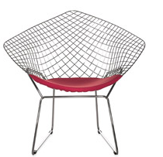


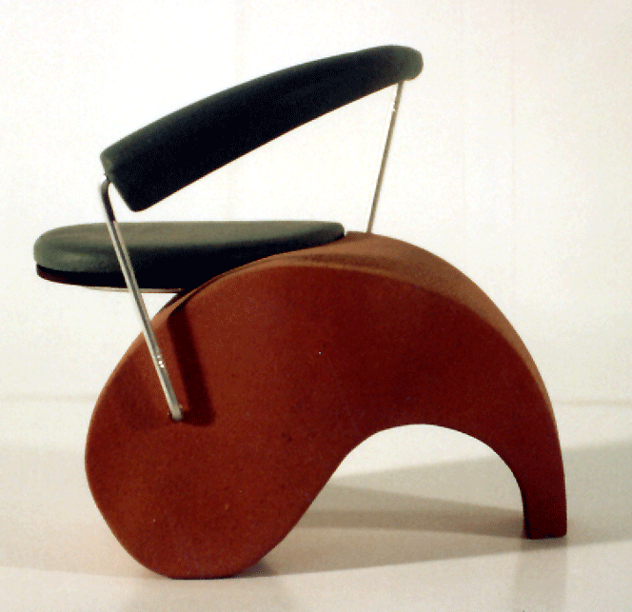
Within-class variations
Svetlana Lazebnik
Notes:
Note English language issues. Try to not let language confound things.

Slide 16
History of ideas in recognition
1960s – early 1990s: the geometric era
Svetlana Lazebnik

Slide 17
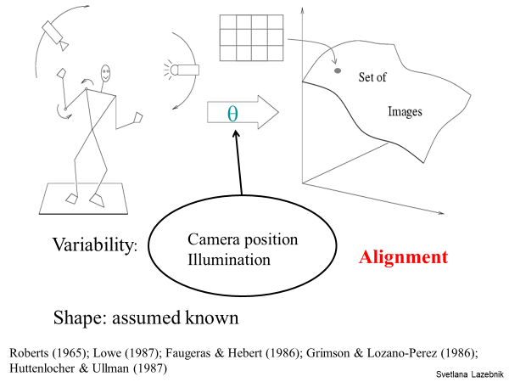

Slide 18
Recall: Alignment
Alignment: fitting a model to a transformation between pairs of features (matches) in two images
x_{i}
x_{i}
Find transformation T
that minimizes
'
T
Svetlana Lazebnik

Slide 19
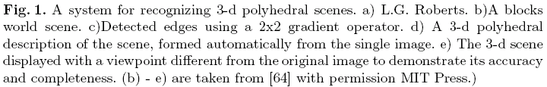
Recognition as an alignment problem:
Block world
L. G. Roberts, Machine Perception of Three Dimensional Solids, Ph.D. thesis, MIT Department of Electrical Engineering, 1963.
J. Mundy, Object Recognition in the Geometric Era: a Retrospective, 2006

Slide 20
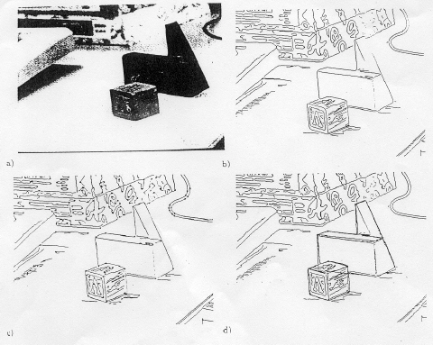
Alignment: Huttenlocher & Ullman (1987)

Slide 21
Variability
Invariance to:
Camera position
Illumination
Internal parameters
Duda & Hart ( 1972); Weiss (1987); Mundy et al. (1992-94);
Rothwell et al. (1992); Burns et al. (1993)
Svetlana Lazebnik

Slide 22
Example: invariant to similarity transformations computed from four points
B
C
D
A
Projective invariants (Rothwell et al., 1992):
General 3D objects do not admit monocular viewpoint
invariants (Burns et al., 1993)

Slide 23






Representing and recognizing object categories
is harder...
ACRONYM (Brooks and Binford, 1981)
Binford (1971), Nevatia & Binford (1972), Marr & Nishihara (1978)

Slide 24
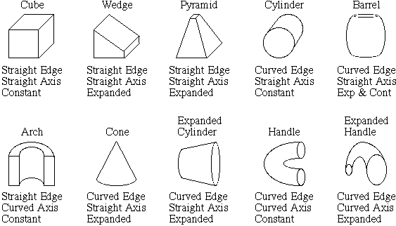
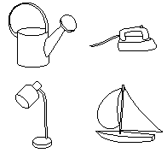
Recognition by components
Biederman (1987)
Primitives (geons)
Objects
http://en.wikipedia.org/wiki/Recognition_by_Components_Theory
Svetlana Lazebnik

Slide 25
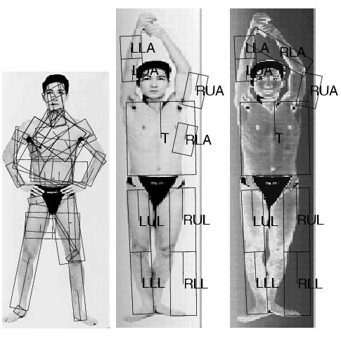
General shape primitives?
Generalized cylinders
Ponce et al. (1989)
Forsyth (2000)
Zisserman et al. (1995)
Svetlana Lazebnik

Slide 26
History of ideas in recognition
1960s – early 1990s: the geometric era
1990s: appearance-based models
Svetlana Lazebnik

Slide 27
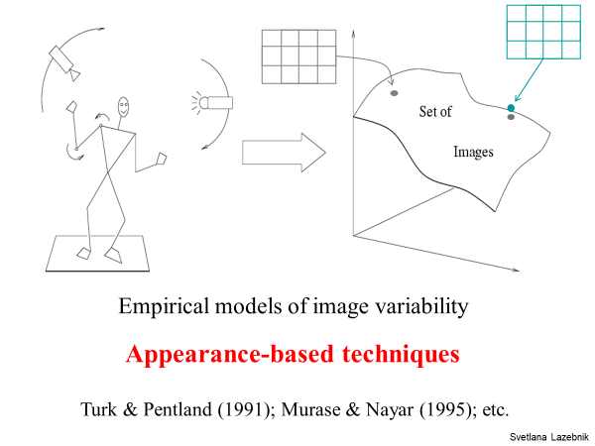

Slide 28
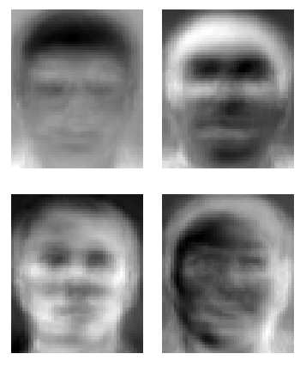
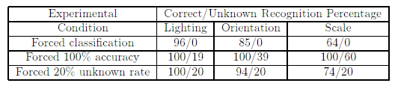
Eigenfaces (Turk & Pentland, 1991)
Svetlana Lazebnik

Slide 29
Color Histograms
Swain and Ballard, Color Indexing, IJCV 1991.
Svetlana Lazebnik

Slide 30
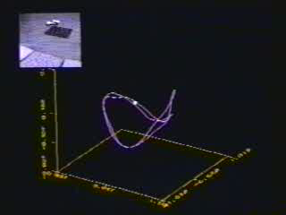
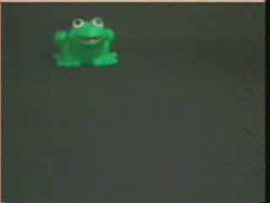
Appearance manifolds
H. Murase and S. Nayar, Visual learning and recognition of 3-d objects from appearance, IJCV 1995

Slide 31
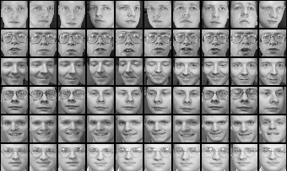
Limitations of global appearance models
Requires global registration of patterns
Not robust to clutter, occlusion, geometric transformations
Svetlana Lazebnik

Slide 32
History of ideas in recognition
1960s – early 1990s: the geometric era
1990s: appearance-based models
1990s – present: sliding window approaches
Svetlana Lazebnik

Slide 33

Sliding window approaches

Slide 34

Sliding window approaches
Turk and Pentland, 1991
Belhumeur, Hespanha, & Kriegman, 1997
Schneiderman & Kanade 2004
Viola and Jones, 2000
Schneiderman & Kanade, 2004
Argawal and Roth, 2002
Poggio et al. 1993

Slide 35
History of ideas in recognition
1960s – early 1990s: the geometric era
1990s: appearance-based models
Mid-1990s: sliding window approaches
Late 1990s: local features
Svetlana Lazebnik

Slide 36
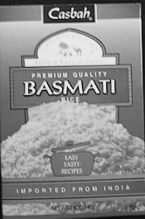
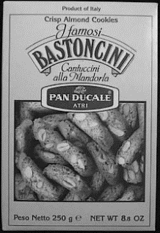
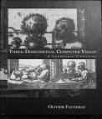
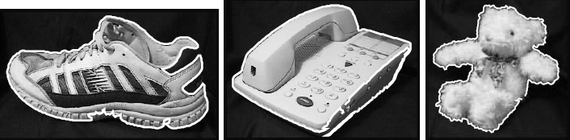
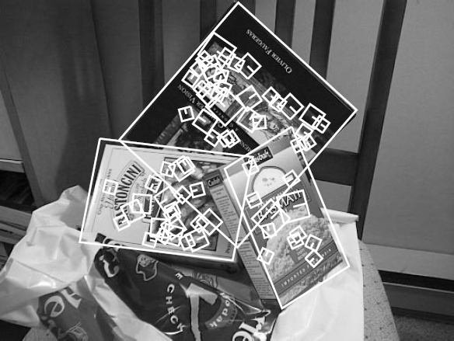
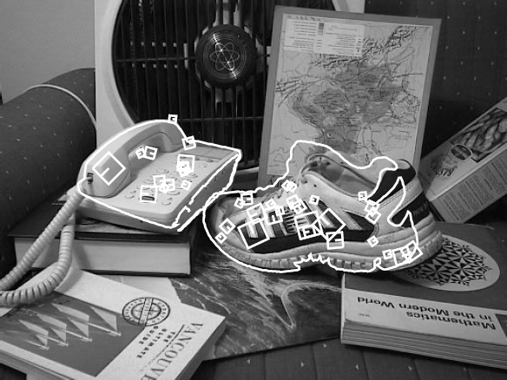
Local features for object instance recognition
D. Lowe (1999, 2004)

Slide 37
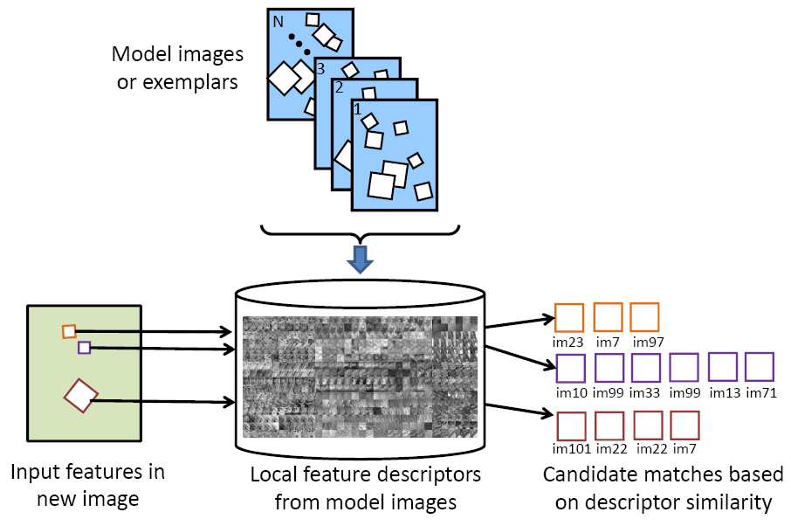
Large-scale image search
Combining local features, indexing, and spatial constraints
Image credit: K. Grauman and B. Leibe

Slide 38
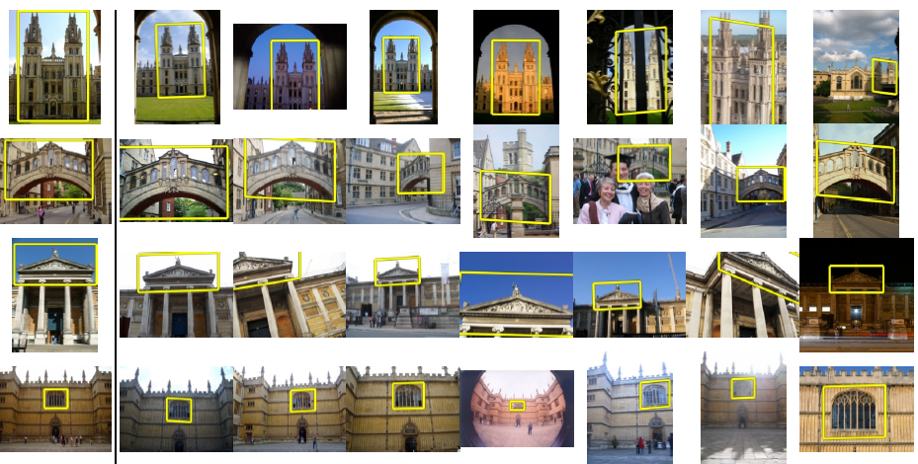
Large-scale image search
Combining local features, indexing, and spatial constraints
Philbin et al. ‘07

Slide 39
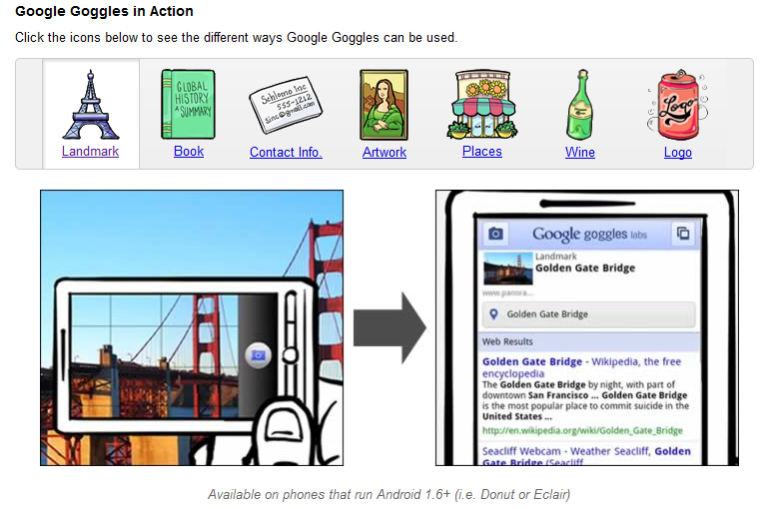
Large-scale image search
Combining local features, indexing, and spatial constraints
Svetlana Lazebnik

Slide 40
History of ideas in recognition
1960s – early 1990s: the geometric era
1990s: appearance-based models
Mid-1990s: sliding window approaches
Late 1990s: local features
Early 2000s: parts-and-shape models

Slide 41
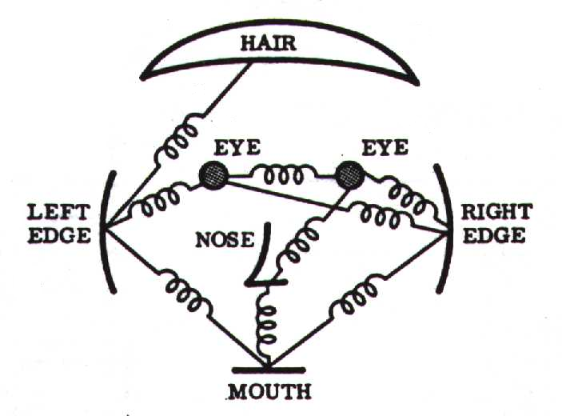
Parts-and-shape models
Model:
  Object as a set of parts
  Relative locations between parts
  Appearance of part
Figure from [Fischler & Elschlager 73]

Slide 42
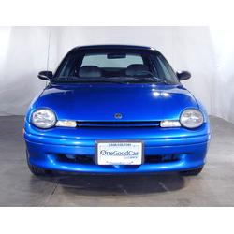
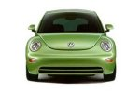
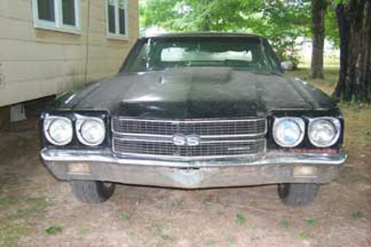
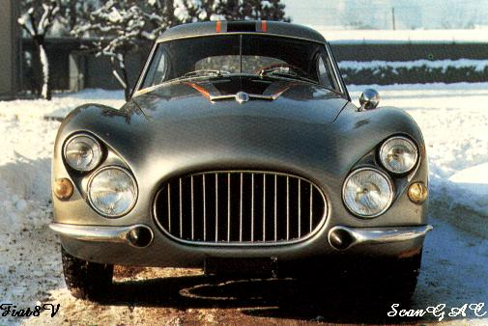
Constellation models
Weber, Welling & Perona (2000), Fergus, Perona & Zisserman (2003)
Notes:
Globally different, but have portions in common

Slide 43
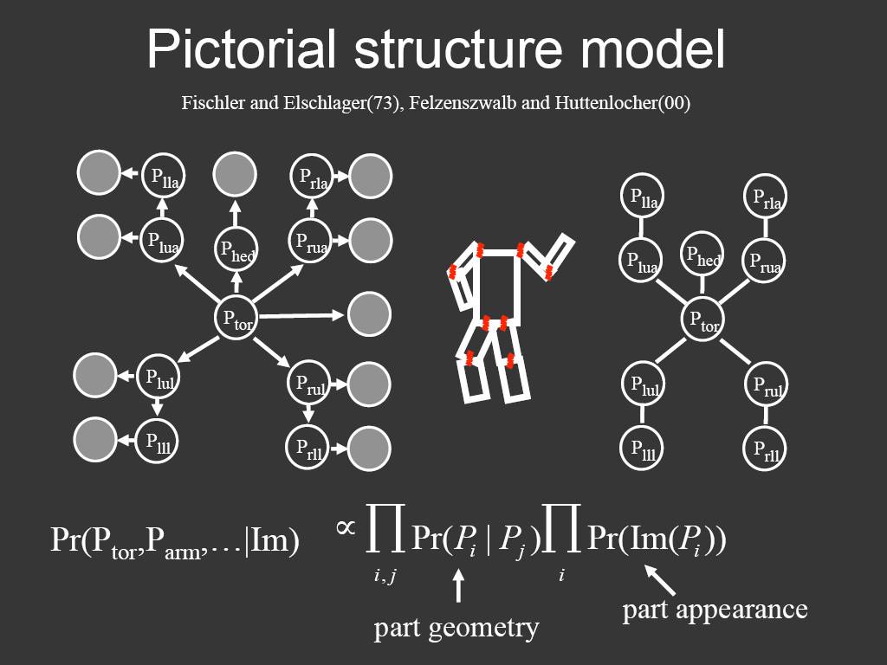
Representing people

Slide 44
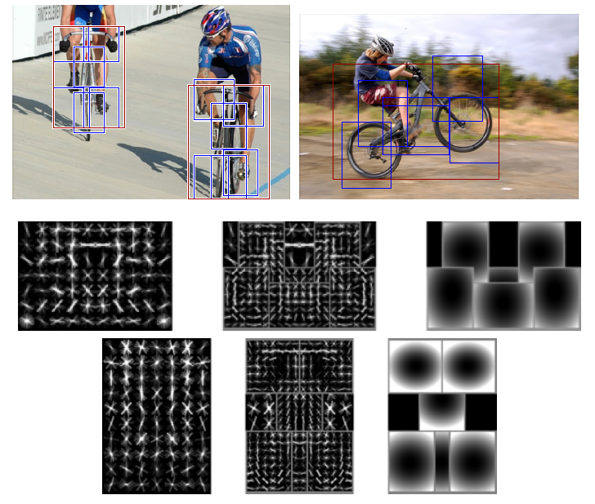
Discriminatively trained part-based models
P. Felzenszwalb, R. Girshick, D. McAllester, D. Ramanan, "Object Detection with Discriminatively Trained Part-Based Models," PAMI 2009

Slide 45
History of ideas in recognition
1960s – early 1990s: the geometric era
1990s: appearance-based models
Mid-1990s: sliding window approaches
Late 1990s: local features
Early 2000s: parts-and-shape models
Mid-2000s: bags of features
Svetlana Lazebnik

Slide 46
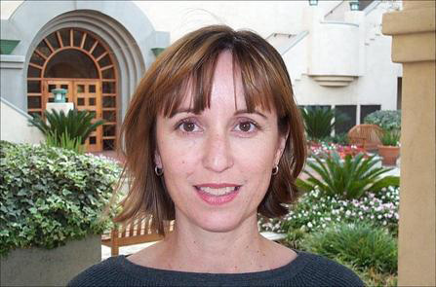
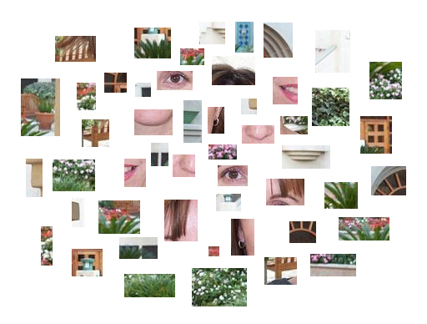
Bag-of-features models
Svetlana Lazebnik

Slide 47

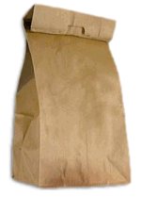

Bag-of-features models
Bag of ‘words’
Object
Svetlana Lazebnik

Slide 48








Objects as texture
All of these are treated as being the same
No distinction between foreground and background: scene recognition?
Svetlana Lazebnik
Notes:
Motivation slide. Clearly location has to help, but bag-of-words doesn’t have it…

Slide 49

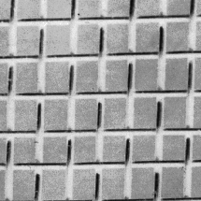
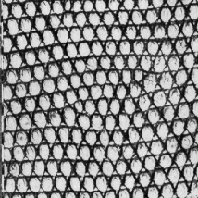



Origin 1: Texture recognition
Texture is characterized by the repetition of basic elements or textons
For stochastic textures, it is the identity of the textons, not their spatial arrangement, that matters
Julesz, 1981; Cula & Dana, 2001; Leung & Malik 2001; Mori, Belongie & Malik, 2001; Schmid 2001; Varma & Zisserman, 2002, 2003; Lazebnik, Schmid & Ponce, 2003

Slide 50

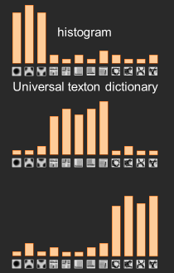
Origin 1: Texture recognition
Julesz, 1981; Cula & Dana, 2001; Leung & Malik 2001; Mori, Belongie & Malik, 2001; Schmid 2001; Varma & Zisserman, 2002, 2003; Lazebnik, Schmid & Ponce, 2003

Slide 51
Origin 2: Bag-of-words models
Orderless document representation: frequencies of words from a dictionary Salton & McGill (1983)

Slide 52
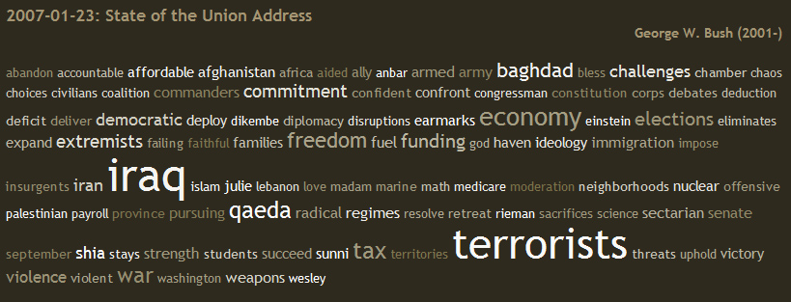
Origin 2: Bag-of-words models
Orderless document representation: frequencies of words from a dictionary Salton & McGill (1983)
US Presidential Speeches Tag Cloud
http://chir.ag/phernalia/preztags/

Slide 53
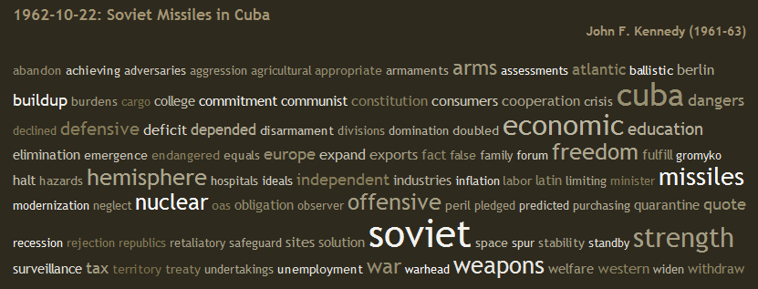
Origin 2: Bag-of-words models
Orderless document representation: frequencies of words from a dictionary Salton & McGill (1983)
US Presidential Speeches Tag Cloud
http://chir.ag/phernalia/preztags/

Slide 54
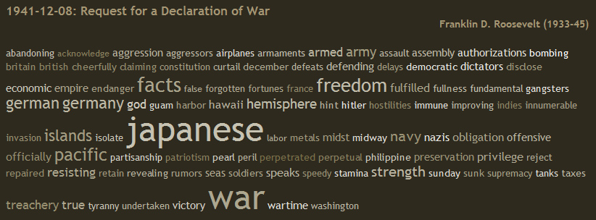
Origin 2: Bag-of-words models
Orderless document representation: frequencies of words from a dictionary Salton & McGill (1983)
US Presidential Speeches Tag Cloud
http://chir.ag/phernalia/preztags/

Slide 55


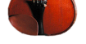
Bag-of-features steps
Extract features
Learn “visual vocabulary”
Quantize features using visual vocabulary
Represent images by frequencies of “visual words”

Slide 56
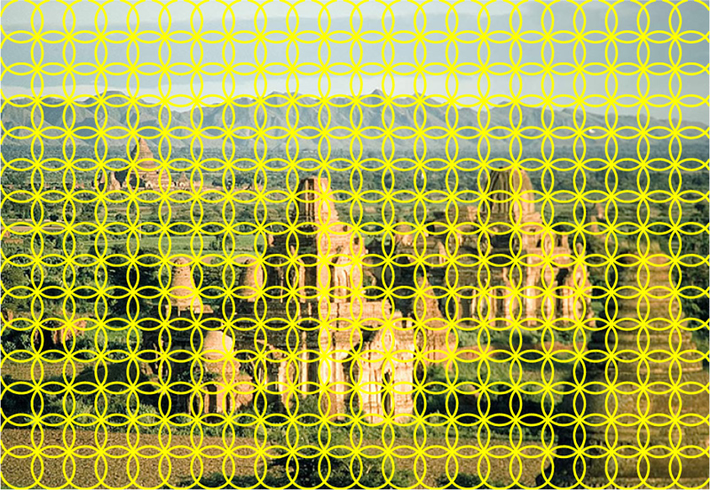

1. Feature extraction
Regular grid or interest regions

Slide 57


1. Feature extraction
Compute descriptor
Normalize patch
Detect patches
Slide credit: Josef Sivic

Slide 58
1. Feature extraction
…
Slide credit: Josef Sivic

Slide 59
2. Learning the visual vocabulary
…
Slide credit: Josef Sivic

Slide 60
2. Learning the visual vocabulary
…
Clustering
Slide credit: Josef Sivic

Slide 61
2. Learning the visual vocabulary
Visual vocabulary
…
Clustering
Slide credit: Josef Sivic

Slide 62
K-means clustering
Want to minimize sum of squared Euclidean distances between points x_{i} and their nearest cluster centers m_{k}
Algorithm:
Randomly initialize K cluster centers
Iterate until convergence:
  Assign each data point to the nearest center
  Recompute each cluster center as the mean of all points assigned to it

Slide 63
Clustering and vector quantization
Clustering is a common method for learning a visual vocabulary or codebook
  Unsupervised learning process
  Each cluster center produced by k-means becomes a codevector
  Codebook can be learned on separate training set
  Provided the training set is sufficiently representative, the codebook will be “universal”
The codebook is used for quantizing features
  A vector quantizer takes a feature vector and maps it to the index of the nearest codevector in a codebook
  Codebook = visual vocabulary
  Codevector = visual word

Slide 64

















Example codebook
…
Appearance codebook
Source: B. Leibe

Slide 65

Another codebook
…
…
…
…
…
Appearance codebook
Source: B. Leibe

Slide 66
Visual vocabularies: Issues
How to choose vocabulary size?
  Too small: visual words not representative of all patches
  Too large: quantization artifacts, overfitting
Computational efficiency
  Vocabulary trees
  (Nister & Stewenius, 2006)

Slide 67




But what about layout?
All of these images have the same color histogram

Slide 68

Spatial pyramid
Compute histogram in each spatial bin

Slide 69


Spatial pyramid representation
Extension of a bag of features
Locally orderless representation at several levels of resolution
level 0
Lazebnik, Schmid & Ponce (CVPR 2006)

Slide 70




Spatial pyramid representation
Extension of a bag of features
Locally orderless representation at several levels of resolution
level 0
level 1
Lazebnik, Schmid & Ponce (CVPR 2006)

Slide 71
















Spatial pyramid representation
Extension of a bag of features
Locally orderless representation at several levels of resolution
level 0
level 1
level 2
Lazebnik, Schmid & Ponce (CVPR 2006)

Slide 72


Scene category dataset
Multi-class classification results
(100 training images per class)

Slide 73















Caltech101 dataset
http://www.vision.caltech.edu/Image_Datasets/Caltech101/Caltech101.html
Multi-class classification results (30 training images per class)

Slide 74

Bags of features for action recognition
Space-time interest points
Juan Carlos Niebles, Hongcheng Wang and Li Fei-Fei, Unsupervised Learning of Human Action Categories Using Spatial-Temporal Words, IJCV 2008.

Slide 75
History of ideas in recognition
1960s – early 1990s: the geometric era
1990s: appearance-based models
Mid-1990s: sliding window approaches
Late 1990s: local features
Early 2000s: parts-and-shape models
Mid-2000s: bags of features
Present trends: combination of local and global methods, context, deep learning
Svetlana Lazebnik

Slide 76
Beyond AlexNet

Slide 77
VERY DEEP CONVOLUTIONAL NETWORKS FOR LARGE-SCALE IMAGE RECOGNITION
Karen Simonyan & Andrew Zisserman 2015
These are the “VGG” networks.
“Perceptual Loss” in generative deep learning refers to these networks

Slide 78

Notes:
Compared to Alex-Net – Deeper, smaller convolutions, more parameters

Slide 79

Notes:
Compared to Alex-Net – Deeper, smaller convolutions, more parameters

Slide 80
Going Deeper with Convolutions
Christian Szegedy, Wei Liu, Yangqing Jia, Pierre Sermanet, Scott Reed,
Dragomir Anguelov, Dumitru Erhan, Vincent Vanhoucke, Andrew Rabinovich
2015
This is the “Inception” architecture or “GoogLeNet”
*The architecture blocks are called “Inception” modules
and the collection of them into a particular net is “GoogLeNet”

Slide 81


Slide 82

Only 6.8 million parameters. AlexNet ~60 million, VGG up to 138 million

Slide 83




Slide 84


Slide 85




ConvNet Depth
28.2
25.8
16.4
11.7
22 layers
6.7
19 layers
7.3
8 layers
8 layers
shallow
 | ILSVRC'14 | ILSVRC'14 | ILSVRC'13 | ILSVRC'12 | ILSVRC'11 | ILSVRC'10
 | GoogleNet | VGG |  | AlexNet
ImageNet Classification top-5 error (%)

Slide 86
Surely it would be ridiculous to go any deeper…
To be continued with ResNet

