Slide 1
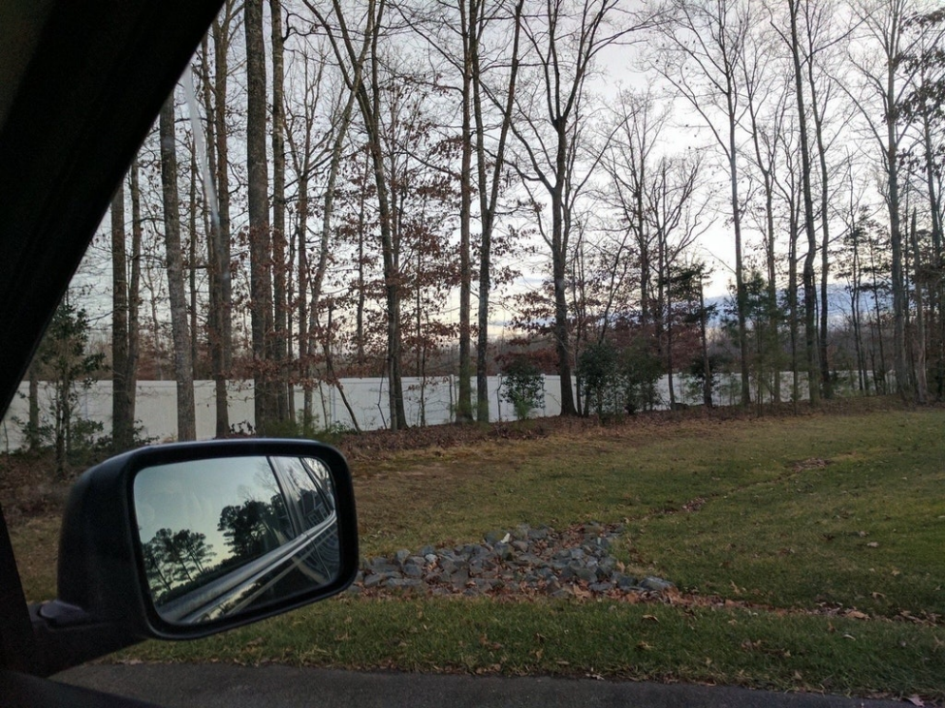
Let’s look at some lakefront property
*actually fences / walls

Slide 5
History of ideas in recognition
1960s – early 1990s: the geometric era
1990s: appearance-based models
Mid-1990s: sliding window approaches
Late 1990s: local features
Early 2000s: parts-and-shape models
Mid-2000s: bags of features
Present trends: combination of local and global methods, context, deep learning
Svetlana Lazebnik

Slide 6
Recap: Convolutional Network, AlexNet

Slide 7
Recap: Convolutional Network Interpretation
1
Object detectors emerge within CNN trained to classify scenes, without any object supervision!

Slide 8
Beyond AlexNet

Slide 9
VERY DEEP CONVOLUTIONAL NETWORKS FOR LARGE-SCALE IMAGE RECOGNITION
Karen Simonyan & Andrew Zisserman 2015
These are the “VGG” networks.
“Perceptual Loss” in generative deep learning refers to these networks

Slide 10
Notes:
Compared to Alex-Net – Deeper, smaller convolutions, more parameters

Slide 11
Notes:
Compared to Alex-Net – Deeper, smaller convolutions, more parameters

Slide 12
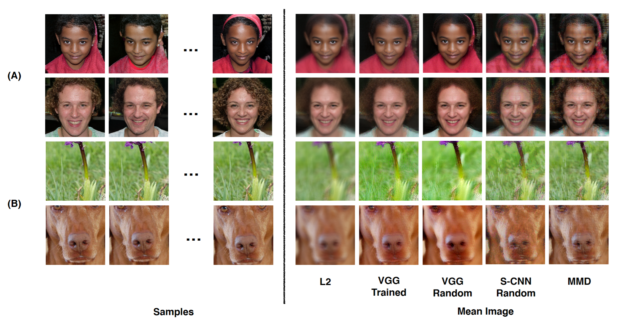
“VGG” networks are commonly used as the basis for “Perceptual Loss”. The images on the right are as close as possible to all images on the left in various feature spaces. Understanding and Simplifying Perceptual Distances. Dan Amir and Yair Weiss. CVPR 2021

Slide 13
Going Deeper with Convolutions
Christian Szegedy, Wei Liu, Yangqing Jia, Pierre Sermanet, Scott Reed,
Dragomir Anguelov, Dumitru Erhan, Vincent Vanhoucke, Andrew Rabinovich 2015
This is the “Inception” architecture or “GoogLeNet”
*The architecture blocks are called “Inception” modules and the collection of them into a particular net is “GoogLeNet”

Slide 15
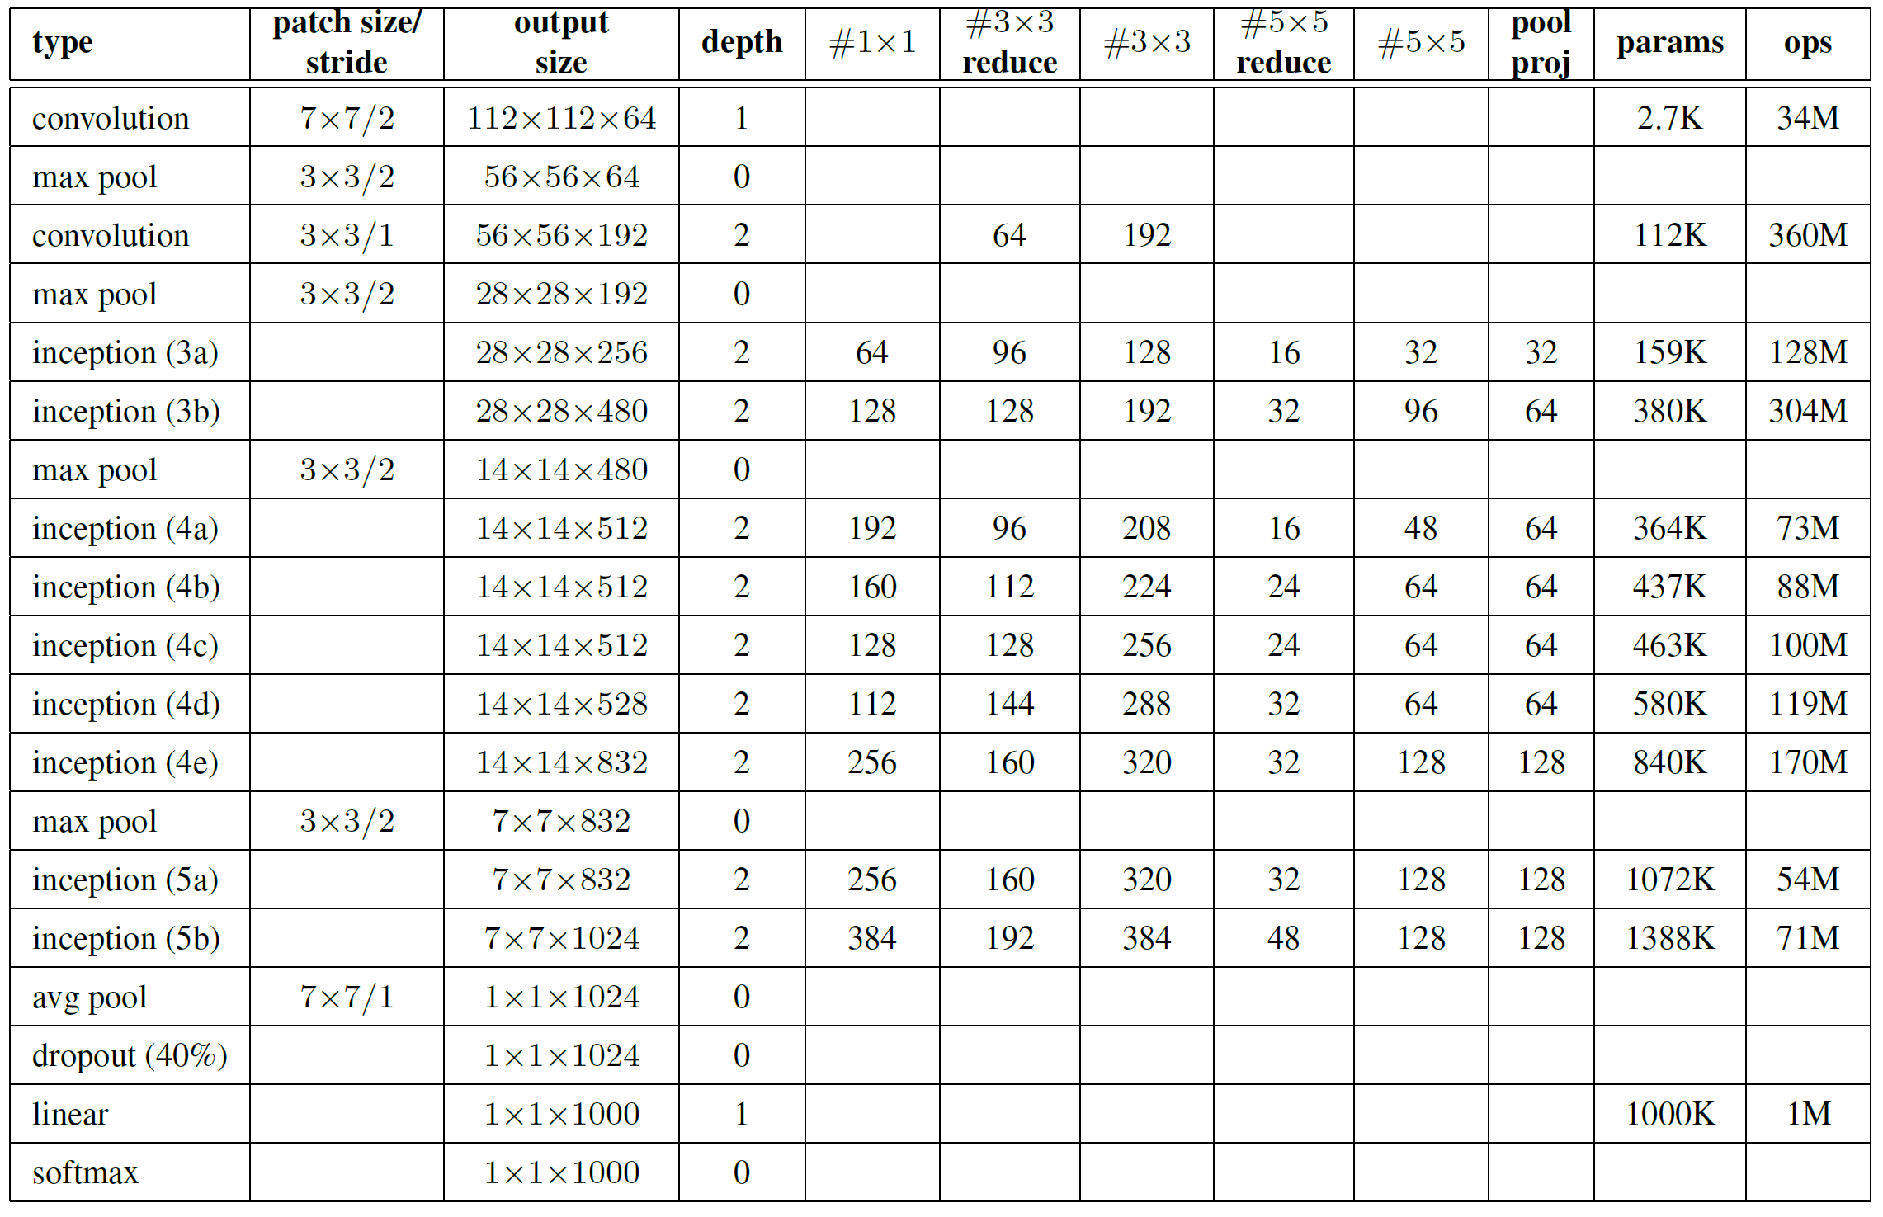
Only 6.8 million parameters. AlexNet ~60 million, VGG up to 138 million

Slide 18
ConvNet Depth
28.2
25.8
16.4
11.7
22 layers
6.7
19 layers
7.3
8 layers
8 layers
shallow
 | ILSVRC'14 | ILSVRC'14 | ILSVRC'13 | ILSVRC'12 | ILSVRC'11 | ILSVRC'10
 | GoogleNet | VGG |  | AlexNet
ImageNet Classification top-5 error (%)

Slide 19
Recap: Beyond AlexNet
VGG
GoogLeNet

Slide 20
Deep Residual Learning for Image Recognition
Kaiming He, Xiangyu Zhang, Shaoqing Ren, Jian Sun
work done at
Microsoft Research Asia
7x7 conv, 64, /2, pool/2
1x1 conv, 64
3x3 conv, 64 1x1 conv, 256 1x1 conv, 64 3x3 conv, 64
1x1 conv, 256 1x1 conv, 64 3x3 conv, 64 1x1 conv, 256
1x1 conv, 128, /2
3x3 conv, 128
1x1 conv, 512
1x1 conv, 128
3x3 conv, 128
1x1 conv, 512
1x1 conv, 128
3x3 conv, 128
1x1 conv, 512
1x1 conv, 128
3x3 conv, 128
1x1 conv, 512
1x1 conv, 128
3x3 conv, 128
1x1 conv, 512
1x1 conv, 128
3x3 conv, 128
1x1 conv, 512
1x1 conv, 128
3x3 conv, 128
1x1 conv, 512
1x1 conv, 128
3x3 conv, 128
1x1 conv, 512
1x1 conv, 256, /2
3x3 conv, 256
1x1 conv, 1024
1x1 conv, 256
3x3 conv, 256
1x1 conv, 1024
1x1 conv, 256
3x3 conv, 256
1x1 conv, 1024
1x1 conv, 256
3x3 conv, 256
1x1 conv, 1024
1x1 conv, 256
3x3 conv, 256
1x1 conv, 1024
1x1 conv, 256
3x3 conv, 256
1x1 conv, 1024
1x1 conv, 256
3x3 conv, 256
1x1 conv, 1024
1x1 conv, 256
3x3 conv, 256
1x1 conv, 1024
1x1 conv, 256
3x3 conv, 256
1x1 conv, 1024
1x1 conv, 256
3x3 conv, 256
1x1 conv, 1024
1x1 conv, 256
3x3 conv, 256
1x1 conv, 1024
1x1 conv, 256
3x3 conv, 256
1x1 conv, 1024
1x1 conv, 256
3x3 conv, 256
1x1 conv, 1024
1x1 conv, 256
3x3 conv, 256
1x1 conv, 1024
1x1 conv, 256
3x3 conv, 256
1x1 conv, 1024
1x1 conv, 256
3x3 conv, 256
1x1 conv, 1024
1x1 conv, 256
3x3 conv, 256
1x1 conv, 1024
1x1 conv, 256
3x3 conv, 256
1x1 conv, 1024
1x1 conv, 256
3x3 conv, 256
1x1 conv, 1024
1x1 conv, 256
3x3 conv, 256
1x1 conv, 1024
1x1 conv, 256
3x3 conv, 256
1x1 conv, 1024
1x1 conv, 256
3x3 conv, 256
1x1 conv, 1024
1x1 conv, 256
3x3 conv, 256
1x1 conv, 1024
1x1 conv, 256
3x3 conv, 256
1x1 conv, 1024
1x1 conv, 256
3x3 conv, 256
1x1 conv, 1024
1x1 conv, 256
3x3 conv, 256
1x1 conv, 1024
1x1 conv, 256
3x3 conv, 256
1x1 conv, 1024
1x1 conv, 256
3x3 conv, 256
1x1 conv, 1024
1x1 conv, 256
3x3 conv, 256
1x1 conv, 1024
1x1 conv, 256
3x3 conv, 256
1x1 conv, 1024
1x1 conv, 256
3x3 conv, 256
1x1 conv, 1024
1x1 conv, 256
3x3 conv, 256
1x1 conv, 1024
1x1 conv, 256
3x3 conv, 256
1x1 conv, 1024
1x1 conv, 256
3x3 conv, 256
1x1 conv, 1024
1x1 conv, 256
3x3 conv, 256
1x1 conv, 1024
1x1 conv, 256
3x3 conv, 256
1x1 conv, 1024
1x1 conv, 512, /2
3x3 conv, 512
1x1 conv, 2048
1x1 conv, 512
3x3 conv, 512
1x1 conv, 2048
1x1 conv, 512
3x3 conv, 512
1x1 conv, 2048
ave pool, fc 1000

Slide 21
Cited 136,837 times as of 10/27/2022.

Slide 22
ResNet @ ILSVRC & COCO 2015 Competitions
1st places in all five main tracks
ImageNet Classification: “Ultra-deep” 152-layer nets
ImageNet Detection: 16% better than 2nd
ImageNet Localization: 27% better than 2nd
COCO Detection: 11% better than 2nd
COCO Segmentation: 12% better than 2nd
*improvements are relative numbers

Slide 23
Revolution of Depth
28.2
25.8
152 layers
16.4
11.7
22 layers
6.7
19 layers
7.3
3.57
8 layers
8 layers
shallow
ILSVRC'15 | ILSVRC'14 | ILSVRC'14 | ILSVRC'13 | ILSVRC'12 | ILSVRC'11 | ILSVRC'10
ResNet | GoogleNet | VGG |  | AlexNet
ImageNet Classification top-5 error (%)

Slide 24
Revolution of Depth
101 layers
86
Engines of
visual recognition
66
58
34
16 layers
8 layers
shallow
HOG, DPM
AlexNet (RCNN)
VGG (RCNN)
ResNet (Faster RCNN)*
PASCAL VOC 2007 Object Detection mAP (%)
*w/ other improvements & more data

Slide 25
Revolution of Depth
AlexNet, 8 layers
(ILSVRC 2012)
11x11 conv, 96, /4, pool/2
5x5 conv, 256, pool/2
3x3 conv, 384
3x3 conv, 384
3x3 conv, 256, pool/2
fc, 4096
fc, 4096
fc, 1000

Slide 26
Revolution of Depth
soft max2
Soft maxAct ivat ion
FC
AlexNet, 8 layers
(ILSVRC 2012)
11x11 conv, 96, /4, pool/2
VGG, 19 layers
(ILSVRC 2014)
3x3 conv, 64
GoogleNet, 22 layers
(ILSVRC 2014)
AveragePool 7x7 + 1 (V)
Dept hConcat
5x5 conv, 256, pool/2
3x3 conv, 64, pool/2
Conv Conv Conv Conv 1x1 + 1 (S) 3x3 + 1 (S) 5x5 + 1 (S) 1x1 + 1 (S)
Conv Conv MaxPool 1x1 + 1 (S) 1x1 + 1 (S) 3x3 + 1 (S)
3x3 conv, 384
3x3 conv, 128
Dept hConcat
Conv Conv Conv Conv 1x1 + 1 (S) 3x3 + 1 (S) 5x5 + 1 (S) 1x1 + 1 (S)
soft max1
3x3 conv, 384
3x3 conv, 128, pool/2
Conv Conv MaxPool 1x1 + 1 (S) 1x1 + 1 (S) 3x3 + 1 (S)
Soft maxAct ivat ion
MaxPool 3x3 + 2 (S)
FC
3x3 conv, 256, pool/2
3x3 conv, 256
Dept hConcat
FC
Conv Conv Conv Conv Conv 1x1 + 1 (S) 3x3 + 1 (S) 5x5 + 1 (S) 1x1 + 1 (S) 1x1 + 1 (S)
fc, 4096
3x3 conv, 256
Conv Conv MaxPool AveragePool 1x1 + 1 (S) 1x1 + 1 (S) 3x3 + 1 (S) 5x5 + 3 (V)
Dept hConcat
fc, 4096
3x3 conv, 256
Conv Conv Conv Conv 1x1 + 1 (S) 3x3 + 1 (S) 5x5 + 1 (S) 1x1 + 1 (S)
Conv Conv MaxPool 1x1 + 1 (S) 1x1 + 1 (S) 3x3 + 1 (S)
fc, 1000
3x3 conv, 256, pool/2
Dept hConcat
soft max0
Conv Conv Conv Conv 1x1 + 1 (S) 3x3 + 1 (S) 5x5 + 1 (S) 1x1 + 1 (S)
Soft maxAct ivat ion
3x3 conv, 512
Conv Conv MaxPool 1x1 + 1 (S) 1x1 + 1 (S) 3x3 + 1 (S)
FC
Dept hConcat
FC
3x3 conv, 512
Conv Conv Conv Conv Conv 1x1 + 1 (S) 3x3 + 1 (S) 5x5 + 1 (S) 1x1 + 1 (S) 1x1 + 1 (S)
Conv Conv MaxPool AveragePool 1x1 + 1 (S) 1x1 + 1 (S) 3x3 + 1 (S) 5x5 + 3 (V)
3x3 conv, 512
Dept hConcat
Conv Conv Conv Conv 1x1 + 1 (S) 3x3 + 1 (S) 5x5 + 1 (S) 1x1 + 1 (S)
3x3 conv, 512, pool/2
Conv Conv MaxPool 1x1 + 1 (S) 1x1 + 1 (S) 3x3 + 1 (S)
MaxPool 3x3 + 2 (S)
3x3 conv, 512
Dept hConcat
Conv Conv Conv Conv 1x1 + 1 (S) 3x3 + 1 (S) 5x5 + 1 (S) 1x1 + 1 (S)
3x3 conv, 512
Conv Conv MaxPool 1x1 + 1 (S) 1x1 + 1 (S) 3x3 + 1 (S)
Dept hConcat
3x3 conv, 512
Conv Conv Conv Conv 1x1 + 1 (S) 3x3 + 1 (S) 5x5 + 1 (S) 1x1 + 1 (S)
Conv Conv MaxPool 1x1 + 1 (S) 1x1 + 1 (S) 3x3 + 1 (S)
3x3 conv, 512, pool/2
MaxPool 3x3 + 2 (S)
LocalRespNorm
fc, 4096
Conv 3x3 + 1 (S)
Conv 1x1 + 1 (V)
fc, 4096
LocalRespNorm
MaxPool 3x3 + 2 (S)
fc, 1000
Conv 7x7 + 2 (S)
input

Slide 27
7x7 conv, 64, /2, pool/2
1x1 conv, 64
3x3 conv, 64
1x1 conv, 256
1x1 conv, 64
3x3 conv, 64
1x1 conv, 256
1x1 conv, 64
3x3 conv, 64
1x1 conv, 256
Revolution of Depth
11x11 conv, 96, /4, pool/2
1x2 conv, 128, /2
3x3 conv, 128
1x1 conv, 512
1x1 conv, 128
3x3 conv, 128
1x1 conv, 512
1x1 conv, 128
3x3 conv, 128
1x1 conv, 512
1x1 conv, 128
3x3 conv, 128
1x1 conv, 512
1x1 conv, 128
3x3 conv, 128
1x1 conv, 512
1x1 conv, 128
3x3 conv, 128
1x1 conv, 512
1x1 conv, 128
3x3 conv, 128
1x1 conv, 512
1x1 conv, 128
3x3 conv, 128
1x1 conv, 512 1x1 conv, 256, /2 3x3 conv, 256
1x1 conv, 1024
AlexNet, 8 layers
(ILSVRC 2012)
5x5 conv, 256, pool/2
3x3 conv, 384
3x3 conv, 384 3x3 conv, 256, pool/2
fc, 4096
fc, 4096
fc, 1000
VGG, 19 layers
(ILSVRC 2014)
3x3 conv, 64
3x3 conv, 64, pool/2 3x3 conv, 128
3x3 conv, 128, pool/2 3x3 conv, 256
3x3 conv, 256
3x3 conv, 256 3x3 conv, 256, pool/2
3x3 conv, 512
3x3 conv, 512
3x3 conv, 512 3x3 conv, 512, pool/2
3x3 conv, 512
3x3 conv, 512
3x3 conv, 512 3x3 conv, 512, pool/2
fc, 4096
fc, 4096
fc, 1000
ResNet, 152 layers
(ILSVRC 2015)
1x1 conv, 256
3x3 conv, 256
1x1 conv, 1024
1x1 conv, 256
3x3 conv, 256
1x1 conv, 1024
1x1 conv, 256
3x3 conv, 256
1x1 conv, 1024
1x1 conv, 256
3x3 conv, 256
1x1 conv, 1024
1x1 conv, 256
3x3 conv, 256
1x1 conv, 1024
1x1 conv, 256
3x3 conv, 256
1x1 conv, 1024
1x1 conv, 256
3x3 conv, 256
1x1 conv, 1024
1x1 conv, 256
3x3 conv, 256
1x1 conv, 1024
1x1 conv, 256
3x3 conv, 256
1x1 conv, 1024
1x1 conv, 256
3x3 conv, 256
1x1 conv, 1024
1x1 conv, 256
3x3 conv, 256
1x1 conv, 1024
1x1 conv, 256
3x3 conv, 256
1x1 conv, 1024
1x1 conv, 256
3x3 conv, 256
1x1 conv, 1024
1x1 conv, 256
3x3 conv, 256
1x1 conv, 1024
1x1 conv, 256
3x3 conv, 256
1x1 conv, 1024
1x1 conv, 256
3x3 conv, 256
1x1 conv, 1024
1x1 conv, 256
3x3 conv, 256
1x1 conv, 1024
1x1 conv, 256
3x3 conv, 256
1x1 conv, 1024
1x1 conv, 256
3x3 conv, 256
1x1 conv, 1024
1x1 conv, 256
3x3 conv, 256
1x1 conv, 1024
1x1 conv, 256
3x3 conv, 256
1x1 conv, 1024
1x1 conv, 256
3x3 conv, 256
1x1 conv, 1024
1x1 conv, 256
3x3 conv, 256
1x1 conv, 1024
1x1 conv, 256
3x3 conv, 256
1x1 conv, 1024
1x1 conv, 256
3x3 conv, 256
1x1 conv, 1024
1x1 conv, 256
3x3 conv, 256
1x1 conv, 1024
1x1 conv, 256
3x3 conv, 256
1x1 conv, 1024
1x1 conv, 256
3x3 conv, 256
1x1 conv, 1024
1x1 conv, 256
3x3 conv, 256
1x1 conv, 1024
1x1 conv, 256
3x3 conv, 256
1x1 conv, 1024
1x1 conv, 256
3x3 conv, 256
1x1 conv, 1024
1x1 conv, 256
3x3 conv, 256
1x1 conv, 1024
1x1 conv, 256
3x3 conv, 256
1x1 conv, 1024
1x1 conv, 256
3x3 conv, 256
1x1 conv, 1024
1x1 conv, 256
3x3 conv, 256
1x1 conv, 1024 1x1 conv, 512, /2 3x3 conv, 512
1x1 conv, 2048
1x1 conv, 512
3x3 conv, 512
1x1 conv, 2048
1x1 conv, 512
3x3 conv, 512
1x1 conv, 2048 ave pool, fc 1000

Slide 28
Is learning better networks
as simple as stacking more layers?

Slide 29
Simply stacking layers?
CIFAR-10
train error (%)
20
test error (%)
20
56-layer
56-layer
10
10
20-layer
20-layer
0 ₀
1
2
3
iter. (1e4)
4
5
6
0
0
1
2
3
iter. (1e4)
4
5
6
Plain nets: stacking 3x3 conv layers…
56-layer net has higher training error and test error than 20-layer net

Slide 30
Simply stacking layers?
CIFAR-10
ImageNet-1000
20
56-layer 44-layer 32-layer 20-layer
60
50
error (%)
error (%)
34-layer
10
40
5
plain-20 plain-32 plain-44 plain-56
30
solid: test/val dashed: train
plain-18 plain-34
18-layer
0
0
1
2
3
iter. (1e4)
4
5
6
20
0
10
20
30
iter. (1e4)
40
50
“Overly deep” plain nets have higher training error
A general phenomenon, observed in many datasets

Slide 31
a shallower model
(18 layers)
7x7 conv, 64, /2
7x7 conv, 64, /2
a deeper counterpart (34 layers)
3x3 conv, 64
3x3 conv, 64
3x3 conv, 64
3x3 conv, 64
3x3 conv, 64
3x3 conv, 64
3x3 conv, 64
3x3 conv, 64
3x3 conv, 64
3x3 conv, 64
3x3 conv, 128, /2
3x3 conv, 128, /2
Richer solution space
3x3 conv, 128
3x3 conv, 128
3x3 conv, 128
3x3 conv, 128
3x3 conv, 128
3x3 conv, 128
3x3 conv, 128
A deeper model should not have higher training error
3x3 conv, 128
3x3 conv, 128
“extra” layers
3x3 conv, 128
3x3 conv, 256, /2
3x3 conv, 256, /2
3x3 conv, 256
3x3 conv, 256
3x3 conv, 256
3x3 conv, 256
A solution by construction:
original layers: copied from a learned shallower model
extra layers: set as identity
at least the same training error
3x3 conv, 256
3x3 conv, 256
3x3 conv, 256
3x3 conv, 256
3x3 conv, 256
3x3 conv, 256
3x3 conv, 256
3x3 conv, 256
3x3 conv, 256
3x3 conv, 256
3x3 conv, 512, /2
3x3 conv, 512, /2
3x3 conv, 512
3x3 conv, 512
Optimization difficulties: solvers cannot find the solution when going deeper…
3x3 conv, 512
3x3 conv, 512
3x3 conv, 512
3x3 conv, 512
3x3 conv, 512
3x3 conv, 512
fc 1000
fc 1000

Slide 32
Deep Residual Learning
𝐻 𝑥 is any desired mapping, hope the 2 weight layers fit 𝐻(𝑥)
Plain net
𝑥
weight layer
 | relu
any two stacked layers
weight layer
relu
𝐻(𝑥)

Slide 33
Deep Residual Learning
𝐻 𝑥 is any desired mapping, hope the 2 weight layers fit 𝐻(𝑥) hope the 2 weight layers fit 𝐹(𝑥) let 𝐻 𝑥 = 𝐹 𝑥 + 𝑥
Residual net
𝑥
weight layer
𝐹(𝑥)
relu
identity
𝑥
weight layer
𝐻
𝑥
= 𝐹
𝑥
+ 𝑥
relu

Slide 34
Deep Residual Learning
𝐹 𝑥 is a residual mapping w.r.t. identity
𝑥
If identity were optimal, easy to set weights as 0
If optimal mapping is closer to identity, easier to find small fluctuations
weight layer
 | relu
𝐹(𝑥)
identity
𝑥
weight layer
𝐻
𝑥
= 𝐹
𝑥
+ 𝑥
relu

Slide 35
7x7 conv, 64, /2
7x7 conv, 64, /2
pool, /2
pool, /2
Network “Design”
Keep it simple
3x3 conv, 64
3x3 conv, 64
plain net
3x3 conv, 64
3x3 conv, 64
ResNet
3x3 conv, 64
3x3 conv, 64
3x3 conv, 64
3x3 conv, 64
3x3 conv, 64
3x3 conv, 64
3x3 conv, 64
3x3 conv, 64
3x3 conv, 128, /2
3x3 conv, 128, /2
3x3 conv, 128
3x3 conv, 128
3x3 conv, 128
3x3 conv, 128
3x3 conv, 128
3x3 conv, 128
3x3 conv, 128
3x3 conv, 128
3x3 conv, 128
3x3 conv, 128
Our basic design (VGG-style)
all 3x3 conv (almost)
spatial size /2 => # filters x2
Simple design; just deep!
3x3 conv, 128
3x3 conv, 128
3x3 conv, 128
3x3 conv, 128
3x3 conv, 256, /2
3x3 conv, 256, /2
3x3 conv, 256
3x3 conv, 256
3x3 conv, 256
3x3 conv, 256
3x3 conv, 256
3x3 conv, 256
3x3 conv, 256
3x3 conv, 256
3x3 conv, 256
3x3 conv, 256
3x3 conv, 256
3x3 conv, 256
3x3 conv, 256
3x3 conv, 256
3x3 conv, 256
3x3 conv, 256
3x3 conv, 256
3x3 conv, 256
3x3 conv, 256
3x3 conv, 256
3x3 conv, 256
3x3 conv, 256
3x3 conv, 512, /2
3x3 conv, 512, /2
3x3 conv, 512
3x3 conv, 512
3x3 conv, 512
3x3 conv, 512
3x3 conv, 512
3x3 conv, 512
3x3 conv, 512
3x3 conv, 512
3x3 conv, 512
3x3 conv, 512
avg pool
avg pool
fc 1000
fc 1000

Slide 36
CIFAR-10 experiments
CIFAR-10 plain nets
CIFAR-10 ResNets
20
20
ResNet-20 ResNet-32 ResNet-44 ResNet-56
56-layer 44-layer 32-layer 20-layer
ResNet-110
20-layer 32-layer 44-layer 56-layer 110-layer
error (%)
error (%)
10
10
5
plain-20 plain-32 plain-44 plain-56
5
bold: test thin: train
0
0
1
2
3
iter. (1e4)
4
5
6
0
0
1
2
3
iter. (1e4)
4
5
6
• Deep ResNets can be trained without difficulties
• Deeper ResNets have lower training error, and also lower test error

Slide 37
ImageNet experiments
ImageNet plain nets
ImageNet ResNets
60
60
50
50
error (%)
34-layer
error (%)
18-layer
40
40
30
solid: test
30
plain-18
plain-34
dashed: train
18-layer
ResNet-18
ResNet-34
34-layer
20
0
10
20
30
iter. (1e4)
40
50
20
0
10
20
30
iter. (1e4)
40
50
• Deep ResNets can be trained without difficulties
• Deeper ResNets have lower training error, and also lower test error

Slide 38
ImageNet experiments
Deeper ResNets have lower error
8
7.4
this model has
lower time complexity
than VGG-16/19
6.7
7
6.1
5.7
6
5
4
ResNet-152
ResNet-101 ResNet-50
10-crop testing, top-5 val error (%)
ResNet-34

Slide 39
Beyond classification
A treasure from ImageNet is on learning features.
Kaiming He, Xiangyu Zhang, Shaoqing Ren, & Jian Sun. “Deep Residual Learning for Image Recognition”. arXiv 2015.

Slide 40
“Features matter.” (quote [Girshick et al. 2014], the R-CNN paper)
task
2nd-place winner
ResNets
margin
(relative)
12.0 9.0
_{53.6} absolute _{62.1}
ImageNet Localization (top-5 error)
27%
ImageNet Detection (mAP@.5)
16%
8.5% better!
33.5 37.3
COCO Detection (mAP@.5:.95)
11%
COCO Segmentation (mAP@.5:.95)
25.1 28.2
12%
Our results are all based on ResNet-101
Our features are well transferrable
Kaiming He, Xiangyu Zhang, Shaoqing Ren, & Jian Sun. “Deep Residual Learning for Image Recognition”. CVPR 2016.

Slide 41
Object Detection (brief)
classifier
RoI pooling
Simply “Faster R-CNN + ResNet”
proposals
Faster R-CNN baseline | mAP@.5 | mAP@.5:.95
VGG-16 | 41.5 | 21.5
ResNet-101 | 48.4 | 27.2
Region Proposal Net
feature map
COCO detection results (ResNet has 28% relative gain)
CNN
image
Kaiming He, Xiangyu Zhang, Shaoqing Ren, & Jian Sun. “Deep Residual Learning for Image Recognition”. CVPR 2016. Shaoqing Ren, Kaiming He, Ross Girshick, & Jian Sun. “Faster R-CNN: Towards Real-Time Object Detection with Region Proposal Networks”. NIPS 2015.

Slide 42
Our results on MS COCO
*the original image is from the COCO dataset
Kaiming He, Xiangyu Zhang, Shaoqing Ren, & Jian Sun. “Deep Residual Learning for Image Recognition”. CVPR 2016. Shaoqing Ren, Kaiming He, Ross Girshick, & Jian Sun. “Faster R-CNN: Towards Real-Time Object Detection with Region Proposal Networks”. NIPS 2015.

Slide 43
this video is available online: https://youtu.be/WZmSMkK9VuA
Results on real video. Model trained on MS COCO w/ 80 categories. (frame-by-frame; no temporal processing)
Kaiming He, Xiangyu Zhang, Shaoqing Ren, & Jian Sun. “Deep Residual Learning for Image Recognition”. arXiv 2015. Shaoqing Ren, Kaiming He, Ross Girshick, & Jian Sun. “Faster R-CNN: Towards Real-Time Object Detection with Region Proposal Networks”. NIPS 2015.

Slide 44
More Visual Recognition Tasks
ResNets lead on these benchmarks (incomplete list):
ImageNet classification, detection, localization
MS COCO detection, segmentation
ResNet-101
PASCAL VOC detection, segmentation
VQA challenge 2016
PASCAL segmentation leaderboard
Human pose estimation [Newell et al 2016]
Depth estimation [Laina et al 2016]
Segment proposal [Pinheiro et al 2016]
…
ResNet-101
PASCAL detection leaderboard

Slide 45
Potential Applications
Visual Recognition
Image Generation (Pixel RNN, Neural Art, etc.)
Natural Language Processing (Very deep CNN)
Speech Recognition (preliminary results)
Advertising, user prediction (preliminary results)
ResNets have shown outstanding or promising results on:
Kaiming He, Xiangyu Zhang, Shaoqing Ren, & Jian Sun. “Deep Residual Learning for Image Recognition”. CVPR 2016.

Slide 46
Conclusions
Deep Residual Networks:
Easy to train
Simply gain accuracy from depth
Well transferrable
Follow-up [He et al. arXiv 2016]
200 layers on ImageNet, 1000 layers on CIFAR
Kaiming He, Xiangyu Zhang, Shaoqing Ren, & Jian Sun. “Identity Mappings in Deep Residual Networks”. arXiv 2016.
Kaiming He, Xiangyu Zhang, Shaoqing Ren, & Jian Sun. “Deep Residual Learning for Image Recognition”. CVPR 2016.

Slide 47
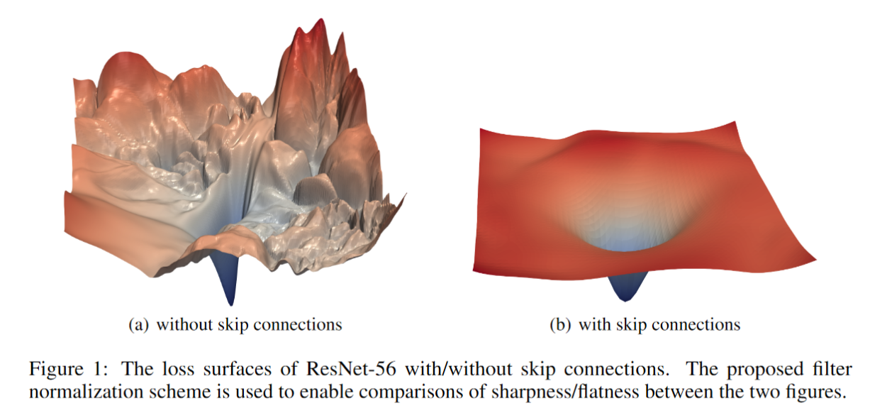
Why does ResNet work so well?
The architecture is somehow easier to optimize.
The authors argue it probably isn’t because it solves the “vanishing gradient” problem.
While the gradients might not be “vanishing” in “plain” nets, they don’t seem as stable and trustworthy, according to follow up work, e.g.
Visualizing the Loss Landscape of Neural Nets. Hao Li, Zheng Xu , Gavin Taylor, Christoph Studer, Tom Goldstein. NeurIPS 2018.

Slide 48
Resources
Models and Code
Our ImageNet models in Caffe: https://github.com/KaimingHe/deep-residual-networks
Many available implementations:
(list in https://github.com/KaimingHe/deep-residual-networks)
Facebook AI Research’s Torch ResNet: https://github.com/facebook/fb.resnet.torch
Torch, CIFAR-10, with ResNet-20 to ResNet-110, training code, and curves: code
Lasagne, CIFAR-10, with ResNet-32 and ResNet-56 and training code: code
Neon, CIFAR-10, with pre-trained ResNet-32 to ResNet-110 models, training code, and curves: code
Torch, MNIST, 100 layers: blog, code
A winning entry in Kaggle's right whale recognition challenge: blog, code
Neon, Place2 (mini), 40 layers: blog, code
…....
Kaiming He, Xiangyu Zhang, Shaoqing Ren, & Jian Sun. “Deep Residual Learning for Image Recognition”. CVPR 2016.

Slide 49
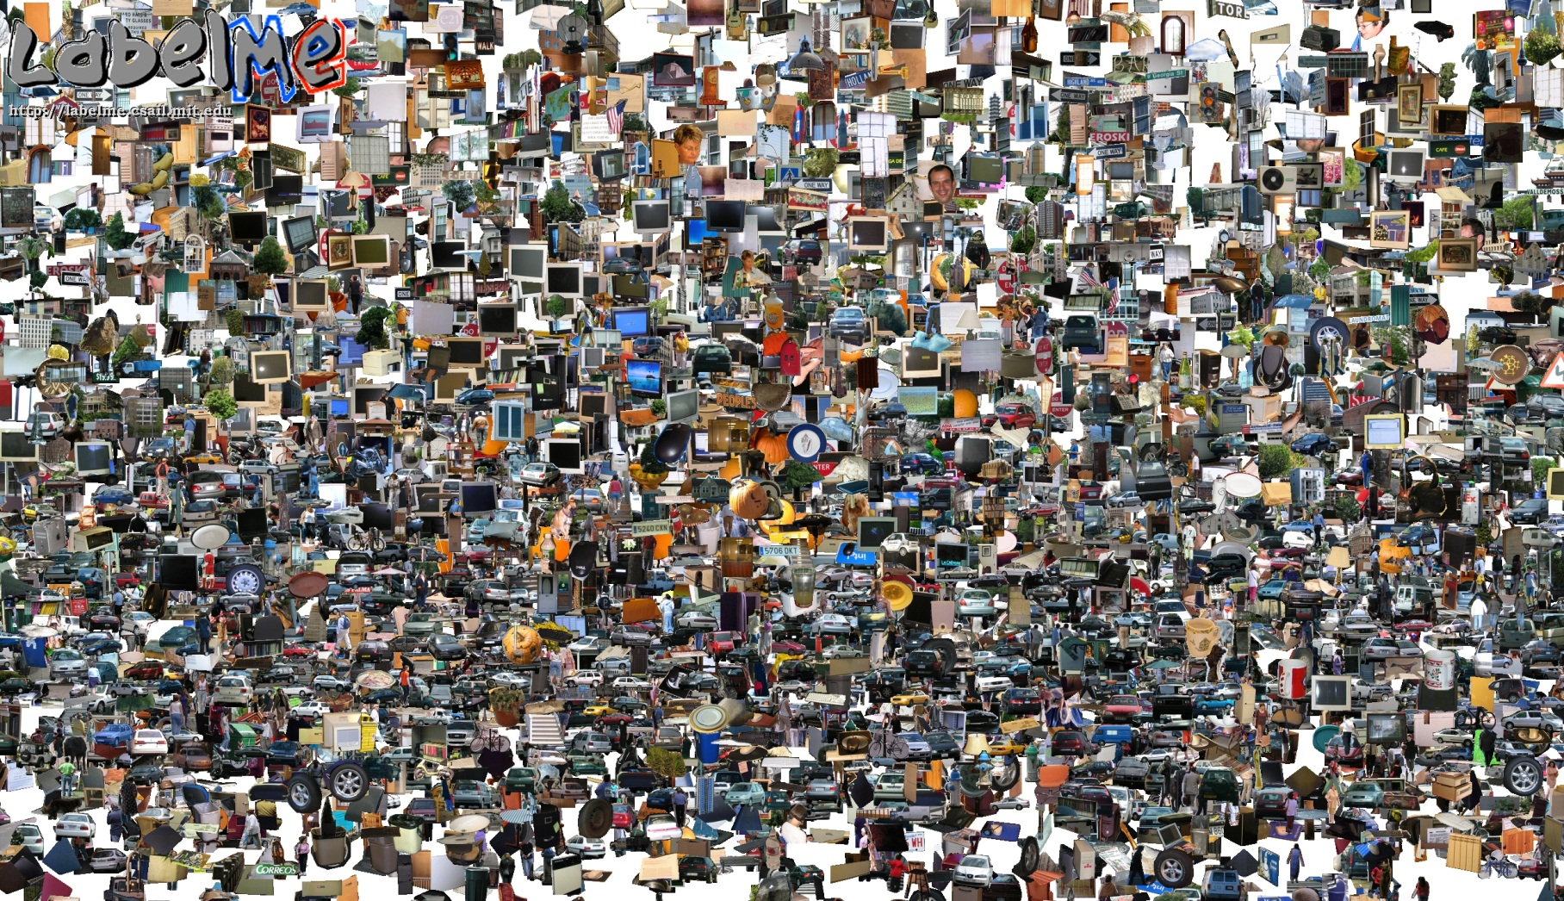
Opportunities of Scale
Computer Vision
James Hays
Many slides from James Hays, Alyosha Efros, and Derek Hoiem
Graphic from Antonio Torralba

Slide 50
Outline
Opportunities of Scale: Data-driven methods
The Unreasonable Effectiveness of Data
Scene Completion
Im2gps
Recognition via Tiny Images

Slide 51
Computer Vision Class so far
The geometry of image formation
Ancient / Renaissance
Signal processing / Convolution
1800, but really the 50’s and 60’s
Hand-designed Features for recognition, either instance-level or categorical
1999 (SIFT), 2003 (Video Google), 2005 (Dalal-Triggs), 2006 (spatial pyramid bag of words)
Learning from Data
1991 (EigenFaces) but late 90’s to now especially
Notes:
Omitting tracking / Multiview

Slide 52
What has changed in the last 15 years?
The Internet
Crowdsourcing
Learning representations from the data these sources provide (deep learning)

Slide 53
To be continued

