Slide 1
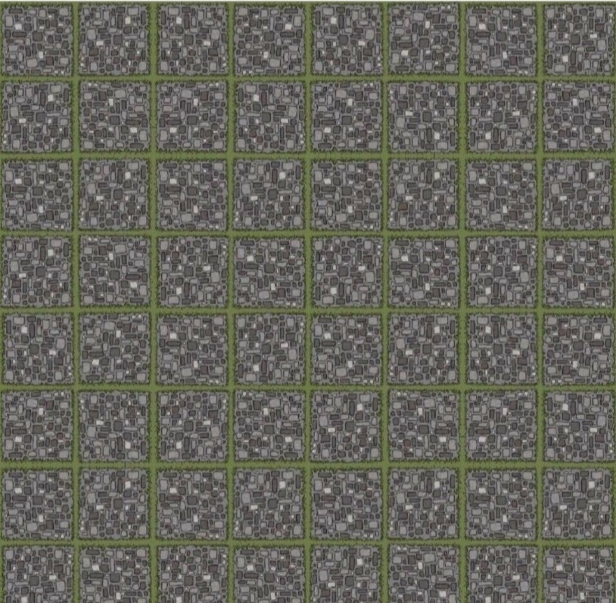
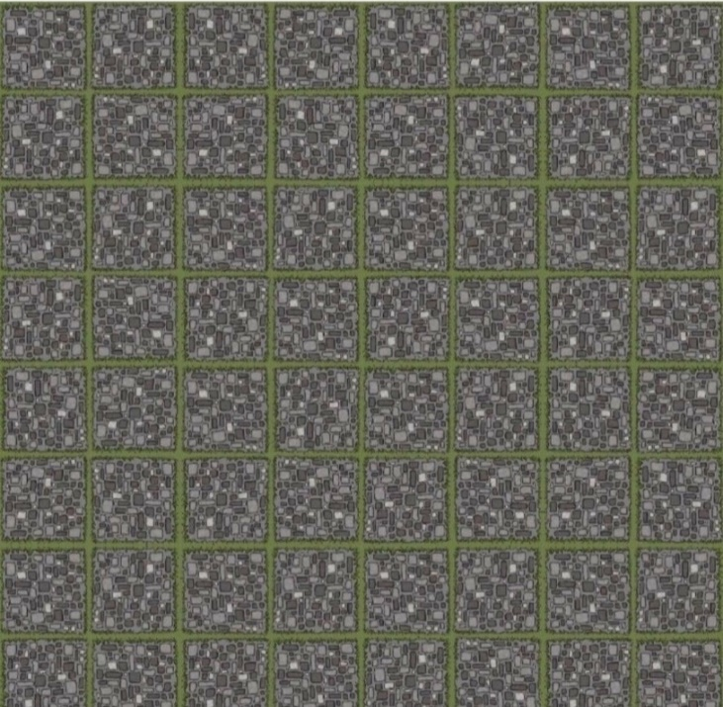
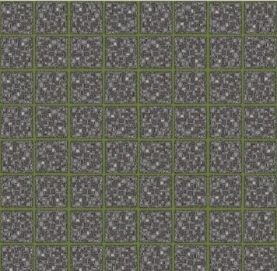

Slide 2


Recap: Resnet
7x7 conv, 64, /2
7x7 conv, 64, /2
pool, /2
pool, /2
3x3 conv, 64
3x3 conv, 64
plain net
3x3 conv, 64
3x3 conv, 64
ResNet
3x3 conv, 64
3x3 conv, 64
3x3 conv, 64
3x3 conv, 64
3x3 conv, 64
3x3 conv, 64
3x3 conv, 64
3x3 conv, 64
3x3 conv, 128, /2
3x3 conv, 128, /2
𝐹 𝑥 is a residual mapping w.r.t. identity
3x3 conv, 128
3x3 conv, 128
3x3 conv, 128
3x3 conv, 128
3x3 conv, 128
3x3 conv, 128
3x3 conv, 128
3x3 conv, 128
𝑥
3x3 conv, 128
3x3 conv, 128
3x3 conv, 128
3x3 conv, 128
3x3 conv, 128
3x3 conv, 128
weight layer
 | relu
3x3 conv, 256, /2
3x3 conv, 256, /2
3x3 conv, 256
3x3 conv, 256
3x3 conv, 256
3x3 conv, 256
𝐹(𝑥)
3x3 conv, 256
3x3 conv, 256
identity
𝑥
3x3 conv, 256
3x3 conv, 256
3x3 conv, 256
3x3 conv, 256
weight layer
3x3 conv, 256
3x3 conv, 256
3x3 conv, 256
3x3 conv, 256
3x3 conv, 256
3x3 conv, 256
3x3 conv, 256
3x3 conv, 256
3x3 conv, 256
3x3 conv, 256
𝐻
𝑥
= 𝐹
𝑥
+ 𝑥
3x3 conv, 256
3x3 conv, 256
relu
3x3 conv, 512, /2
3x3 conv, 512, /2
3x3 conv, 512
3x3 conv, 512
3x3 conv, 512
3x3 conv, 512
3x3 conv, 512
3x3 conv, 512
3x3 conv, 512
3x3 conv, 512
3x3 conv, 512
3x3 conv, 512
avg pool
avg pool
fc 1000
fc 1000

Slide 3
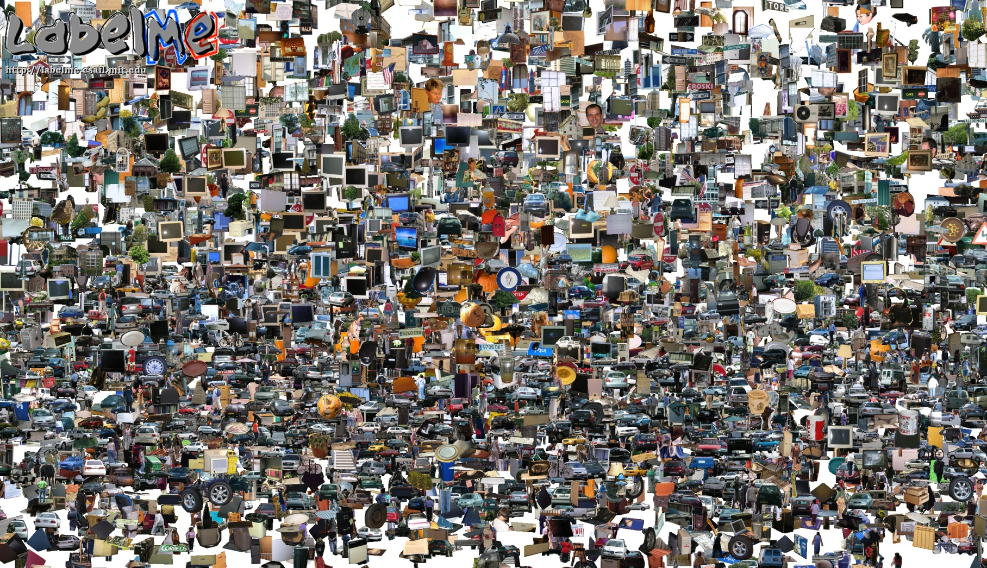
Opportunities of Scale
Computer Vision
James Hays
Many slides from James Hays, Alyosha Efros, and Derek Hoiem
Graphic from Antonio Torralba

Slide 4
Outline
Opportunities of Scale: Data-driven methods
  The Unreasonable Effectiveness of Data
  Scene Completion
  Im2gps
  Recognition via Tiny Images

Slide 5
Computer Vision Class so far
The geometry of image formation
  Ancient / Renaissance
Signal processing / Convolution
  1800, but really the 50’s and 60’s
Hand-designed Features for recognition, either instance-level or categorical
  1999 (SIFT), 2003 (Video Google), 2005 (Dalal-Triggs), 2006 (spatial pyramid bag of words)
Learning from Data
  1991 (EigenFaces) but late 90’s to now especially
Notes:
Omitting tracking / Multiview

Slide 6
What has changed in the last 15 years?
The Internet
Crowdsourcing
Learning representations from the data these sources provide (deep learning)

Slide 7
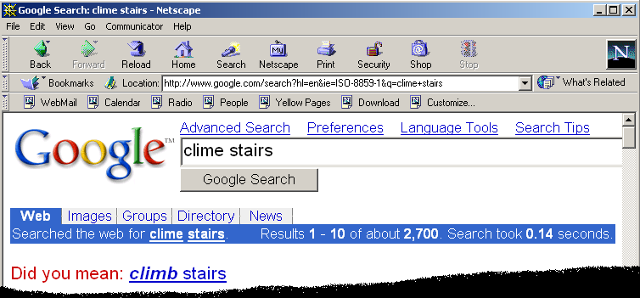
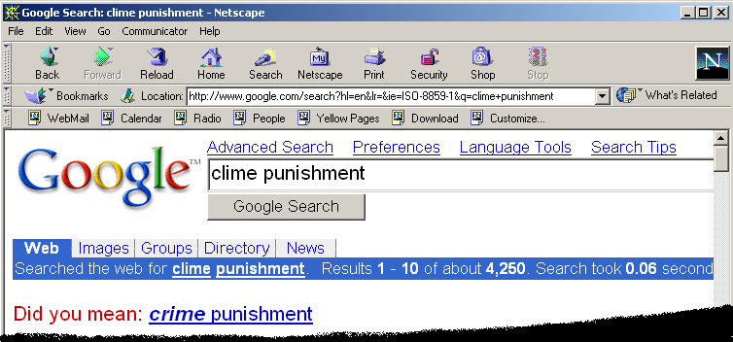
Google and massive data-driven algorithms
A.I. for the postmodern world:
  all questions have already been answered…many times, in many ways
  Google is dumb, the “intelligence” is in the data

Slide 8
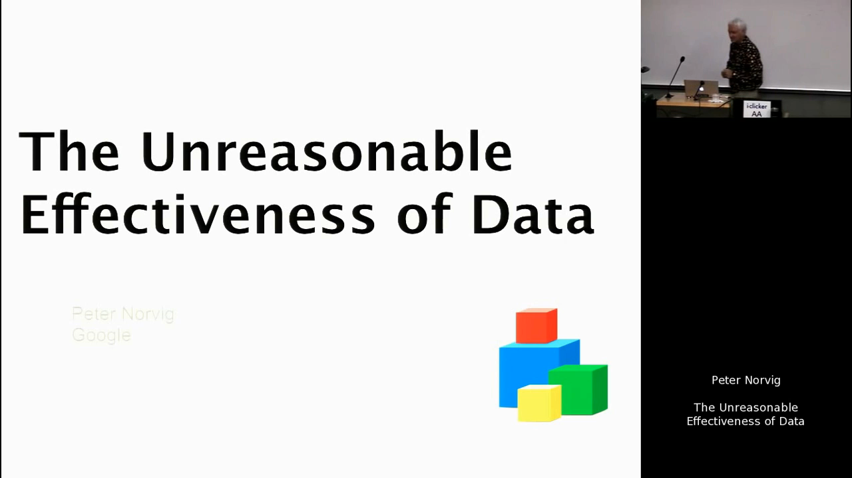
https://youtu.be/yvDCzhbjYWs?t=24
Watch until 9:42

Slide 9
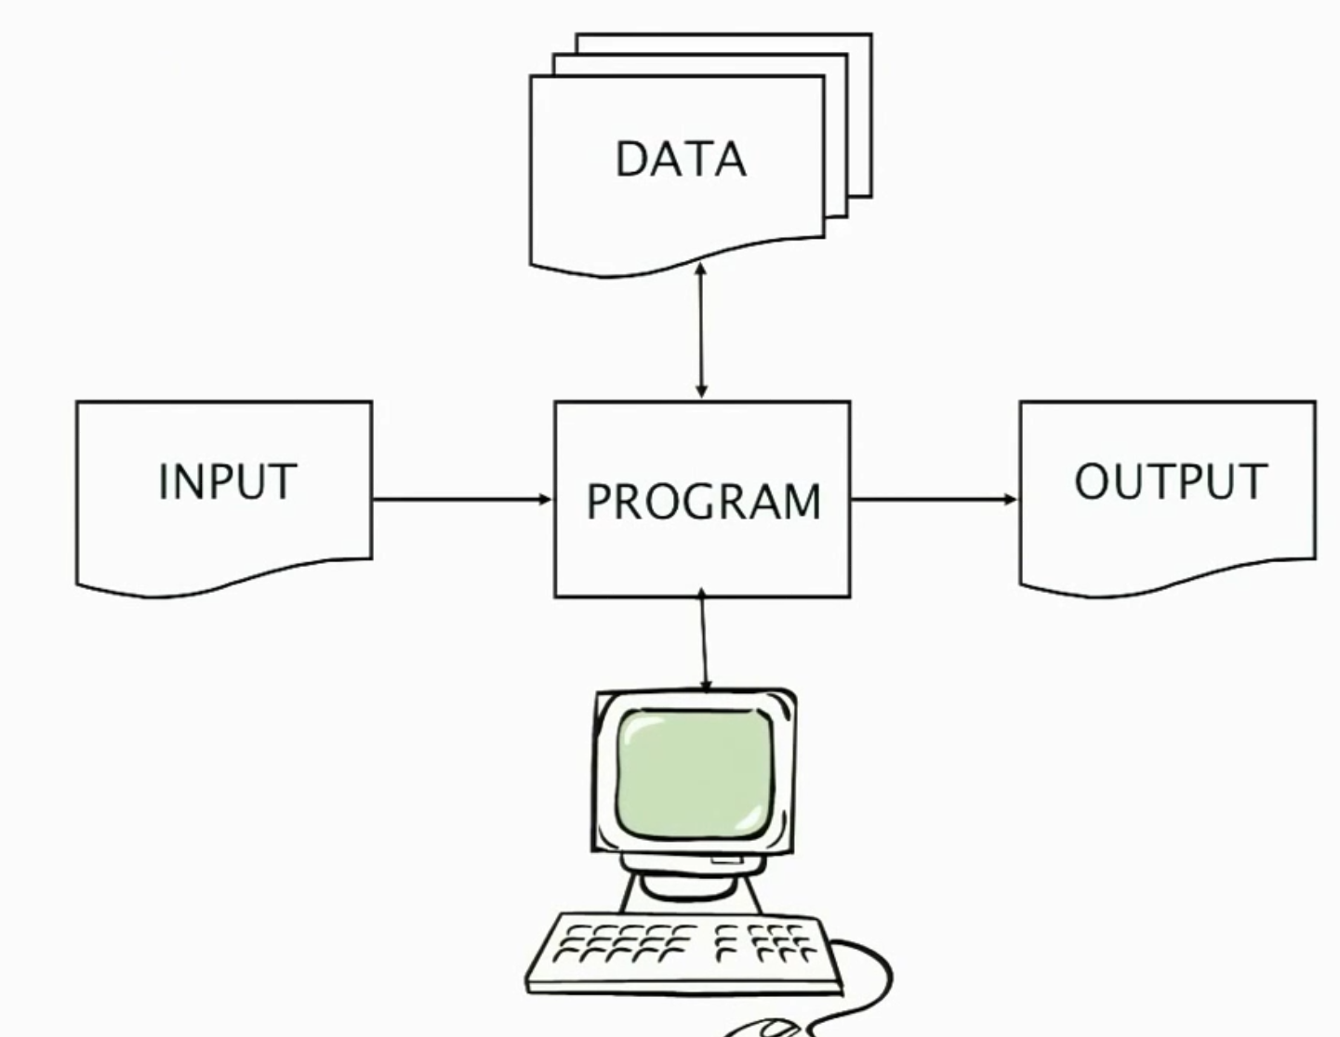

Slide 10
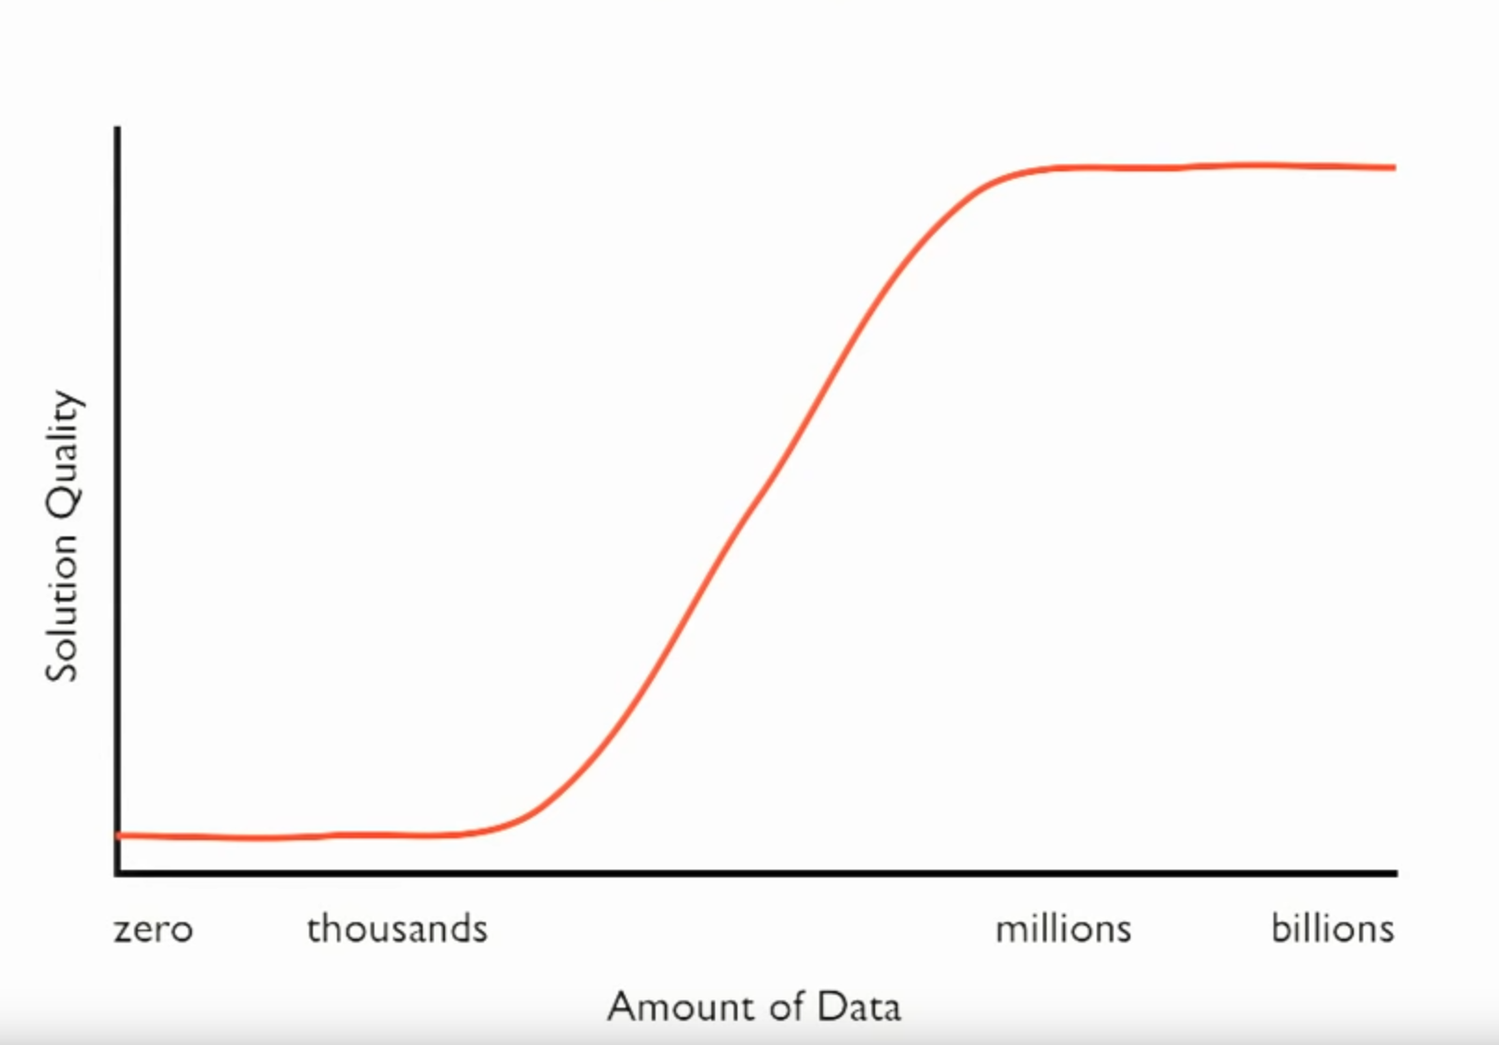

Slide 11
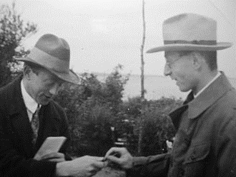
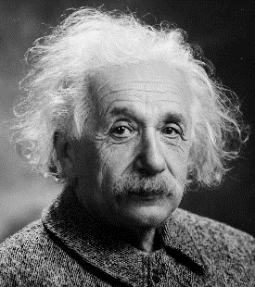
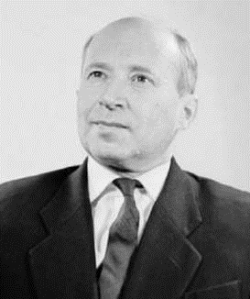
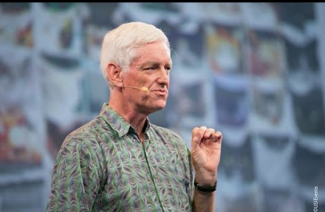
The Unreasonable Effectiveness of Math
“The miracle of the appropriateness of the language of mathematics…” Eugene Wigner
“The most incomprehensible thing about the universe is that it is comprehensible.” Albert Einstein
“There is only one thing which is more unreasonable than the unreasonable effectiveness of mathematics in physics, and this is the unreasonable ineffectiveness of mathematics in biology.” Israel Gelfand
“We should stop acting as if our goal is to author extremely elegant theories, and instead embrace complexity and make use of the best ally we have: the unreasonable effectiveness of data.” Peter Norvig

Slide 12
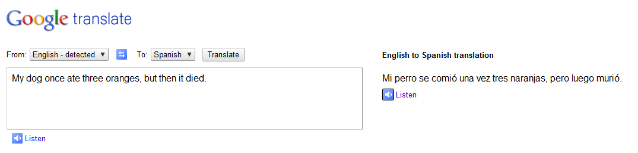
Google Translate
http://ackuna.com/badtranslator
Notes:
http://translationparty.com/#9988025
http://ackuna.com/badtranslator

Slide 13
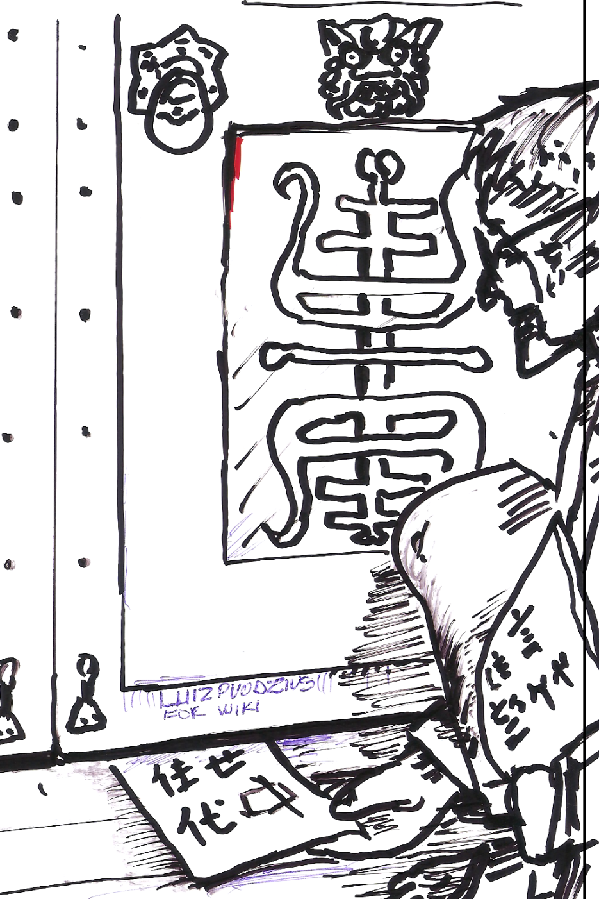
Chinese Room, John Searle (1980)
If a machine can convincingly simulate an intelligent conversation, does it necessarily understand? In the experiment, Searle imagines himself in a room, acting as a computer by manually executing a program that convincingly simulates the behavior of a native Chinese speaker.
Most of the discussion consists of attempts to refute it. "The overwhelming majority," notes BBS editor Stevan Harnad,“ still think that the Chinese Room Argument is dead wrong." The sheer volume of the literature that has grown up around it inspired Pat Hayes to quip that the field of cognitive science ought to be redefined as "the ongoing research program of showing Searle's Chinese Room Argument to be false.
Notes:
The experiment is the centerpiece of Searle's Chinese Room Argument which holds that a program cannot give a computer a "mind" or "understanding", regardless of how intelligently it may make it behave. He concludes that "programs are neither constitutive of nor sufficient for minds." "I can have any formal program you like, but I still understand nothing."
Searle “according to strong AI, . . . the appropriately programmed computer really is a mind, in the sense that computers given the right programs can be literally said to understand and have other cognitive states.”

Slide 14
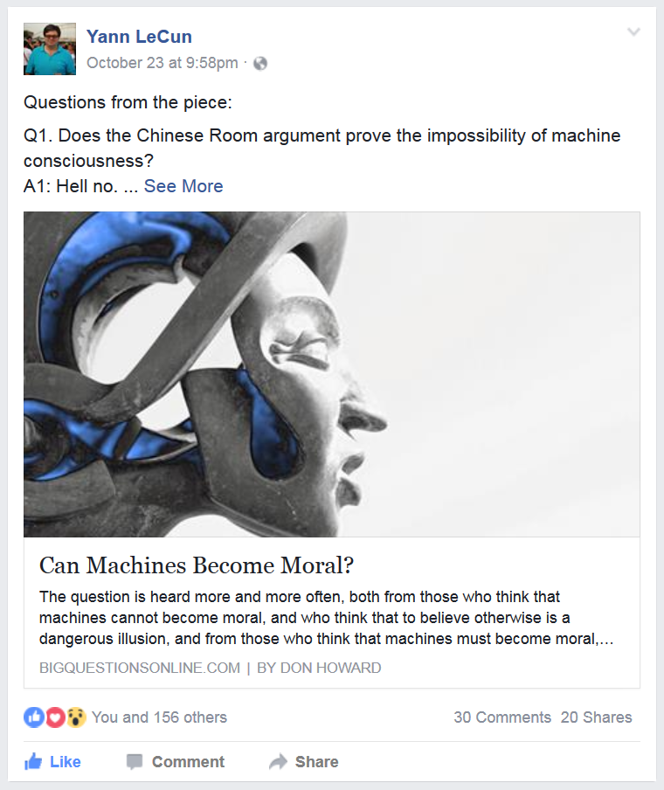

Slide 15
Big Idea
Do we need computer vision systems to have strong AI-like reasoning about our world?
What if invariance / generalization isn’t actually the core difficulty of computer vision?
What if we can perform high level reasoning with brute-force, data-driven algorithms?

Slide 16
Scene Completion
[Hays and Efros. Scene Completion Using Millions of Photographs. SIGGRAPH 2007 and CACM October 2008.]
http://graphics.cs.cmu.edu/projects/scene-completion/

Slide 17
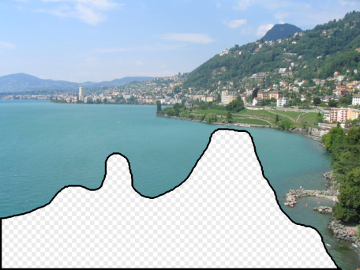
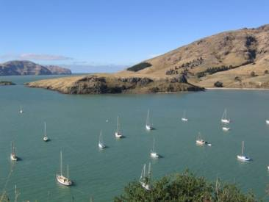
How it works
Find a similar image from a large dataset
Blend a region from that image into the hole
Dataset

Slide 18
General Principal
Huge Dataset
Images
image
matching
Info from Most Similar Images
Input Image
Associated Info
Hopefully, If you have enough images, the dataset will contain very similar images that you can find with simple matching methods.

Slide 19
How many images is enough?

Slide 20
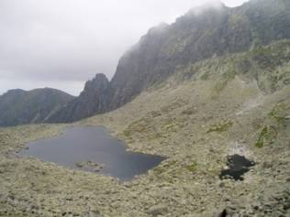
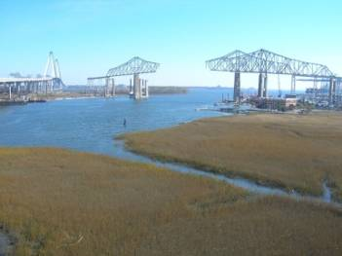
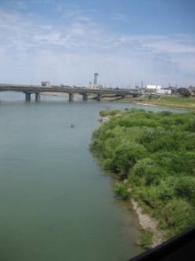
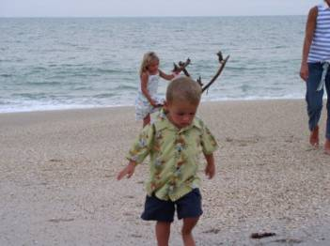
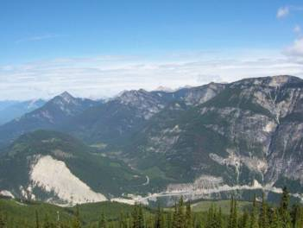
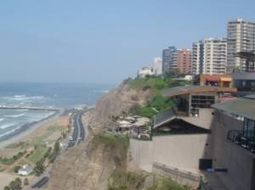
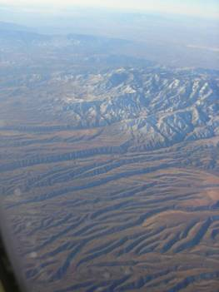
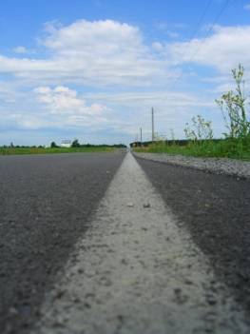
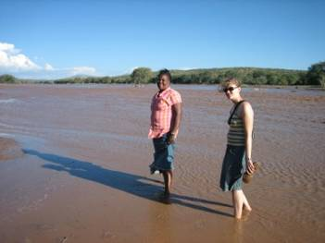
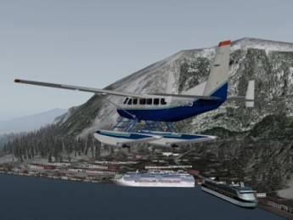
Nearest neighbors from a
collection of 20 thousand images
Notes:
20

Slide 21
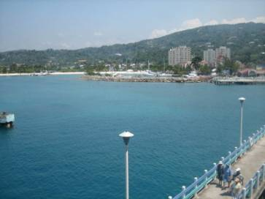
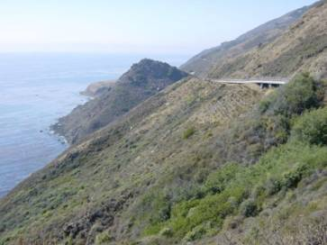
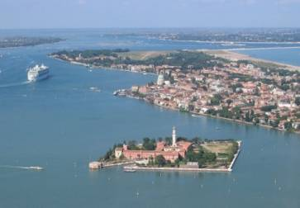
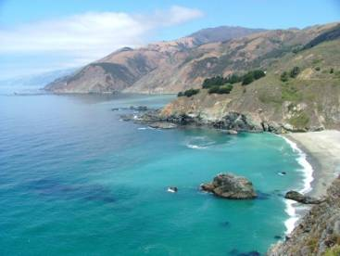

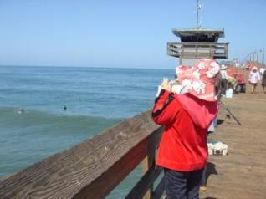
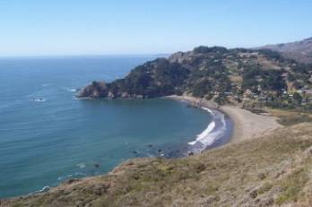
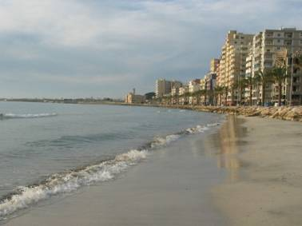
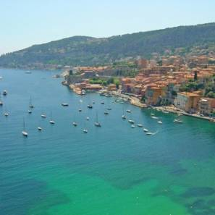
Nearest neighbors from a
collection of 2 million images
Notes:
21

Slide 22
Image Data on the Internet
Flickr (as of Sept. 19th, 2010)
  5 billion photographs
  100+ million geotagged images
Facebook (as of 2009)
  15 billion
http://royal.pingdom.com/2010/01/22/internet-2009-in-numbers/

Slide 23
Image Data on the Internet
Flickr (as of Nov 2013)
  10 billion photographs
  100+ million geotagged images
  3.5 million a day
Facebook (as of Sept 2013)
  250 billion+
  300 million a day
Instagram
  55 million a day

Slide 24
Image Data on the Internet
Instagram
  100 million a day (as of 2017)
1 trillion photos taken per day.
Notes:
https://bernardmarr.com/how-much-data-do-we-create-every-day-the-mind-blowing-stats-everyone-should-read/

Slide 25
Scene Completion: how it works
[Hays and Efros. Scene Completion Using Millions of Photographs. SIGGRAPH 2007 and CACM October 2008.]

Slide 26
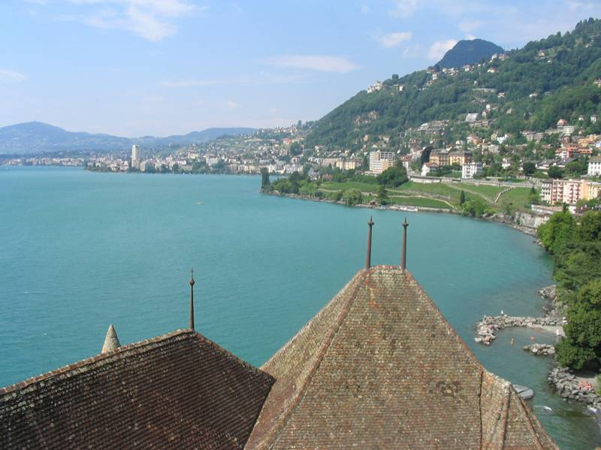
The Algorithm
Notes:
26
Introduce gist.

Slide 27
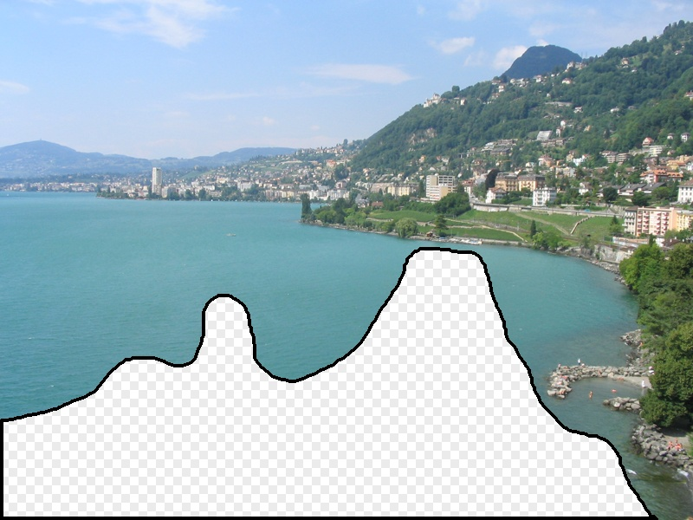
Scene Matching
Notes:
27
Introduce gist.

Slide 28
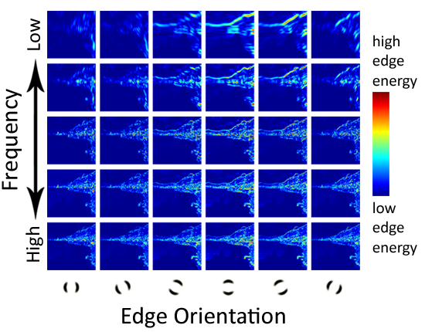
Scene Descriptor
Notes:
Edge energy is just the magnitude of directional derivatives of image intensity.
28

Slide 29
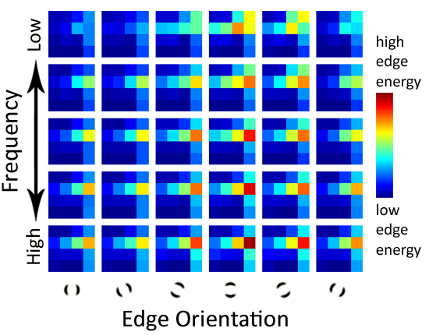
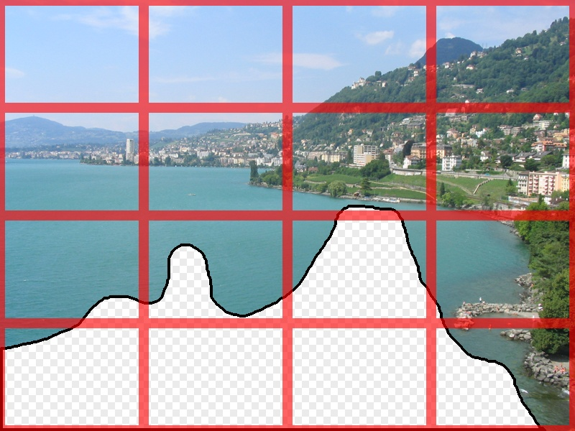
Scene Descriptor
Scene Gist Descriptor
(Oliva and Torralba 2001)

Slide 30

Scene Descriptor
+
Scene Gist Descriptor
(Oliva and Torralba 2001)

Slide 31
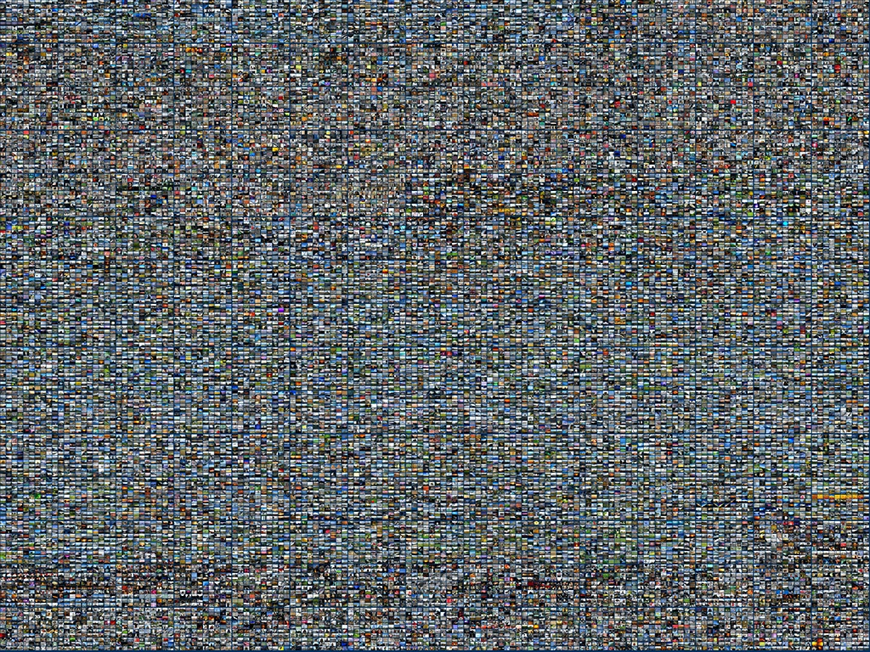
2 Million Flickr Images
Notes:
31
Now we take our gist (and mask and color image) and find it’s L2 nearest neighbors in the database of 2.3 million images, and here they are

Slide 32
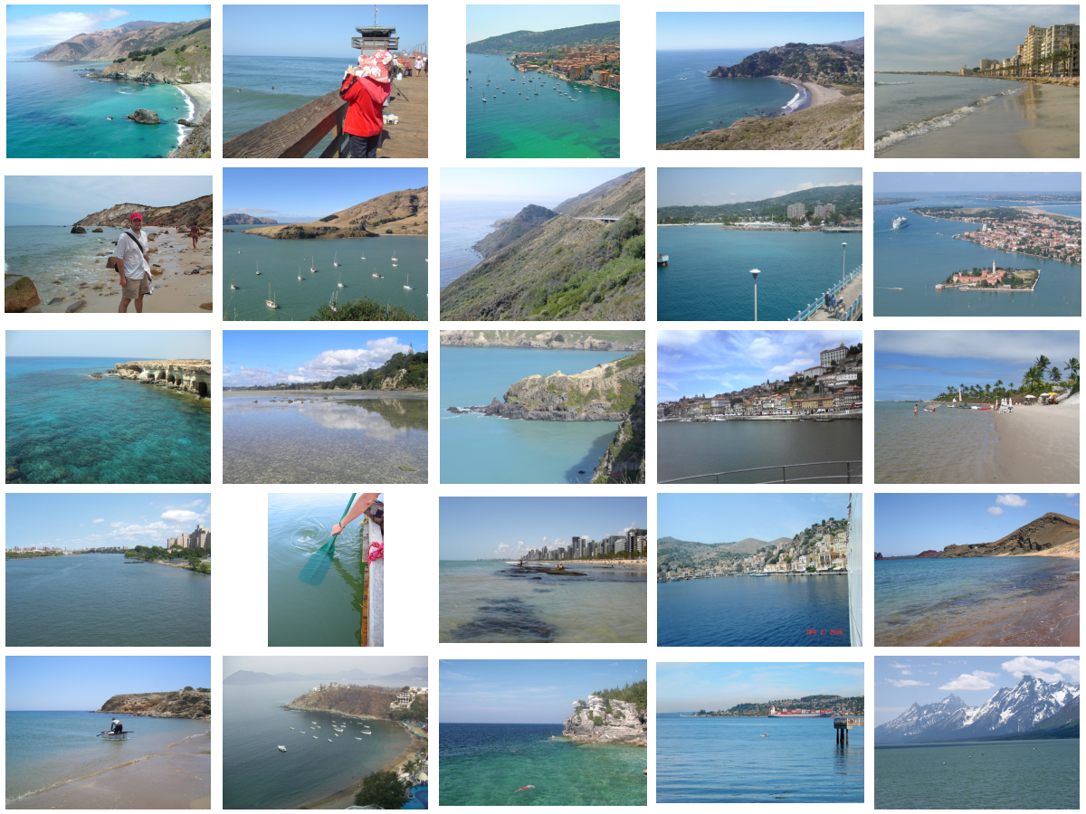
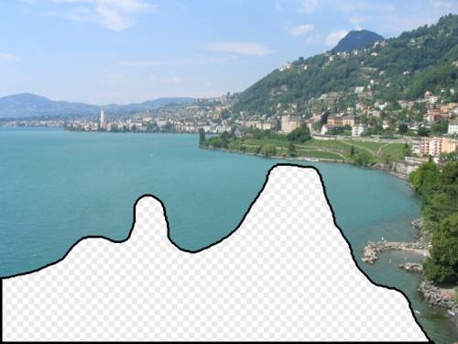
… 200 total
Notes:
32

Slide 33
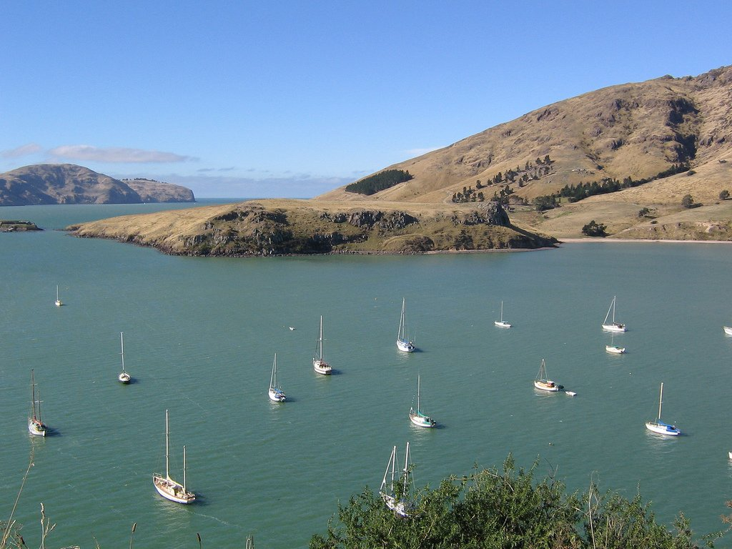
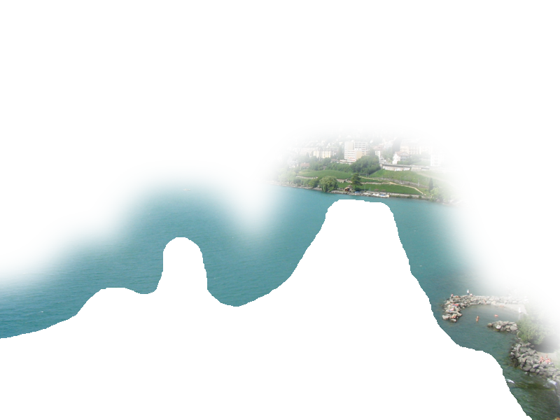
Context Matching

Slide 34
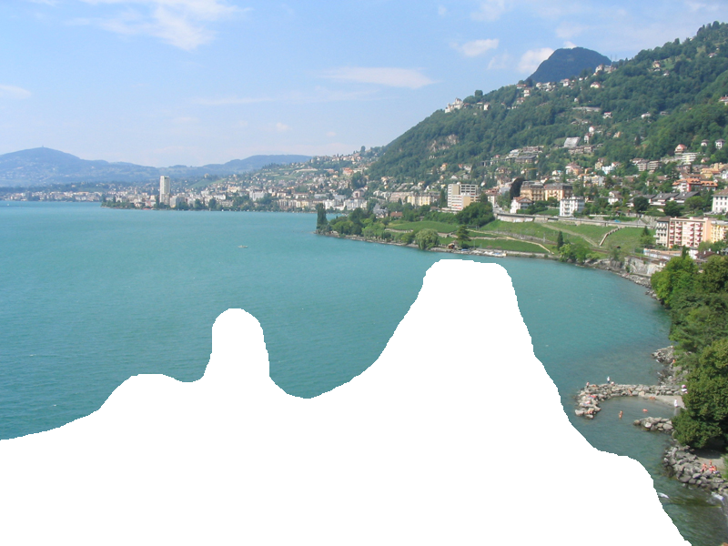
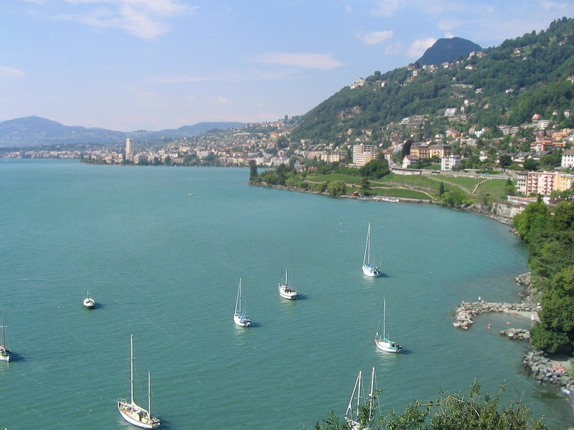
Graph cut + Poisson blending

Slide 35



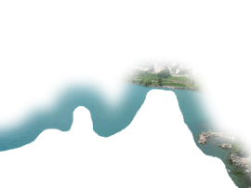
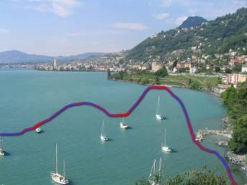
Result Ranking
We assign each of the 200 results a score which is the sum of:
The scene matching distance
The context matching distance
(color + texture)
The graph cut cost
Notes:
35
Johnson et al. used the graph cut cost to sort results for users in Semantic Photo Synthesis

Slide 36


Slide 37


Slide 38


Slide 39


Slide 40

Notes:
40

Slide 41

Notes:
41

Slide 42

Notes:
42

Slide 43


… 200 scene matches
Notes:
43

Slide 44

Notes:
44
Not actually the same scene, even though they’re startlingly similar

Slide 46


Slide 47


Slide 48


Slide 49


Which is the original?

Slide 50


Slide 51

Notes:
51

Slide 52

Notes:
52
Can justify broader use of image completion here

Slide 53

Diffusion Result
Notes:
53

Slide 54

Efros and Leung result
Notes:
54
Efros and leung result

Slide 55

Scene Completion Result

Slide 56


Slide 57
Outline
Opportunities of Scale: Data-driven methods
  The Unreasonable Effectiveness of Data
  Scene Completion
  Im2gps
  Recognition via Tiny Images

Slide 58
General Principal
Huge Dataset
Images
image
matching
Info from Most Similar Images
Input Image
Associated Info
Hopefully, If you have enough images, the dataset will contain very similar images that you can find with simple matching methods.

Slide 59
… 200 total
Notes:
59

Slide 60
Graph cut + Poisson blending

Slide 61

https://www.geoguessr.com/
https://www.youtube.com/c/GeoWizard/videos

Slide 62

im2gps (Hays & Efros, CVPR 2008)
6 million geo-tagged Flickr images
http://graphics.cs.cmu.edu/projects/im2gps/

Slide 63

How much can an image tell about its geographic location?

Slide 64

Nearest Neighbors according to gist + bag of SIFT + color histogram + a few others

Slide 65


Slide 66

Im2gps

Slide 67

Example Scene Matches

Slide 68

Voting Scheme
Notes:
Probability map for that same image
Explain the green circles and how they relate to evaluation
68

Slide 69

im2gps

Slide 70


Slide 71


Slide 72

Effect of Dataset Size

Slide 73


Follow up works
PlaNet - photo geolocation with convolutional neural networks. T. Weyand, I. Kostrikov, and J. Philbin. ECCV 2016
Revisiting IM2GPS in the Deep Learning Era.
Nam Vo, Nathan Jacobs, James Hays. ICCV 2017

Slide 74

Population density ranking
High Predicted Density
Low Predicted Density

Slide 75

Where is This?
[Olga Vesselova, Vangelis Kalogerakis, Aaron Hertzmann, James Hays, Alexei A. Efros. Image Sequence Geolocation. ICCV’09]
Notes:
75

Slide 76

Where is This?

Slide 77


Where are These?
15:14,
June 18th, 2006
16:31,
June 18th, 2006
Notes:
Individually each photograph is 16%, but together they reinforce each other well
77

Slide 78

Where are These?
15:14,
June 18th, 2006
16:31,
June 18th, 2006
17:24,
June 19th, 2006
Notes:
If you know that brits love to vacation in greece…
78

Slide 79

Results
im2gps – 10% (geo-loc within 400 km)
temporal im2gps – 56%

Slide 80

Tiny Images
80 million tiny images: a large dataset for non-parametric object and scene recognition Antonio Torralba, Rob Fergus and William T. Freeman. PAMI 2008.
http://groups.csail.mit.edu/vision/TinyImages/

Slide 81


Slide 84


Slide 85

Human Scene Recognition

Slide 86

Humans vs. Computers:
Car-Image Classification
Various computer vision algorithms for full resolution images
Humans for 32 pixel tall images

Slide 87





Powers of 10
Number of images on my hard drive: 10⁴
Number of images seen during my first 10 years: 10⁸
(3 images/second * 60 * 60 * 16 * 365 * 10 = 630720000)
Number of images seen by all humanity: 10²⁰
106,456,367,669 humans¹ * 60 years * 3 images/second * 60 * 60 * 16 * 365 =
1 from http://www.prb.org/Articles/2002/HowManyPeopleHaveEverLivedonEarth.aspx
Number of photons in the universe: 10⁸⁸
Number of all 32x32 images: 10⁷³⁷³
256 ^{32*32*3} ~ 10⁷³⁷³
Notes:
so don’t listen to anyone claiming to brute force image space
But most of image space is empty, never observed. If you were to run the rand() command in Matlab, how often would it generate a plausible image?

Slide 88

Scenes are unique
Notes:
Scene and object recognition at human performance is very hard because we are able to deal with so many different kinds of scenes…
Scenes are so unique.

Slide 89









But not all scenes are so original
Notes:
But most scenes are not really like that. Most of the time, scenes are boring places in which nothing really surprising happens. For instance, this street… there is nothing really special about it. In fact, I can easily find thousands of other street pictures that look just like this. Of course, these scenes are different in the details, just as two faces are different, but at a coarser level they are form by similar objects arranged in a similar spatial configuration.

Slide 90
Lots
Of
Images
A. Torralba, R. Fergus, W.T.Freeman. PAMI 2008

Slide 91
Lots
Of
Images
A. Torralba, R. Fergus, W.T.Freeman. PAMI 2008

Slide 92
Lots
Of
Images

Slide 93






Application: Automatic Colorization
Input
Color Transfer
Color Transfer
Matches (gray)
Matches (w/ color)
Avg Color of Match

Slide 94






Application: Automatic Colorization
Input
Color Transfer
Color Transfer
Matches (gray)
Matches (w/ color)
Avg Color of Match

Slide 95

Application: Person Detection
80 million “tiny images” downloaded by keyword search.
80 nearest neighbors vote for image category.

Slide 96

Re-ranking Altavista search for “person”

Slide 97

Automatic Orientation Examples
A. Torralba, R. Fergus, W.T.Freeman. 2008
Notes:
Based on average correlation to the top 50 nearest neighbors. Note that this doesn’t really beat just assuming that the image is upright.
97

Slide 98

Summary
With billions of images on the web, it’s often possible to find a close nearest neighbor
In such cases, we can shortcut hard problems by “looking up” the answer, stealing the labels from our nearest neighbor. For example, simple (or learned) associations can be used to synthesize background regions, colorize, or recognize objects
But we can’t really “brute force” computer vision. Still, it’s nice to get an intuition for the size of “image space”.

