Slide 1
Structured Predictions with Deep Learning, Part 2
James Hays

Slide 2
Outline – More complex outputs from deep networks
Image Output (e.g. colorization, semantic segmentation, super-resolution, stylization, depth estimation…)
Attributes
Text Captions
Semantic Keypoints
Object Detection

Slide 3
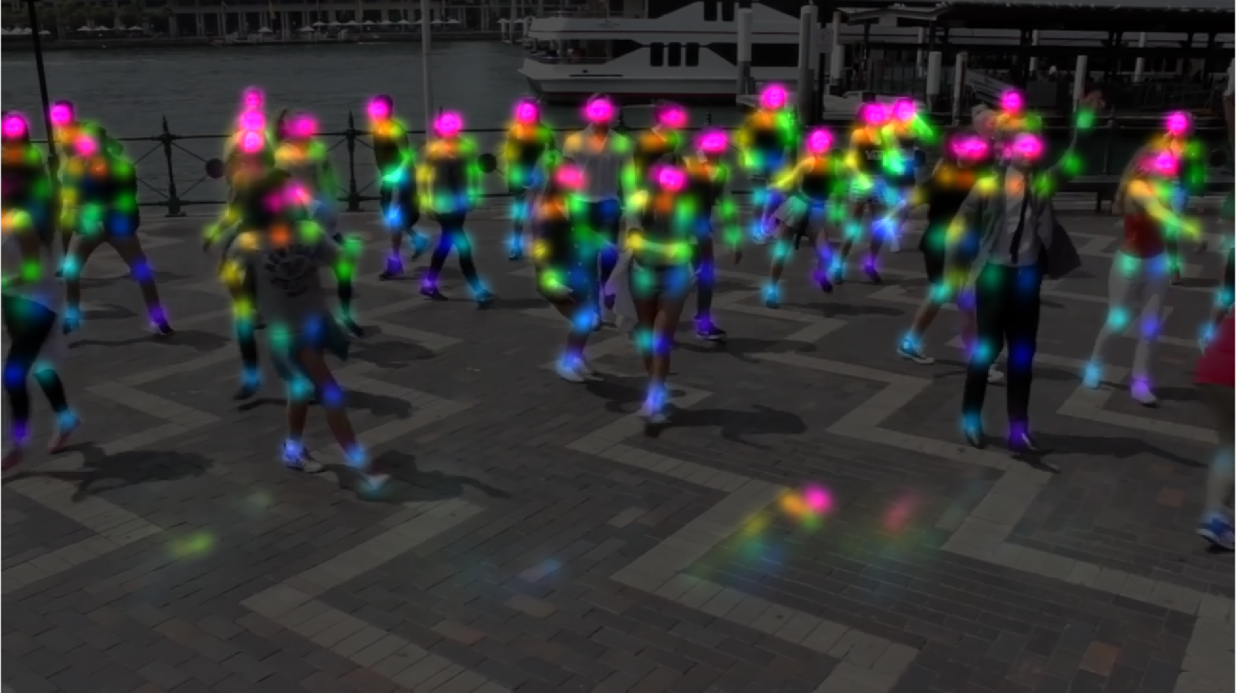
Multi-Person Pose Estimation
Color encodes the body part type
Notes:
We can extend the parts detection to the case of multiple people using fully convolutional network. Now we can have reliable part confidence map predictions,

Slide 4
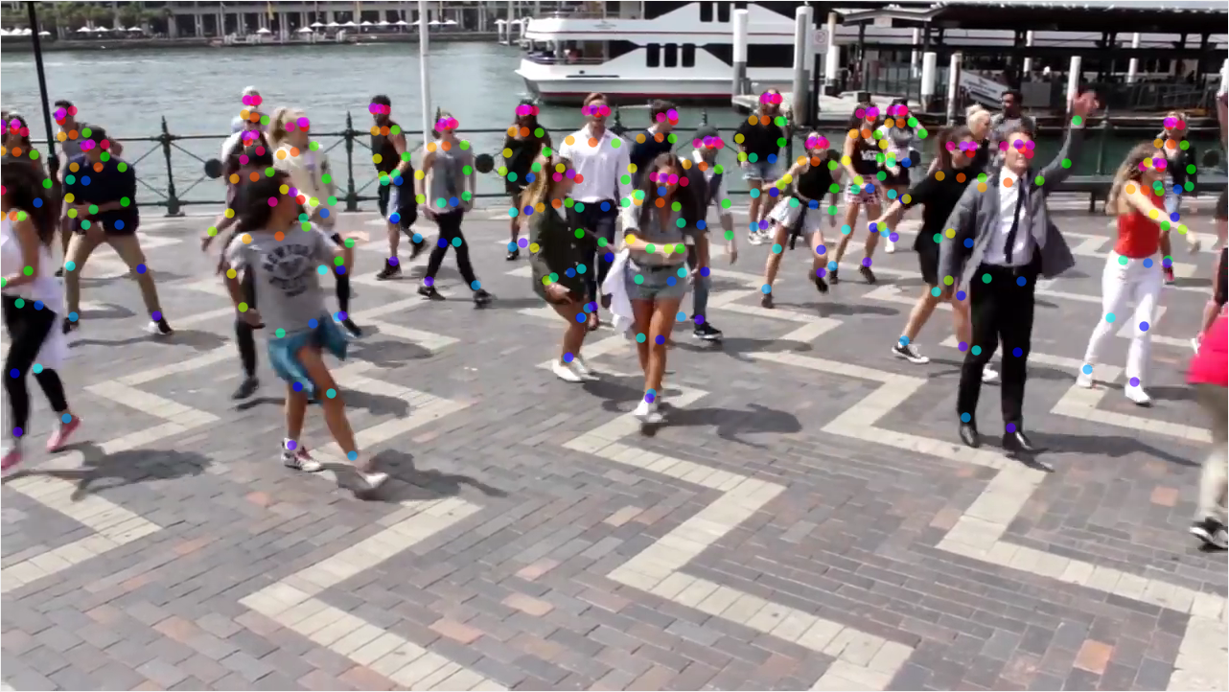
Multi-Person Pose Estimation
Notes:
using non-maximum suppression, we can obtain all the detection candidates, is this problem solved?

Slide 5
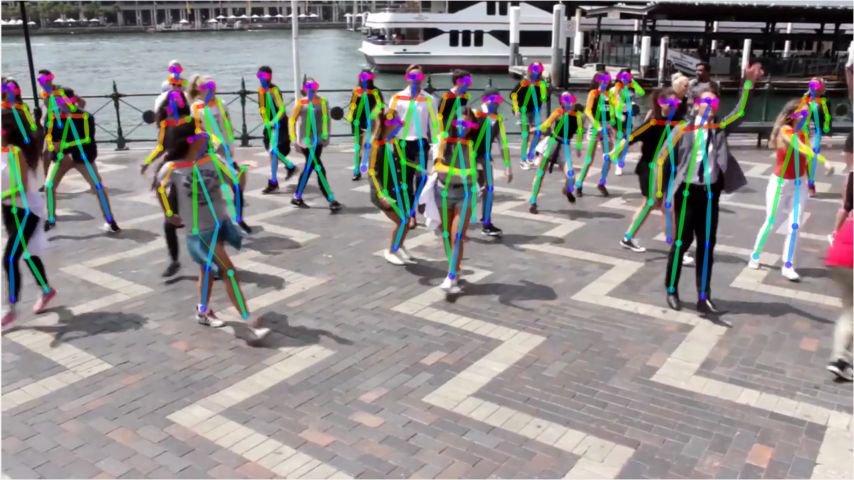
Major Challenge: Part-to-Person Association
Notes:
The answer is no, we still need to obtain part-to-person association and grouping the part detections into different skeletons.

Slide 6
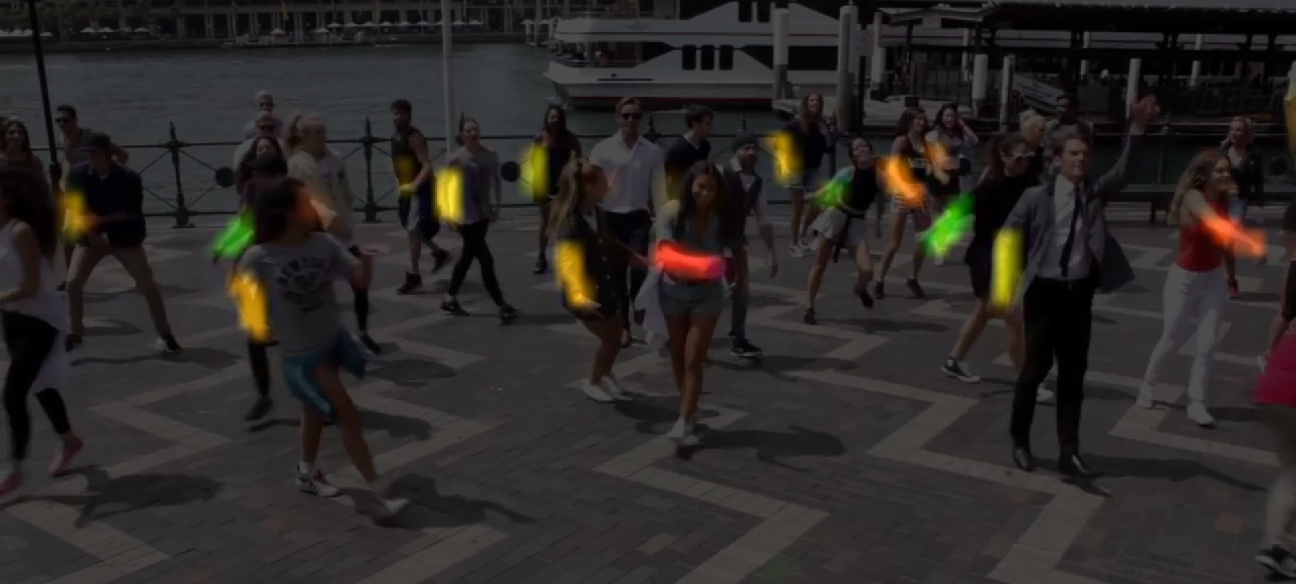
Novelty: Part Affinity Fields for Parts Association
Part Affinity Field between right elbow and wrist
Notes:
We call this representation part affinity field, it is a flow field that flows from one body part to the other. The figure shows an example part affinity field between right elbow and wrist, the color encodes the orientation.

Slide 7
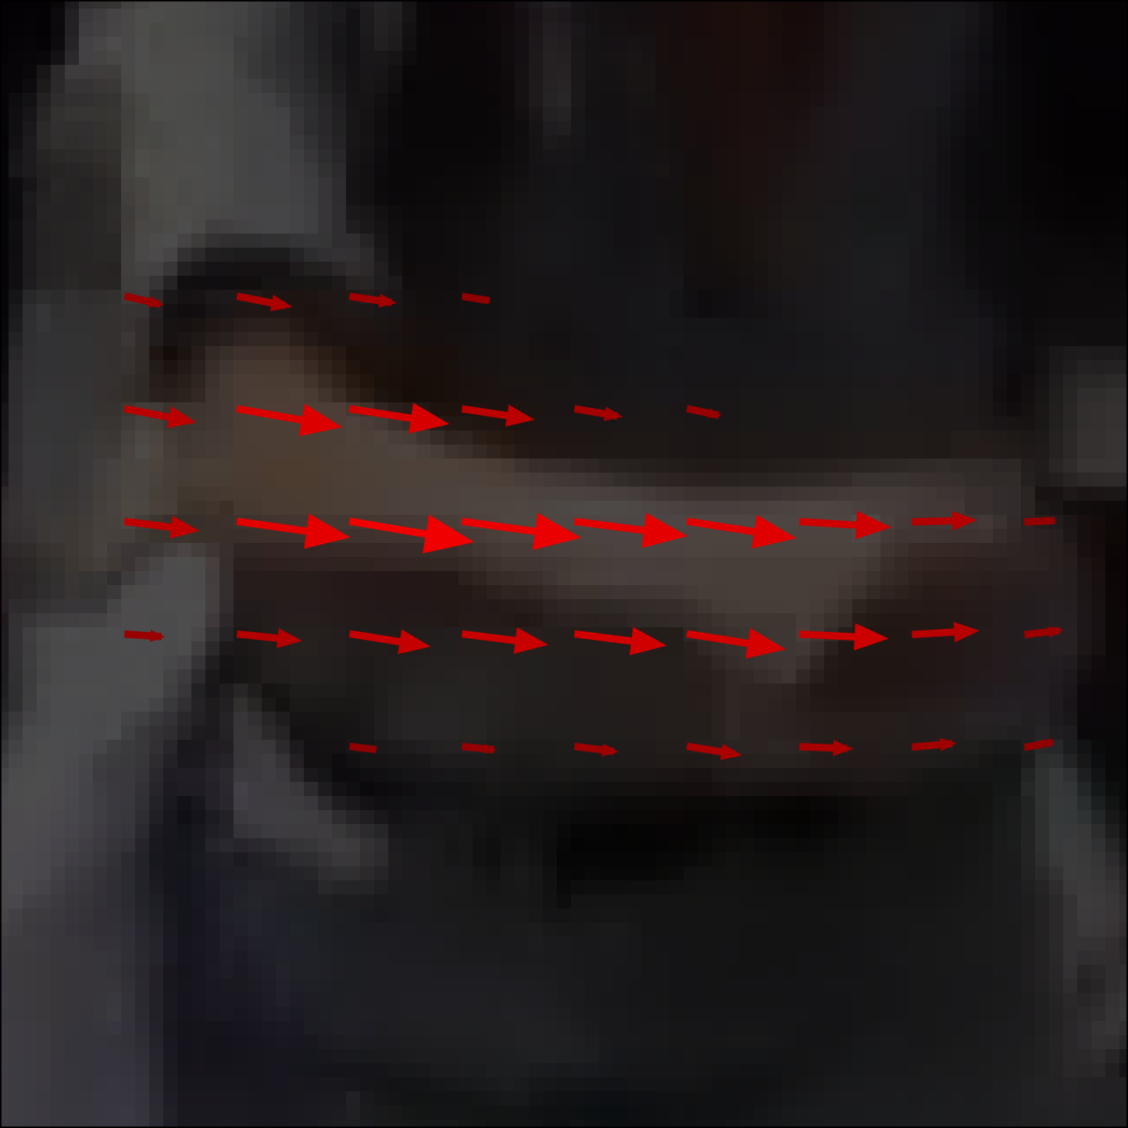
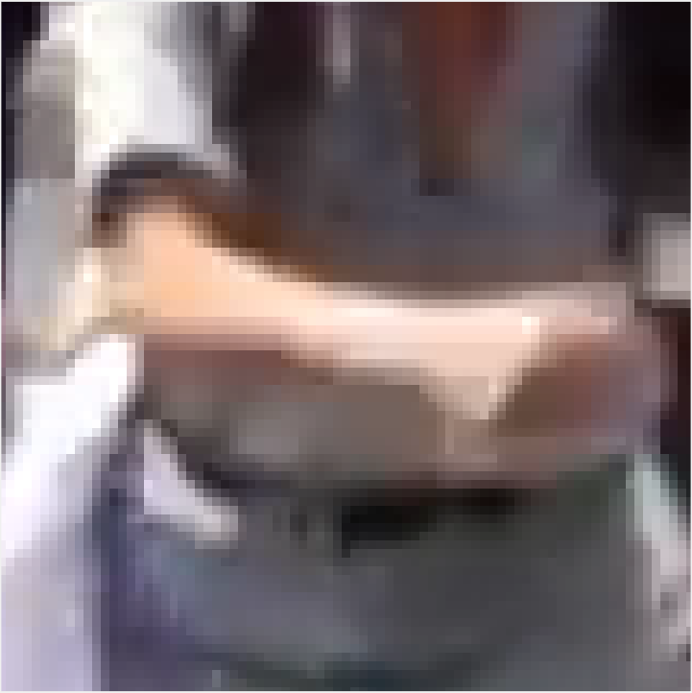
Novelty: Part Affinity Fields for Parts Association
Part Affinity Field between right elbow and wrist
Notes:
Specifically, for each pixel in the human limb area, we predict a direction vector which points from one part to another part. The strength of the vector represents the confidence of the prediction. This representation encodes both direction and position of the human limb. The intuition of the representation is straightforward, that visual appearance of human limbs encodes the part-to-part association information.

Slide 8
Realtime Multi-Person Pose Estimation using Part Affinity Fields
Zhe Cao, Tomas Simon, Shih-En Wei, Yaser Sheikh. CVPR 2017
“Bottom Up” method of detecting one category of objects (people)
Instead of detecting person instances and then their keypoints, it detects keypoints and then assembles them into person instances.
The method is not “end to end”. The network is supervised to produce an intermediate representation that is easy to post-process into the desired output. The network still does the heavy lifting.

Slide 9
Outline – More complex outputs from deep networks
Image Output (e.g. colorization, semantic segmentation, super-resolution, stylization, depth estimation…)
Attributes
Text Captions
Semantic Keypoints
Object Detection
“Single shot” or “one stage” detectors like YOLO or SSD. The network runs once per image.
“Two stage” detectors like Mask RCNN. A feature extractor network runs once per image, various “head” networks run an arbitrary amount of times.

Slide 11
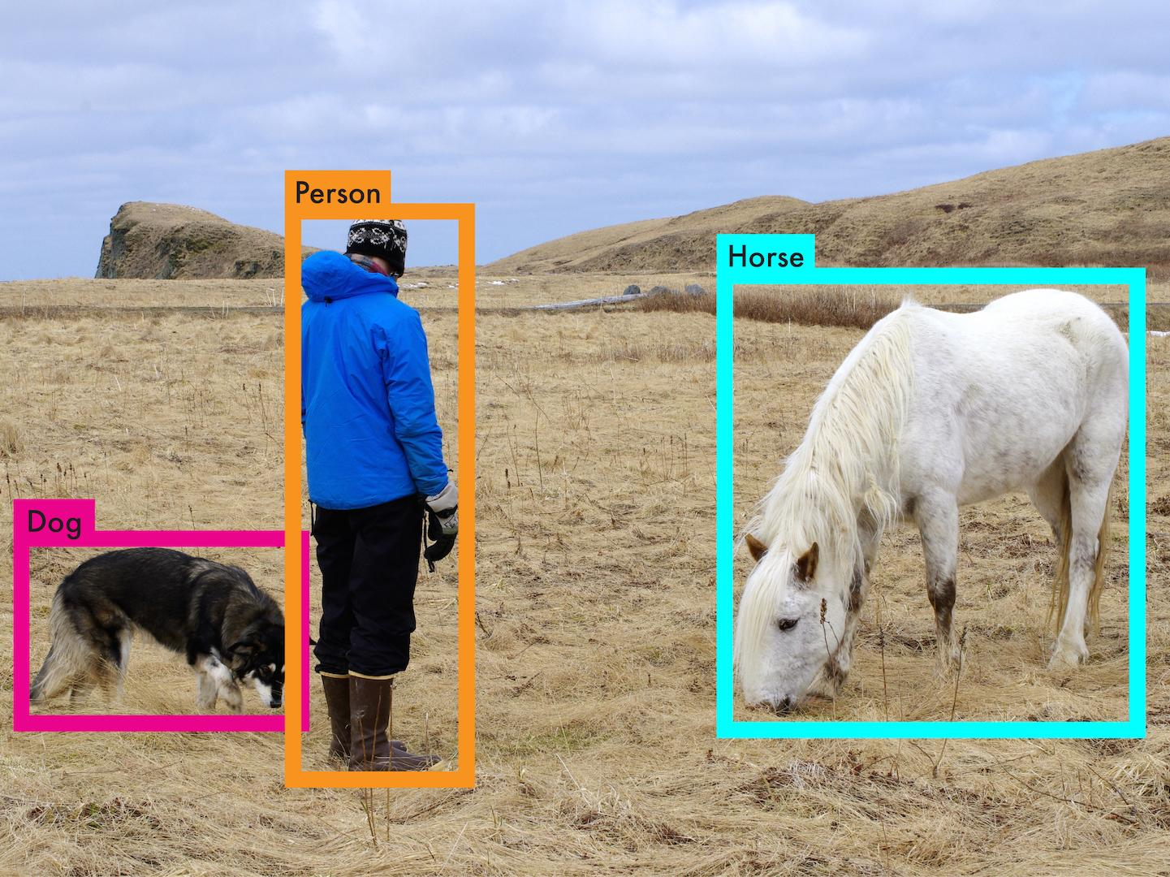

Slide 12
Accurate object detection is slow!
 | Pascal 2007 mAP | Speed
DPM v5 | 33.7 | .07 FPS | 14 s/img

Slide 13
Accurate object detection is slow!
 | Pascal 2007 mAP | Speed
DPM v5 | 33.7 | .07 FPS | 14 s/img
R-CNN | 66.0 | .05 FPS | 20 s/img

Slide 16
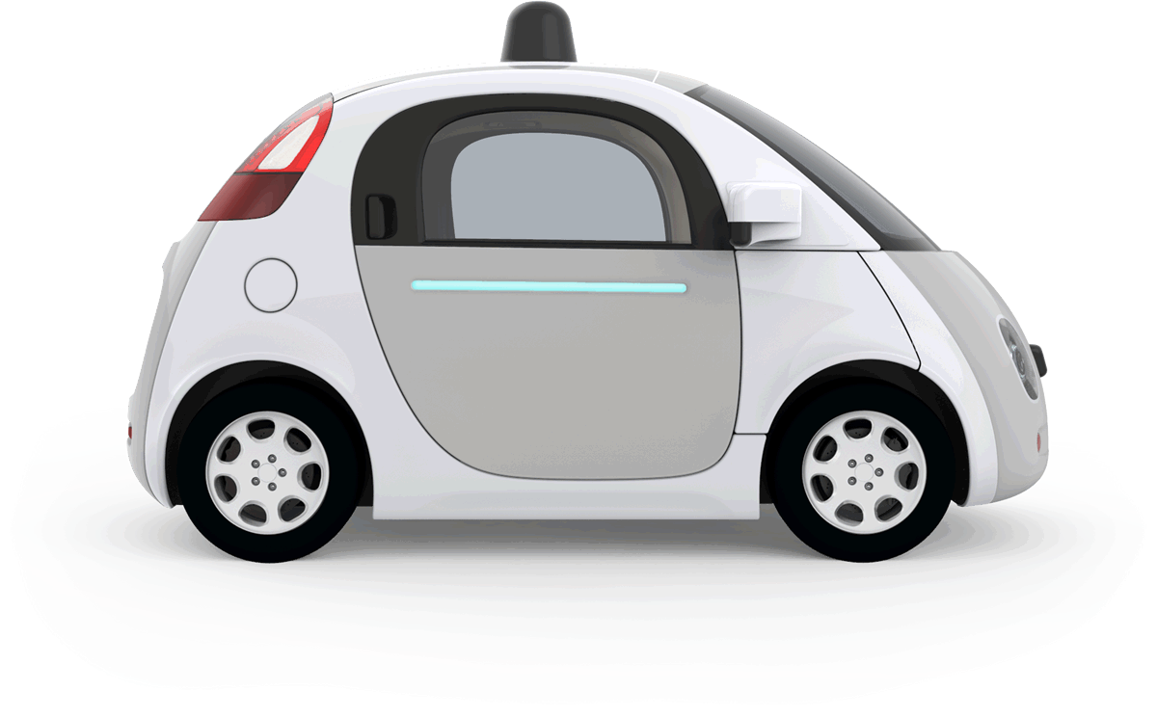
Accurate object detection is slow!
 | Pascal 2007 mAP | Speed
DPM v5 | 33.7 | .07 FPS | 14 s/img
R-CNN | 66.0 | .05 FPS | 20 s/img
⅓ Mile, 1760 feet

Slide 17
Accurate object detection is slow!
 | Pascal 2007 mAP | Speed
DPM v5 | 33.7 | .07 FPS | 14 s/img
R-CNN | 66.0 | .05 FPS | 20 s/img
Fast R-CNN | 70.0 | .5 FPS | 2 s/img
176 feet

Slide 18
Accurate object detection is slow!
 | Pascal 2007 mAP | Speed
DPM v5 | 33.7 | .07 FPS | 14 s/img
R-CNN | 66.0 | .05 FPS | 20 s/img
Fast R-CNN | 70.0 | .5 FPS | 2 s/img
Faster R-CNN | 73.2 | 7 FPS | 140 ms/img
8 feet
12 feet

Slide 19
Accurate object detection is slow!
 | Pascal 2007 mAP | Speed
DPM v5 | 33.7 | .07 FPS | 14 s/img
R-CNN | 66.0 | .05 FPS | 20 s/img
Fast R-CNN | 70.0 | .5 FPS | 2 s/img
Faster R-CNN | 73.2 | 7 FPS | 140 ms/img
YOLO | 63.4 | 45 FPS | 22 ms/img
2 feet

Slide 20
Accurate object detection is slow!
 | Pascal 2007 mAP | Speed
DPM v5 | 33.7 | .07 FPS | 14 s/img
R-CNN | 66.0 | .05 FPS | 20 s/img
Fast R-CNN | 70.0 | .5 FPS | 2 s/img
Faster R-CNN | 73.2 | 7 FPS | 140 ms/img
YOLO | 69.0 | 45 FPS | 22 ms/img
2 feet

Slide 21
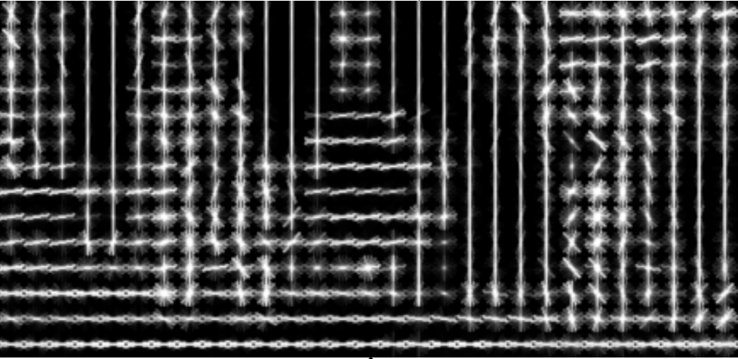
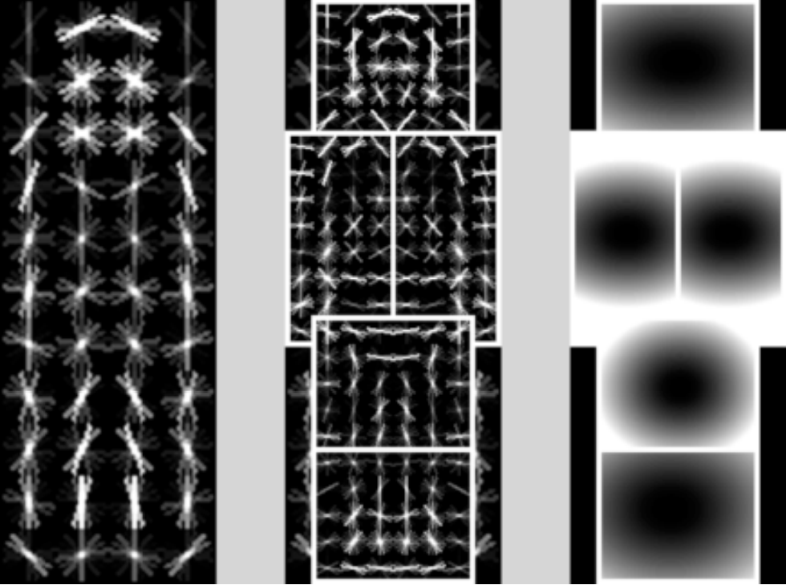
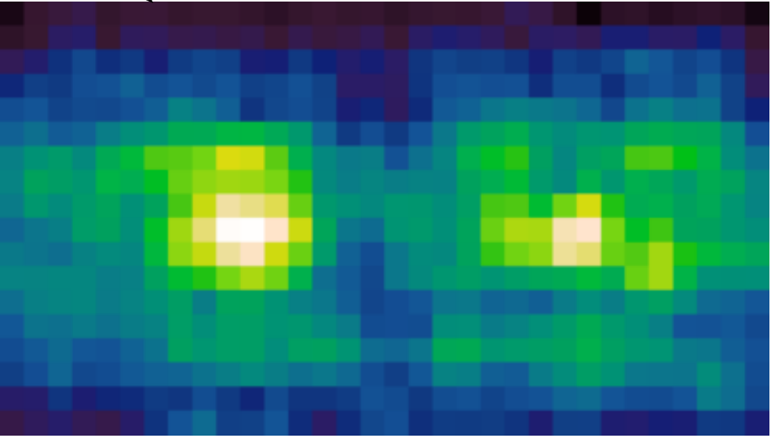
DPM: Deformable Part Models

Slide 23
Sliding window, DPM, R-CNN all train region-based classifiers to perform detection
DPM: Deformable Part Models

Slide 25
With YOLO, you only look once at an image to perform detection
YOLO: You Only Look Once

Slide 26
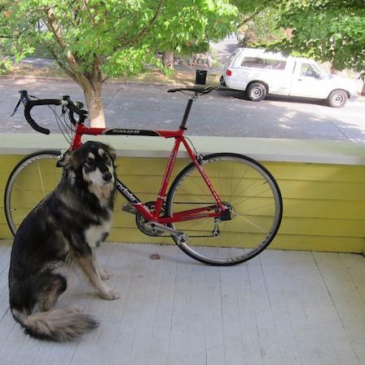

Slide 27
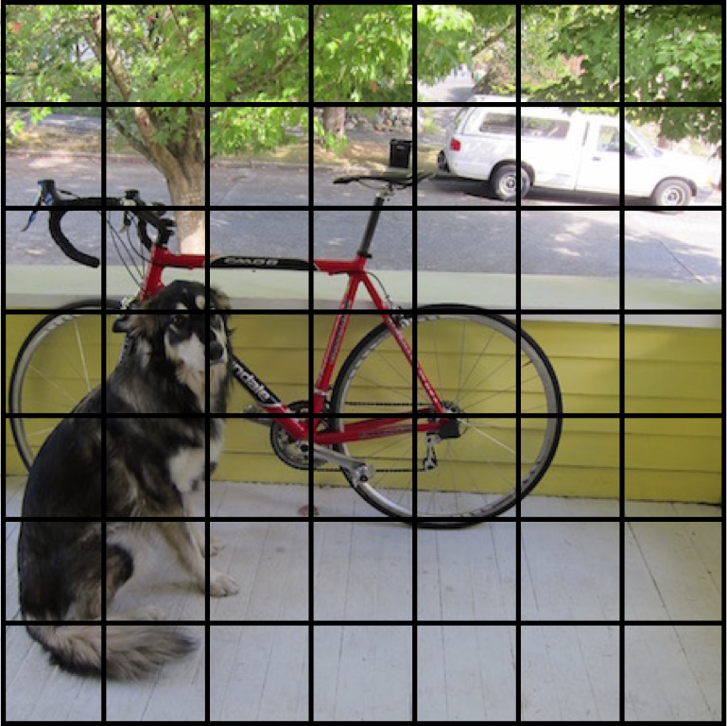
We split the image into a grid

Slide 28
Each cell predicts boxes and confidences: P(Object)

Slide 29
Each cell predicts boxes and confidences: P(Object)

Slide 30
Each cell predicts boxes and confidences: P(Object)

Slide 31
Each cell predicts boxes and confidences: P(Object)

Slide 32
Each cell predicts boxes and confidences: P(Object)

Slide 33
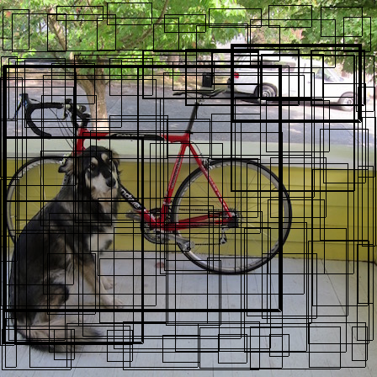
Each cell predicts boxes and confidences: P(Object)

Slide 34
Each cell also predicts a class probability.

Slide 35
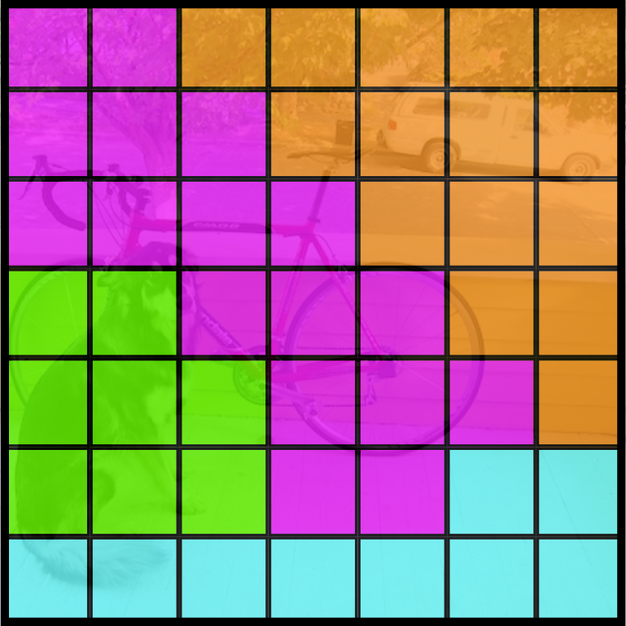
Each cell also predicts a class probability.
Bicycle
Car
Dog
Dining Table

Slide 36
Conditioned on object: P(Car | Object)
Bicycle
Car
Dog
Dining Table

Slide 37
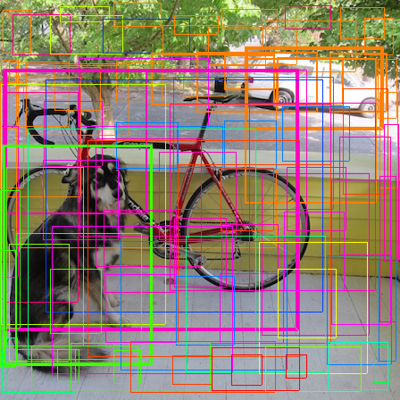
Then we combine the box and class predictions.

Slide 38
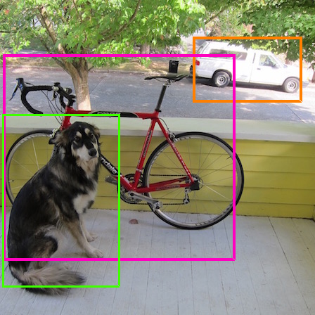
Finally we do NMS and threshold detections

Slide 39
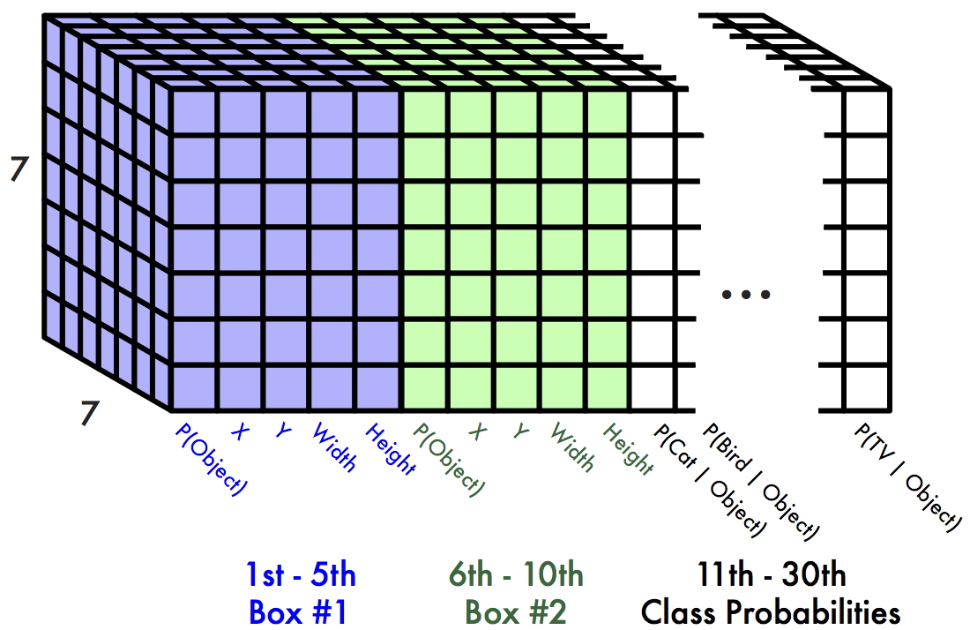
This parameterization fixes the output size
Each cell predicts:
For each bounding box:
4 coordinates (x, y, w, h)
1 confidence value
Some number of class probabilities
For Pascal VOC:
7x7 grid
2 bounding boxes / cell
20 classes
7 x 7 x (2 x 5 + 20) = 7 x 7 x 30 tensor = 1470 outputs

Slide 40
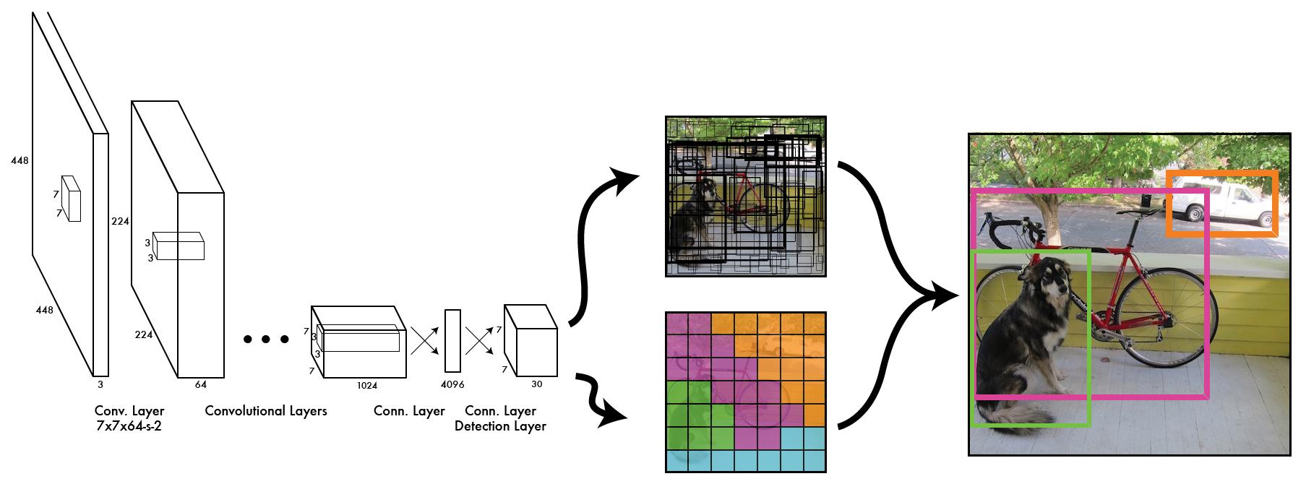
Thus we can train one neural network to be a whole detection pipeline

Slide 41
During training, match example to the right cell

Slide 42
During training, match example to the right cell

Slide 43
Adjust that cell’s class prediction
Dog = 1
Cat = 0
Bike = 0
...

Slide 44
Look at that cell’s predicted boxes

Slide 45
Find the best one, adjust it, increase the confidence

Slide 46
Find the best one, adjust it, increase the confidence

Slide 47
Find the best one, adjust it, increase the confidence

Slide 48
Decrease the confidence of other boxes

Slide 49
Decrease the confidence of other boxes

Slide 50
Some cells don’t have any ground truth detections!

Slide 51
Some cells don’t have any ground truth detections!

Slide 52
Decrease the confidence of these boxes

Slide 53
Decrease the confidence of these boxes

Slide 54
Don’t adjust the class probabilities or coordinates

Slide 55
We train with standard tricks:
Pretraining on Imagenet
SGD with decreasing learning rate
Extensive data augmentation
For details, see the paper

Slide 56
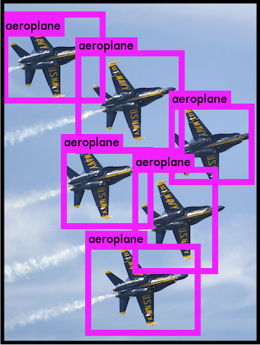
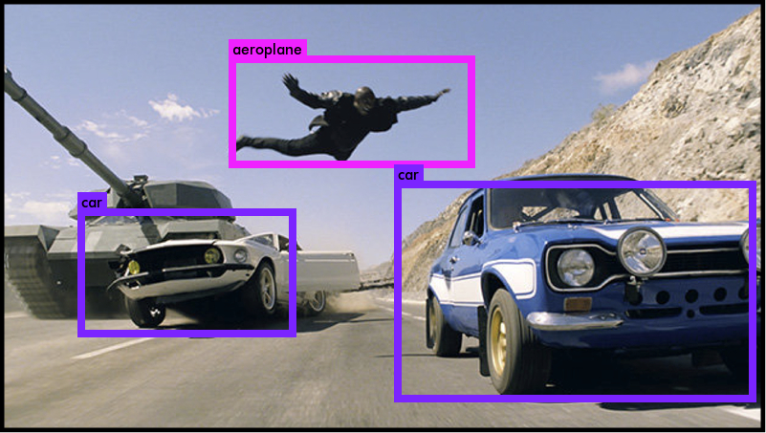
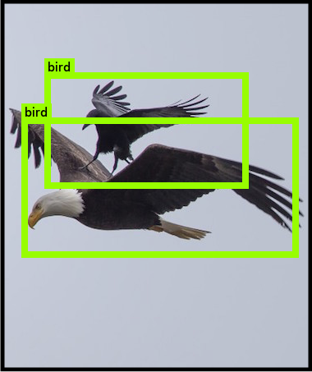
YOLO works across a variety of natural images

Slide 57
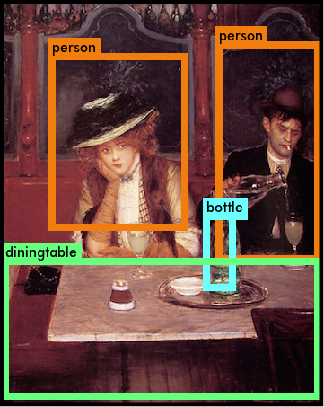
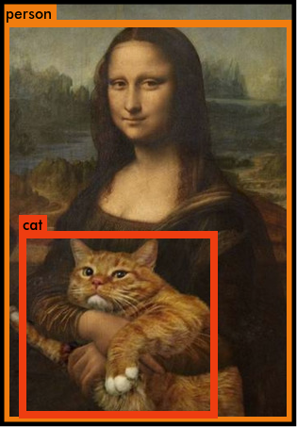
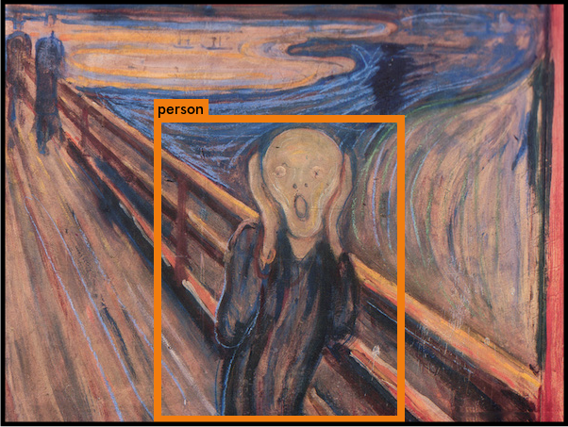
It also generalizes well to new domains (like art)

Slide 58
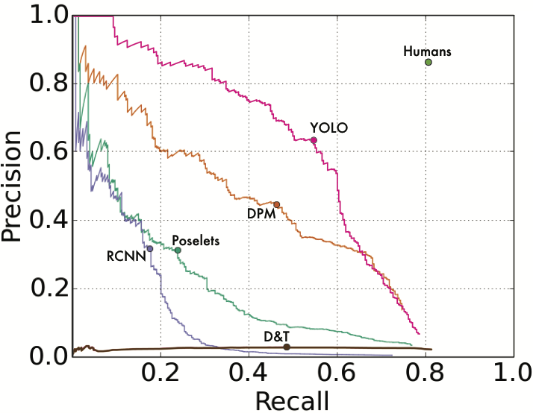
YOLO outperforms methods like DPM and R-CNN when generalizing to person detection in artwork
S. Ginosar, D. Haas, T. Brown, and J. Malik. Detecting people in cubist art. In Computer Vision-ECCV 2014 Workshops, pages 101–116. Springer, 2014.
H. Cai, Q. Wu, T. Corradi, and P. Hall. The cross-depiction problem: Computer vision algorithms for recognising objects in artwork and in photographs.

Slide 59
Code available! pjreddie.com/yolo
 | Pascal 2007 mAP | Speed
DPM v5 | 33.7 | .07 FPS | 14 s/img
R-CNN | 66.0 | .05 FPS | 20 s/img
Fast R-CNN | 70.0 | .5 FPS | 2 s/img
Faster R-CNN | 73.2 | 7 FPS | 140 ms/img
YOLO | 69.0 | 45 FPS | 22 ms/img

Slide 60
YOLO (V1) Summary
Simple way to detect objects. The problem of arbitrary cardinality output with continuous positioning is solved by having a bounded, fixed, output (7x7 grid of outputs, with at most 2 boxes per grid cell)
Works well on PASCAL VOC. Doesn’t work well on MS COCO or crowded scenes.
There are a string of works following the original YOLO with various improvements.

Slide 62
 | Pascal 2007 mAP | Speed
DPM v5 | 33.7 | .07 FPS | 14 s/img
R-CNN | 66.0 | .05 FPS | 20 s/img
Fast R-CNN | 70.0 | .5 FPS | 2 s/img
Faster R-CNN | 73.2 | 7 FPS | 140 ms/img
YOLO | 63.4 | 45 FPS | 22 ms/img

Slide 63
 | Pascal 2007 mAP | Speed
DPM v5 | 33.7 | .07 FPS | 14 s/img
R-CNN | 66.0 | .05 FPS | 20 s/img
Fast R-CNN | 70.0 | .5 FPS | 2 s/img
Faster R-CNN | 73.2 | 7 FPS | 140 ms/img
YOLO | 63.4 | 45 FPS | 22 ms/img

Slide 64
 | Pascal 2007 mAP | Speed
DPM v5 | 33.7 | .07 FPS | 14 s/img
R-CNN | 66.0 | .05 FPS | 20 s/img
Fast R-CNN | 70.0 | .5 FPS | 2 s/img
Faster R-CNN | 73.2 | 7 FPS | 140 ms/img
YOLO | 63.4 | 45 FPS | 22 ms/img

Slide 65
Train on ImageNet
Resize network
Fine-tune on detection

Slide 66
Fine-tune 448x448 Classifier: +3.5% mAP
Train on ImageNet
Resize, fine-tune
on ImageNet
Fine-tune on detection

Slide 67
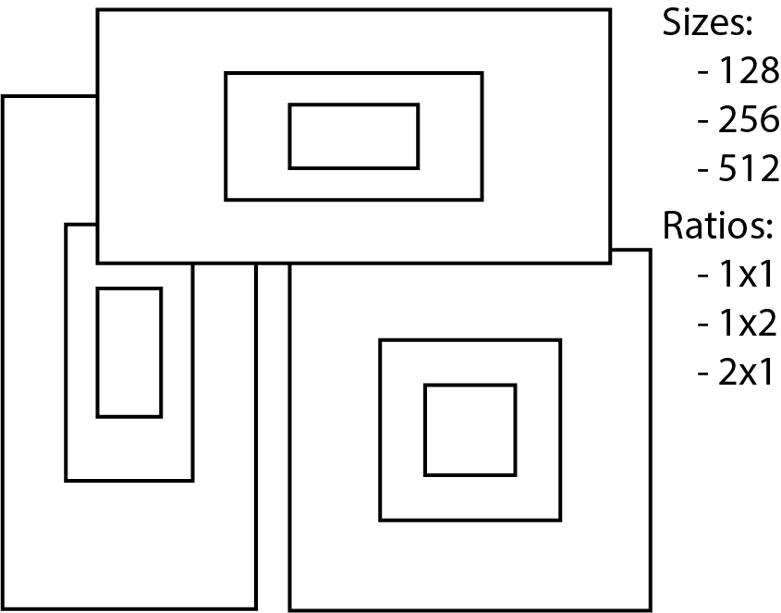
Anchor boxes use static initialization

Slide 68
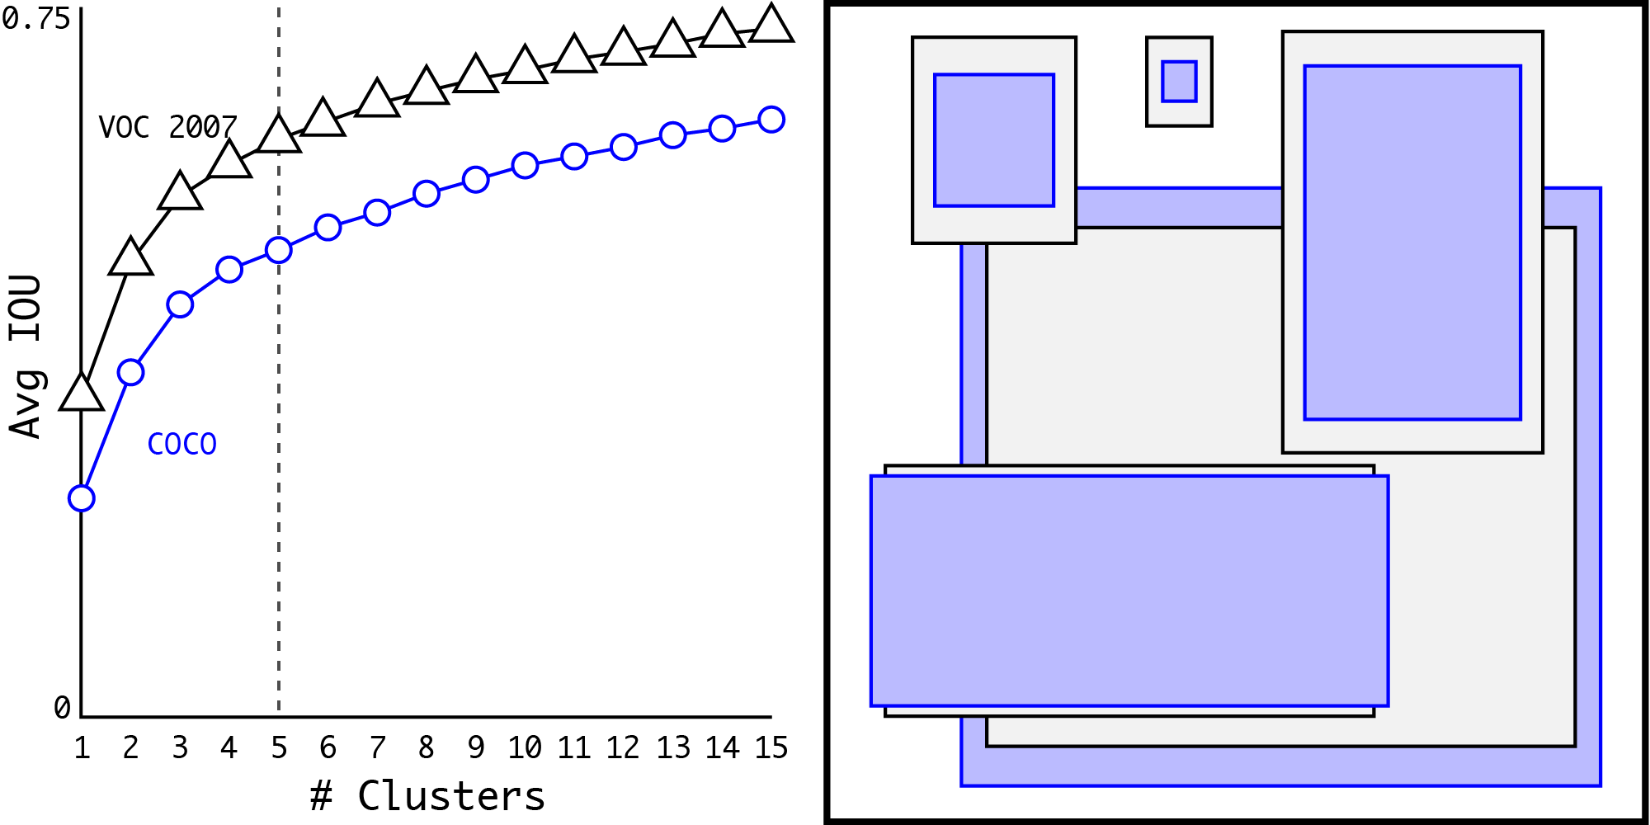
We use k-means to find better initializations

Slide 69
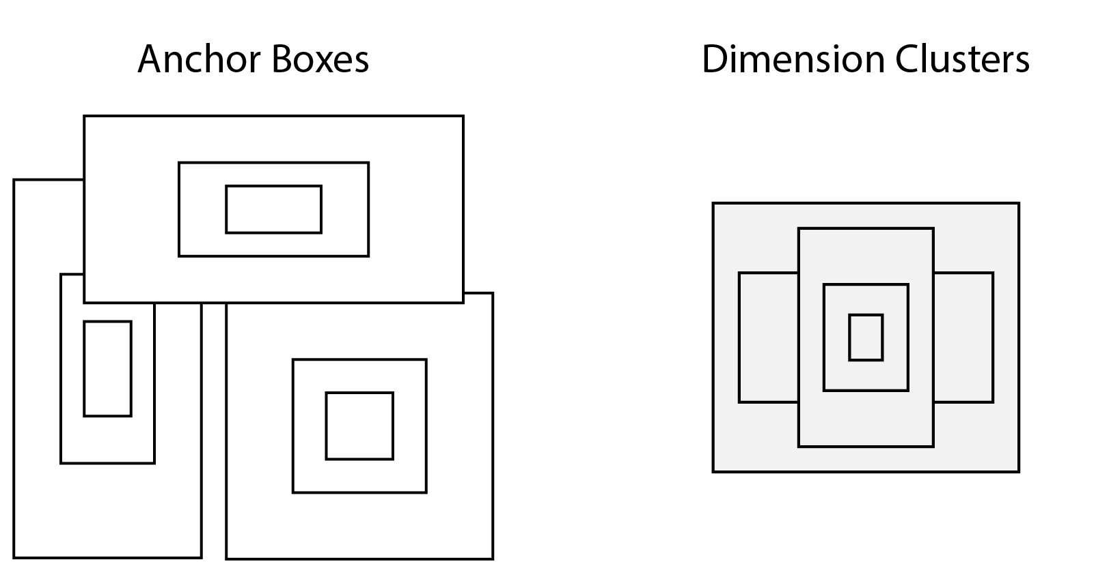

Slide 70
Dimension Clusters: +5% mAP

Slide 71
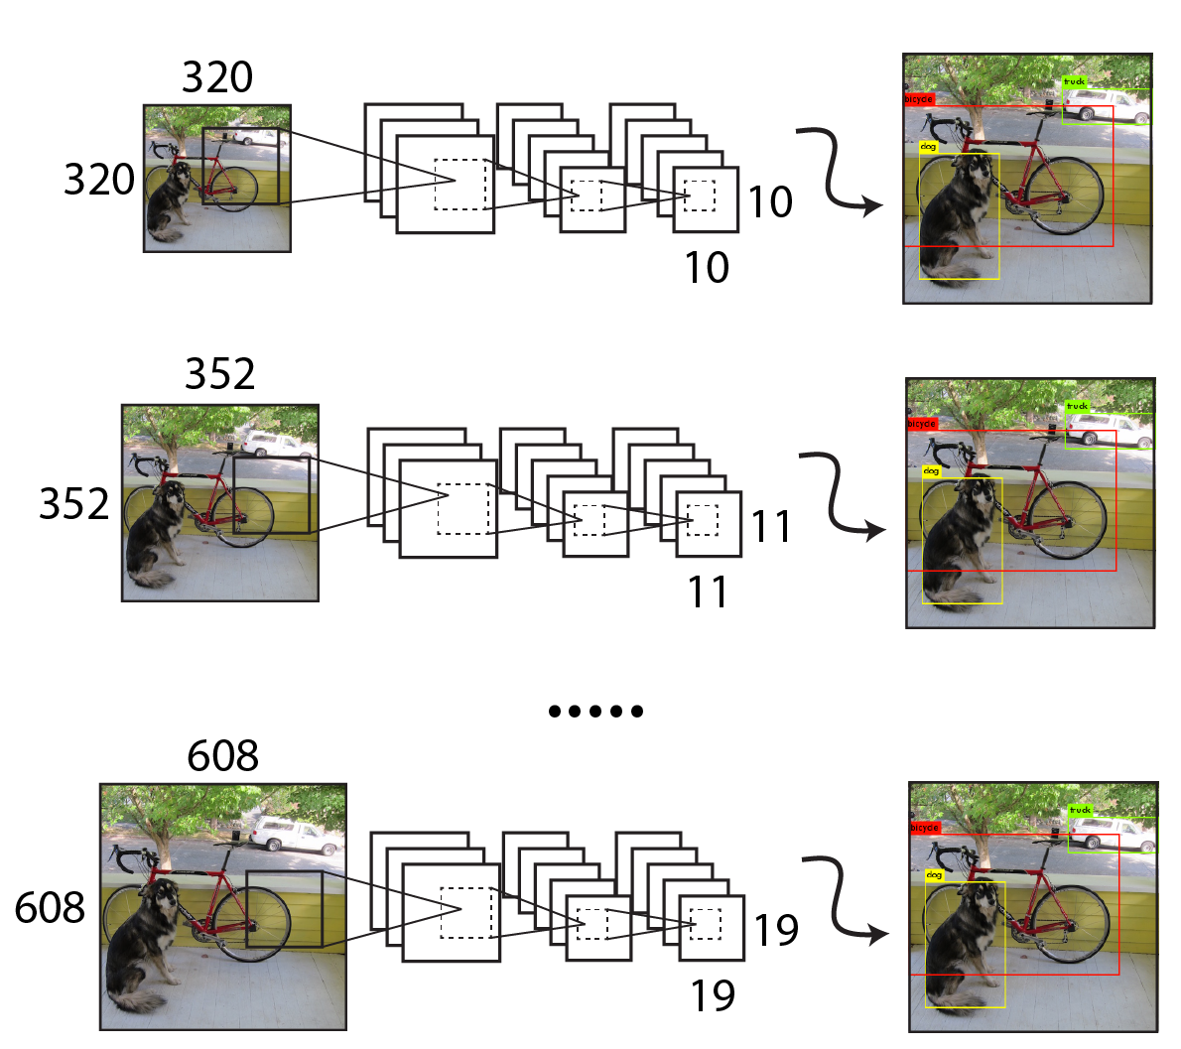
Multi-scale training: +1.5% mAP

Slide 72
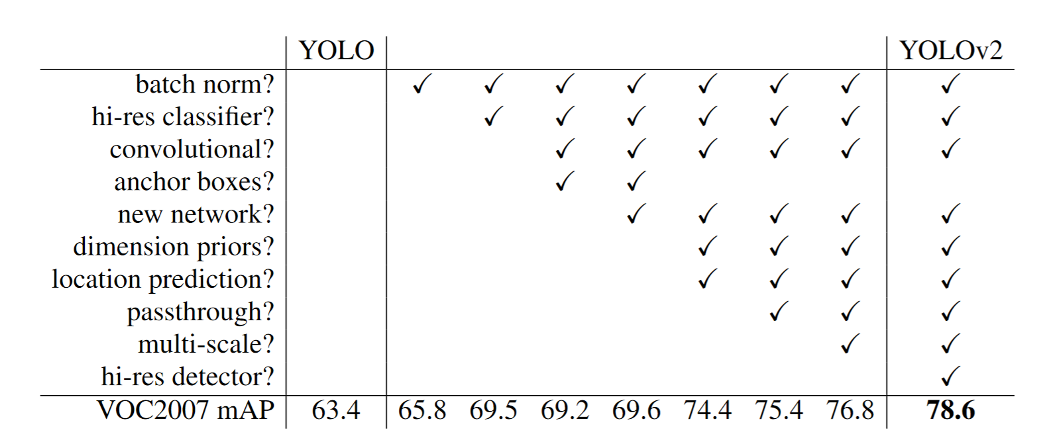
Ablations

Slide 73
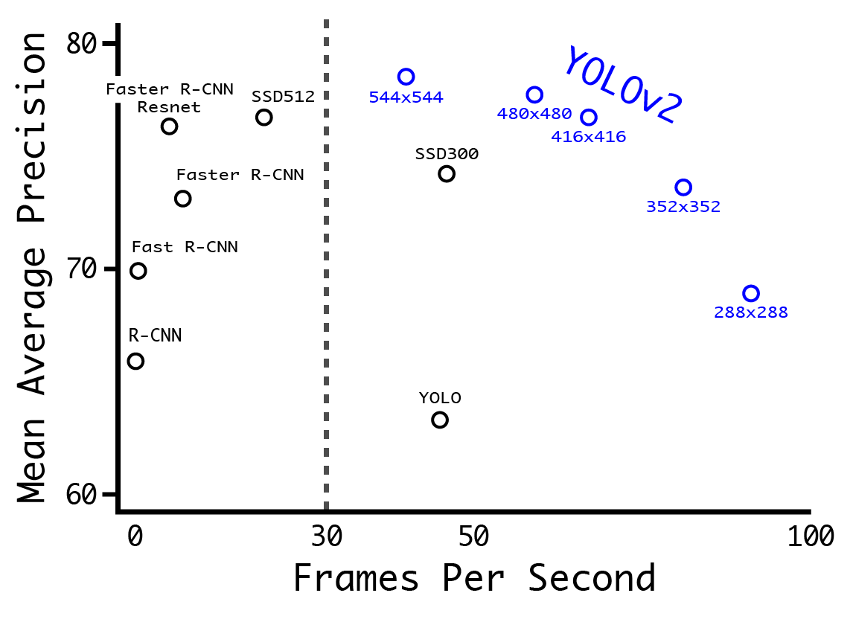
YOLOv2: Fast, Accurate Detection

Slide 74
COCO dataset performance

Slide 75
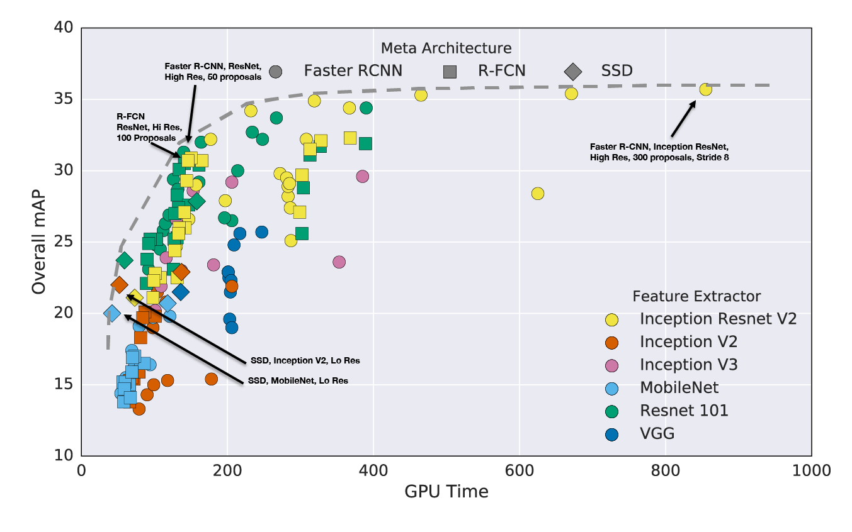
Huang, Jonathan, et al. "Speed/accuracy trade-offs for modern convolutional object detectors." arXiv preprint arXiv:1611.10012 (2016).

Slide 76
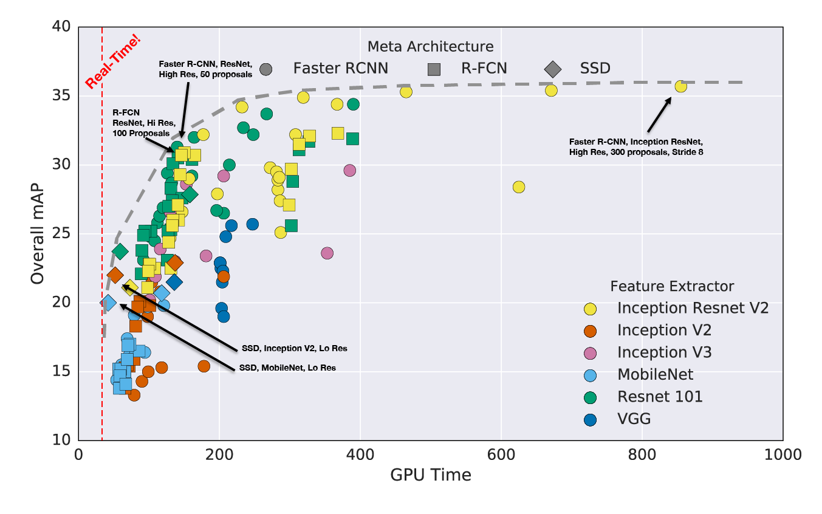
Huang, Jonathan, et al. "Speed/accuracy trade-offs for modern convolutional object detectors." arXiv preprint arXiv:1611.10012 (2016).

Slide 77
YOLOv2
Huang, Jonathan, et al. "Speed/accuracy trade-offs for modern convolutional object detectors." arXiv preprint arXiv:1611.10012 (2016).

Slide 78
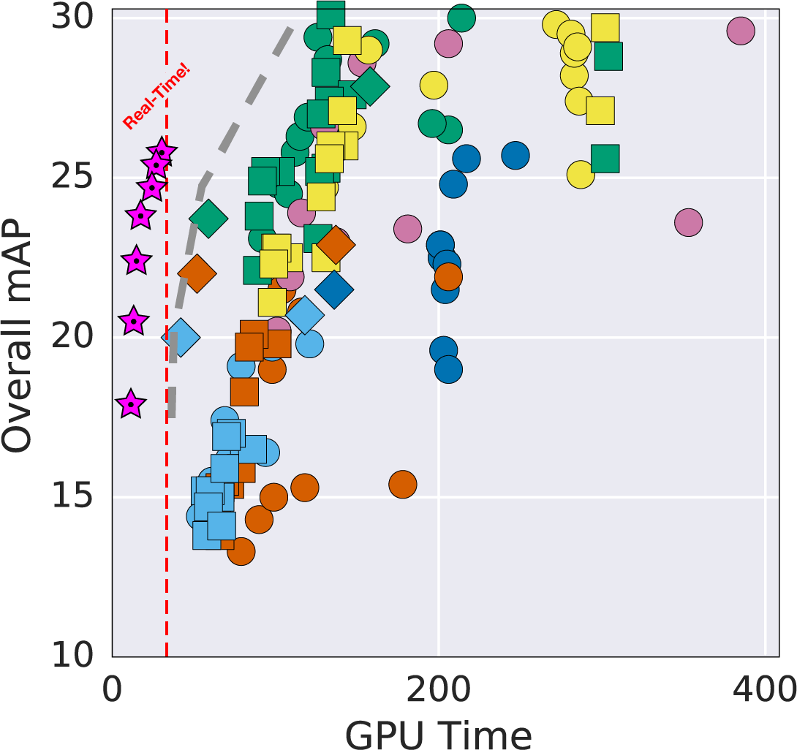

Slide 79
Speed is not just parameter counts or FLOPs
 | Top 1 | Top 5 | FLOPs | GPU Speed
VGG-16 | 70.5 | 90.0 | 30.95 Bn | 100 FPS
Extraction (YOLOv1) | 72.5 | 90.8 | 8.52 Bn | 180 FPS
Resnet50 | 75.3 | 92.2 | 7.66 Bn | 90 FPS

Slide 80
Darknet19: A good balance of speed and accuracy
 | Top 1 | Top 5 | FLOPs | GPU Speed
VGG-16 | 70.5 | 90.0 | 30.95 Bn | 100 FPS
Extraction (YOLOv1) | 72.5 | 90.8 | 8.52 Bn | 180 FPS
Resnet50 | 75.3 | 92.2 | 7.66 Bn | 90 FPS
Darknet19 | 74.0 | 91.8 | 5.58 Bn | 200 FPS

Slide 81
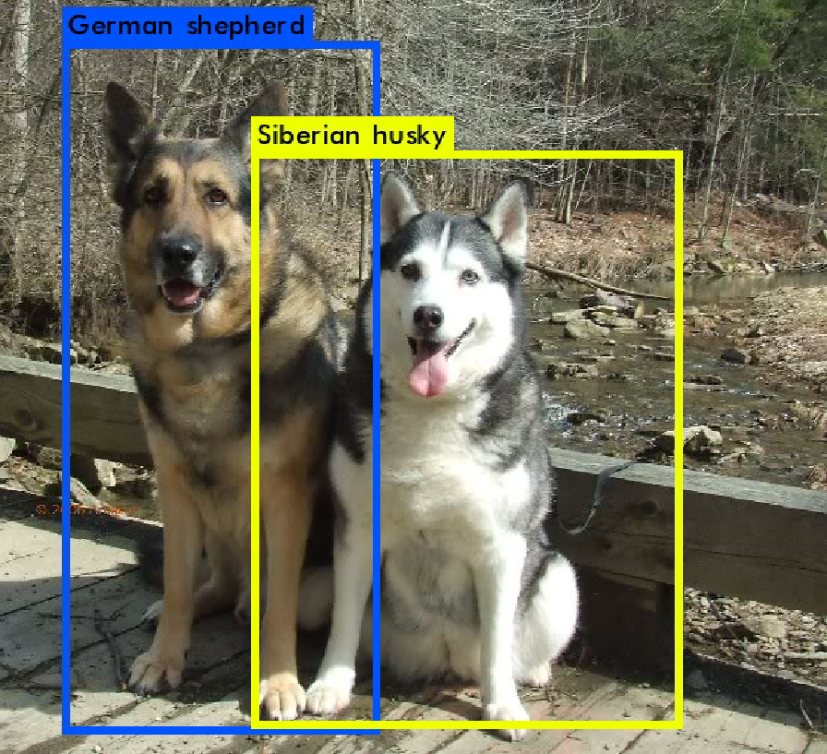

Slide 82
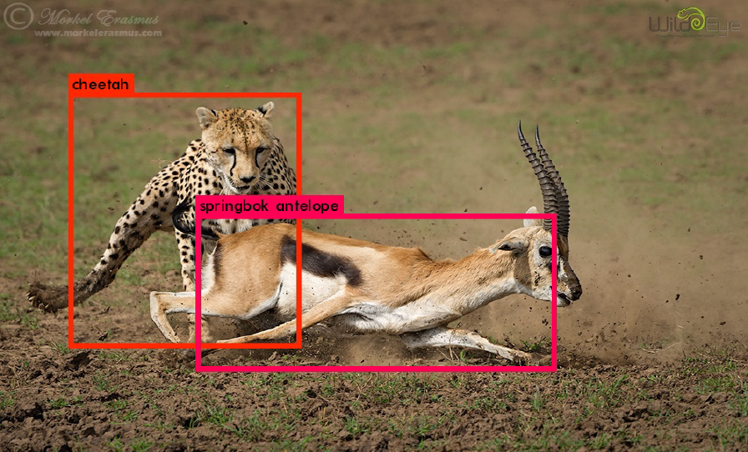

Slide 83
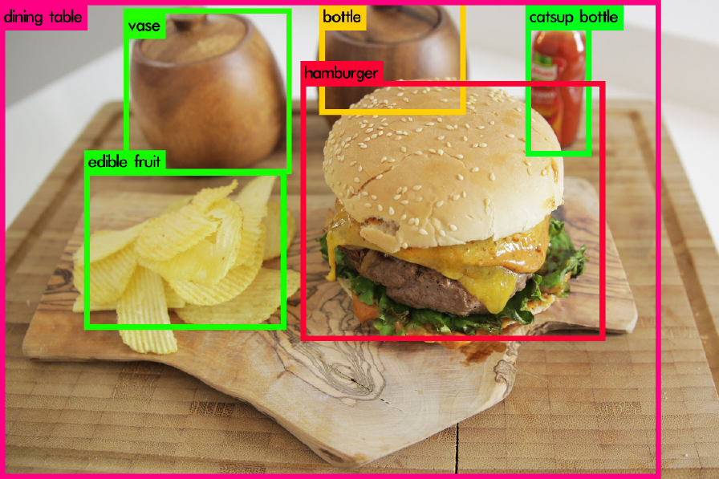

Slide 84
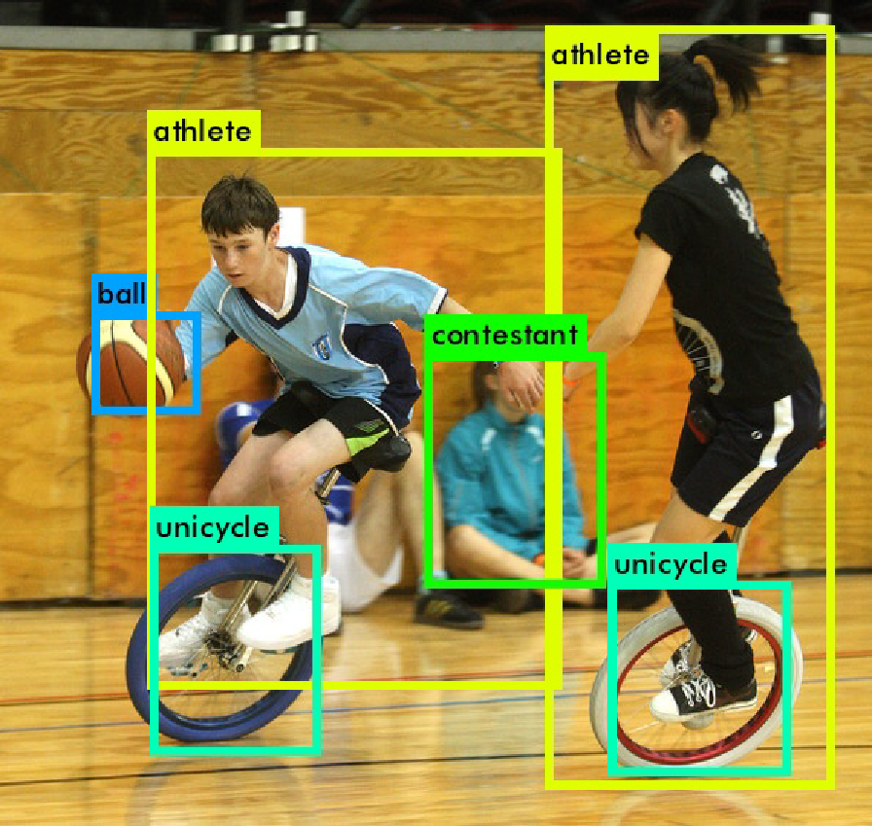

Slide 85
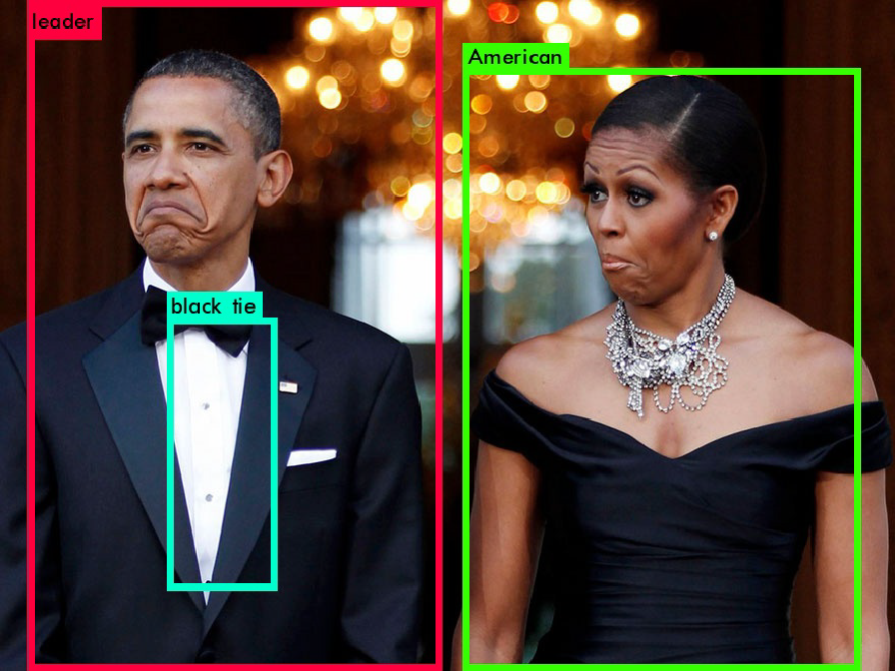

Slide 86
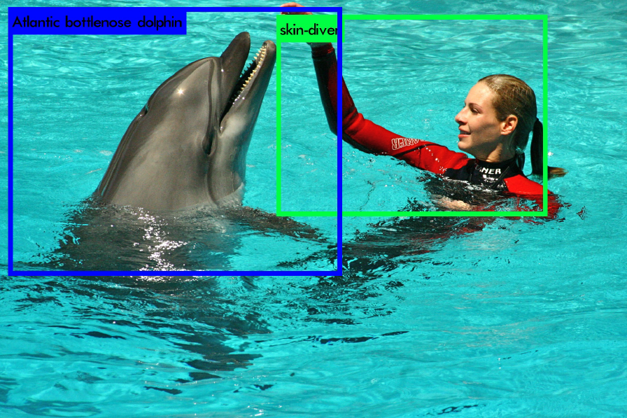

Slide 87
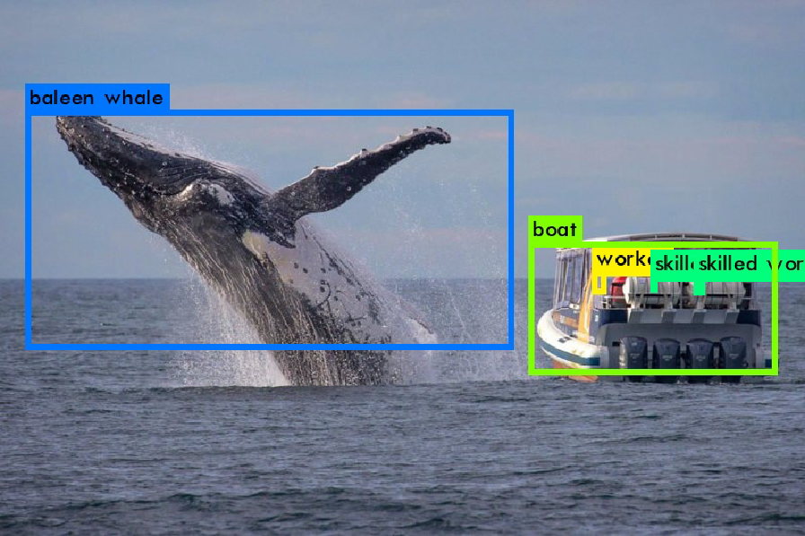

Slide 88
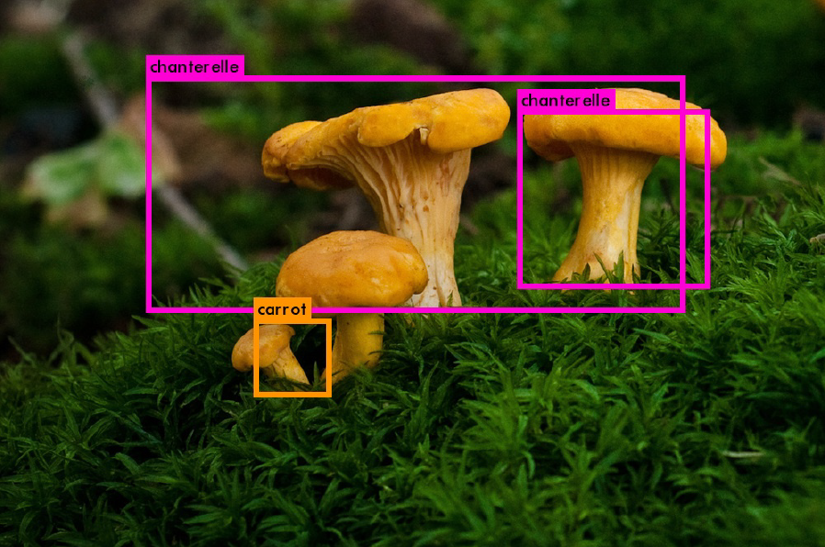

Slide 89
Outline – More complex outputs from deep networks
Image Output (e.g. colorization, semantic segmentation, super-resolution, stylization, depth estimation…)
Attributes
Text Captions
Semantic Keypoints
Object Detection
“Single shot” or “one stage” detectors like YOLO or SSD. The network runs once per image.
“Two stage” detectors like Mask RCNN. A feature extractor network runs once per image, various “head” networks run an arbitrary amount of times.

Slide 90
Mask R-CNN
ICCV 2017
Kaiming He
Georgia Gkioxari, Piotr Dollár, and Ross Girshick Facebook AI Research (FAIR)

Slide 91
Visual Perception Problems
Person 4
Person 5
Person 1
Person
Person 2
Person 3
Object Detection
Semantic Segmentation
Instance Segmentation
?
✓
✓

Slide 92
A Challenging Problem...
# entries on COCO leaderboard
31
# entries on Cityscapes leaderboard
58
5
11
Object Det.
Instance Seg.
Semantic Seg.
Instance Seg.

Slide 93
Object Detection
Fast/Faster R-CNN
Good speed
Good accuracy
Intuitive
Easy to use
Ross Girshick. “Fast R-CNN”. ICCV 2015. Shaoqing Ren, Kaiming He, Ross Girshick, & Jian Sun. “Faster R-CNN: Towards Real-Time Object Detection with Region Proposal Networks”. NIPS 2015.

Slide 94
Semantic Segmentation
Fully Convolutional Net (FCN)
Good speed
Good accuracy
Intuitive
Easy to use
Figure credit: Long et al
Jonathan Long, Evan Shelhamer, & Trevor Darrell. “Fully Convolutional Networks for Semantic Segmentation”. CVPR 2015.

Slide 95
Instance Segmentation
Goals of Mask R-CNN
Good speed
Good accuracy
Intuitive
Easy to use

Slide 96
Instance Segmentation Methods
R-CNN driven FCN driven
?
?
?
?
person
?
(proposals)
Person 4
Person 5
Person 4
Person 5
Person 1
Person 1
Person 2
Person 3
Person 2
Person 3

Slide 97
Instance Segmentation Methods
?
?
?
Person
?
?
Person 4
Person 3
SDS [Hariharan et al, ECCV’14]
HyperCol [Hariharan et al, CVPR’15]
CFM [Dai et al, CVPR’15]
MNC [Dai et al, CVPR’16]
Person 4
Person 3
Person 1
Person 2
Person 5
Person 1
Person 2
Person 5
RCNN-driven
PFN [Liang et al, arXiv’15]
FCN-driven
InstanceCut [Kirillov et al, CVPR’17]
Watershed [Bai & Urtasun, CVPR’17]
FCIS [Li et al, CVPR’17]
DIN [Arnab & Torr, CVPR’17]

Slide 98
Mask R-CNN
Mask R-CNN = Faster R-CNN with FCN on RoIs
Faster R-CNN
FCN on RoI

Slide 99
Parallel Heads
Easy, fast to implement and train
cls
cls
step1 cls
bbox reg
Feat.
step2 bbox reg
Feat.
Feat.
bbox reg
mask
(slow) R-CNN
Fast/er R-CNN
Mask R-CNN

Slide 100
A Perspective on Equivariance

Slide 101
How can we draw the Apple logo?

Slide 102
How can we draw the Apple logo?
figure source: http://mymodernmet.com/famous-company-logos-memory/

Slide 103
How can we draw the Apple logo?
ground truth
figure source: http://mymodernmet.com/famous-company-logos-memory/

Slide 104
What is given?
What can be drawn?
memory
+
apple, with a bite
blank paper
+
apple, with a bite on the right, a leaf on top
ground truth seen
blank paper
THE apple logo,
pixel-to-pixel aligned
ground truth reference on paper

Slide 105
Invariance vs. Equivariance
“apple”
“apple”
translation-equivariant
“apple, bite on right”
“apple, bite on right”
scale-equivariant
see also “What is wrong with convolutional neural nets?”, Geoffrey Hinton, 2017

Slide 106
Invariance vs. Equivariance
Equivariance: changes in input lead to corresponding changes in output
Classification desires invariant representations: output a label
Instance Seg. desires equivariant representations:
Translated object => translated mask
Scaled object => scaled mask
Big and small objects are equally important (due to AP metric)
unlike semantic seg. (counting pixels)

Slide 107
Invariance vs. Equivariance
Convolutions are translation-equivariant
Fully-ConvNet (FCN) is translation-equivariant
ConvNet becomes translation-invariant due to fully-connected or global pool layers

Slide 108
Equivariance in Mask R-CNN
1. Fully-Conv Features:
equivariant to global (image) translation

Slide 109
Equivariance in Mask R-CNN
2. Fully-Conv on RoI:
equivariant to translation within RoI

Slide 110
Fully-Conv on RoI
target masks on RoIs
Translation of object in RoI => Same translation of mask in RoI
Equivariant to small translation of RoIs
More robust to RoI’s localization imperfection

Slide 111
Equivariance in Mask R-CNN
3. RoIAlign:
3a. maintain translation-equivariance before/after RoI

Slide 112
FAQs: how to sample grid points within a cell?
RoIAlign
4 regular points in 2x2 sub-cells
other implementation could work
conv feat. map
(Fixed dimensional representation)
Grid points of bilinear interpolation
RoIAlign output
(Variable size RoI)

Slide 113
RoIAlign vs. RoIPool
see also “What is wrong with convolutional neural nets?”, Geoffrey Hinton, 2017
RoIPool breaks pixel-to-pixel translation-equivariance
😖
😖
 | ori |  |  | ginal Ro
 |  |  |  |  |  | I
RoIPool coordinate
quantization
quant
ized RoI
😖

Slide 114
Equivariance in Mask R-CNN
3. RoIAlign:
3b. Scale-equivariant (and aspect-ratio-equivariant)

Slide 115
RoIAlign: Scale-Equivariance
normalized w.r.t RoI,
invariant representations
RoI
RoI
RoI
image
RoIAlign
output
RoIAlign creates scale-invariant representations
RoIAlign + “output pasted back” provides scale-equivariance

Slide 116
More about Scale-Equivariance: FPN
FPN
RoIAlign is scale-invariant if on raw pixels:
• = (slow) R-CNN: crops and warps RoIs
RoIAlign is scale-invariant if on scale-invariant feature maps
Feature Pyramid Network (FPN) [Lin et al. CVPR’17]
creates approx. scale-invariant features

Slide 117
Equivariance in Mask R-CNN: Summary
Translation-equivariant
FCN features
FCN mask head
RoIAlign (pixel-to-pixel behavior)
Scale-equivariant (and aspect-ratio-equivariant)
RoIAlign (warping and normalization behavior) + paste-back
FPN features

Slide 118
Instance Seg: When we don’t want equivariance?
A pixel x could have a different label w.r.t. different RoIs
zero-padding in RoI boundary breaks equivariance
outside objects are suppressed
only equivariant to small changes of RoIs (which is desired)

Slide 119
object surrounded by same-category objects
Mask R-CNN results on COCO

Slide 120
Result Analysis

Slide 121
Ablation: RoIPool vs. RoIAlign
baseline: ResNet-50-Conv5 backbone, stride=32
mask AP box AP
huge gain at high IoU, in case of big stride (32)

Slide 122
Ablation: RoIPool vs. RoIAlign
baseline: ResNet-50-Conv5 backbone, stride=32
mask AP box AP
nice box AP without dilation/upsampling

Slide 123
Ablation: Multinomial vs. Binary Masks
cls head: did recognition
baseline: ResNet-50-Conv4 backbone, stride=16
cls
“apple”
bbox reg
Feat.
mask
mask head: no need to recognize again

Slide 124
Ablation: MLP vs. FCN mask
MLP: lose “place-coded” info, too abstract
baseline: ResNet-50-FPN backbone
FCN: translation-equivariant
• +2.1 point

Slide 125
Instance Segmentation Results on COCO
2 AP better than SOTA w/ R101, without bells and whistles
200ms / img

Slide 126
Instance Segmentation Results on COCO
benefit from better features (ResNeXt [Xie et al. CVPR’17])

Slide 127
Object Detection Results on COCO
bbox detection improved by:
RoIAlign

Slide 128
Object Detection Results on COCO
bbox detection improved by:
RoIAlign
Multi-task training w/ mask

Slide 129
disconnected object
Mask R-CNN results on COCO

Slide 130
small objects
Mask R-CNN results on COCO

Slide 131
Mask R-CNN results on CityScapes

Slide 132
Failure case: detection/segmentation
missing
missing, false mask
Mask R-CNN results on COCO

Slide 133
Failure case: recognition
not a kite
Mask R-CNN results on COCO

Slide 134
28x28 soft prediction from Mask R-CNN
(enlarged)
Soft prediction resampled to image coordinates
(bilinear and bicubic interpolation work equally well)
Final prediction (threshold at 0.5)
Validation image with box detection shown in red

Slide 135
28x28 soft prediction
Resized Soft prediction
Final mask
Validation image with box detection shown in red

Slide 136
Mask R-CNN: for Human Keypoint Detection
1 keypoint = 1-hot “mask”
Human pose = 17 masks
Softmax over spatial locations
e.g. 56²-way softmax on 56x56
Desire the same equivariances
translation, scale, aspect ratio

Slide 138
Conclusion
Mask R-CNN
Good speed
Good accuracy
Intuitive
Easy to use
Equivariance matters
Code will be open-sourced as Facebook AI Research’s Detectron platform

Slide 139
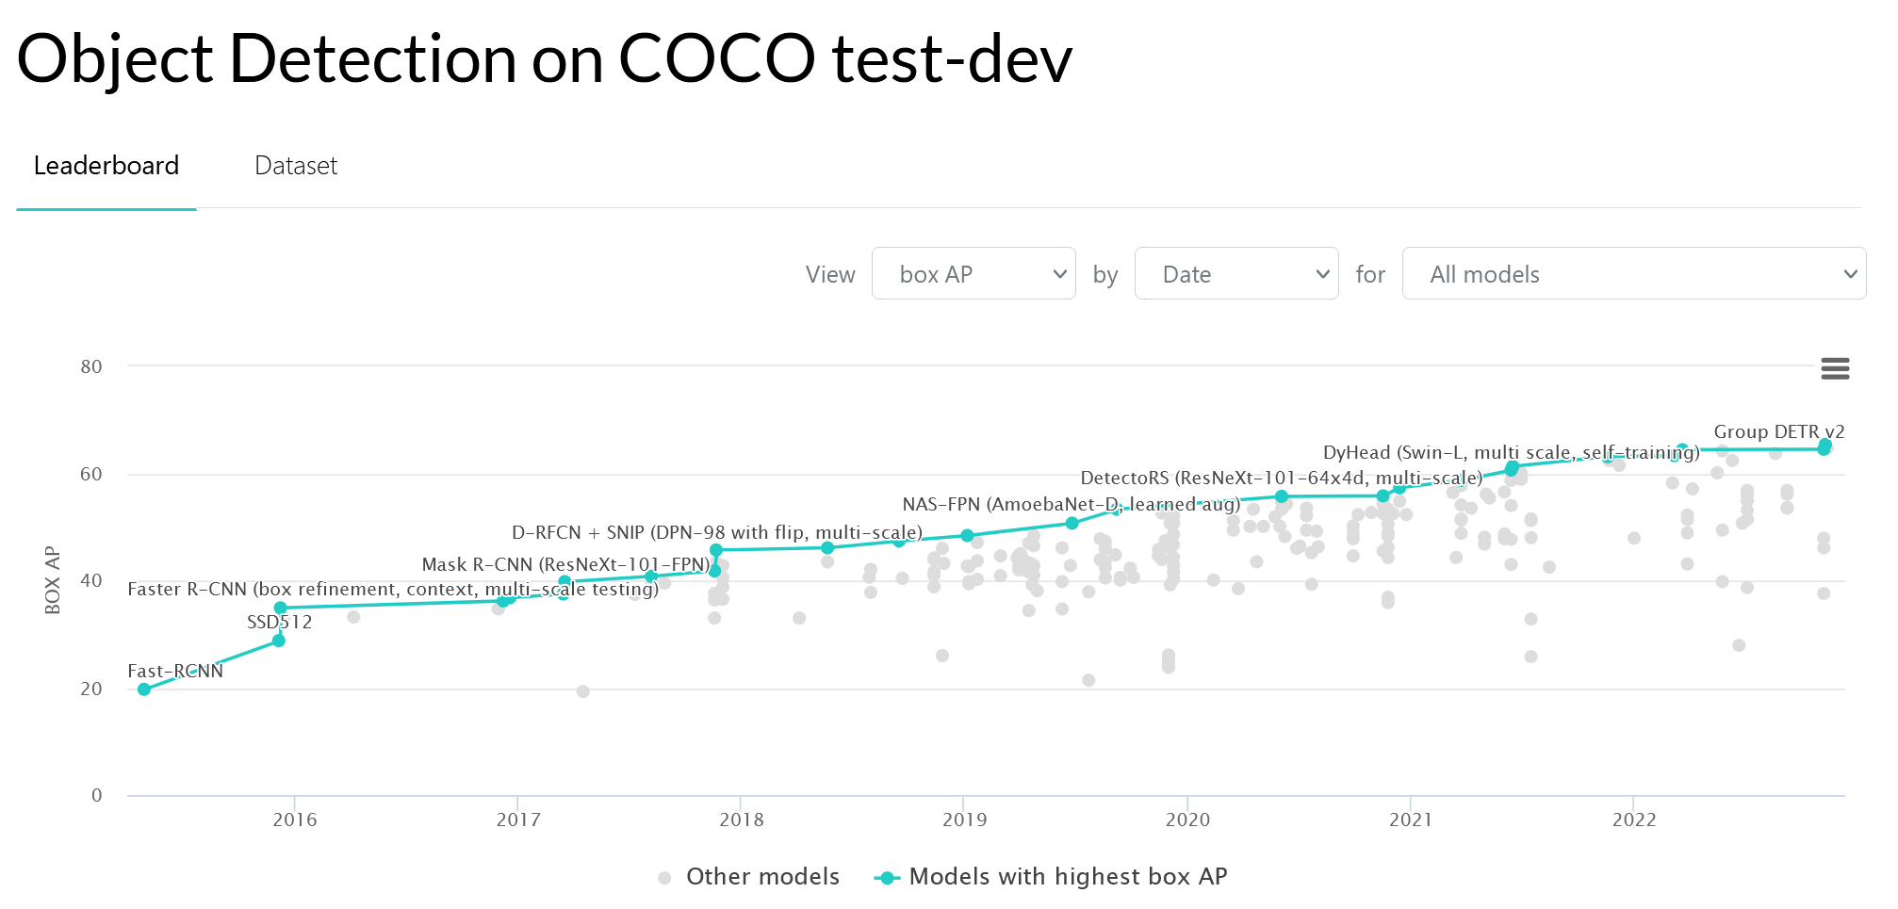
https://paperswithcode.com/sota/object-detection-on-coco

Slide 140
Summary – More complex outputs from deep networks
Image Output (e.g. colorization, semantic segmentation, super-resolution, stylization, depth estimation…)
Attributes
Text Captions
Semantic Keypoints
Object Detection

