Slide 1
3D Point Processing
James Hays

Slide 2
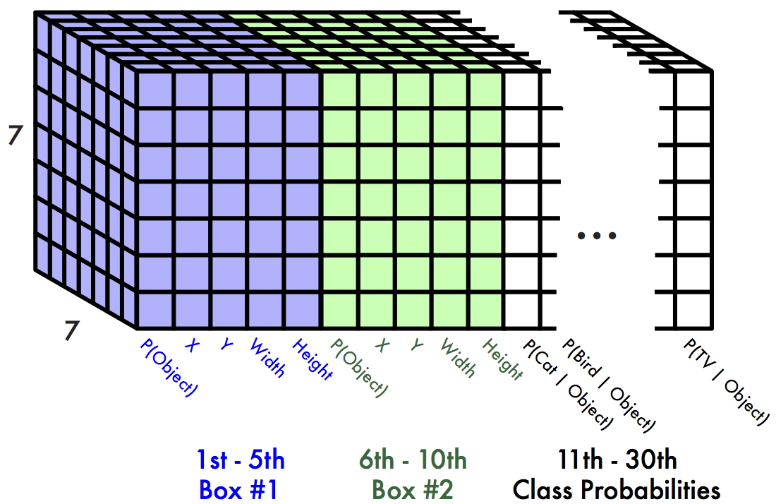
Recap – Structured Output from Deep Networks
Convolutional Pose Machines and follow up works
Mask R-CNN and “two stage” object detectors
YOLO, SSD, and “one stage” object detectors
A lot of machine learning tools, such as convolutional networks, don’t naturally handle tasks with arbitrary numbers of outputs. These are a few clever methods, typical of the literature as a whole, to work around this.

Slide 3
Outline
How do we measure 3D points?
How do we make decisions about point clouds?
PointNet – orderless point processing
VoxelNet – voxel-based point processing
PointPillars – bird’s eye view point processing
Exploiting Visibility for 3D Object Detection
LaserNet – range image point processing
PseudoLidar – Bird’s eye view depth map processing

Slide 4
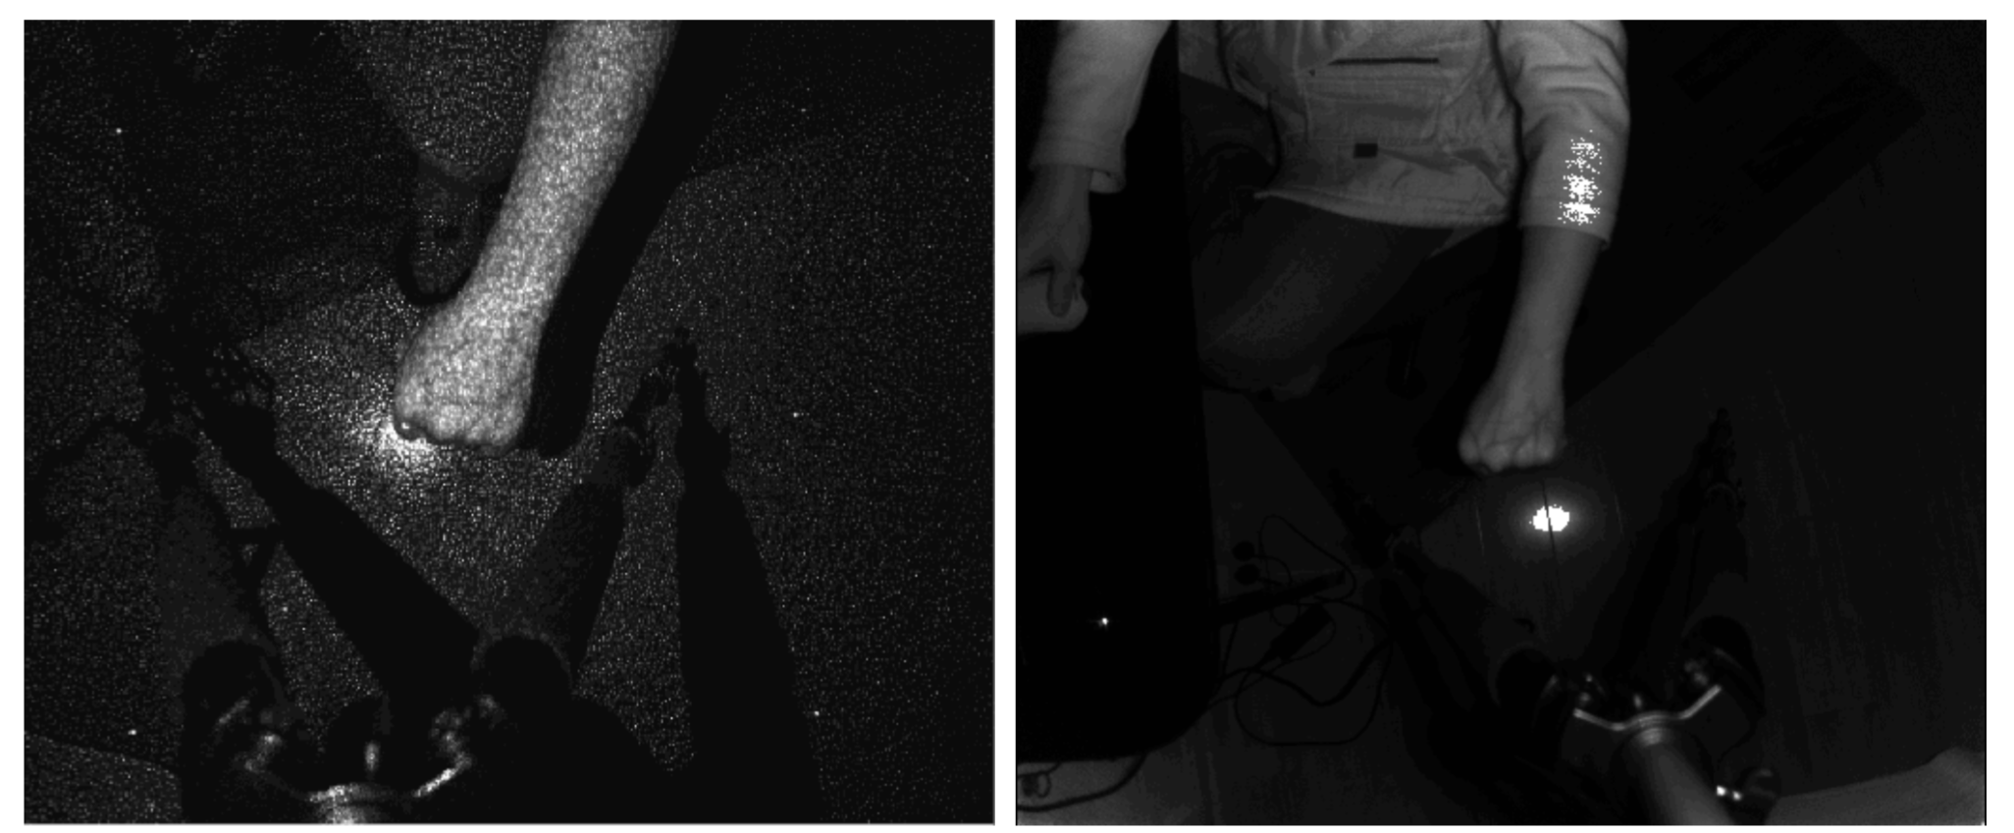
Kinect V1 and V2
Infrared images of Kinect V1 structured light pattern and Kinect V2 time of flight pattern. Credit “Lightweight Algorithms for Depth Sensor Equipped Embedded Devices” by Henry Zhong

Slide 5
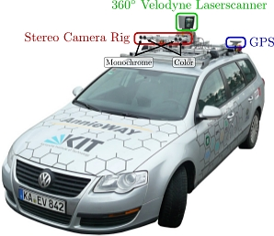
Lidar overview

Slide 6
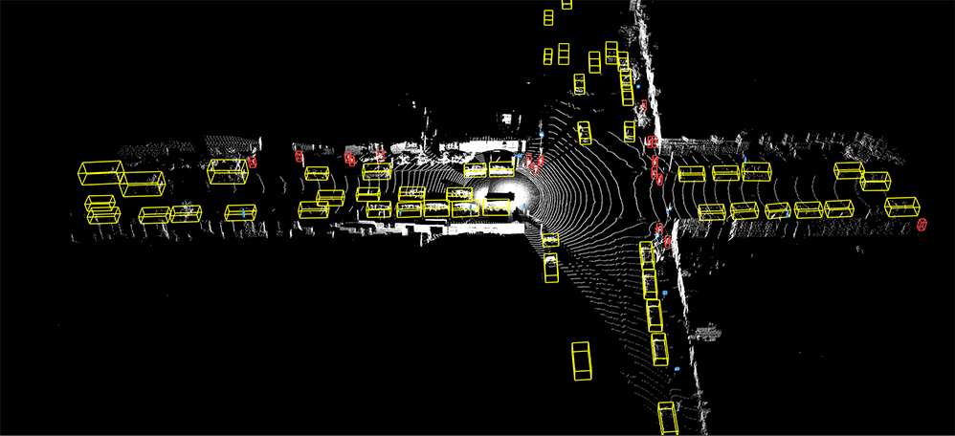
Lidar overview
Source: Waymo Open Dataset

Slide 7
State of the art lidar

Slide 8
Outline
What is lidar?
How do we make decisions about point clouds?
PointNet – orderless point processing
VoxelNet – voxel-based point processing
PointPillars – bird’s eye view point processing
Exploiting Visibility for 3D Object Detection
LaserNet – range image point processing
PseudoLidar – Bird’s eye view depth map processing

Slide 9
PointNet: Deep Learning on Point Sets for 3D Classification and Segmentation
Charles R. Qi* Hao Su* Kaichun Mo Leonidas J. Guibas

Slide 10
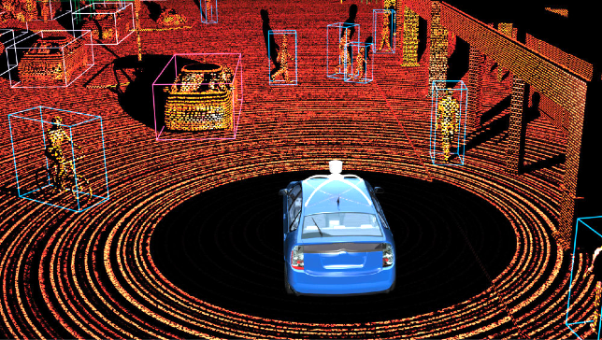
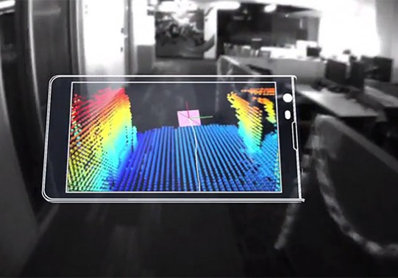
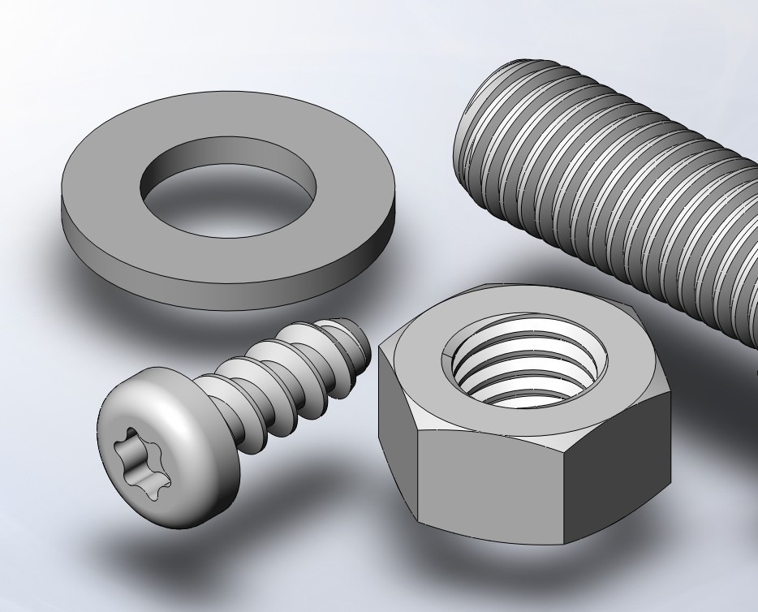
Big Data + Deep Representation Learning
Robot Perception Augmented Reality Shape Design
source: Scott J Grunewald
source: Google Tango
source: solidsolutions
Need for 3D Deep Learning!

Slide 11
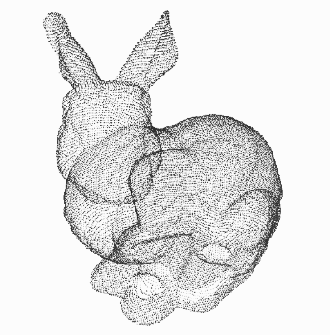
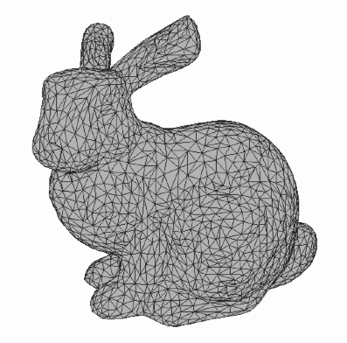
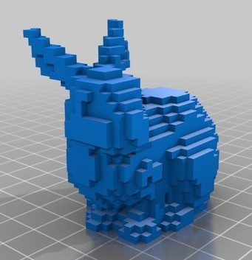
3D Representations
…
Point Cloud
Mesh
Volumetric
Projected View RGB(D)

Slide 12
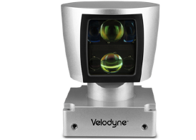
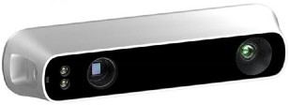
3D Representation: Point Cloud
Point cloud is close to raw sensor data
LiDAR
Point Cloud
Depth Sensor

Slide 13
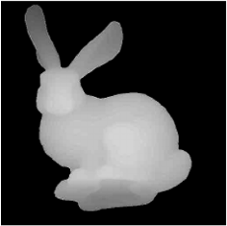
3D Representation: Point Cloud
Point cloud is close to raw sensor data
Point cloud is canonical
Mesh
LiDAR
Volumetric
Point Cloud
Depth Sensor
Depth Map

Slide 14
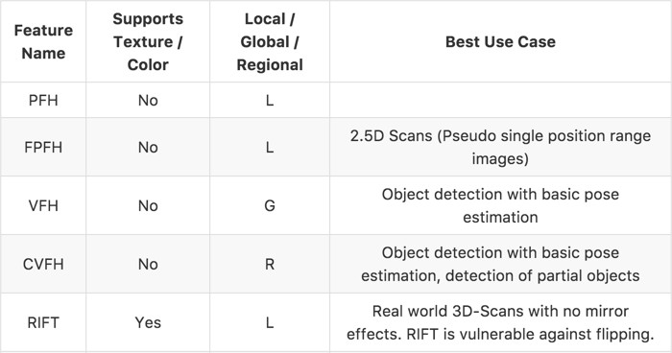
Previous Works
Most existing point cloud features are handcrafted
towards specific tasks
Source: https://github.com/PointCloudLibrary/pcl/wiki/Overview-and-Comparison-of-Features

Slide 15
Previous Works
Point cloud is converted to other representations
before it’s fed to a deep neural network
Conversion | Deep Net
Voxelization | 3D CNN
Projection/Rendering | 2D CNN
Feature extraction | Fully Connected

Slide 16
Research Question:
Can we achieve effective feature learning directly on point clouds?

Slide 17
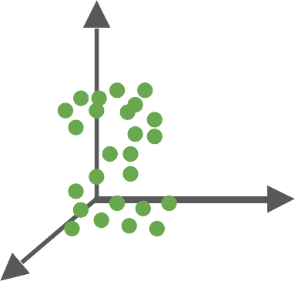
Our Work: PointNet
End-to-end learning for scattered, unordered point data
PointNet

Slide 18
Our Work: PointNet
End-to-end learning for scattered, unordered point data
Unified framework for various tasks
Object Classification
PointNet
Object Part Segmentation
Semantic Scene Parsing
...

Slide 19
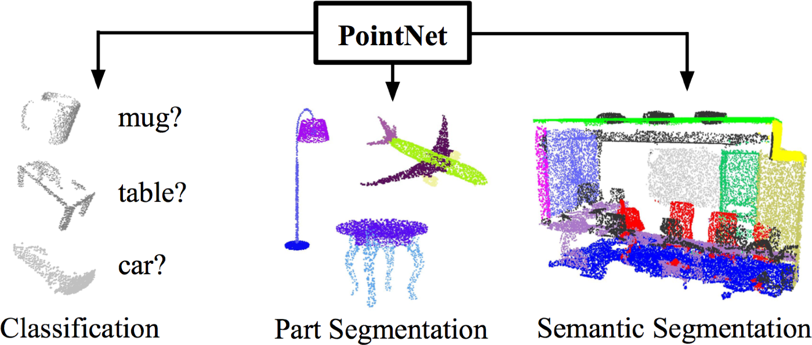
Our Work: PointNet
End-to-end learning for scattered, unordered point data
Unified framework for various tasks

Slide 20
Challenges
Unordered point set as input
Model needs to be invariant to N! permutations.
Invariance under geometric transformations
Point cloud rotations should not alter classification results.

Slide 21
Challenges
Unordered point set as input
Model needs to be invariant to N! permutations.
Invariance under geometric transformations
Point cloud rotations should not alter classification results.

Slide 22
Unordered Input
Point cloud: N orderless points, each represented by a D dim vector
D
N

Slide 23
Unordered Input
Point cloud: N orderless points, each represented by a D dim vector
D
D
N
represents the same set as
N

Slide 24
Unordered Input
Point cloud: N orderless points, each represented by a D dim vector
D
D
N
represents the same set as
N
Model needs to be invariant to N! permutations

Slide 25
Permutation Invariance: Symmetric Function
f (x₁, x₂ ,…, x_{n} ) ≡ f (x_{π}
1
, x_{π} ,…, x_{π} ), x ∈
2 n
D
R
i

Slide 26
Permutation Invariance: Symmetric Function
f (x₁, x₂ ,…, x_{n} ) ≡ f (x_{π}
1
, x_{π} ,…, x_{π} ), x ∈
2 n
D
R
i
Examples:
f (x₁, x₂ ,…, x_{n} ) = max{x₁, x₂ ,…, x_{n} }
f (x₁, x₂ ,…, x_{n} ) = x₁ + x₂ +…+ x_{n}
…

Slide 27
Permutation Invariance: Symmetric Function
f (x₁, x₂ ,…, x_{n} ) ≡ f (x_{π}
1
, x_{π} ,…, x_{π} ), x ∈
2 n
D
R
i
Examples:
f (x₁, x₂ ,…, x_{n} ) = max{x₁, x₂ ,…, x_{n} }
f (x₁, x₂ ,…, x_{n} ) = x₁ + x₂ +…+ x_{n}
…
How can we construct a family of symmetric functions by neural networks?

Slide 28
Permutation Invariance: Symmetric Function
Observe:
f (x₁, x₂ ,…, x_{n} ) = γ ͦ g(h(x₁ ),…, h(x_{n} )) is symmetric if g is symmetric

Slide 29
Permutation Invariance: Symmetric Function
Observe:
f (x₁, x₂ ,…, x_{n} ) = γ ͦ g(h(x₁ ),…, h(x_{n} )) is symmetric if g is symmetric
h
(1,2,3)
(1,1,1)
(2,3,2)
(2,3,4)
…

Slide 30
Permutation Invariance: Symmetric Function
Observe:
f (x₁, x₂ ,…, x_{n} ) = γ ͦ g(h(x₁ ),…, h(x_{n} )) is symmetric if g is symmetric
h
(1,2,3)
simple symmetric function
(1,1,1)
g
(2,3,2)
(2,3,4)
…

Slide 31
Permutation Invariance: Symmetric Function
Observe:
f (x₁, x₂ ,…, x_{n} ) = γ ͦ g(h(x₁ ),…, h(x_{n} )) is symmetric if g is symmetric
h
(1,2,3)
simple symmetric function
(1,1,1)
g
γ
(2,3,2)
…
(2,3,4)
PointNet (vanilla)

Slide 32
Permutation Invariance: Symmetric Function
What symmetric functions can be constructed by PointNet?
Symmetric functions
PointNet (vanilla)

Slide 33
Universal Set Function Approximator
Theorem:
A Hausdorff continuous symmetric function f : 2^{X} → can be arbitrarily approximated by PointNet.
R
S ⊆ !^{d}
PointNet (vanilla)

Slide 34
Basic PointNet Architecture
Empirically, we use multi-layer perceptron (MLP) and max pooling:
h
MLP
(1,2,3)
g
(1,1,1)
γ
MLP
MLP
max
(2,3,2)
MLP
…
(2,3,4)
PointNet (vanilla)
MLP

Slide 35
Challenges
Unordered point set as input
Model needs to be invariant to N! permutations.
Invariance under geometric transformations
Point cloud rotations should not alter classification results.

Slide 36
Input Alignment by Transformer Network
Idea: Data dependent transformation for automatic alignment
3
T-Net
transform params
3
N
Transform
N
Transformed Data
Data

Slide 37
Input Alignment by Transformer Network
The transformation is just matrix multiplication!
3
T-Net
transform
3
params: 3x3
Matrix Mult.
N
Transformed Data
Data

Slide 38
Embedding Space Alignment
transform params: 64x64
T-Net
Matrix Mult.
Input embeddings: Nx64
Transformed embeddings: Nx64

Slide 39
Embedding Space Alignment
transform params: 64x64
T-Net
Regularization:
Transform matrix A 64x64 close to orthogonal:
Matrix Mult.
Input embeddings: Nx64
Transformed embeddings: Nx64

Slide 40
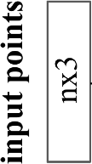
PointNet Classification Network

Slide 41
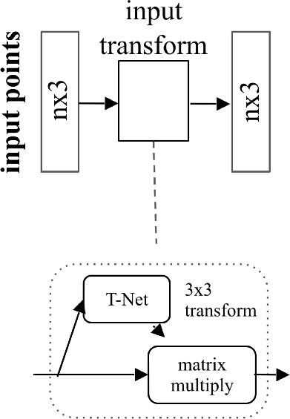
PointNet Classification Network

Slide 42
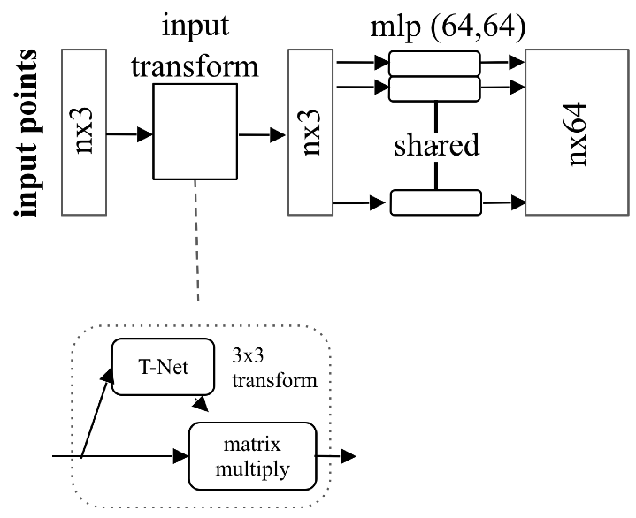
PointNet Classification Network

Slide 43
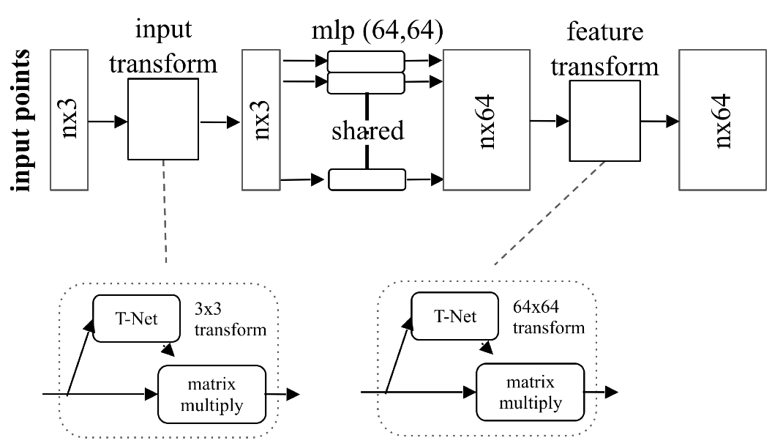
PointNet Classification Network

Slide 44
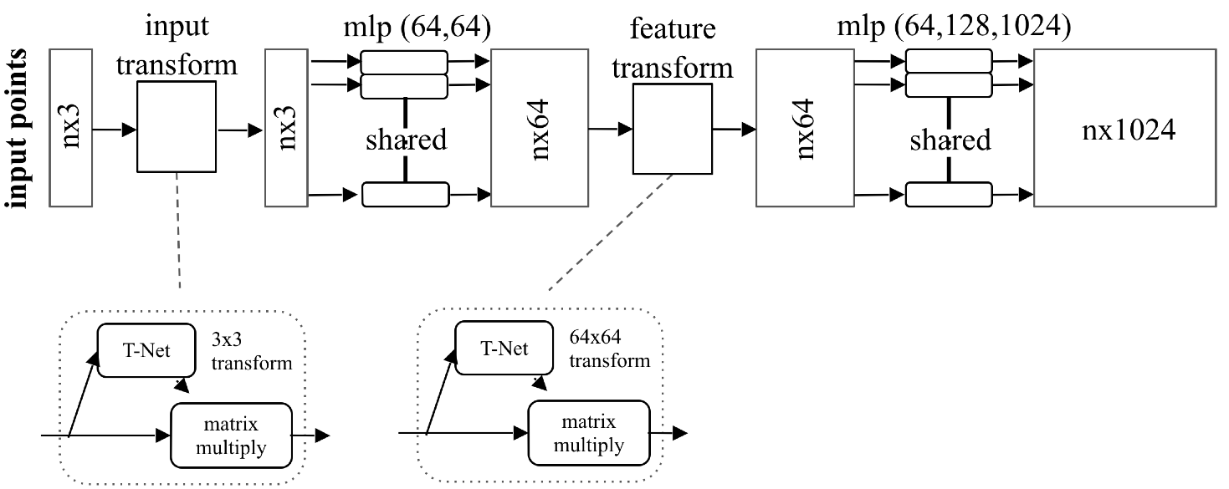
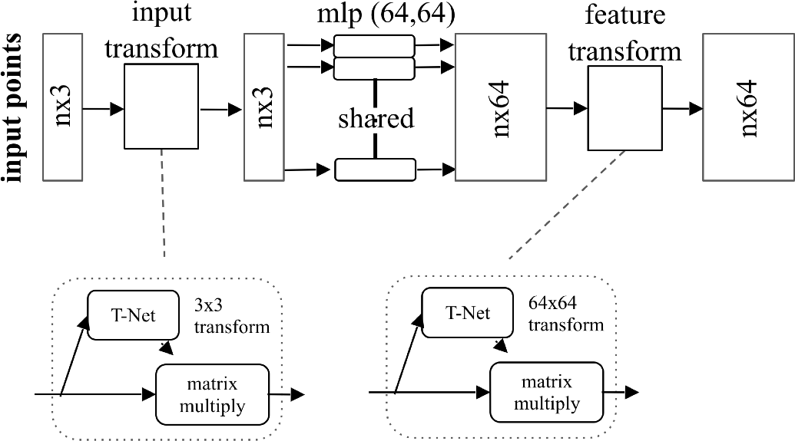
PointNet Classification Network

Slide 45
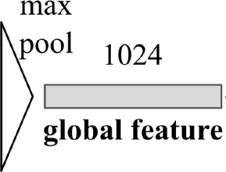
PointNet Classification Network

Slide 46
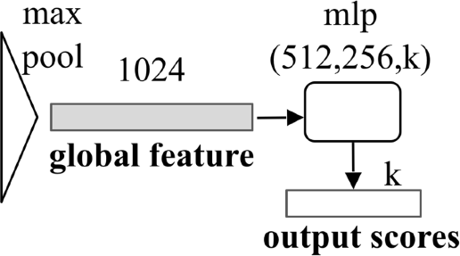
PointNet Classification Network

Slide 47
Extension to PointNet Segmentation Network
local embedding
global feature

Slide 48
Extension to PointNet Segmentation Network
local embedding
global feature

Slide 49
Results

Slide 50
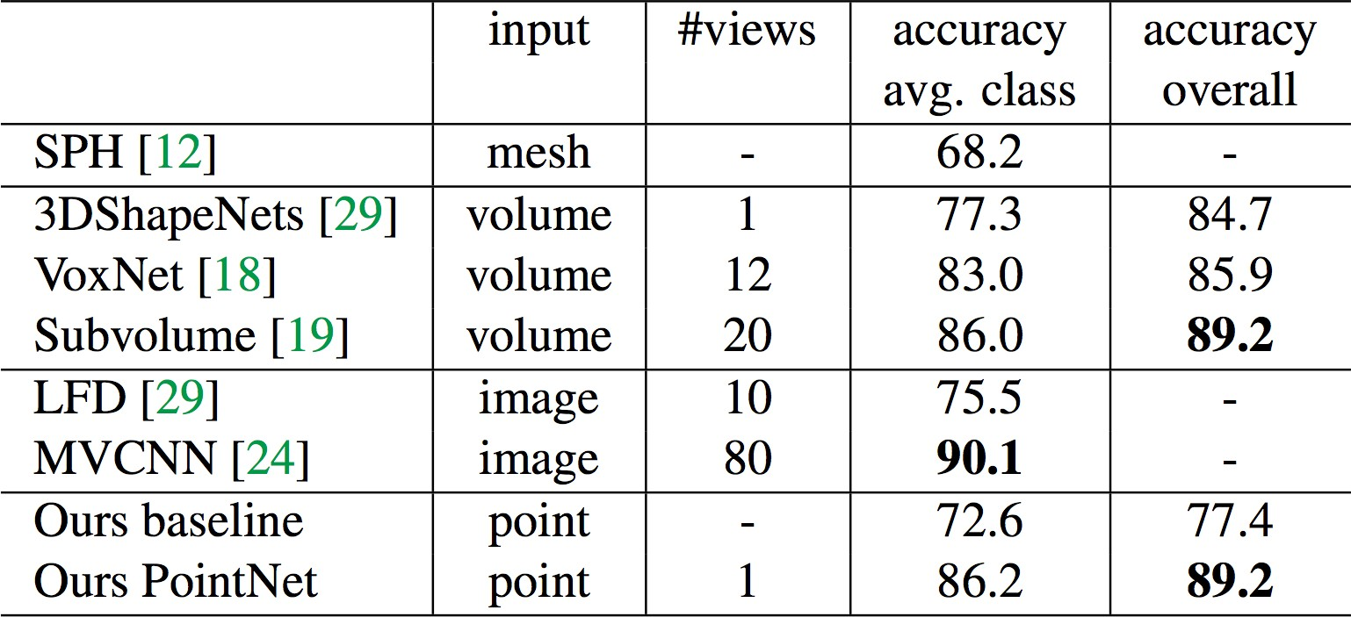
Results on Object Classification
3D CNNs
dataset: ModelNet40; metric: 40-class classification accuracy (%)

Slide 51
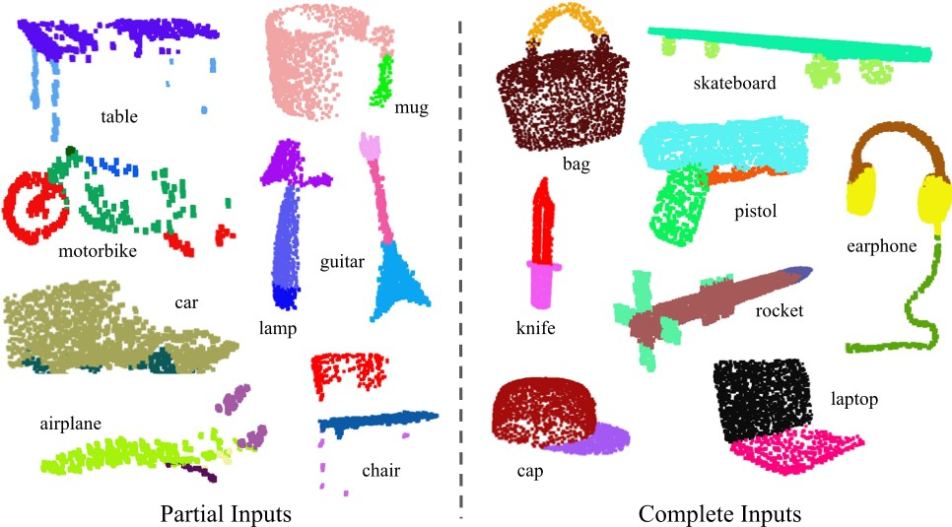
Results on Object Part Segmentation

Slide 52
Results on Object Part Segmentation
dataset: ShapeNetPart; metric: mean IoU (%)

Slide 53
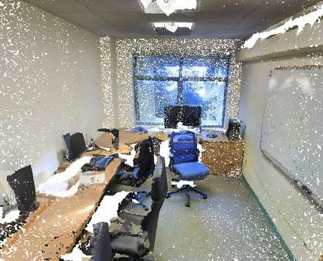
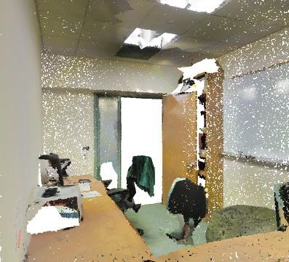
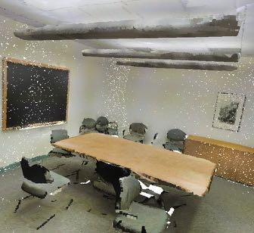
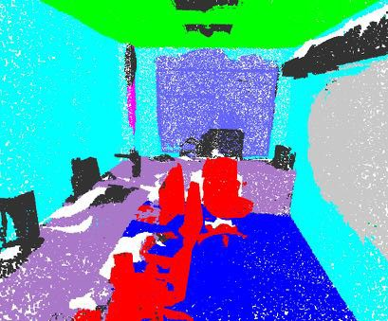
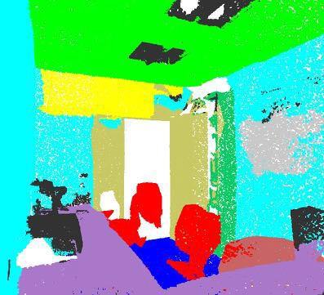
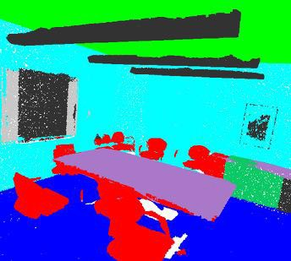
Results on Semantic Scene Parsing
Input
Output
dataset: Stanford 2D-3D-S (Matterport scans)

Slide 54
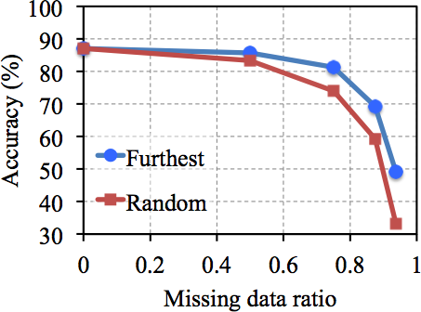
Robustness to Data Corruption
dataset: ModelNet40; metric: 40-class classification accuracy (%)

Slide 55
Robustness to Data Corruption
Less than 2% accuracy drop with 50% missing data
dataset: ModelNet40; metric: 40-class classification accuracy (%)

Slide 56
Robustness to Data Corruption
dataset: ModelNet40; metric: 40-class classification accuracy (%)
Notes:
Figure 6. PointNet robustness test. The metric is overall classification accuracy on ModelNet40 test set. Left: Delete points. Furthest means the original 1024 points are sampled with furthest sampling. Middle: Insertion. Outliers uniformly scattered in the unit sphere. Right: Perturbation. Add Gaussian noise to each point independently.

Slide 57
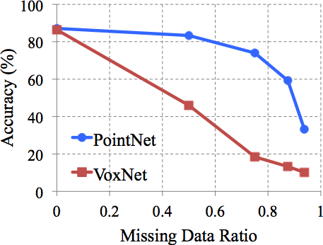
Robustness to Data Corruption
Why is PointNet so robust to missing data?
3D CNN

Slide 58
Visualizing Global Point Cloud Features
3
MLP
1024
maxpool
n
shared
global feature
Which input points are contributing to the global feature?
(critical points)

Slide 59
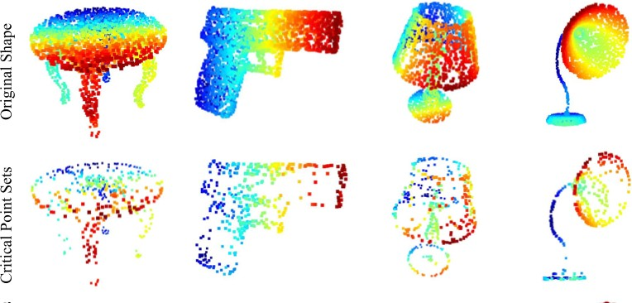
Visualizing Global Point Cloud Features
Original Shape:
Critical Point Sets:

Slide 60
Visualizing Global Point Cloud Features
3
MLP
1024
maxpool
n
shared
global feature
Which points won’t affect the global feature?

Slide 61
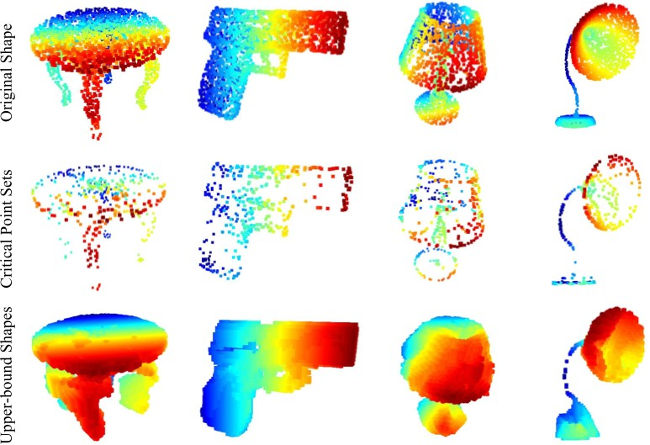
Visualizing Global Point Cloud Features
Original Shape:
Critical Point Set:
Upper bound set:

Slide 62
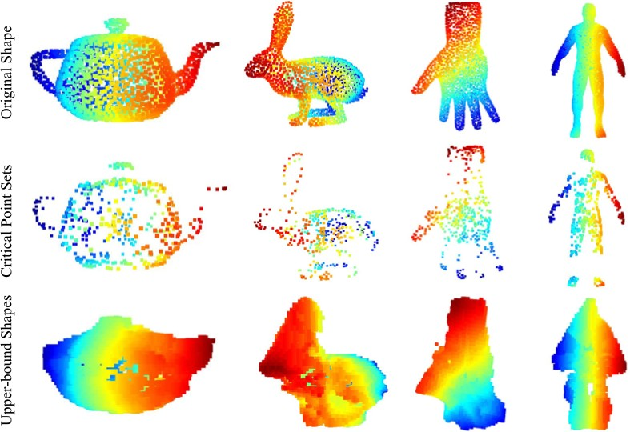
Visualizing Global Point Cloud Features (OOS)
Original Shape:
Critical Point Set:
Upper bound Set:

Slide 63
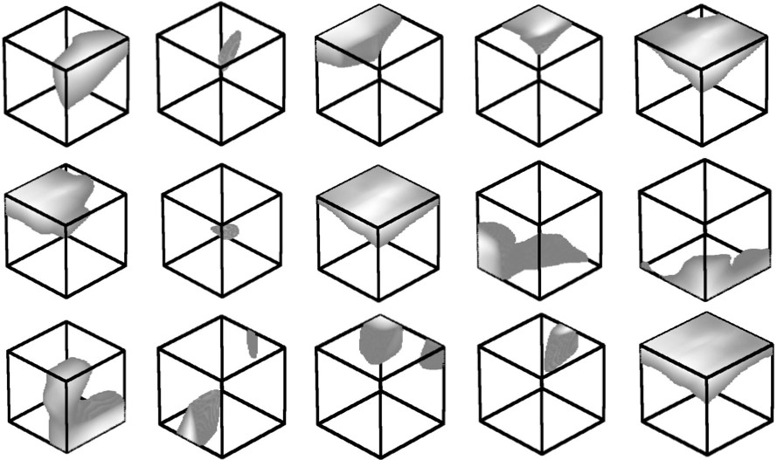
Visualizing Point Functions
Notes:
Our classification Point- Net computes K (we take K = 1024 in this visualization) dimension point features for each point
Point function visualization. For each per-point function h, we calculate the values h(p) for all the points p in a cube of diameter two located at the origin, which spatially covers the unit sphere to which our input shapes are normalized when training our PointNet. In this figure, we visualize all the points p that give h(p) > 0.5 with function values color-coded by the brightness of the voxel. We randomly pick 15 point functions and visualize the activation regions for them

Slide 64
Conclusion
PointNet is a novel deep neural network that directly consumes point cloud.
A unified approach to various 3D recognition tasks.
Rich theoretical analysis and experimental results.
Code & Data Available!
http://stanford.edu/~rqi/pointnet

Slide 65
Speed and Model Size
Inference time 11.6ms, 25.3ms GTX1080, batch size 8

Slide 66
Permutation Invariance: How about Sorting?
“Sort” the points before feeding them into a network.
Unfortunately, there is no canonical order in high dim space.
lexsorted
(1,1,1)
(1,2,3)
(1,2,3)
(1,1,1)
(2,3,2)
(2,3,4)
(2,3,2)
(2,3,4)
MLP

Slide 67
Permutation Invariance: How about Sorting?
“Sort” the points before feeding them into a network.
Unfortunately, there is no canonical order in high dim space.
Multi-Layer Perceptron
(ModelNet shape classification)
lexsorted
(1,1,1)
(1,2,3)
(1,2,3)
(1,1,1)
(2,3,2)
(2,3,4)
 | Accuracy
Unordered Input | 12%
Lexsorted Input | 40%
PointNet (vanilla) | 87%
(2,3,2)
(2,3,4)
MLP

Slide 68
Permutation Invariance: How about RNNs?
Train RNN with permutation augmentation. However, RNN forgets and order matters.
LSTM
LSTM
LSTM
…
LSTM
MLP
MLP
MLP
…
MLP
(1,2,3)
(1,1,1)
(2,3,2)
(2,3,4)

Slide 69
Permutation Invariance: How about RNNs?
Train RNN with permutation augmentation. However, RNN forgets and order matters.
LSTM Network
(ModelNet shape classification)
LSTM
LSTM
LSTM
…
LSTM
 | Accuracy
LSTM | 75%
PointNet (vanilla) | 87%
MLP
MLP
MLP
…
MLP
(1,2,3)
(1,1,1)
(2,3,2)
(2,3,4)

Slide 70
PointNet Classification Network
ModelNet40 | Accuracy
PointNet (vanilla) | 87.1%
+ input 3x3 | 87.9%
+ feature 64x64 | 86.9%
+ feature 64x64 + reg | 87.4%
+ both | 89.2%

Slide 71
Visualizing Point Functions
1x3
1x1024
Compact View:
FCs
1x3
1x1024
Expanded View:
FC
FC
FC
FC
FC
64
64
64
128
Which input point will activate neuron X?
Find the top-K points in a dense volumetric grid that activates neuron X.

Slide 72
Outline
What is lidar?
How do we make decisions about point clouds?
PointNet – orderless point processing
VoxelNet – voxel-based point processing
PointPillars – bird’s eye view point processing
Exploiting Visibility for 3D Object Detection
LaserNet – range image point processing
PseudoLidar – Bird’s eye view depth map processing

Slide 73
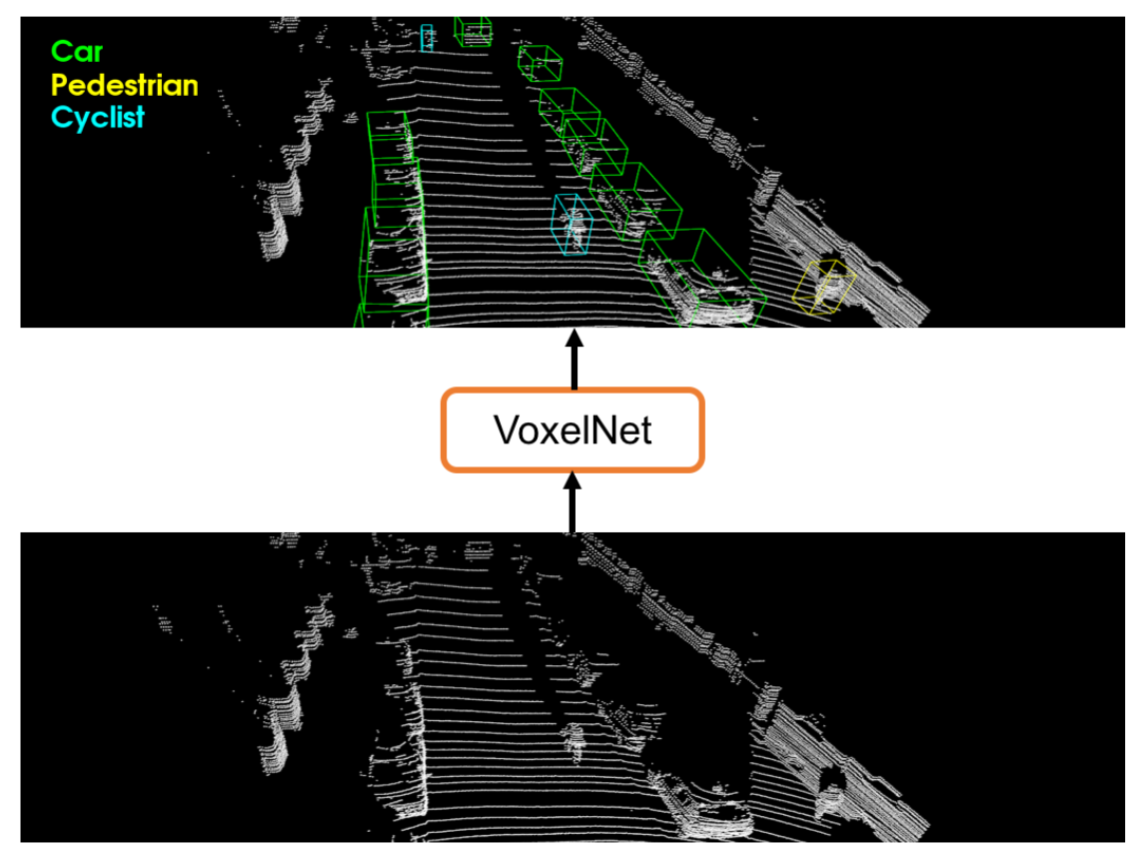
VoxelNet
VoxelNet: End-to-End Learning for Point Cloud Based 3D Object Detection Yin Zhou and Oncel Tuzel. CVPR 2018

Slide 74
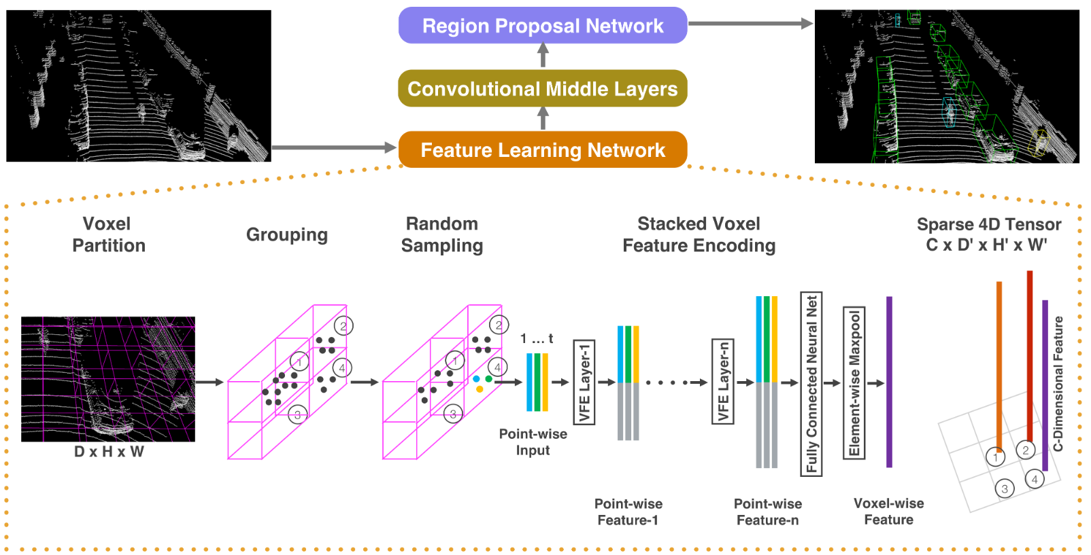
VoxelNet Overview

Slide 75
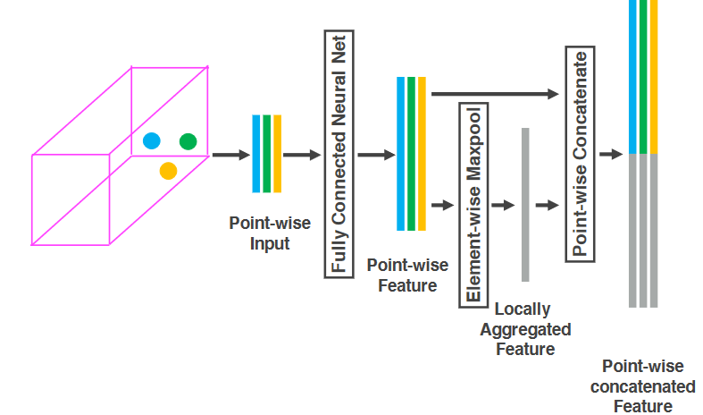
VoxelNet Voxel encoding looks a lot like PointNet

Slide 76
VoxelNet Overview

Slide 77
VoxelNet “Convolutional Middle Layers”
For car detection, divide the world into 10 x 400 x 352 voxels, corresponding to voxels that are 40 cm tall and 20 cm in width/length.
Uses 3D convolutions instead of 2D as we’ve seen before.
The Z / height dimension gets downsampled away after many layers

Slide 78
VoxelNet Overview

Slide 79
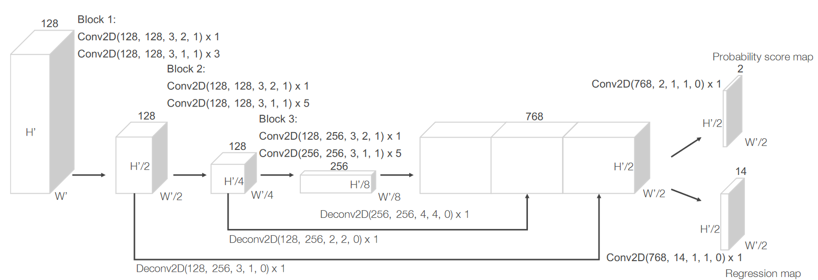
VoxelNet Region Proposal Network

Slide 80
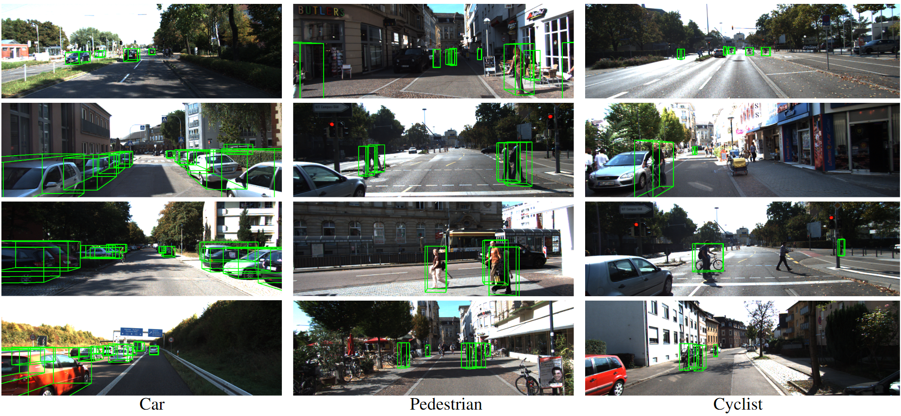
VoxelNet qualitative results

Slide 81
VoxelNet quantitative results
Evaluation on KITTI according to 3D IoU

Slide 82
Outline
What is lidar?
How do we make decisions about point clouds?
PointNet – orderless point processing
VoxelNet – voxel-based point processing
PointPillars – bird’s eye view point processing
Exploiting Visibility for 3D Object Detection
LaserNet – range image point processing
PseudoLidar – Bird’s eye view depth map processing

Slide 83
PointPillars
PointPillars: Fast Encoders for Object Detection from Point Clouds
Alex H. Lang, Sourabh Vora, Holger Caesar, Lubing Zhou, Jiong Yang, Oscar Beijbom. CVPR 2019

Slide 84
Notes:
Qualitative analysis of KITTI results. We show a bird’s-eye view of the lidar point cloud (top), as well as the 3D bounding boxes projected into the image for clearer visualization. Note that our method only uses lidar. We show predicted boxes for car (orange), cyclist(red) and pedestrian (blue). Ground truth boxes are shown in gray. The orientation of boxes is shown by a line connected the bottom center to the front of the box.

Slide 85
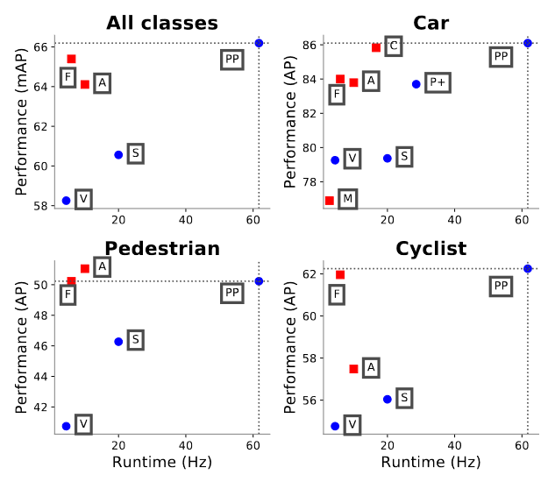
Runtime / accuracy tradeoff
Notes:
Bird’s eye view performance vs speed for our proposed PointPillars, PP method on the KITTI [5] test set. Lidar-only methods drawn as blue circles; lidar & vision methods drawn as red squares. Also drawn are top methods from the KITTI leader- board: M : MV3D [2], A AVOD [11], C : ContFuse [15], V : VoxelNet [31], F : Frustum PointNet [21], S : SECOND [28], P+ PIXOR++ [29]. PointPillars outperforms all other lidar-only methods in terms of both speed and accuracy by a large margin. It also outperforms all fusion based method except on pedestrians. Similar performance is achieved on the 3D metric (Table 2)

Slide 86
Outline
What is lidar?
How do we make decisions about point clouds?
PointNet – orderless point processing
VoxelNet – voxel-based point processing
PointPillars – bird’s eye view point processing
Exploiting Visibility for 3D Object Detection
LaserNet – range image point processing
PseudoLidar – Bird’s eye view depth map processing

Slide 87
What You See Is What You Get Exploiting Visibility for 3D Object Detection
Peiyun Hu, Jason Ziglar, David Held, Deva Ramanan
Carnegie Mellon University Argo AI
CVPR 2020

Slide 88
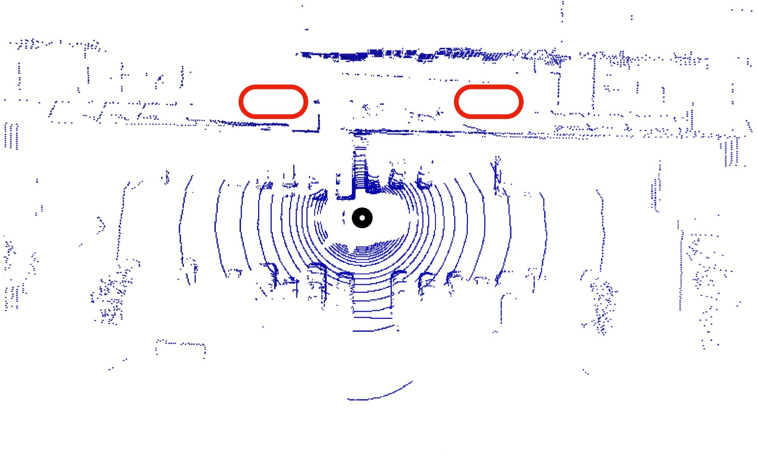
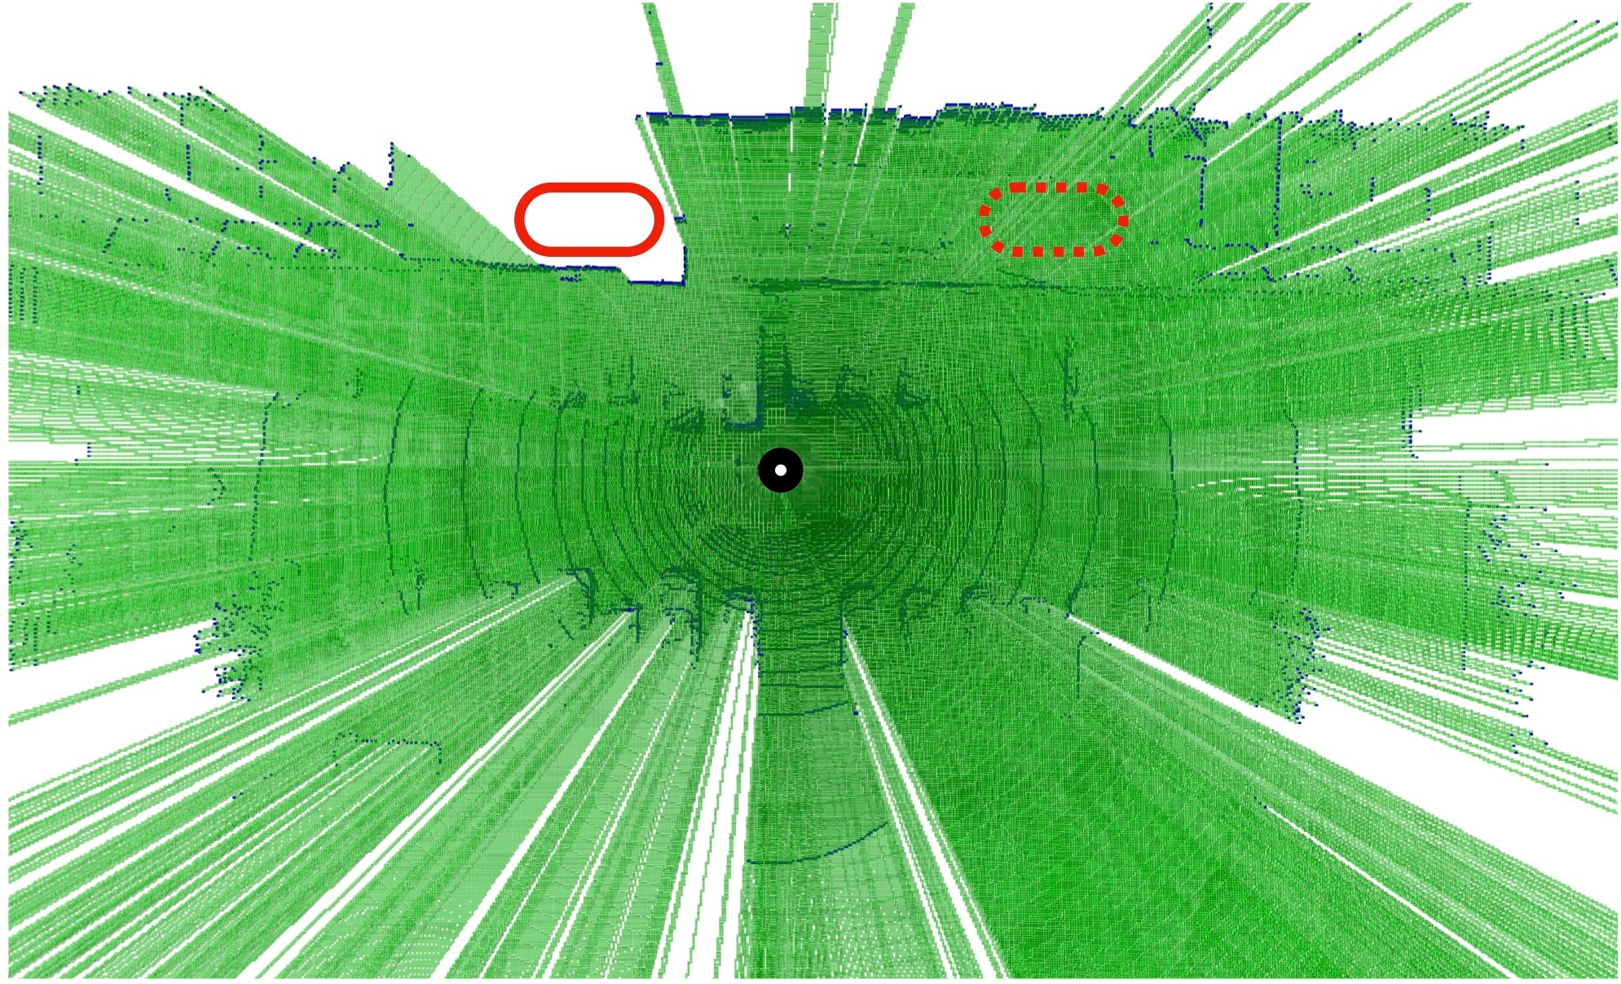
What is a good representation for LiDAR data?
LiDAR data provides more than just point measurements
Rays emanating from the sensor to each 3D point must pass through free space
Representing LiDAR data as (x, y, z)s fundamentally destroys such freespace information

Slide 89
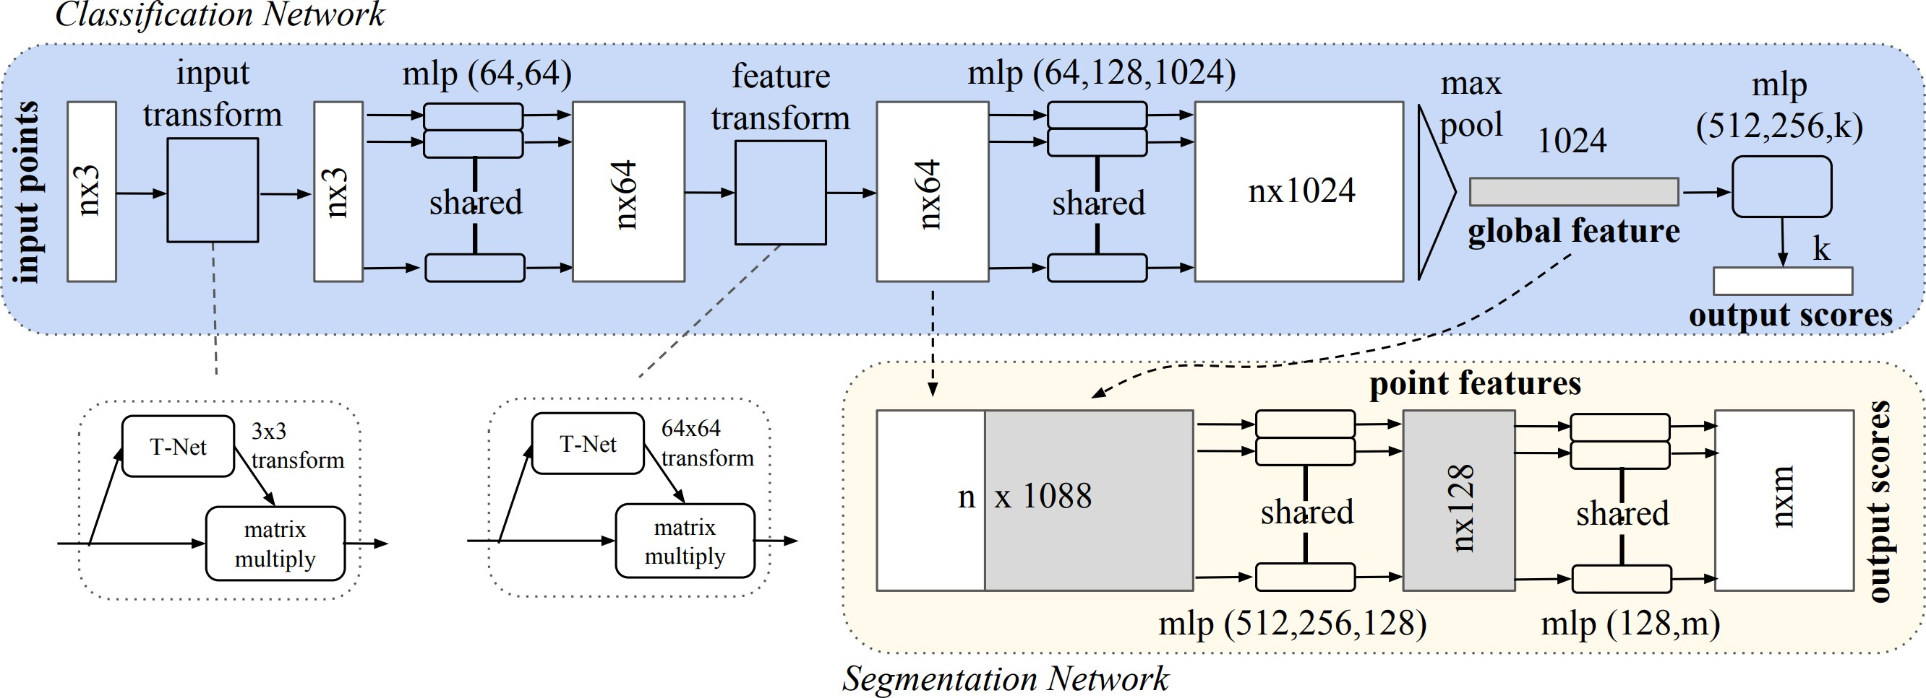
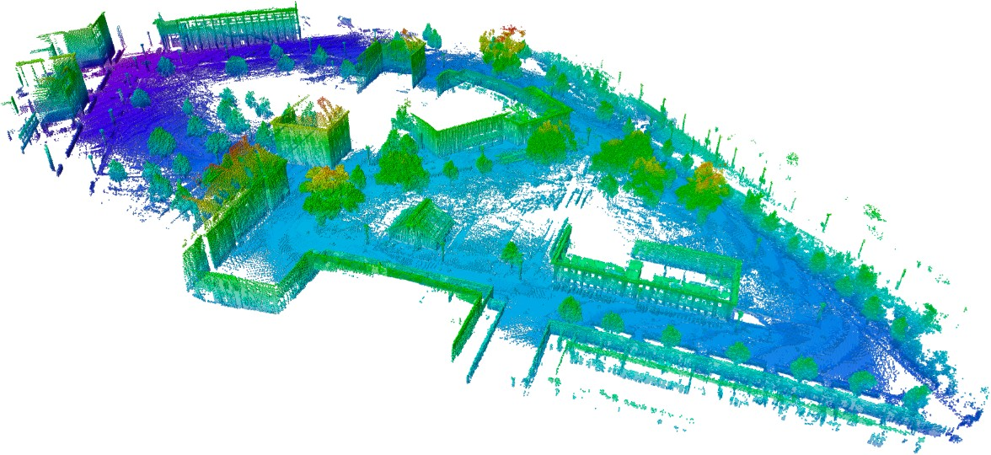
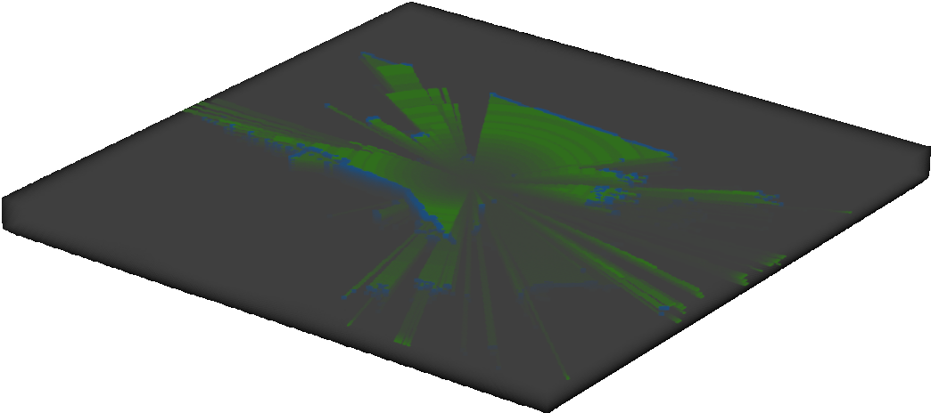
What representations do we have?
Deep Point Representation
PointNet, Qi et al., CVPR’17
Deep Voxel Representation
PointPillars, Lang et al., CVPR’19
This work
Visibility Augmented Deep Voxels
WYSIWYG, Hu et al., CVPR’20
Occupancy Voxels
OctoMap, Hornung et al., Autonomous Robots’13

Slide 90
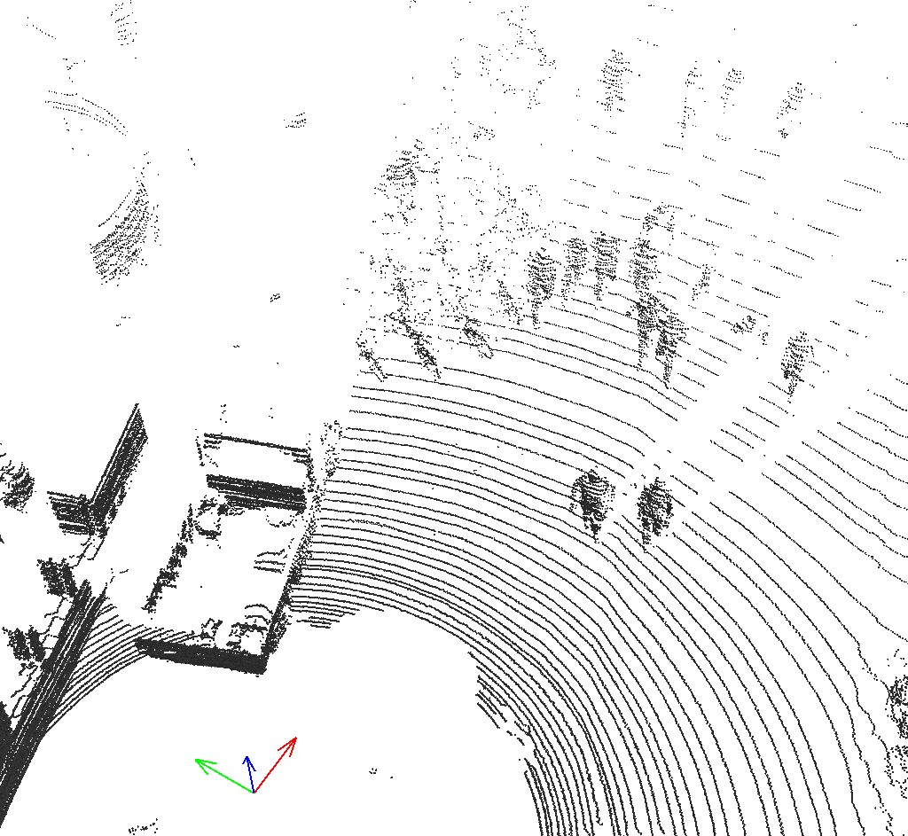
A Simple Approach to Augment Visibility
Deep Voxel Representation
Voxel Encoder
W
H × C
L
H
Concat
W
W
L
H × (C + 1)
L
Point Cloud
Voxel Grid
Ray-casting
Visibility-augmented Deep Voxel Representation
W
H
L
Visibility Volume

Slide 91
Efficient Ray-casting via Voxel Traversal
Unknown
END
Occupied
Free
START
Though animated in 2D, the idea generalizes in 3D.
A Fast Voxel Traversal Algorithm for Ray Tracing
John Amanatides, Andrew Woo
Eurographics 1987
3D Visibility Volume

Slide 92
Visibility over Multiple LiDAR Sweeps
Single sweep
Discrete visibility (one slice)
Multiple sweeps
Continuous visibility (one slice)
OctoMap, Hornung et al., Autonomous Robots’13

Slide 93
Visibility-aware LiDAR Synthesis
Should be occluded!
Occluded!
Naive Object Augmentation
PointPillars, Lang et al., CVPR'19
SECOND, Yan et al., Sensors’18
Visibility-aware Object Augmentation

Slide 94
Improve PointPillars by 4.5% in overall mAP
PointPillars Ours
80%
79.1%
68.4%
NuScenes Benchmark (test set)
65.0%
60%
59.7%
46.6%
40%
38.9%
40.1%
34.7%
35.0%
30.8%_{28.8%}
30.4% _{28.2%}
30.5%
27.4%
23.0%
23.4%
20%
18.2%
7.1%
4.1%
0%
1.1% _{0.1%}
bicyc. mAP
car pedes.
barri.
traff.
truck
bus trail.
const.
motor.
More than 10%
Almost 20%

Slide 95
https://cs.cmu.edu/~peiyunh/wysiwyg

Slide 96
Outline
What is lidar?
How do we make decisions about point clouds?
PointNet – orderless point processing
VoxelNet – voxel-based point processing
PointPillars – bird’s eye view point processing
Exploiting Visibility for 3D Object Detection
LaserNet – range image point processing
PseudoLidar – Bird’s eye view depth map processing

Slide 97
LaserNet: An Efficient Probabilistic 3D Object Detector for Autonomous Driving
Gregory P. Meyer*, Ankit Laddha*, Eric Kee, Carlos Vallespi-Gonzalez, Carl K. Wellington
Uber Advanced Technologies Group. CVPR 2019

Slide 98
Outline
What is lidar?
How do we make decisions about point clouds?
PointNet – orderless point processing
VoxelNet – voxel-based point processing
PointPillars – bird’s eye view point processing
Exploiting Visibility for 3D Object Detection
LaserNet – range image point processing
PseudoLidar – Bird’s eye view depth map processing

Slide 99
Pseudo-LiDAR from Visual Depth Estimation: Bridging the Gap in 3D Object Detection for Autonomous Driving
Yan Wang, Wei-Lun Chao, Divyansh Garg, Bharath Hariharan, Mark Campbell, and Kilian Q. Weinberger.
CVPR 2019
Notes:
Figure 1: Pseudo-LiDAR signal from visual depth esti-mation.Top-left: a KITTI street scene with super-imposed bounding boxes around cars obtained with LiDAR (red) and pseudo-LiDAR (green). Bottom-left: estimated disparity map. Right: pseudo-LiDAR (blue) vs. LiDAR (yellow) —the pseudo-LiDAR points align remarkably well with the LiDAR ones. Best viewed in color (zoom in for details.)

Slide 102
Summary
Popular CNN backbones aren’t a direct fit for 3D point processing tasks.
It’s not clear how to use deep learning on 3D data
Use a truly permutation invariant representation (PointNet)
Use a voxel representation (VoxelNet)
Use a bird’s a view representation (PointPillars)
Create a range image (LaserNet)
These alternate representations might be applicable more broadly, e.g. reasoning about depth estimates might be easier in bird’s eye view (PseudoLidar)

