Slide 1
“Attention” and “Transformer” Architectures
James Hays

Slide 2
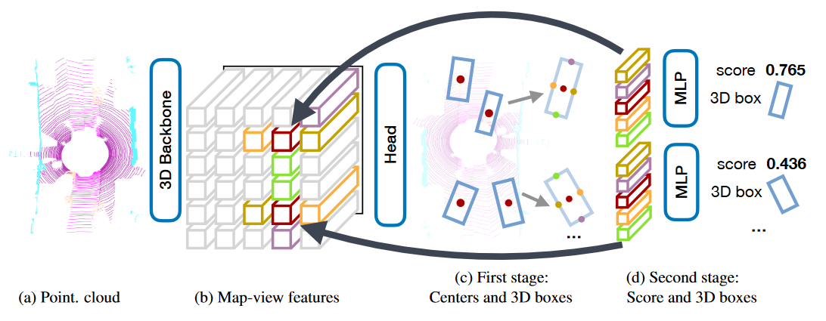
Recap – 3D point processing
Popular CNN backbones aren’t a direct fit for 3D point processing tasks.
It’s not clear how best to use deep learning on 3D data
Use a truly permutation invariant representation (PointNet)
Use a voxel representation (VoxelNet)
Use a bird’s a view representation (PointPillars)
Create a range image (LaserNet)
Project 3D data into fixed 2D views (MVCNN)
With lidar, multi-modal approaches (adding images, radar) help surprisingly little compared to lidar-only approaches.
These alternate representations might be applicable more broadly, e.g. reasoning about depth estimates might be easier in bird’s eye view (PseudoLidar)
CenterPoint, which is near state of the art for 3D object detection when using VoxelNet backbone. Center-based 3D Object Detection and Tracking. Tianwei Yin, Xingyi Zhou, Philipp Krähenbühl. CVPR 2021
https://paperswithcode.com/sota/3d-object-detection-on-nuscenes

Slide 3
Outline
Context and Receptive Field
Going Beyond Convolutions in…
Text
Point Clouds
Images

Slide 4
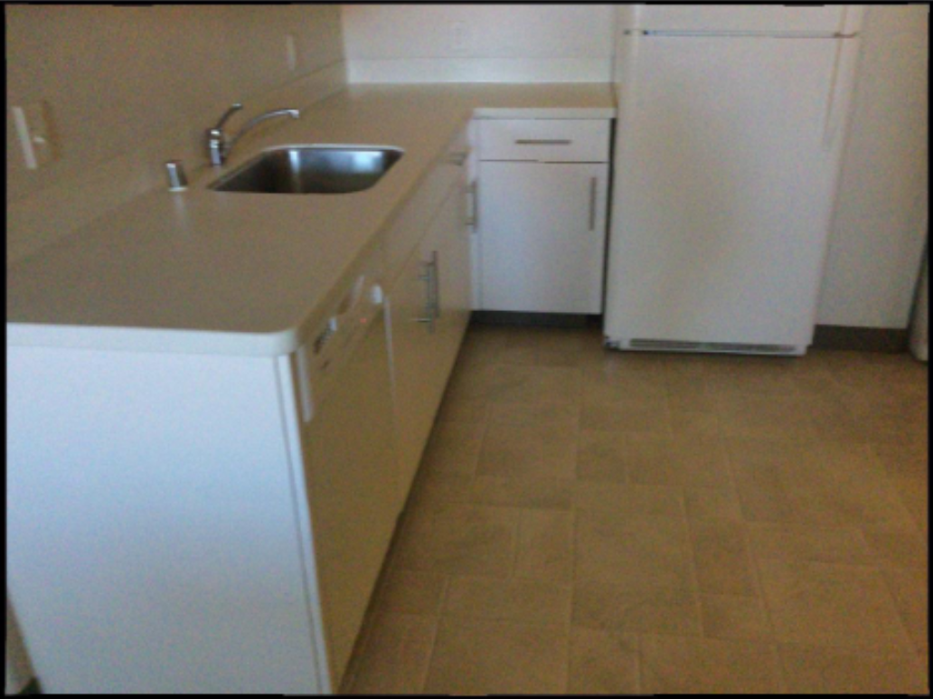

Slide 5
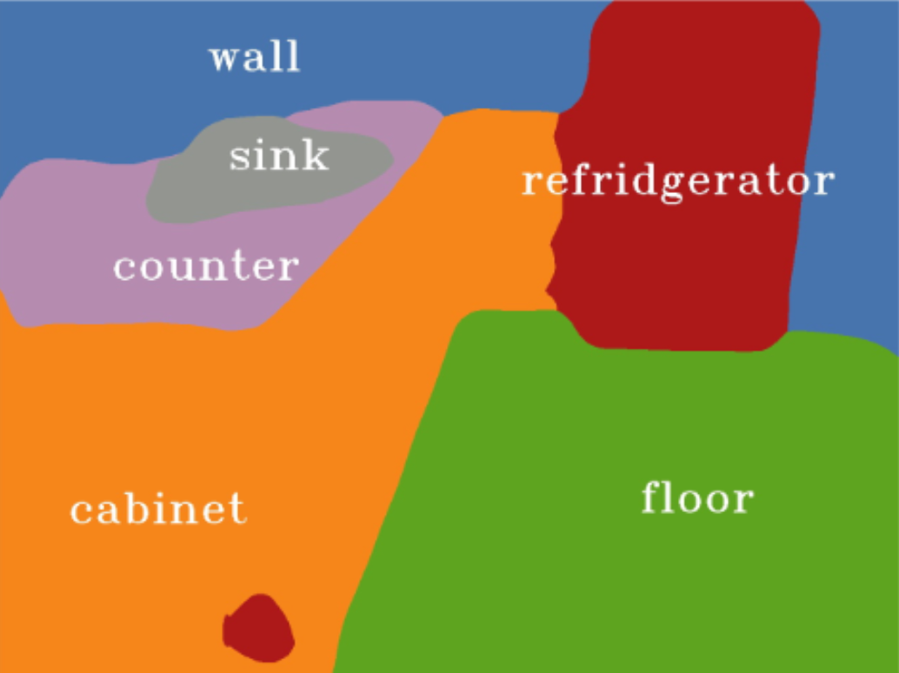
Ground truth
Prediction from Mseg
Notes:
Left – ground truth
Right – result from mseg http://vladlen.info/publications/mseg-composite-dataset-multi-domain-semantic-segmentation/

Slide 9
Language understanding
… serve …

Slide 10
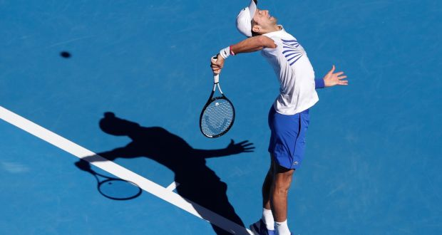
Language understanding
… great serve from Djokovic …

Slide 11
Language understanding
… be right back after I serve these salads …

Slide 12
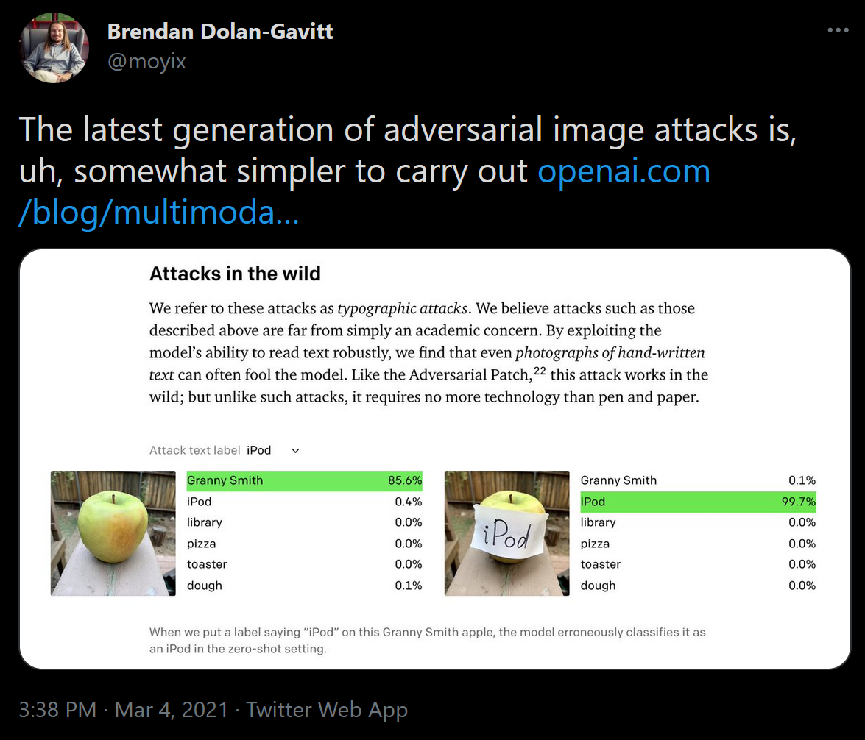

Slide 13
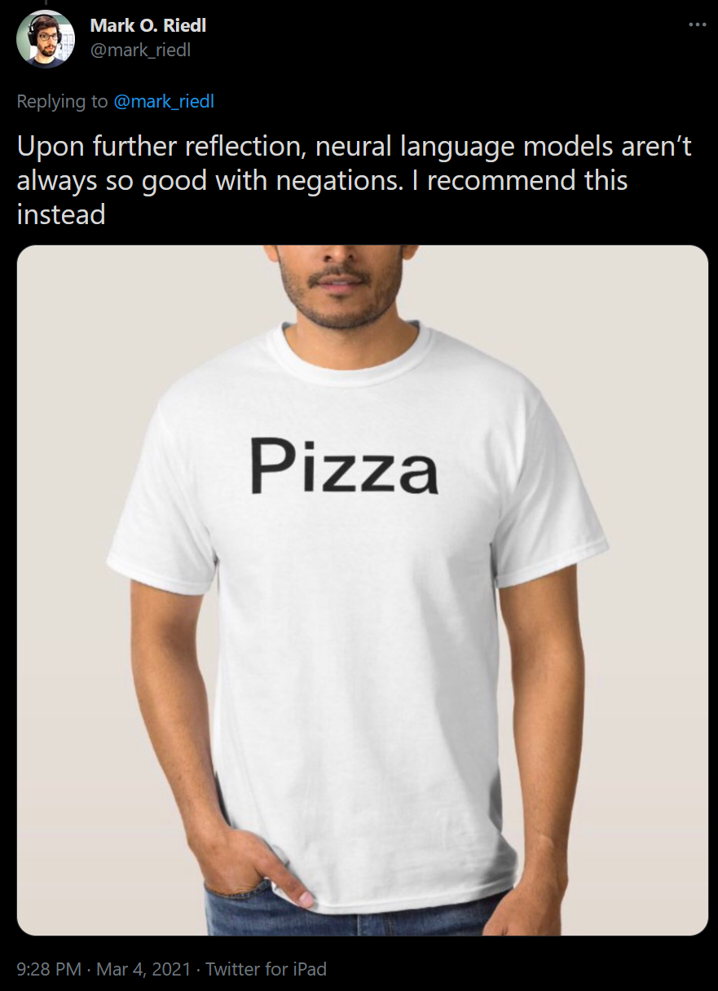

Slide 14
So how do we fix these problems?

Slide 15
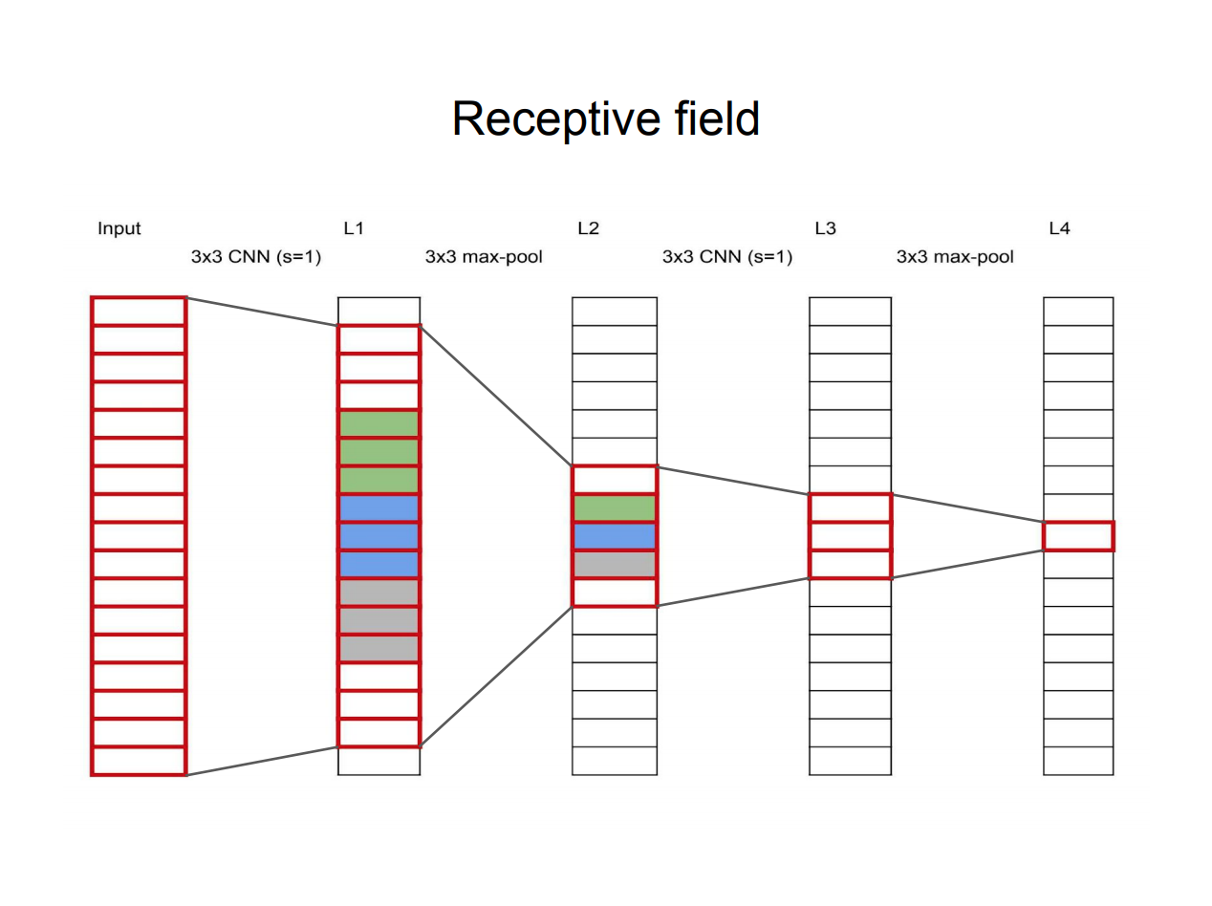
Slide Credit: Frank Dellaert https://dellaert.github.io/19F-4476/resources/receptiveField.pdf

Slide 16
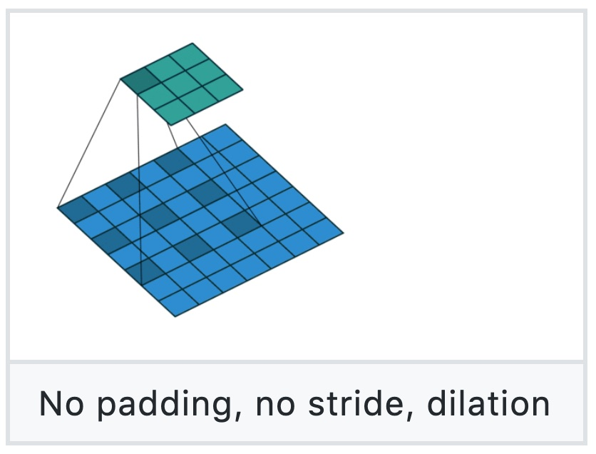
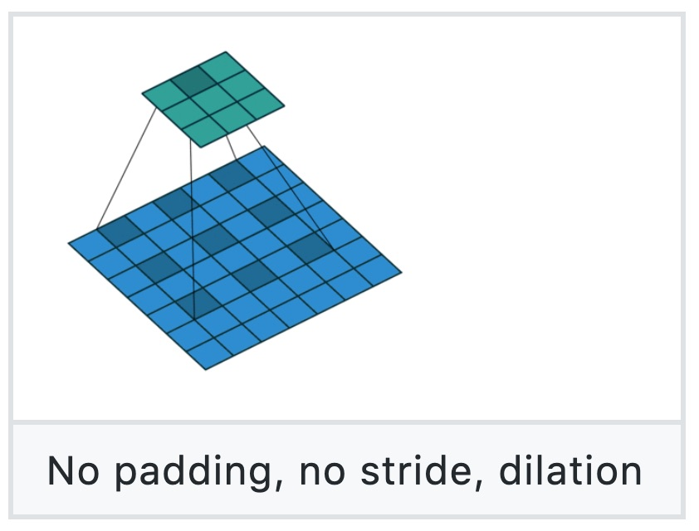
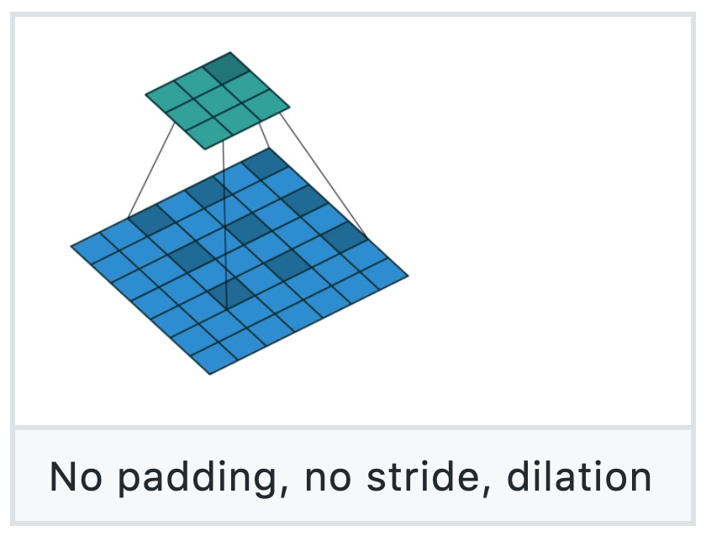
Dilated Convolution
Figure source: https://github.com/vdumoulin/conv_arithmetic

Slide 17
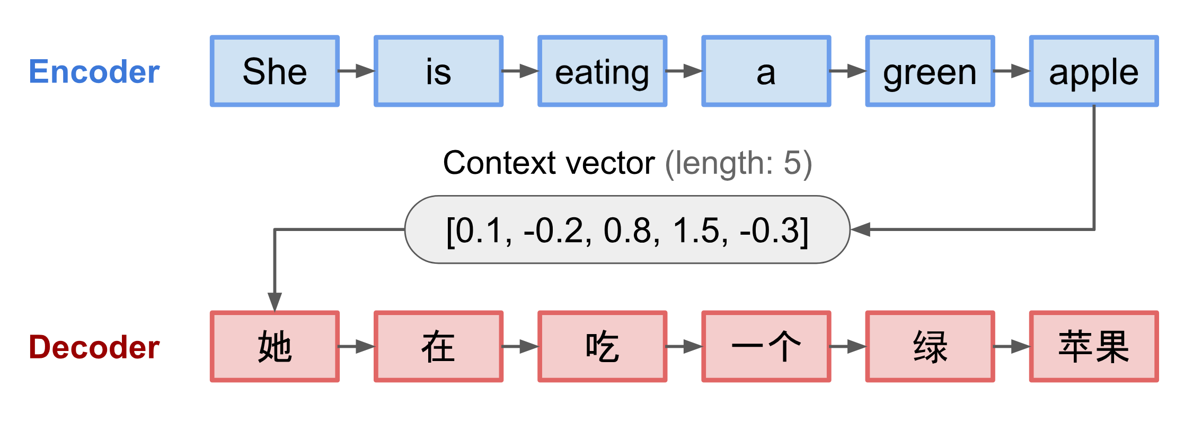
Sequence 2 Sequence models in language
Source: https://lilianweng.github.io/lil-log/2018/06/24/attention-attention.html

Slide 18
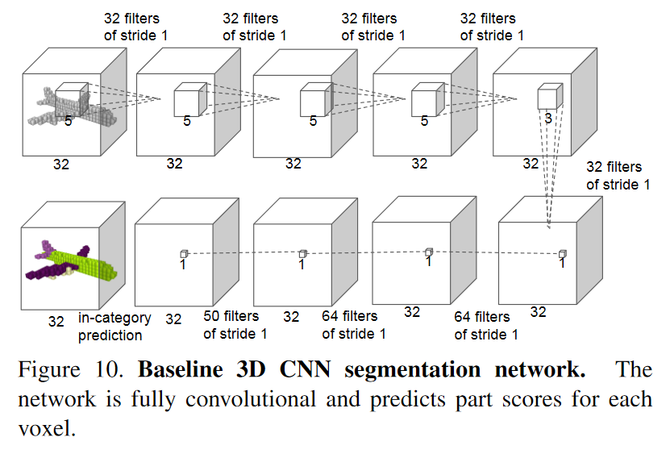
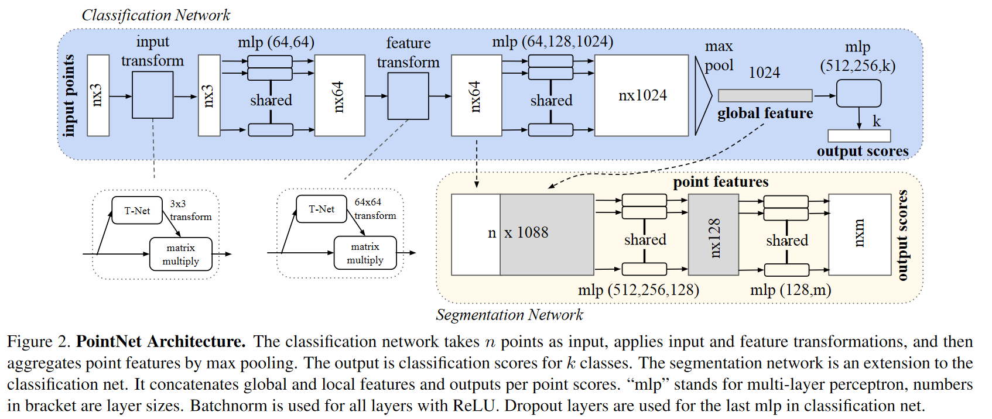

Slide 19
Outline
Context and Receptive Field
Going Beyond Convolutions in…
Text
Point Clouds
Images

Slide 20
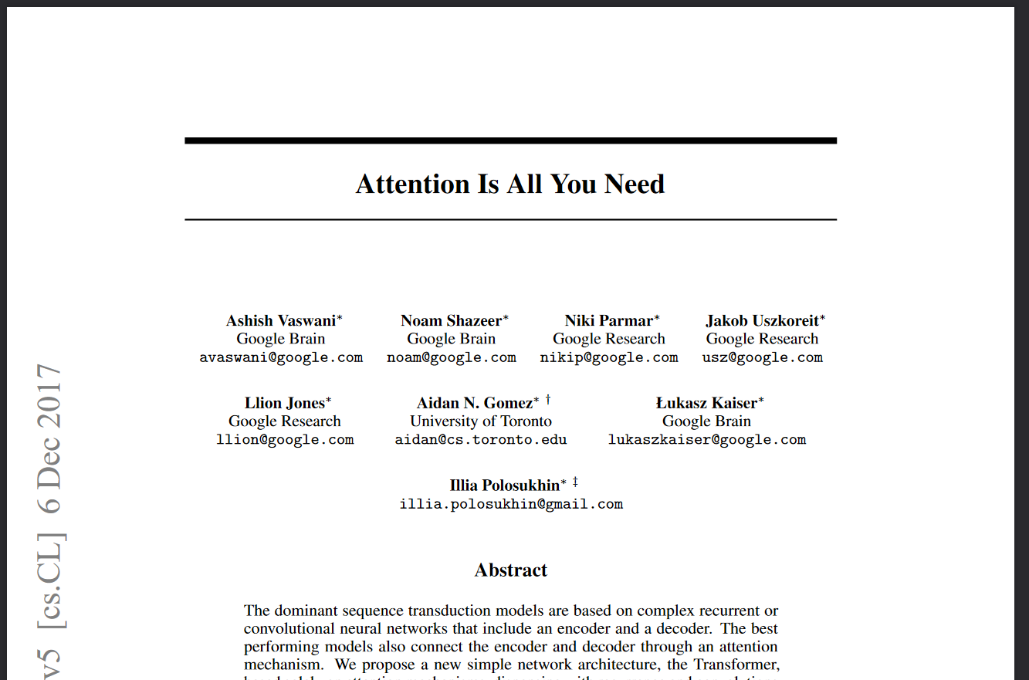
Notes:
*Bert*, GPT, etc build on this. Introduced “transformer”, as well
40 thousand citations in April 2022

Slide 22
From https://medium.com/lsc-psd/introduction-of-self-attention-layer-in-transformer-fc7bff63f3bc

Slide 23
From https://medium.com/lsc-psd/introduction-of-self-attention-layer-in-transformer-fc7bff63f3bc

Slide 24
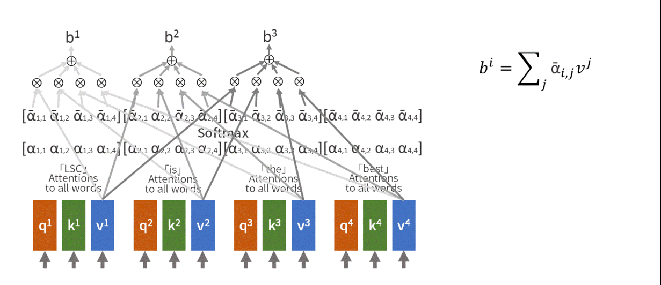

Slide 25
Complexity Comparison
Notes:
Table 1: Maximum path lengths, per-layer complexity and minimum number of sequential operations for different layer types. N is the sequence length, d is the representation dimension, k is the kernel size of convolutions and r the size of the neighborhood in restricted self-attention.

Slide 26
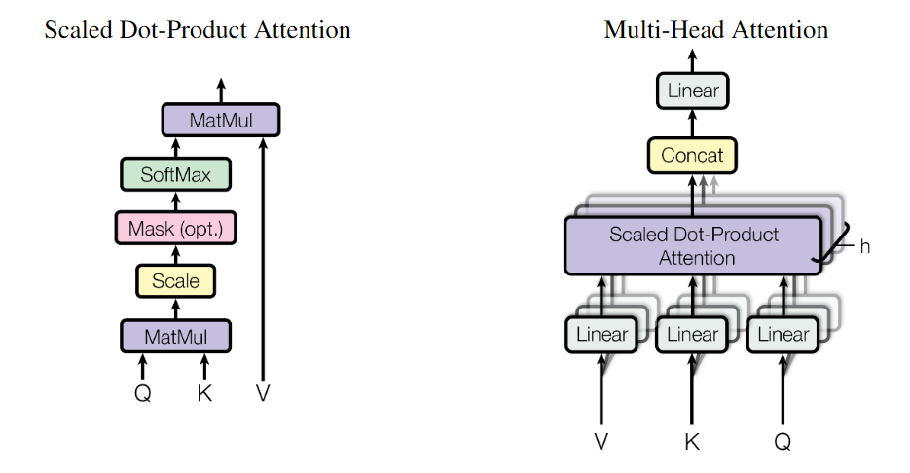

Slide 27
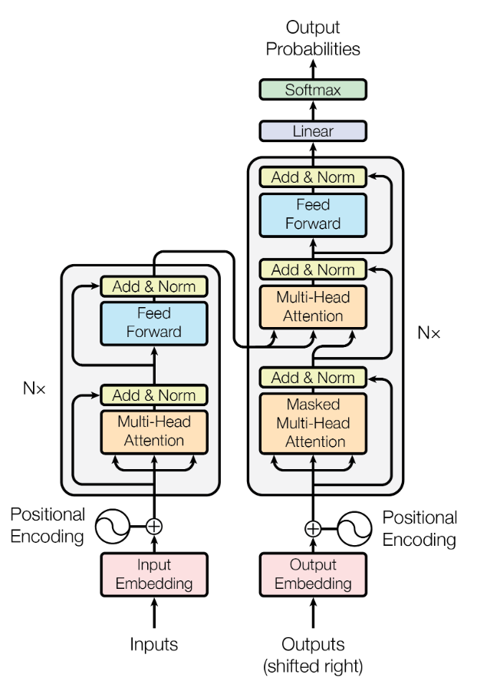
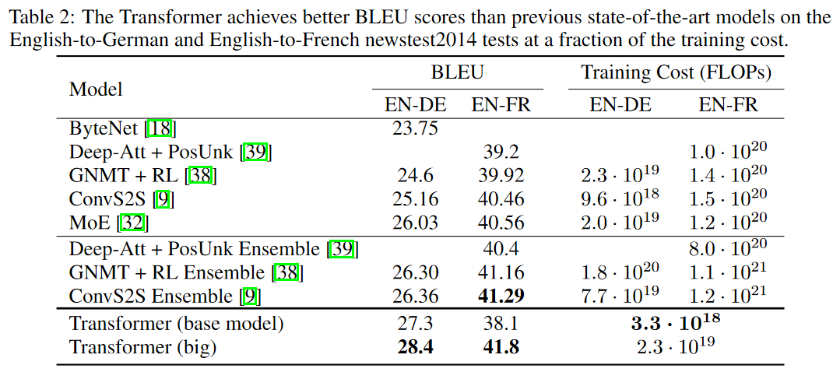
Transformer Architecture
Notes:
GPT and Bert build on these ideas

Slide 28
Outline
Context and Receptive Field
Going Beyond Convolutions in…
Text
Point Clouds
Images

Slide 29
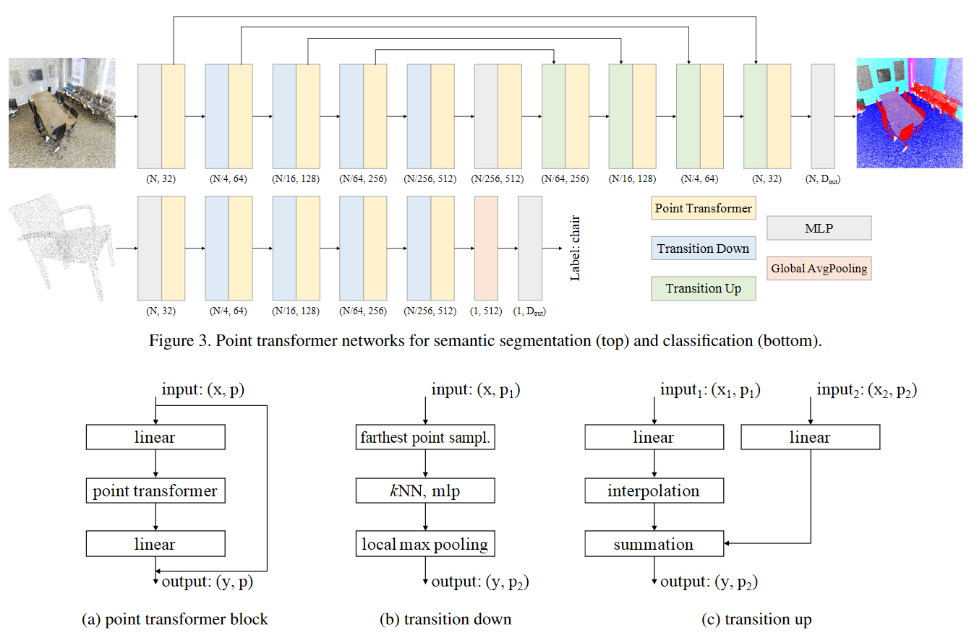
Point Transformer. Hengshuang Zhao, Li Jiang, Jiaya Jia, Philip Torr, Vladlen Koltun
Notes:
Coarse to fine

Slide 30
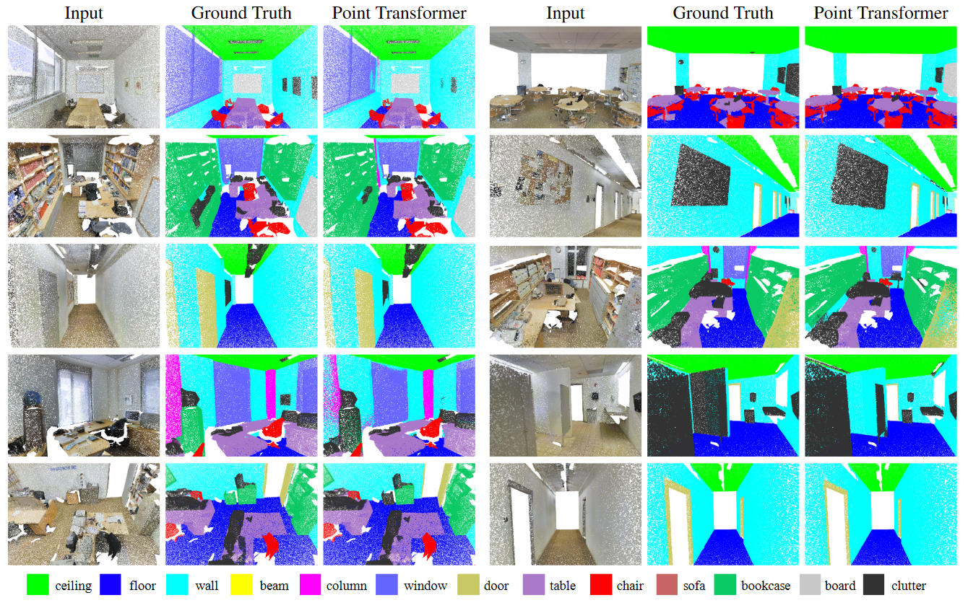

Slide 31
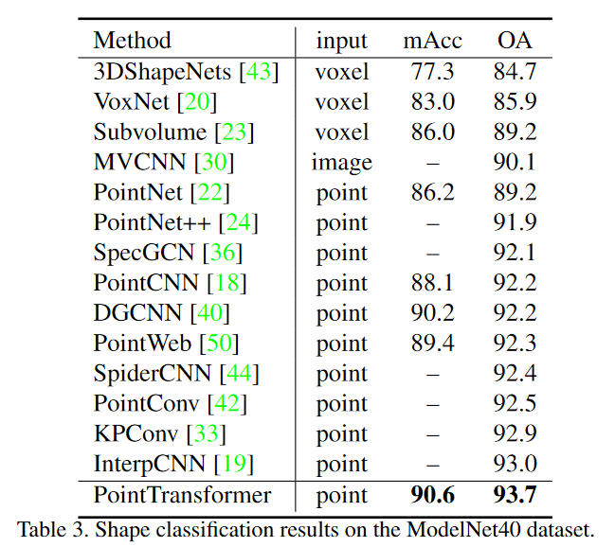
https://paperswithcode.com/sota/3d-point-cloud-classification-on-modelnet40
Notes:
Not actually state of the art any more. And never was by a big margin. A surprisingly simple baseline can beat it https://openreview.net/pdf?id=XwATtbX3oCz

Slide 32
Outline
Context and Receptive Field
Going Beyond Convolutions in…
Text
Point Clouds
Images

Slide 33
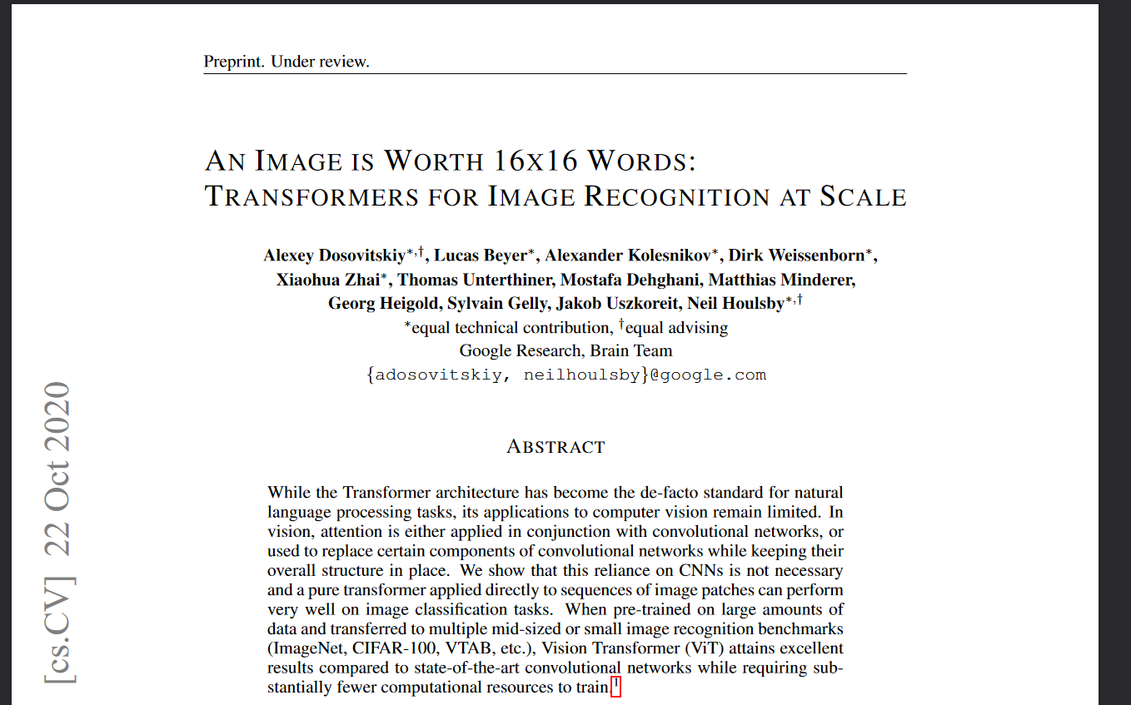
Notes:
3500 citations as of April 2022. Called “ViT” commonly.

Slide 34
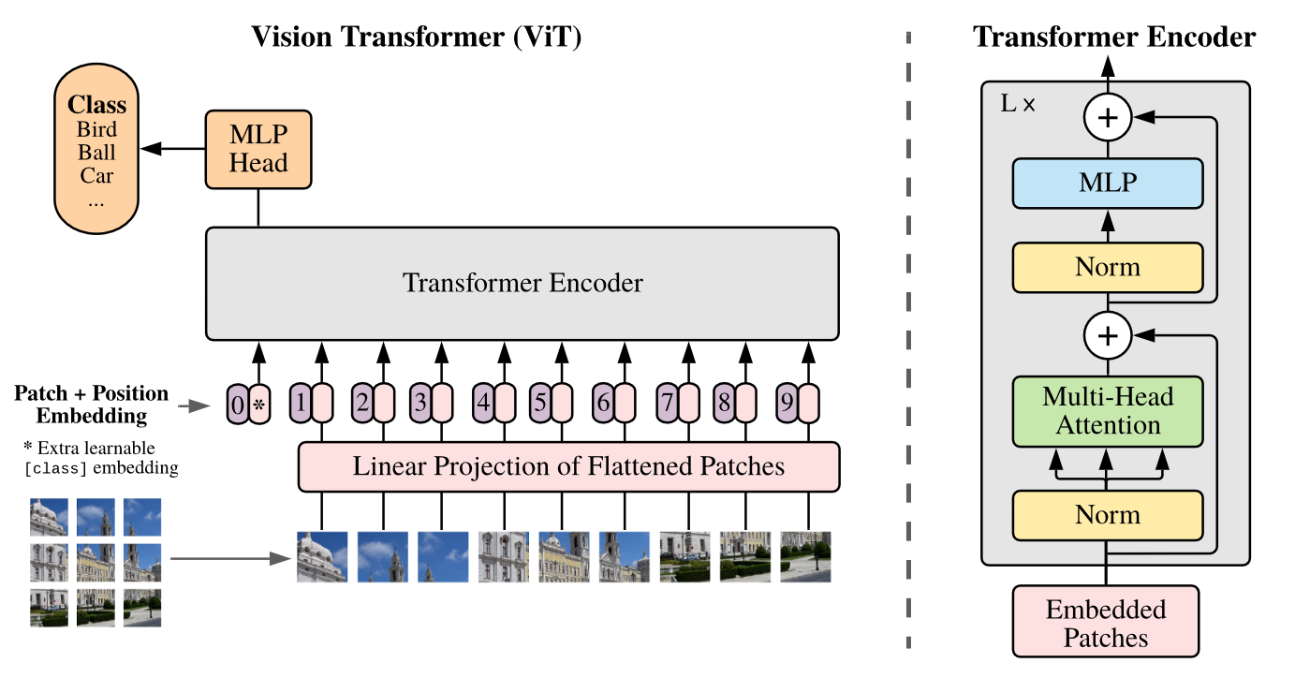
Notes:
Model overview. We split an image into fixed-size patches, linearly embed each of them, add position embeddings, and feed the resulting sequence of vectors to a standard Transformer encoder. In order to perform classification, we use the standard approach of adding an extra learnable “classification token” to the sequence. The illustration of the Transformer encoder was inspired by Vaswani et al. (2017)

Slide 35
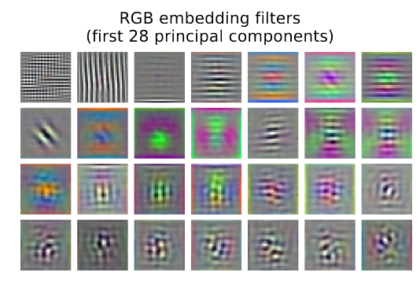
Notes:
Model overview. We split an image into fixed-size patches, linearly embed each of them, add position embeddings, and feed the resulting sequence of vectors to a standard Transformer encoder. In order to perform classification, we use the standard approach of adding an extra learnable “classification token” to the sequence. The illustration of the Transformer encoder was inspired by Vaswani et al. (2017)

Slide 36
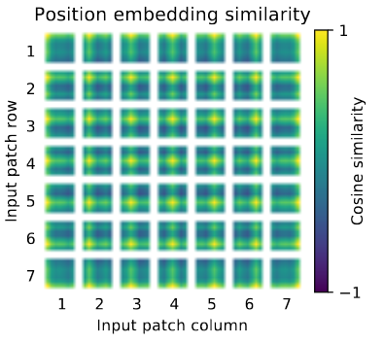
Notes:
Model overview. We split an image into fixed-size patches, linearly embed each of them, add position embeddings, and feed the resulting sequence of vectors to a standard Transformer encoder. In order to perform classification, we use the standard approach of adding an extra learnable “classification token” to the sequence. The illustration of the Transformer encoder was inspired by Vaswani et al. (2017)

Slide 37
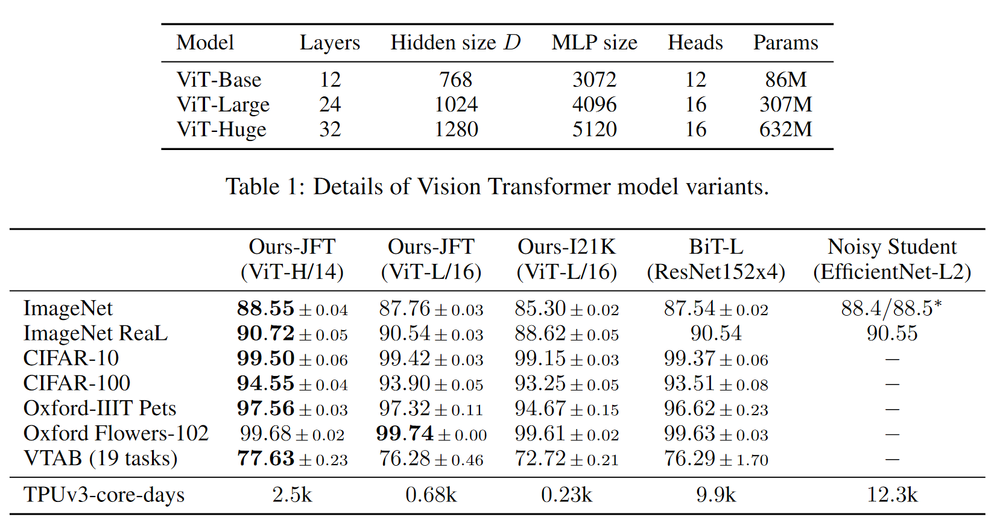

Slide 38
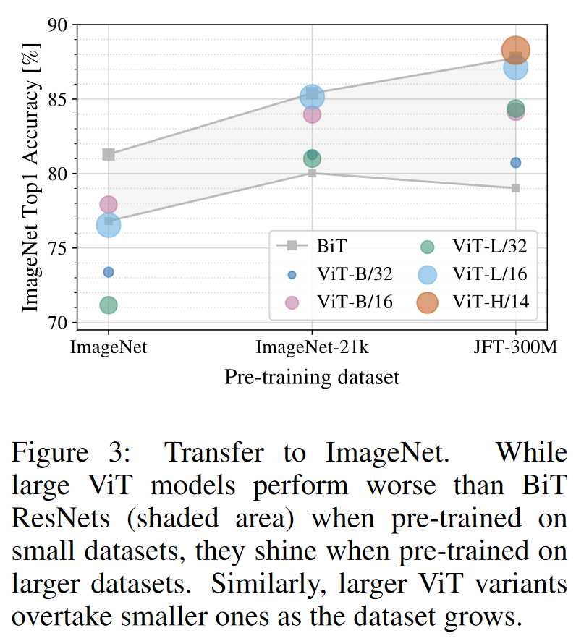
When trained on mid-sized datasets such as ImageNet, such models yield modest accuracies of a few percentage points below ResNets of comparable size. This seemingly discouraging outcome maybe expected: Transformers lack some of the inductive biases inherent to CNNs, such as translation equivariance and locality, and therefore do not generalize well when trained on insufficient amounts of data.
However, the picture changes if the models are trained on larger datasets (14M-300M images). We find that large scale training trumps inductive bias.
Dosovitskiy et al.
https://paperswithcode.com/sota/image-classification-on-imagenet

Slide 39
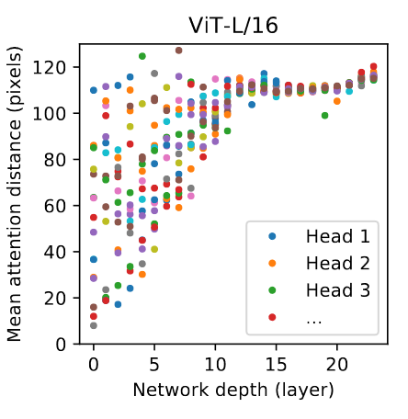

Slide 40
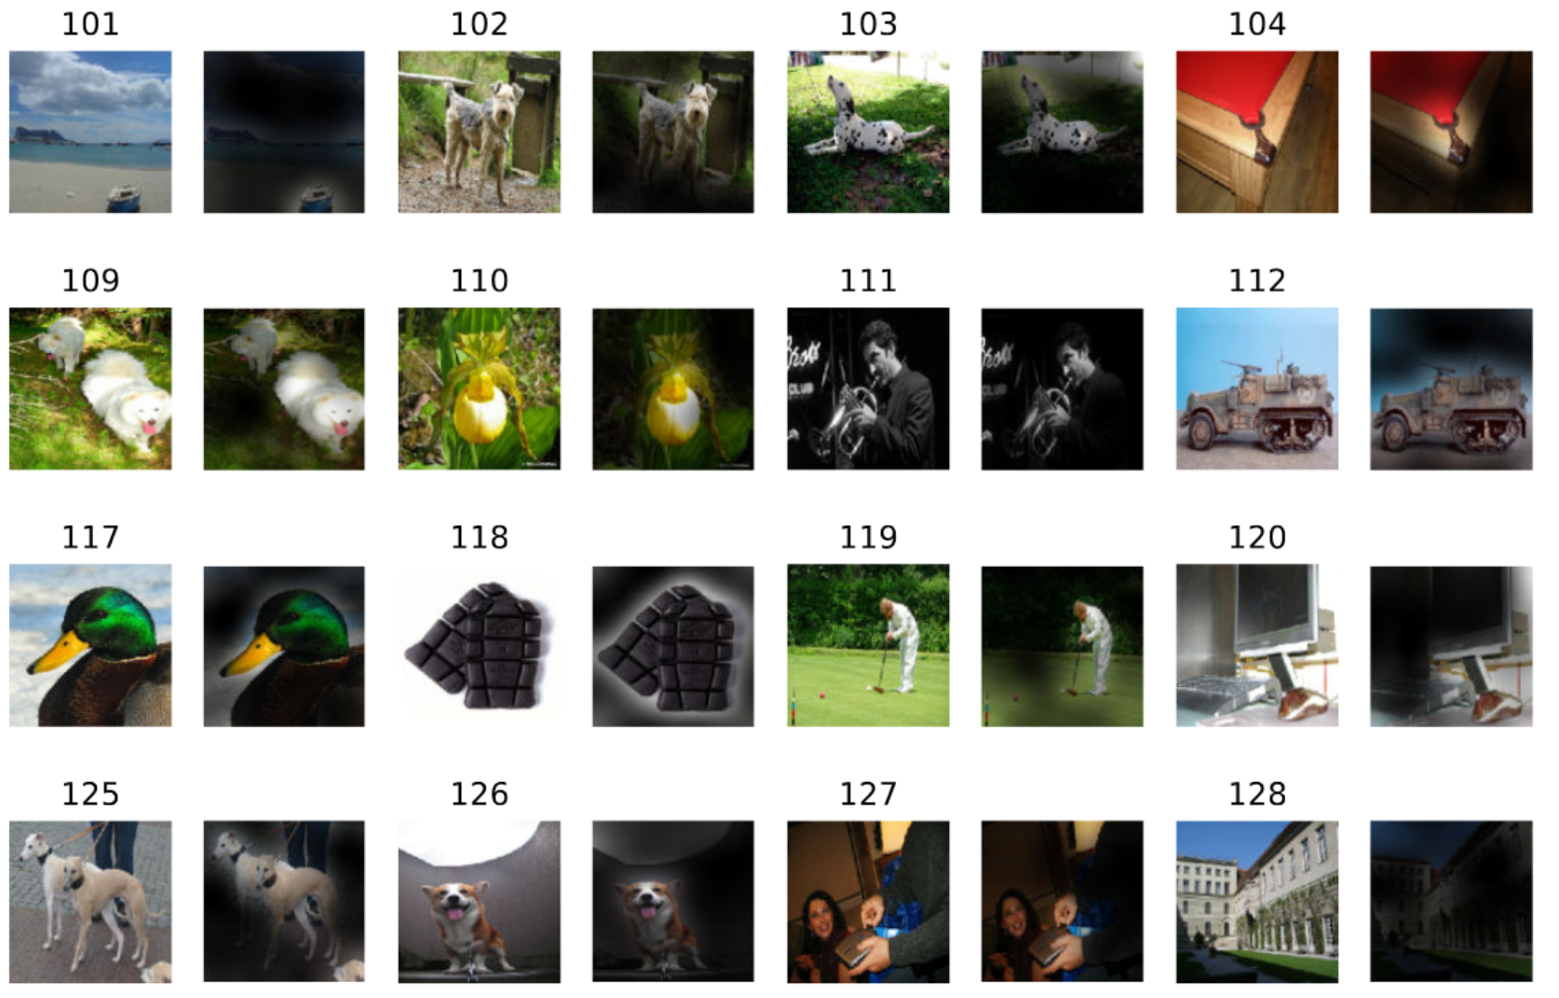

Slide 41
This can’t be ideal, right?

Slide 42
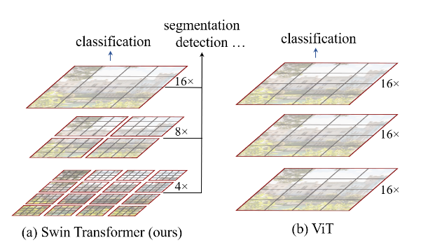
Swin Transformer: Hierarchical Vision Transformer using Shifted Windows
Ze Liu, Yutong Lin, Yue Cao, Han Hu, Yixuan Wei, Zheng Zhang, Stephen Lin, Baining Guo
Notes:
August 2021, 1163 citations

Slide 43
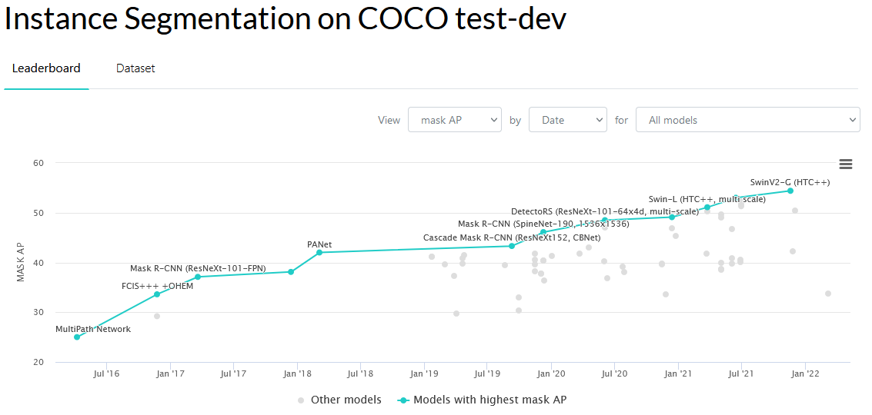
https://paperswithcode.com/sota/instance-segmentation-on-coco

Slide 44
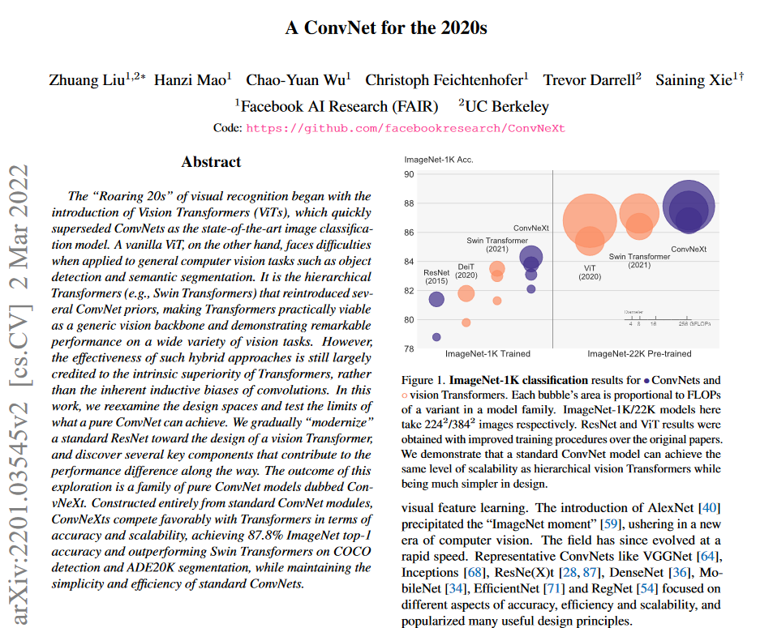

Slide 45
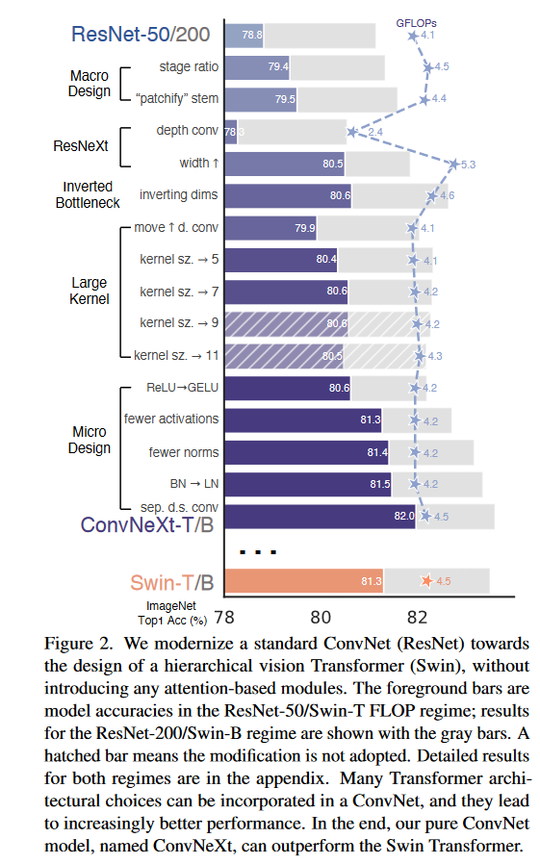
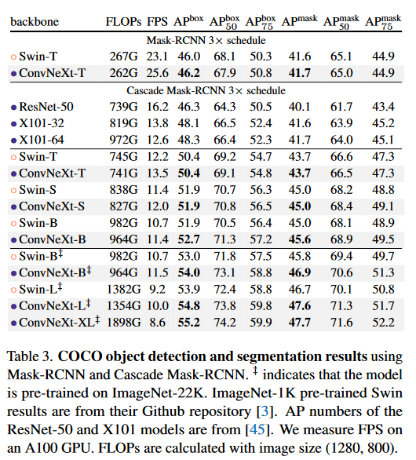

Slide 46
Summary
“Attention” models outperform recurrent models and convolutional models for sequence processing. They allow long range interactions.
These models do best with LOTS of training data
They seem like a good fit for point processing tasks, although maybe there isn’t enough data for them to outperform other methods.
Naïve attention mechanisms have quadratic complexity with the number of input tokens, but there are often workarounds for this.
Attentional models seem to succeed when they copy the inductive biases of convolutional models.
For “traditional” image processing, it is not clear if Transformers outperform convolutional networks.

