Slide 1
Welcome back!
You may need to log in to Gatech’s Github for us to be able to add you to the classroom Github group. You can debug this with project 0.
Project 1 will be out soon.
Read Szeliski 2.1, especially 2.1.4
First quiz will be Thursday, October 6th.
Today
  Image projection
  Filtering

Slide 2
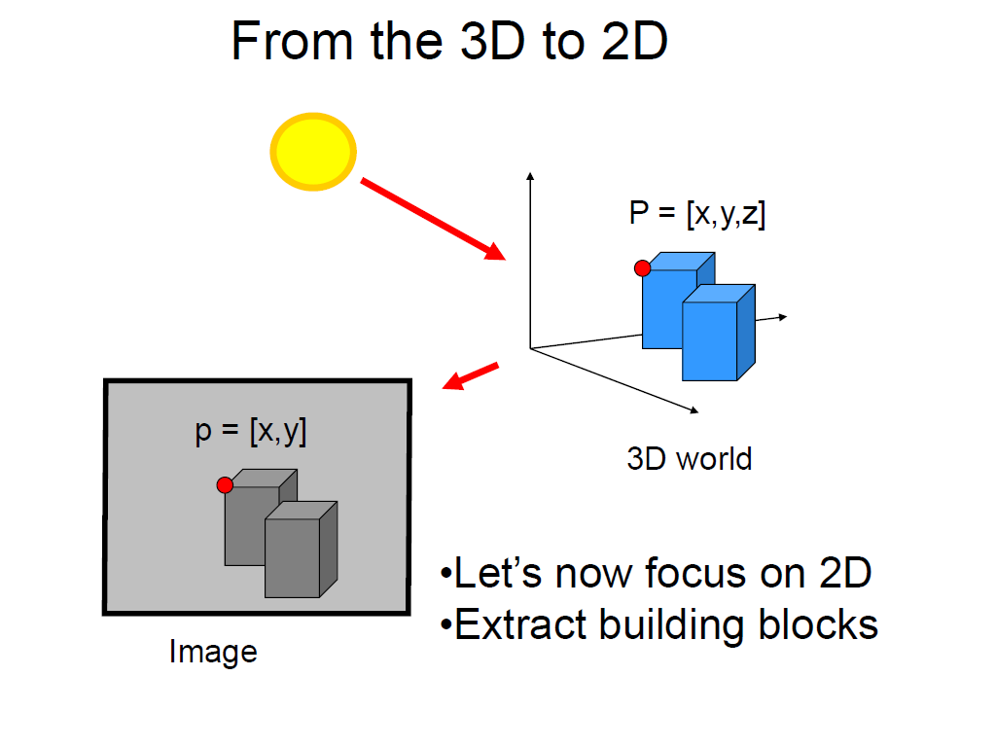
Slide credit Fei Fei Li

Slide 3
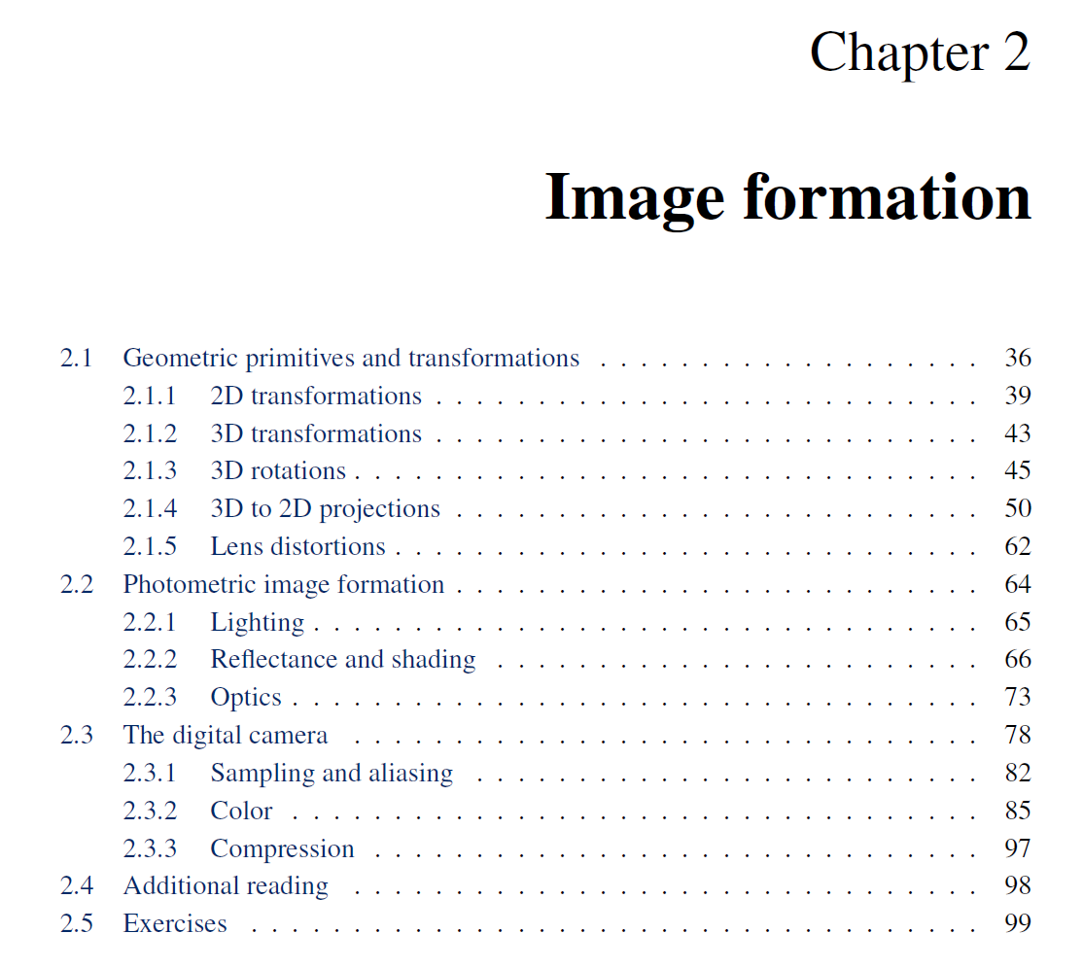

Slide 4
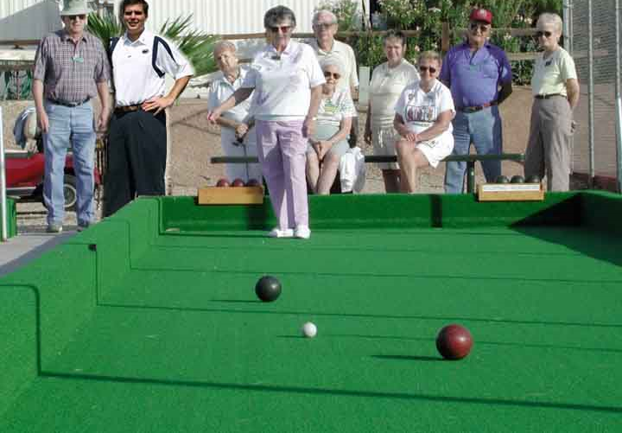
Projective Geometry
What is lost?
Length
Who is taller?
Which is closer?

Slide 5
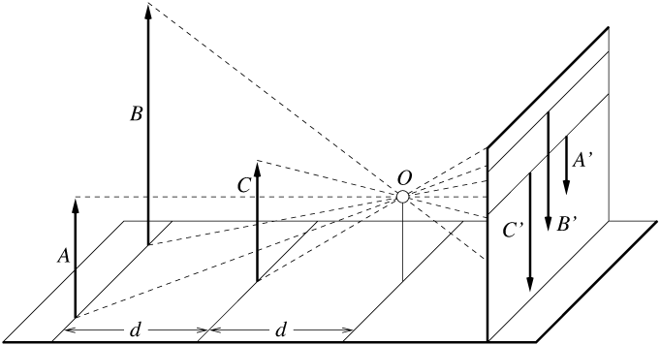
Length and area are not preserved
A’
C’
B’
Figure by David Forsyth

Slide 6
Projective Geometry
What is lost?
Length
Angles
Parallel?
Perpendicular?

Slide 7
Projective Geometry
What is preserved?
Straight lines are still straight

Slide 8
Projection: world coordinates→image coordinates
.
.
.
3
f
5
y
2
z
v’
?
.
Camera Center (0, 0, 0)
u’
If x = 2, y = 3, z = 5, and f = 2
What are u’ and v’?
Notes:
Being a little loose about coordinates vs lengths
u and v prime because they are in the same coordinate system as x, y, and z but in later slides u and v will be –u’ and –v’ because they are in their own coordinate system which is mirrored

Slide 9
Projection: world coordinates→image coordinates
.
Optical Center (u₀, v₀)
.
.
f
Z
Y
.
v
Camera Center (t_{x}, t_{y}, t_{z})
u
How do we handle the general case?

Slide 10
Interlude: why does this matter?

Slide 11
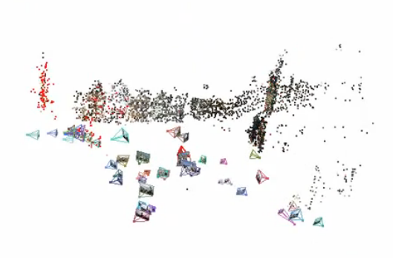
Relating multiple views

Slide 12


Slide 13
Projection: world coordinates→image coordinates
.
Optical Center (u₀, v₀)
.
.
f
Z
Y
.
v
Camera Center (t_{x}, t_{y}, t_{z})
u
How do we handle the general case?

Slide 14
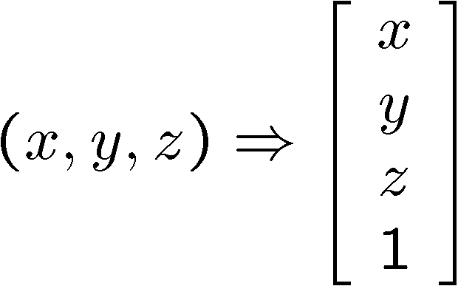
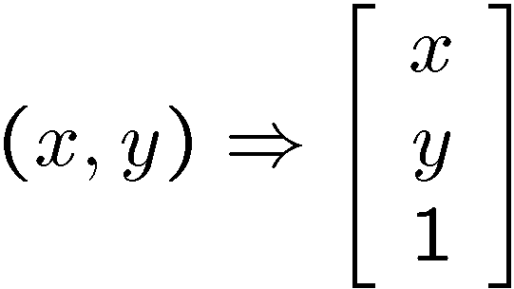
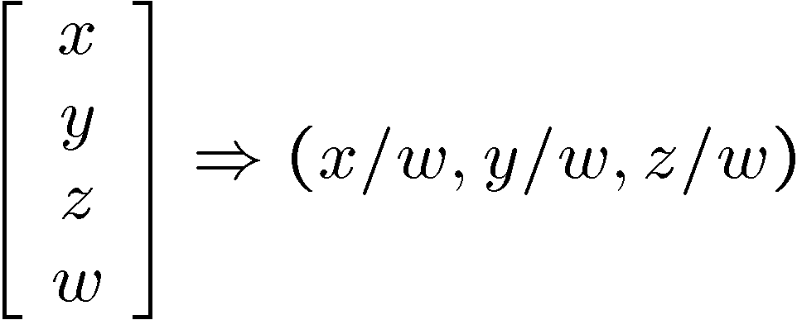
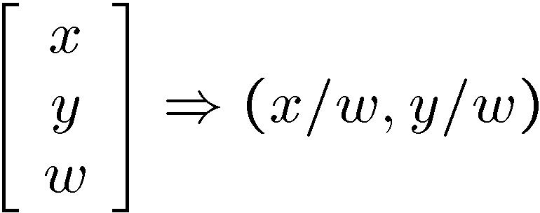
Homogeneous coordinates
Conversion
Converting to homogeneous coordinates
homogeneous image
coordinates
homogeneous scene
coordinates
Converting from homogeneous coordinates
Notes:
Append coordinate with value 1; proportional coordinate system

Slide 15
Homogeneous coordinates
Invariant to scaling
Point in Cartesian is ray in Homogeneous
Homogeneous Coordinates
Cartesian Coordinates
Notes:
Q: Suppose we have a point in Cartesian coordinates. What is that in homogeneous coordinates? A: a ray

Slide 16
Basic geometry in homogeneous coordinates
Line equation: ax + by + c = 0
Append 1 to pixel coordinate to get homogeneous coordinate
Line given by cross product of two points
Intersection of two lines given by cross product of the lines

Slide 17
Another problem solved by homogeneous coordinates
Intersection of parallel lines
  Cartesian: (Inf, Inf)
  Homogeneous: (1, 1, 0)
  Cartesian: (Inf, Inf)
Homogeneous: (1, 2, 0)
Notes:
Parallel lines intersect at different infinities

Slide 18
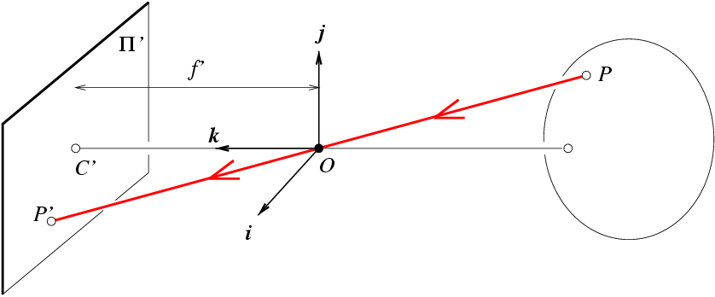
Projection matrix
Slide Credit: Savarese
R,t
j_{w}
X
k_{w}
O_{w}
x
i_{w}
x: Image Coordinates: (u,v,1)
K: Intrinsic Matrix (3x3)
R: Rotation (3x3)
t: Translation (3x1)
X: World Coordinates: (X,Y,Z,1)
Notes:
We can use homogeneous coordinates to write camera matrix in linear form.

Slide 19
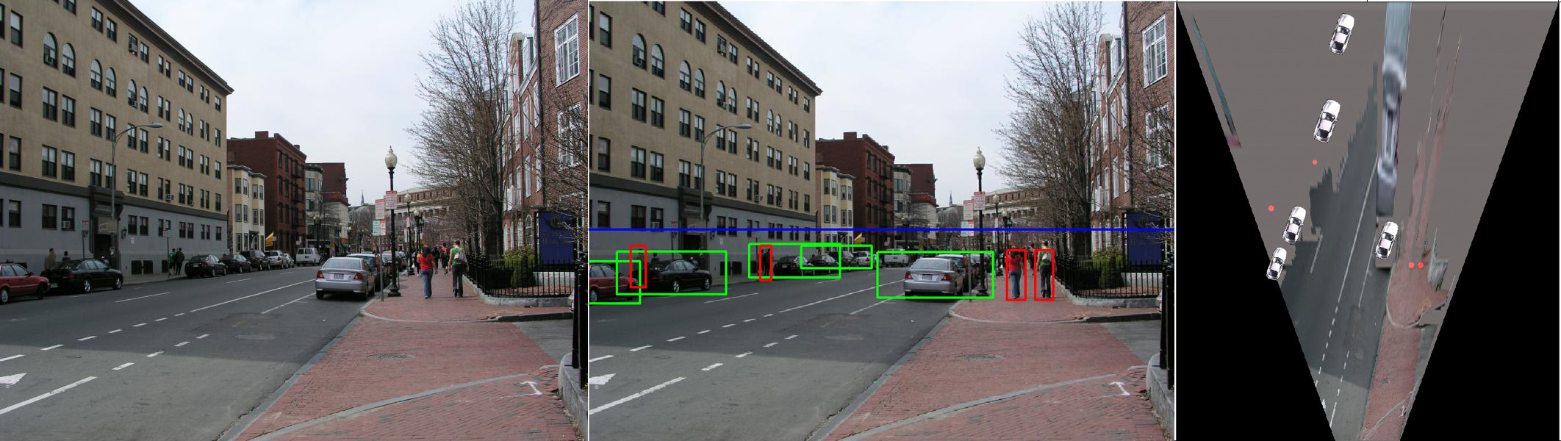
Object Recognition (CVPR 2006)

Slide 20
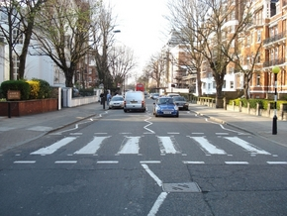
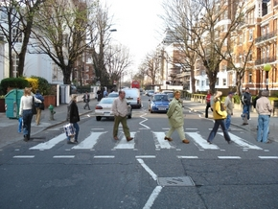
Inserting photographed objects into images (SIGGRAPH 2007)
Original
Created

Slide 21
Pinhole Camera Model
x: Image Coordinates: (u,v,1)
K: Intrinsic Matrix (3x3)
R: Rotation (3x3)
t: Translation (3x1)
X: World Coordinates: (X,Y,Z,1)

Slide 22
Projection matrix
X
x
Intrinsic Assumptions
Unit aspect ratio
Optical center at (0,0)
No skew
Extrinsic Assumptions
No rotation
Camera at (0,0,0)
K
Slide Credit: Savarese
Notes:
Work through equations for u and v on board

Slide 23
Projection matrix
X
x
Intrinsic Assumptions
Unit aspect ratio
Optical center at (0,0)
No skew
Extrinsic Assumptions
No rotation
Camera at (0,0,0)
Slide Credit: Savarese
Notes:
Work through equations for u and v on board

Slide 24
Remove assumption: known optical center
Intrinsic Assumptions
Unit aspect ratio
No skew
Extrinsic Assumptions
No rotation
Camera at (0,0,0)

Slide 25
Remove assumption: square pixels
Intrinsic Assumptions
No skew
Extrinsic Assumptions
No rotation
Camera at (0,0,0)

Slide 26
Remove assumption: non-skewed pixels
Intrinsic Assumptions
Extrinsic Assumptions
No rotation
Camera at (0,0,0)
Note: different books use different notation for parameters

Slide 27
Oriented and Translated Camera
R
j_{w}
X
t
k_{w}
O_{w}
x
i_{w}

Slide 28
Allow camera translation
Intrinsic Assumptions
Extrinsic Assumptions
No rotation

Slide 29
3D Rotation of Points
Slide Credit: Saverese
Rotation around the coordinate axes, counter-clockwise:
p’
γ
y
p
z

Slide 30
Allow camera rotation

Slide 31
Degrees of freedom
5
6
Notes:
How many known points are needed to estimate this?

Slide 32
Vanishing Point = Projection from Infinity

Slide 33
Orthographic Projection
Special case of perspective projection
  Distance from the COP to the image plane is infinite
  Also called “parallel projection”
  What’s the projection matrix?
Image
World
Slide by Steve Seitz

Slide 34
Scaled Orthographic Projection
Special case of perspective projection
  Object dimensions are small compared to distance to camera
  Also called “weak perspective”
  What’s the projection matrix?
Image
World
Slide by Steve Seitz

Slide 35
Field of View (Zoom, focal length)

Slide 36
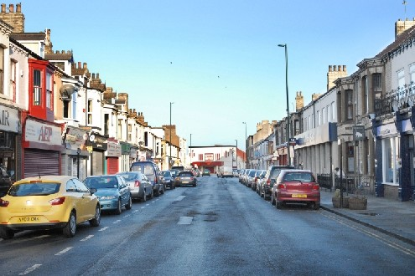
Suppose we have two 3D cubes on the ground facing the viewer, one near, one far.
What would they look like in perspective?
What would they look like in weak perspective?
Photo credit: GazetteLive.co.uk

Slide 37
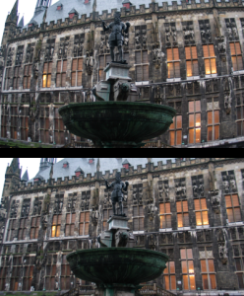
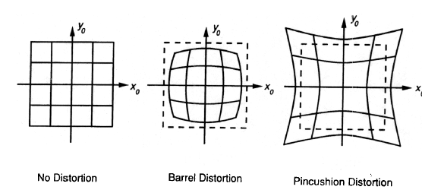
Beyond Pinholes: Radial Distortion
Corrected Barrel Distortion
Image from Martin Habbecke

Slide 38
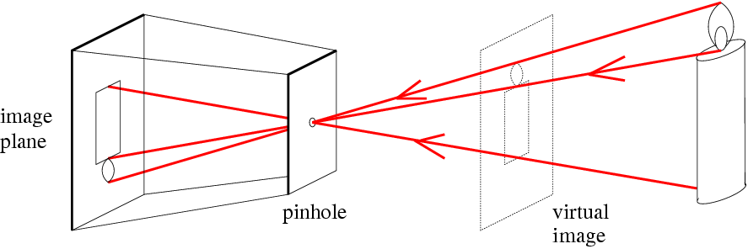
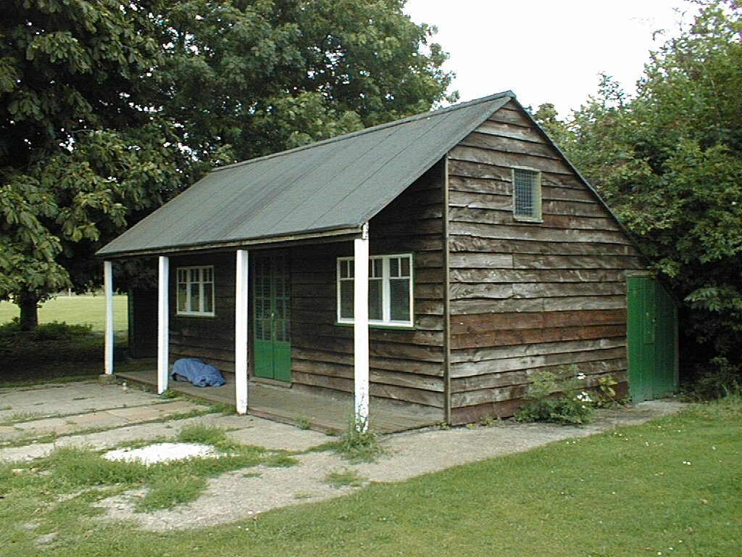
Things to remember
Vertical vanishing
point
(at infinity)
Vanishing points and vanishing lines
Pinhole camera model and camera projection matrix
Homogeneous coordinates
Vanishing
line
Vanishing
point
Vanishing
point

Slide 39
Reminder: read your book
Lectures have assigned readings
Szeliski 2.1 and especially 2.1.4 cover the geometry of image formation

Slide 40
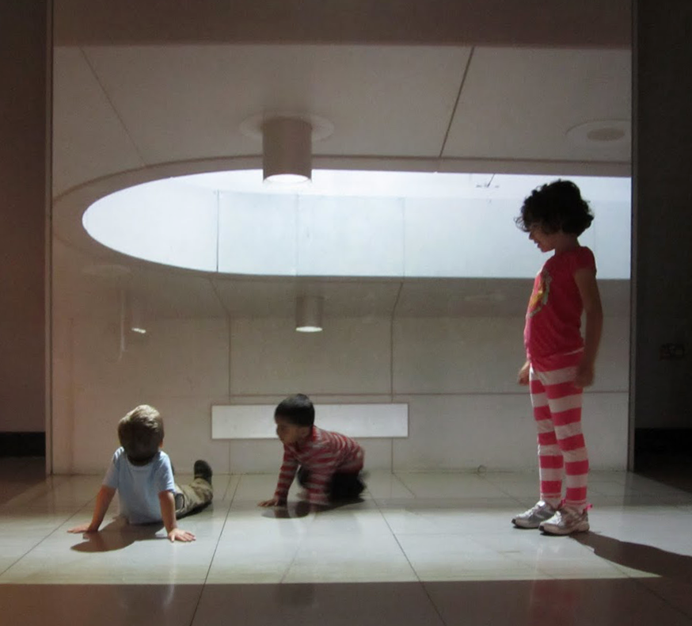
Image Filtering
Computer Vision
James Hays
Many slides by Derek Hoiem

Slide 41
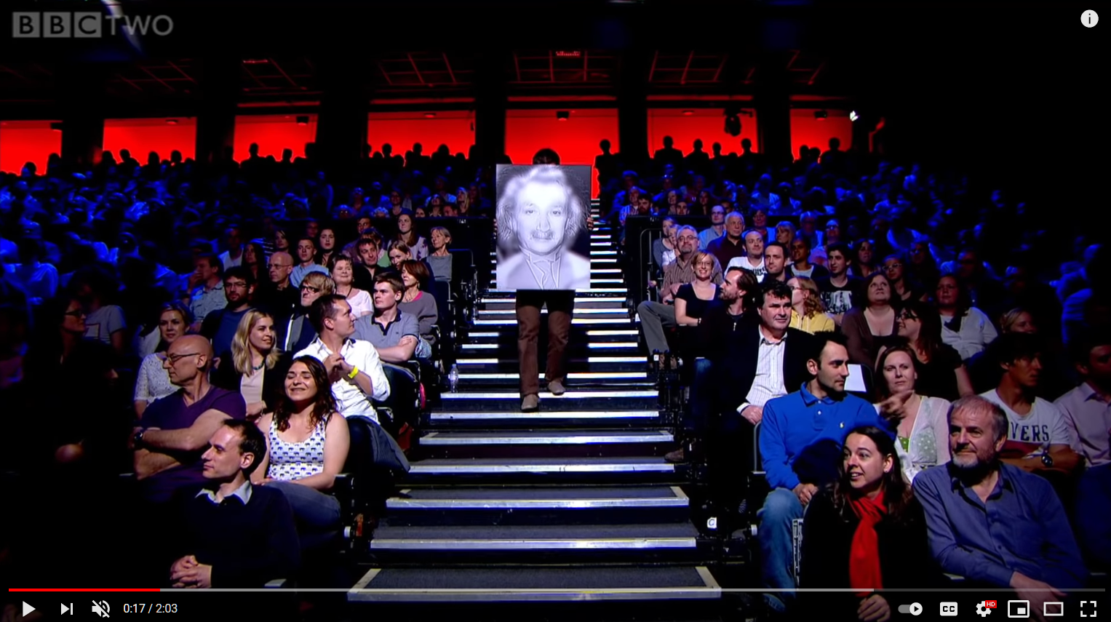
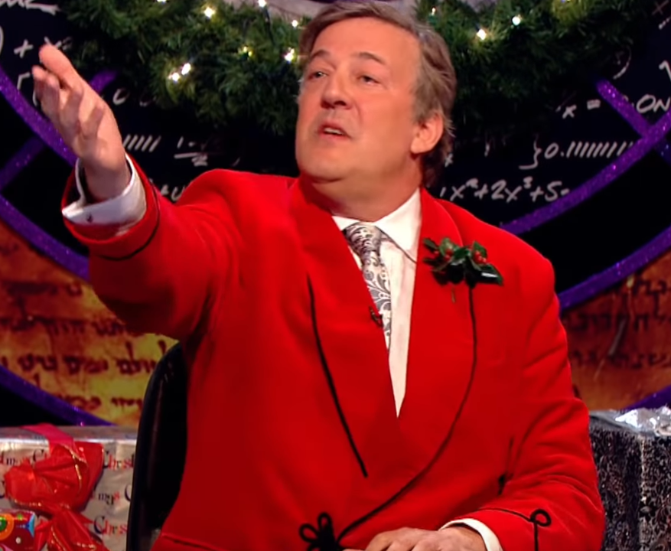
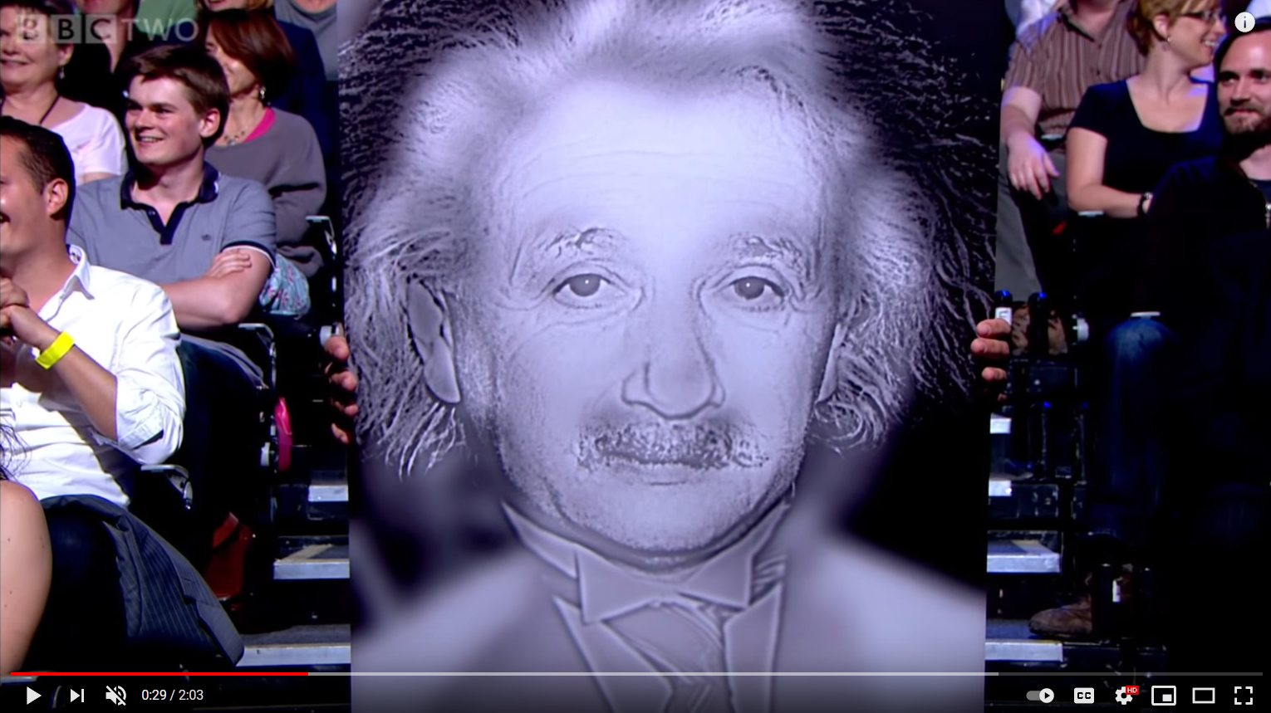
Project 1
BBC Clip: https://www.youtube.com/watch/OlumoQ05gS8

Slide 42
Slide credit Fei Fei Li

Slide 43
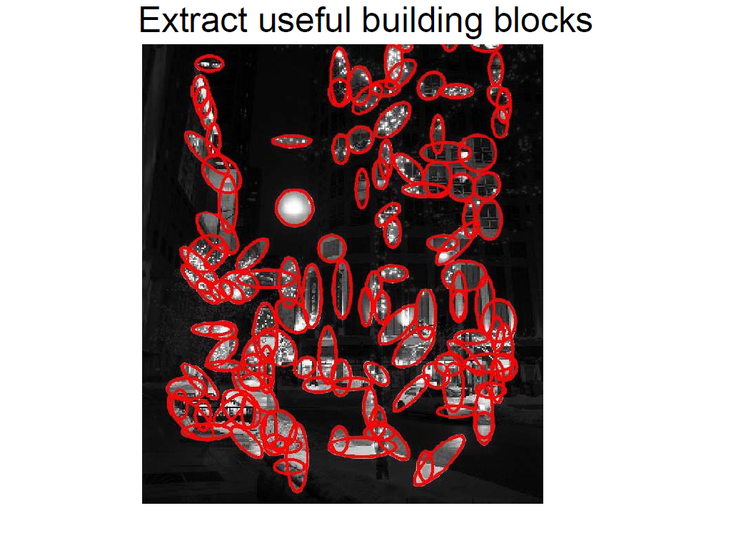
Slide credit Fei Fei Li

Slide 44
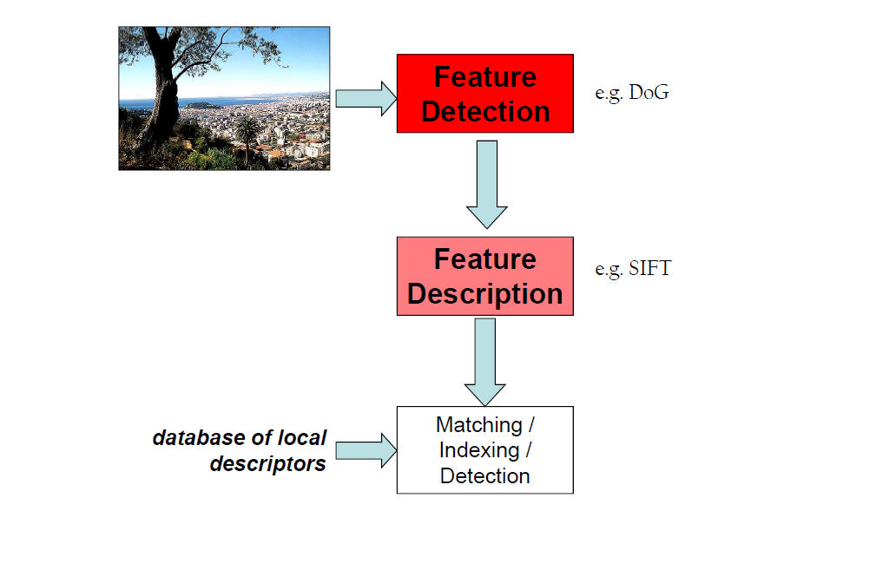
Slide credit Fei Fei Li

Slide 45
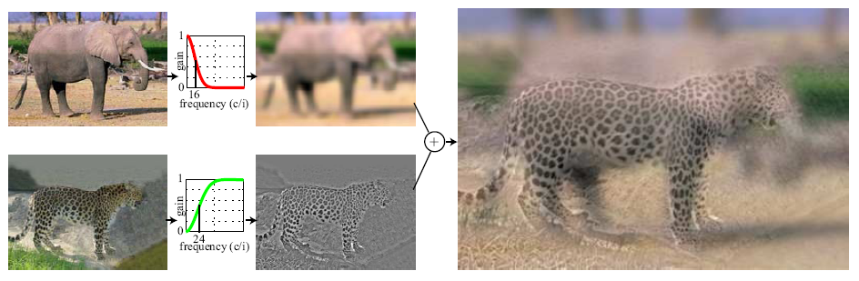
Hybrid Images
A. Oliva, A. Torralba, P.G. Schyns,
“Hybrid Images,” SIGGRAPH 2006

Slide 46
Upcoming classes: two views of filtering
Image filters in spatial domain
  Filter is a mathematical operation of a grid of numbers
  Smoothing, sharpening, measuring texture
Image filters in the frequency domain
  Filtering is a way to modify the frequencies of images
  Denoising, sampling, image compression

Slide 47
Image filtering (or convolution)
Image filtering: compute function of local neighborhood at each position
Really important!
  Enhance images
    Denoise, resize, increase contrast, etc.
  Extract information from images
    Texture, edges, distinctive points, etc.
  Detect patterns
    Template matching
  Deep Convolutional Networks

Slide 48

Example: box filter
1
1
1
1
1
1
1
1
1
Slide credit: David Lowe (UBC)

Slide 49
Image filtering
1
1
1
1
1
1
1
1
1
0 | 0 | 0 | 0 | 0 | 0 | 0 | 0 | 0 | 0
0 | 0 | 0 | 0 | 0 | 0 | 0 | 0 | 0 | 0
0 | 0 | 0 | 90 | 90 | 90 | 90 | 90 | 0 | 0
0 | 0 | 0 | 90 | 90 | 90 | 90 | 90 | 0 | 0
0 | 0 | 0 | 90 | 90 | 90 | 90 | 90 | 0 | 0
0 | 0 | 0 | 90 | 0 | 90 | 90 | 90 | 0 | 0
0 | 0 | 0 | 90 | 90 | 90 | 90 | 90 | 0 | 0
0 | 0 | 0 | 0 | 0 | 0 | 0 | 0 | 0 | 0
0 | 0 | 90 | 0 | 0 | 0 | 0 | 0 | 0 | 0
0 | 0 | 0 | 0 | 0 | 0 | 0 | 0 | 0 | 0
 | 0
0 | 0 | 0 | 0 | 0 | 0 | 0 | 0 | 0 | 0
0 | 0 | 0 | 0 | 0 | 0 | 0 | 0 | 0 | 0
0 | 0 | 0 | 90 | 90 | 90 | 90 | 90 | 0 | 0
0 | 0 | 0 | 90 | 90 | 90 | 90 | 90 | 0 | 0
0 | 0 | 0 | 90 | 90 | 90 | 90 | 90 | 0 | 0
0 | 0 | 0 | 90 | 0 | 90 | 90 | 90 | 0 | 0
0 | 0 | 0 | 90 | 90 | 90 | 90 | 90 | 0 | 0
0 | 0 | 0 | 0 | 0 | 0 | 0 | 0 | 0 | 0
0 | 0 | 90 | 0 | 0 | 0 | 0 | 0 | 0 | 0
0 | 0 | 0 | 0 | 0 | 0 | 0 | 0 | 0 | 0
Credit: S. Seitz
Notes:
ones, divide by 9

Slide 50
Image filtering
1
1
1
1
1
1
1
1
1
0 | 0 | 0 | 0 | 0 | 0 | 0 | 0 | 0 | 0
0 | 0 | 0 | 0 | 0 | 0 | 0 | 0 | 0 | 0
0 | 0 | 0 | 90 | 90 | 90 | 90 | 90 | 0 | 0
0 | 0 | 0 | 90 | 90 | 90 | 90 | 90 | 0 | 0
0 | 0 | 0 | 90 | 90 | 90 | 90 | 90 | 0 | 0
0 | 0 | 0 | 90 | 0 | 90 | 90 | 90 | 0 | 0
0 | 0 | 0 | 90 | 90 | 90 | 90 | 90 | 0 | 0
0 | 0 | 0 | 0 | 0 | 0 | 0 | 0 | 0 | 0
0 | 0 | 90 | 0 | 0 | 0 | 0 | 0 | 0 | 0
0 | 0 | 0 | 0 | 0 | 0 | 0 | 0 | 0 | 0
 | 0 | 10
0 | 0 | 0 | 0 | 0 | 0 | 0 | 0 | 0 | 0
0 | 0 | 0 | 0 | 0 | 0 | 0 | 0 | 0 | 0
0 | 0 | 0 | 90 | 90 | 90 | 90 | 90 | 0 | 0
0 | 0 | 0 | 90 | 90 | 90 | 90 | 90 | 0 | 0
0 | 0 | 0 | 90 | 90 | 90 | 90 | 90 | 0 | 0
0 | 0 | 0 | 90 | 0 | 90 | 90 | 90 | 0 | 0
0 | 0 | 0 | 90 | 90 | 90 | 90 | 90 | 0 | 0
0 | 0 | 0 | 0 | 0 | 0 | 0 | 0 | 0 | 0
0 | 0 | 90 | 0 | 0 | 0 | 0 | 0 | 0 | 0
0 | 0 | 0 | 0 | 0 | 0 | 0 | 0 | 0 | 0
Credit: S. Seitz
Notes:
ones, divide by 9

Slide 51
Image filtering
1
1
1
1
1
1
1
1
1
0 | 0 | 0 | 0 | 0 | 0 | 0 | 0 | 0 | 0
0 | 0 | 0 | 0 | 0 | 0 | 0 | 0 | 0 | 0
0 | 0 | 0 | 90 | 90 | 90 | 90 | 90 | 0 | 0
0 | 0 | 0 | 90 | 90 | 90 | 90 | 90 | 0 | 0
0 | 0 | 0 | 90 | 90 | 90 | 90 | 90 | 0 | 0
0 | 0 | 0 | 90 | 0 | 90 | 90 | 90 | 0 | 0
0 | 0 | 0 | 90 | 90 | 90 | 90 | 90 | 0 | 0
0 | 0 | 0 | 0 | 0 | 0 | 0 | 0 | 0 | 0
0 | 0 | 90 | 0 | 0 | 0 | 0 | 0 | 0 | 0
0 | 0 | 0 | 0 | 0 | 0 | 0 | 0 | 0 | 0
 | 0 | 10 | 20
0 | 0 | 0 | 0 | 0 | 0 | 0 | 0 | 0 | 0
0 | 0 | 0 | 0 | 0 | 0 | 0 | 0 | 0 | 0
0 | 0 | 0 | 90 | 90 | 90 | 90 | 90 | 0 | 0
0 | 0 | 0 | 90 | 90 | 90 | 90 | 90 | 0 | 0
0 | 0 | 0 | 90 | 90 | 90 | 90 | 90 | 0 | 0
0 | 0 | 0 | 90 | 0 | 90 | 90 | 90 | 0 | 0
0 | 0 | 0 | 90 | 90 | 90 | 90 | 90 | 0 | 0
0 | 0 | 0 | 0 | 0 | 0 | 0 | 0 | 0 | 0
0 | 0 | 90 | 0 | 0 | 0 | 0 | 0 | 0 | 0
0 | 0 | 0 | 0 | 0 | 0 | 0 | 0 | 0 | 0
Credit: S. Seitz
Notes:
ones, divide by 9

Slide 52
Image filtering
1
1
1
1
1
1
1
1
1
0 | 0 | 0 | 0 | 0 | 0 | 0 | 0 | 0 | 0
0 | 0 | 0 | 0 | 0 | 0 | 0 | 0 | 0 | 0
0 | 0 | 0 | 90 | 90 | 90 | 90 | 90 | 0 | 0
0 | 0 | 0 | 90 | 90 | 90 | 90 | 90 | 0 | 0
0 | 0 | 0 | 90 | 90 | 90 | 90 | 90 | 0 | 0
0 | 0 | 0 | 90 | 0 | 90 | 90 | 90 | 0 | 0
0 | 0 | 0 | 90 | 90 | 90 | 90 | 90 | 0 | 0
0 | 0 | 0 | 0 | 0 | 0 | 0 | 0 | 0 | 0
0 | 0 | 90 | 0 | 0 | 0 | 0 | 0 | 0 | 0
0 | 0 | 0 | 0 | 0 | 0 | 0 | 0 | 0 | 0
 | 0 | 10 | 20 | 30
0 | 0 | 0 | 0 | 0 | 0 | 0 | 0 | 0 | 0
0 | 0 | 0 | 0 | 0 | 0 | 0 | 0 | 0 | 0
0 | 0 | 0 | 90 | 90 | 90 | 90 | 90 | 0 | 0
0 | 0 | 0 | 90 | 90 | 90 | 90 | 90 | 0 | 0
0 | 0 | 0 | 90 | 90 | 90 | 90 | 90 | 0 | 0
0 | 0 | 0 | 90 | 0 | 90 | 90 | 90 | 0 | 0
0 | 0 | 0 | 90 | 90 | 90 | 90 | 90 | 0 | 0
0 | 0 | 0 | 0 | 0 | 0 | 0 | 0 | 0 | 0
0 | 0 | 90 | 0 | 0 | 0 | 0 | 0 | 0 | 0
0 | 0 | 0 | 0 | 0 | 0 | 0 | 0 | 0 | 0
Credit: S. Seitz
Notes:
ones, divide by 9

Slide 53
Image filtering
1
1
1
1
1
1
1
1
1
0 | 0 | 0 | 0 | 0 | 0 | 0 | 0 | 0 | 0
0 | 0 | 0 | 0 | 0 | 0 | 0 | 0 | 0 | 0
0 | 0 | 0 | 90 | 90 | 90 | 90 | 90 | 0 | 0
0 | 0 | 0 | 90 | 90 | 90 | 90 | 90 | 0 | 0
0 | 0 | 0 | 90 | 90 | 90 | 90 | 90 | 0 | 0
0 | 0 | 0 | 90 | 0 | 90 | 90 | 90 | 0 | 0
0 | 0 | 0 | 90 | 90 | 90 | 90 | 90 | 0 | 0
0 | 0 | 0 | 0 | 0 | 0 | 0 | 0 | 0 | 0
0 | 0 | 90 | 0 | 0 | 0 | 0 | 0 | 0 | 0
0 | 0 | 0 | 0 | 0 | 0 | 0 | 0 | 0 | 0
 | 0 | 10 | 20 | 30 | 30
Credit: S. Seitz
Notes:
ones, divide by 9

Slide 54
Image filtering
1
1
1
1
1
1
1
1
1
0 | 0 | 0 | 0 | 0 | 0 | 0 | 0 | 0 | 0
0 | 0 | 0 | 0 | 0 | 0 | 0 | 0 | 0 | 0
0 | 0 | 0 | 90 | 90 | 90 | 90 | 90 | 0 | 0
0 | 0 | 0 | 90 | 90 | 90 | 90 | 90 | 0 | 0
0 | 0 | 0 | 90 | 90 | 90 | 90 | 90 | 0 | 0
0 | 0 | 0 | 90 | 0 | 90 | 90 | 90 | 0 | 0
0 | 0 | 0 | 90 | 90 | 90 | 90 | 90 | 0 | 0
0 | 0 | 0 | 0 | 0 | 0 | 0 | 0 | 0 | 0
0 | 0 | 90 | 0 | 0 | 0 | 0 | 0 | 0 | 0
0 | 0 | 0 | 0 | 0 | 0 | 0 | 0 | 0 | 0
 | 0 | 10 | 20 | 30 | 30
?
Credit: S. Seitz
Notes:
ones, divide by 9

Slide 55
Image filtering
1
1
1
1
1
1
1
1
1
0 | 0 | 0 | 0 | 0 | 0 | 0 | 0 | 0 | 0
0 | 0 | 0 | 0 | 0 | 0 | 0 | 0 | 0 | 0
0 | 0 | 0 | 90 | 90 | 90 | 90 | 90 | 0 | 0
0 | 0 | 0 | 90 | 90 | 90 | 90 | 90 | 0 | 0
0 | 0 | 0 | 90 | 90 | 90 | 90 | 90 | 0 | 0
0 | 0 | 0 | 90 | 0 | 90 | 90 | 90 | 0 | 0
0 | 0 | 0 | 90 | 90 | 90 | 90 | 90 | 0 | 0
0 | 0 | 0 | 0 | 0 | 0 | 0 | 0 | 0 | 0
0 | 0 | 90 | 0 | 0 | 0 | 0 | 0 | 0 | 0
0 | 0 | 0 | 0 | 0 | 0 | 0 | 0 | 0 | 0
 | 0 | 10 | 20 | 30 | 30
 |  |  |  | 50
?
Credit: S. Seitz
Notes:
ones, divide by 9

Slide 56
Image filtering
1
1
1
1
1
1
1
1
1
0 | 0 | 0 | 0 | 0 | 0 | 0 | 0 | 0 | 0
0 | 0 | 0 | 0 | 0 | 0 | 0 | 0 | 0 | 0
0 | 0 | 0 | 90 | 90 | 90 | 90 | 90 | 0 | 0
0 | 0 | 0 | 90 | 90 | 90 | 90 | 90 | 0 | 0
0 | 0 | 0 | 90 | 90 | 90 | 90 | 90 | 0 | 0
0 | 0 | 0 | 90 | 0 | 90 | 90 | 90 | 0 | 0
0 | 0 | 0 | 90 | 90 | 90 | 90 | 90 | 0 | 0
0 | 0 | 0 | 0 | 0 | 0 | 0 | 0 | 0 | 0
0 | 0 | 90 | 0 | 0 | 0 | 0 | 0 | 0 | 0
0 | 0 | 0 | 0 | 0 | 0 | 0 | 0 | 0 | 0
 | 0 | 10 | 20 | 30 | 30 | 30 | 20 | 10
 | 0 | 20 | 40 | 60 | 60 | 60 | 40 | 20
 | 0 | 30 | 60 | 90 | 90 | 90 | 60 | 30
 | 0 | 30 | 50 | 80 | 80 | 90 | 60 | 30
 | 0 | 30 | 50 | 80 | 80 | 90 | 60 | 30
 | 0 | 20 | 30 | 50 | 50 | 60 | 40 | 20
 | 10 | 20 | 30 | 30 | 30 | 30 | 20 | 10
 | 10 | 10 | 10 | 0 | 0 | 0 | 0 | 0
Credit: S. Seitz

Slide 57
Box Filter
What does it do?
Replaces each pixel with an average of its neighborhood
Achieve smoothing effect (remove sharp features)
1
1
1
1
1
1
1
1
1
Slide credit: David Lowe (UBC)

Slide 58
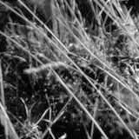
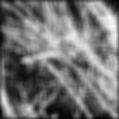
Smoothing with box filter

Slide 59
One more on board…

Slide 60
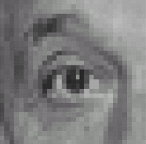
Practice with linear filters
0
0
0
?
0
1
0
0
0
0
Original
Source: D. Lowe

Slide 61
Practice with linear filters
0
0
0
0
1
0
0
0
0
Original
Filtered
(no change)
Source: D. Lowe

Slide 62
Practice with linear filters
0
0
0
?
0
0
1
0
0
0
Original
Source: D. Lowe

Slide 63
Practice with linear filters
0
0
0
0
0
1
0
0
0
Original
Shifted left
By 1 pixel
Source: D. Lowe

Slide 64

Practice with linear filters
0
0
0
-
1
1
1
?
0
2
0
1
1
1
0
0
0
1
1
1
(Note that filter sums to 1)
Original
Source: D. Lowe

Slide 65
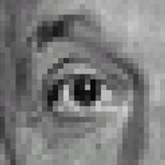
Practice with linear filters
0
0
0
-
1
1
1
0
2
0
1
1
1
0
0
0
1
1
1
Original
Sharpening filter
  Accentuates differences with local average
Source: D. Lowe

Slide 66
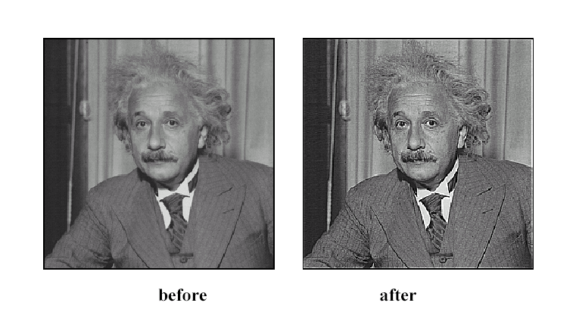
Sharpening
Source: D. Lowe

Slide 67
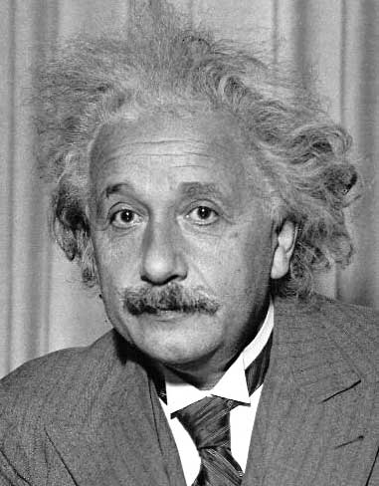
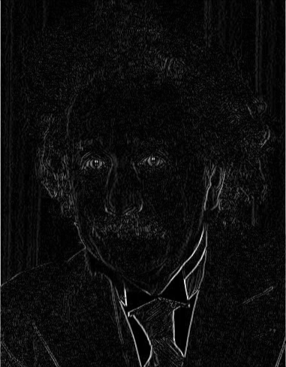
Other filters
1
0
-1
2
0
-2
1
0
-1
Sobel
Vertical Edge
(absolute value)

Slide 68
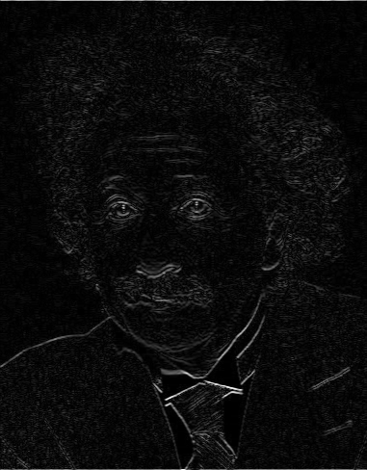
Other filters
1
2
1
0
0
0
-1
-2
-1
Sobel
Horizontal Edge
(absolute value)
Notes:
Questions at this point?

Slide 69
How could we synthesize motion blur?
theta = 30; len = 20;
fil = imrotate(ones(1, len), theta, 'bilinear');
fil = fil / sum(fil(:));
figure(2), imshow(imfilter(im, fil));

Slide 70
Filtering vs. Convolution
f=filter, size k x l
I=image, size m x n
2d filtering
2d convolution
In Python you can use https://docs.scipy.org/doc/scipy/reference/generated/scipy.signal.convolve2d.html

Slide 71
Key properties of linear filters
Linearity:
imfilter(I, f₁ + f₂) =
imfilter(I,f₁) + imfilter(I,f₂)
Shift invariance: same behavior regardless of pixel location
imfilter(I,shift(f)) = shift(imfilter(I,f))
Any linear, shift-invariant operator can be represented as a convolution
Source: S. Lazebnik
Notes:
f is image

Slide 72
More properties
Commutative: a * b = b * a
  Conceptually no difference between filter and signal
  But particular filtering implementations might break this equality
Associative: a * (b * c) = (a * b) * c
  Often apply several filters one after another: (((a * b₁) * b₂) * b₃)
  This is equivalent to applying one filter: a * (b₁ * b₂ * b₃)
Distributes over addition: a * (b + c) = (a * b) + (a * c)
Scalars factor out: ka * b = a * kb = k (a * b)
Identity: unit impulse e = [0, 0, 1, 0, 0],
a * e = a
Source: S. Lazebnik

Slide 73
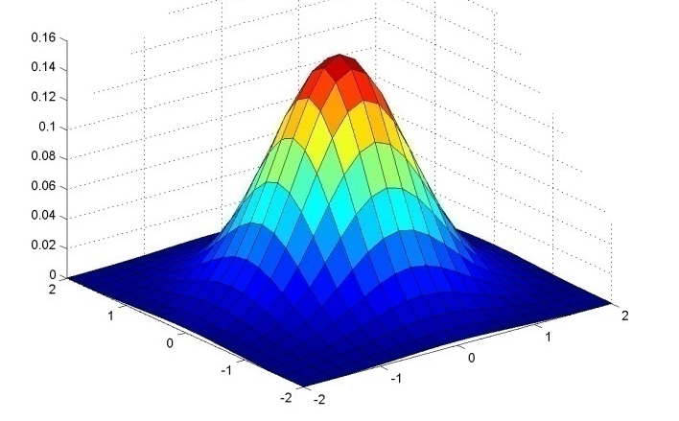
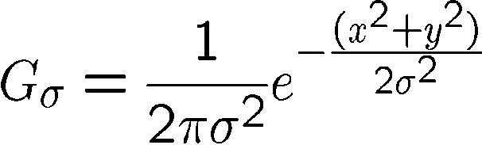
Important filter: Gaussian
Weight contributions of neighboring pixels by nearness
0.003 0.013 0.022 0.013 0.003
0.013 0.059 0.097 0.059 0.013
0.022 0.097 0.159 0.097 0.022
0.013 0.059 0.097 0.059 0.013
0.003 0.013 0.022 0.013 0.003
5 x 5, σ = 1
Slide credit: Christopher Rasmussen
Notes:
e^0 = 1, e^-1 = .37, e^-2 = .14, etc.

Slide 74

Smoothing with Gaussian filter

Slide 75
Smoothing with box filter

Slide 76
Gaussian filters
Remove “high-frequency” components from the image (low-pass filter)
  Images become more smooth
Convolution with self is another Gaussian
  So can smooth with small-width kernel, repeat, and get same result as larger-width kernel would have
  Convolving two times with Gaussian kernel of width σ is same as convolving once with kernel of width σ√2
Separable kernel
  Factors into product of two 1D Gaussians
Source: K. Grauman
Notes:
Linear vs. quadratic in mask size

Slide 77
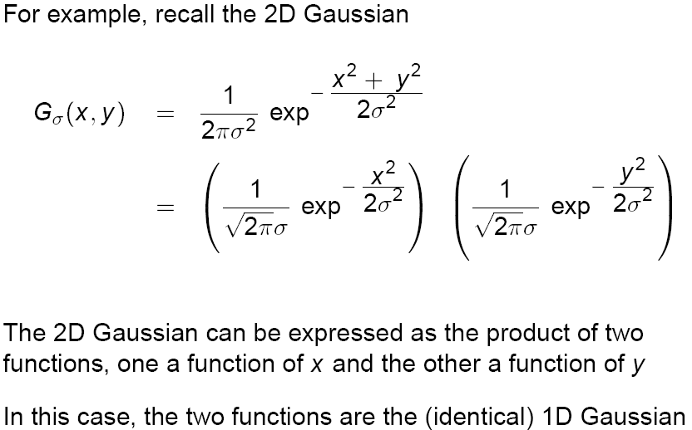
Separability of the Gaussian filter
Source: D. Lowe

Slide 78
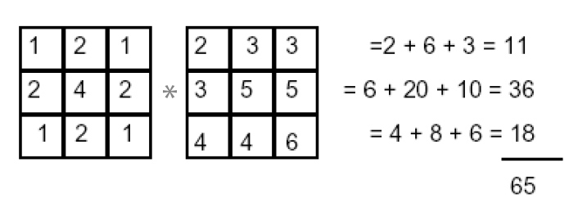
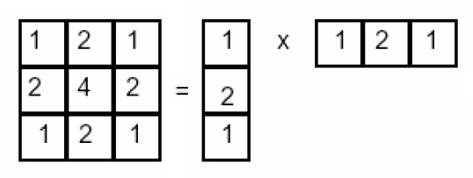
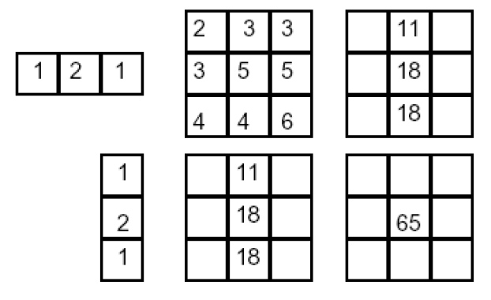
Separability example
2D convolution
(center location only)
The filter factors
into a product of 1D
filters:
Perform convolution
along rows:
*
=
Followed by convolution
along the remaining column:
*
=
Source: K. Grauman
Notes:
Convolution vs filtering doesn’t matter here because the filter is symmetric

Slide 79
Separability
Why is separability useful in practice?

Slide 80
Some practical matters

Slide 81
Practical matters
How big should the filter be?
Values at edges should be near zero
Rule of thumb for Gaussian: set filter half-width to about 3 σ

Slide 82













Practical matters
What about near the edge?
  the filter window falls off the edge of the image
  need to extrapolate
  methods:
    clip filter (black)
    wrap around
    copy edge
    reflect across edge
Source: S. Marschner

Slide 83
To be continued…

Slide 84
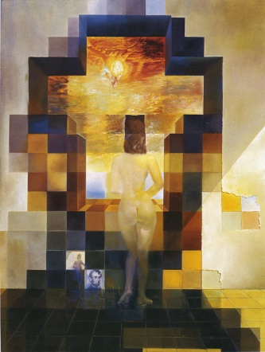
Next class: Light and Color and
Thinking in Frequency

