Slide 1
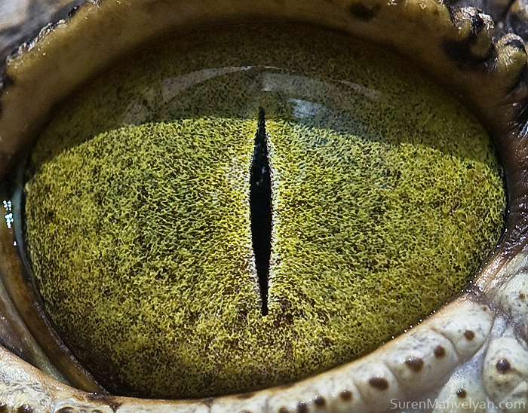
By Suren Manvelyan, http://www.surenmanvelyan.com/gallery/7116
Notes:
http://www.surenmanvelyan.com/gallery/7116
Crocodile (nile crocodile?)

Slide 2
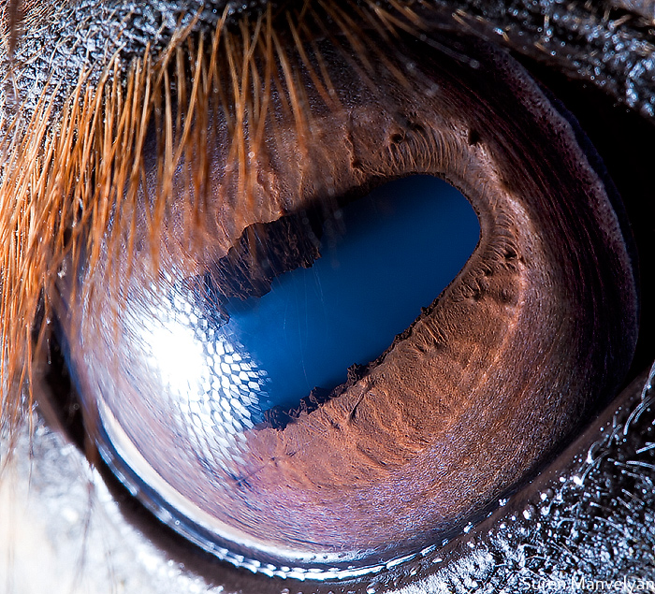
By Suren Manvelyan, http://www.surenmanvelyan.com/gallery/7116
Notes:
http://www.surenmanvelyan.com/gallery/7116
horse

Slide 3
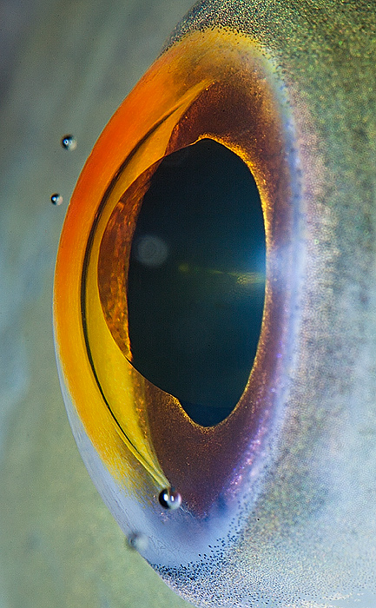
By Suren Manvelyan, http://www.surenmanvelyan.com/gallery/7116
Notes:
http://www.surenmanvelyan.com/gallery/7116
fish

Slide 4
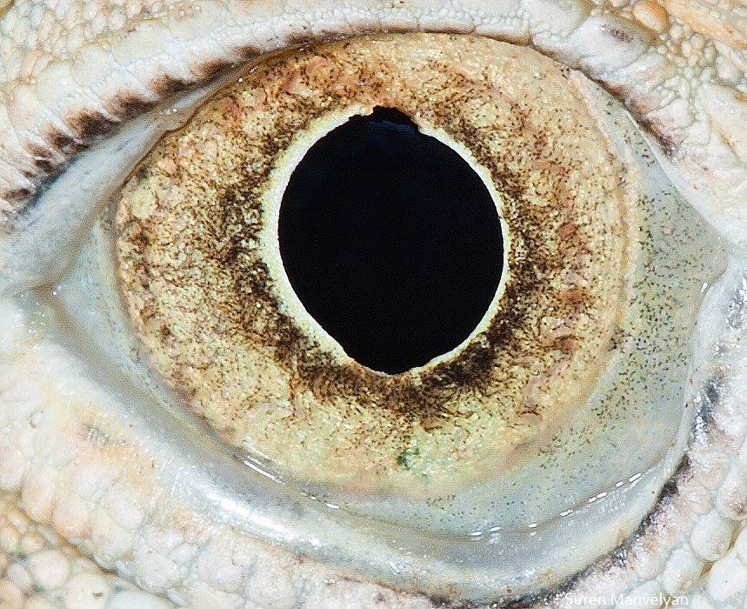
By Suren Manvelyan, http://www.surenmanvelyan.com/gallery/7116
Notes:
http://www.surenmanvelyan.com/gallery/7116
iguana

Slide 5
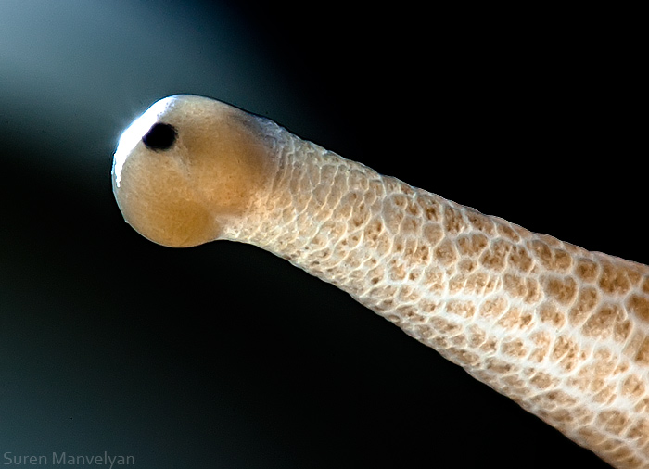
By Suren Manvelyan, http://www.surenmanvelyan.com/gallery/7116
Notes:
http://www.surenmanvelyan.com/gallery/7116
snail

Slide 6
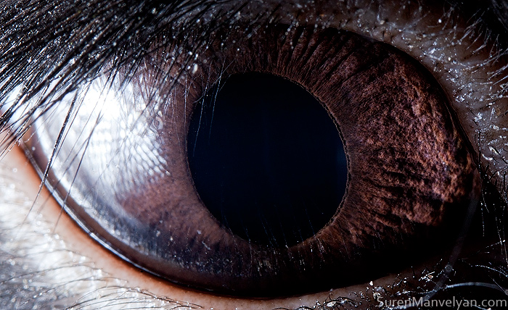
By Suren Manvelyan, http://www.surenmanvelyan.com/gallery/7116
Notes:
http://www.surenmanvelyan.com/gallery/7116
rabbit

Slide 7
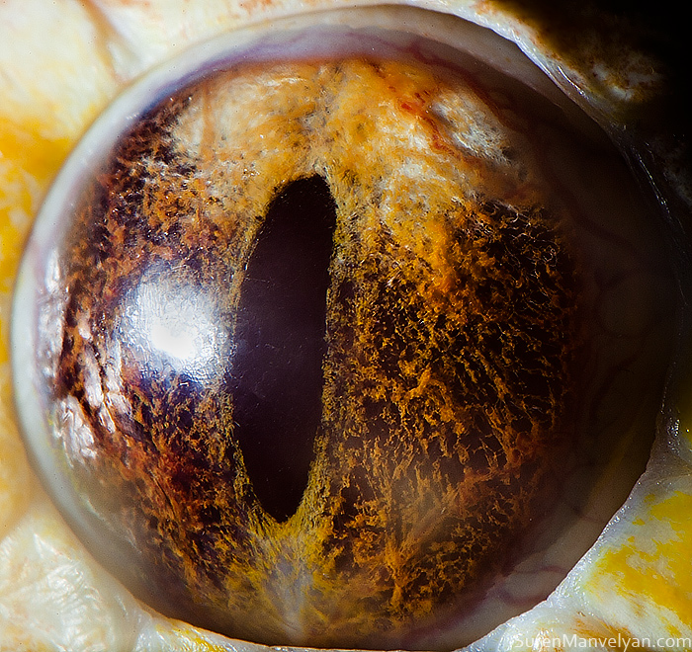
By Suren Manvelyan, http://www.surenmanvelyan.com/gallery/7116
Notes:
http://www.surenmanvelyan.com/gallery/7116
Tiger python

Slide 8
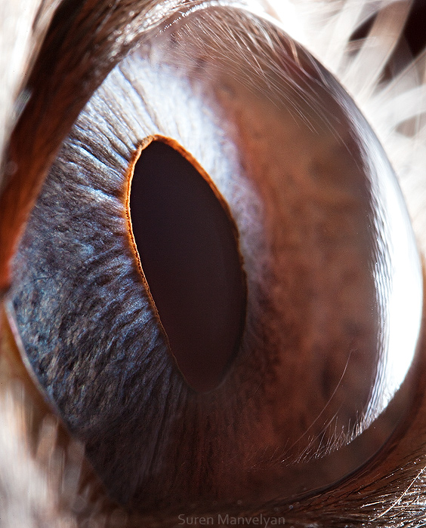
By Suren Manvelyan, http://www.surenmanvelyan.com/gallery/7116
Notes:
http://www.surenmanvelyan.com/gallery/7116
Siam cat

Slide 9
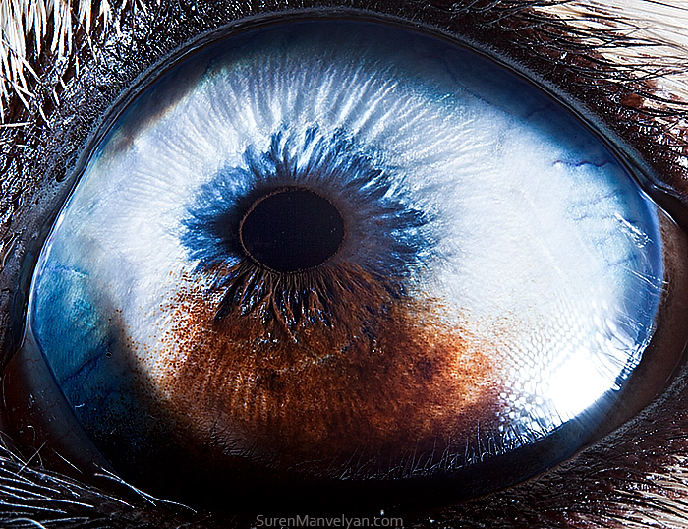
By Suren Manvelyan, http://www.surenmanvelyan.com/gallery/7116
Notes:
http://www.surenmanvelyan.com/gallery/7116
Husky with heterochromia

Slide 10
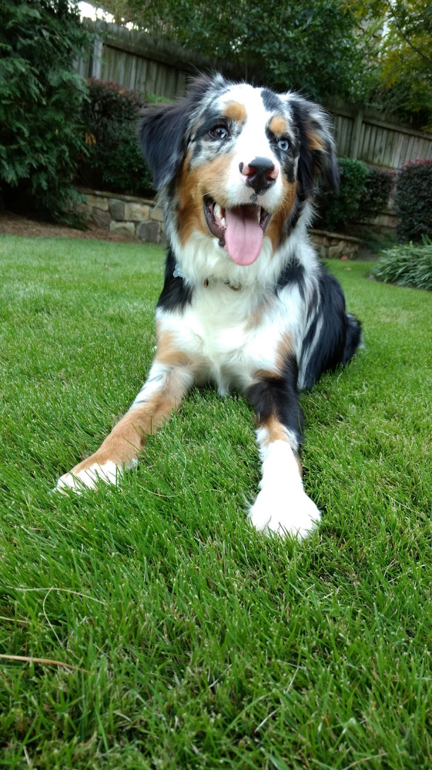
Indy
Notes:
http://www.surenmanvelyan.com/gallery/7116
Crocodile (nile crocodile?)

Slide 11

Indy
Notes:
http://www.surenmanvelyan.com/gallery/7116
Crocodile (nile crocodile?)

Slide 12
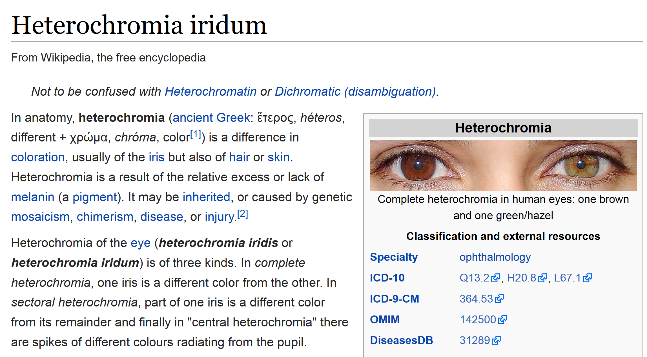

Slide 13
Interest Points and Corners
Computer Vision
James Hays
Read Szeliski 7.1.1 and 7.1.2
Slides from Rick Szeliski, Svetlana Lazebnik, Derek Hoiem and Grauman&Leibe 2008 AAAI Tutorial

Slide 14
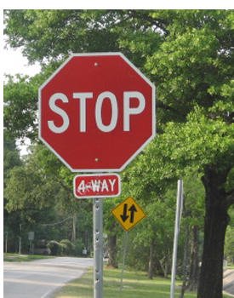


Correspondence across views
Correspondence: matching points, patches, edges, or regions across images
≈

Slide 15
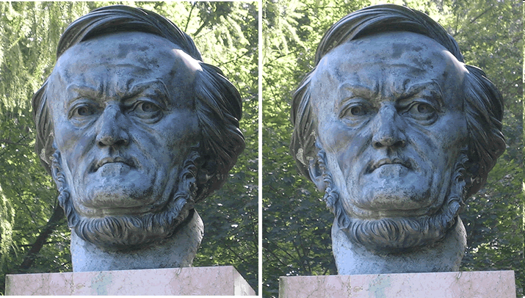
Example: estimating “fundamental matrix” that corresponds two views
Slide from Silvio Savarese

Slide 16
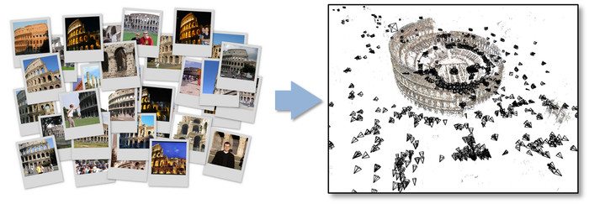
Example: structure from motion

Slide 17
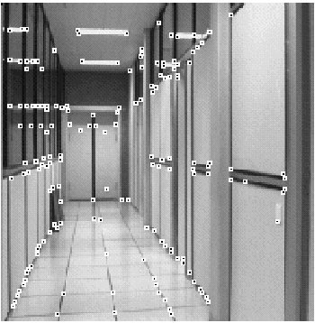
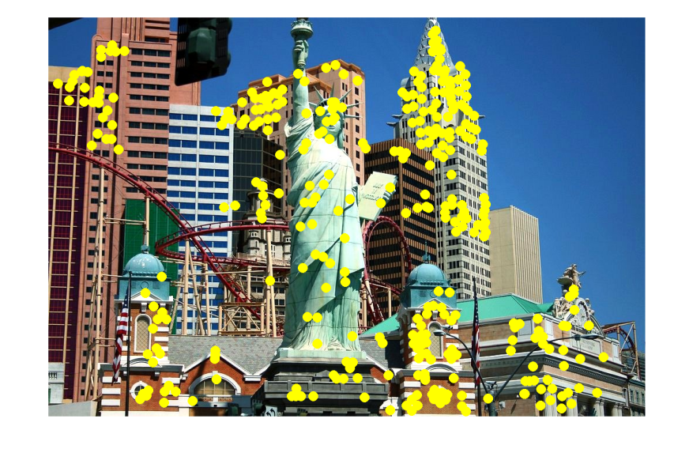
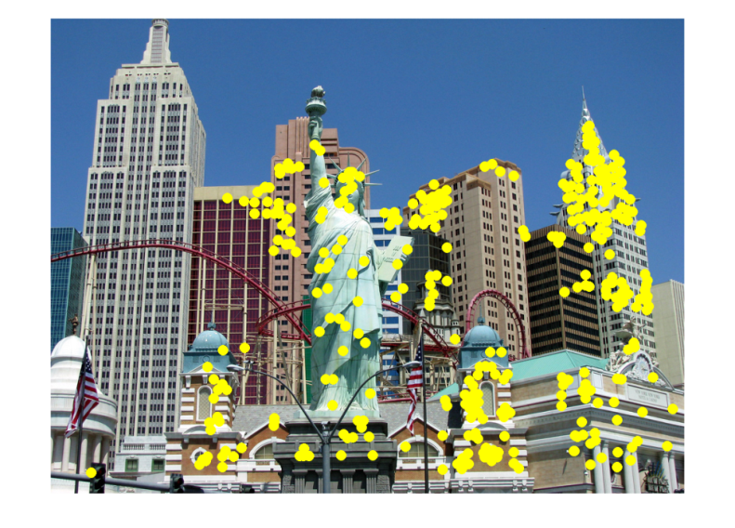
Applications
Feature points are used for:
  Image alignment
  3D reconstruction
  Motion tracking
  Robot navigation
  Indexing and database retrieval
  Object recognition

Slide 18
Project 2: interest points and local features
Note: “interest points” = “keypoints”, also sometimes called “features”

Slide 19
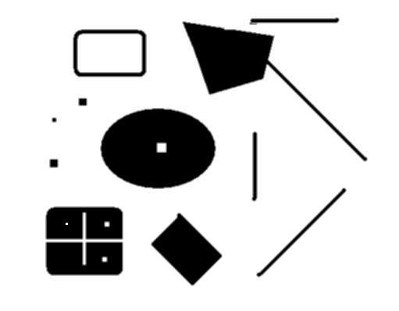
This class: interest points
original
Suppose you have to click on some point, go away and come back after I deform the image, and click on the same points again.
  Which points would you choose?
deformed

Slide 20




Overview of Keypoint Matching
1. Find a set of distinctive keypoints
A₁
B₃
A₂
A₃
2. Compute a local descriptor from the region around each keypoint
B₁
B₂
3. Match local descriptors

Slide 21
Goals for Keypoints
Detect points that are repeatable and distinctive

Slide 22
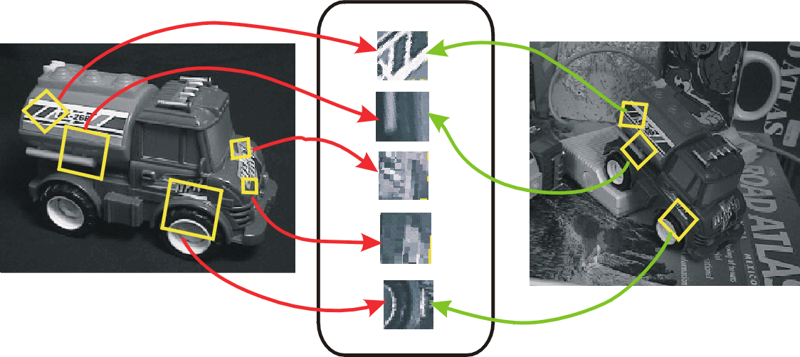
Invariant Local Features
Image content is transformed into local feature coordinates that are invariant to translation, rotation, scale, and other imaging parameters
Features Descriptors

Slide 23
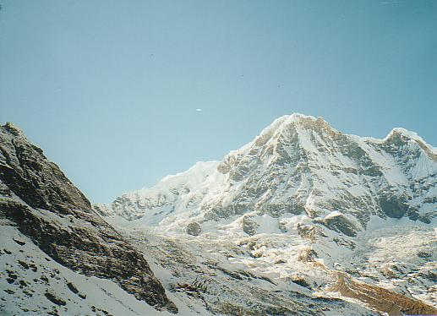
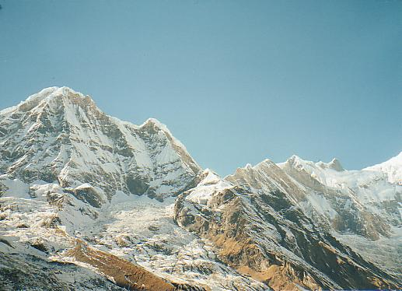
Why extract features?
Motivation: panorama stitching
  We have two images – how do we combine them?

Slide 24
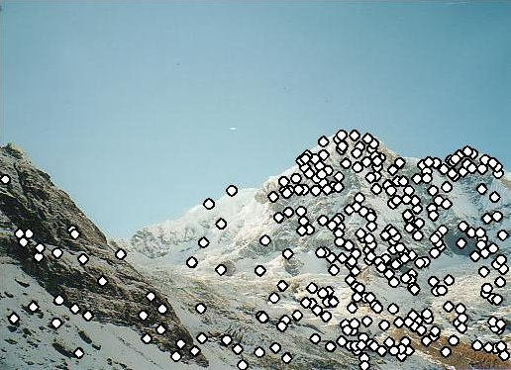
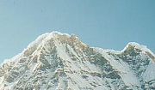

Local features: main components
Detection: Identify the interest points
Description: Extract vector feature descriptor surrounding each interest point.
Matching: Determine correspondence between descriptors in two views
Kristen Grauman

Slide 25
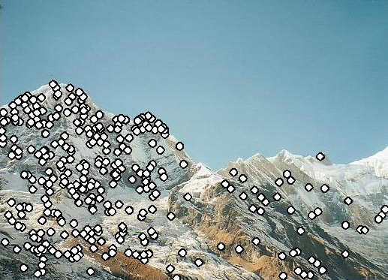
Characteristics of good features
Repeatability
  The same feature can be found in several images despite geometric and photometric transformations
Saliency
  Each feature is distinctive
Compactness and efficiency
  Many fewer features than image pixels
Locality
  A feature occupies a relatively small area of the image; robust to clutter and occlusion

Slide 26
Goal: interest operator repeatability
We want to detect (at least some of) the same points in both images.
Yet we have to be able to run the detection procedure independently per image.
No chance to find true matches!
Kristen Grauman
Notes:
26

Slide 27
Goal: descriptor distinctiveness
We want to be able to reliably determine which point goes with which.
Must provide some invariance to geometric and photometric differences between the two views.
?
Kristen Grauman

Slide 28
Local features: main components
Detection: Identify the interest points
Description:Extract vector feature descriptor surrounding each interest point.
Matching: Determine correspondence between descriptors in two views

Slide 29
Many Existing Detectors Available
Hessian & Harris [Beaudet ‘78], [Harris ‘88]
Laplacian, DoG [Lindeberg ‘98], [Lowe 1999]
Harris-/Hessian-Laplace [Mikolajczyk & Schmid ‘01]
Harris-/Hessian-Affine [Mikolajczyk & Schmid ‘04]
EBR and IBR [Tuytelaars & Van Gool ‘04]
MSER [Matas ‘02]
Salient Regions [Kadir & Brady ‘01]
Others…

Slide 30

Corner Detection: Basic Idea
We should easily recognize the point by looking through a small window
Shifting a window in any direction should give a large change in intensity
“flat” region:
no change in all directions
“edge”:
no change along the edge direction
“corner”:
significant change in all directions
Source: A. Efros

Slide 31
Corner Detection: Baseline strategies
First, cornerness is a property of a “patch”, not a single pixel
Let’s look for patches that have high gradients in the x and y directions.
“flat” region:
no gradients
“edge”:
gradients in one direction
“corner”:
gradients in both directions
Source: James Hays

Slide 32
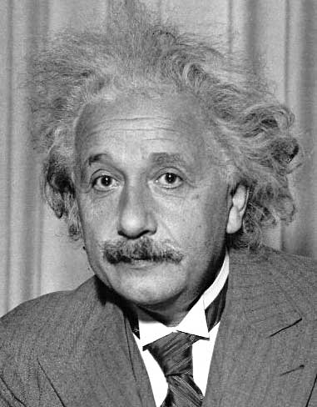
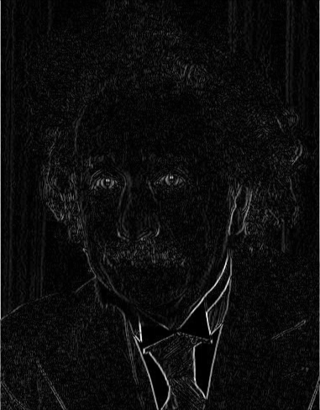
Reminder: gradients measured with filtering
1
0
-1
2
0
-2
1
0
-1
Sobel
Vertical Edge
(absolute value)

Slide 33
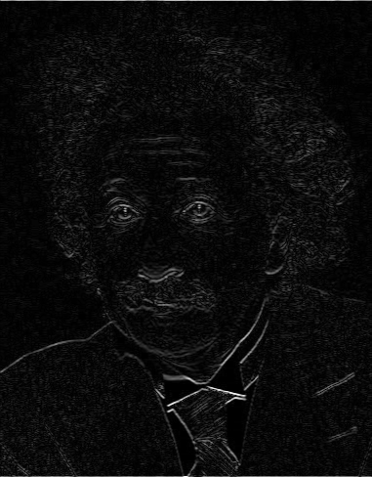
Reminder: gradients measured with filtering
1
2
1
0
0
0
-1
-2
-1
Sobel
Horizontal Edge
(absolute value)
Notes:
Questions at this point?

Slide 34
Corner Detection: Baseline strategies
First, cornerness is a property of a “patch”, not a single pixel
Let’s look for patches that have high gradients in the x and y directions.
“flat” region:
no gradients
“edge”:
gradients in one direction
“corner”:
gradients in both directions
“edge”:
gradients in both directions
Source: James Hays

Slide 35
Corner Detection: Baseline strategies
Let’s look for patches that have high gradients in the x and y directions.
Not a sufficient strategy
“flat” region:
no gradients
“edge”:
gradients in one direction
“corner”:
gradients in both directions
“edge”:
gradients in both directions
Source: James Hays

Slide 36
Corner Detection: Baseline strategies
Let’s write down what the gradients actually look like in different scenarios
“flat” region:
no gradients
“edge”:
gradients in one direction
“corner”:
gradients in both directions
“edge”:
gradients in both directions
Source: James Hays

Slide 37
Corner Detection: Baseline strategies
For a patch to be a corner, the gradient distribution needs to be full rank
We should check more than 2 pixels
How do we measure this rank?
“flat” region:
no gradients
“edge”:
gradients in one direction
“corner”:
gradients in both directions
“edge”:
gradients in both directions
Source: James Hays

Slide 38
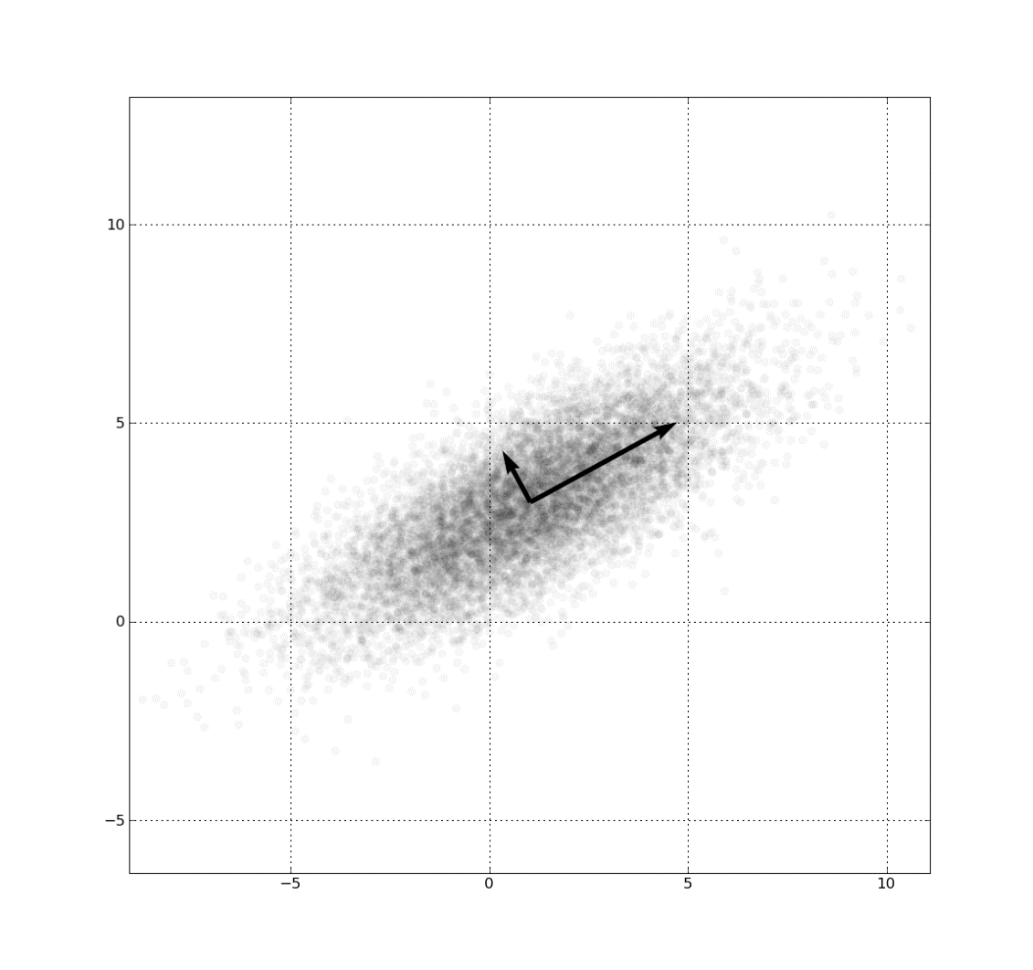
Eigenvalues tell us the rank
I = [-5, 0
0, 3
-3, 0
5, 5
…
...]
https://en.wikipedia.org/wiki/Eigenvalues_and_eigenvectors

Slide 39
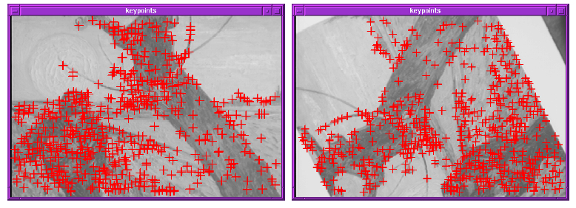
Finding Corners
Key property: in the region around a corner, image gradient has two or more dominant directions
Corners are repeatable and distinctive
C.Harris and M.Stephens. "A Combined Corner and Edge Detector.“ Proceedings of the 4th Alvey Vision Conference: pages 147--151.

Slide 40
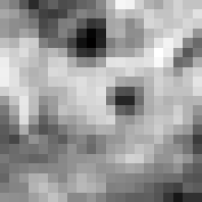

Corner Detection: Mathematics
Change in appearance of window w(x,y)
for the shift [u,v]:
I(x, y)
E(u, v)
E(3,2)
w(x, y)

Slide 41
Corner Detection: Mathematics
Change in appearance of window w(x,y)
for the shift [u,v]:
I(x, y)
E(u, v)
E(0,0)
w(x, y)

Slide 42
Corner Detection: Mathematics
Change in appearance of window w(x,y)
for the shift [u,v]:
Window function
Shifted intensity
Intensity
Window function w(x,y) =
or
1 in window, 0 outside
Gaussian
Source: R. Szeliski

Slide 43
Corner Detection: Mathematics
Change in appearance of window w(x,y)
for the shift [u,v]:
We want to find out how this function behaves for small shifts
E(u, v)

Slide 44
Corner Detection: Mathematics
Change in appearance of window w(x,y)
for the shift [u,v]:
We want to find out how this function behaves for small shifts
But this is very slow to compute naively.
O(window_width² * shift_range² * image_width²)
O( 11² * 11² * 600² ) = 5.2 billion of these
14.6 thousand per pixel in your image

Slide 45
Corner Detection: Mathematics
Change in appearance of window w(x,y)
for the shift [u,v]:
We want to find out how this function behaves for small shifts
Recall Taylor series expansion. A function f can be approximated around point a as

Slide 46
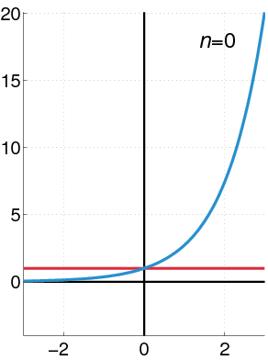
Recall: Taylor series expansion
A function f can be approximated as
Approximation of
f(x) = e^{x}
centered at f(0)

Slide 47
Corner Detection: Mathematics
Change in appearance of window w(x,y)
for the shift [u,v]:
We want to find out how this function behaves for small shifts
Local quadratic approximation of E(u,v) in the neighborhood of (0,0) is given by the second-order Taylor expansion:
Notes:
Technically a Maclaurin expansion, a special case of Taylor expansion centered at 0.
What is the point? Well, now we’re just extrapolating local measurements instead of doing 10s of thousands of computations.

Slide 48
Corner Detection: Mathematics
Local quadratic approximation of E(u,v) in the neighborhood of (0,0) is given by the second-order Taylor expansion:
E(u, v)
Always 0
First derivative is 0
Notes:
Technically a Maclaurin expansion, a special case of Taylor expansion centered at 0.

Slide 49
Corner Detection: Mathematics
Second-order Taylor expansion of E(u,v) about (0,0):

Slide 50
Corner Detection: Mathematics
Second-order Taylor expansion of E(u,v) about (0,0):

Slide 51
Corner Detection: Mathematics
Second-order Taylor expansion of E(u,v) about (0,0):

Slide 52
Corner Detection: Mathematics
The quadratic approximation simplifies to
where M is a second moment matrix computed from image derivatives:
M

Slide 53
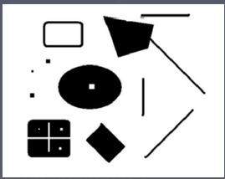
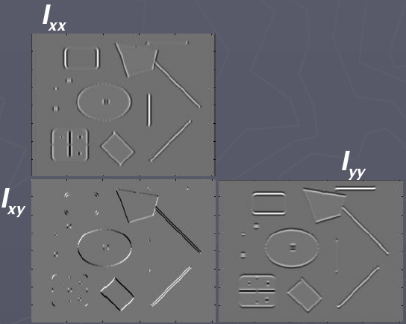
Corners as distinctive interest points
2 x 2 matrix of image derivatives (averaged in neighborhood of a point).
Notation:
M

Slide 54
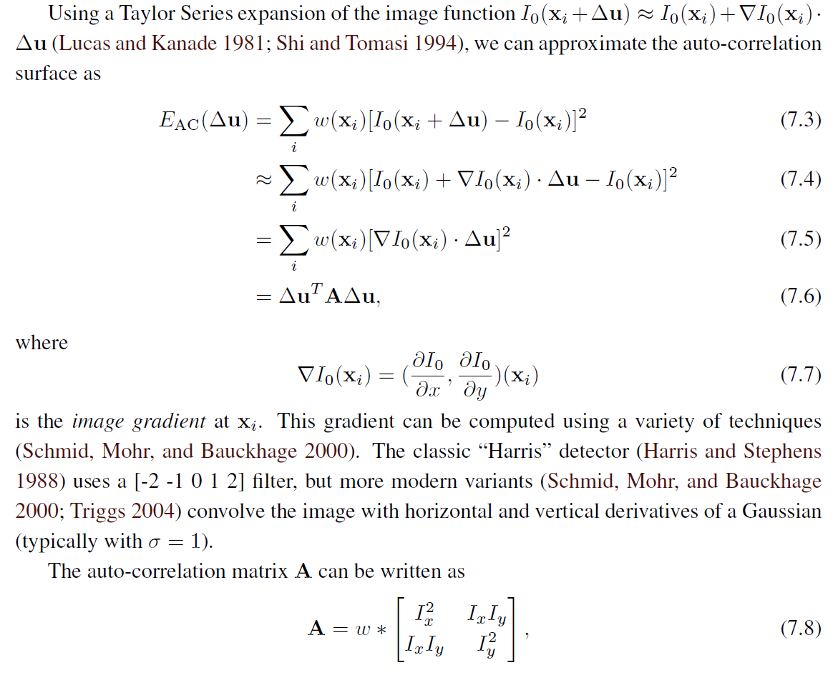
Different derivations exist.
This is the textbook version.

Slide 55
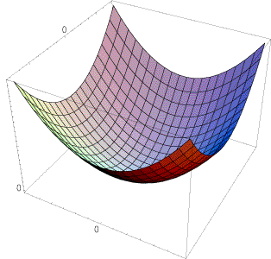
Interpreting the second moment matrix
The surface E(u,v) is locally approximated by a quadratic form. Let’s try to understand its shape.

Slide 56
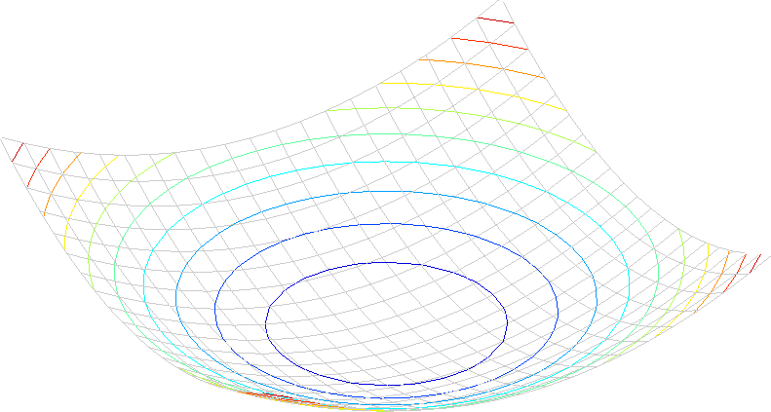
Interpreting the second moment matrix
Consider a horizontal “slice” of E(u, v):
This is the equation of an ellipse.

Slide 57
Interpreting the second moment matrix
First, consider the axis-aligned case (gradients are either horizontal or vertical)
If either λ is close to 0, then this is not a corner, so look for locations where both are large.

Slide 58
Interpreting the second moment matrix
Consider a horizontal “slice” of E(u, v):
This is the equation of an ellipse.
Diagonalization of M:
The axis lengths of the ellipse are determined by the eigenvalues and the orientation is determined by R
direction of the fastest change
direction of the slowest change
(λ_{max})^{-1/2}
(λ_{min})^{-1/2}

Slide 59
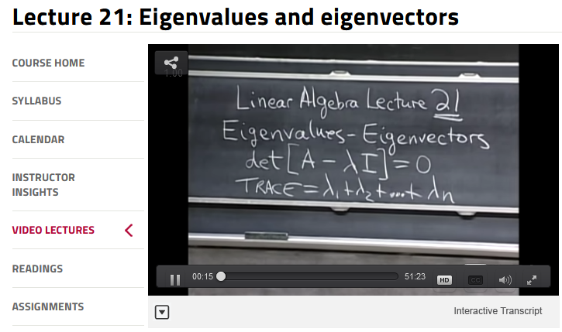
If you’re not comfortable with Eigenvalues and Eigenvectors, Gilbert Strang’s linear algebra lectures are linked from the course homepage

Slide 60
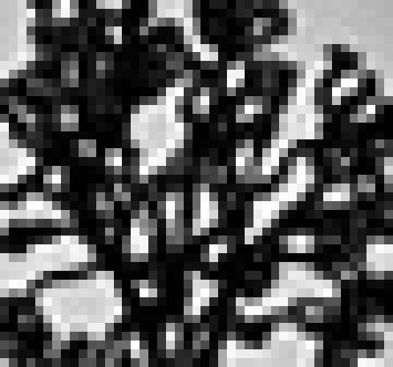
Visualization of second moment matrices

Slide 61
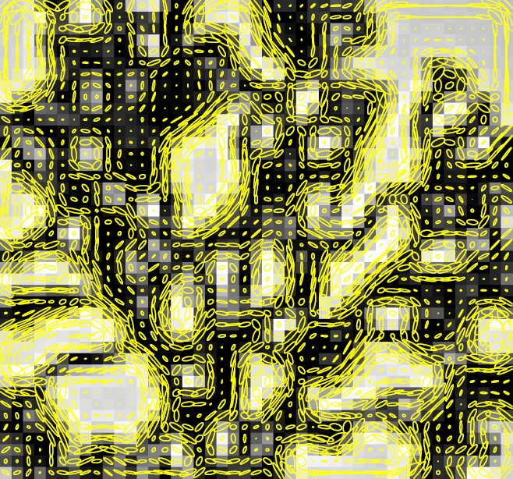
Visualization of second moment matrices

Slide 62
Interpreting the eigenvalues
Classification of image points using eigenvalues of M:
λ₂
“Edge”
λ₂ >> λ₁
“Corner”
λ₁ and λ₂ are large,
λ₁ ~ λ₂;
E increases in all directions
λ₁ and λ₂ are small;
E is almost constant in all directions
“Flat” region
“Edge”
λ₁ >> λ₂
λ₁

Slide 63
Corner response function
α: constant (0.04 to 0.06)
“Edge”
R < 0
“Corner”
R > 0
|R| small
“Flat” region
“Edge”
R < 0

Slide 64
Harris corner detector
Compute M matrix for each image window to get their cornerness scores.
Find points whose surrounding window gave large corner response (f> threshold)
Take the points of local maxima, i.e., perform non-maximum suppression
C.Harris and M.Stephens. “A Combined Corner and Edge Detector.” Proceedings of the 4th Alvey Vision Conference: pages 147—151, 1988.
Notes:
64

Slide 65

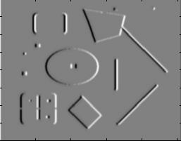
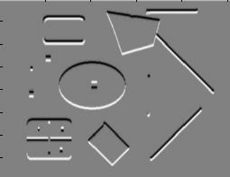
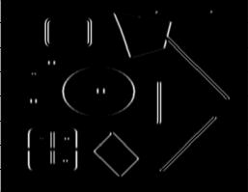
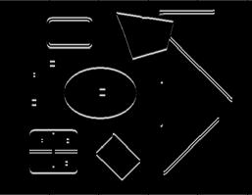
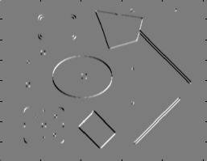
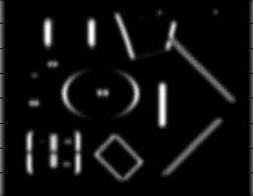
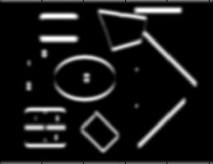
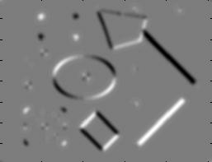
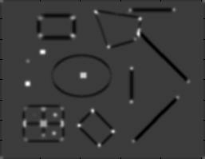
Harris Detector [Harris88]
Second moment matrix
1. Image derivatives
I_{x}
I_{y}
(optionally, blur first)
I_{x}²
I_{y}²
I_{x}I_{y}
2. Square of derivatives
3. Gaussian
filter g(σ_{I})
g(I_{x}²)
g(I_{y}²)
g(I_{x}I_{y})
4. Cornerness function – both eigenvalues are strong
5. Non-maxima suppression
har

Slide 66
Harris Corners – Why so complicated?
Can’t we just check for regions with lots of gradients in the x and y directions?
  No! A diagonal line would satisfy that criteria
Current Window

Slide 67
Harris Detector [Harris88]
Second moment matrix
1. Image derivatives
I_{x}
I_{y}
(optionally, blur first)
I_{x}²
I_{y}²
I_{x}I_{y}
2. Square of derivatives
3. Gaussian
filter g(σ_{I})
g(I_{x}²)
g(I_{y}²)
g(I_{x}I_{y})
4. Cornerness function – both eigenvalues are strong
5. Non-maxima suppression
har

Slide 68
Harris Corners – Why so complicated?
Current Window
What does the structure matrix look here?

Slide 69
Harris Corners – Why so complicated?
Current Window
What does the structure matrix look here?

Slide 70
Harris Corners – Why so complicated?
Current Window
What does the structure matrix look here?

Slide 71
Harris Detector [Harris88]
Second moment matrix
1. Image derivatives
I_{x}
I_{y}
(optionally, blur first)
I_{x}²
I_{y}²
I_{x}I_{y}
2. Square of derivatives
3. Gaussian
filter g(σ_{I})
g(I_{x}²)
g(I_{y}²)
g(I_{x}I_{y})
4. Cornerness function – both eigenvalues are strong
5. Non-maxima suppression
har

Slide 72
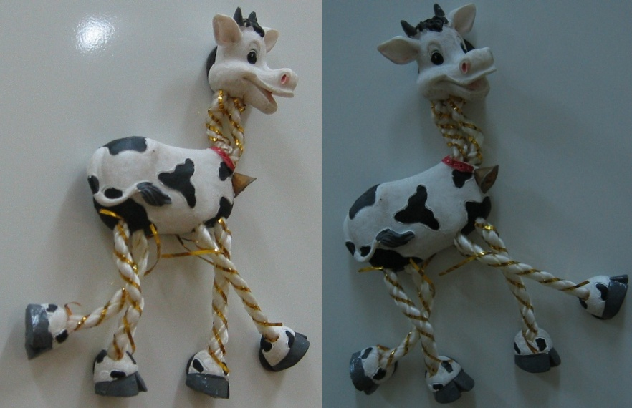
Harris Detector: Steps

Slide 73
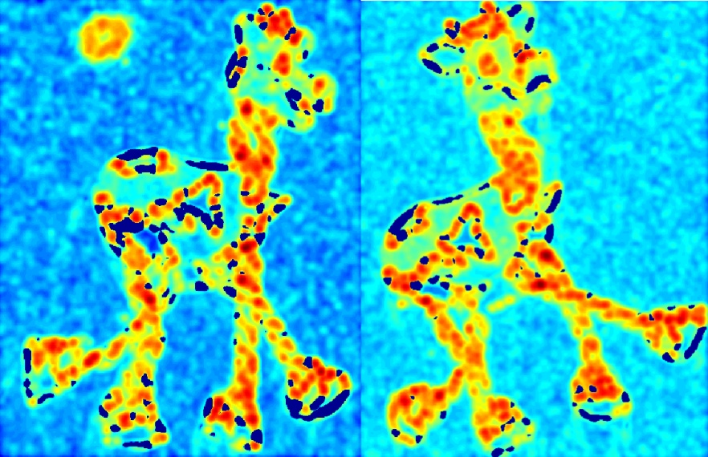
Harris Detector: Steps
Compute corner response R

Slide 74

Harris Detector: Steps
Find points with large corner response: R>threshold

Slide 75

Harris Detector: Steps
Take only the points of local maxima of R

Slide 76

Harris Detector: Steps

Slide 77
Invariance and covariance
We want corner locations to be invariant to photometric transformations and covariant to geometric transformations
  Invariance: image is transformed and corner locations do not change
  Covariance: if we have two transformed versions of the same image, features should be detected in corresponding locations

Slide 78
Affine intensity change
I → a I + b
Only derivatives are used => invariance to intensity shift I → I + b
Intensity scaling: I → a I
R
R
threshold
x (image coordinate)
x (image coordinate)
Partially invariant to affine intensity change

Slide 79
Image translation
Derivatives and window function are shift-invariant
Corner location is covariant w.r.t. translation

Slide 80
Image rotation
Second moment ellipse rotates but its shape (i.e. eigenvalues) remains the same
Corner location is covariant w.r.t. rotation

Slide 81
Scaling
Corner
All points will be classified as edges
Corner location is not covariant to scaling!

