Slide 1
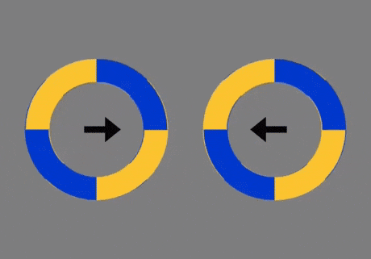

Slide 2
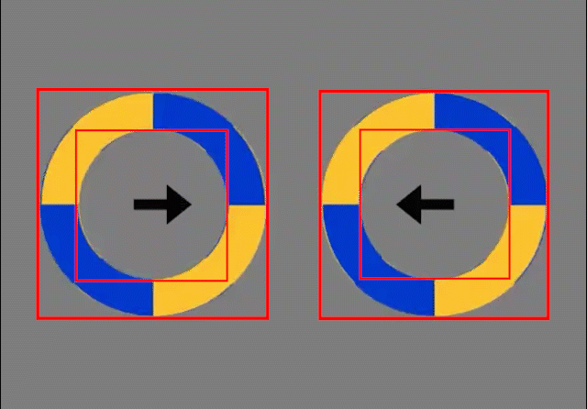

Slide 4
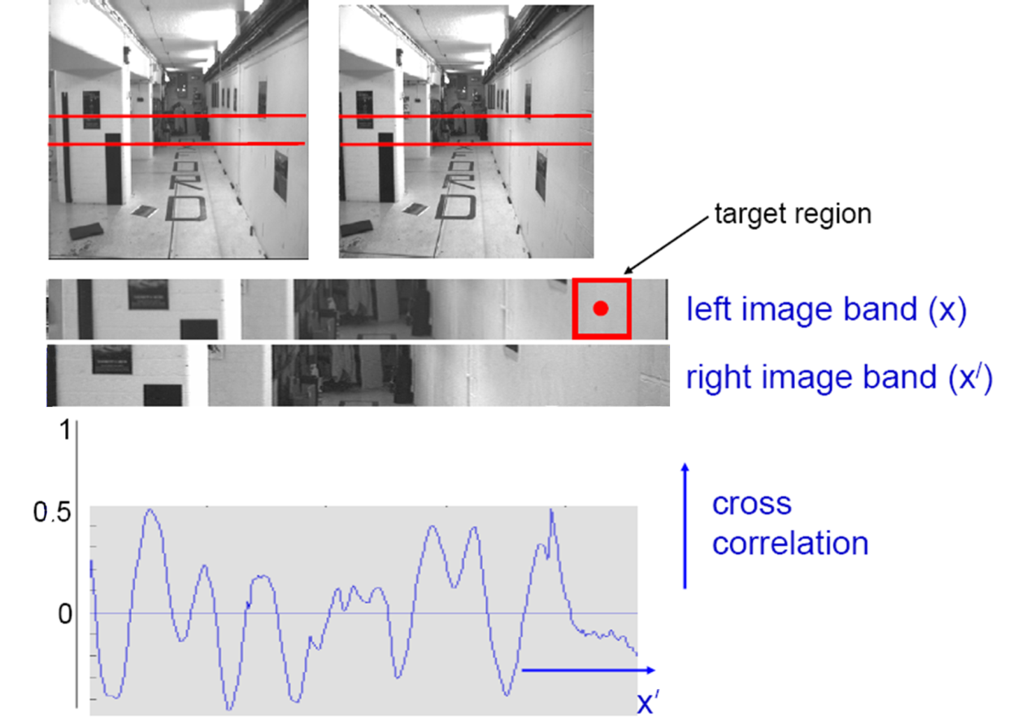
Review: last lecture on stereo matching
???
Textureless regions are non-distinct; high ambiguity for matches.
Notes:
We get this corrleation.
[a] And where the peak is located is hard to tell.
How could we fix that? Well…

Slide 5
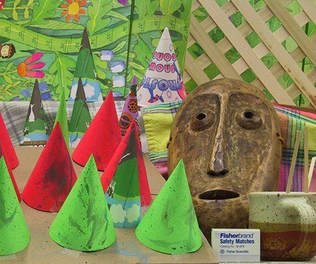
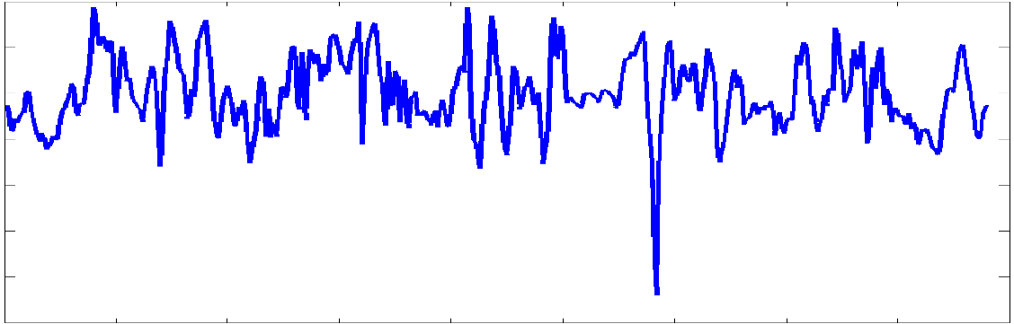
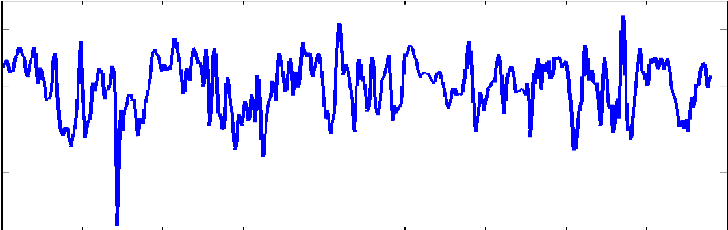
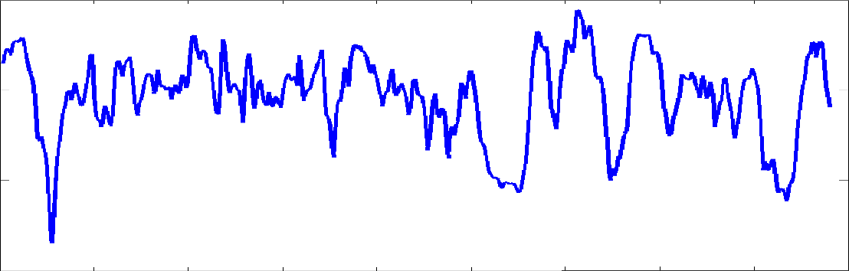
Review: last lecture on stereo matching
Fight back against ambiguity by considering matches jointly with a preference for smooth disparities
  Scanline stereo uses dynamic programming to optimize each scanline (1d smoothness)
  Graph cut formulations include 2d smoothness
  Semi-global matches is a greedy optimization that considers 2d smoothness. Fast but still pretty accurate.
Enter each vector of
match scores as a column in the DSI
Dissimilarity Values
Notes:
We get this corrleation.
[a] And where the peak is located is hard to tell.
How could we fix that? Well…

Slide 6
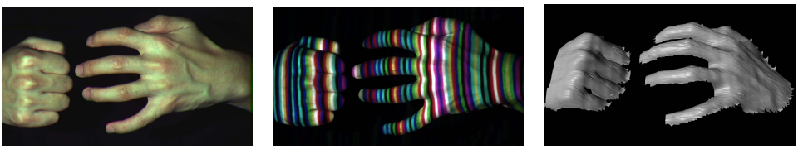
Review: last lecture on stereo matching
Or simply remove the ambiguity by projecting structured light patterns onto the scene
  Simplifies the correspondence problem
  Replaces one camera in the stereo system with a projector
Notes:
We get this corrleation.
[a] And where the peak is located is hard to tell.
How could we fix that? Well…

Slide 7
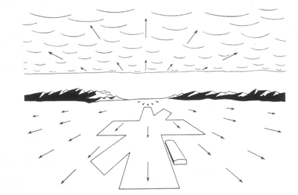
Computer Vision
Motion and Optical Flow
Many slides adapted from S. Seitz, R. Szeliski, M. Pollefeys, K. Grauman and others…

Slide 8
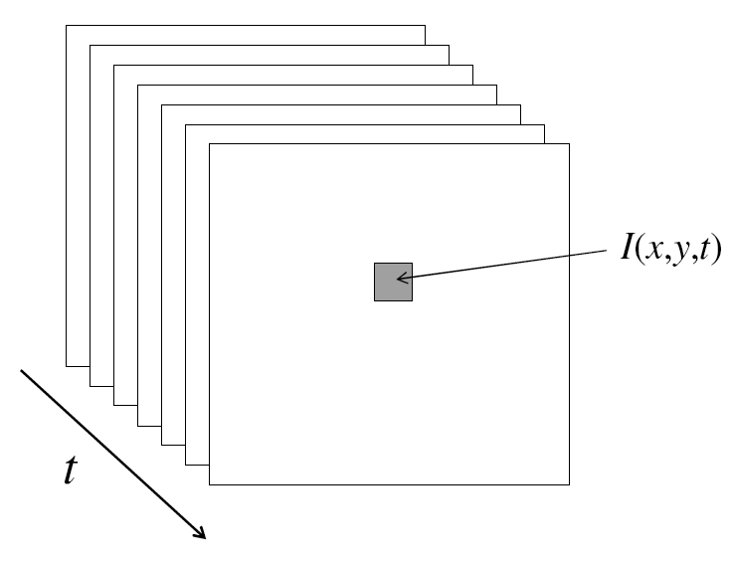
Video
A video is a sequence of frames captured over time
Now our image data is a function of space
(x, y) and time (t)

Slide 9
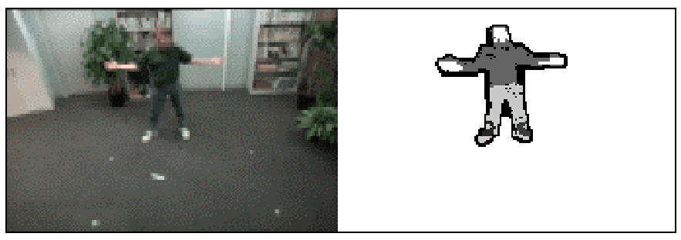
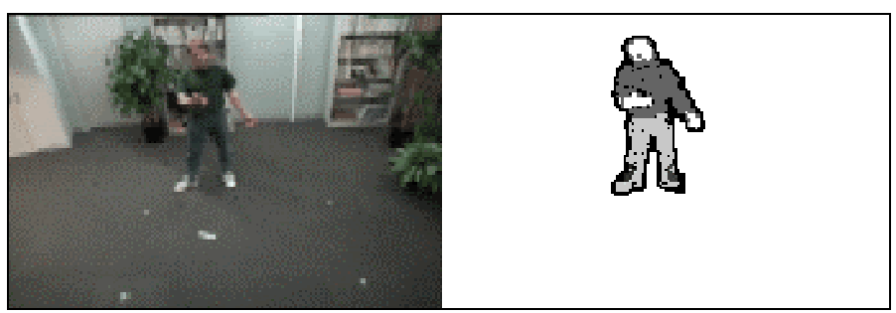
Motion Applications: Segmentation of video
Background subtraction
  A static camera is observing a scene
  Goal: separate the static background from the moving foreground

Slide 10
Applications of segmentation to video
Background subtraction
  Form an initial background estimate
  For each frame:
    Update estimate using a moving average
    Subtract the background estimate from the frame
    Label as foreground each pixel where the magnitude of the difference is greater than some threshold
    Use median filtering to “clean up” the results

Slide 11
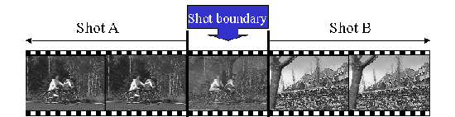
Motion Applications: Segmentation of video
Background subtraction
Shot boundary detection
  Commercial video is usually composed of shots or sequences showing the same objects or scene
  Goal: segment video into shots for summarization and browsing (each shot can be represented by a single keyframe in a user interface)
  Difference from background subtraction: the camera is not necessarily stationary

Slide 12
Applications of segmentation to video
Background subtraction
Shot boundary detection
  For each frame
    Compute the distance between the current frame and the previous one
      Pixel-by-pixel differences
      Differences of color histograms
      Block comparison
    If the distance is greater than some threshold, classify the frame as a shot boundary

Slide 13
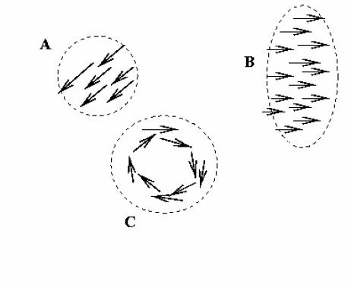
Motion Applications: Segmentation of video
Background subtraction
Shot boundary detection
Motion segmentation
  Segment the video into multiple coherently moving objects

Slide 14
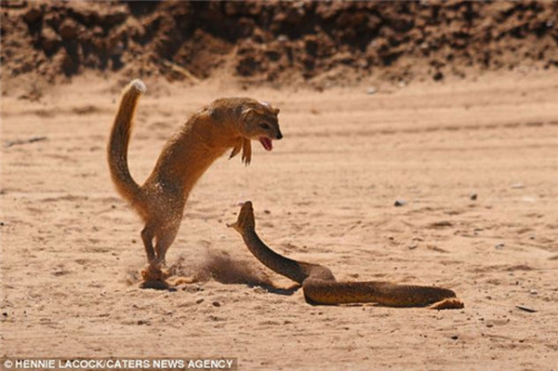
Motion Applications: Segmentation of video
Background subtraction
Shot boundary detection
Motion segmentation
  Segment the video into multiple coherently moving objects

Slide 15
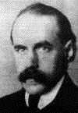
Motion and perceptual organization
Gestalt psychology (Max Wertheimer, 1880-1943)

Slide 16
Motion and perceptual organization
Sometimes, motion is the only cue
Gestalt psychology (Max Wertheimer, 1880-1943)

Slide 17
Motion and perceptual organization
Sometimes, motion is the only cue
Notes:
Now take it away. And count to 3…

Slide 18
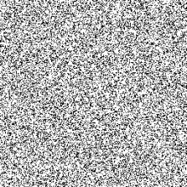
Motion and perceptual organization
Sometimes, motion is the only cue
Notes:
Now put another one. You probably don’t see anything special.

Slide 19
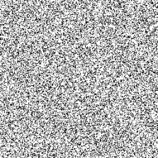
Motion and perceptual organization
Sometimes, motion is the only cue
Notes:
But put them in sequence…. And you see the moving square. The only indication of the square is the common motion.

Slide 20
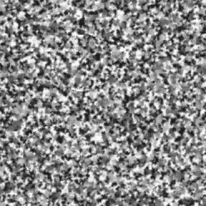
Motion and perceptual organization
Sometimes, motion is the only cue http://www.youtube.com/watch?v=aEoxO_RdGhE

Slide 21
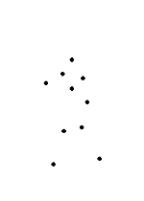
Motion and perceptual organization
Even “impoverished” motion data can evoke a strong percept
G. Johansson, “Visual Perception of Biological Motion and a Model For Its Analysis", Perception and Psychophysics 14, 201-211, 1973.

Slide 22
Motion and perceptual organization
Even “impoverished” motion data can evoke a strong percept
G. Johansson, “Visual Perception of Biological Motion and a Model For Its Analysis", Perception and Psychophysics 14, 201-211, 1973.

Slide 23
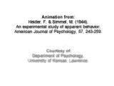
Motion and perceptual organization
Experimental study of apparent behavior.
Fritz Heider & Marianne Simmel. 1944

Slide 24
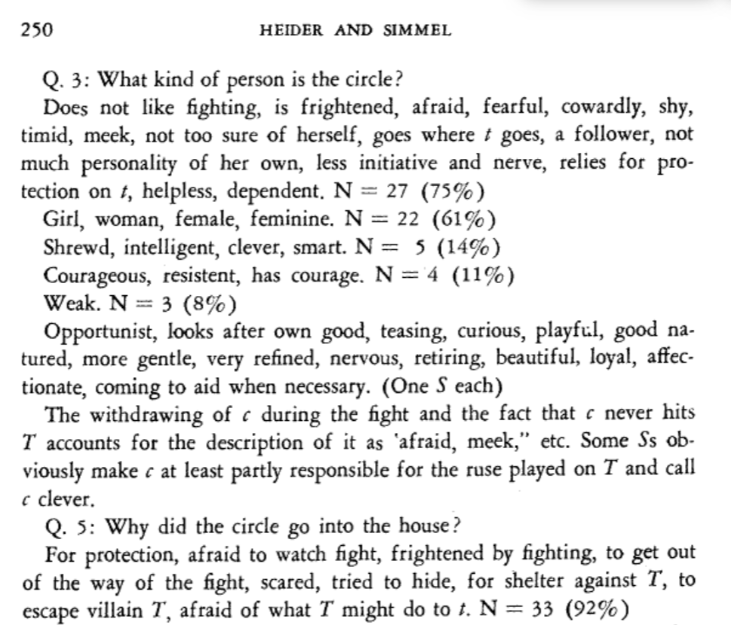

Slide 25
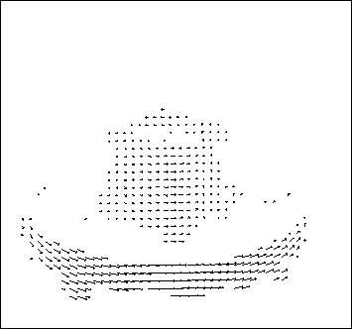
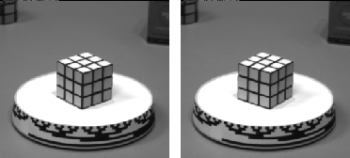
Motion estimation: Optical flow
Optical flow is the apparent motion of objects or surfaces
The term “scene flow” is used to describe 3d motion estimation

Slide 26
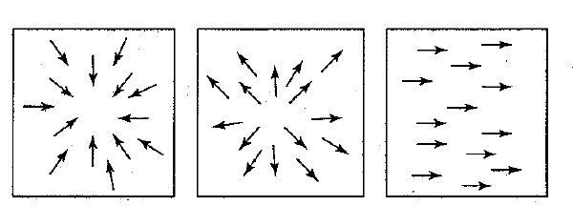
Motion field + camera motion
Zoom out
Zoom in
Pan right to left

Slide 27
Problem definition: optical flow
How to estimate pixel motion from image I(x,y,t) to I(x,y,t+1) ?
  Solve pixel correspondence problem
    given a pixel in I(x,y,t), look for nearby pixels of the same color in I(x,y,t+1)
Key assumptions
  color constancy: a point in I(x,y,t) looks the same in I(x,y,t+1)
    For grayscale images, this is brightness constancy
  small motion: points do not move very far
This is called the optical flow problem

Slide 28


Optical flow constraints (grayscale images)
Let’s look at these constraints more closely
  brightness constancy constraint (equation)
  small motion: (u and v are less than 1 pixel, or smooth) Taylor series expansion of the spatial changes of I:
Notes:
A: H(x,y) = I(x+u, y+v)

Slide 29
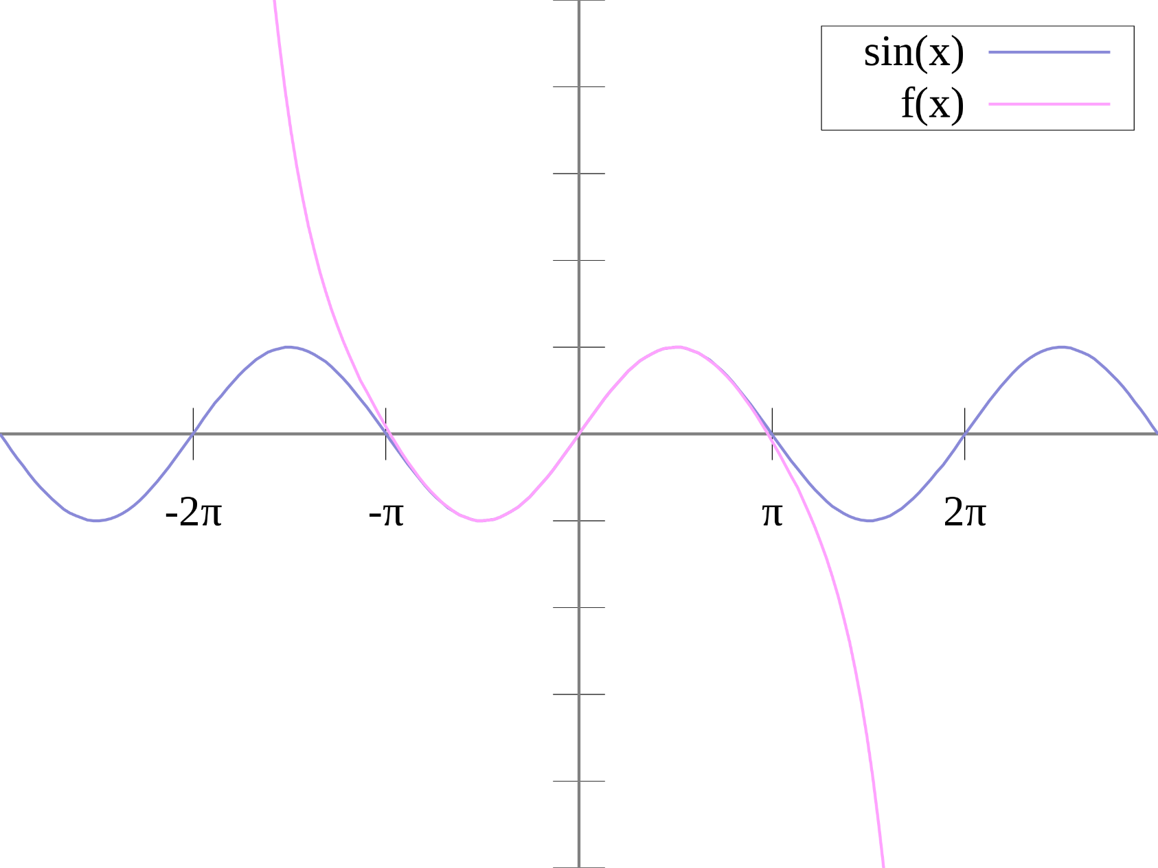
Taylor Series Reminder
The sine function (blue) is closely approximated by its Taylor polynomial of degree 7 (pink) for a full period centered at the origin.
By No machine-readable author provided. Riojajar~commonswiki assumed (based on copyright claims). - No machine-readable source provided. Own work assumed (based on copyright claims)., Public Domain, https://commons.wikimedia.org/w/index.php?curid=825819

Slide 30
Optical flow constraints (grayscale images)
Let’s look at these constraints more closely
  brightness constancy constraint (equation)
  small motion: (u and v are less than 1 pixel, or smooth) Taylor series expansion of the spatial changes of I:
Notes:
A: H(x,y) = I(x+u, y+v)

Slide 31
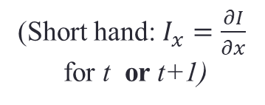
Optical flow equation
Combining these two equations
(Short hand: $I_{x}=\frac{∂I}{∂x}$
for t or t+1)

Slide 32
Optical flow equation
Combining these two equations
(Short hand: $I_{x}=\frac{∂I}{∂x}$
for t or t+1)
In the limit as u and v go to zero, this becomes exact
  Brightness constancy constraint equation

Slide 33
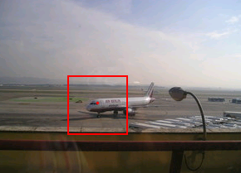
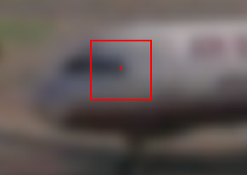
How does this make sense?
  Brightness constancy constraint equation
What do the static image gradients have to do with motion estimation?
If I told you I_{t} is -5
I_{x} is 2.5
I_{y} is 0
What was the pixel shift (u,v)?

Slide 34
How does this make sense?
  Brightness constancy constraint equation
What do the static image gradients have to do with motion estimation?
If I told you I_{t} is -5
I_{x} is 2
I_{y} is 1
What was the pixel shift (u,v)?

Slide 35
The brightness constancy constraint
Can we use this equation to recover image motion (u,v) at each pixel?
or
How many equations and unknowns per pixel?
  One equation (this is a scalar equation!), two unknowns (u,v)
The component of the motion perpendicular to the gradient (i.e., parallel to the edge) cannot be measured
  If (u, v) satisfies the equation,
  so does (u+u’, v+v’ ) if
gradient
(u,v)
(u’,v’)
(u+u’,v+v’)
edge
Notes:
A: u and v are unknown, 1 equation

Slide 36
Aperture problem

Slide 37
Aperture problem

Slide 38
Aperture problem

Slide 39
Apparently an aperture problem

Slide 40

The barber pole illusion
http://en.wikipedia.org/wiki/Barberpole_illusion

Slide 41


The barber pole illusion
http://en.wikipedia.org/wiki/Barberpole_illusion

Slide 42
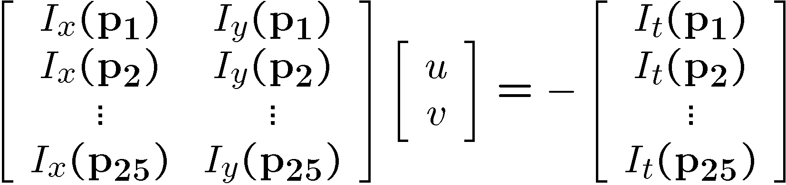
Solving the ambiguity…
B. Lucas and T. Kanade. An iterative image registration technique with an application to stereo vision. In Proceedings of the International Joint Conference on Artificial Intelligence, pp. 674–679, 1981.
How to get more equations for a pixel?
Spatial coherence constraint
Assume the pixel’s neighbors have the same (u,v)
  If we use a 5x5 window, that gives us 25 equations per pixel

Slide 43




Solving the ambiguity…
Least squares problem:

Slide 44

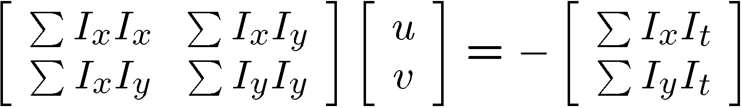


Matching patches across images
Overconstrained linear system
Least squares solution for d given by
  The summations are over all pixels in the K x K window

Slide 45


Conditions for solvability
  Optimal (u, v) satisfies Lucas-Kanade equation
When is this solvable? I.e., what are good points to track?
  A^{T}A should be invertible
  A^{T}A should not be too small due to noise
    eigenvalues λ₁ and λ ₂ of A^{T}A should not be too small
  A^{T}A should be well-conditioned
    λ ₁/ λ ₂ should not be too large (λ ₁ = larger eigenvalue)
Does this remind you of anything?
Criteria for Harris corner detector
Notes:
http://en.wikipedia.org/wiki/Invertible_matrix

Slide 46
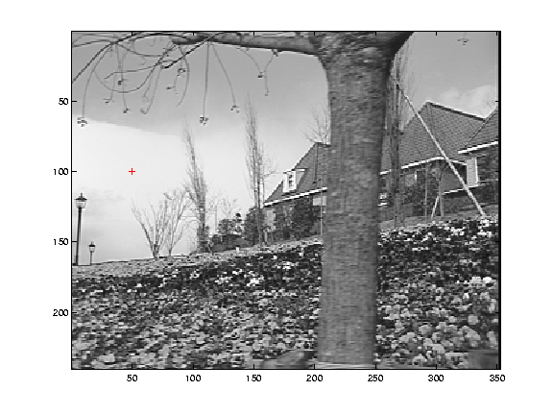
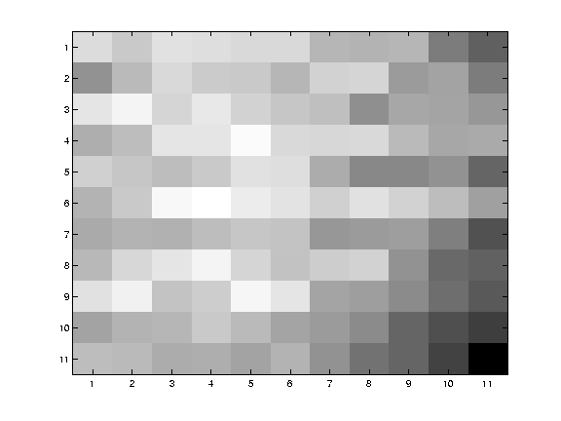
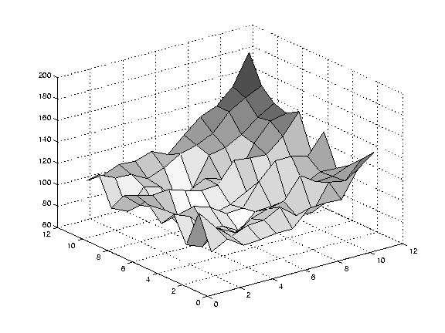
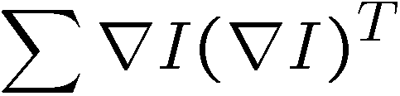
Low texture region
gradients have small magnitude
small λ₁, small λ₂
Notes:
Can’t estimate motion here…nothing you can see moving.

Slide 47
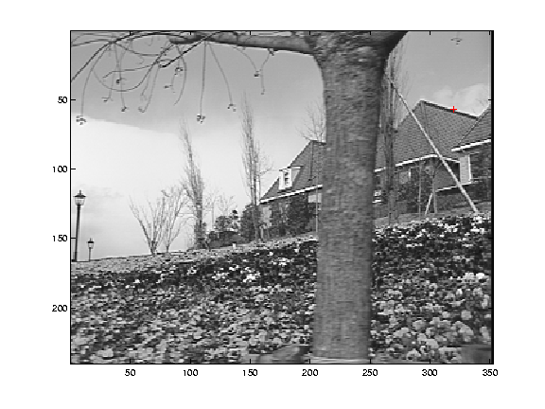
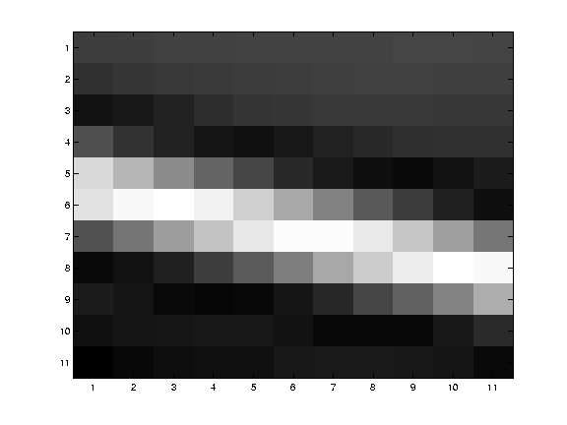
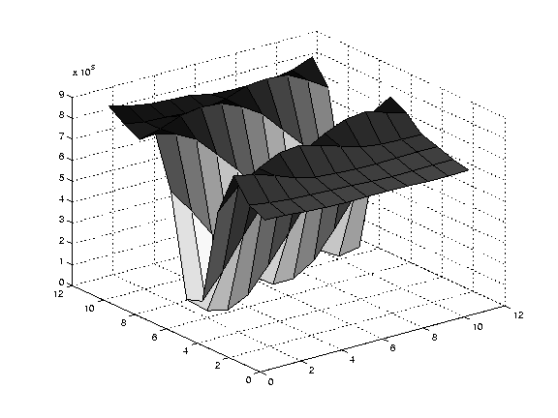
Edge
large gradients, all the same
large λ₁, small λ₂
Notes:
On an edge you can estimate motion perpendicular to the edge but not along it.

Slide 48
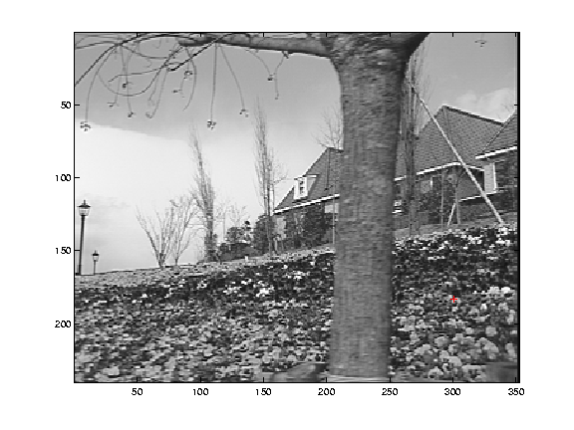
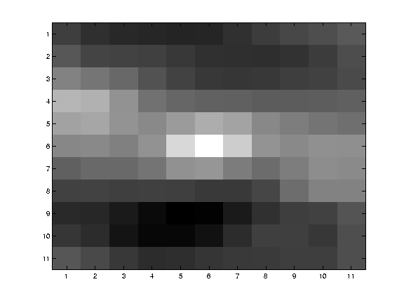
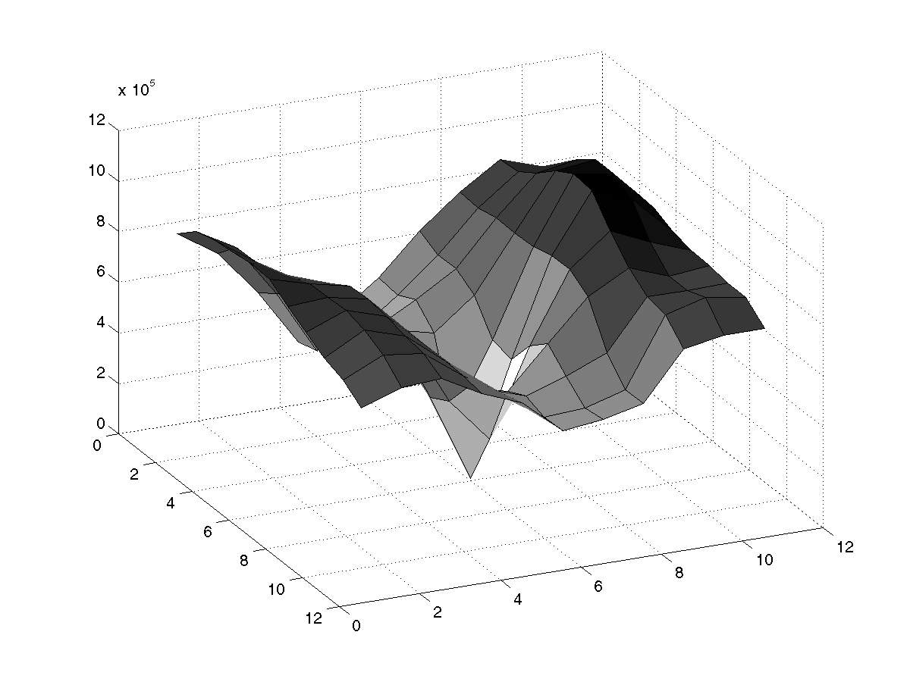
High textured region
gradients are different, large magnitudes
large λ₁, large λ₂
Notes:
But on nice textured regions motion is well estimated because the gradient varies over the window.

Slide 49
The aperture problem resolved
Actual motion

Slide 50
The aperture problem resolved
Perceived motion

Slide 51
Errors in Lucas-Kanade
A point does not move like its neighbors
  Motion segmentation
Brightness constancy does not hold
  Do exhaustive neighborhood search with normalized correlation - tracking features – maybe SIFT – more later….
The motion is large (larger than a pixel)
  Not-linear: Iterative refinement
  Local minima: coarse-to-fine estimation

Slide 52
Not tangent: Iterative Refinement
Iterative Lukas-Kanade Algorithm
  Estimate velocity at each pixel by solving Lucas-Kanade equations
  Warp I_{t} towards I_{t+1} using the estimated flow field
    - use image warping techniques
  Repeat until convergence

Slide 53
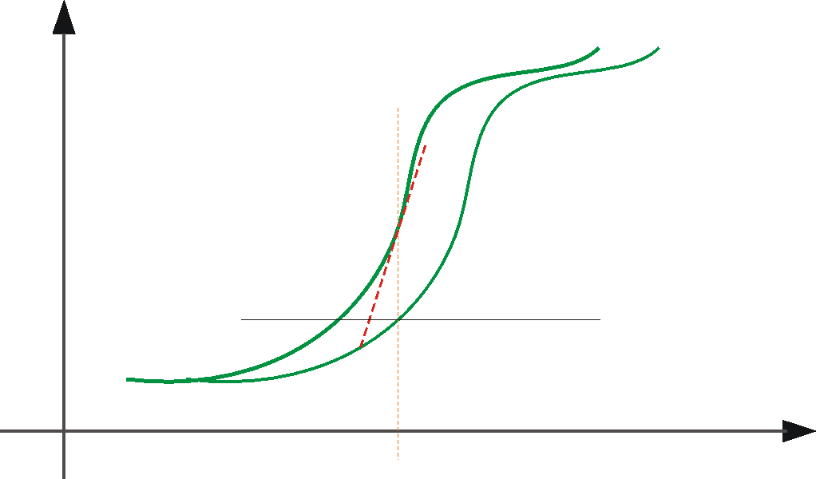





Optical Flow: Iterative Estimation
estimate update
Initial guess:
Estimate:
x₀
x
(using d for displacement here instead of u)

Slide 54
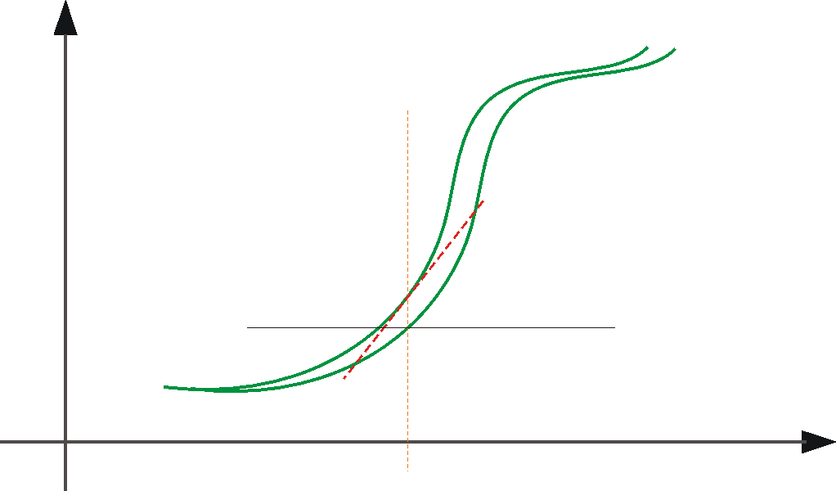



Optical Flow: Iterative Estimation
estimate update
Initial guess:
Estimate:
x₀
x

Slide 55
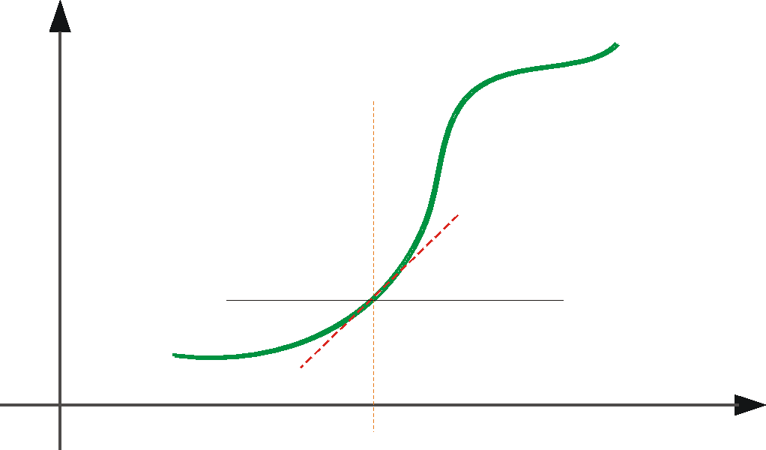



Optical Flow: Iterative Estimation
estimate update
Initial guess:
Estimate:
Initial guess:
Estimate:
x₀
x

Slide 56
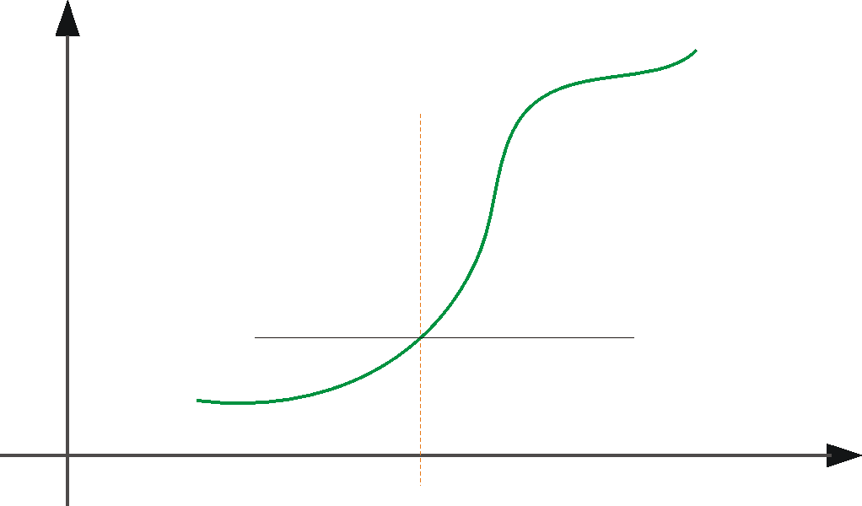

Optical Flow: Iterative Estimation
x₀
x

Slide 57
Optical Flow: Iterative Estimation
Some Implementation Issues:
  Warping is not easy (ensure that errors in warping are smaller than the estimate refinement) – but it is in MATLAB!
  Often useful to low-pass filter the images before motion estimation (for better derivative estimation, and linear approximations to image intensity)

Slide 58
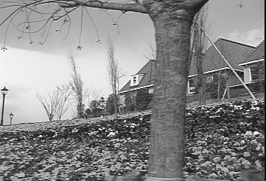
Revisiting the small motion assumption
Is this motion small enough?
  Probably not—it’s much larger than one pixel
  How might we solve this problem?

Slide 59


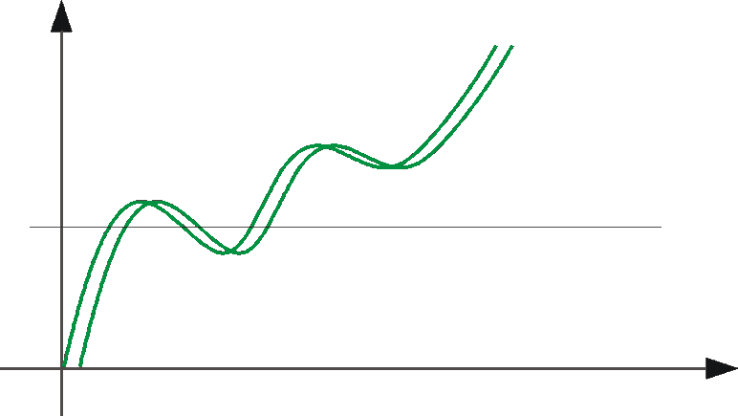
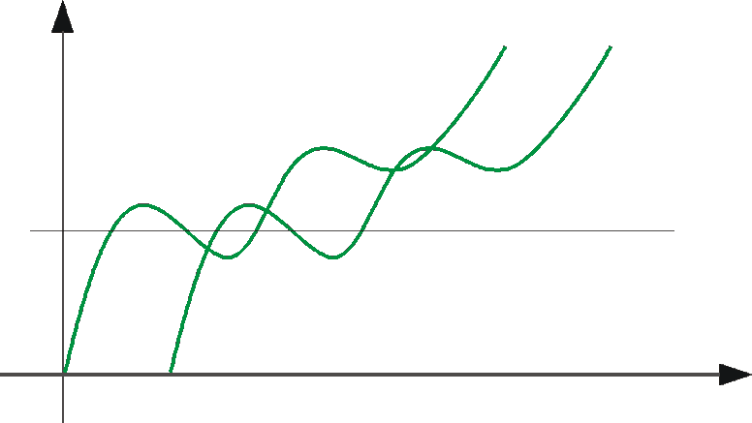
Optical Flow: Aliasing
Temporal aliasing causes ambiguities in optical flow because images can have many pixels with the same intensity.
I.e., how do we know which ‘correspondence’ is correct?
actual shift
estimated shift
nearest match is correct (no aliasing)
nearest match is incorrect (aliasing)
To overcome aliasing: coarse-to-fine estimation.

Slide 60
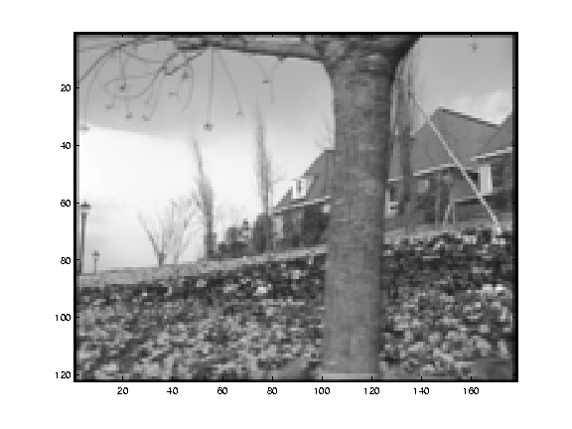
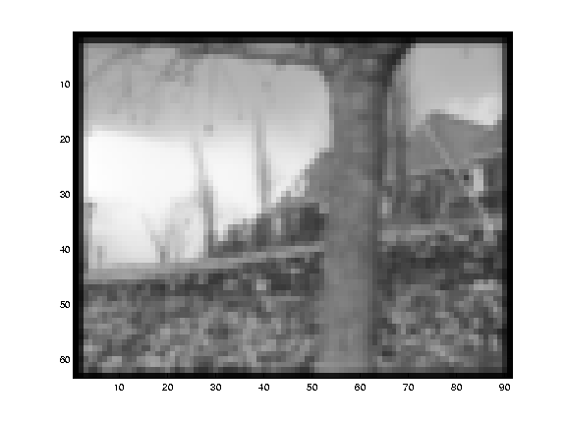


Reduce the resolution!

Slide 61
Coarse-to-fine optical flow estimation
u=1.25 pixels
u=2.5 pixels
u=5 pixels
image 1
u=10 pixels
image 2
image 1
image 2
Gaussian pyramid of image 1
Gaussian pyramid of image 2

Slide 62
Coarse-to-fine optical flow estimation
run iterative L-K
warp & upsample
run iterative L-K
.
.
.
image J
image I
image 1
image 2
Gaussian pyramid of image 1
Gaussian pyramid of image 2
Notes:
Far more details: http://robots.stanford.edu/cs223b04/algo_tracking.pdf

Slide 63

Optical Flow Results
* From Khurram Hassan-Shafique CAP5415 Computer Vision 2003

Slide 64

Optical Flow Results
* From Khurram Hassan-Shafique CAP5415 Computer Vision 2003

Slide 65


State-of-the-art optical flow in 2009
Start with something similar to Lucas-Kanade
+ gradient constancy
+ energy minimization with smoothing term
+ region matching
+ keypoint matching (long-range)
Region-based
+Pixel-based
+Keypoint-based
Large displacement optical flow, Brox et al., CVPR 2009

Slide 66

State-of-the-art optical flow in 2015
Deep convolutional network which accepts a pair of input frames and upsamples the estimated flow back to input resolution. Very fast because of deep network, near the state-of-the-art in terms of end-point-error.
Fischer et al. 2015. https://arxiv.org/abs/1504.06852
Notes:
Optical flow as supervised learning

Slide 67

Deep optical flow, 2015
Synthetic Training data
Fischer et al. 2015. https://arxiv.org/abs/1504.06852

Slide 68

Deep optical flow, 2015
Results on Sintel
Fischer et al. 2015. https://arxiv.org/abs/1504.06852

Slide 69
Wrap up: Optical flow
Definition: optical flow is the apparent motion of brightness patterns in the image
Ideally, optical flow would be the same as the motion field
Have to be careful: apparent motion can be caused by lighting changes without any actual motion
  Think of a uniform rotating sphere under fixed lighting vs. a stationary sphere under moving illumination

Slide 70

Scene Flow: 3D scene motion

Slide 71

Scene Flow: 3D scene motion
DeFlow. Qingwen Zhang, Yi Yang, Heng Fang, Ruoyu Geng, and Patric Jensfelt. RPL lab @ KTH

Slide 72
Sample quiz questions (new window)

