Slide 1
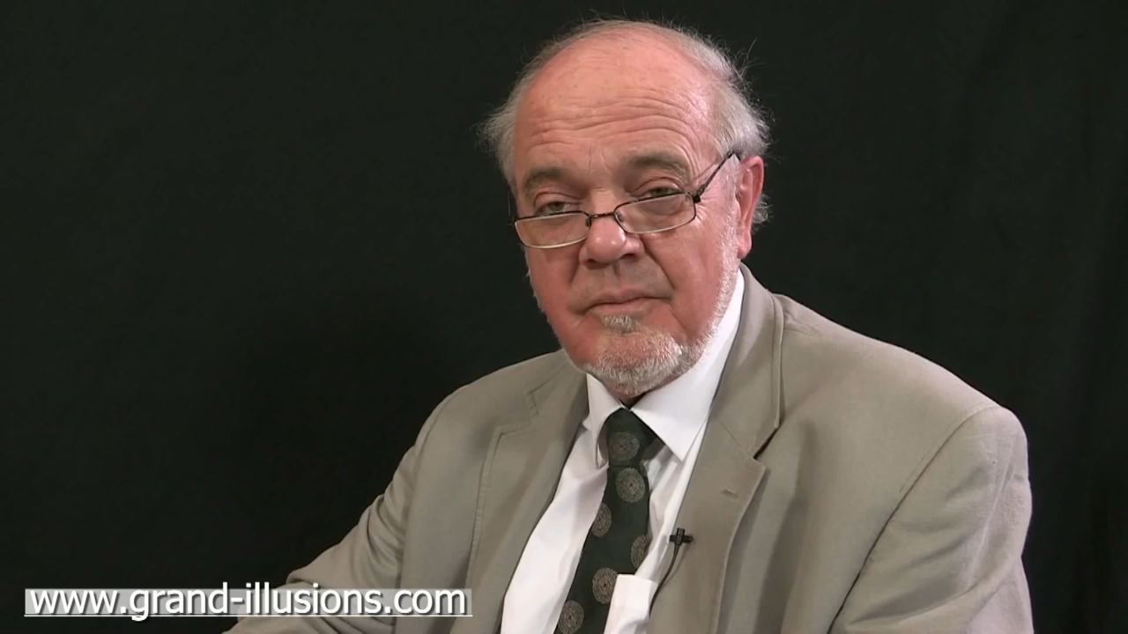

Slide 2
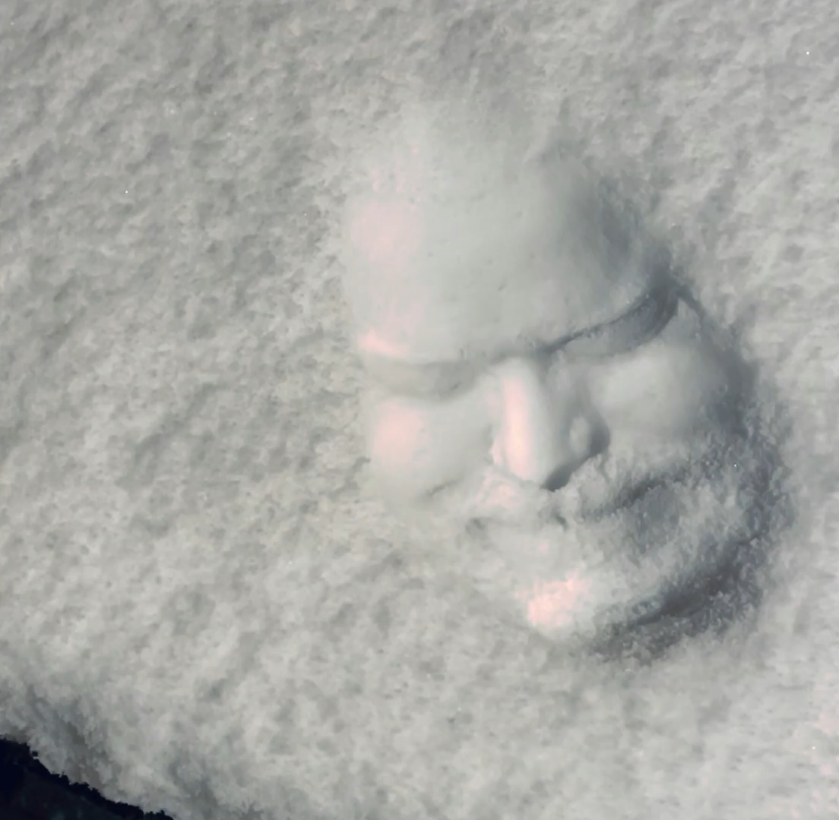
source
Notes:
From https://www.reddit.com/r/illusionporn/comments/sz7nnx/i_meticulously_sculpted_my_face_in_snow_it_took_6/

Slide 3
Deep Learning
Neural Net Basics
Computer Vision
James Hays
Many slides by Marc’Aurelio Ranzato

Slide 4
Outline
Neural Networks
Convolutional Neural Networks
Variants
  Detection
  Segmentation
  Siamese Networks
Visualization of Deep Networks

Slide 5
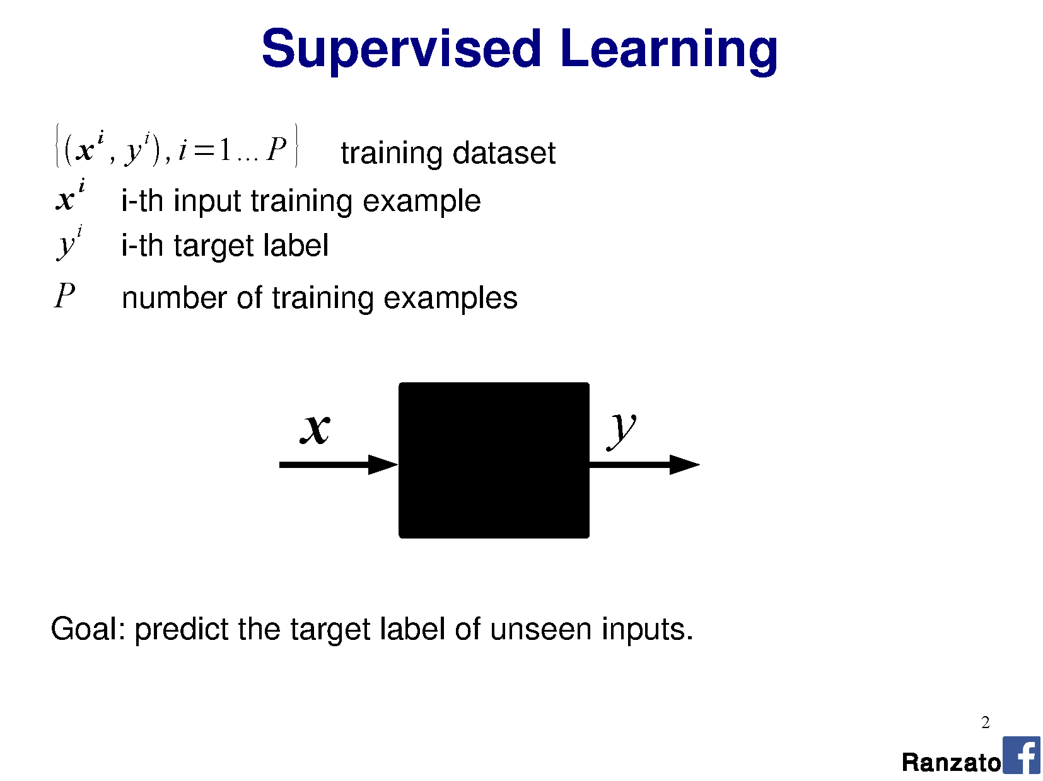

Slide 6
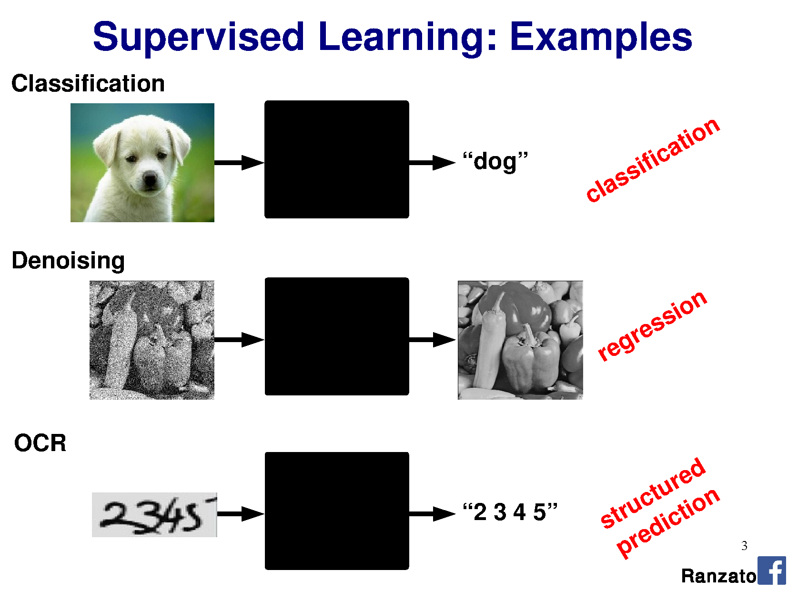

Slide 7
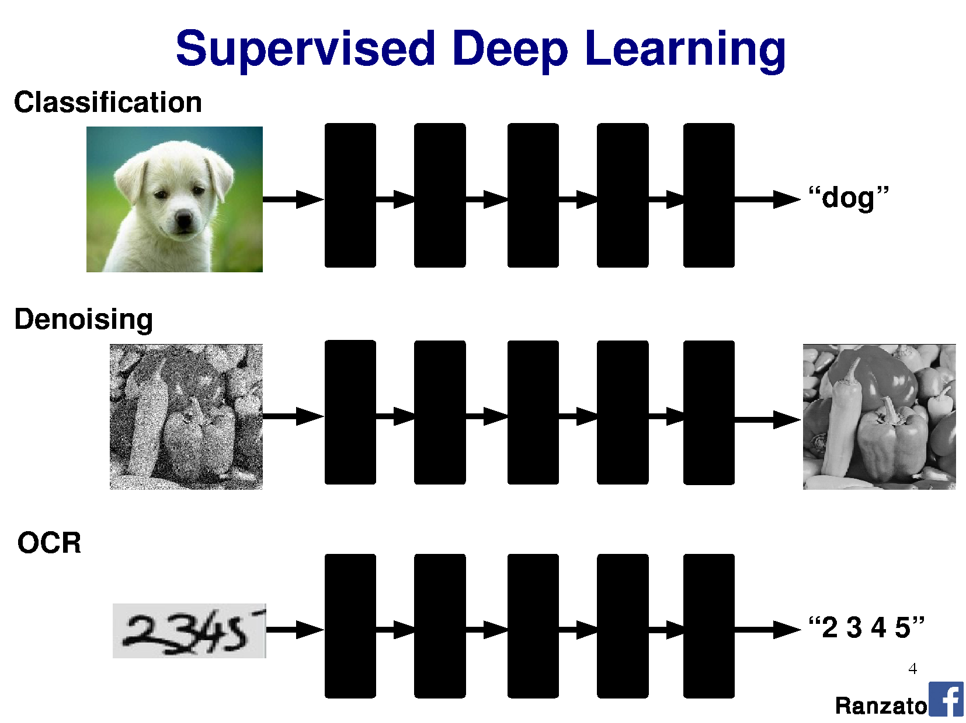

Slide 8
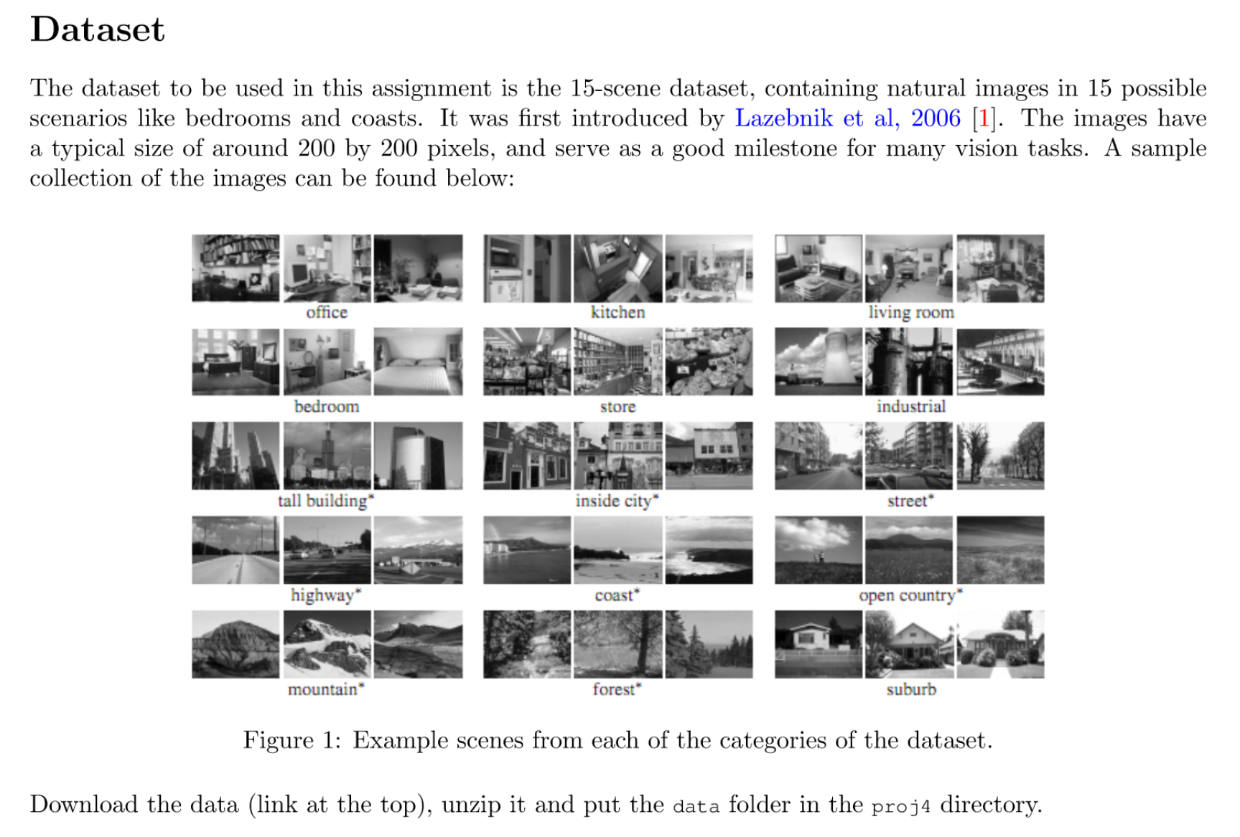
Project 4: Scene Classification with Deep Nets

Slide 9
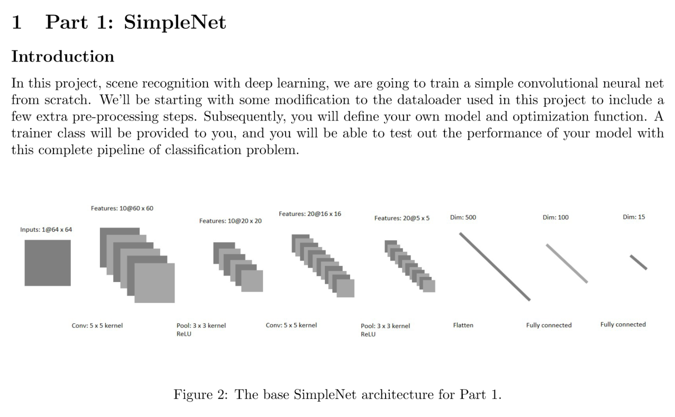

Slide 10
Outline
Neural Networks
Convolutional Neural Networks
Variants
  Detection
  Segmentation
  Siamese Networks
Visualization of Deep Networks

Slide 11
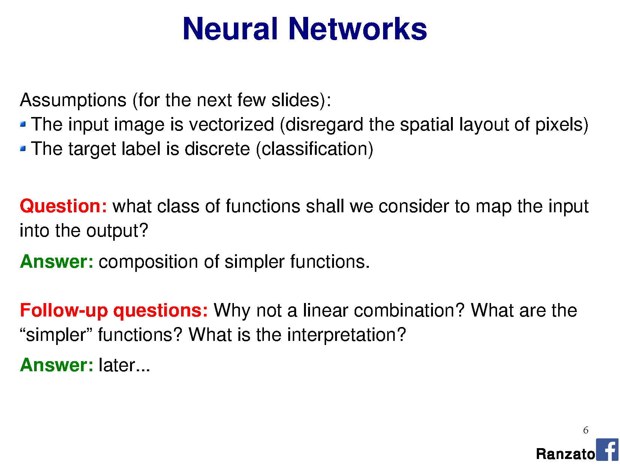

Slide 13
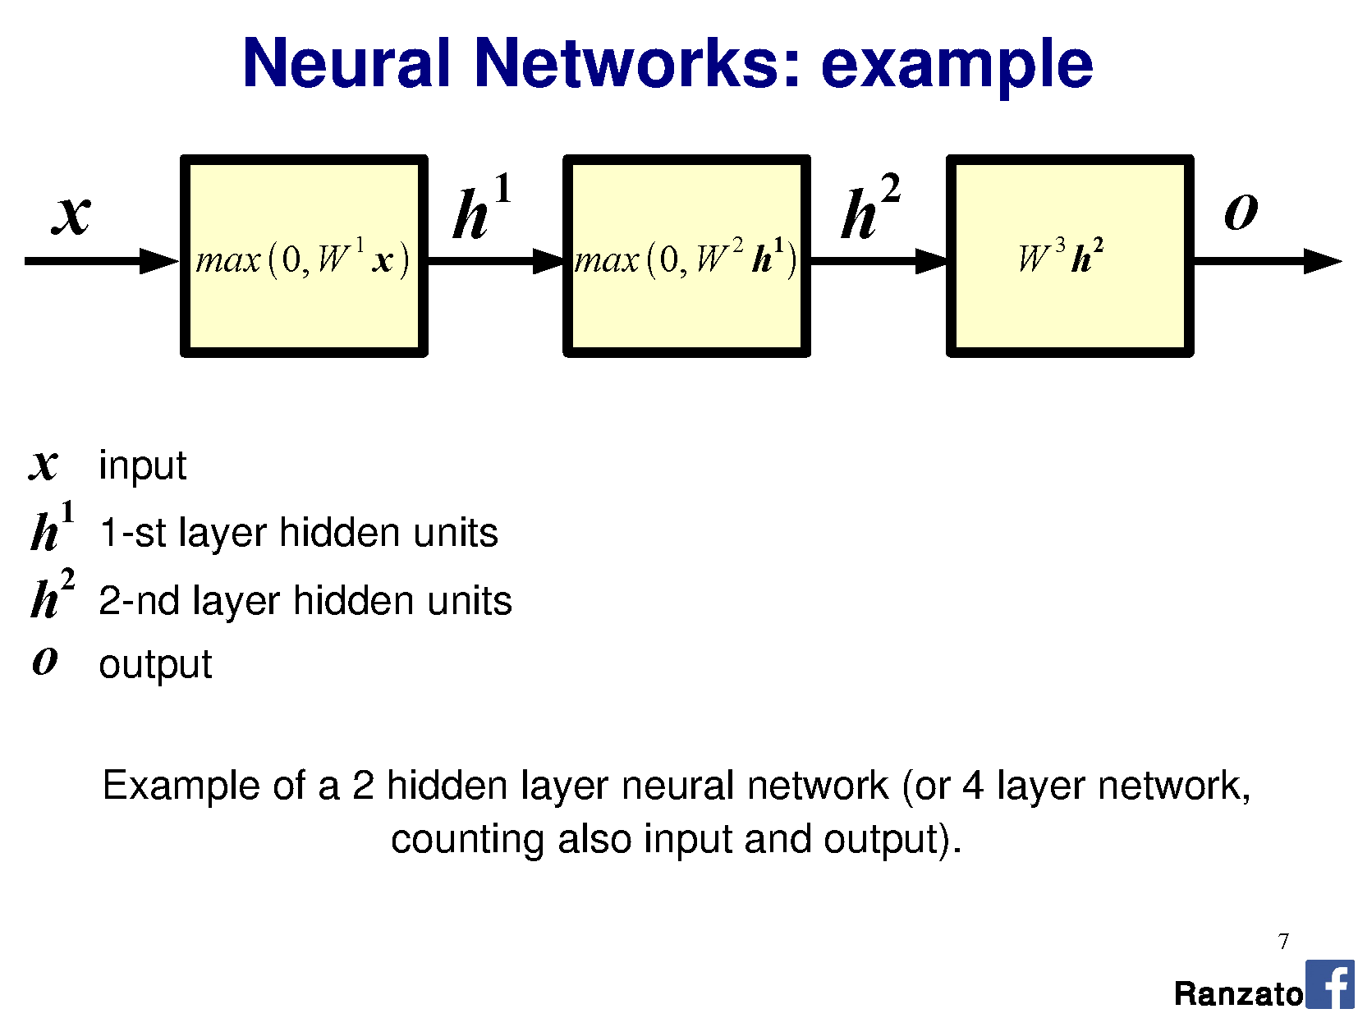
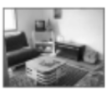

Slide 14
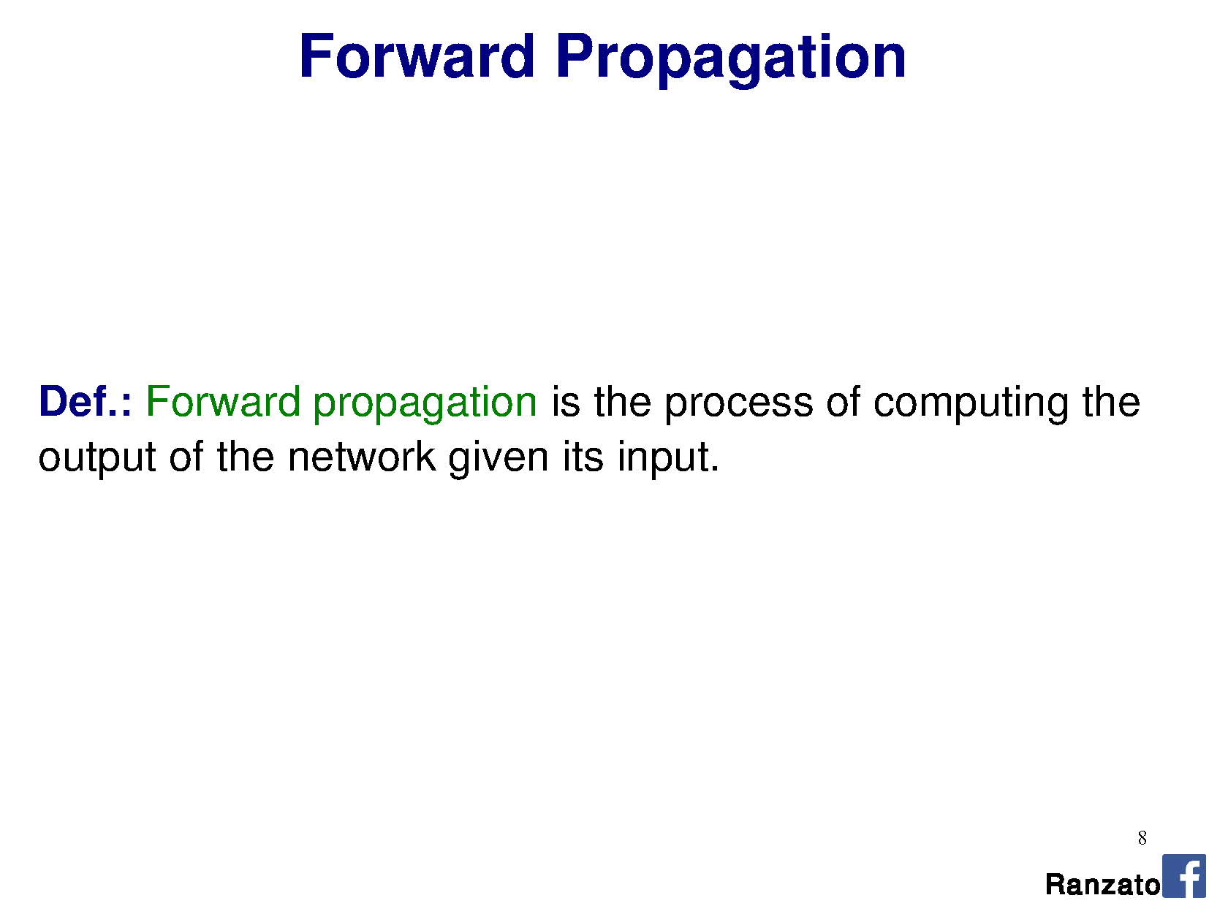

Slide 15
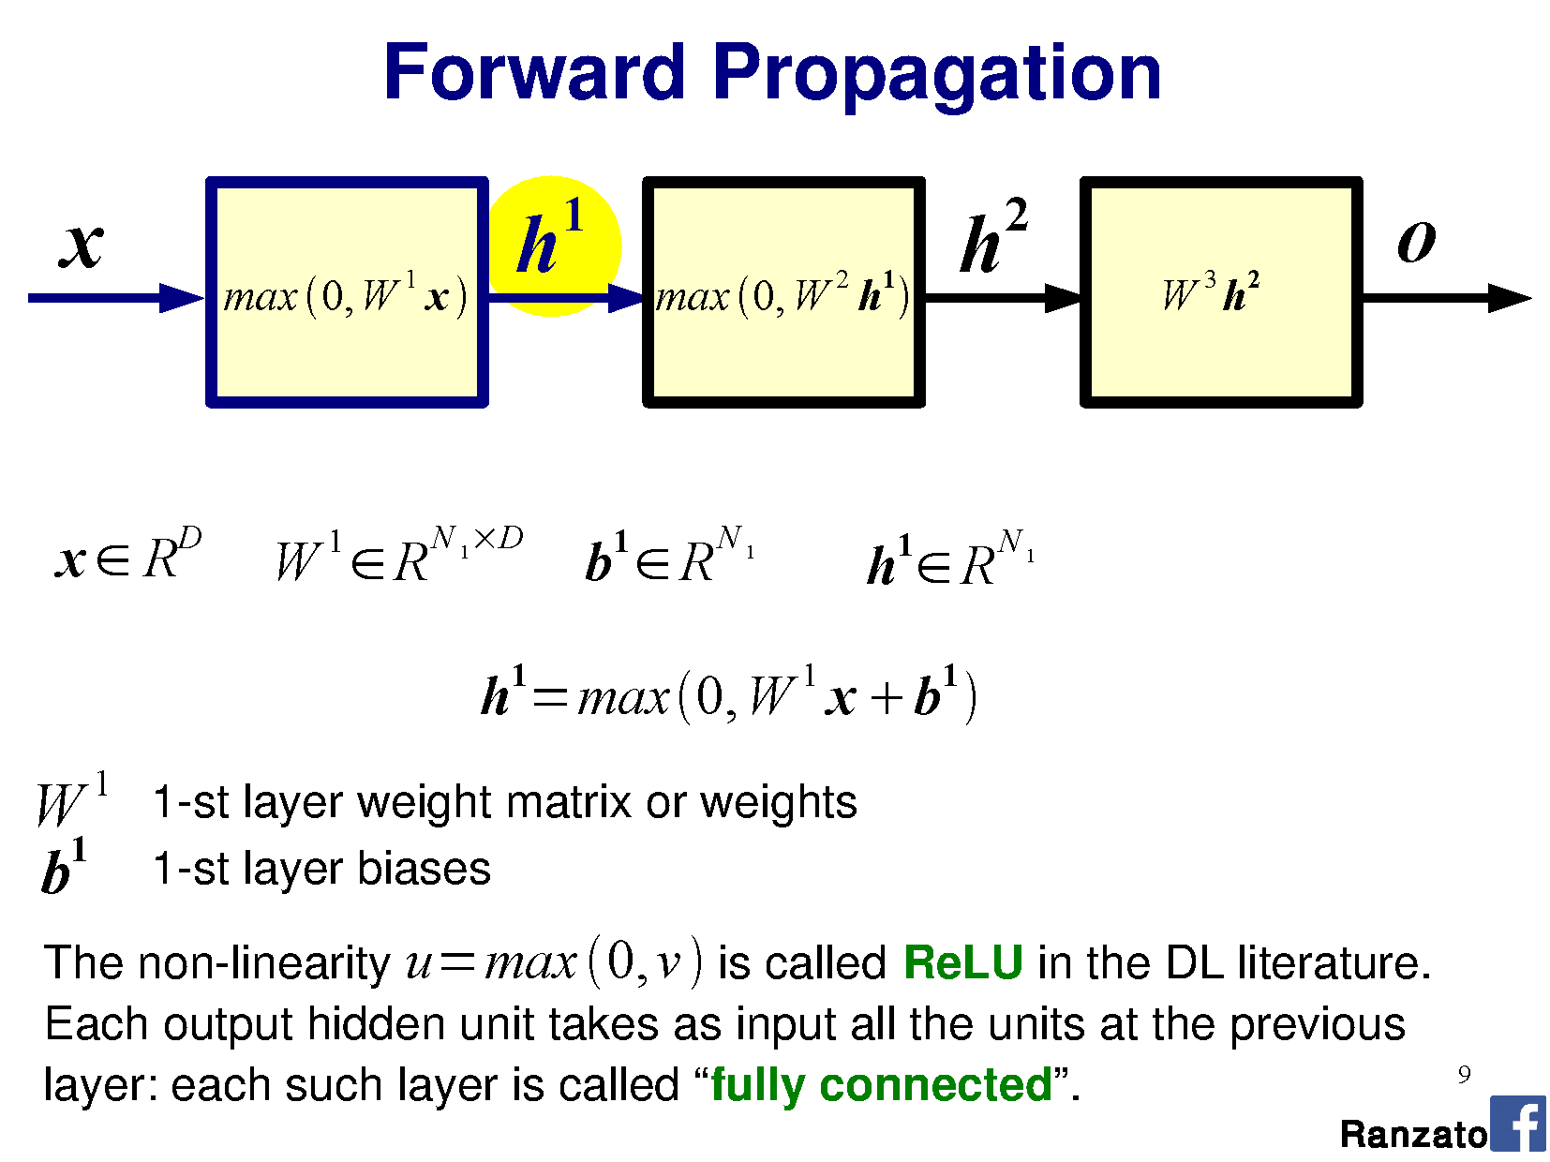

Slide 16
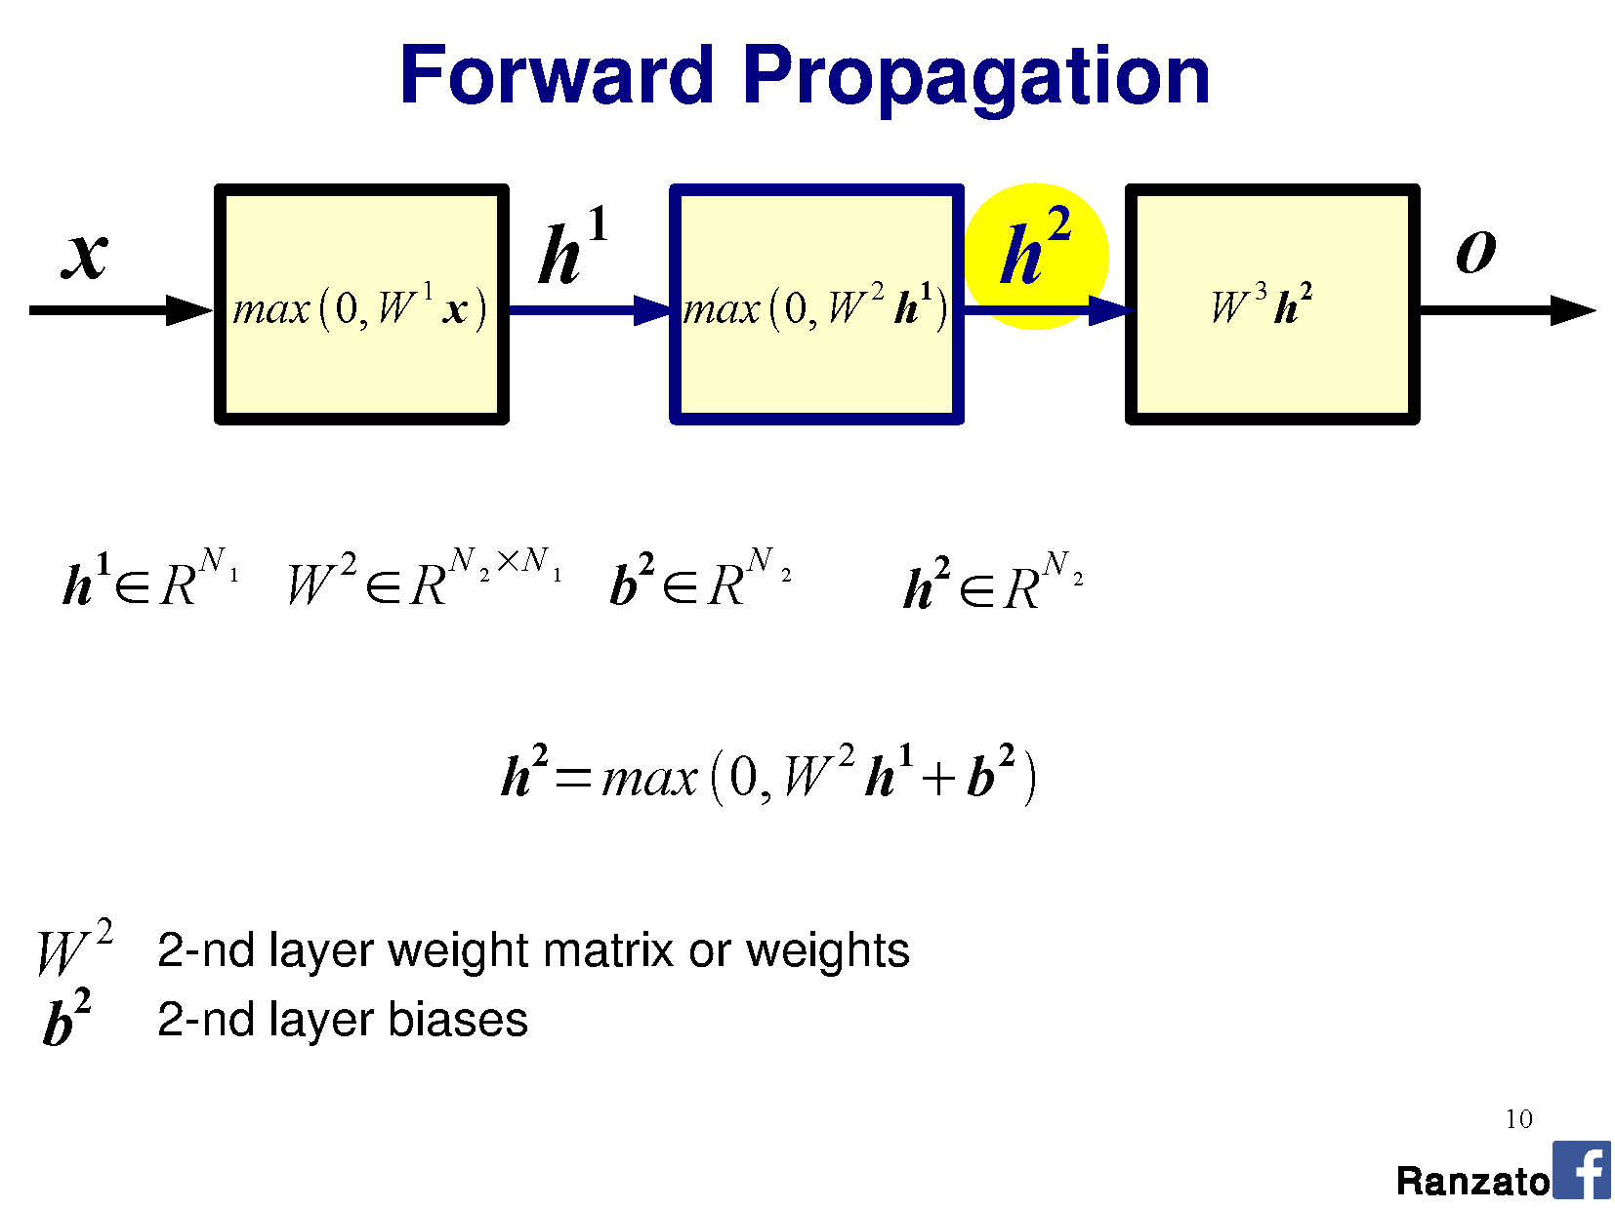

Slide 17
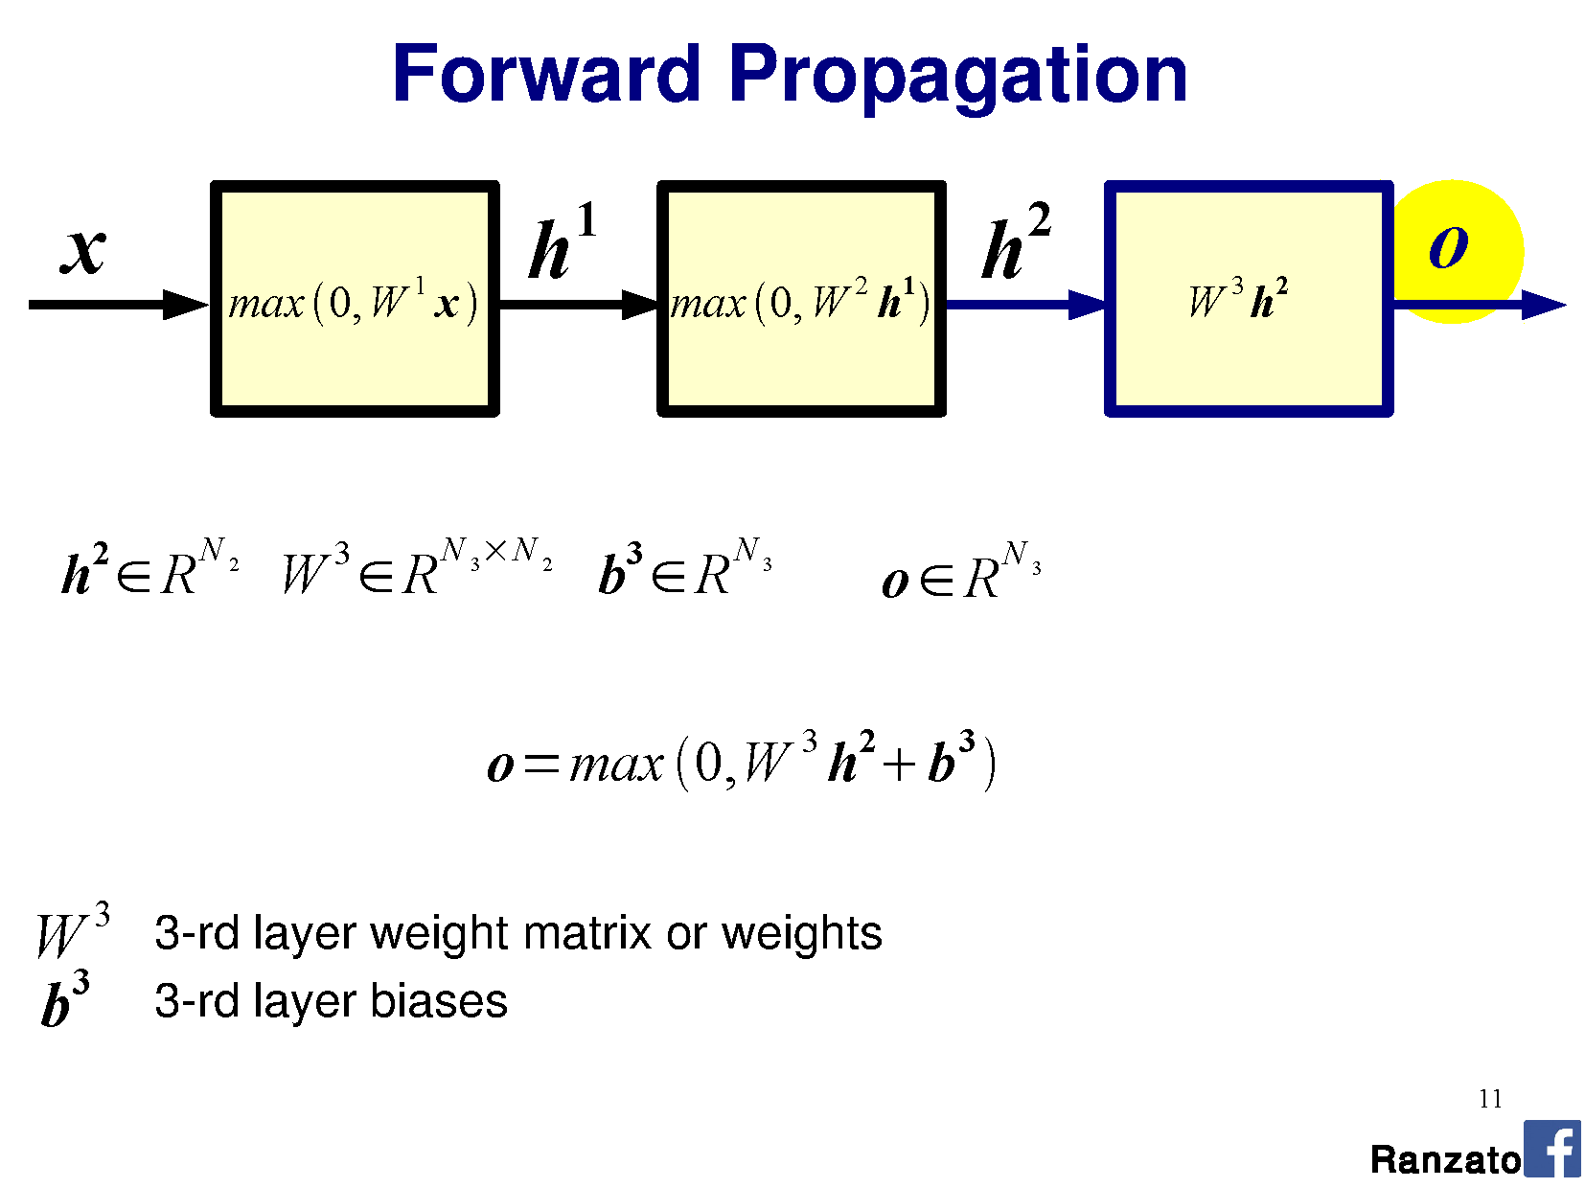

Slide 18
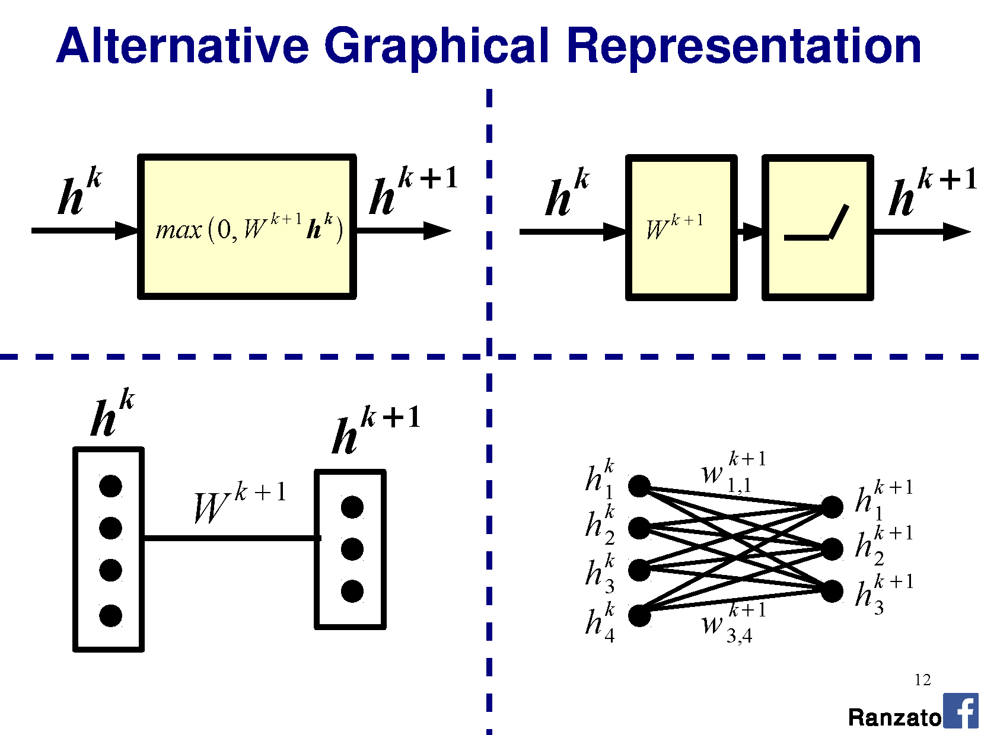

Slide 19
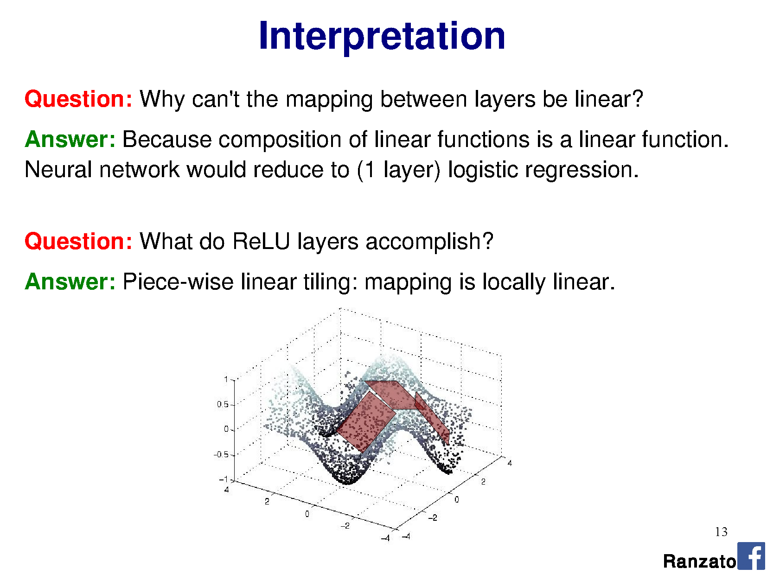

Slide 20
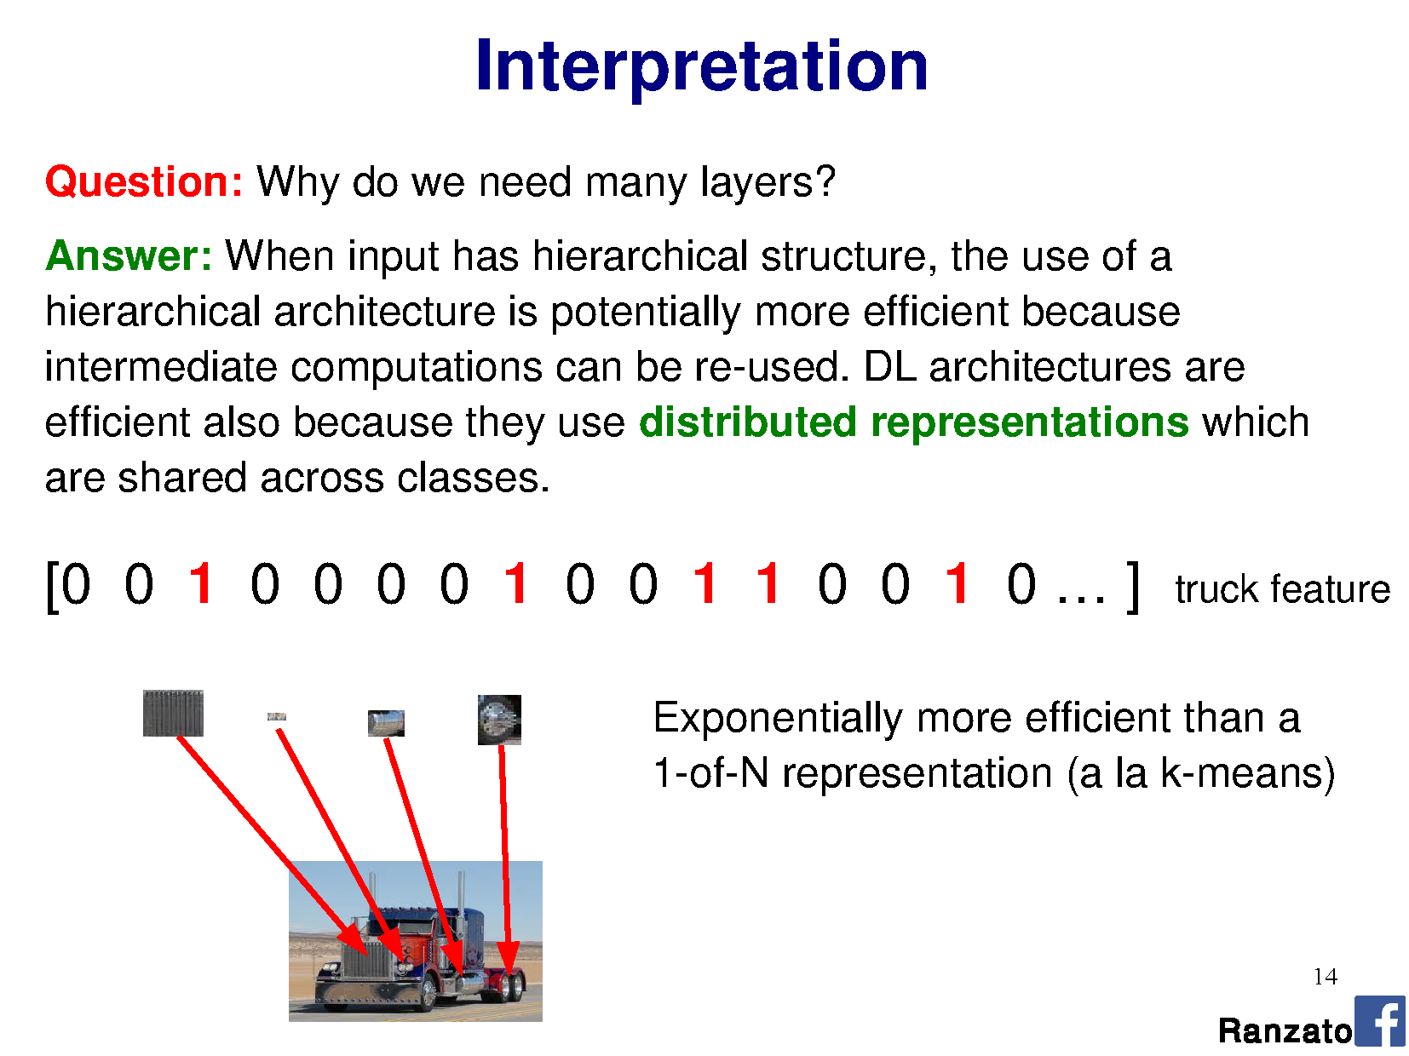

Slide 21
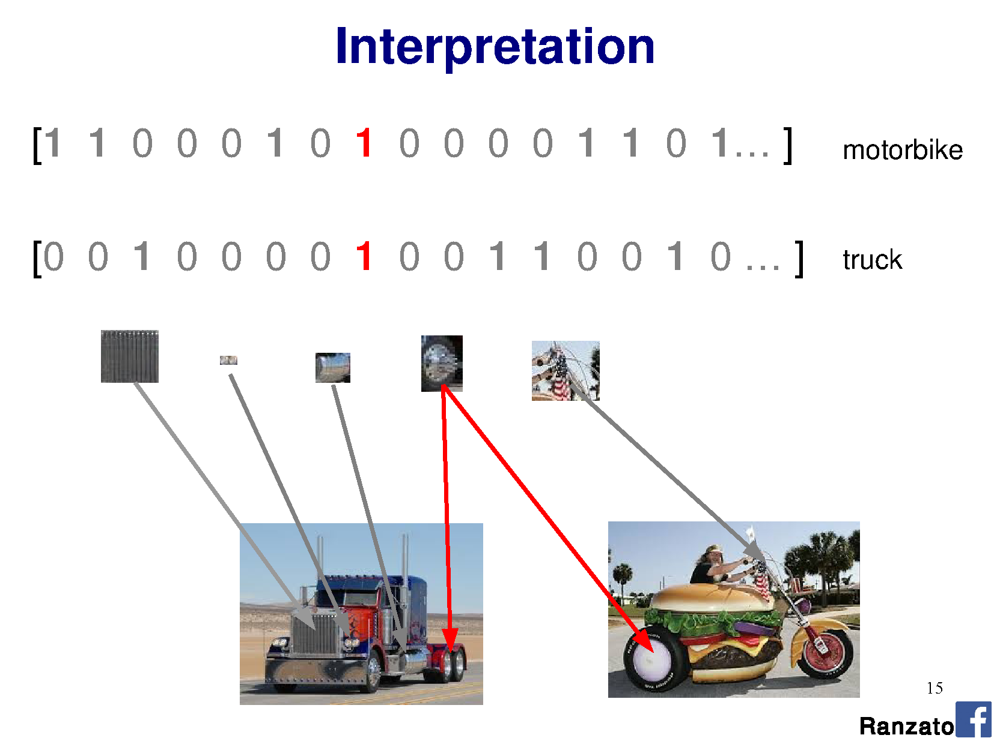

Slide 22
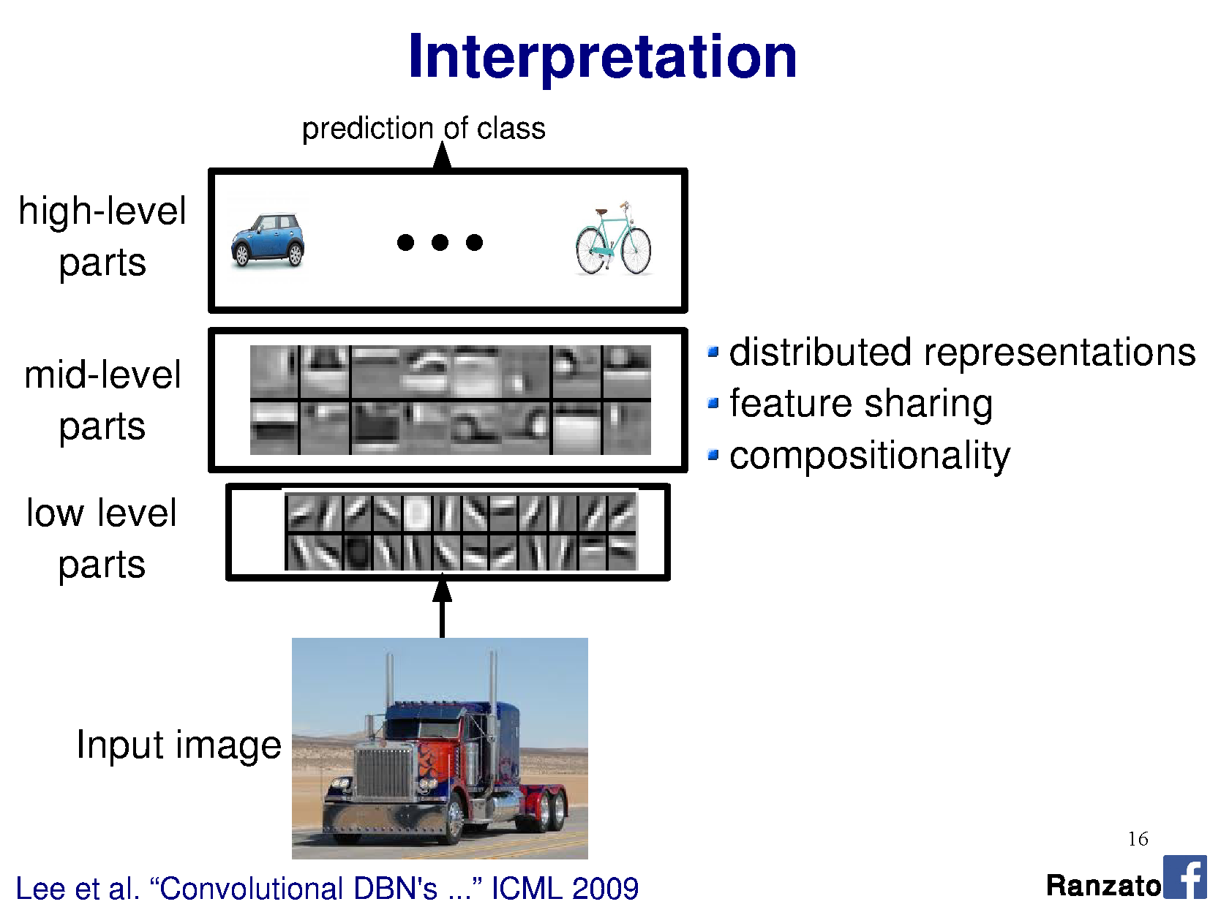

Slide 23
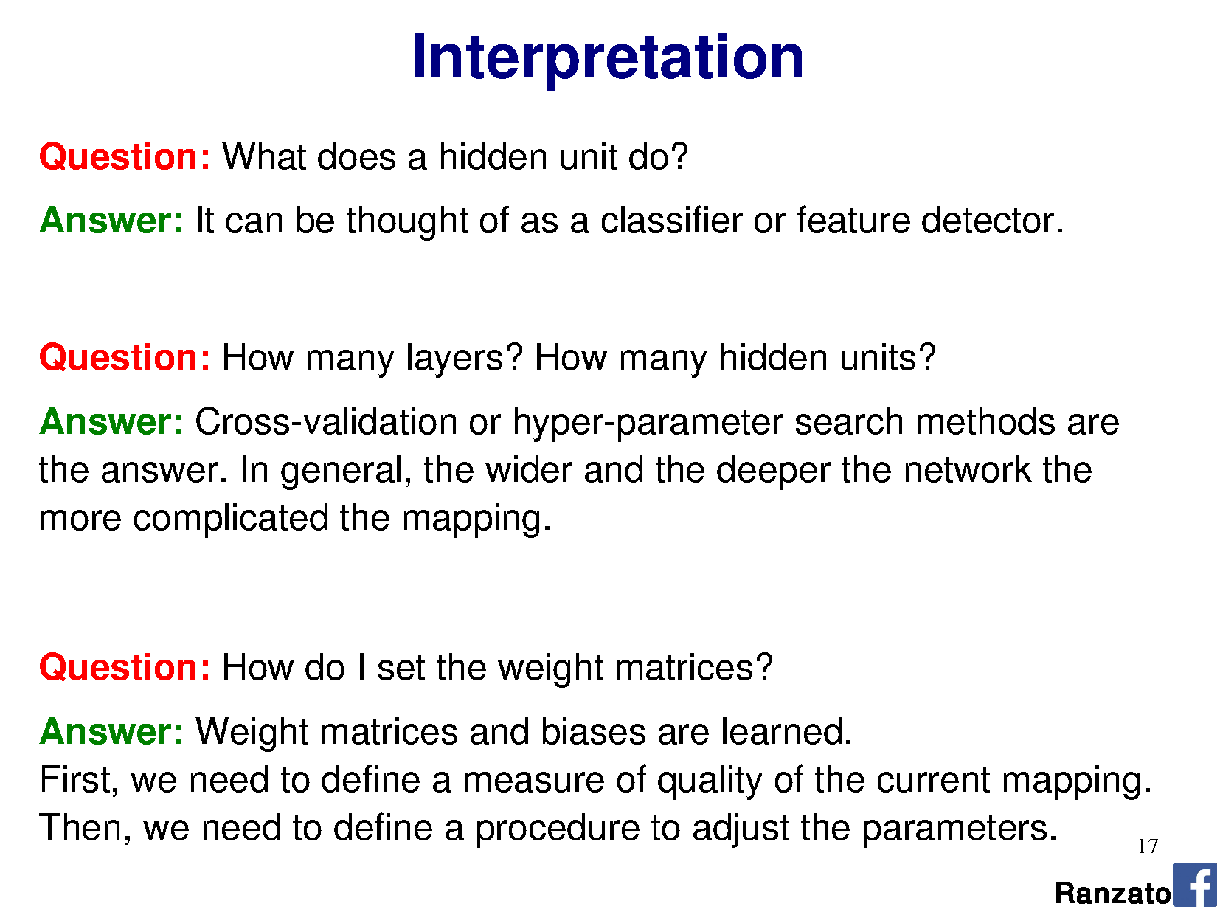

Slide 26
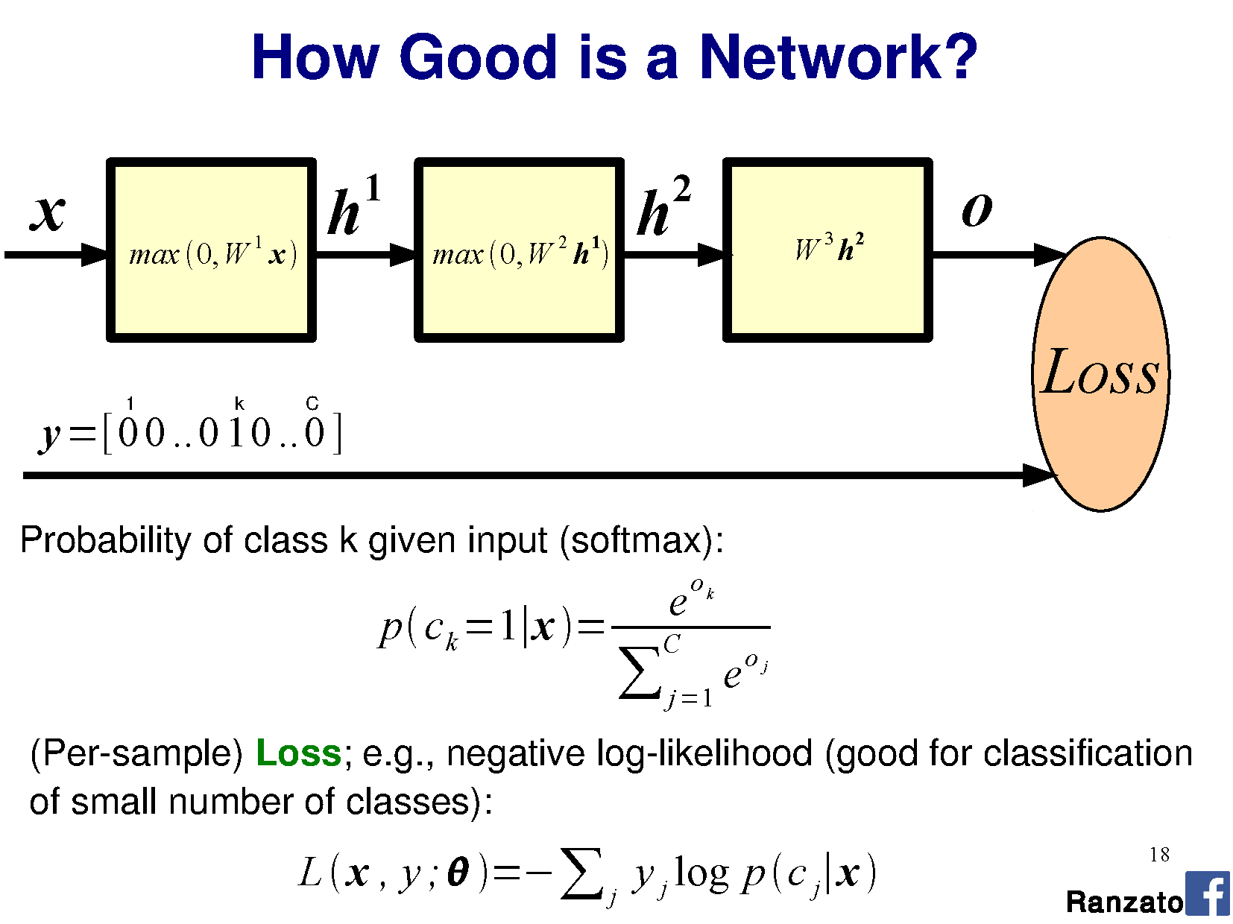

Slide 27
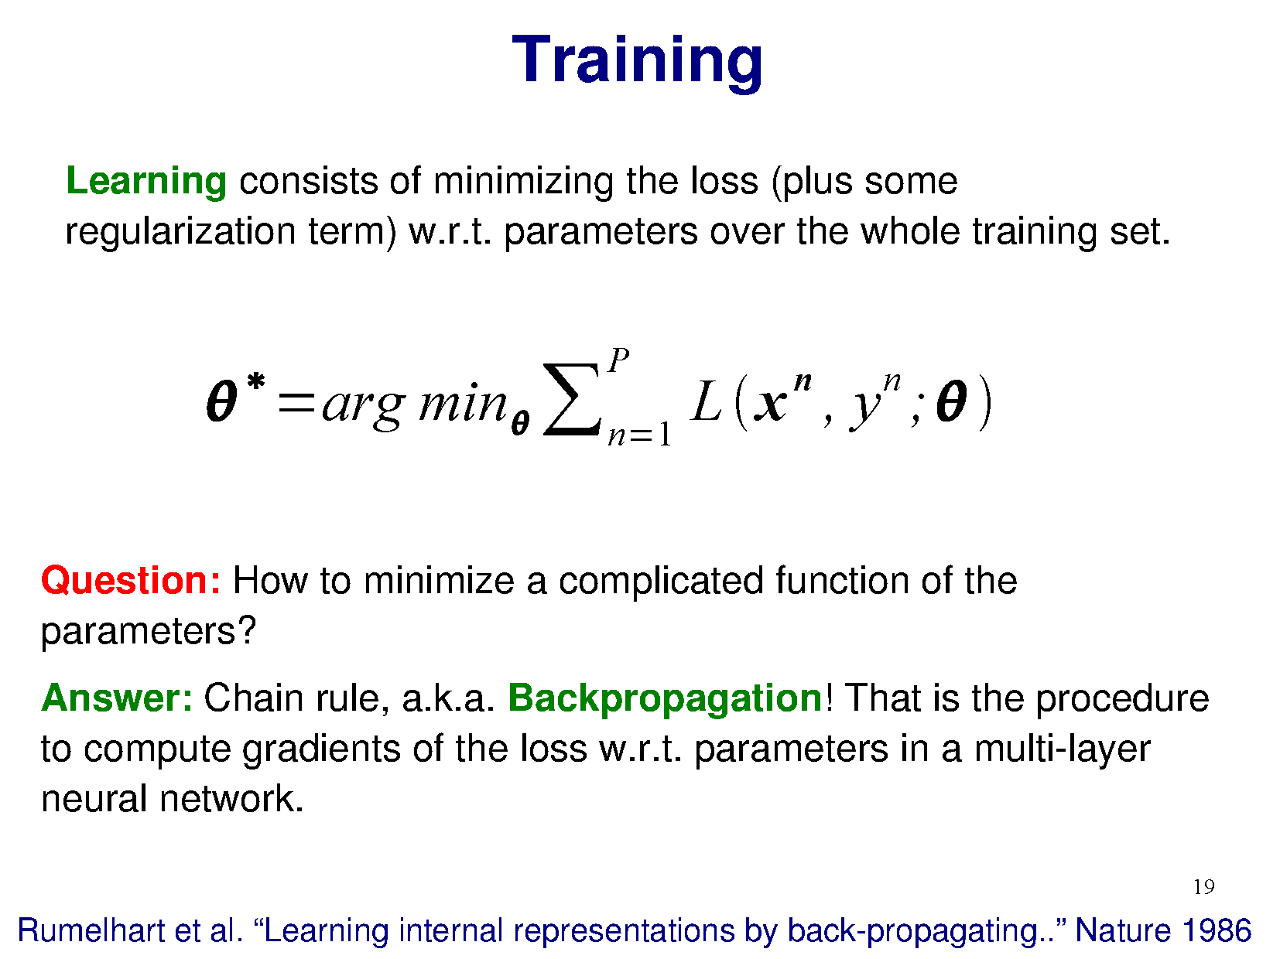

Slide 29
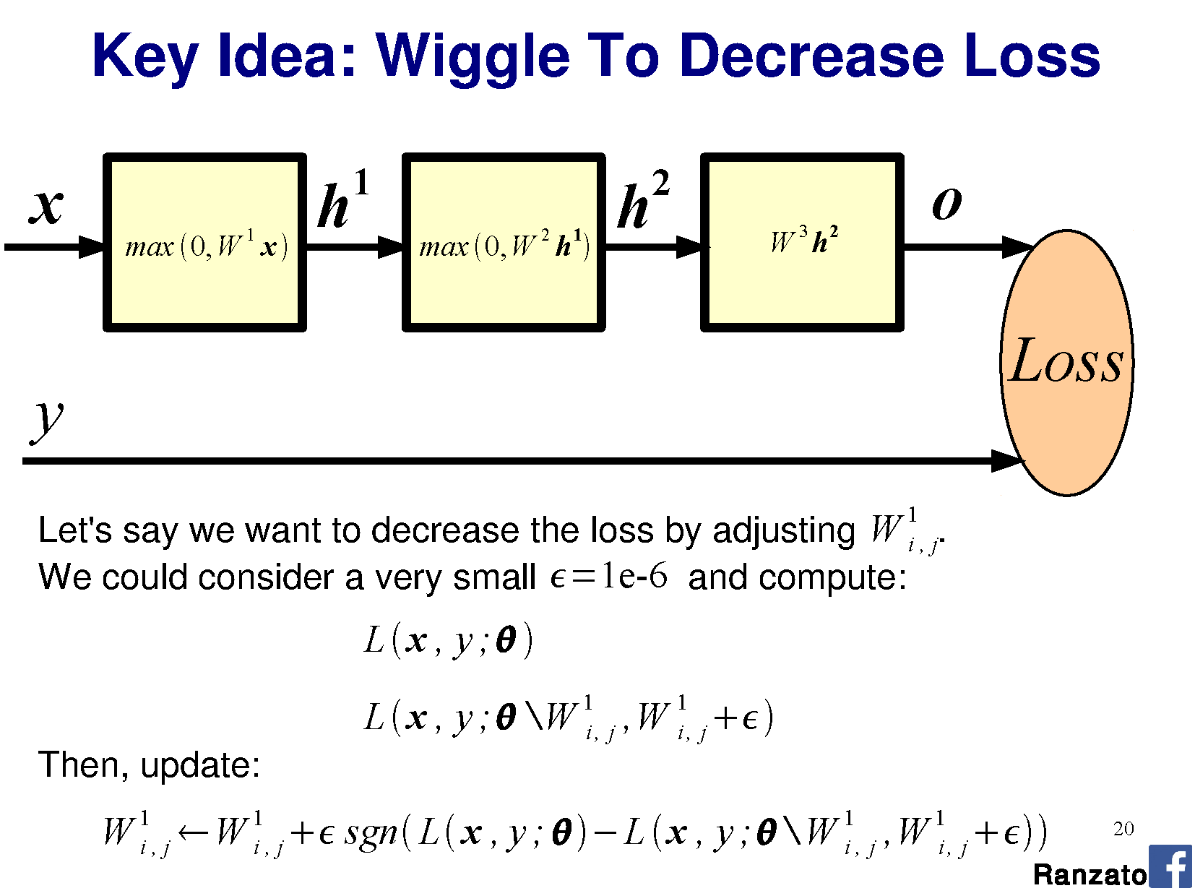

Slide 30
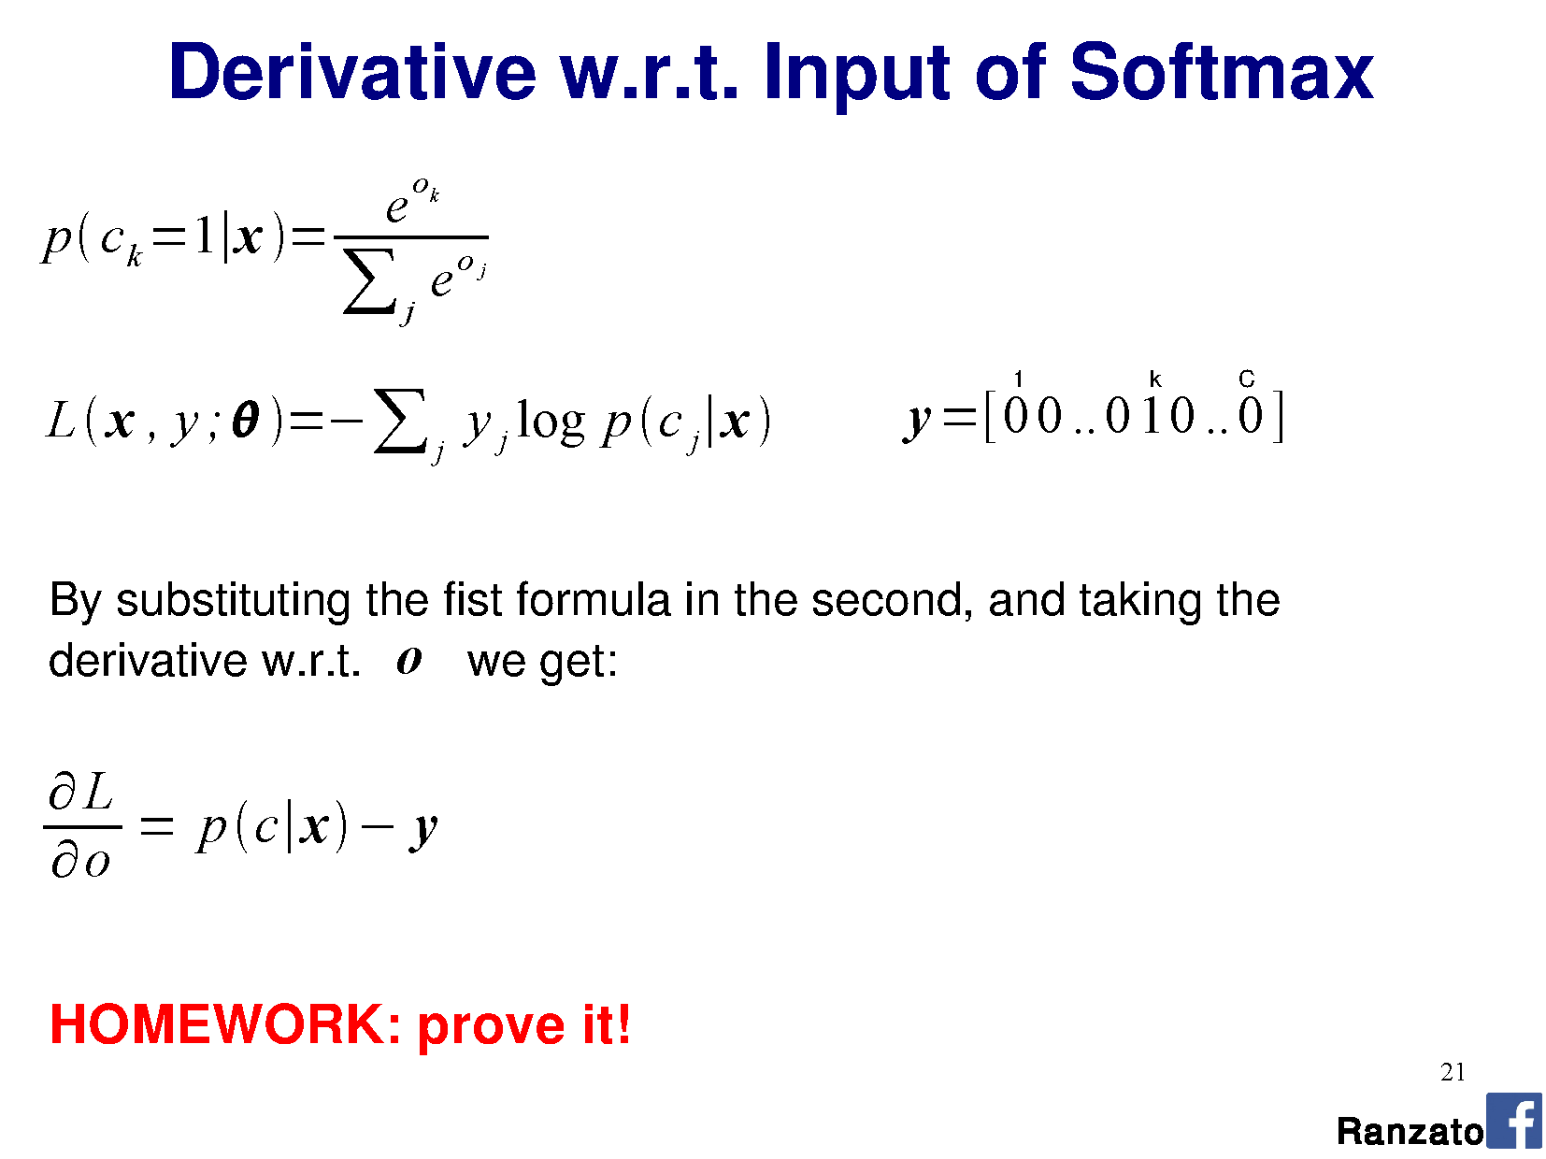

Slide 31
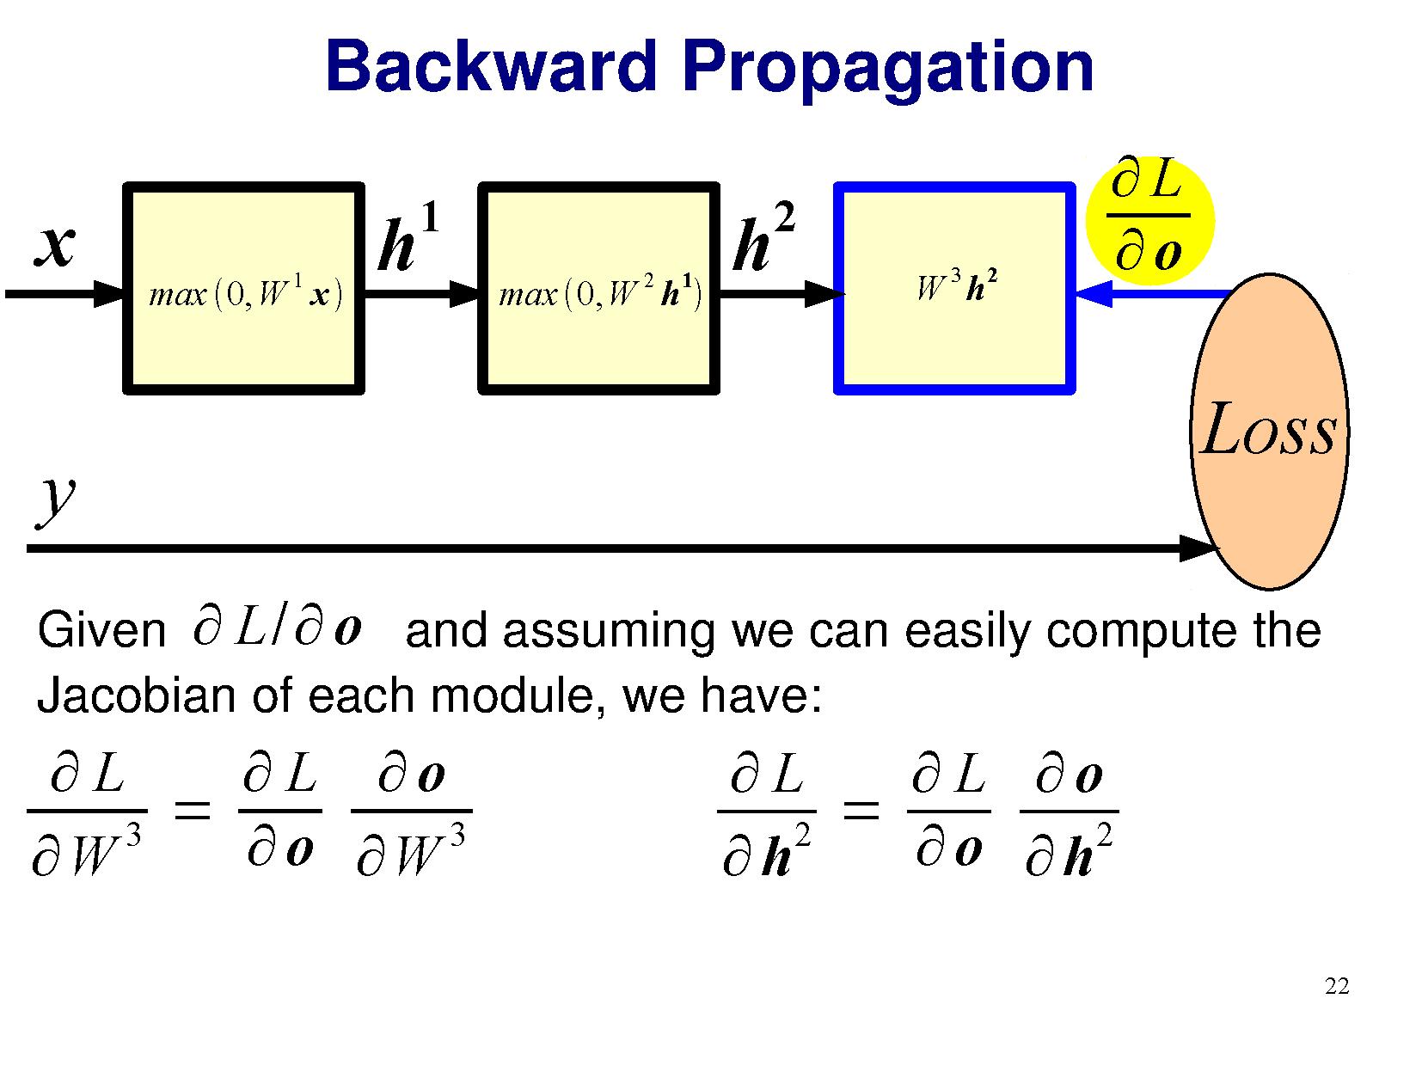

Slide 32
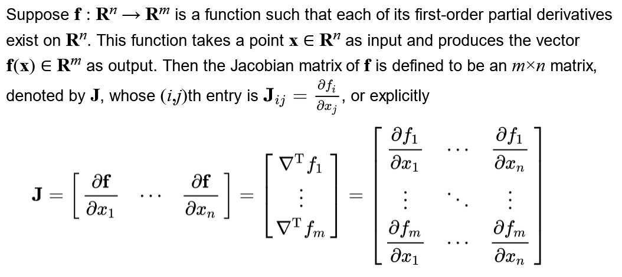

Slide 34
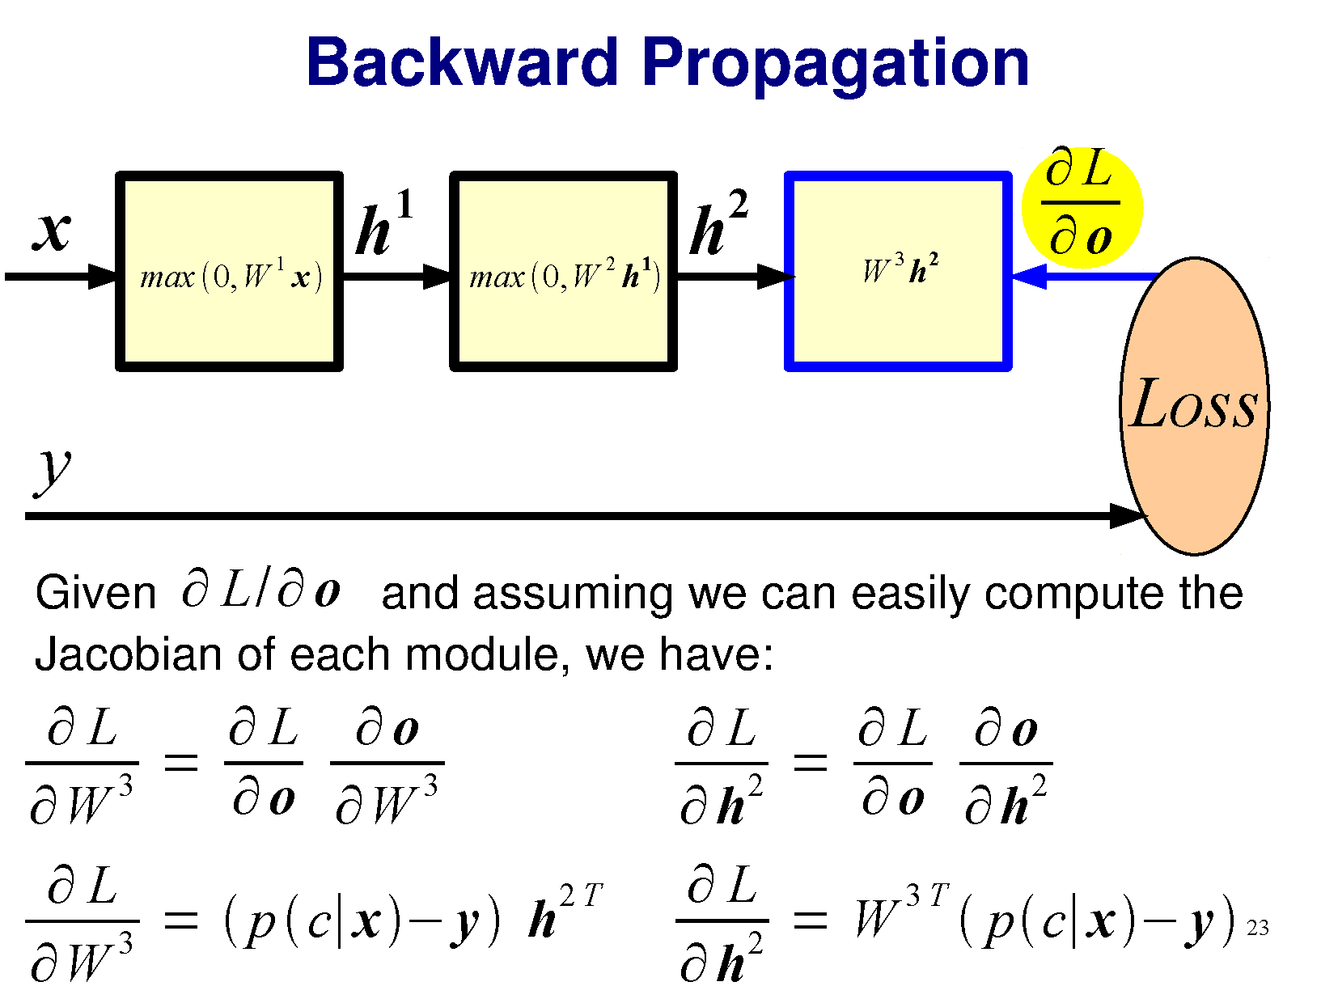

Slide 35
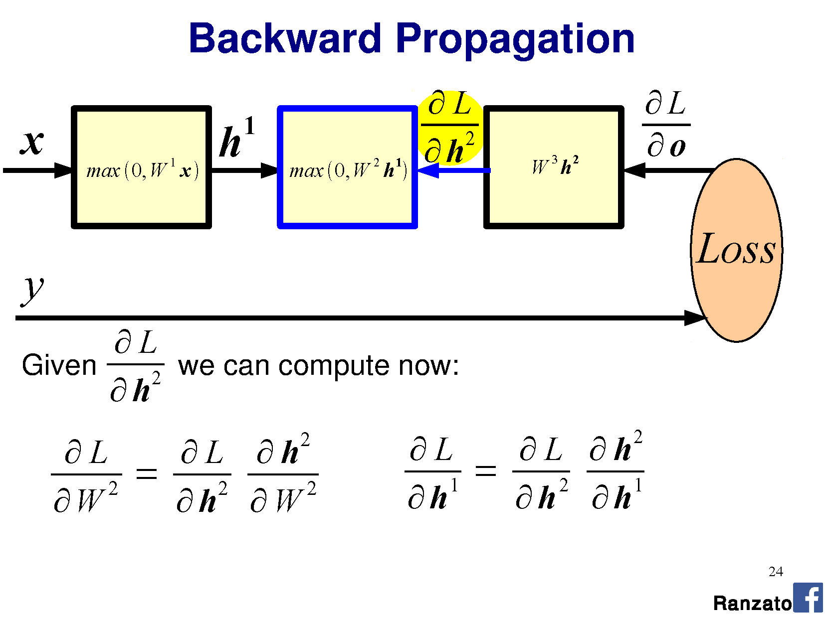

Slide 36
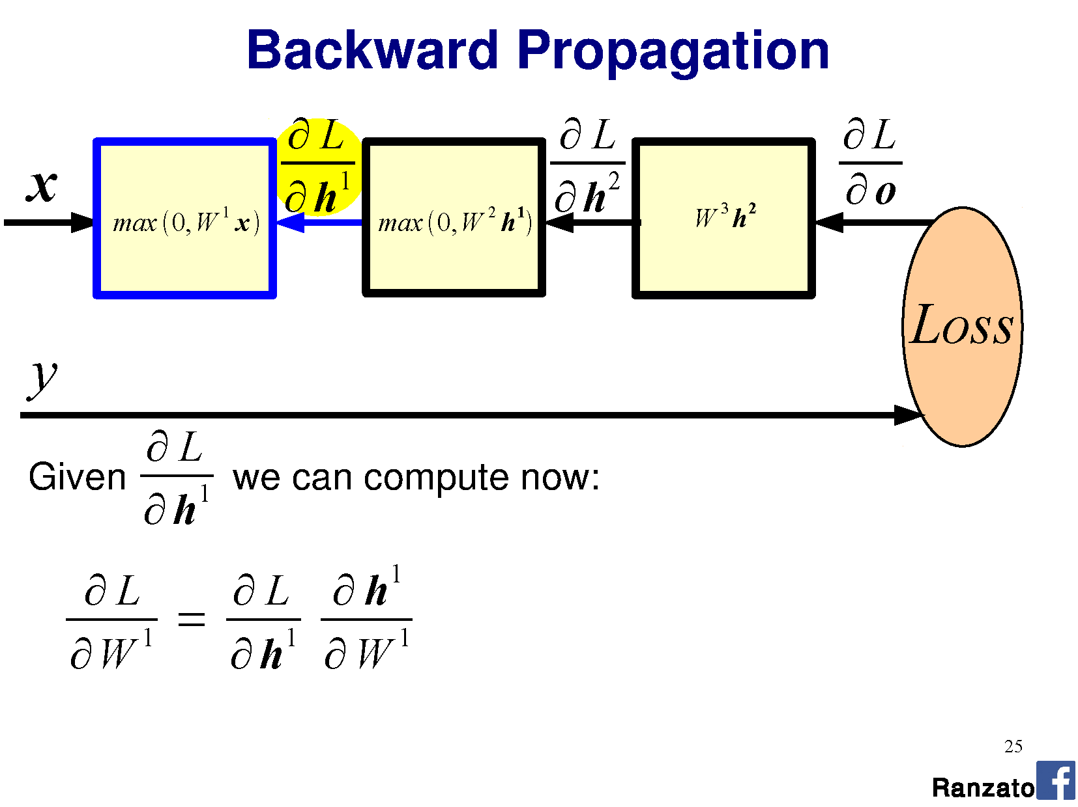

Slide 37
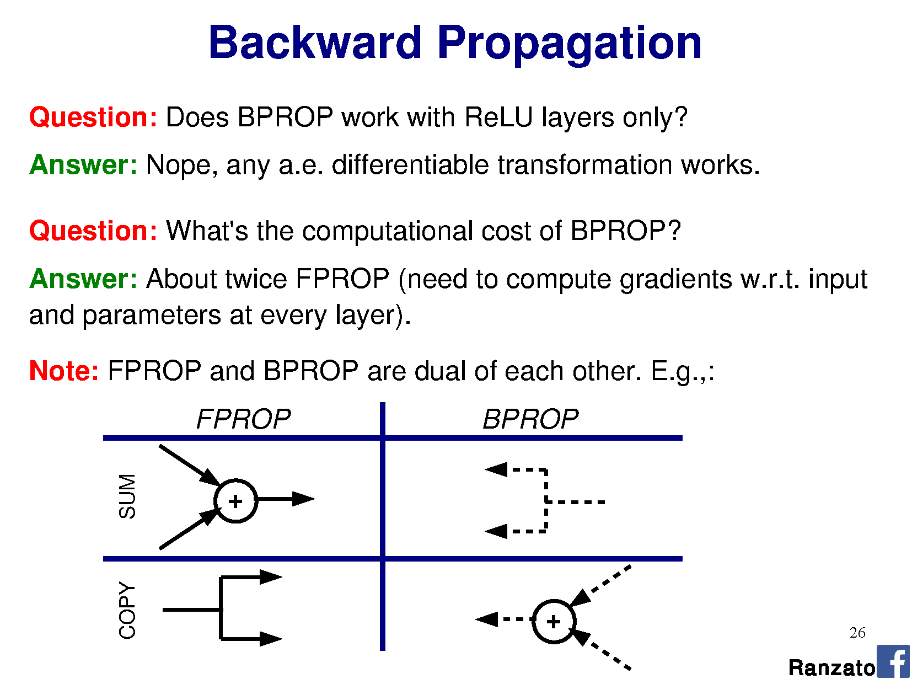

Slide 39
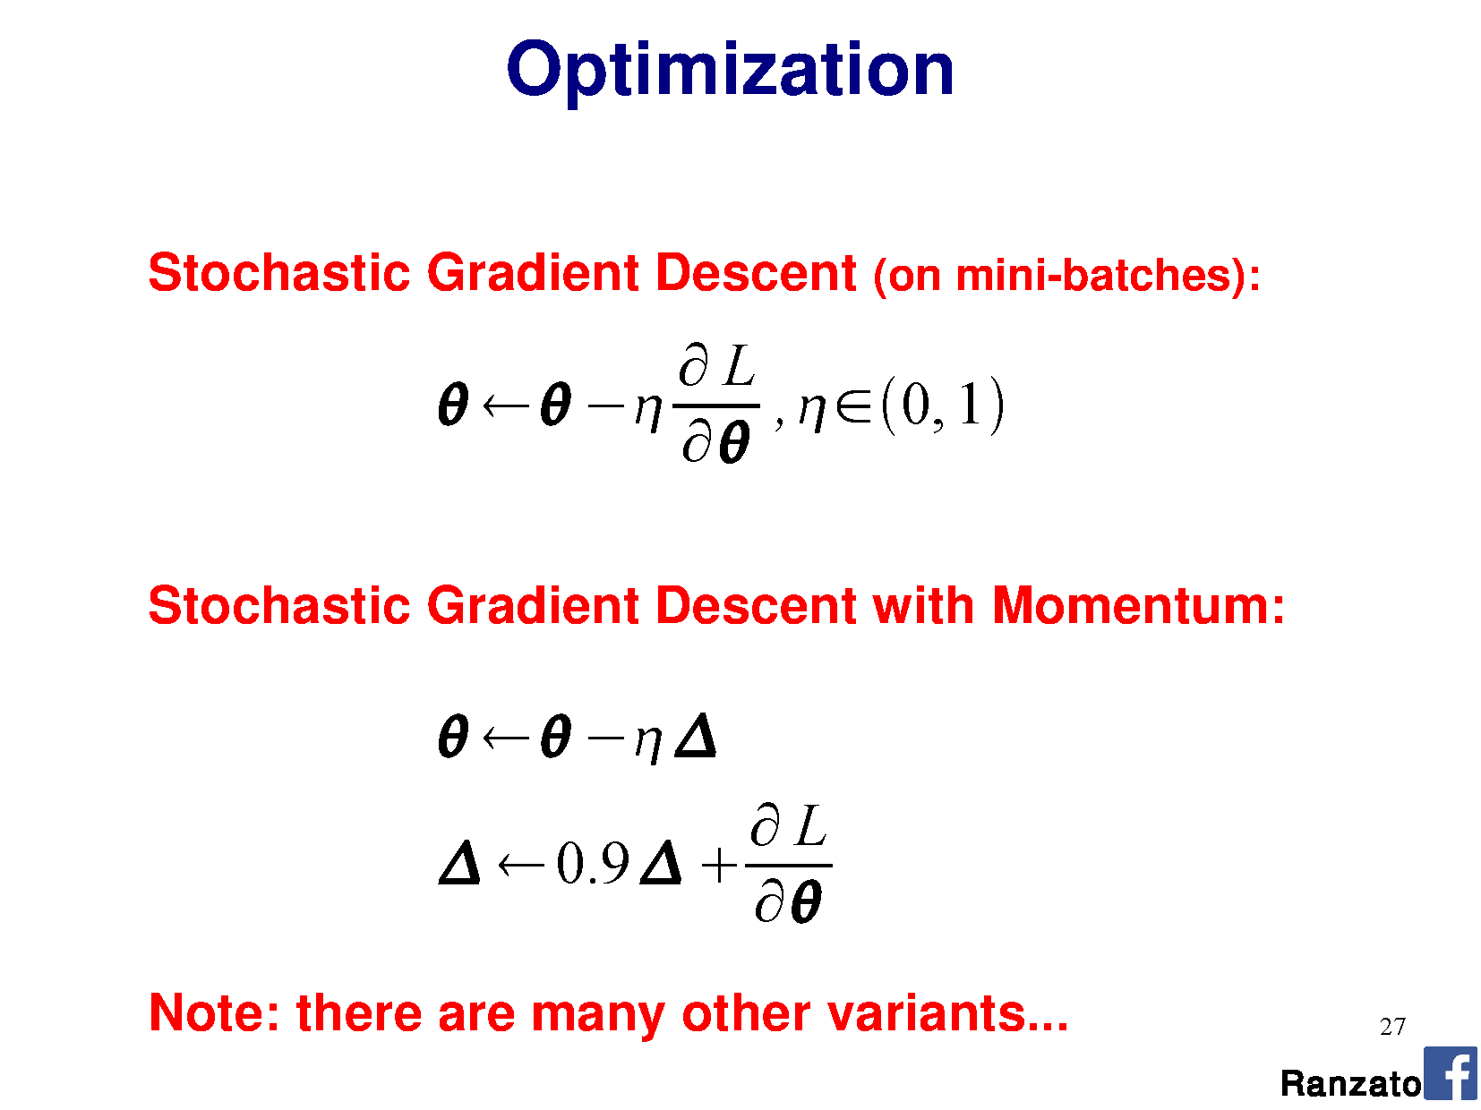

Slide 40
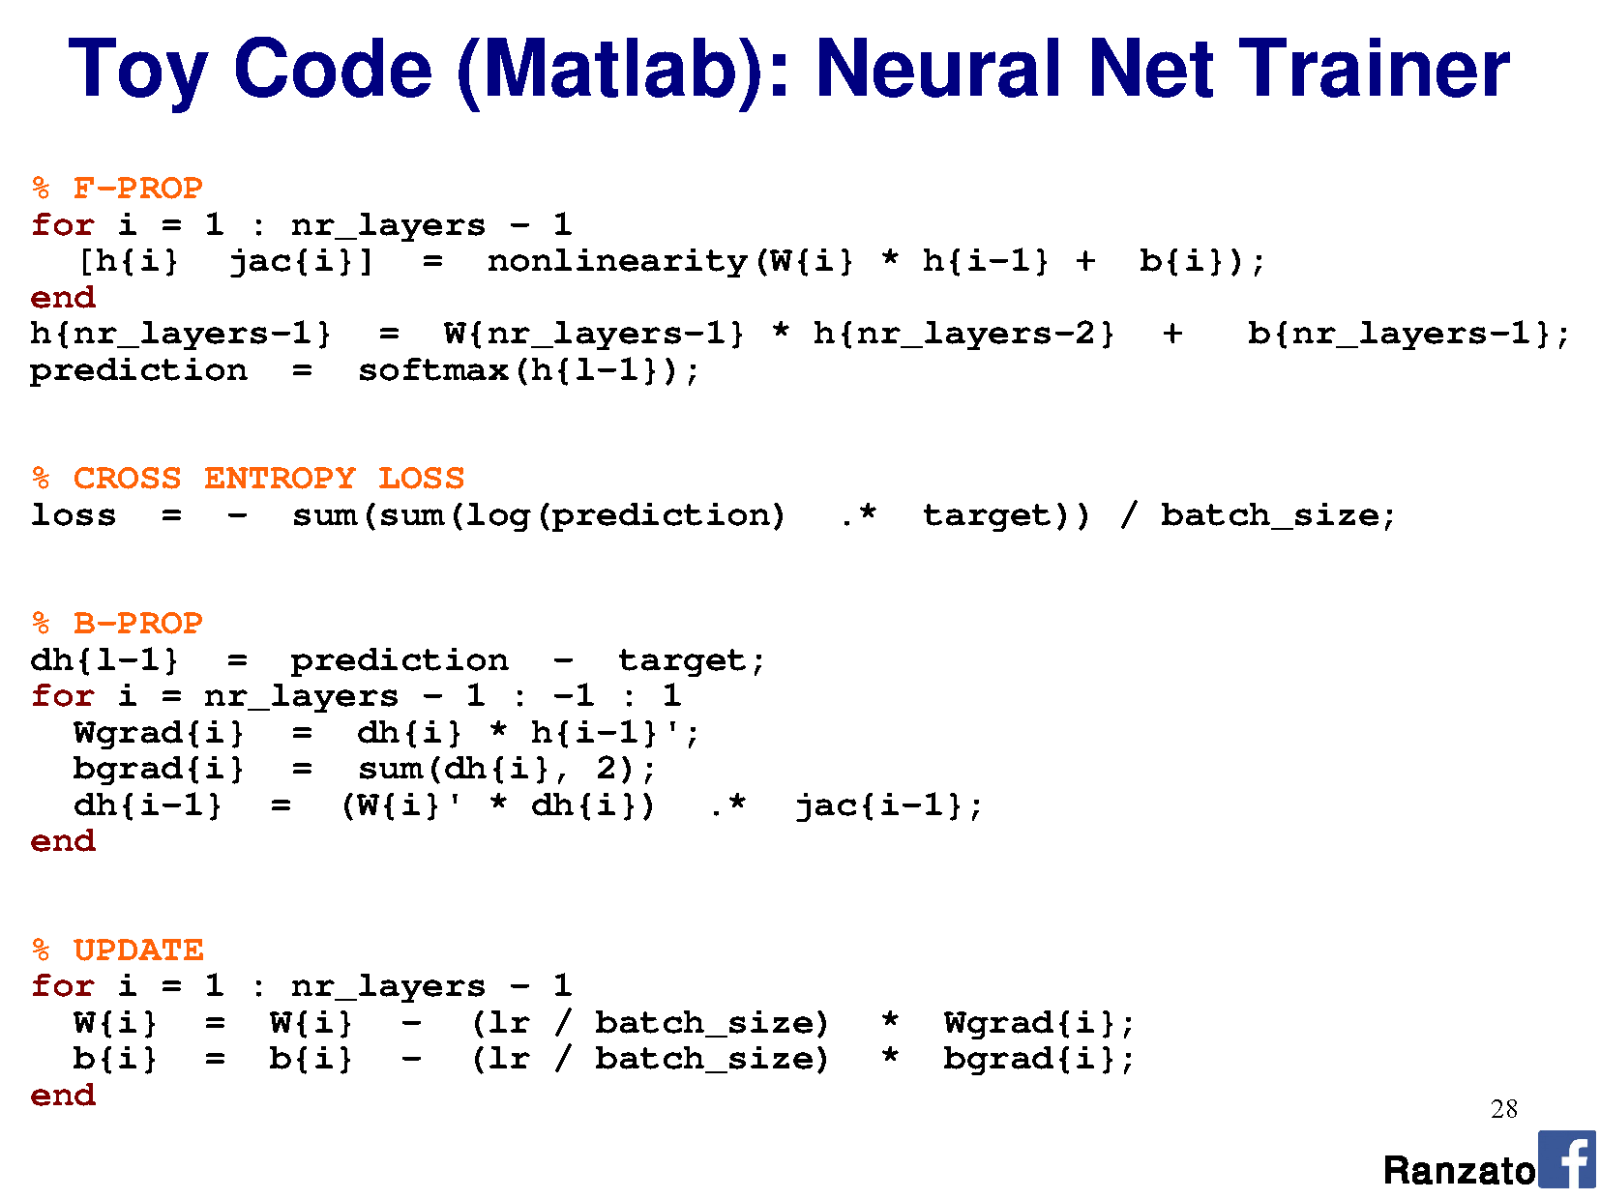

Slide 41
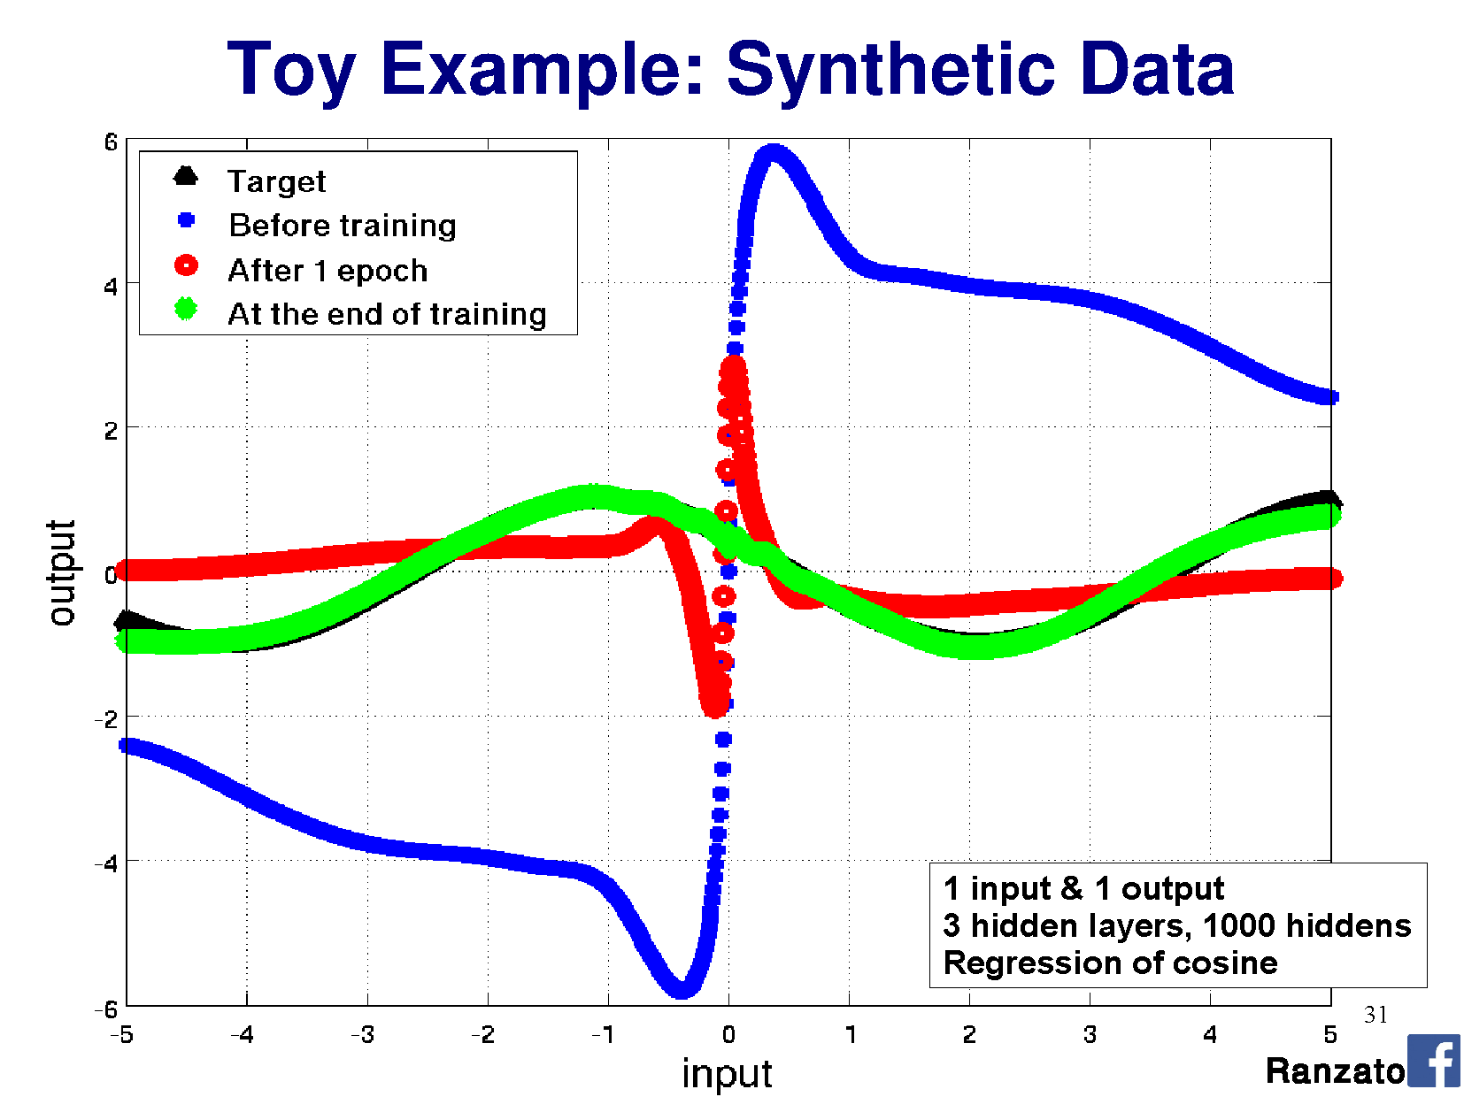

Slide 42
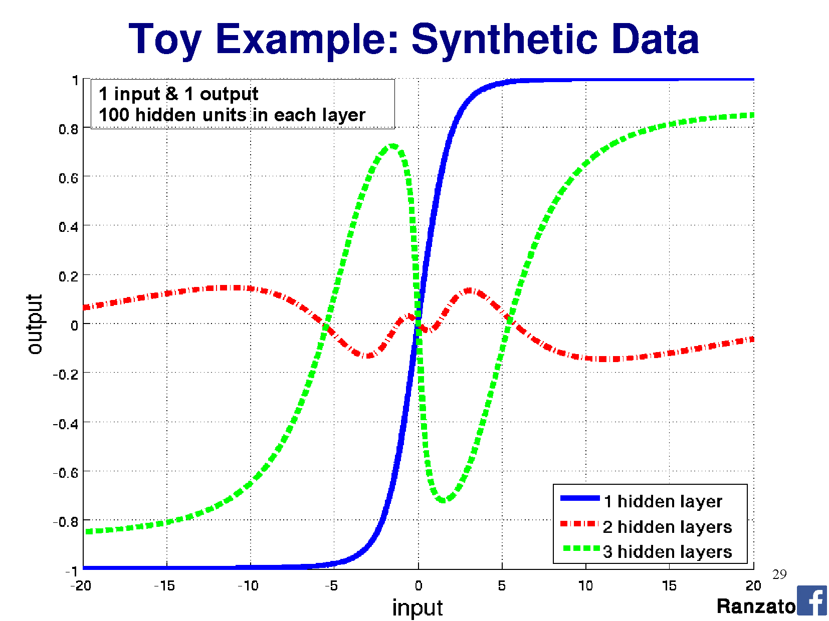

Slide 43
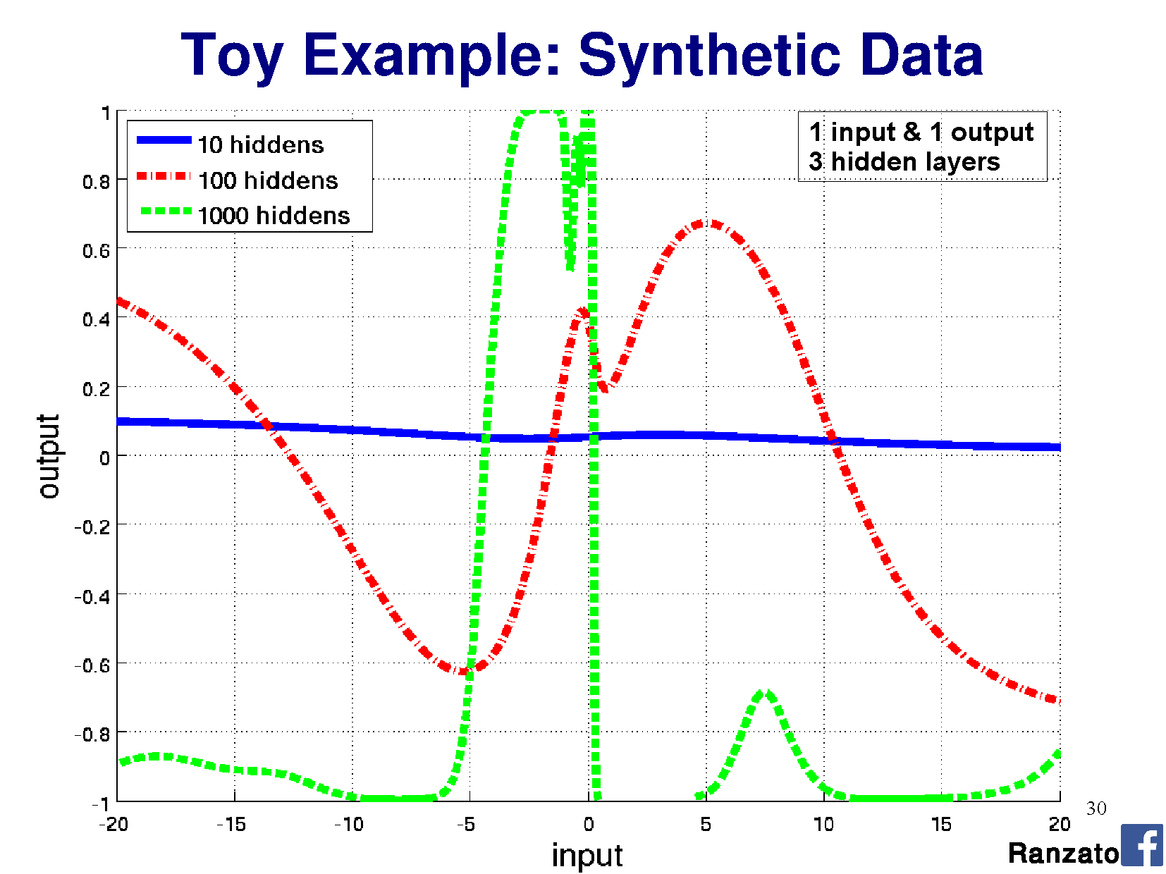

Slide 44
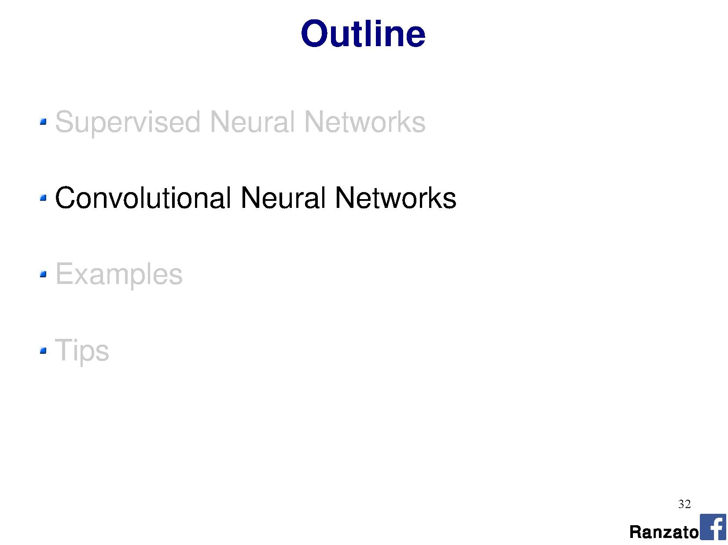

Slide 45
This all seems pretty complicated. Why are we using Neural Networks? James’s rough assessment:
Learning method | Ease of configuration
Neural Network | 1
Nearest Neighbor | 10
Linear SVM | 10
Non-linear SVM | 5
Decision Tree or Random Forest | 4

Slide 46
This all seems pretty complicated. Why are we using Neural Networks? James’s rough assessment:
Learning method | Ease of configuration | Ease of interpretation
Neural Network | 1 | 1
Nearest Neighbor | 10 | 10
Linear SVM | 10 | 9
Non-linear SVM | 5 | 4
Decision Tree or Random Forest | 4 | 4

Slide 47
This all seems pretty complicated. Why are we using Neural Networks? James’s rough assessment:
Learning method | Ease of configuration | Ease of interpretation | Speed / memory when training
Neural Network | 1 | 1 | 1
Nearest Neighbor | 10 | 10 | 8
Linear SVM | 10 | 9 | 10
Non-linear SVM | 5 | 4 | 2
Decision Tree or Random Forest | 4 | 4 | 4

Slide 48
This all seems pretty complicated. Why are we using Neural Networks? James’s rough assessment:
Learning method | Ease of configuration | Ease of interpretation | Speed / memory when training | Speed / memory at test time
Neural Network | 1 | 1 | 1 | 6
Nearest Neighbor | 10 | 10 | 8 | 4
Linear SVM | 10 | 9 | 10 | 10
Non-linear SVM | 5 | 4 | 2 | 2
Decision Tree or Random Forest | 4 | 4 | 4 | 8

Slide 49
This all seems pretty complicated. Why are we using Neural Networks? James’s rough assessment:
Learning method | Ease of configuration | Ease of interpretation | Speed / memory when training | Speed / memory at test time | Accuracy w/ lots of data
Neural Network | 1 | 1 | 1 | 6 | 10
Nearest Neighbor | 10 | 10 | 8 | 4 | 7
Linear SVM | 10 | 9 | 10 | 10 | 5
Non-linear SVM | 5 | 4 | 2 | 2 | 8
Decision Tree or Random Forest | 4 | 4 | 4 | 8 | 7

Slide 50
This all seems pretty complicated. Why are we using Neural Networks? James’s rough assessment:
Learning method | Ease of configuration | Ease of interpretation | Speed / memory when training | Speed / memory at test time | Accuracy w/ lots of data
Neural Network | 1 | 1 | 1 | 6 | 10
Nearest Neighbor | 10 | 10 | 8 | 4 | 7
Linear SVM | 10 | 9 | 10 | 10 | 5
Non-linear SVM | 5 | 4 | 2 | 2 | 8
Decision Tree or Random Forest | 4 | 4 | 4 | 8 | 7
Representation design matters more for all of these

Slide 53
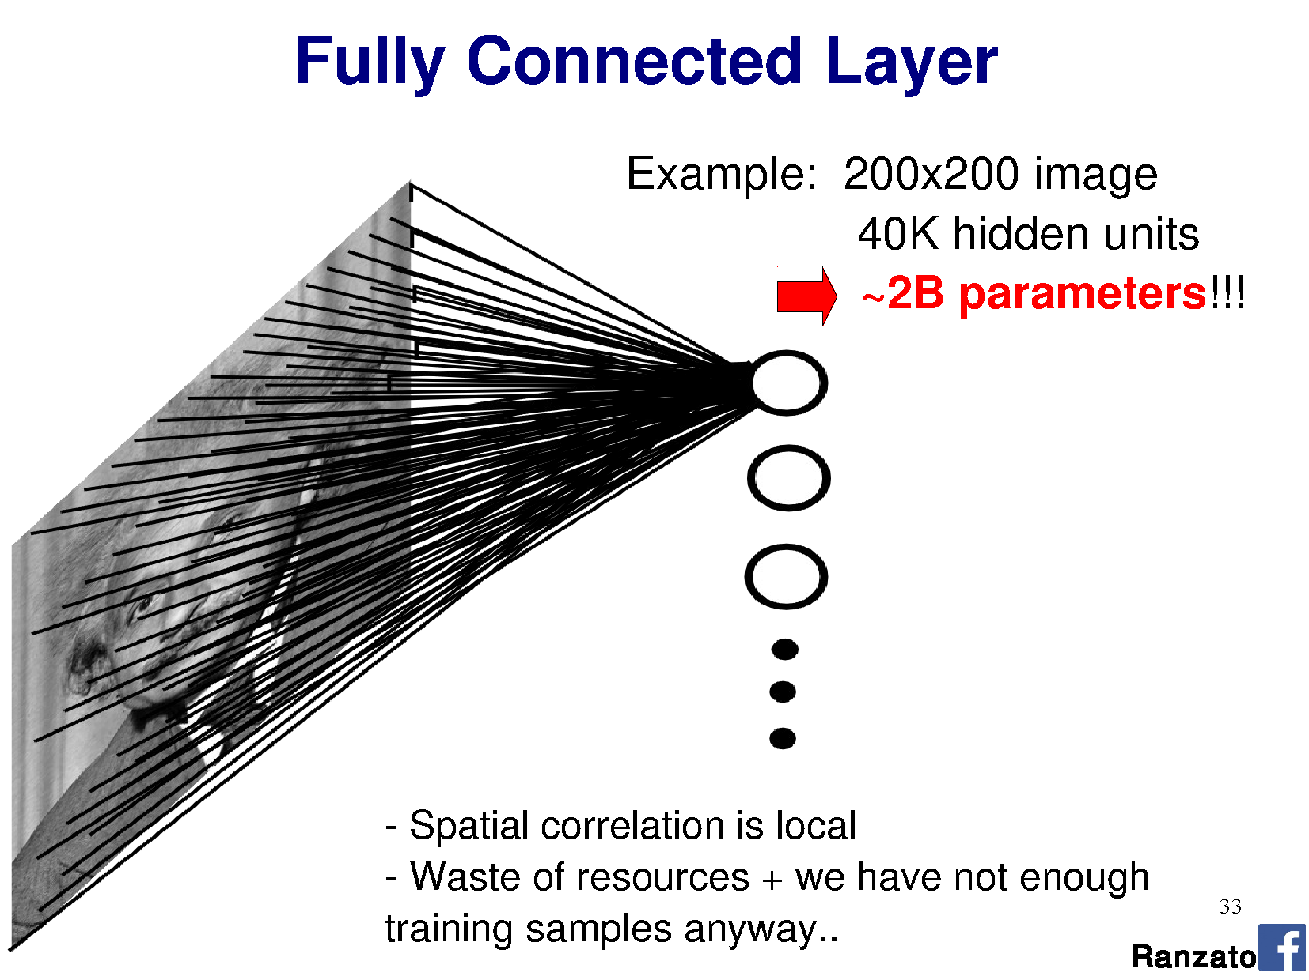

Slide 54
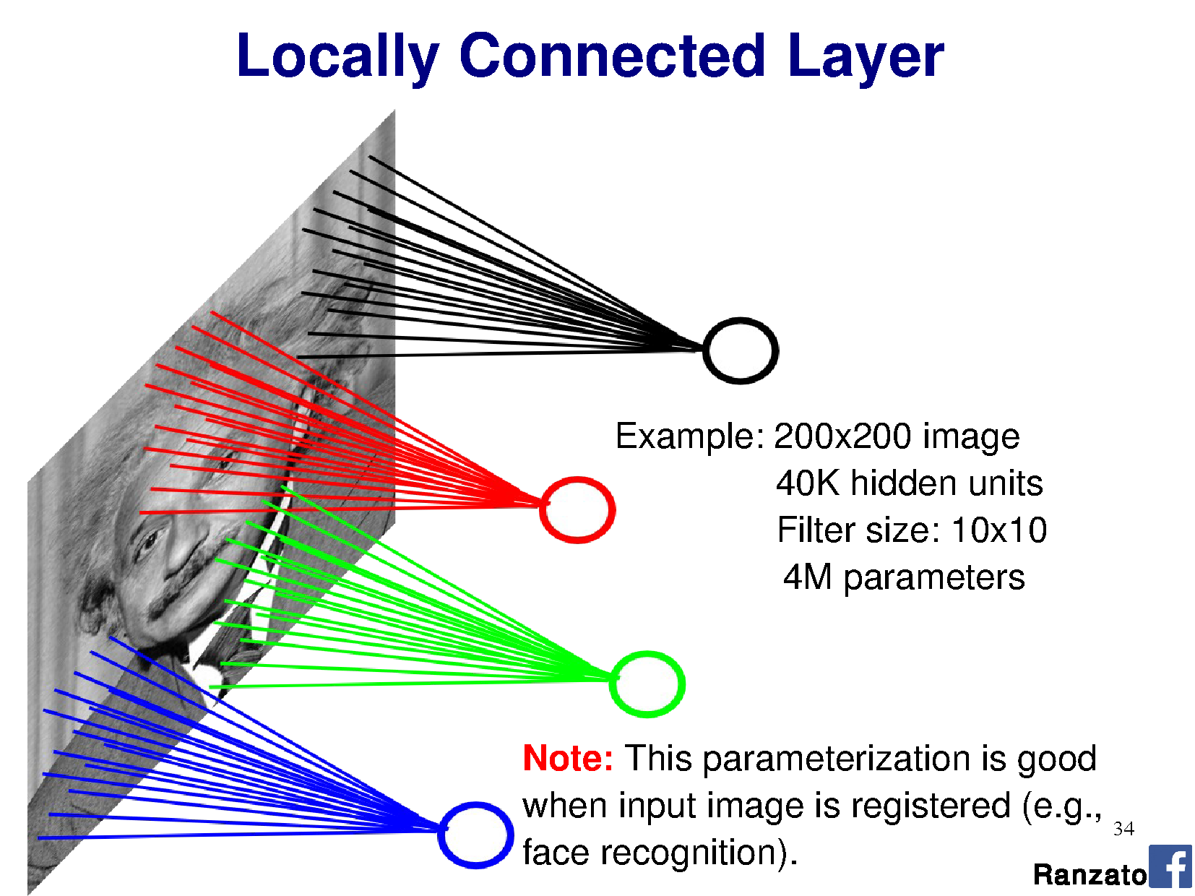

Slide 55
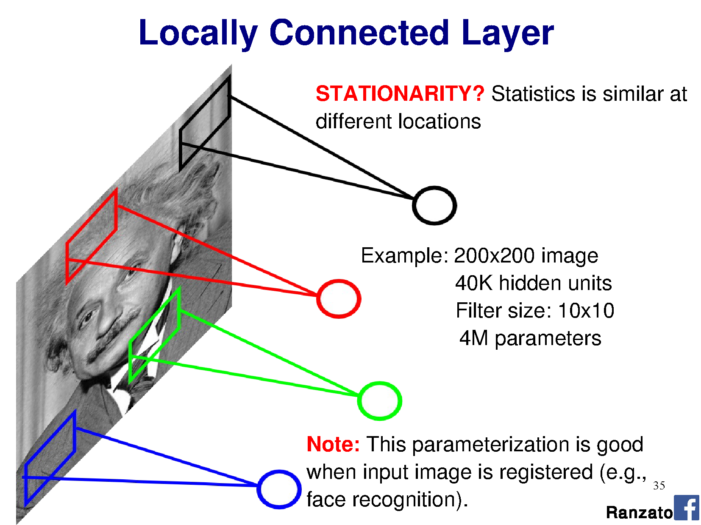

Slide 56
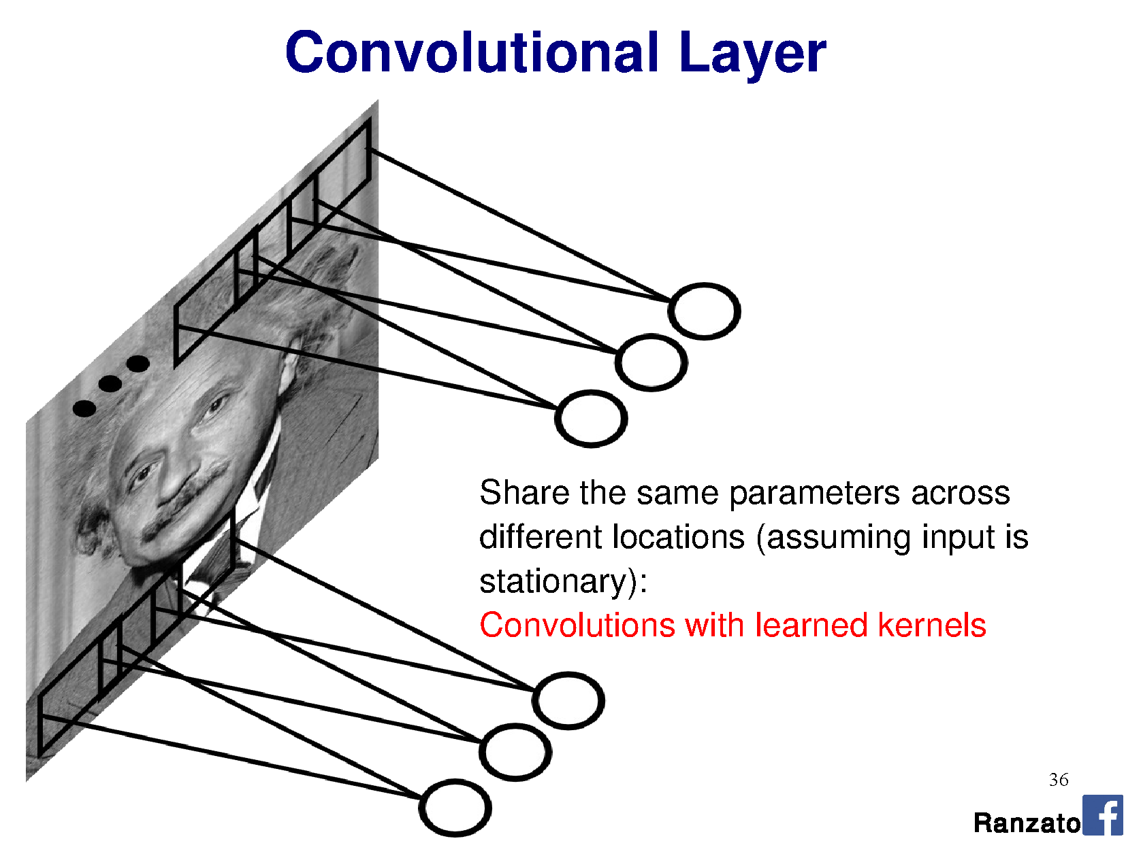

Slide 57
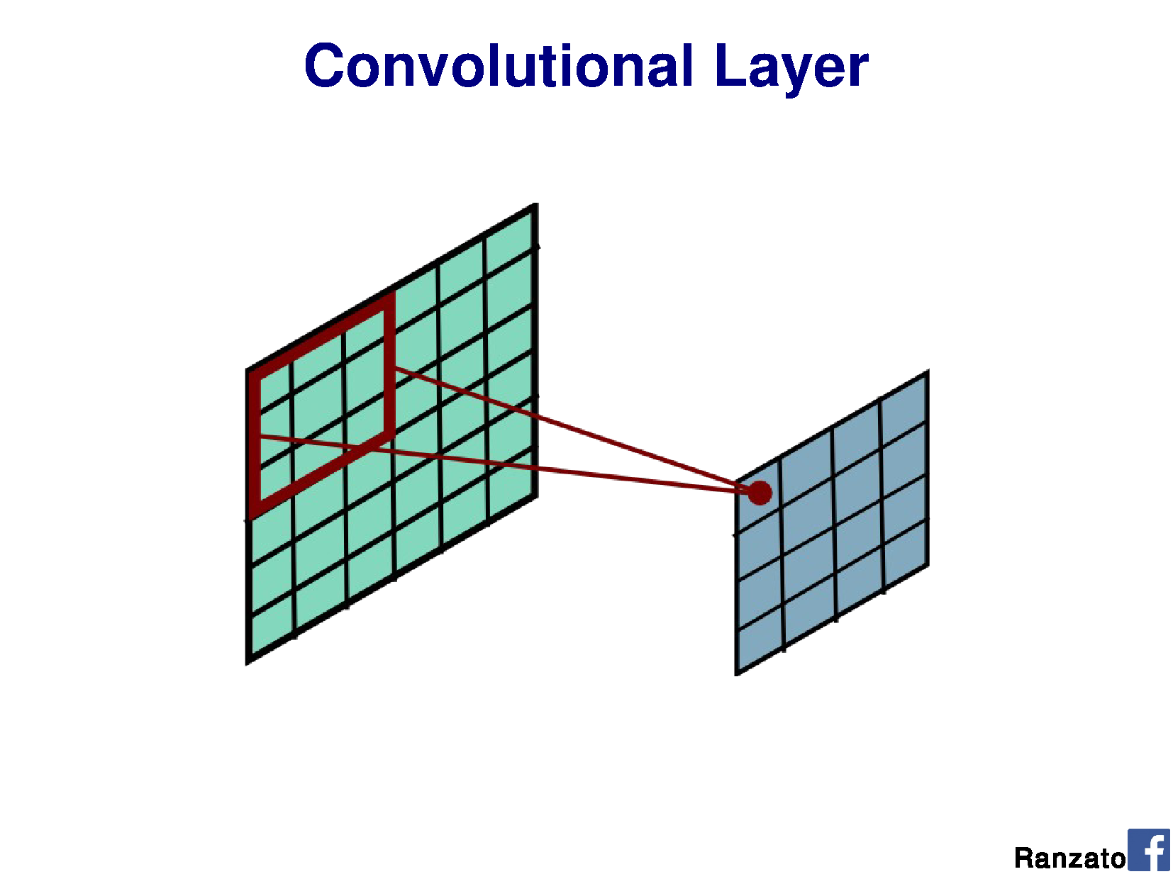

Slide 58
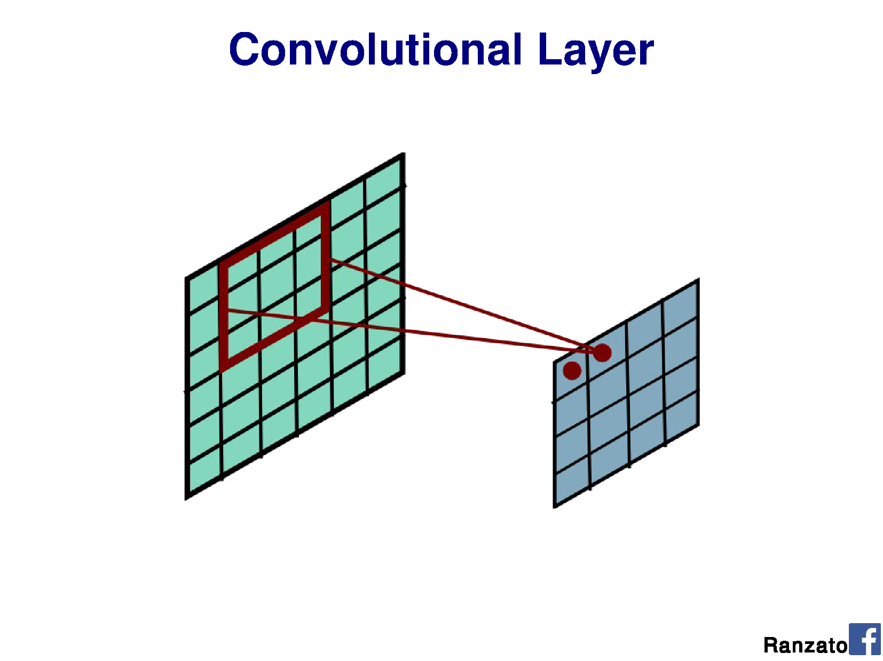

Slide 59
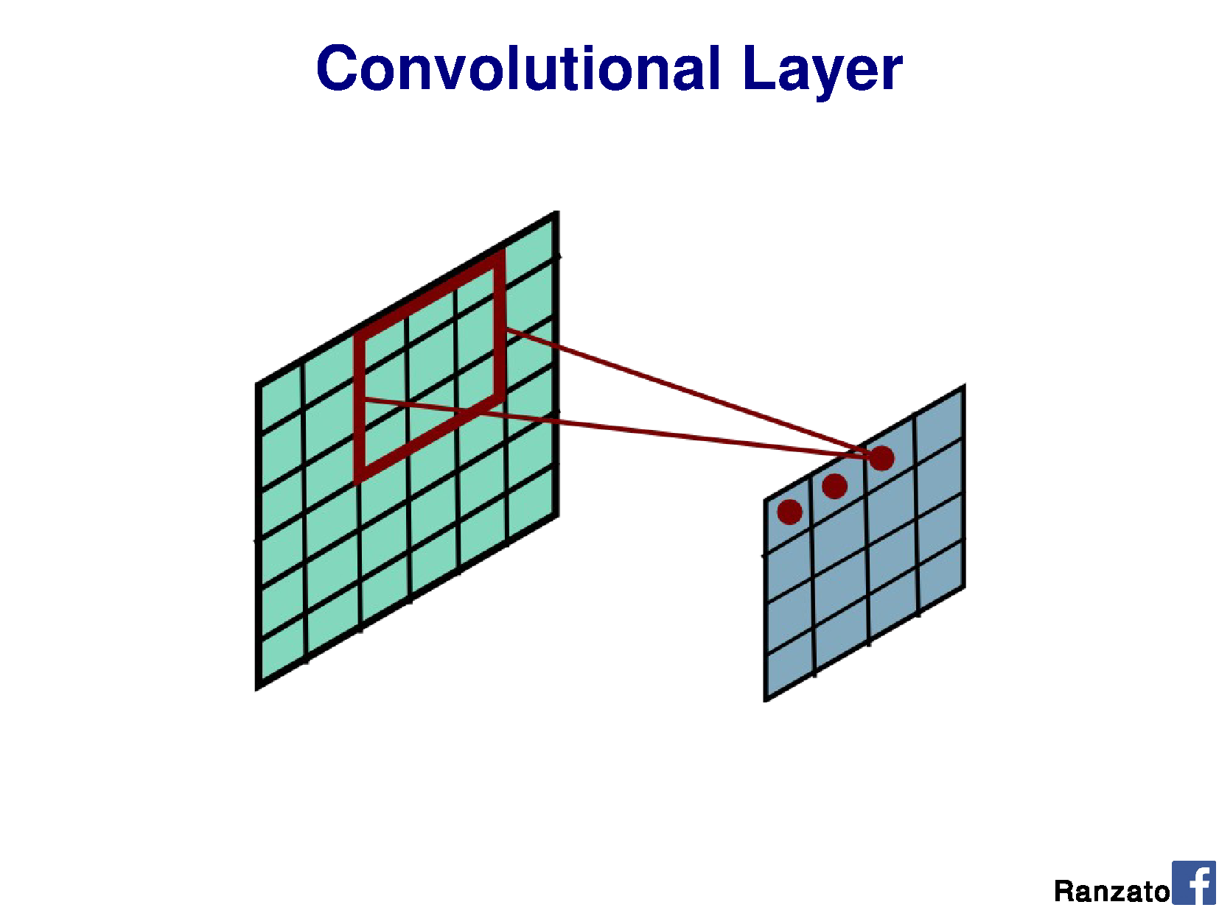

Slide 60
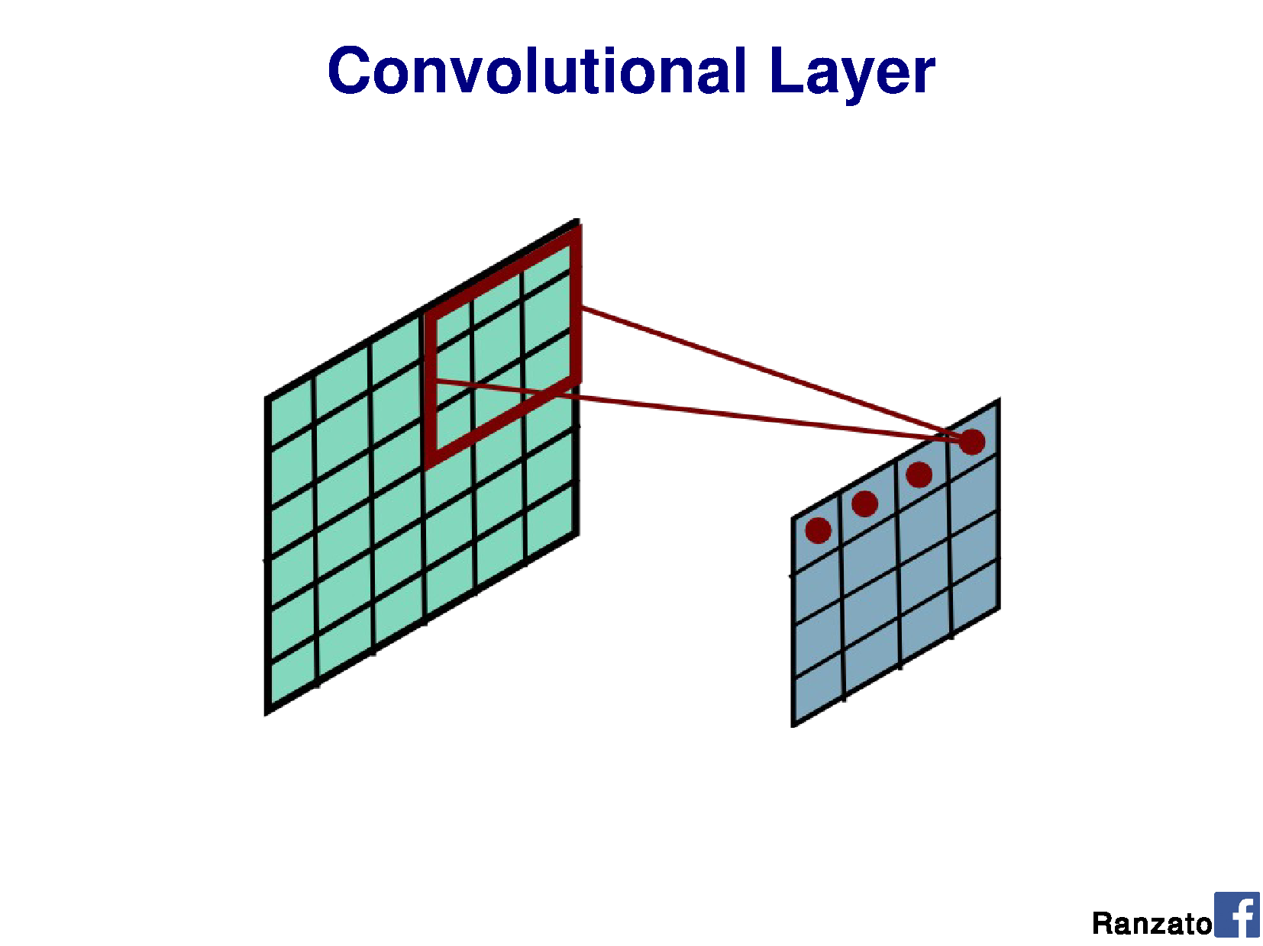

Slide 61
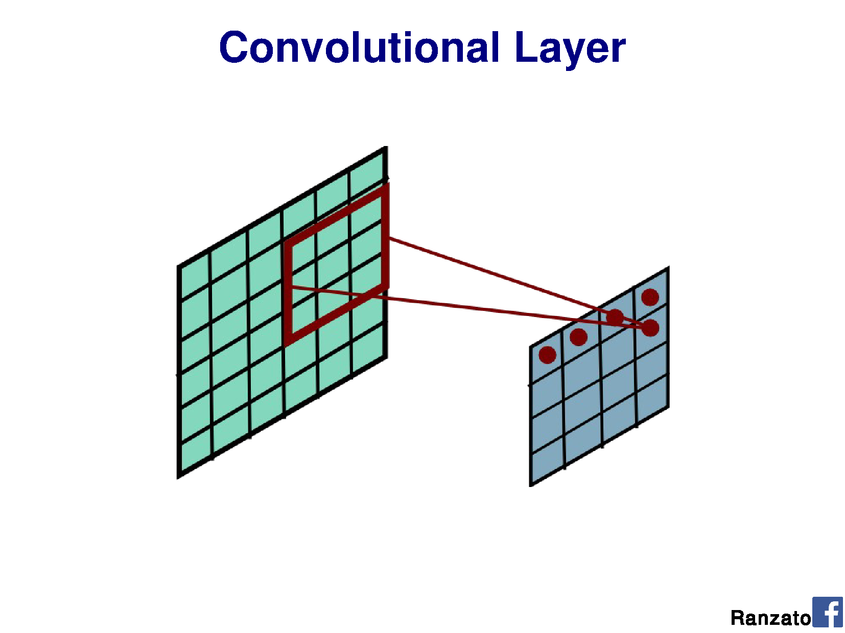

Slide 62
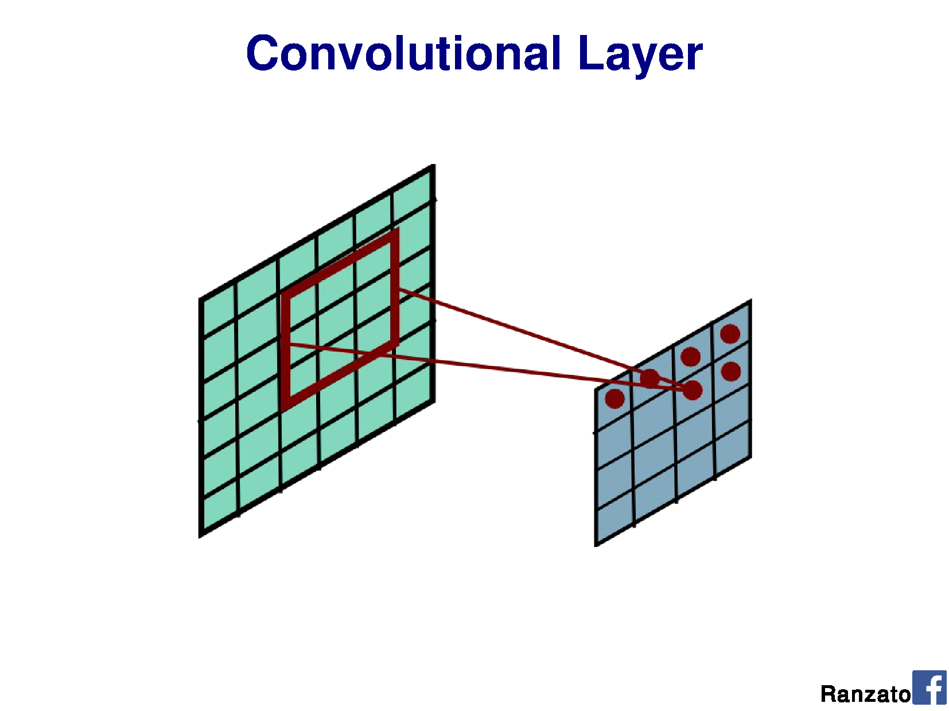

Slide 63
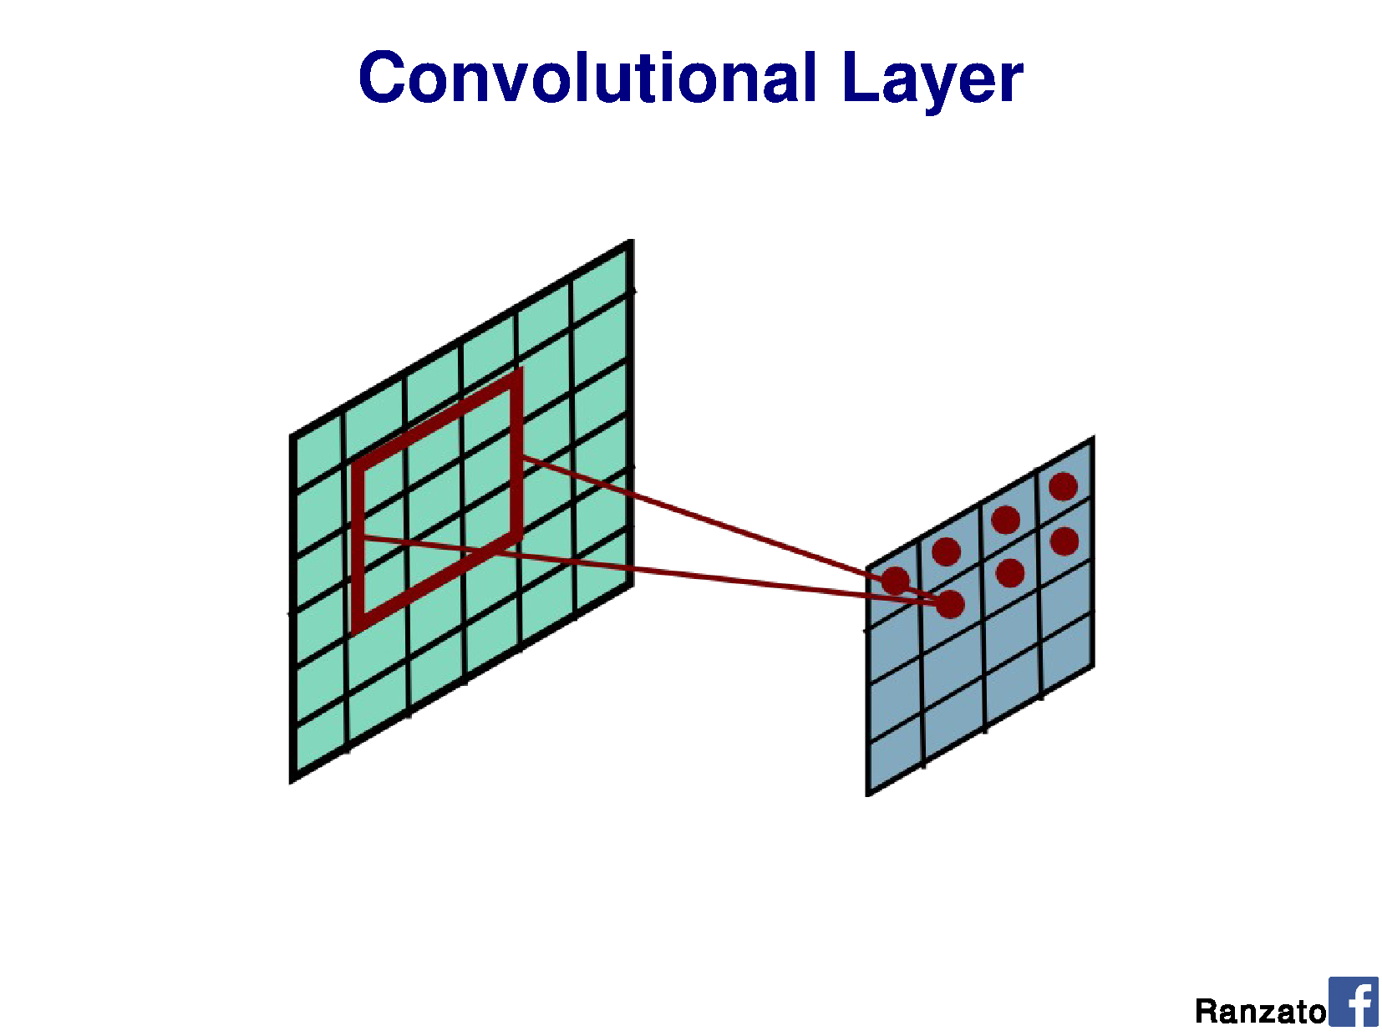

Slide 64
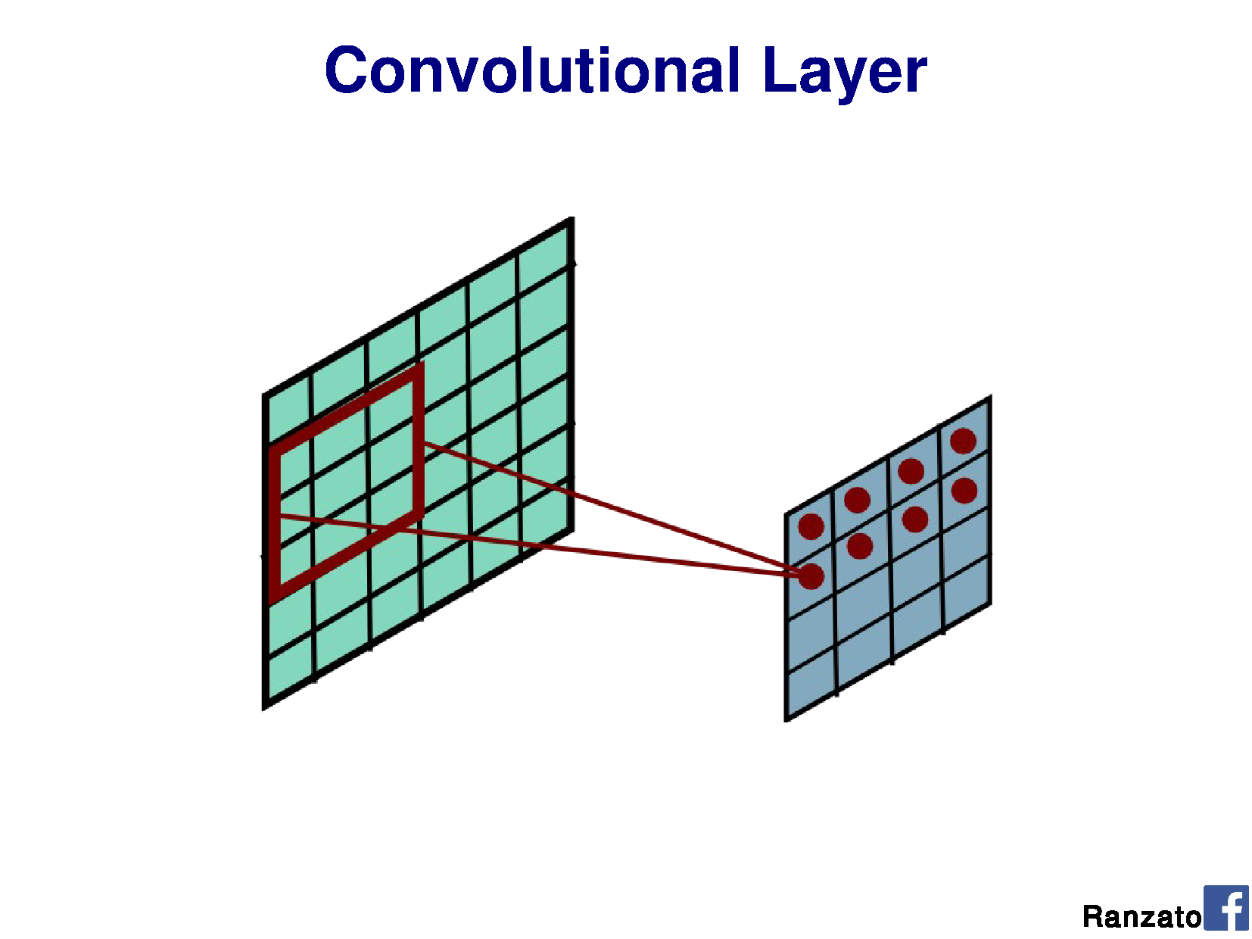

Slide 65
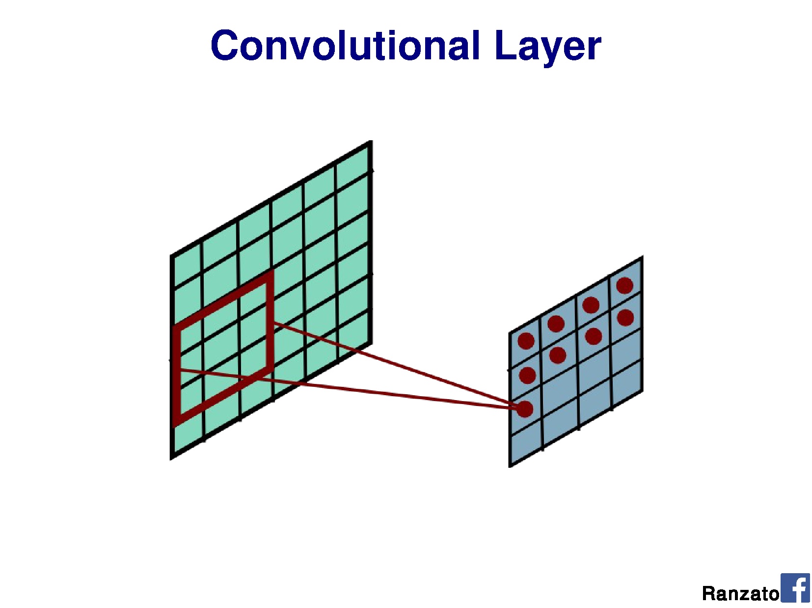

Slide 66
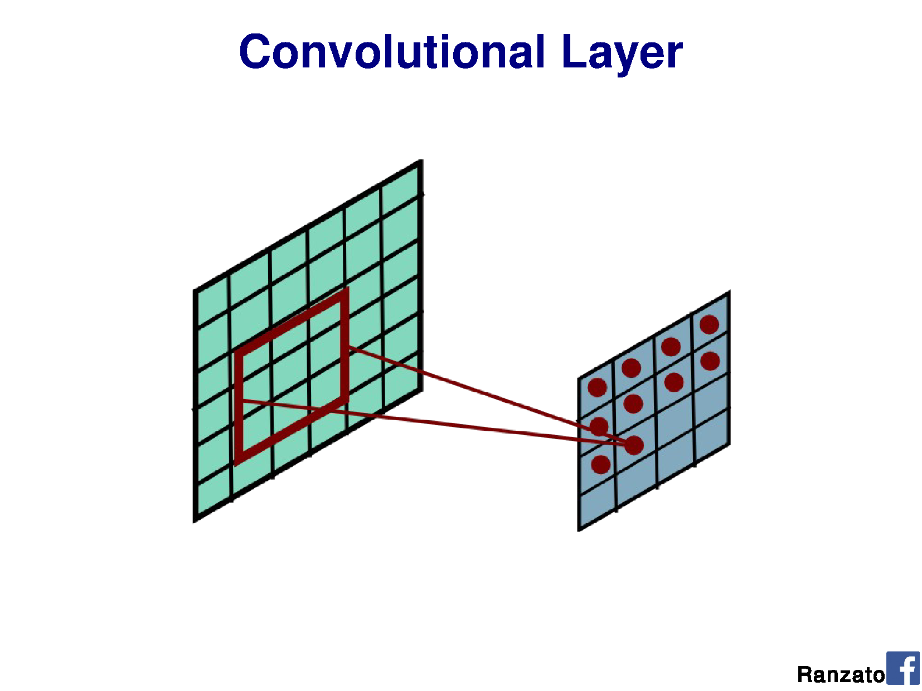

Slide 67


Slide 68


Slide 69


Slide 70


Slide 71


Slide 72


Slide 73


Slide 74


Slide 75


Slide 76


Slide 77


Slide 78


Slide 79


Slide 80


Slide 81


Slide 82


Slide 83


Slide 84


Slide 85


Slide 86


Slide 87


Slide 88


Slide 89


Slide 90


Slide 91


Slide 92


Slide 93


Slide 94


