Slide 1
Convolutional Neural Networks
Computer Vision
James Hays
Many slides by Marc’Aurelio Ranzato

Slide 2
Outline
Neural Networks (covered in previous lecture)
Convolutional Neural Networks
Visualization and interpretation of Deep Networks

Slide 3
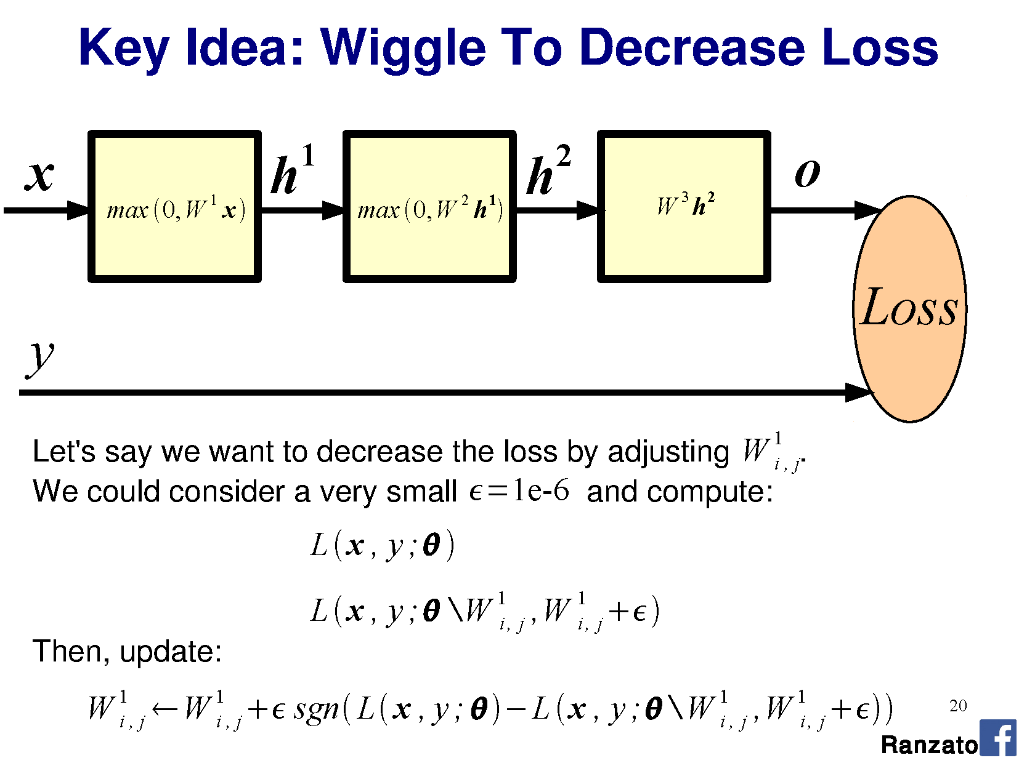

Slide 4
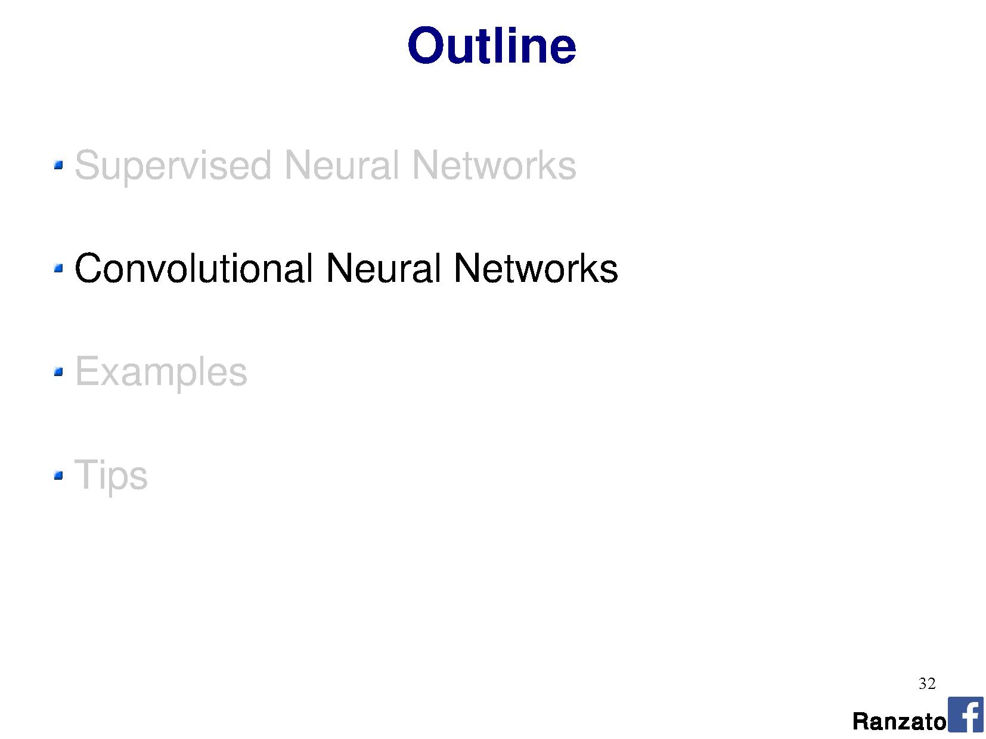

Slide 5
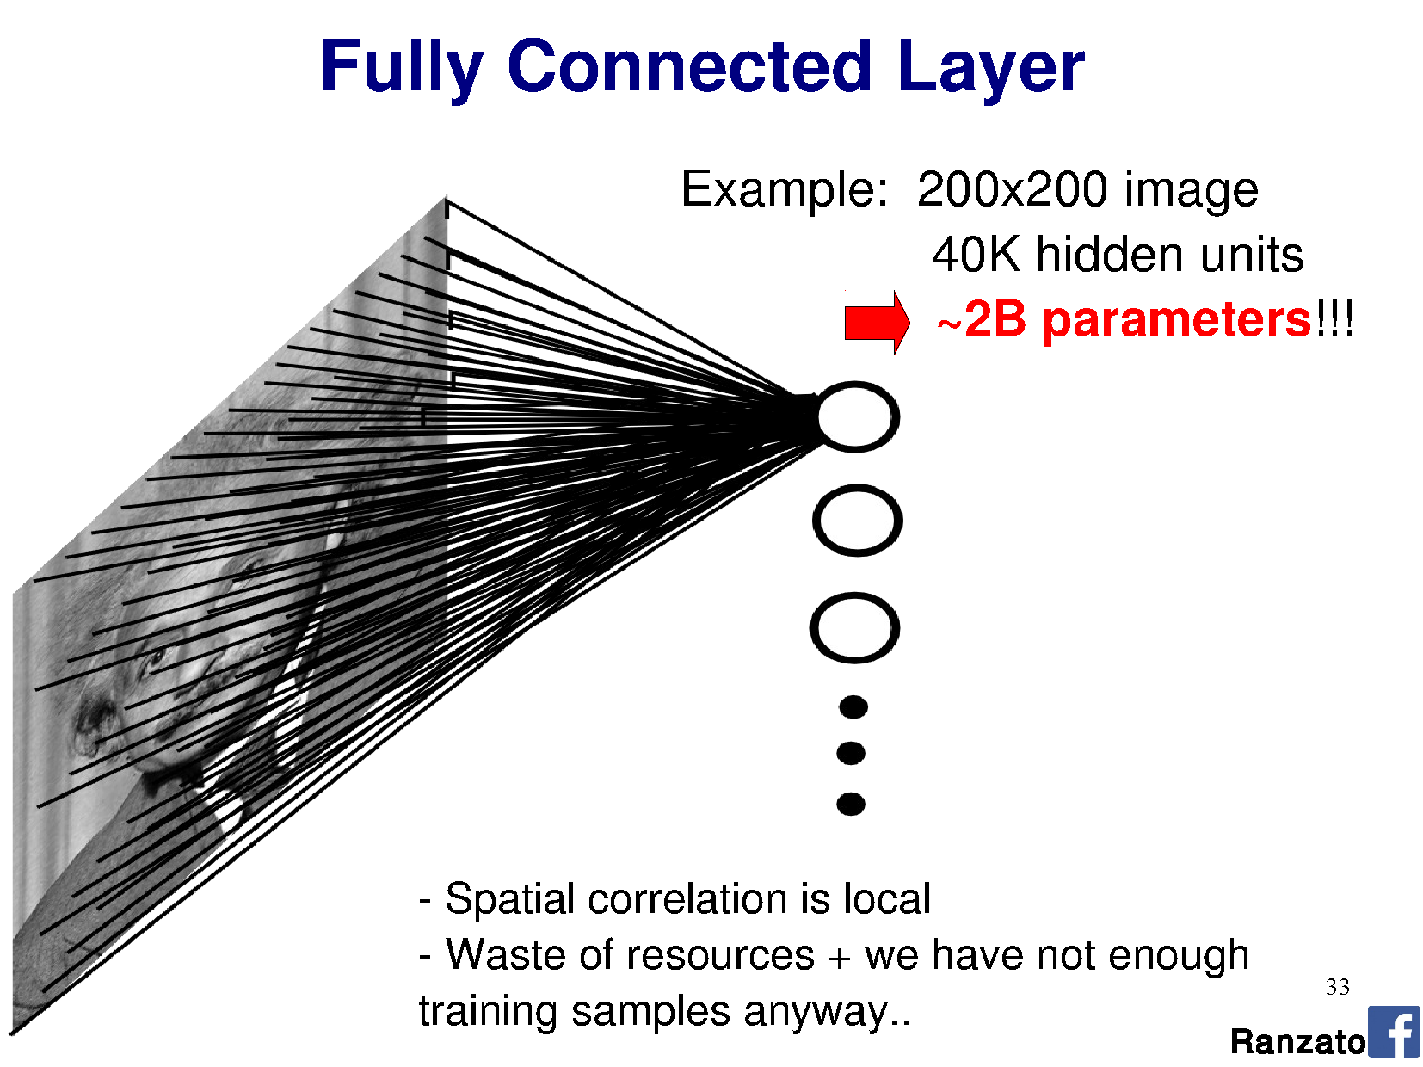

Slide 6
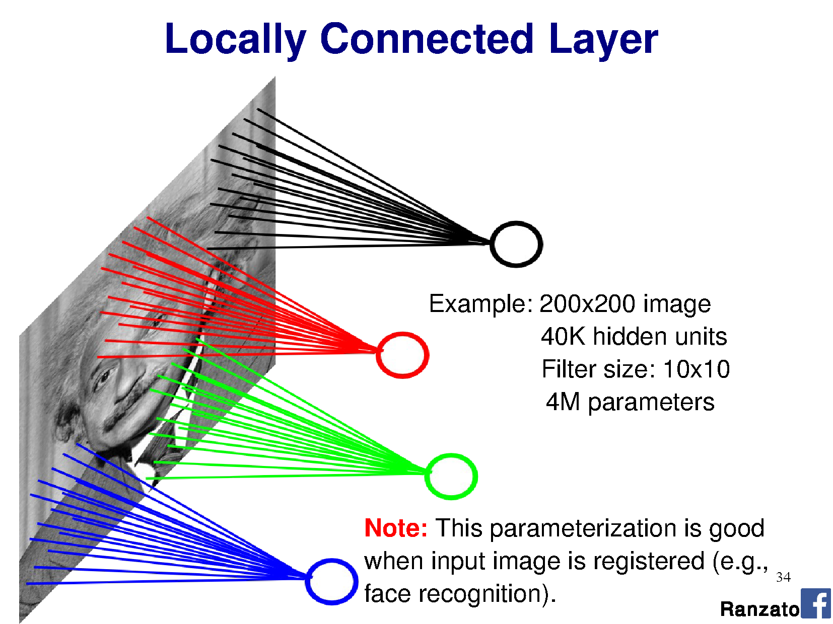

Slide 7
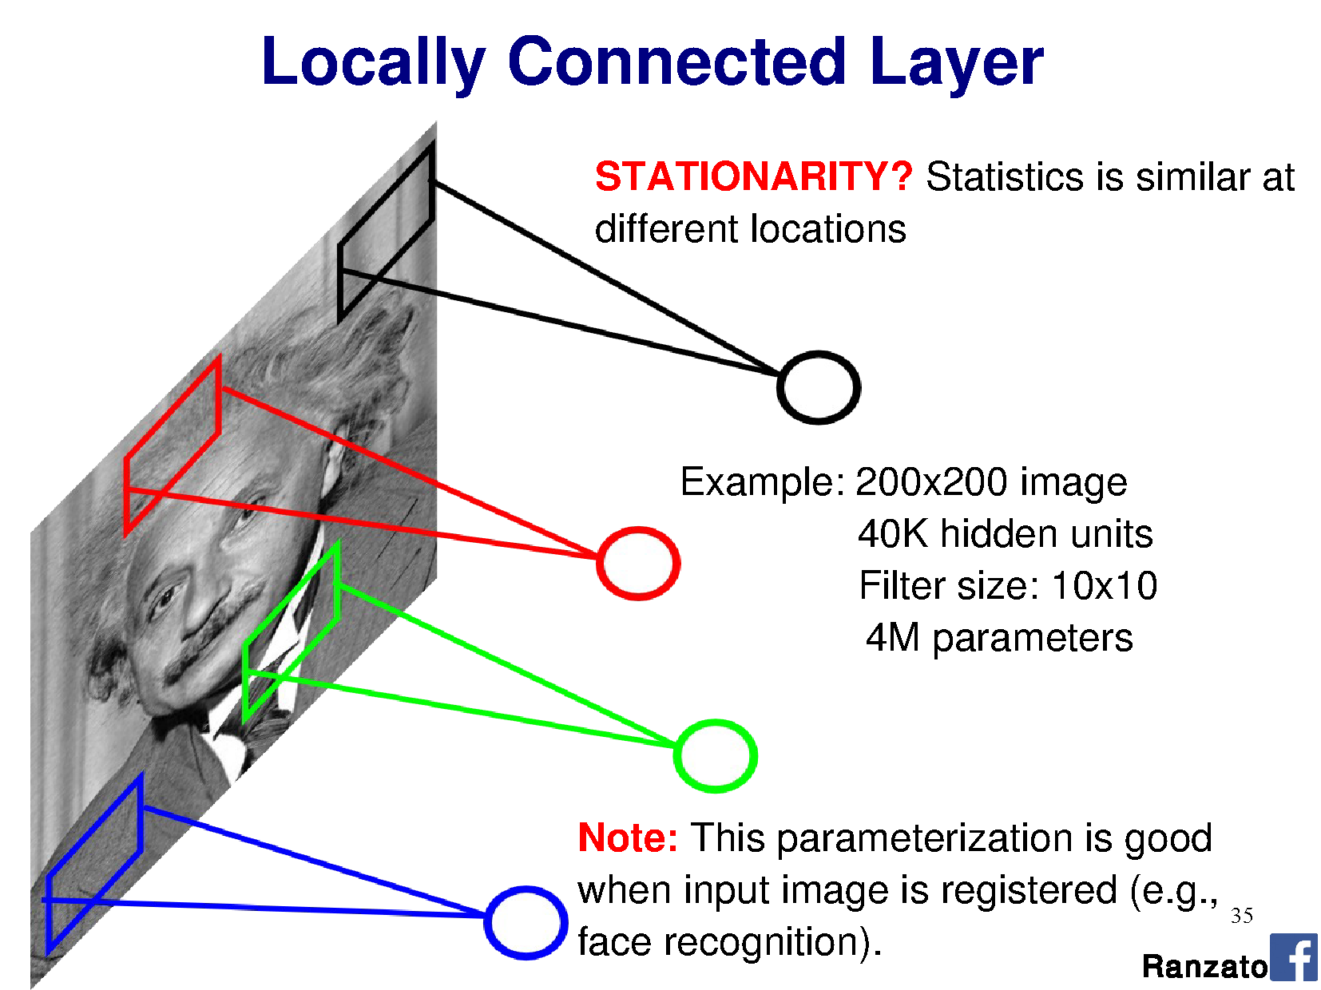

Slide 8
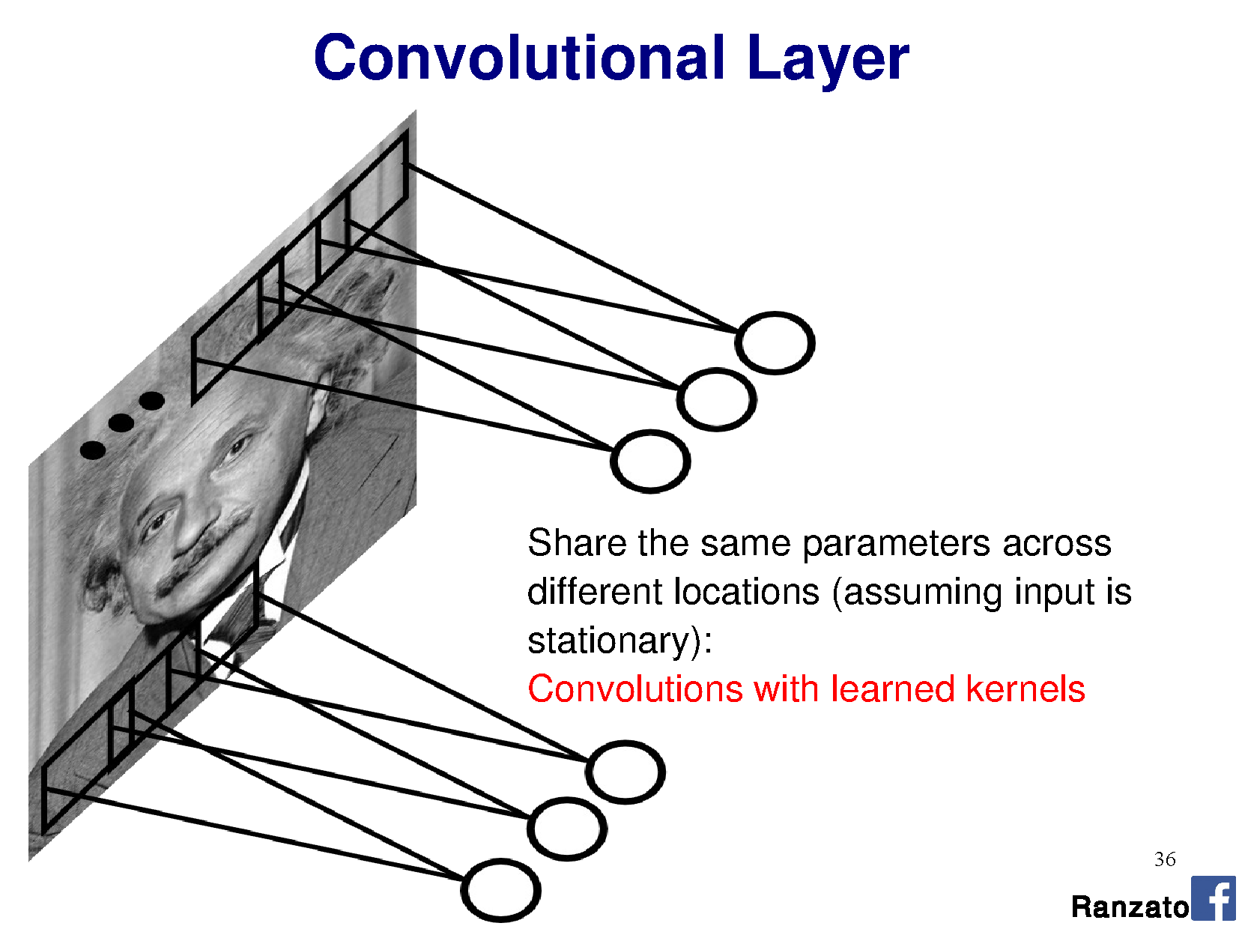

Slide 9
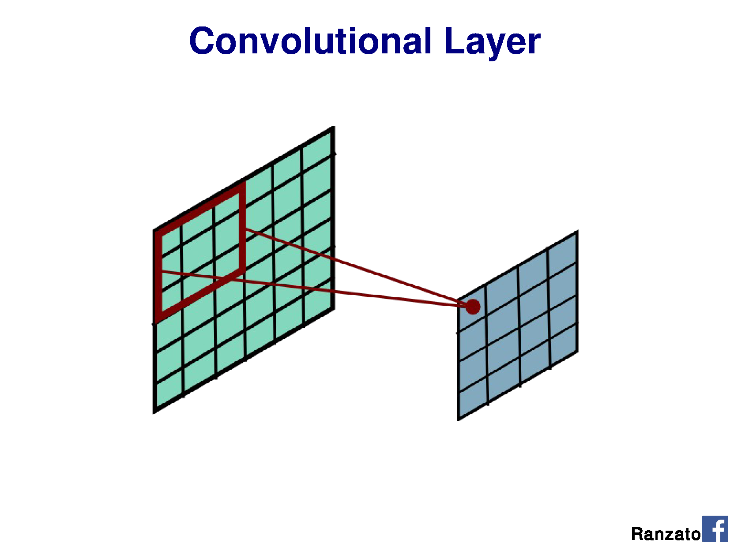

Slide 10
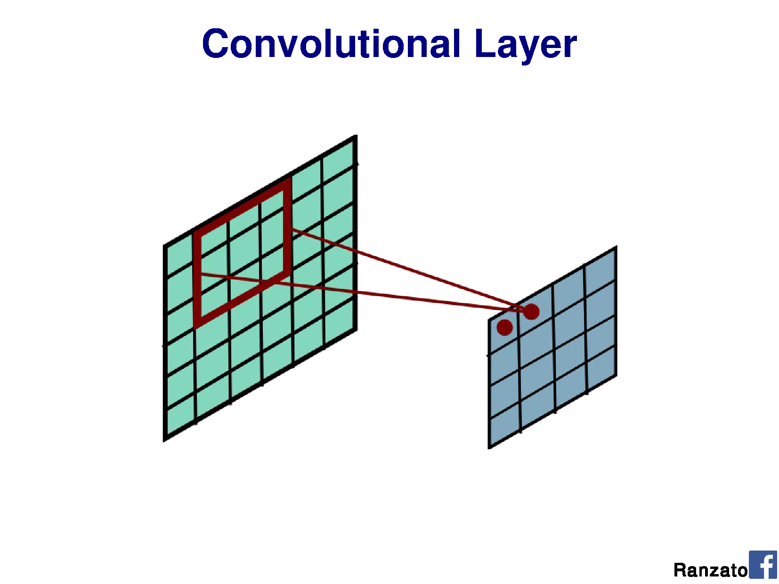

Slide 11
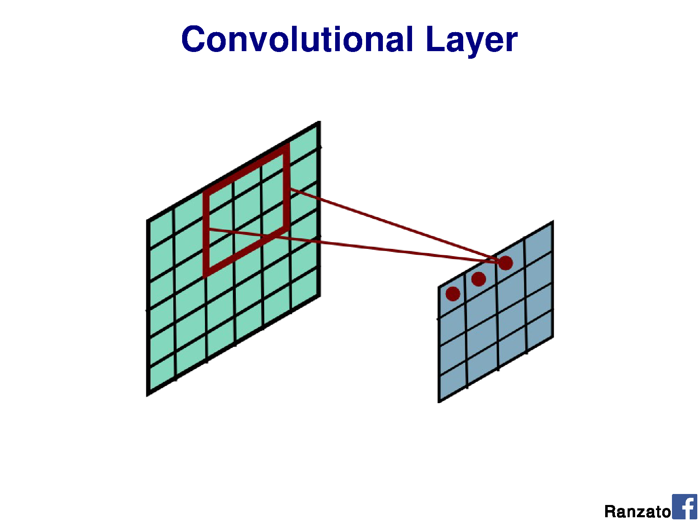

Slide 12
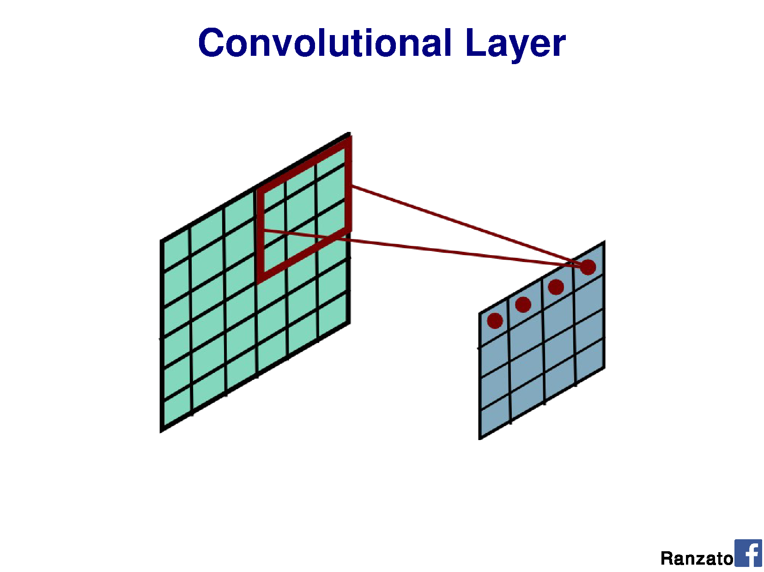

Slide 13
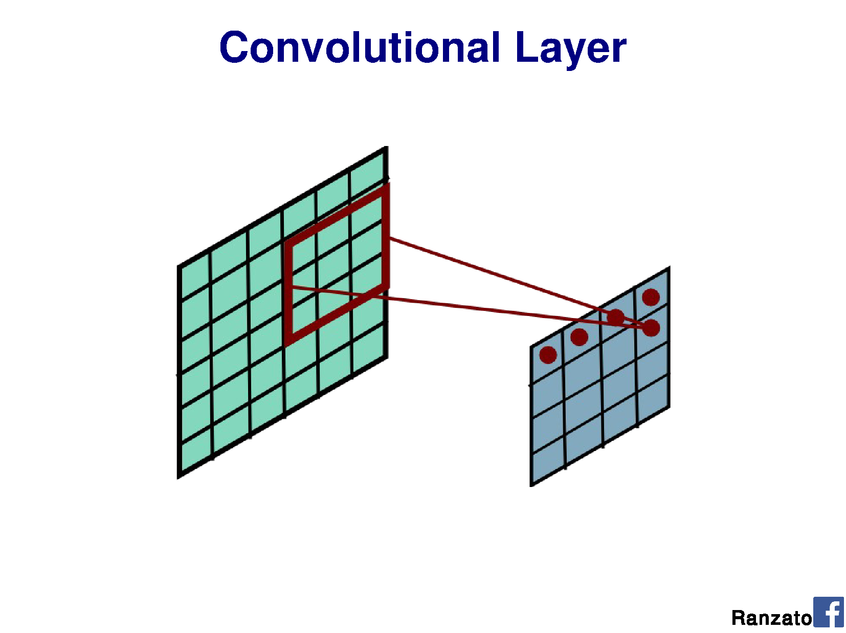

Slide 14
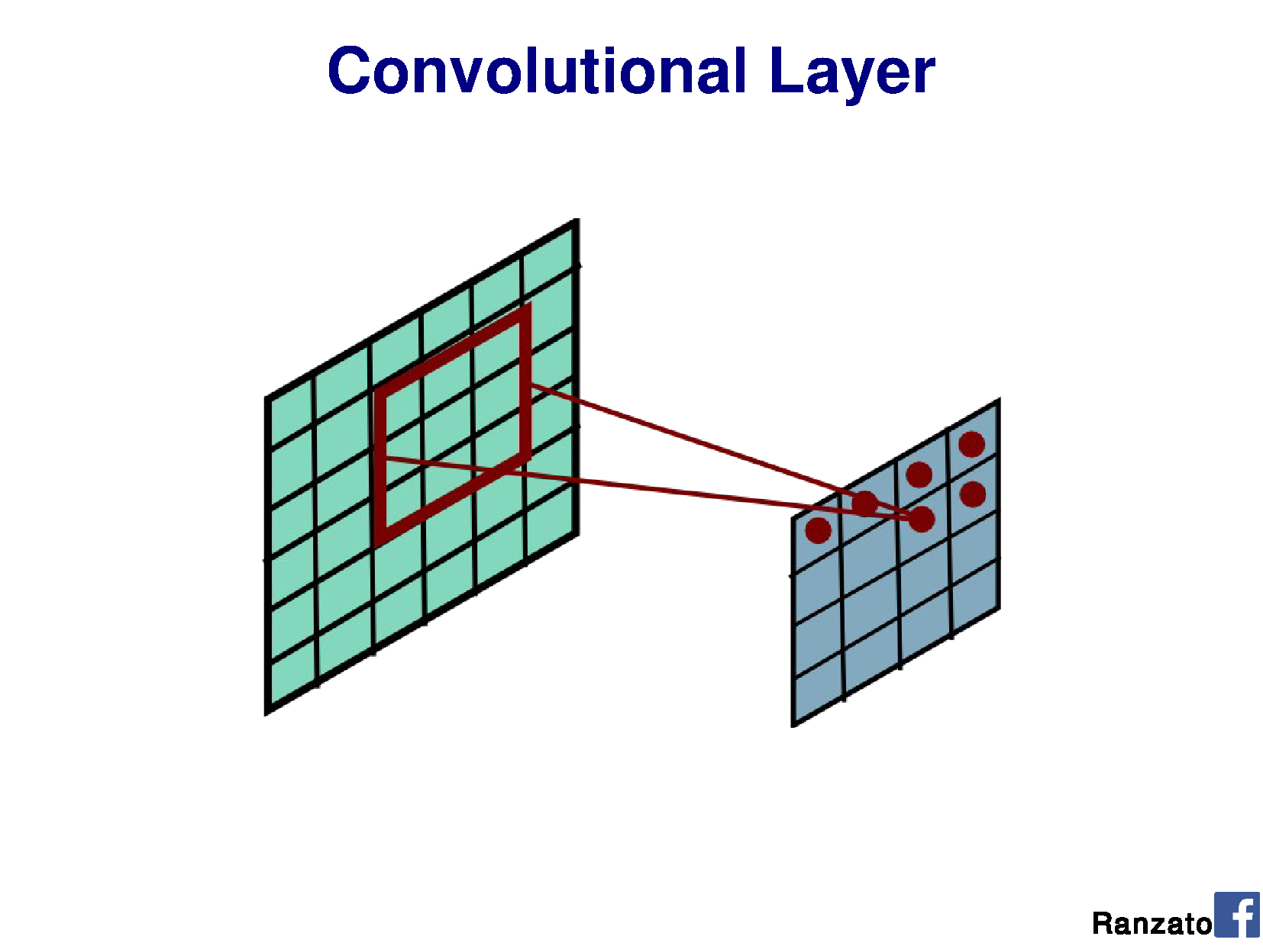

Slide 15
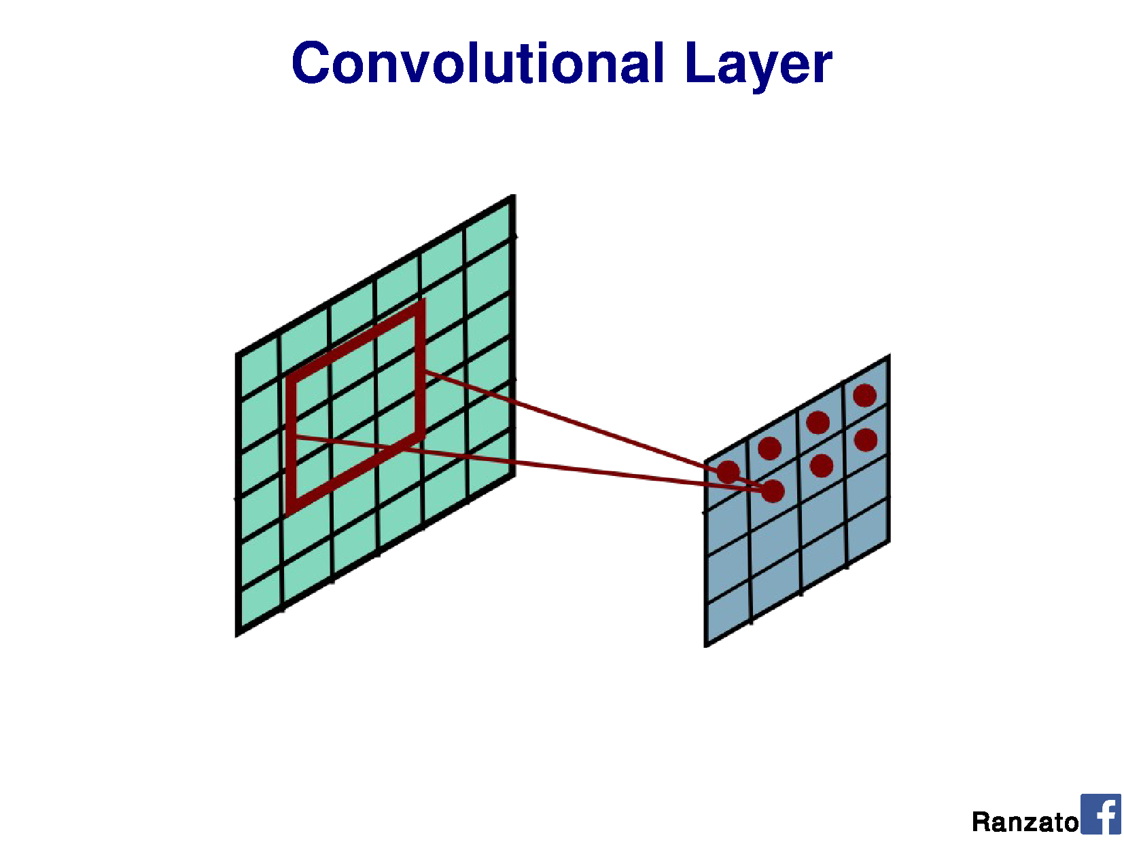

Slide 16
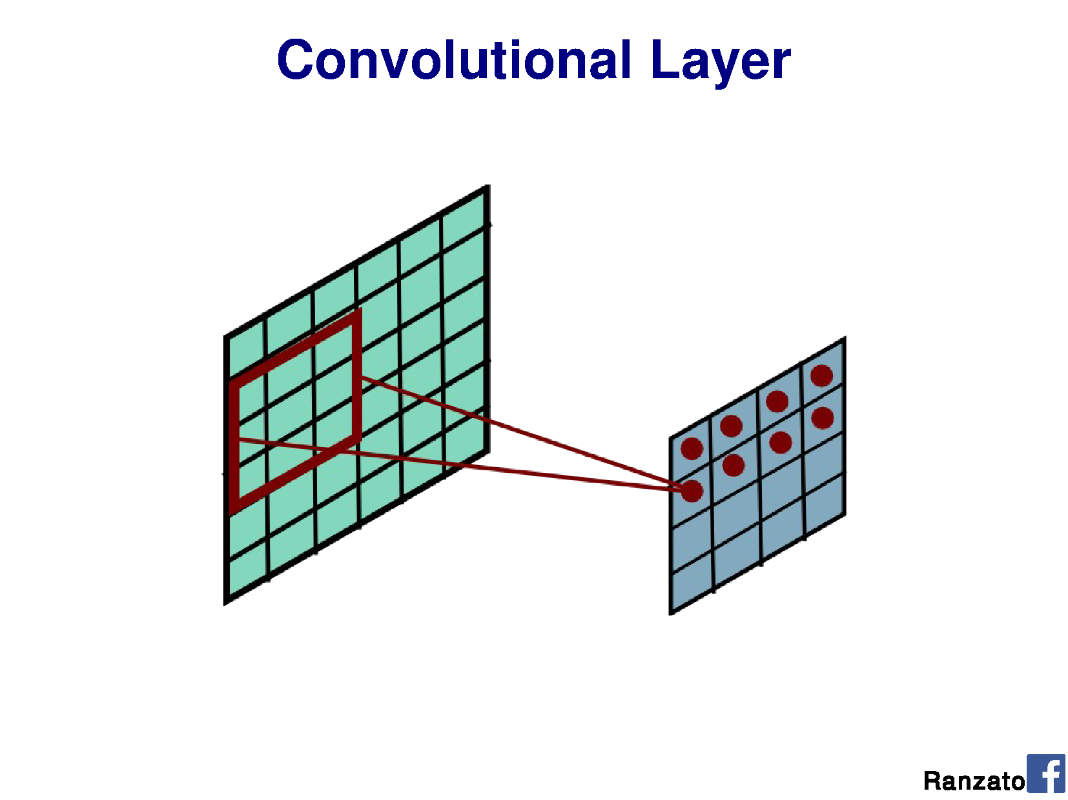

Slide 17
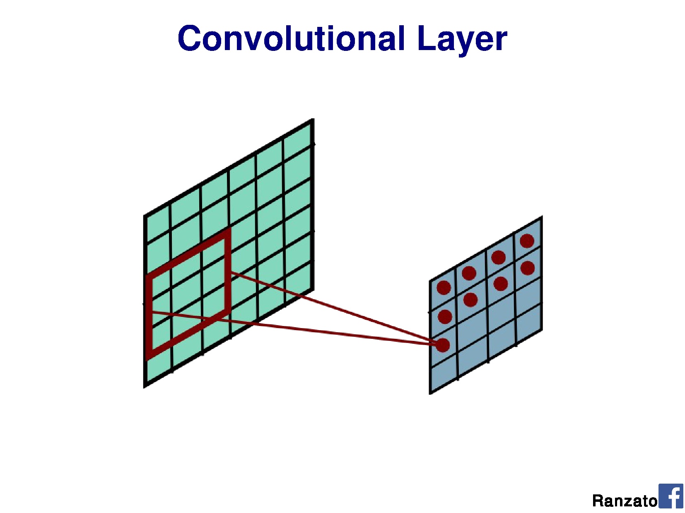

Slide 18
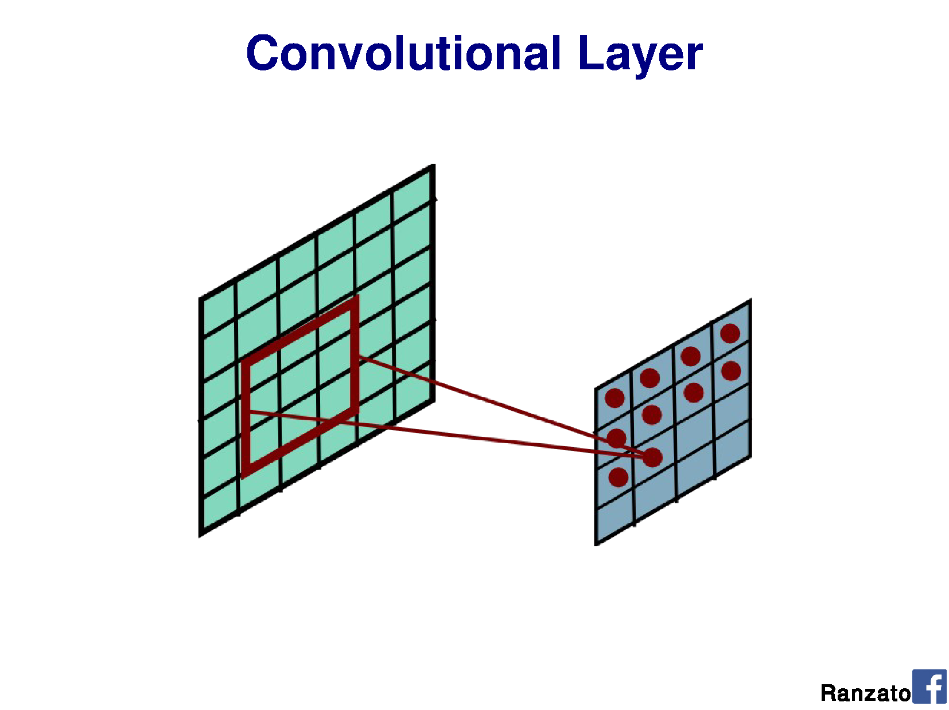

Slide 19
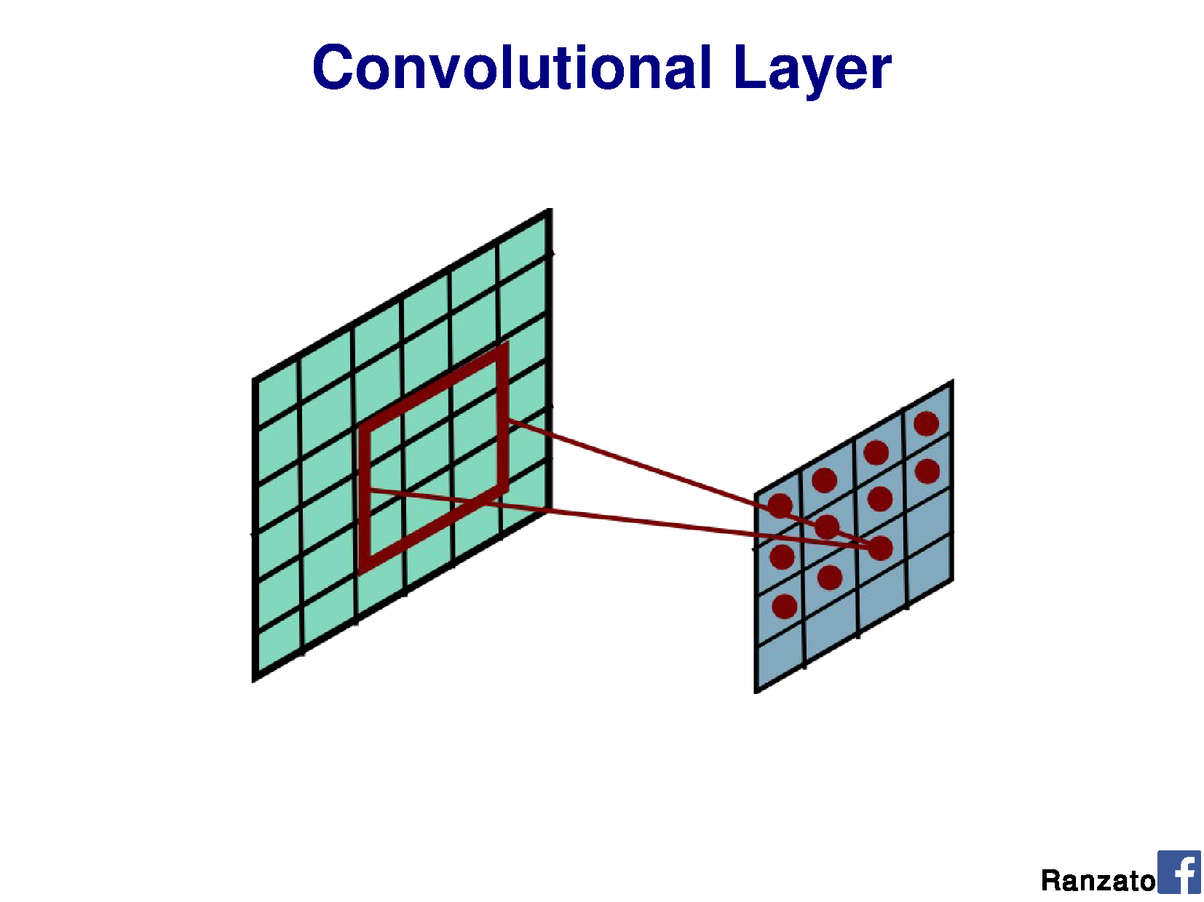

Slide 20
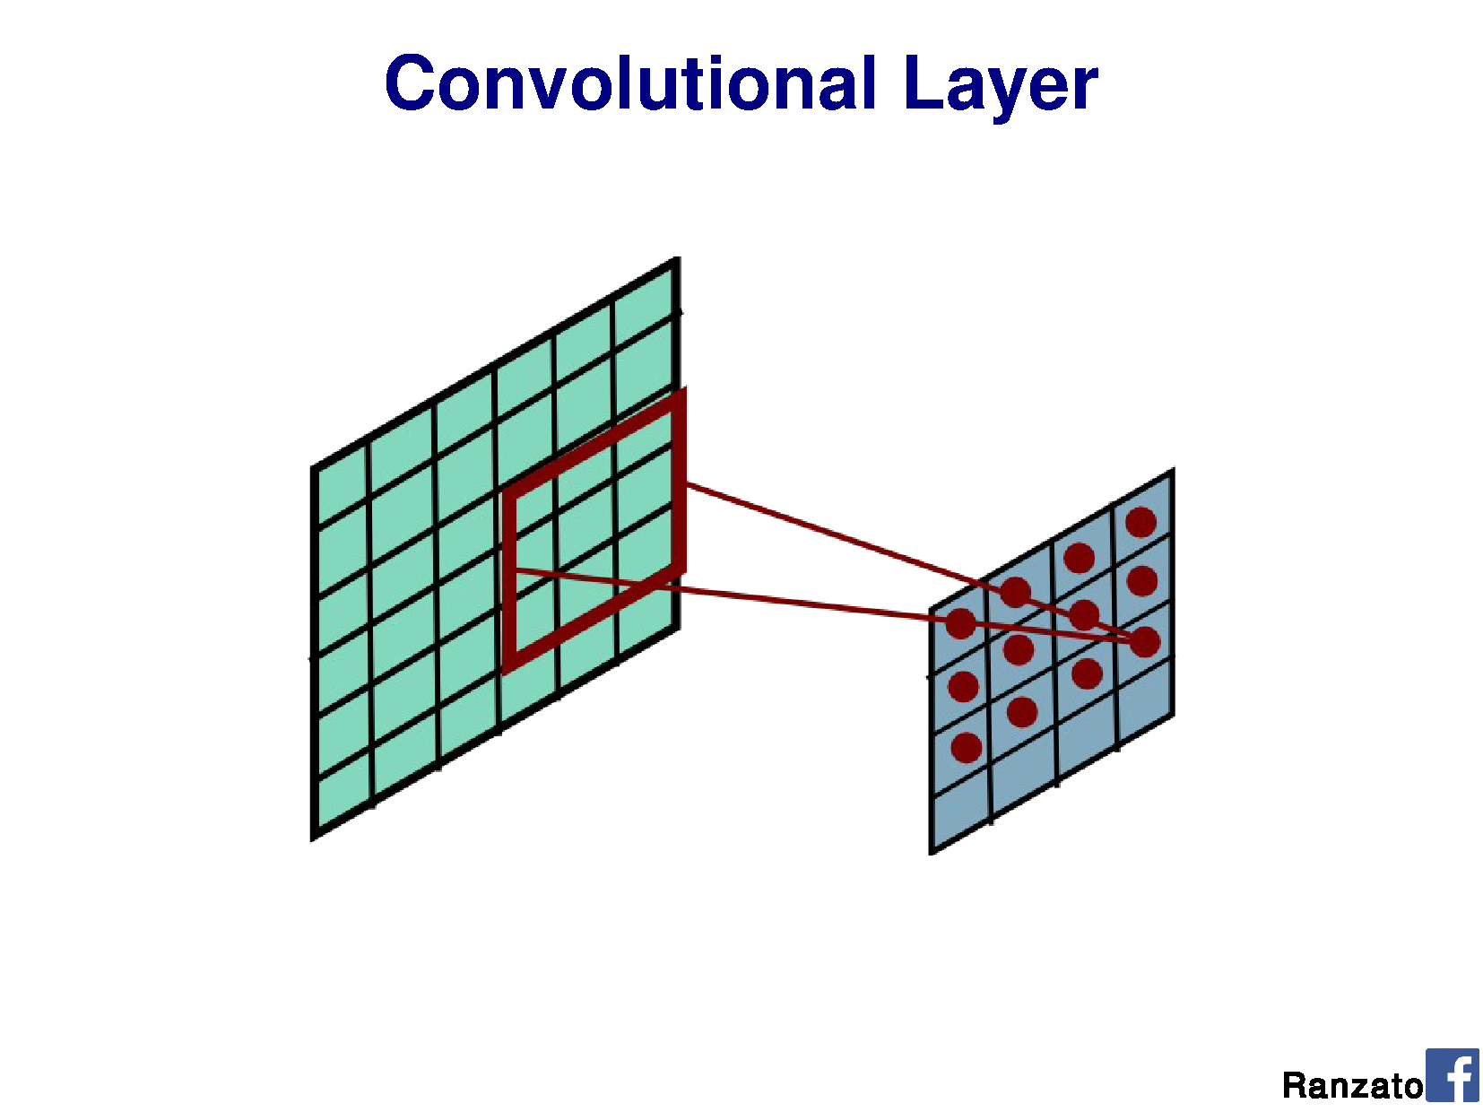

Slide 21


Slide 22


Slide 23
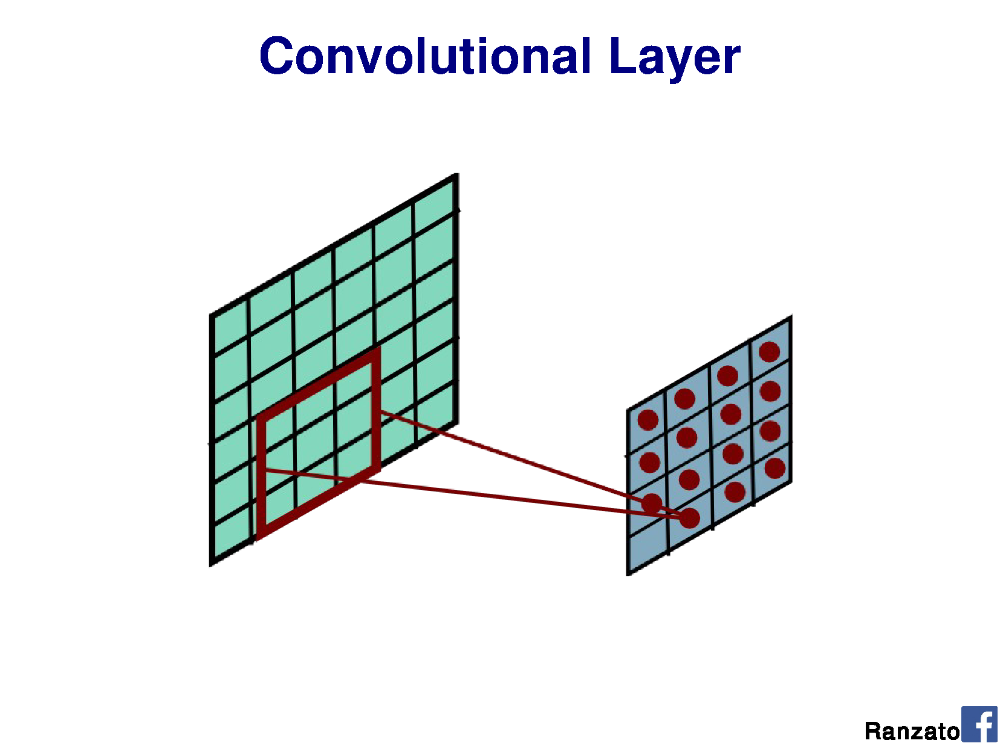

Slide 24
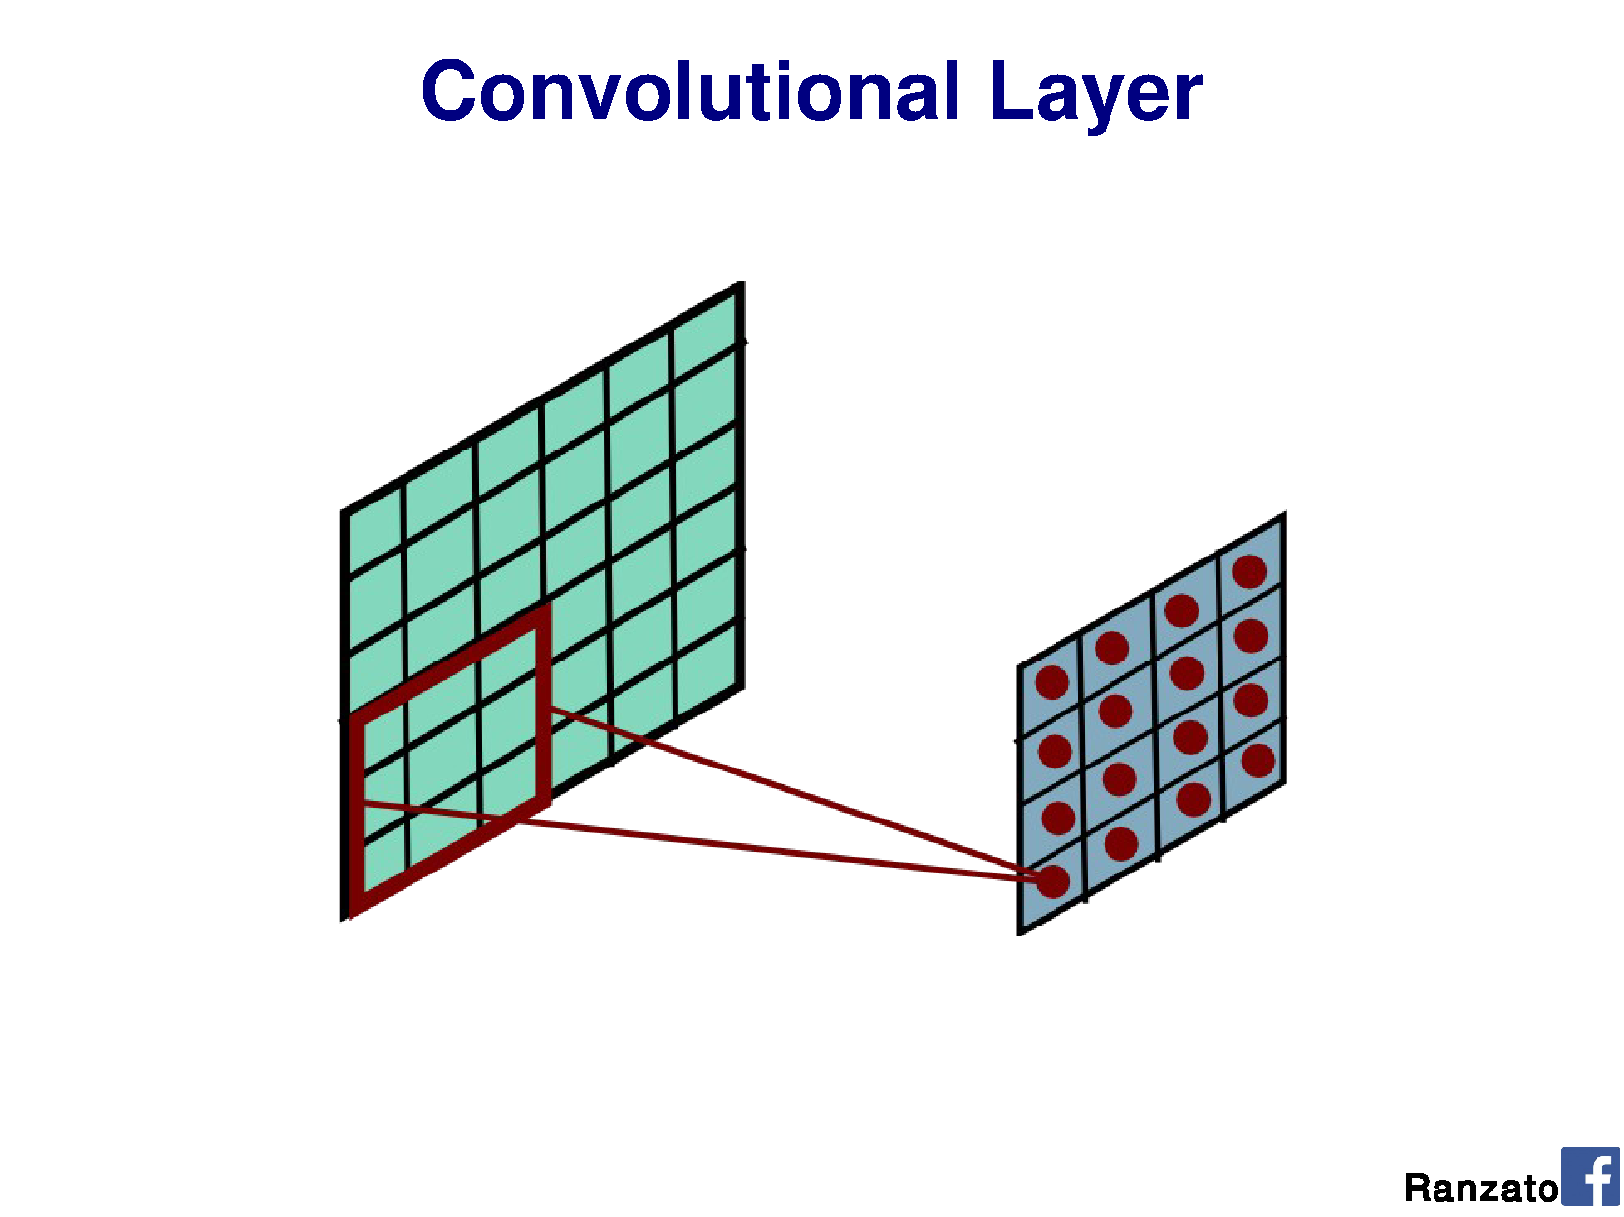

Slide 25
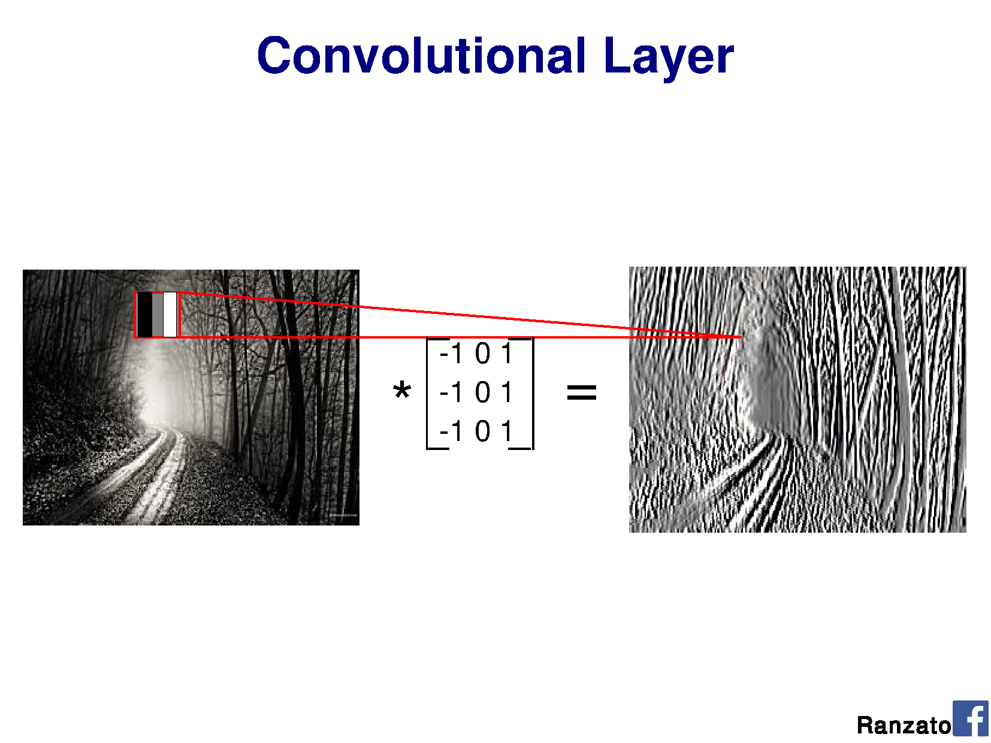

Slide 26
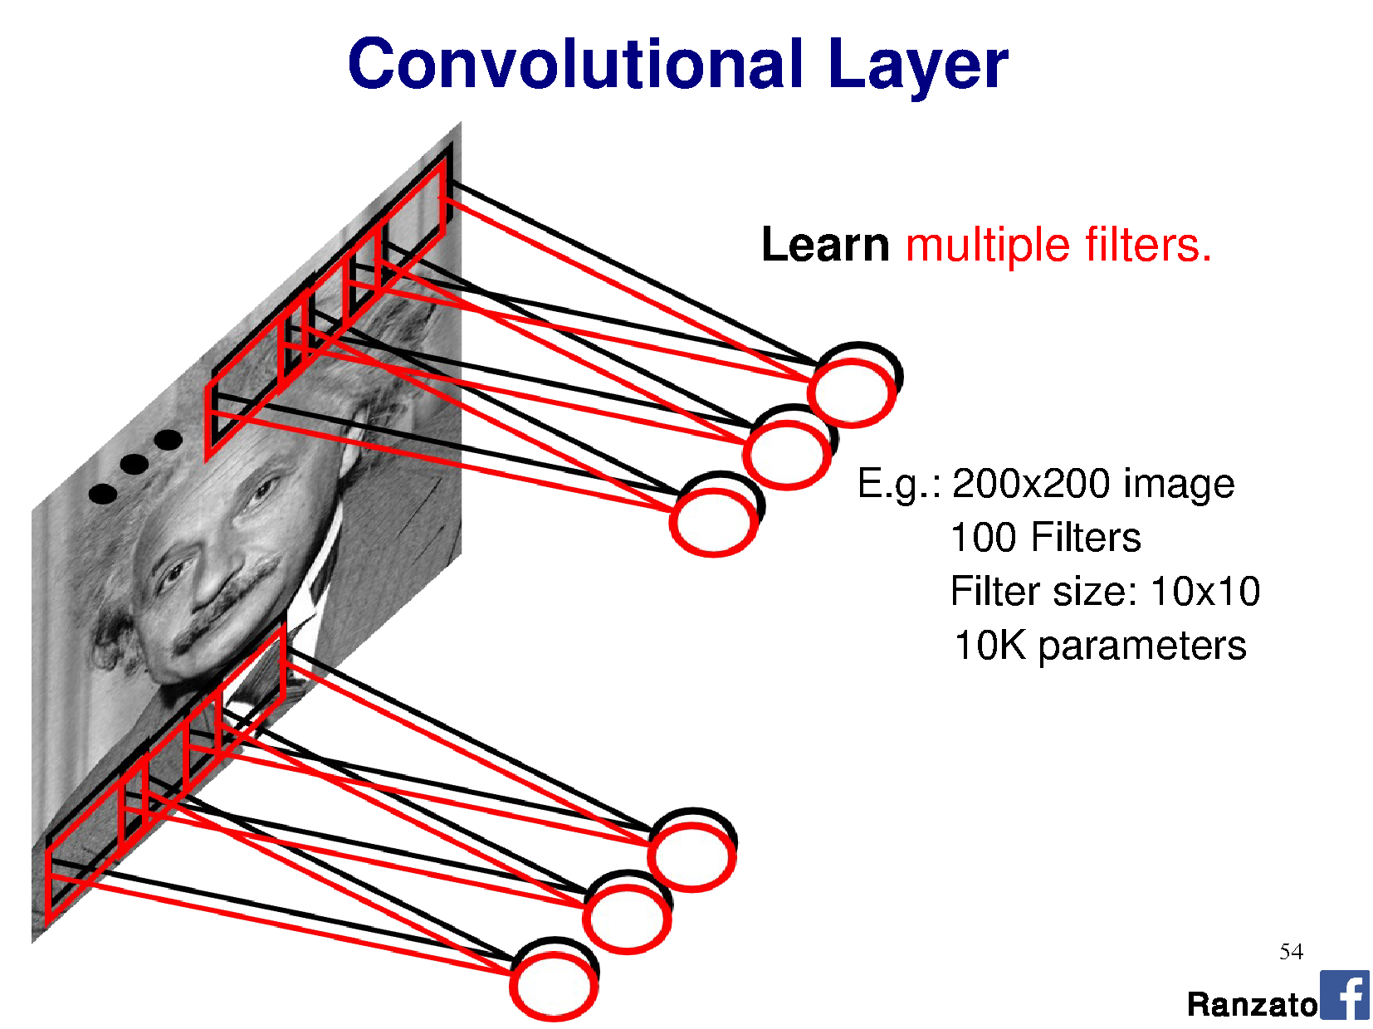

Slide 27
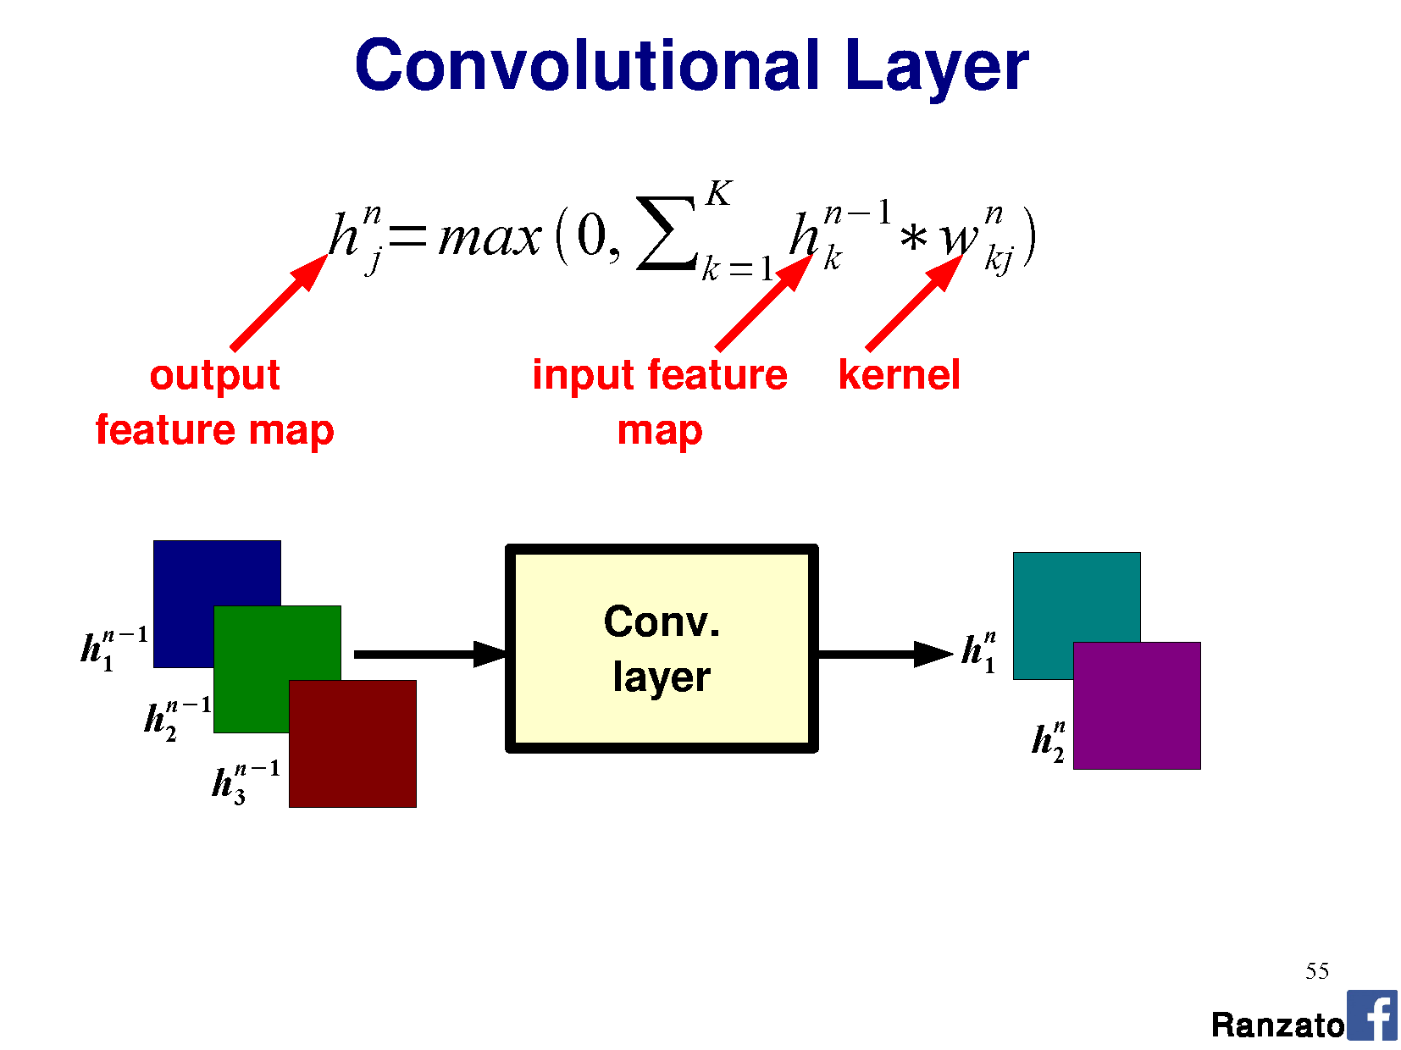

Slide 28
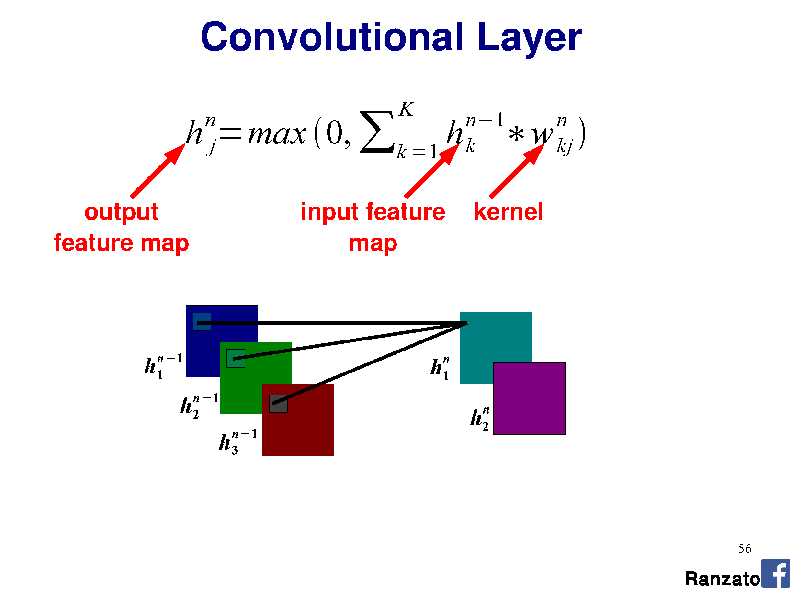

Slide 29
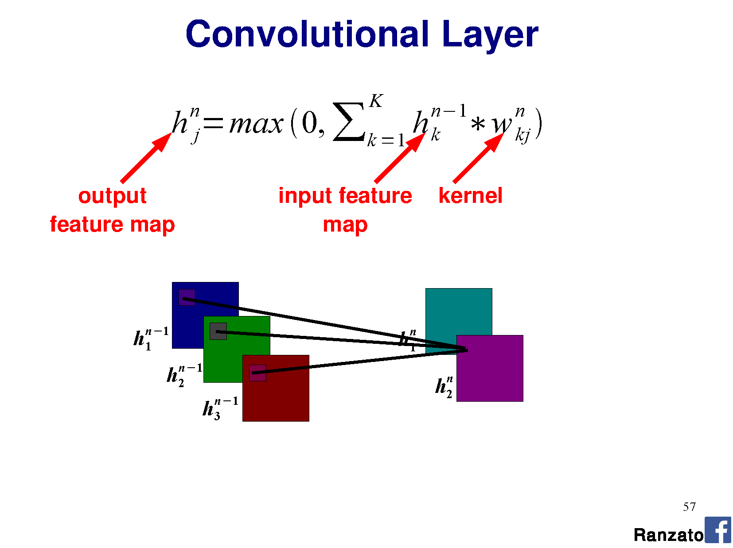

Slide 30
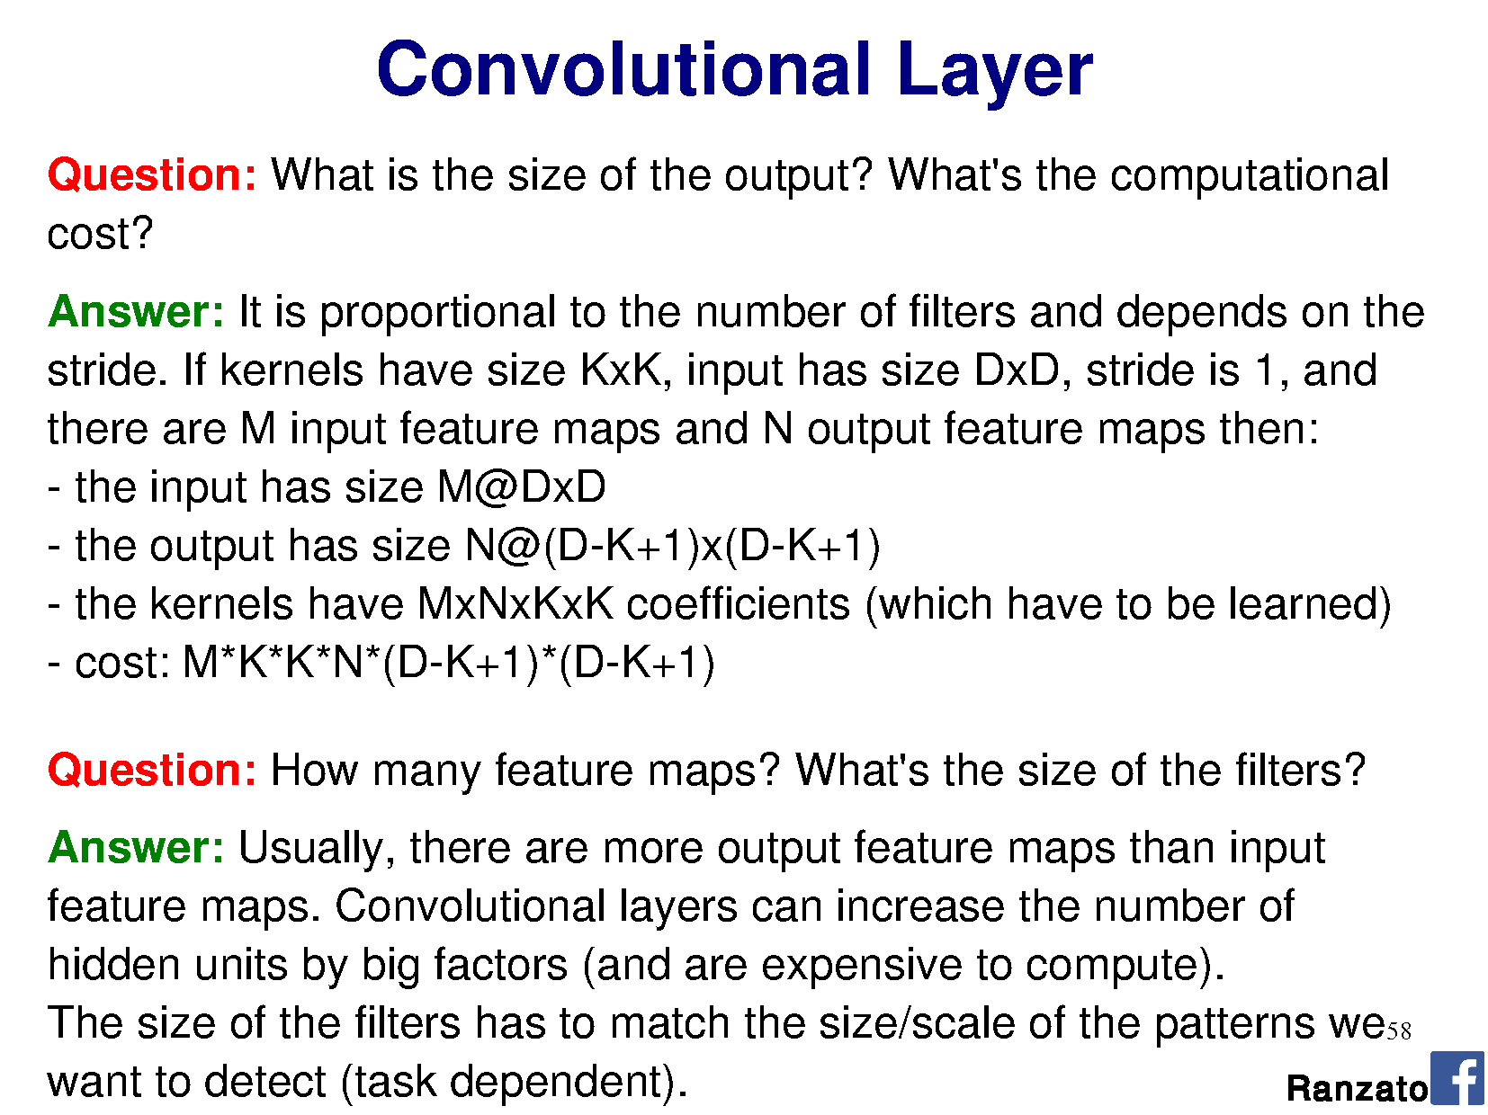

Slide 31
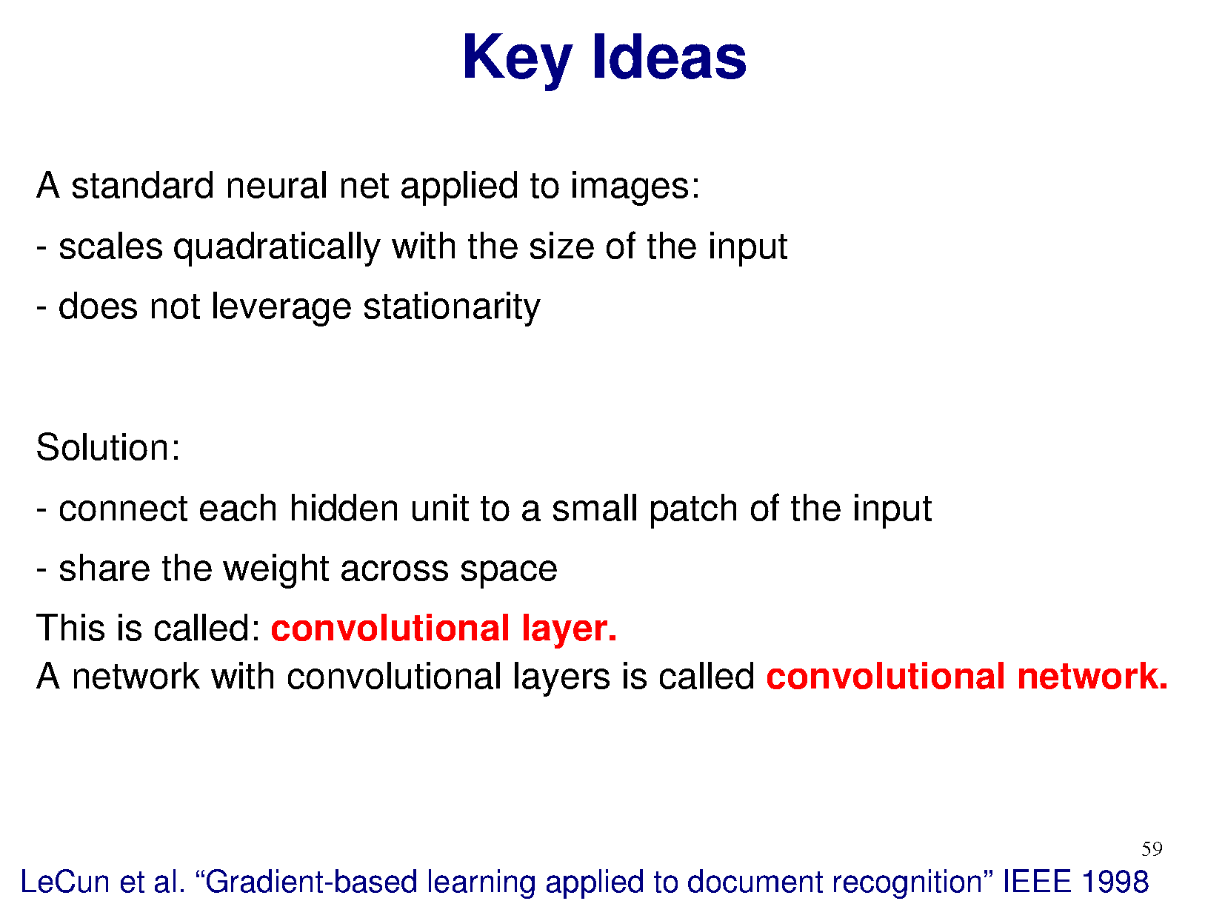

Slide 32
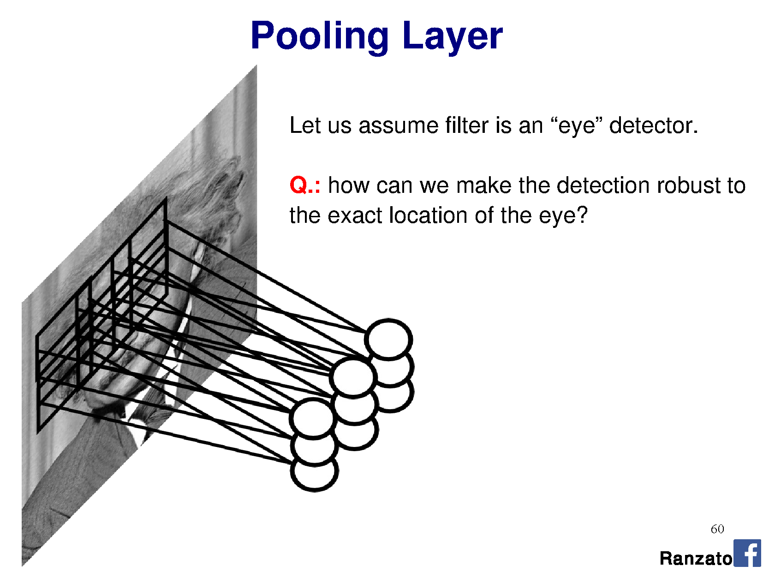

Slide 33
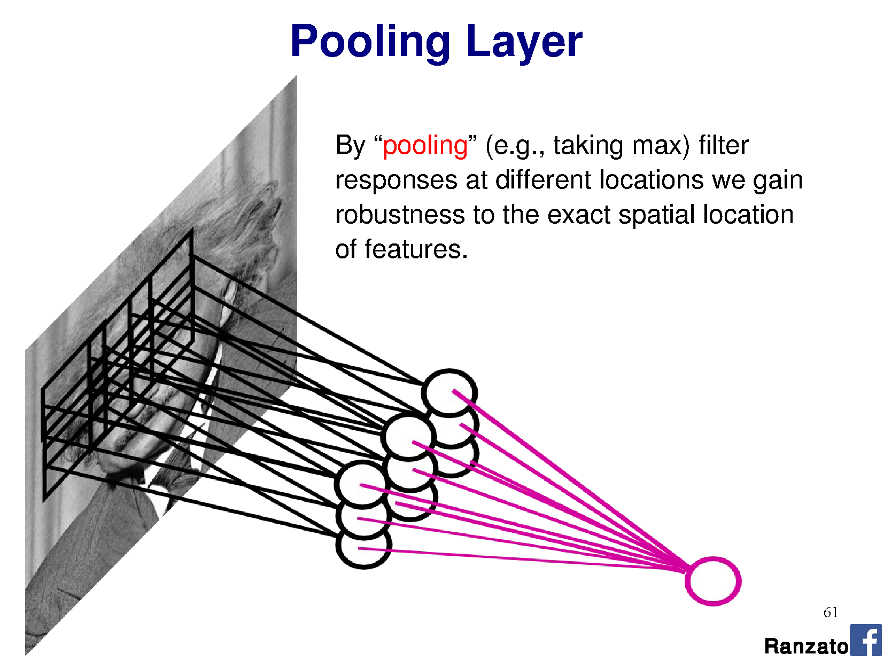

Slide 34
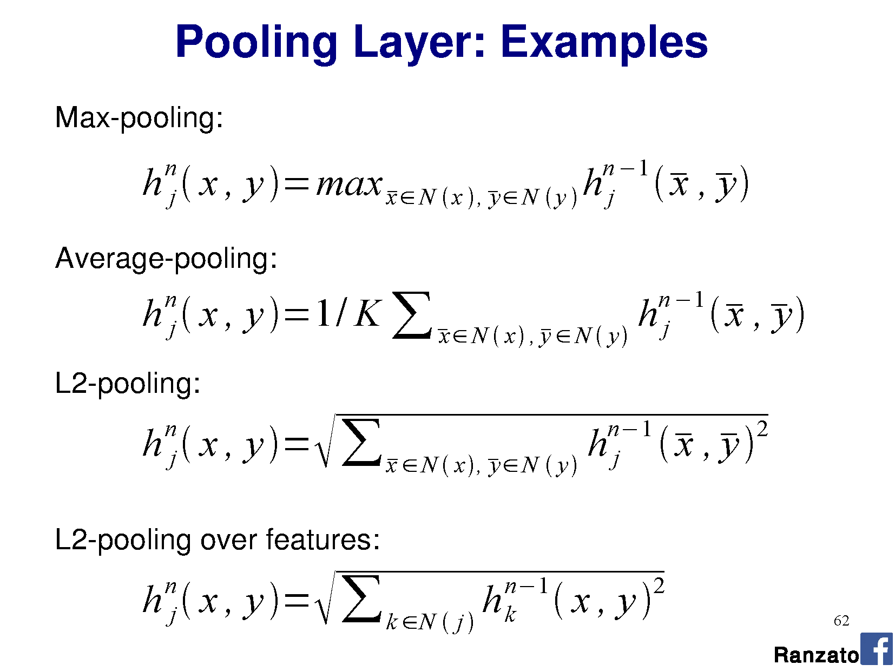

Slide 35
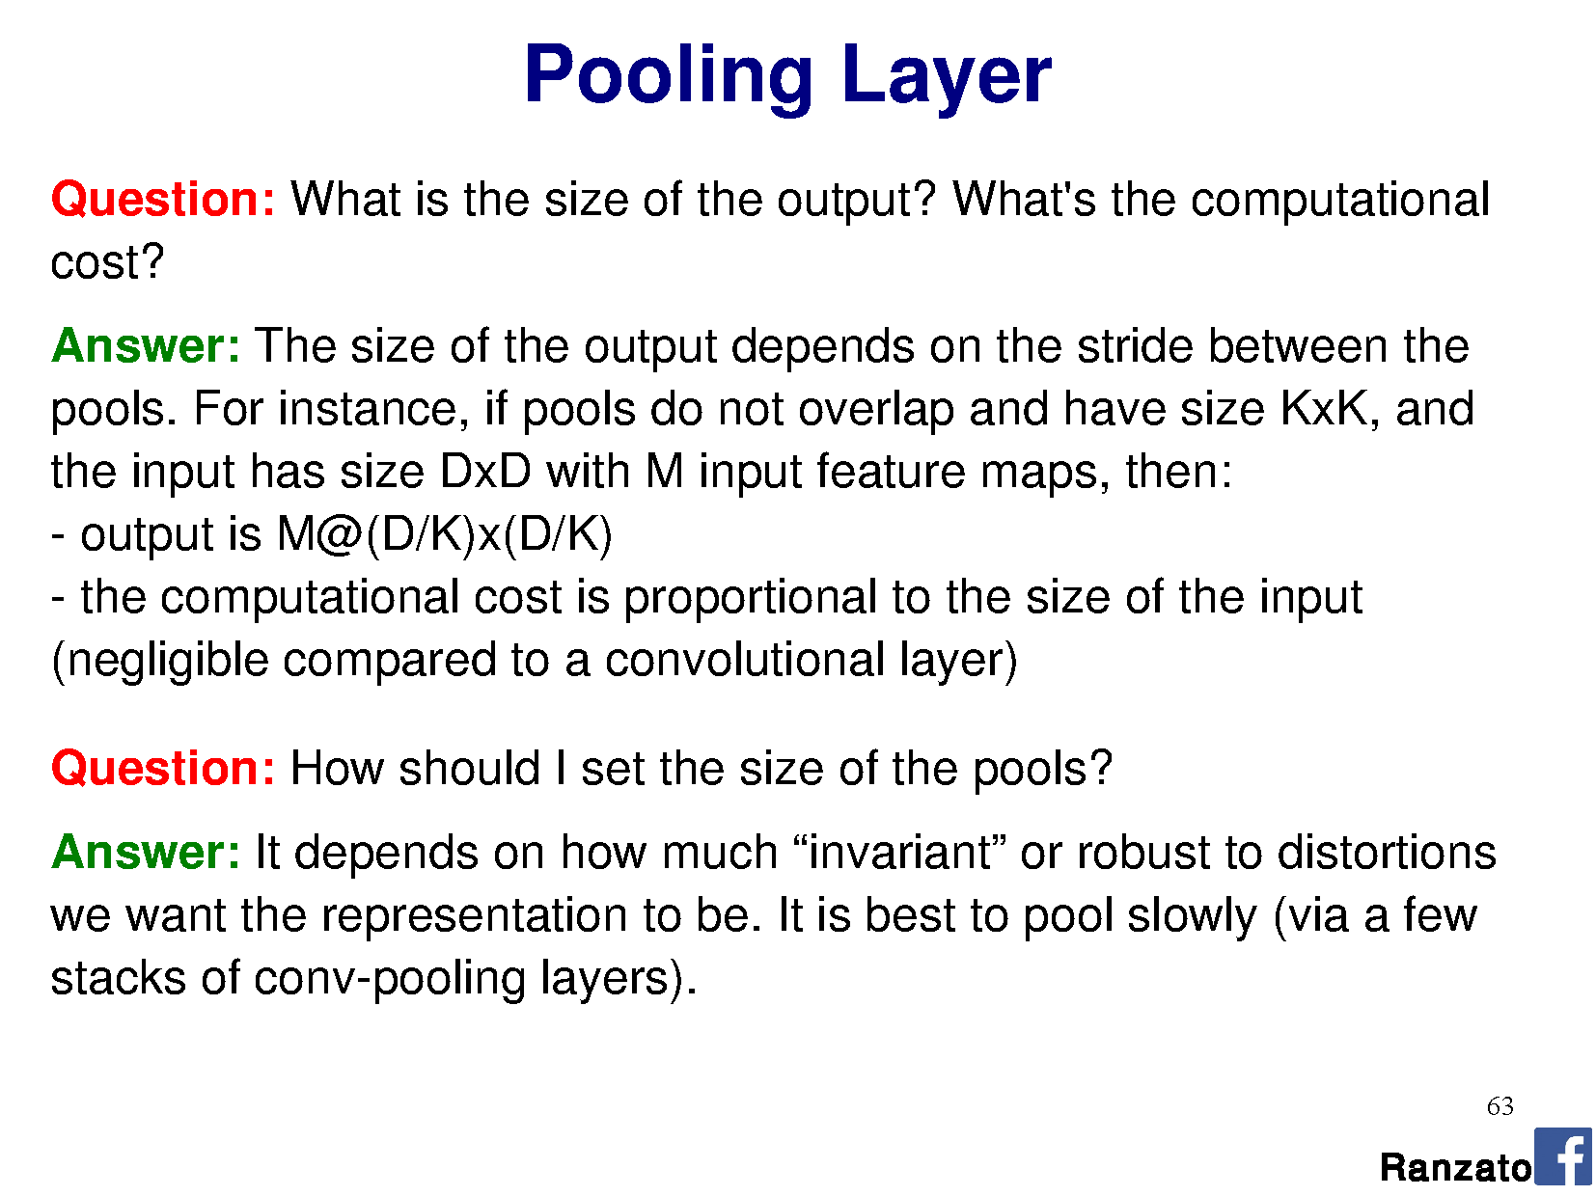

Slide 36
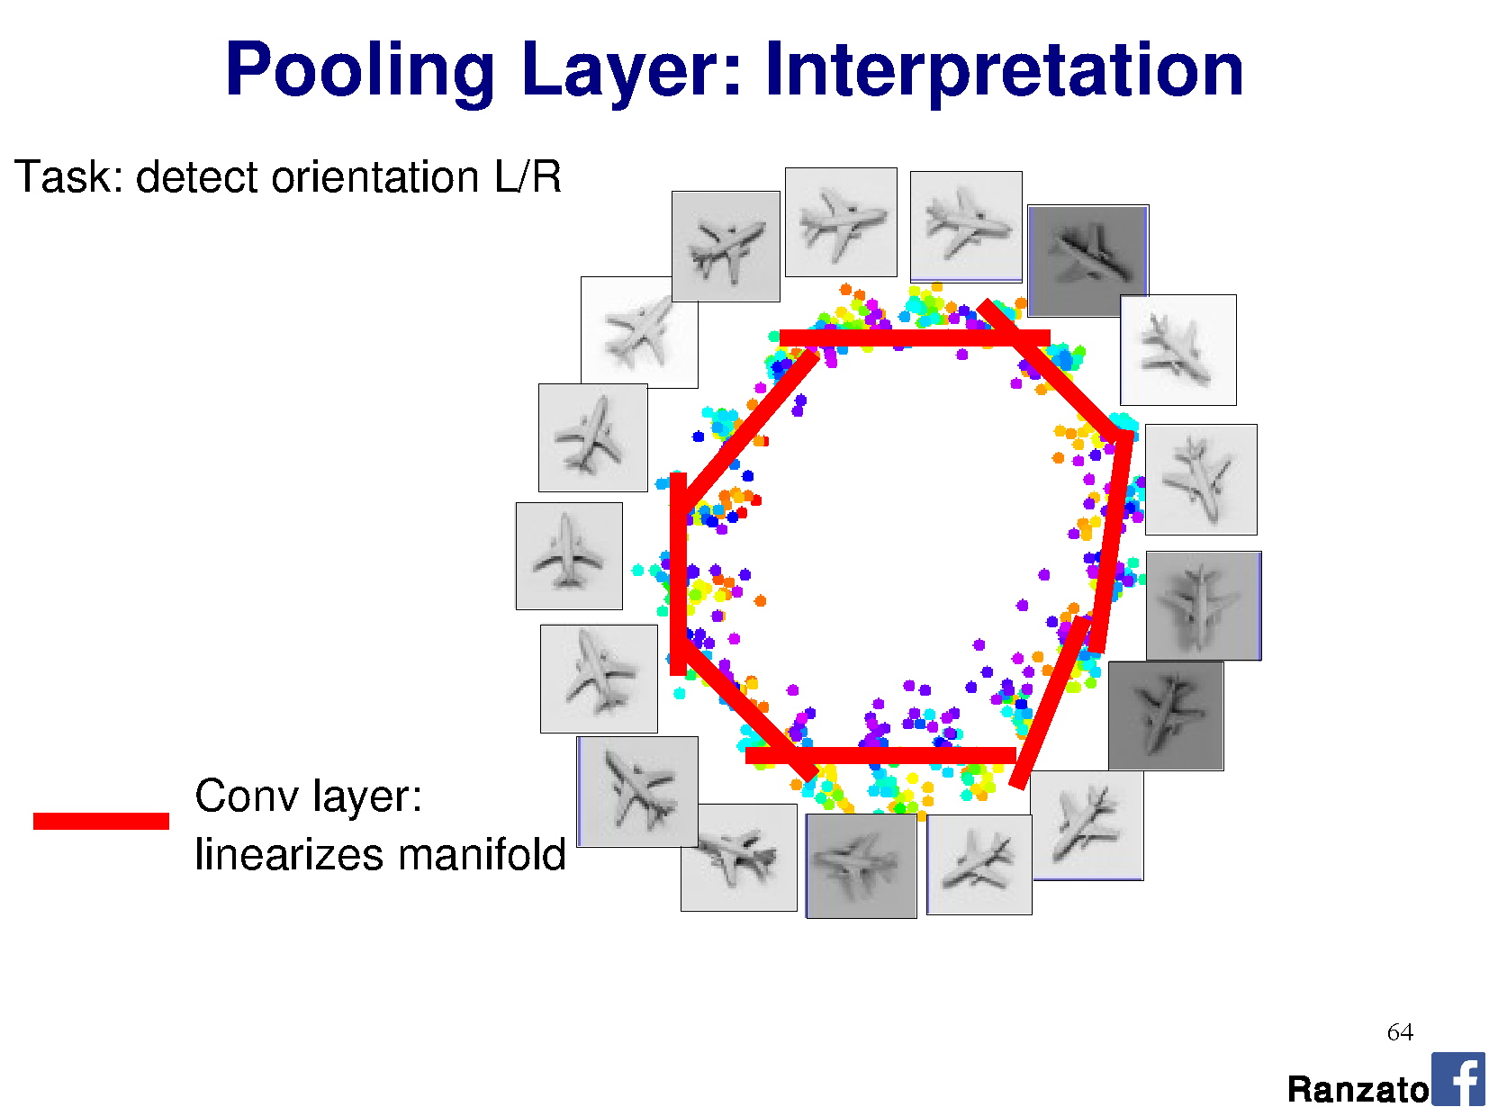

Slide 37
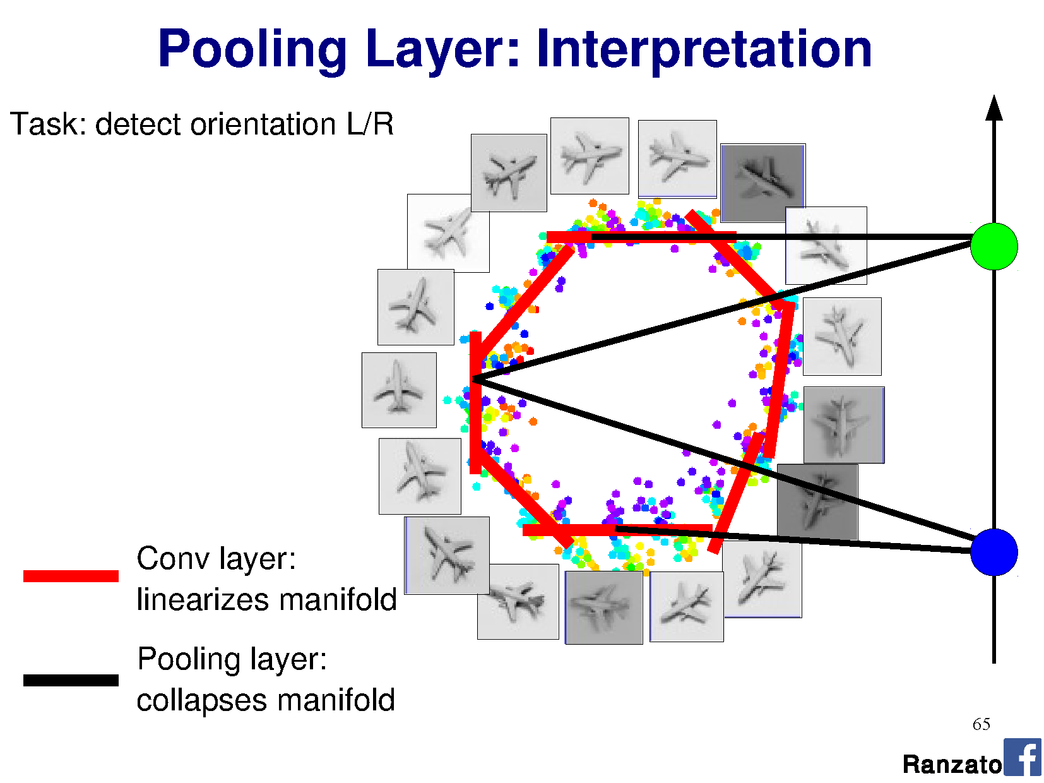

Slide 38
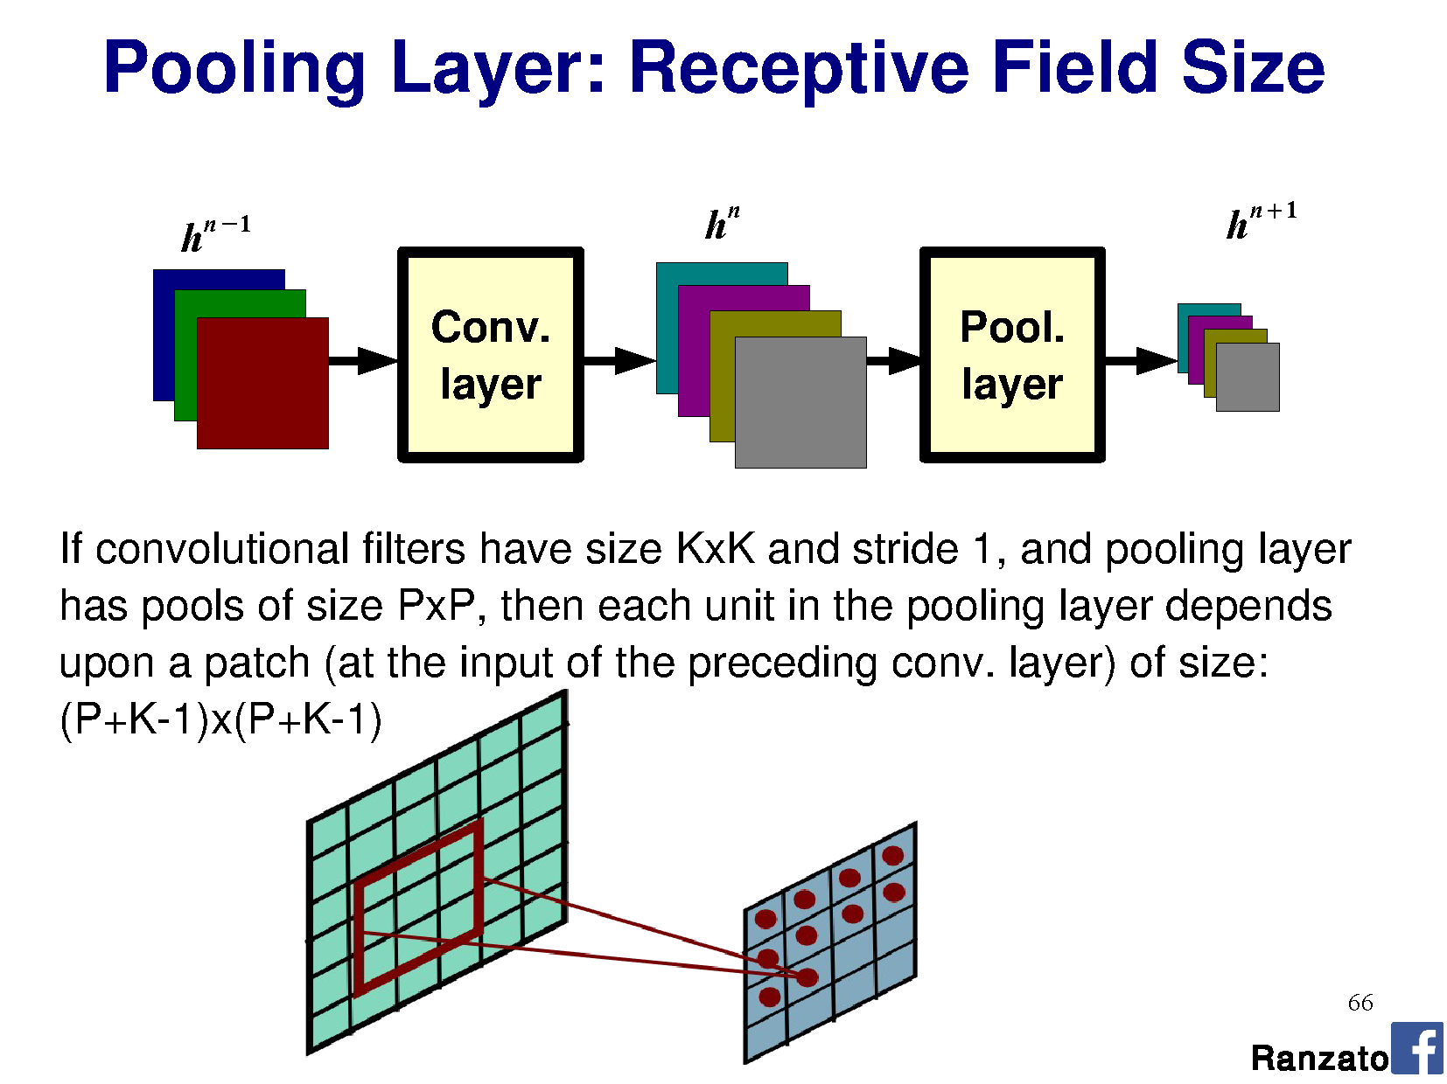

Slide 39
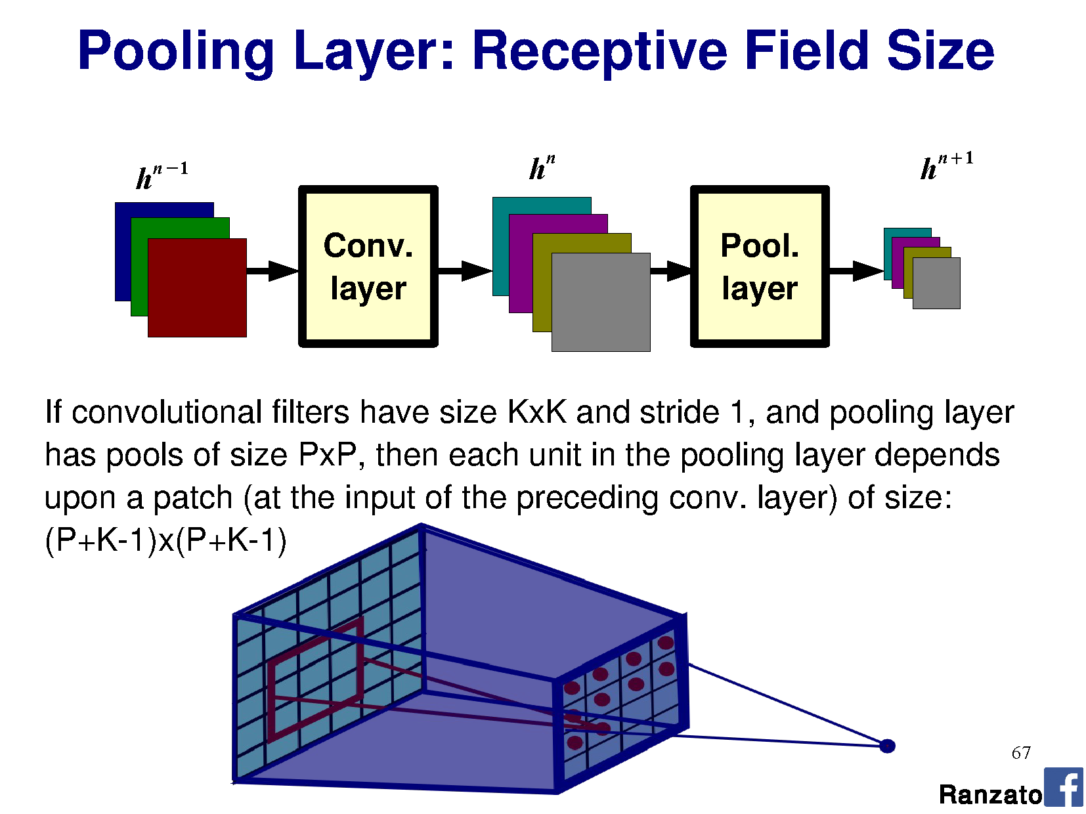

Slide 40
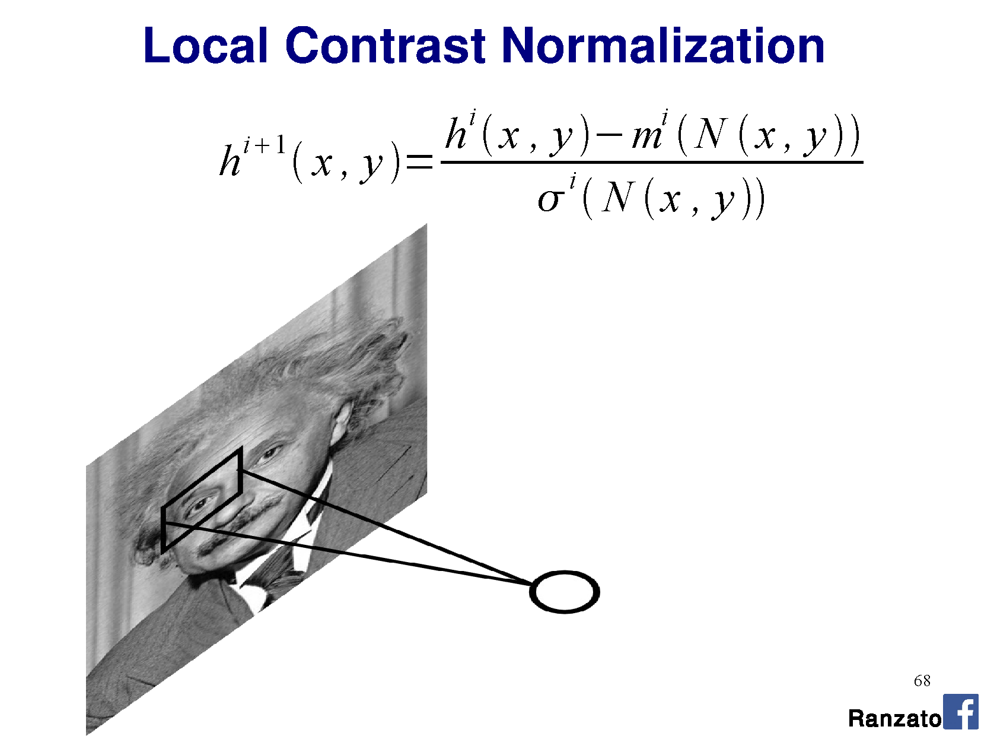

Slide 41
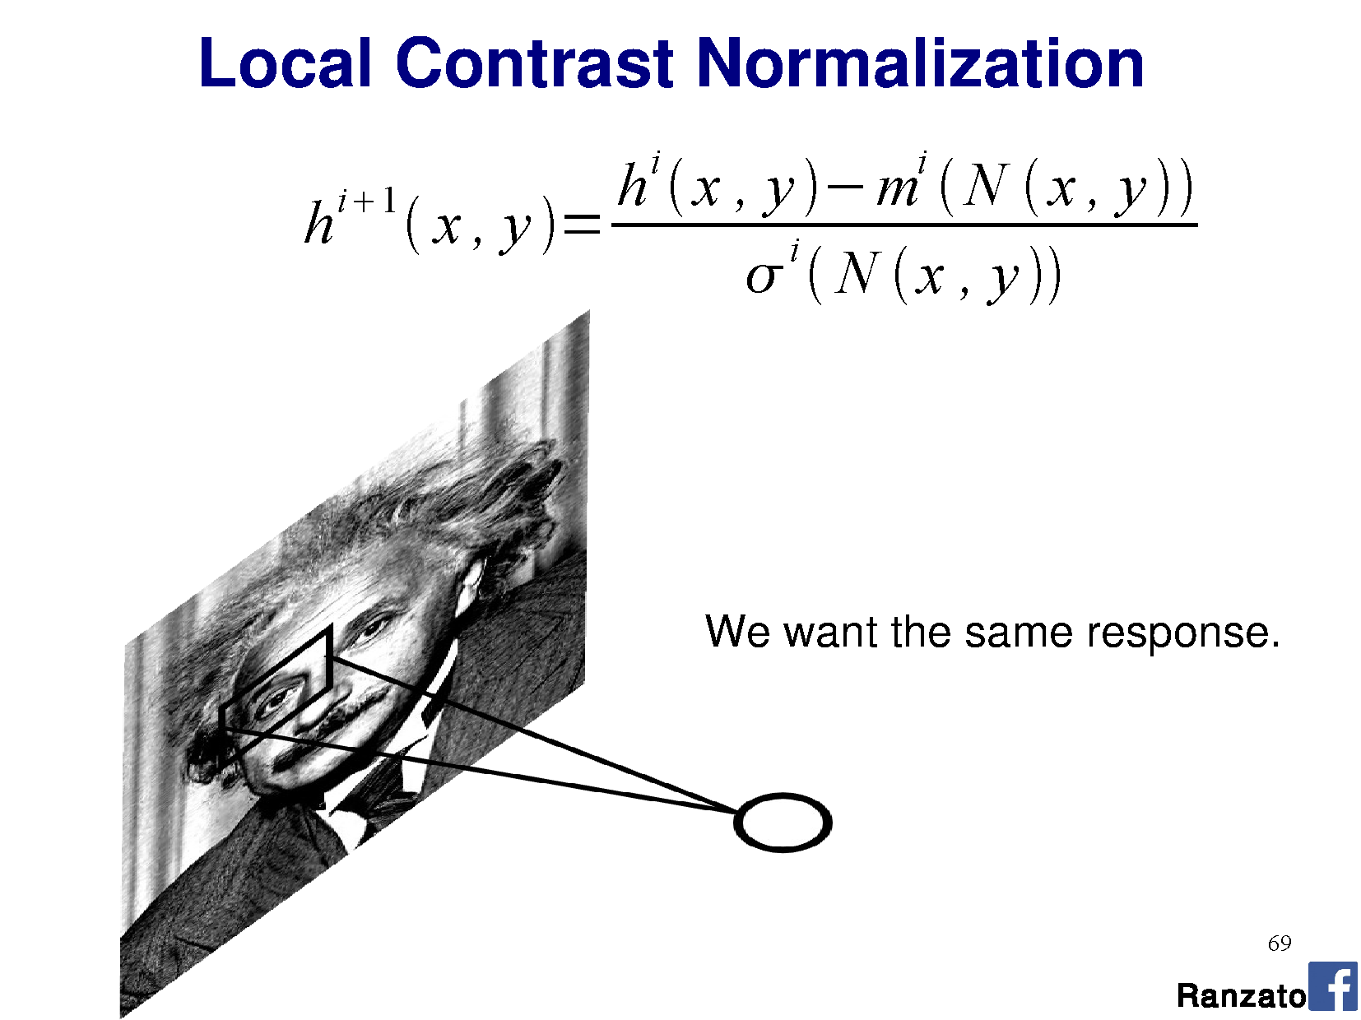

Slide 42
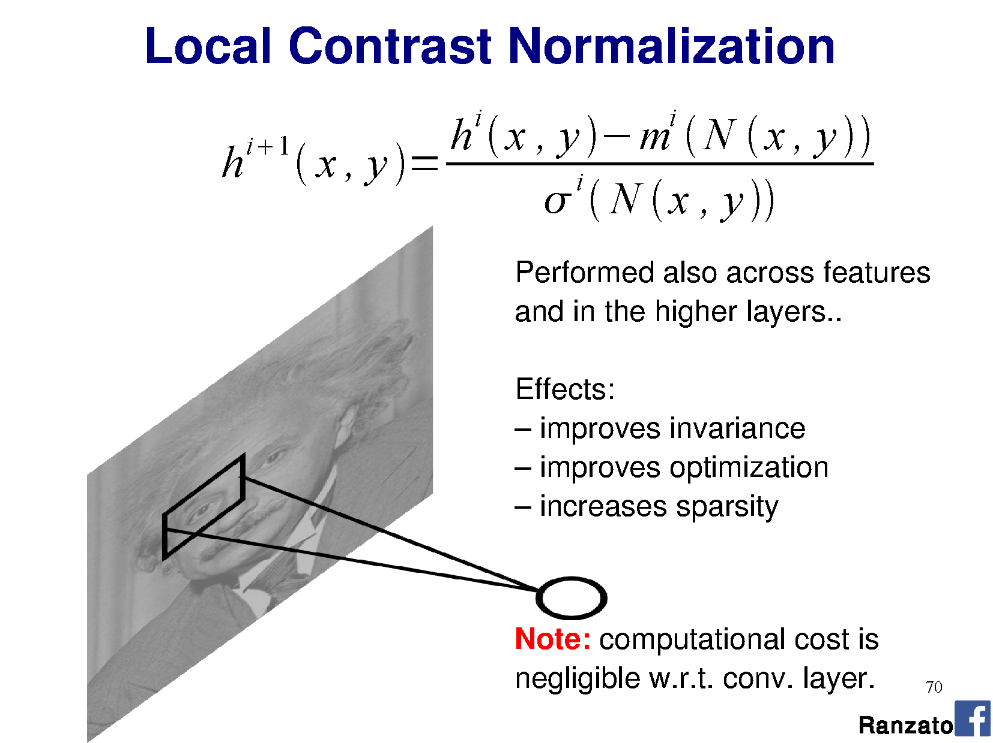

Slide 43
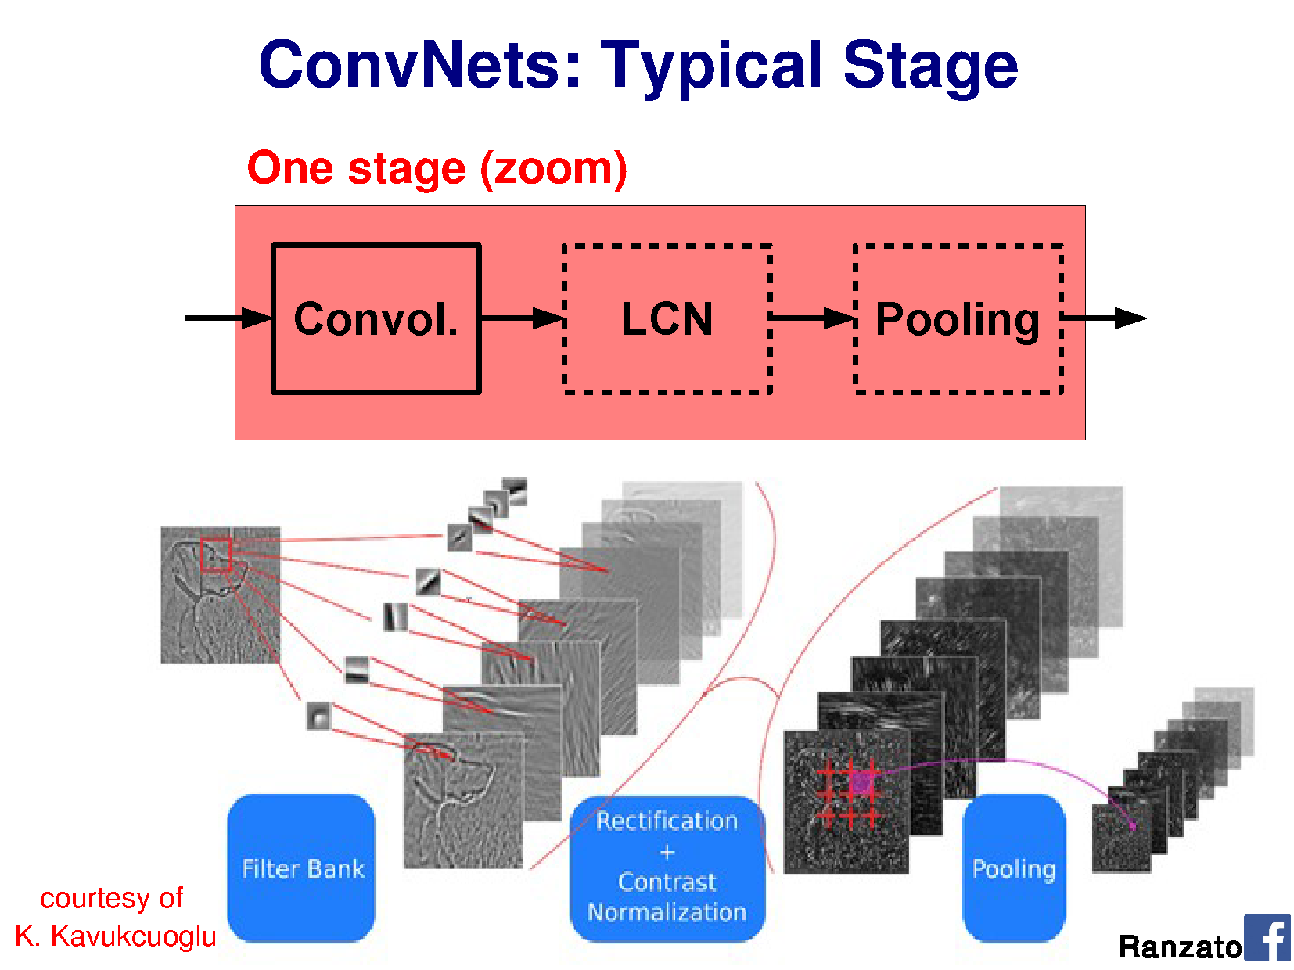

Slide 44
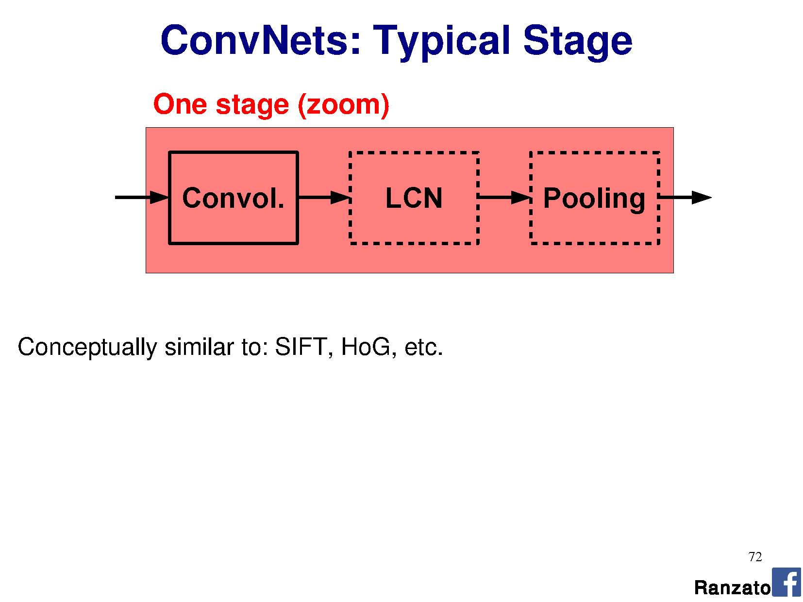

Slide 45
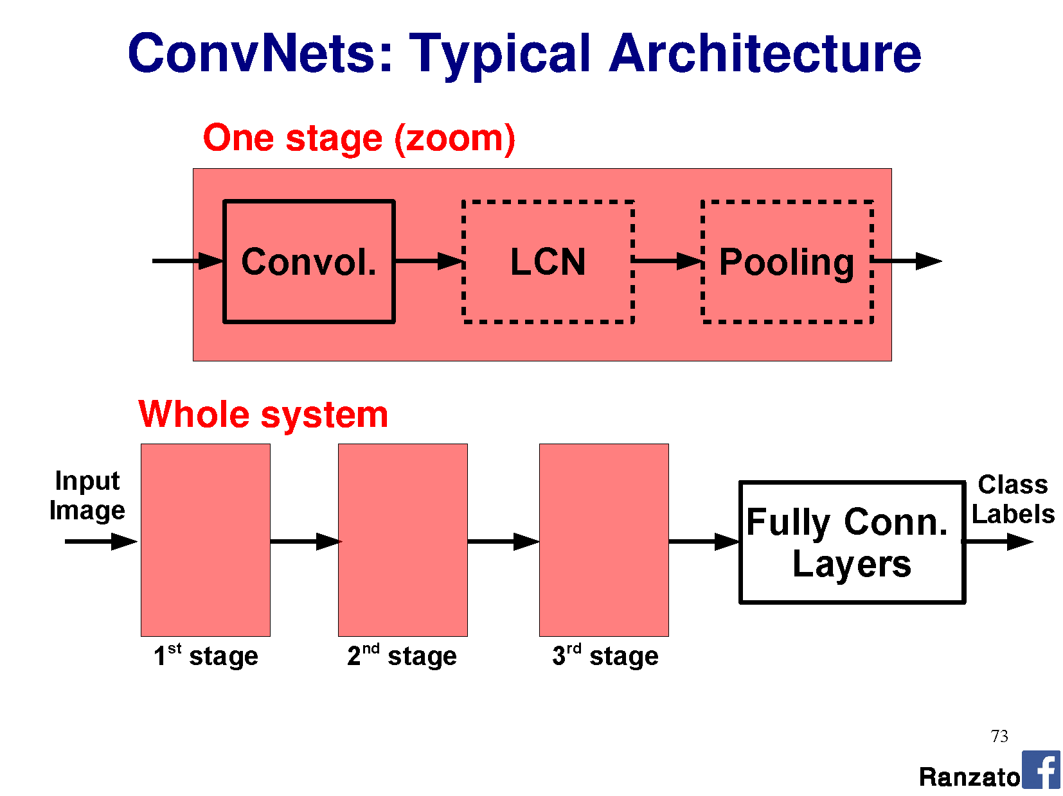

Slide 46
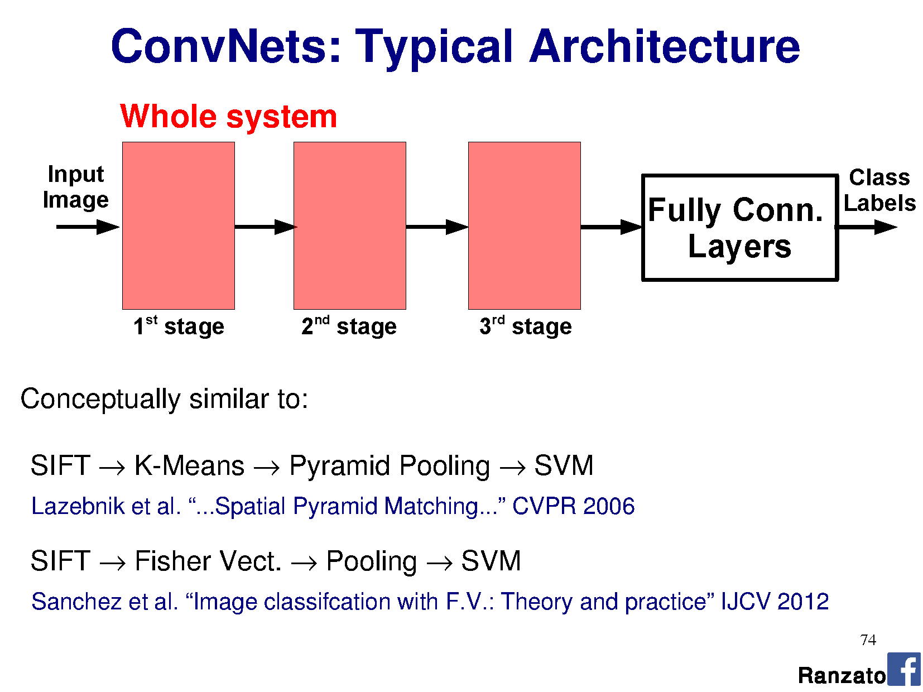

Slide 47
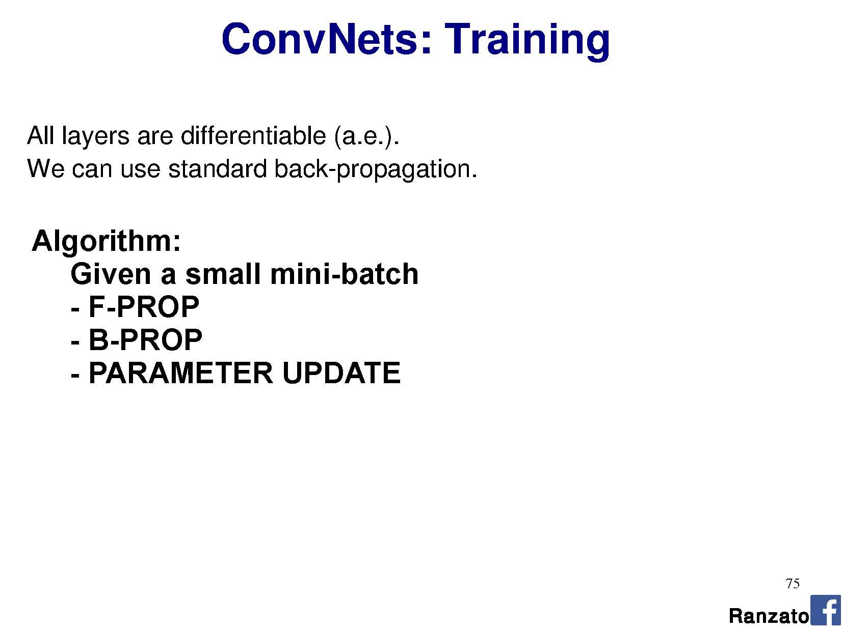

Slide 48
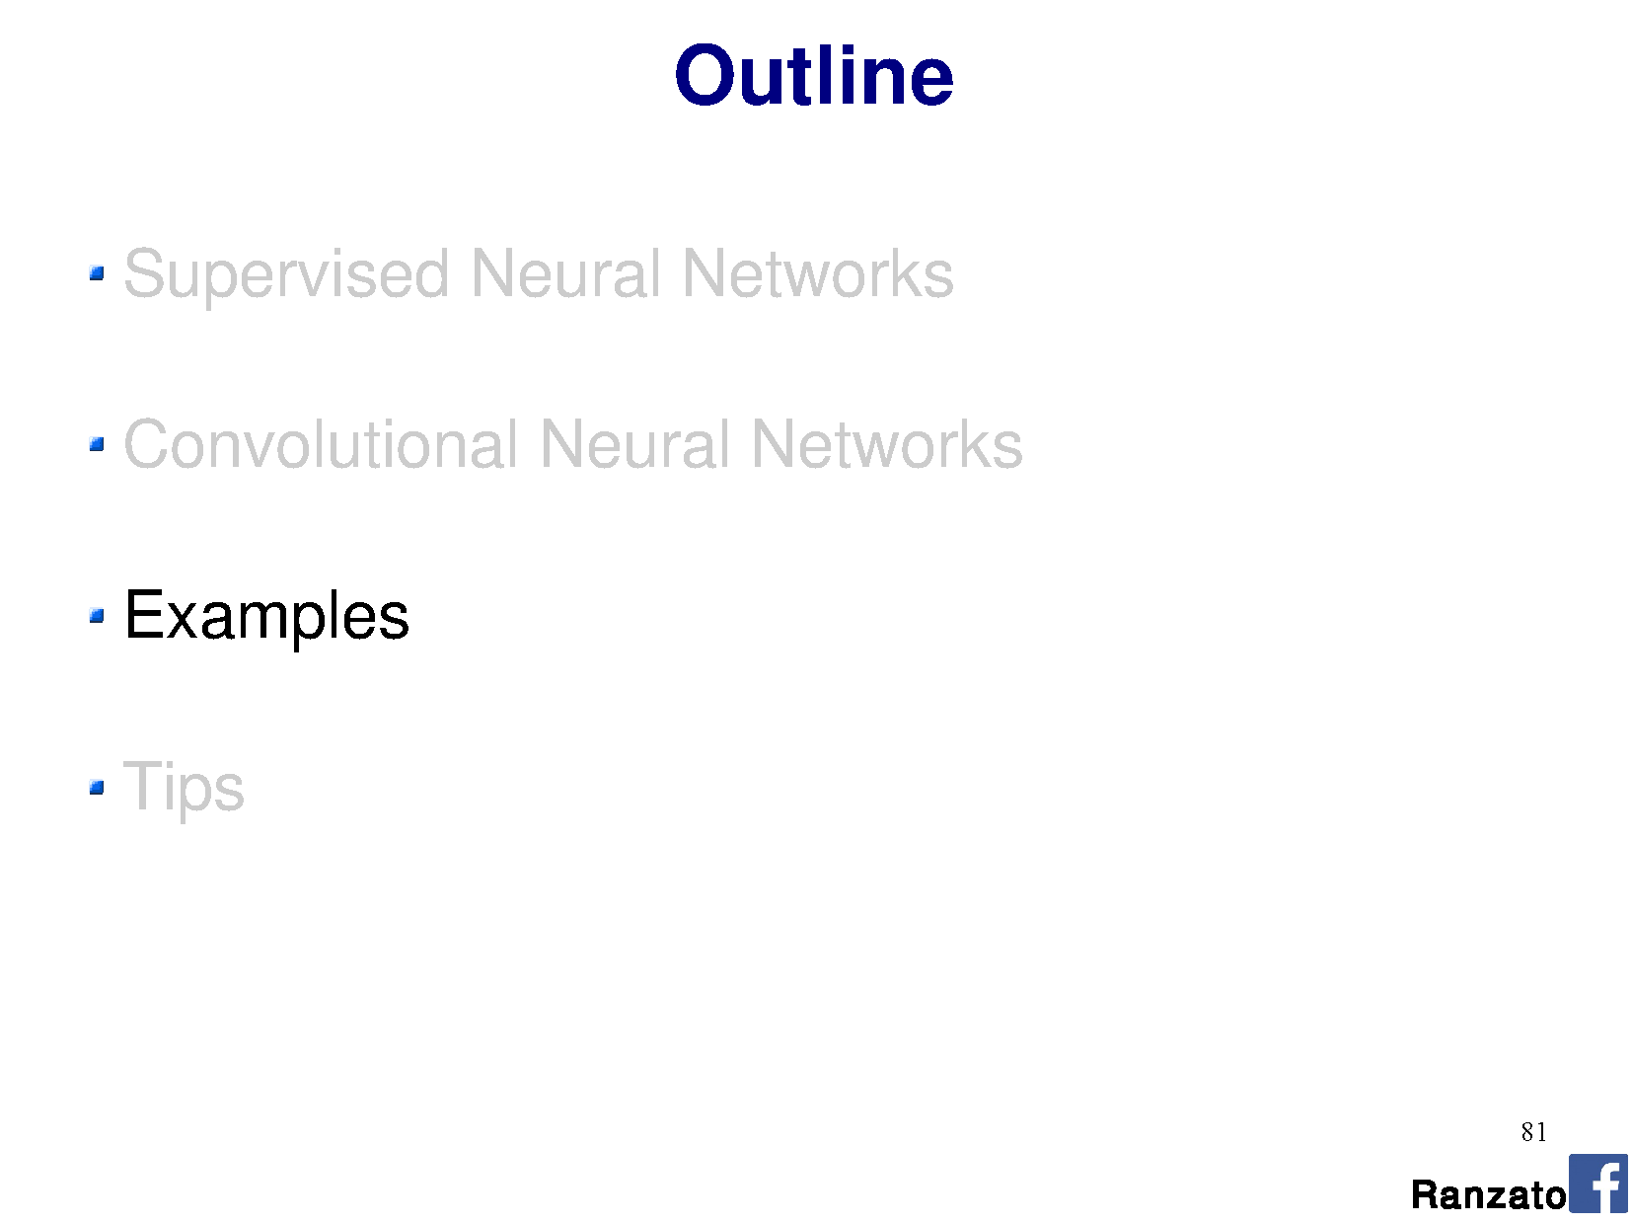

Slide 49
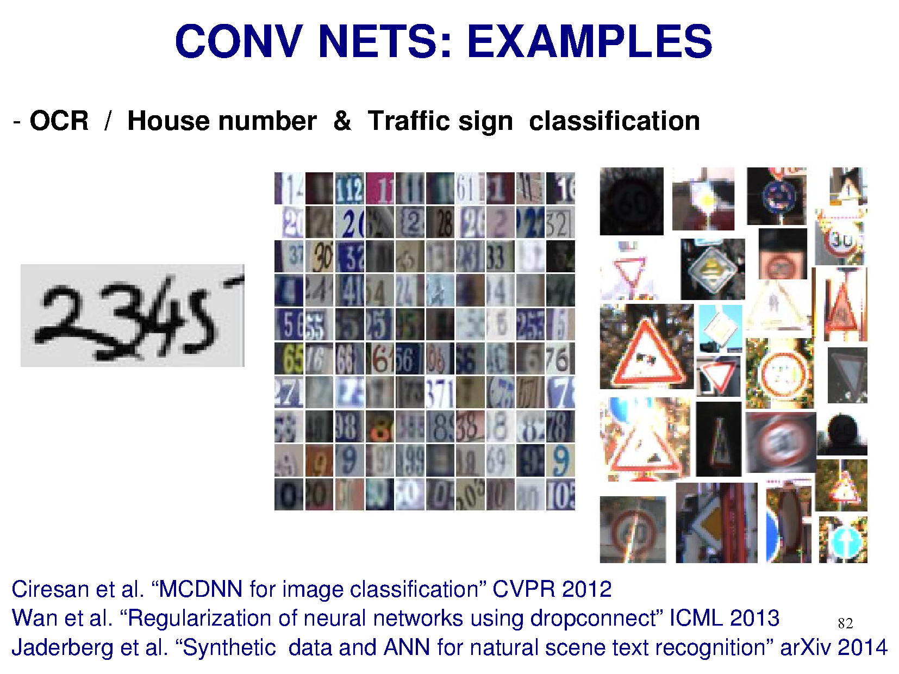

Slide 50
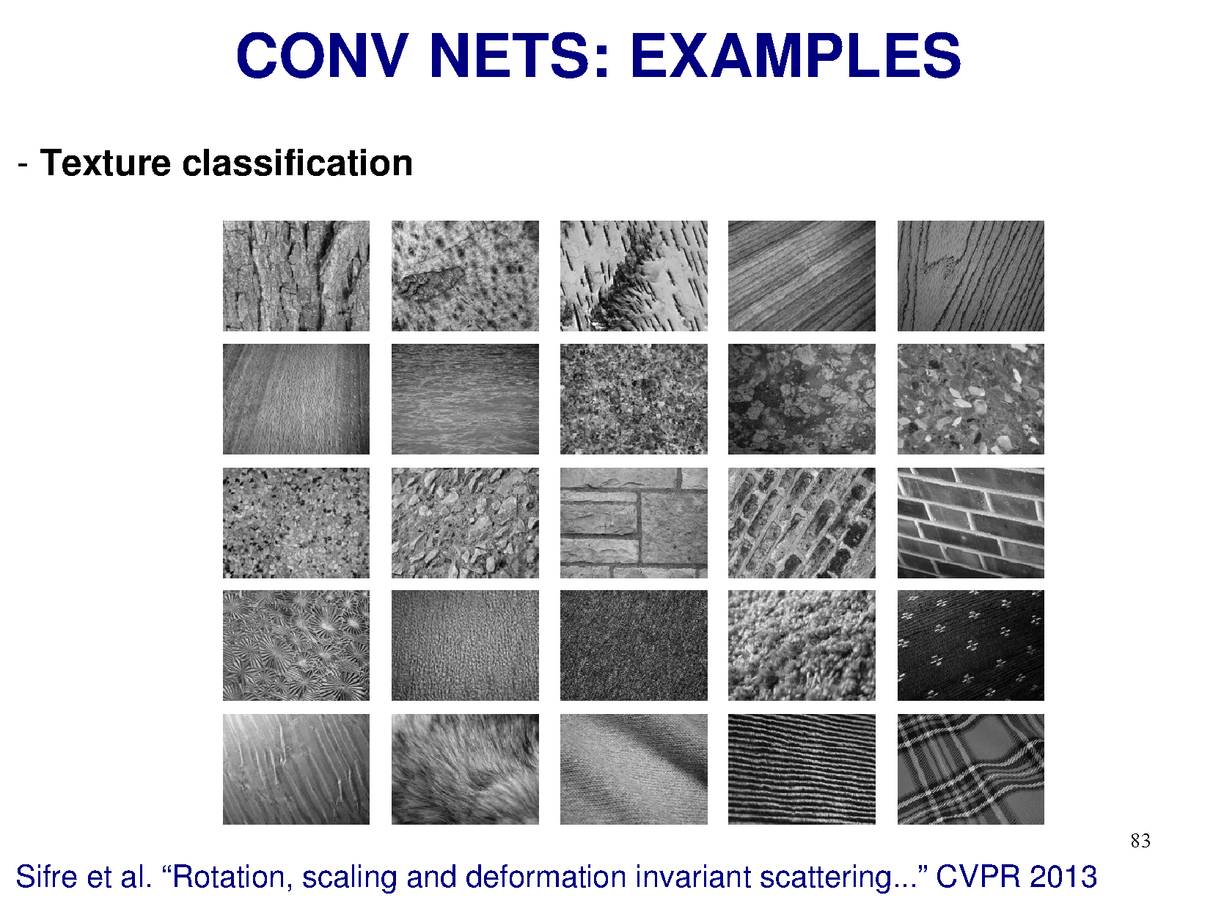

Slide 51
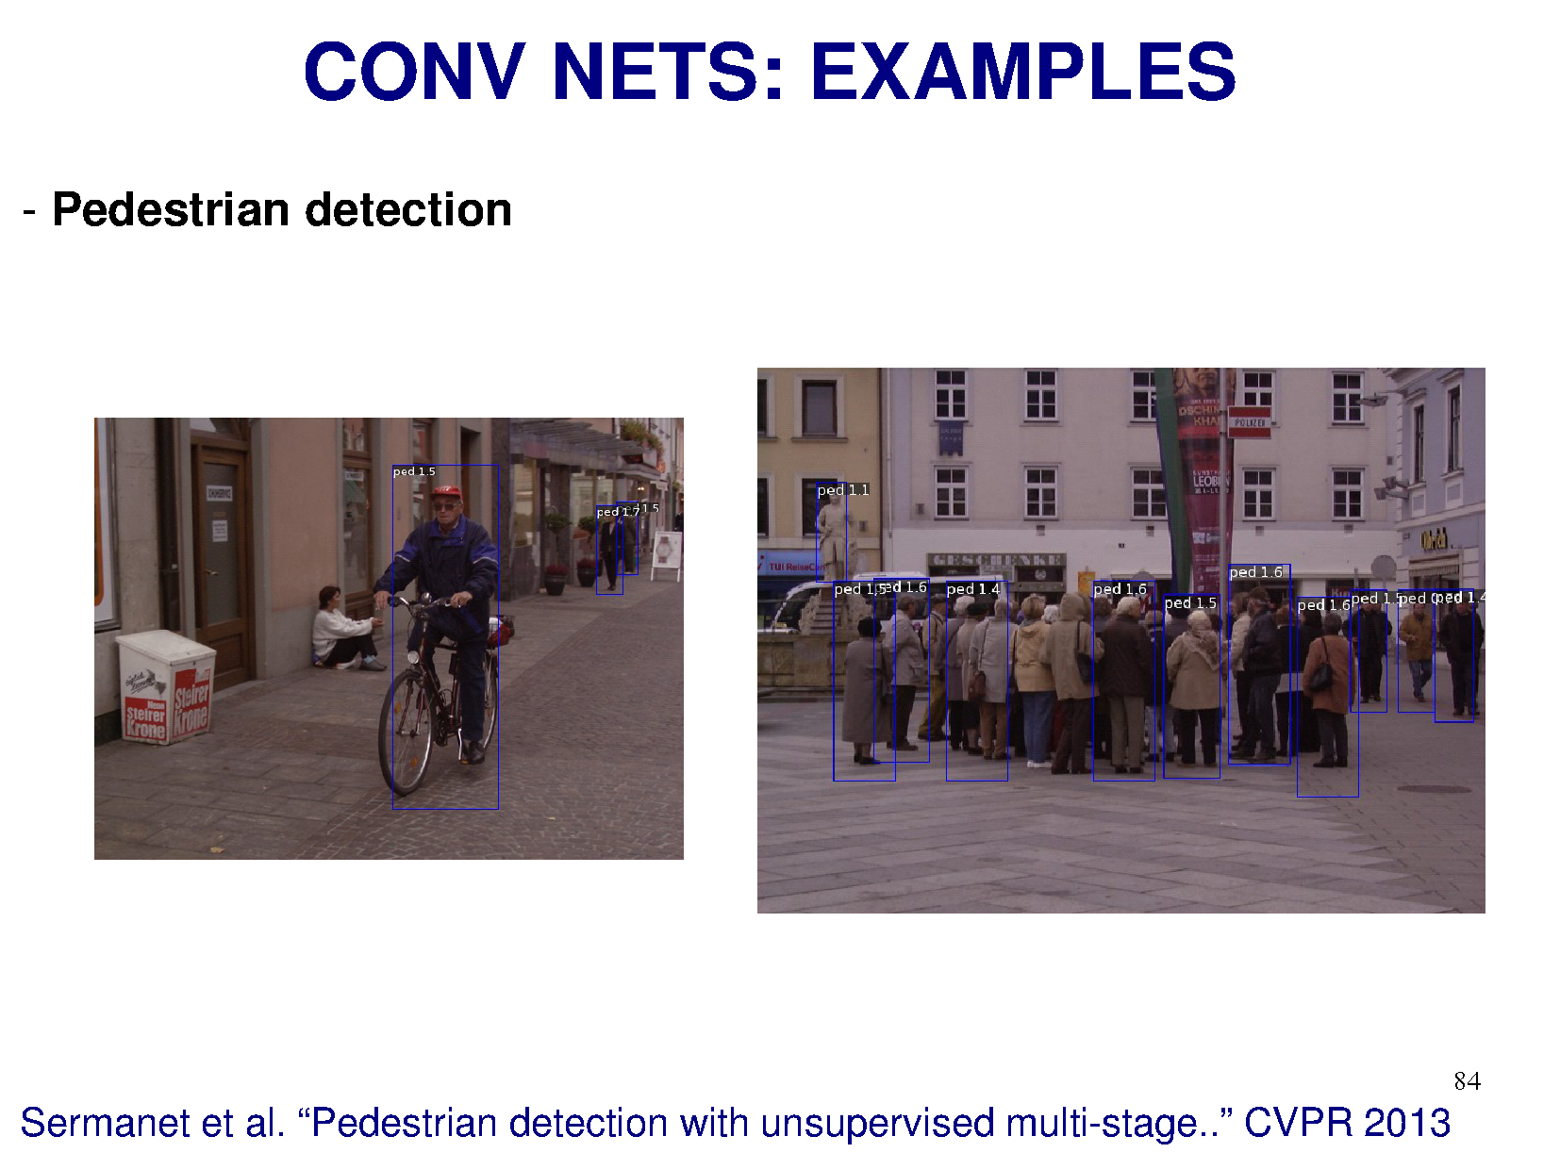

Slide 52
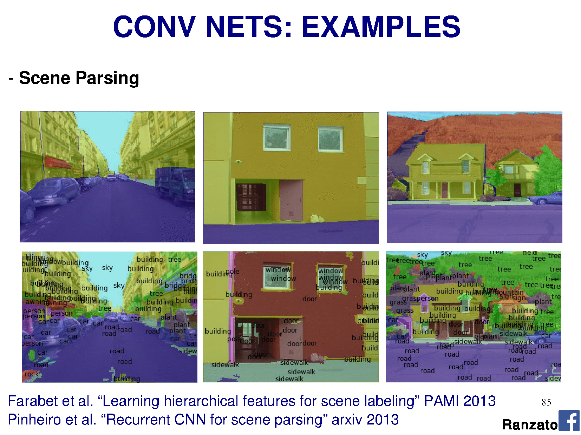

Slide 53
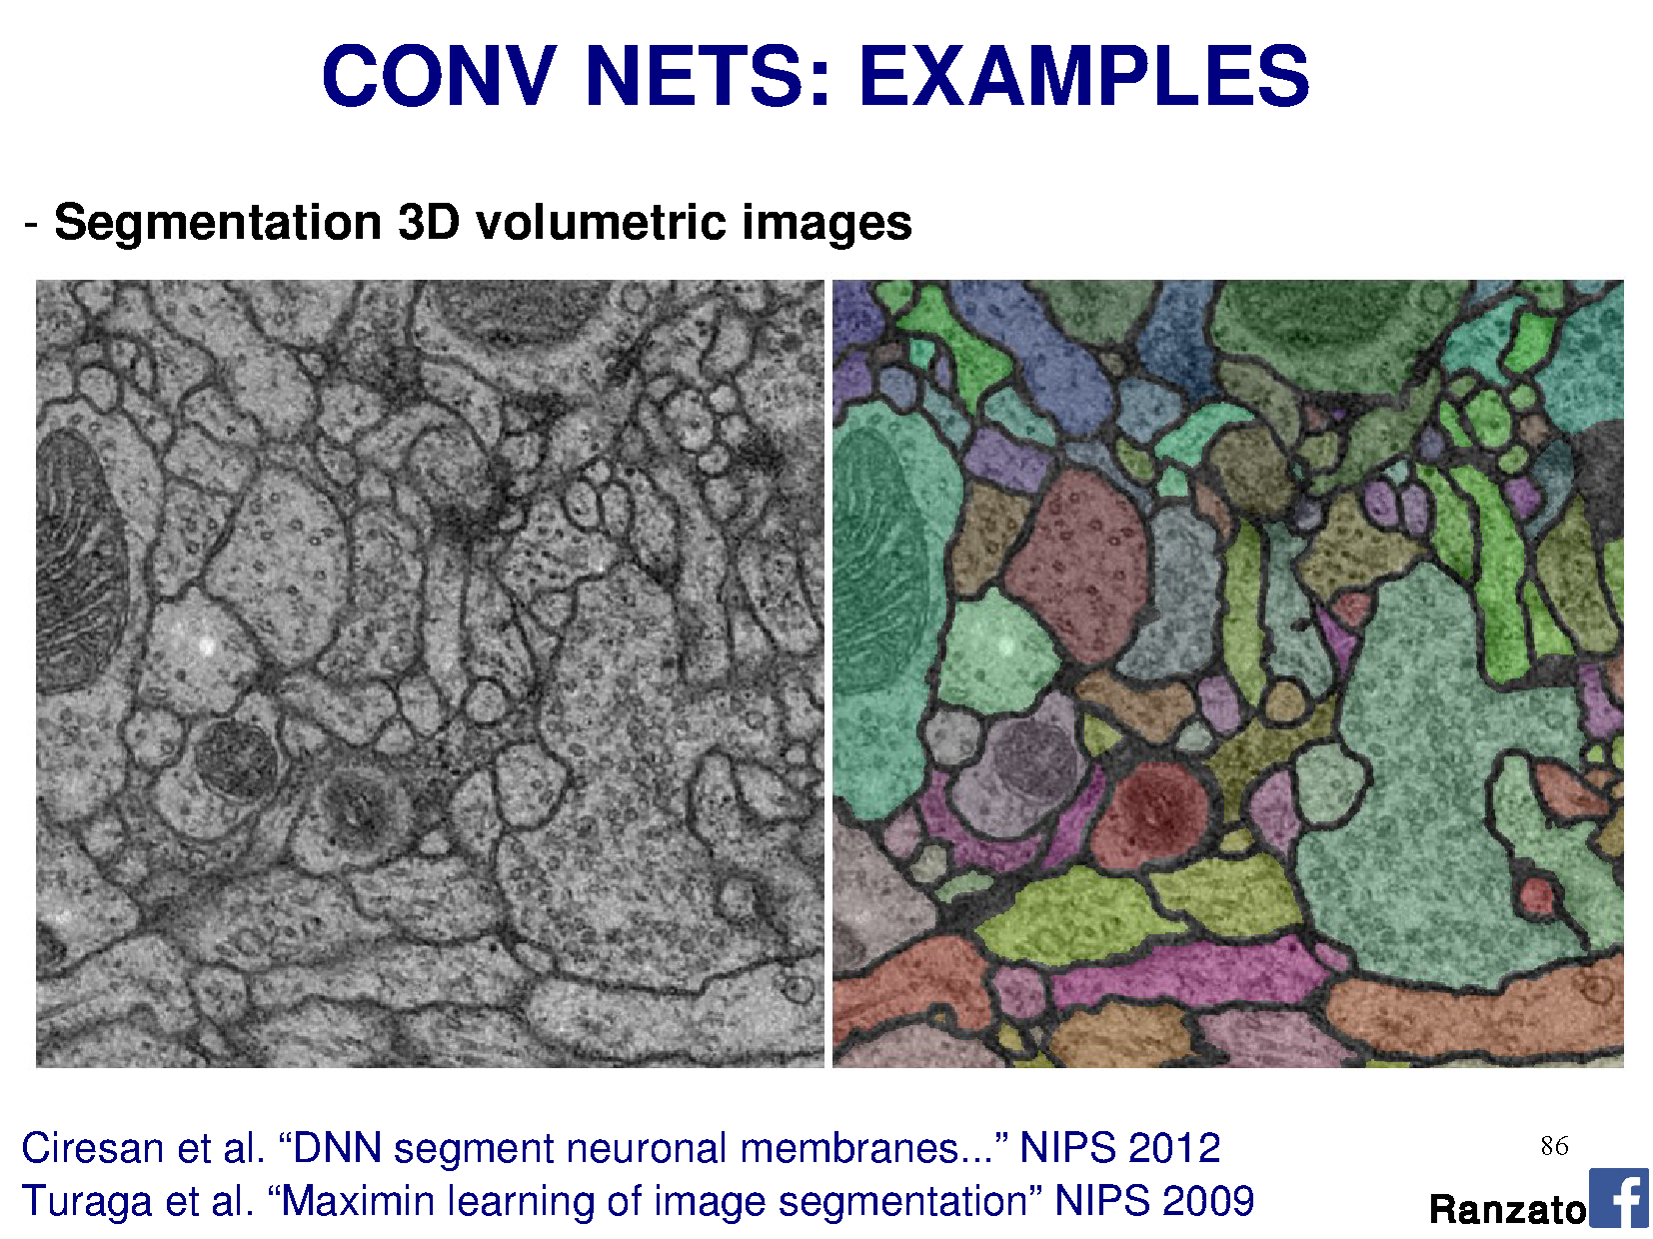

Slide 54
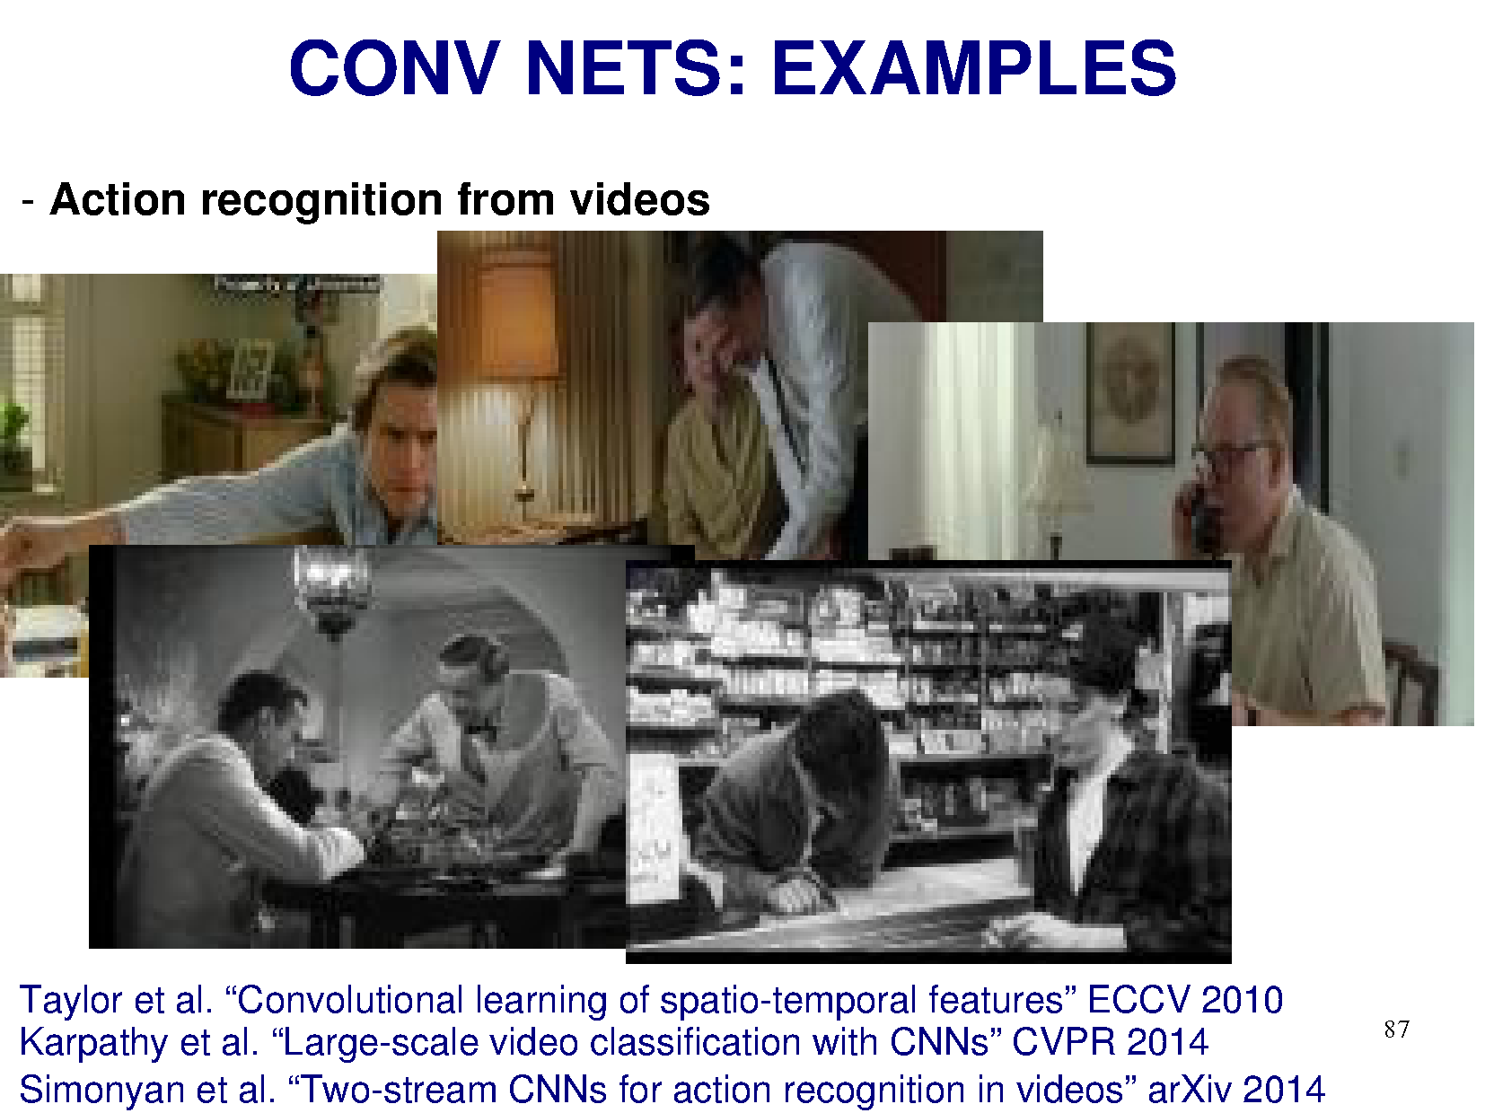

Slide 55


Slide 56


Slide 57


Slide 58


Slide 59


Slide 60


Slide 61


Slide 62


Slide 63

Notes:
This is top 5 error

Slide 64


Slide 65


Slide 66


Slide 67







Object Detectors Emerge in Deep Scene CNNs
Bolei Zhou, Aditya Khosla, Agata Lapedriza, Aude Oliva, Antonio Torralba
Massachusetts Institute of Technology

Slide 68

CNN for Object Recognition
Large-scale image classification result on ImageNet
CNN methods
Figure from Olga Russakovsky ECCV'14 workshop

Slide 69

How Objects are Represented in CNN?
Conv1
Conv2
Conv3
Conv4 Pool5
DrawCNN: visualizing the units' connections

Slide 70




How Objects are Represented in CNN?
Deconvolution
Zeiler, M. et al. Visualizing and Understanding Convolutional Networks,ECCV 2014.
Strong activation image
Girshick, R., Donahue, J., Darrell, T., Malik, J.: Rich feature hierarchies for accu-rate object detection and semantic segmentation. CVPR 2014
Back-propagation
Simonyan, K. et al. Deep inside convolutional networks: Visualising image classification models and saliency maps. ICLR workshop, 2014

Slide 71

Another CNN interpretation method: Simplifying Scenes While Maintaining Classifier Decision

Slide 72

Object Representations in Computer Vision
Part-based models are used to represent objects and visual patterns.
-Object as a set of parts
-Relative locations between parts
Figure from Fischler & Elschlager (1973)

Slide 73




















Object Representations in Computer Vision
Constellation model
Deformable Part model
Weber, Welling & Perona (2000), Fergus, Perona & Zisserman (2003)
P. Felzenszwalb, R. Girshick, D. McAllester, D. Ramanan (2010)
Bag-of-word model
Class-specific graph model
Lazebnik, Schmid & Ponce(2003), Fei-Fei Perona (2005)
Kumar, Torr and Zisserman (2005), Felzenszwalb & Huttenlocher (2005)

Slide 74



Learning to Recognize Objects
brambling
terrier
Possible internal representations:
Object parts
Textures
Attributes

Slide 75
How Objects are Represented in CNN?
CNN uses distributed code to represent objects.
Conv1
Conv2
Conv3
Conv4 Pool5
Agrawal, et al. Analyzing the performance of multilayer neural networks for object recognition. ECCV, 2014 Szegedy, et al. Intriguing properties of neural networks.arXiv preprint arXiv:1312.6199, 2013.
Zeiler, M. et al. Visualizing and Understanding Convolutional Networks, ECCV 2014.

Slide 76




Another recognition task: Scene Recognition
Given an image, predict which place we are in.
Bedroom
Harbor

Slide 77




Learning to Recognize Scenes
bedroom
mountain
Possible internal representations:
Objects (scene parts?)
Scene attributes
Object parts
Textures

Slide 78




CNN for Scene Recognition
Places Database: 7 million images from 400 scene categories
#
scene category
Places-CNN: AlexNet CNN on 2.5 million images from 205 scene categories.
Scene Recognition Demo: 78% top-5 recognition accuracy in the wild
http://places.csail.mit.edu
Zhou, et al. NIPS, 2014.

Slide 79





ImageNet CNN and Places CNN
ImageNet CNN for Object Classification
Same architecture: AlexNet
Places CNN for Scene Classification
Places

Slide 80







Data-Driven Approach to Study CNN
Neuroscientists study brain
d
ImageNet CNN Places CNN
200,000 image stimuli of objects and scene categories (ImageNet TestSet+SUN database)

Slide 81





Estimating the Receptive Fields
Estimated receptive fields
pool1
Actual size of RF is much smaller than the theoretic size
conv3 pool5
Segmentation using the RF of Units
More semantically meaningful

Slide 82

Annotating the Semantics of Units
Top ranked segmented images are cropped and sent to Amazon Turk for annotation.

Slide 83



Annotating the Semantics of Units
Pool5, unit 76; Label: ocean; Type: scene; Precision: 93%

Slide 84


Annotating the Semantics of Units
Pool5, unit 13; Label: Lamps; Type: object; Precision: 84%

Slide 85



Annotating the Semantics of Units
Pool5, unit 77; Label:legs; Type: object part; Precision: 96%

Slide 86



Annotating the Semantics of Units
Pool5, unit 112; Label: pool table; Type: object; Precision: 70%

Slide 87

Annotating the Semantics of Units
Pool5, unit 22; Label: dinner table; Type: scene; Precision: 60%

Slide 88













Distribution of Semantic Types at Each Layer
1
Object detectors emerge within CNN trained to classify scenes, without any object supervision!

Slide 89






Histogram of Emerged Objects in Pool5
ImageNet-CNN (59/256)

Slide 90






Histogram of Emerged Objects in Pool5
Places-CNN (151/256)

Slide 92


Evaluation on SUN Database
Evaluate the performance of the emerged object detectors

Slide 93



Evaluation on SUN Database
Correlation:0.53
Correlation:0.84

Slide 94
Conclusion
We show that object detectors emerge inside a CNN trained to classify scenes, without any object supervision.
Places database, Places CNN, and unit annotations could be downloaded at
http://places.csail.mit.edu

