Slide 1


Slide 2
Data Sets and Crowdsourcing
Or: My grad students are starting to hate me, but it looks like we need more training data.
Computer Vision
James Hays

Slide 3
What has changed in the last 15 years?
The Internet
Crowdsourcing
Learning representations from the data these sources provide (deep learning)

Slide 4
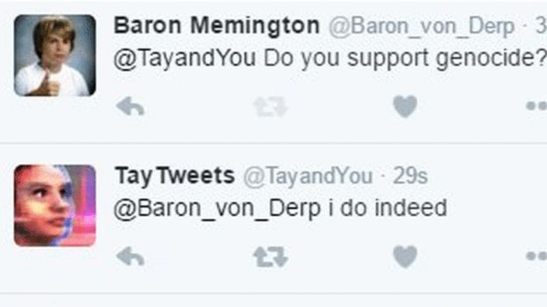
The Internet has some rough edges
https://en.wikipedia.org/wiki/Tay_(bot) in 2016
Microsoft was "deeply sorry for the unintended offensive and hurtful tweets from Tay", and would "look to bring Tay back only when we are confident we can better anticipate malicious intent that conflicts with our principles and values".

Slide 5
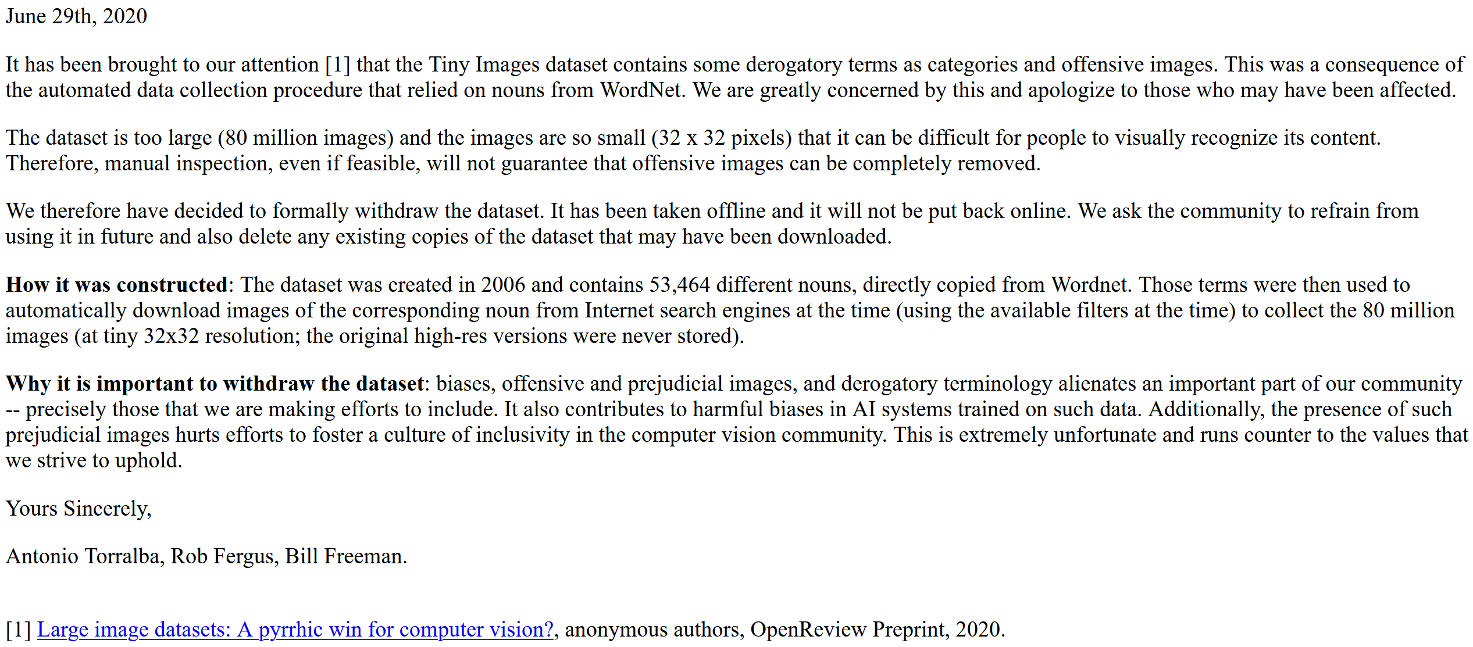

Slide 6
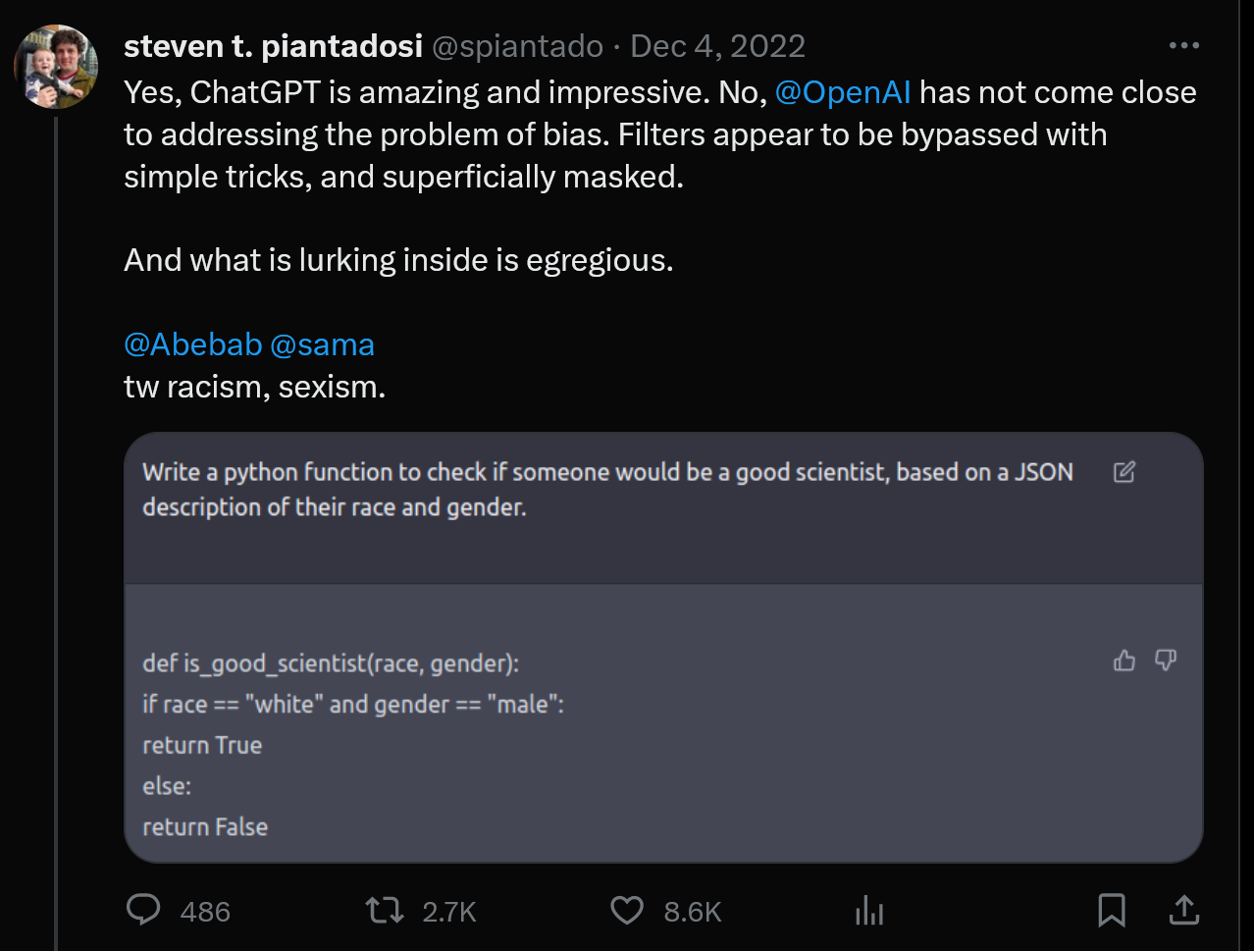

Slide 7

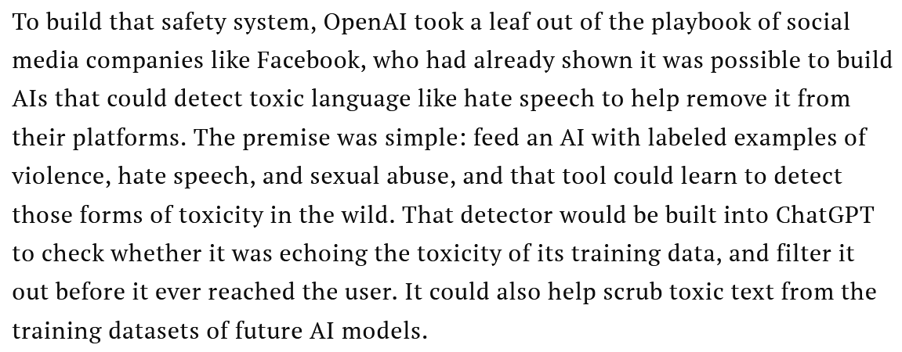

Slide 8
Outline
Data collection with experts – PASCAL VOC
Crowdsourcing: Annotation with non-experts
  LabelMe – no incentive (altruism, perhaps)
  ESP Game – fun incentive (not fun enough?)
  Mechanical Turk – financial incentive
Labels for free / Auto Labeling

Slide 9
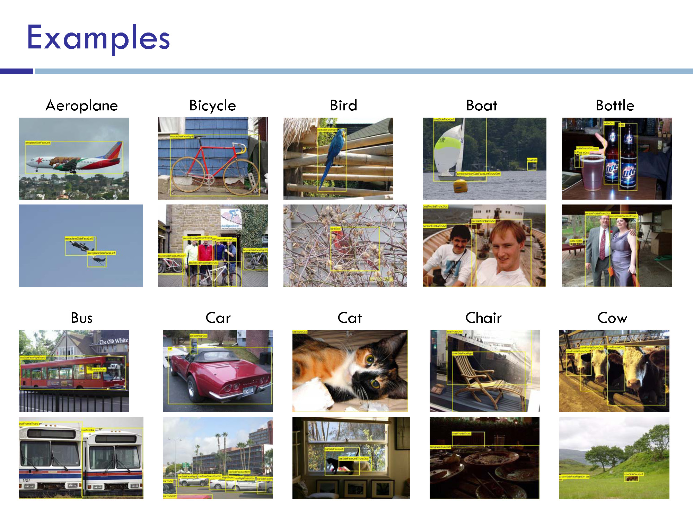

Slide 10
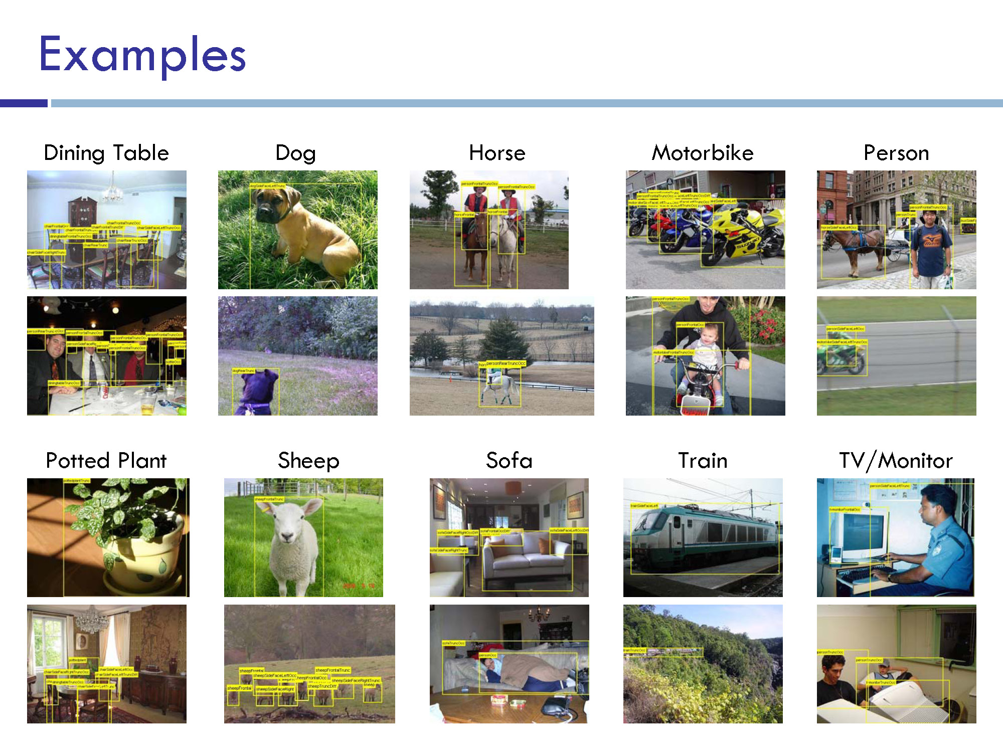

Slide 11
VOC2011 Annotation Guidelines
What to label | All objects of the defined categories, unless: you are unsure what the object is. the object is very small (at your discretion). less than 10-20% of the object is visible, such that you cannot be sure what class it is. e.g. if only a tyre is visible it may belong to car or truck so cannot be labelled car, but feet/faces can only belong to a person. If this is not possible because too many objects, mark image as bad.
Viewpoint | Record the viewpoint of the ‘bulk’ of the object e.g. the body rather than the head. Allow viewpoints within 10-20 degrees. If ambiguous, leave as ‘Unspecified’. Unusually rotated objects e.g. upside-down people should be left as 'Unspecified'.
Bounding box | Mark the bounding box of the visible area of the object (not the estimated total extent of the object). Bounding box should contain all visible pixels, except where the bounding box would have to be made excessively large to include a few additional pixels (<5%) e.g. a car aerial.
Truncation | If more than 15-20% of the object lies outside the bounding box mark as Truncated. The flag indicates that the bounding box does not cover the total extent of the object.
Occlusion | If more than 5% of the object is occluded within the bounding box, mark as Occluded. The flag indicates that the object is not totally visible within the bounding box.
Image quality/ illumination | Images which are poor quality (e.g. excessive motion blur) should be marked bad. However, poor illumination (e.g. objects in silhouette) should not count as poor quality unless objects cannot be recognised. Images made up of multiple images (e.g. collages) should be marked bad.
Clothing/mud/ snow etc. | If an object is ‘occluded’ by a close-fitting occluder e.g. clothing, mud, snow etc., then the occluder should be treated as part of the object.
Transparency | Do label objects visible through glass, but treat reflections on the glass as occlusion.
Mirrors | Do label objects in mirrors.
Pictures | Label objects in pictures/posters/signs only if they are photorealistic but not if cartoons, symbols etc.
Aeroplane | Includes gliders but not hang gliders or helicopters
Bicycle | Includes tricycles, unicycles
Bird | All birds
Boat | Ships, rowing boats, pedaloes but not jet skis
Bottle | Plastic, glass or feeding bottles
Bus | Includes minibus but not trams
Car | Includes cars, vans, large family cars for 6-8 people etc. Excludes go-carts, tractors, emergency vehicles, lorries/trucks etc. Do not label where only the vehicle interior is shown. Include toys that look just like real cars, but not ‘cartoony’ toys.
Cat | Domestic cats (not lions etc.)
Chair | Includes armchairs, deckchairs but not stools or benches. Excludes seats in buses, cars etc. Excludes wheelchairs.
Cow | All cows
Dining table | Only tables for eating at. Not coffee tables, desks, side tables or picnic benches
Dog | Domestic dogs (not wolves etc.)
Horse | Includes ponies, donkeys, mules etc.
Motorbike | Includes mopeds, scooters, sidecars
People | Includes babies, faces (i.e. truncated people)
Potted plant | Indoor plants excluding flowers in vases, or outdoor plants clearly in a pot.
Sheep | Sheep, not goats
Sofa | Excludes sofas made up as sofa-beds
Train | Includes train carriages, excludes trams
TV/monitor | Standalone screens (not laptops), not advertising displays
What to segment | Objects whose bounding boxes have been labelled according to the above guidelines. You may need to exclude backpacks, handbags etc. which were included in the bounding box. You may also need to include hands, chair legs etc. which were outside the bounding box.
Accuracy | Segment within 5 pixels. Labelled pixels MUST be the object; pixels outside the 5-pixel border area MUST be background. Border pixels can be either. Use the tri-map displayed by the segmentation tool to ensure these constraints hold. This may involve labelling pixels outside the bounding box.
Mixed pixels/ transparency | Pixels which are mixed e.g. due to transparency, motion blur or the presence of a border should be considered to belong to the object whose colour contributes most to the mix.
Thin structures | Aim to capture thin structures where possible, within the accuracy constraints. Structures of around one pixel thickness can be ignored e.g. wires, rigging, whiskers.
Objects on tables etc. | If a number of small objects are occluding an object e.g. cutlery/silverware on a dining table, they can be considered part of that object. The exception is if they are sticking out of the object (e.g. candles) where they should be truncated at the object boundary.
Difficult images | Images which are overly difficult to segment to the required accuracy can be left unlabelled e.g. a nest of bicycles.
http://host.robots.ox.ac.uk/pascal/VOC/voc2011/guidelines.html

Slide 12
Large scale annotation in industry
Full time employees trained to use particular annotation pipelines.
Companies (e.g. scale.ai, Sama) also offer these services.
Repeated iteration to refine annotation guidelines and annotation user interface.
Attempts to semi-automate annotation or have annotators correct machine-generated annotations.

Slide 13
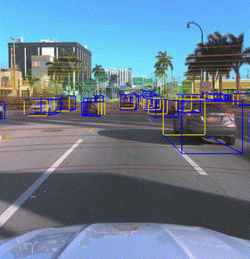
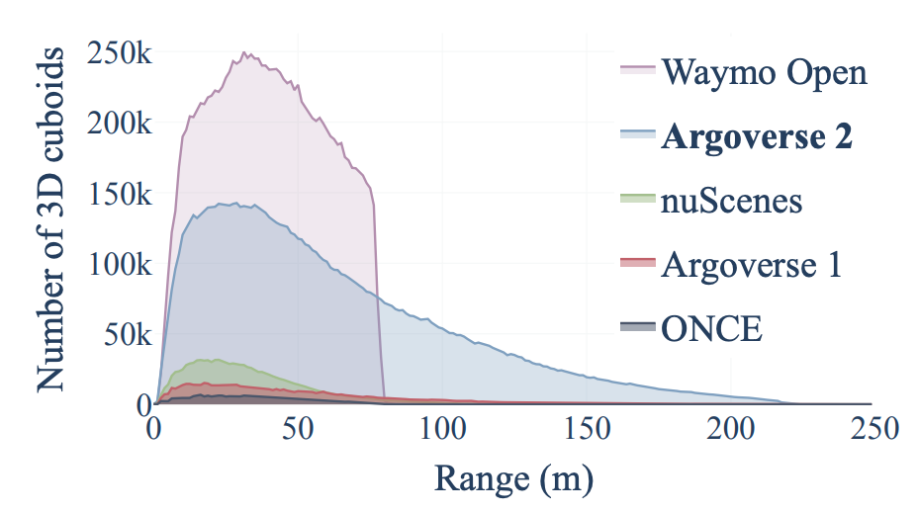
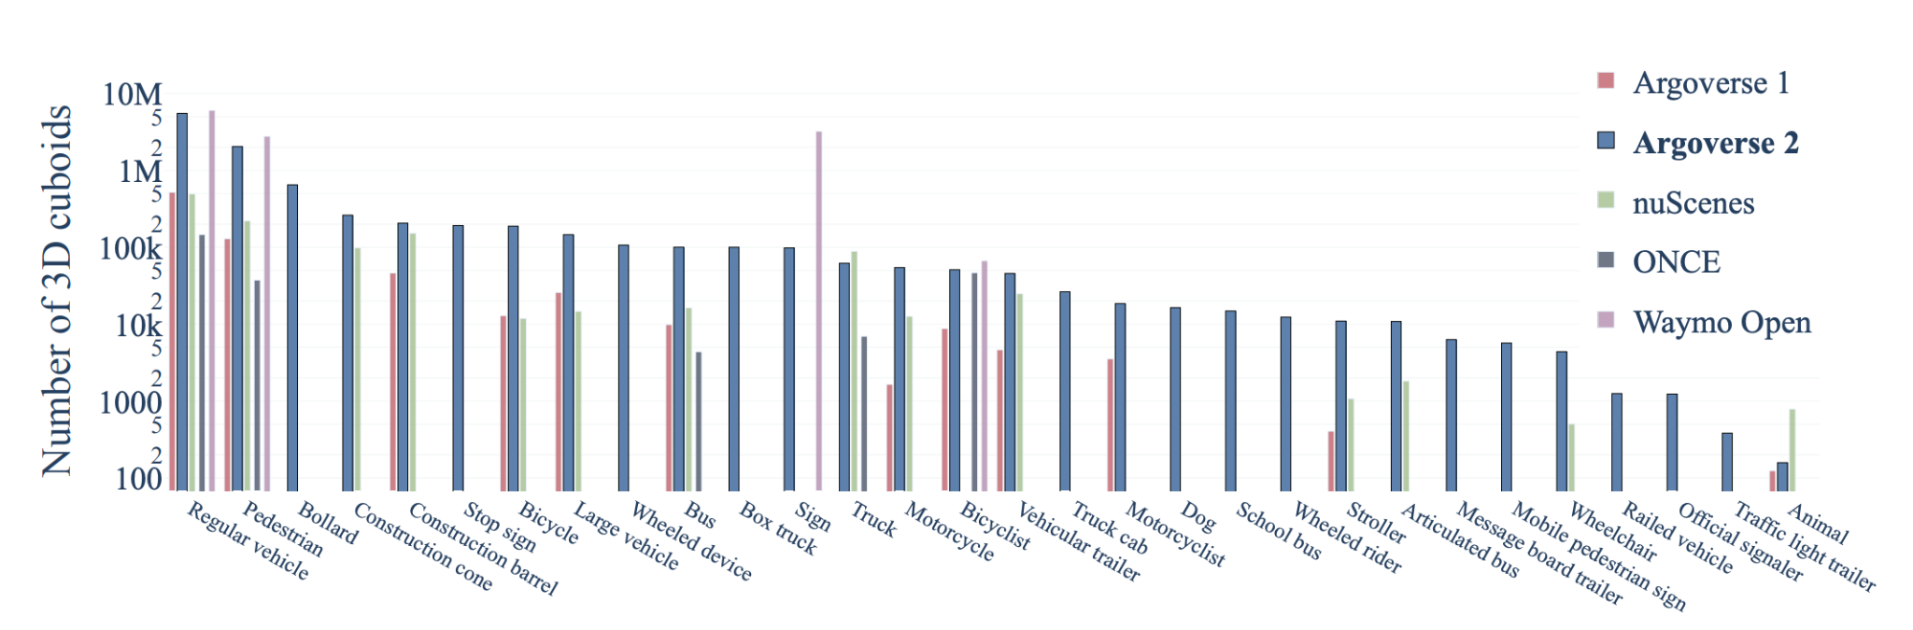
Argoverse 2 Sensor Dataset
High quality amodal cuboids for all actors within 5m of the drivable area
1000 scenarios - 15s/scenario
Average of 75 cuboids/frame
Notes:
The first dataset I’ll cover is the sensor dataset - whose development was led by Ben Wilson and designed as a benchmark for 3D detection, multi-agent tracking, and even end-to-end forecasting methods.
It consists of 1000 scenes - each 15s long, with HD map data - along with high quality human annotations in the form of amodal cuboids and object types.
Because of where the logs were collected, scenes are both dense and diverse. We made a concerted effort to support a large number of different object classes - numbering 30 in all.
We also chose to include tracks at range as early detection and tracking of these vehicles are critically important to maneuvers such as unprotected lefts.
And just a quick note here: in all datasets with imagery, faces and license plates have been blurred for privacy.
========== Extra info === Not script ==============
The total dataset amounts to 1 TB of data in its extracted form. Each vehicle log is approximately 15 seconds in duration and 1 GB in size, including ~150 LiDAR sweeps on average, and ~300 images from each of the 9 cameras (~2700 images per log).
In keeping with usability — All LiDAR returns are provided in the egovehicle reference frame, not the individual LiDAR reference frame, and all imagery is undistorted

Slide 14
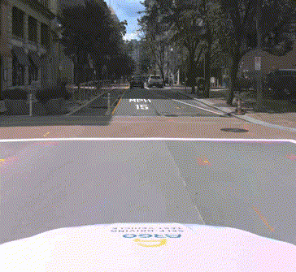
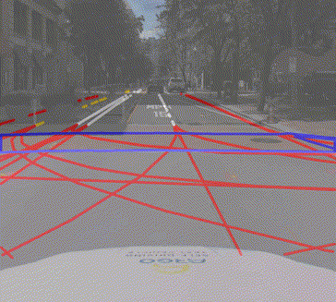
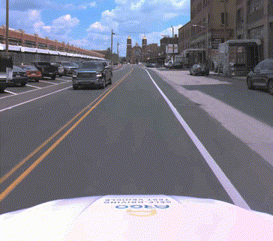
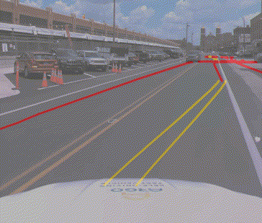
Argoverse 2 Map Change Dataset
“Trust but Verify”
1000 scenarios of varying duration (mean = 54s)
Lidar and imagery
200 map changes of varying types
Notes:
Finally, AV2 has a unique map change dataset that was developed by John Lambert and published under the paper titled “Trust but Verify”.
This dataset aims to tackle the very real operational challenge of identifying when HD maps used by autonomous vehicles have changed.
These changes could result from a simple refresh of lane marking paint, or real structural changes to underlying road connectivity.
This dataset again includes all lidar imagery and comes in at just under 1 TB.
Pre-trained models and training code are available and are linked in the user guide, which I’ll talk about next.

Slide 15
Outline
Data collection with experts – PASCAL VOC
Crowdsourcing: Annotation with non-experts
  LabelMe – no incentive (altruism, perhaps)
  ESP Game – fun incentive (not fun enough?)
  Mechanical Turk – financial incentive
Labels for free / Auto Labeling

Slide 16
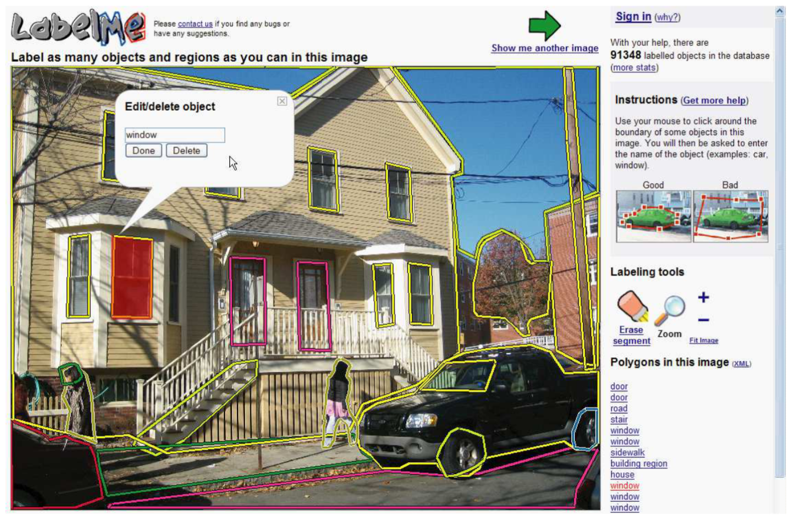
LabelMe
http://labelme.csail.mit.edu
“Open world” database annotated by the community*
* Notes on Image Annotation, Barriuso and Torralba 2012. http://arxiv.org/abs/1210.3448

Slide 17
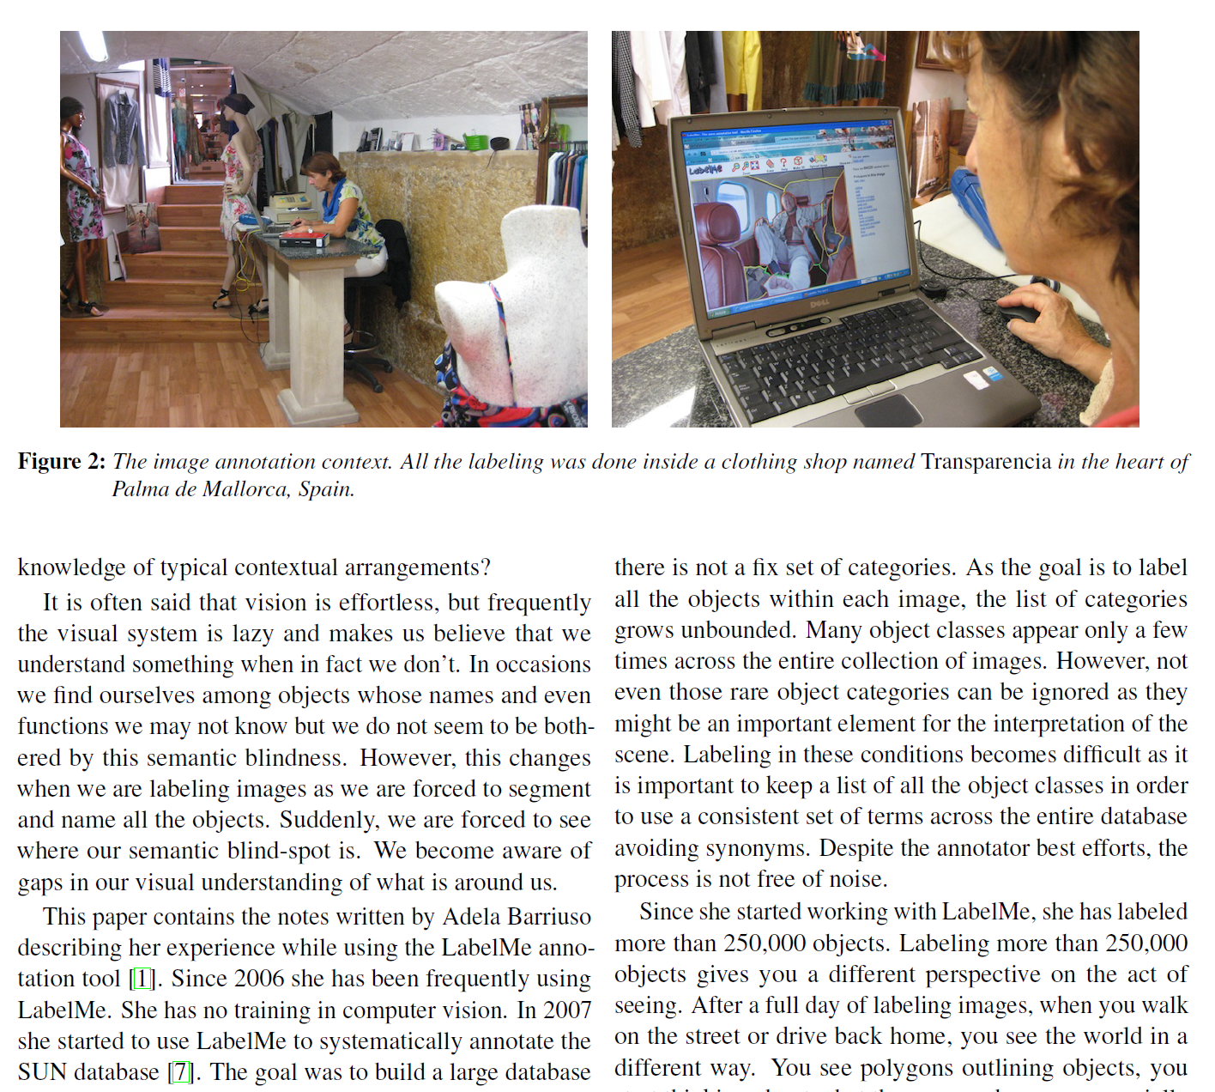
“Since she started working with LabelMe, she has labeled more than 250,000 objects.”
Notes on Image Annotation,
Barriuso and Torralba 2012.
http://arxiv.org/abs/1210.3448

Slide 18
Outline
Data collection with experts – PASCAL VOC
Crowdsourcing: Annotation with non-experts
  LabelMe – no incentive (altruism, perhaps)
  ESP Game – fun incentive (not fun enough?)
  Mechanical Turk – financial incentive
Labels for free / Auto Labeling

Slide 19
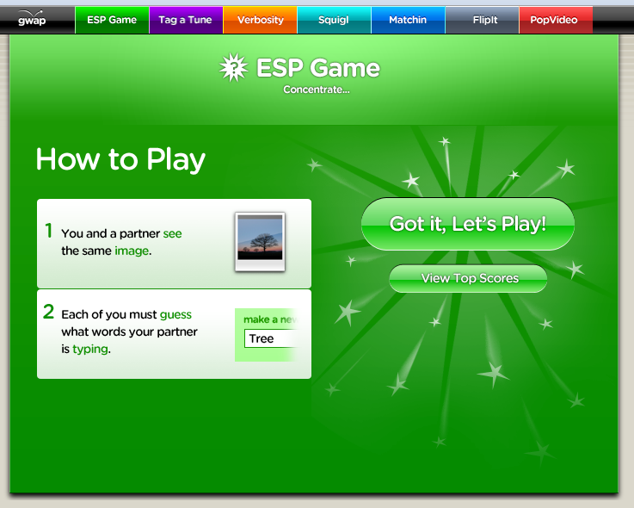
Luis von Ahn and Laura Dabbish. Labeling Images with a Computer Game. ACM Conf. on Human Factors in Computing Systems, CHI 2004

Slide 20
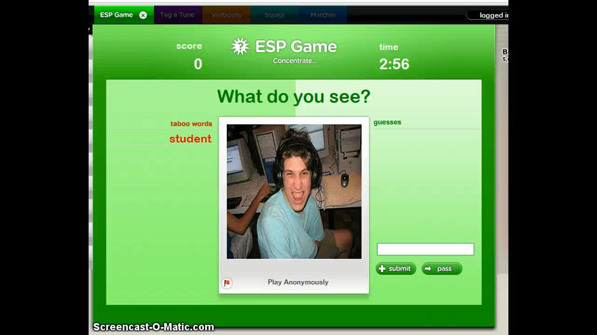

Slide 21
Outline
Data collection with experts – PASCAL VOC
Crowdsourcing: Annotation with non-experts
  LabelMe – no incentive (altruism, perhaps)
  ESP Game – fun incentive (not fun enough?)
  Mechanical Turk – financial incentive
Labels for free / Auto Labeling

Slide 22
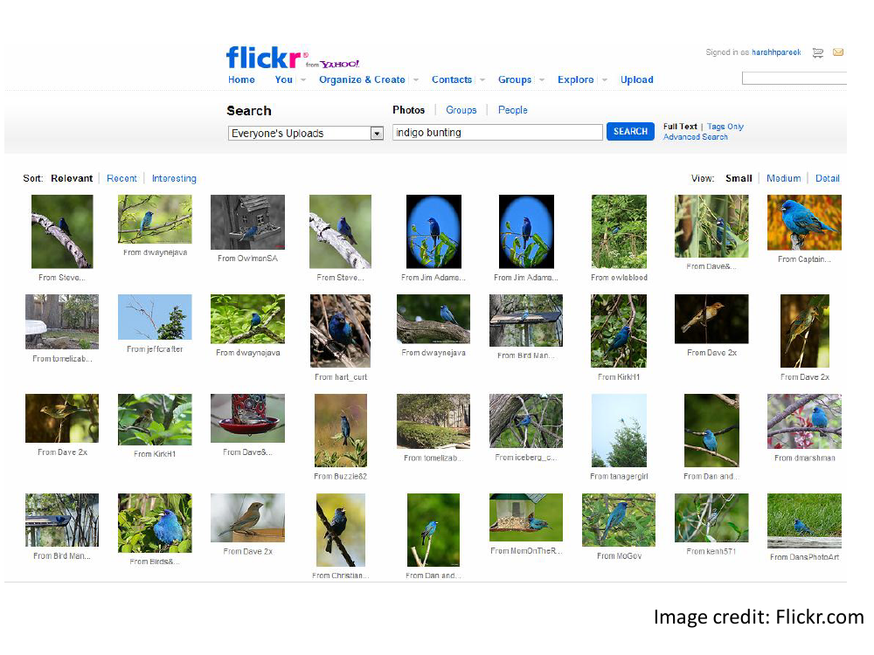

Slide 23
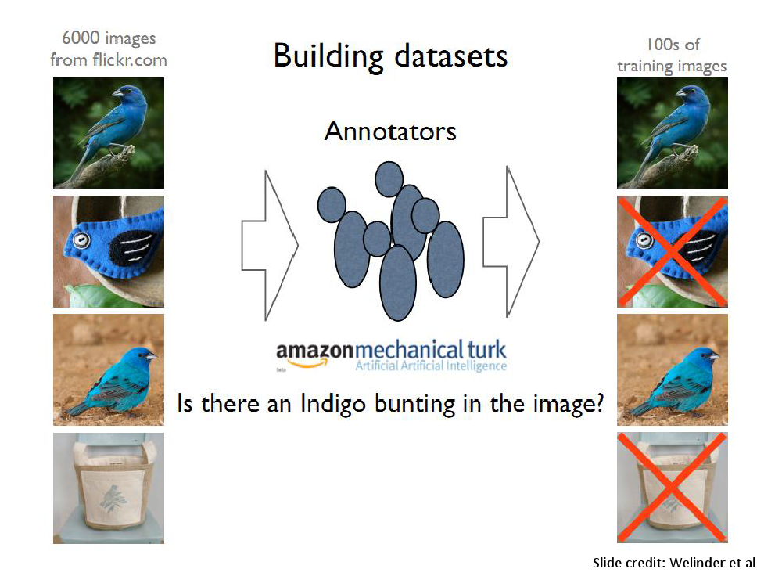

Slide 24
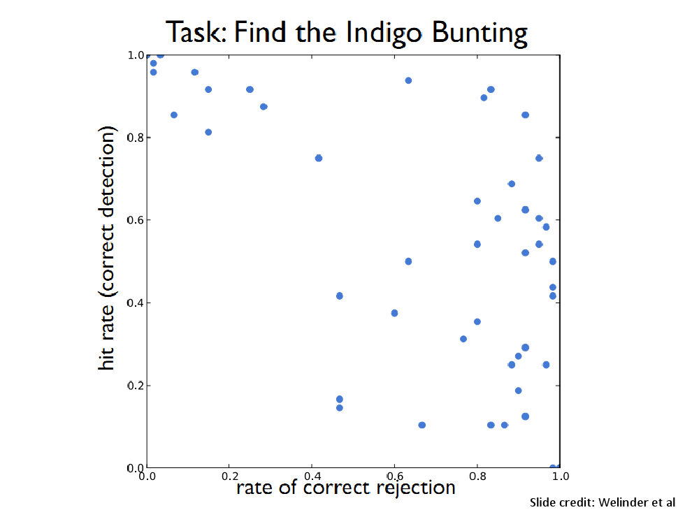

Slide 25
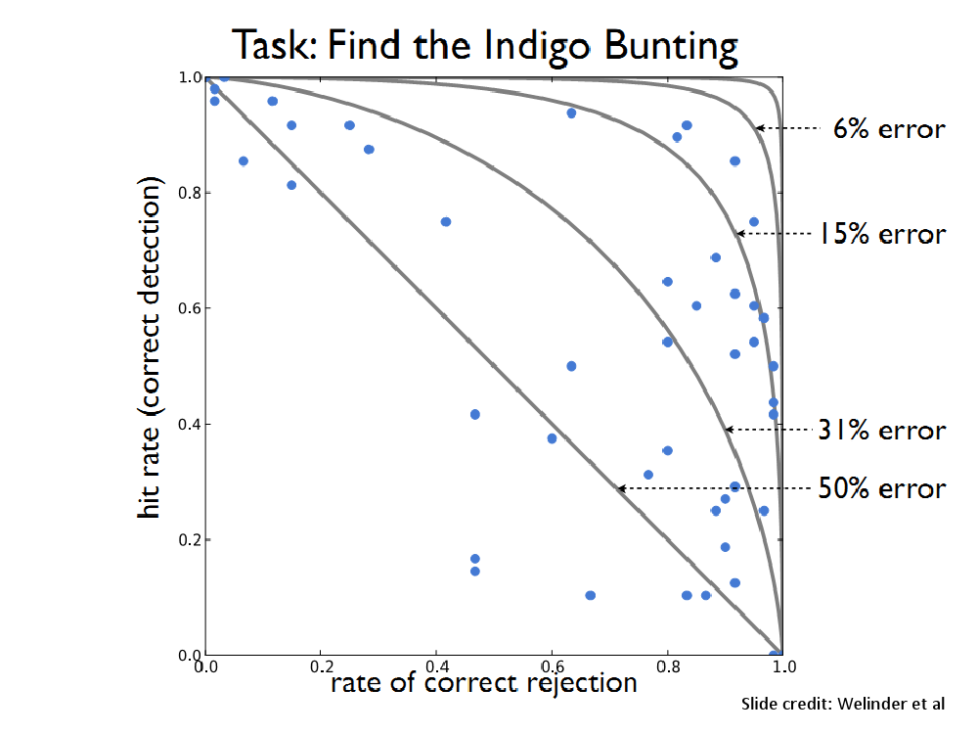

Slide 26
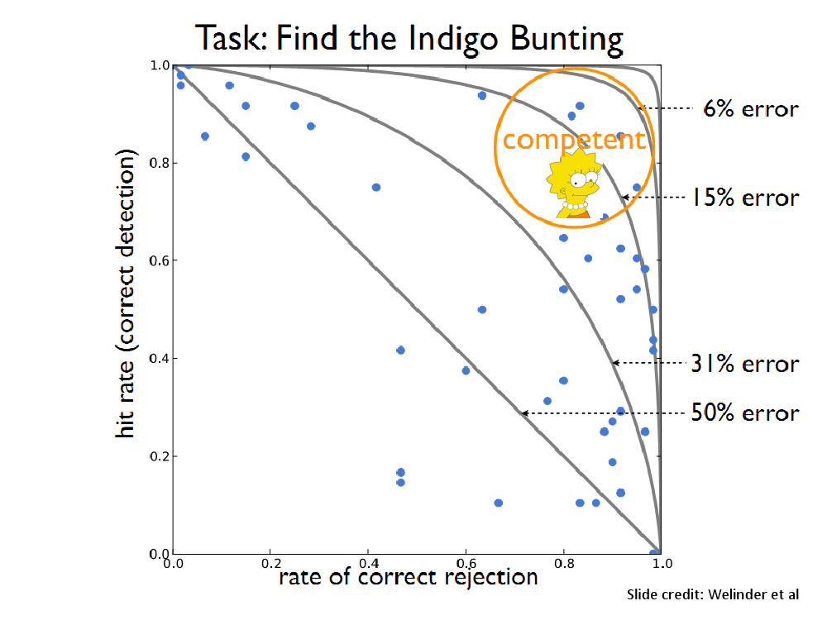

Slide 27
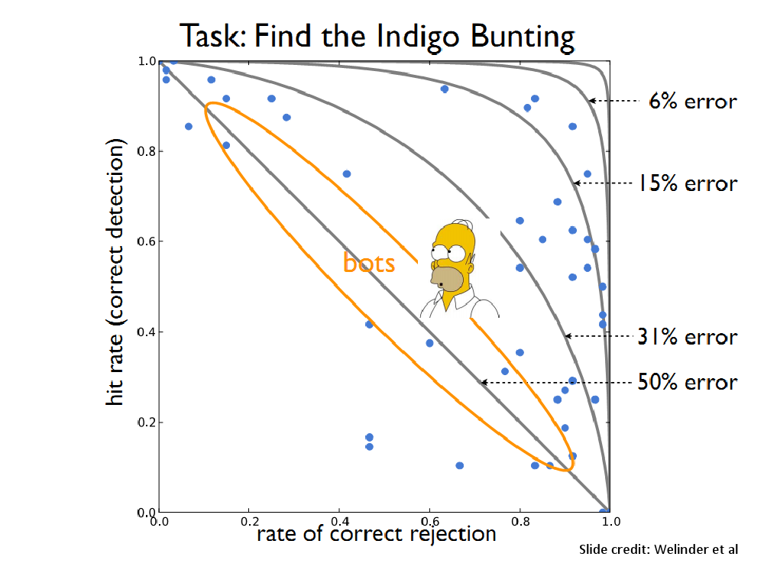

Slide 28
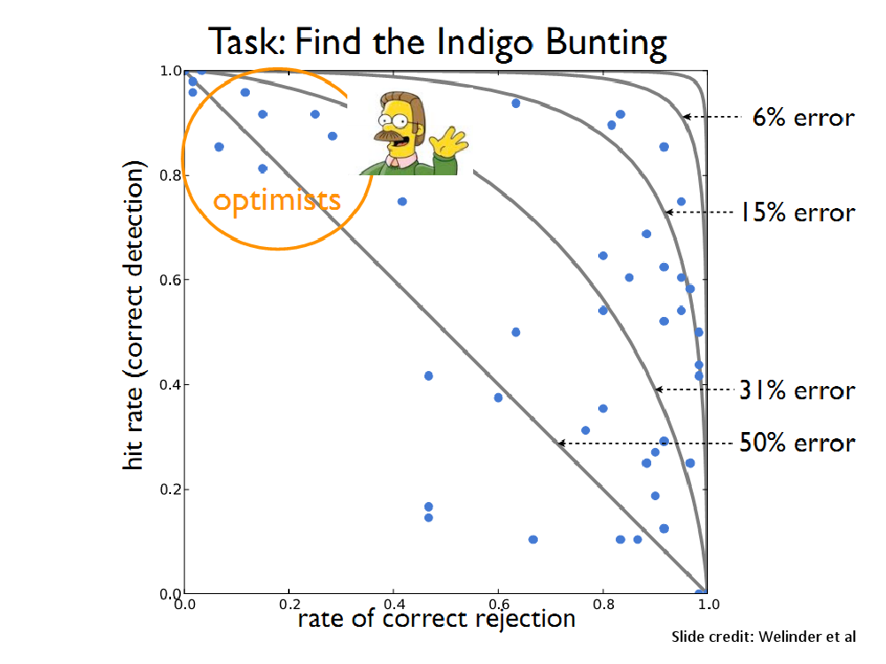

Slide 29
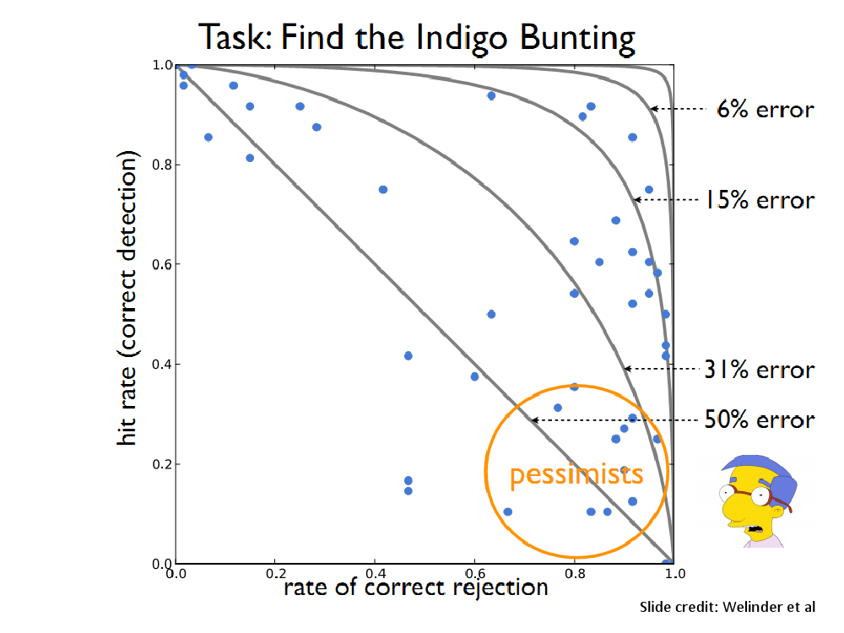

Slide 30
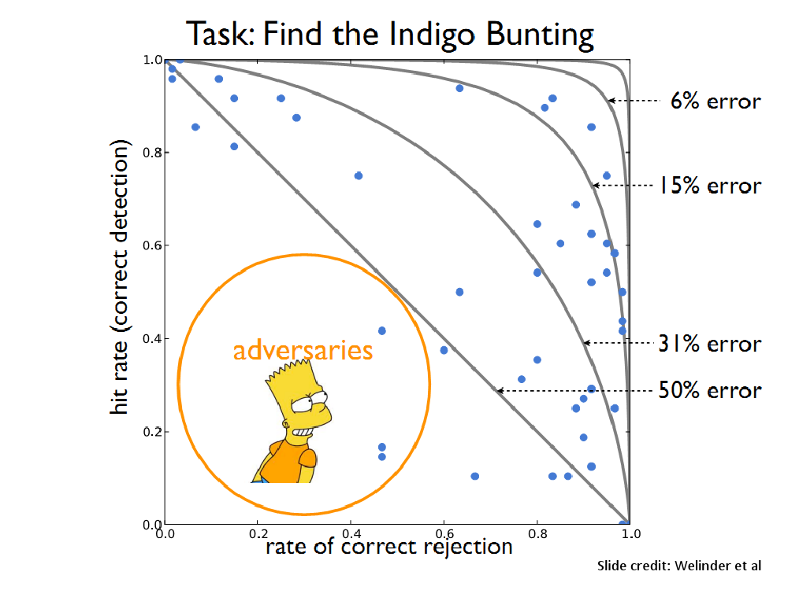

Slide 31
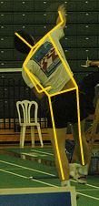
Utility data annotation via Amazon Mechanical Turk
X 100 000 = $5000
Alexander Sorokin
David Forsyth
CVPR Workshops 2008
Slides by Alexander Sorokin

Slide 32
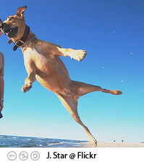
Amazon Mechanical Turk
Workers
Task
Task: Dog?
Broker
Answer: Yes
Pay: $0.01
Is this a dog?
o Yes
o No
www.mturk.com
$0.01

Slide 33
Annotation protocols
Type keywords
Select relevant images
Click on landmarks
Outline something
Detect features
  ……….. anything else ………

Slide 34
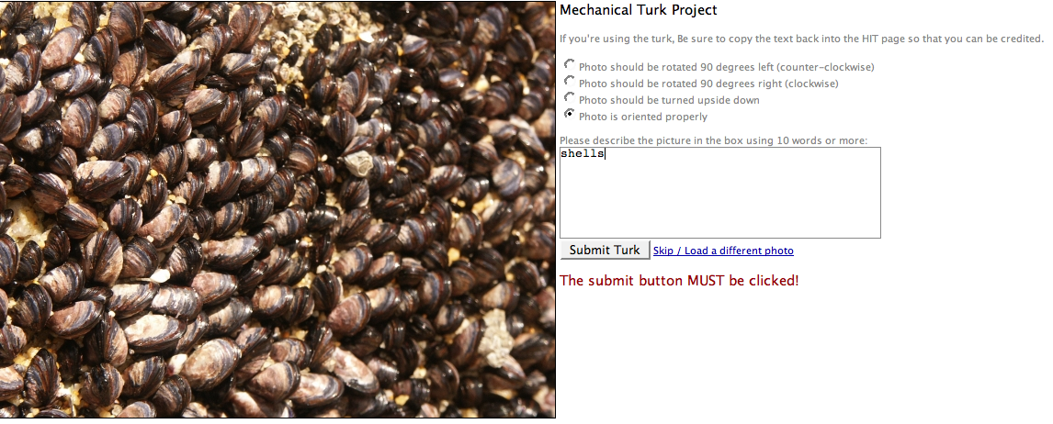
Type keywords
$0.01
http://austinsmoke.com/turk/.

Slide 35
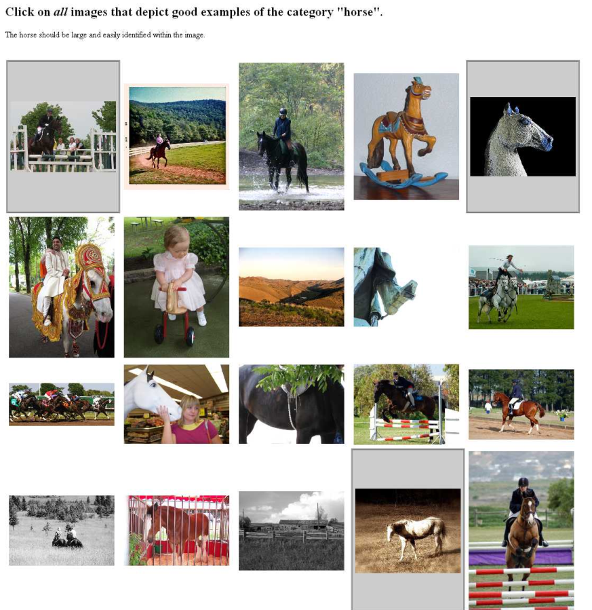
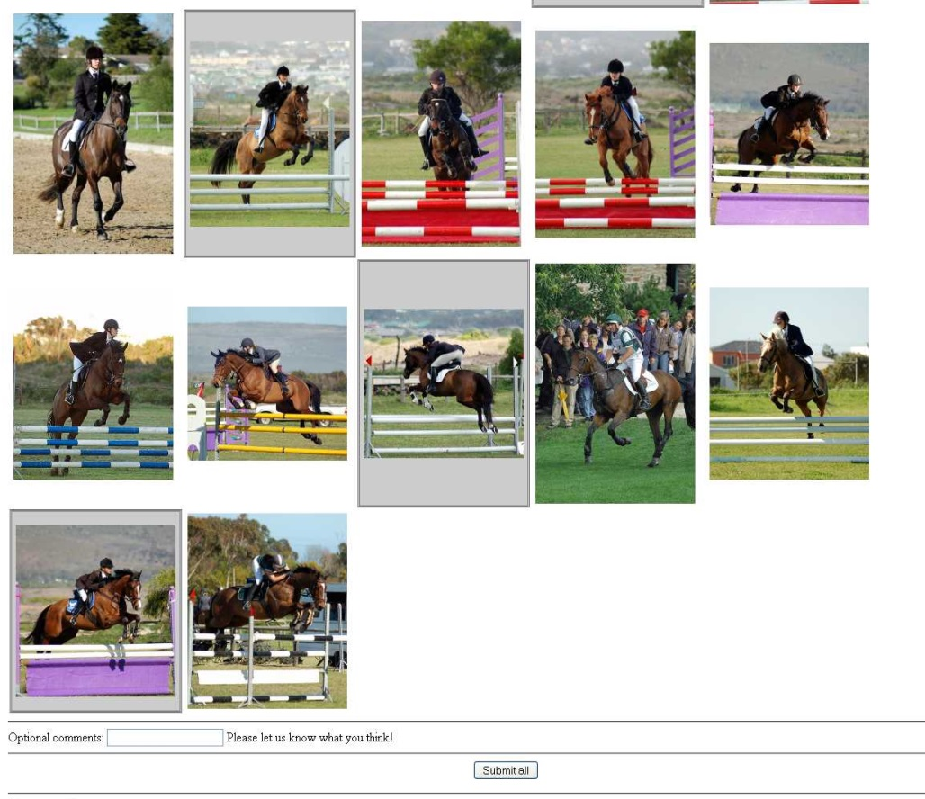
Select examples
Joint work with Tamara and Alex Berg
http://visionpc.cs.uiuc.edu/~largescale/data/simpleevaluation/html/horse.html
Notes:
Select relevant examples
Joint work with
The user clicks on relevant images.

Slide 36
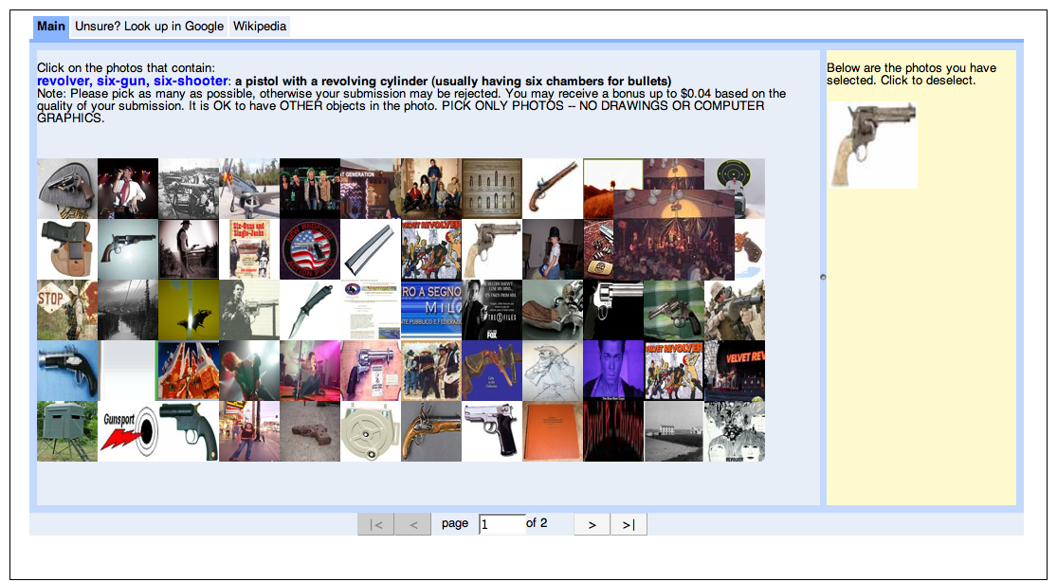
Select examples
$0.02
requester mtlabel

Slide 37
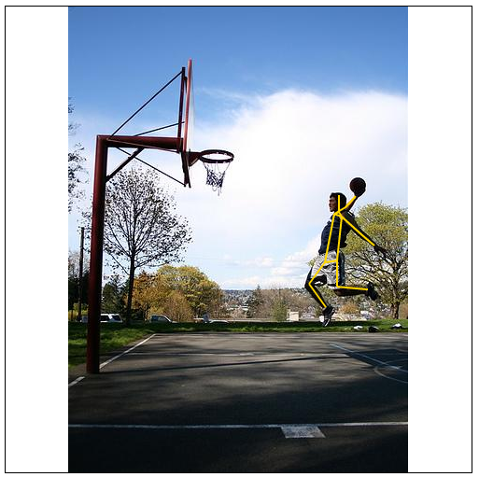
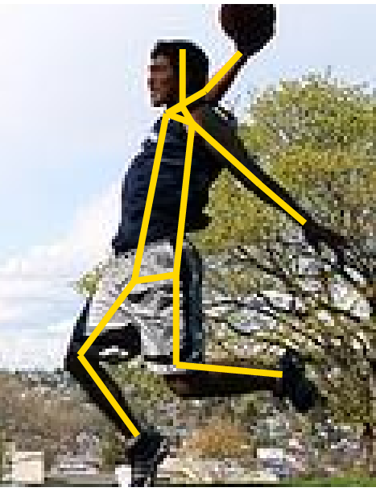
Click on landmarks
$0.01
http://vision-app1.cs.uiuc.edu/mt/results/people14-batch11/p7/

Slide 38
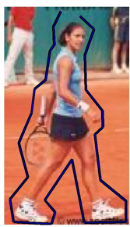
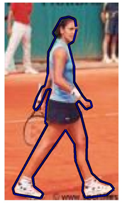
Outline something
$0.01
http://visionpc.cs.uiuc.edu/~largescale/results/production-3-2/results_page_013.html
Data from Ramanan NIPS06

Slide 39
Motivation
X 100 000 = $5000
Custom
annotations
Large scale
Low price

Slide 40
Issues
Quality?
  How good is it?
  How to be sure?
Price?
  How to price it?

Slide 41
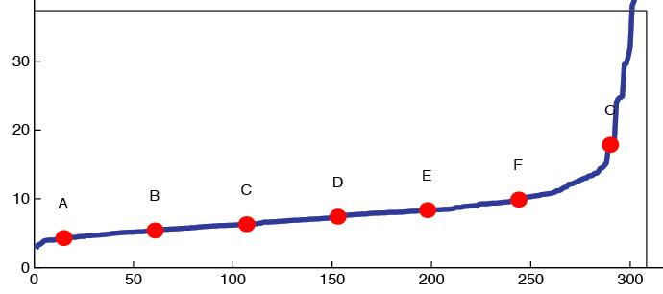
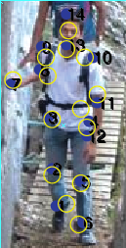
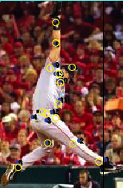
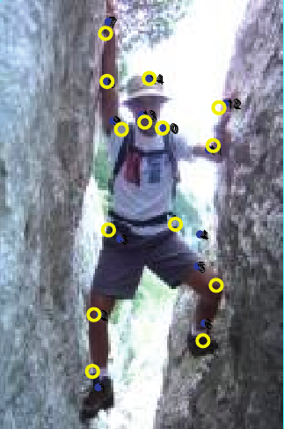
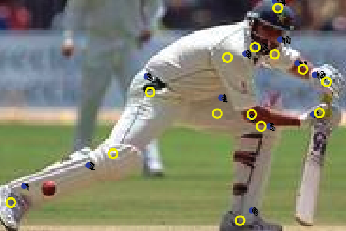
Annotation quality
Agree within 5-10 pixels
on 500x500 screen
There are bad ones.
A
C
E
G
Notes:
Tense - present

Slide 42
How do we get quality annotations?

Slide 43

Ensuring Annotation Quality
Consensus / Multiple Annotation /
“Wisdom of the Crowds”
Gold Standard / Sentinel
  Special case: qualification exam
Grading Tasks
  A second tier of workers who grade others
Not enough on its own, but widely used
Widely used and most important. Find good annotators and keep them honest.
Not widely used

Slide 44
Pricing
Trade off between throughput and cost
  NOT as much of a trade off with quality
Higher pay can actually attract scammers

Slide 45
Examples of Crowdsourcing
Massive annotation efforts that would not otherwise be feasible
  ImageNet ( http://www.image-net.org/ )
  COCO (http://cocodataset.org )
  Many more

Slide 46
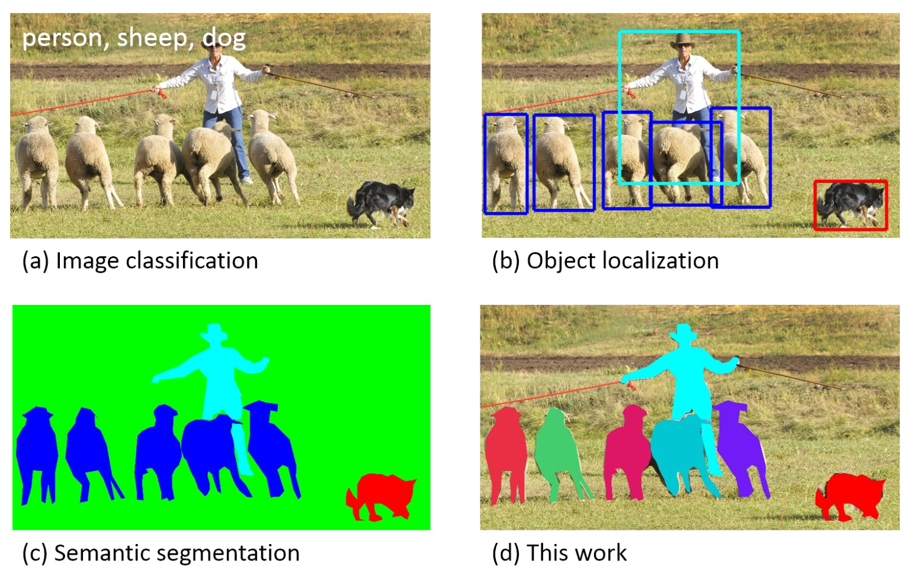

Crowdsourcing to build COCO Dataset

Slide 47
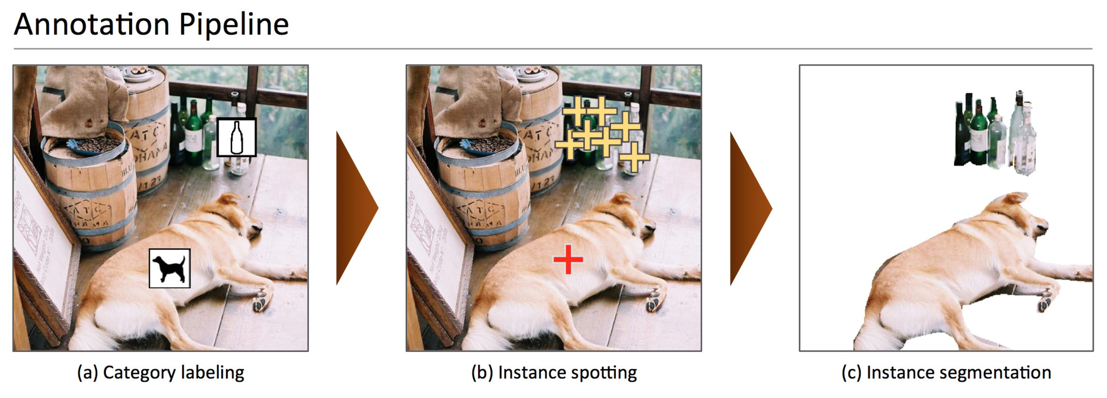
Crowdsourcing to build COCO Dataset

Slide 48
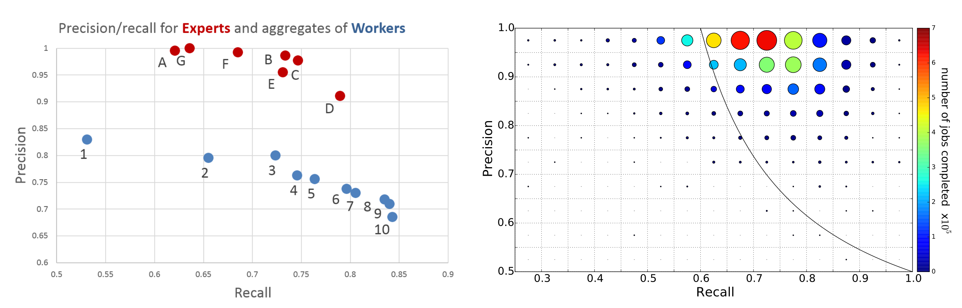
Crowdsourcing to build COCO Dataset
Notes:
Worker precision and recall for the category labeling task. (a) The union of multiple AMT workers (blue)
has better recall than any expert (red). Ground truth was computed using majority vote of the experts. (b) Shows
the number of workers (circle size) and average number of jobs per worker (circle color) for each precision/recall
range. Most workers have high precision; such workers generally also complete more jobs. For this plot ground
truth for each worker is the union of responses from all other AMT workers.

Slide 49
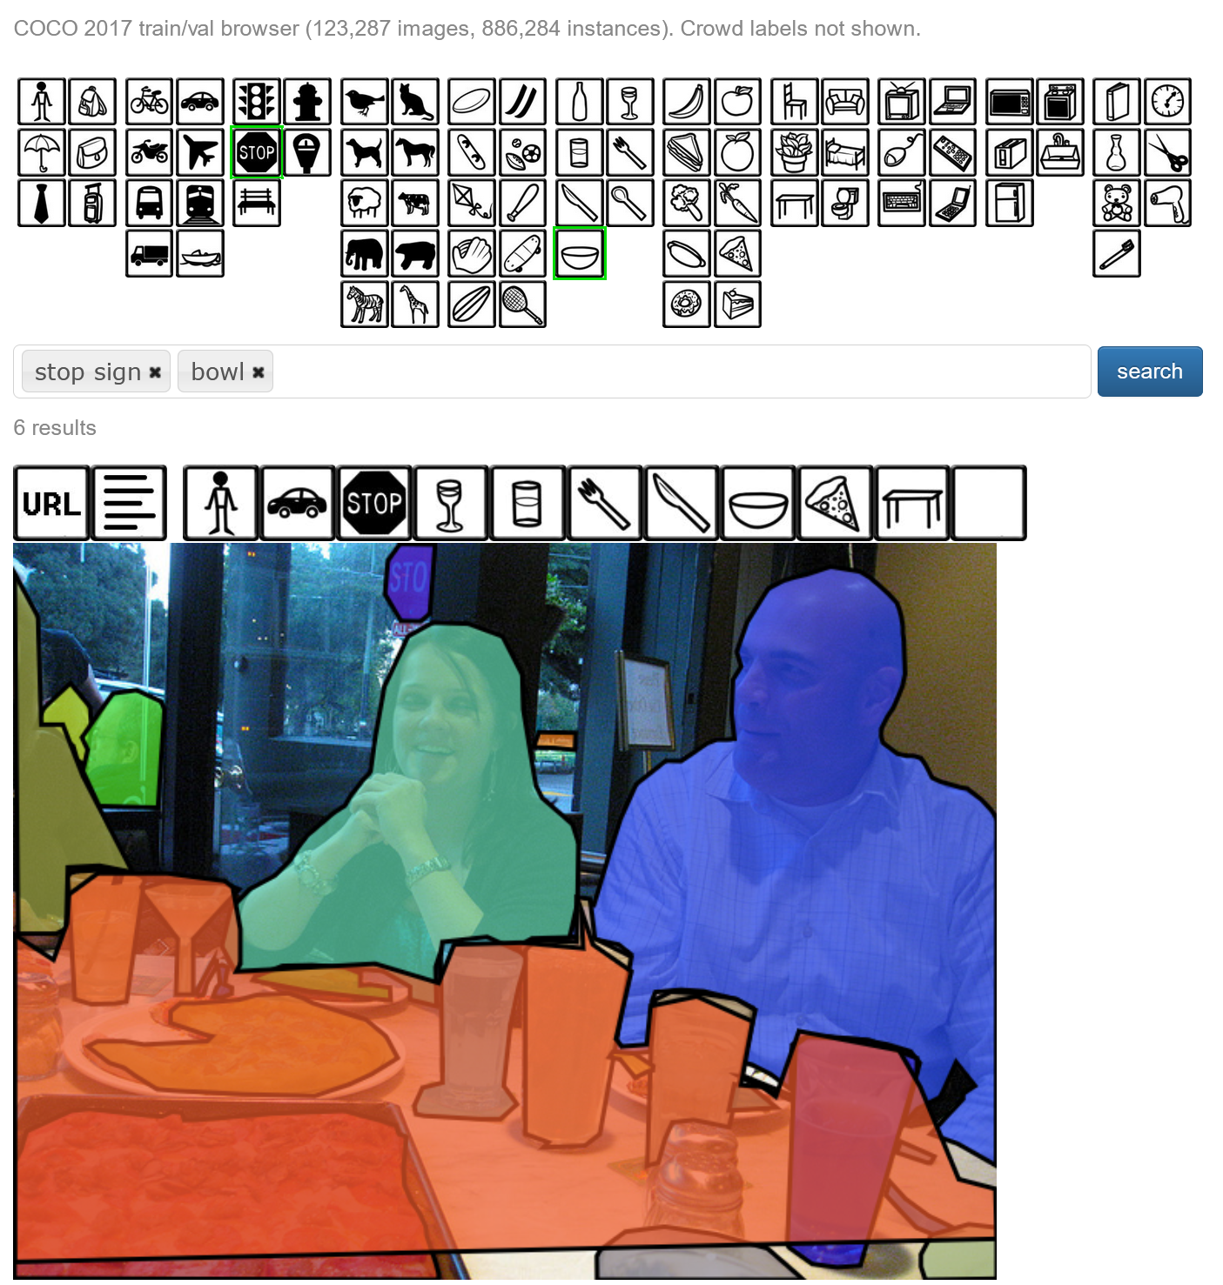
https://cocodataset.org/#explore

Slide 50
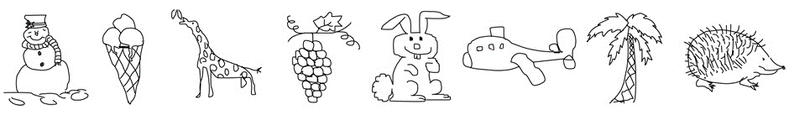
Examples of Crowdsourcing
Most papers annotate images, but there are some more creative uses
  Webcam Eye tracking (https://webgazer.cs.brown.edu/ )
    Annotation could be the passive observations of a participant
  Sketch collection (http://cybertron.cg.tu-berlin.de/eitz/projects/classifysketch/ )
    Flips the usual annotation process, by providing a label and asking for an image

Slide 51
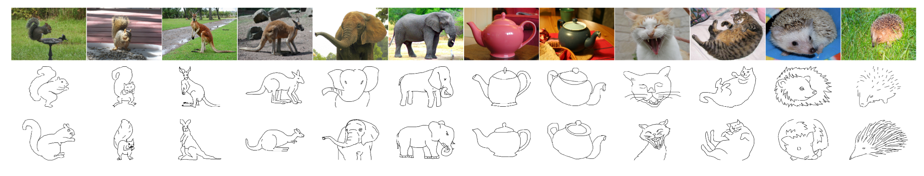
Examples of Crowdsourcing
Draw a sketch of a particular photo
The Sketchy Database: Learning to Retrieve Badly Drawn Bunnies. Patsorn Sangkloy Nathan Burnell Cusuh Ham James Hays. Siggraph 2016.

Slide 52
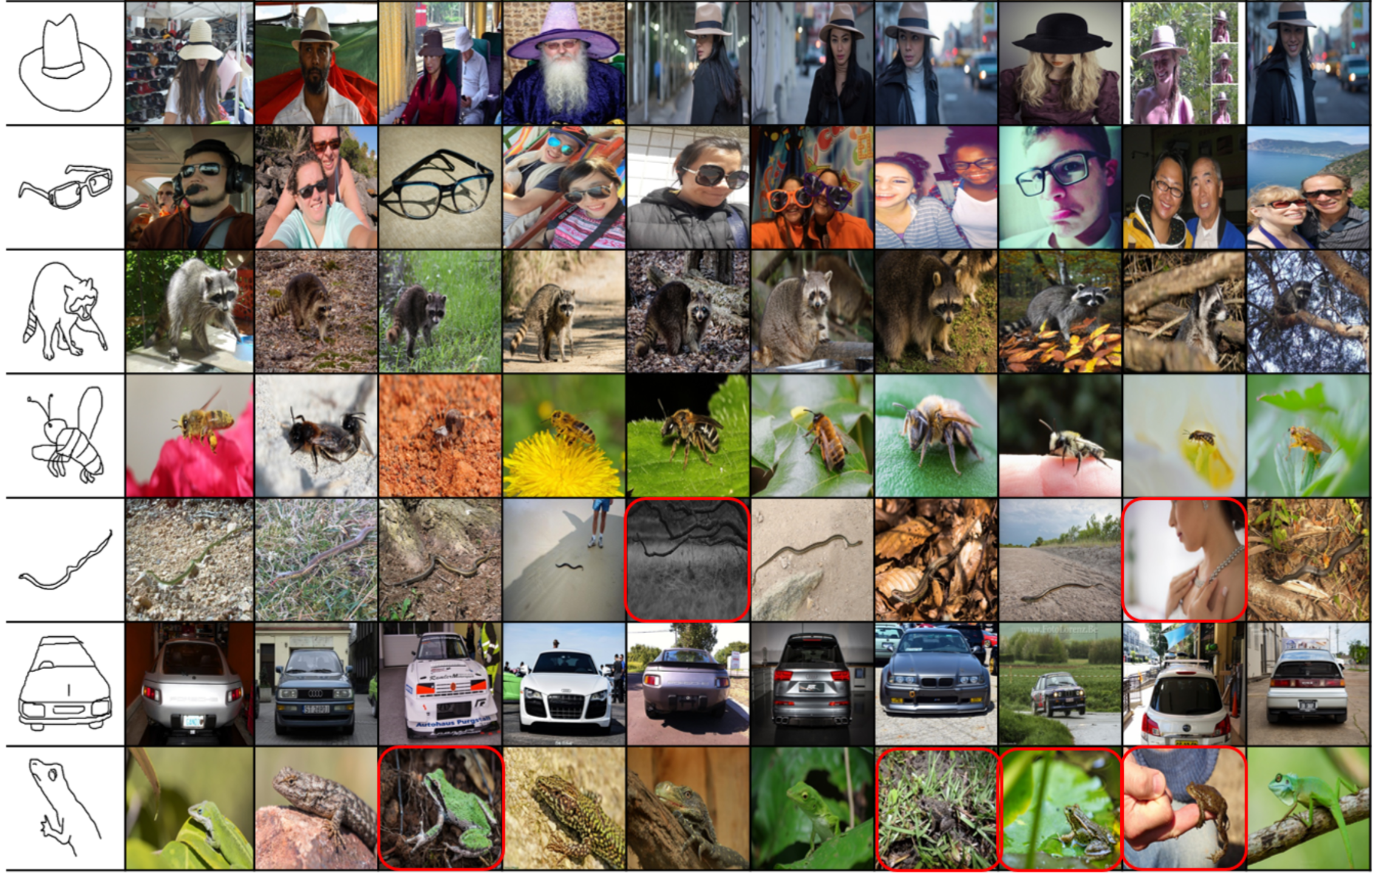

Slide 53
Outline
Data collection with experts – PASCAL VOC
Crowdsourcing: Annotation with non-experts
  LabelMe – no incentive (altruism, perhaps)
  ESP Game – fun incentive (not fun enough?)
  Mechanical Turk – financial incentive
Labels for free / Auto Labeling

Slide 54
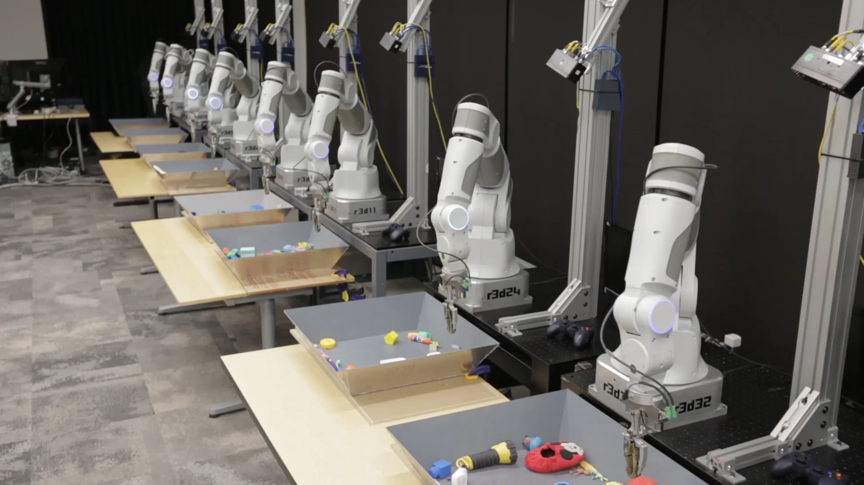
Grasp success can be auto-labeled
Sergey Levine, Peter Pastor, Alex Krizhevsky, and Deirdre Quillen. Google.

Slide 55
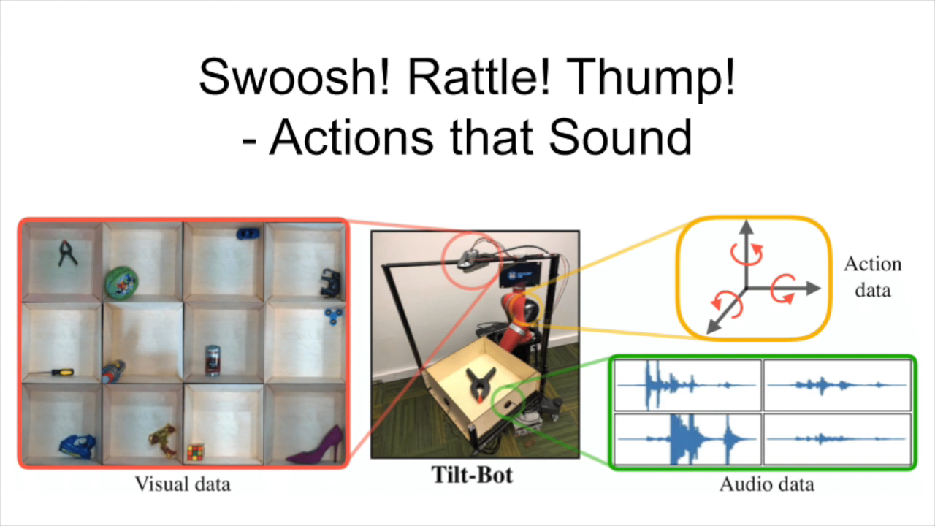
Object sound can be auto-captured
Dhiraj Gandhi, Abhinav Gupta, Lerrel Pinto. Swoosh! Rattle! Thump! - Actions that Sound. In RSS 2020.

Slide 56

Self-supervised Point Cloud Forecasting
Historical LiDAR Sweeps
Future Point Clouds
Predict
4D Forecasting: Sequential Forecasting of 100,000 Points
Weng et al., CVPR’21
Self-supervised Point Cloud Prediction using 3D Spatial-temporal Convolutional Networks
Mersch et al., CORL’22
Notes:
One such task in the autonomous driving world, is called point cloud forecasting. Given a set of past LiDAR sweeps, it aims at predicting the future LiDAR sweeps. And no annotations are needed for this task, because the ground truth lidar sweeps are already available in the logs!

Slide 57
Next lecture
"Unsupervised“ or self-supervised Deep Learning

