Slide 1
Welcome back!
Optional project 0 is out.
Project 1 will be out soon.
Read Szeliski 2.1, especially 2.1.4
Today
  Image projection
  Filtering

Slide 2
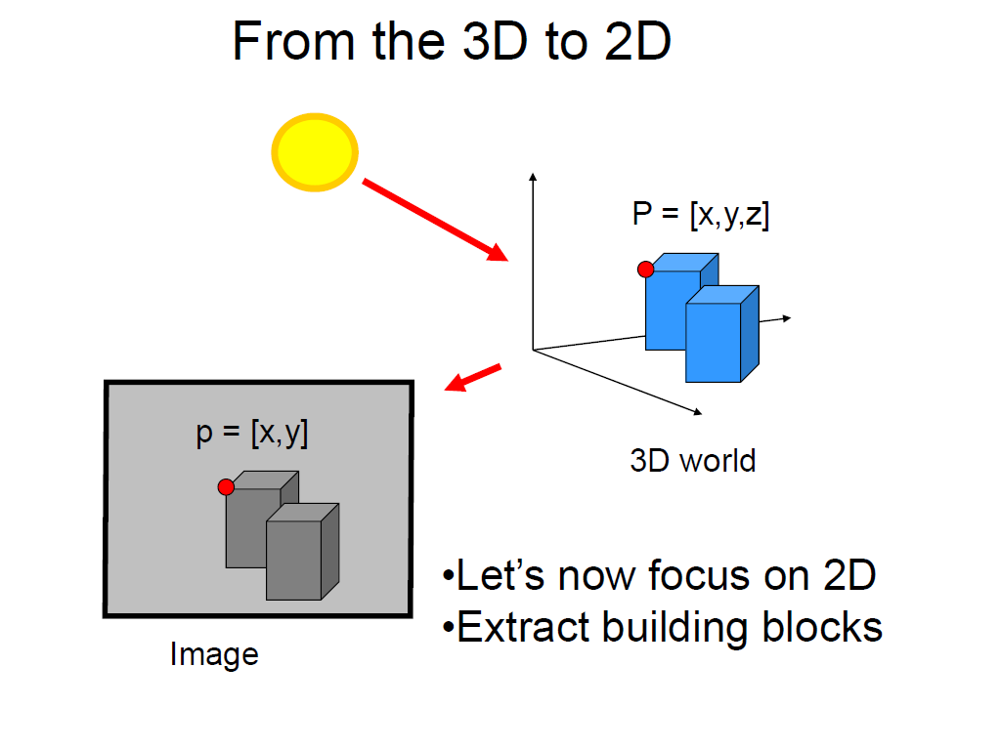
Slide credit Fei Fei Li

Slide 3
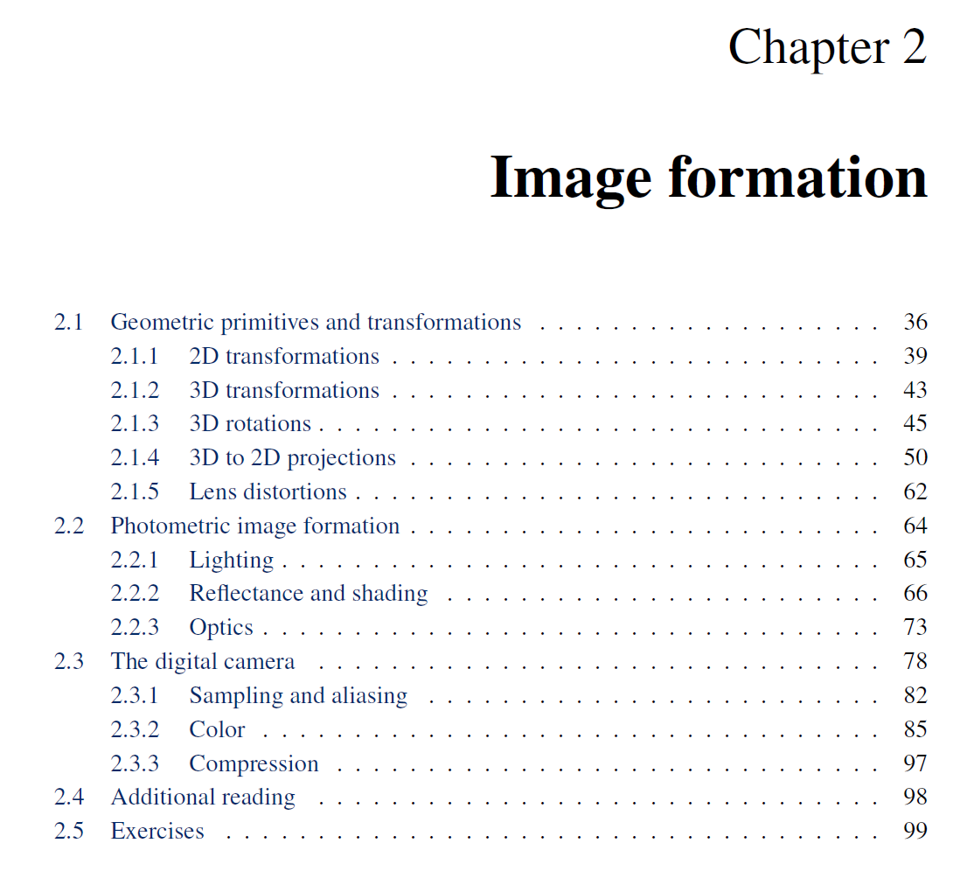

Slide 4
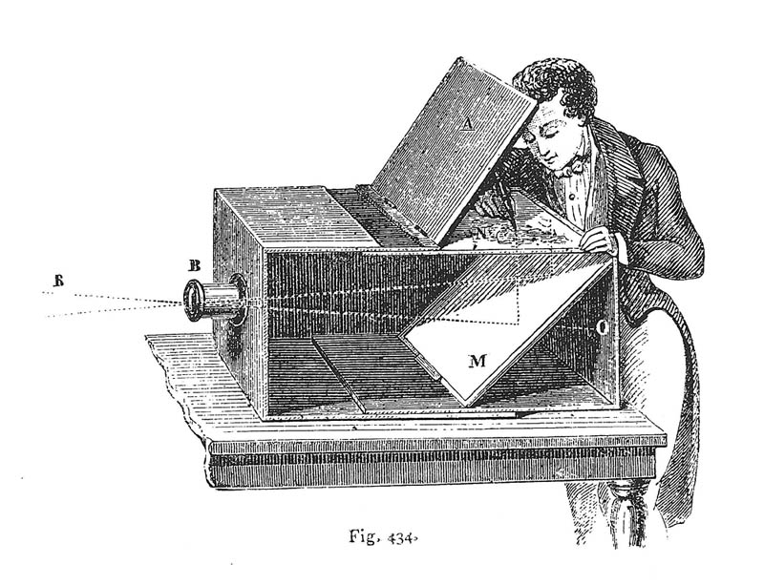
Camera Obscura used for Tracing
Lens Based Camera Obscura, 1568

Slide 5
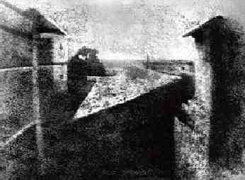
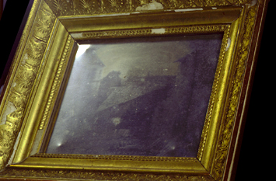
First Photograph
Oldest surviving photograph
  Took 8 hours on pewter plate
Photograph of the first photograph
Joseph Niepce, 1826
Stored at UT Austin
Niepce later teamed up with Daguerre, who eventually created Daguerrotypes

Slide 6
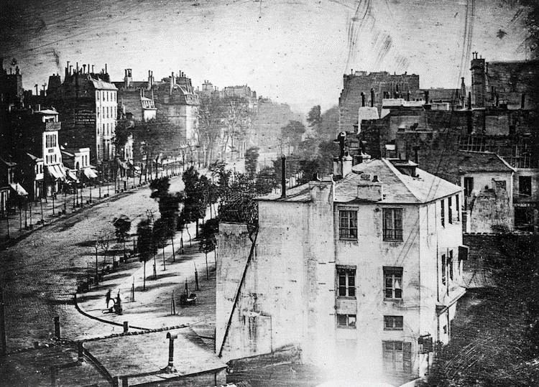
“Louis Daguerre—the inventor of daguerreotype—shot what is not only the world's oldest photograph of Paris, but also the first photo with humans. The 10-minute long exposure was taken in 1839 in Place de la République and it's just possible to make out two blurry figures in the left-hand corner.”
Source

Slide 7
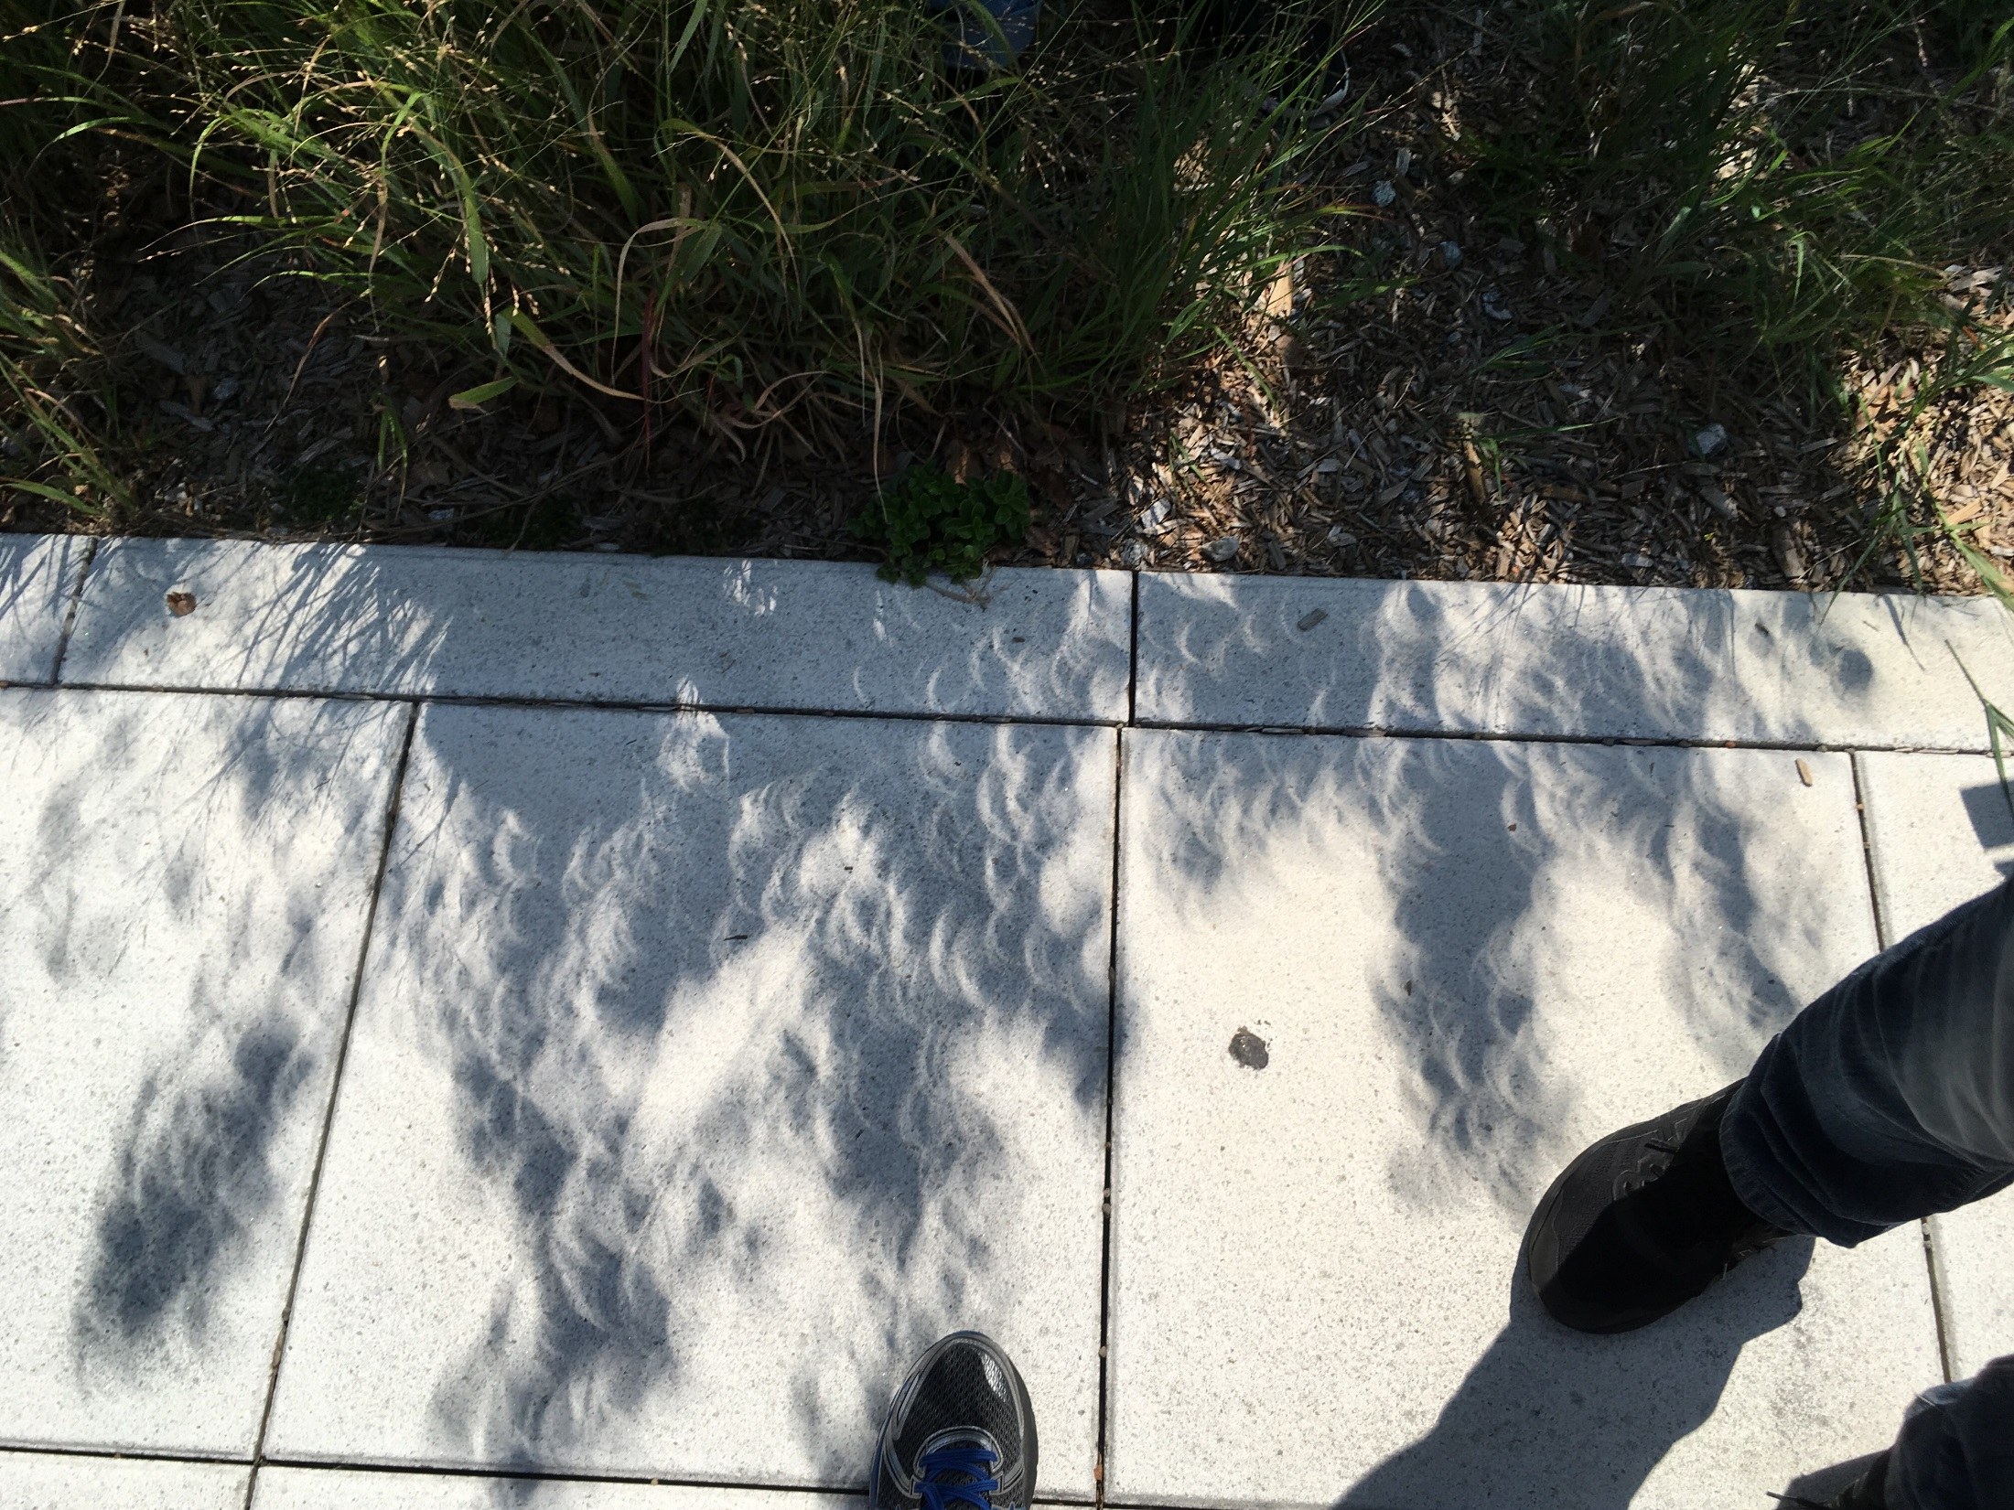
Notes:
Partial eclipse

Slide 8
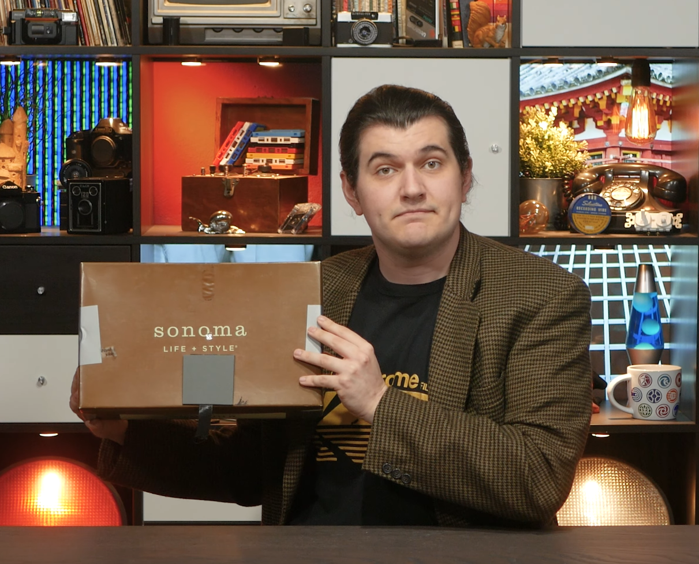
Great history lesson on the chemistry and engineering challenges of early photography from the “Technology Connections” YouTube channel.
https://www.youtube.com/watch?v=wbbH77rYaa8&list=PLv0jwu7G_DFV6yW240e6CbiwCLaZ0Z6PV

Slide 9
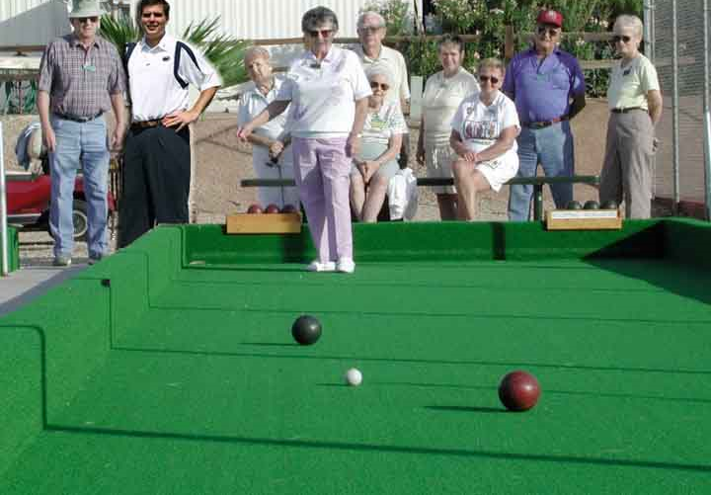
Projective Geometry
What is lost?
Length
Who is taller?
Which is closer?

Slide 10
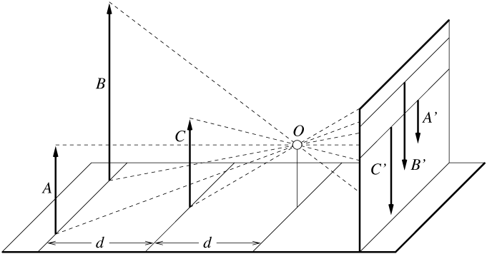
Length and area are not preserved
A’
C’
B’
Figure by David Forsyth

Slide 11
Projective Geometry
What is lost?
Length
Angles
Parallel?
Perpendicular?

Slide 12
Projective Geometry
What is preserved?
Straight lines are still straight

Slide 13
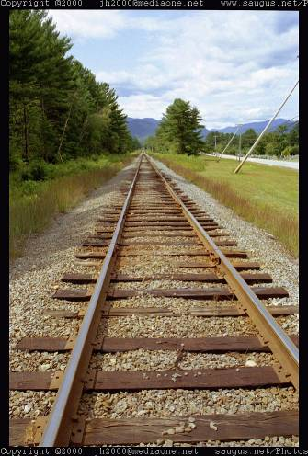
Vanishing points and lines
Parallel lines in the world intersect in the image at a “vanishing point”
Notes:
Go to board, sketch out various properties of vanishing points/lines

Slide 14
Vanishing points and lines
Vanishing Point
Vanishing Point
o
o
Vanishing Line
Notes:
Go to board, sketch out various properties of vanishing points/lines
Parallel lines intersect at a point
The intersection of red lines and blue lines form a parallelogram
Sets of parallel lines on the same plane form a vanishing line
Sets of parallel planes form a vanishing line
Not all lines that intersect are parallel

Slide 15
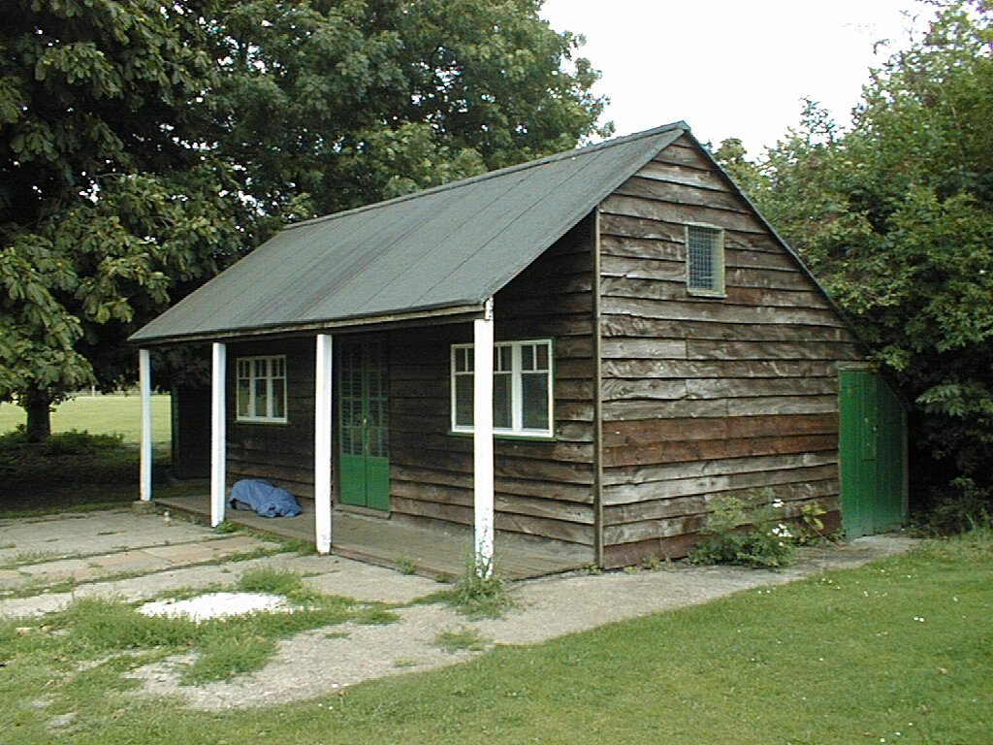
Vanishing points and lines
Vertical vanishing
point
(at infinity)
Vanishing
point
Vanishing
point
Slide from Efros, Photo from Criminisi

Slide 16
Projection: world coordinates→image coordinates
.
.
.
3
f
5
y
2
z
v’
?
.
Camera Center (0, 0, 0)
u’
If x = 2, y = 3, z = 5, and f = 2
What are u’ and v’?
Notes:
Being a little loose about coordinates vs lengths
u and v prime because they are in the same coordinate system as x, y, and z but in later slides u and v will be –u’ and –v’ because they are in their own coordinate system which is mirrored

Slide 17
Projection: world coordinates→image coordinates
.
Optical Center (u₀, v₀)
.
.
f
Z
Y
.
v
Camera Center (t_{x}, t_{y}, t_{z})
u
How do we handle the general case?

Slide 18
Interlude: why does this matter?

Slide 19
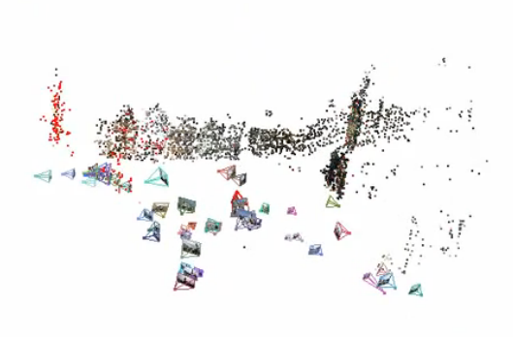
Relating multiple views

Slide 20


Slide 21
Projection: world coordinates→image coordinates
.
Optical Center (u₀, v₀)
.
.
f
Z
Y
.
v
Camera Center (t_{x}, t_{y}, t_{z})
u
How do we handle the general case?

Slide 22
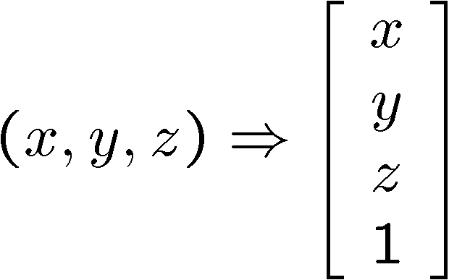
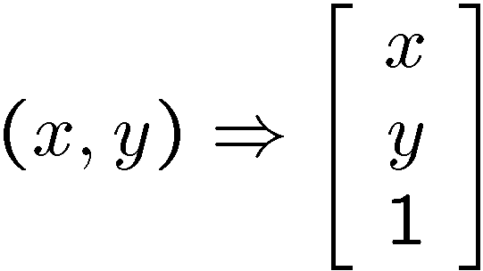
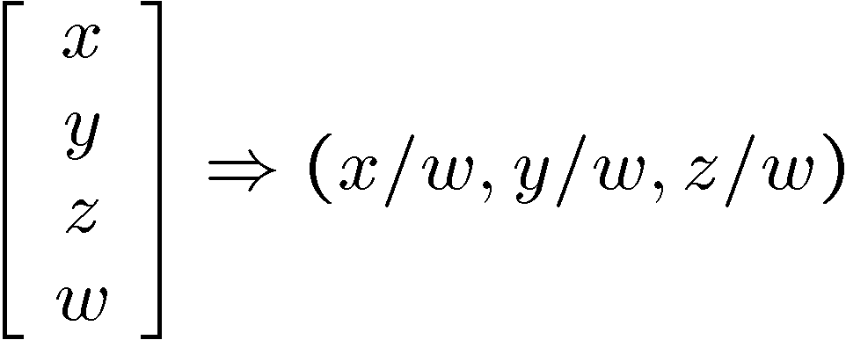
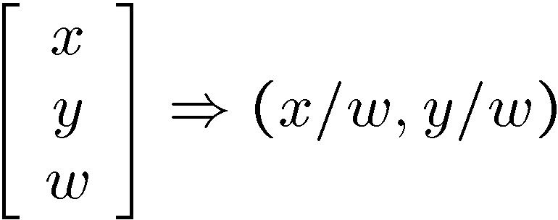
Homogeneous coordinates
Conversion
Converting to homogeneous coordinates
homogeneous image
coordinates
homogeneous scene
coordinates
Converting from homogeneous coordinates
Notes:
Append coordinate with value 1; proportional coordinate system

Slide 23
Homogeneous coordinates
Invariant to scaling
Point in Cartesian is ray in Homogeneous
Homogeneous Coordinates
Cartesian Coordinates
Notes:
Q: Suppose we have a point in Cartesian coordinates. What is that in homogeneous coordinates? A: a ray

Slide 24
Basic geometry in homogeneous coordinates
Line equation: ax + by + c = 0
Append 1 to pixel coordinate to get homogeneous coordinate
Line given by cross product of two points
Intersection of two lines given by cross product of the lines

Slide 25
Another problem solved by homogeneous coordinates
Intersection of parallel lines
  Cartesian: (Inf, Inf)
  Homogeneous: (1, 1, 0)
  Cartesian: (Inf, Inf)
Homogeneous: (1, 2, 0)
Notes:
Parallel lines intersect at different infinities

Slide 26
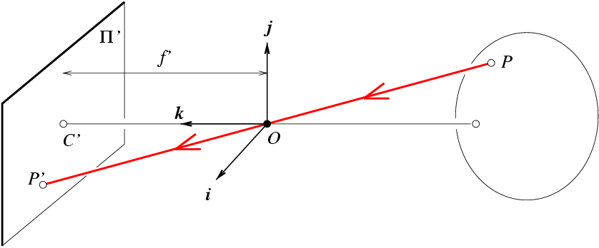
Projection matrix
Slide Credit: Savarese
R,t
j_{w}
X
k_{w}
O_{w}
x
i_{w}
x: Image Coordinates: (u,v,1)
K: Intrinsic Matrix (3x3)
R: Rotation (3x3)
t: Translation (3x1)
X: World Coordinates: (X,Y,Z,1)
Notes:
We can use homogeneous coordinates to write camera matrix in linear form.

Slide 27
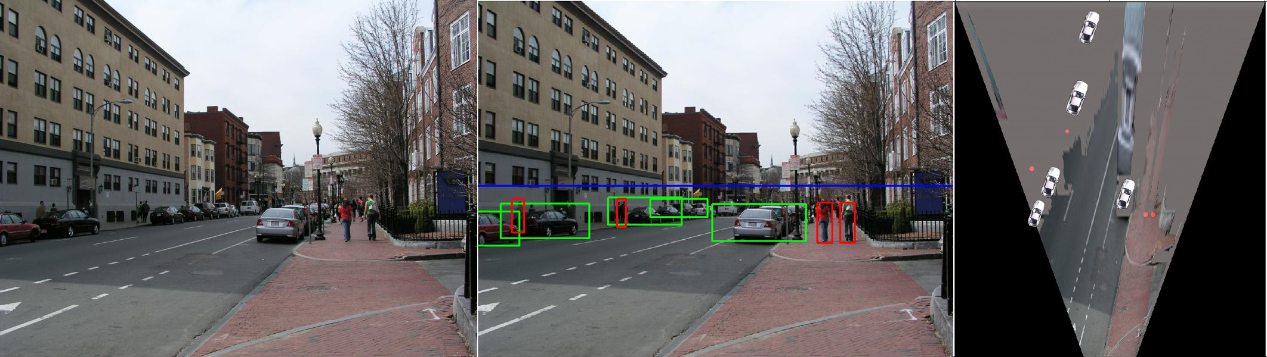
Object Recognition (CVPR 2006)

Slide 28
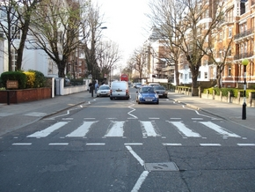
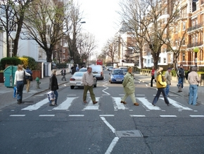
Inserting photographed objects into images (SIGGRAPH 2007)
Original
Created

Slide 29
Pinhole Camera Model
x: Image Coordinates: (u,v,1)
K: Intrinsic Matrix (3x3)
R: Rotation (3x3)
t: Translation (3x1)
X: World Coordinates: (X,Y,Z,1)

Slide 30
Projection matrix
X
x
Intrinsic Assumptions
Unit aspect ratio
Optical center at (0,0)
No skew
Extrinsic Assumptions
No rotation
Camera at (0,0,0)
K
Slide Credit: Savarese
Notes:
Work through equations for u and v on board

Slide 31
Projection matrix
X
x
Intrinsic Assumptions
Unit aspect ratio
Optical center at (0,0)
No skew
Extrinsic Assumptions
No rotation
Camera at (0,0,0)
Slide Credit: Savarese
Notes:
Work through equations for u and v on board

Slide 32
Remove assumption: known optical center
Intrinsic Assumptions
Unit aspect ratio
No skew
Extrinsic Assumptions
No rotation
Camera at (0,0,0)

Slide 33
Remove assumption: square pixels
Intrinsic Assumptions
No skew
Extrinsic Assumptions
No rotation
Camera at (0,0,0)

Slide 34
Remove assumption: non-skewed pixels
Intrinsic Assumptions
Extrinsic Assumptions
No rotation
Camera at (0,0,0)
Note: different books use different notation for parameters

Slide 35
Oriented and Translated Camera
R
j_{w}
X
t
k_{w}
O_{w}
x
i_{w}

Slide 36
Allow camera translation
Intrinsic Assumptions
Extrinsic Assumptions
No rotation

Slide 37
3D Rotation of Points
Slide Credit: Saverese
Rotation around the coordinate axes, counter-clockwise:
p’
γ
y
p
z

Slide 38
Allow camera rotation

Slide 39
Degrees of freedom
5
6
Notes:
How many known points are needed to estimate this?

Slide 40
Vanishing Point = Projection from Infinity

Slide 41
Orthographic Projection
Special case of perspective projection
  Distance from the COP to the image plane is infinite
  Also called “parallel projection”
  What’s the projection matrix?
Image
World
Slide by Steve Seitz

Slide 42
Scaled Orthographic Projection
Special case of perspective projection
  Object dimensions are small compared to distance to camera
  Also called “weak perspective”
  What’s the projection matrix?
Image
World
Slide by Steve Seitz

Slide 43
Field of View (Zoom, focal length)

Slide 44
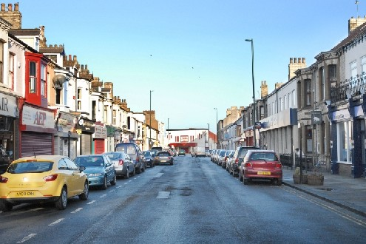
Suppose we have two 3D cubes on the ground facing the viewer, one near, one far.
What would they look like in perspective?
What would they look like in weak perspective?
Photo credit: GazetteLive.co.uk

Slide 45
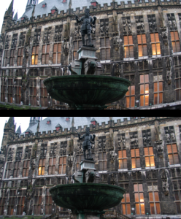
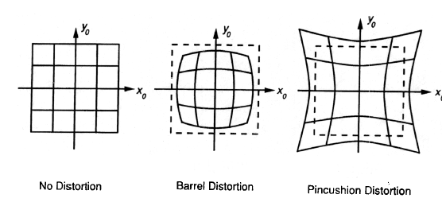
Beyond Pinholes: Radial Distortion
Corrected Barrel Distortion
Image from Martin Habbecke

Slide 46
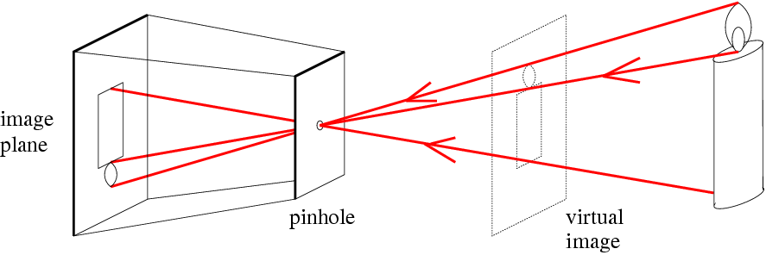
Things to remember
Vertical vanishing
point
(at infinity)
Vanishing points and vanishing lines
Pinhole camera model and camera projection matrix
Homogeneous coordinates
Vanishing
line
Vanishing
point
Vanishing
point

Slide 47
Reminder: read your book
Lectures have assigned readings
Szeliski 2.1 and especially 2.1.4 cover the geometry of image formation

Slide 48
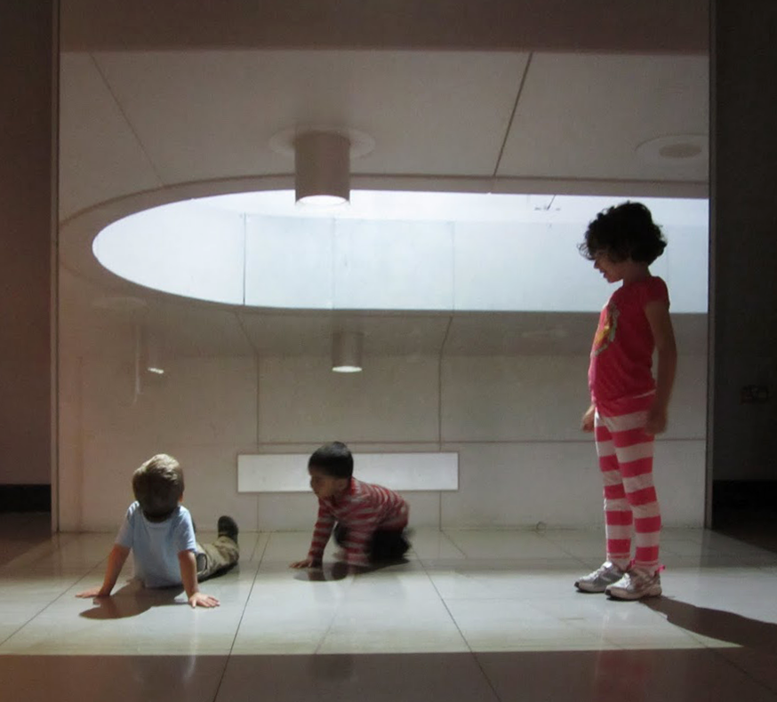
Image Filtering
Computer Vision
James Hays
Many slides by Derek Hoiem

Slide 49
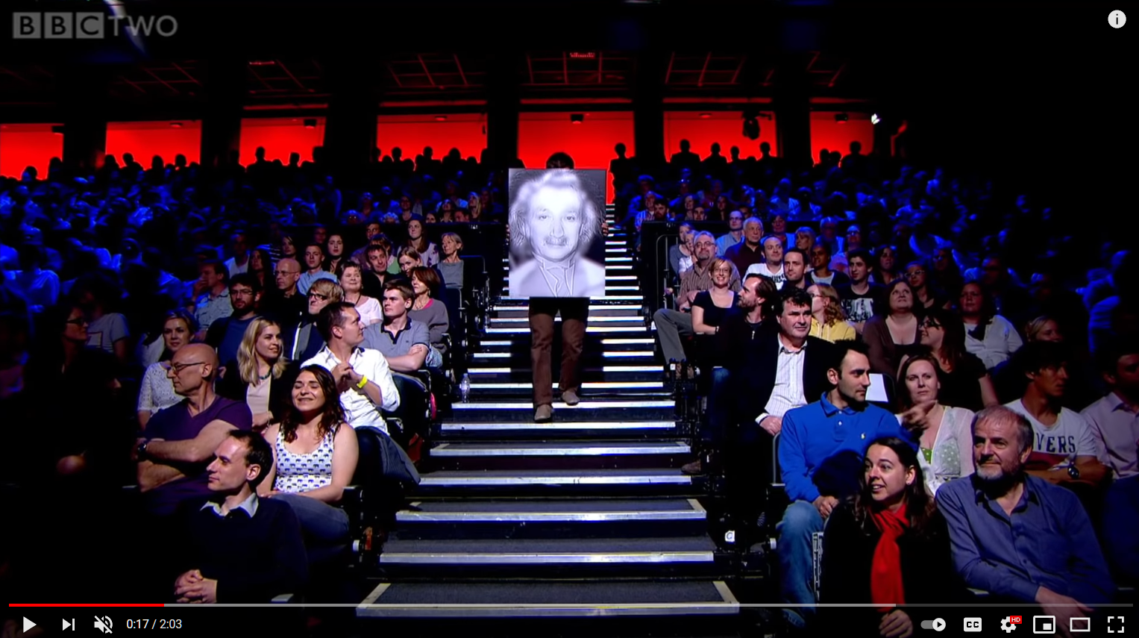
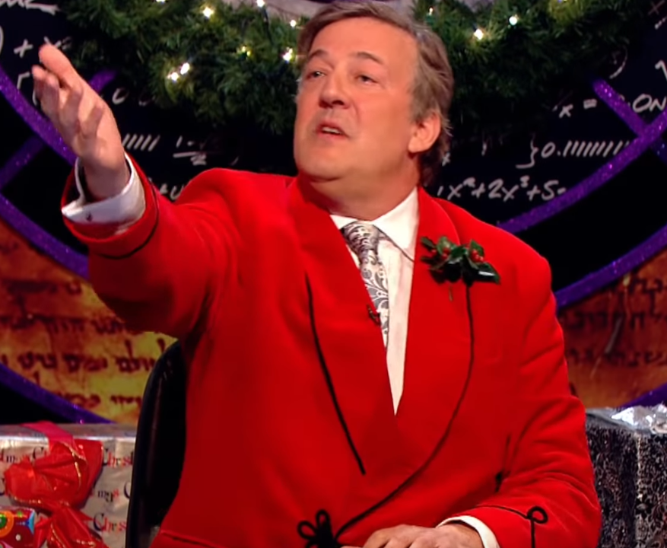
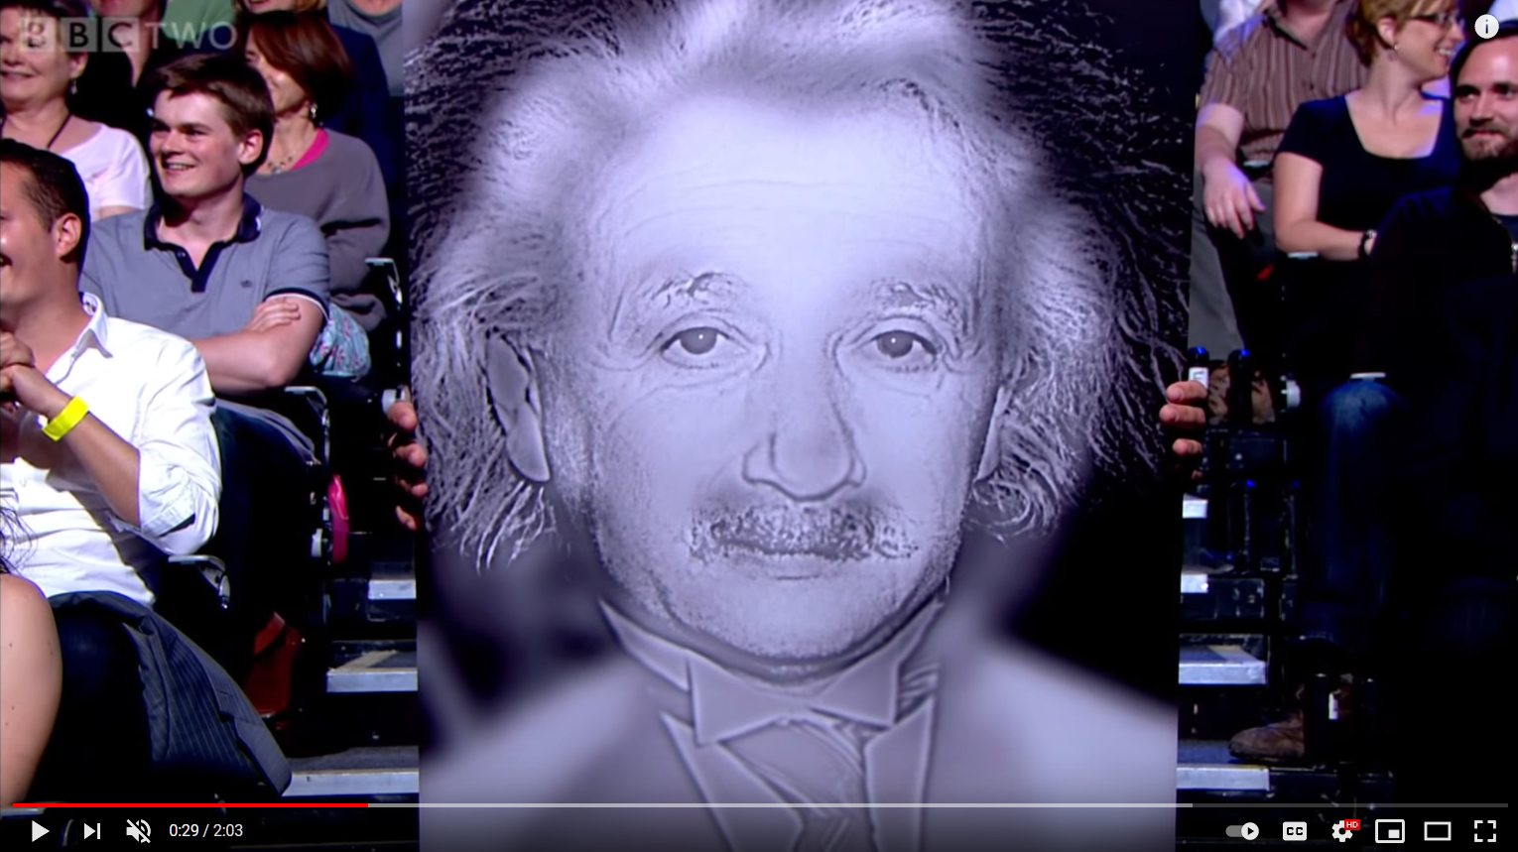
Project 1
BBC Clip: https://www.youtube.com/watch/OlumoQ05gS8

Slide 50
Slide credit Fei Fei Li

Slide 51
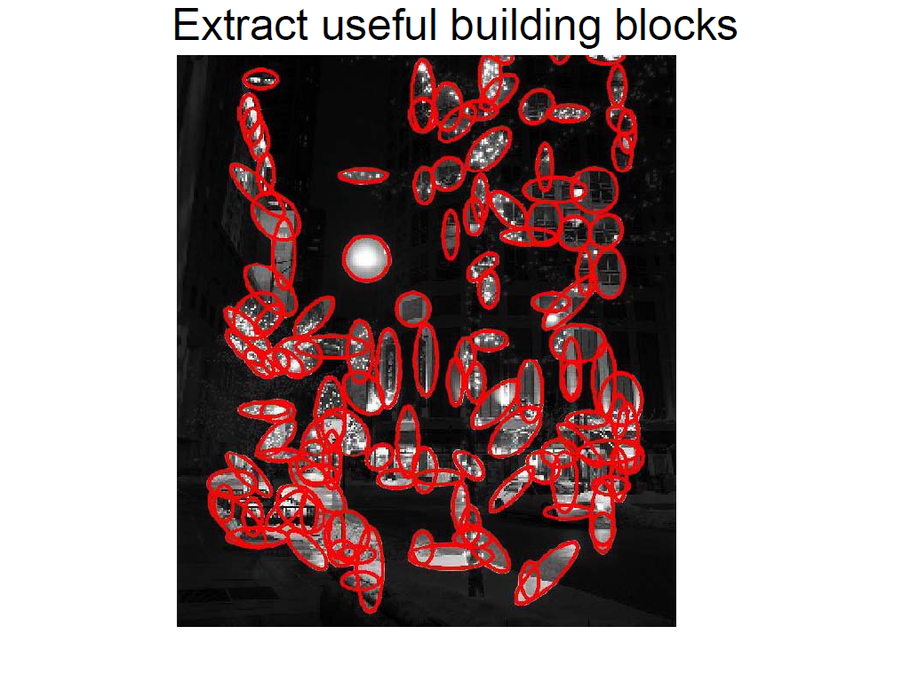
Slide credit Fei Fei Li

Slide 52
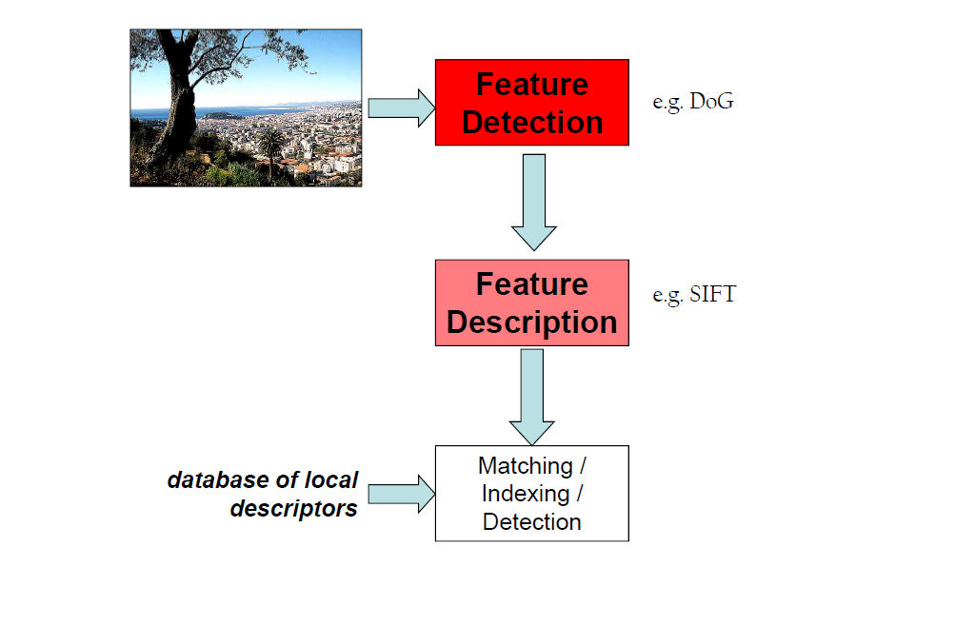
Slide credit Fei Fei Li

Slide 53
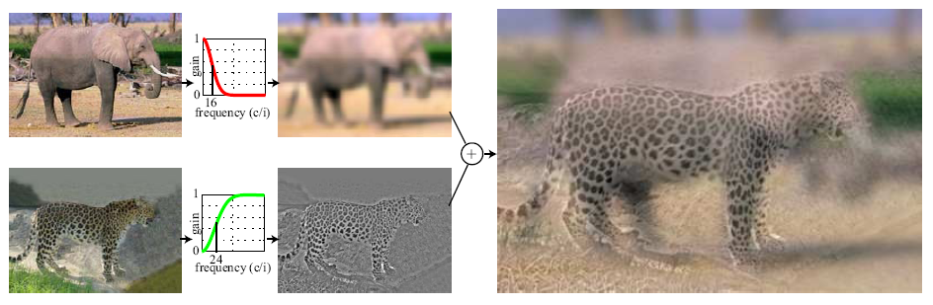
Hybrid Images
A. Oliva, A. Torralba, P.G. Schyns,
“Hybrid Images,” SIGGRAPH 2006

Slide 54
Upcoming classes: two views of filtering
Image filters in spatial domain
  Filter is a mathematical operation of a grid of numbers
  Smoothing, sharpening, measuring texture
Image filters in the frequency domain
  Filtering is a way to modify the frequencies of images
  Denoising, sampling, image compression

Slide 55
Image filtering (or convolution)
Image filtering: compute function of local neighborhood at each position
Really important!
  Enhance images
    Denoise, resize, increase contrast, etc.
  Extract information from images
    Texture, edges, distinctive points, etc.
  Detect patterns
    Template matching
  Deep Convolutional Networks

Slide 56

Example: box filter
1
1
1
1
1
1
1
1
1
Slide credit: David Lowe (UBC)

Slide 57
Image filtering
1
1
1
1
1
1
1
1
1
0 | 0 | 0 | 0 | 0 | 0 | 0 | 0 | 0 | 0
0 | 0 | 0 | 0 | 0 | 0 | 0 | 0 | 0 | 0
0 | 0 | 0 | 90 | 90 | 90 | 90 | 90 | 0 | 0
0 | 0 | 0 | 90 | 90 | 90 | 90 | 90 | 0 | 0
0 | 0 | 0 | 90 | 90 | 90 | 90 | 90 | 0 | 0
0 | 0 | 0 | 90 | 0 | 90 | 90 | 90 | 0 | 0
0 | 0 | 0 | 90 | 90 | 90 | 90 | 90 | 0 | 0
0 | 0 | 0 | 0 | 0 | 0 | 0 | 0 | 0 | 0
0 | 0 | 90 | 0 | 0 | 0 | 0 | 0 | 0 | 0
0 | 0 | 0 | 0 | 0 | 0 | 0 | 0 | 0 | 0
 | 0
0 | 0 | 0 | 0 | 0 | 0 | 0 | 0 | 0 | 0
0 | 0 | 0 | 0 | 0 | 0 | 0 | 0 | 0 | 0
0 | 0 | 0 | 90 | 90 | 90 | 90 | 90 | 0 | 0
0 | 0 | 0 | 90 | 90 | 90 | 90 | 90 | 0 | 0
0 | 0 | 0 | 90 | 90 | 90 | 90 | 90 | 0 | 0
0 | 0 | 0 | 90 | 0 | 90 | 90 | 90 | 0 | 0
0 | 0 | 0 | 90 | 90 | 90 | 90 | 90 | 0 | 0
0 | 0 | 0 | 0 | 0 | 0 | 0 | 0 | 0 | 0
0 | 0 | 90 | 0 | 0 | 0 | 0 | 0 | 0 | 0
0 | 0 | 0 | 0 | 0 | 0 | 0 | 0 | 0 | 0
Credit: S. Seitz
Notes:
ones, divide by 9

Slide 58
Image filtering
1
1
1
1
1
1
1
1
1
0 | 0 | 0 | 0 | 0 | 0 | 0 | 0 | 0 | 0
0 | 0 | 0 | 0 | 0 | 0 | 0 | 0 | 0 | 0
0 | 0 | 0 | 90 | 90 | 90 | 90 | 90 | 0 | 0
0 | 0 | 0 | 90 | 90 | 90 | 90 | 90 | 0 | 0
0 | 0 | 0 | 90 | 90 | 90 | 90 | 90 | 0 | 0
0 | 0 | 0 | 90 | 0 | 90 | 90 | 90 | 0 | 0
0 | 0 | 0 | 90 | 90 | 90 | 90 | 90 | 0 | 0
0 | 0 | 0 | 0 | 0 | 0 | 0 | 0 | 0 | 0
0 | 0 | 90 | 0 | 0 | 0 | 0 | 0 | 0 | 0
0 | 0 | 0 | 0 | 0 | 0 | 0 | 0 | 0 | 0
 | 0 | 10
0 | 0 | 0 | 0 | 0 | 0 | 0 | 0 | 0 | 0
0 | 0 | 0 | 0 | 0 | 0 | 0 | 0 | 0 | 0
0 | 0 | 0 | 90 | 90 | 90 | 90 | 90 | 0 | 0
0 | 0 | 0 | 90 | 90 | 90 | 90 | 90 | 0 | 0
0 | 0 | 0 | 90 | 90 | 90 | 90 | 90 | 0 | 0
0 | 0 | 0 | 90 | 0 | 90 | 90 | 90 | 0 | 0
0 | 0 | 0 | 90 | 90 | 90 | 90 | 90 | 0 | 0
0 | 0 | 0 | 0 | 0 | 0 | 0 | 0 | 0 | 0
0 | 0 | 90 | 0 | 0 | 0 | 0 | 0 | 0 | 0
0 | 0 | 0 | 0 | 0 | 0 | 0 | 0 | 0 | 0
Credit: S. Seitz
Notes:
ones, divide by 9

Slide 59
Image filtering
1
1
1
1
1
1
1
1
1
0 | 0 | 0 | 0 | 0 | 0 | 0 | 0 | 0 | 0
0 | 0 | 0 | 0 | 0 | 0 | 0 | 0 | 0 | 0
0 | 0 | 0 | 90 | 90 | 90 | 90 | 90 | 0 | 0
0 | 0 | 0 | 90 | 90 | 90 | 90 | 90 | 0 | 0
0 | 0 | 0 | 90 | 90 | 90 | 90 | 90 | 0 | 0
0 | 0 | 0 | 90 | 0 | 90 | 90 | 90 | 0 | 0
0 | 0 | 0 | 90 | 90 | 90 | 90 | 90 | 0 | 0
0 | 0 | 0 | 0 | 0 | 0 | 0 | 0 | 0 | 0
0 | 0 | 90 | 0 | 0 | 0 | 0 | 0 | 0 | 0
0 | 0 | 0 | 0 | 0 | 0 | 0 | 0 | 0 | 0
 | 0 | 10 | 20
0 | 0 | 0 | 0 | 0 | 0 | 0 | 0 | 0 | 0
0 | 0 | 0 | 0 | 0 | 0 | 0 | 0 | 0 | 0
0 | 0 | 0 | 90 | 90 | 90 | 90 | 90 | 0 | 0
0 | 0 | 0 | 90 | 90 | 90 | 90 | 90 | 0 | 0
0 | 0 | 0 | 90 | 90 | 90 | 90 | 90 | 0 | 0
0 | 0 | 0 | 90 | 0 | 90 | 90 | 90 | 0 | 0
0 | 0 | 0 | 90 | 90 | 90 | 90 | 90 | 0 | 0
0 | 0 | 0 | 0 | 0 | 0 | 0 | 0 | 0 | 0
0 | 0 | 90 | 0 | 0 | 0 | 0 | 0 | 0 | 0
0 | 0 | 0 | 0 | 0 | 0 | 0 | 0 | 0 | 0
Credit: S. Seitz
Notes:
ones, divide by 9

Slide 60
Image filtering
1
1
1
1
1
1
1
1
1
0 | 0 | 0 | 0 | 0 | 0 | 0 | 0 | 0 | 0
0 | 0 | 0 | 0 | 0 | 0 | 0 | 0 | 0 | 0
0 | 0 | 0 | 90 | 90 | 90 | 90 | 90 | 0 | 0
0 | 0 | 0 | 90 | 90 | 90 | 90 | 90 | 0 | 0
0 | 0 | 0 | 90 | 90 | 90 | 90 | 90 | 0 | 0
0 | 0 | 0 | 90 | 0 | 90 | 90 | 90 | 0 | 0
0 | 0 | 0 | 90 | 90 | 90 | 90 | 90 | 0 | 0
0 | 0 | 0 | 0 | 0 | 0 | 0 | 0 | 0 | 0
0 | 0 | 90 | 0 | 0 | 0 | 0 | 0 | 0 | 0
0 | 0 | 0 | 0 | 0 | 0 | 0 | 0 | 0 | 0
 | 0 | 10 | 20 | 30
0 | 0 | 0 | 0 | 0 | 0 | 0 | 0 | 0 | 0
0 | 0 | 0 | 0 | 0 | 0 | 0 | 0 | 0 | 0
0 | 0 | 0 | 90 | 90 | 90 | 90 | 90 | 0 | 0
0 | 0 | 0 | 90 | 90 | 90 | 90 | 90 | 0 | 0
0 | 0 | 0 | 90 | 90 | 90 | 90 | 90 | 0 | 0
0 | 0 | 0 | 90 | 0 | 90 | 90 | 90 | 0 | 0
0 | 0 | 0 | 90 | 90 | 90 | 90 | 90 | 0 | 0
0 | 0 | 0 | 0 | 0 | 0 | 0 | 0 | 0 | 0
0 | 0 | 90 | 0 | 0 | 0 | 0 | 0 | 0 | 0
0 | 0 | 0 | 0 | 0 | 0 | 0 | 0 | 0 | 0
Credit: S. Seitz
Notes:
ones, divide by 9

Slide 61
Image filtering
1
1
1
1
1
1
1
1
1
0 | 0 | 0 | 0 | 0 | 0 | 0 | 0 | 0 | 0
0 | 0 | 0 | 0 | 0 | 0 | 0 | 0 | 0 | 0
0 | 0 | 0 | 90 | 90 | 90 | 90 | 90 | 0 | 0
0 | 0 | 0 | 90 | 90 | 90 | 90 | 90 | 0 | 0
0 | 0 | 0 | 90 | 90 | 90 | 90 | 90 | 0 | 0
0 | 0 | 0 | 90 | 0 | 90 | 90 | 90 | 0 | 0
0 | 0 | 0 | 90 | 90 | 90 | 90 | 90 | 0 | 0
0 | 0 | 0 | 0 | 0 | 0 | 0 | 0 | 0 | 0
0 | 0 | 90 | 0 | 0 | 0 | 0 | 0 | 0 | 0
0 | 0 | 0 | 0 | 0 | 0 | 0 | 0 | 0 | 0
 | 0 | 10 | 20 | 30 | 30
Credit: S. Seitz
Notes:
ones, divide by 9

Slide 62
Image filtering
1
1
1
1
1
1
1
1
1
0 | 0 | 0 | 0 | 0 | 0 | 0 | 0 | 0 | 0
0 | 0 | 0 | 0 | 0 | 0 | 0 | 0 | 0 | 0
0 | 0 | 0 | 90 | 90 | 90 | 90 | 90 | 0 | 0
0 | 0 | 0 | 90 | 90 | 90 | 90 | 90 | 0 | 0
0 | 0 | 0 | 90 | 90 | 90 | 90 | 90 | 0 | 0
0 | 0 | 0 | 90 | 0 | 90 | 90 | 90 | 0 | 0
0 | 0 | 0 | 90 | 90 | 90 | 90 | 90 | 0 | 0
0 | 0 | 0 | 0 | 0 | 0 | 0 | 0 | 0 | 0
0 | 0 | 90 | 0 | 0 | 0 | 0 | 0 | 0 | 0
0 | 0 | 0 | 0 | 0 | 0 | 0 | 0 | 0 | 0
 | 0 | 10 | 20 | 30 | 30
?
Credit: S. Seitz
Notes:
ones, divide by 9

Slide 63
Image filtering
1
1
1
1
1
1
1
1
1
0 | 0 | 0 | 0 | 0 | 0 | 0 | 0 | 0 | 0
0 | 0 | 0 | 0 | 0 | 0 | 0 | 0 | 0 | 0
0 | 0 | 0 | 90 | 90 | 90 | 90 | 90 | 0 | 0
0 | 0 | 0 | 90 | 90 | 90 | 90 | 90 | 0 | 0
0 | 0 | 0 | 90 | 90 | 90 | 90 | 90 | 0 | 0
0 | 0 | 0 | 90 | 0 | 90 | 90 | 90 | 0 | 0
0 | 0 | 0 | 90 | 90 | 90 | 90 | 90 | 0 | 0
0 | 0 | 0 | 0 | 0 | 0 | 0 | 0 | 0 | 0
0 | 0 | 90 | 0 | 0 | 0 | 0 | 0 | 0 | 0
0 | 0 | 0 | 0 | 0 | 0 | 0 | 0 | 0 | 0
 | 0 | 10 | 20 | 30 | 30
 |  |  |  | 50
?
Credit: S. Seitz
Notes:
ones, divide by 9

Slide 64
Image filtering
1
1
1
1
1
1
1
1
1
0 | 0 | 0 | 0 | 0 | 0 | 0 | 0 | 0 | 0
0 | 0 | 0 | 0 | 0 | 0 | 0 | 0 | 0 | 0
0 | 0 | 0 | 90 | 90 | 90 | 90 | 90 | 0 | 0
0 | 0 | 0 | 90 | 90 | 90 | 90 | 90 | 0 | 0
0 | 0 | 0 | 90 | 90 | 90 | 90 | 90 | 0 | 0
0 | 0 | 0 | 90 | 0 | 90 | 90 | 90 | 0 | 0
0 | 0 | 0 | 90 | 90 | 90 | 90 | 90 | 0 | 0
0 | 0 | 0 | 0 | 0 | 0 | 0 | 0 | 0 | 0
0 | 0 | 90 | 0 | 0 | 0 | 0 | 0 | 0 | 0
0 | 0 | 0 | 0 | 0 | 0 | 0 | 0 | 0 | 0
 | 0 | 10 | 20 | 30 | 30 | 30 | 20 | 10
 | 0 | 20 | 40 | 60 | 60 | 60 | 40 | 20
 | 0 | 30 | 60 | 90 | 90 | 90 | 60 | 30
 | 0 | 30 | 50 | 80 | 80 | 90 | 60 | 30
 | 0 | 30 | 50 | 80 | 80 | 90 | 60 | 30
 | 0 | 20 | 30 | 50 | 50 | 60 | 40 | 20
 | 10 | 20 | 30 | 30 | 30 | 30 | 20 | 10
 | 10 | 10 | 10 | 0 | 0 | 0 | 0 | 0
Credit: S. Seitz

Slide 65
Box Filter
What does it do?
Replaces each pixel with an average of its neighborhood
Achieve smoothing effect (remove sharp features)
1
1
1
1
1
1
1
1
1
Slide credit: David Lowe (UBC)

Slide 66
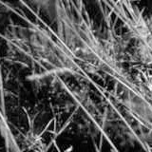
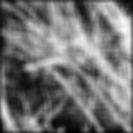
Smoothing with box filter

Slide 67
One more on board…

Slide 68
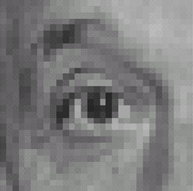
Practice with linear filters
0
0
0
?
0
1
0
0
0
0
Original
Source: D. Lowe

Slide 69
Practice with linear filters
0
0
0
0
1
0
0
0
0
Original
Filtered
(no change)
Source: D. Lowe

Slide 70
Practice with linear filters
0
0
0
?
0
0
1
0
0
0
Original
Source: D. Lowe

Slide 71
Practice with linear filters
0
0
0
0
0
1
0
0
0
Original
Shifted left
By 1 pixel
Source: D. Lowe

Slide 72

Practice with linear filters
0
0
0
-
1
1
1
?
0
2
0
1
1
1
0
0
0
1
1
1
(Note that filter sums to 1)
Original
Source: D. Lowe

Slide 73
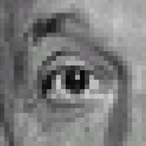
Practice with linear filters
0
0
0
-
1
1
1
0
2
0
1
1
1
0
0
0
1
1
1
Original
Sharpening filter
  Accentuates differences with local average
Source: D. Lowe

Slide 74
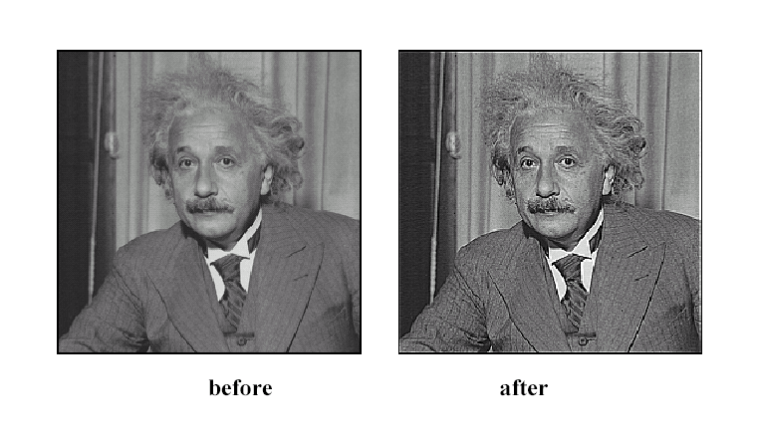
Sharpening
Source: D. Lowe

Slide 75
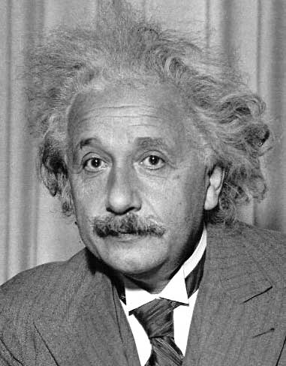
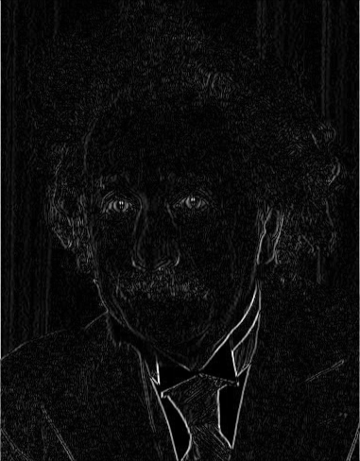
Other filters
1
0
-1
2
0
-2
1
0
-1
Sobel
Vertical Edge
(absolute value)

Slide 76
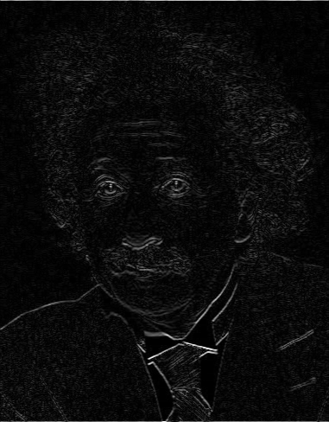
Other filters
1
2
1
0
0
0
-1
-2
-1
Sobel
Horizontal Edge
(absolute value)
Notes:
Questions at this point?

Slide 77
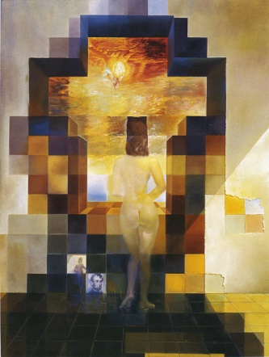
Next class: Light and Color and
Thinking in Frequency

