Slide 1
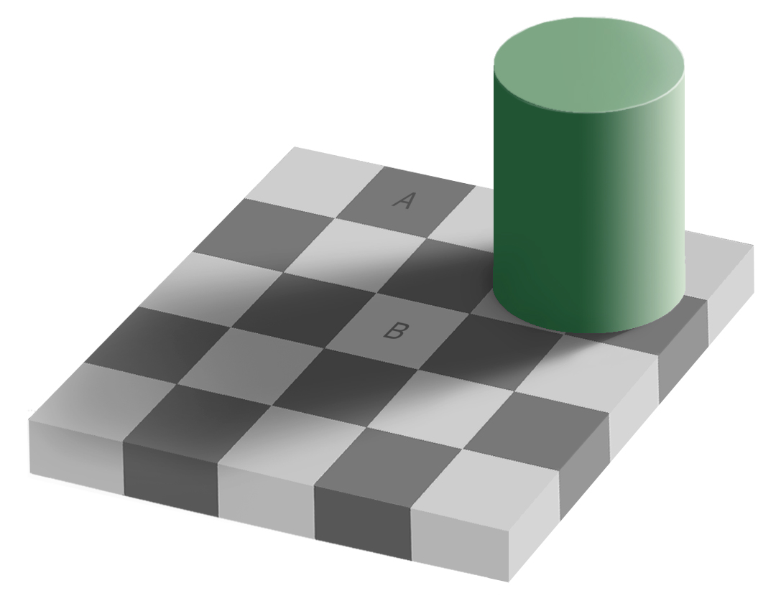

Slide 2
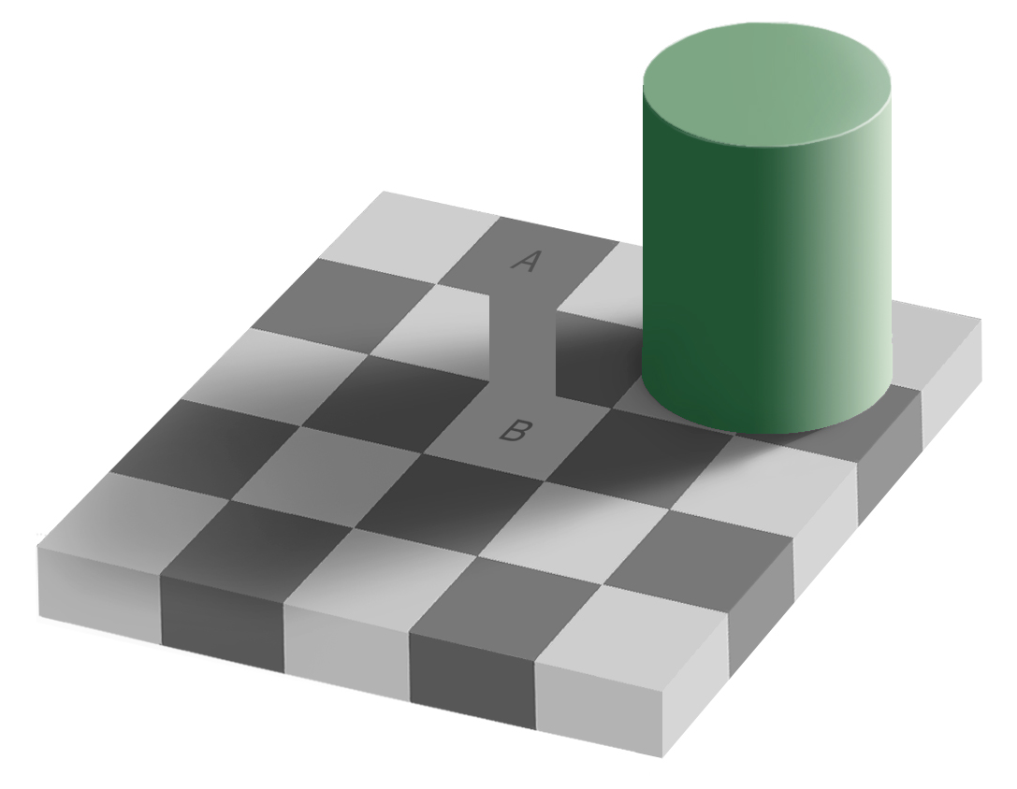

Slide 4
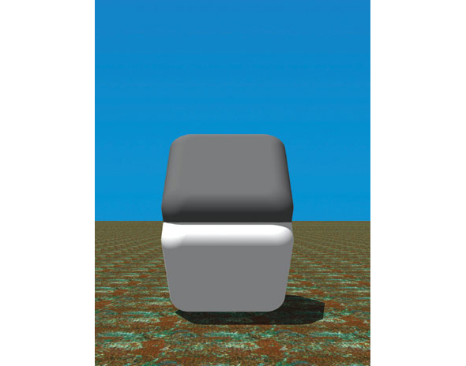

Slide 5
RANSAC, ICP, Fitting and Alignment
Computer Vision
James Hays
Szeliski 2.1 and 8.1
Acknowledgment: Many slides from Derek Hoiem, Lana Lazebnik,
and Grauman&Leibe 2008 AAAI Tutorial

Slide 6
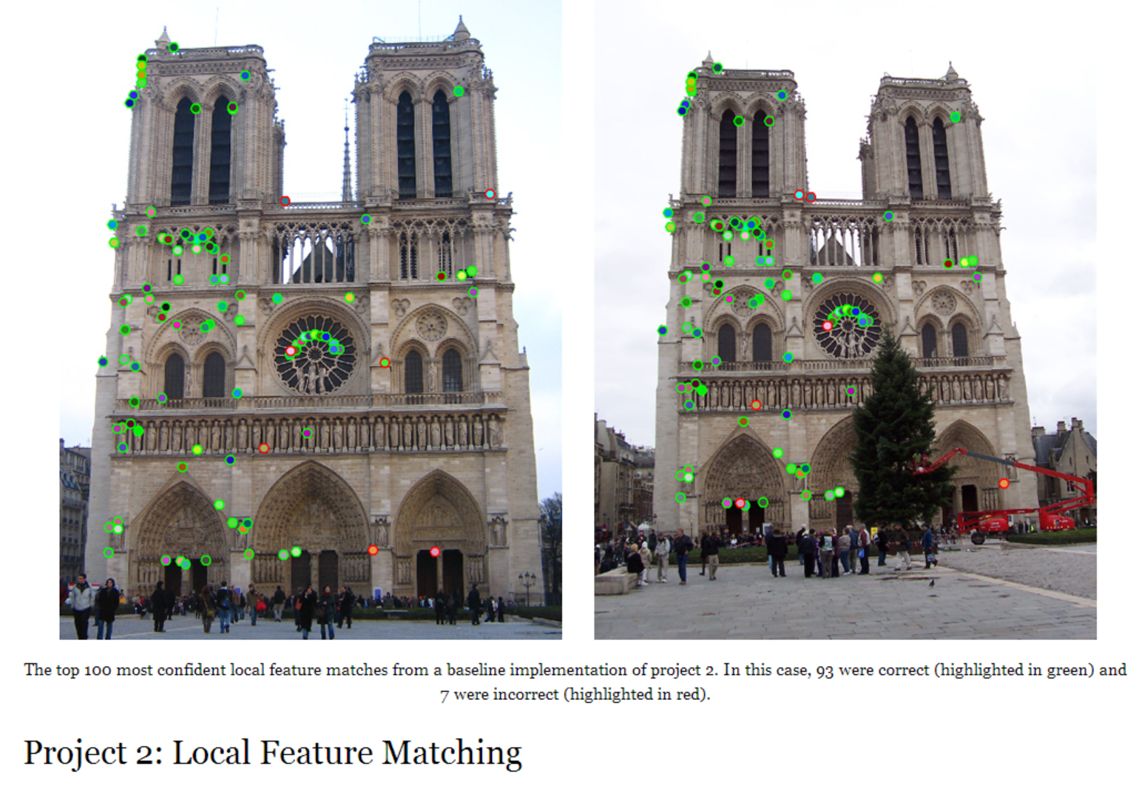
Project 2

Slide 7
Review
Fitting: find the parameters of a model that best fit the data
Alignment: find the parameters of the transformation that best align matched points

Slide 8
Review: Fitting and Alignment
Design challenges
  Design a suitable goodness of fit measure
    Similarity should reflect application goals
    Encode robustness to outliers and noise
  Design an optimization method
    Avoid local optima
    Find best parameters quickly

Slide 9
Fitting and Alignment: Methods
Global optimization / Search for parameters
  Least squares fit
  Robust least squares
  Other parameter search methods
Hypothesize and test
  Hough transform
  RANSAC
Iterative Closest Points (ICP)

Slide 10
Review: Hough Transform
Create a grid of parameter values
Each point (or correspondence) votes for a set of parameters, incrementing those values in grid
Find maximum or local maxima in grid

Slide 11
Review: Hough transform
P.V.C. Hough, Machine Analysis of Bubble Chamber Pictures, Proc. Int. Conf. High Energy Accelerators and Instrumentation, 1959
Given a set of points, find the curve or line that explains the data points best
y
m
x
b
Hough space
y = m x + b
Slide from S. Savarese
Notes:
􀁑 Basic ideas
• A line is represented as . Every line in the image corresponds
to a point in the parameter space
• Every point in the image domain corresponds to a line in the parameter
space (why ? Fix (x,y), (m,n) can change on the line . In other
words, for all the lines passing through (x,y) in the image space, their
parameters form a line in the parameter space)
• Points along a line in the space correspond to lines passing through the
same point in the parameter space (why ?)

Slide 12
Review: Hough transform
y
m
x
b
y
m
3
5
3
3
2
2
3
7
11
10
4
3
2
3
1
4
5
2
2
1
0
1
3
3
x
b
Slide from S. Savarese
Notes:
􀁑 Basic ideas
• A line is represented as . Every line in the image corresponds
to a point in the parameter space
• Every point in the image domain corresponds to a line in the parameter
space (why ? Fix (x,y), (m,n) can change on the line . In other
words, for all the lines passing through (x,y) in the image space, their
parameters form a line in the parameter space)
• Points along a line in the space correspond to lines passing through the
same point in the parameter space (why ?)

Slide 13

Hough transform for circles
Conceptually equivalent (but maybe less efficient) grid search procedure: for each (x,y,r), draw the corresponding circle in the image and compute its “support”
r
x
y
Is this more or less efficient than voting with features?

Slide 14
Hough Transform
How would we find circles?
  Of fixed radius
  Of unknown radius
  Of unknown radius but with known edge orientation

Slide 15
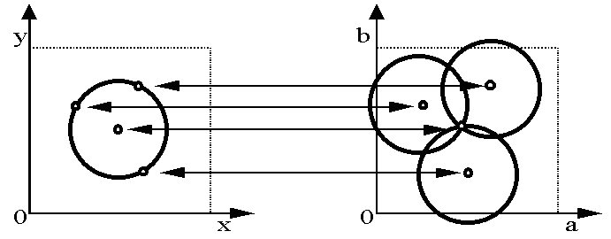
Hough transform for circles
Circle: center (a,b) and radius r
Equation of circle?
For a fixed radius r
Equation of set of circles that all pass through a point?
Image space
Hough space
Adapted by Devi Parikh from: Kristen Grauman

Slide 16
Hough transform for circles
Circle: center (a,b) and radius r
For a fixed radius r
Intersection: most votes for center occur here.
Image space
Hough space
Kristen Grauman

Slide 17
Hough transform for circles
Circle: center (a,b) and radius r
For an unknown radius r
r
?
b
a
Image space
Hough space
Kristen Grauman

Slide 18
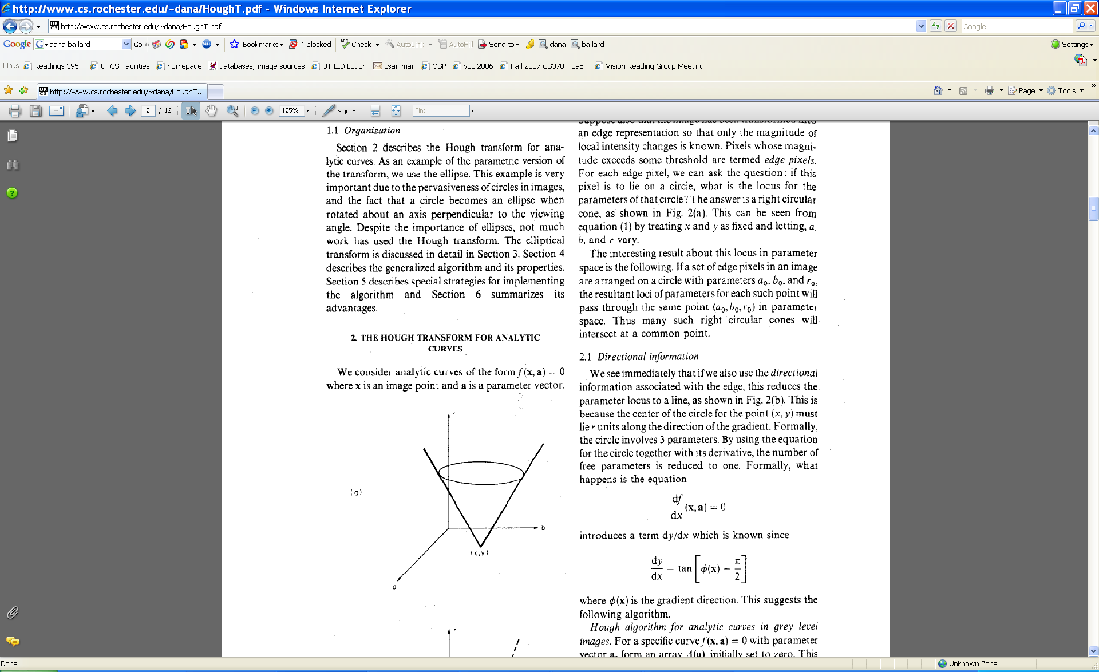
Hough transform for circles
Circle: center (a,b) and radius r
For an unknown radius r
r
b
a
Image space
Hough space
Kristen Grauman

Slide 19
Hough Transform
How would we find circles?
  Of fixed radius
  Of unknown radius
  Of unknown radius but with known edge orientation

Slide 20
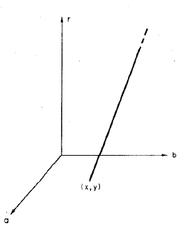
Hough transform for circles
Circle: center (a,b) and radius r
For an unknown radius r, known gradient direction
x
θ
Image space
Hough space
Kristen Grauman

Slide 21
Hough transform for circles
For every edge pixel (x,y) :
For each possible radius value r:
For each possible gradient direction θ:
// or use estimated gradient at (x,y)
a = x – r cos(θ) // column
b = y + r sin(θ) // row
H[a,b,r] += 1
end
end
Kristen Grauman

Slide 22
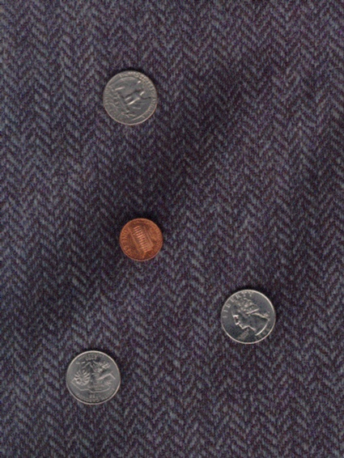
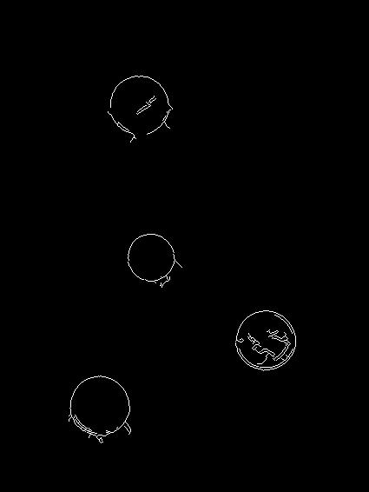
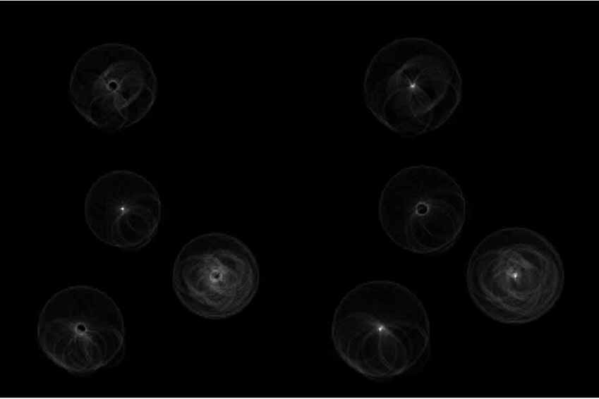
Example: detecting circles with Hough
Original
Edges
Votes: Penny
Note: a different Hough transform (with separate accumulators) was used for each circle radius (quarters vs. penny).
Slide credit: Kristen Grauman

Slide 23
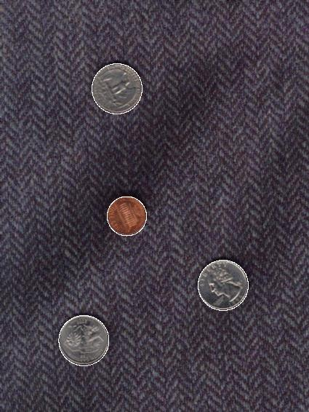
Example: detecting circles with Hough
Original
Combined detections
Edges
Votes: Quarter
Slide credit: Kristen Grauman
Coin finding sample images from: Vivek Kwatra

Slide 24
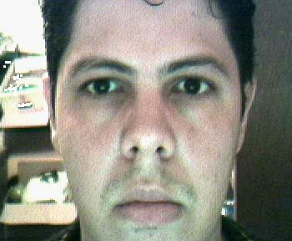
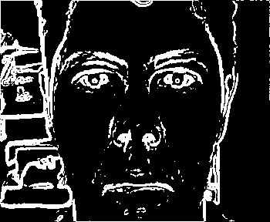
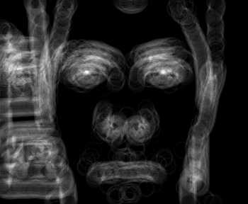

Example: iris detection
Gradient+threshold
Hough space (fixed radius)
Max detections
Hemerson Pistori and Eduardo Rocha Costa http://rsbweb.nih.gov/ij/plugins/hough-circles.html
Kristen Grauman

Slide 25
Fitting and Alignment: Methods
Global optimization / Search for parameters
  Least squares fit
  Robust least squares
  Other parameter search methods
Hypothesize and test
  Hough transform
  RANSAC
Iterative Closest Points (ICP)

Slide 26
RANSAC
_{(RANdom SAmple Consensus) :}
Fischler & Bolles in ‘81.
Algorithm:
Sample (randomly) the number of points required to fit the model
Solve for model parameters using samples
Score by the fraction of inliers within a preset threshold of the model
Repeat 1-3 until the best model is found with high confidence
Notes:
Let me give you an intuition of what is going on. Suppose we have the standard line fitting problem in presence of outliers.
We can formulate this problem as follows: want to find the best partition of points in inlier set and outlier set such that…
The objective consists of adjusting the parameters of a model function so as to best fit a data set.
"best" is defined by a function f that needs to be minimized.
Such that the best parameter of fitting the line give rise to a residual error lower that delta
as when the sum, S, of squared residuals

Slide 27
RANSAC
Line fitting example
Algorithm:
Sample (randomly) the number of points required to fit the model (#=2)
Solve for model parameters using samples
Score by the fraction of inliers within a preset threshold of the model
Repeat 1-3 until the best model is found with high confidence
Illustration by Savarese
Notes:
Let me give you an intuition of what is going on. Suppose we have the standard line fitting problem in presence of outliers.
We can formulate this problem as follows: want to find the best partition of points in inlier set and outlier set such that…
The objective consists of adjusting the parameters of a model function so as to best fit a data set.
"best" is defined by a function f that needs to be minimized.
Such that the best parameter of fitting the line give rise to a residual error lower that delta
as when the sum, S, of squared residuals

Slide 28
RANSAC
Line fitting example
Algorithm:
Sample (randomly) the number of points required to fit the model (#=2)
Solve for model parameters using samples
Score by the fraction of inliers within a preset threshold of the model
Repeat 1-3 until the best model is found with high confidence
Notes:
Let me give you an intuition of what is going on. Suppose we have the standard line fitting problem in presence of outliers.
We can formulate this problem as follows: want to find the best partition of points in inlier set and outlier set such that…
The objective consists of adjusting the parameters of a model function so as to best fit a data set.
"best" is defined by a function f that needs to be minimized.
Such that the best parameter of fitting the line give rise to a residual error lower that delta
as when the sum, S, of squared residuals

Slide 29
RANSAC
Line fitting example
Algorithm:
Sample (randomly) the number of points required to fit the model (#=2)
Solve for model parameters using samples
Score by the fraction of inliers within a preset threshold of the model
Repeat 1-3 until the best model is found with high confidence
Notes:
Let me give you an intuition of what is going on. Suppose we have the standard line fitting problem in presence of outliers.
We can formulate this problem as follows: want to find the best partition of points in inlier set and outlier set such that…
The objective consists of adjusting the parameters of a model function so as to best fit a data set.
"best" is defined by a function f that needs to be minimized.
Such that the best parameter of fitting the line give rise to a residual error lower that delta
as when the sum, S, of squared residuals

Slide 30
RANSAC
Algorithm:
Sample (randomly) the number of points required to fit the model (#=2)
Solve for model parameters using samples
Score by the fraction of inliers within a preset threshold of the model
Repeat 1-3 until the best model is found with high confidence
Notes:
Let me give you an intuition of what is going on. Suppose we have the standard line fitting problem in presence of outliers.
We can formulate this problem as follows: want to find the best partition of points in inlier set and outlier set such that…
The objective consists of adjusting the parameters of a model function so as to best fit a data set.
"best" is defined by a function f that needs to be minimized.
Such that the best parameter of fitting the line give rise to a residual error lower that delta
as when the sum, S, of squared residuals

Slide 31
How to choose parameters?
Number of samples N
  Choose N so that, with probability p, at least one random sample is free from outliers (e.g. p=0.99) (outlier ratio: e )
Number of sampled points s
  Minimum number needed to fit the model
Distance threshold δ
  Choose δ so that a good point with noise is likely (e.g., prob=0.95) within threshold
 | proportion of outliers e
s | 5% | 10% | 20% | 25% | 30% | 40% | 50%
2 | 2 | 3 | 5 | 6 | 7 | 11 | 17
3 | 3 | 4 | 7 | 9 | 11 | 19 | 35
4 | 3 | 5 | 9 | 13 | 17 | 34 | 72
5 | 4 | 6 | 12 | 17 | 26 | 57 | 146
6 | 4 | 7 | 16 | 24 | 37 | 97 | 293
7 | 4 | 8 | 20 | 33 | 54 | 163 | 588
8 | 5 | 9 | 26 | 44 | 78 | 272 | 1177
For p = 0.99
modified from M. Pollefeys

Slide 32
RANSAC conclusions
Good
Robust to outliers
Applicable for larger number of model parameters than Hough transform
Optimization parameters are easier to choose than Hough transform
Bad
Computational time grows quickly with fraction of outliers and number of parameters
Not good for getting multiple fits
Common applications
Computing a homography (e.g., image stitching)
Estimating fundamental matrix (relating two views)

Slide 33
Can we use RANSAC instead of Hough transform?
Original
Edges
Votes: Penny
Note: a different Hough transform (with separate accumulators) was used for each circle radius (quarters vs. penny).
Slide credit: Kristen Grauman

Slide 34
Canvas Quiz: RANSAC
Original
Edges
Let’s find circles of any radius from 6 to 55 pixels
Let’s assume that for a particular coin, 10% of the overall edge pixels are “inliers” (on the perimeter of that coin)
Recall this equation to estimate the number of RANSAC iterations needed, N
s = number of samples needed to fit a model
p = desired probability of finding an outlier free solution
e = proportion of outliers

Slide 35
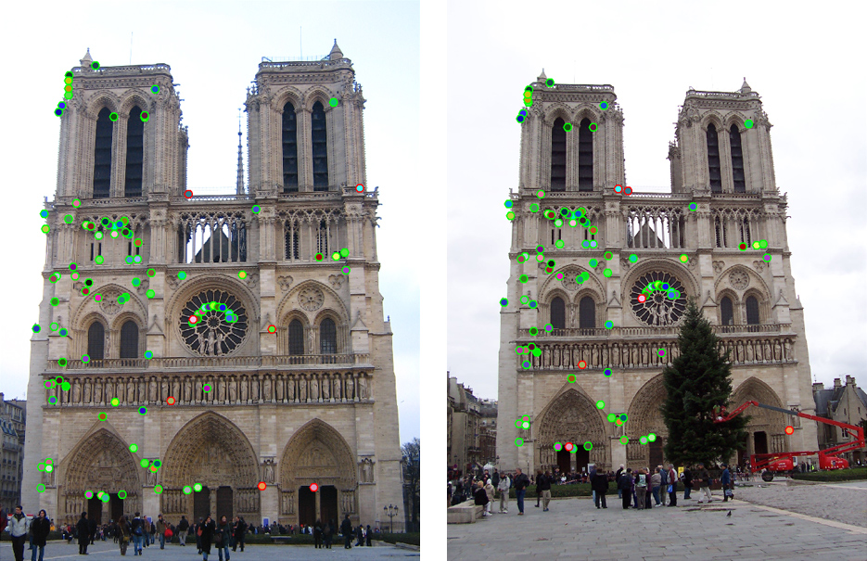
How do we fit the best alignment?

Slide 36
How do we fit the best alignment?

Slide 37
How do we fit the best alignment?

Slide 38
Alignment
Alignment: find parameters of model that maps one set of points to another
Typically want to solve for a global transformation that accounts for *most* true correspondences
Difficulties
  Noise (typically 1-3 pixels)
  Outliers (often 50%)
  Many-to-one matches or multiple objects

Slide 39
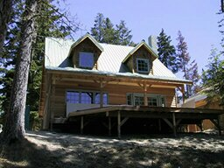
Parametric (global) warping
T
p = (x,y)
p’ = (x’,y’)
Transformation T is a coordinate-changing machine:
p’ = T(p)
What does it mean that T is global and parametric?
  Global: Is the same for any point p
  Parametric: can be described by just a few numbers
We’re going to focus on linear transformations, we can represent T as a matrix multiplication
p’ = Tp

Slide 40
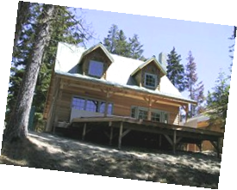
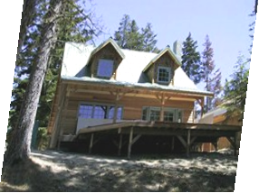
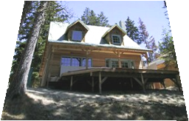
Common transformations
original
Transformed
translation
rotation
aspect
affine
perspective
Slide credit (next few slides): A. Efros and/or S. Seitz

Slide 41
Scaling
Scaling a coordinate means multiplying each of its components by a scalar
Uniform scaling means this scalar is the same for all components:
× 2

Slide 42
Scaling
Non-uniform scaling: different scalars per component:
X × 2,
Y × 0.5

Slide 43
Scaling
Scaling operation:
Or, in matrix form:
scaling matrix S

Slide 44
2-D Rotation (around the origin)
(x’, y’)
(x, y)
x’ = x cos(θ) - y sin(θ)
y’ = x sin(θ) + y cos(θ)
θ

Slide 45
2-D Rotation
Polar coordinates…
x = r cos (φ)
y = r sin (φ)
x’ = r cos (φ + θ)
y’ = r sin (φ + θ)
Trig Identity…
x’ = r cos(φ) cos(θ) – r sin(φ) sin(θ)
y’ = r sin(φ) cos(θ) + r cos(φ) sin(θ)
Substitute…
x’ = x cos(θ) - y sin(θ)
y’ = x sin(θ) + y cos(θ)
(x’, y’)
(x, y)
θ
φ

Slide 46
2-D Rotation
This is easy to capture in matrix form:
Even though sin(θ) and cos(θ) are nonlinear functions of θ,
  For a particular θ, x’ is a linear combination of x and y
  For a particular θ, y’ is a linear combination of x and y
What is the inverse transformation?
  Rotation by –θ
  For rotation matrices
R

Slide 47
Basic 2D transformations
Scale
Shear
Rotate
Translate
Affine is any combination of translation, scale, rotation, shear
Affine

Slide 48
2D Affine Transformations
Affine transformations are combinations of …
  Linear transformations, and
  Translations
Parallel lines remain parallel
Slide credit: Kristen Grauman

Slide 49
Projective Transformations
Projective transformations:
  Affine transformations, and
  Projective warps
Parallel lines do not necessarily remain parallel
Slide credit: Kristen Grauman

Slide 50
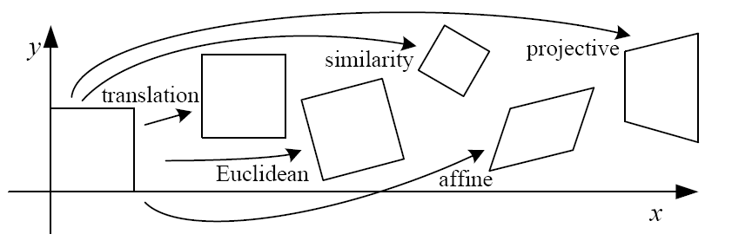
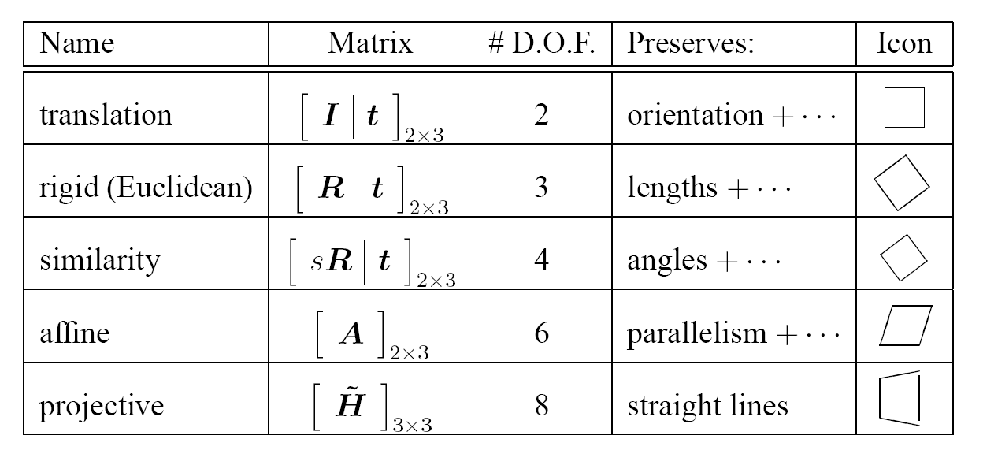
2D image transformations (reference table)
Szeliski 2.1

Slide 51
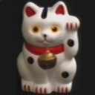
Example: solving for translation
A₁
A₂
A₃
B₁
B₂
B₃
Given matched points in {A} and {B}, estimate the translation of the object

Slide 52
Example: solving for translation
A₁
A₂
A₃
(t_{x}, t_{y})
B₁
B₂
B₃
Least squares solution
Write down objective function
Derived solution
  Compute derivative
  Compute solution
Computational solution
  Write in form Ax=b
  Solve using pseudo-inverse or eigenvalue decomposition

Slide 53
Example: solving for translation
A₁
A₅
B₄
A₂
A₃
(t_{x}, t_{y})
B₁
A₄
B₂
B₃
B₅
Problem: outliers
RANSAC solution
Sample a set of matching points (1 pair)
Solve for transformation parameters
Score parameters with number of inliers
Repeat steps 1-3 N times

Slide 54
Example: solving for translation
B₄
A₁
B₅
B₆
A₂
A₃
(t_{x}, t_{y})
B₁
A₄
B₂
B₃
A₅
A₆
Problem: outliers, multiple objects, and/or many-to-one matches
Hough transform solution
Initialize a grid of parameter values
Each matched pair casts a vote for consistent values
Find the parameters with the most votes
Solve using least squares with inliers

Slide 55
Example: solving for translation
(t_{x}, t_{y})
Problem: no initial guesses for correspondence

Slide 56
Fitting and Alignment: Methods
Global optimization / Search for parameters
  Least squares fit
  Robust least squares
  Other parameter search methods
Hypothesize and test
  Hough transform
  RANSAC
Iterative Closest Points (ICP)

Slide 57
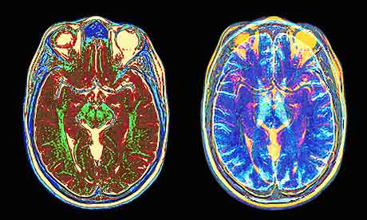
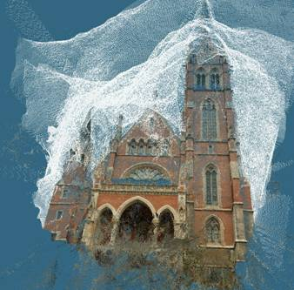
What if you want to align but have no prior matched pairs?
Hough transform and RANSAC not applicable
Important applications
Medical imaging: align brain scans or contours
Robotics: align point clouds

Slide 58
Iterative Closest Points (ICP) Algorithm
Goal: estimate transform between two dense sets of points
Initialize transformation (e.g., compute difference in means and scale)
Assign each point in {Set 1} to its nearest spatial neighbor in {Set 2}
Estimate transformation parameters
  e.g., least squares or robust least squares
Transform the points in {Set 1} using estimated parameters
Repeat steps 2-4 until change is very small

Slide 59
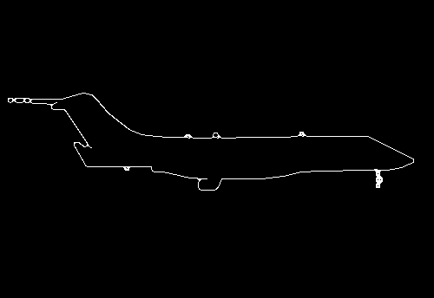
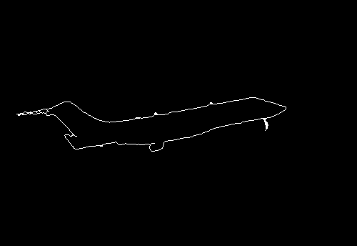

Example: aligning boundaries
Extract edge pixels $p1..pn$ and $q1..qm$
Compute initial transformation (e.g., compute translation and scaling by center of mass, variance within each image)
Get nearest neighbors: for each point $pi$ find corresponding $match(i)=\underset{j}{argmin}{dist(pi,qj)}$
Compute transformation T based on matches
Warp points p according to T
Repeat 3-5 until convergence
p
q

Slide 60
Example: solving for translation
(t_{x}, t_{y})
Problem: no initial guesses for correspondence
ICP solution
Find nearest neighbors for each point
Compute transform using matches
Move points using transform
Repeat steps 1-3 until convergence

Slide 61


Slide 62
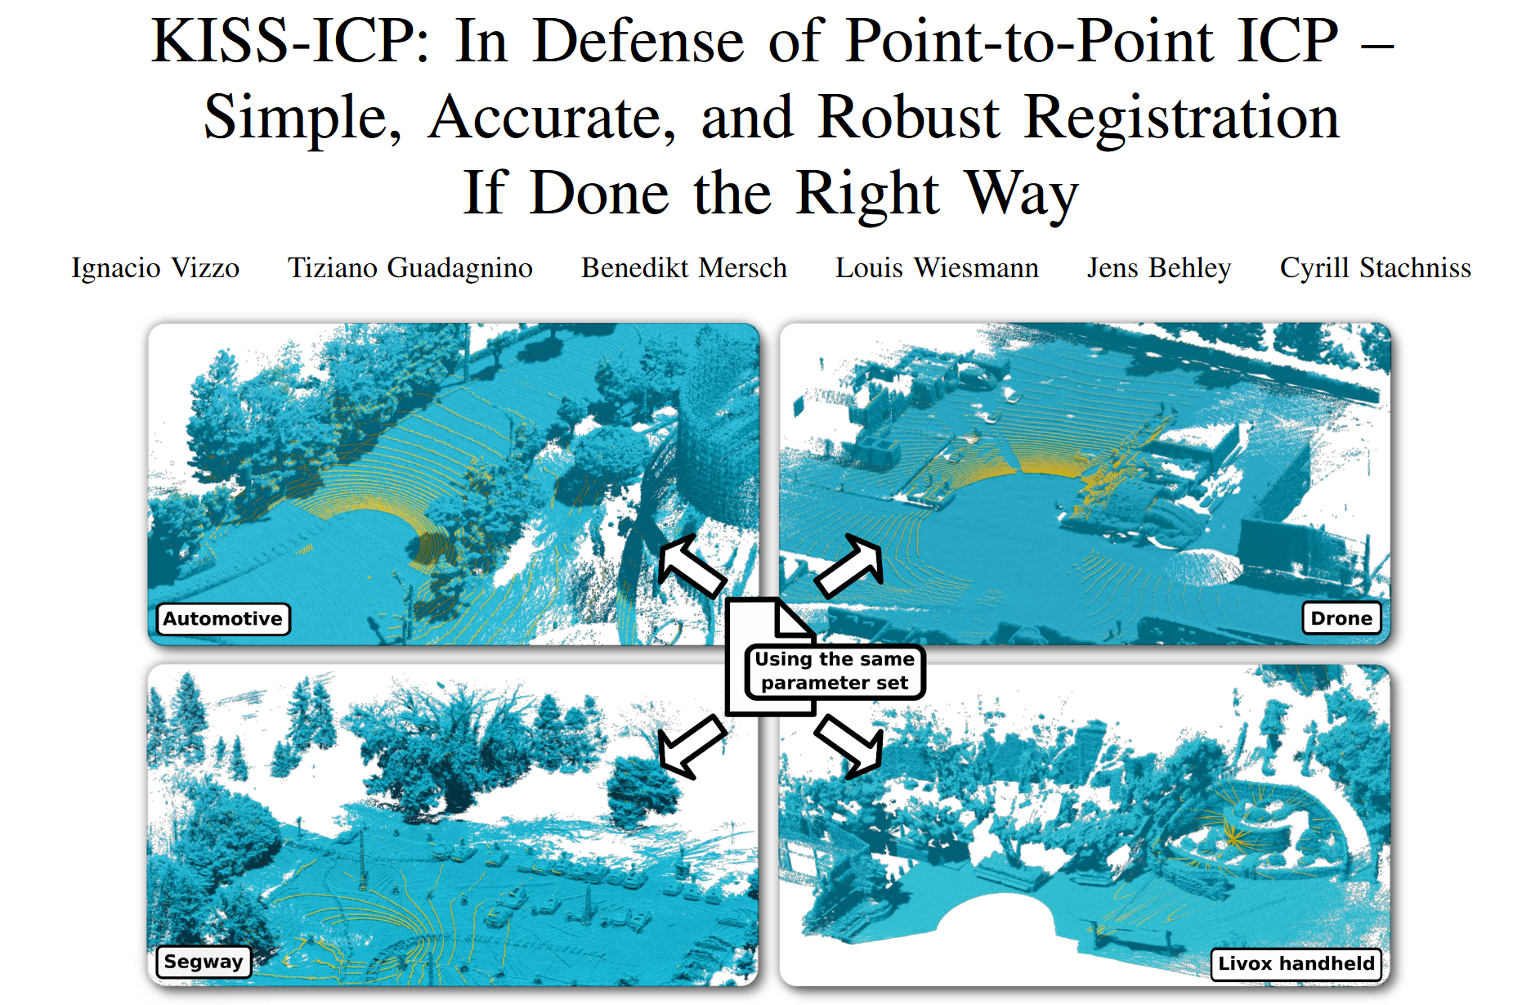

Slide 63
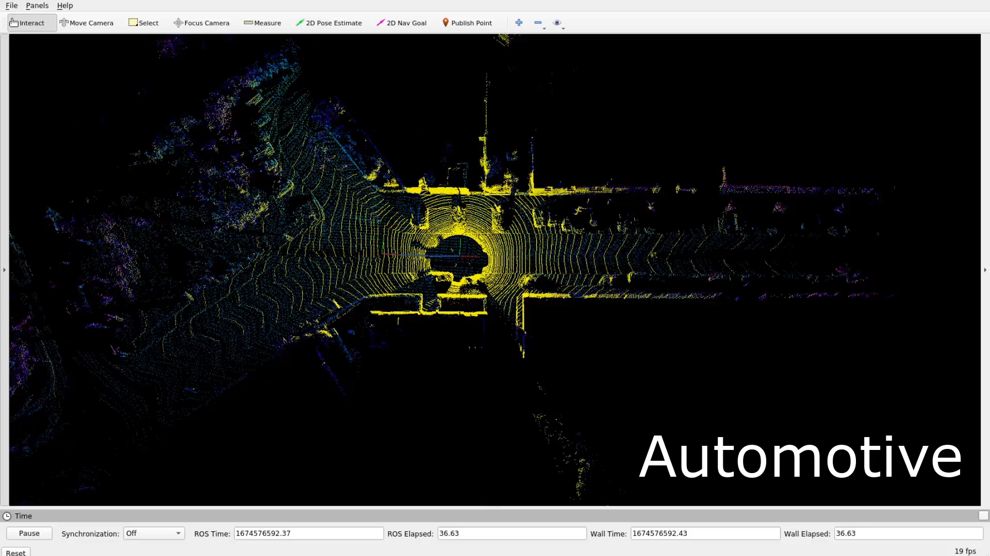

Slide 64
Algorithm Summaries
Least Squares Fit
  closed form solution
  robust to noise
  not robust to outliers
Robust Least Squares
  improves robustness to outliers
  requires iterative optimization
Hough transform
  robust to noise and outliers
  can fit multiple models
  only works for a few parameters (1-4 typically)
RANSAC
  robust to noise and outliers
  works with a moderate number of parameters (e.g, 1-8)
Iterative Closest Point (ICP)
  For local alignment only: does not require initial correspondences
  Sensitive to initialization

Slide 65
Rough count of mentions in recent literature
Keypoint 2,180 mentions
SIFT 3,530 mentions
“Least Squares” 2,290 mentions
“Robust Least Squares” 4 mentions
Hough: 901 mentions
RANSAC: 1,690 mentions
ICP: 895 mentions
Affine 2,970
ResNet: 8,510 mentions
Google search for site:https://openaccess.thecvf.com [term]
Seems to find results since 2013.

Slide 66
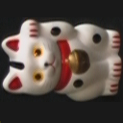
Object Instance Recognition
Match keypoints to object model
Solve for affine transformation parameters
Score by inliers and choose solutions with score above threshold
A₁
B₃
A₃
A₂
Matched keypoints
B₁
B₂
Affine Parameters
This Class
# Inliers
Choose hypothesis with max score above threshold

Slide 67


Overview of Keypoint Matching
1. Find a set of
distinctive key-
points
A₁
B₃
2. Define a region
around each
keypoint
A₂
A₃
B₁
B₂
3. Extract and
normalize the
region content
4. Compute a local
descriptor from the
normalized region
N pixels
e.g. color
e.g. color
N pixels
5. Match local
descriptors

Slide 68
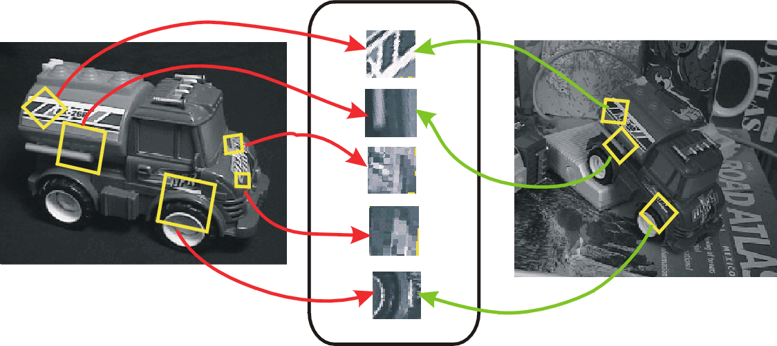
Keypoint-based instance recognition
Given two images and their keypoints (position, scale, orientation, descriptor)
Goal: Verify if they belong to a consistent configuration
Local Features,
e.g. SIFT
Slide credit: David Lowe

Slide 69
Finding the objects (overview)
Input Image
Stored Image
Match interest points from input image to database image
Matched points vote for rough position/orientation/scale of object
Find position/orientation/scales that have at least three votes
Compute affine registration and matches using iterative least squares with outlier check
Report object if there are at least T matched points

Slide 70
Matching Keypoints
Want to match keypoints between:
  Query image
  Stored image containing the object
Given descriptor x₀, find two nearest neighbors x₁, x₂ with distances d₁, d₂
x₁ matches x₀ if d₁/d₂ < 0.8
  This gets rid of 90% false matches, 5% of true matches in Lowe’s study

Slide 71
Affine Object Model
Accounts for 3D rotation of a surface under orthographic projection

Slide 72

Affine Object Model
Accounts for 3D rotation of a surface under orthographic projection
What is the minimum number of matched points that we need?

Slide 73
Finding the objects (SIFT, Lowe 2004)
Match interest points from input image to database image
Get location/scale/orientation using Hough voting
  In training, each point has known position/scale/orientation wrt whole object
  Matched points vote for the position, scale, and orientation of the entire object
  Bins for x, y, scale, orientation
    Wide bins (0.25 object length in position, 2x scale, 30 degrees orientation)
    Vote for two closest bin centers in each direction (16 votes total)
Geometric verification
  For each bin with at least 3 keypoints
  Iterate between least squares fit and checking for inliers and outliers
Report object if > T inliers (T is typically 3, can be computed to match some probabilistic threshold)

Slide 74
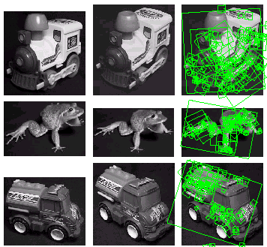
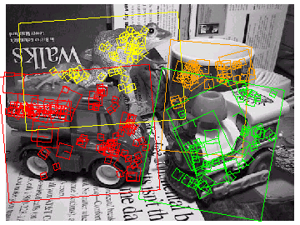
Examples of recognized objects

