Slide 1
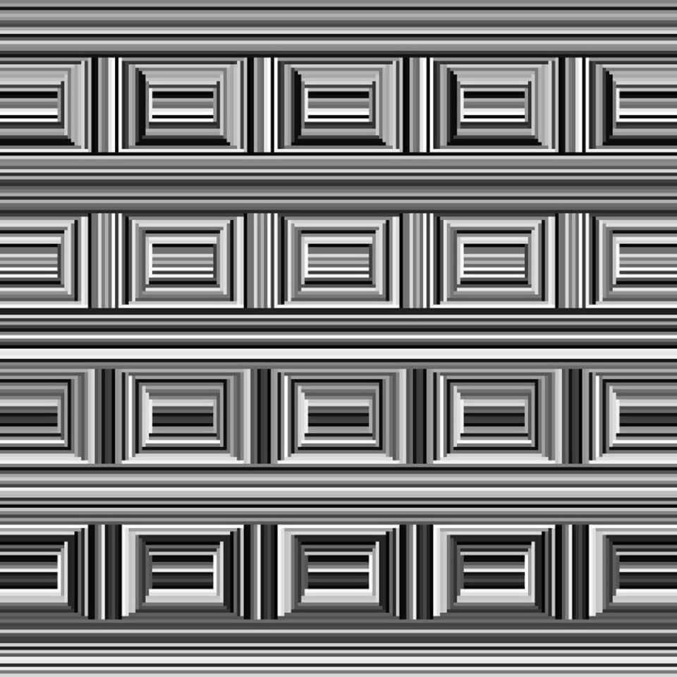

Slide 2
Notes:
http://www.erikjohanssonphoto.com/

Slide 3
Stereo and lidar can fall victim to reflections?
Yes, there’s no easy way around that
https://youtu.be/pBzU8TD1iks

Slide 4
Last lecture: World vs Camera coordinates

Slide 5
Today’s Outline
Epipolar Geometry
Finding epipolar relationship between two images
Using epipolar geometry to rule out outliers
Finding dense correspondence along epipolar lines

Slide 6
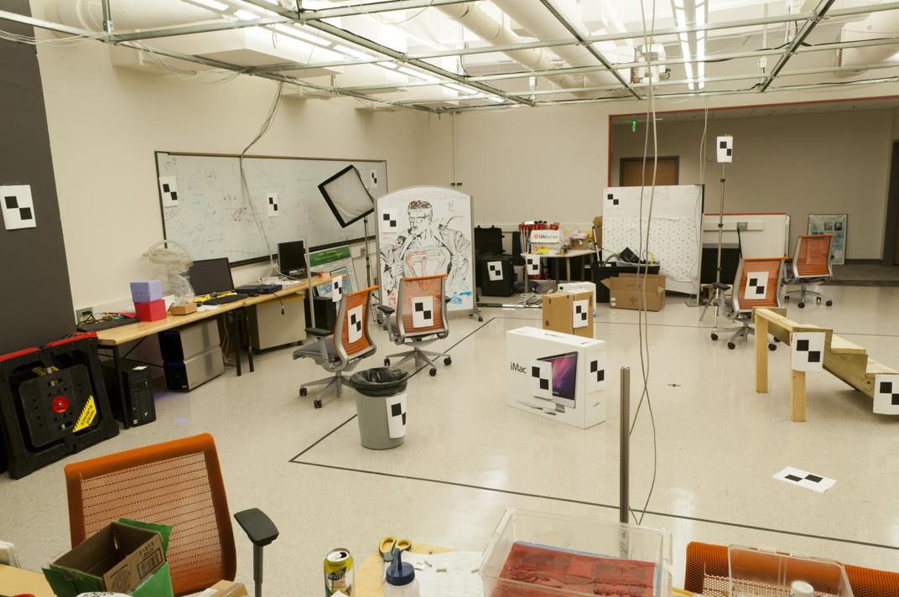
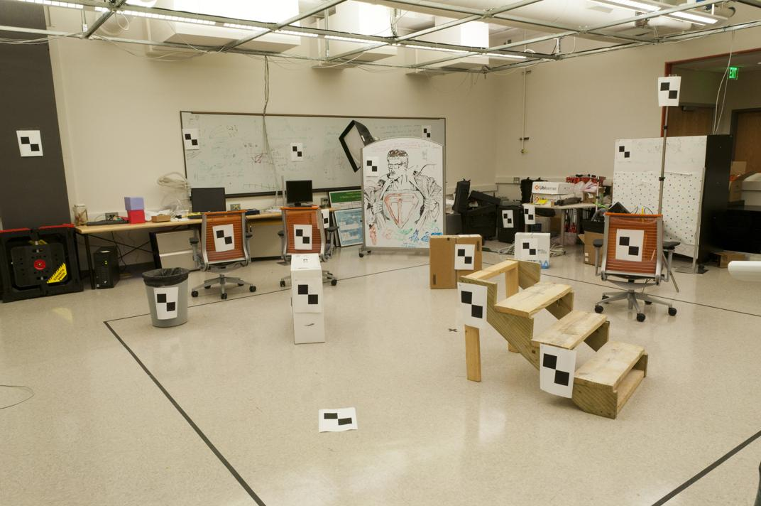
Where do we need to search?

Slide 7
Epipolar Geometry and Stereo Vision
Chapter 11.3 in Szeliski
Many slides adapted from Derek Hoiem, Lana Lazebnik, Silvio Saverese, Steve Seitz, many figures from Hartley & Zisserman

Slide 8
Epipolar geometry
Relates cameras from two positions

Slide 9
Depth from Stereo
Goal: recover depth by finding image coordinate x’ that corresponds to x
X
X
x
z
x
x’
x'
f
f
C
Baseline B
C’

Slide 10
Depth from Stereo
Goal: recover depth by finding image coordinate x’ that corresponds to x
Sub-Problems
Calibration: How do we recover the relation of the cameras (if not already known)?
Correspondence: How do we search for the matching point x’?
X
x
x'

Slide 11
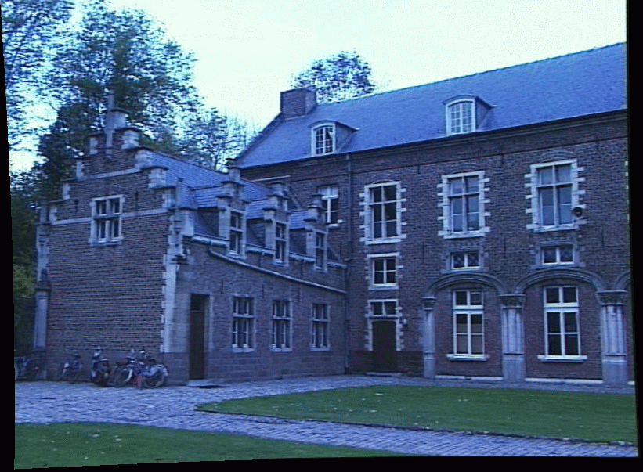
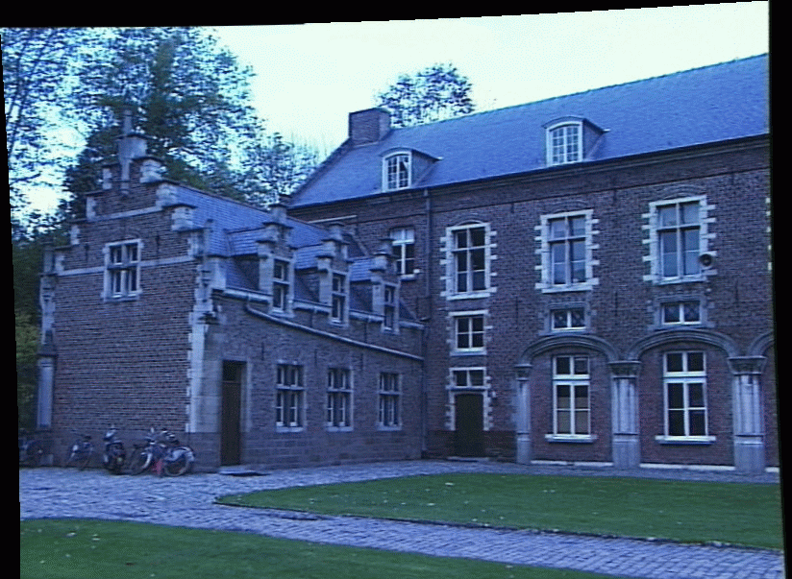
Correspondence Problem
x
?
We have two images taken from cameras with different intrinsic and extrinsic parameters
How do we match a point in the first image to a point in the second? How can we constrain our search?

Slide 12
Where do we need to search?

Slide 13
Key idea: Epipolar constraint

Slide 14
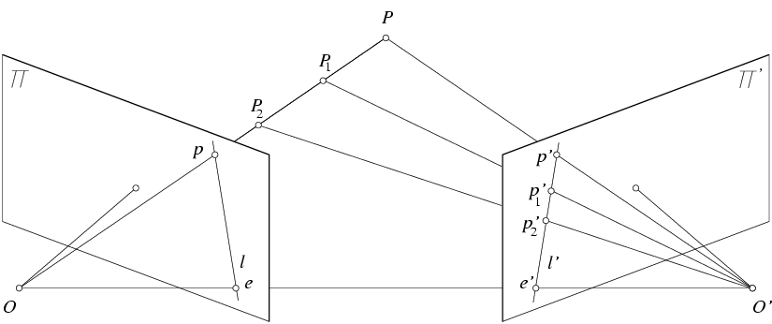
Key idea: Epipolar constraint
X
X
X
x
x’
x’
x’
Potential matches for x have to lie on the corresponding line l’.
Potential matches for x’ have to lie on the corresponding line l.

Slide 15
Wouldn’t it be nice to know where matches can live? To constrain our 2d search to 1d.

Slide 16
VLFeat’s 800 most confident matches among 10,000+ local features.

Slide 17
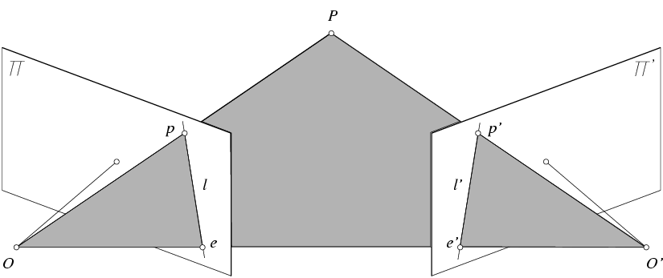
Epipolar geometry: notation
X
x
x’
Baseline – line connecting the two camera centers
Epipoles
= intersections of baseline with image planes
= projections of the other camera center
Epipolar Plane – plane containing baseline (1D family)

Slide 18
Epipolar geometry: notation
X
x
x’
Baseline – line connecting the two camera centers
Epipoles
= intersections of baseline with image planes
= projections of the other camera center
Epipolar Plane – plane containing baseline (1D family)
Epipolar Lines - intersections of epipolar plane with image planes (always come in corresponding pairs)

Slide 19
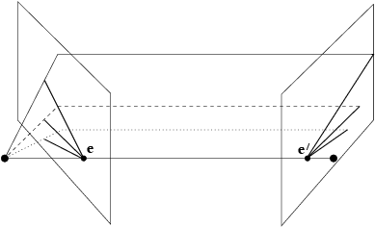
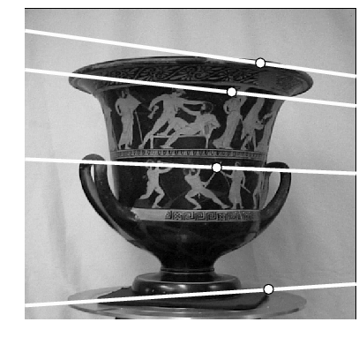
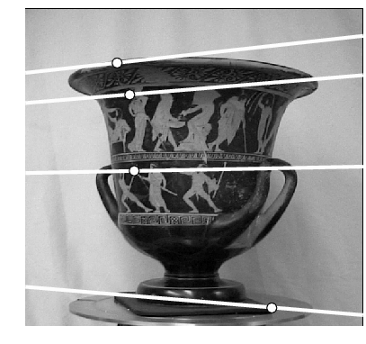
Example: Converging cameras

Slide 20
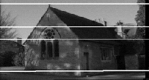
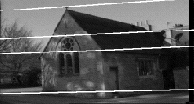
Example: Motion or displacement parallel to image plane

Slide 21
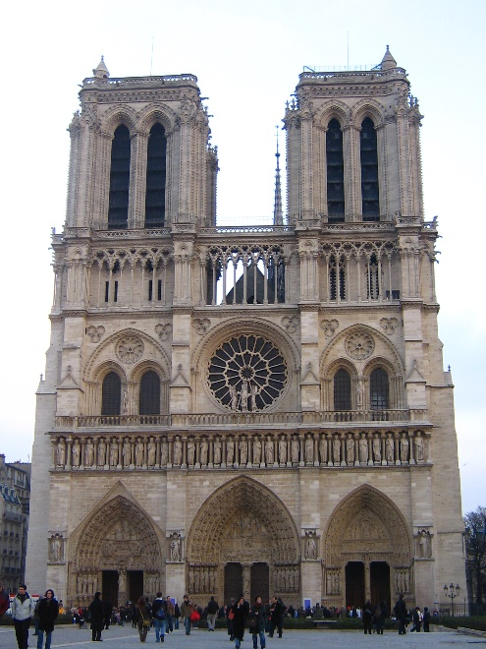
Example: Forward motion
What would the epipolar lines look like if the camera moves directly forward?
a
b
c
d

Slide 22
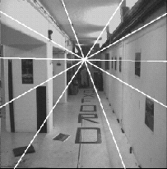
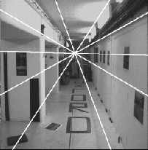
Example: Forward motion
e’
e
Epipole has same coordinates in both images.
Points move along lines radiating from e: “Focus of expansion”

Slide 23
Epipolar constraint: Calibrated case
X
x
x’
Given the intrinsic parameters of the cameras:
Convert to normalized coordinates by pre-multiplying all points with the inverse of the calibration matrix; set first camera’s coordinate system to world coordinates
3D scene point
Homogeneous 2d point (3D ray towards X)
2D pixel coordinate (homogeneous)
3D scene point in 2nd camera’s 3D coordinates

Slide 24
Epipolar constraint: Calibrated case
X
x
x’
Given the intrinsic parameters of the cameras:
Convert to normalized coordinates by pre-multiplying all points with the inverse of the calibration matrix; set first camera’s coordinate system to world coordinates
Define some R and t that relate X to X’ as below
for some scale factor

Slide 25
Epipolar constraint: Calibrated case
X
x
x’
$$\hat{x}$$
$${\hat{x}}^{′}$$
(because $\hat{x}, R{\hat{x}}^{′},$ and $t$ are co-planar)
Notes:
X’ is X in the second camera’s coordinate system
We can identify the non-homogeneous 3D vectors X and X’ with the homogeneous coordinate vectors x and x’ of the projections of the two points into the two respective images

Slide 26
Essential matrix
X
x
x’
Essential Matrix
(Longuet-Higgins, 1981)
Notes:
[t]_{x} is the skew symmetric matrix of t

Slide 27
Properties of the Essential matrix
X
x
x’
Drop ^ below to simplify notation
Skew-symmetric matrix
E x’ is the epipolar line associated with x’ (l = E x’)
E^{T}x is the epipolar line associated with x (l’ = E^{T}x)
E e’ = 0 and E^{T}e = 0
E is singular (rank two)
E has five degrees of freedom
(3 for R, 2 for t because it’s up to a scale)

Slide 28
Epipolar constraint: Uncalibrated case
X
x
x’
If we don’t know K and K’, then we can write the epipolar constraint in terms of unknown normalized coordinates:

Slide 29
The Fundamental Matrix
Without knowing K and K’, we can define a similar relation using unknown normalized coordinates
Fundamental Matrix
(Faugeras and Luong, 1992)

Slide 30
Properties of the Fundamental matrix
X
x
x’
F x’ = 0 is the epipolar line associated with x’
F^{T}x = 0 is the epipolar line associated with x
F e’ = 0 and F^{T}e = 0
F is singular (rank two): det(F)=0
F has seven degrees of freedom: 9 entries but defined up to scale, det(F)=0

Slide 31
Estimating the Fundamental Matrix
8-point algorithm
Least squares solution using SVD on equations from 8 pairs of correspondences
Enforce det(F)=0 constraint using SVD on F
7-point algorithm
Use least squares to solve for null space (two vectors) using SVD and 7 pairs of correspondences
Solve for linear combination of null space vectors that satisfies det(F)=0
Minimize reprojection error
Non-linear least squares
Note: estimation of F (or E) is degenerate for a planar scene.

Slide 32
8-point algorithm
Solve a system of homogeneous linear equations
Write down the system of equations
$$uu^{′}f_{11}+uv^{′}f_{12}+uf_{13}+vu^{′}f_{21}+vv^{′}f_{22}+vf_{23}+u^{′}f_{31}+v^{′}f_{32}+f_{33}=0$$
$Af=\left[\begin{matrix}u_{1}u_{1}′ & u_{1}v_{1}′ & \begin{matrix}u_{1} & v_{1}u_{1}′ & \begin{matrix}v_{1}v_{1}′ & v_{1} & \begin{matrix}u_{1}′ & v_{1}′ & 1\end{matrix}\end{matrix}\end{matrix} \\ \begin{matrix}⋮ \\ u_{n}u_{v}^{′}\end{matrix} & \begin{matrix}⋮ \\ u_{n}v_{n}′\end{matrix} & \begin{matrix}\begin{matrix}⋮ \\ u_{n}\end{matrix} & \begin{matrix}⋮ \\ v_{n}u_{n}′\end{matrix} & \begin{matrix}\begin{matrix}⋮ \\ v_{n}v_{n}′\end{matrix} & \begin{matrix}⋮ \\ v_{n}\end{matrix} & \begin{matrix}\begin{matrix}⋮ \\ u_{n}′\end{matrix} & \begin{matrix}⋮ \\ v_{n}′\end{matrix} & \begin{matrix}⋮ \\ 1\end{matrix}\end{matrix}\end{matrix}\end{matrix}\end{matrix}\right]\left[\begin{matrix}f_{11} \\ f_{12} \\ \begin{aligned}f_{13} \\ f_{21} \\ ⋮ \\ f_{33}\end{aligned}\end{matrix}\right]$=0

Slide 33
8-point algorithm
Solve a system of homogeneous linear equations
Write down the system of equations
Solve f from Af=0 using SVD
Matlab:
[U, S, V] = svd(A);
f = V(:, end);
F = reshape(f, [3 3])’;
For python, see
numpy.linalg.svd

Slide 34
Need to enforce singularity constraint

Slide 35
8-point algorithm
Solve a system of homogeneous linear equations
Write down the system of equations
Solve f from Af=0 using SVD
Resolve det(F) = 0 constraint using SVD
Matlab:
[U, S, V] = svd(A);
f = V(:, end);
F = reshape(f, [3 3])’;
Matlab:
[U, S, V] = svd(F);
S(3,3) = 0;
F = U*S*V’;
For python, see
numpy.linalg.svd

Slide 36
8-point algorithm
Solve a system of homogeneous linear equations
Write down the system of equations
Solve f from Af=0 using SVD
Resolve det(F) = 0 constraint by SVD
Notes:
Use RANSAC to deal with outliers (sample 8 points)
How to test for outliers?
Notes:
Test for outliers by computing distance from epipolar line to corresponding point (NOT by taking square of x^{T}Fx’)

Slide 37
How to test for outliers?

Slide 38
Problem with eight-point algorithm

Slide 39
Problem with eight-point algorithm
Poor numerical conditioning
Can be fixed by rescaling the data

Slide 40
The normalized eight-point algorithm
(Hartley, 1995)
Center the image data at the origin, and scale it so the mean squared distance between the origin and the data points is 2 pixels
Use the eight-point algorithm to compute F from the normalized points
Enforce the rank-2 constraint (for example, take SVD of F and throw out the smallest singular value)
Transform fundamental matrix back to original units: if T and T’ are the normalizing transformations in the two images, than the fundamental matrix in original coordinates is T’^{T} F T

Slide 41
VLFeat’s 800 most confident matches among 10,000+ local features.

Slide 42
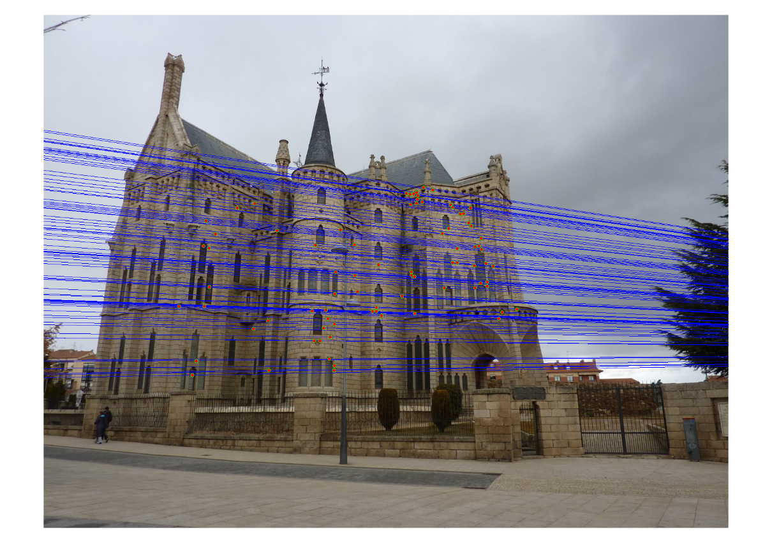
Epipolar lines

Slide 43
Keep only the matches at are “inliers” with respect to the “best” fundamental matrix

Slide 44
The scale of algorithm name quality
better
RANSAC
SIFT
Deep Learning
Optical Flow
Hough Transform
Neural Networks
Essential and Fundamental Matrix
worse
Dynamic Programming

Slide 45
In class written Quiz format
15 to 20 short answer or multiple choice questions
Typically can be done in half an hour
No calculators needed
Closed book
Only covers material discussed in class, not book. But the book is still a useful resource
Covers all material through the quiz date

Slide 46
7-point algorithm
Faster (need fewer points) and could be more robust (fewer points), but also need to check for degenerate cases

Slide 47
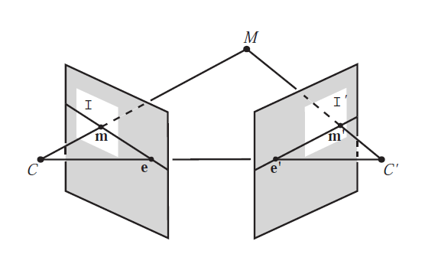
“Gold standard” algorithm
Use 8-point algorithm to get initial value of F
Use F to solve for P and P’ (discussed later)
Jointly solve for 3d points X and F that minimize the squared re-projection error
X
x
x'
See Algorithm 11.2 and Algorithm 11.3 in HZ (pages 284-285) for details

Slide 48
Comparison of estimation algorithms
 | 8-point | Normalized 8-point | Nonlinear least squares
Av. Dist. 1 | 2.33 pixels | 0.92 pixel | 0.86 pixel
Av. Dist. 2 | 2.18 pixels | 0.85 pixel | 0.80 pixel

Slide 49
We can get projection matrices P and P’ up to a projective ambiguity
Code:
function P = vgg_P_from_F(F)
[U,S,V] = svd(F);
e = U(:,3);
P = [-vgg_contreps(e)*F e];
K’*rotation
K’*translation
See HZ p. 255-256
If we know the intrinsic matrices (K and K’), we can resolve the ambiguity

Slide 50
From epipolar geometry to camera calibration
Estimating the fundamental matrix is known as “weak calibration”
We cIf we know the calibration matrices of the two cameras, we can estimate the essential matrix: E = K^{T}FK’
The essential matrix gives us the relative rotation and translation between the cameras, or their extrinsic parameters

Slide 51
Let’s recap…
Fundamental matrix song

