Slide 1
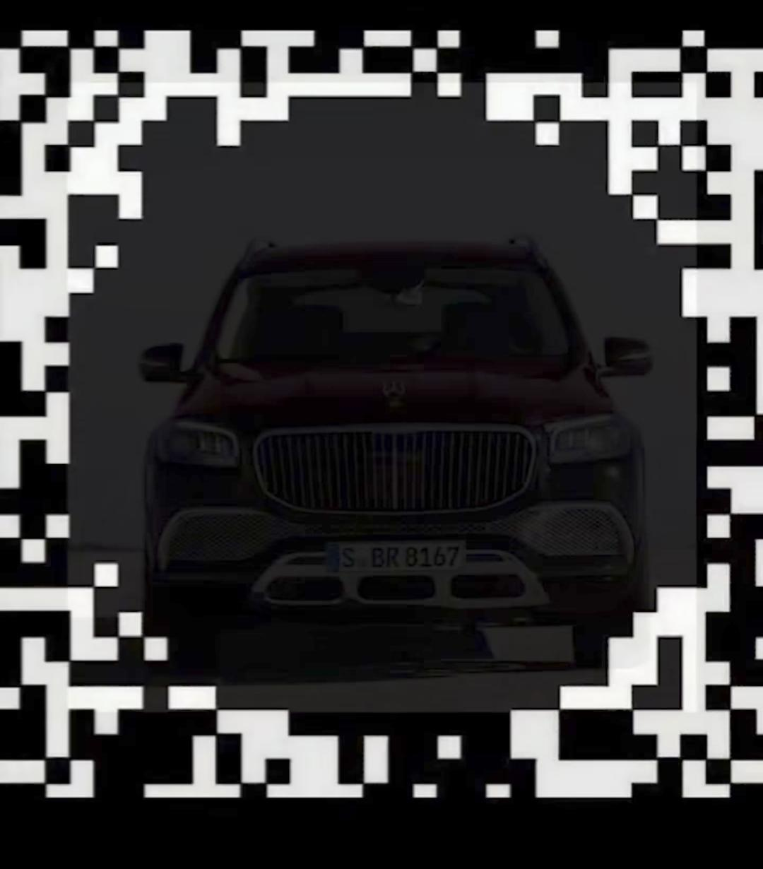

Slide 2
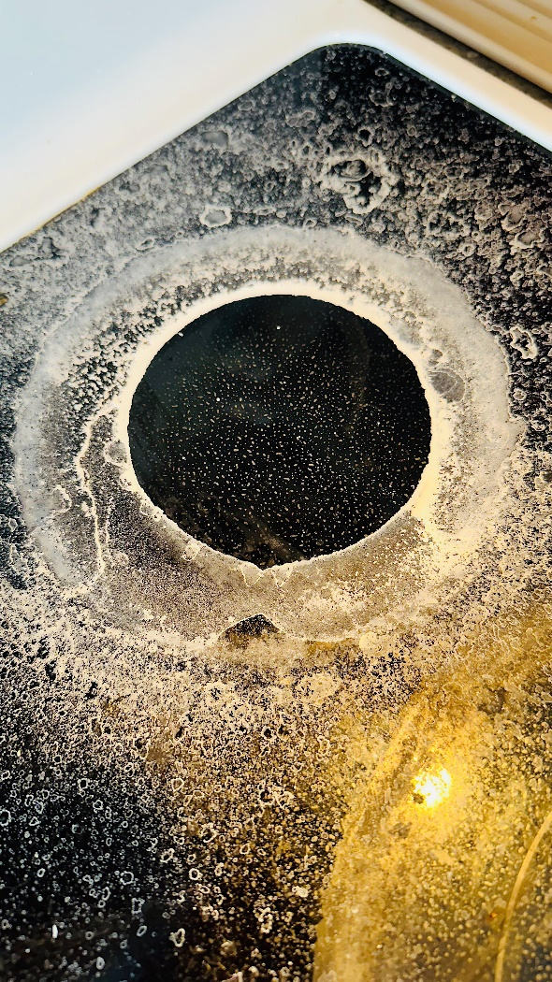
spilled sodium bicarbonate on the stove

Slide 3
spilled sodium bicarbonate on the stove

Slide 4
spilled sodium bicarbonate on the stove

Slide 5
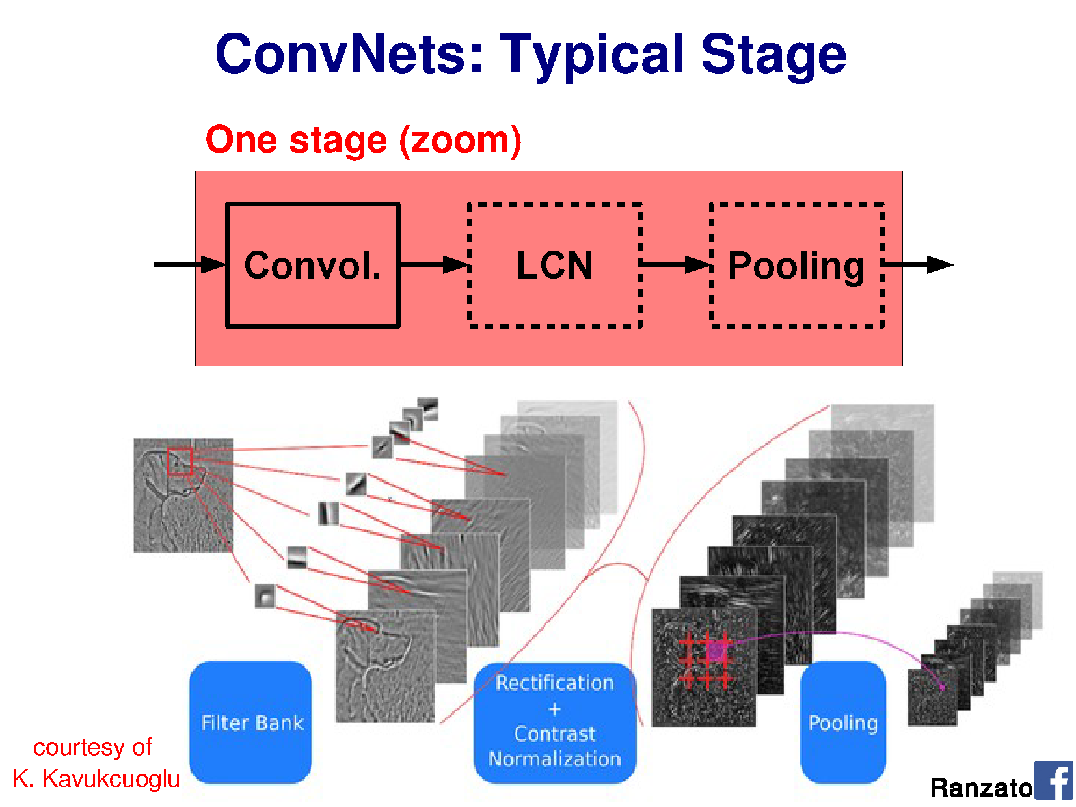

Slide 6
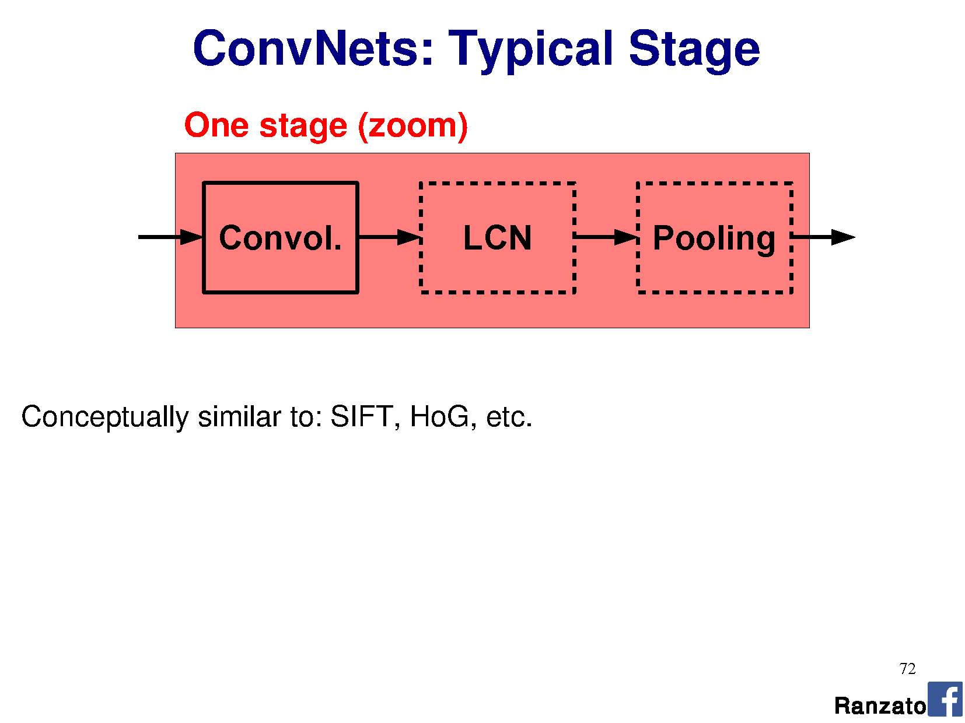

Slide 7
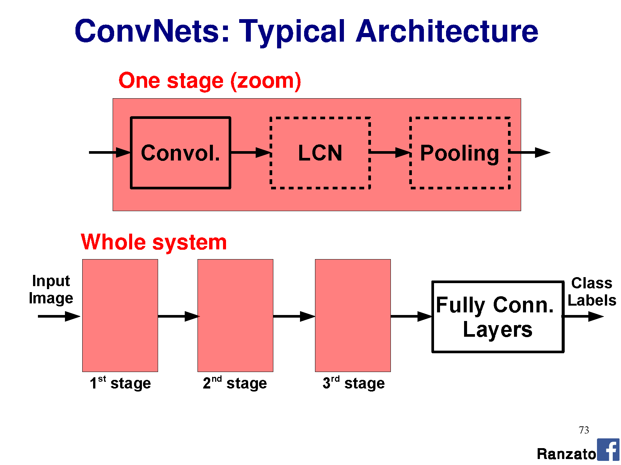

Slide 8
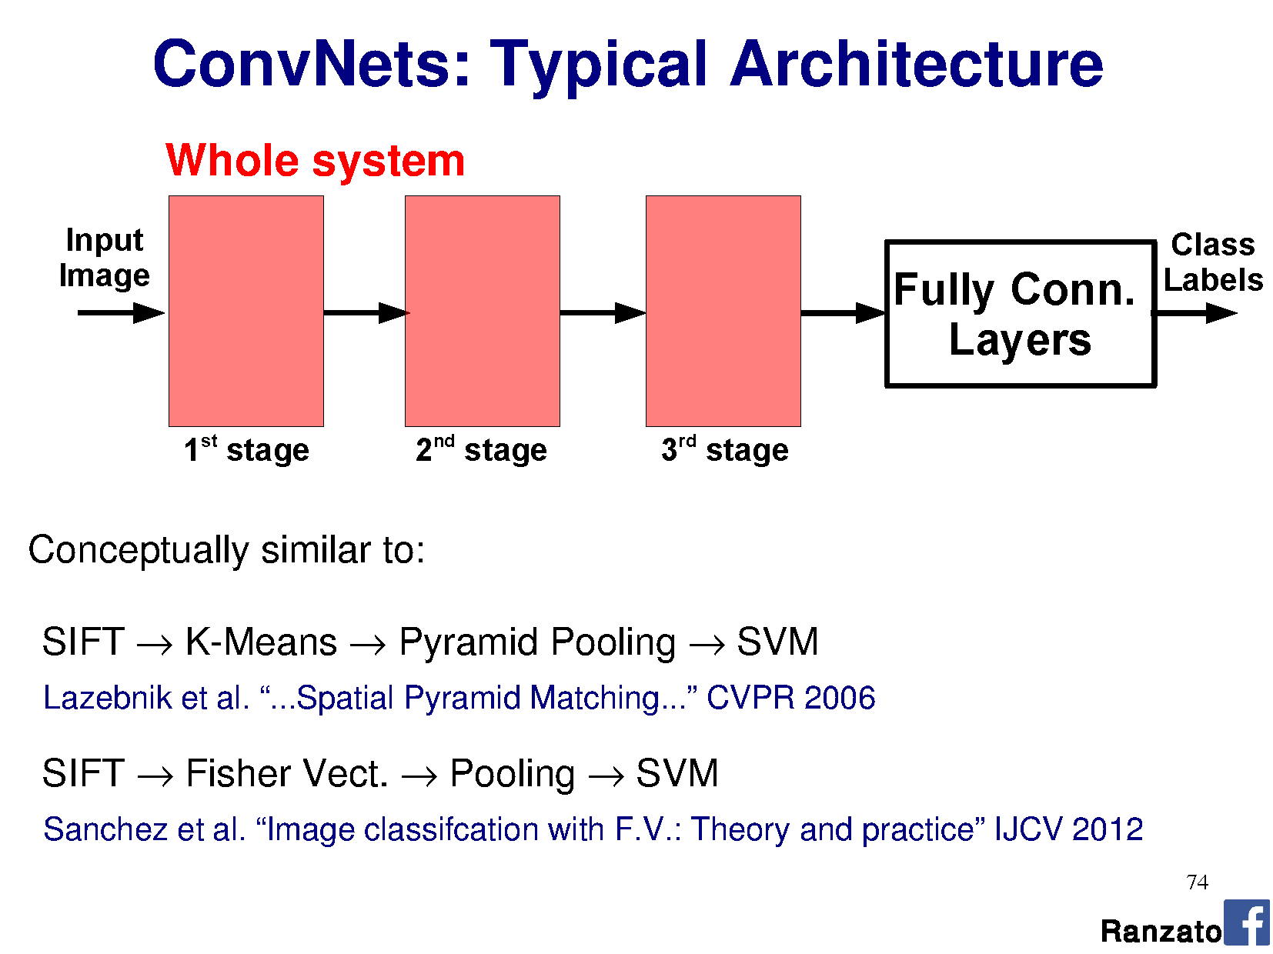

Slide 9
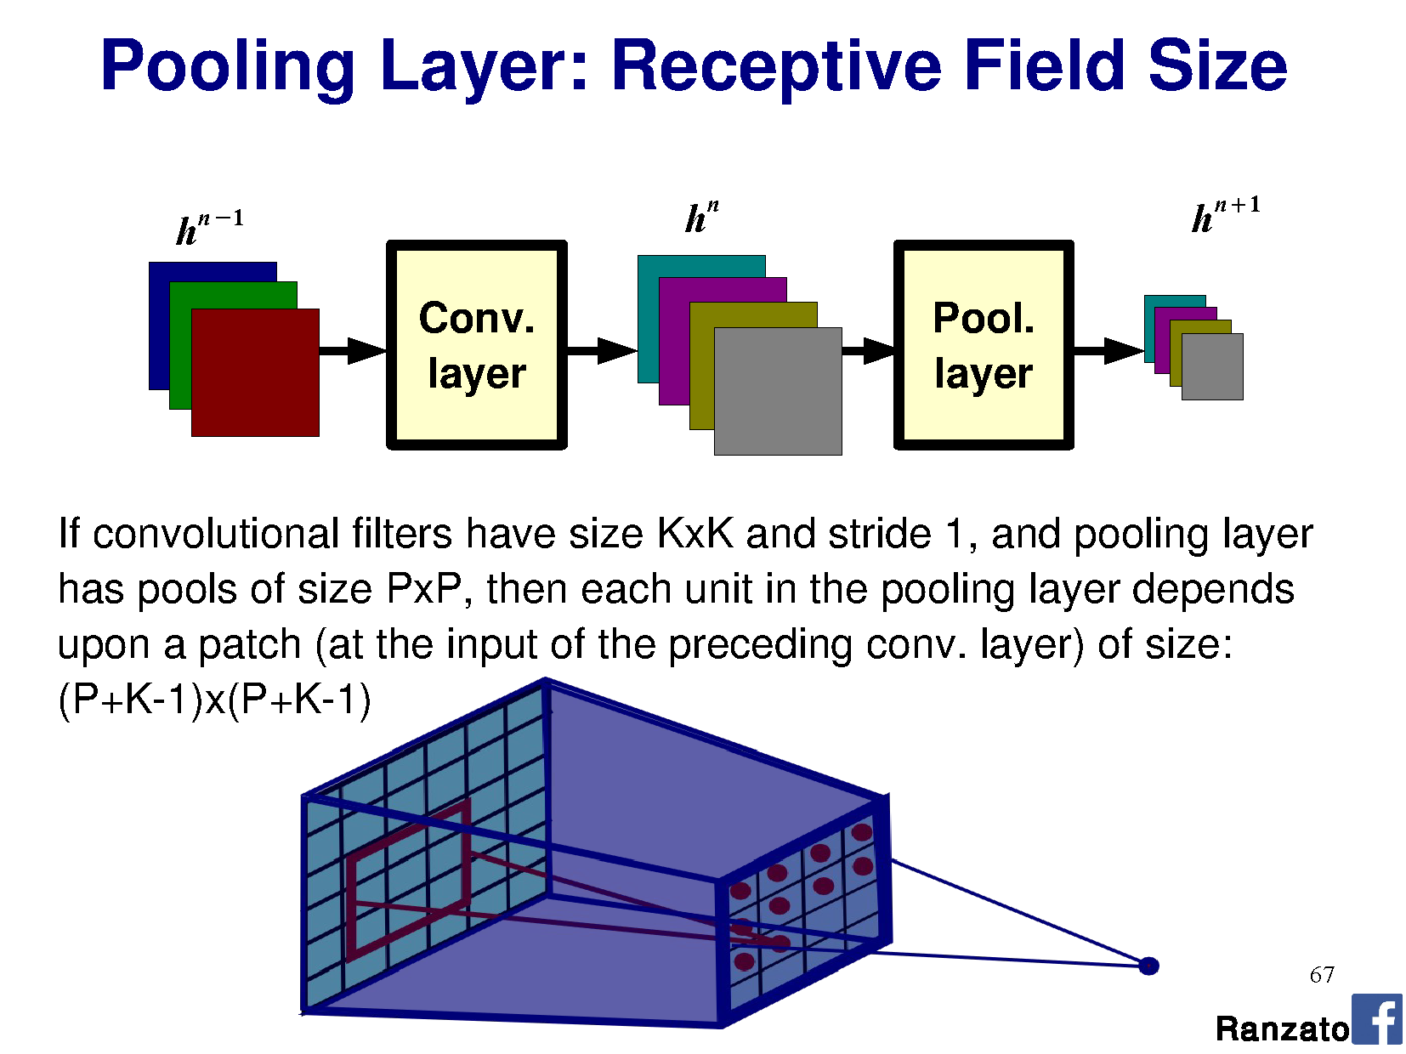

Slide 10
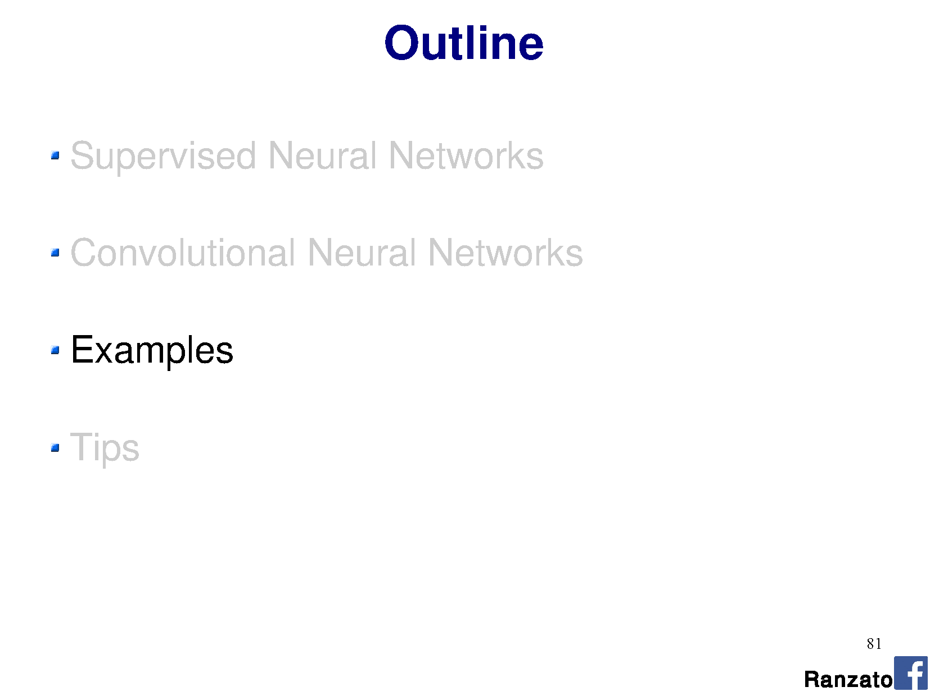

Slide 11
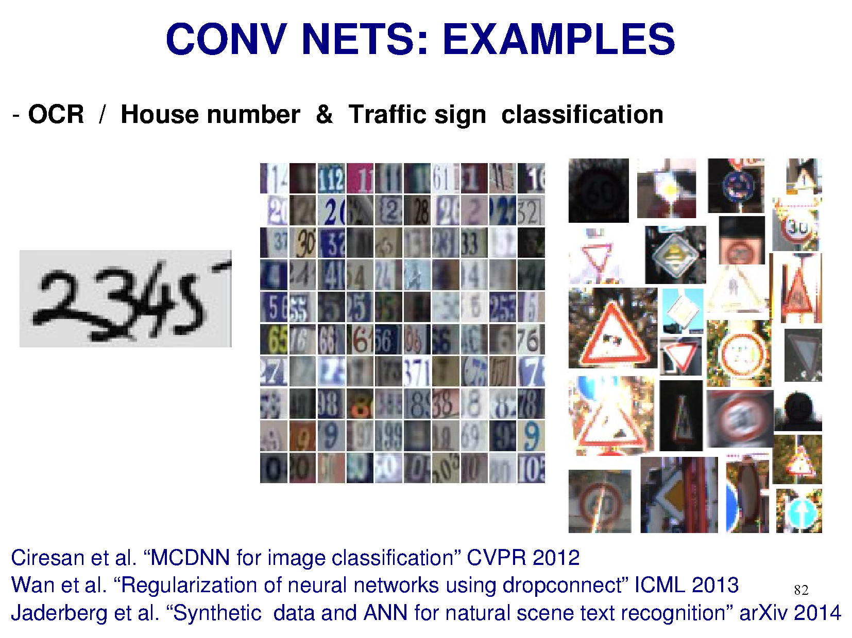

Slide 12
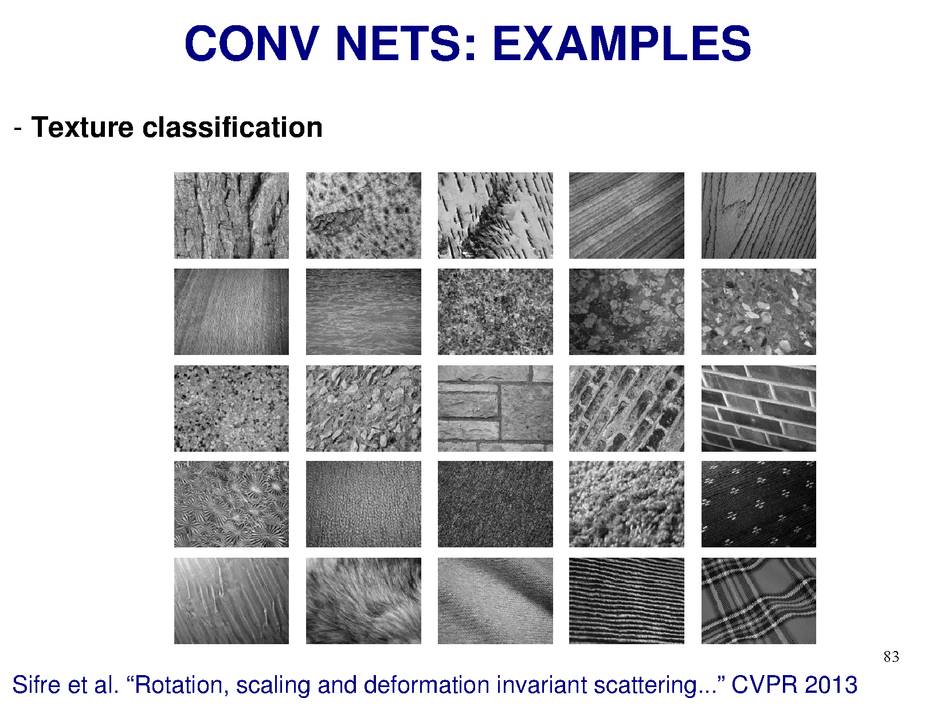

Slide 13
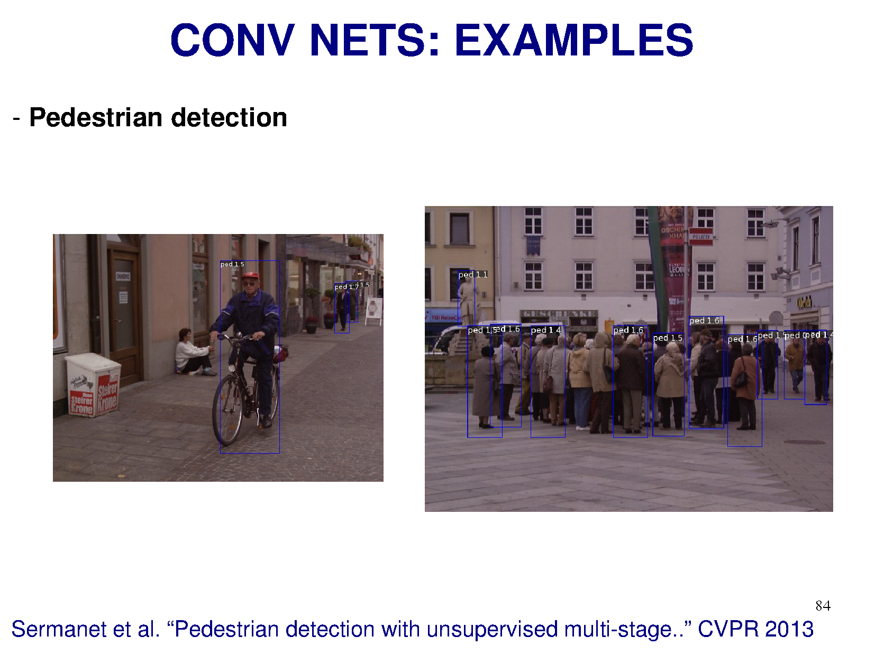

Slide 14
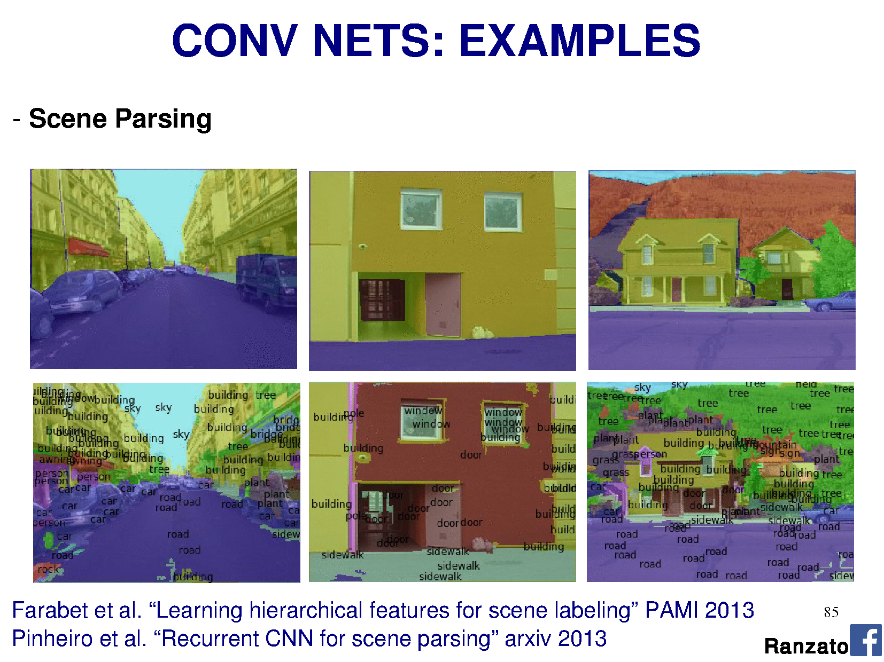

Slide 15
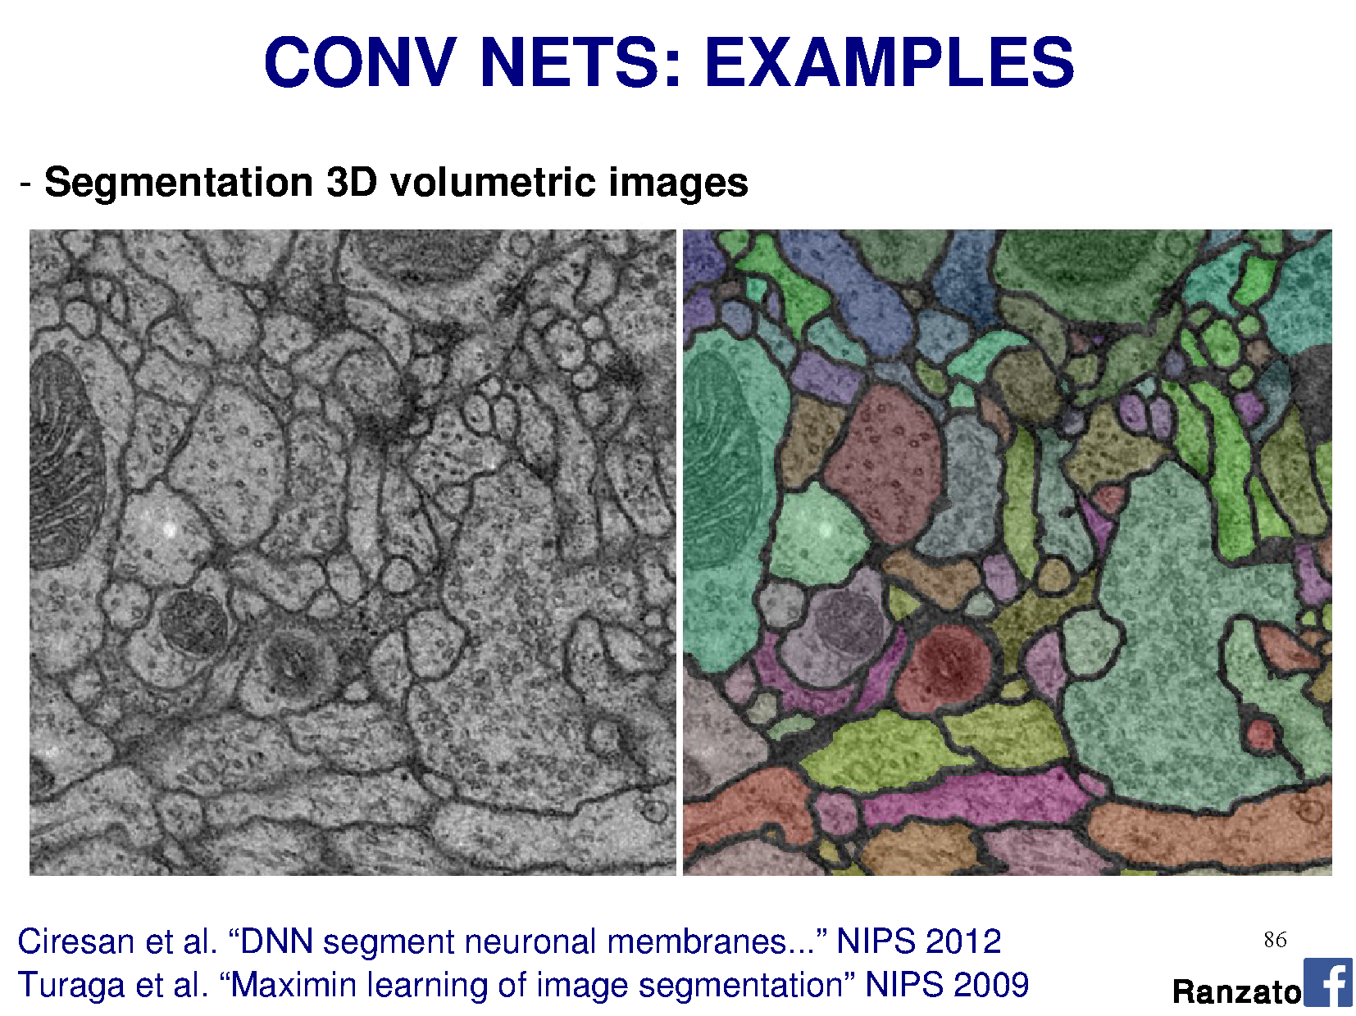

Slide 16
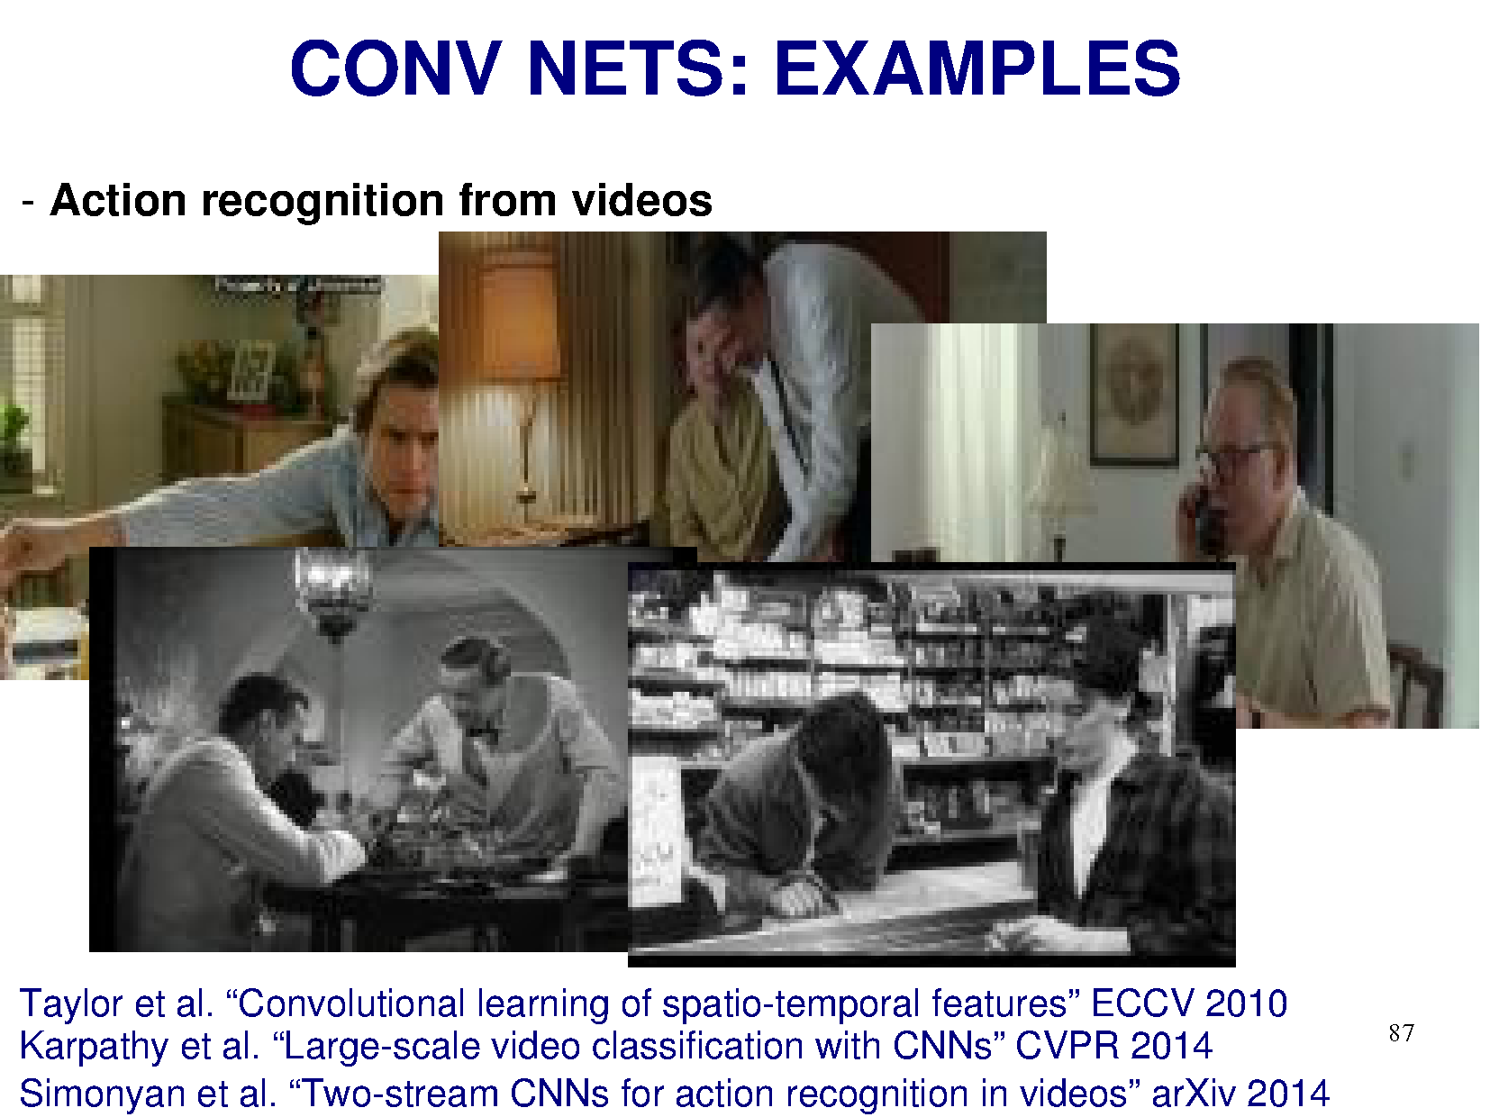

Slide 17
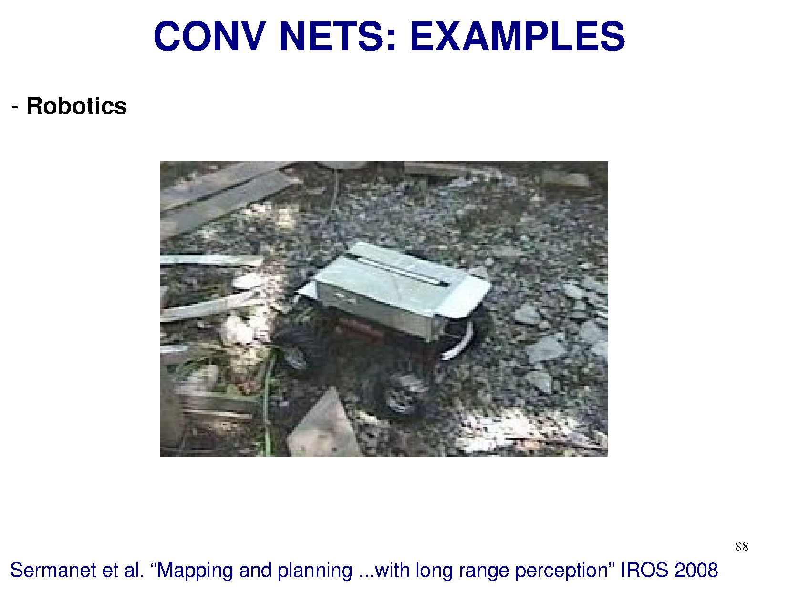

Slide 18
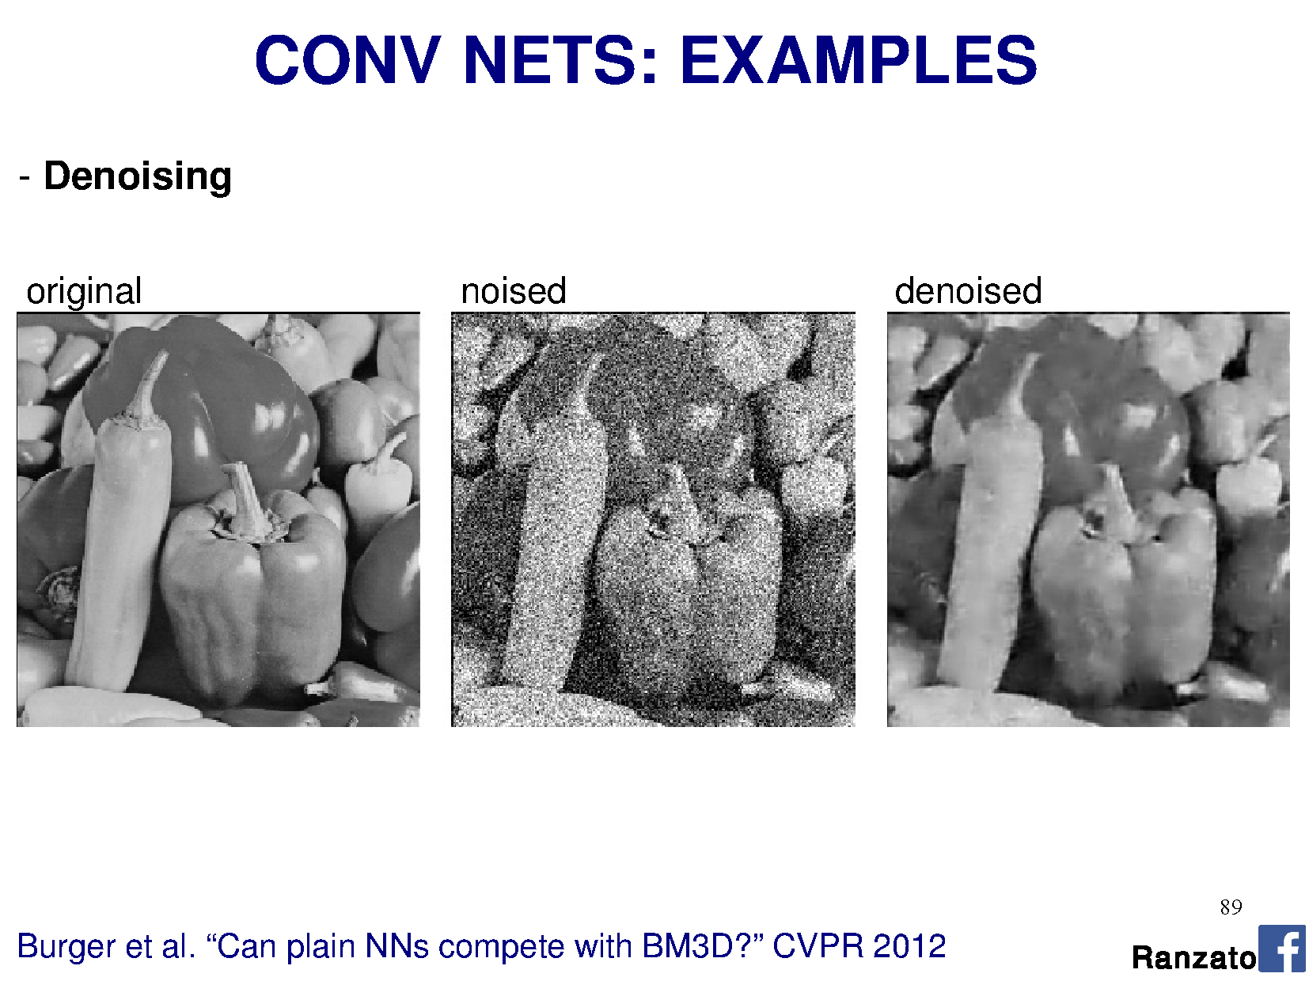

Slide 19
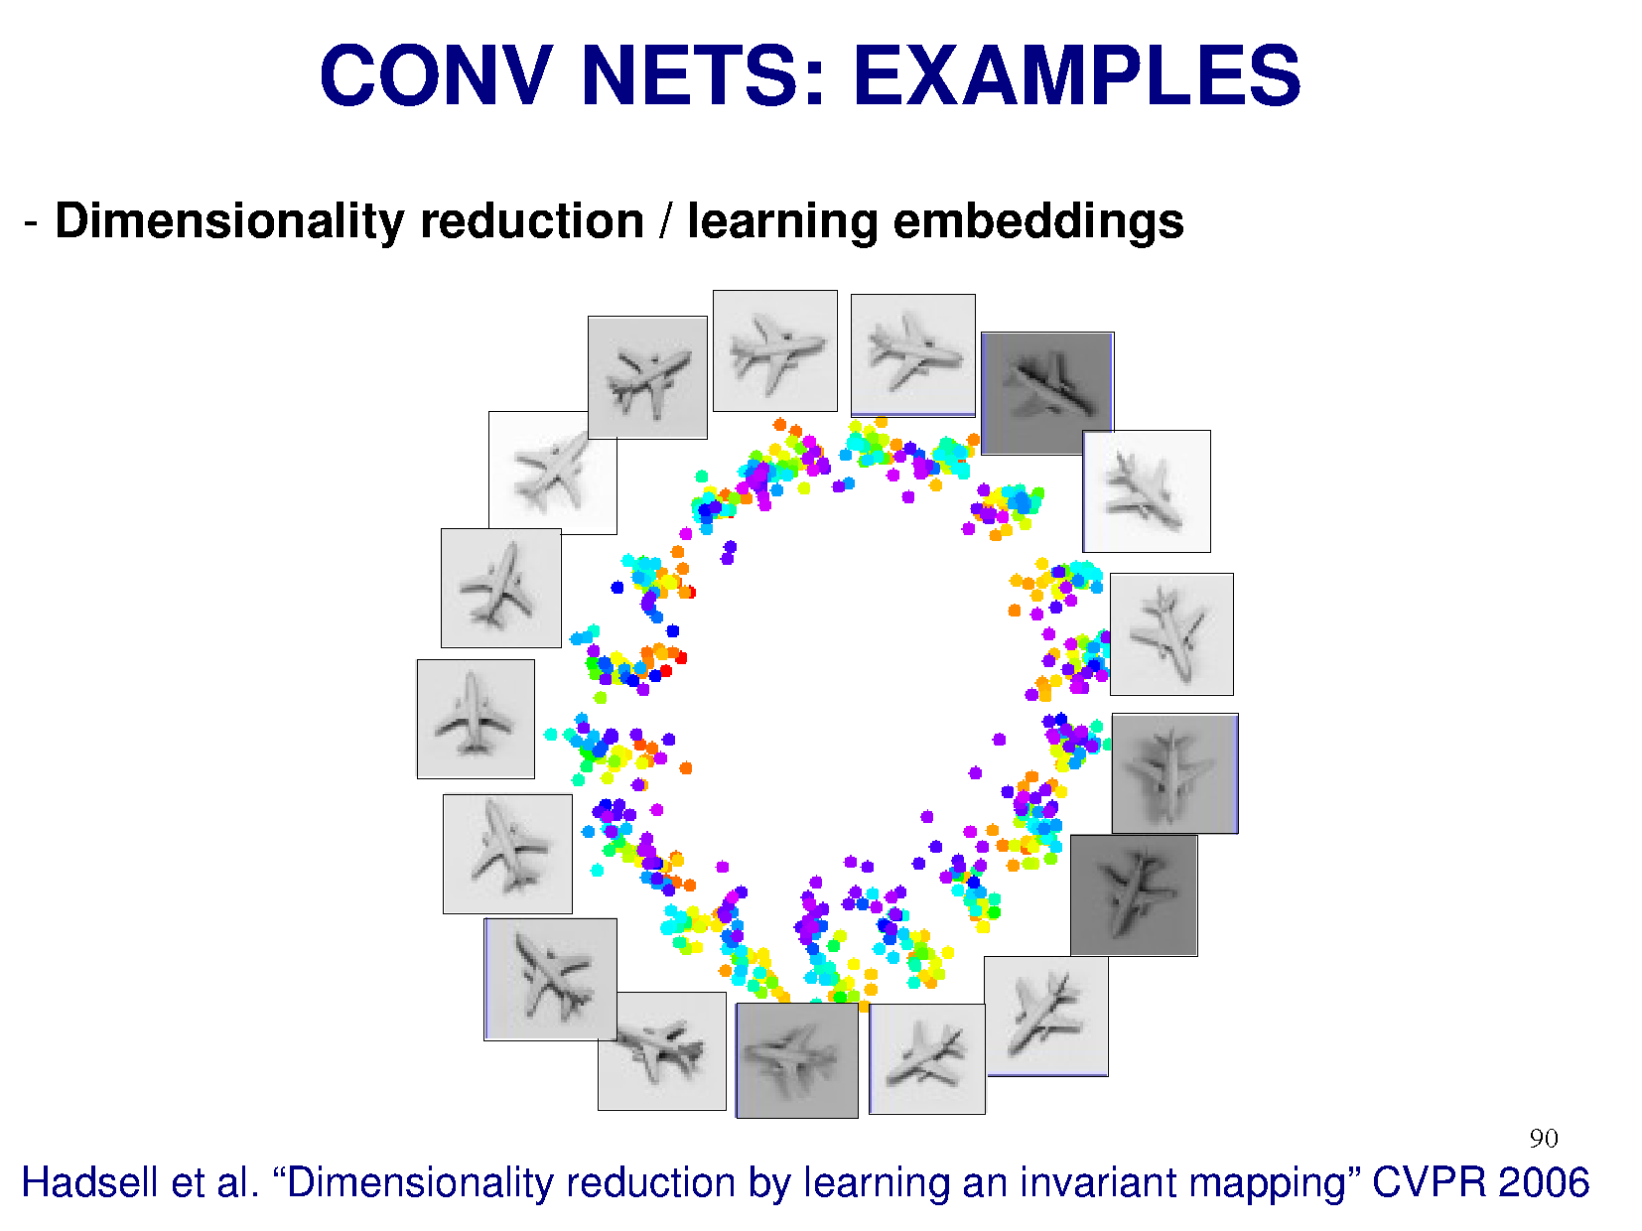

Slide 20
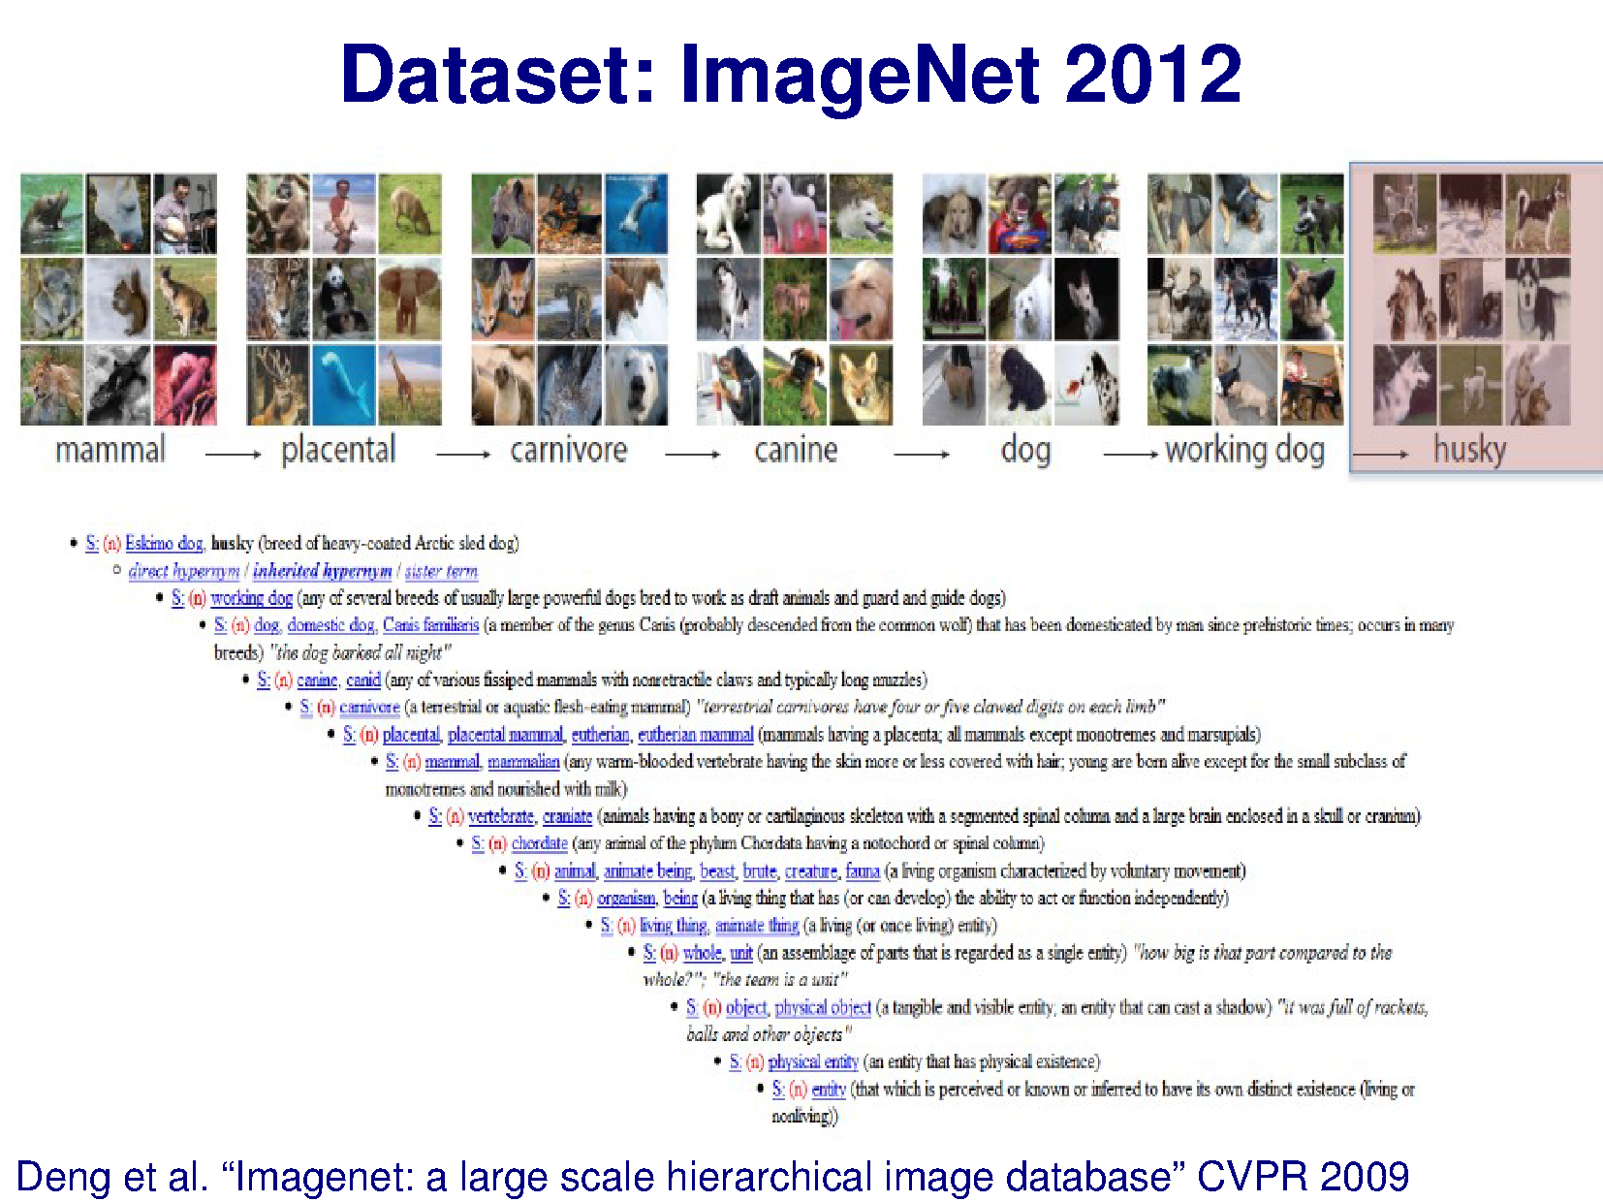

Slide 21
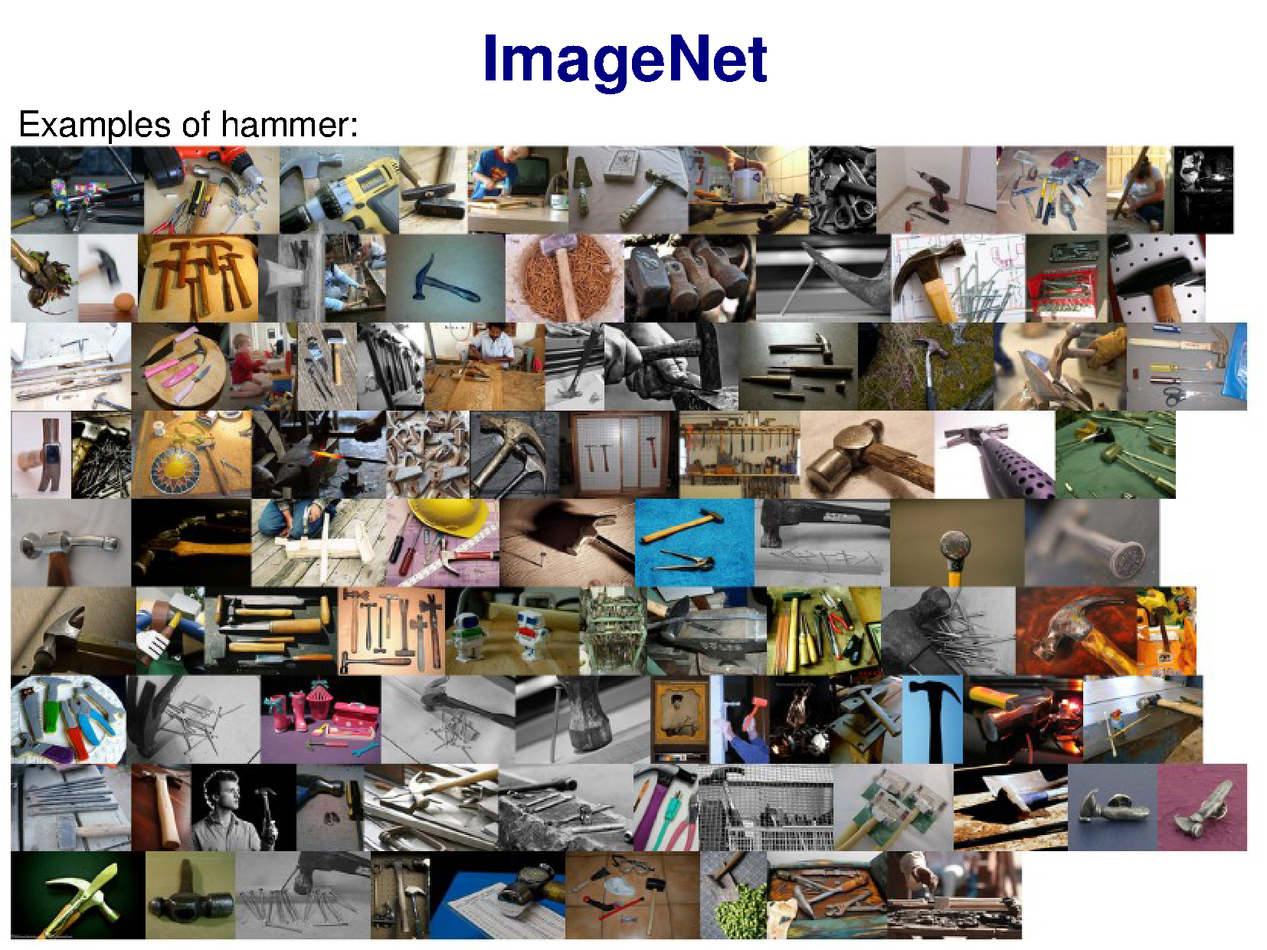

Slide 22
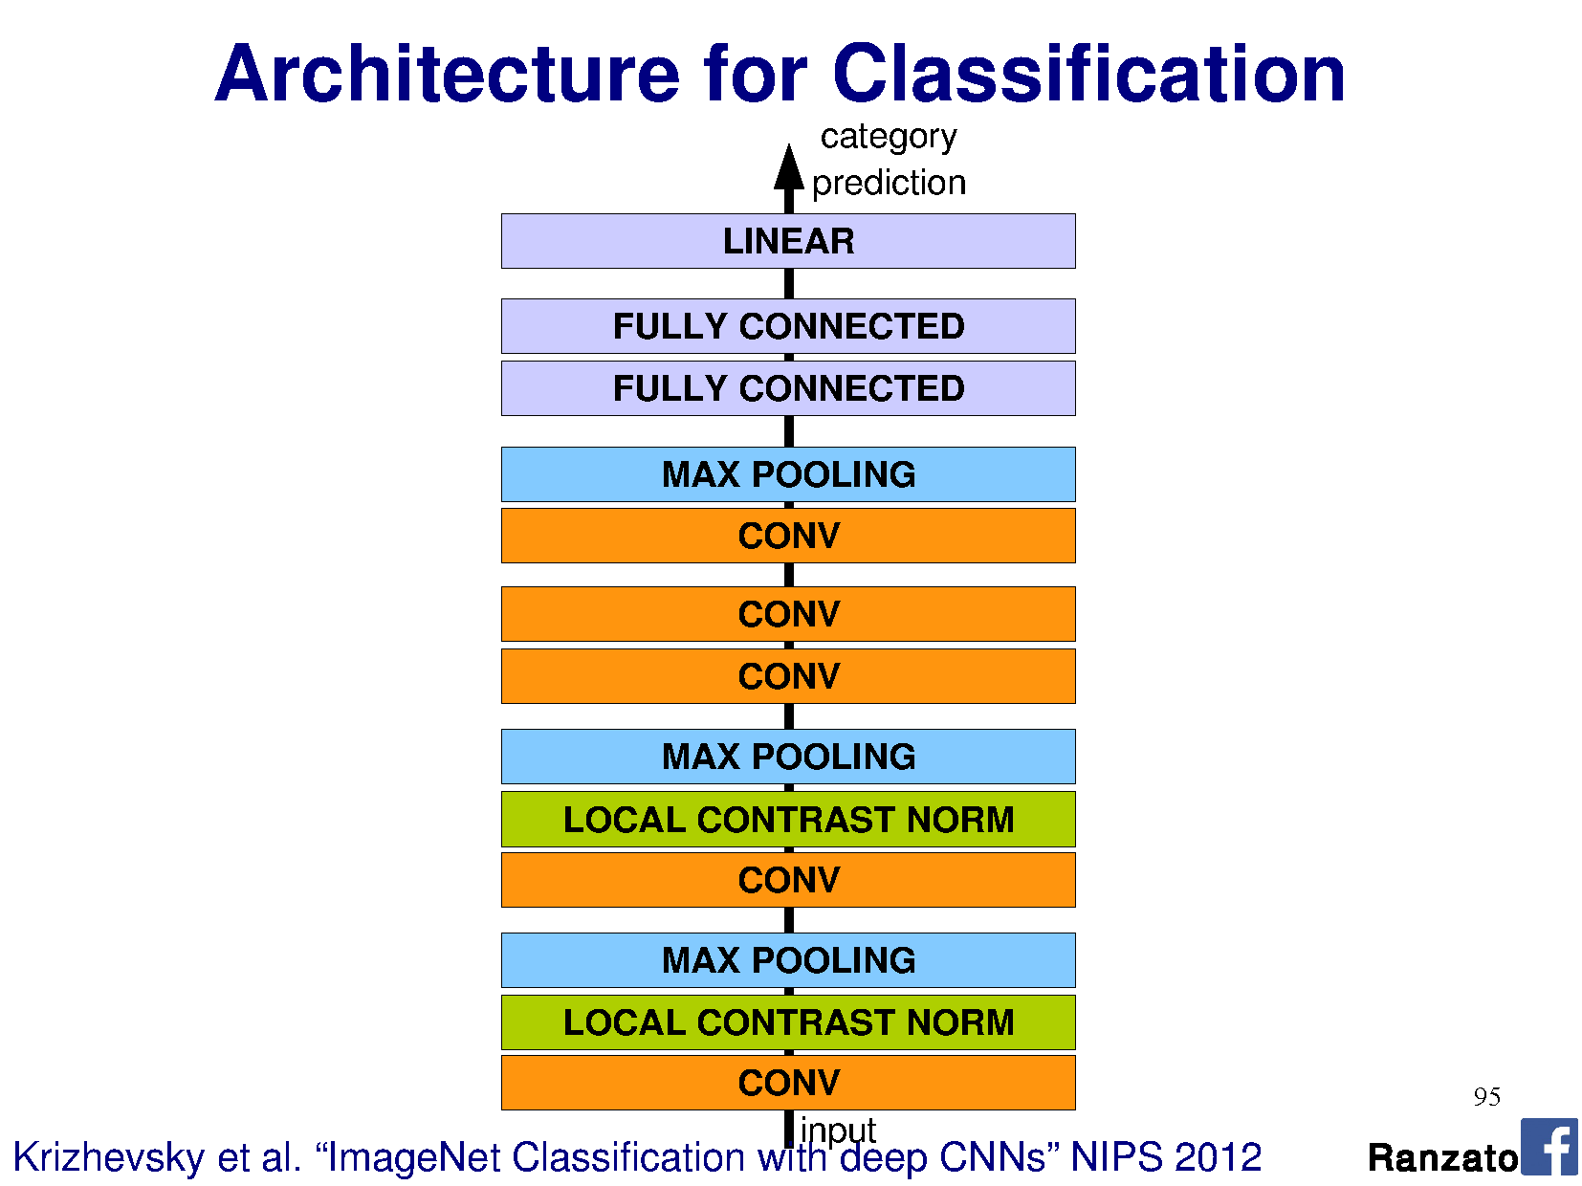

Slide 23
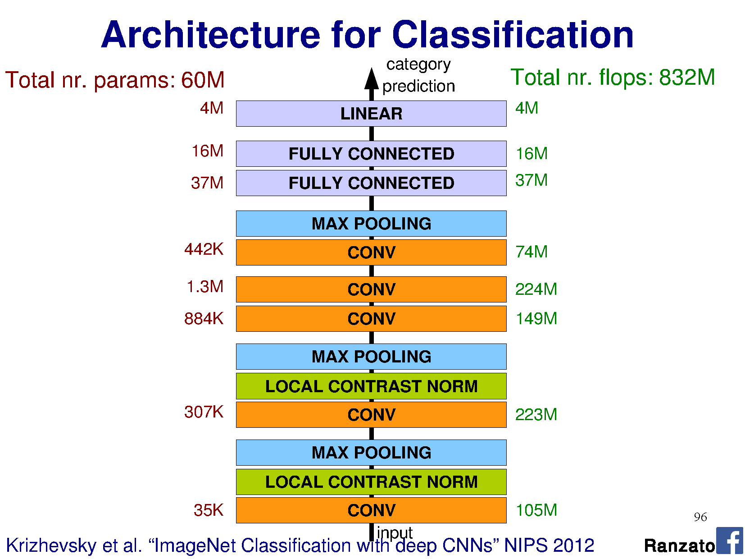

Slide 24
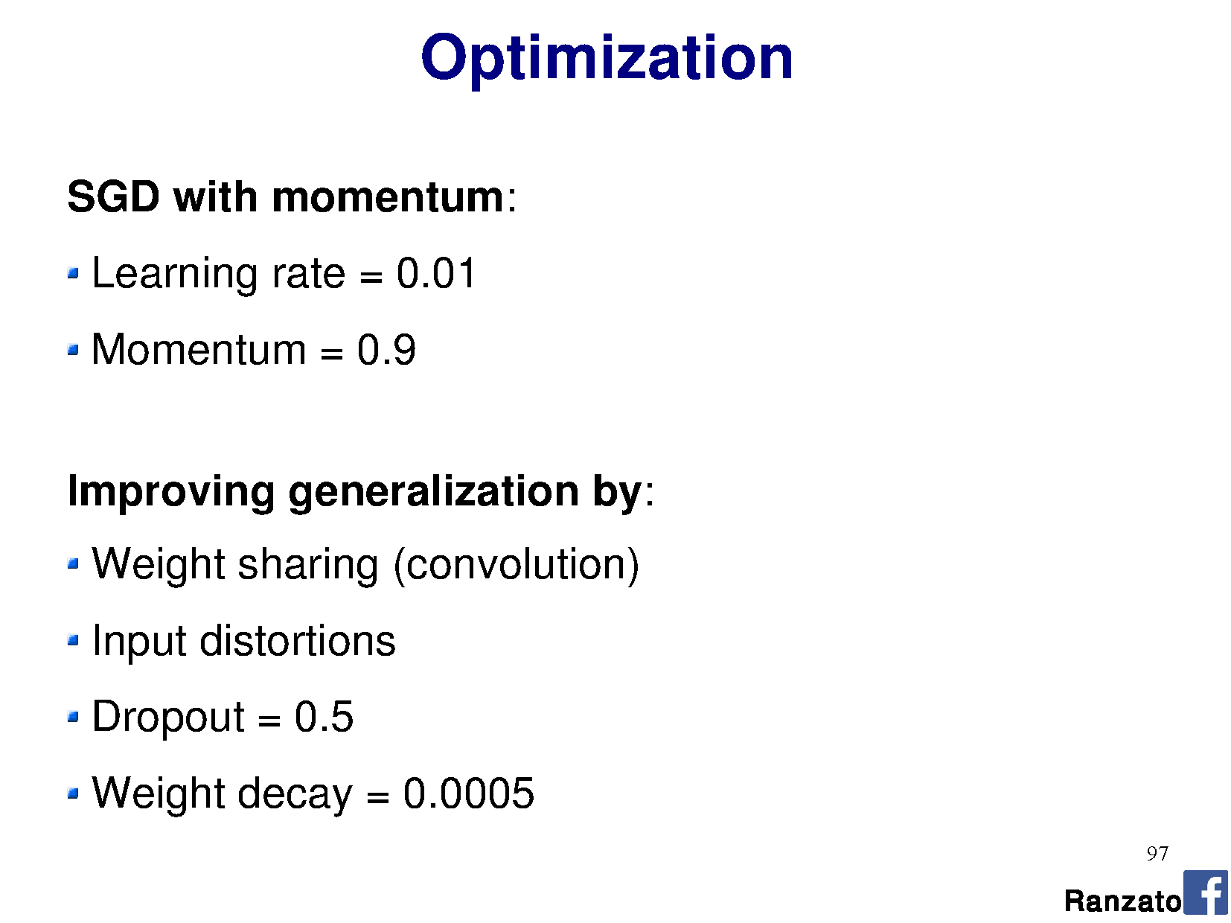

Slide 25
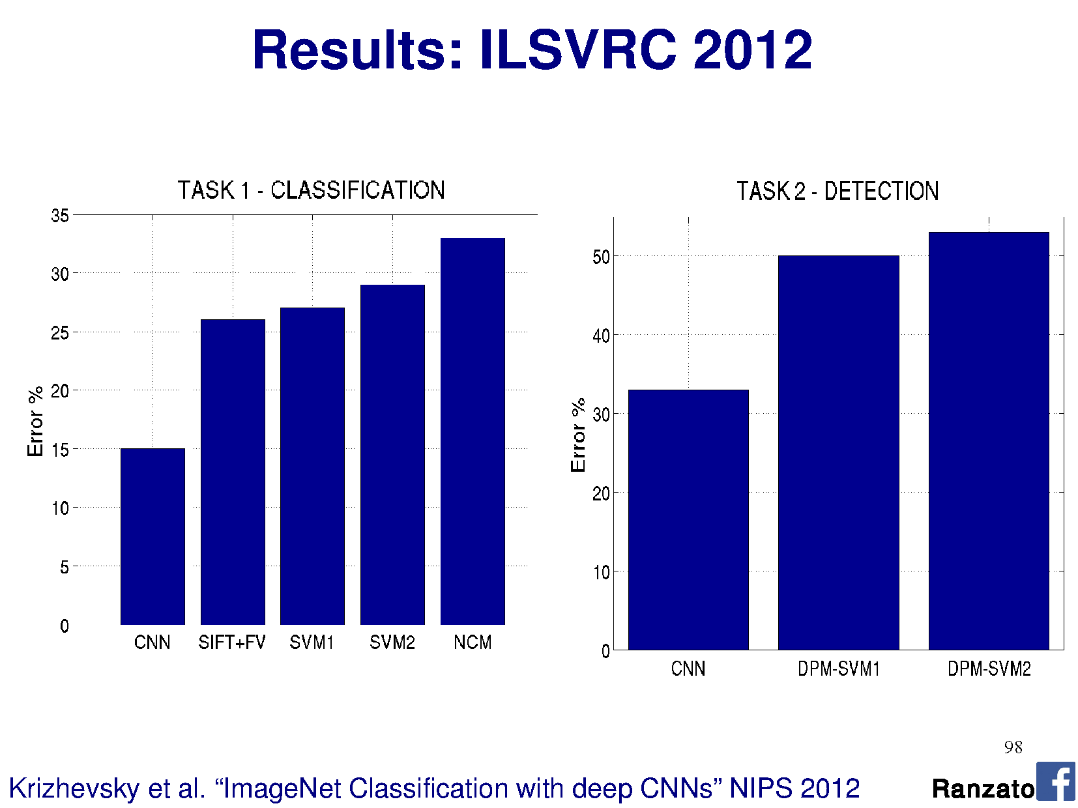
Notes:
This is top 5 error

Slide 26
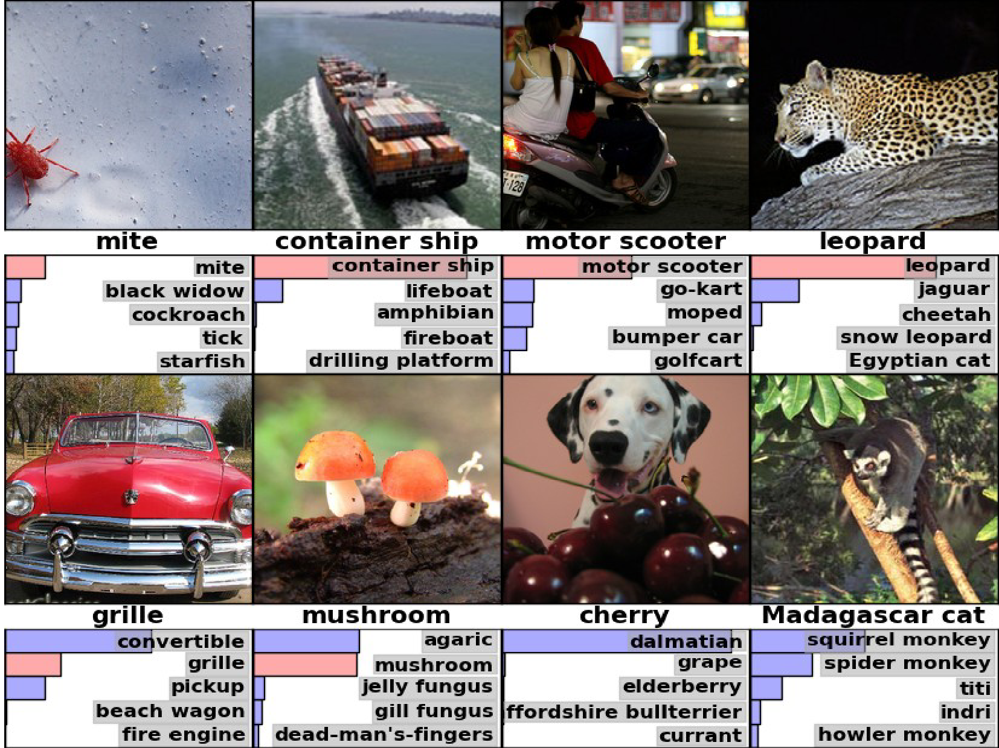

Slide 27
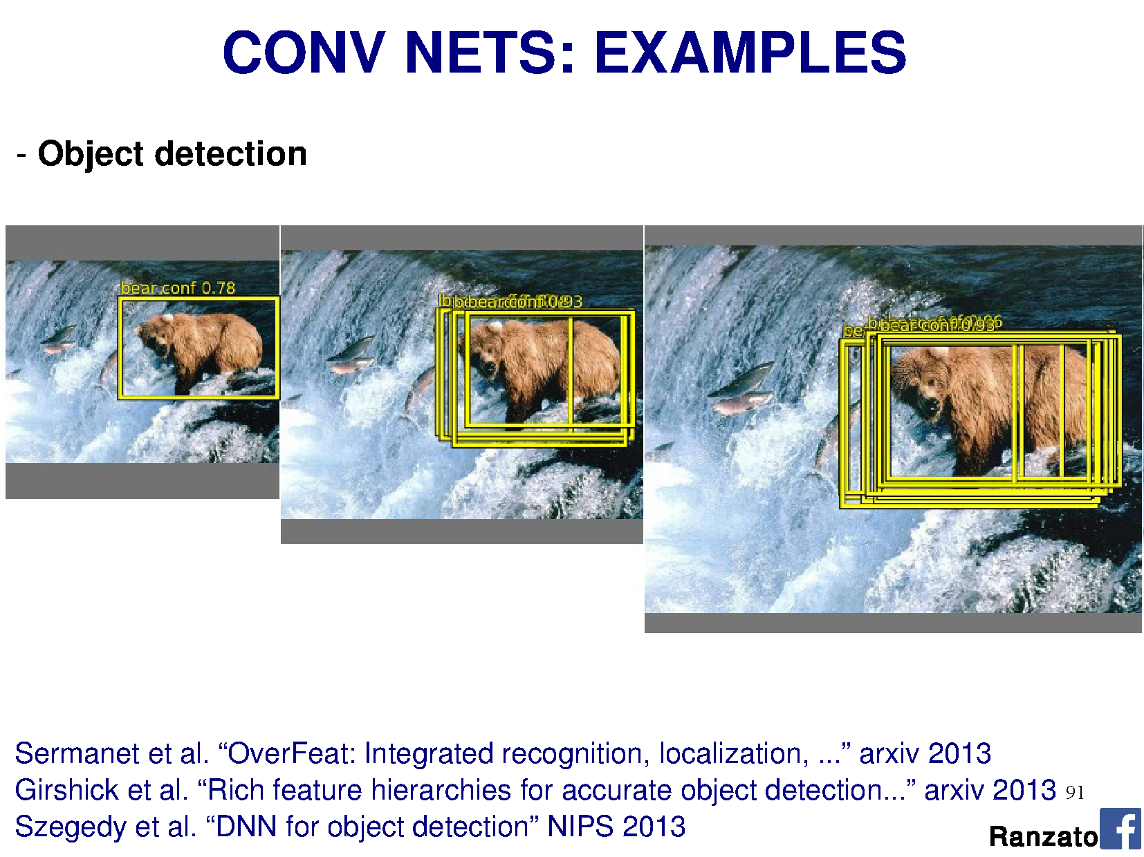

Slide 28
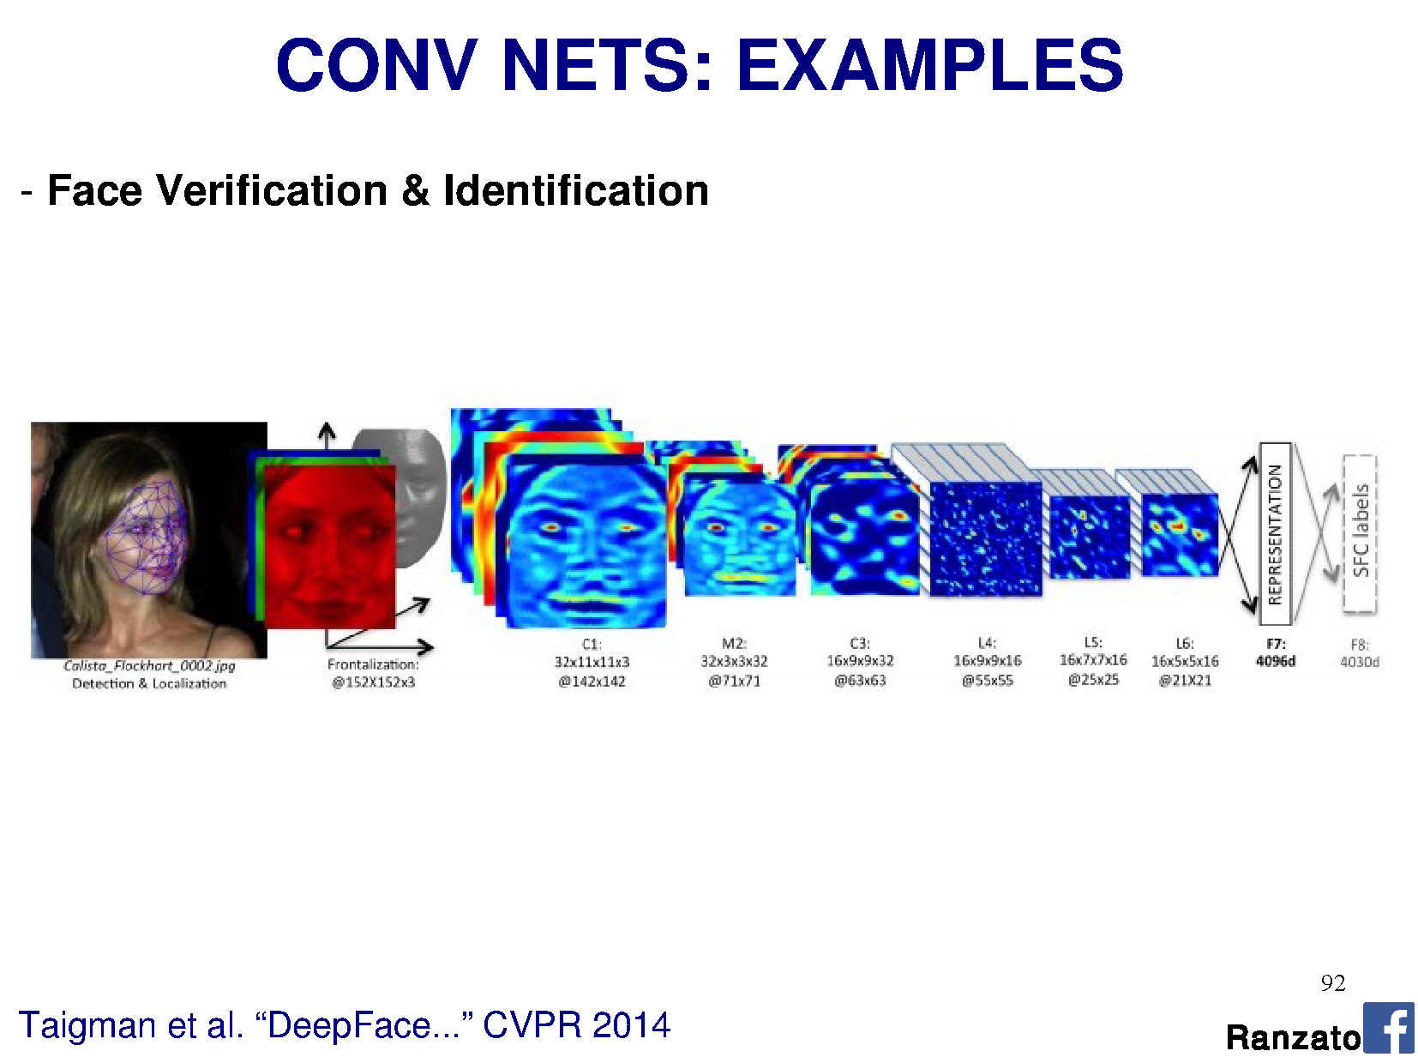

Slide 29





Object Detectors Emerge in Deep Scene CNNs
Bolei Zhou, Aditya Khosla, Agata Lapedriza, Aude Oliva, Antonio Torralba
Massachusetts Institute of Technology

Slide 30
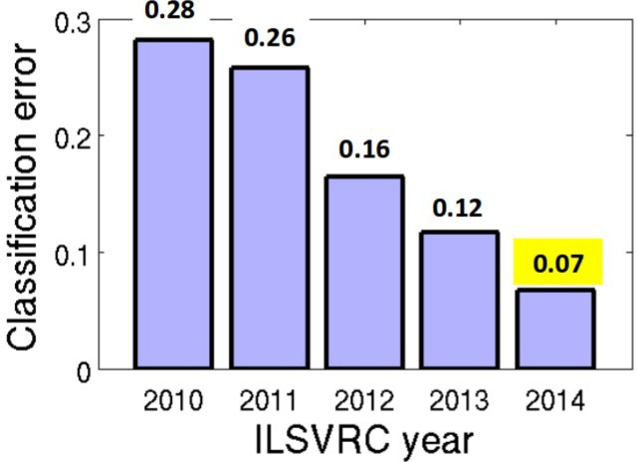
CNN for Object Recognition
Large-scale image classification result on ImageNet
CNN methods
Figure from Olga Russakovsky ECCV'14 workshop

Slide 31
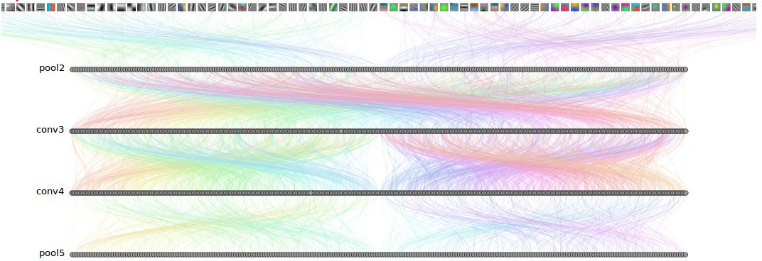
How Objects are Represented in CNN?
Conv1
Conv2
Conv3
Conv4 Pool5
DrawCNN: visualizing the units' connections

Slide 32
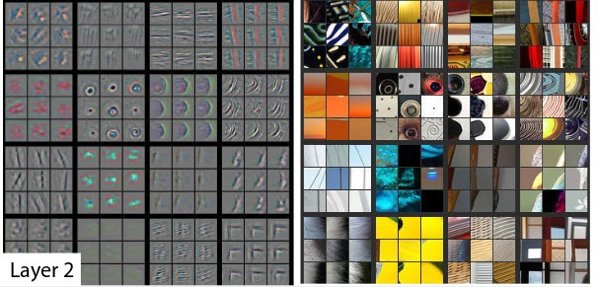
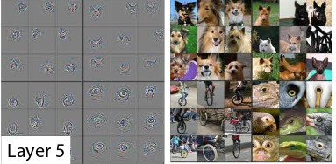
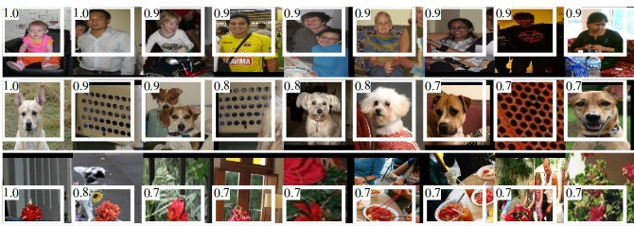
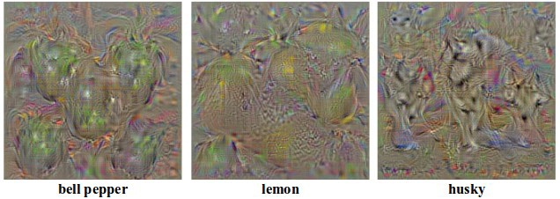
How Objects are Represented in CNN?
Deconvolution
Zeiler, M. et al. Visualizing and Understanding Convolutional Networks,ECCV 2014.
Strong activation image
Girshick, R., Donahue, J., Darrell, T., Malik, J.: Rich feature hierarchies for accu-rate object detection and semantic segmentation. CVPR 2014
Back-propagation
Simonyan, K. et al. Deep inside convolutional networks: Visualising image classification models and saliency maps. ICLR workshop, 2014

Slide 33
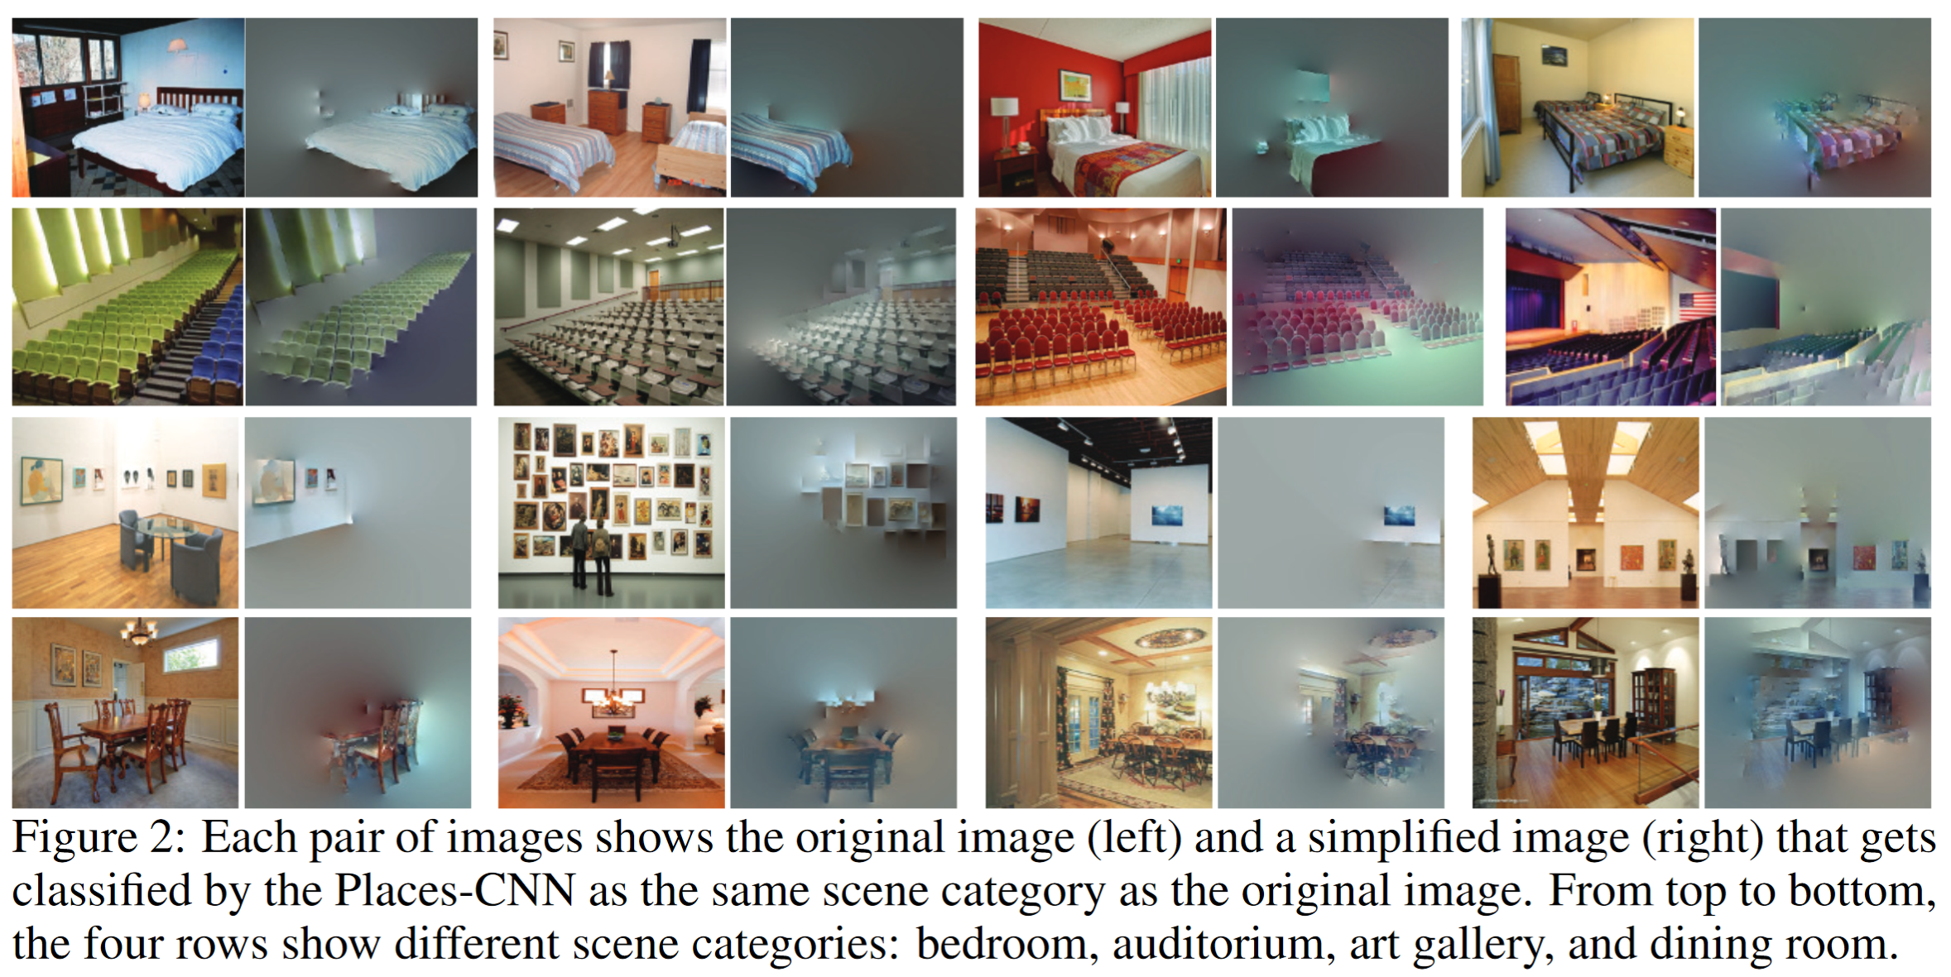
Another CNN interpretation method: Simplifying Scenes While Maintaining Classifier Decision

Slide 34
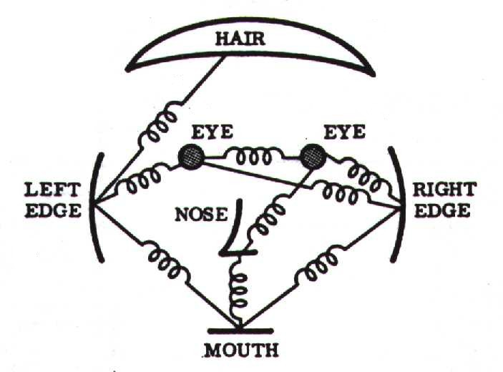
Object Representations in Computer Vision
Part-based models are used to represent objects and visual patterns.
-Object as a set of parts
-Relative locations between parts
Figure from Fischler & Elschlager (1973)

Slide 35
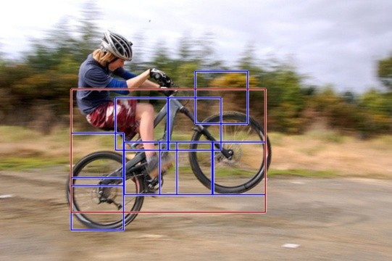
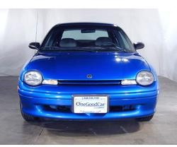

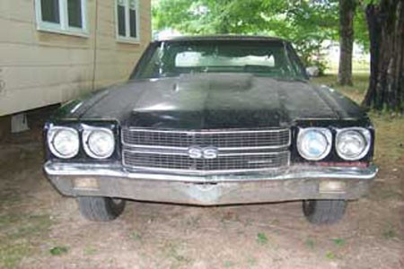
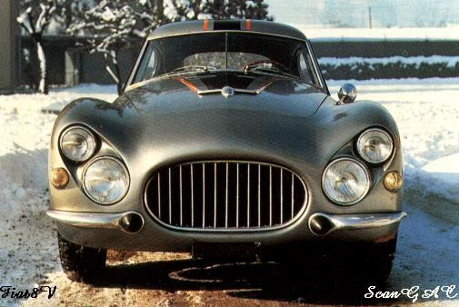
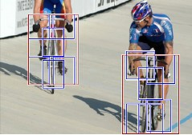

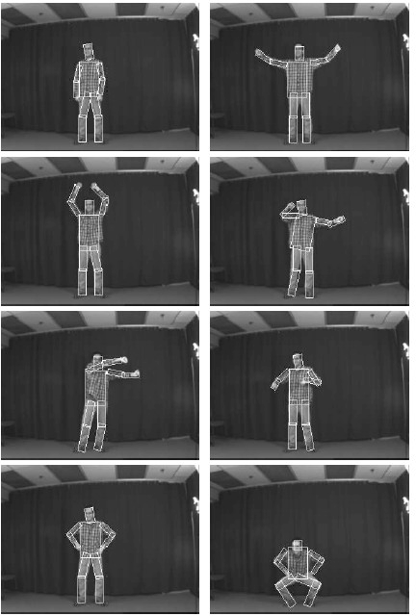
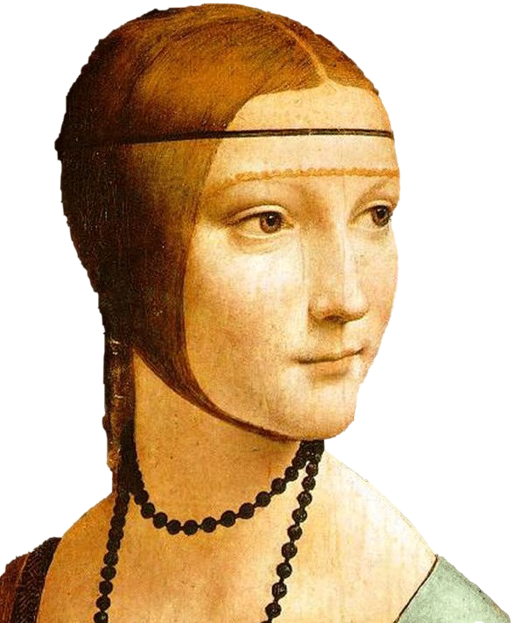


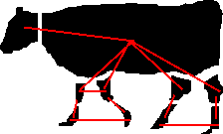








Object Representations in Computer Vision
Constellation model
Deformable Part model
Weber, Welling & Perona (2000), Fergus, Perona & Zisserman (2003)
P. Felzenszwalb, R. Girshick, D. McAllester, D. Ramanan (2010)
Bag-of-word model
Class-specific graph model
Lazebnik, Schmid & Ponce(2003), Fei-Fei Perona (2005)
Kumar, Torr and Zisserman (2005), Felzenszwalb & Huttenlocher (2005)

Slide 36

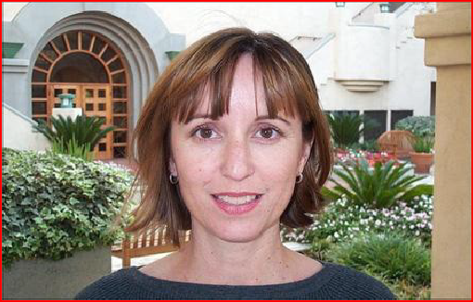
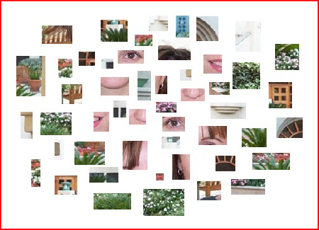
Learning to Recognize Objects
brambling
terrier
Possible internal representations:
Object parts
Textures
Attributes

Slide 37
How Objects are Represented in CNN?
CNN uses distributed code to represent objects.
Conv1
Conv2
Conv3
Conv4 Pool5
Agrawal, et al. Analyzing the performance of multilayer neural networks for object recognition. ECCV, 2014 Szegedy, et al. Intriguing properties of neural networks.arXiv preprint arXiv:1312.6199, 2013.
Zeiler, M. et al. Visualizing and Understanding Convolutional Networks, ECCV 2014.

Slide 38


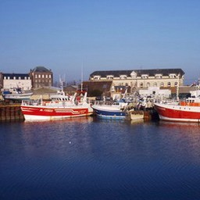
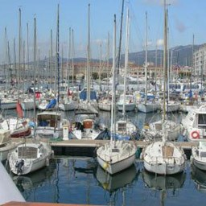
Another recognition task: Scene Recognition
Given an image, predict which place we are in.
Bedroom
Harbor

Slide 39


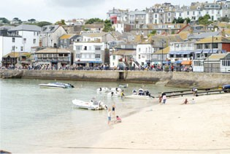
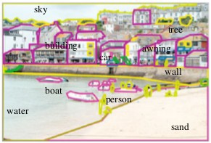
Learning to Recognize Scenes
bedroom
mountain
Possible internal representations:
Objects (scene parts?)
Scene attributes
Object parts
Textures

Slide 40

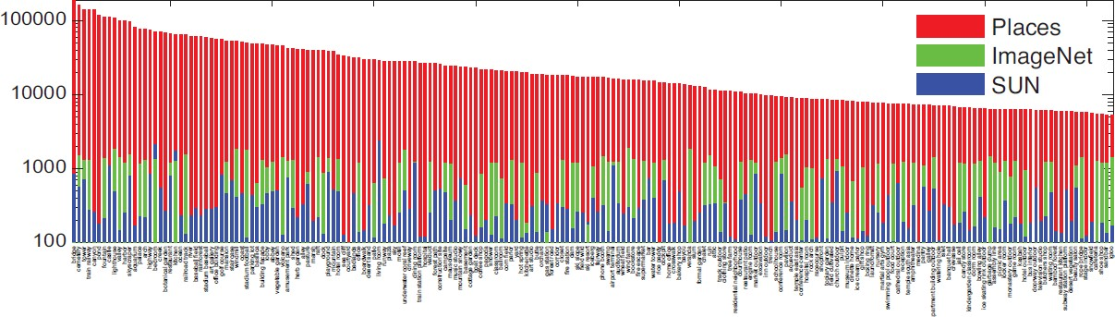

CNN for Scene Recognition
Places Database: 7 million images from 400 scene categories
#
scene category
Places-CNN: AlexNet CNN on 2.5 million images from 205 scene categories.
Zhou, et al. NIPS, 2014.

Slide 41
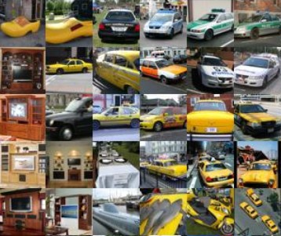




ImageNet CNN and Places CNN
ImageNet CNN for Object Classification
Same architecture: AlexNet
Places CNN for Scene Classification
Places

Slide 42







Data-Driven Approach to Study CNN
Neuroscientists study brain
ImageNet CNN Places CNN
200,000 image stimuli of objects and scene categories (ImageNet TestSet+SUN database)

Slide 43

Estimating the Receptive Fields

Slide 44





Estimating the Receptive Fields
Estimated receptive fields
pool1
Actual size of RF is much smaller than the theoretic size
conv3 pool5
Segmentation using the RF of Units
More semantically meaningful

Slide 45

Annotating the Semantics of Units
Top ranked segmented images are cropped and sent to Amazon Turk for annotation.

Slide 46



Annotating the Semantics of Units
Pool5, unit 76; Label: ocean; Type: scene; Precision: 93%

Slide 47


Annotating the Semantics of Units
Pool5, unit 13; Label: Lamps; Type: object; Precision: 84%

Slide 48



Annotating the Semantics of Units
Pool5, unit 77; Label:legs; Type: object part; Precision: 96%

Slide 49



Annotating the Semantics of Units
Pool5, unit 112; Label: pool table; Type: object; Precision: 70%

Slide 50

Annotating the Semantics of Units
Pool5, unit 22; Label: dinner table; Type: scene; Precision: 60%

Slide 51













Distribution of Semantic Types at Each Layer
1
Object detectors emerge within CNN trained to classify scenes, without any object supervision!

Slide 52






Histogram of Emerged Objects in Pool5
ImageNet-CNN (59/256)

Slide 53






Histogram of Emerged Objects in Pool5
Places-CNN (151/256)

Slide 55


Evaluation on SUN Database
Evaluate the performance of the emerged object detectors

Slide 56



Evaluation on SUN Database
Correlation:0.53
Correlation:0.84

Slide 57
Wrap up
There are many ways to visualize what a neural network has learned
Networks learn smaller receptive fields than the “theoretical” receptive field.
As you go deeper in the network, the hidden activations correspond more to high-level semantic concepts
Object detectors emerge inside a CNN trained to classify scenes, without any object supervision.

