Slide 1
Recognition Techniques, old and new

Slide 2
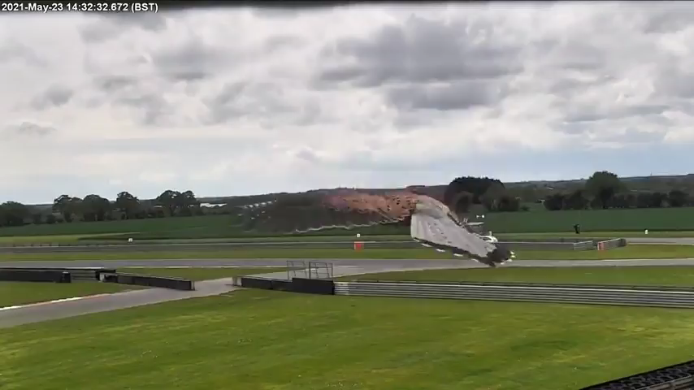

Slide 3
Today’s outline
We’ve covered Deep Convolutional Networks. But what did recognition techniques look like before AlexNet?
  Bag of words models
  Sliding window models
What do more recent deep learning architectures look like?
  VGG Net
  Google Inception architectures
  ResNet

Slide 4
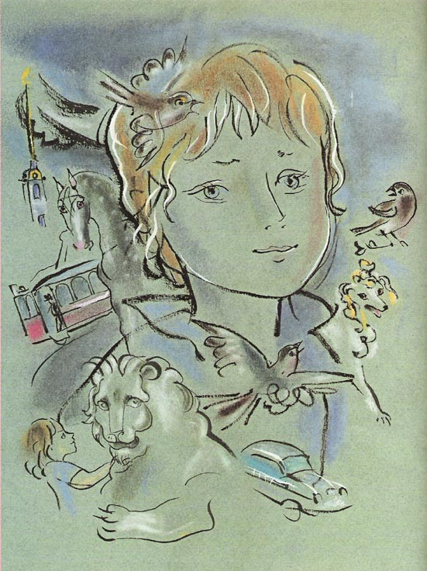
Recognition: Overview and History
Slides from Lana Lazebnik, Fei-Fei Li, Rob Fergus, Antonio Torralba, and Jean Ponce

Slide 5
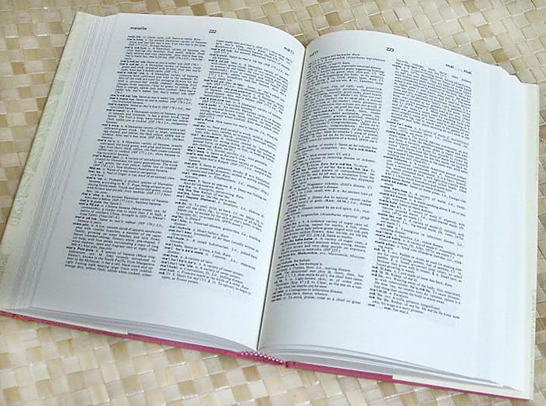

How many visual object categories are there?
~10,000 to 30,000
Biederman 1987
Notes:
1500-3000 basic-level nouns, ~10 types per basic-level category
Alternative explanation (Perona): ~1000 names per domain (broad scene category), 20-30 domains

Slide 6
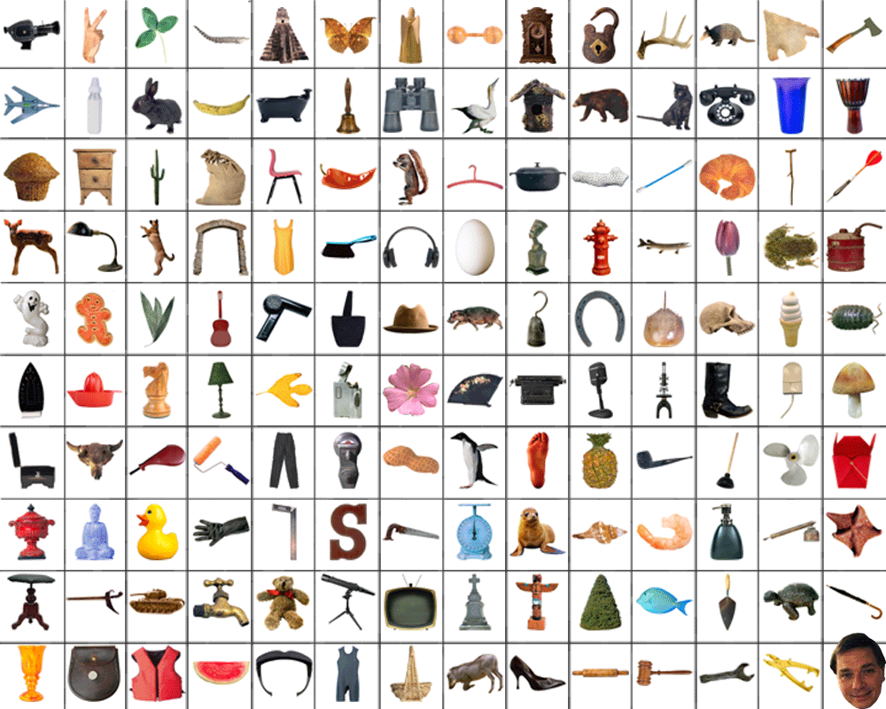
~10,000 to 30,000
But there’s really a “heavy tail” of rarer object categories that
humans can often understand after seeing few or no examples

Slide 7
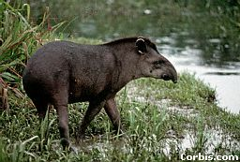
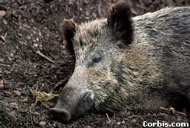
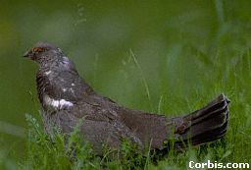
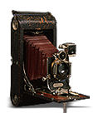
OBJECTS
ANIMALS
PLANTS
INANIMATE
NATURAL
MAN-MADE
…..
VERTEBRATE
MAMMALS
BIRDS
TAPIR
BOAR
GROUSE
CAMERA

Slide 8
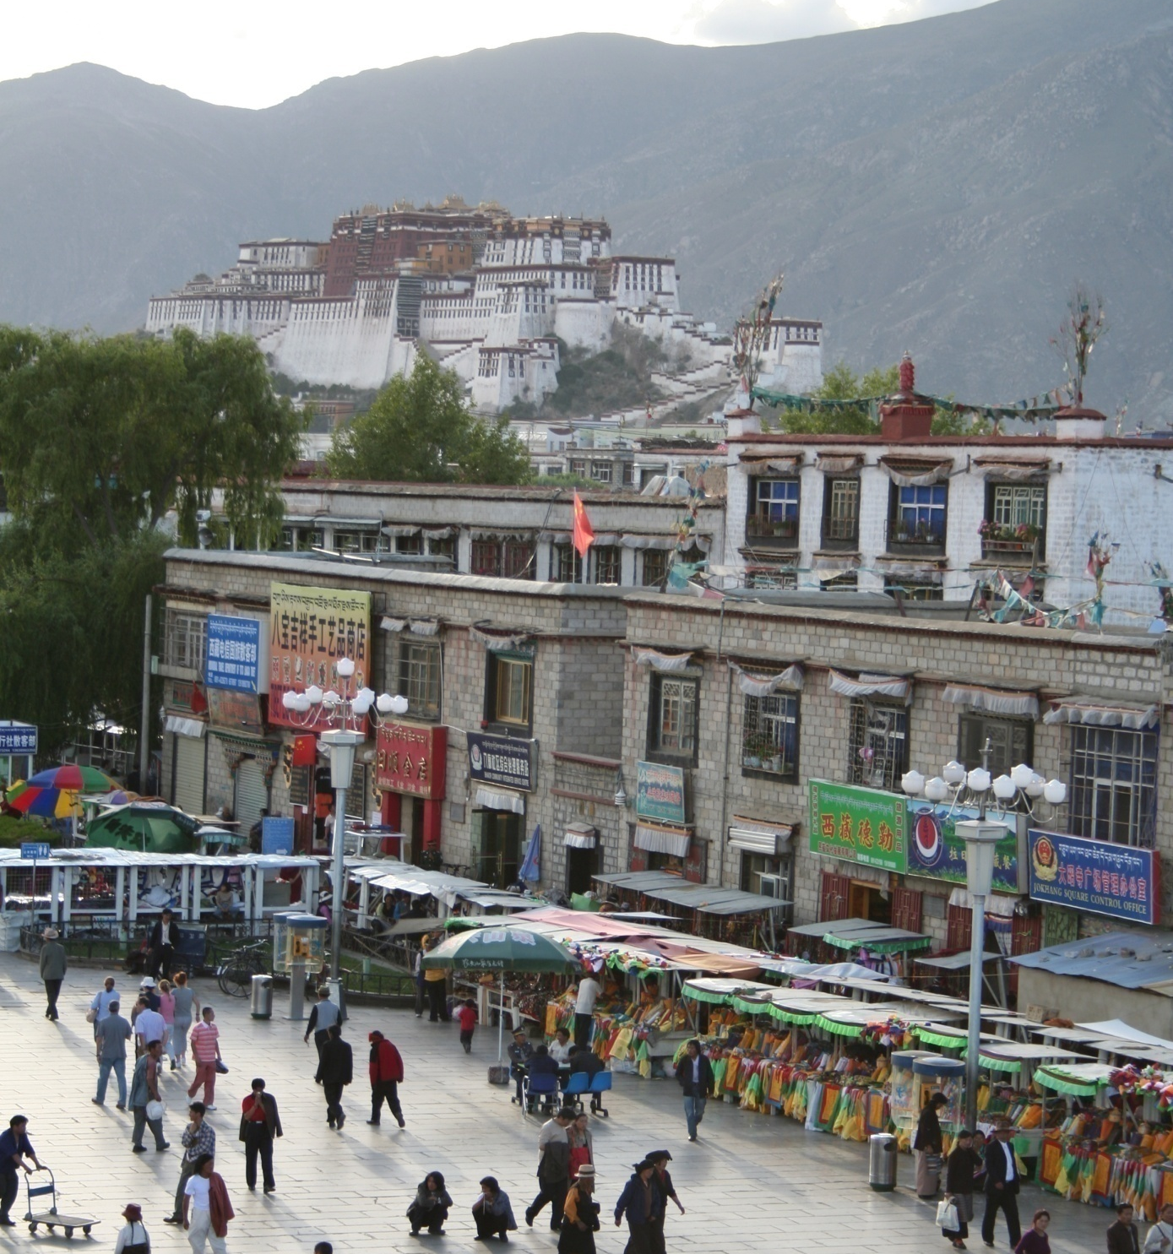
Specific recognition tasks
Svetlana Lazebnik

Slide 9
Scene categorization or classification
outdoor/indoor
city/forest/factory/etc.
Svetlana Lazebnik

Slide 10
Image annotation / tagging / attributes
street
people
building
mountain
tourism
cloudy
brick
…
Categories are exclusive. An instance belongs to one category.
Attributes are not exclusive. An instance can have many or none.
Svetlana Lazebnik

Slide 11
Object detection
find pedestrians
Svetlana Lazebnik

Slide 12
Image parsing / semantic segmentation
sky
mountain
building
tree
building
banner
street lamp
market
people
Svetlana Lazebnik

Slide 13
Scene understanding?
Svetlana Lazebnik

Slide 14
Recognition is all about modeling variability
Variability of a single object instance due to:
Camera position
Illumination
Shape parameters
Within-class variations among multiple object instances?
Svetlana Lazebnik
Notes:
One could argue that invariance is the key challenge to computer vision. But is this still true with big data?

Slide 15
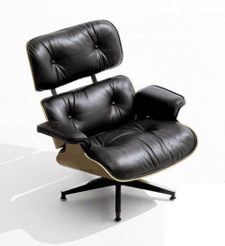
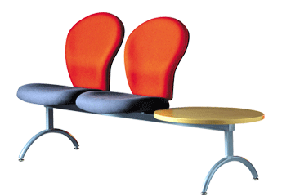
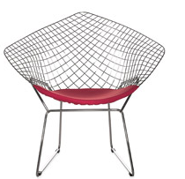
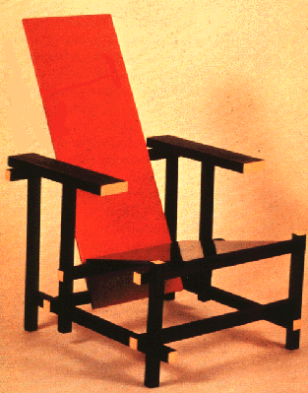
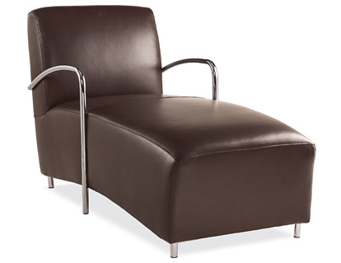
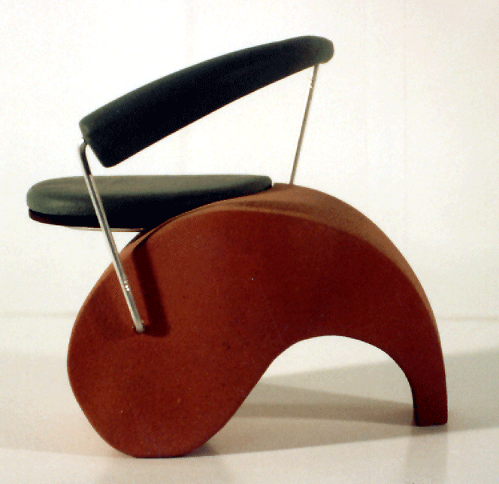
Within-class variations
Svetlana Lazebnik
Notes:
Note English language issues. Try to not let language confound things.

Slide 16
History of ideas in recognition
1960s – early 1990s: the geometric era
Svetlana Lazebnik

Slide 17
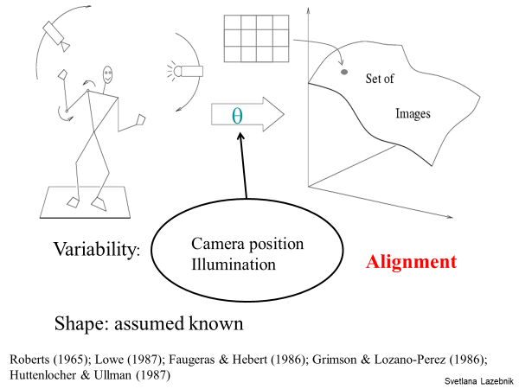

Slide 18
Recall: Alignment
Alignment: fitting a model to a transformation between pairs of features (matches) in two images
x_{i}
x_{i}
Find transformation T
that minimizes
'
T
Svetlana Lazebnik

Slide 19
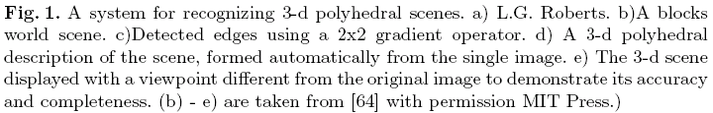
Recognition as an alignment problem:
Block world
L. G. Roberts, Machine Perception of Three Dimensional Solids, Ph.D. thesis, MIT Department of Electrical Engineering, 1963.
J. Mundy, Object Recognition in the Geometric Era: a Retrospective, 2006

Slide 20
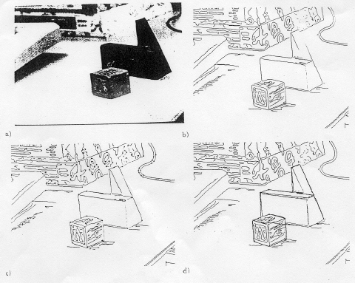
Alignment: Huttenlocher & Ullman (1987)

Slide 21
Variability
Invariance to:
Camera position
Illumination
Internal parameters
Duda & Hart ( 1972); Weiss (1987); Mundy et al. (1992-94);
Rothwell et al. (1992); Burns et al. (1993)
Svetlana Lazebnik

Slide 22
Example: invariant to similarity transformations computed from four points
B
C
D
A
Projective invariants (Rothwell et al., 1992):
General 3D objects do not admit monocular viewpoint
invariants (Burns et al., 1993)

Slide 23






Representing and recognizing object categories
is harder...
ACRONYM (Brooks and Binford, 1981)
Binford (1971), Nevatia & Binford (1972), Marr & Nishihara (1978)

Slide 24
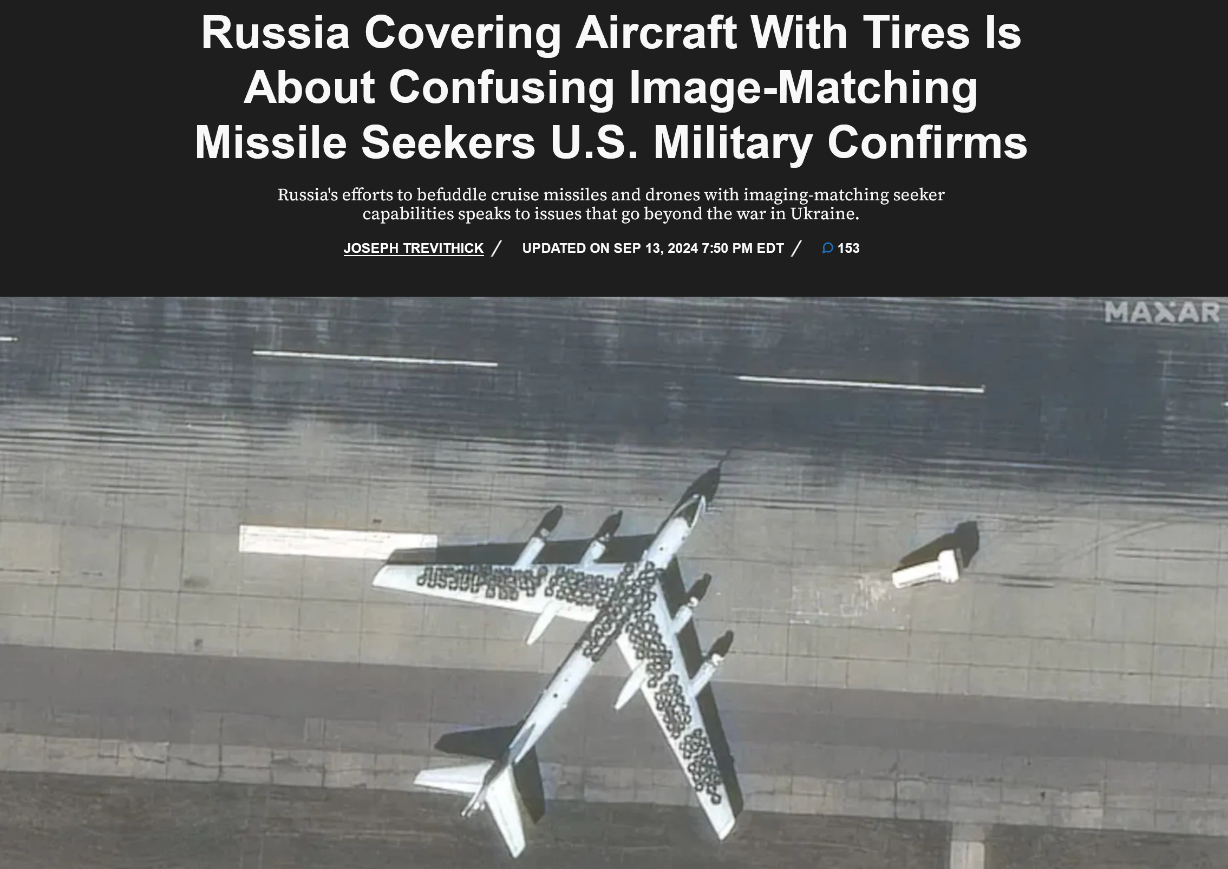
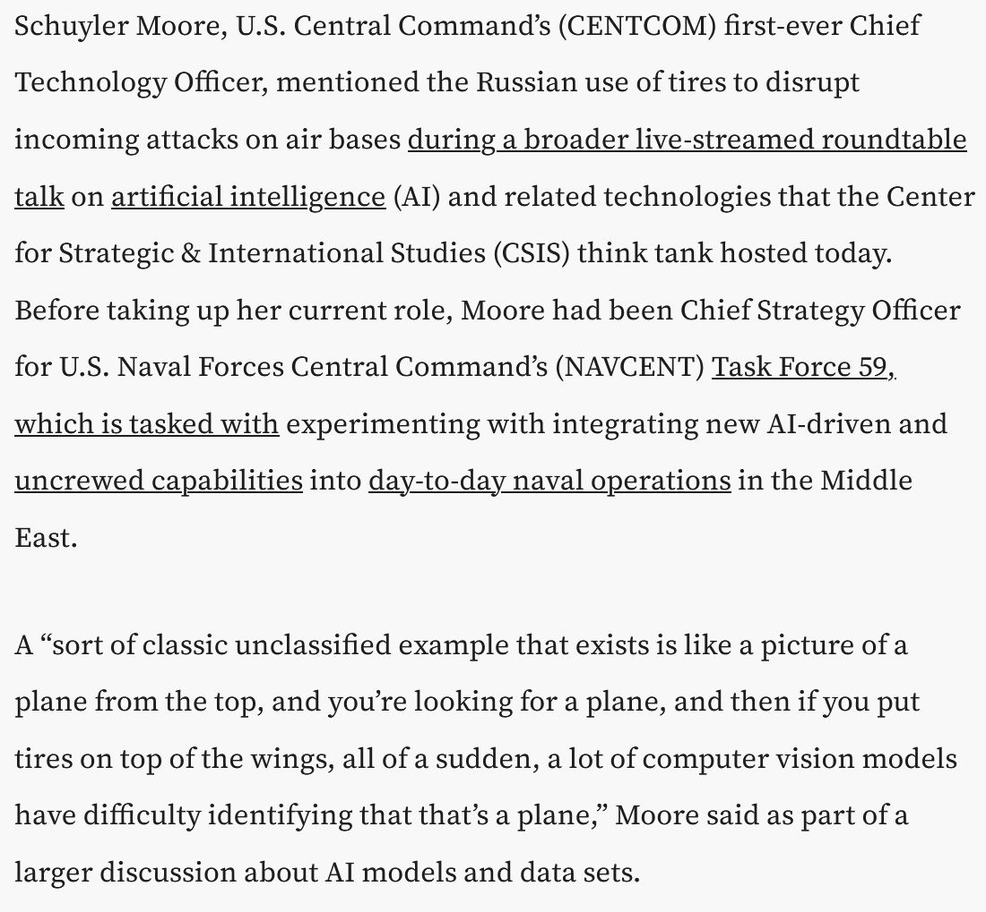
https://www.twz.com/air/russia-covering-its-aircraft-in-tires-is-about-befuddling-image-matching-seekers-u-s-military-confirms

Slide 25
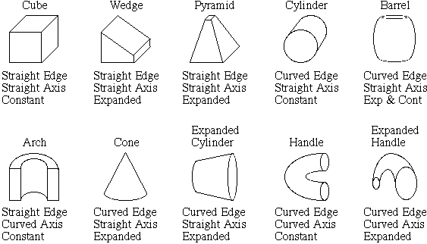
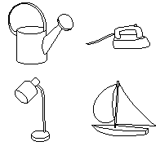
Recognition by components
Biederman (1987)
Primitives (geons)
Objects
http://en.wikipedia.org/wiki/Recognition_by_Components_Theory
Svetlana Lazebnik

Slide 26
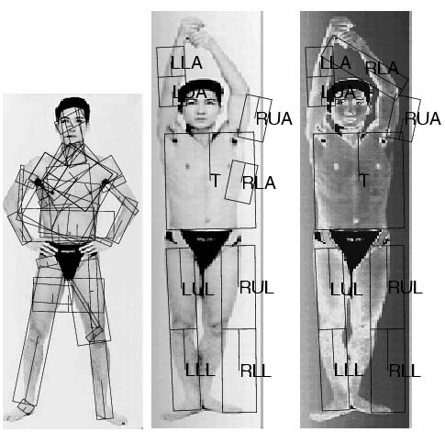
General shape primitives?
Generalized cylinders
Ponce et al. (1989)
Forsyth (2000)
Zisserman et al. (1995)
Svetlana Lazebnik

Slide 27
History of ideas in recognition
1960s – early 1990s: the geometric era
1990s: appearance-based models
Svetlana Lazebnik

Slide 28
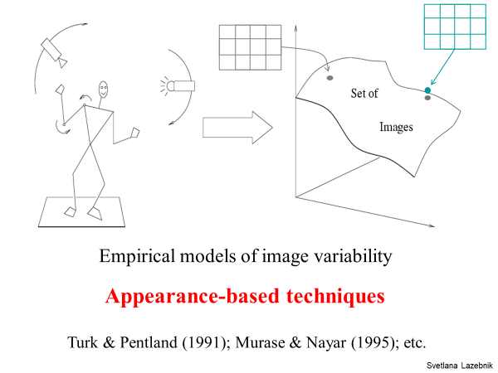

Slide 29
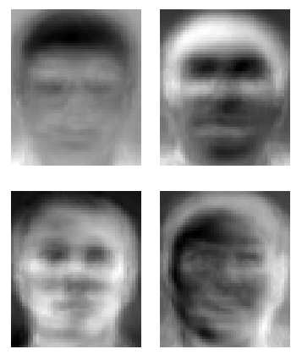
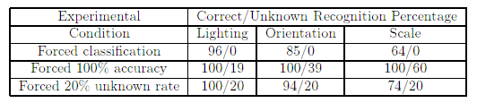
Eigenfaces (Turk & Pentland, 1991)
Svetlana Lazebnik

Slide 30
Color Histograms
Swain and Ballard, Color Indexing, IJCV 1991.
Svetlana Lazebnik

Slide 31
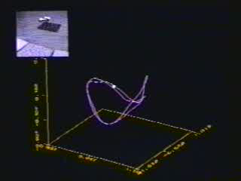
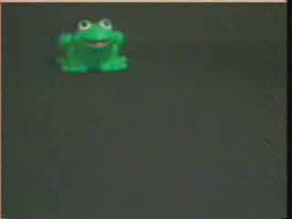
Appearance manifolds
H. Murase and S. Nayar, Visual learning and recognition of 3-d objects from appearance, IJCV 1995

Slide 32
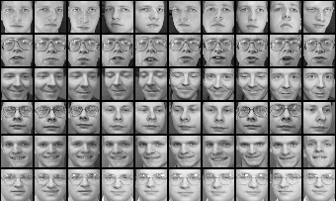
Limitations of global appearance models
Requires global registration of patterns
Not robust to clutter, occlusion, geometric transformations
Svetlana Lazebnik

Slide 33
History of ideas in recognition
1960s – early 1990s: the geometric era
1990s: appearance-based models
1990s – present: sliding window approaches
Svetlana Lazebnik

Slide 34
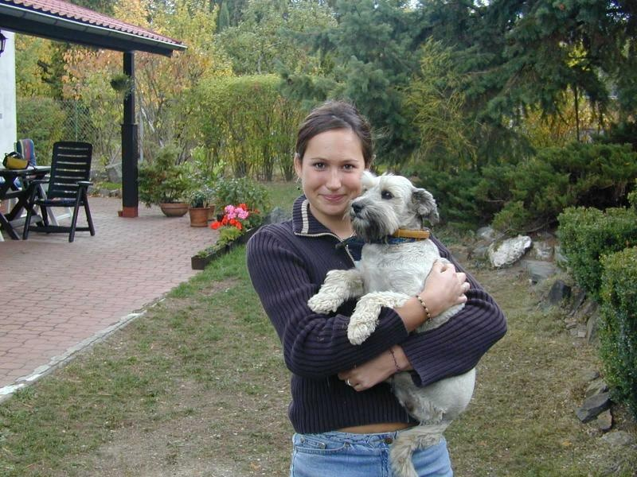
Sliding window approaches

Slide 35
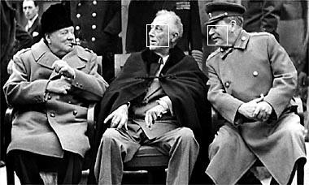
Sliding window approaches
Turk and Pentland, 1991
Belhumeur, Hespanha, & Kriegman, 1997
Schneiderman & Kanade 2004
Viola and Jones, 2000
Schneiderman & Kanade, 2004
Argawal and Roth, 2002
Poggio et al. 1993

Slide 36
History of ideas in recognition
1960s – early 1990s: the geometric era
1990s: appearance-based models
Mid-1990s: sliding window approaches
Late 1990s: local features
Svetlana Lazebnik

Slide 37
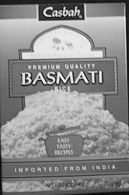
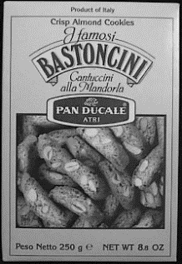

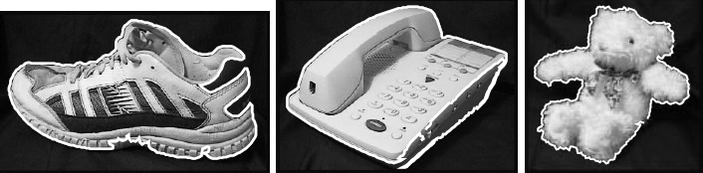
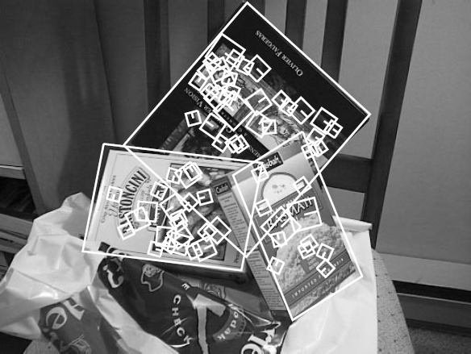
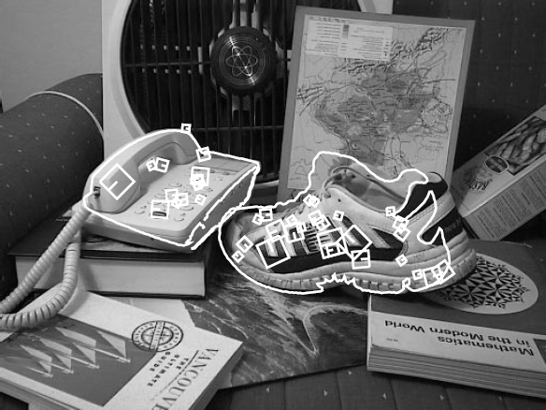
Local features for object instance recognition
D. Lowe (1999, 2004)

Slide 38
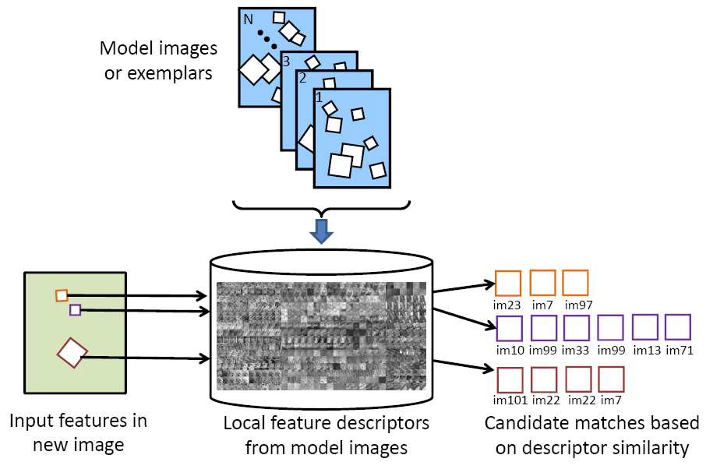
Large-scale image search
Combining local features, indexing, and spatial constraints
Image credit: K. Grauman and B. Leibe

Slide 39
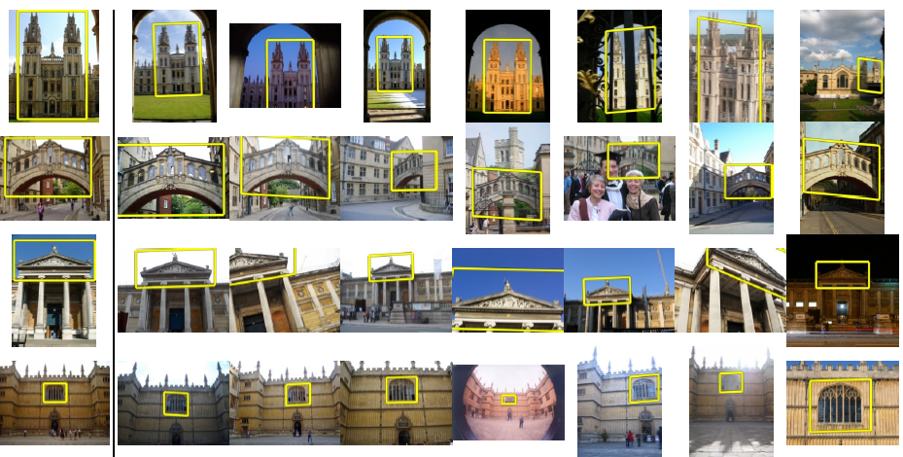
Large-scale image search
Combining local features, indexing, and spatial constraints
Philbin et al. ‘07

Slide 40
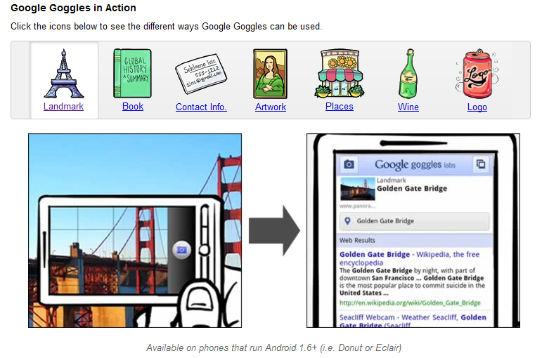
Large-scale image search
Combining local features, indexing, and spatial constraints
Svetlana Lazebnik

Slide 41
History of ideas in recognition
1960s – early 1990s: the geometric era
1990s: appearance-based models
Mid-1990s: sliding window approaches
Late 1990s: local features
Early 2000s: parts-and-shape models

Slide 42
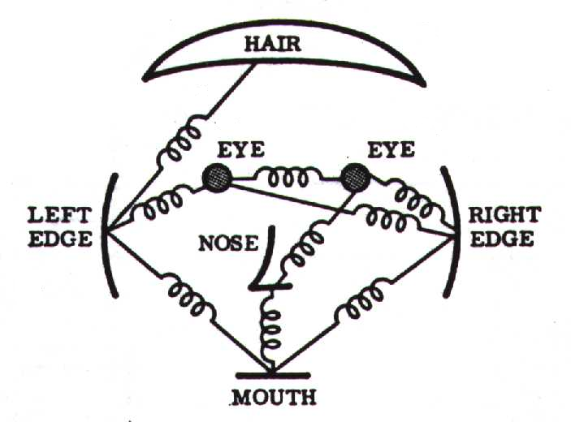
Parts-and-shape models
Model:
  Object as a set of parts
  Relative locations between parts
  Appearance of part
Figure from [Fischler & Elschlager 73]

Slide 43
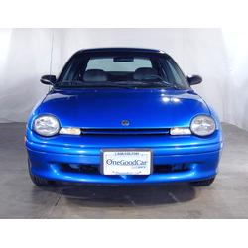
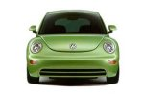
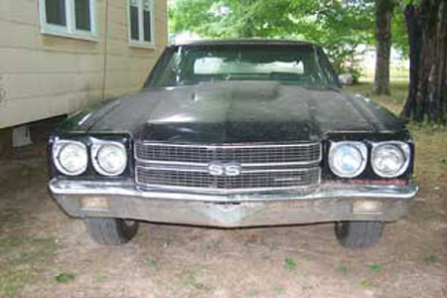
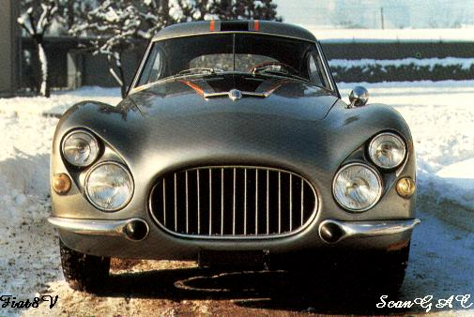
Constellation models
Weber, Welling & Perona (2000), Fergus, Perona & Zisserman (2003)
Notes:
Globally different, but have portions in common

Slide 44
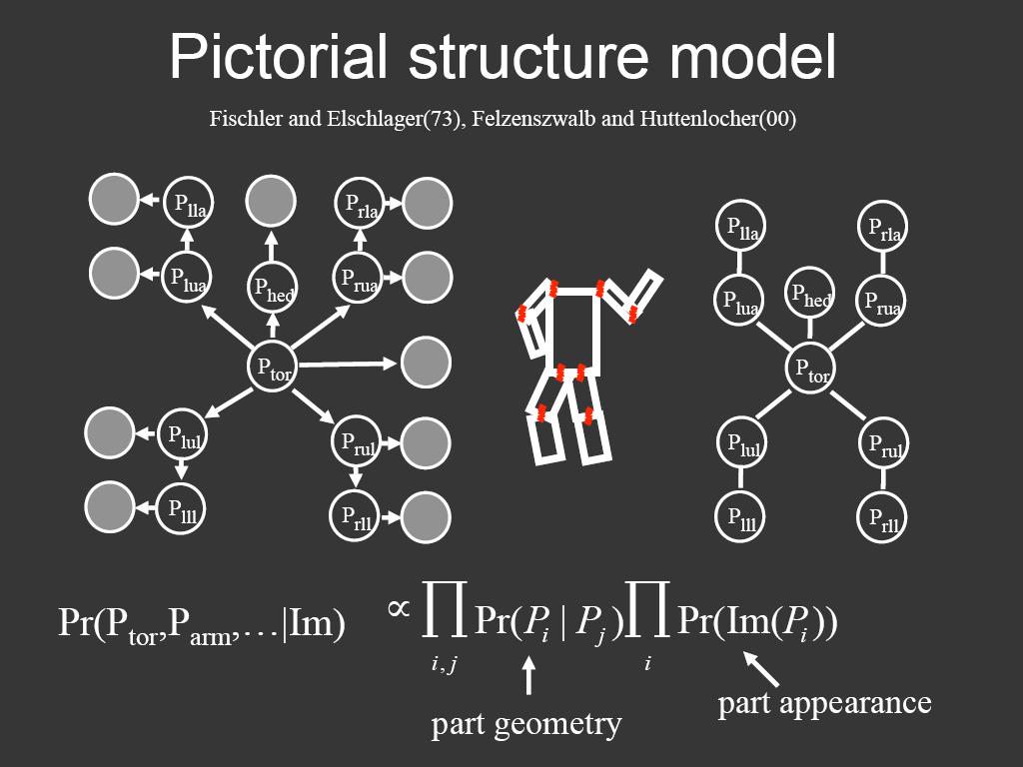
Representing people

Slide 45
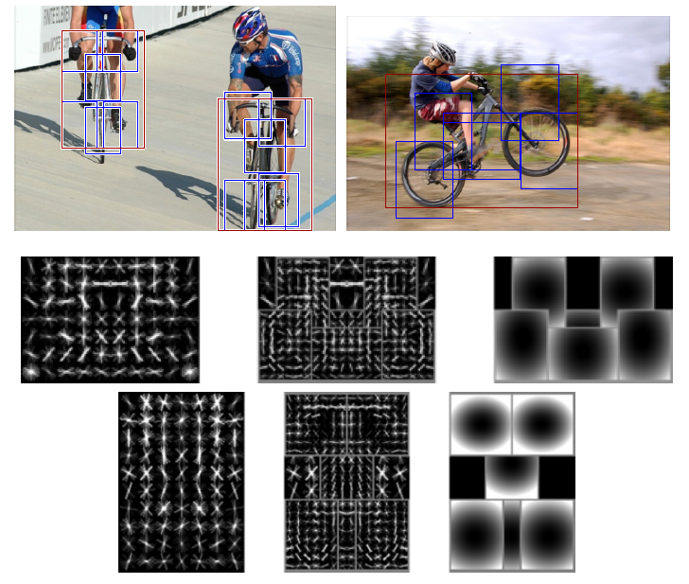
Discriminatively trained part-based models
P. Felzenszwalb, R. Girshick, D. McAllester, D. Ramanan, "Object Detection with Discriminatively Trained Part-Based Models," PAMI 2009

Slide 46
History of ideas in recognition
1960s – early 1990s: the geometric era
1990s: appearance-based models
Mid-1990s: sliding window approaches
Late 1990s: local features
Early 2000s: parts-and-shape models
Mid-2000s: bags of features
Svetlana Lazebnik

Slide 47
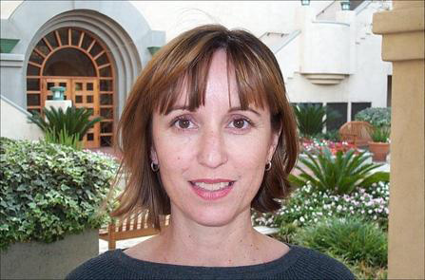
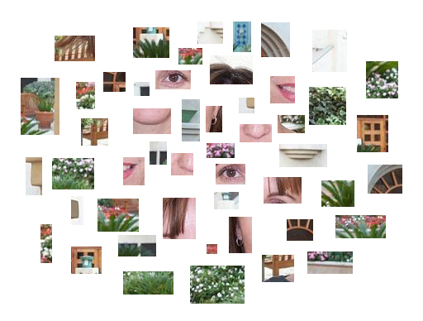
Bag-of-features models
Svetlana Lazebnik

Slide 48
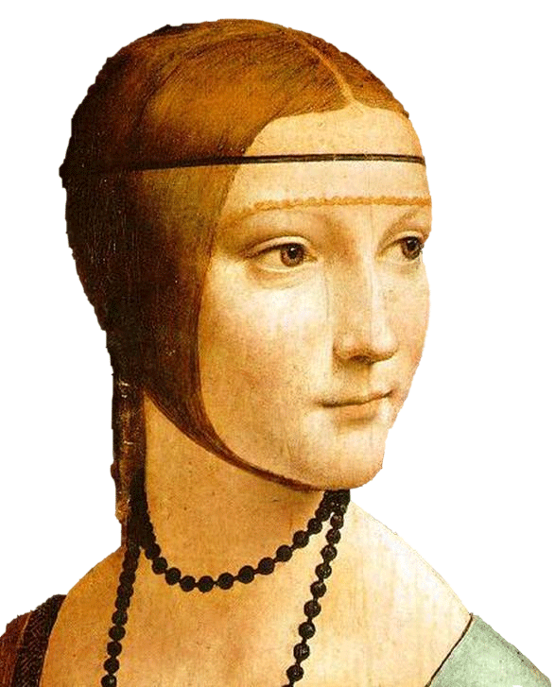
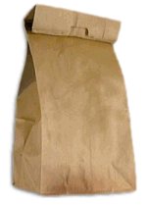

Bag-of-features models
Bag of ‘words’
Object
Svetlana Lazebnik

Slide 49








Objects as texture
All of these are treated as being the same
No distinction between foreground and background. No concern about spatial layout.
Svetlana Lazebnik
Notes:
Motivation slide. Clearly location has to help, but bag-of-words doesn’t have it…

Slide 50






Origin 1: Texture recognition
Texture is characterized by the repetition of basic elements or textons
For stochastic textures, it is the identity of the textons, not their spatial arrangement, that matters
Julesz, 1981; Cula & Dana, 2001; Leung & Malik 2001; Mori, Belongie & Malik, 2001; Schmid 2001; Varma & Zisserman, 2002, 2003; Lazebnik, Schmid & Ponce, 2003

Slide 51


Origin 1: Texture recognition
Julesz, 1981; Cula & Dana, 2001; Leung & Malik 2001; Mori, Belongie & Malik, 2001; Schmid 2001; Varma & Zisserman, 2002, 2003; Lazebnik, Schmid & Ponce, 2003

Slide 52
Origin 2: Bag-of-words models
Orderless document representation: frequencies of words from a dictionary Salton & McGill (1983)

Slide 53

Origin 2: Bag-of-words models
Orderless document representation: frequencies of words from a dictionary Salton & McGill (1983)
US Presidential Speeches Tag Cloud
http://chir.ag/phernalia/preztags/

Slide 54

Origin 2: Bag-of-words models
Orderless document representation: frequencies of words from a dictionary Salton & McGill (1983)
US Presidential Speeches Tag Cloud
http://chir.ag/phernalia/preztags/

Slide 55

Origin 2: Bag-of-words models
Orderless document representation: frequencies of words from a dictionary Salton & McGill (1983)
US Presidential Speeches Tag Cloud
http://chir.ag/phernalia/preztags/

Slide 56



Bag-of-features steps
Extract features
Learn “visual vocabulary”
Quantize features using visual vocabulary
Represent images by frequencies of “visual words”

Slide 57


1. Feature extraction
Regular grid or interest regions

Slide 58


1. Feature extraction
Compute descriptor
Normalize patch
Detect patches
Slide credit: Josef Sivic

Slide 59
1. Feature extraction
…
Slide credit: Josef Sivic

Slide 60
2. Learning the visual vocabulary
…
Slide credit: Josef Sivic

Slide 61
2. Learning the visual vocabulary
…
Clustering
Slide credit: Josef Sivic

Slide 62
2. Learning the visual vocabulary
Visual vocabulary
…
Clustering
Slide credit: Josef Sivic

Slide 63
K-means clustering
Want to minimize sum of squared Euclidean distances between points x_{i} and their nearest cluster centers m_{k}
Algorithm:
Randomly initialize K cluster centers
Iterate until convergence:
  Assign each data point to the nearest center
  Recompute each cluster center as the mean of all points assigned to it

Slide 64
Clustering and vector quantization
Clustering is a common method for learning a visual vocabulary or codebook
  Unsupervised learning process
  Each cluster center produced by k-means becomes a codevector
  Codebook can be learned on separate training set
  Provided the training set is sufficiently representative, the codebook will be “universal”
The codebook is used for quantizing features
  A vector quantizer takes a feature vector and maps it to the index of the nearest codevector in a codebook
  Codebook = visual vocabulary
  Codevector = visual word

Slide 65

















Example codebook
…
Appearance codebook
Source: B. Leibe

Slide 66

Another codebook
…
…
…
…
…
Appearance codebook
Source: B. Leibe

Slide 67
Visual vocabularies: Issues
How to choose vocabulary size?
  Too small: visual words not representative of all patches
  Too large: quantization artifacts, overfitting
Computational efficiency
  Vocabulary trees
  (Nister & Stewenius, 2006)

Slide 68




But what about layout?
All of these images have the same color histogram

Slide 69

Spatial pyramid
Compute histogram in each spatial bin

Slide 70


Spatial pyramid representation
Extension of a bag of features
Locally orderless representation at several levels of resolution
level 0
Lazebnik, Schmid & Ponce (CVPR 2006)

Slide 71




Spatial pyramid representation
Extension of a bag of features
Locally orderless representation at several levels of resolution
level 0
level 1
Lazebnik, Schmid & Ponce (CVPR 2006)

Slide 72
















Spatial pyramid representation
Extension of a bag of features
Locally orderless representation at several levels of resolution
level 0
level 1
level 2
Lazebnik, Schmid & Ponce (CVPR 2006)

Slide 73


Scene category dataset
Multi-class classification results
(100 training images per class)

Slide 74















Caltech101 dataset
http://www.vision.caltech.edu/Image_Datasets/Caltech101/Caltech101.html
Multi-class classification results (30 training images per class)

Slide 75

Bags of features for action recognition
Space-time interest points
Juan Carlos Niebles, Hongcheng Wang and Li Fei-Fei, Unsupervised Learning of Human Action Categories Using Spatial-Temporal Words, IJCV 2008.

Slide 76
History of ideas in recognition
1960s – early 1990s: the geometric era
1990s: appearance-based models
Mid-1990s: sliding window approaches
Late 1990s: local features
Early 2000s: parts-and-shape models
Mid-2000s: bags of features
Present trends: deep learning
Svetlana Lazebnik

Slide 77
Beyond AlexNet

Slide 78

Recap: Convolutional Network, AlexNet

Slide 79













Recap: Convolutional Network Interpretation
1
Object detectors emerge within CNN trained to classify scenes, without any object supervision!

Slide 80
Beyond AlexNet

Slide 81
VERY DEEP CONVOLUTIONAL NETWORKS FOR LARGE-SCALE IMAGE RECOGNITION
Karen Simonyan & Andrew Zisserman 2015
These are the “VGG” networks.
“Perceptual Loss” in generative deep learning refers to these networks

Slide 82

Notes:
Compared to Alex-Net – Deeper, smaller convolutions, more parameters

Slide 83

Notes:
Compared to Alex-Net – Deeper, smaller convolutions, more parameters

Slide 84

“VGG” networks are commonly used as the basis for “Perceptual Loss”.
The images on the right are as close as possible to all images on the left in various feature spaces.
Understanding and Simplifying Perceptual Distances. Dan Amir and Yair Weiss. CVPR 2021

Slide 85



https://generative-dynamics.github.io/

Slide 86
Going Deeper with Convolutions
Christian Szegedy, Wei Liu, Yangqing Jia, Pierre Sermanet, Scott Reed,
Dragomir Anguelov, Dumitru Erhan, Vincent Vanhoucke, Andrew Rabinovich
2015
This is the “Inception” architecture or “GoogLeNet”
*The architecture blocks are called “Inception” modules
and the collection of them into a particular net is “GoogLeNet”

Slide 87


Slide 88

Only 6.8 million parameters. AlexNet ~60 million, VGG up to 138 million

Slide 89




Slide 90


Slide 91




ConvNet Depth
28.2
25.8
16.4
11.7
22 layers
6.7
19 layers
7.3
8 layers
8 layers
shallow
 | ILSVRC'14 | ILSVRC'14 | ILSVRC'13 | ILSVRC'12 | ILSVRC'11 | ILSVRC'10
 | GoogleNet | VGG |  | AlexNet
ImageNet Classification top-5 error (%)

Slide 92
Surely it would be ridiculous to go any deeper…

Slide 93
Deep Residual Learning for Image Recognition
Kaiming He, Xiangyu Zhang, Shaoqing Ren, Jian Sun
work done at
Microsoft Research Asia
7x7 conv, 64, /2, pool/2
1x1 conv, 64
3x3 conv, 64 1x1 conv, 256 1x1 conv, 64 3x3 conv, 64
1x1 conv, 256 1x1 conv, 64 3x3 conv, 64 1x1 conv, 256
1x1 conv, 128, /2
3x3 conv, 128
1x1 conv, 512
1x1 conv, 128
3x3 conv, 128
1x1 conv, 512
1x1 conv, 128
3x3 conv, 128
1x1 conv, 512
1x1 conv, 128
3x3 conv, 128
1x1 conv, 512
1x1 conv, 128
3x3 conv, 128
1x1 conv, 512
1x1 conv, 128
3x3 conv, 128
1x1 conv, 512
1x1 conv, 128
3x3 conv, 128
1x1 conv, 512
1x1 conv, 128
3x3 conv, 128
1x1 conv, 512
1x1 conv, 256, /2
3x3 conv, 256
1x1 conv, 1024
1x1 conv, 256
3x3 conv, 256
1x1 conv, 1024
1x1 conv, 256
3x3 conv, 256
1x1 conv, 1024
1x1 conv, 256
3x3 conv, 256
1x1 conv, 1024
1x1 conv, 256
3x3 conv, 256
1x1 conv, 1024
1x1 conv, 256
3x3 conv, 256
1x1 conv, 1024
1x1 conv, 256
3x3 conv, 256
1x1 conv, 1024
1x1 conv, 256
3x3 conv, 256
1x1 conv, 1024
1x1 conv, 256
3x3 conv, 256
1x1 conv, 1024
1x1 conv, 256
3x3 conv, 256
1x1 conv, 1024
1x1 conv, 256
3x3 conv, 256
1x1 conv, 1024
1x1 conv, 256
3x3 conv, 256
1x1 conv, 1024
1x1 conv, 256
3x3 conv, 256
1x1 conv, 1024
1x1 conv, 256
3x3 conv, 256
1x1 conv, 1024
1x1 conv, 256
3x3 conv, 256
1x1 conv, 1024
1x1 conv, 256
3x3 conv, 256
1x1 conv, 1024
1x1 conv, 256
3x3 conv, 256
1x1 conv, 1024
1x1 conv, 256
3x3 conv, 256
1x1 conv, 1024
1x1 conv, 256
3x3 conv, 256
1x1 conv, 1024
1x1 conv, 256
3x3 conv, 256
1x1 conv, 1024
1x1 conv, 256
3x3 conv, 256
1x1 conv, 1024
1x1 conv, 256
3x3 conv, 256
1x1 conv, 1024
1x1 conv, 256
3x3 conv, 256
1x1 conv, 1024
1x1 conv, 256
3x3 conv, 256
1x1 conv, 1024
1x1 conv, 256
3x3 conv, 256
1x1 conv, 1024
1x1 conv, 256
3x3 conv, 256
1x1 conv, 1024
1x1 conv, 256
3x3 conv, 256
1x1 conv, 1024
1x1 conv, 256
3x3 conv, 256
1x1 conv, 1024
1x1 conv, 256
3x3 conv, 256
1x1 conv, 1024
1x1 conv, 256
3x3 conv, 256
1x1 conv, 1024
1x1 conv, 256
3x3 conv, 256
1x1 conv, 1024
1x1 conv, 256
3x3 conv, 256
1x1 conv, 1024
1x1 conv, 256
3x3 conv, 256
1x1 conv, 1024
1x1 conv, 256
3x3 conv, 256
1x1 conv, 1024
1x1 conv, 256
3x3 conv, 256
1x1 conv, 1024
1x1 conv, 256
3x3 conv, 256
1x1 conv, 1024
1x1 conv, 512, /2
3x3 conv, 512
1x1 conv, 2048
1x1 conv, 512
3x3 conv, 512
1x1 conv, 2048
1x1 conv, 512
3x3 conv, 512
1x1 conv, 2048
ave pool, fc 1000

Slide 94

Cited 185,914 times as of 10/26/2023.

Slide 95
ResNet @ ILSVRC & COCO 2015 Competitions
1st places in all five main tracks
ImageNet Classification: “Ultra-deep” 152-layer nets
ImageNet Detection: 16% better than 2nd
ImageNet Localization: 27% better than 2nd
COCO Detection: 11% better than 2nd
COCO Segmentation: 12% better than 2nd
*improvements are relative numbers

Slide 96
Revolution of Depth
28.2
25.8
152 layers
16.4
11.7
22 layers
6.7
19 layers
7.3
3.57
8 layers
8 layers
shallow
ILSVRC'15 | ILSVRC'14 | ILSVRC'14 | ILSVRC'13 | ILSVRC'12 | ILSVRC'11 | ILSVRC'10
ResNet | GoogleNet | VGG |  | AlexNet
ImageNet Classification top-5 error (%)

Slide 97

Revolution of Depth
101 layers
86
Engines of
visual recognition
66
58
34
16 layers
8 layers
shallow
HOG, DPM
AlexNet (RCNN)
VGG (RCNN)
ResNet (Faster RCNN)*
PASCAL VOC 2007 Object Detection mAP (%)
*w/ other improvements & more data

Slide 98
Revolution of Depth
AlexNet, 8 layers
(ILSVRC 2012)
11x11 conv, 96, /4, pool/2
5x5 conv, 256, pool/2
3x3 conv, 384
3x3 conv, 384
3x3 conv, 256, pool/2
fc, 4096
fc, 4096
fc, 1000

Slide 99

Revolution of Depth
soft max2
Soft maxAct ivat ion
FC
AlexNet, 8 layers
(ILSVRC 2012)
11x11 conv, 96, /4, pool/2
VGG, 19 layers
(ILSVRC 2014)
3x3 conv, 64
GoogleNet, 22 layers
(ILSVRC 2014)
AveragePool 7x7 + 1 (V)
Dept hConcat
5x5 conv, 256, pool/2
3x3 conv, 64, pool/2
Conv Conv Conv Conv 1x1 + 1 (S) 3x3 + 1 (S) 5x5 + 1 (S) 1x1 + 1 (S)
Conv Conv MaxPool 1x1 + 1 (S) 1x1 + 1 (S) 3x3 + 1 (S)
3x3 conv, 384
3x3 conv, 128
Dept hConcat
Conv Conv Conv Conv 1x1 + 1 (S) 3x3 + 1 (S) 5x5 + 1 (S) 1x1 + 1 (S)
soft max1
3x3 conv, 384
3x3 conv, 128, pool/2
Conv Conv MaxPool 1x1 + 1 (S) 1x1 + 1 (S) 3x3 + 1 (S)
Soft maxAct ivat ion
MaxPool 3x3 + 2 (S)
FC
3x3 conv, 256, pool/2
3x3 conv, 256
Dept hConcat
FC
Conv Conv Conv Conv Conv 1x1 + 1 (S) 3x3 + 1 (S) 5x5 + 1 (S) 1x1 + 1 (S) 1x1 + 1 (S)
fc, 4096
3x3 conv, 256
Conv Conv MaxPool AveragePool 1x1 + 1 (S) 1x1 + 1 (S) 3x3 + 1 (S) 5x5 + 3 (V)
Dept hConcat
fc, 4096
3x3 conv, 256
Conv Conv Conv Conv 1x1 + 1 (S) 3x3 + 1 (S) 5x5 + 1 (S) 1x1 + 1 (S)
Conv Conv MaxPool 1x1 + 1 (S) 1x1 + 1 (S) 3x3 + 1 (S)
fc, 1000
3x3 conv, 256, pool/2
Dept hConcat
soft max0
Conv Conv Conv Conv 1x1 + 1 (S) 3x3 + 1 (S) 5x5 + 1 (S) 1x1 + 1 (S)
Soft maxAct ivat ion
3x3 conv, 512
Conv Conv MaxPool 1x1 + 1 (S) 1x1 + 1 (S) 3x3 + 1 (S)
FC
Dept hConcat
FC
3x3 conv, 512
Conv Conv Conv Conv Conv 1x1 + 1 (S) 3x3 + 1 (S) 5x5 + 1 (S) 1x1 + 1 (S) 1x1 + 1 (S)
Conv Conv MaxPool AveragePool 1x1 + 1 (S) 1x1 + 1 (S) 3x3 + 1 (S) 5x5 + 3 (V)
3x3 conv, 512
Dept hConcat
Conv Conv Conv Conv 1x1 + 1 (S) 3x3 + 1 (S) 5x5 + 1 (S) 1x1 + 1 (S)
3x3 conv, 512, pool/2
Conv Conv MaxPool 1x1 + 1 (S) 1x1 + 1 (S) 3x3 + 1 (S)
MaxPool 3x3 + 2 (S)
3x3 conv, 512
Dept hConcat
Conv Conv Conv Conv 1x1 + 1 (S) 3x3 + 1 (S) 5x5 + 1 (S) 1x1 + 1 (S)
3x3 conv, 512
Conv Conv MaxPool 1x1 + 1 (S) 1x1 + 1 (S) 3x3 + 1 (S)
Dept hConcat
3x3 conv, 512
Conv Conv Conv Conv 1x1 + 1 (S) 3x3 + 1 (S) 5x5 + 1 (S) 1x1 + 1 (S)
Conv Conv MaxPool 1x1 + 1 (S) 1x1 + 1 (S) 3x3 + 1 (S)
3x3 conv, 512, pool/2
MaxPool 3x3 + 2 (S)
LocalRespNorm
fc, 4096
Conv 3x3 + 1 (S)
Conv 1x1 + 1 (V)
fc, 4096
LocalRespNorm
MaxPool 3x3 + 2 (S)
fc, 1000
Conv 7x7 + 2 (S)
input

Slide 100
7x7 conv, 64, /2, pool/2
1x1 conv, 64
3x3 conv, 64
1x1 conv, 256
1x1 conv, 64
3x3 conv, 64
1x1 conv, 256
1x1 conv, 64
3x3 conv, 64
1x1 conv, 256
Revolution of Depth
11x11 conv, 96, /4, pool/2
1x2 conv, 128, /2
3x3 conv, 128
1x1 conv, 512
1x1 conv, 128
3x3 conv, 128
1x1 conv, 512
1x1 conv, 128
3x3 conv, 128
1x1 conv, 512
1x1 conv, 128
3x3 conv, 128
1x1 conv, 512
1x1 conv, 128
3x3 conv, 128
1x1 conv, 512
1x1 conv, 128
3x3 conv, 128
1x1 conv, 512
1x1 conv, 128
3x3 conv, 128
1x1 conv, 512
1x1 conv, 128
3x3 conv, 128
1x1 conv, 512 1x1 conv, 256, /2 3x3 conv, 256
1x1 conv, 1024
AlexNet, 8 layers
(ILSVRC 2012)
5x5 conv, 256, pool/2
3x3 conv, 384
3x3 conv, 384 3x3 conv, 256, pool/2
fc, 4096
fc, 4096
fc, 1000
VGG, 19 layers
(ILSVRC 2014)
3x3 conv, 64
3x3 conv, 64, pool/2 3x3 conv, 128
3x3 conv, 128, pool/2 3x3 conv, 256
3x3 conv, 256
3x3 conv, 256 3x3 conv, 256, pool/2
3x3 conv, 512
3x3 conv, 512
3x3 conv, 512 3x3 conv, 512, pool/2
3x3 conv, 512
3x3 conv, 512
3x3 conv, 512 3x3 conv, 512, pool/2
fc, 4096
fc, 4096
fc, 1000
ResNet, 152 layers
(ILSVRC 2015)
1x1 conv, 256
3x3 conv, 256
1x1 conv, 1024
1x1 conv, 256
3x3 conv, 256
1x1 conv, 1024
1x1 conv, 256
3x3 conv, 256
1x1 conv, 1024
1x1 conv, 256
3x3 conv, 256
1x1 conv, 1024
1x1 conv, 256
3x3 conv, 256
1x1 conv, 1024
1x1 conv, 256
3x3 conv, 256
1x1 conv, 1024
1x1 conv, 256
3x3 conv, 256
1x1 conv, 1024
1x1 conv, 256
3x3 conv, 256
1x1 conv, 1024
1x1 conv, 256
3x3 conv, 256
1x1 conv, 1024
1x1 conv, 256
3x3 conv, 256
1x1 conv, 1024
1x1 conv, 256
3x3 conv, 256
1x1 conv, 1024
1x1 conv, 256
3x3 conv, 256
1x1 conv, 1024
1x1 conv, 256
3x3 conv, 256
1x1 conv, 1024
1x1 conv, 256
3x3 conv, 256
1x1 conv, 1024
1x1 conv, 256
3x3 conv, 256
1x1 conv, 1024
1x1 conv, 256
3x3 conv, 256
1x1 conv, 1024
1x1 conv, 256
3x3 conv, 256
1x1 conv, 1024
1x1 conv, 256
3x3 conv, 256
1x1 conv, 1024
1x1 conv, 256
3x3 conv, 256
1x1 conv, 1024
1x1 conv, 256
3x3 conv, 256
1x1 conv, 1024
1x1 conv, 256
3x3 conv, 256
1x1 conv, 1024
1x1 conv, 256
3x3 conv, 256
1x1 conv, 1024
1x1 conv, 256
3x3 conv, 256
1x1 conv, 1024
1x1 conv, 256
3x3 conv, 256
1x1 conv, 1024
1x1 conv, 256
3x3 conv, 256
1x1 conv, 1024
1x1 conv, 256
3x3 conv, 256
1x1 conv, 1024
1x1 conv, 256
3x3 conv, 256
1x1 conv, 1024
1x1 conv, 256
3x3 conv, 256
1x1 conv, 1024
1x1 conv, 256
3x3 conv, 256
1x1 conv, 1024
1x1 conv, 256
3x3 conv, 256
1x1 conv, 1024
1x1 conv, 256
3x3 conv, 256
1x1 conv, 1024
1x1 conv, 256
3x3 conv, 256
1x1 conv, 1024
1x1 conv, 256
3x3 conv, 256
1x1 conv, 1024
1x1 conv, 256
3x3 conv, 256
1x1 conv, 1024
1x1 conv, 256
3x3 conv, 256
1x1 conv, 1024 1x1 conv, 512, /2 3x3 conv, 512
1x1 conv, 2048
1x1 conv, 512
3x3 conv, 512
1x1 conv, 2048
1x1 conv, 512
3x3 conv, 512
1x1 conv, 2048 ave pool, fc 1000

Slide 101
Is learning better networks
as simple as stacking more layers?

Slide 102
Simply stacking layers?
CIFAR-10
train error (%)
20
test error (%)
20
56-layer
56-layer
10
10
20-layer
20-layer
0 ₀
1
2
3
iter. (1e4)
4
5
6
0
0
1
2
3
iter. (1e4)
4
5
6
Plain nets: stacking 3x3 conv layers…
56-layer net has higher training error and test error than 20-layer net

Slide 103
Simply stacking layers?
CIFAR-10
ImageNet-1000
20
56-layer 44-layer 32-layer 20-layer
60
50
error (%)
error (%)
34-layer
10
40
5
plain-20 plain-32 plain-44 plain-56
30
solid: test/val dashed: train
plain-18 plain-34
18-layer
0
0
1
2
3
iter. (1e4)
4
5
6
20
0
10
20
30
iter. (1e4)
40
50
“Overly deep” plain nets have higher training error
A general phenomenon, observed in many datasets

Slide 104
a shallower model
(18 layers)
7x7 conv, 64, /2
7x7 conv, 64, /2
a deeper counterpart (34 layers)
3x3 conv, 64
3x3 conv, 64
3x3 conv, 64
3x3 conv, 64
3x3 conv, 64
3x3 conv, 64
3x3 conv, 64
3x3 conv, 64
3x3 conv, 64
3x3 conv, 64
3x3 conv, 128, /2
3x3 conv, 128, /2
Richer solution space
3x3 conv, 128
3x3 conv, 128
3x3 conv, 128
3x3 conv, 128
3x3 conv, 128
3x3 conv, 128
3x3 conv, 128
A deeper model should not have higher training error
3x3 conv, 128
3x3 conv, 128
“extra” layers
3x3 conv, 128
3x3 conv, 256, /2
3x3 conv, 256, /2
3x3 conv, 256
3x3 conv, 256
3x3 conv, 256
3x3 conv, 256
A solution by construction:
  original layers: copied from a learned shallower model
  extra layers: set as identity
  at least the same training error
3x3 conv, 256
3x3 conv, 256
3x3 conv, 256
3x3 conv, 256
3x3 conv, 256
3x3 conv, 256
3x3 conv, 256
3x3 conv, 256
3x3 conv, 256
3x3 conv, 256
3x3 conv, 512, /2
3x3 conv, 512, /2
3x3 conv, 512
3x3 conv, 512
Optimization difficulties: solvers cannot find the solution when going deeper…
3x3 conv, 512
3x3 conv, 512
3x3 conv, 512
3x3 conv, 512
3x3 conv, 512
3x3 conv, 512
fc 1000
fc 1000

Slide 105


Deep Residual Learning
𝐻 𝑥 is any desired mapping, hope the 2 weight layers fit 𝐻(𝑥)
Plain net
𝑥
weight layer
 | relu
any two stacked layers
weight layer
relu
𝐻(𝑥)

Slide 106


Deep Residual Learning
𝐻 𝑥 is any desired mapping, hope the 2 weight layers fit 𝐻(𝑥) hope the 2 weight layers fit 𝐹(𝑥) let 𝐻 𝑥 = 𝐹 𝑥 + 𝑥
Residual net
𝑥
weight layer
𝐹(𝑥)
relu
identity
𝑥
weight layer
𝐻
𝑥
= 𝐹
𝑥
+ 𝑥
relu

Slide 107
Deep Residual Learning
𝐹 𝑥 is a residual mapping w.r.t. identity
𝑥
If identity were optimal, easy to set weights as 0
If optimal mapping is closer to identity, easier to find small fluctuations
weight layer
 | relu
𝐹(𝑥)
identity
𝑥
weight layer
𝐻
𝑥
= 𝐹
𝑥
+ 𝑥
relu

Slide 108
7x7 conv, 64, /2
7x7 conv, 64, /2
pool, /2
pool, /2
Network “Design”
Keep it simple
3x3 conv, 64
3x3 conv, 64
plain net
3x3 conv, 64
3x3 conv, 64
ResNet
3x3 conv, 64
3x3 conv, 64
3x3 conv, 64
3x3 conv, 64
3x3 conv, 64
3x3 conv, 64
3x3 conv, 64
3x3 conv, 64
3x3 conv, 128, /2
3x3 conv, 128, /2
3x3 conv, 128
3x3 conv, 128
3x3 conv, 128
3x3 conv, 128
3x3 conv, 128
3x3 conv, 128
3x3 conv, 128
3x3 conv, 128
3x3 conv, 128
3x3 conv, 128
Our basic design (VGG-style)
  all 3x3 conv (almost)
  spatial size /2 => # filters x2
  Simple design; just deep!
3x3 conv, 128
3x3 conv, 128
3x3 conv, 128
3x3 conv, 128
3x3 conv, 256, /2
3x3 conv, 256, /2
3x3 conv, 256
3x3 conv, 256
3x3 conv, 256
3x3 conv, 256
3x3 conv, 256
3x3 conv, 256
3x3 conv, 256
3x3 conv, 256
3x3 conv, 256
3x3 conv, 256
3x3 conv, 256
3x3 conv, 256
3x3 conv, 256
3x3 conv, 256
3x3 conv, 256
3x3 conv, 256
3x3 conv, 256
3x3 conv, 256
3x3 conv, 256
3x3 conv, 256
3x3 conv, 256
3x3 conv, 256
3x3 conv, 512, /2
3x3 conv, 512, /2
3x3 conv, 512
3x3 conv, 512
3x3 conv, 512
3x3 conv, 512
3x3 conv, 512
3x3 conv, 512
3x3 conv, 512
3x3 conv, 512
3x3 conv, 512
3x3 conv, 512
avg pool
avg pool
fc 1000
fc 1000

Slide 109
CIFAR-10 experiments
CIFAR-10 plain nets
CIFAR-10 ResNets
20
20
ResNet-20 ResNet-32 ResNet-44 ResNet-56
56-layer 44-layer 32-layer 20-layer
ResNet-110
20-layer 32-layer 44-layer 56-layer 110-layer
error (%)
error (%)
10
10
5
plain-20 plain-32 plain-44 plain-56
5
bold: test thin: train
0
0
1
2
3
iter. (1e4)
4
5
6
0
0
1
2
3
iter. (1e4)
4
5
6
• Deep ResNets can be trained without difficulties
• Deeper ResNets have lower training error, and also lower test error

Slide 110
ImageNet experiments
ImageNet plain nets
ImageNet ResNets
60
60
50
50
error (%)
34-layer
error (%)
18-layer
40
40
30
solid: test
30
plain-18
plain-34
dashed: train
18-layer
ResNet-18
ResNet-34
34-layer
20
0
10
20
30
iter. (1e4)
40
50
20
0
10
20
30
iter. (1e4)
40
50
• Deep ResNets can be trained without difficulties
• Deeper ResNets have lower training error, and also lower test error

Slide 111
ImageNet experiments
Deeper ResNets have lower error
8
7.4
this model has
lower time complexity
than VGG-16/19
6.7
7
6.1
5.7
6
5
4
ResNet-152
ResNet-101 ResNet-50
10-crop testing, top-5 val error (%)
ResNet-34

Slide 112
Beyond classification
A treasure from ImageNet is on learning features.
Kaiming He, Xiangyu Zhang, Shaoqing Ren, & Jian Sun. “Deep Residual Learning for Image Recognition”. arXiv 2015.

Slide 113
“Features matter.” (quote [Girshick et al. 2014], the R-CNN paper)
task
2nd-place winner
ResNets
margin
(relative)
12.0 9.0
_{53.6} absolute _{62.1}
ImageNet Localization (top-5 error)
27%
ImageNet Detection (mAP@.5)
16%
8.5% better!
33.5 37.3
COCO Detection (mAP@.5:.95)
11%
COCO Segmentation (mAP@.5:.95)
25.1 28.2
12%
Our results are all based on ResNet-101
Our features are well transferrable
Kaiming He, Xiangyu Zhang, Shaoqing Ren, & Jian Sun. “Deep Residual Learning for Image Recognition”. CVPR 2016.

Slide 114


Object Detection (brief)
classifier
RoI pooling
Simply “Faster R-CNN + ResNet”
proposals
Faster R-CNN baseline | mAP@.5 | mAP@.5:.95
VGG-16 | 41.5 | 21.5
ResNet-101 | 48.4 | 27.2
Region Proposal Net
feature map
COCO detection results (ResNet has 28% relative gain)
CNN
image
Kaiming He, Xiangyu Zhang, Shaoqing Ren, & Jian Sun. “Deep Residual Learning for Image Recognition”. CVPR 2016. Shaoqing Ren, Kaiming He, Ross Girshick, & Jian Sun. “Faster R-CNN: Towards Real-Time Object Detection with Region Proposal Networks”. NIPS 2015.

Slide 115

Our results on MS COCO
*the original image is from the COCO dataset
Kaiming He, Xiangyu Zhang, Shaoqing Ren, & Jian Sun. “Deep Residual Learning for Image Recognition”. CVPR 2016. Shaoqing Ren, Kaiming He, Ross Girshick, & Jian Sun. “Faster R-CNN: Towards Real-Time Object Detection with Region Proposal Networks”. NIPS 2015.

Slide 116

this video is available online: https://youtu.be/WZmSMkK9VuA
Results on real video. Model trained on MS COCO w/ 80 categories. (frame-by-frame; no temporal processing)
Kaiming He, Xiangyu Zhang, Shaoqing Ren, & Jian Sun. “Deep Residual Learning for Image Recognition”. arXiv 2015. Shaoqing Ren, Kaiming He, Ross Girshick, & Jian Sun. “Faster R-CNN: Towards Real-Time Object Detection with Region Proposal Networks”. NIPS 2015.

Slide 117


More Visual Recognition Tasks
ResNets lead on these benchmarks (incomplete list):
ImageNet classification, detection, localization
MS COCO detection, segmentation
ResNet-101
PASCAL VOC detection, segmentation
VQA challenge 2016
PASCAL segmentation leaderboard
Human pose estimation [Newell et al 2016]
Depth estimation [Laina et al 2016]
Segment proposal [Pinheiro et al 2016]
…
ResNet-101
PASCAL detection leaderboard

Slide 118
Potential Applications
Visual Recognition
Image Generation (Pixel RNN, Neural Art, etc.)
Natural Language Processing (Very deep CNN)
Speech Recognition (preliminary results)
Advertising, user prediction (preliminary results)
ResNets have shown outstanding or promising results on:
Kaiming He, Xiangyu Zhang, Shaoqing Ren, & Jian Sun. “Deep Residual Learning for Image Recognition”. CVPR 2016.

Slide 119
Conclusions
Deep Residual Networks:
  Easy to train
  Simply gain accuracy from depth
  Well transferrable
Follow-up [He et al. arXiv 2016]
  200 layers on ImageNet, 1000 layers on CIFAR
Kaiming He, Xiangyu Zhang, Shaoqing Ren, & Jian Sun. “Identity Mappings in Deep Residual Networks”. arXiv 2016.
Kaiming He, Xiangyu Zhang, Shaoqing Ren, & Jian Sun. “Deep Residual Learning for Image Recognition”. CVPR 2016.

Slide 120


Why does ResNet work so well?
The architecture is somehow easier to optimize.
The authors argue it probably isn’t because it solves the “vanishing gradient” problem.
While the gradients might not be “vanishing” in “plain” nets, they don’t seem as stable and trustworthy, according to follow up work, e.g.
Visualizing the Loss Landscape of Neural Nets. Hao Li, Zheng Xu , Gavin Taylor, Christoph Studer, Tom Goldstein. NeurIPS 2018.

