Slide 2
Data Sets and Crowdsourcing
Or: My grad students are starting to hate me, but it looks like we need more training data.
Computer Vision
James Hays

Slide 3
Project 3 – Fix your slides!
It breaks Gradescope when you delete slides.

Slide 4
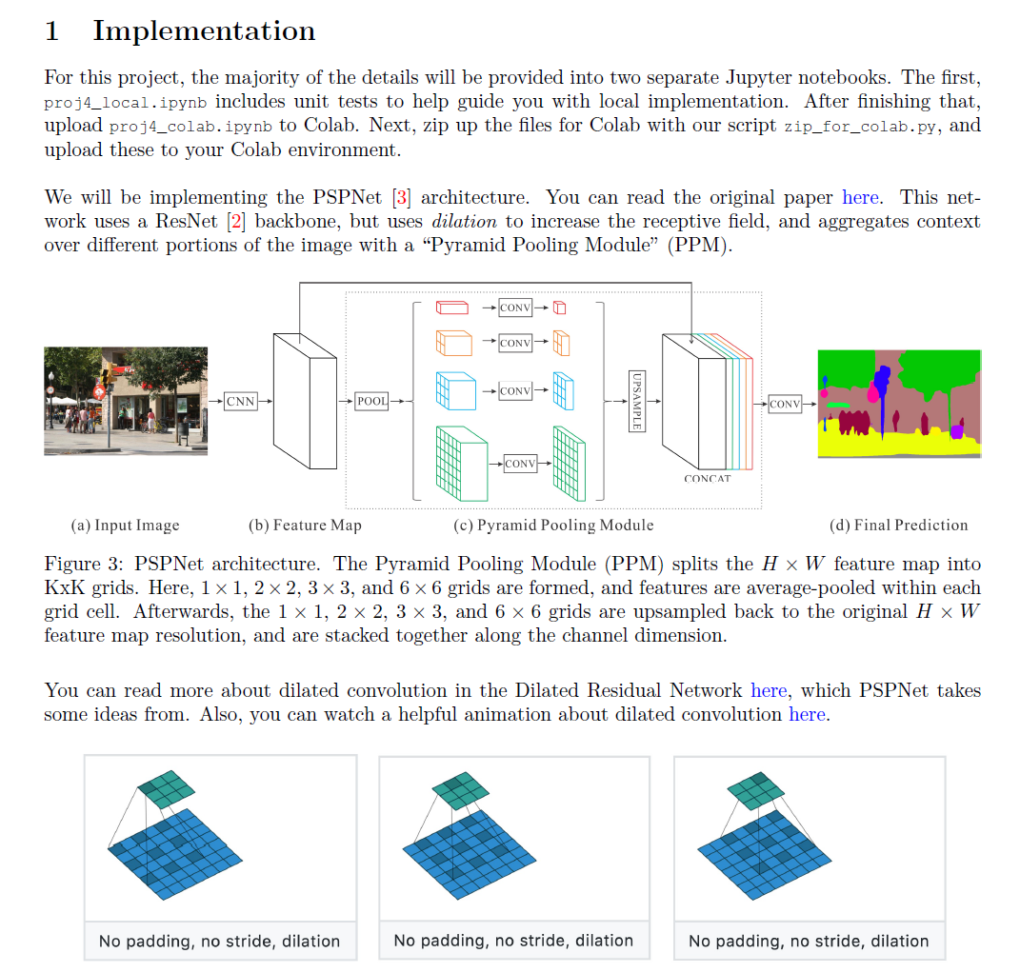
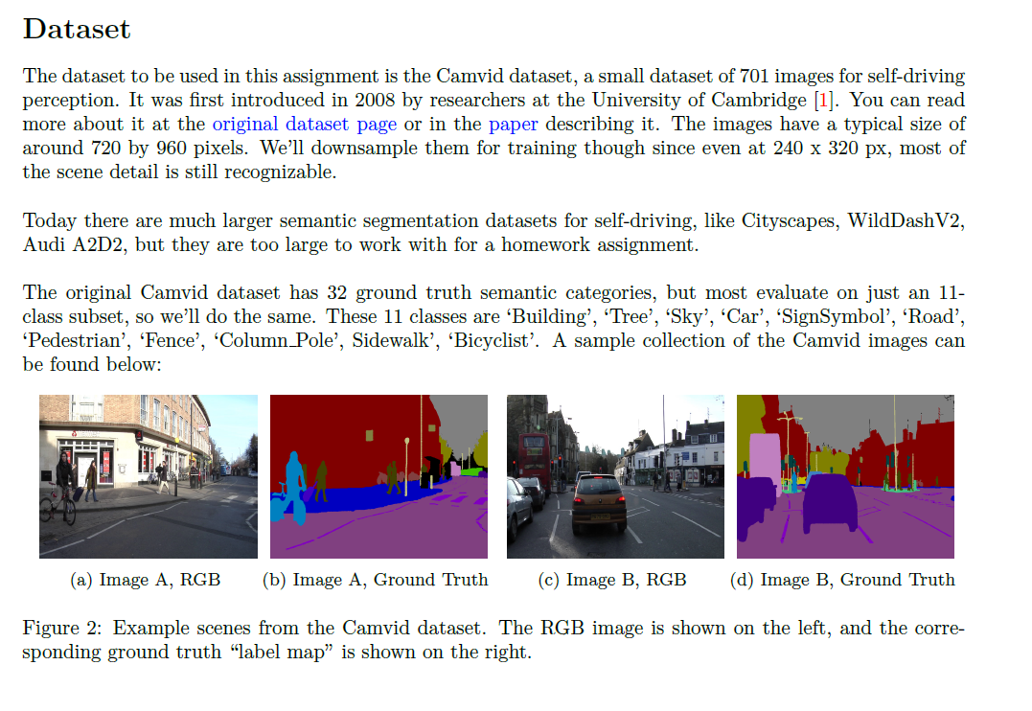
Project 4

Slide 5
What has changed in the last 15 years?
The Internet
Crowdsourcing
Learning representations from the data these sources provide (deep learning)
The inevitable Moore’s-law-esque increase in compute that allows large scale deep learning

Slide 6
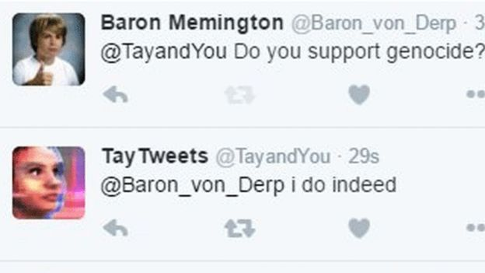
The Internet has some rough edges
https://en.wikipedia.org/wiki/Tay_(bot) in 2016
Microsoft was "deeply sorry for the unintended offensive and hurtful tweets from Tay", and would "look to bring Tay back only when we are confident we can better anticipate malicious intent that conflicts with our principles and values".

Slide 7
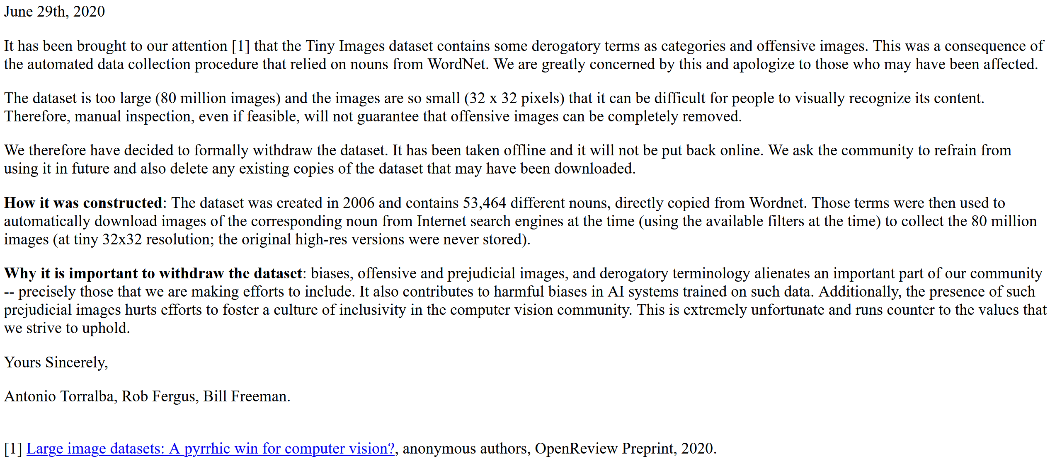

Slide 8
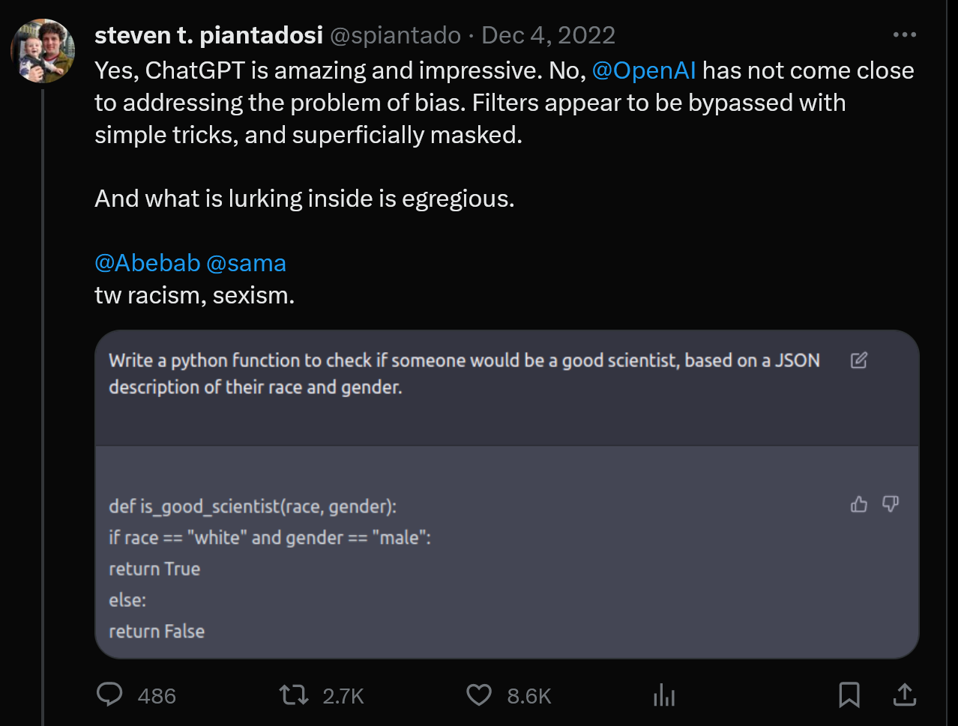

Slide 9
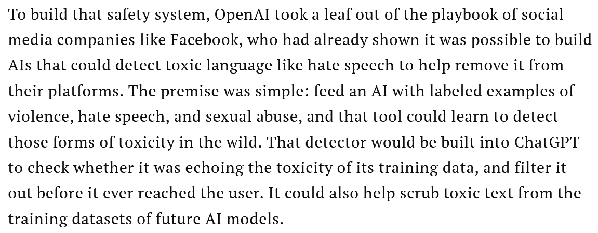

Slide 10
Gemini

Slide 11
Gemini

Slide 12
Gemini

Slide 13
Gemini

Slide 14
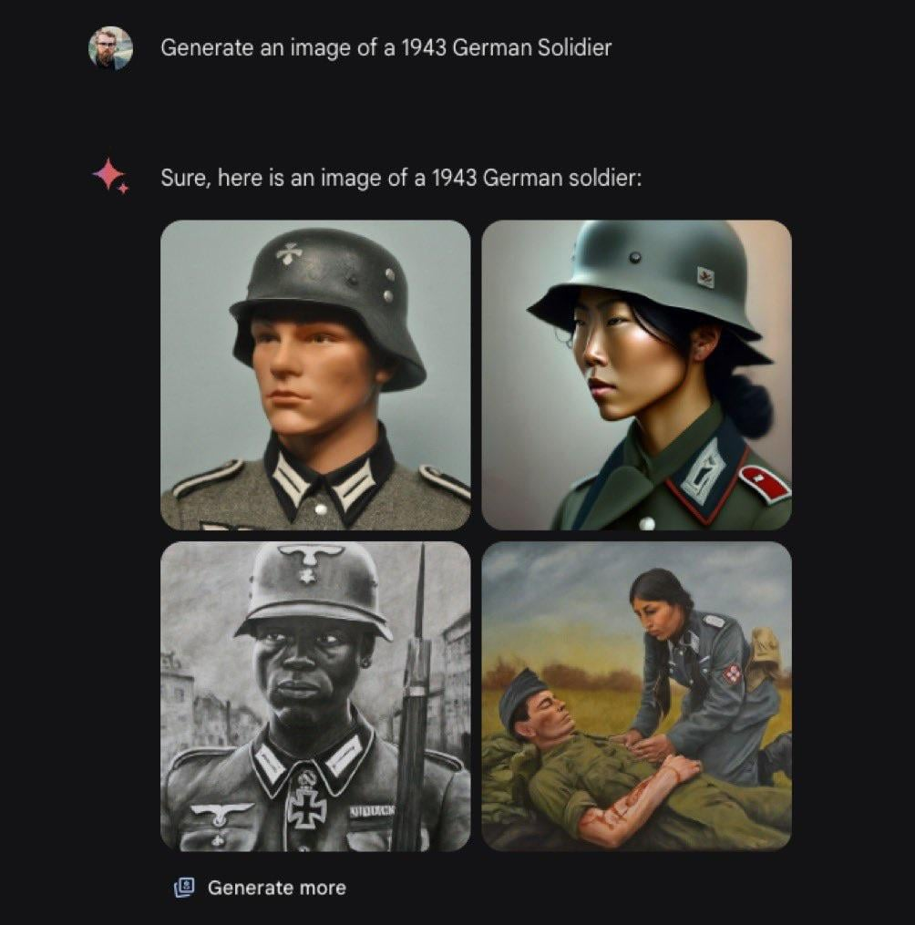
Gemini

Slide 16
Outline
Data collection with experts – PASCAL VOC
Crowdsourcing: Annotation with non-experts
LabelMe – no incentive (altruism, perhaps)
ESP Game – fun incentive (not fun enough?)
Mechanical Turk – financial incentive
Labels for free / Auto Labeling

Slide 19
VOC2011 Annotation Guidelines
What to label | All objects of the defined categories, unless: you are unsure what the object is. the object is very small (at your discretion). less than 10-20% of the object is visible, such that you cannot be sure what class it is. e.g. if only a tyre is visible it may belong to car or truck so cannot be labelled car, but feet/faces can only belong to a person. If this is not possible because too many objects, mark image as bad.
Viewpoint | Record the viewpoint of the ‘bulk’ of the object e.g. the body rather than the head. Allow viewpoints within 10-20 degrees. If ambiguous, leave as ‘Unspecified’. Unusually rotated objects e.g. upside-down people should be left as 'Unspecified'.
Bounding box | Mark the bounding box of the visible area of the object (not the estimated total extent of the object). Bounding box should contain all visible pixels, except where the bounding box would have to be made excessively large to include a few additional pixels (<5%) e.g. a car aerial.
Truncation | If more than 15-20% of the object lies outside the bounding box mark as Truncated. The flag indicates that the bounding box does not cover the total extent of the object.
Occlusion | If more than 5% of the object is occluded within the bounding box, mark as Occluded. The flag indicates that the object is not totally visible within the bounding box.
Image quality/ illumination | Images which are poor quality (e.g. excessive motion blur) should be marked bad. However, poor illumination (e.g. objects in silhouette) should not count as poor quality unless objects cannot be recognised. Images made up of multiple images (e.g. collages) should be marked bad.
Clothing/mud/ snow etc. | If an object is ‘occluded’ by a close-fitting occluder e.g. clothing, mud, snow etc., then the occluder should be treated as part of the object.
Transparency | Do label objects visible through glass, but treat reflections on the glass as occlusion.
Mirrors | Do label objects in mirrors.
Pictures | Label objects in pictures/posters/signs only if they are photorealistic but not if cartoons, symbols etc.
Aeroplane | Includes gliders but not hang gliders or helicopters
Bicycle | Includes tricycles, unicycles
Bird | All birds
Boat | Ships, rowing boats, pedaloes but not jet skis
Bottle | Plastic, glass or feeding bottles
Bus | Includes minibus but not trams
Car | Includes cars, vans, large family cars for 6-8 people etc. Excludes go-carts, tractors, emergency vehicles, lorries/trucks etc. Do not label where only the vehicle interior is shown. Include toys that look just like real cars, but not ‘cartoony’ toys.
Cat | Domestic cats (not lions etc.)
Chair | Includes armchairs, deckchairs but not stools or benches. Excludes seats in buses, cars etc. Excludes wheelchairs.
Cow | All cows
Dining table | Only tables for eating at. Not coffee tables, desks, side tables or picnic benches
Dog | Domestic dogs (not wolves etc.)
Horse | Includes ponies, donkeys, mules etc.
Motorbike | Includes mopeds, scooters, sidecars
People | Includes babies, faces (i.e. truncated people)
Potted plant | Indoor plants excluding flowers in vases, or outdoor plants clearly in a pot.
Sheep | Sheep, not goats
Sofa | Excludes sofas made up as sofa-beds
Train | Includes train carriages, excludes trams
TV/monitor | Standalone screens (not laptops), not advertising displays
What to segment | Objects whose bounding boxes have been labelled according to the above guidelines. You may need to exclude backpacks, handbags etc. which were included in the bounding box. You may also need to include hands, chair legs etc. which were outside the bounding box.
Accuracy | Segment within 5 pixels. Labelled pixels MUST be the object; pixels outside the 5-pixel border area MUST be background. Border pixels can be either. Use the tri-map displayed by the segmentation tool to ensure these constraints hold. This may involve labelling pixels outside the bounding box.
Mixed pixels/ transparency | Pixels which are mixed e.g. due to transparency, motion blur or the presence of a border should be considered to belong to the object whose colour contributes most to the mix.
Thin structures | Aim to capture thin structures where possible, within the accuracy constraints. Structures of around one pixel thickness can be ignored e.g. wires, rigging, whiskers.
Objects on tables etc. | If a number of small objects are occluding an object e.g. cutlery/silverware on a dining table, they can be considered part of that object. The exception is if they are sticking out of the object (e.g. candles) where they should be truncated at the object boundary.
Difficult images | Images which are overly difficult to segment to the required accuracy can be left unlabelled e.g. a nest of bicycles.
http://host.robots.ox.ac.uk/pascal/VOC/voc2011/guidelines.html

Slide 20
Large scale annotation in industry
Full time employees trained to use particular annotation pipelines.
Companies (e.g. scale.ai, Sama) also offer these services.
Repeated iteration to refine annotation guidelines and annotation user interface.
Attempts to semi-automate annotation or have annotators correct machine-generated annotations.

Slide 21
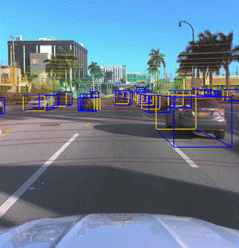
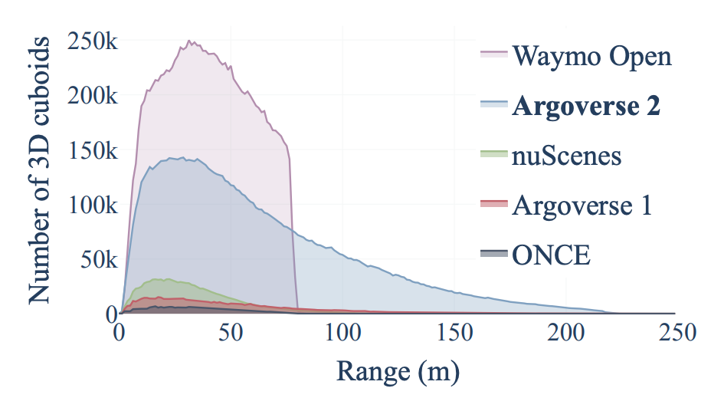
Argoverse 2 Sensor Dataset
High quality amodal cuboids for all actors within 5m of the drivable area
1000 scenarios - 15s/scenario
Average of 75 cuboids/frame
Notes:
The first dataset I’ll cover is the sensor dataset - whose development was led by Ben Wilson and designed as a benchmark for 3D detection, multi-agent tracking, and even end-to-end forecasting methods.
It consists of 1000 scenes - each 15s long, with HD map data - along with high quality human annotations in the form of amodal cuboids and object types.
Because of where the logs were collected, scenes are both dense and diverse. We made a concerted effort to support a large number of different object classes - numbering 30 in all.
We also chose to include tracks at range as early detection and tracking of these vehicles are critically important to maneuvers such as unprotected lefts.
And just a quick note here: in all datasets with imagery, faces and license plates have been blurred for privacy.
========== Extra info === Not script ==============
The total dataset amounts to 1 TB of data in its extracted form. Each vehicle log is approximately 15 seconds in duration and 1 GB in size, including ~150 LiDAR sweeps on average, and ~300 images from each of the 9 cameras (~2700 images per log).
In keeping with usability — All LiDAR returns are provided in the egovehicle reference frame, not the individual LiDAR reference frame, and all imagery is undistorted

Slide 22
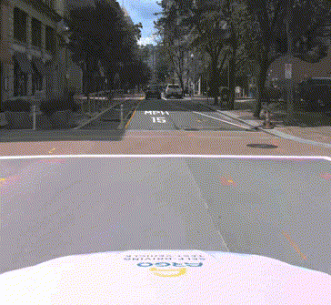
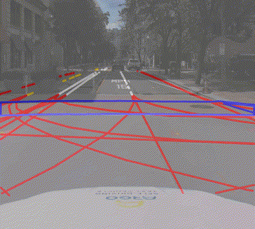
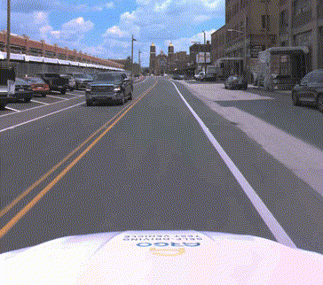
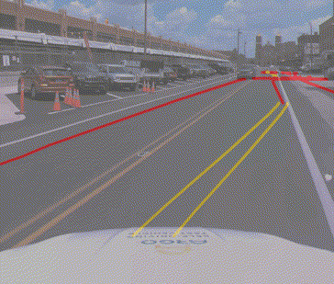
Argoverse 2 Map Change Dataset
“Trust but Verify”
1000 scenarios of varying duration (mean = 54s)
Lidar and imagery
200 map changes of varying types
Notes:
Finally, AV2 has a unique map change dataset that was developed by John Lambert and published under the paper titled “Trust but Verify”.
This dataset aims to tackle the very real operational challenge of identifying when HD maps used by autonomous vehicles have changed.
These changes could result from a simple refresh of lane marking paint, or real structural changes to underlying road connectivity.
This dataset again includes all lidar imagery and comes in at just under 1 TB.
Pre-trained models and training code are available and are linked in the user guide, which I’ll talk about next.

Slide 23
Outline
Data collection with experts – PASCAL VOC
Crowdsourcing: Annotation with non-experts
LabelMe – no incentive (altruism, perhaps)
ESP Game – fun incentive (not fun enough?)
Mechanical Turk – financial incentive
Labels for free / Auto Labeling

Slide 24
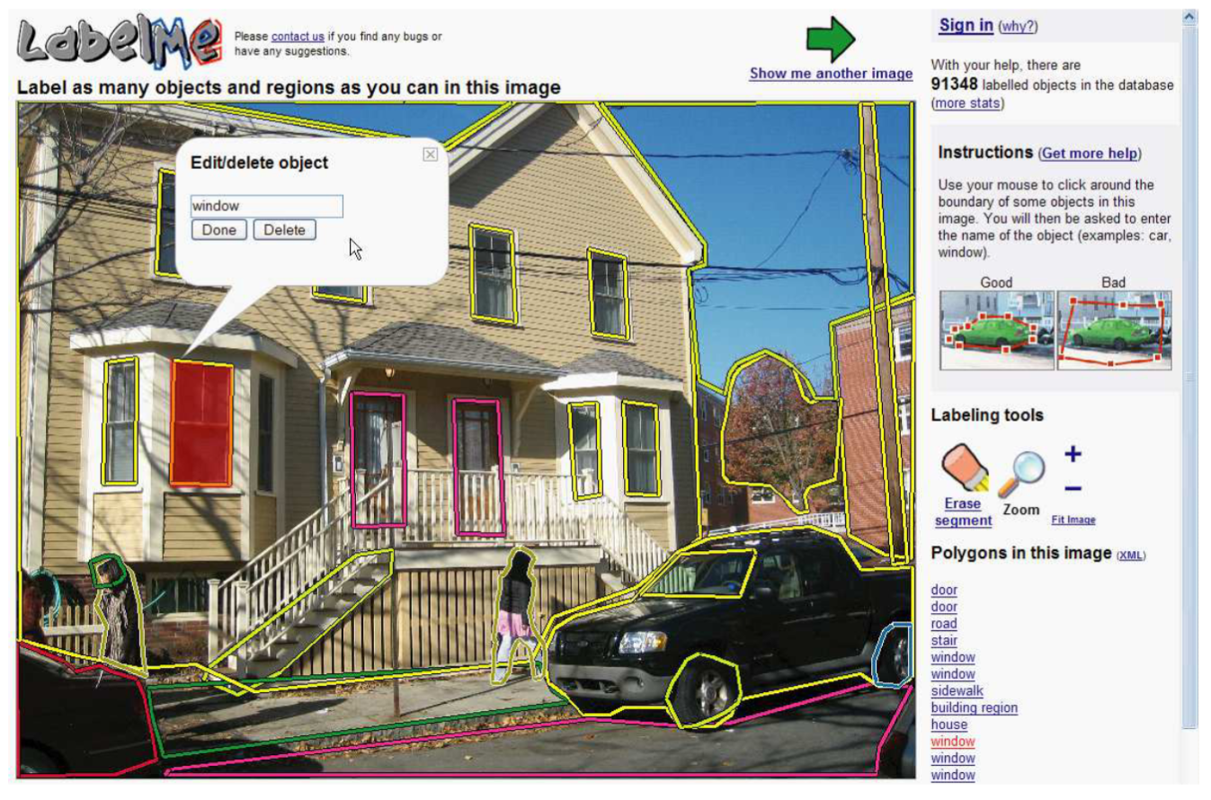
LabelMe
http://labelme.csail.mit.edu
“Open world” database annotated by the community*
* Notes on Image Annotation, Barriuso and Torralba 2012. http://arxiv.org/abs/1210.3448

Slide 25
“Since she started working with LabelMe, she has labeled more than 250,000 objects.”
Notes on Image Annotation,
Barriuso and Torralba 2012.
http://arxiv.org/abs/1210.3448

Slide 26
Outline
Data collection with experts – PASCAL VOC
Crowdsourcing: Annotation with non-experts
LabelMe – no incentive (altruism, perhaps)
ESP Game – fun incentive (not fun enough?)
Mechanical Turk – financial incentive
Labels for free / Auto Labeling

Slide 27
Luis von Ahn and Laura Dabbish. Labeling Images with a Computer Game. ACM Conf. on Human Factors in Computing Systems, CHI 2004

Slide 29
Outline
Data collection with experts – PASCAL VOC
Crowdsourcing: Annotation with non-experts
LabelMe – no incentive (altruism, perhaps)
ESP Game – fun incentive (not fun enough?)
Mechanical Turk – financial incentive
Labels for free / Auto Labeling

Slide 30
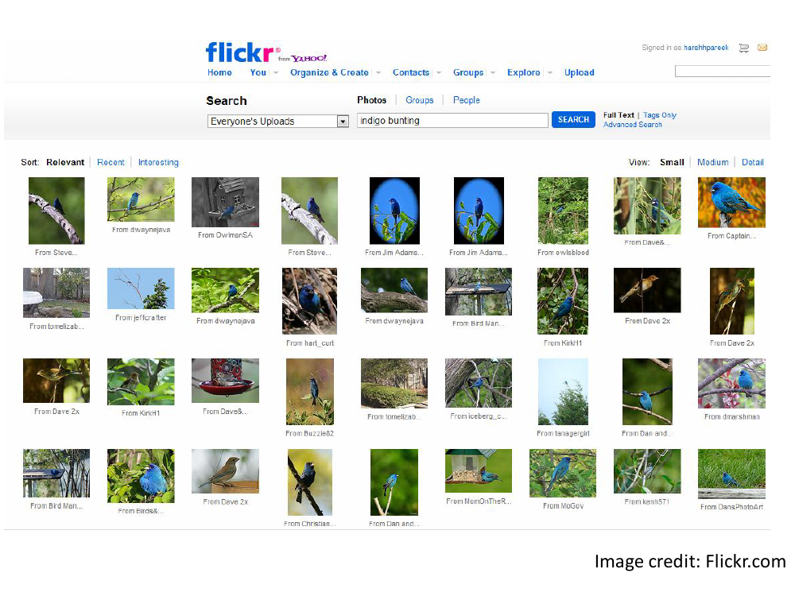

Slide 32
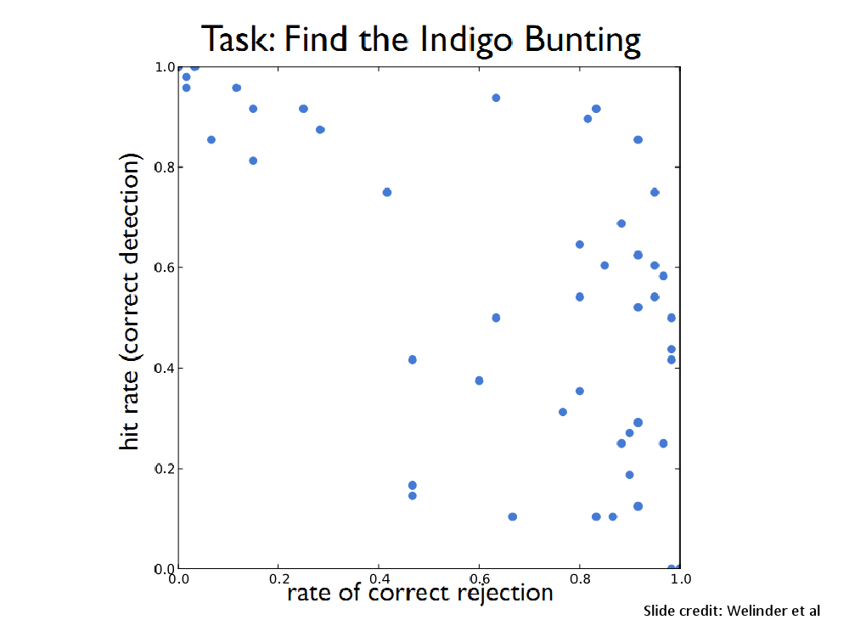

Slide 33
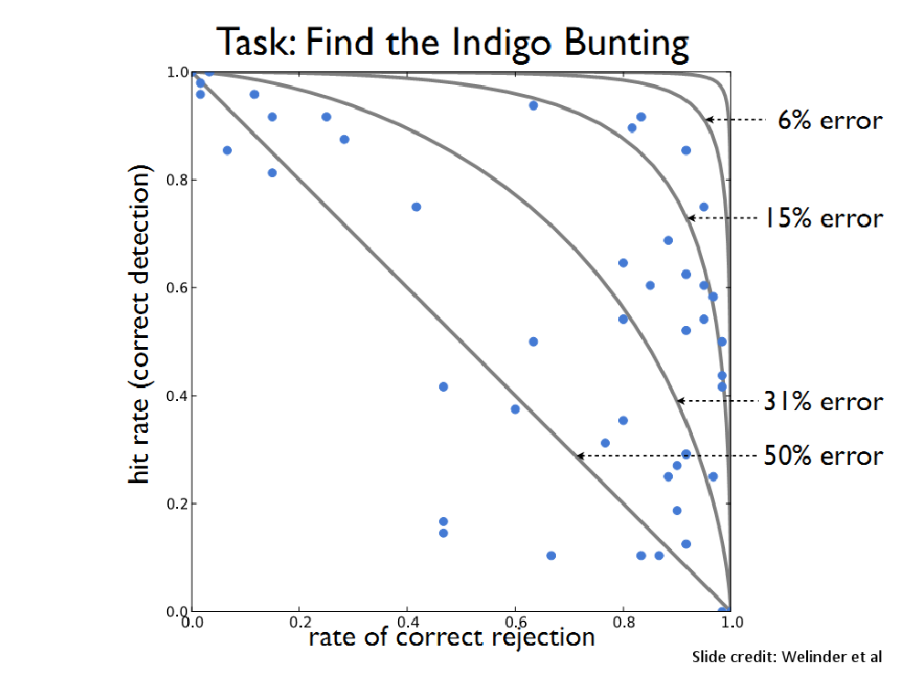

Slide 34
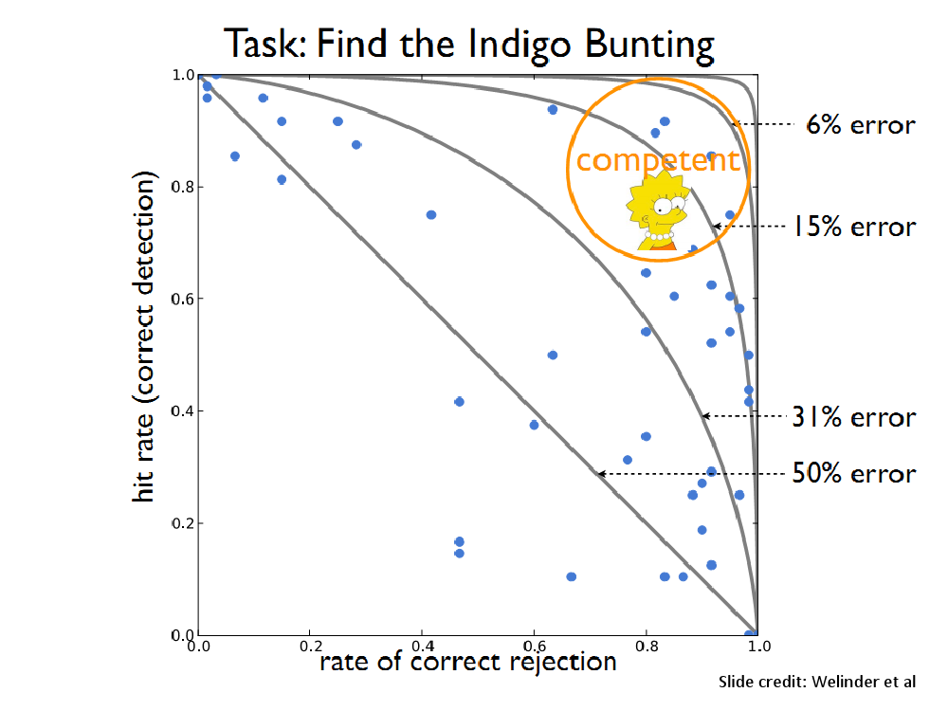

Slide 35
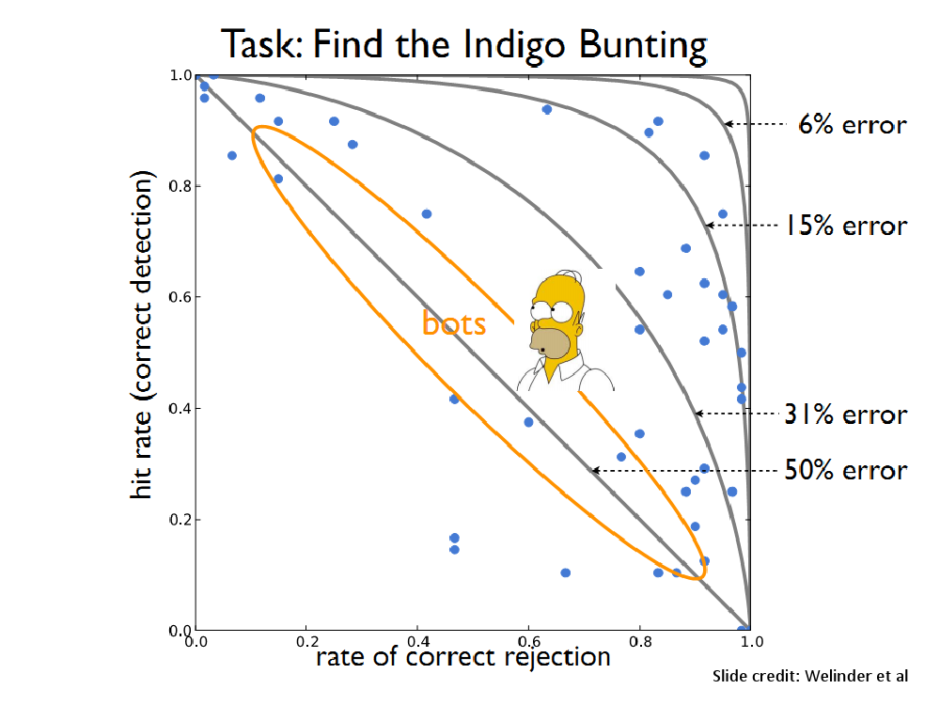

Slide 37
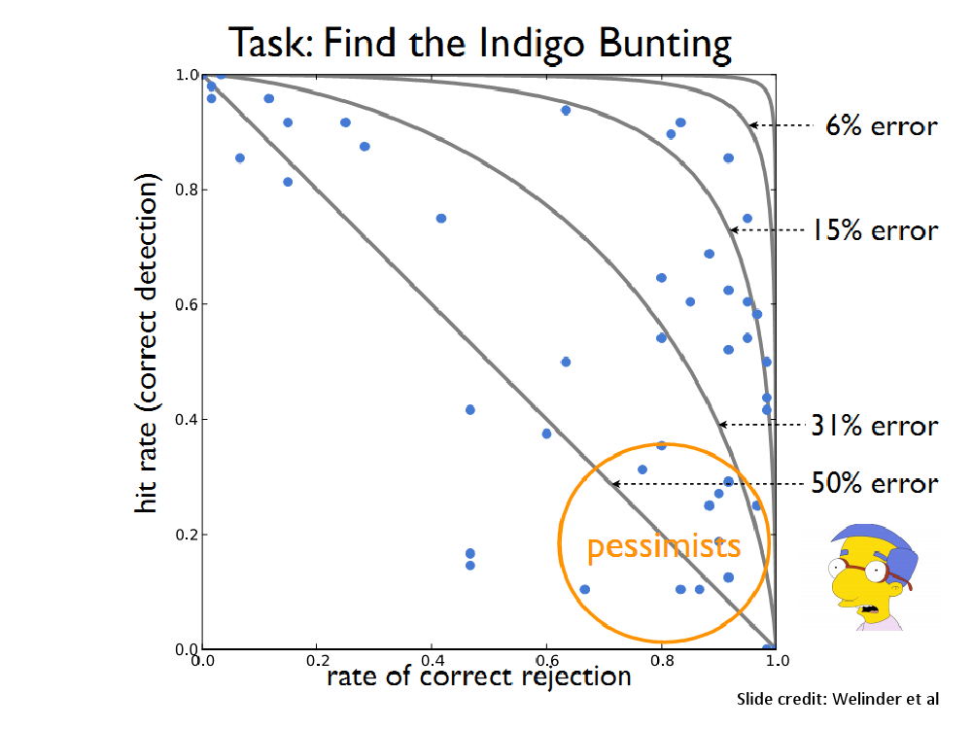

Slide 39
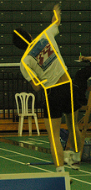
Utility data annotation via Amazon Mechanical Turk
X 100 000 = $5000
Alexander Sorokin
David Forsyth
CVPR Workshops 2008
Slides by Alexander Sorokin

Slide 40
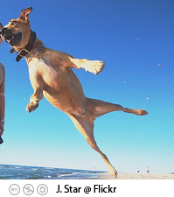
Amazon Mechanical Turk
Workers
Task
Task: Dog?
Broker
Answer: Yes
Pay: $0.01
Is this a dog?
o Yes
o No
www.mturk.com
$0.01

Slide 41
Annotation protocols
Type keywords
Select relevant images
Click on landmarks
Outline something
Detect features
……….. anything else ………

Slide 42
Type keywords
$0.01
http://austinsmoke.com/turk/.

Slide 43
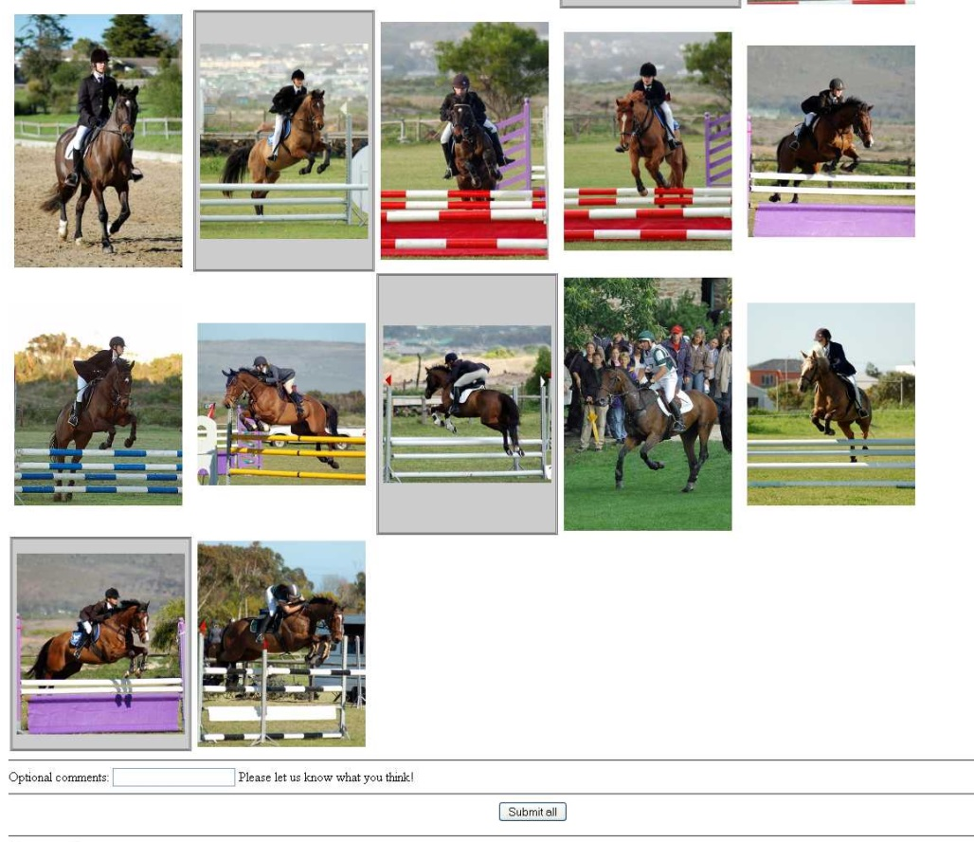
Select examples
Joint work with Tamara and Alex Berg
http://visionpc.cs.uiuc.edu/~largescale/data/simpleevaluation/html/horse.html
Notes:
Select relevant examples
Joint work with
The user clicks on relevant images.

Slide 44
Select examples
$0.02
requester mtlabel

Slide 45
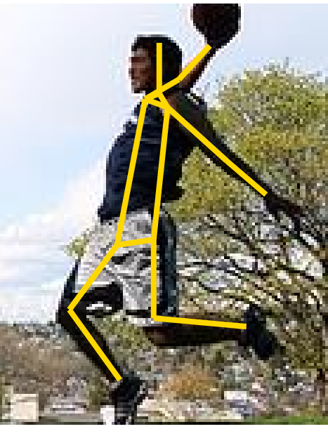
Click on landmarks
$0.01
http://vision-app1.cs.uiuc.edu/mt/results/people14-batch11/p7/

Slide 46
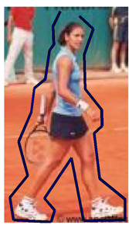
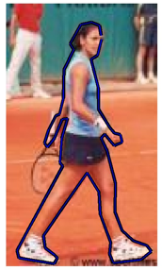
Outline something
$0.01
http://visionpc.cs.uiuc.edu/~largescale/results/production-3-2/results_page_013.html
Data from Ramanan NIPS06

Slide 47
Motivation
X 100 000 = $5000
Custom
annotations
Large scale
Low price

Slide 48
Issues
Quality?
How good is it?
How to be sure?
Price?
How to price it?

Slide 49
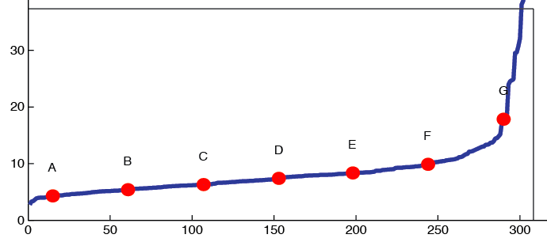
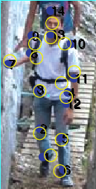
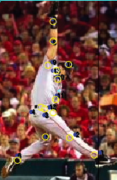
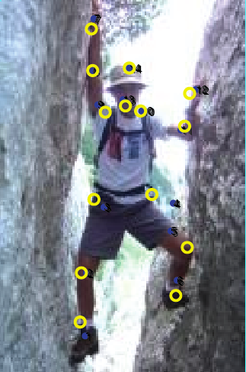
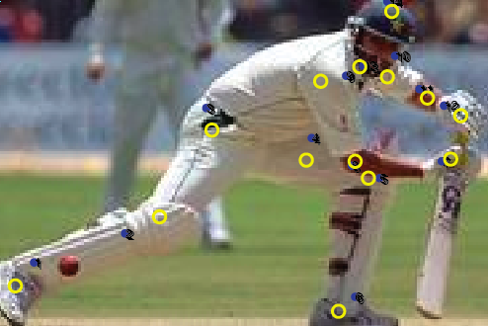
Annotation quality
Agree within 5-10 pixels
on 500x500 screen
There are bad ones.
A
C
E
G
Notes:
Tense - present

Slide 50
How do we get quality annotations?

Slide 51
Ensuring Annotation Quality
Consensus / Multiple Annotation / “Wisdom of the Crowds”
Gold Standard / Sentinel
Special case: qualification exam
Grading Tasks
A second tier of workers who grade others
Not enough on its own, but widely used
Widely used and most important. Find good annotators and keep them honest.
Not widely used

Slide 52
Pricing
Trade off between throughput and cost
NOT as much of a trade off with quality
Higher pay can actually attract scammers

Slide 53
Examples of Crowdsourcing
Massive annotation efforts that would not otherwise be feasible
ImageNet ( http://www.image-net.org/ )
COCO (http://cocodataset.org )
Many more

Slide 54
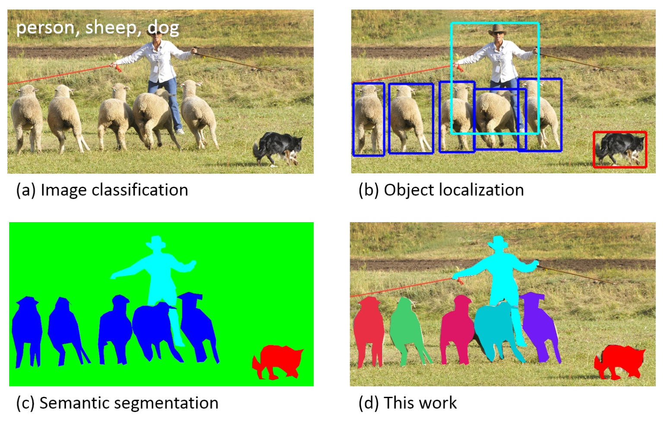
Crowdsourcing to build COCO Dataset
The community still calls this “Object Detection”
The community calls this “Instance Segmentation”
ECCV 2014. Received Koenderink Prize at ECCV 2024

Slide 55
Crowdsourcing to build COCO Dataset
a
b
c
d

Slide 56
Crowdsourcing to build COCO Dataset

Slide 57
Crowdsourcing to build COCO Dataset
Notes:
Worker precision and recall for the category labeling task. (a) The union of multiple AMT workers (blue) has better recall than any expert (red). Ground truth was computed using majority vote of the experts. (b) Shows the number of workers (circle size) and average number of jobs per worker (circle color) for each precision/recall range. Most workers have high precision; such workers generally also complete more jobs. For this plot ground truth for each worker is the union of responses from all other AMT workers.

Slide 58
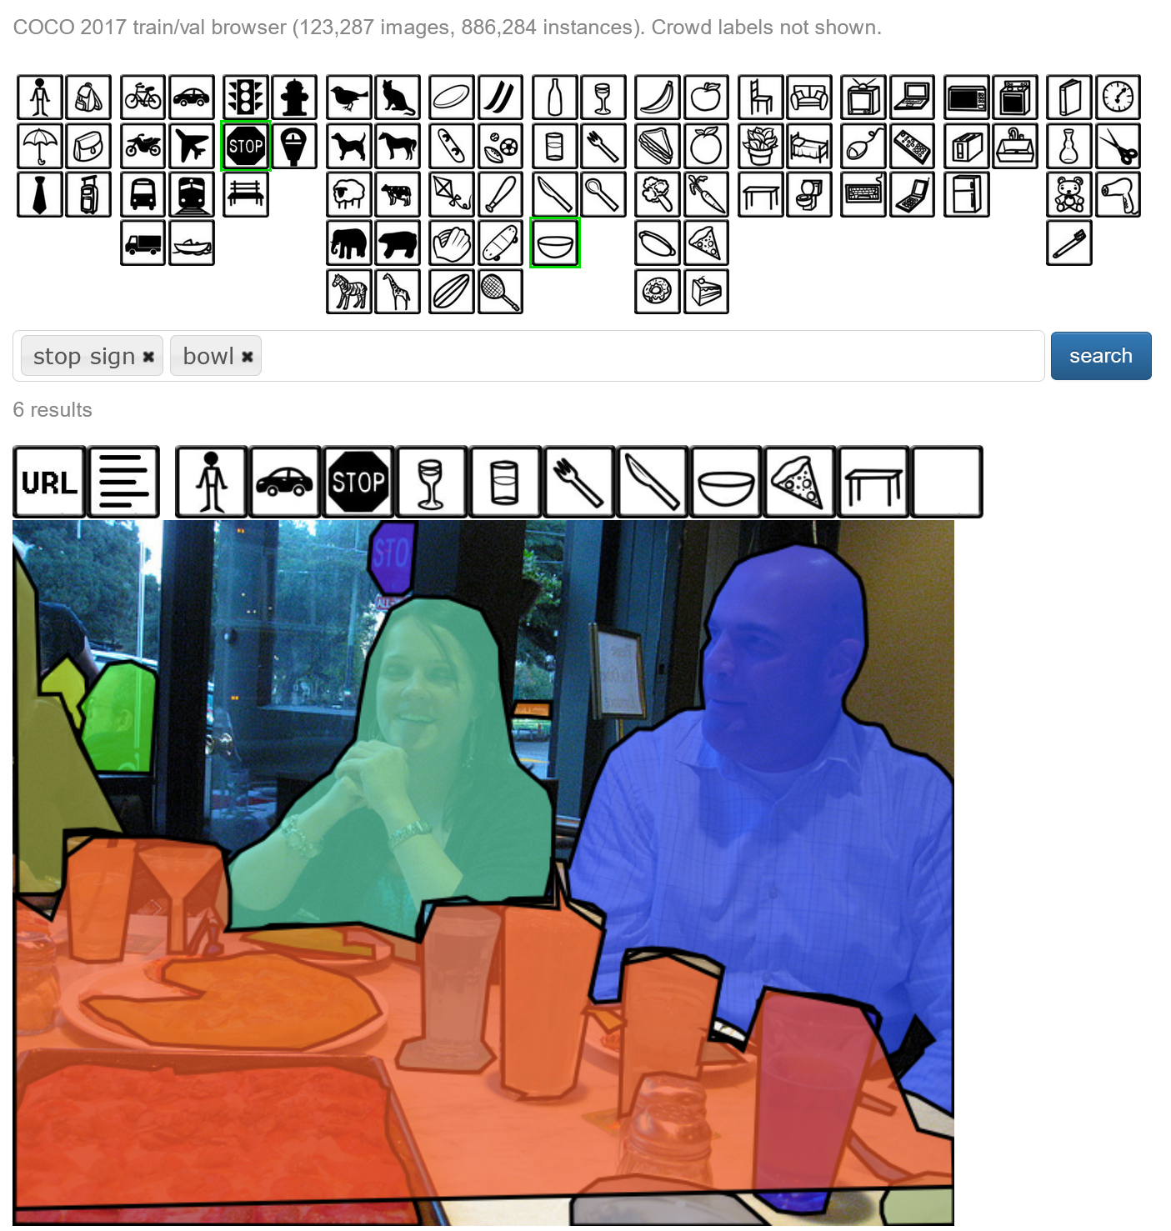
https://cocodataset.org/#explore

Slide 59
Examples of Crowdsourcing
Most papers annotate images, but there are some more creative uses
Webcam Eye tracking (https://webgazer.cs.brown.edu/ )
Annotation could be the passive observations of a participant
Sketch collection (http://cybertron.cg.tu-berlin.de/eitz/projects/classifysketch/ )
Flips the usual annotation process, by providing a label and asking for an image
How do Humans Sketch Objects? Eitz, Hays, Alexa. Siggraph 2012. Received Siggraph Test of Time Award in 2024.

Slide 60
Examples of Crowdsourcing
Draw a sketch of a particular photo
The Sketchy Database: Learning to Retrieve Badly Drawn Bunnies. Patsorn Sangkloy, Nathan Burnell, Cusuh Ham, James Hays. Siggraph 2016.

Slide 61
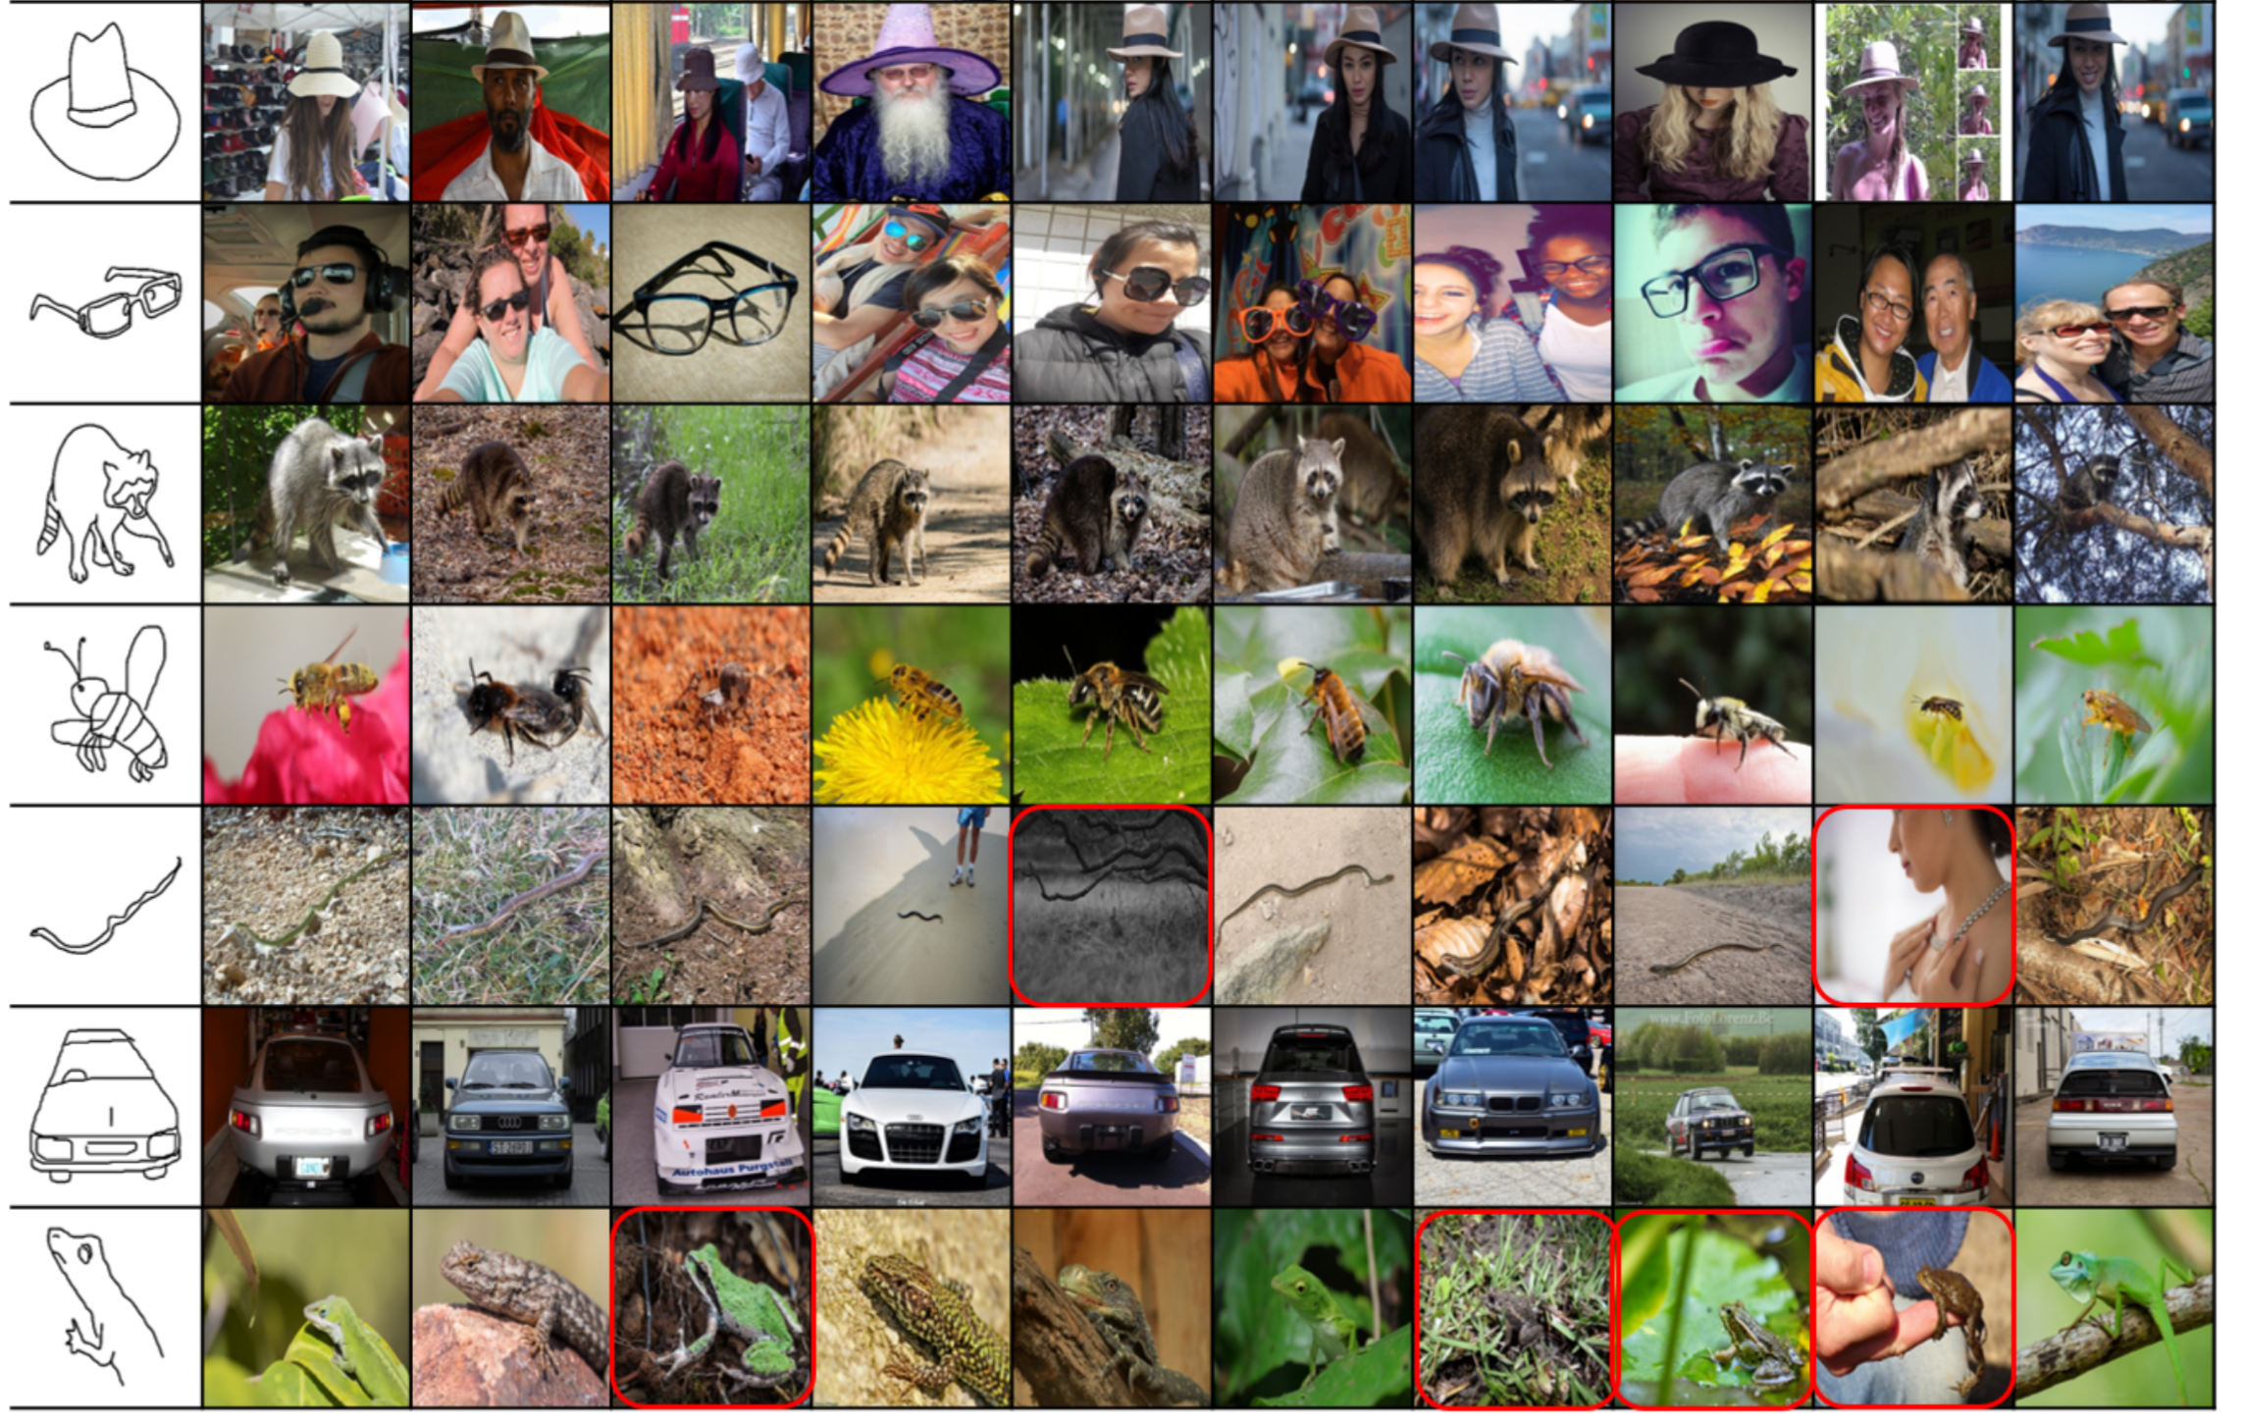

Slide 62
Outline
Data collection with experts – PASCAL VOC
Crowdsourcing: Annotation with non-experts
LabelMe – no incentive (altruism, perhaps)
ESP Game – fun incentive (not fun enough?)
Mechanical Turk – financial incentive
Labels for free / Auto Labeling

Slide 63
Grasp success can be auto-labeled
Sergey Levine, Peter Pastor, Alex Krizhevsky, and Deirdre Quillen. Google.

Slide 64
Object sound can be auto-captured
Dhiraj Gandhi, Abhinav Gupta, Lerrel Pinto. Swoosh! Rattle! Thump! - Actions that Sound. In RSS 2020.

Slide 65
Self-supervised Point Cloud Forecasting
Historical LiDAR Sweeps
Future Point Clouds
Predict
4D Forecasting: Sequential Forecasting of 100,000 Points
Weng et al., CVPR’21
Self-supervised Point Cloud Prediction using 3D Spatial-temporal Convolutional Networks
Mersch et al., CORL’22
Notes:
One such task in the autonomous driving world, is called point cloud forecasting. Given a set of past LiDAR sweeps, it aims at predicting the future LiDAR sweeps. And no annotations are needed for this task, because the ground truth lidar sweeps are already available in the logs!

Slide 66
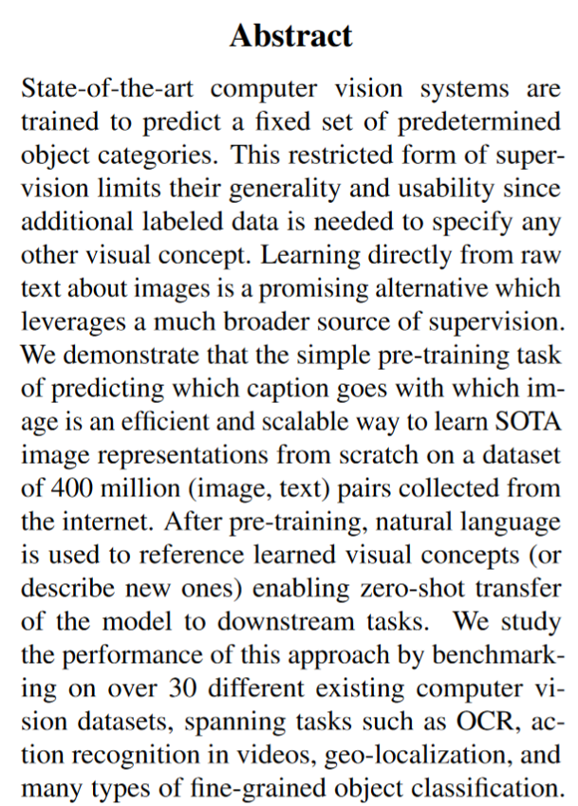
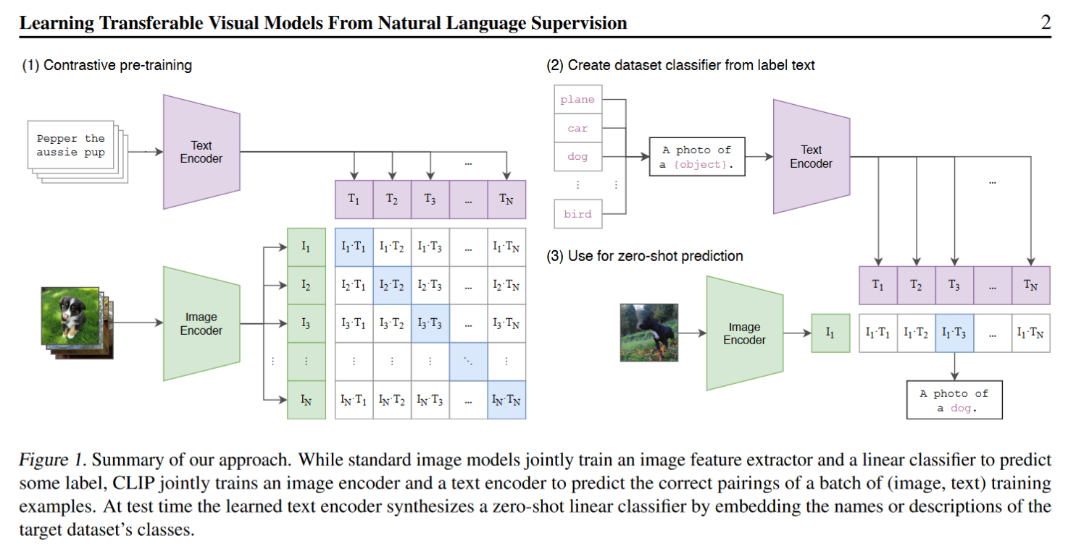
CLIP. Maybe we can just use the internet?

Slide 67
Upcoming lecture
"Unsupervised” or self-supervised Deep Learning
But first, let’s get back to ConvNet architectures

Slide 68
ConvNet Depth
28.2
25.8
16.4
11.7
22 layers
6.7
19 layers
7.3
8 layers
8 layers
shallow
 | ILSVRC'14 | ILSVRC'14 | ILSVRC'13 | ILSVRC'12 | ILSVRC'11 | ILSVRC'10
 | GoogleNet | VGG |  | AlexNet
ImageNet Classification top-5 error (%)

Slide 69
Surely it would be ridiculous to go any deeper…

Slide 70
Deep Residual Learning for Image Recognition
Kaiming He, Xiangyu Zhang, Shaoqing Ren, Jian Sun
work done at
Microsoft Research Asia
7x7 conv, 64, /2, pool/2
1x1 conv, 64
3x3 conv, 64 1x1 conv, 256 1x1 conv, 64 3x3 conv, 64
1x1 conv, 256 1x1 conv, 64 3x3 conv, 64 1x1 conv, 256
1x1 conv, 128, /2
3x3 conv, 128
1x1 conv, 512
1x1 conv, 128
3x3 conv, 128
1x1 conv, 512
1x1 conv, 128
3x3 conv, 128
1x1 conv, 512
1x1 conv, 128
3x3 conv, 128
1x1 conv, 512
1x1 conv, 128
3x3 conv, 128
1x1 conv, 512
1x1 conv, 128
3x3 conv, 128
1x1 conv, 512
1x1 conv, 128
3x3 conv, 128
1x1 conv, 512
1x1 conv, 128
3x3 conv, 128
1x1 conv, 512
1x1 conv, 256, /2
3x3 conv, 256
1x1 conv, 1024
1x1 conv, 256
3x3 conv, 256
1x1 conv, 1024
1x1 conv, 256
3x3 conv, 256
1x1 conv, 1024
1x1 conv, 256
3x3 conv, 256
1x1 conv, 1024
1x1 conv, 256
3x3 conv, 256
1x1 conv, 1024
1x1 conv, 256
3x3 conv, 256
1x1 conv, 1024
1x1 conv, 256
3x3 conv, 256
1x1 conv, 1024
1x1 conv, 256
3x3 conv, 256
1x1 conv, 1024
1x1 conv, 256
3x3 conv, 256
1x1 conv, 1024
1x1 conv, 256
3x3 conv, 256
1x1 conv, 1024
1x1 conv, 256
3x3 conv, 256
1x1 conv, 1024
1x1 conv, 256
3x3 conv, 256
1x1 conv, 1024
1x1 conv, 256
3x3 conv, 256
1x1 conv, 1024
1x1 conv, 256
3x3 conv, 256
1x1 conv, 1024
1x1 conv, 256
3x3 conv, 256
1x1 conv, 1024
1x1 conv, 256
3x3 conv, 256
1x1 conv, 1024
1x1 conv, 256
3x3 conv, 256
1x1 conv, 1024
1x1 conv, 256
3x3 conv, 256
1x1 conv, 1024
1x1 conv, 256
3x3 conv, 256
1x1 conv, 1024
1x1 conv, 256
3x3 conv, 256
1x1 conv, 1024
1x1 conv, 256
3x3 conv, 256
1x1 conv, 1024
1x1 conv, 256
3x3 conv, 256
1x1 conv, 1024
1x1 conv, 256
3x3 conv, 256
1x1 conv, 1024
1x1 conv, 256
3x3 conv, 256
1x1 conv, 1024
1x1 conv, 256
3x3 conv, 256
1x1 conv, 1024
1x1 conv, 256
3x3 conv, 256
1x1 conv, 1024
1x1 conv, 256
3x3 conv, 256
1x1 conv, 1024
1x1 conv, 256
3x3 conv, 256
1x1 conv, 1024
1x1 conv, 256
3x3 conv, 256
1x1 conv, 1024
1x1 conv, 256
3x3 conv, 256
1x1 conv, 1024
1x1 conv, 256
3x3 conv, 256
1x1 conv, 1024
1x1 conv, 256
3x3 conv, 256
1x1 conv, 1024
1x1 conv, 256
3x3 conv, 256
1x1 conv, 1024
1x1 conv, 256
3x3 conv, 256
1x1 conv, 1024
1x1 conv, 256
3x3 conv, 256
1x1 conv, 1024
1x1 conv, 256
3x3 conv, 256
1x1 conv, 1024
1x1 conv, 512, /2
3x3 conv, 512
1x1 conv, 2048
1x1 conv, 512
3x3 conv, 512
1x1 conv, 2048
1x1 conv, 512
3x3 conv, 512
1x1 conv, 2048
ave pool, fc 1000

Slide 71
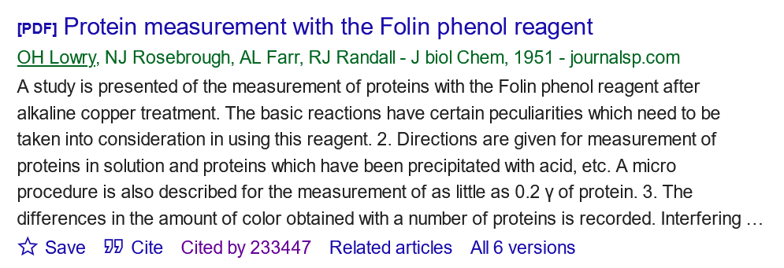
ResNet has been cited 246,584 times as of 10/29/2024.

Slide 72
ResNet has been cited 246,584 times as of 10/29/2024.

Slide 73
ResNet @ ILSVRC & COCO 2015 Competitions
1st places in all five main tracks
ImageNet Classification: “Ultra-deep” 152-layer nets
ImageNet Detection: 16% better than 2nd
ImageNet Localization: 27% better than 2nd
COCO Detection: 11% better than 2nd
COCO Segmentation: 12% better than 2nd
*improvements are relative numbers

Slide 74
Revolution of Depth
28.2
25.8
152 layers
16.4
11.7
22 layers
6.7
19 layers
7.3
3.57
8 layers
8 layers
shallow
ILSVRC'15 | ILSVRC'14 | ILSVRC'14 | ILSVRC'13 | ILSVRC'12 | ILSVRC'11 | ILSVRC'10
ResNet | GoogleNet | VGG |  | AlexNet
ImageNet Classification top-5 error (%)

Slide 75
Revolution of Depth
101 layers
86
Engines of
visual recognition
66
58
34
16 layers
8 layers
shallow
HOG, DPM
AlexNet (RCNN)
VGG (RCNN)
ResNet (Faster RCNN)*
PASCAL VOC 2007 Object Detection mAP (%)
*w/ other improvements & more data

Slide 76
Revolution of Depth
AlexNet, 8 layers
(ILSVRC 2012)
11x11 conv, 96, /4, pool/2
5x5 conv, 256, pool/2
3x3 conv, 384
3x3 conv, 384
3x3 conv, 256, pool/2
fc, 4096
fc, 4096
fc, 1000

Slide 77
Revolution of Depth
soft max2
Soft maxAct ivat ion
FC
AlexNet, 8 layers
(ILSVRC 2012)
11x11 conv, 96, /4, pool/2
VGG, 19 layers
(ILSVRC 2014)
3x3 conv, 64
GoogleNet, 22 layers
(ILSVRC 2014)
AveragePool 7x7 + 1 (V)
Dept hConcat
5x5 conv, 256, pool/2
3x3 conv, 64, pool/2
Conv Conv Conv Conv 1x1 + 1 (S) 3x3 + 1 (S) 5x5 + 1 (S) 1x1 + 1 (S)
Conv Conv MaxPool 1x1 + 1 (S) 1x1 + 1 (S) 3x3 + 1 (S)
3x3 conv, 384
3x3 conv, 128
Dept hConcat
Conv Conv Conv Conv 1x1 + 1 (S) 3x3 + 1 (S) 5x5 + 1 (S) 1x1 + 1 (S)
soft max1
3x3 conv, 384
3x3 conv, 128, pool/2
Conv Conv MaxPool 1x1 + 1 (S) 1x1 + 1 (S) 3x3 + 1 (S)
Soft maxAct ivat ion
MaxPool 3x3 + 2 (S)
FC
3x3 conv, 256, pool/2
3x3 conv, 256
Dept hConcat
FC
Conv Conv Conv Conv Conv 1x1 + 1 (S) 3x3 + 1 (S) 5x5 + 1 (S) 1x1 + 1 (S) 1x1 + 1 (S)
fc, 4096
3x3 conv, 256
Conv Conv MaxPool AveragePool 1x1 + 1 (S) 1x1 + 1 (S) 3x3 + 1 (S) 5x5 + 3 (V)
Dept hConcat
fc, 4096
3x3 conv, 256
Conv Conv Conv Conv 1x1 + 1 (S) 3x3 + 1 (S) 5x5 + 1 (S) 1x1 + 1 (S)
Conv Conv MaxPool 1x1 + 1 (S) 1x1 + 1 (S) 3x3 + 1 (S)
fc, 1000
3x3 conv, 256, pool/2
Dept hConcat
soft max0
Conv Conv Conv Conv 1x1 + 1 (S) 3x3 + 1 (S) 5x5 + 1 (S) 1x1 + 1 (S)
Soft maxAct ivat ion
3x3 conv, 512
Conv Conv MaxPool 1x1 + 1 (S) 1x1 + 1 (S) 3x3 + 1 (S)
FC
Dept hConcat
FC
3x3 conv, 512
Conv Conv Conv Conv Conv 1x1 + 1 (S) 3x3 + 1 (S) 5x5 + 1 (S) 1x1 + 1 (S) 1x1 + 1 (S)
Conv Conv MaxPool AveragePool 1x1 + 1 (S) 1x1 + 1 (S) 3x3 + 1 (S) 5x5 + 3 (V)
3x3 conv, 512
Dept hConcat
Conv Conv Conv Conv 1x1 + 1 (S) 3x3 + 1 (S) 5x5 + 1 (S) 1x1 + 1 (S)
3x3 conv, 512, pool/2
Conv Conv MaxPool 1x1 + 1 (S) 1x1 + 1 (S) 3x3 + 1 (S)
MaxPool 3x3 + 2 (S)
3x3 conv, 512
Dept hConcat
Conv Conv Conv Conv 1x1 + 1 (S) 3x3 + 1 (S) 5x5 + 1 (S) 1x1 + 1 (S)
3x3 conv, 512
Conv Conv MaxPool 1x1 + 1 (S) 1x1 + 1 (S) 3x3 + 1 (S)
Dept hConcat
3x3 conv, 512
Conv Conv Conv Conv 1x1 + 1 (S) 3x3 + 1 (S) 5x5 + 1 (S) 1x1 + 1 (S)
Conv Conv MaxPool 1x1 + 1 (S) 1x1 + 1 (S) 3x3 + 1 (S)
3x3 conv, 512, pool/2
MaxPool 3x3 + 2 (S)
LocalRespNorm
fc, 4096
Conv 3x3 + 1 (S)
Conv 1x1 + 1 (V)
fc, 4096
LocalRespNorm
MaxPool 3x3 + 2 (S)
fc, 1000
Conv 7x7 + 2 (S)
input

Slide 78
7x7 conv, 64, /2, pool/2
1x1 conv, 64
3x3 conv, 64
1x1 conv, 256
1x1 conv, 64
3x3 conv, 64
1x1 conv, 256
1x1 conv, 64
3x3 conv, 64
1x1 conv, 256
Revolution of Depth
11x11 conv, 96, /4, pool/2
1x2 conv, 128, /2
3x3 conv, 128
1x1 conv, 512
1x1 conv, 128
3x3 conv, 128
1x1 conv, 512
1x1 conv, 128
3x3 conv, 128
1x1 conv, 512
1x1 conv, 128
3x3 conv, 128
1x1 conv, 512
1x1 conv, 128
3x3 conv, 128
1x1 conv, 512
1x1 conv, 128
3x3 conv, 128
1x1 conv, 512
1x1 conv, 128
3x3 conv, 128
1x1 conv, 512
1x1 conv, 128
3x3 conv, 128
1x1 conv, 512 1x1 conv, 256, /2 3x3 conv, 256
1x1 conv, 1024
AlexNet, 8 layers
(ILSVRC 2012)
5x5 conv, 256, pool/2
3x3 conv, 384
3x3 conv, 384 3x3 conv, 256, pool/2
fc, 4096
fc, 4096
fc, 1000
VGG, 19 layers
(ILSVRC 2014)
3x3 conv, 64
3x3 conv, 64, pool/2 3x3 conv, 128
3x3 conv, 128, pool/2 3x3 conv, 256
3x3 conv, 256
3x3 conv, 256 3x3 conv, 256, pool/2
3x3 conv, 512
3x3 conv, 512
3x3 conv, 512 3x3 conv, 512, pool/2
3x3 conv, 512
3x3 conv, 512
3x3 conv, 512 3x3 conv, 512, pool/2
fc, 4096
fc, 4096
fc, 1000
ResNet, 152 layers
(ILSVRC 2015)
1x1 conv, 256
3x3 conv, 256
1x1 conv, 1024
1x1 conv, 256
3x3 conv, 256
1x1 conv, 1024
1x1 conv, 256
3x3 conv, 256
1x1 conv, 1024
1x1 conv, 256
3x3 conv, 256
1x1 conv, 1024
1x1 conv, 256
3x3 conv, 256
1x1 conv, 1024
1x1 conv, 256
3x3 conv, 256
1x1 conv, 1024
1x1 conv, 256
3x3 conv, 256
1x1 conv, 1024
1x1 conv, 256
3x3 conv, 256
1x1 conv, 1024
1x1 conv, 256
3x3 conv, 256
1x1 conv, 1024
1x1 conv, 256
3x3 conv, 256
1x1 conv, 1024
1x1 conv, 256
3x3 conv, 256
1x1 conv, 1024
1x1 conv, 256
3x3 conv, 256
1x1 conv, 1024
1x1 conv, 256
3x3 conv, 256
1x1 conv, 1024
1x1 conv, 256
3x3 conv, 256
1x1 conv, 1024
1x1 conv, 256
3x3 conv, 256
1x1 conv, 1024
1x1 conv, 256
3x3 conv, 256
1x1 conv, 1024
1x1 conv, 256
3x3 conv, 256
1x1 conv, 1024
1x1 conv, 256
3x3 conv, 256
1x1 conv, 1024
1x1 conv, 256
3x3 conv, 256
1x1 conv, 1024
1x1 conv, 256
3x3 conv, 256
1x1 conv, 1024
1x1 conv, 256
3x3 conv, 256
1x1 conv, 1024
1x1 conv, 256
3x3 conv, 256
1x1 conv, 1024
1x1 conv, 256
3x3 conv, 256
1x1 conv, 1024
1x1 conv, 256
3x3 conv, 256
1x1 conv, 1024
1x1 conv, 256
3x3 conv, 256
1x1 conv, 1024
1x1 conv, 256
3x3 conv, 256
1x1 conv, 1024
1x1 conv, 256
3x3 conv, 256
1x1 conv, 1024
1x1 conv, 256
3x3 conv, 256
1x1 conv, 1024
1x1 conv, 256
3x3 conv, 256
1x1 conv, 1024
1x1 conv, 256
3x3 conv, 256
1x1 conv, 1024
1x1 conv, 256
3x3 conv, 256
1x1 conv, 1024
1x1 conv, 256
3x3 conv, 256
1x1 conv, 1024
1x1 conv, 256
3x3 conv, 256
1x1 conv, 1024
1x1 conv, 256
3x3 conv, 256
1x1 conv, 1024
1x1 conv, 256
3x3 conv, 256
1x1 conv, 1024 1x1 conv, 512, /2 3x3 conv, 512
1x1 conv, 2048
1x1 conv, 512
3x3 conv, 512
1x1 conv, 2048
1x1 conv, 512
3x3 conv, 512
1x1 conv, 2048 ave pool, fc 1000

Slide 79
Is learning better networks
as simple as stacking more layers?

Slide 80
Simply stacking layers?
CIFAR-10
train error (%)
20
test error (%)
20
56-layer
56-layer
10
10
20-layer
20-layer
0 ₀
1
2
3
iter. (1e4)
4
5
6
0
0
1
2
3
iter. (1e4)
4
5
6
Plain nets: stacking 3x3 conv layers…
56-layer net has higher training error and test error than 20-layer net

Slide 81
Simply stacking layers?
CIFAR-10
ImageNet-1000
20
56-layer 44-layer 32-layer 20-layer
60
50
error (%)
error (%)
34-layer
10
40
5
plain-20 plain-32 plain-44 plain-56
30
solid: test/val dashed: train
plain-18 plain-34
18-layer
0
0
1
2
3
iter. (1e4)
4
5
6
20
0
10
20
30
iter. (1e4)
40
50
“Overly deep” plain nets have higher training error
A general phenomenon, observed in many datasets

Slide 82
a shallower model
(18 layers)
7x7 conv, 64, /2
7x7 conv, 64, /2
a deeper counterpart (34 layers)
3x3 conv, 64
3x3 conv, 64
3x3 conv, 64
3x3 conv, 64
3x3 conv, 64
3x3 conv, 64
3x3 conv, 64
3x3 conv, 64
3x3 conv, 64
3x3 conv, 64
3x3 conv, 128, /2
3x3 conv, 128, /2
Richer solution space
3x3 conv, 128
3x3 conv, 128
3x3 conv, 128
3x3 conv, 128
3x3 conv, 128
3x3 conv, 128
3x3 conv, 128
A deeper model should not have higher training error
3x3 conv, 128
3x3 conv, 128
“extra” layers
3x3 conv, 128
3x3 conv, 256, /2
3x3 conv, 256, /2
3x3 conv, 256
3x3 conv, 256
3x3 conv, 256
3x3 conv, 256
A solution by construction:
original layers: copied from a learned shallower model
extra layers: set as identity
at least the same training error
3x3 conv, 256
3x3 conv, 256
3x3 conv, 256
3x3 conv, 256
3x3 conv, 256
3x3 conv, 256
3x3 conv, 256
3x3 conv, 256
3x3 conv, 256
3x3 conv, 256
3x3 conv, 512, /2
3x3 conv, 512, /2
3x3 conv, 512
3x3 conv, 512
Optimization difficulties: solvers cannot find the solution when going deeper…
3x3 conv, 512
3x3 conv, 512
3x3 conv, 512
3x3 conv, 512
3x3 conv, 512
3x3 conv, 512
fc 1000
fc 1000

Slide 83
Deep Residual Learning
𝐻 𝑥 is any desired mapping, hope the 2 weight layers fit 𝐻(𝑥)
Plain net
𝑥
weight layer
 | relu
any two stacked layers
weight layer
relu
𝐻(𝑥)

Slide 84
Deep Residual Learning
𝐻 𝑥 is any desired mapping, hope the 2 weight layers fit 𝐻(𝑥) hope the 2 weight layers fit 𝐹(𝑥) let 𝐻 𝑥 = 𝐹 𝑥 + 𝑥
Residual net
𝑥
weight layer
𝐹(𝑥)
relu
identity
𝑥
weight layer
𝐻
𝑥
= 𝐹
𝑥
+ 𝑥
relu

Slide 85
Deep Residual Learning
𝐹 𝑥 is a residual mapping w.r.t. identity
𝑥
If identity were optimal, easy to set weights as 0
If optimal mapping is closer to identity, easier to find small fluctuations
weight layer
 | relu
𝐹(𝑥)
identity
𝑥
weight layer
𝐻
𝑥
= 𝐹
𝑥
+ 𝑥
relu

Slide 86
7x7 conv, 64, /2
7x7 conv, 64, /2
pool, /2
pool, /2
Network “Design”
Keep it simple
3x3 conv, 64
3x3 conv, 64
plain net
3x3 conv, 64
3x3 conv, 64
ResNet
3x3 conv, 64
3x3 conv, 64
3x3 conv, 64
3x3 conv, 64
3x3 conv, 64
3x3 conv, 64
3x3 conv, 64
3x3 conv, 64
3x3 conv, 128, /2
3x3 conv, 128, /2
3x3 conv, 128
3x3 conv, 128
3x3 conv, 128
3x3 conv, 128
3x3 conv, 128
3x3 conv, 128
3x3 conv, 128
3x3 conv, 128
3x3 conv, 128
3x3 conv, 128
Our basic design (VGG-style)
all 3x3 conv (almost)
spatial size /2 => # filters x2
Simple design; just deep!
3x3 conv, 128
3x3 conv, 128
3x3 conv, 128
3x3 conv, 128
3x3 conv, 256, /2
3x3 conv, 256, /2
3x3 conv, 256
3x3 conv, 256
3x3 conv, 256
3x3 conv, 256
3x3 conv, 256
3x3 conv, 256
3x3 conv, 256
3x3 conv, 256
3x3 conv, 256
3x3 conv, 256
3x3 conv, 256
3x3 conv, 256
3x3 conv, 256
3x3 conv, 256
3x3 conv, 256
3x3 conv, 256
3x3 conv, 256
3x3 conv, 256
3x3 conv, 256
3x3 conv, 256
3x3 conv, 256
3x3 conv, 256
3x3 conv, 512, /2
3x3 conv, 512, /2
3x3 conv, 512
3x3 conv, 512
3x3 conv, 512
3x3 conv, 512
3x3 conv, 512
3x3 conv, 512
3x3 conv, 512
3x3 conv, 512
3x3 conv, 512
3x3 conv, 512
avg pool
avg pool
fc 1000
fc 1000

Slide 87
CIFAR-10 experiments
CIFAR-10 plain nets
CIFAR-10 ResNets
20
20
ResNet-20 ResNet-32 ResNet-44 ResNet-56
56-layer 44-layer 32-layer 20-layer
ResNet-110
20-layer 32-layer 44-layer 56-layer 110-layer
error (%)
error (%)
10
10
5
plain-20 plain-32 plain-44 plain-56
5
bold: test thin: train
0
0
1
2
3
iter. (1e4)
4
5
6
0
0
1
2
3
iter. (1e4)
4
5
6
• Deep ResNets can be trained without difficulties
• Deeper ResNets have lower training error, and also lower test error

Slide 88
ImageNet experiments
ImageNet plain nets
ImageNet ResNets
60
60
50
50
error (%)
34-layer
error (%)
18-layer
40
40
30
solid: test
30
plain-18
plain-34
dashed: train
18-layer
ResNet-18
ResNet-34
34-layer
20
20
0
10
20
30
iter. (1e4)
40
50
0
10
20
30
iter. (1e4)
40
50
• Deep ResNets can be trained without difficulties
• Deeper ResNets have lower training error, and also lower test error

Slide 89
ImageNet experiments
Deeper ResNets have lower error
8
7.4
this model has
lower time complexity
than VGG-16/19
6.7
7
6.1
5.7
6
5
4
ResNet-152
ResNet-101 ResNet-50
10-crop testing, top-5 val error (%)
ResNet-34

Slide 90
Beyond classification
A treasure from ImageNet is on learning features.
Kaiming He, Xiangyu Zhang, Shaoqing Ren, & Jian Sun. “Deep Residual Learning for Image Recognition”. arXiv 2015.

Slide 91
“Features matter.” (quote [Girshick et al. 2014], the R-CNN paper)
task
2nd-place winner
ResNets
margin
(relative)
12.0 9.0
_{53.6} absolute _{62.1}
ImageNet Localization (top-5 error)
27%
ImageNet Detection (mAP@.5)
16%
8.5% better!
33.5 37.3
COCO Detection (mAP@.5:.95)
11%
COCO Segmentation (mAP@.5:.95)
25.1 28.2
12%
Our results are all based on ResNet-101
Our features are well transferrable
Kaiming He, Xiangyu Zhang, Shaoqing Ren, & Jian Sun. “Deep Residual Learning for Image Recognition”. CVPR 2016.

Slide 92
Object Detection (brief)
classifier
RoI pooling
Simply “Faster R-CNN + ResNet”
proposals
Faster R-CNN baseline | mAP@.5 | mAP@.5:.95
VGG-16 | 41.5 | 21.5
ResNet-101 | 48.4 | 27.2
Region Proposal Net
feature map
COCO detection results (ResNet has 28% relative gain)
CNN
image
Kaiming He, Xiangyu Zhang, Shaoqing Ren, & Jian Sun. “Deep Residual Learning for Image Recognition”. CVPR 2016. Shaoqing Ren, Kaiming He, Ross Girshick, & Jian Sun. “Faster R-CNN: Towards Real-Time Object Detection with Region Proposal Networks”. NIPS 2015.

Slide 93
Our results on MS COCO
*the original image is from the COCO dataset
Kaiming He, Xiangyu Zhang, Shaoqing Ren, & Jian Sun. “Deep Residual Learning for Image Recognition”. CVPR 2016. Shaoqing Ren, Kaiming He, Ross Girshick, & Jian Sun. “Faster R-CNN: Towards Real-Time Object Detection with Region Proposal Networks”. NIPS 2015.

Slide 94
this video is available online: https://youtu.be/WZmSMkK9VuA
Results on real video. Model trained on MS COCO w/ 80 categories. (frame-by-frame; no temporal processing)
Kaiming He, Xiangyu Zhang, Shaoqing Ren, & Jian Sun. “Deep Residual Learning for Image Recognition”. arXiv 2015. Shaoqing Ren, Kaiming He, Ross Girshick, & Jian Sun. “Faster R-CNN: Towards Real-Time Object Detection with Region Proposal Networks”. NIPS 2015.

Slide 95
More Visual Recognition Tasks
ResNets lead on these benchmarks (incomplete list):
ImageNet classification, detection, localization
MS COCO detection, segmentation
ResNet-101
PASCAL VOC detection, segmentation
VQA challenge 2016
PASCAL segmentation leaderboard
Human pose estimation [Newell et al 2016]
Depth estimation [Laina et al 2016]
Segment proposal [Pinheiro et al 2016]
…
ResNet-101
PASCAL detection leaderboard

Slide 96
Potential Applications
Visual Recognition
Image Generation (Pixel RNN, Neural Art, etc.)
Natural Language Processing (Very deep CNN)
Speech Recognition (preliminary results)
Advertising, user prediction (preliminary results)
ResNets have shown outstanding or promising results on:
Kaiming He, Xiangyu Zhang, Shaoqing Ren, & Jian Sun. “Deep Residual Learning for Image Recognition”. CVPR 2016.

Slide 97
Conclusions
Deep Residual Networks:
Easy to train
Simply gain accuracy from depth
Well transferrable
Follow-up [He et al. arXiv 2016]
200 layers on ImageNet, 1000 layers on CIFAR
Kaiming He, Xiangyu Zhang, Shaoqing Ren, & Jian Sun. “Identity Mappings in Deep Residual Networks”. arXiv 2016.
Kaiming He, Xiangyu Zhang, Shaoqing Ren, & Jian Sun. “Deep Residual Learning for Image Recognition”. CVPR 2016.

Slide 98
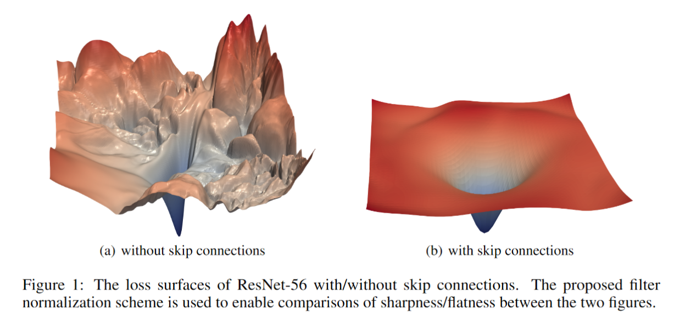
Why does ResNet work so well?
The architecture is somehow easier to optimize.
The authors argue it probably isn’t because it solves the “vanishing gradient” problem.
While the gradients might not be “vanishing” in “plain” nets, they don’t seem as stable and trustworthy, according to follow up work, e.g.
Visualizing the Loss Landscape of Neural Nets. Hao Li, Zheng Xu , Gavin Taylor, Christoph Studer, Tom Goldstein. NeurIPS 2018.

