Slide 1
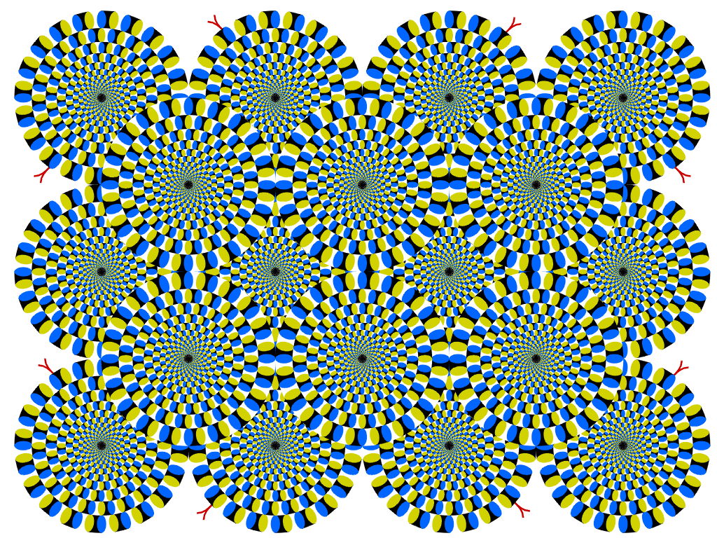

Slide 2
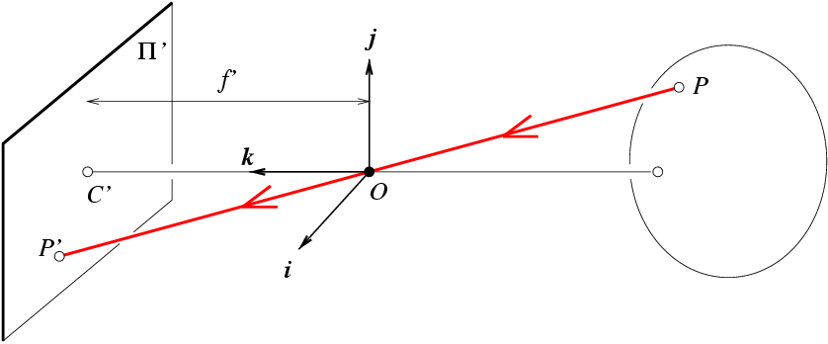
Recap: projection
X
x

Slide 3
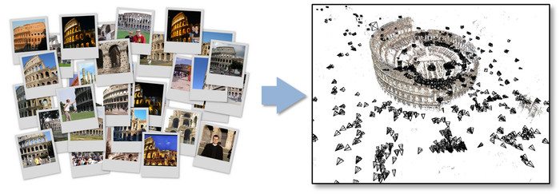
Relating multiple views
Figure Credit: Bundler: Structure from Motion (SfM) for Unordered Image Collections

Slide 4
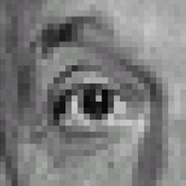

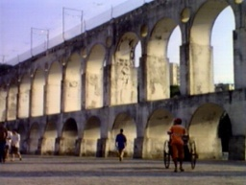
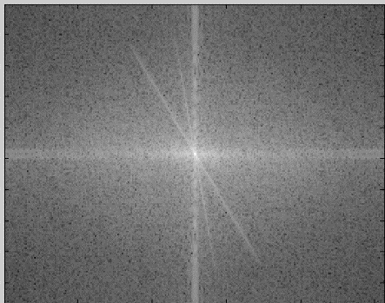
Recap of Filtering
Linear filtering is dot product at each position
Not a matrix multiplication
Can smooth, sharpen, translate (among many other uses)
We can use the Fourier transform to represent images in the frequency domain.
Filtering in the spatial domain is multiplication in the frequency domain.
1
1
1
1
1
1
1
1
1

Slide 5
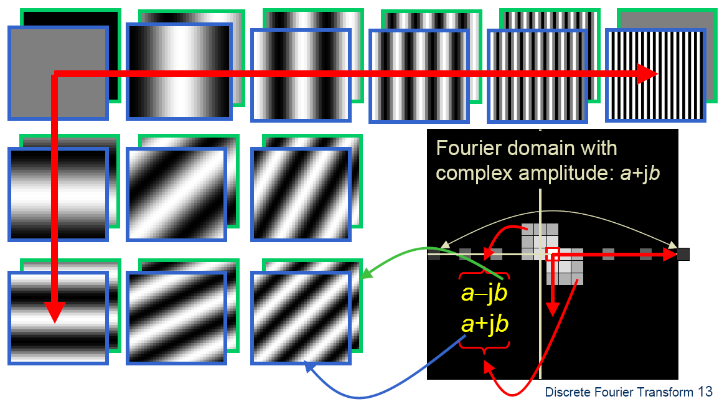
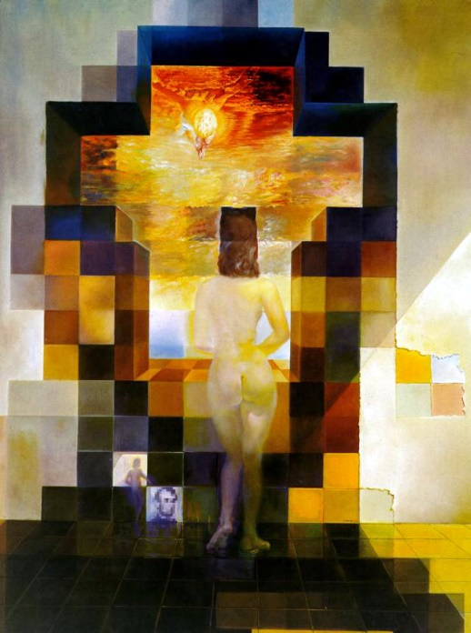
Fourier Bases
Teases away fast vs. slow changes in the image.
This change of basis is the Fourier Transform

Slide 6
Fourier Bases

Slide 7
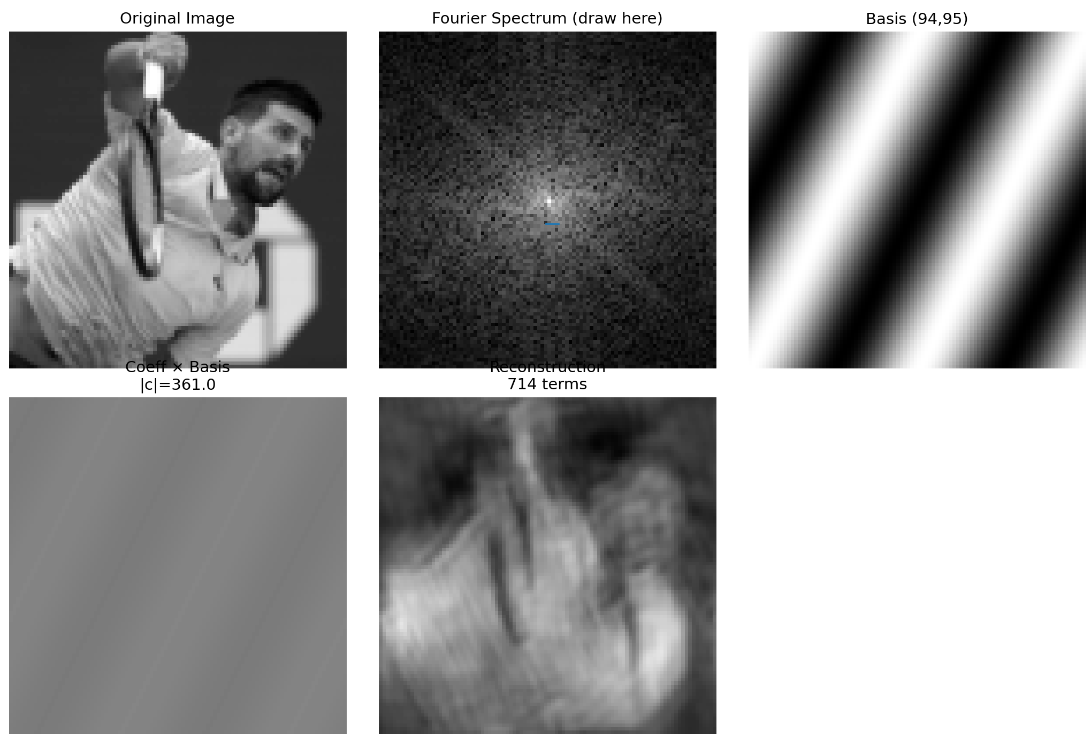

Slide 8
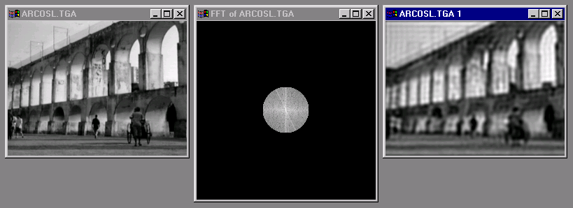
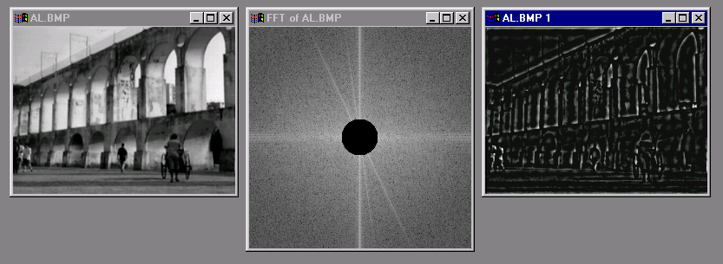
Low and High Pass filtering

Slide 9
The Convolution Theorem
The Fourier transform of the convolution of two functions is the product of their Fourier transforms
Convolution in spatial domain is equivalent to multiplication in frequency domain!

Slide 10
Properties of Fourier Transforms
Linearity
Fourier transform of a real signal is symmetric about the origin
The energy of the signal is the same as the energy of its Fourier transform
See Szeliski Book (3.4)

Slide 11
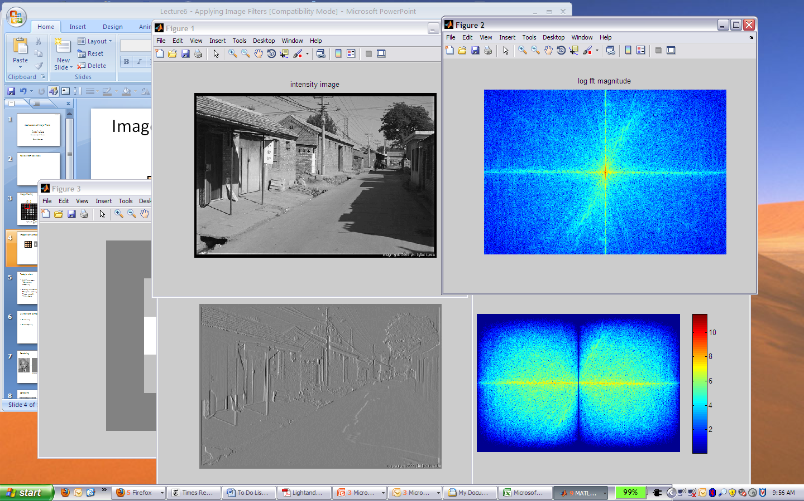
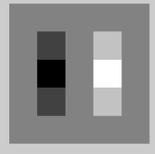
Filtering in spatial domain
1
0
-1
2
0
-2
1
0
-1
*
=

Slide 12
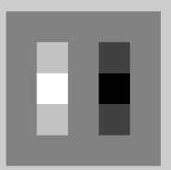

Filtering in frequency domain
FFT
FFT
=
Inverse FFT
Slide: Hoiem

Slide 13

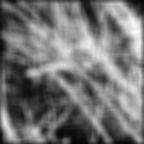
Filtering
Why does the Gaussian give a nice smooth image, but the square filter give edgy artifacts?
Gaussian
Box filter
Notes:
Things we can’t understand without thinking in frequency

Slide 14
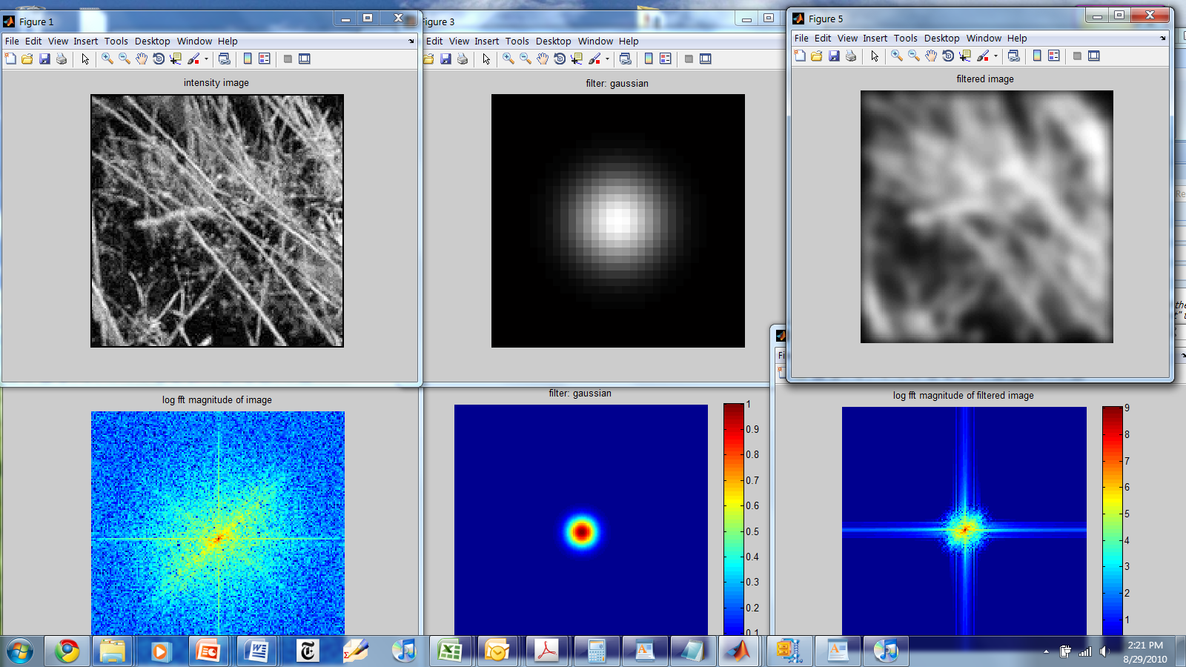
Gaussian

Slide 15
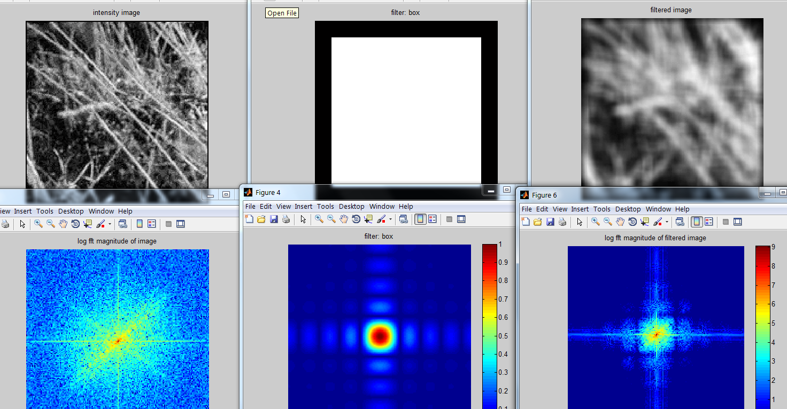
Box Filter

Slide 16
Is convolution invertible?
If convolution is just multiplication in the Fourier domain, isn’t deconvolution just division?
Sometimes, it clearly is invertible (e.g. a convolution with an identity filter)
In one case, it clearly isn’t invertible (e.g. convolution with an all zero filter)
What about for common filters like a Gaussian?

Slide 17
But you can’t invert multiplication by 0
But it’s not quite zero, is it…

Slide 18
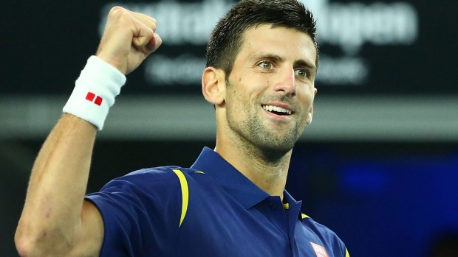
Let’s experiment on Novak

Slide 19

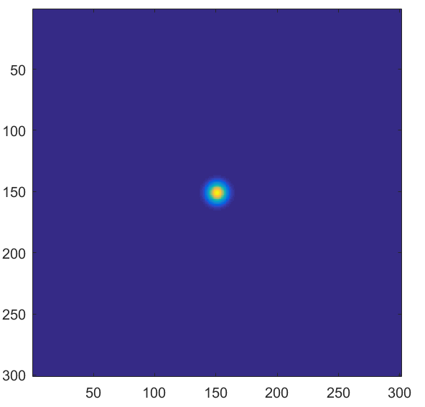

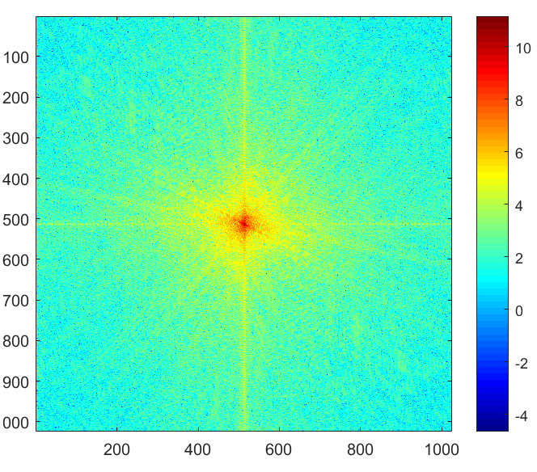
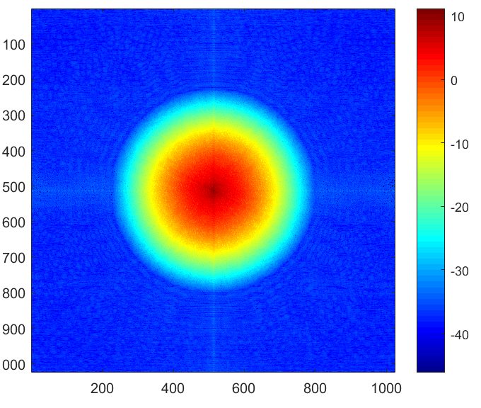
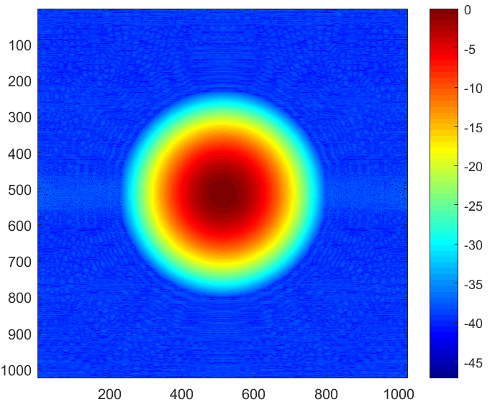
Convolution
*
=
FFT
FFT
iFFT
.*
=

Slide 20
Deconvolution?
iFFT
FFT
FFT
=
./
Notes:
It works… if everything is double precision with no noise

Slide 21
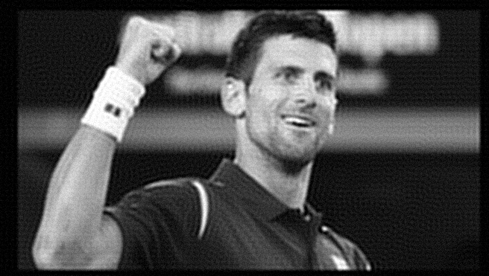
But under more realistic conditions
Random noise, .000001 magnitude
iFFT
FFT
FFT
=
./

Slide 22

But under more realistic conditions
Random noise, .0001 magnitude
iFFT
FFT
FFT
=
./

Slide 23
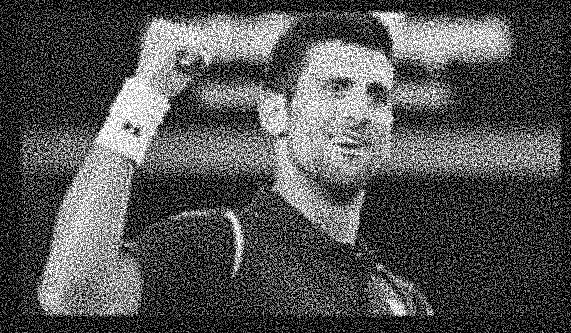
But under more realistic conditions
Random noise, .001 magnitude
iFFT
FFT
FFT
=
./

Slide 24


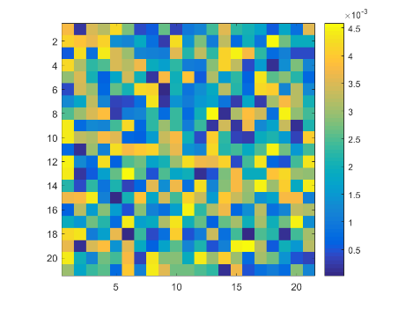
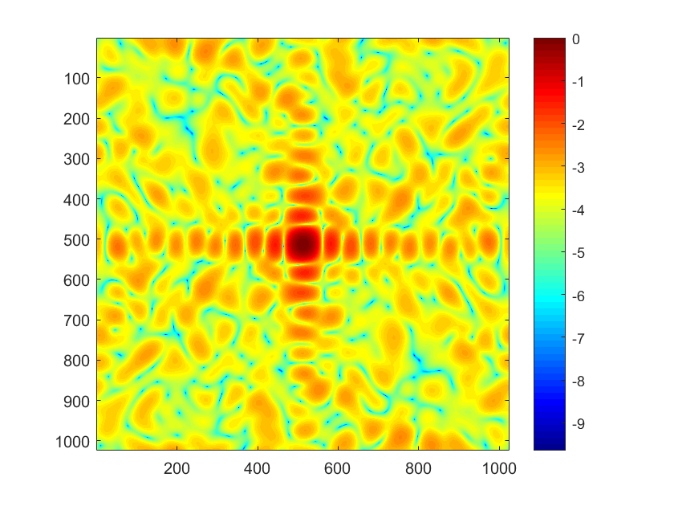
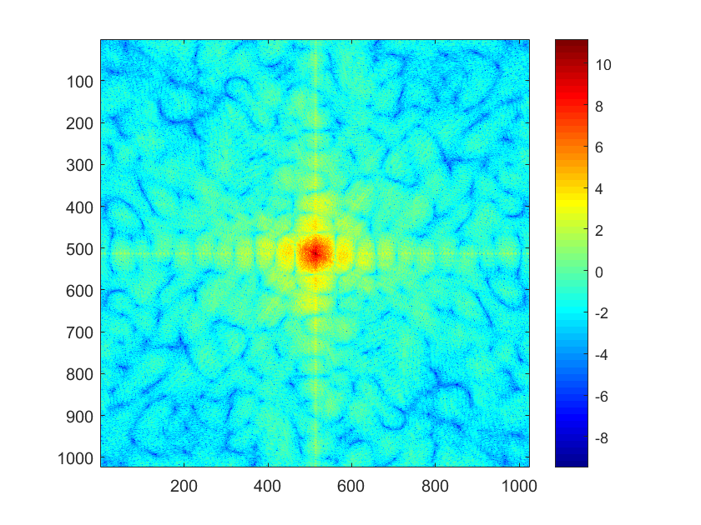
With a random filter…
Random noise, .001 magnitude
iFFT
FFT
FFT
=
./
Notes:
Random filter is easier to invert / deconvolve. The inversion isn’t perfect, still.

Slide 25
Deconvolution is hard
Active research area.
Even if you know the filter (non-blind deconvolution), it is still very hard and requires strong regularization.
If you don’t know the filter (blind deconvolution) it is harder still.

Slide 26
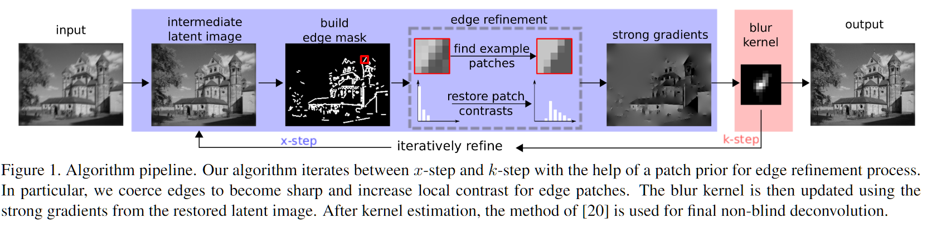
Blind Deconvolution Example
Edge-based Blur Kernel Estimation Using Patch Priors.
Libin Sun, Sunghyun Cho, Jue Wang, and James Hays.
IEEE International Conference on Computational Photography 2013.

Slide 27
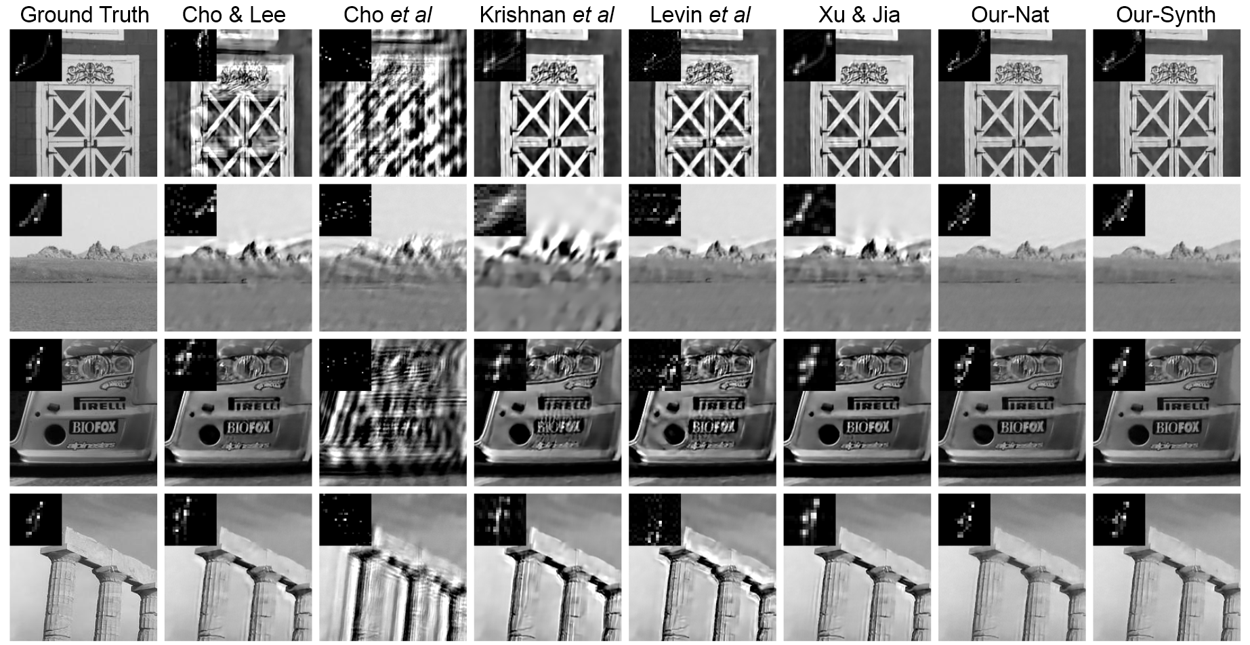
Edge-based Blur Kernel Estimation Using Patch Priors.
Libin Sun, Sunghyun Cho, Jue Wang, and James Hays.
IEEE International Conference on Computational Photography 2013.

Slide 28
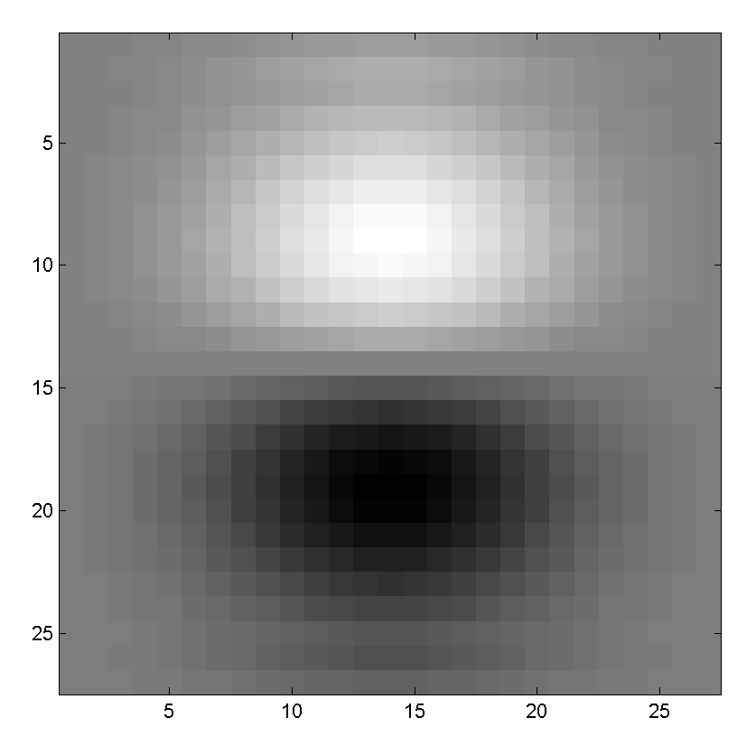

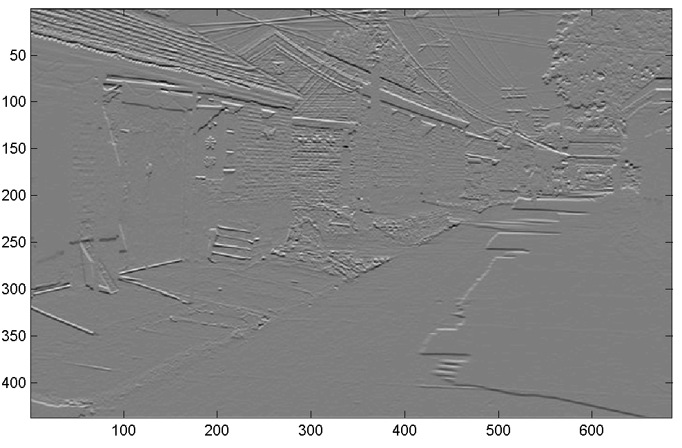
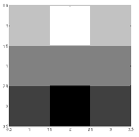
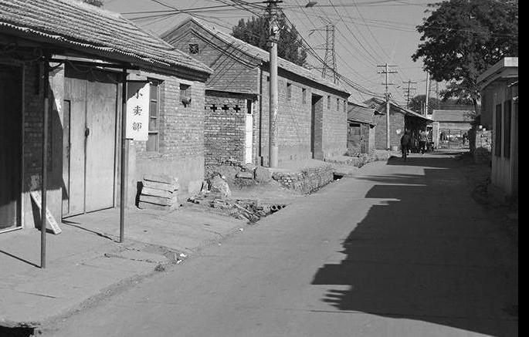
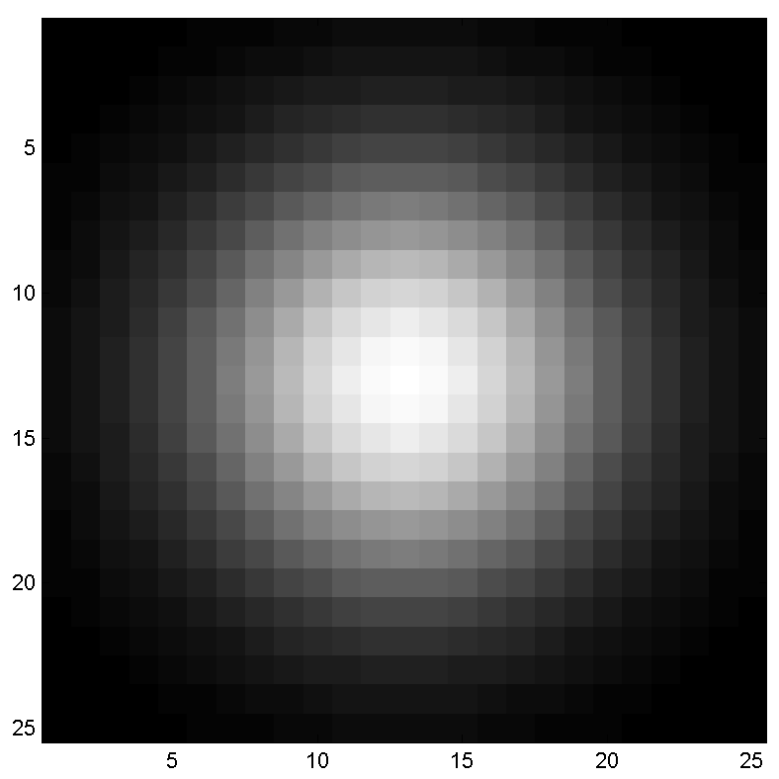
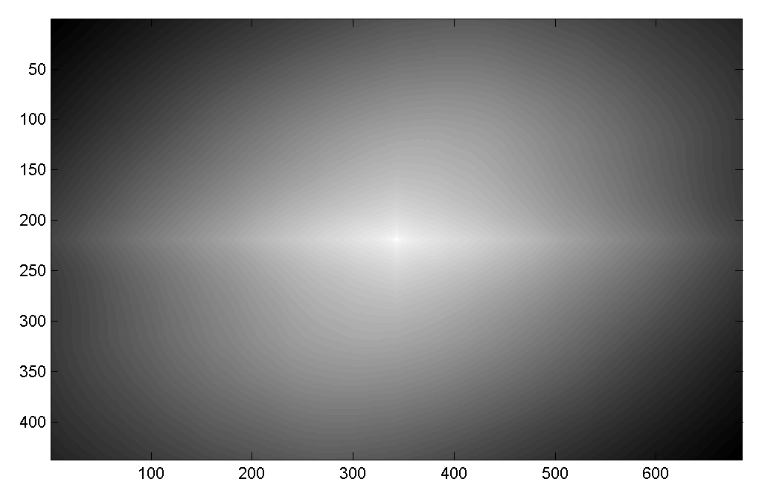
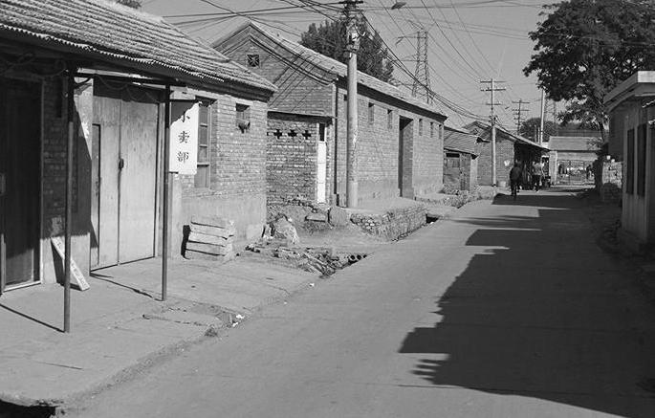

Canvas Quiz
Filtering Operator
1) _ = D * B
2) A = _ * C
3) F = D * _
4) _ = D * D
Fill in the blanks:
A
E
B
G
F
C
I
H
D
Slide: Hoiem

Slide 29
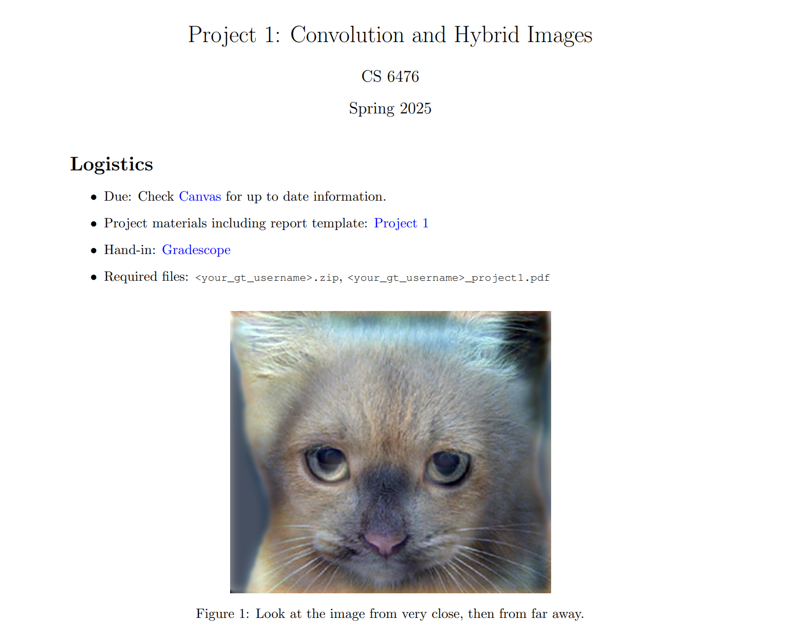

Slide 30
Next Topics
Image Formation
Biological Vision
Light and Color

Slide 31
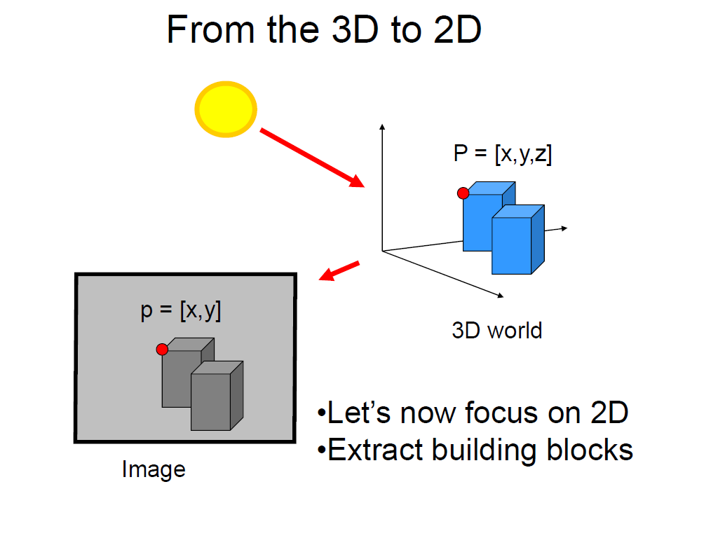
Slide credit Fei Fei Li

Slide 32
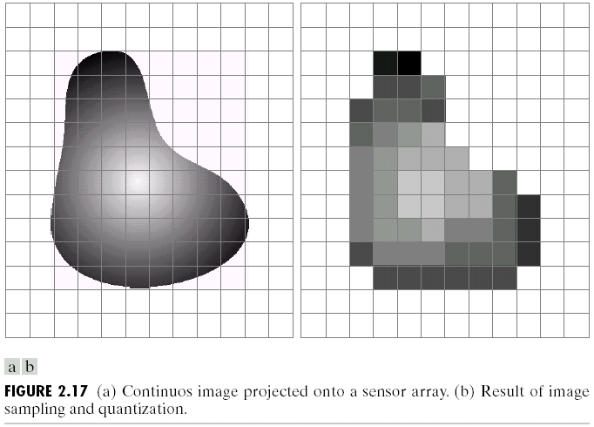
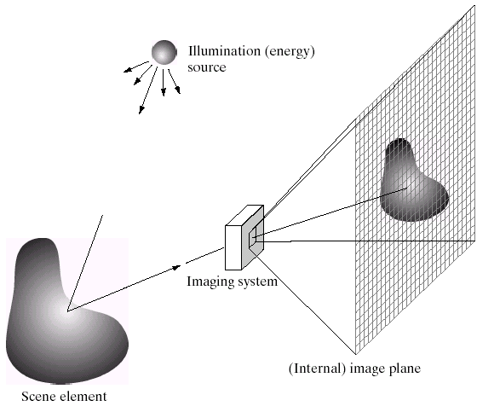
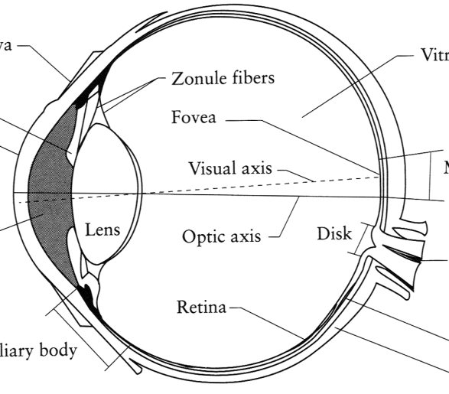
Image Formation
Digital Camera
Film
The Eye

Slide 33
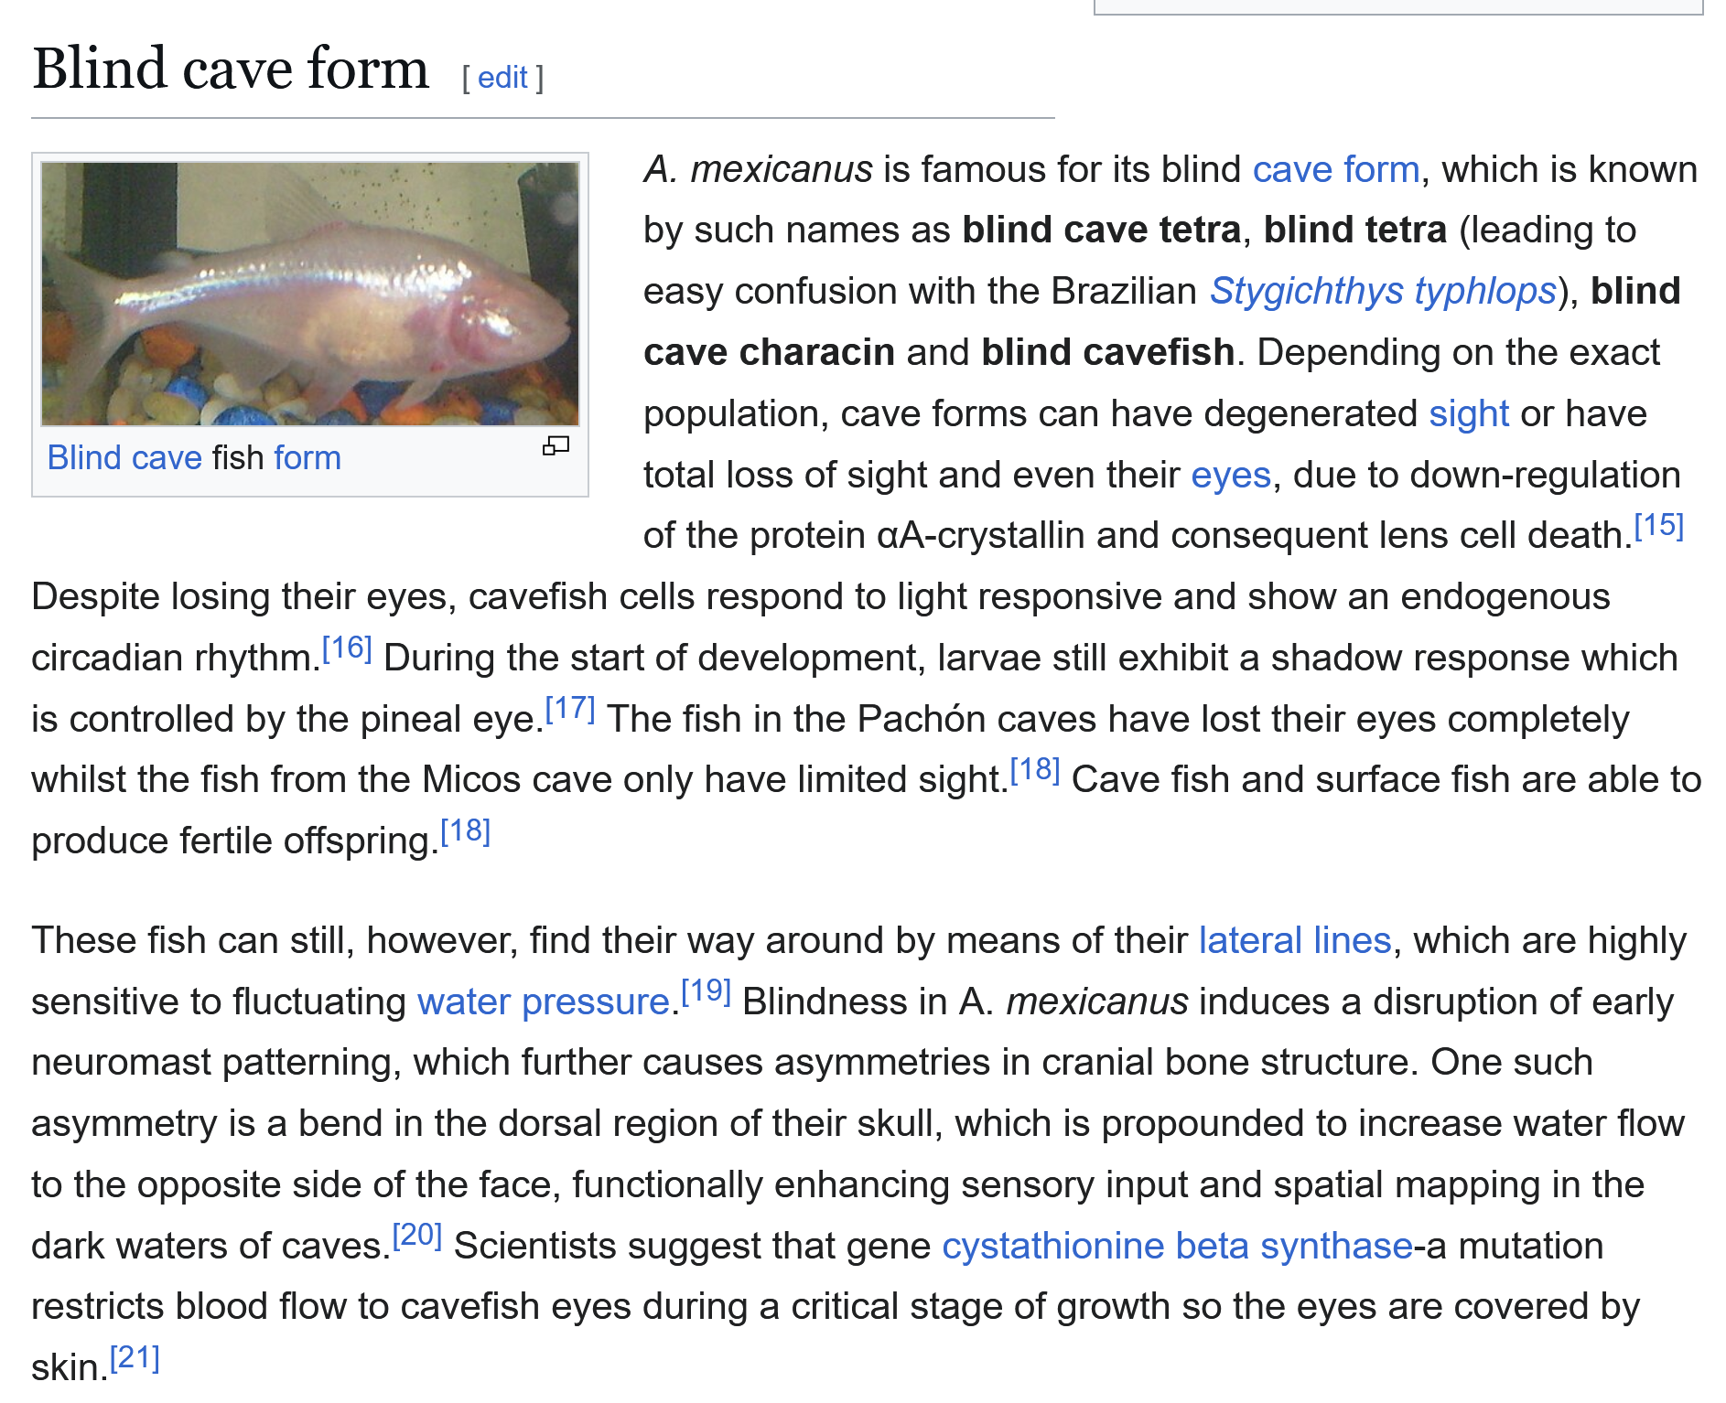
Vision is so biologically ubiquitious that it is interesting when it is not present, e.g. the blind cava tetra

Slide 34
A photon’s life choices
Absorption
Diffusion
Reflection
Transparency
Refraction
Fluorescence
Subsurface scattering
Phosphorescence
light source
λ
?

Slide 35
A photon’s life choices
Absorption
Diffusion
Reflection
Transparency
Refraction
Fluorescence
Subsurface scattering
Phosphorescence
light source
λ

Slide 36
A photon’s life choices
Absorption
Diffuse Reflection (e.g. matte surface)
Reflection
Transparency
Refraction
Fluorescence
Subsurface scattering
Phosphorescence
light source
λ

Slide 37
A photon’s life choices
Absorption
Diffusion
Reflection (e.g. specular surface)
Transparency
Refraction
Fluorescence
Subsurface scattering
Phosphorescence
light source
λ

Slide 38
A photon’s life choices
Absorption
Diffusion
Reflection
Transparency
Refraction
Fluorescence
Subsurface scattering
Phosphorescence
light source
λ

Slide 39
A photon’s life choices
Absorption
Diffusion
Reflection
Transparency
Refraction
Fluorescence
Subsurface scattering
Phosphorescence
light source
λ

Slide 40
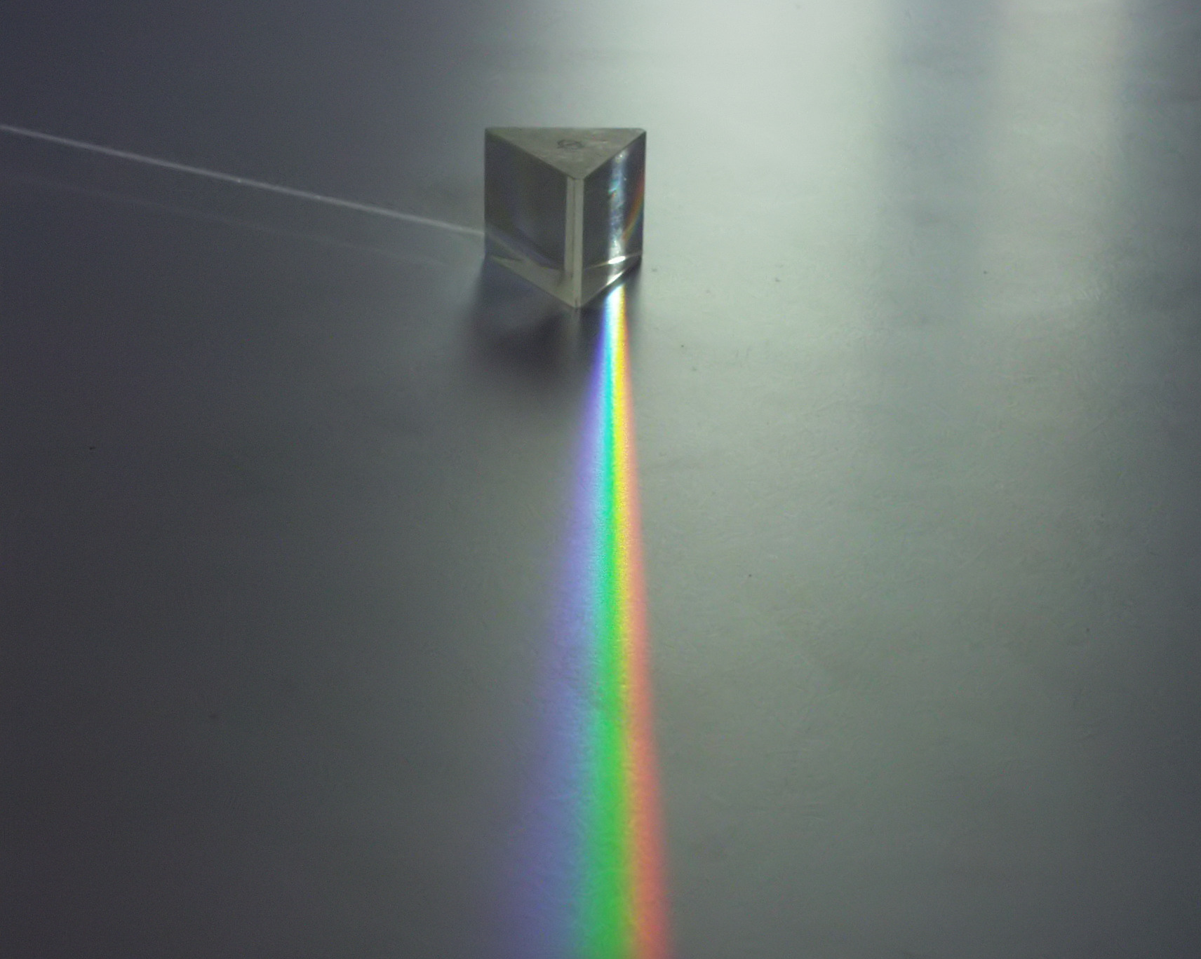
Notes:
https://en.wikipedia.org/wiki/Refraction

Slide 41
A photon’s life choices
Absorption
Diffusion
Reflection
Transparency
Refraction
Fluorescence
Subsurface scattering
Phosphorescence
light source
λ₁
λ₂

Slide 42


Slide 43
A photon’s life choices
Absorption
Diffusion
Reflection
Transparency
Refraction
Fluorescence
Subsurface scattering
Phosphorescence
light source
λ

Slide 44
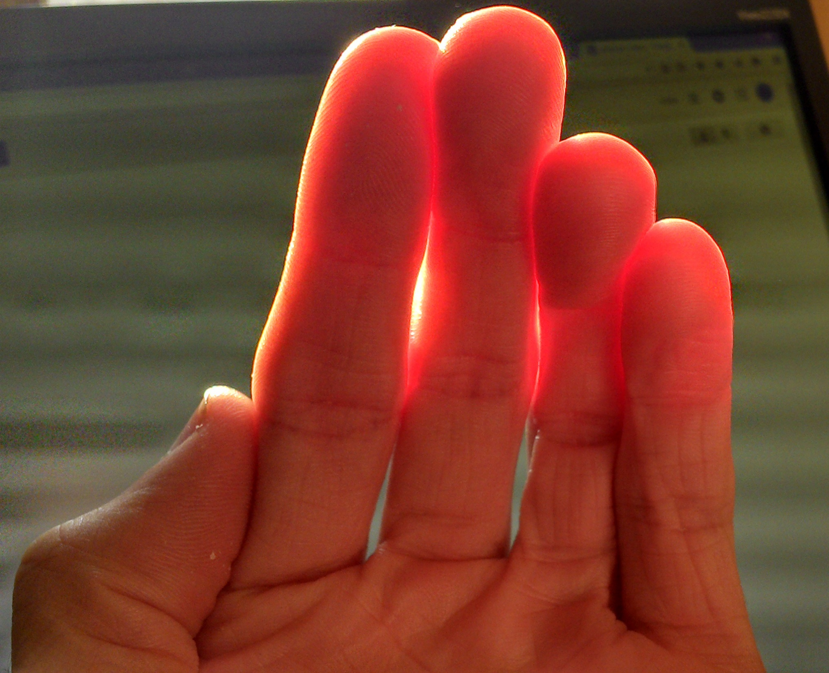
Notes:
https://en.wikipedia.org/wiki/Subsurface_scattering

Slide 45
A photon’s life choices
Absorption
Diffusion
Reflection
Transparency
Refraction
Fluorescence
Subsurface scattering
Phosphorescence
light source
t=1
t=n

Slide 46

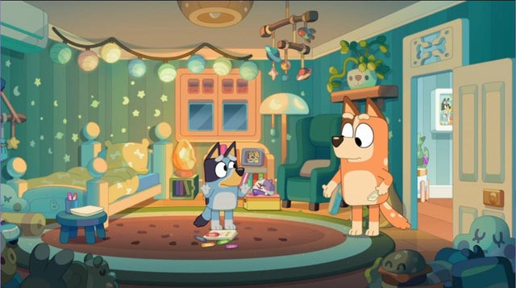

Slide 47
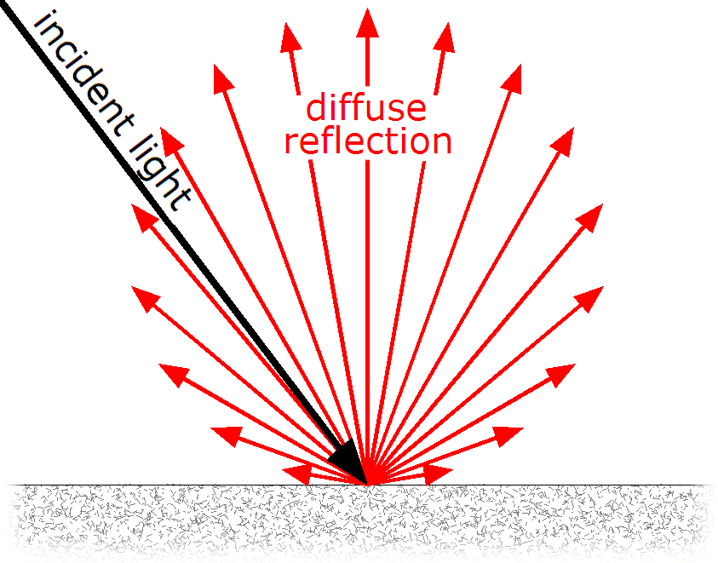
Lambertian Reflectance
In computer vision, the complexity of light transport is mostly ignored.
Surfaces are often assumed to be ideal diffuse reflectors with no dependence on viewing direction.
https://en.wikipedia.org/wiki/Lambertian_reflectance

Slide 48
Image Formation
Digital Camera
Film
The Eye

Slide 49
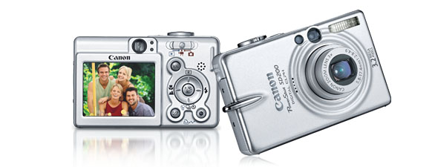
Digital camera
A digital camera replaces film with a sensor array
Each cell in the array is light-sensitive diode that converts photons to electrons
Two common types
Charge Coupled Device (CCD)
CMOS
http://electronics.howstuffworks.com/digital-camera.htm
Slide by Steve Seitz

Slide 50
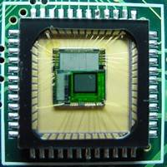
Sensor Array
CMOS sensor

Slide 51
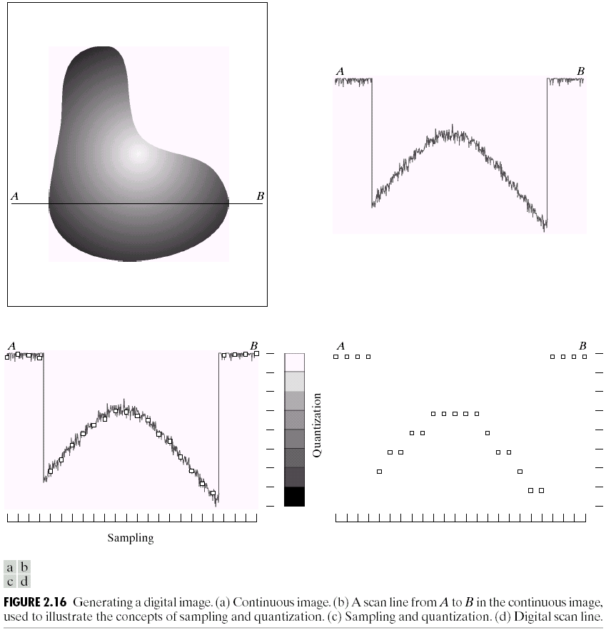
Sampling and Quantization

Slide 52
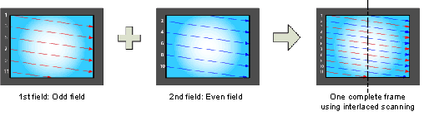


Interlace vs. progressive scan
http://www.axis.com/products/video/camera/progressive_scan.htm
Slide by Steve Seitz

Slide 53

Progressive scan or Global shutter
http://www.axis.com/products/video/camera/progressive_scan.htm
Slide by Steve Seitz

Slide 54

Interlaced
http://www.axis.com/products/video/camera/progressive_scan.htm
Slide by Steve Seitz

Slide 55

Slow mo guys – CRTs
https://youtu.be/3BJU2drrtCM

Slide 56


Rolling Shutter
Notes:
http://en.wikipedia.org/wiki/Rolling_shutter
Even DSLRs have this problem.

Slide 57
The Retina

Slide 58

Retina up-close
Light
Notes:
Tapetum lucidum

Slide 59




What humans don’t have: tapetum lucidum
Human eyes can reflect a tiny bit and blood in the retina makes this reflection red.
Notes:
Animals with Tapetum Lucidum also have RPE, just not in the same part of the eye.

Slide 60

Wait, the blood vessels are in front of the photoreceptors??
https://www.youtube.com/watch?v=L_W-IXqoxHA
Notes:
Yes, and you can see them!

