Slide 1
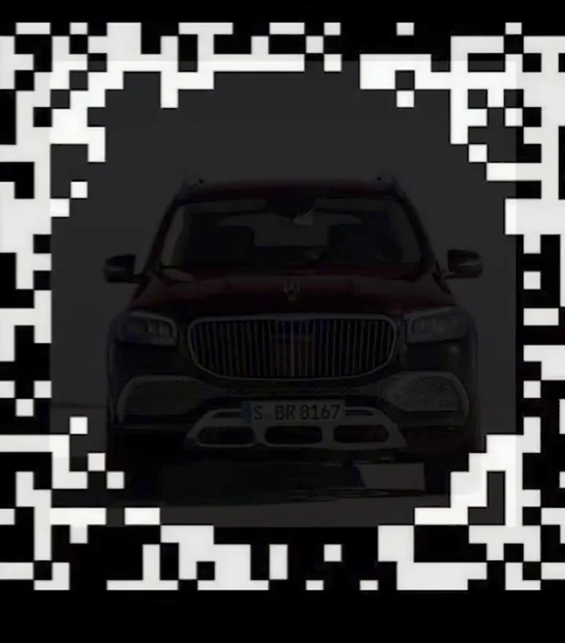

Slide 2
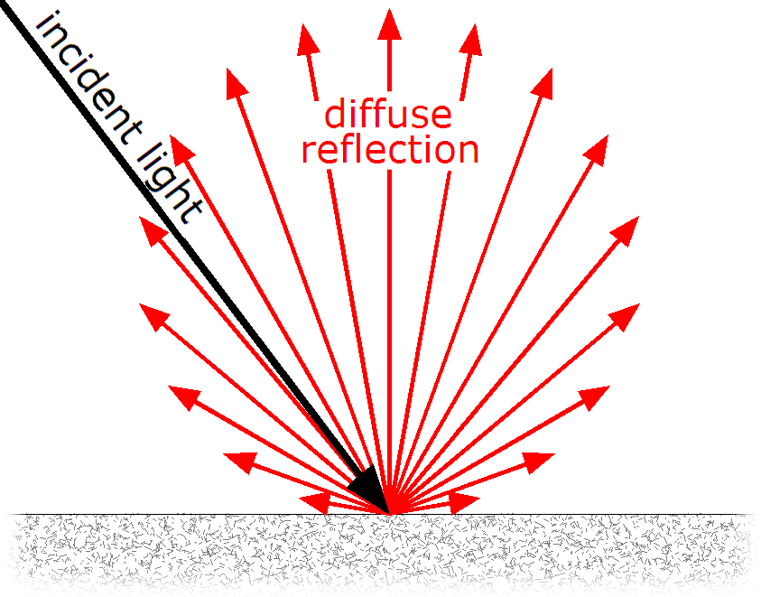
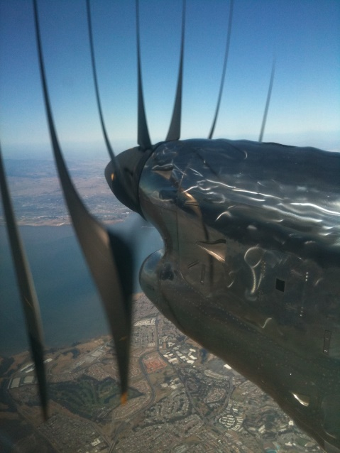
Recap of Light and Cameras
Light transport is complex, but in computer vision we often assume their interactions follow the Lambertian reflectance model.
Time, Intensity, and Space are all continuous, but they are all discretized when capturing images. Sometimes this leads to artifacts.

Slide 3
This lecture
Eyes (your cameras)
Light and Color
Next lecture: Interest Points

Slide 4
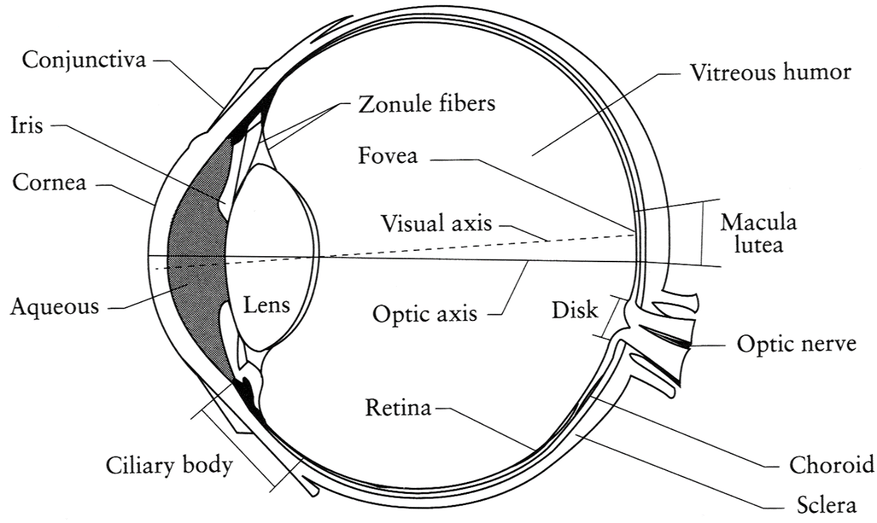
The Eye
The human eye is a camera!
  Iris - colored annulus with radial muscles
  Pupil - the hole (aperture) whose size is controlled by the iris
  What’s the “film”?
    photoreceptor cells (rods and cones) in the retina
Slide by Steve Seitz

Slide 5
Why do we care about human vision in this class?
We don’t, necessarily.

Slide 6
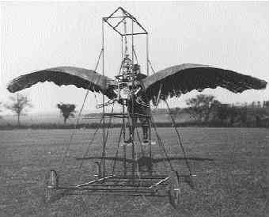
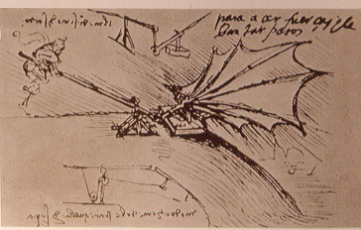
Ornithopters

Slide 7
Why do we care about human vision in this class?
We don’t, necessarily.
But cameras necessarily imitate the frequency response of the human eye, so we should know that much.
Also, computer vision probably wouldn’t get as much scrutiny if biological vision (especially human vision) hadn’t proved that it was possible to make important judgements from 2D images.

Slide 8
Does computer vision “understand” images?
"Can machines fly?" The answer is yes, because airplanes fly.
"Can machines swim?" The answer is no, because submarines don't swim.
"Can machines think?" Is this question like the first, or like the second?
Source: Norvig

Slide 9
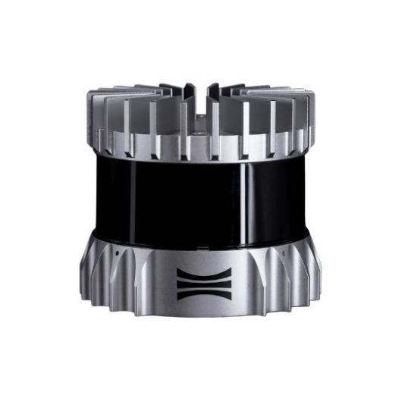
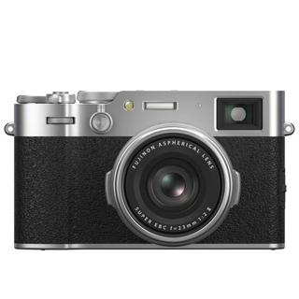
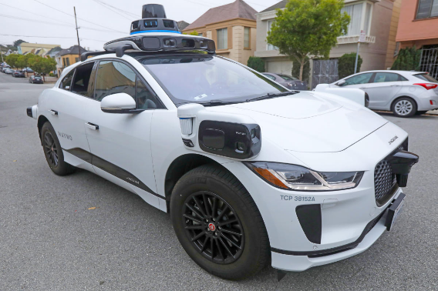
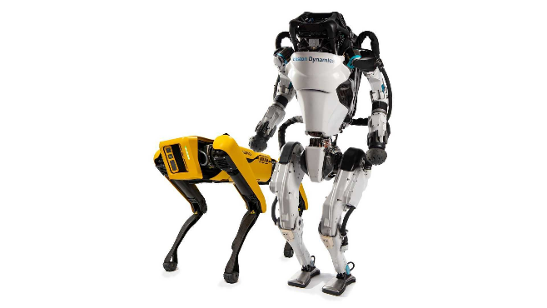
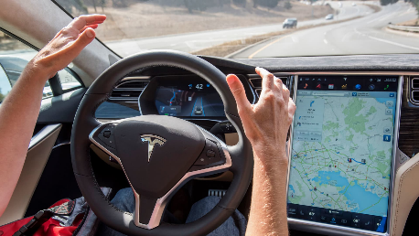
The Spectrum of Biological Inspiration
Radar
Lidar
Traditional cameras
Tesla autopilot
Humanoid and Quadruped robots
Less biologically inspired
More biologically inspired

Slide 10
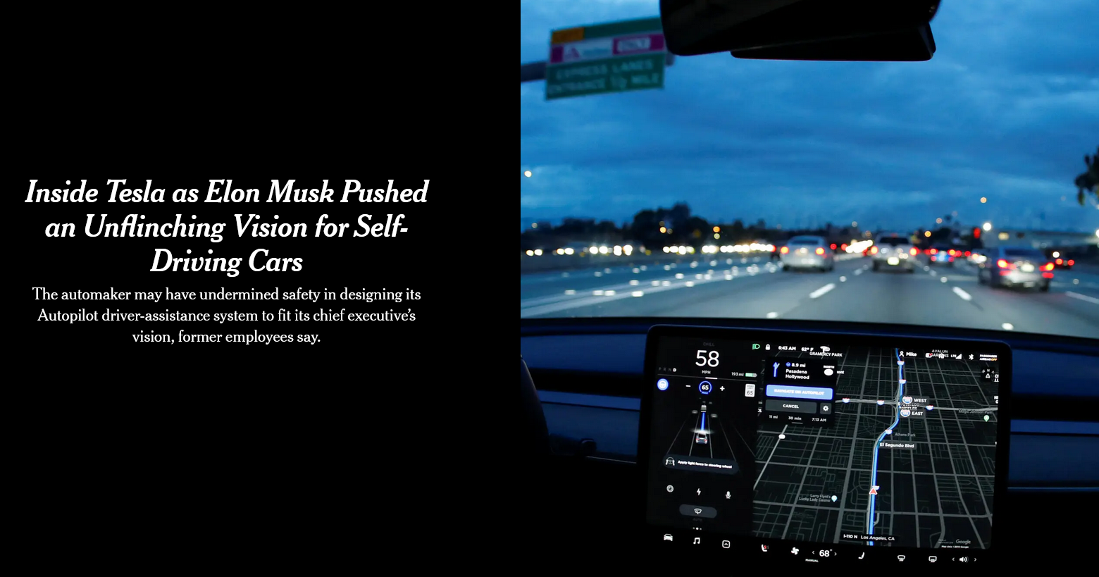
Notes:
December 6th, 2021 New York Times

Slide 11
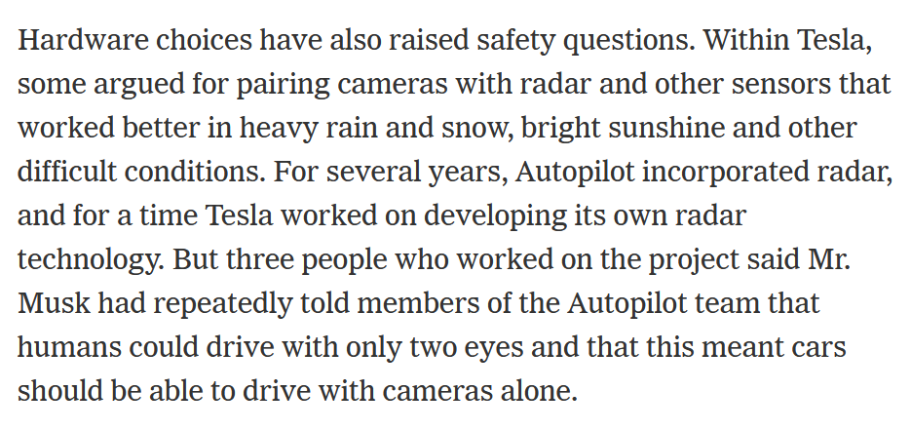

Slide 12
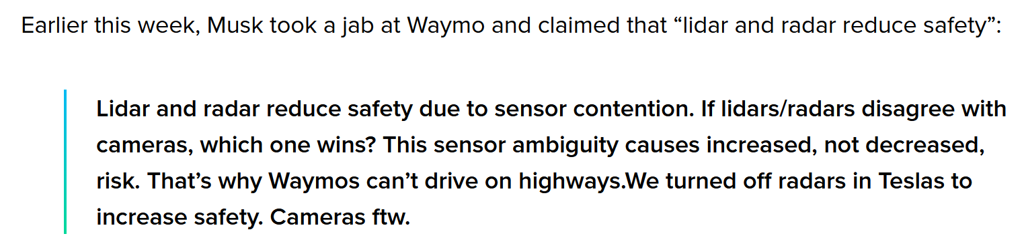
August 2025

Slide 13
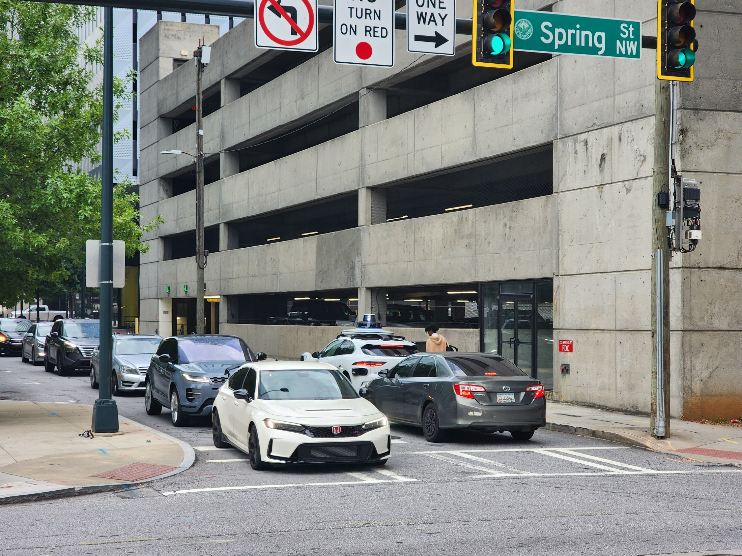

Slide 14
The Retina

Slide 15
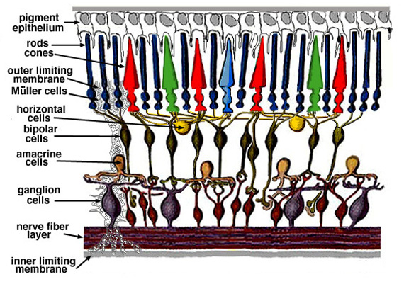
Retina up-close
Light
Notes:
Tapetum lucidum

Slide 16
Two types of light-sensitive receptors
Cones
cone-shaped
less sensitive
operate in high light
color vision
Rods
rod-shaped
highly sensitive
operate at night
gray-scale vision
© Stephen E. Palmer, 2002

Slide 17
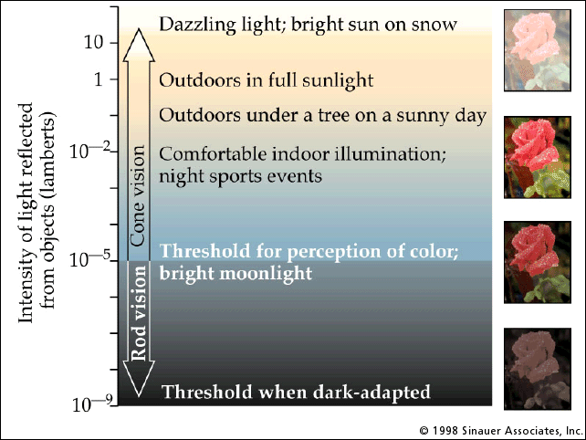
Rod / Cone sensitivity

Slide 18
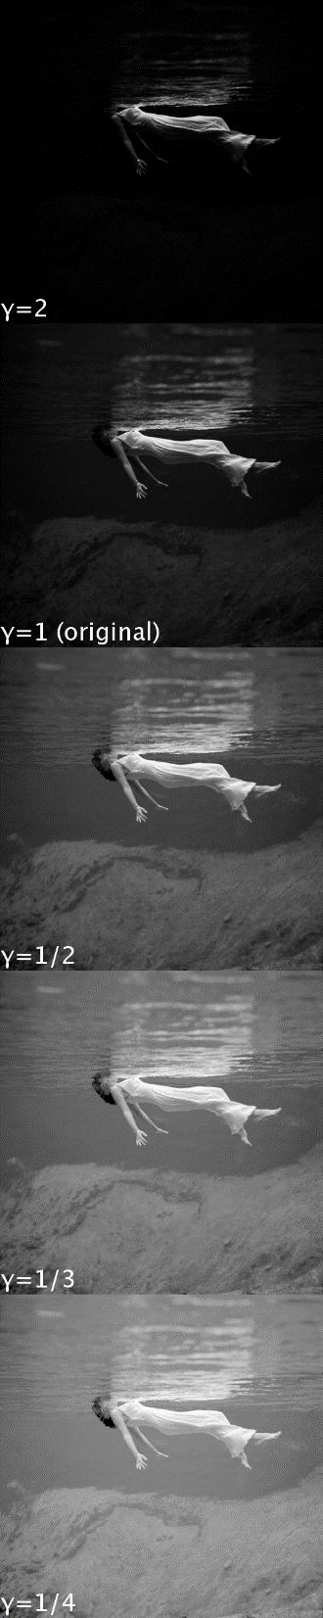
Camera Gamma Curve
$$encoded brightness={measured brightness}^{γ}$$
Typical encoding gamma value
In this class (e.g. for project 1), you are manipulating encoded brightness values. A pixel with value of “100” does not mean twice the light emissions as a pixel with value of “50”.
https://en.wikipedia.org/wiki/Gamma_correction

Slide 19
Distribution of Rods and Cones
Night Sky: why are there more stars off-center?
Averted vision: http://en.wikipedia.org/wiki/Averted_vision
© Stephen E. Palmer, 2002

Slide 20
Eye Movements
Saccades
Can be consciously controlled. Related to perceptual attention.
200ms to initiation, 20 to 200ms to carry out. Large amplitude.
Microsaccades
Involuntary. Smaller amplitude. Especially evident during prolonged fixation. Function debated.
Ocular microtremor (OMT)
Involuntary. high frequency (up to 80Hz), small amplitude.
Smooth pursuit – tracking an object

Slide 21
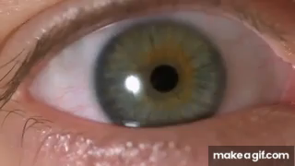
Slow mo guys – Saccades
https://youtu.be/Fmg9ZOHESgQ?t=21s

Slide 22
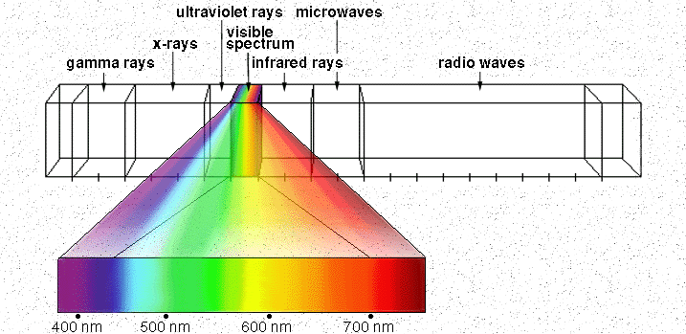
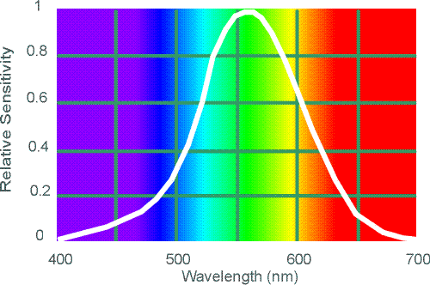
Electromagnetic Spectrum
Human Luminance Sensitivity Function
http://www.yorku.ca/eye/photopik.htm
Notes:
At least 3 spectral bands required (e.g. R,G,B)

Slide 23
Visible Light
Why do we see light of these wavelengths?
…because that’s where the
Sun radiates EM energy
© Stephen E. Palmer, 2002
Notes:
Because that’s where the Sun’s peak radiation was
Because the atmosphere is fairly transparent in that range
Because biology has many important markers in that range (but that’s because of the previous two reasons)

Slide 24
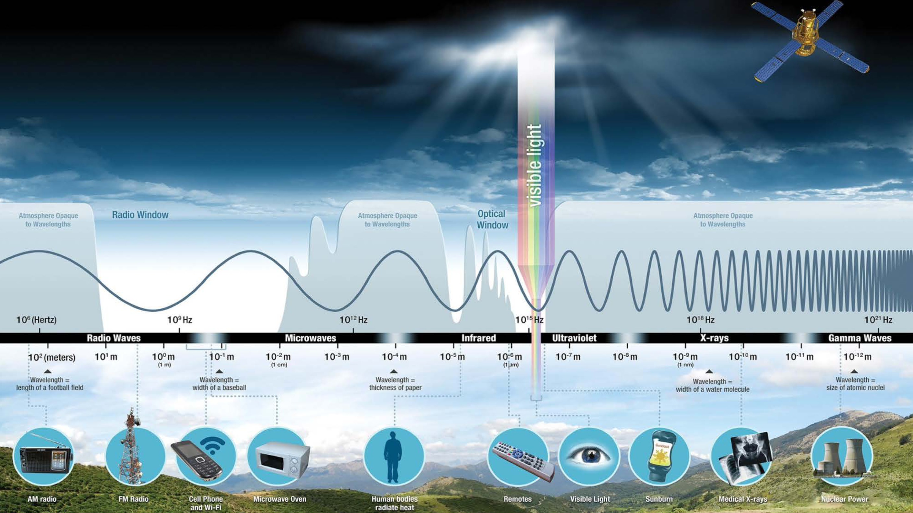
Notes:
Slide credit: NASA

Slide 25
The Physics of Light
Any patch of light can be completely described
physically by its spectrum: the number of photons
(per time unit) at each wavelength 400 - 700 nm.
© Stephen E. Palmer, 2002

Slide 26
The Physics of Light
Some examples of the spectra of light sources
© Stephen E. Palmer, 2002

Slide 27
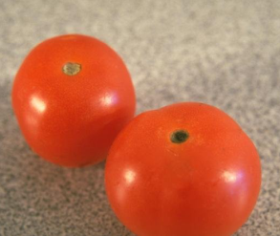
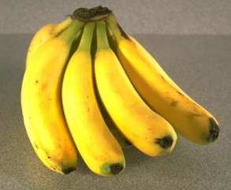
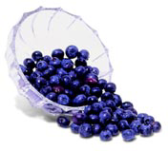
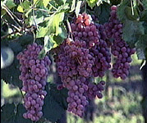
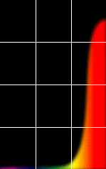
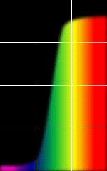
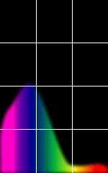
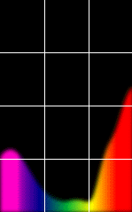
The Physics of Light
Some examples of the reflectance spectra of surfaces
Red
Yellow
Blue
Purple
% Photons Reflected
400 700
400 700
400 700
400 700
Wavelength (nm)
© Stephen E. Palmer, 2002

Slide 28
The Psychophysical Correspondence
There is no simple functional description for the perceived
color of all lights under all viewing conditions, but …...
A helpful constraint:
Consider only physical spectra with normal distributions
mean
area
variance
© Stephen E. Palmer, 2002

Slide 29
The Psychophysical Correspondence
Mean
Hue
# Photons
Wavelength
© Stephen E. Palmer, 2002

Slide 30
The Psychophysical Correspondence
Variance
Saturation
# Photons
Wavelength
© Stephen E. Palmer, 2002

Slide 31
The Psychophysical Correspondence
Area
Brightness
# Photons
Wavelength
© Stephen E. Palmer, 2002

Slide 32
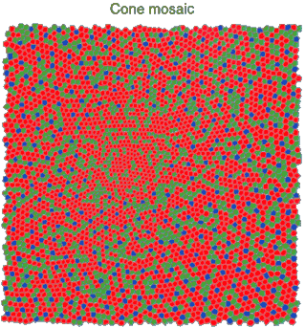
Physiology of Color Vision
Three kinds of cones:
Why are M and L cones so close?
Why are there 3?
© Stephen E. Palmer, 2002

Slide 33


Impossible Colors
Can you make the cones respond in ways that typical light spectra never would?
http://en.wikipedia.org/wiki/Impossible_colors

Slide 34
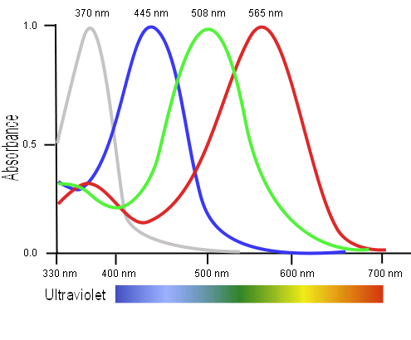
Tetrachromacy
Bird cone responses
Most birds, and many other animals, have cones for ultraviolet light.
Some humans, mostly female, seem to have slight tetrachromatism.

Slide 35
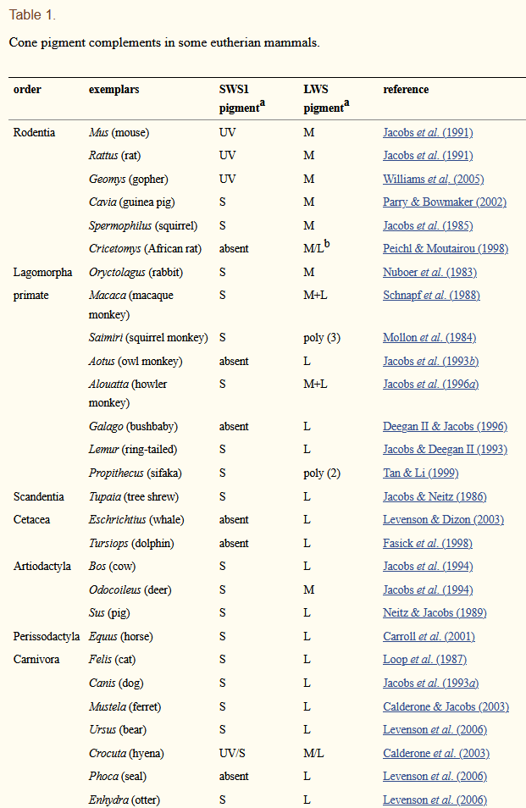
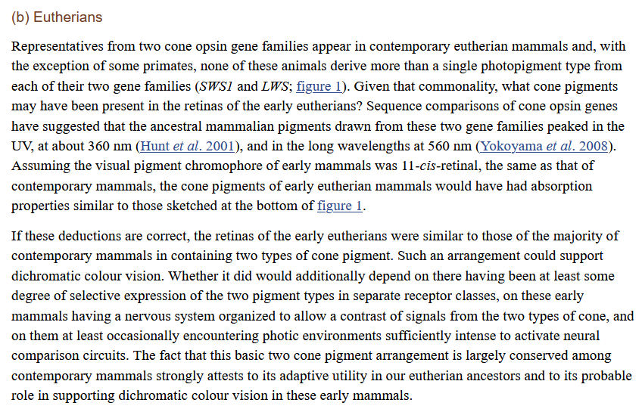
Jacobs GH. Evolution of colour vision in mammals. Philos Trans R Soc Lond B Biol Sci. 2009;364(1531):2957-2967. doi:10.1098/rstb.2009.0039

Slide 36
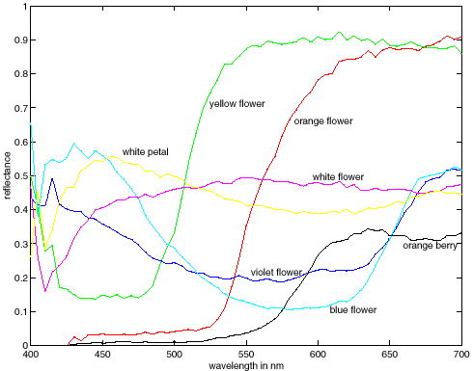
More Spectra
metamers
Notes:
Metamerism can be illuminant based or observer based. Color blindness produced well known instances of metamerism.

Slide 37
Multispectral / Hyperspectral Imaging
Astronomy / Earth Observation have long relied on multi-spectral imaging.

Slide 38
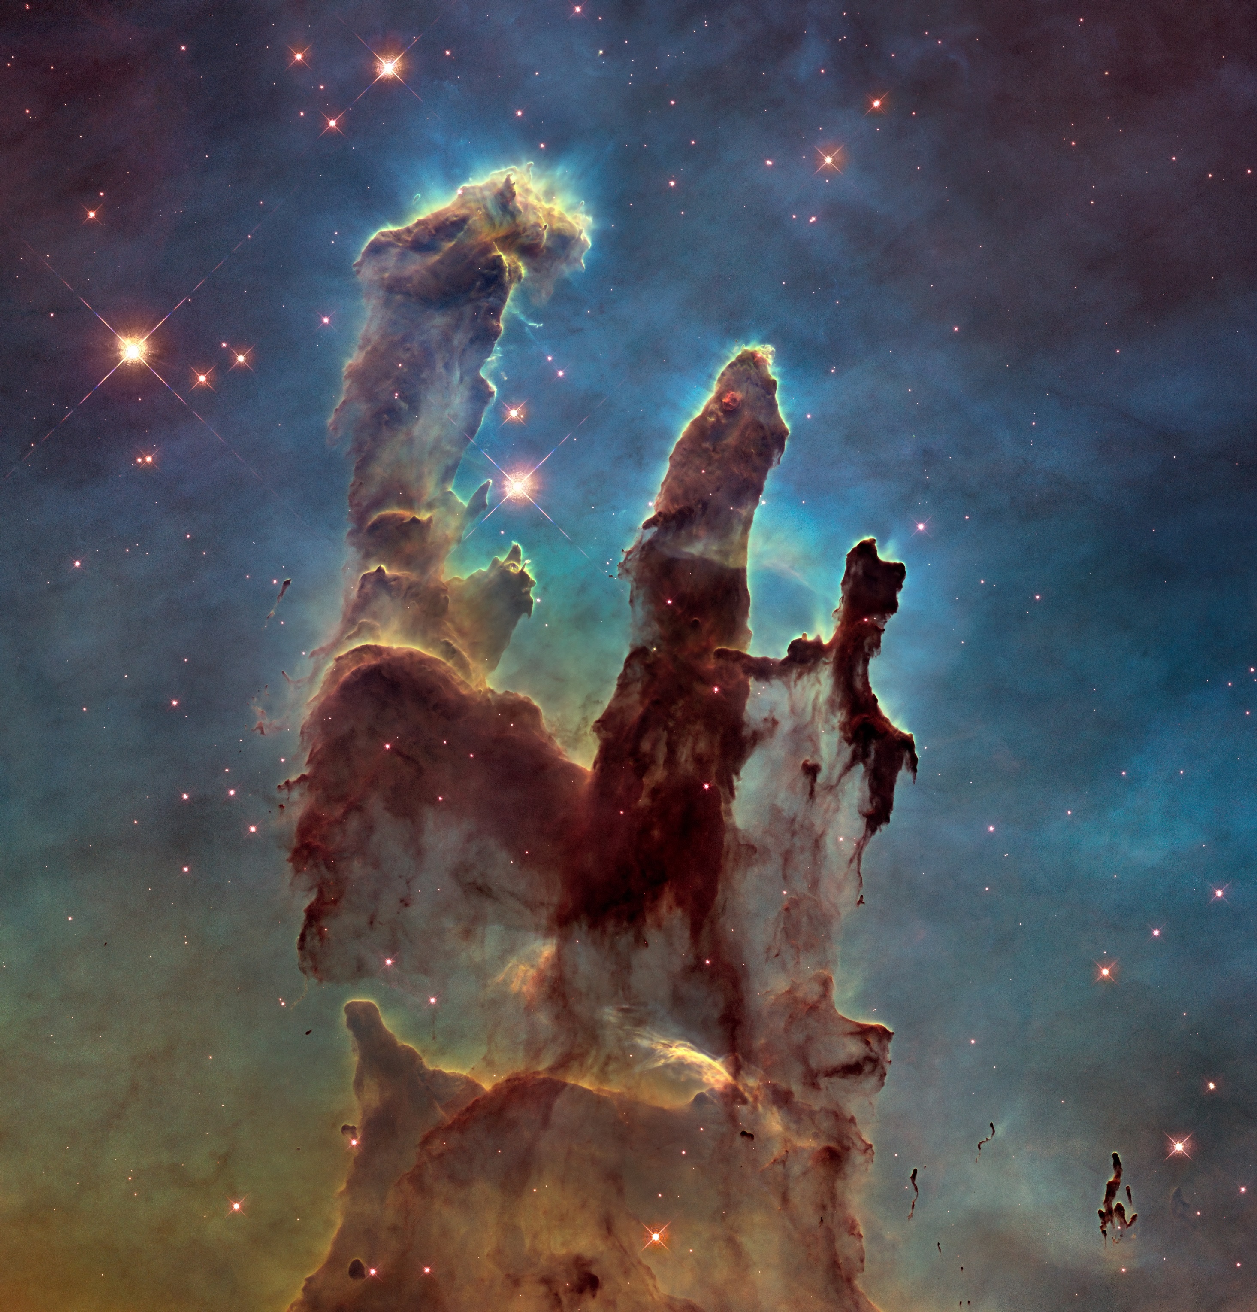
Hubble Space Telescope image of the Pillars of Creation, taken in 2014
Notes:
Hubble Space Telescope image of the Pillars of Creation, taken in 2014

Slide 39

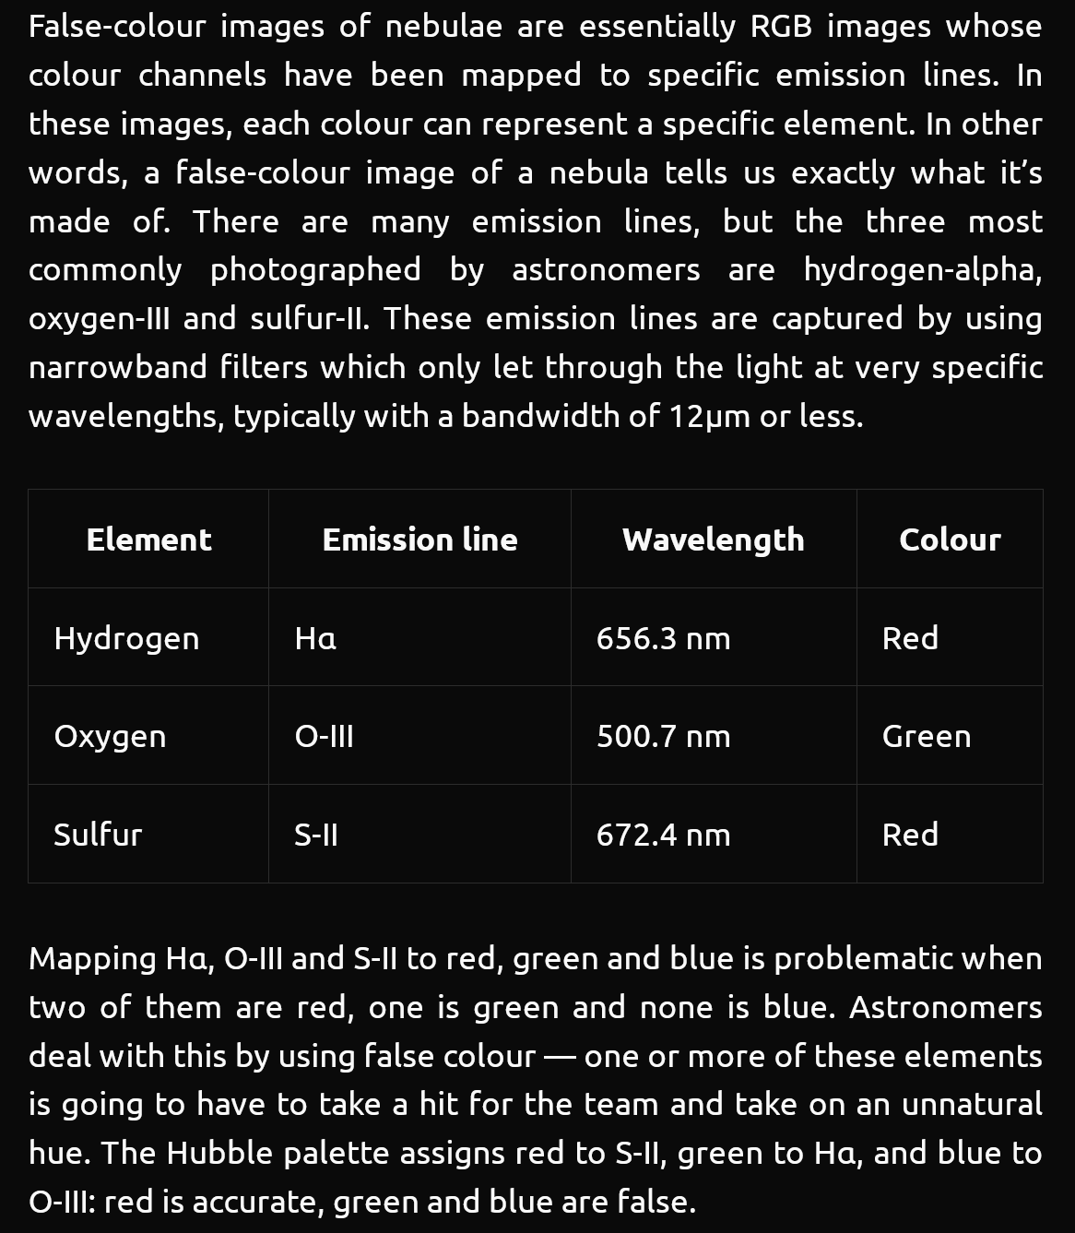
https://delsaert.com/deep-sky/nebulae/h-alpha/

Slide 40
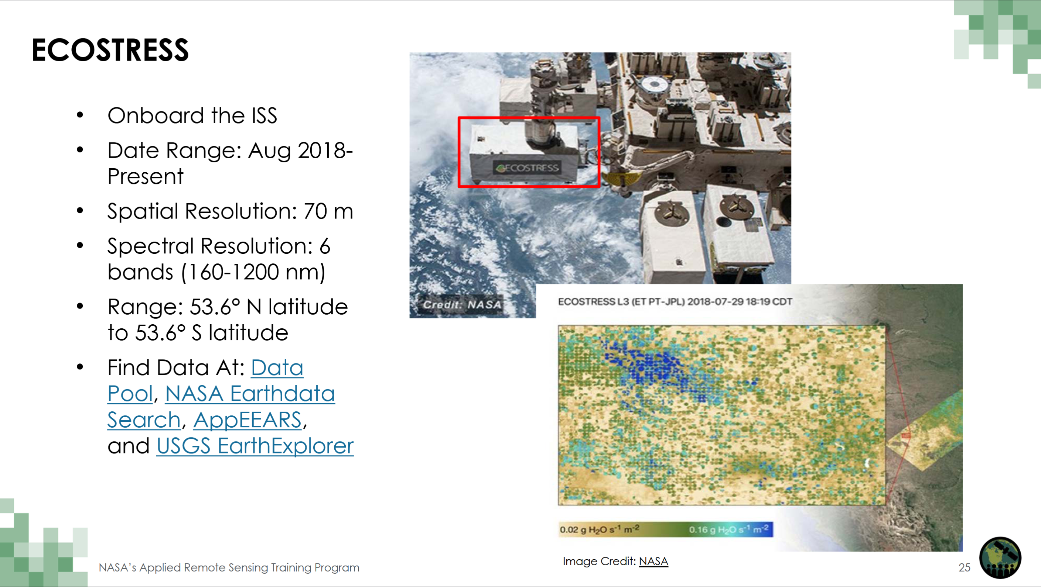

Slide 41
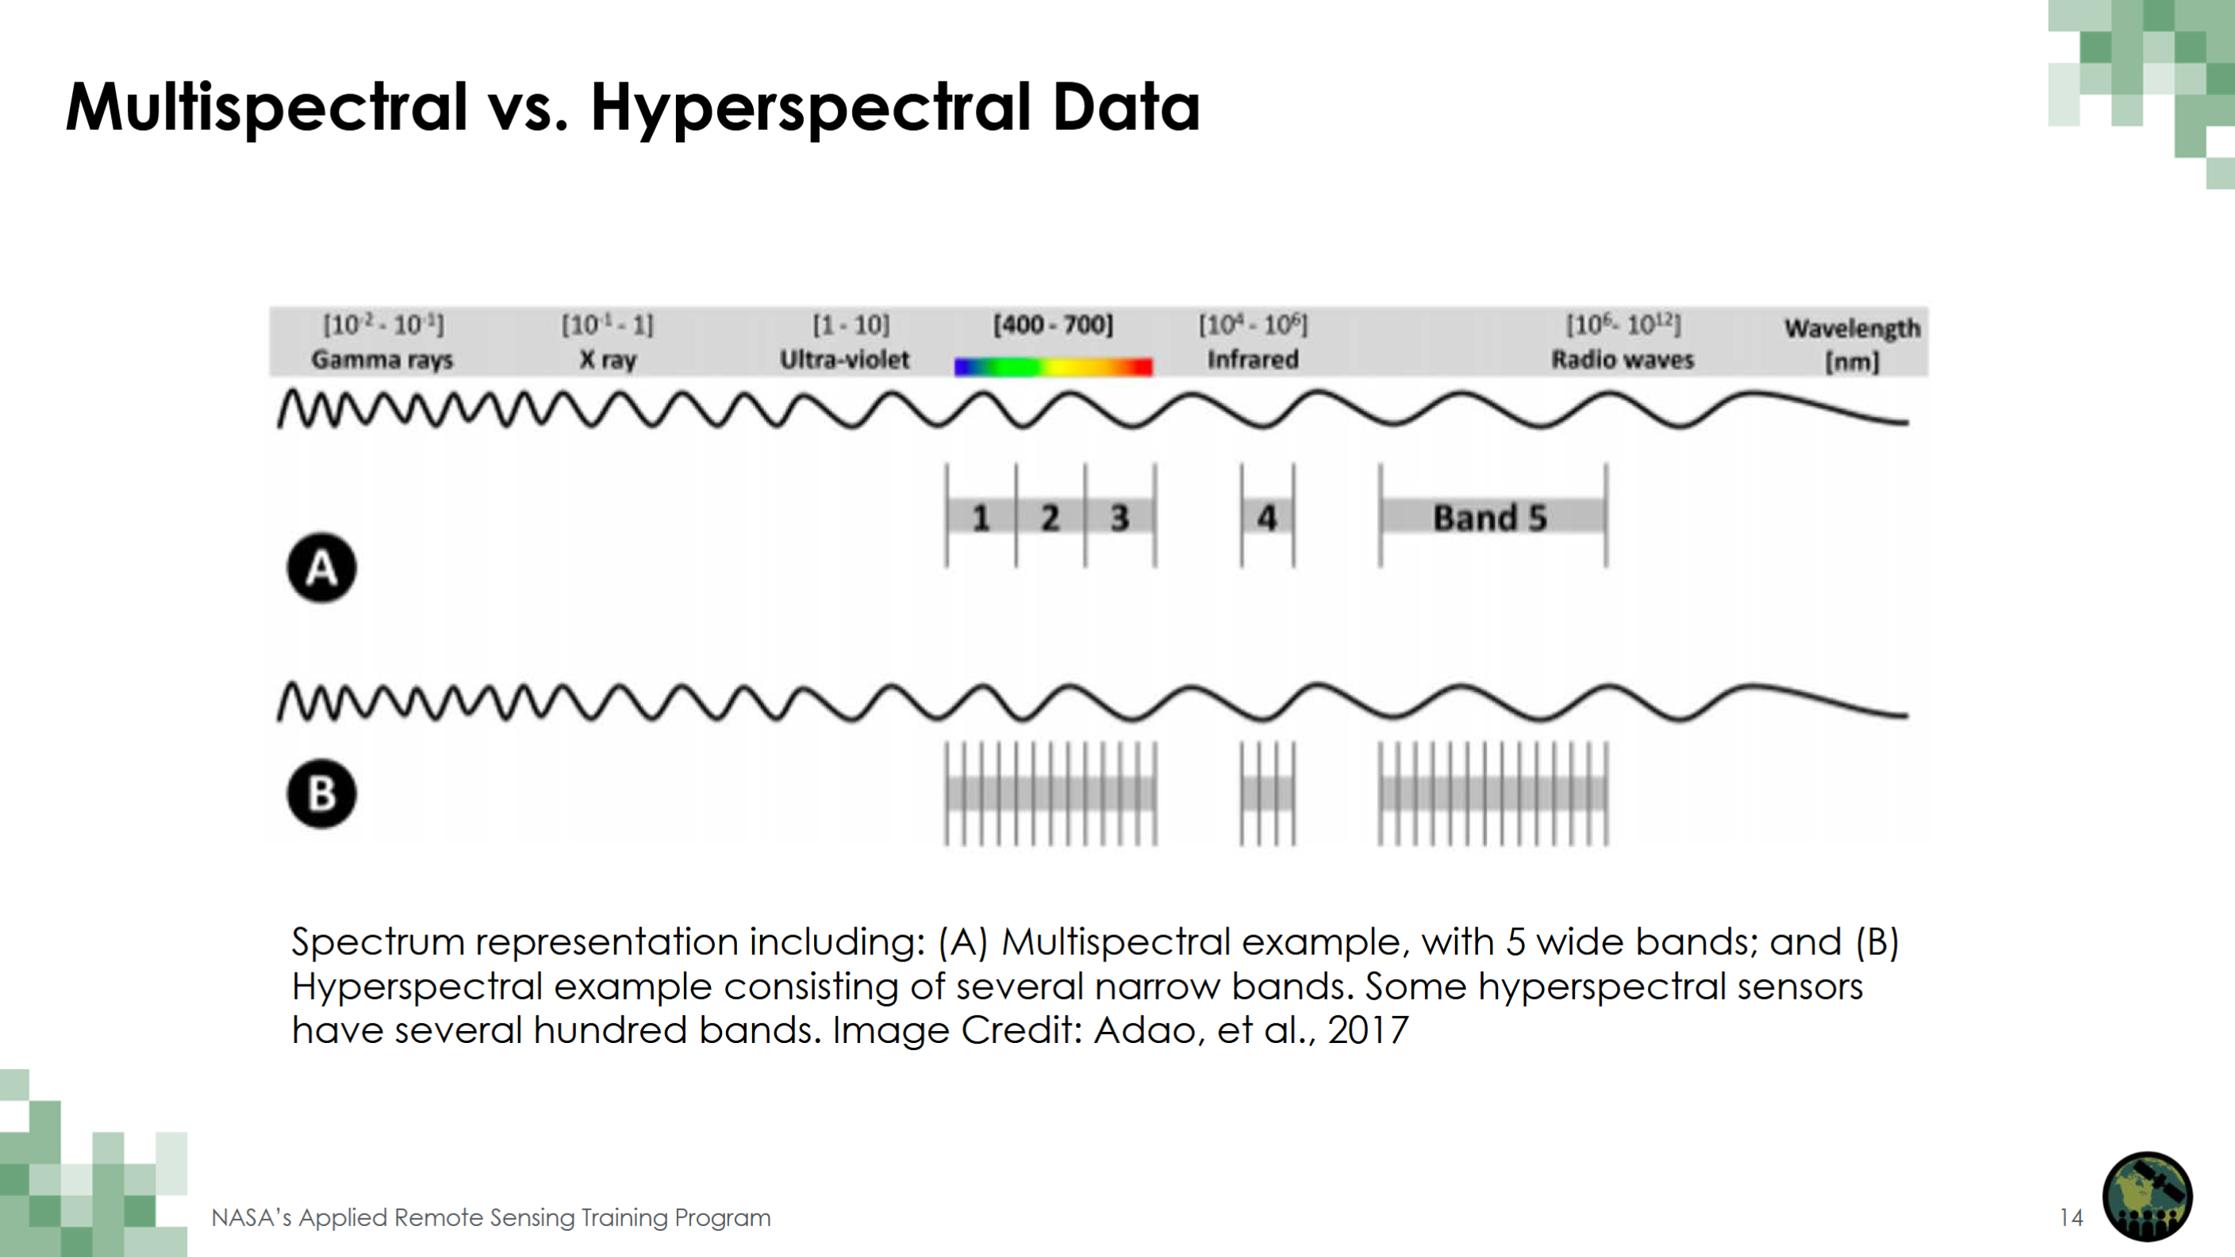

Slide 42
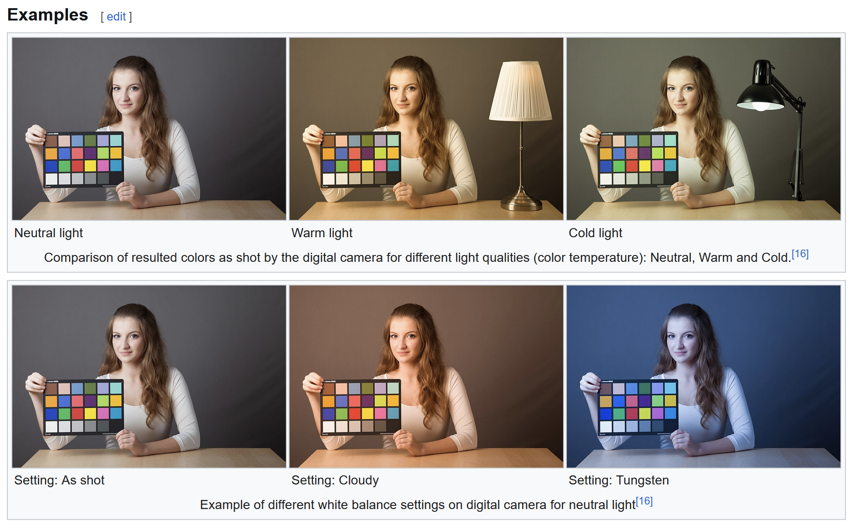
Cameras don’t faithfully capture color.
RGB don’t correspond to particular wavelengths.
Notes:
https://en.wikipedia.org/wiki/Color_balance

Slide 43
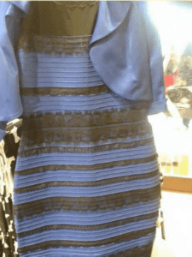
Color can be ambiguous

Slide 44
Color can be ambiguous

Slide 45
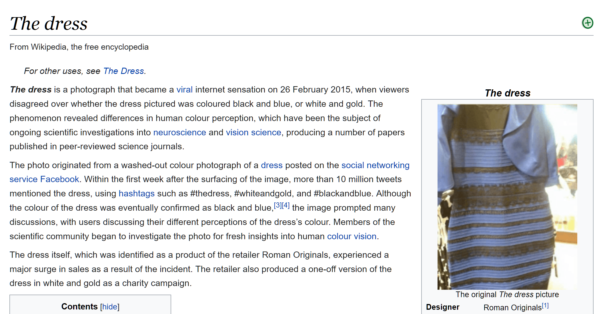
https://en.wikipedia.org/wiki/The_dress

Slide 46
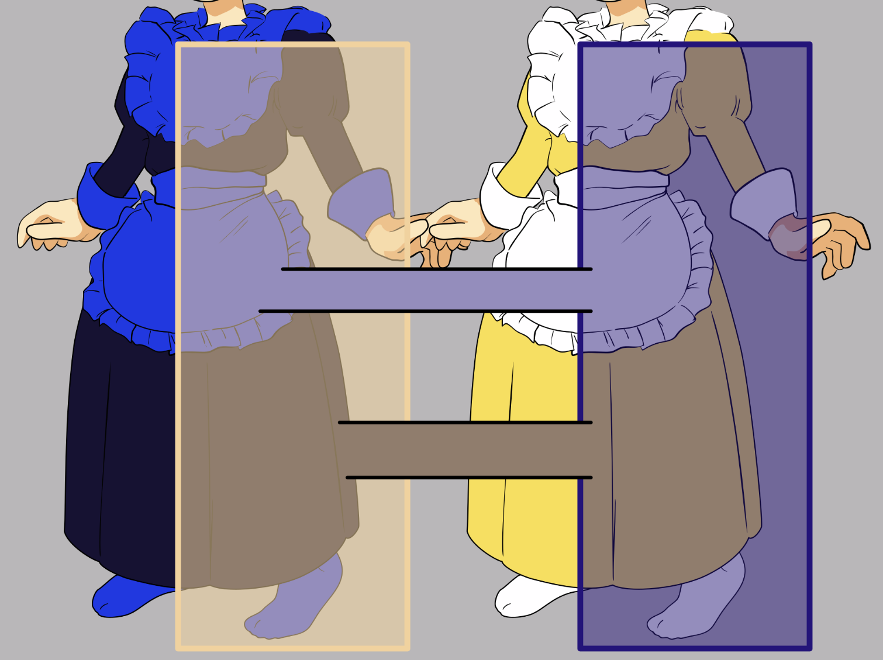
https://en.wikipedia.org/wiki/The_dress
Notes:
https://en.wikipedia.org/wiki/The_dress

Slide 47
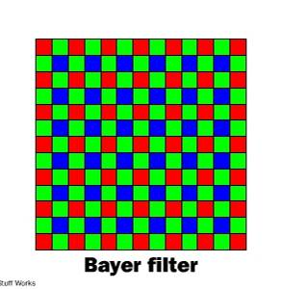
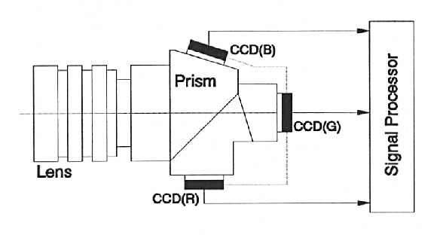
Color Sensing in Camera (RGB)
3-chip vs. 1-chip: quality vs. cost
Why more green?
Why 3 colors?
http://www.cooldictionary.com/words/Bayer-filter.wikipedia
Slide by Steve Seitz

Slide 48
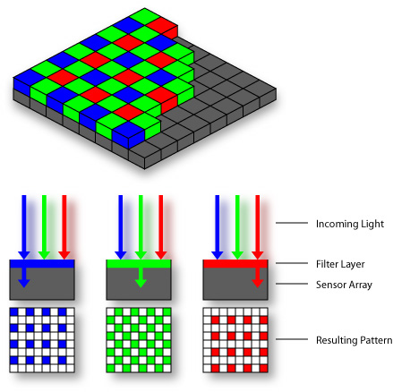

Practical Color Sensing: Bayer Grid
Estimate RGB
at ‘G’ cells from neighboring values
Slide by Steve Seitz

Slide 49
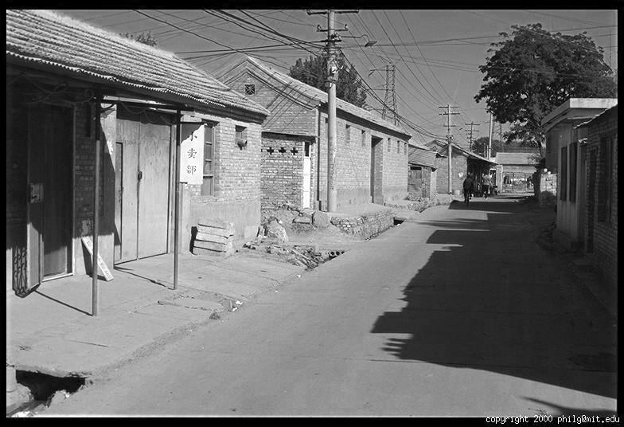
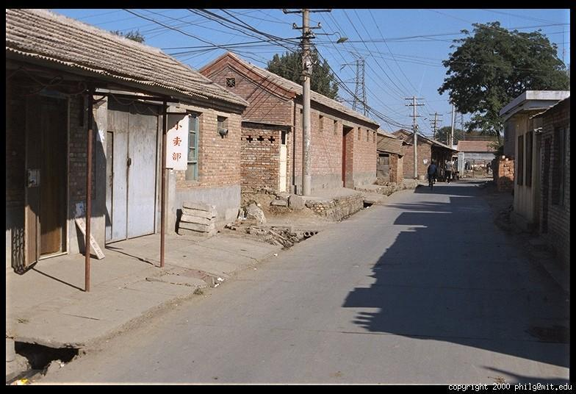
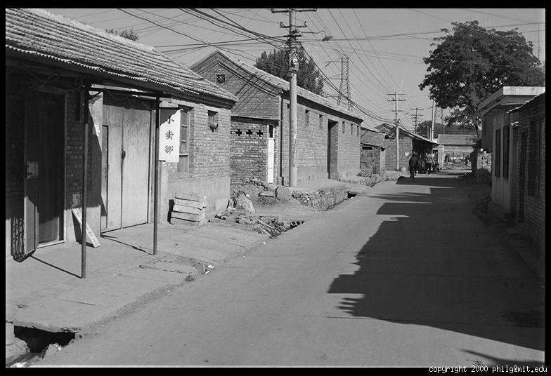
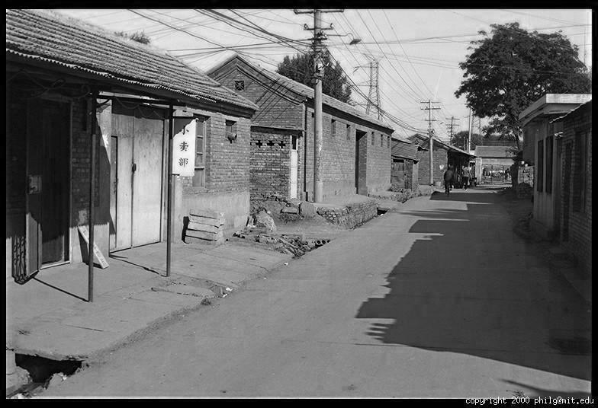
Color Image
R
G
B

Slide 50
Images in Python
Images represented as a matrix
Suppose we have a NxM RGB image called “im”
  im(0,0,0) = top-left pixel value in R-channel
  im(y, x, b) = y pixels down, x pixels to right in the b^{th} channel
  im(N-1, M-1, 2) = bottom-right pixel in B-channel
column
row
R
0.92 | 0.93 | 0.94 | 0.97 | 0.62 | 0.37 | 0.85 | 0.97 | 0.93 | 0.92 | 0.99
0.95 | 0.89 | 0.82 | 0.89 | 0.56 | 0.31 | 0.75 | 0.92 | 0.81 | 0.95 | 0.91
0.89 | 0.72 | 0.51 | 0.55 | 0.51 | 0.42 | 0.57 | 0.41 | 0.49 | 0.91 | 0.92
0.96 | 0.95 | 0.88 | 0.94 | 0.56 | 0.46 | 0.91 | 0.87 | 0.90 | 0.97 | 0.95
0.71 | 0.81 | 0.81 | 0.87 | 0.57 | 0.37 | 0.80 | 0.88 | 0.89 | 0.79 | 0.85
0.49 | 0.62 | 0.60 | 0.58 | 0.50 | 0.60 | 0.58 | 0.50 | 0.61 | 0.45 | 0.33
0.86 | 0.84 | 0.74 | 0.58 | 0.51 | 0.39 | 0.73 | 0.92 | 0.91 | 0.49 | 0.74
0.96 | 0.67 | 0.54 | 0.85 | 0.48 | 0.37 | 0.88 | 0.90 | 0.94 | 0.82 | 0.93
0.69 | 0.49 | 0.56 | 0.66 | 0.43 | 0.42 | 0.77 | 0.73 | 0.71 | 0.90 | 0.99
0.79 | 0.73 | 0.90 | 0.67 | 0.33 | 0.61 | 0.69 | 0.79 | 0.73 | 0.93 | 0.97
0.91 | 0.94 | 0.89 | 0.49 | 0.41 | 0.78 | 0.78 | 0.77 | 0.89 | 0.99 | 0.93
G
0.92 | 0.93 | 0.94 | 0.97 | 0.62 | 0.37 | 0.85 | 0.97 | 0.93 | 0.92 | 0.99
0.95 | 0.89 | 0.82 | 0.89 | 0.56 | 0.31 | 0.75 | 0.92 | 0.81 | 0.95 | 0.91
0.89 | 0.72 | 0.51 | 0.55 | 0.51 | 0.42 | 0.57 | 0.41 | 0.49 | 0.91 | 0.92
0.96 | 0.95 | 0.88 | 0.94 | 0.56 | 0.46 | 0.91 | 0.87 | 0.90 | 0.97 | 0.95
0.71 | 0.81 | 0.81 | 0.87 | 0.57 | 0.37 | 0.80 | 0.88 | 0.89 | 0.79 | 0.85
0.49 | 0.62 | 0.60 | 0.58 | 0.50 | 0.60 | 0.58 | 0.50 | 0.61 | 0.45 | 0.33
0.86 | 0.84 | 0.74 | 0.58 | 0.51 | 0.39 | 0.73 | 0.92 | 0.91 | 0.49 | 0.74
0.96 | 0.67 | 0.54 | 0.85 | 0.48 | 0.37 | 0.88 | 0.90 | 0.94 | 0.82 | 0.93
0.69 | 0.49 | 0.56 | 0.66 | 0.43 | 0.42 | 0.77 | 0.73 | 0.71 | 0.90 | 0.99
0.79 | 0.73 | 0.90 | 0.67 | 0.33 | 0.61 | 0.69 | 0.79 | 0.73 | 0.93 | 0.97
0.91 | 0.94 | 0.89 | 0.49 | 0.41 | 0.78 | 0.78 | 0.77 | 0.89 | 0.99 | 0.93
B
0.92 | 0.93 | 0.94 | 0.97 | 0.62 | 0.37 | 0.85 | 0.97 | 0.93 | 0.92 | 0.99
0.95 | 0.89 | 0.82 | 0.89 | 0.56 | 0.31 | 0.75 | 0.92 | 0.81 | 0.95 | 0.91
0.89 | 0.72 | 0.51 | 0.55 | 0.51 | 0.42 | 0.57 | 0.41 | 0.49 | 0.91 | 0.92
0.96 | 0.95 | 0.88 | 0.94 | 0.56 | 0.46 | 0.91 | 0.87 | 0.90 | 0.97 | 0.95
0.71 | 0.81 | 0.81 | 0.87 | 0.57 | 0.37 | 0.80 | 0.88 | 0.89 | 0.79 | 0.85
0.49 | 0.62 | 0.60 | 0.58 | 0.50 | 0.60 | 0.58 | 0.50 | 0.61 | 0.45 | 0.33
0.86 | 0.84 | 0.74 | 0.58 | 0.51 | 0.39 | 0.73 | 0.92 | 0.91 | 0.49 | 0.74
0.96 | 0.67 | 0.54 | 0.85 | 0.48 | 0.37 | 0.88 | 0.90 | 0.94 | 0.82 | 0.93
0.69 | 0.49 | 0.56 | 0.66 | 0.43 | 0.42 | 0.77 | 0.73 | 0.71 | 0.90 | 0.99
0.79 | 0.73 | 0.90 | 0.67 | 0.33 | 0.61 | 0.69 | 0.79 | 0.73 | 0.93 | 0.97
0.91 | 0.94 | 0.89 | 0.49 | 0.41 | 0.78 | 0.78 | 0.77 | 0.89 | 0.99 | 0.93

Slide 51

Color spaces
Are there other ways to encode color beyond R, G, B?
http://en.wikipedia.org/wiki/File:RGB_illumination.jpg

Slide 52





Color spaces: RGB
Default color space
0,1,0
R
(G=0,B=0)
1,0,0
G
(R=0,B=0)
0,0,1
B
(R=0,G=0)
Some drawbacks
Strongly correlated channels
Non-perceptual
Image from: http://en.wikipedia.org/wiki/File:RGB_color_solid_cube.png

Slide 53




Color spaces: HSV
Intuitive color space
H
(S=1,V=1)
S
(H=1,V=1)
V
(H=1,S=0)

Slide 54






Color spaces: YCbCr
Fast to compute, good for compression, used by TV
Y=0
Y=0.5
Y
(Cb=0.5,Cr=0.5)
Cr
Cb
(Y=0.5,Cr=0.5)
Cb
Y=1
Cr
(Y=0.5,Cb=05)

Slide 55




Color spaces: L*a*b*
“Perceptually uniform”* color space
L
(a=0,b=0)
a
(L=65,b=0)
b
(L=65,a=0)

Slide 56
If you had to choose, would you rather go without luminance or chrominance?

Slide 57
If you had to choose, would you rather go without luminance or chrominance?

Slide 58

Most information in intensity
Only color shown – constant intensity

Slide 59

Most information in intensity
Only intensity shown – constant color

Slide 60
Most information in intensity
Original image

Slide 61

Back to grayscale intensity
0.92 | 0.93 | 0.94 | 0.97 | 0.62 | 0.37 | 0.85 | 0.97 | 0.93 | 0.92 | 0.99
0.95 | 0.89 | 0.82 | 0.89 | 0.56 | 0.31 | 0.75 | 0.92 | 0.81 | 0.95 | 0.91
0.89 | 0.72 | 0.51 | 0.55 | 0.51 | 0.42 | 0.57 | 0.41 | 0.49 | 0.91 | 0.92
0.96 | 0.95 | 0.88 | 0.94 | 0.56 | 0.46 | 0.91 | 0.87 | 0.90 | 0.97 | 0.95
0.71 | 0.81 | 0.81 | 0.87 | 0.57 | 0.37 | 0.80 | 0.88 | 0.89 | 0.79 | 0.85
0.49 | 0.62 | 0.60 | 0.58 | 0.50 | 0.60 | 0.58 | 0.50 | 0.61 | 0.45 | 0.33
0.86 | 0.84 | 0.74 | 0.58 | 0.51 | 0.39 | 0.73 | 0.92 | 0.91 | 0.49 | 0.74
0.96 | 0.67 | 0.54 | 0.85 | 0.48 | 0.37 | 0.88 | 0.90 | 0.94 | 0.82 | 0.93
0.69 | 0.49 | 0.56 | 0.66 | 0.43 | 0.42 | 0.77 | 0.73 | 0.71 | 0.90 | 0.99
0.79 | 0.73 | 0.90 | 0.67 | 0.33 | 0.61 | 0.69 | 0.79 | 0.73 | 0.93 | 0.97
0.91 | 0.94 | 0.89 | 0.49 | 0.41 | 0.78 | 0.78 | 0.77 | 0.89 | 0.99 | 0.93

Slide 62
Wrap up: Why do we care about cameras vs eyes?
Notes:
December 6th, 2021 New York Times

Slide 63
Notes:
December 6th, 2021 New York Times

Slide 65


Slide 66

Another driving system with human level eyesight
https://www.youtube.com/watch?v=5fvsItXYgzk

Slide 67


Slide 68

https://twitter.com/JordanTeslaTech/status/1418413307862585344

Slide 69

https://www.reddit.com/r/teslamotors/comments/nrs8kf/you_think_ice_cream_truck_stop_signs_are_a_problem/

Slide 70
On the whole, cameras are a reasonable analogy for eyes. They do capture sufficient information for safe driving 99.9% of the time.

Slide 71

https://www.youtube.com/watch?v=s1eTBMYEs-Y
Notes:
But maybe some cameras don’t have enough dynamic range at the moment

Slide 72
On the whole, cameras are a reasonable analogy for eyes. They do capture sufficient information for safe driving 99.9% of the time.
  Imagine remote controlling a vehicle based on a camera feed.
But the computer vision and machine learning methods that interpret the camera images are not yet a reasonable analogy for the human brain.
And there are outlier cases where humans must do more than just passively perceive from a single fixed viewpoint.

Slide 73
Next: Interest points and corners
Slides: Hoiem, Efros, and others

