Slide 1
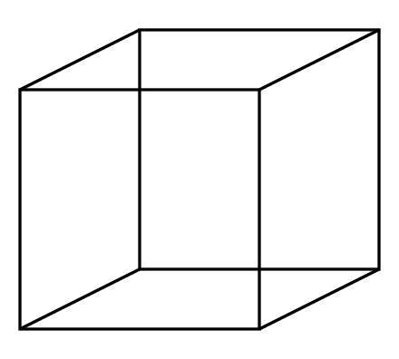
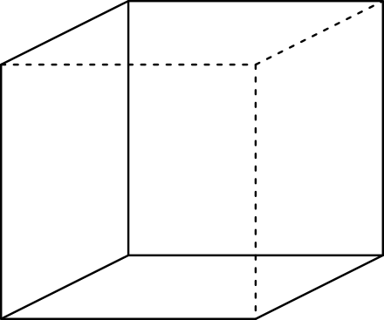
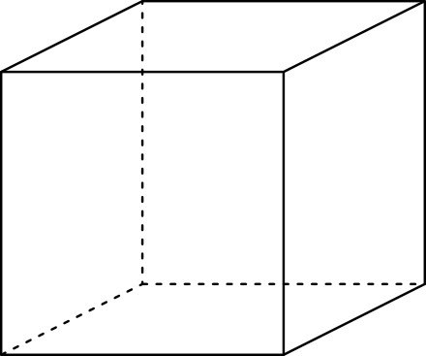
Multi-stable Perception
Necker Cube

Slide 2
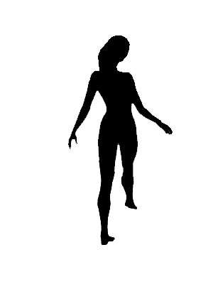
Spinning dancer illusion, Nobuyuki Kayahara
Notes:
2021 poll results
https://linkto.run/p/2VGXTJD3
Surprisingly many people could see it rotating either way, hypothesizing that the low framerate on Bluejeans made it easier

Slide 3
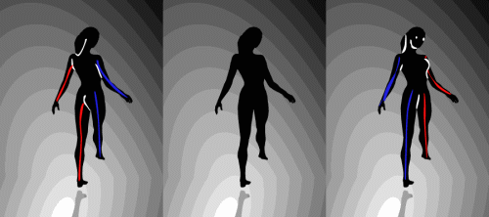

Slide 4
Feature Matching and Robust Fitting
Read Szeliski 7.4.2 and 2.1
Computer Vision
James Hays
Acknowledgment: Many slides from Derek Hoiem and Grauman&Leibe 2008 AAAI Tutorial

Slide 5
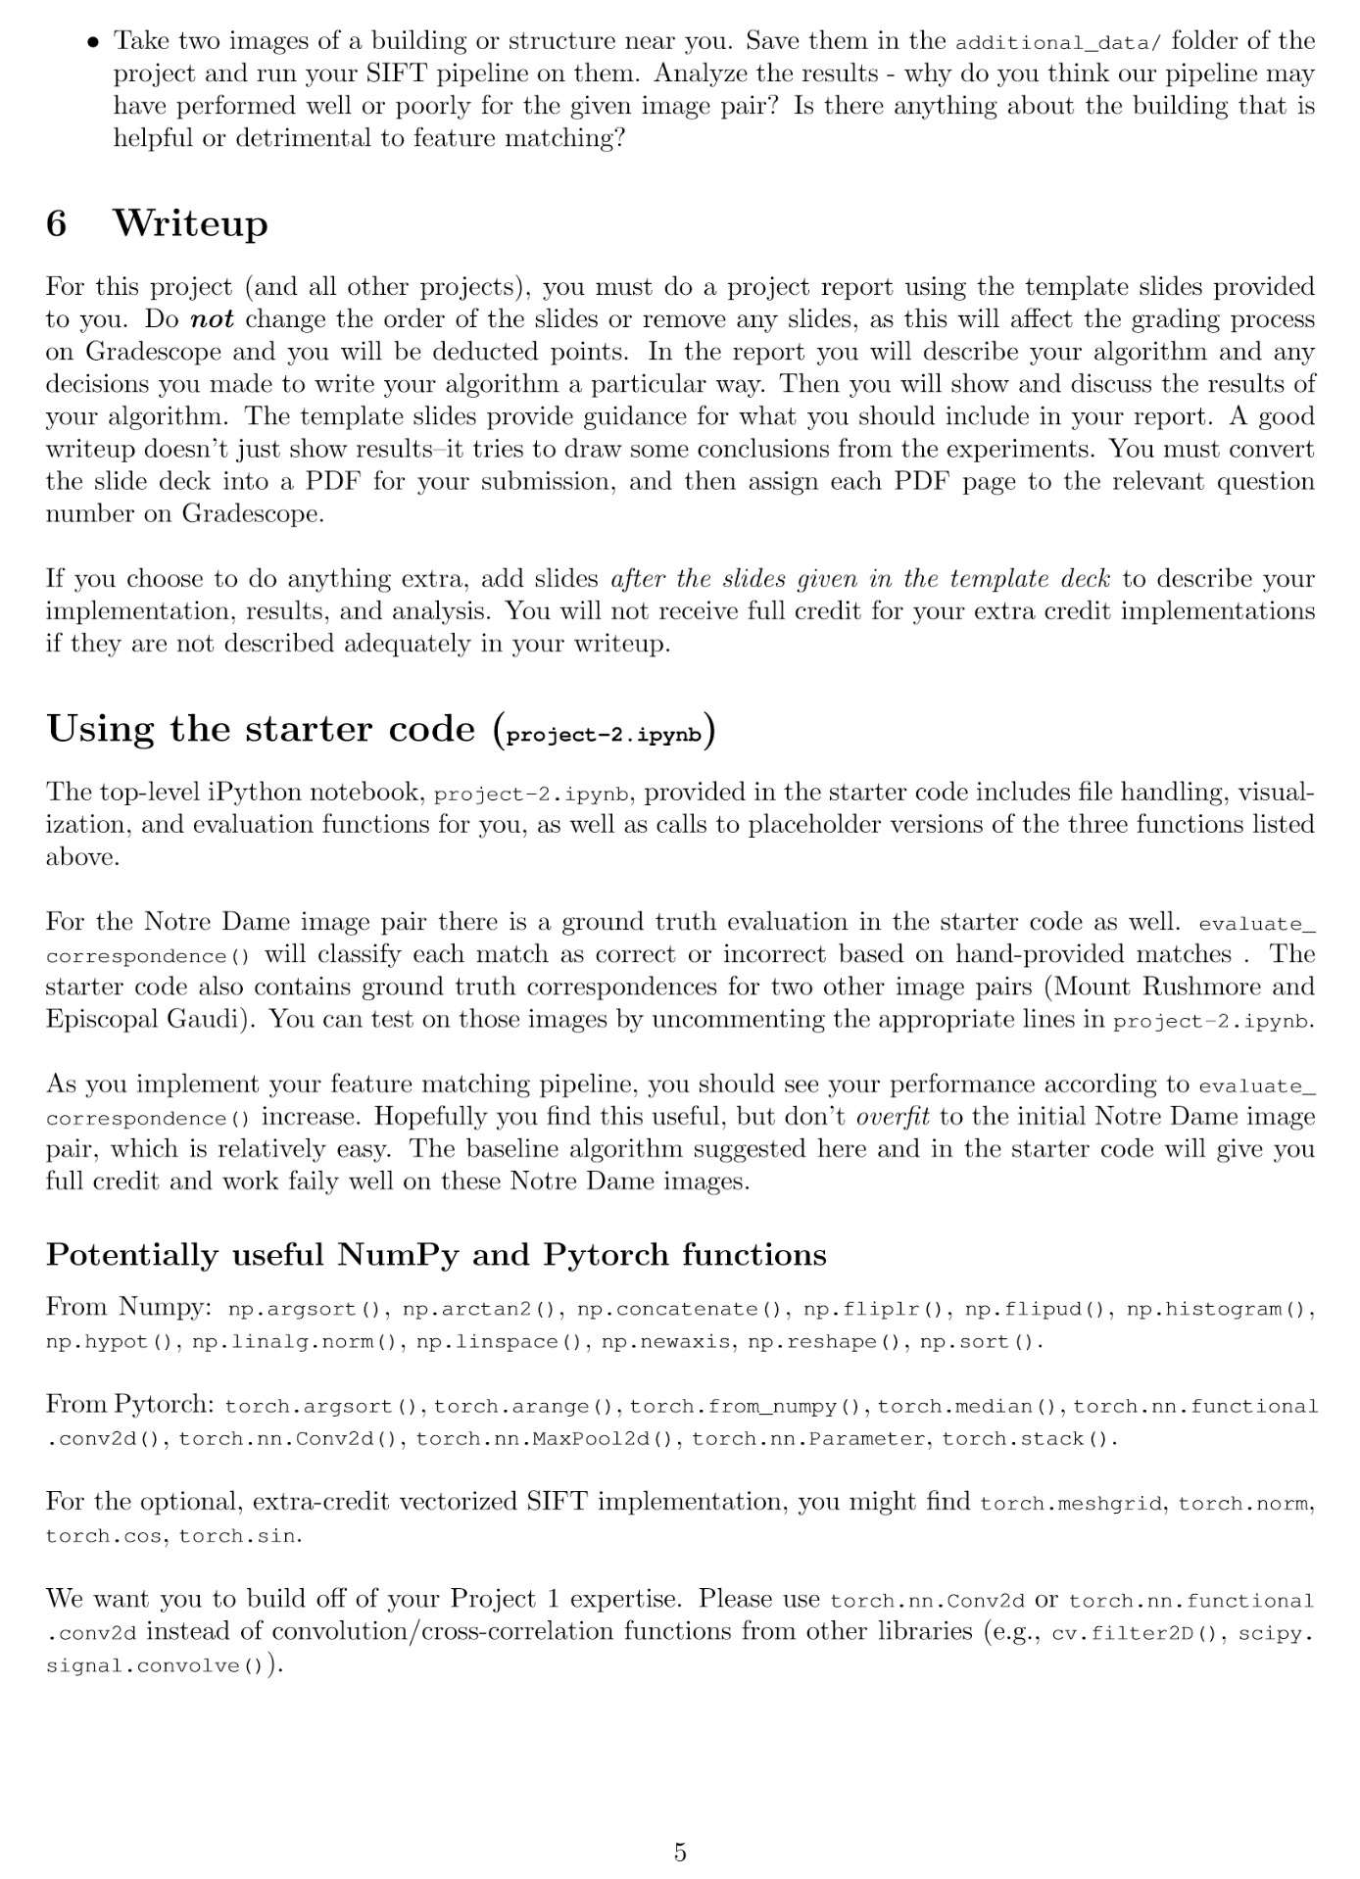
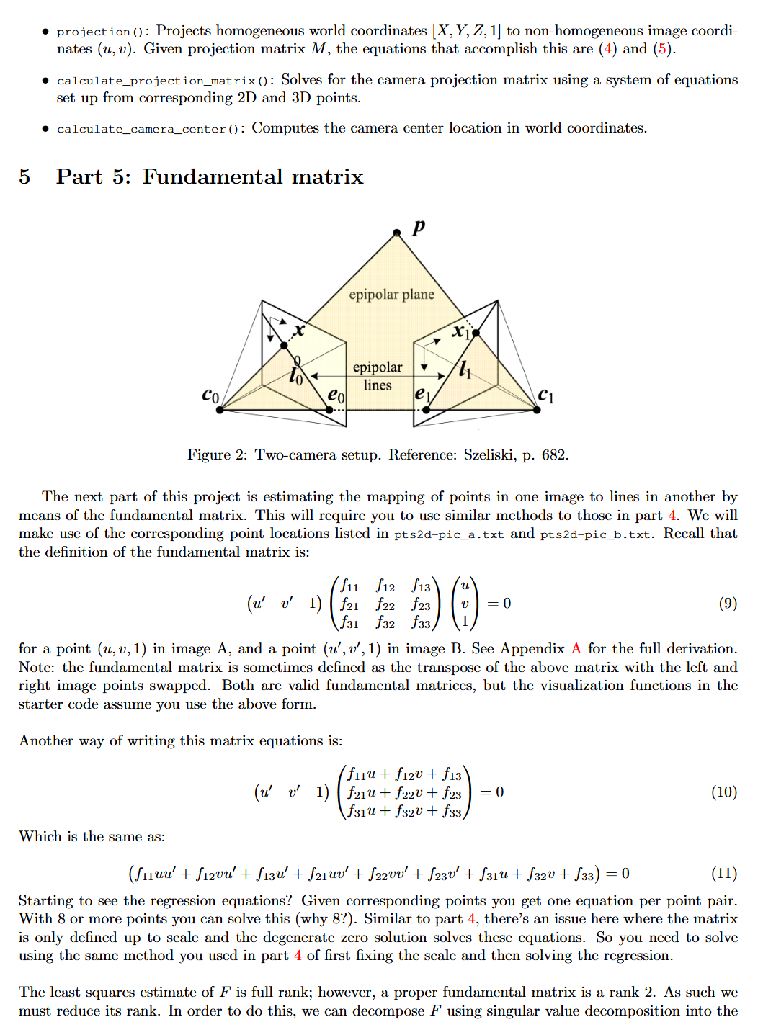
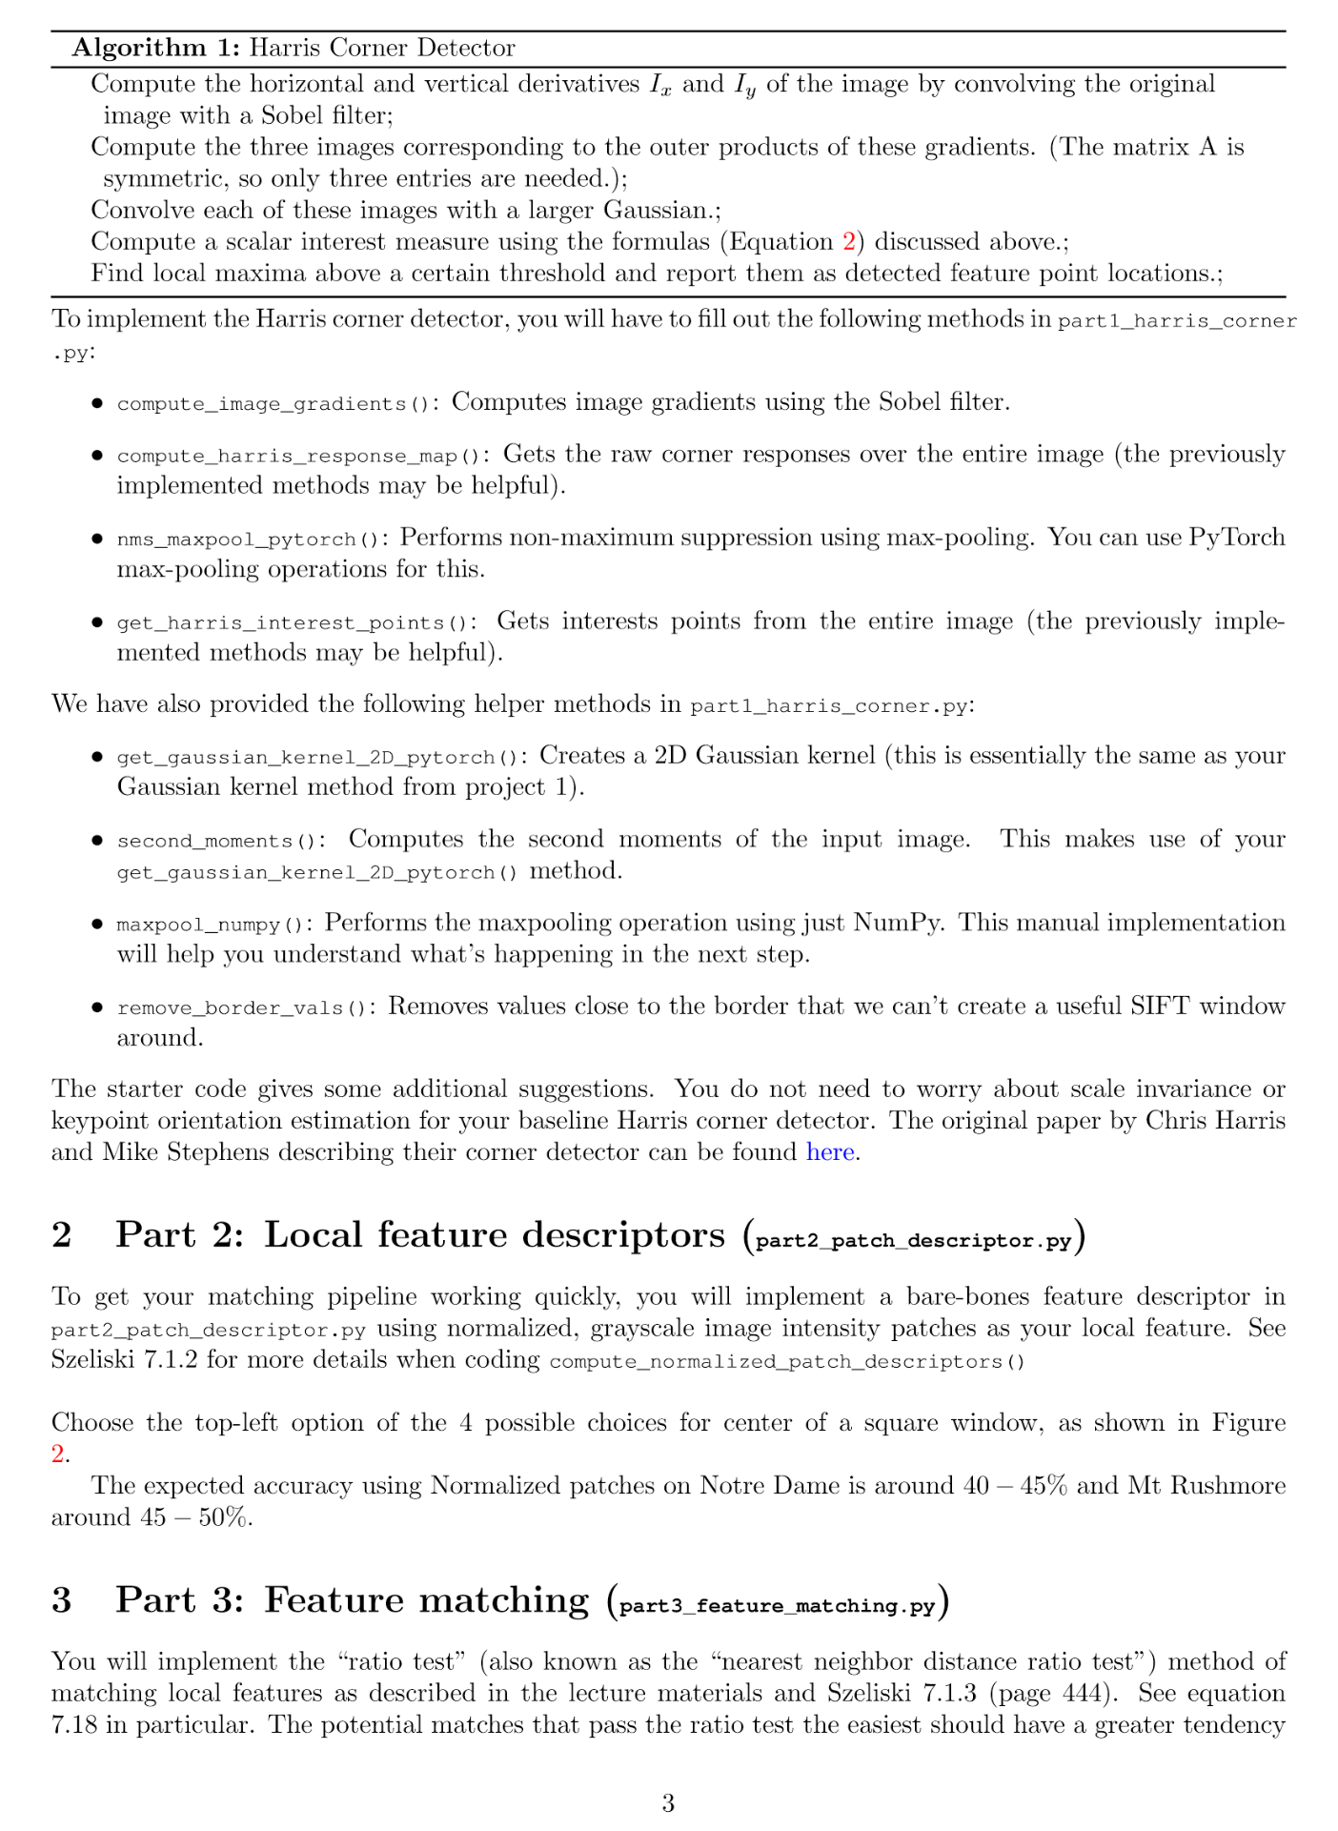
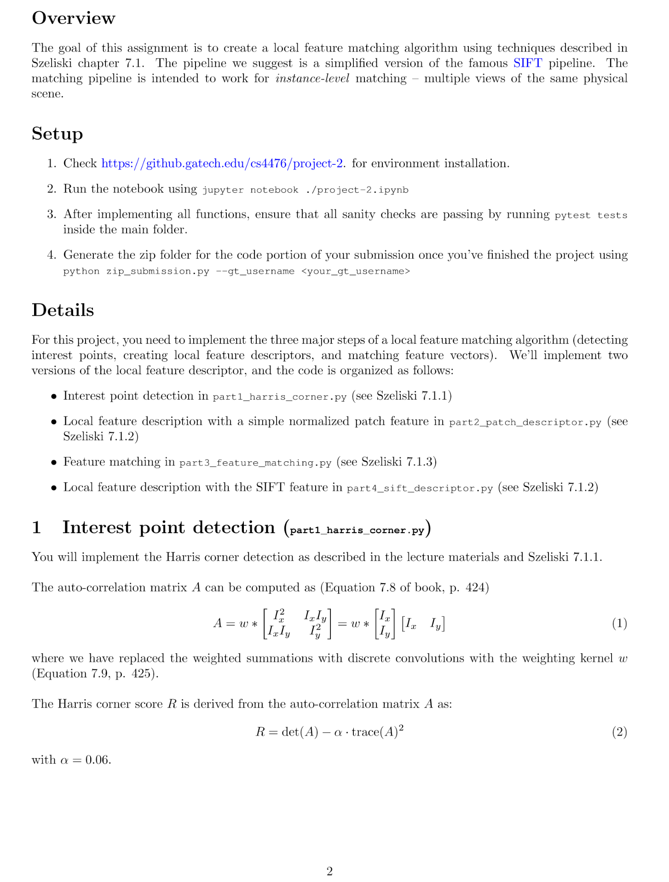
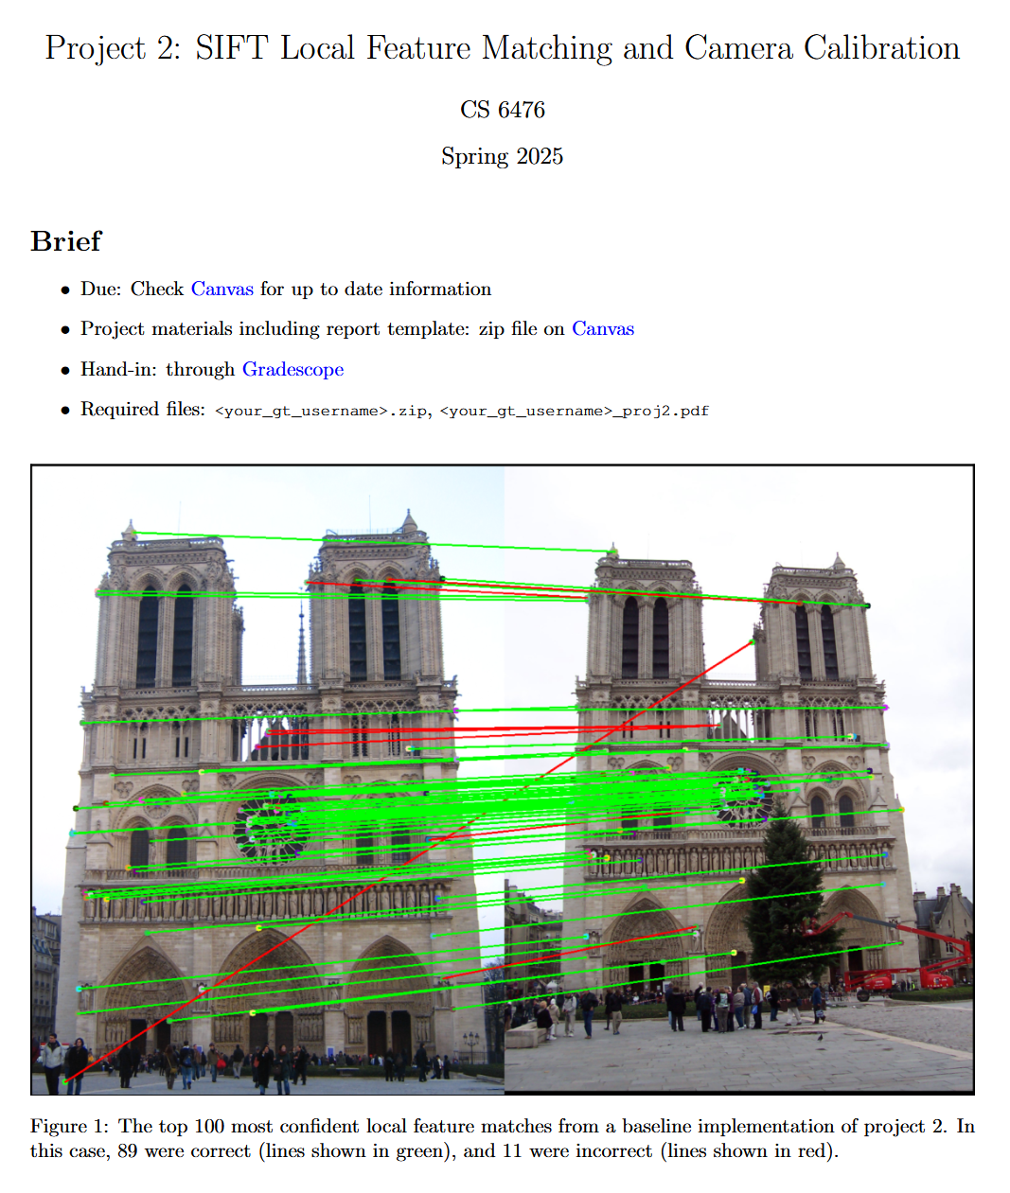
Project 2

Slide 6
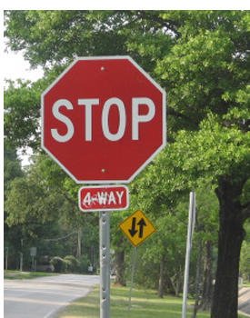
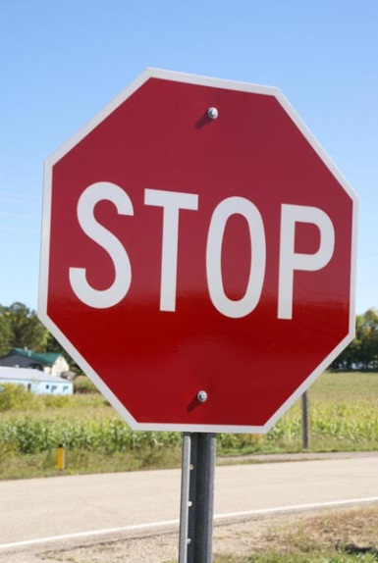
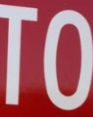
This section: correspondence and alignment
Correspondence: matching points, patches, edges, or regions across images
≈

Slide 7
Review: Local Descriptors
Most features can be thought of as templates, histograms (counts), or combinations
The ideal descriptor should be
  Robust and Distinctive
  Compact and Efficient
Most available descriptors focus on edge/gradient information
  Capture texture information
  Color rarely used

Slide 8
Are there alternatives to SIFT?

Slide 9
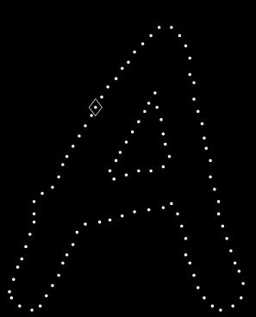
Local Descriptors: Shape Context
Count the number of points inside each bin, e.g.:
Count = 4
...
Count = 10
Log-polar binning: more precision for nearby points, more flexibility for farther points.
Belongie & Malik, ICCV 2001
K. Grauman, B. Leibe

Slide 10
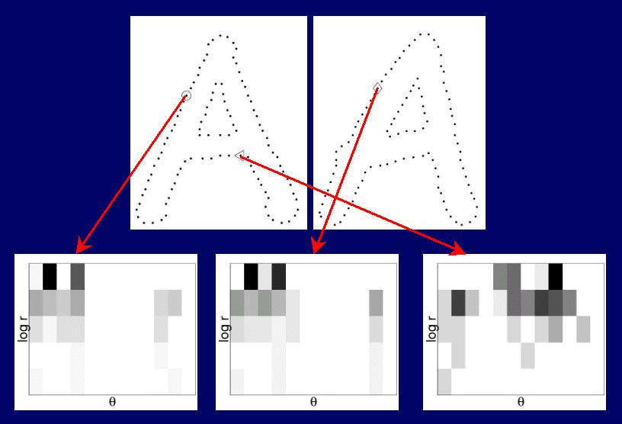
Shape Context Descriptor

Slide 11
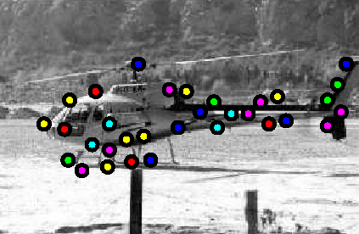
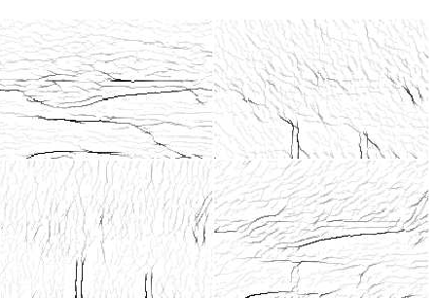
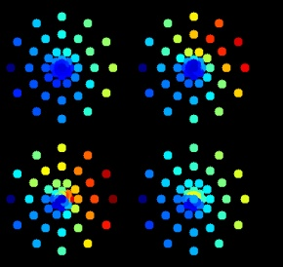
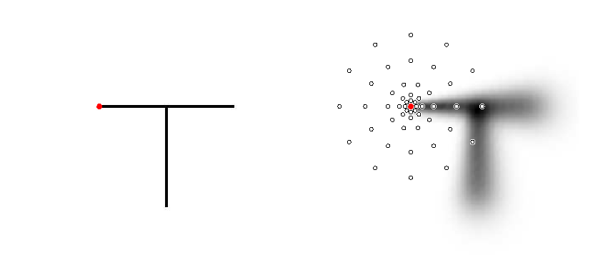
Local Descriptors: Geometric Blur
Compute edges at four orientations
Extract a patch
in each channel
~
Apply spatially varying
blur and sub-sample
Example descriptor
(Idealized signal)
Berg & Malik, CVPR 2001
K. Grauman, B. Leibe

Slide 12
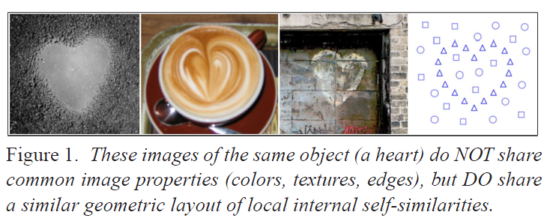
Self-similarity Descriptor
Matching Local Self-Similarities across Images and Videos, Shechtman and Irani, 2007

Slide 13
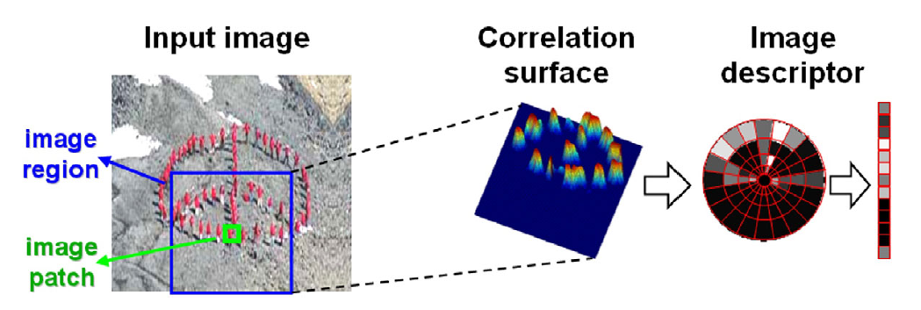
Self-similarity Descriptor
Matching Local Self-Similarities across Images and Videos, Shechtman and Irani, 2007

Slide 14
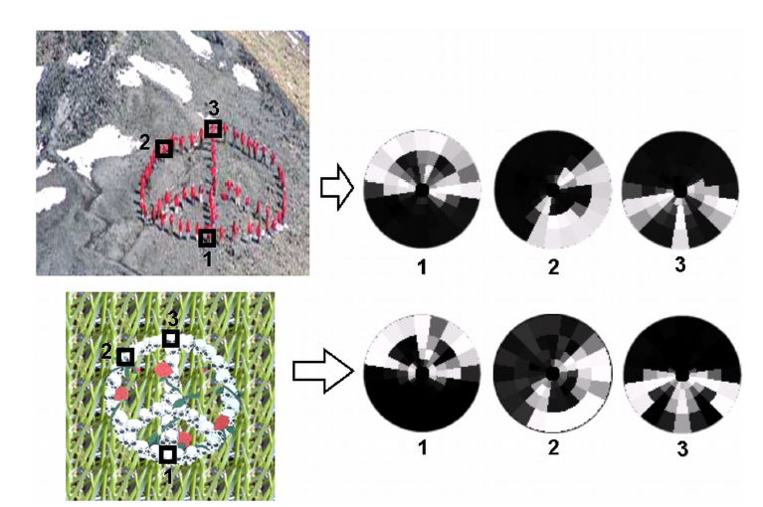
Self-similarity Descriptor
Matching Local Self-Similarities across Images and Videos, Shechtman and Irani, 2007

Slide 15
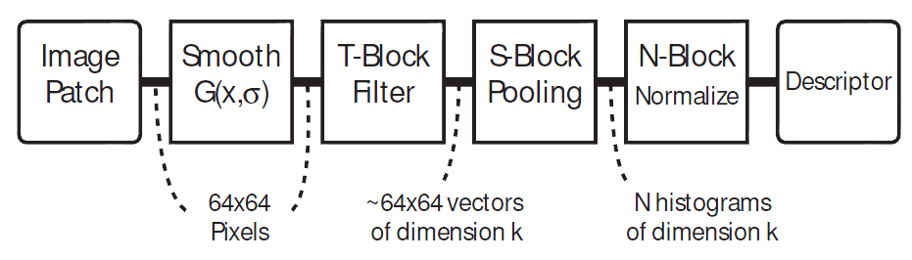
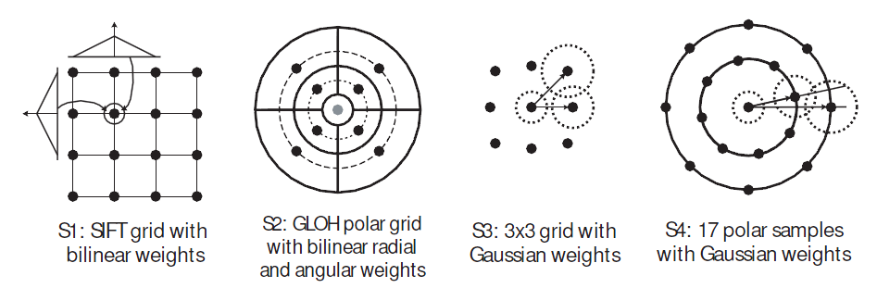
Learning Local Image Descriptors, Winder and Brown, CVPR 2007

Slide 16
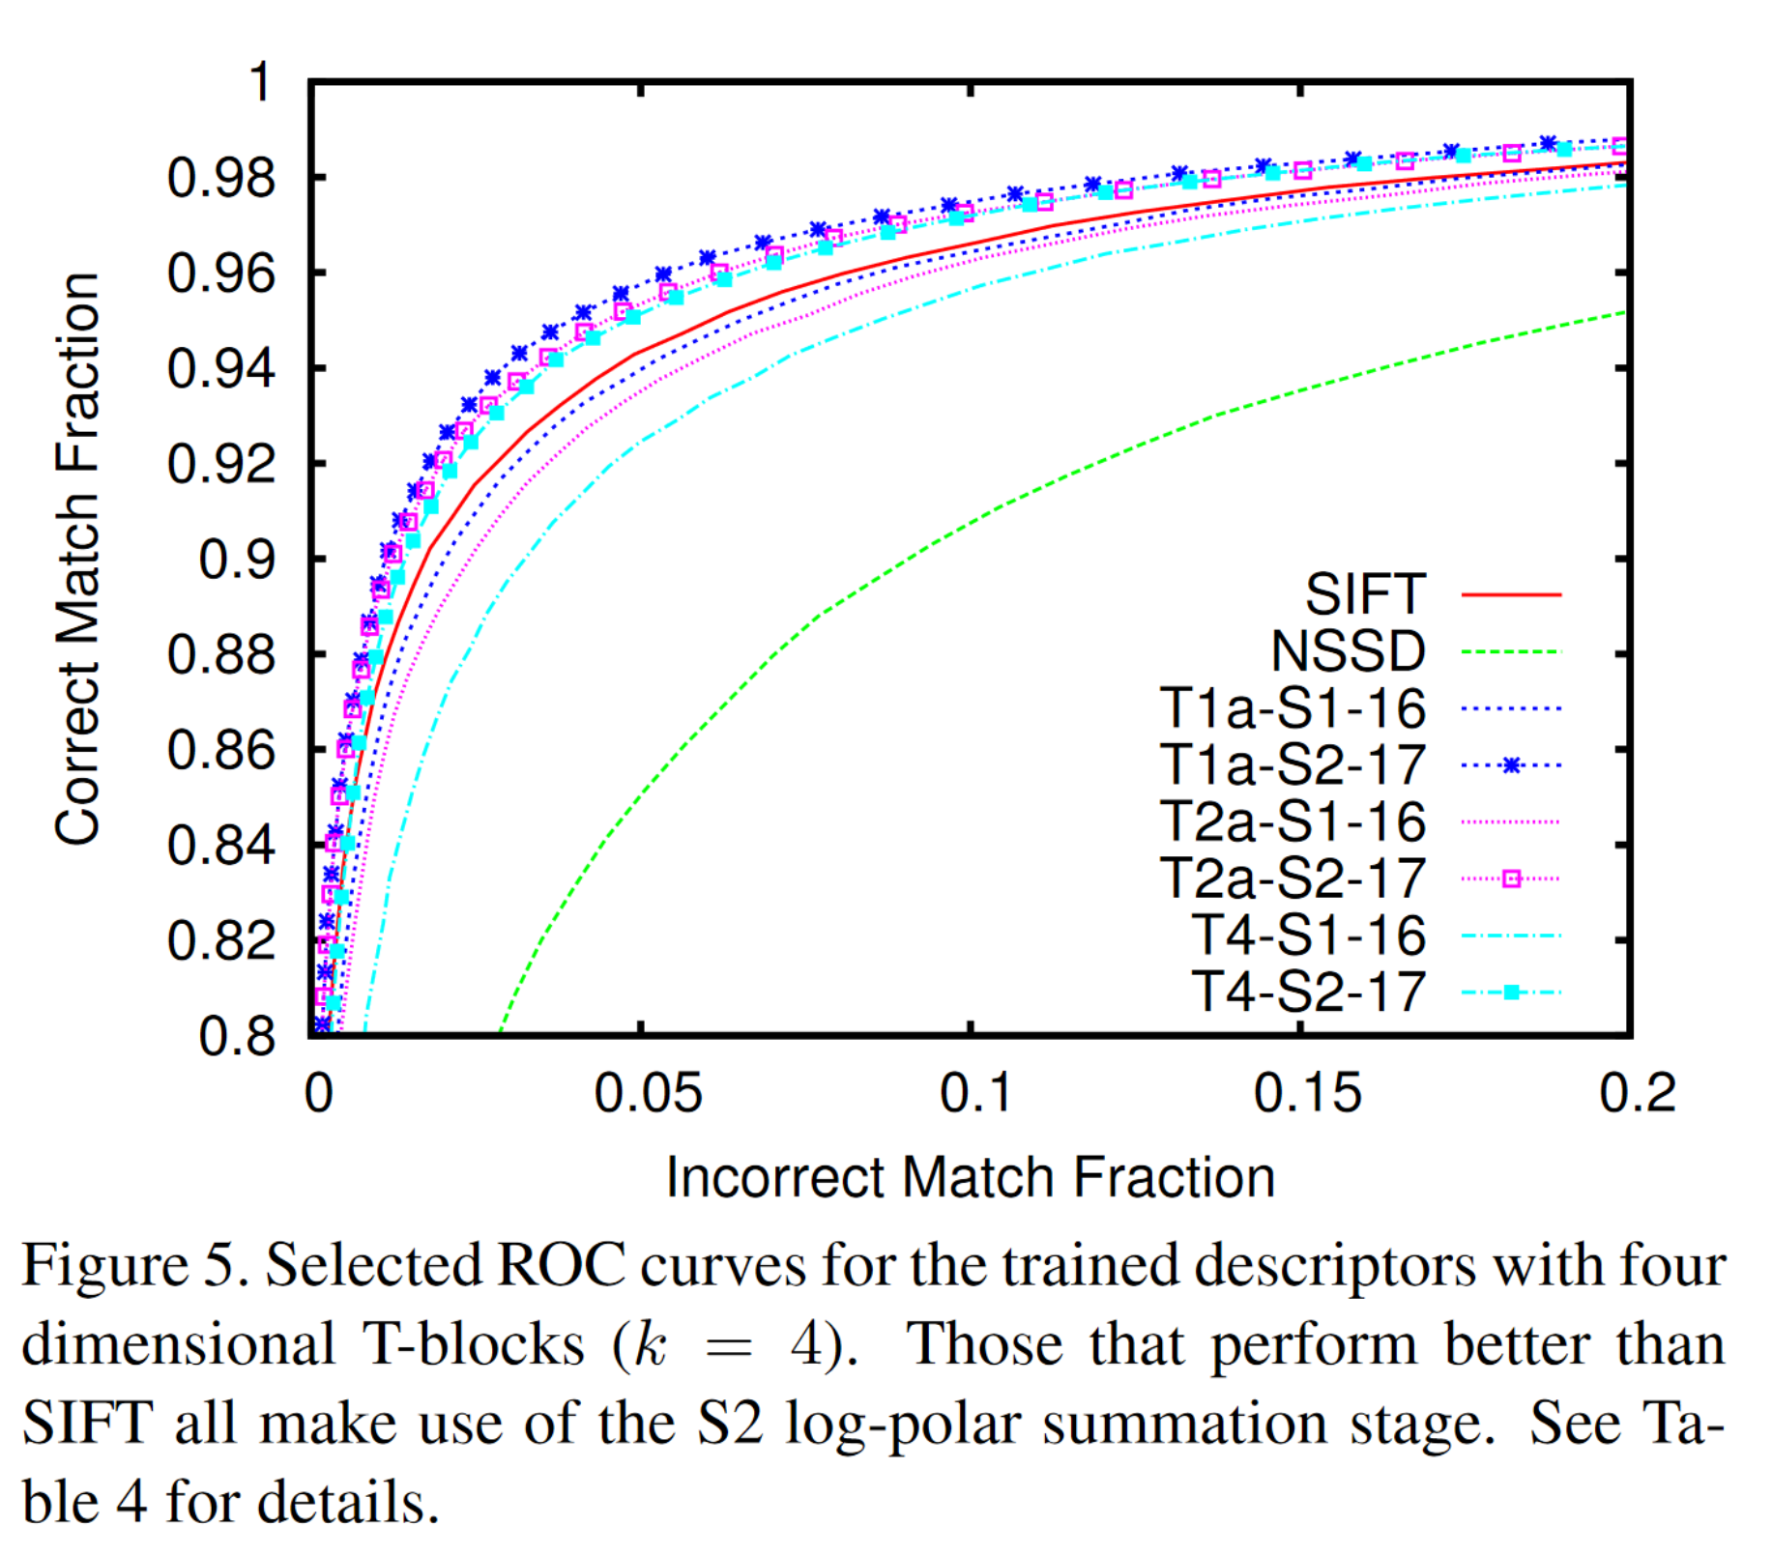
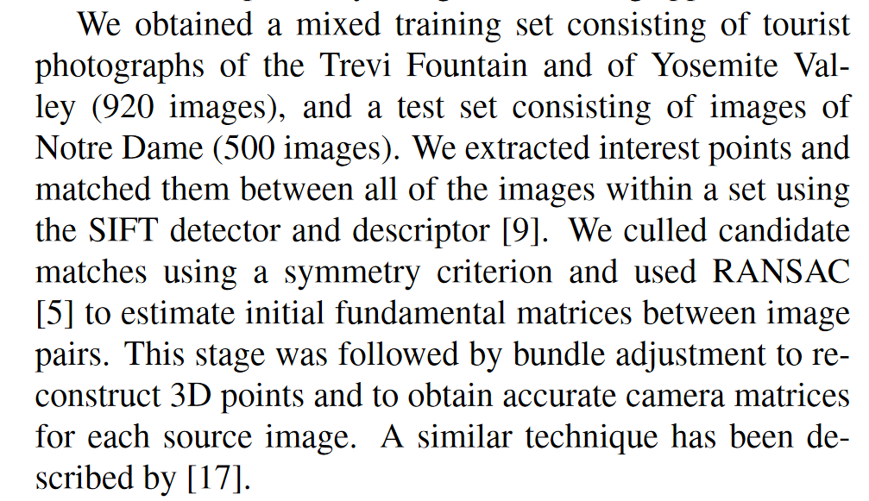
Learning Local Image Descriptors, Winder and Brown, CVPR 2007
Notes:
The paper doesn’t use the ratio test for matching.
The better descriptors use the log polar binning instead of the square grid.

Slide 17
How lossy is this? Can we invert SIFT descriptors?

Slide 18
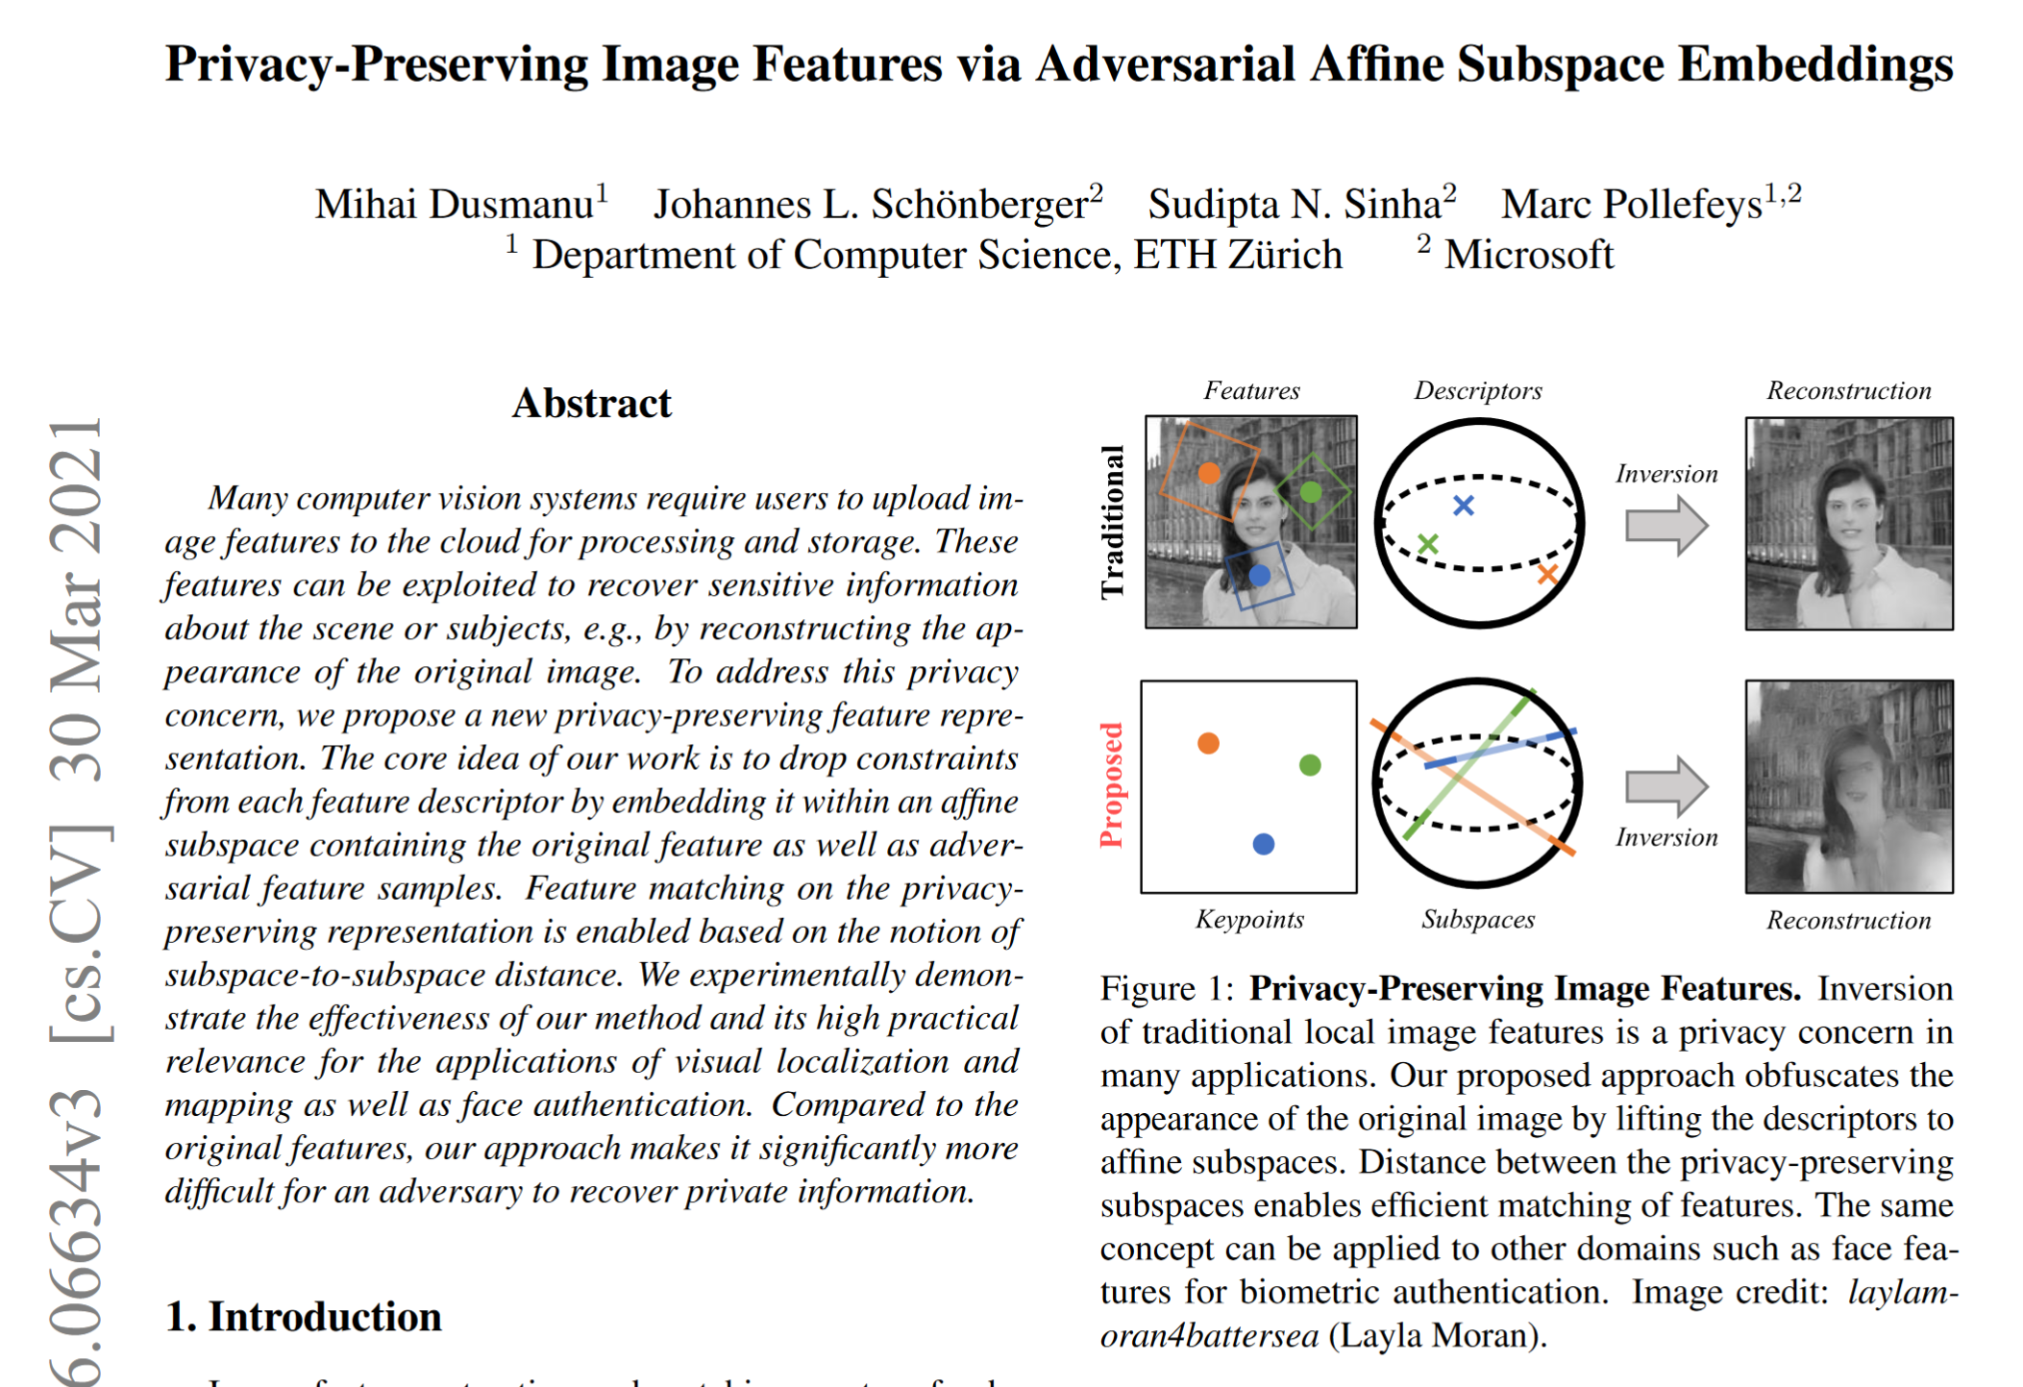
Can we invert SIFT descriptors?

Slide 19
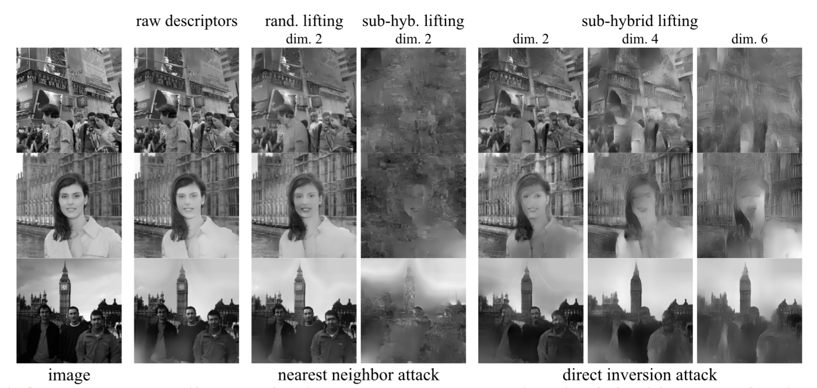
Can we invert SIFT descriptors?

Slide 20
SIFT is 20+ years old. Is it still useful?

Slide 21
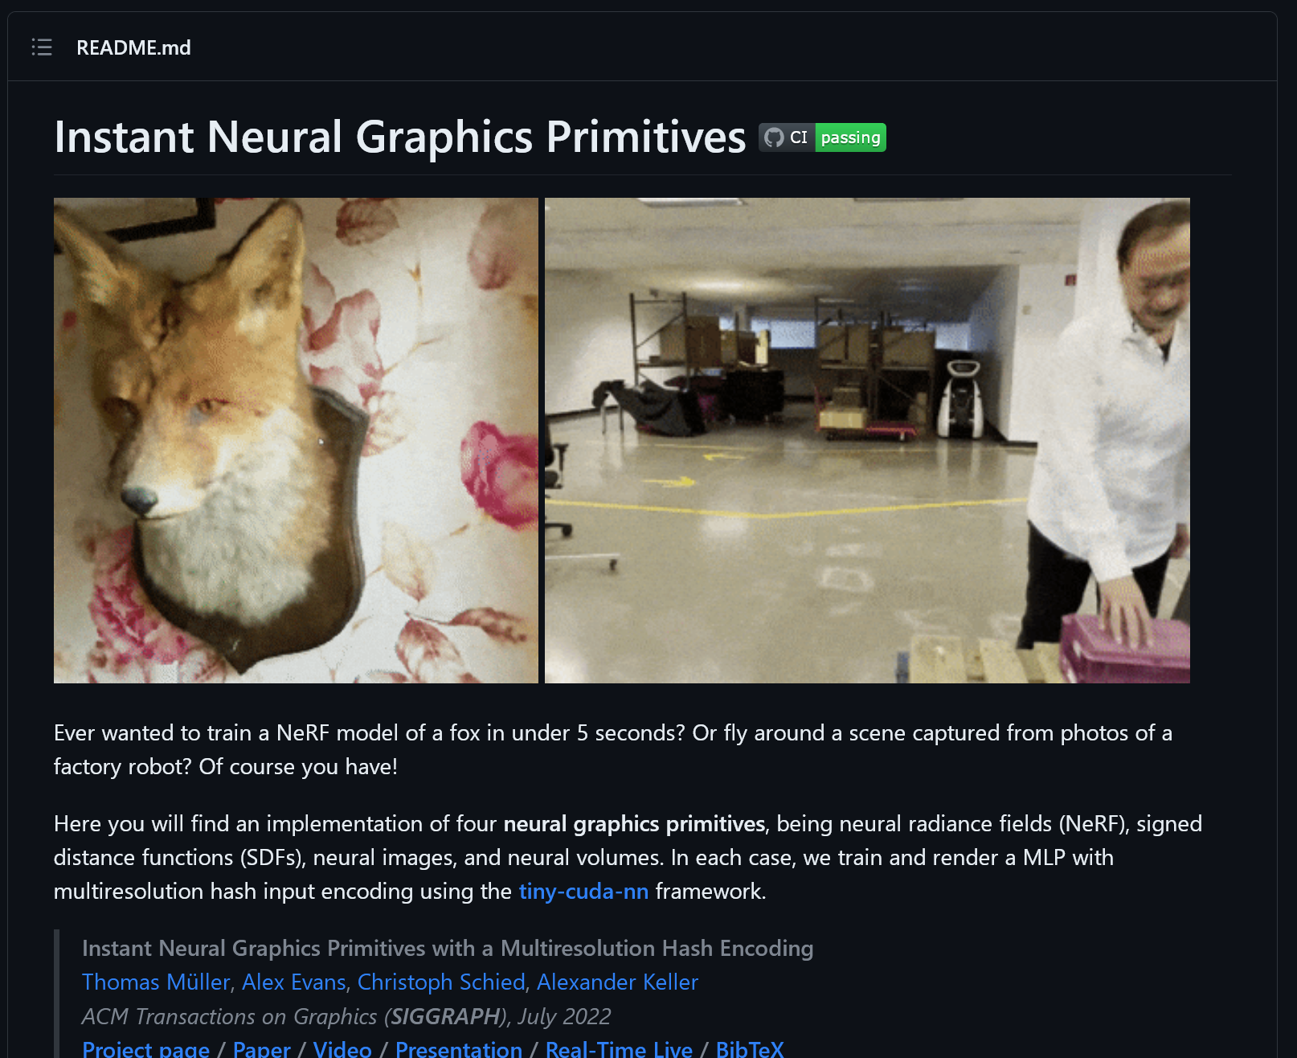
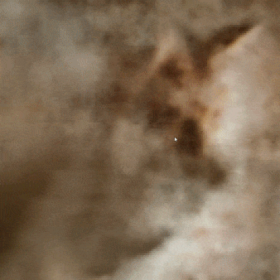
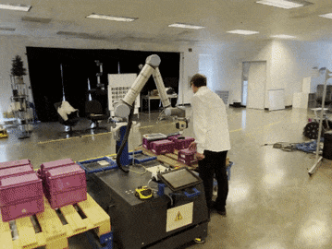
SIFT is 20+ years old. Is it still useful?
Let’s look at some trendy research on Neural Radiance Fields (NeRF)
Notes:
In one year, this work has 5000 citations and 16.9k stars on Github

Slide 22
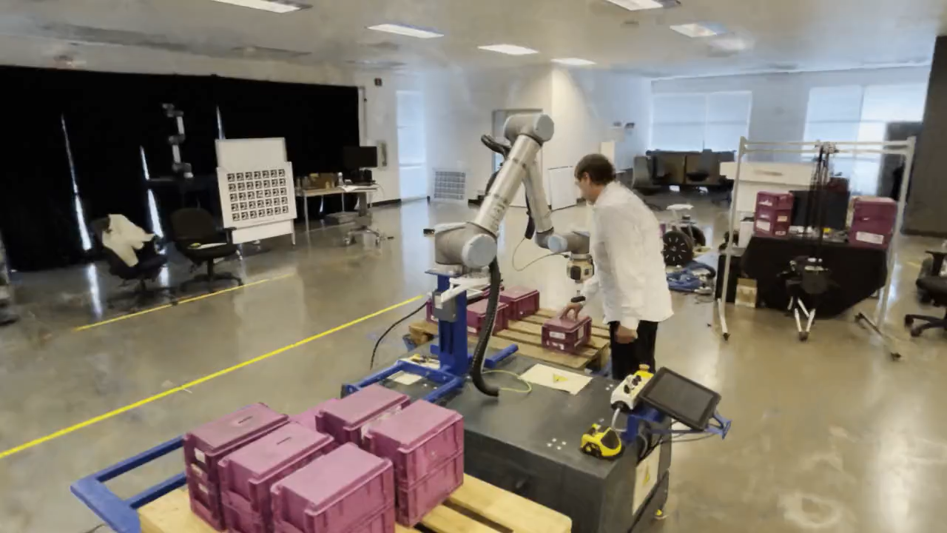
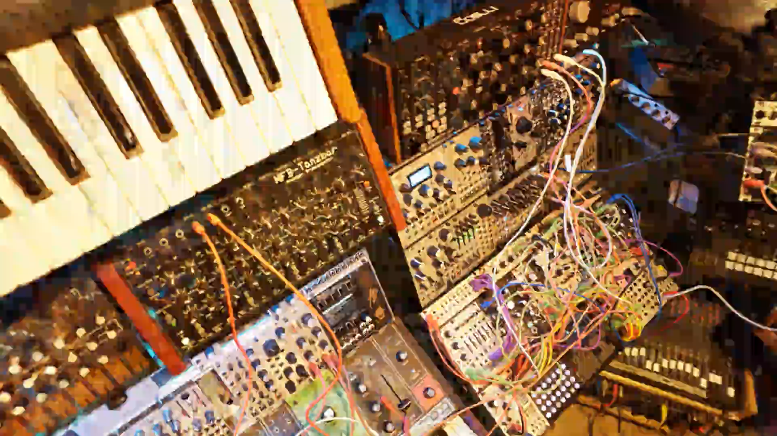
NeRFs optimized with InstantNGP
Fly-throughs of trained real-world NeRFs. Large, natural 360 scenes (left) as well as complex scenes with many disocclusions and specular surfaces (right) are well supported. Both models can be rendered in real time and were trained in under 5 minutes from casually captured data: the left one from an iPhone video and the right one from 34 photographs.

Slide 23
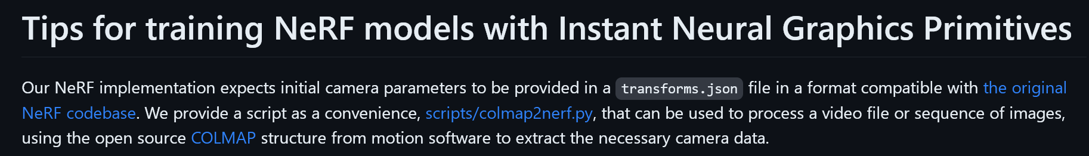
SIFT is 20+ years old. Is it still useful?
Let’s look at some trendy research on Neural Radiance Fields (NeRF)
Let’s look under the hood
Notes:
Colmap

Slide 24
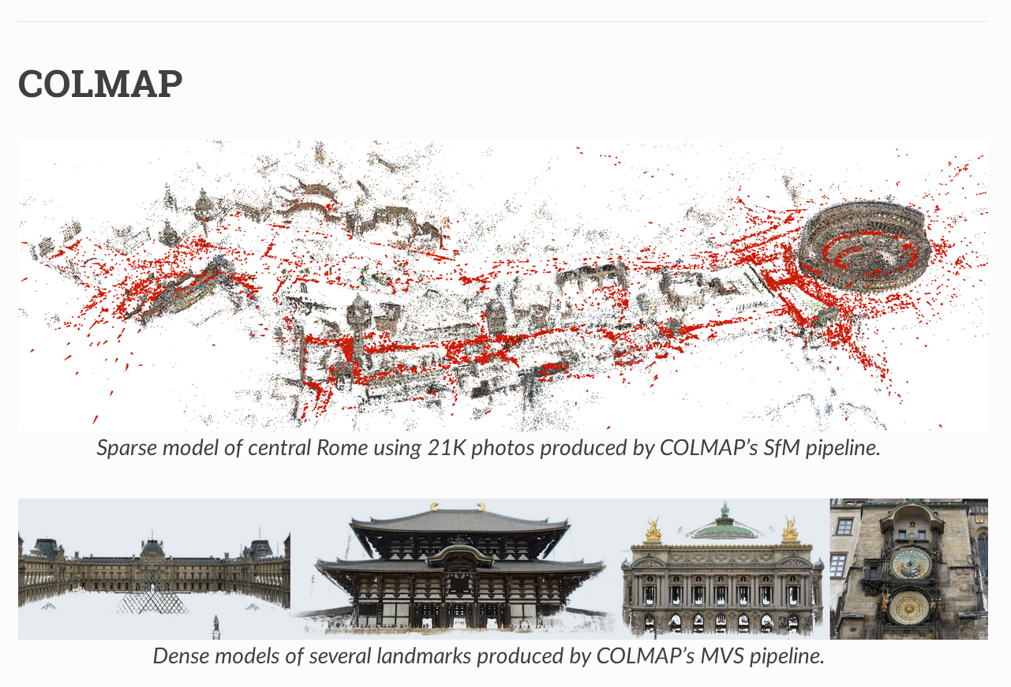
SIFT is 20+ years old. Is it still useful?
COLMAP is the “standard” way to do structure from motion these days
“Structure-From-Motion Revisited”. Johannes L. Schonberger, Jan-Michael Frahm; CVPR 2016
5k+ citations
Notes:
Colmap

Slide 25
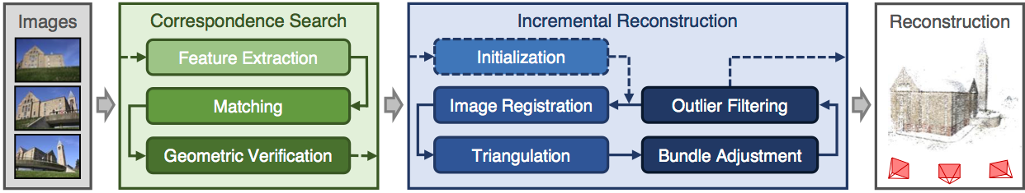
SIFT is 20+ years old. Is it still useful?
COLMAP is the “standard” way to do structure from motion these days
“Structure-From-Motion Revisited”. Johannes L. Schonberger, Jan-Michael Frahm; CVPR 2016
5k+ citations
Notes:
Colmap

Slide 26
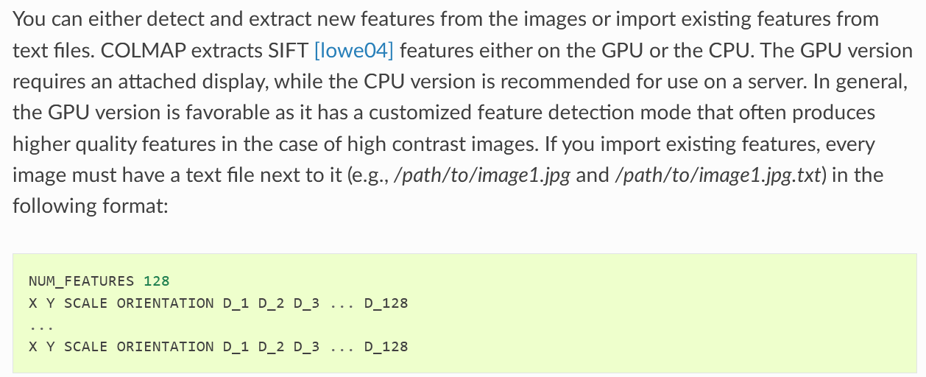
SIFT is 20+ years old. Is it still useful?
COLMAP is the “standard” way to do structure from motion these days
“Structure-From-Motion Revisited”. Johannes L. Schonberger, Jan-Michael Frahm; CVPR 2016
5k+ citations
Notes:
Colmap

Slide 27
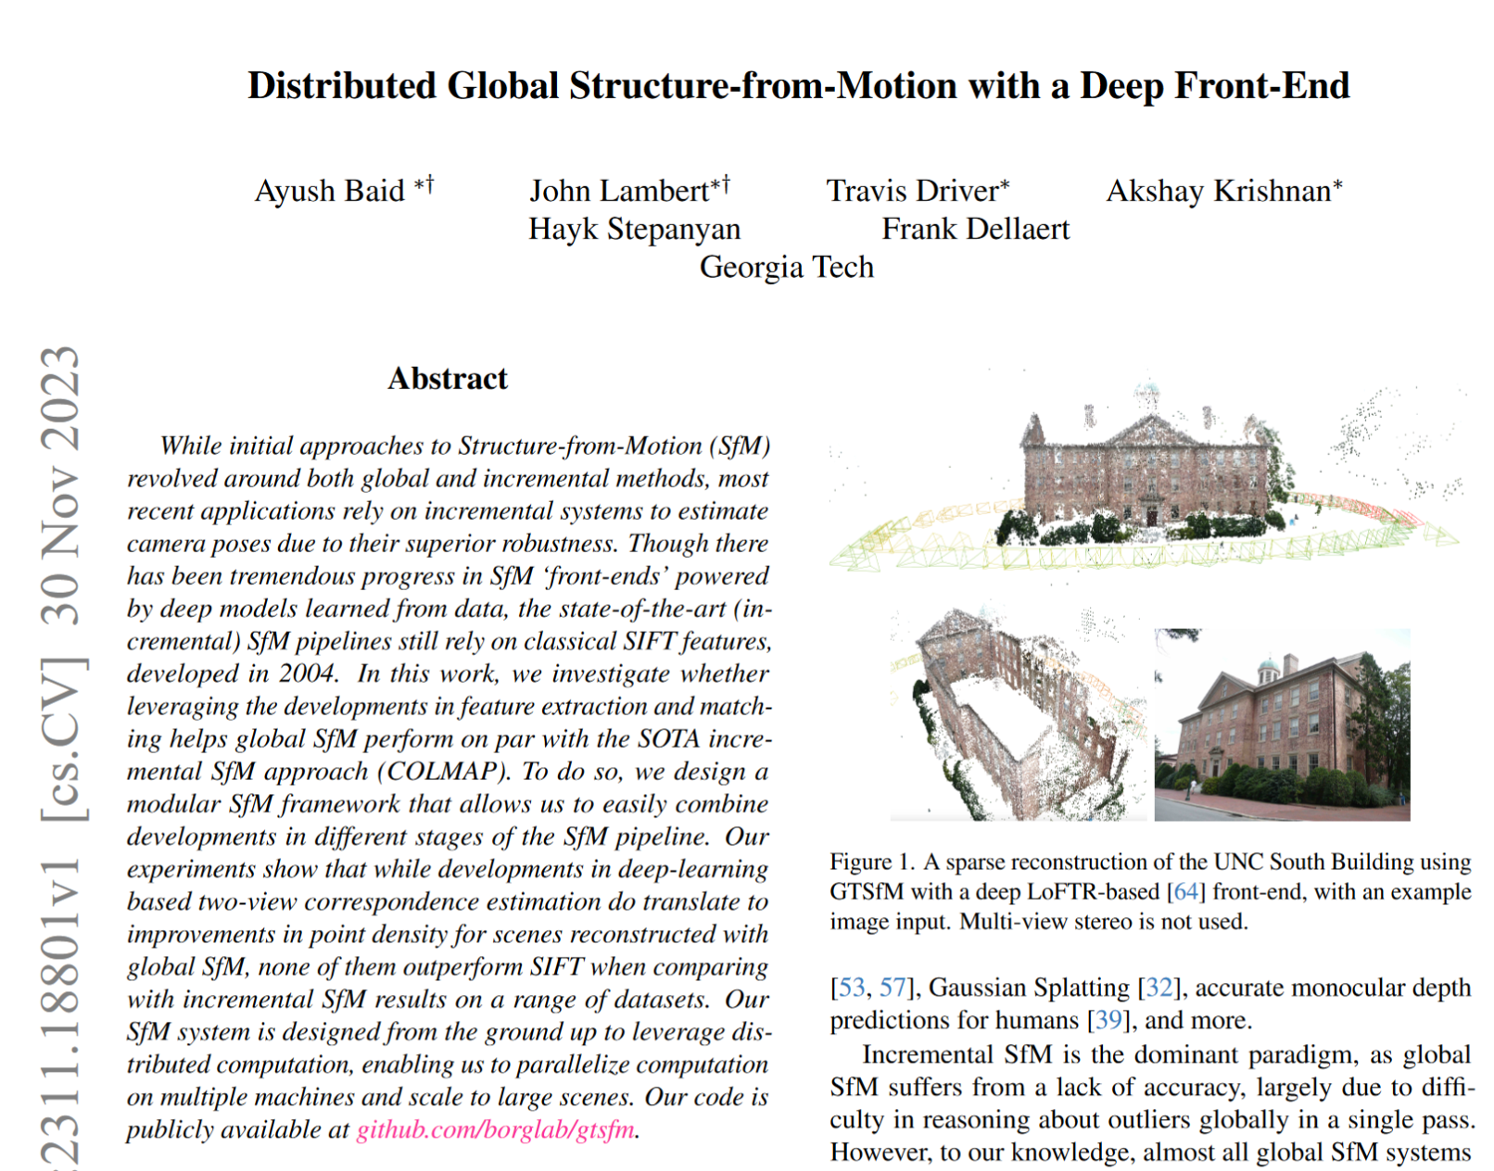

Slide 28
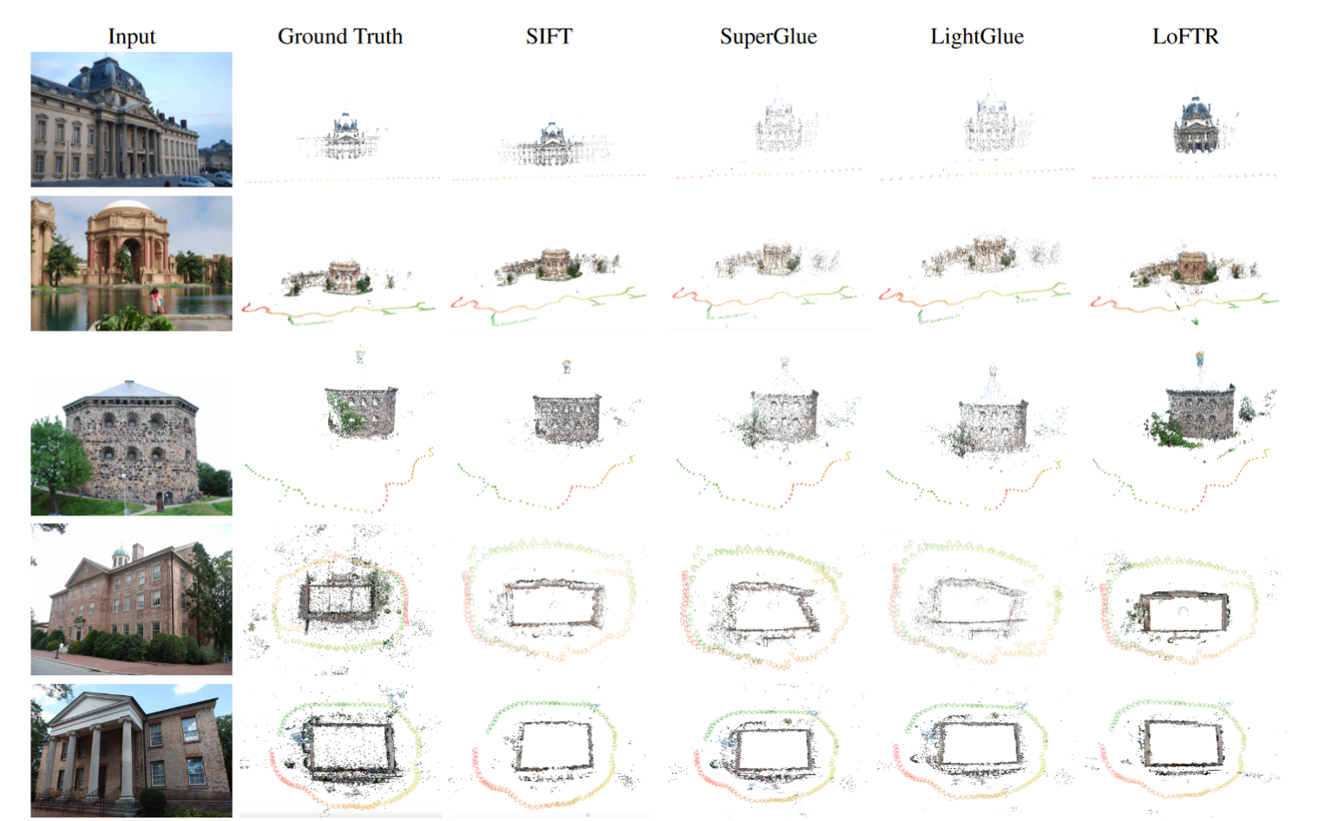
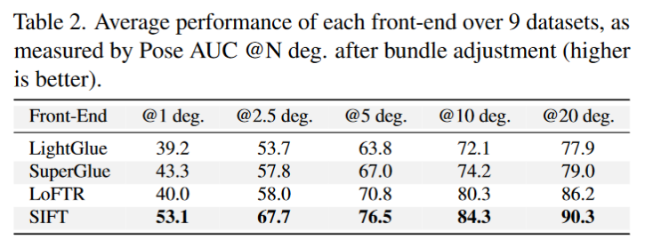

Slide 29
What is “Geometric Verification”?
COLMAP is the standard way to do structure from motion these days
“Structure-From-Motion Revisited”. Johannes L. Schonberger, Jan-Michael Frahm; CVPR 2016
5k+ citations
Notes:
Colmap

Slide 30
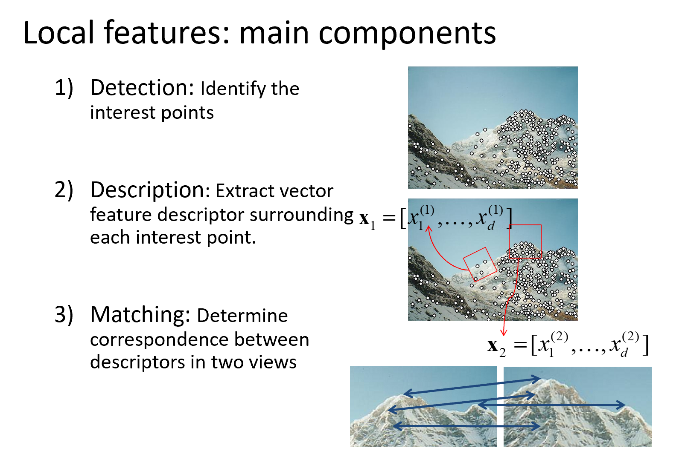
What is “Geometric Verification”?
COLMAP is the standard way to do structure from motion these days
“Structure-From-Motion Revisited”. Johannes L. Schonberger, Jan-Michael Frahm; CVPR 2016
5k+ citations
Notes:
Colmap

Slide 31
Matching
Simplest approach: Pick the nearest neighbor. Threshold on absolute distance
Problem: Lots of self similarity in many photos

Slide 32
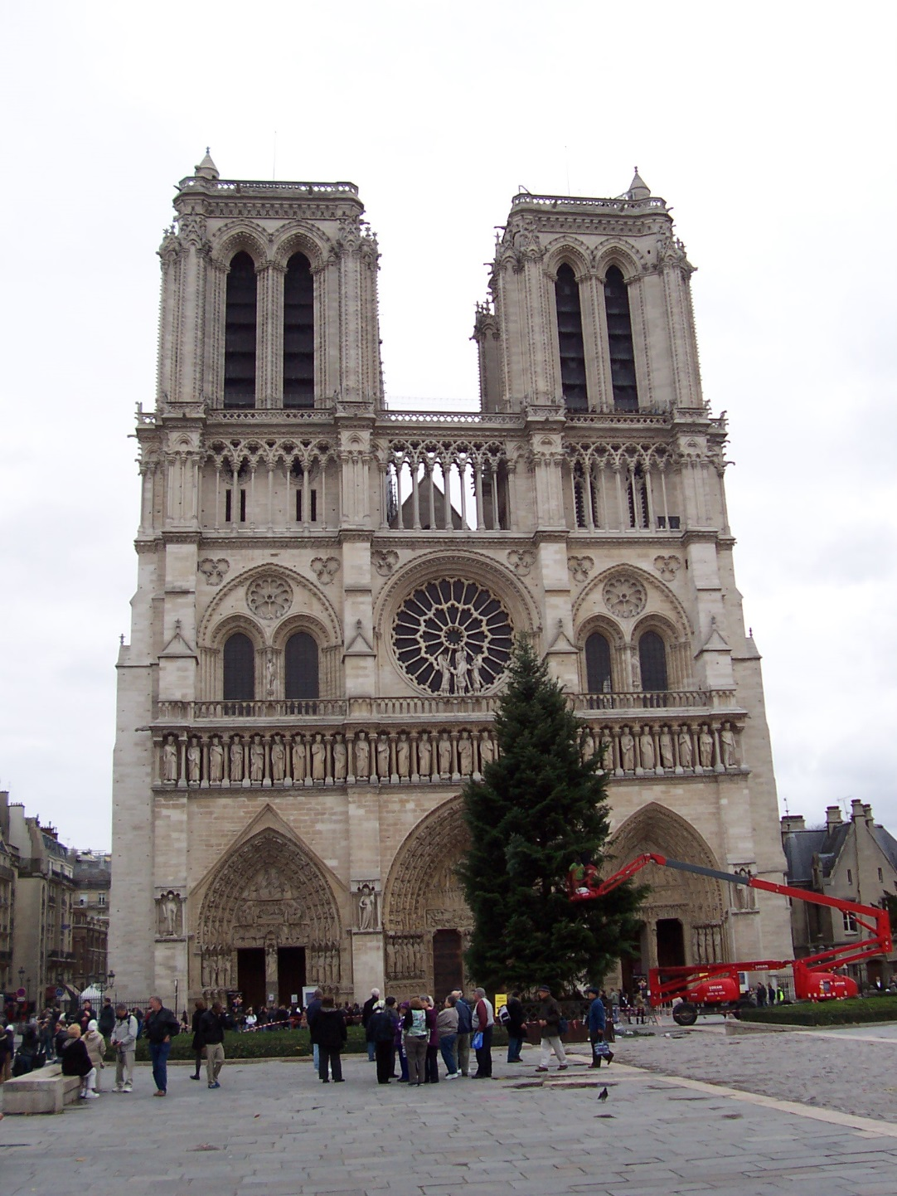
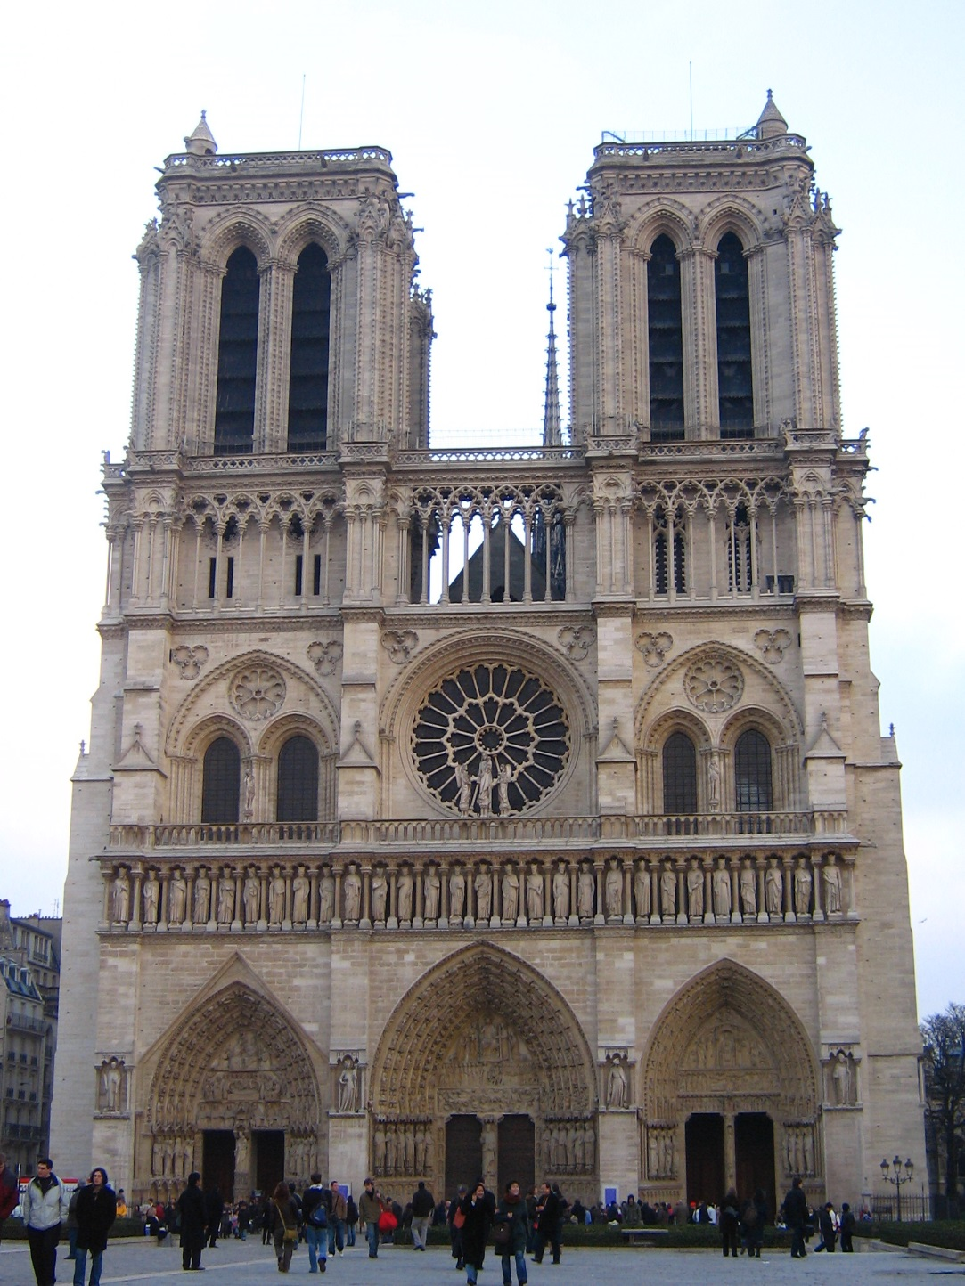
Distance: 0.34, 0.30, 0.40 Distance: 0.61
Distance: 1.22

Slide 33

Nearest Neighbor Distance Ratio
$\frac{NN1}{NN2}$ where NN1 is the distance to the first nearest neighbor and NN2 is the distance to the second nearest neighbor.
Sorting by this ratio (into ascending order) puts matches in order of confidence (in descending order of confidence).

Slide 34
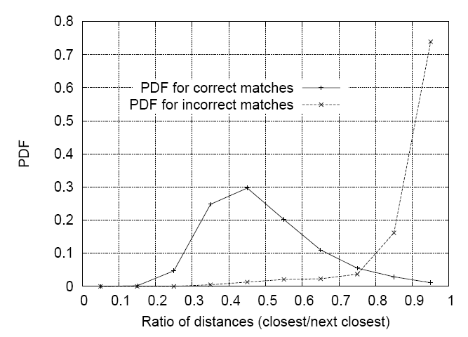
Matching Local Features
Nearest neighbor (Euclidean distance)
Threshold ratio of nearest to 2nd nearest descriptor
Lowe IJCV 2004

Slide 35
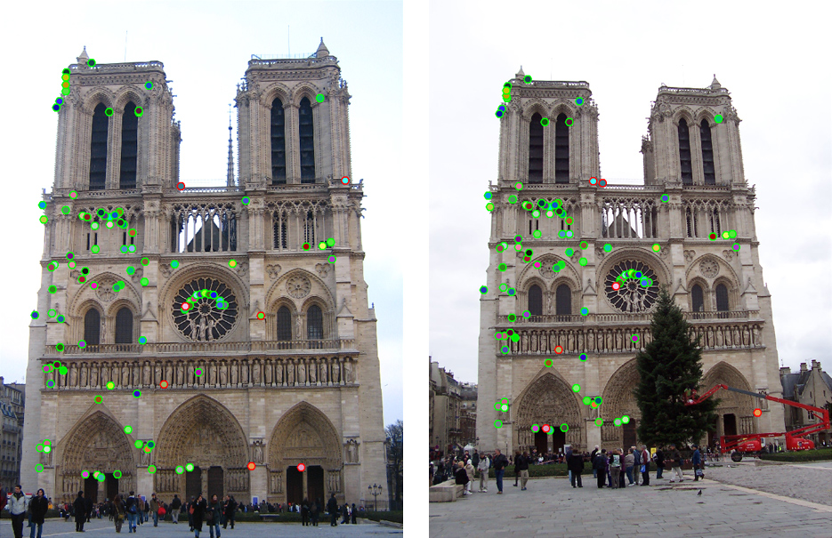
Can we refine this further?

Slide 36
Can we refine this further?

Slide 37
Can we refine this further?

Slide 38
Can we refine this further?

Slide 39
What is the space of allowable correspondences?
Notes:
If the scene is static
If we have a pinhole camera

Slide 40
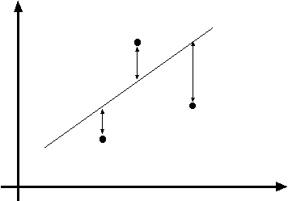
y=mx+b
(x_{i}, y_{i})
Fitting: find the parameters of a model that best fit the data
Alignment: find the parameters of the transformation that best align matched points

Slide 41
Fitting and Alignment
Design challenges
  Design a suitable goodness of fit measure
    Similarity should reflect application goals
    Encode robustness to outliers and noise
  Design an optimization method
    Avoid local optima
    Find best parameters quickly
y=mx+b
(x_{i}, y_{i})

Slide 42
Fitting and Alignment: Methods
Global optimization / Search for parameters
  Least squares fit
  Robust least squares
  Other parameter search methods
Hypothesize and test
  Generalized Hough transform
  RANSAC
Iterative Closest Points (ICP)

Slide 43
Fitting and Alignment: Methods
Global optimization / Search for parameters
  Least squares fit
  Robust least squares
  Other parameter search methods
Hypothesize and test
  Generalized Hough transform
  RANSAC
Iterative Closest Points (ICP)

Slide 44
Simple example: Fitting a line

Slide 45
Least squares line fitting
Data: (x₁, y₁), …, (x_{n}, y_{n})
Line equation: y_{i} = m x_{i} + b
Find (m, b) to minimize
y=mx+b
(x_{i}, y_{i})
Matlab: p = A \ y;
Python: p =
numpy.linalg.lstsq(A, y)
Modified from S. Lazebnik

Slide 46
Problem with “vertical” least squares
Not rotation-invariant
Fails completely for vertical lines
Slide from S. Lazebnik

Slide 47
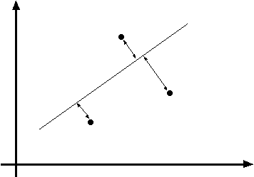
Total least squares
Slide modified from S. Lazebnik
If (a²+b²=1) then
Distance between point (x_{i}, y_{i}) is
|ax_{i} + by_{i} + c|
ax+by+c=0
Unit normal: N=(a, b)
(x_{i}, y_{i})
proof: http://mathworld.wolfram.com/Point-LineDistance2-Dimensional.html

Slide 48
Total least squares
Slide modified from S. Lazebnik
If (a²+b²=1) then
Distance between point (x_{i}, y_{i}) is
|ax_{i} + by_{i} + c|
Find (a, b, c) to minimize the sum of squared perpendicular distances
ax+by+c=0
Unit normal: N=(a, b)
(x_{i}, y_{i})

Slide 49
Total least squares
Slide modified from S. Lazebnik
Find (a, b, c) to minimize the sum of squared perpendicular distances
ax+by+c=0
Unit normal: N=(a, b)
(x_{i}, y_{i})
Solution is eigenvector corresponding to smallest eigenvalue of A^{T}A
See details on Raleigh Quotient: http://en.wikipedia.org/wiki/Rayleigh_quotient

Slide 50
Recap: Two Common Optimization Problems
Problem statement
Solution
(matlab)
Problem statement
Solution

Slide 51
Least squares (global) optimization
Good
Clearly specified objective
Optimization is easy
Bad
May not be what you want to optimize
Sensitive to outliers
  Bad matches, extra points
Doesn’t allow you to get multiple good fits
  Detecting multiple objects, lines, etc.

Slide 52
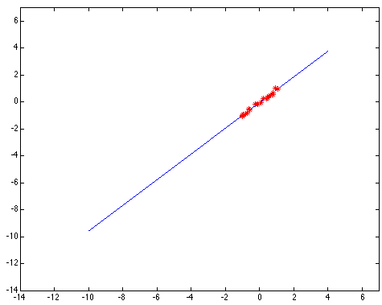
Least squares: Robustness to noise
Least squares fit to the red points:

Slide 53
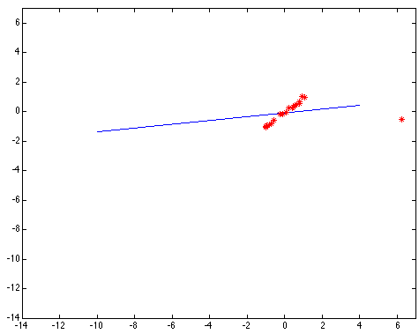
Least squares: Robustness to noise
Least squares fit with an outlier:
Problem: squared error heavily penalizes outliers

Slide 54
Fitting and Alignment: Methods
Global optimization / Search for parameters
  Least squares fit
  Robust least squares
  Other parameter search methods
Hypothesize and test
  Generalized Hough transform
  RANSAC
Iterative Closest Points (ICP)

Slide 55


Robust least squares (to deal with outliers)
General approach:
minimize
u_{i} (x_{i}, θ) – residual of i^{th} point w.r.t. model parameters θ
ρ – robust function with scale parameter σ
The robust function ρ
Favors a configuration
with small residuals
Constant penalty for large residuals
Slide from S. Savarese

Slide 56

Choosing the scale: Just right
The effect of the outlier is minimized
Notes:
Fit to earlier data with an appropriate choice of s

Slide 57

Choosing the scale: Too small
The error value is almost the same for every
point and the fit is very poor

Slide 58

Choosing the scale: Too large
Behaves much the same as least squares

Slide 59
Robust estimation: Details
Robust fitting is a nonlinear optimization problem that must be solved iteratively
Least squares solution can be used for initialization
Scale of robust function should be chosen adaptively based on median residual

Slide 60
Fitting and Alignment: Methods
Global optimization / Search for parameters
  Least squares fit
  Robust least squares
  Other parameter search methods
Hypothesize and test
  Generalized Hough transform
  RANSAC
Iterative Closest Points (ICP)

Slide 61
Other ways to search for parameters
(for when no closed form solution exists)
Line search (see also“coordinate descent”)
  For each parameter, step through values and choose value that gives best fit
  Repeat (1) until no parameter changes
Grid search
  Propose several sets of parameters, evenly sampled in the joint set
  Choose best (or top few) and sample joint parameters around the current best; repeat
Gradient descent
  Provide initial position (e.g., random)
  Locally search for better parameters by following gradient

Slide 62
Fitting and Alignment: Methods
Global optimization / Search for parameters
  Least squares fit
  Robust least squares
  Other parameter search methods
Hypothesize and test
  Generalized Hough transform
  RANSAC
Iterative Closest Points (ICP)

Slide 63
Hypothesize and test
Propose parameters
  Try all possible
  Each point votes for all consistent parameters
  Repeatedly sample enough points to solve for parameters
Score the given parameters
  Number of consistent points, possibly weighted by distance
Choose from among the set of parameters
  Global or local maximum of scores
Possibly refine parameters using inliers

Slide 64
Fitting and Alignment: Methods
Global optimization / Search for parameters
  Least squares fit
  Robust least squares
  Other parameter search methods
Hypothesize and test
  Generalized Hough transform
  RANSAC
Iterative Closest Points (ICP)

Slide 65
Hough Transform: Outline
Create a grid of parameter values
Each point (or observation of correspondence) votes for a set of parameters, incrementing those values in grid
Find maximum or local maxima in grid

Slide 66
Hough transform
P.V.C. Hough, Machine Analysis of Bubble Chamber Pictures, Proc. Int. Conf. High Energy Accelerators and Instrumentation, 1959
Given a set of points, find the curve or line that explains the data points best
y
m
x
b
Hough space
y = m x + b
Slide from S. Savarese
Notes:
􀁑 Basic ideas
• A line is represented as . Every line in the image corresponds
to a point in the parameter space
• Every point in the image domain corresponds to a line in the parameter
space (why ? Fix (x,y), (m,n) can change on the line . In other
words, for all the lines passing through (x,y) in the image space, their
parameters form a line in the parameter space)
• Points along a line in the space correspond to lines passing through the
same point in the parameter space (why ?)

Slide 67
Hough transform
y
m
x
b
y
m
3
5
3
3
2
2
3
7
11
10
4
3
2
3
1
4
5
2
2
1
0
1
3
3
x
b
Slide from S. Savarese
Notes:
􀁑 Basic ideas
• A line is represented as . Every line in the image corresponds
to a point in the parameter space
• Every point in the image domain corresponds to a line in the parameter
space (why ? Fix (x,y), (m,n) can change on the line . In other
words, for all the lines passing through (x,y) in the image space, their
parameters form a line in the parameter space)
• Points along a line in the space correspond to lines passing through the
same point in the parameter space (why ?)

Slide 68
Hough transform
P.V.C. Hough, Machine Analysis of Bubble Chamber Pictures, Proc. Int. Conf. High Energy Accelerators and Instrumentation, 1959
Issue : parameter space [m,b] is unbounded…
Slide from S. Savarese
Notes:
􀁑 Basic ideas
• A line is represented as . Every line in the image corresponds
to a point in the parameter space
• Every point in the image domain corresponds to a line in the parameter
space (why ? Fix (x,y), (m,n) can change on the line . In other
words, for all the lines passing through (x,y) in the image space, their
parameters form a line in the parameter space)
• Points along a line in the space correspond to lines passing through the
same point in the parameter space (why ?)

Slide 69
Hough transform
P.V.C. Hough, Machine Analysis of Bubble Chamber Pictures, Proc. Int. Conf. High Energy Accelerators and Instrumentation, 1959
Issue : parameter space [m,b] is unbounded…
Use a polar representation for the parameter space
y
x
Hough space
Slide from S. Savarese
Notes:
􀁑 Basic ideas
• A line is represented as . Every line in the image corresponds
to a point in the parameter space
• Every point in the image domain corresponds to a line in the parameter
space (why ? Fix (x,y), (m,n) can change on the line . In other
words, for all the lines passing through (x,y) in the image space, their
parameters form a line in the parameter space)
• Points along a line in the space correspond to lines passing through the
same point in the parameter space (why ?)

Slide 70

Hough transform - experiments
features
votes
Slide from S. Savarese
Notes:
Figure 15.1, top half. Note that most points in the vote array are very dark, because they
get only one vote.

Slide 71

Hough transform - experiments
Noisy data
features
votes
Need to adjust grid size or smooth
Slide from S. Savarese
Notes:
This is 15.1 lower half

Slide 72

Hough transform - experiments
features
votes
Issue: spurious peaks due to uniform noise
Slide from S. Savarese
Notes:
15.2; main point is that lots of noise can lead to large peaks in the array

Slide 73


1. Image → Canny Edge Detection

Slide 74

2. Canny → Hough votes

Slide 75

3. Hough votes → Edges
Find peaks and post-process

Slide 76

Hough transform example
http://ostatic.com/files/images/ss_hough.jpg

Slide 77



Incorporating image gradients
Recall: when we detect an
edge point, we also know its
gradient direction
But this means that the line
is uniquely determined!
Modified Hough transform:
For each edge point (x,y)
θ = gradient orientation at (x,y)
ρ = x cos θ + y sin θ
H(θ, ρ) = H(θ, ρ) + 1
end

Slide 78
Finding lines using Hough transform
Using m,b parameterization
Using r, theta parameterization
  Using oriented gradients
Practical considerations
  Bin size
  Smoothing
  Finding multiple lines
  Finding line segments

Slide 79
Hough Transform
How would we find circles?
  Of fixed radius
  Of unknown radius
  Of unknown radius but with known edge orientation

Slide 80

Hough transform for circles
Grid search equivalent procedure: for each (x,y,r), draw the corresponding circle in the image and compute its “support”
r
x
y

Slide 81
Hough Transform
How would we find circles?
  Of fixed radius
  Of unknown radius
  Of unknown radius but with known edge orientation

Slide 82
Hough transform for circles
image space
Hough parameter space
r
y
(x,y)
x
x
y

Slide 83
Hough transform conclusions
Good
Robust to outliers: each point votes separately
Fairly efficient (often faster than trying all sets of parameters)
Provides multiple good fits
Bad
Some sensitivity to noise
Bin size trades off between noise tolerance, precision, and speed/memory
  Can be hard to find sweet spot
Not suitable for more than a few parameters
  grid size grows exponentially
Common applications
Line fitting (also circles, ellipses, etc.)
Object instance recognition (parameters are affine transform)
Object category recognition (parameters are position/scale)

Slide 84
Fitting and Alignment: Methods
Global optimization / Search for parameters
  Least squares fit
  Robust least squares
  Other parameter search methods
Hypothesize and test
  Generalized Hough transform
  RANSAC
Iterative Closest Points (ICP)

