Slide 1
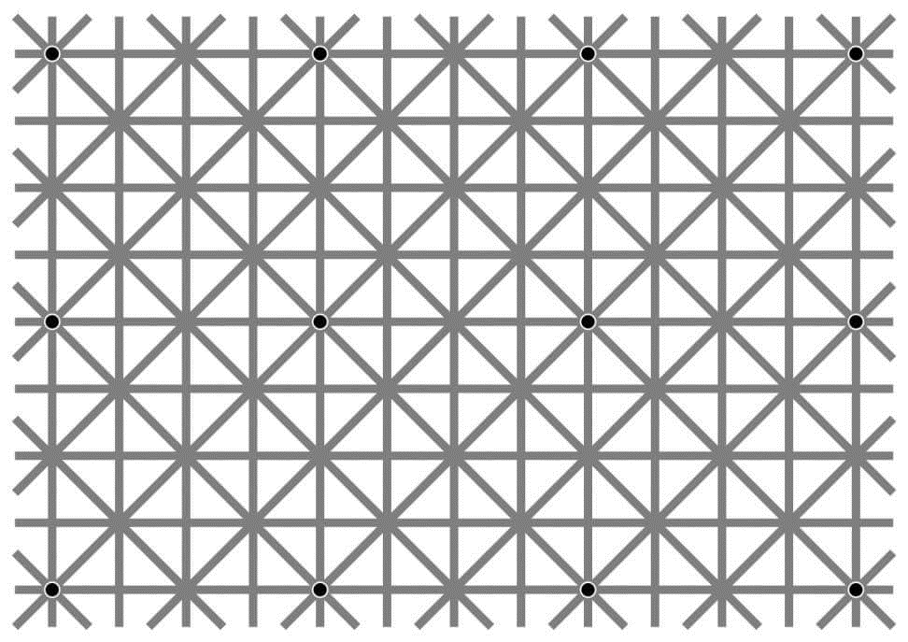
Ninio, J. and Stevens, K. A. (2000) Variations on the Hermann grid: an extinction illusion. Perception, 29, 1209-1217.

Slide 2
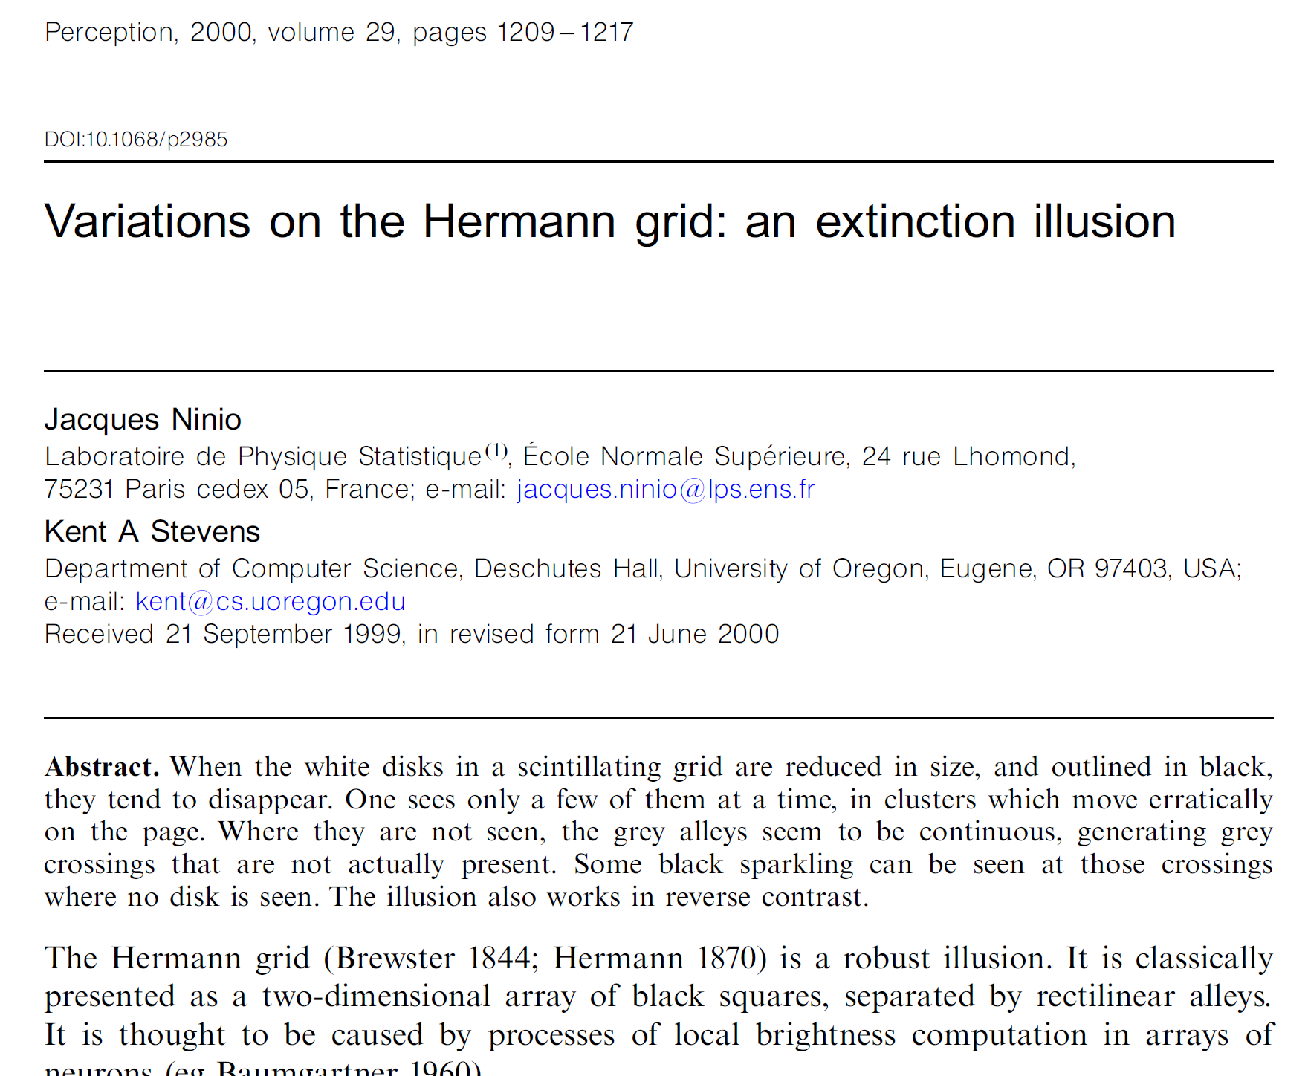

Slide 3
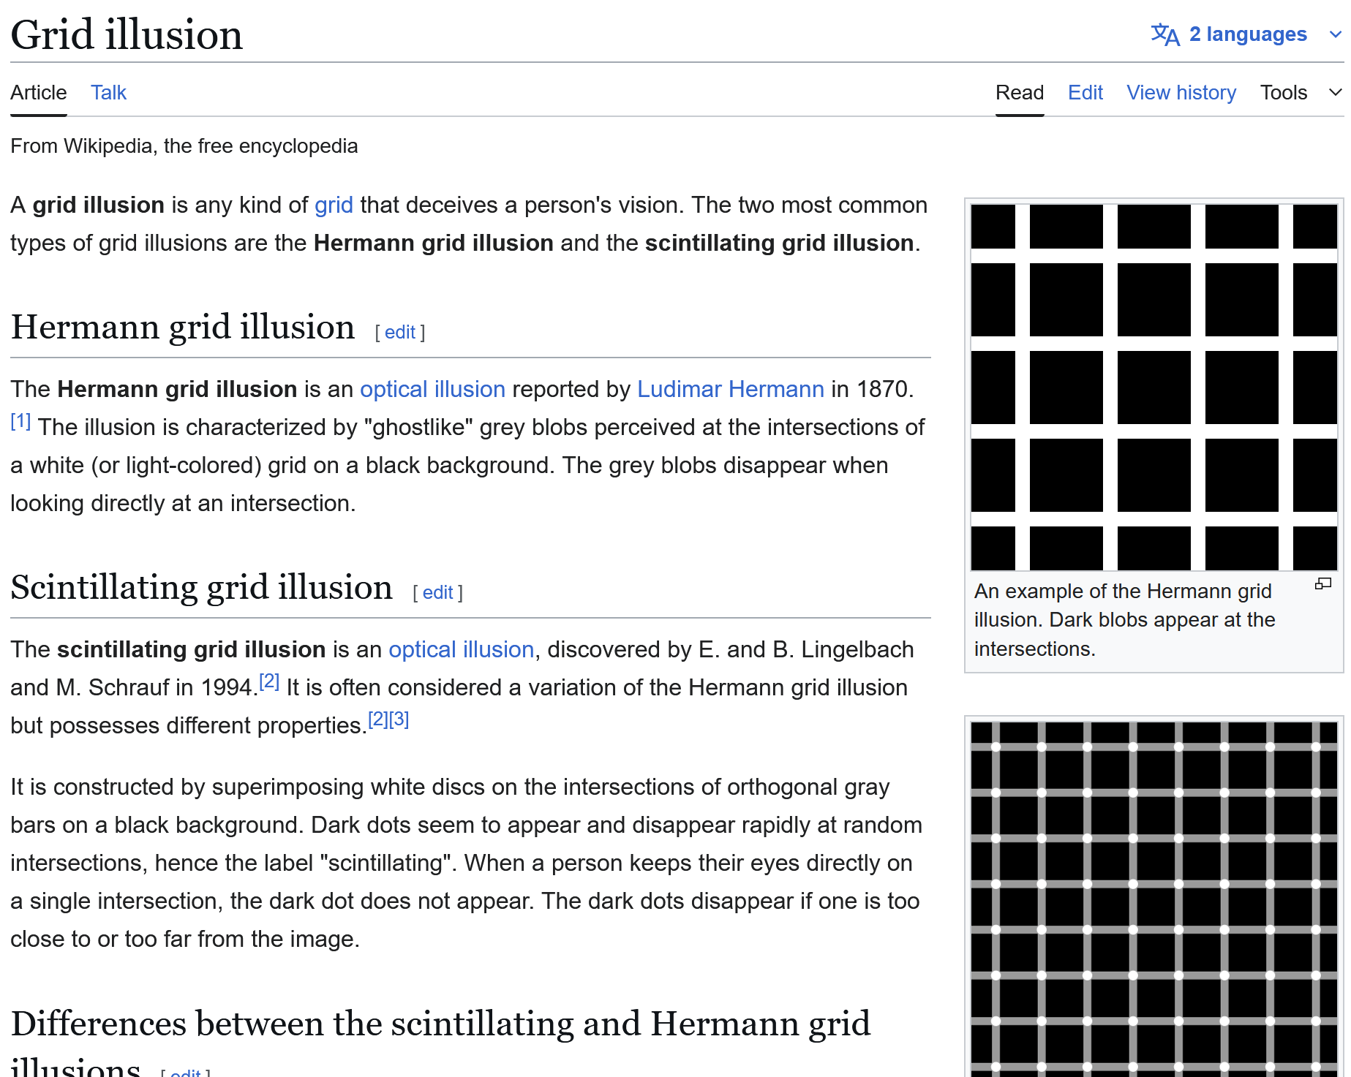
https://en.wikipedia.org/wiki/Grid_illusion

Slide 4
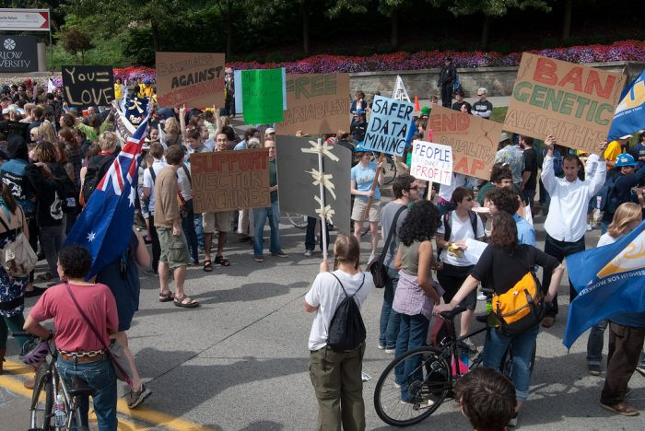
Machine Learning Crash Course
Computer Vision
James Hays
Slides: Isabelle Guyon,
Erik Sudderth,
Mark Johnson,
Derek Hoiem
Photo: CMU Machine Learning
Department protests G20

Slide 5
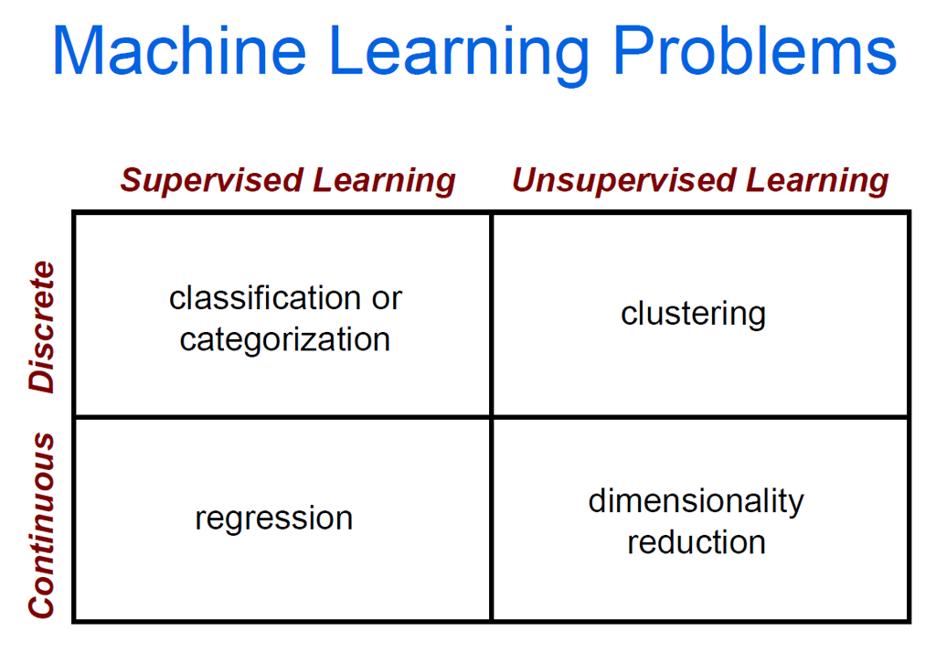

Slide 6

Dimensionality Reduction
Simplest dimensionality reduction: drop a dimension
Credit: xkcd

Slide 7
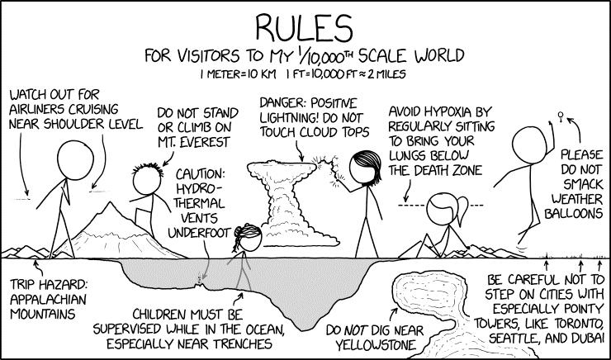
Dimensionality Reduction
The Earth is pretty smooth
Credit: xkcd

Slide 8
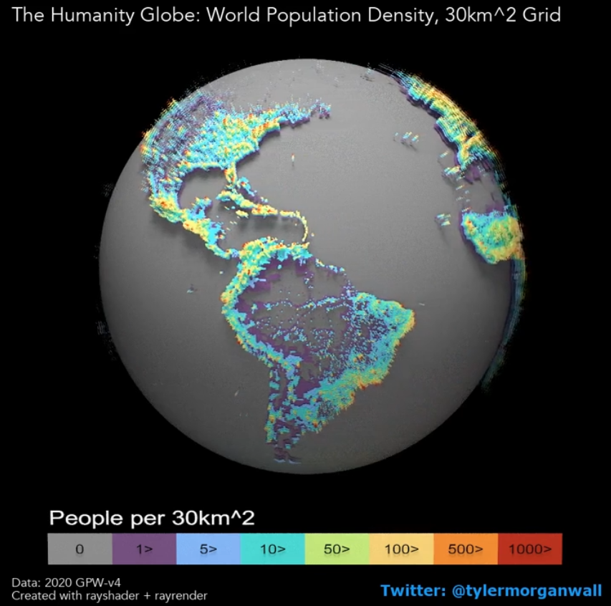
Non-linear Dimensionality Reduction
Credit: xkcd

Slide 9
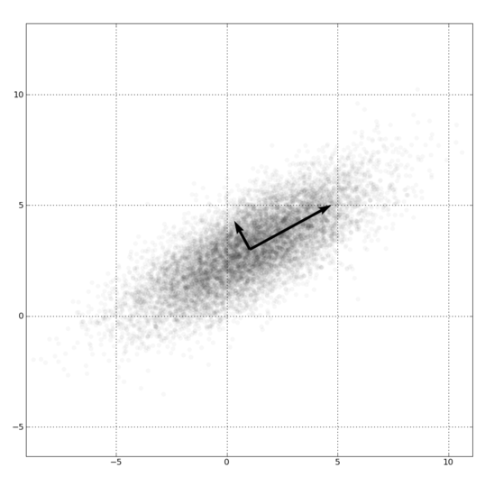
Dimensionality Reduction
PCA, ICA, LLE, Isomap, Autoencoder
PCA is the most important technique to know. It takes advantage of correlations in data dimensions to produce the best possible lower dimensional representation based on linear projections (minimizes reconstruction error).
Be wary of trying to assign meaning to the discovered bases.

Slide 10
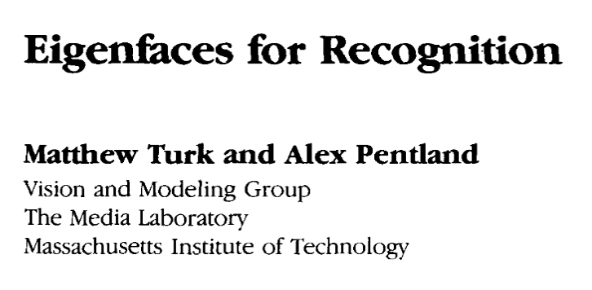
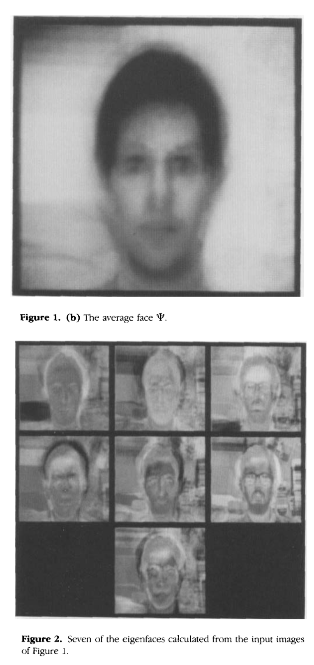
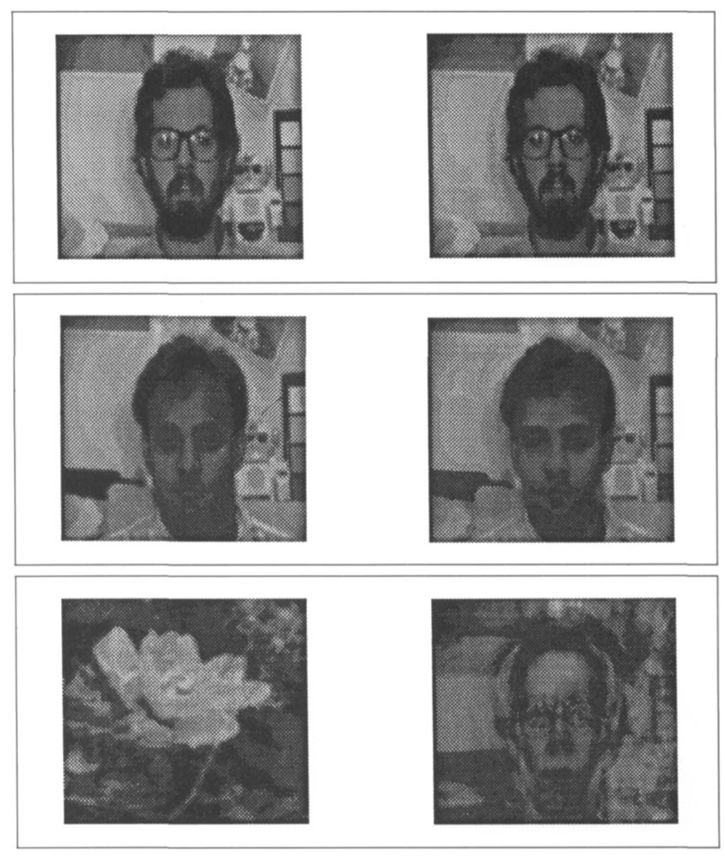
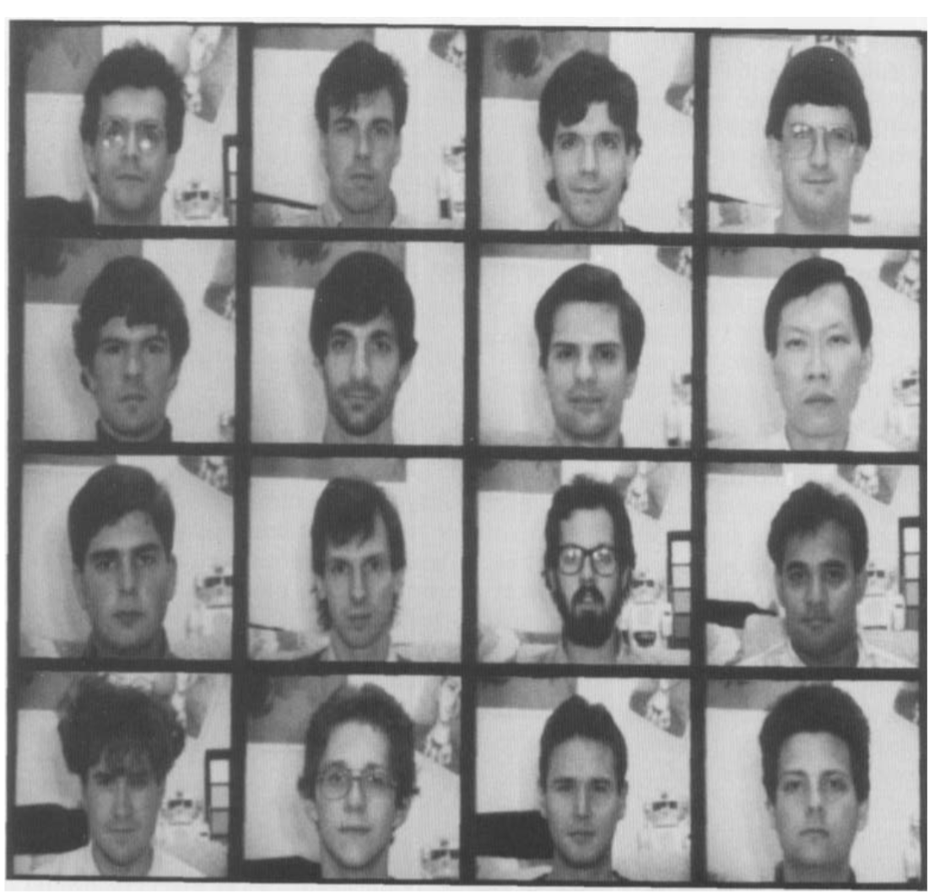
Training data
16 256x256 images
Reconstruction of in-domain and out-of-domain images
The “Eigenfaces”

Slide 11
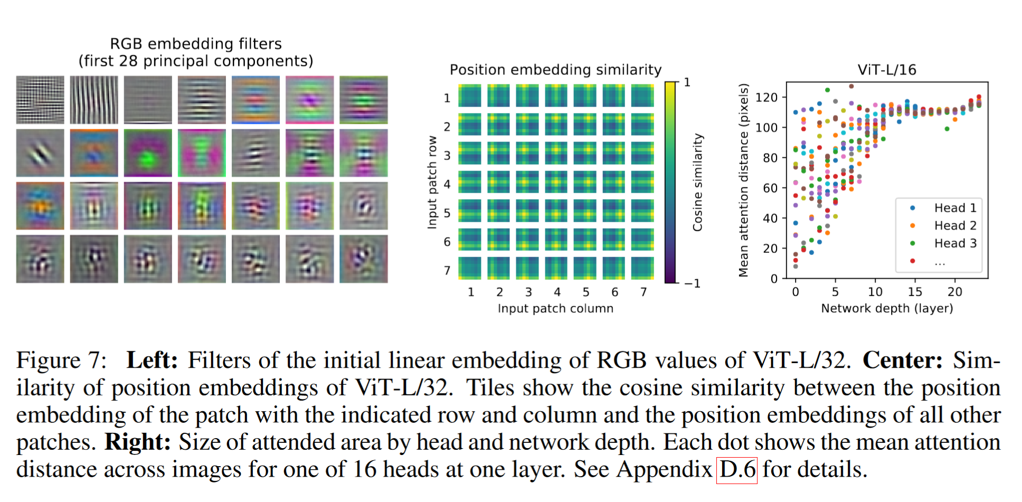
PCA as a data interpretation tool
An Image is Worth 16x16 Words: Transformers for Image Recognition at Scale. Alexey Dosovitskiy, Lucas Beyer, Alexander Kolesnikov, Dirk Weissenborn, Xiaohua Zhai, Thomas Unterthiner, Mostafa Dehghani, Matthias Minderer, Georg Heigold, Sylvain Gelly, Jakob Uszkoreit, Neil Houlsby. ICLR 2021

Slide 13
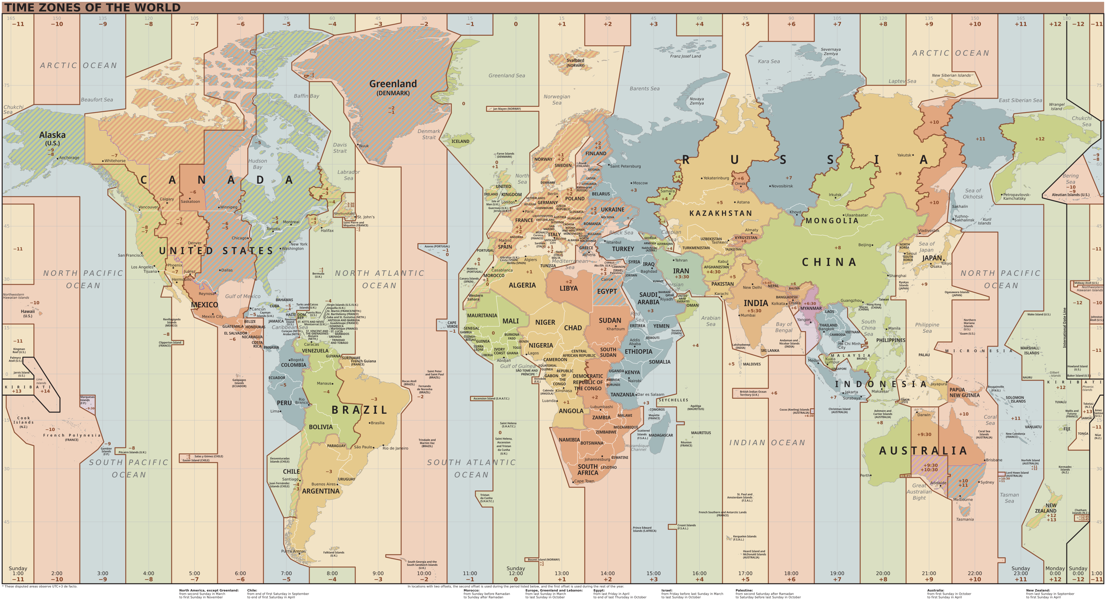
Notes:
https://en.wikipedia.org/wiki/Time_zone#/media/File:World_Time_Zones_Map.svg

Slide 14
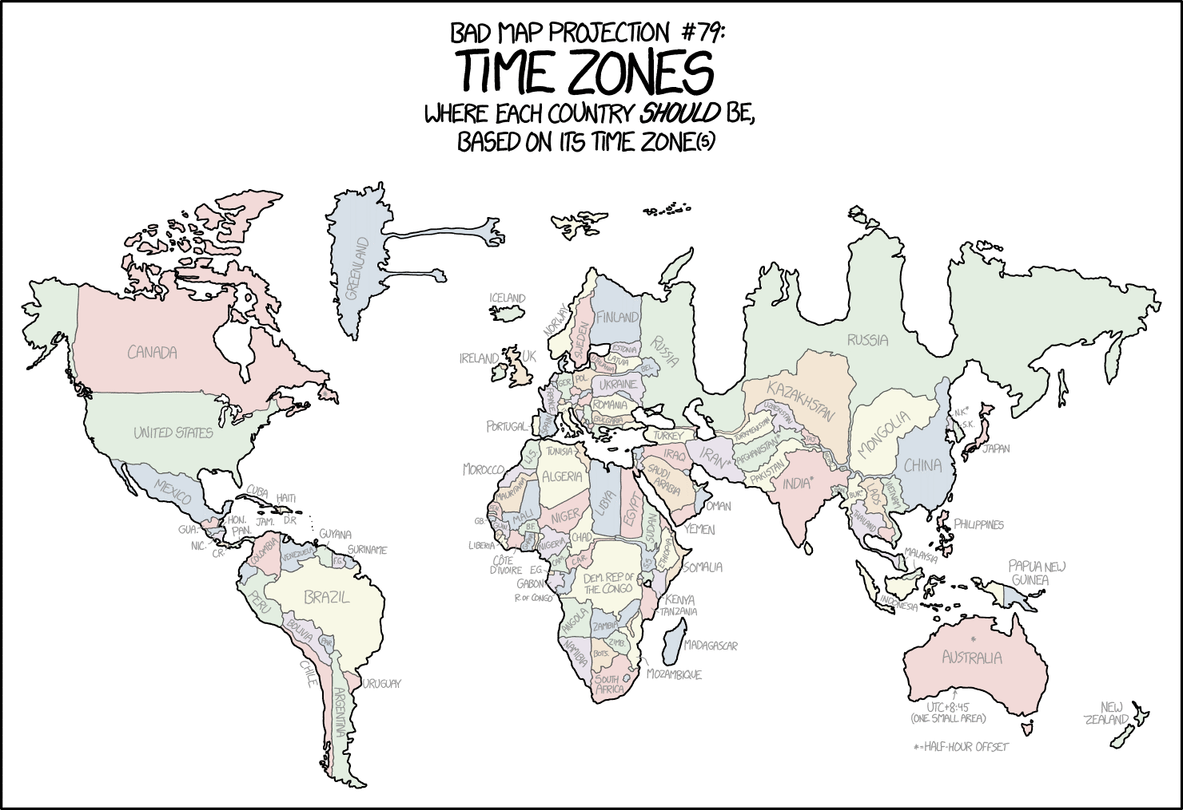
Credit: xkcd

Slide 15
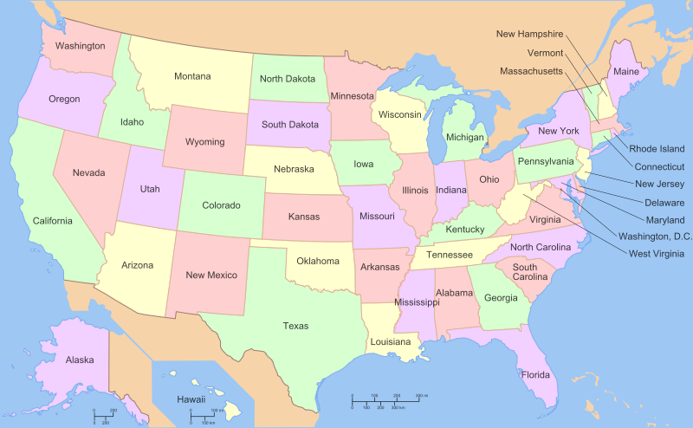

Slide 16
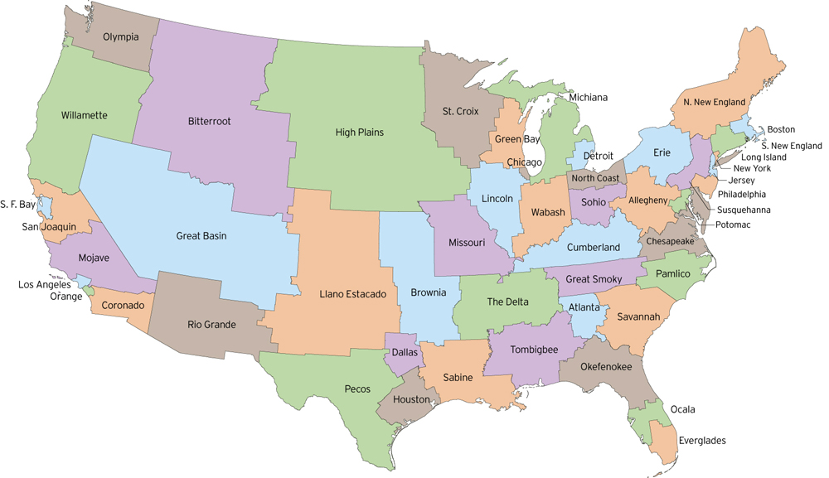
http://fakeisthenewreal.org/reform/
Notes:
~5,617,000 population in each state

Slide 17
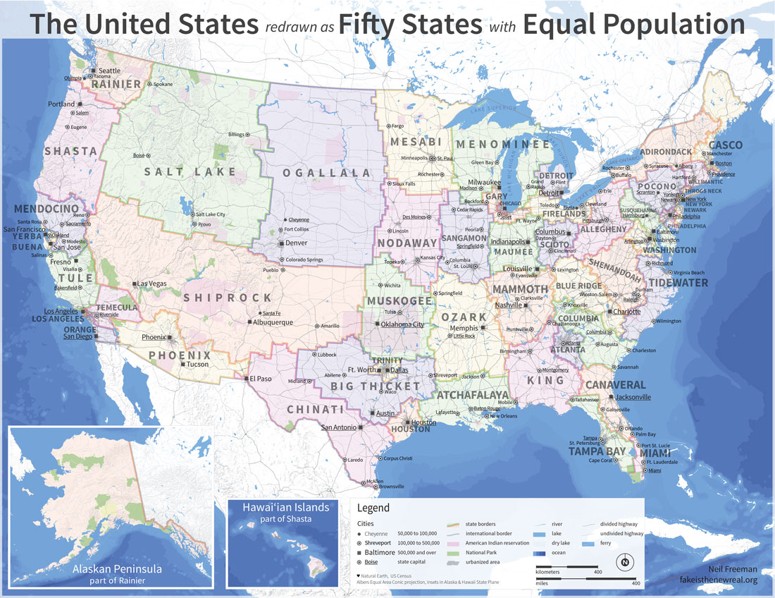
http://fakeisthenewreal.org/reform/
Notes:
~5,617,000 population in each state

Slide 18
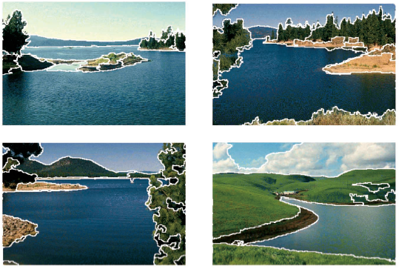
Clustering example: image segmentation
Goal: Break up the image into meaningful or perceptually similar regions

Slide 19
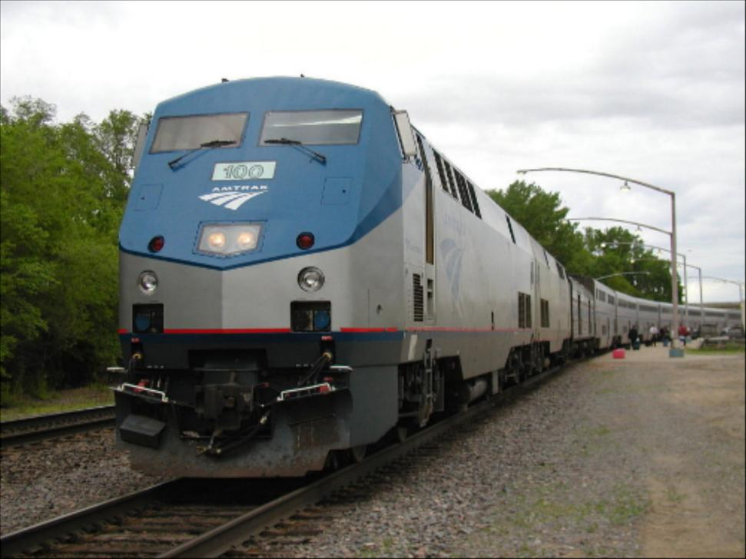
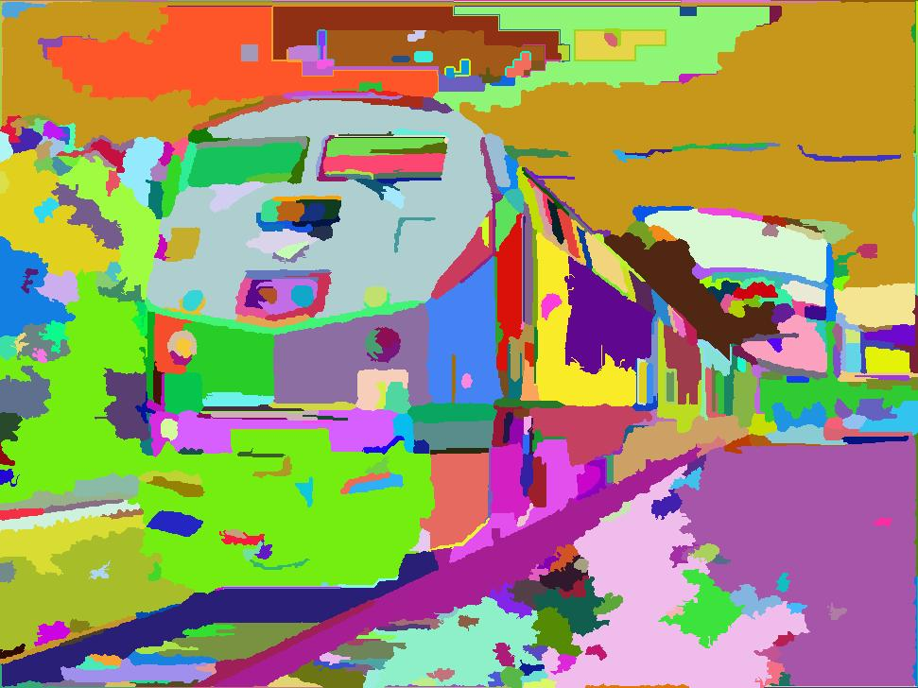

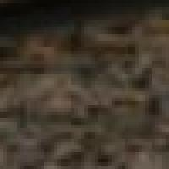
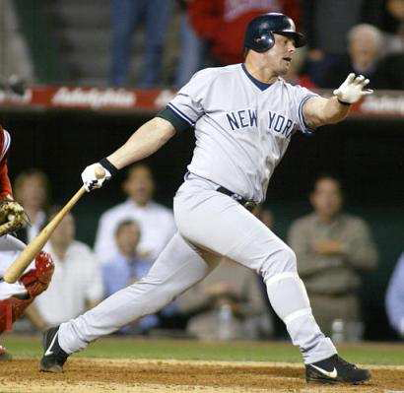
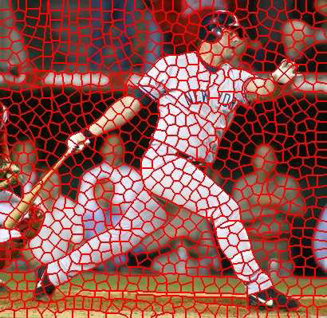
Segmentation for feature support or efficiency
(I.e. Superpixels)
50x50 Patch
50x50 Patch
[Felzenszwalb and Huttenlocher 2004]
[Shi and Malik 2001]
Slide: Derek Hoiem
[Hoiem et al. 2005, Mori 2005]

Slide 20
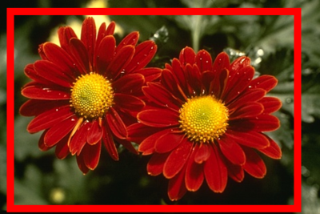
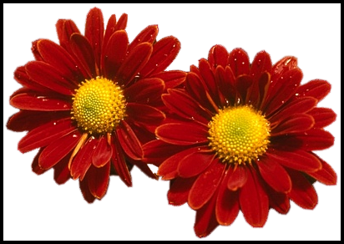
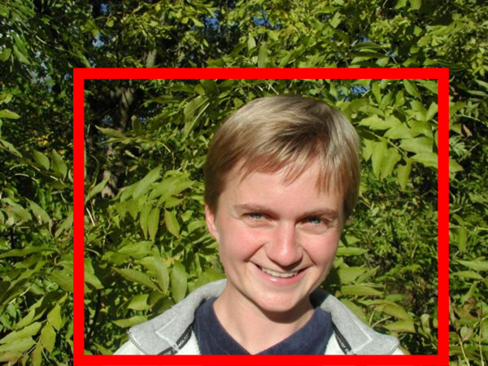
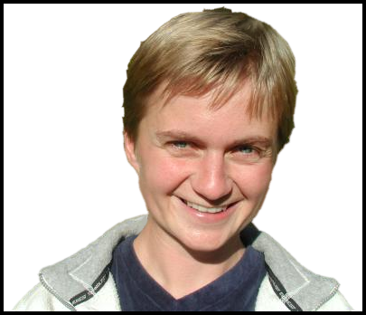
Segmentation as a result
Rother et al. 2004

Slide 21
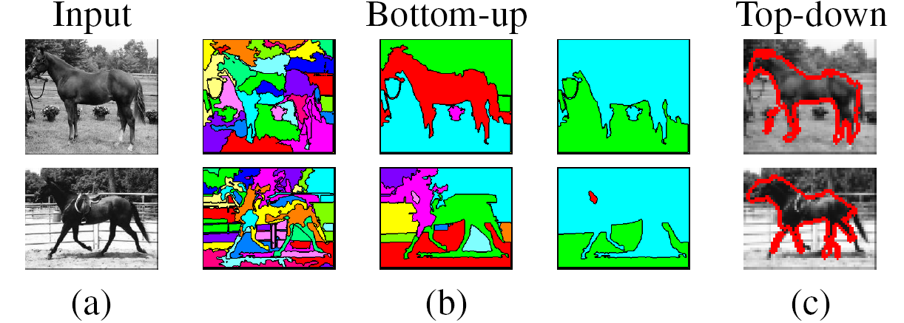
Types of segmentations
Oversegmentation
Undersegmentation
Multiple Segmentations

Slide 22
Major processes for segmentation
Bottom-up: group tokens with similar features
Top-down: group tokens that likely belong to the same object
[Levin and Weiss 2006]

Slide 23
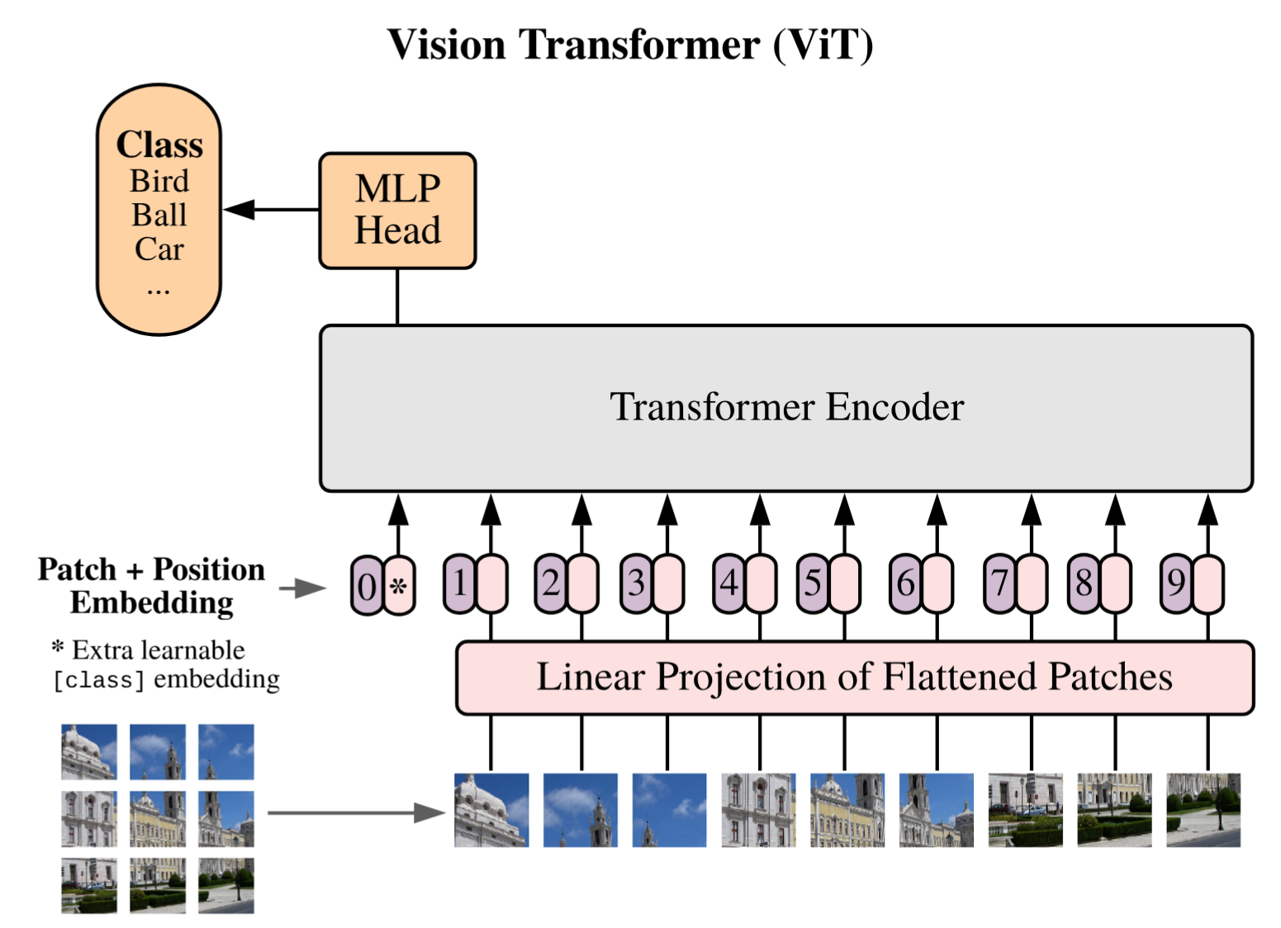

Slide 24
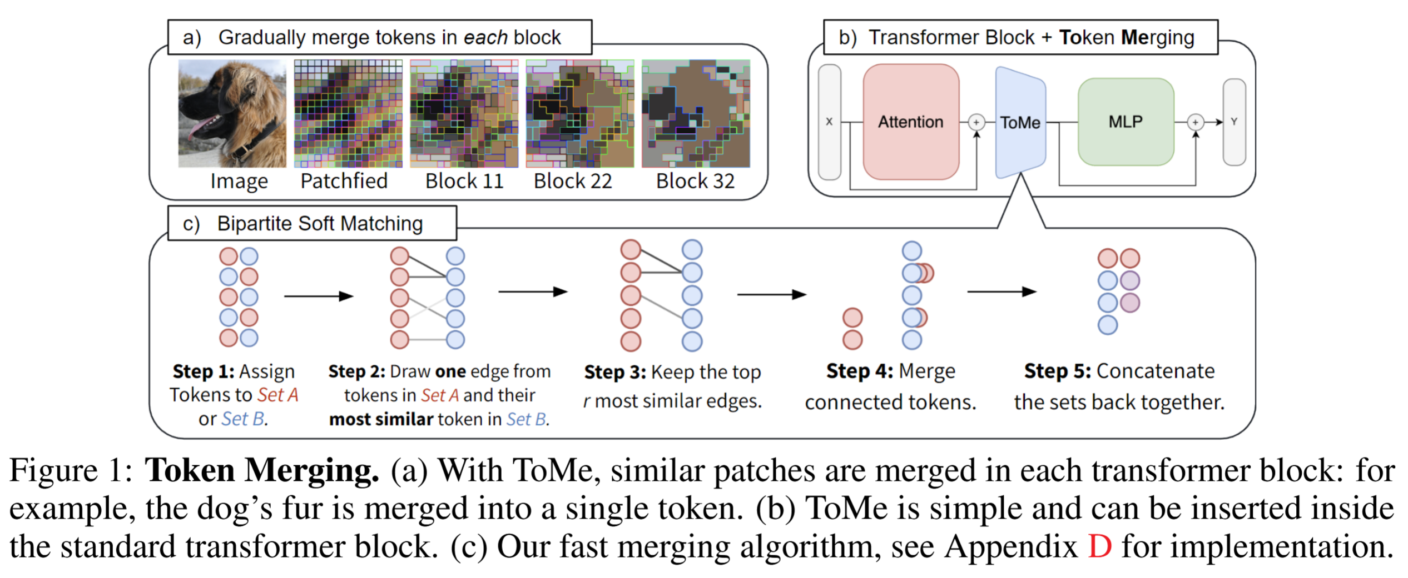
Token Merging: Your ViT But Faster
Daniel Bolya, Cheng-Yang Fu, Xiaoliang Dai, Peizhao Zhang, Christoph Feichtenhofer, Judy Hoffman

Slide 25
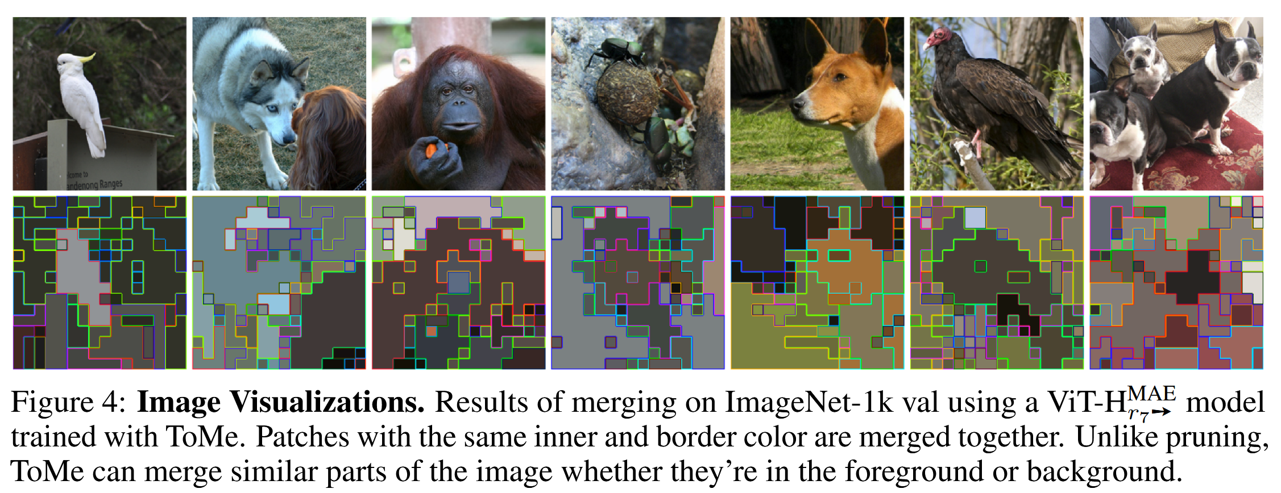
Token Merging: Your ViT But Faster
Daniel Bolya, Cheng-Yang Fu, Xiaoliang Dai, Peizhao Zhang, Christoph Feichtenhofer, Judy Hoffman

Slide 26
Clustering: group together similar points and represent them with a single token
Key Challenges:
1) What makes two points/images/patches similar?
2) How do we compute an overall grouping from pairwise similarities?
Slide: Derek Hoiem

Slide 27
Why do we cluster?
Summarizing data
  Look at large amounts of data
  Patch-based compression or denoising
  Represent a large continuous vector with the cluster number
Counting
  Histograms of texture, color, SIFT vectors
Segmentation
  Separate the image into different regions
Prediction
  Images in the same cluster may have the same labels
Slide: Derek Hoiem

Slide 28
How do we cluster?
K-means
  Iteratively re-assign points to the nearest cluster center
Agglomerative clustering
  Start with each point as its own cluster and iteratively merge the closest clusters
Mean-shift clustering
  Estimate modes of pdf
Spectral clustering
  Split the nodes in a graph based on assigned links with similarity weights

Slide 29
Clustering for Summarization
Goal: cluster to minimize variance in data given clusters
  Preserve information
Cluster center
Data
Whether x_{j} is assigned to c_{i}
Slide: Derek Hoiem

Slide 30
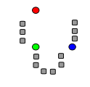
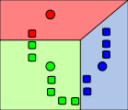
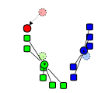
K-means algorithm
1. Randomly select K centers
2. Assign each point to nearest center
3. Compute new center (mean) for each cluster
Illustration: http://en.wikipedia.org/wiki/K-means_clustering

Slide 31
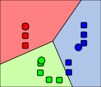
K-means algorithm
1. Randomly select K centers
2. Assign each point to nearest center
Back to 2
3. Compute new center (mean) for each cluster
Illustration: http://en.wikipedia.org/wiki/K-means_clustering

Slide 32
K-means
Initialize cluster centers: c⁰ ; t=0
Assign each point to the closest center
Update cluster centers as the mean of the points
Repeat 2-3 until no points are re-assigned (t=t+1)
Slide: Derek Hoiem

Slide 33
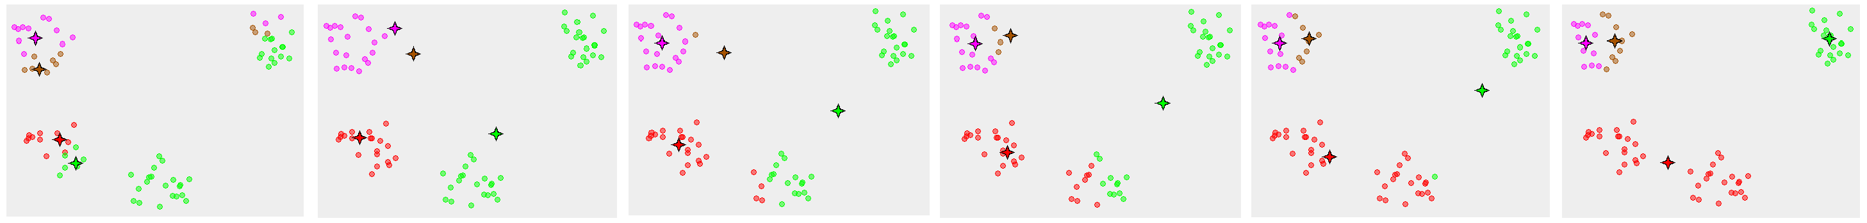
K-means converges to a local minimum

Slide 34
K-means: design choices
Initialization
  Randomly select K points as initial cluster center
  Or greedily choose K points to minimize residual
Distance measures
  Traditionally Euclidean, could be others
Optimization
  Will converge to a local minimum
  May want to perform multiple restarts

Slide 35
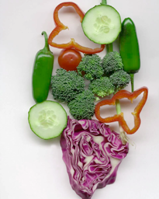
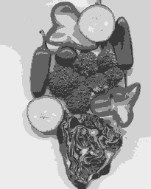
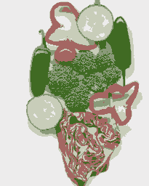
K-means clustering using intensity or color
Image
Clusters on intensity
Clusters on color
Notes:
I gave each pixel the mean intensity or mean color of its cluster --- this is basically just vector quantizing the image intensities/colors. Notice that there is no requirement that clusters be spatially localized and they’re not.

Slide 36
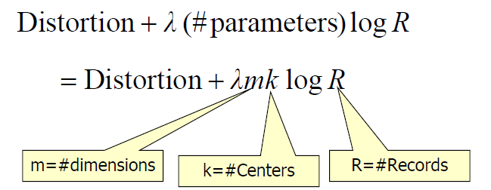
How to choose the number of clusters?
Minimum Description Length (MDL) principal for model comparison
Minimize Schwarz Criterion
  also called Bayes Information Criteria (BIC)

Slide 37
How to evaluate clusters?
Generative
  How well are points reconstructed from the clusters?
Discriminative
  How well do the clusters correspond to labels?
    Purity
  Note: unsupervised clustering does not aim to be discriminative
Slide: Derek Hoiem

Slide 38
How to choose the number of clusters?
Validation set
  Try different numbers of clusters and look at performance on some downstream task
    When building dictionaries (discussed later), more clusters typically work better
Slide: Derek Hoiem

Slide 39
K-means demos
General
http://home.dei.polimi.it/matteucc/Clustering/tutorial_html/AppletKM.html
http://www.cs.washington.edu/research/imagedatabase/demo/kmcluster/
Color clustering

Slide 40
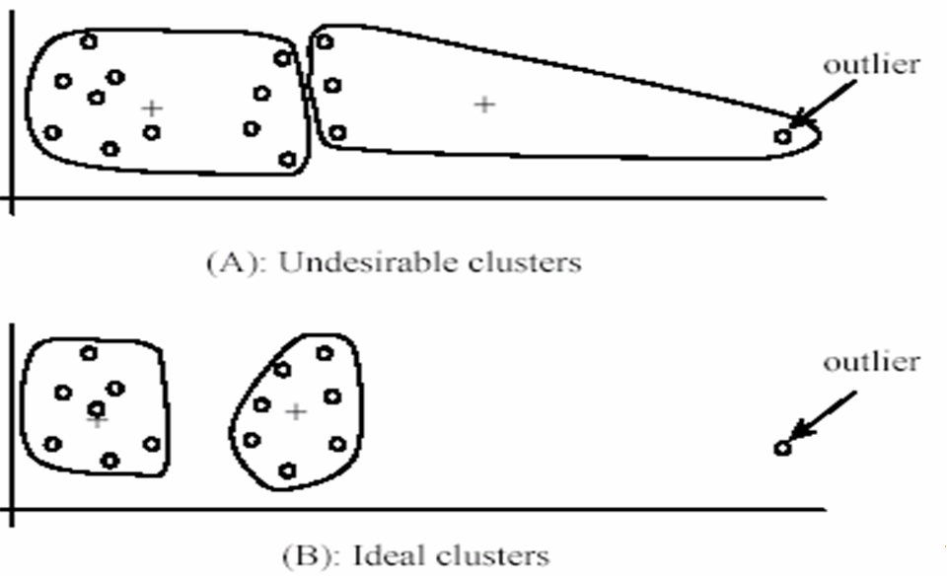
K-Means pros and cons
Pros
  Finds cluster centers that minimize conditional variance (good representation of data)
  Simple and fast*
  Easy to implement
Cons
  Need to choose K
  Sensitive to outliers
  Prone to local minima
  All clusters have the same parameters (e.g., distance measure is non-adaptive)
  *Can be slow: each iteration is O(KNd) for N d-dimensional points
Usage
  Rarely used for pixel segmentation

Slide 41

Building Visual Dictionaries
Sample patches from a database
  E.g., 128 dimensional SIFT vectors
Cluster the patches
  Cluster centers are the dictionary
Assign a codeword (number) to each new patch, according to the nearest cluster

Slide 42
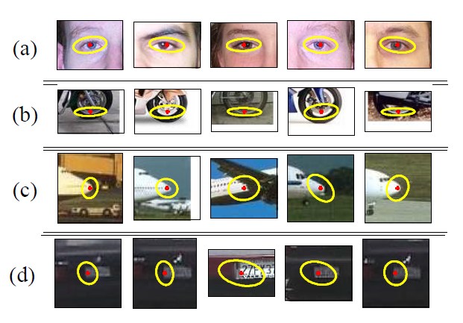
Examples of learned codewords
Most likely codewords for 4 learned “topics”
http://www.robots.ox.ac.uk/~vgg/publications/papers/sivic05b.pdf
Sivic et al. ICCV 2005

Slide 43
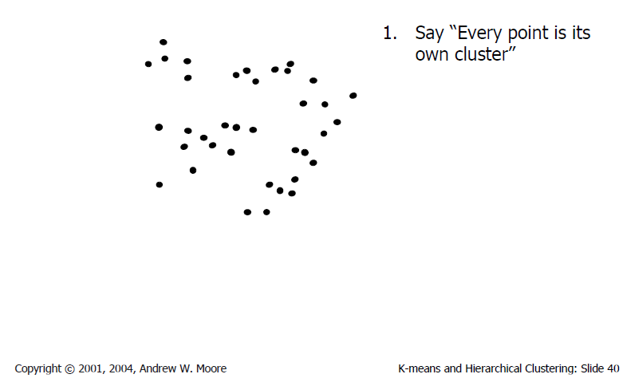
Agglomerative clustering

Slide 44
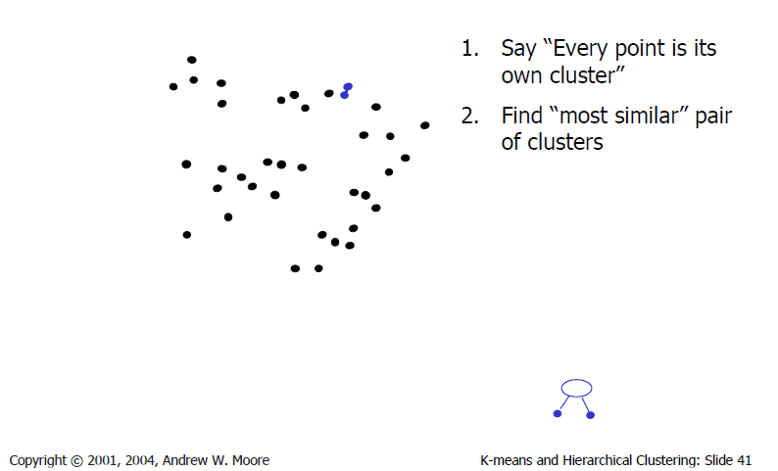
Agglomerative clustering

Slide 45
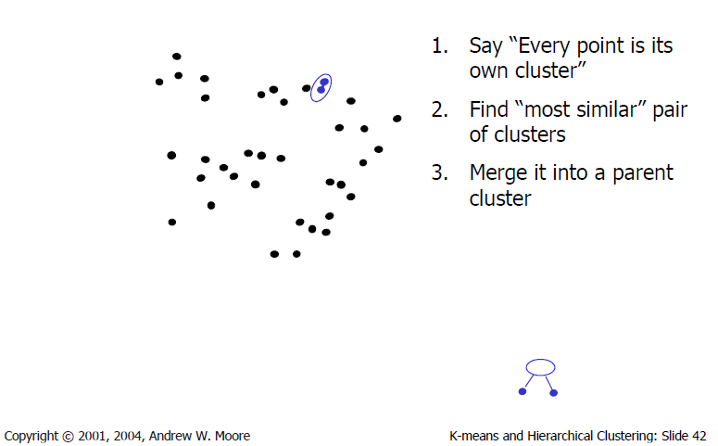
Agglomerative clustering

Slide 46
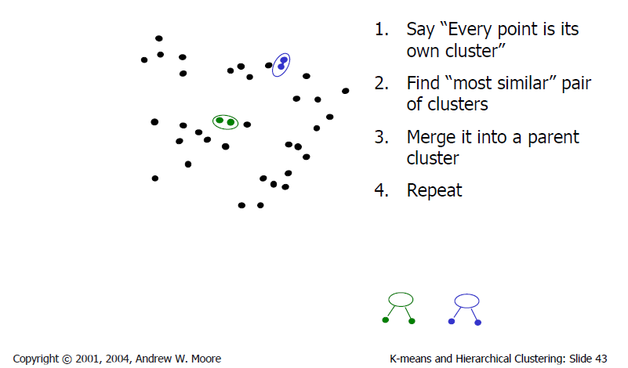
Agglomerative clustering

Slide 47
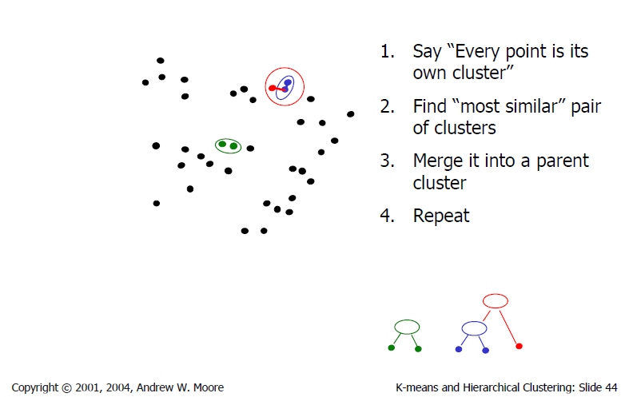
Agglomerative clustering

Slide 48
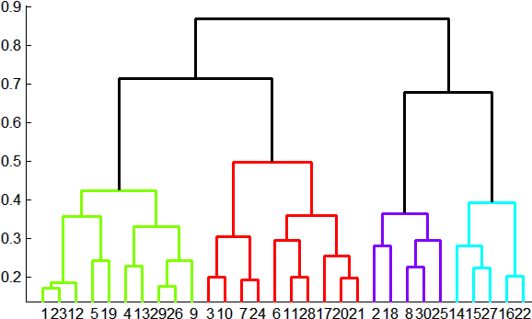
Agglomerative clustering
How to define cluster similarity?
Average distance between points, maximum distance, minimum distance
Distance between means or medoids
How many clusters?
Clustering creates a dendrogram (a tree)
Threshold based on max number of clusters or based on distance between merges
distance

Slide 49
Conclusions: Agglomerative Clustering
Good
Simple to implement, widespread application
Clusters have adaptive shapes
Provides a hierarchy of clusters
Bad
May have imbalanced clusters
Still have to choose number of clusters or threshold
Need to use an “ultrametric” to get a meaningful hierarchy
Notes:
Ultrametric – stronger requirement than triangle inequality. Distance between two points must be at least a large as the distance of connecting those two points through any intermediate point.

Slide 50
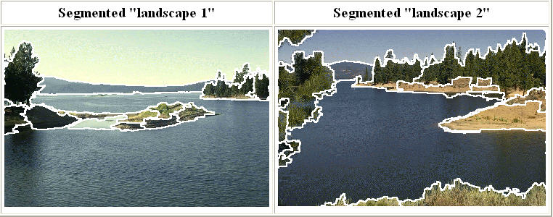
Mean shift segmentation
D. Comaniciu and P. Meer, Mean Shift: A Robust Approach toward Feature Space Analysis, PAMI 2002.
Versatile technique for clustering-based segmentation

Slide 51



Mean shift algorithm
Try to find modes of this non-parametric density

Slide 52


Kernel density estimation
Kernel density estimation function
Gaussian kernel

Slide 53
Mean shift
Region of
interest
Center of
mass
Mean Shift
vector
Slide by Y. Ukrainitz & B. Sarel

Slide 54
Mean shift
Region of
interest
Center of
mass
Mean Shift
vector
Slide by Y. Ukrainitz & B. Sarel

Slide 55
Mean shift
Region of
interest
Center of
mass
Mean Shift
vector
Slide by Y. Ukrainitz & B. Sarel

Slide 56
Mean shift
Region of
interest
Center of
mass
Mean Shift
vector
Slide by Y. Ukrainitz & B. Sarel

Slide 57
Mean shift
Region of
interest
Center of
mass
Mean Shift
vector
Slide by Y. Ukrainitz & B. Sarel

Slide 58
Mean shift
Region of
interest
Center of
mass
Mean Shift
vector
Slide by Y. Ukrainitz & B. Sarel

Slide 59
Mean shift
Region of
interest
Center of
mass
Slide by Y. Ukrainitz & B. Sarel

Slide 60
Computing the Mean Shift
Simple Mean Shift procedure:
Compute mean shift vector
Translate the Kernel window by m(x)
Slide by Y. Ukrainitz & B. Sarel

Slide 61

Attraction basin
Attraction basin: the region for which all trajectories lead to the same mode
Cluster: all data points in the attraction basin of a mode
Slide by Y. Ukrainitz & B. Sarel

Slide 62

Attraction basin

Slide 63
Mean shift clustering
The mean shift algorithm seeks modes of the given set of points
  Choose kernel and bandwidth
  For each point:
    Center a window on that point
    Compute the mean of the data in the search window
    Center the search window at the new mean location
    Repeat (b,c) until convergence
  Assign points that lead to nearby modes to the same cluster

Slide 64

Segmentation by Mean Shift
Compute features for each pixel (color, gradients, texture, etc)
Set kernel size for features K_{f} and position K_{s}
Initialize windows at individual pixel locations
Perform mean shift for each window until convergence
Merge windows that are within width of K_{f} and K_{s}

Slide 65




Mean shift segmentation results
Comaniciu and Meer 2002
Notes:
Clustering based on feature (LUV colors), location (x y coordinates), and eliminating small clusters

Slide 66
Comaniciu and Meer 2002

Slide 67
Mean-shift: other issues
Speedups
  Binned estimation
  Fast search of neighbors
  Update each window in each iteration (faster convergence)
Other tricks
  Use kNN to determine window sizes adaptively
Lots of theoretical support
  D. Comaniciu and P. Meer, Mean Shift: A Robust Approach toward Feature Space Analysis, PAMI 2002.

Slide 68
Mean shift pros and cons
Pros
  Good general-practice segmentation
  Flexible in number and shape of regions
  Robust to outliers
Cons
  Have to choose kernel size in advance
  Not suitable for high-dimensional features
When to use it
  Oversegmentatoin
  Multiple segmentations
  Tracking, clustering, filtering applications

Slide 69

Spectral clustering
Group points based on links in a graph
B
A

Slide 70

Cuts in a graph
B
A
Normalized Cut
  a cut penalizes large segments
  fix by normalizing for size of segments
  volume(A) = sum of costs of all edges that touch A
Source: Seitz

Slide 71

Normalized cuts for segmentation

Slide 72
Visual PageRank
Determining importance by random walk
  What’s the probability that you will randomly walk to a given node?
    Create adjacency matrix based on visual similarity
    Edge weights determine probability of transition
Jing Baluja 2008

Slide 73


Which algorithm to try first?
Quantization/Summarization: K-means
  Aims to preserve variance of original data
  Can easily assign new point to a cluster
Summary of 20,000 photos of Rome using “greedy k-means”
http://grail.cs.washington.edu/projects/canonview/
Quantization for computing histograms

Slide 74




Which algorithm to use?
Image segmentation: agglomerative clustering
  More flexible with distance measures (e.g., can be based on boundary prediction)
  Adapts better to specific data
  Hierarchy can be useful
http://www.cs.berkeley.edu/~arbelaez/UCM.html

Slide 75


Things to remember
K-means useful for summarization, building dictionaries of patches, general clustering
Agglomerative clustering useful for segmentation, general clustering
Spectral clustering useful for determining relevance, summarization, segmentation

Slide 76

Clustering
Key algorithm
K-means

Slide 78



The machine learning framework
Apply a prediction function to a feature representation of the image to get the desired output:
f( ) = “apple”
f( ) = “tomato”
f( ) = “cow”
Slide credit: L. Lazebnik

Slide 79
Learning a classifier
Given some set of features with corresponding labels, learn a function to predict the labels from the features
x
x
x
x
x
x
o
x
x
o
o
o
o
x2
x1

Slide 80


Generalization
Training set (labels known)
Test set (labels unknown)
How well does a learned model generalize from the data it was trained on to a new test set?
Slide credit: L. Lazebnik

Slide 81
Very brief tour of some classifiers
K-nearest neighbor
SVM
Boosted Decision Trees
Neural networks
Naïve Bayes
Bayesian network
Logistic regression
Randomized Forests
RBMs
Deep Convolutional Network
Attentional models or “Transformers”
Etc.

Slide 82
Generative vs. Discriminative Classifiers
Generative Models
Represent both the data and the labels
Often, makes use of conditional independence and priors
Examples
  Naïve Bayes classifier
  Bayesian network
Models of data may apply to future prediction problems
Discriminative Models
Learn to directly predict the labels from the data
Often, assume a simple boundary (e.g., linear)
Examples
  Logistic regression
  SVM
  Boosted decision trees
Often easier to predict a label from the data than to model the data
Slide credit: D. Hoiem
Notes:
Generative classifiers try to model the data. Discriminative classifiers try to predict the label.

Slide 83
Classification
Assign input vector to one of two or more classes
Any decision rule divides input space into decision regions separated by decision boundaries
Slide credit: L. Lazebnik

Slide 84

Nearest Neighbor Classifier
Assign label of nearest training data point to each test data point
from Duda et al.
Voronoi partitioning of feature space
for two-category 2D and 3D data
Source: D. Lowe

Slide 85
K-nearest neighbor
x
x
x
o
x
x
x
+
o
o
x
x
o
o
+
o
o
x2
x1

Slide 86
1-nearest neighbor
x
x
x
o
x
x
x
+
o
o
x
x
o
o
+
o
o
x2
x1

Slide 87
3-nearest neighbor
x
x
x
o
x
x
x
+
o
o
x
x
o
o
+
o
o
x2
x1

Slide 88
5-nearest neighbor
x
x
x
o
x
x
x
+
o
o
x
x
o
o
+
o
o
x2
x1

Slide 89
Using K-NN
Simple to implement and interpret, a good classifier to try first

Slide 90
Naïve Bayes
y
x₁
x₂
x₃

Slide 91
Using Naïve Bayes
Simple thing to try for categorical data
Very fast to train/test

Slide 92
Classifiers: Logistic Regression
Maximize likelihood of label given data, assuming a log-linear model
x
x
x
x
x
x
male
o
x
x
o
o
Height
o
female
o
x2
x1
Pitch of voice

Slide 93
Using Logistic Regression
Quick, simple classifier (try it first)
Outputs a probabilistic label confidence
Use L2 or L1 regularization
  L1 does feature selection and is robust to irrelevant features but slower to train

Slide 94
Classifiers: Linear SVM
x
x
x
x
x
x
o
x
x
o
o
o
o
x2
x1
Find a linear function to separate the classes:
f(x) = sgn(w ⋅ x + b)

Slide 95
Classifiers: Linear SVM
x
x
x
x
x
x
o
x
x
o
o
o
o
x2
x1
Find a linear function to separate the classes:
f(x) = sgn(w ⋅ x + b)
Notes:
Maximizes a margin

Slide 96
Classifiers: Linear SVM
x
x
x
o
x
x
x
o
x
x
o
o
o
o
x2
x1
Find a linear function to separate the classes:
f(x) = sgn(w ⋅ x + b)

Slide 97
Nonlinear SVMs
Datasets that are linearly separable work out great:
But what if the dataset is just too hard?
We can map it to a higher-dimensional space:
0
x
0
x
x²
0
x
Slide credit: Andrew Moore

Slide 98
Nonlinear SVMs
General idea: the original input space can always be mapped to some higher-dimensional feature space where the training set is separable:
Φ: x → φ(x)
Slide credit: Andrew Moore

Slide 99
Nonlinear SVMs
The kernel trick: instead of explicitly computing the lifting transformation φ(x), define a kernel function K such that
K(x_{i} , x_{j}) = φ(x_{i} ) · φ(x_{j})
(to be valid, the kernel function must satisfy Mercer’s condition)
This gives a nonlinear decision boundary in the original feature space:
C. Burges, A Tutorial on Support Vector Machines for Pattern Recognition, Data Mining and Knowledge Discovery, 1998
Notes:
The kernel must be equivalent to a dot product in some space.

Slide 100
Nonlinear kernel: Example
Consider the mapping
x²

Slide 101
State of the art in 2007: Kernels for bags of features
Histogram intersection kernel:
Generalized Gaussian kernel:
D can be (inverse) L1 distance, Euclidean distance, χ² distance, etc.
J. Zhang, M. Marszalek, S. Lazebnik, and C. Schmid, Local Features and Kernels for Classifcation of Texture and Object Categories: A Comprehensive Study, IJCV 2007

Slide 102
Summary: SVMs for image classification
Pick an image representation (e.g. histogram of quantized sift features)
Pick a kernel function for that representation
Compute the matrix of kernel values between every pair of training examples
Feed the kernel matrix into your favorite SVM solver to obtain support vectors and weights
At test time: compute kernel values for your test example and each support vector, and combine them with the learned weights to get the value of the decision function
Slide credit: L. Lazebnik

Slide 103
What about multi-class SVMs?
Unfortunately, there is no “definitive” multi-class SVM formulation
In practice, we have to obtain a multi-class SVM by combining multiple two-class SVMs
One vs. others
  Traning: learn an SVM for each class vs. the others
  Testing: apply each SVM to test example and assign to it the class of the SVM that returns the highest decision value
One vs. one
  Training: learn an SVM for each pair of classes
  Testing: each learned SVM “votes” for a class to assign to the test example
Slide credit: L. Lazebnik

Slide 104
SVMs: Pros and cons
Pros
  Linear SVMs are surprisingly accurate, while being lightweight and interpretable
  Non-linear, kernel-based SVMs are very powerful, flexible
  SVMs work very well in practice, even with very small training sample sizes
Cons
  No “direct” multi-class SVM, must combine two-class SVMs
  Computation, memory
    During training time, must compute matrix of kernel values for every pair of examples. Quadratic memory consumption.
    Learning can take a very long time for large-scale problems

Slide 105
Summary: Classifiers
Nearest-neighbor and k-nearest-neighbor classifiers
  L1 distance, χ² distance, quadratic distance, histogram intersection
Support vector machines
  Linear classifiers
  Margin maximization
  The kernel trick
  Kernel functions: histogram intersection, generalized Gaussian, pyramid match
  Multi-class
Of course, there are many other classifiers out there
  Neural networks, boosting, decision trees, …
Slide credit: L. Lazebnik

Slide 106
Classifiers: Decision Trees
x
x
x
o
x
x
x
o
x
o
x
o
o
o
o
x2
x1

Slide 107

Ensemble Methods: Boosting
figure from Friedman et al. 2000

Slide 108

Boosted Decision Trees
High in
Image?
Gray?
Yes
No
Yes
No
Smooth?
Green?
High in
Image?
Many Long
Lines?
…
Yes
No
Yes
No
Yes
No
Yes
No
Blue?
Very High
Vanishing
Point?
Yes
No
Yes
No
Ground Vertical Sky
P(label | good segment, data)
[Collins et al. 2002]

Slide 109
Using Boosted Decision Trees
Flexible: can deal with both continuous and categorical variables
How to control bias/variance trade-off
  Size of trees
  Number of trees
Boosting trees often works best with a small number of well-designed features
Boosting “stubs” can give a fast classifier

Slide 110
Ideals for a classification algorithm
Objective function: encodes the right loss for the problem
Parameterization: takes advantage of the structure of the problem
Regularization: good priors on the parameters
Training algorithm: can find parameters that maximize objective on training set
Inference algorithm: can solve for labels that maximize objective function for a test example

Slide 111
Two ways to think about classifiers
What is the objective? What are the parameters? How are the parameters learned? How is the learning regularized? How is inference performed?
How is the data modeled? How is similarity defined? What is the shape of the boundary?
Slide credit: D. Hoiem

Slide 112
Comparison
assuming x in {0 1}
Learning Objective
Training
Inference
Naïve Bayes
Logistic Regression
Gradient ascent
Linear SVM
Linear programming
Kernelized SVM
complicated to write
Quadratic programming
Nearest Neighbor
most similar features → same label
Record data
Slide credit: D. Hoiem

Slide 113
Very brief tour of some classifiers
K-nearest neighbor
SVM
Boosted Decision Trees
Neural networks
Naïve Bayes
Bayesian network
Logistic regression
Randomized Forests
RBMs
Deep Convolutional Network
Attentional models or “Transformers”
Etc.

Slide 114
Generalization
Training set (labels known)
Test set (labels unknown)
How well does a learned model generalize from the data it was trained on to a new test set?
Slide credit: L. Lazebnik

Slide 115
Generalization
Components of generalization error
  Bias: how much the average model over all training sets differ from the true model?
    Error due to inaccurate assumptions/simplifications made by the model. “Bias” sounds negative. “Regularization” sounds nicer.
  Variance: how much models estimated from different training sets differ from each other. Typical of more “expressive” models.
Underfitting: model is too “simple” to represent all the relevant class characteristics
  High bias (few degrees of freedom) and low variance
  High training error and high test error
Overfitting: model is too “complex” and fits irrelevant characteristics (noise) in the data
  Low bias (many degrees of freedom) and high variance
  Low training error and high test error
Slide credit: L. Lazebnik

Slide 116

No Free Lunch Theorem
Slide credit: D. Hoiem
Notes:
You can only get generalization through assumptions.

Slide 117


Bias-Variance Trade-off
Models with too few parameters are inaccurate because of a large bias (not enough flexibility).
Models with too many parameters are inaccurate because of a large variance (too much sensitivity to the sample).
Slide credit: D. Hoiem
Notes:
http://www.aiaccess.net/English/Glossaries/GlosMod/e_gm_bias_variance.htm

Slide 118
Bias-Variance Trade-off
E(MSE) = noise² + bias² + variance
Error due to variance of training samples
Unavoidable error
Error due to incorrect assumptions
See the following for explanations of bias-variance (also Bishop’s “Neural Networks” book):
http://www.inf.ed.ac.uk/teaching/courses/mlsc/Notes/Lecture4/BiasVariance.pdf
Slide credit: D. Hoiem
Notes:
From the link above:
You can only get generalization through assumptions.
Thus in order to minimize the MSE, we need to minimize both
the bias and the variance. However, this is not trivial to do this. For instance, just
neglecting the input data and predicting the output somehow (e.g., just a constant), would definitely minimize the variance of our predictions: they would be
always the same, thus the variance would be zero—but the bias of our estimate
(i.e., the amount we are off the real function) would be tremendously large. On
the other hand, the neural network could perfectly interpolate the training data,
i.e., it predict y=t for every data point. This will make the bias term vanish entirely, since the E(y)=f (insert this above into the squared bias term to verify this),
but the variance term will become equal to the variance of the noise, which may
be significant (see also Bishop Chapter 9 and the Geman et al. Paper). In general,
finding an optimal bias-variance tradeoff is hard, but acceptable solutions can be
found, e.g., by means of cross validation or regularization.

Slide 119
Bias-variance tradeoff
Underfitting
Overfitting
Error
Test error
Training error
High Bias
Low Variance
Strong Regularization
Complexity
Low Bias
High Variance
Expressive model
Slide credit: D. Hoiem

Slide 120
Bias-variance tradeoff
Few training examples
Test Error
Many training examples
High Bias
Low Variance
Strong Regularization
Complexity
Low Bias
High Variance
Expressive model
Slide credit: D. Hoiem
Notes:
Note: these figures don’t work in pdf

Slide 121
Effect of Training Size
Fixed prediction model
Error
Testing
Generalization Error
Training
Number of Training Examples
Slide credit: D. Hoiem

Slide 122
The perfect classification algorithm
Objective function: encodes the right loss for the problem
Parameterization: makes assumptions that fit the problem
Regularization: right level of regularization for amount of training data
Training algorithm: can find parameters that maximize objective on training set
Inference algorithm: can solve for objective function in evaluation
Slide credit: D. Hoiem

Slide 123
Remember…
No classifier is inherently better than any other: you need to make assumptions to generalize
Error sources
  Bias: due to over-simplifications / regularization
  Variance: due to inability to perfectly estimate parameters from limited data
Slide credit: D. Hoiem
Notes:
You can only get generalization through assumptions.

Slide 124
How to reduce variance (expressiveness)?
  Choose a simpler classifier
  Regularize the parameters
  Get more training data
How to reduce bias (regularization)?
  Choose a more complex, more expressive classifier
  Remove regularization
  (These might not be safe to do unless you get more training data)
Slide credit: D. Hoiem
Notes:
The simpler classifier or regularization could increase bias and lead to more error.

Slide 125
What to remember about classifiers
No free lunch: machine learning algorithms are tools, not dogmas
Try simple classifiers first
Better to have smart features and simple classifiers than simple features and smart classifiers
Use increasingly expressive classifiers with more training data (bias-variance tradeoff)
Slide credit: D. Hoiem

Slide 126
Machine Learning Considerations
3 important design decisions:
  1) What data do I use?
  2) How do I represent my data (what feature)?
  3) What classifier / regressor / machine learning tool do I use?
These are in decreasing order of importance
Deep learning addresses 2 and 3 simultaneously (and blurs the boundary between them).
You can take the representation from deep learning and use it with any classifier.

Slide 128

Andrew Ng’s ranking of machine learning impact
  Supervised Learning
  Transfer Learning
  Unsupervised Learning (I prefer “self-supervised” learning)
  Reinforcement Learning
James thinks 2 and 3 might have switched ranks.

Slide 129
Usage in recent computer vision papers
“PCA” 3,610
“K-means” 2,950
“ResNet” 14,900
“ViT” 5,540
“Reinforcement learning” 3,320
“Self-supervised” 11,300
“Unsupervised” 18,400
site:https://openaccess.thecvf.com “search term” seems to search ICCV, CVPR, and WACV papers

Slide 130
Some Machine Learning References
General
  Tom Mitchell, Machine Learning, McGraw Hill, 1997
  Christopher Bishop, Neural Networks for Pattern Recognition, Oxford University Press, 1995
Adaboost
  Friedman, Hastie, and Tibshirani, “Additive logistic regression: a statistical view of boosting”, Annals of Statistics, 2000
SVMs
  http://www.support-vector.net/icml-tutorial.pdf
Slide credit: D. Hoiem

