Slide 1


Slide 2
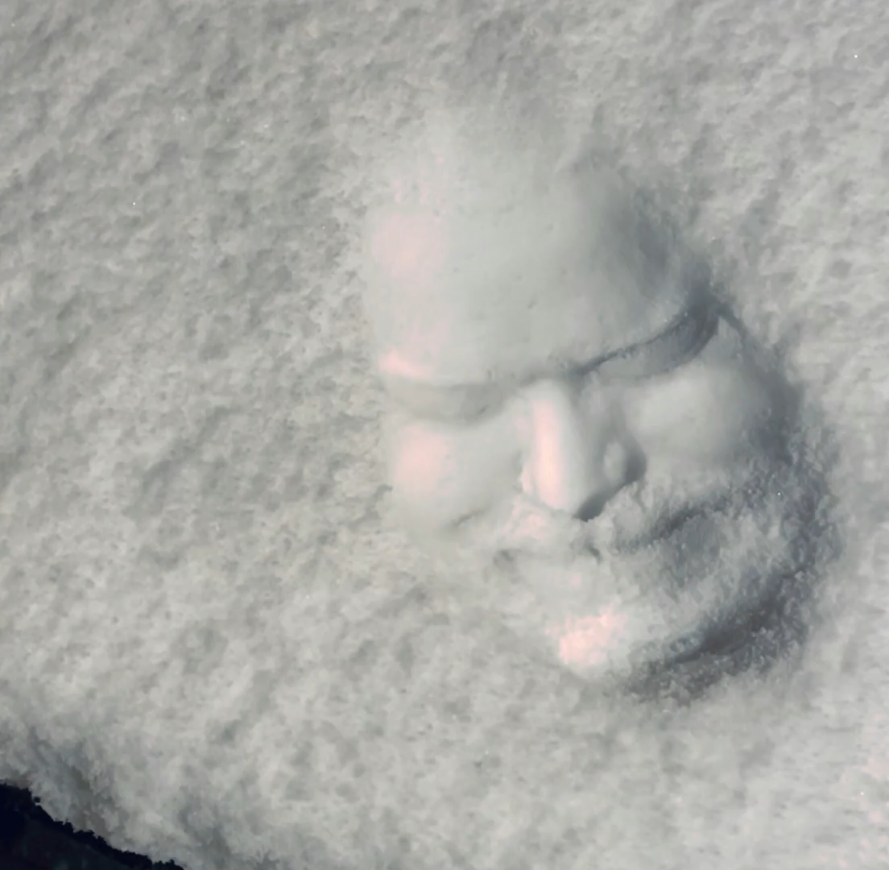
source
Notes:
From https://www.reddit.com/r/illusionporn/comments/sz7nnx/i_meticulously_sculpted_my_face_in_snow_it_took_6/

Slide 3
Deep Learning Neural Net Basics
Computer Vision
James Hays
Many slides by Marc’Aurelio Ranzato

Slide 4
Outline
Neural Networks
Convolutional Neural Networks
Variants
Detection
Segmentation
Siamese Networks
Visualization of Deep Networks

Slide 5
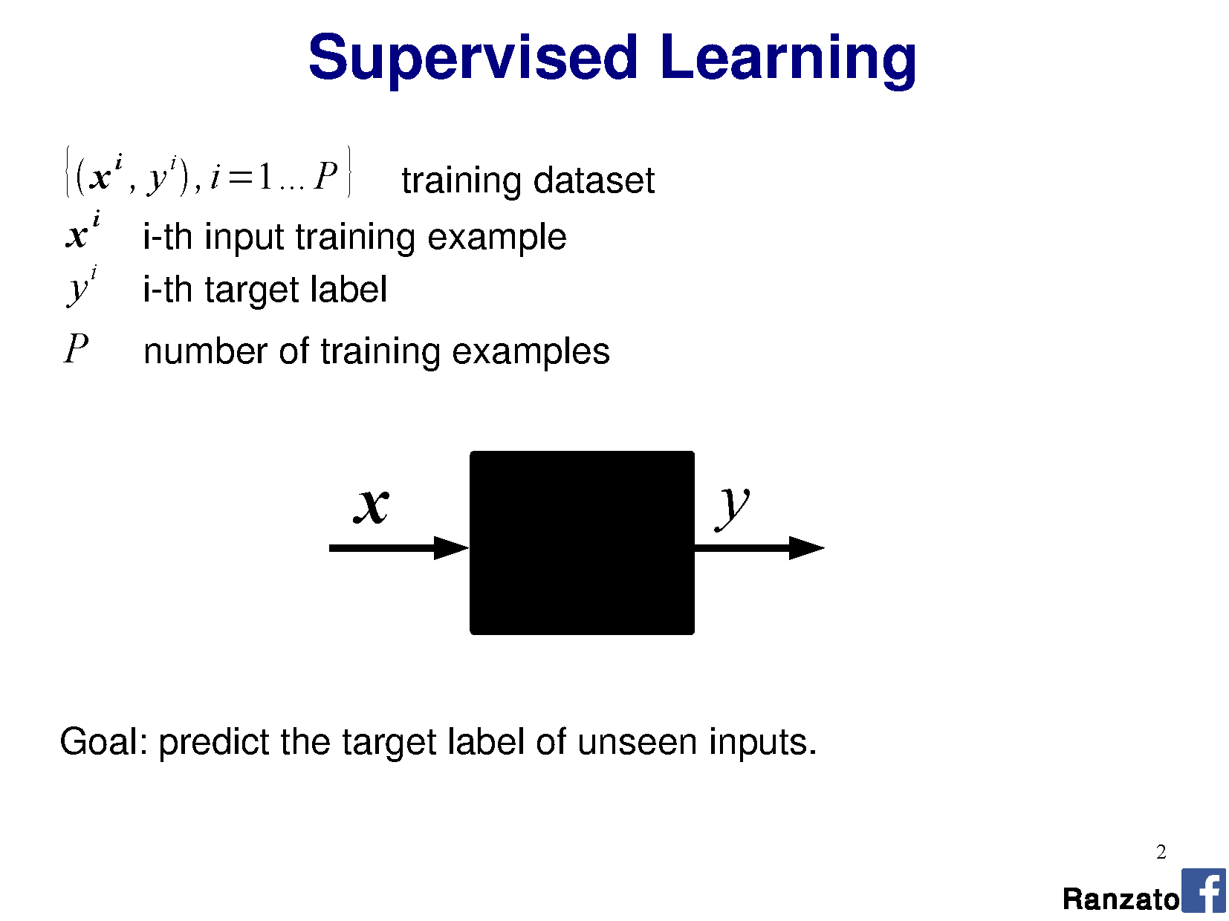

Slide 6
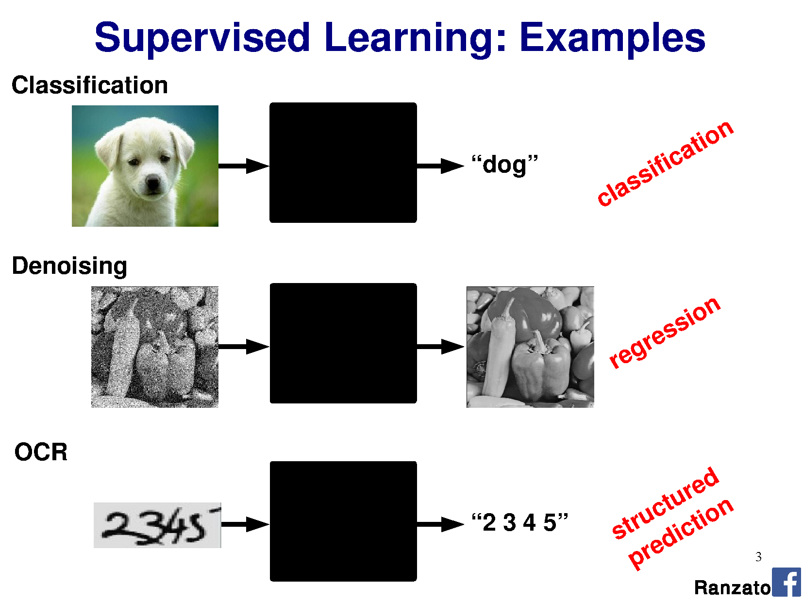

Slide 7
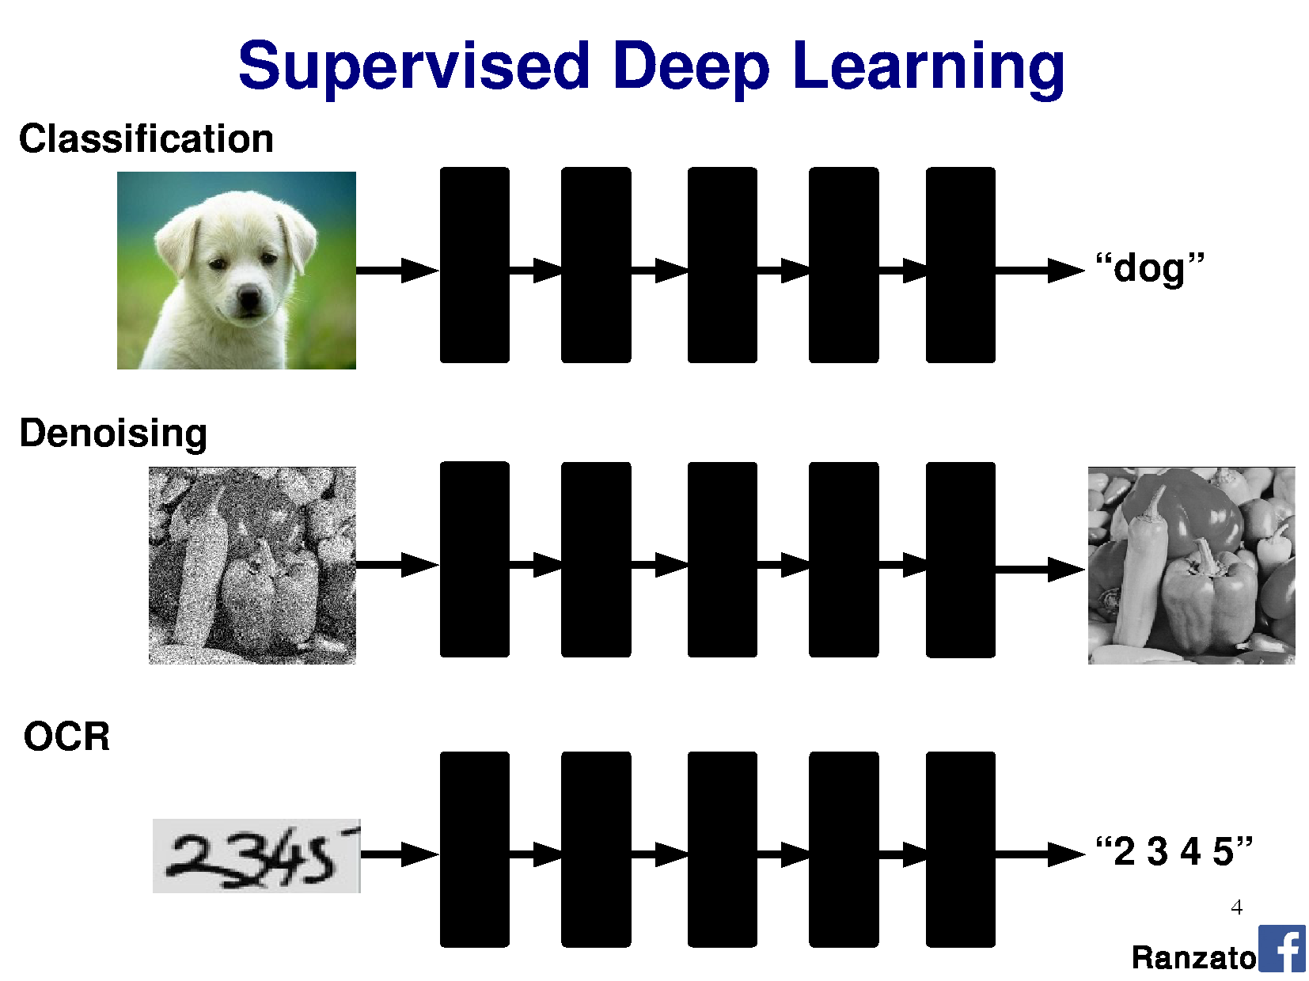

Slide 8
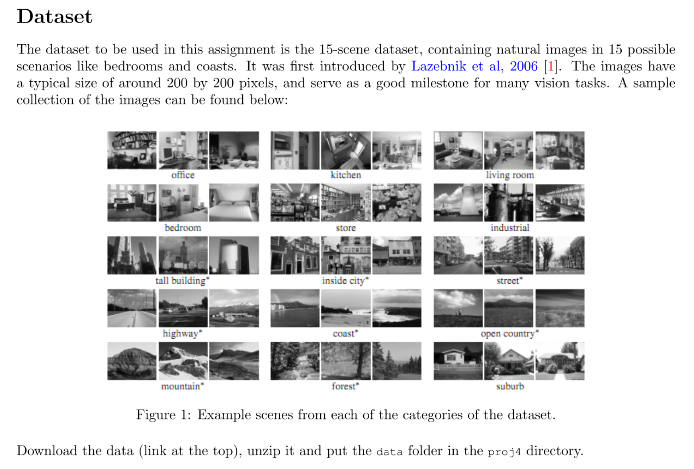
Project 3: Scene Classification with Deep Nets

Slide 9
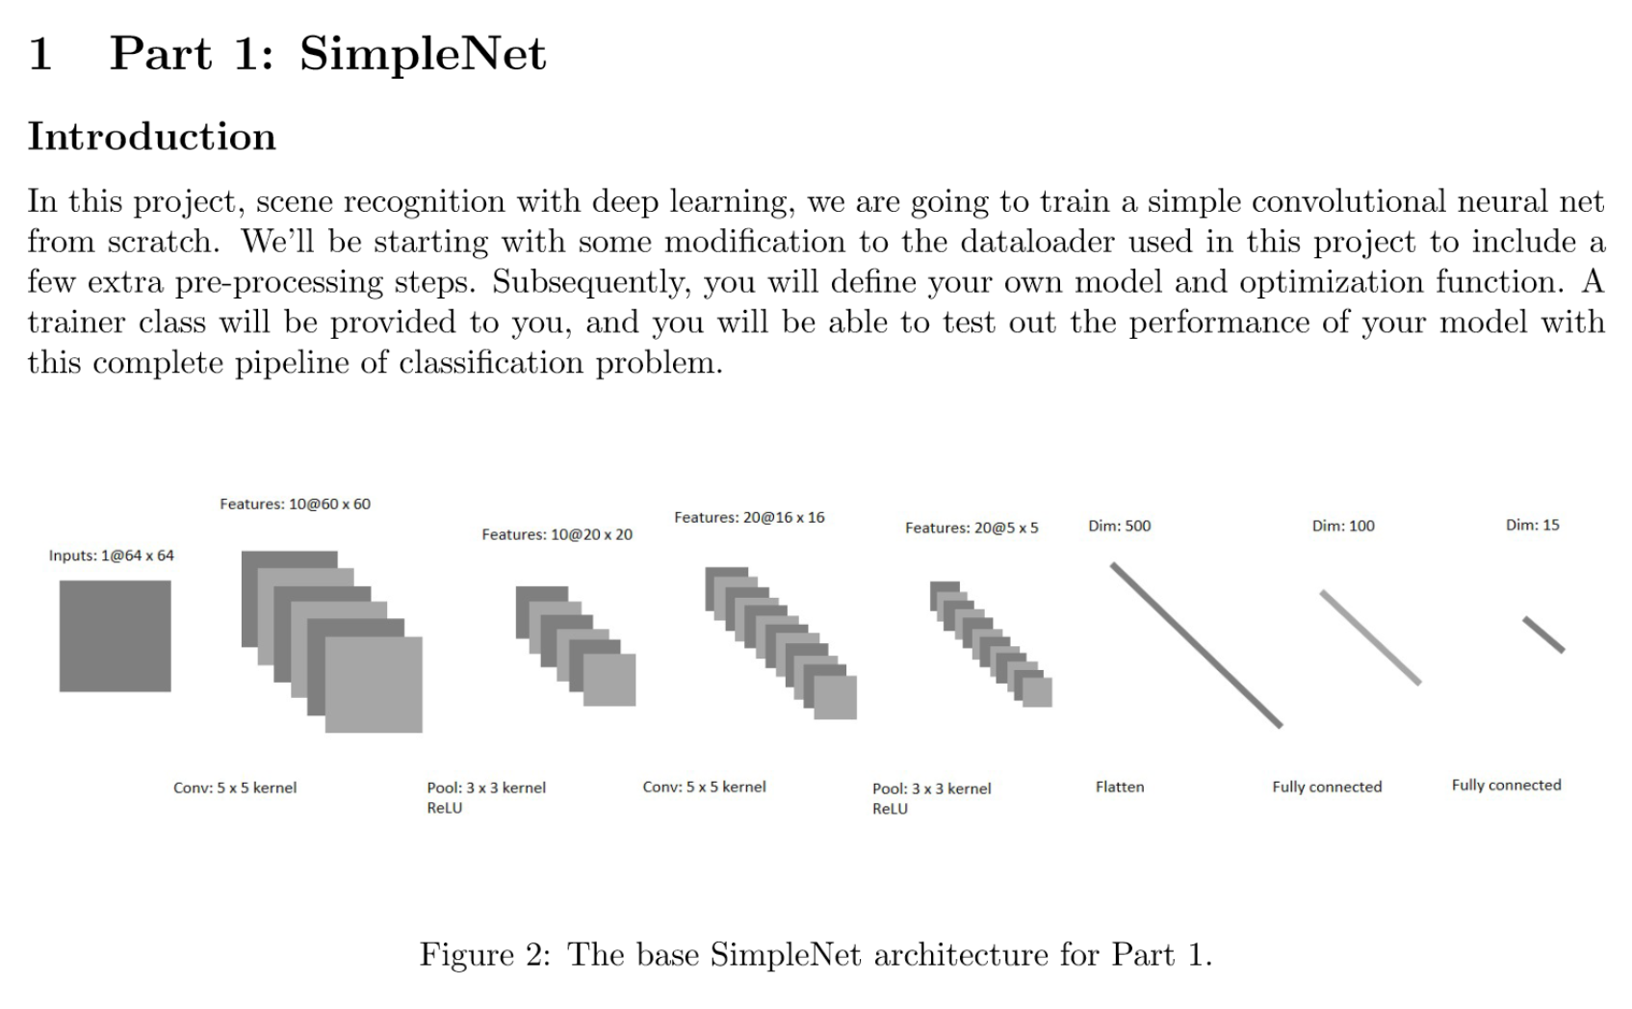

Slide 10
Outline
Neural Networks
Convolutional Neural Networks
Variants
Detection
Segmentation
Siamese Networks
Visualization of Deep Networks

Slide 11
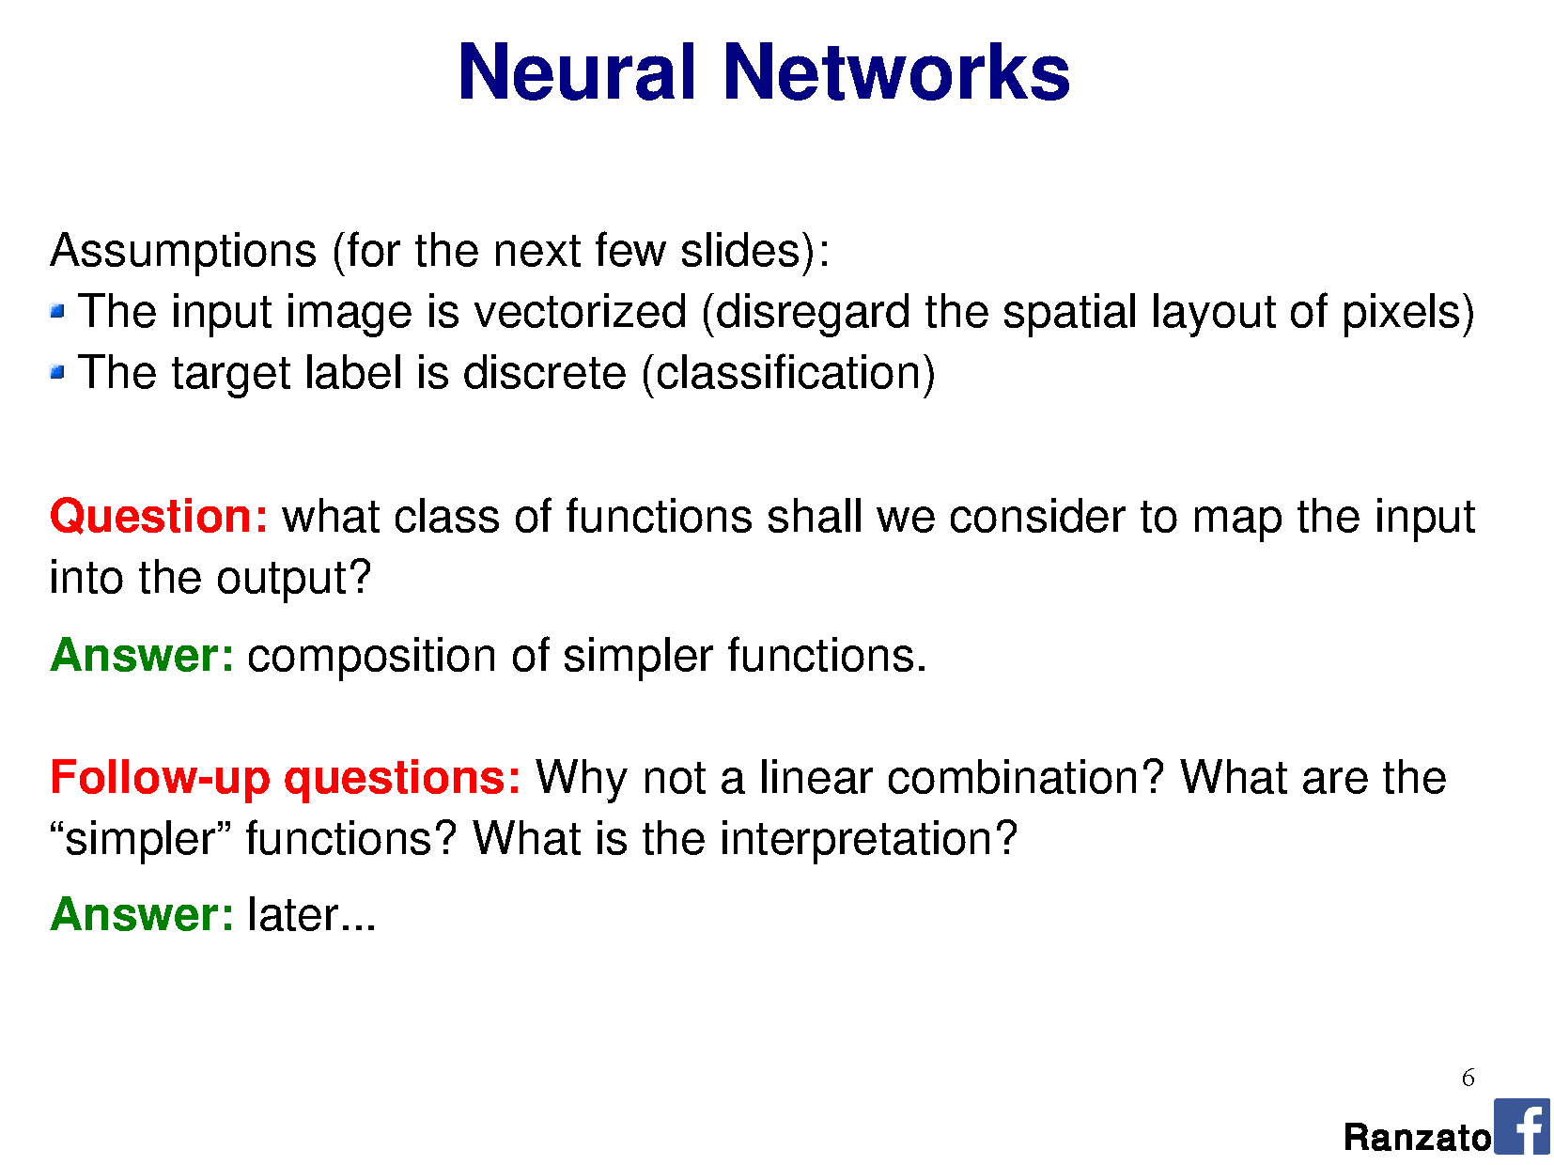

Slide 13
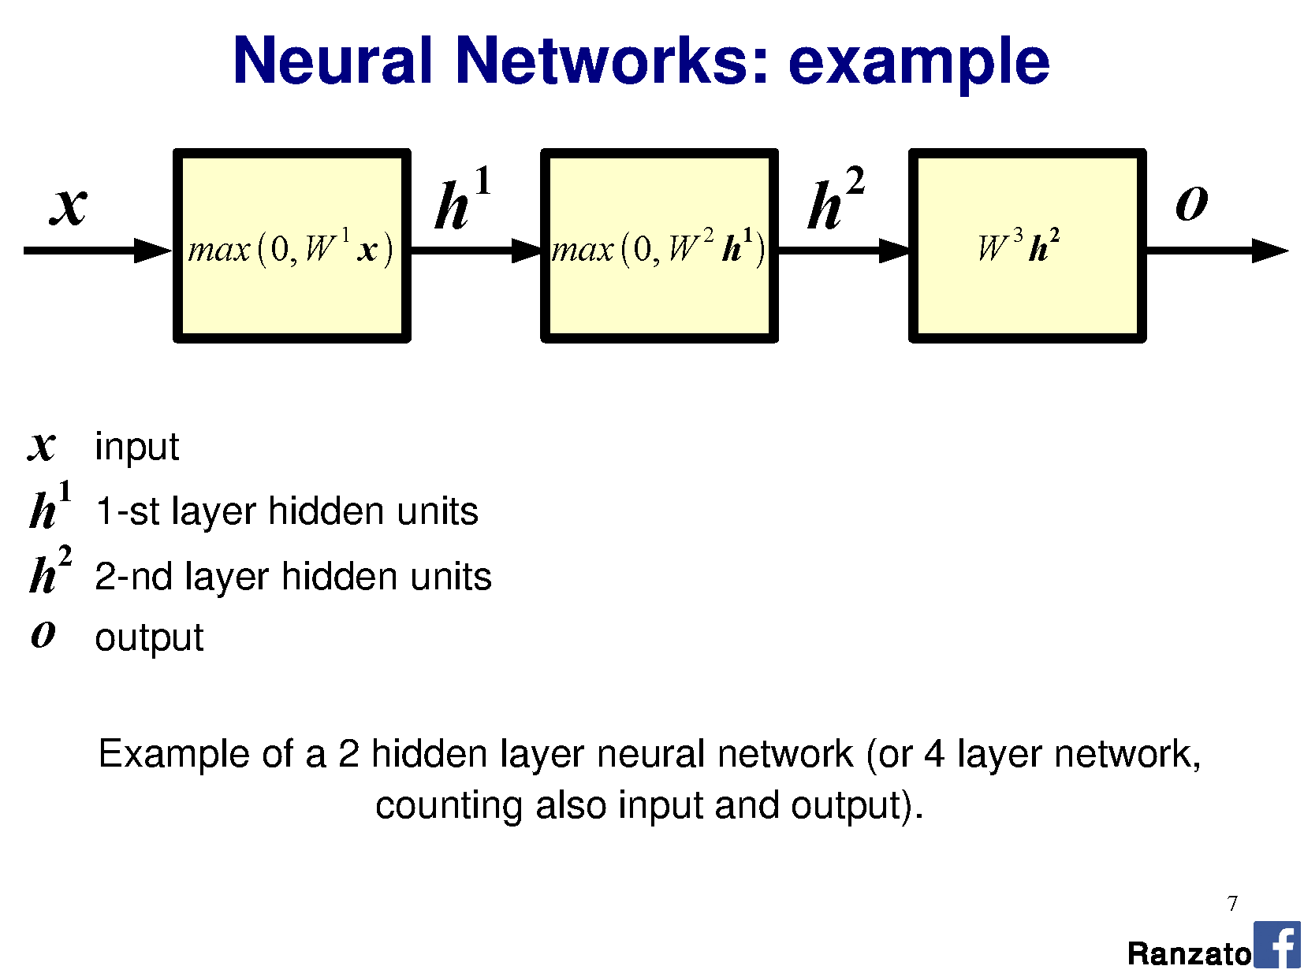


Slide 14
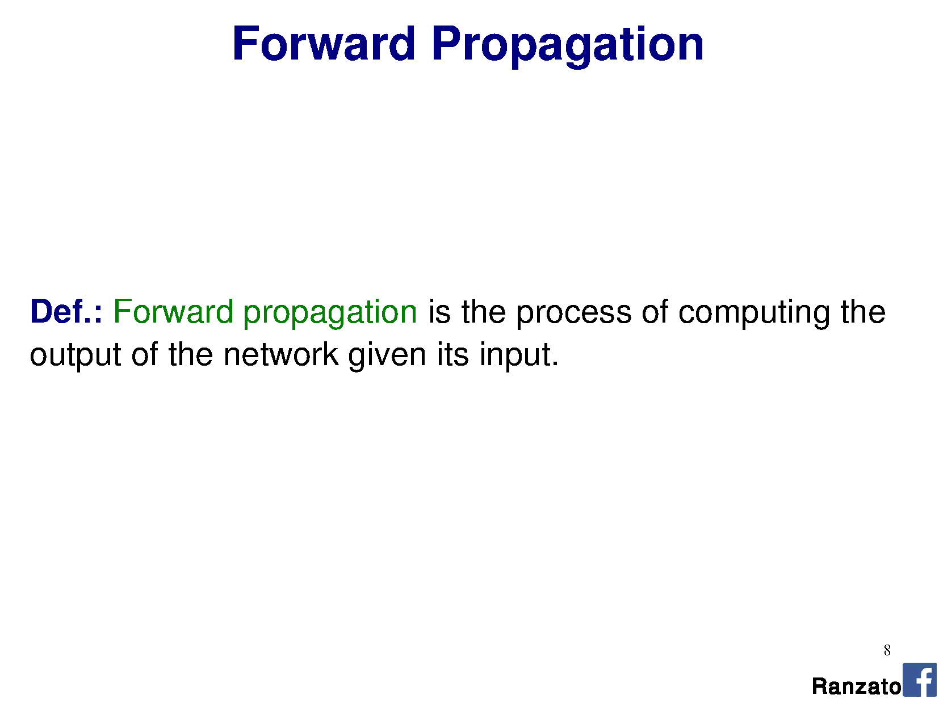

Slide 15
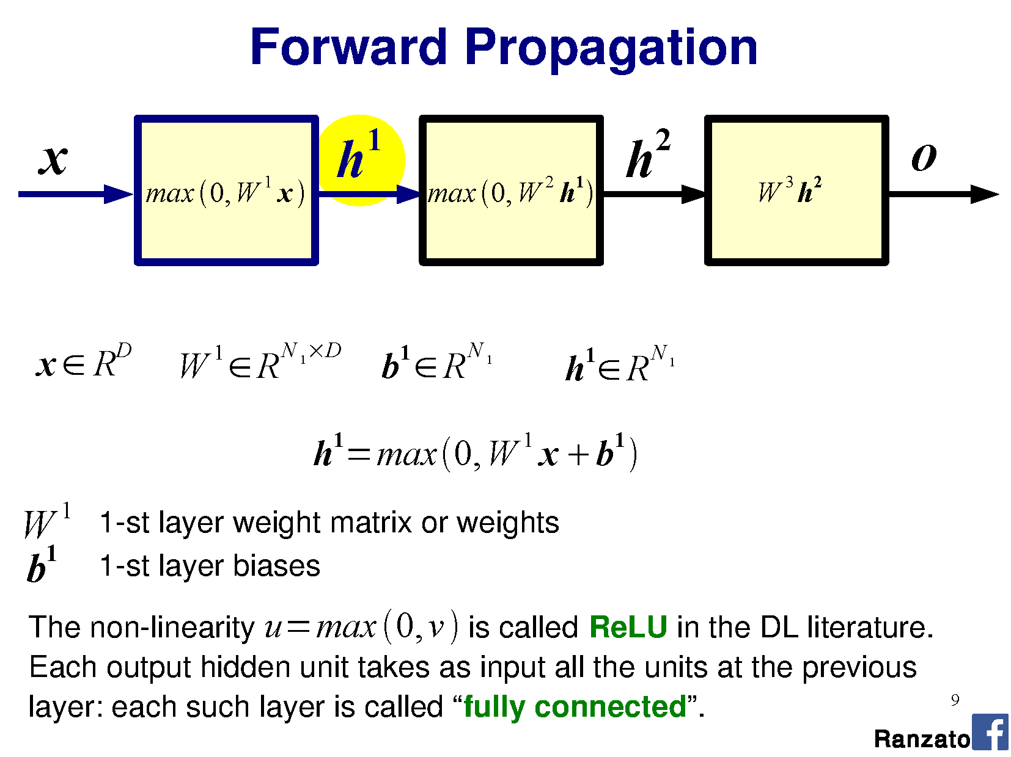

Slide 16
W1 200x256
+
=
x 256x1
h1 200x1
b1 200x1

Slide 17
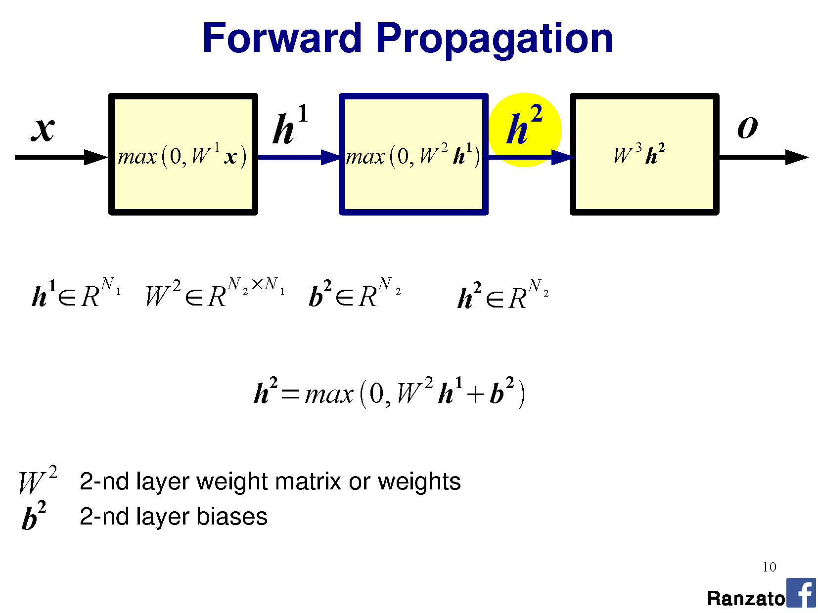

Slide 18
W2 100x200
h1 200x1
=
+
h2 100x1
b2 100x1

Slide 19
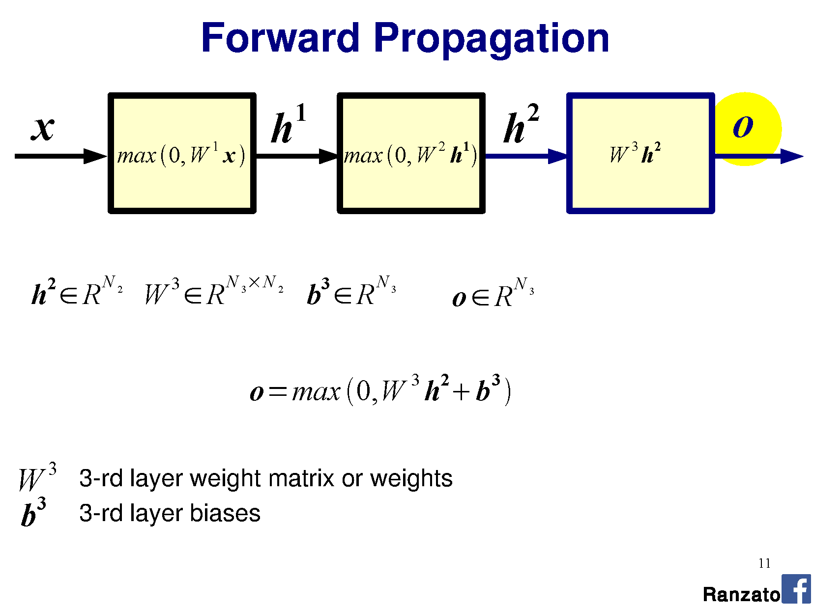

Slide 20
h2 100x1
+
o 15x1
b3 15x1
=
W2 15x100
73,015 learnable parameters for this simple network

Slide 21
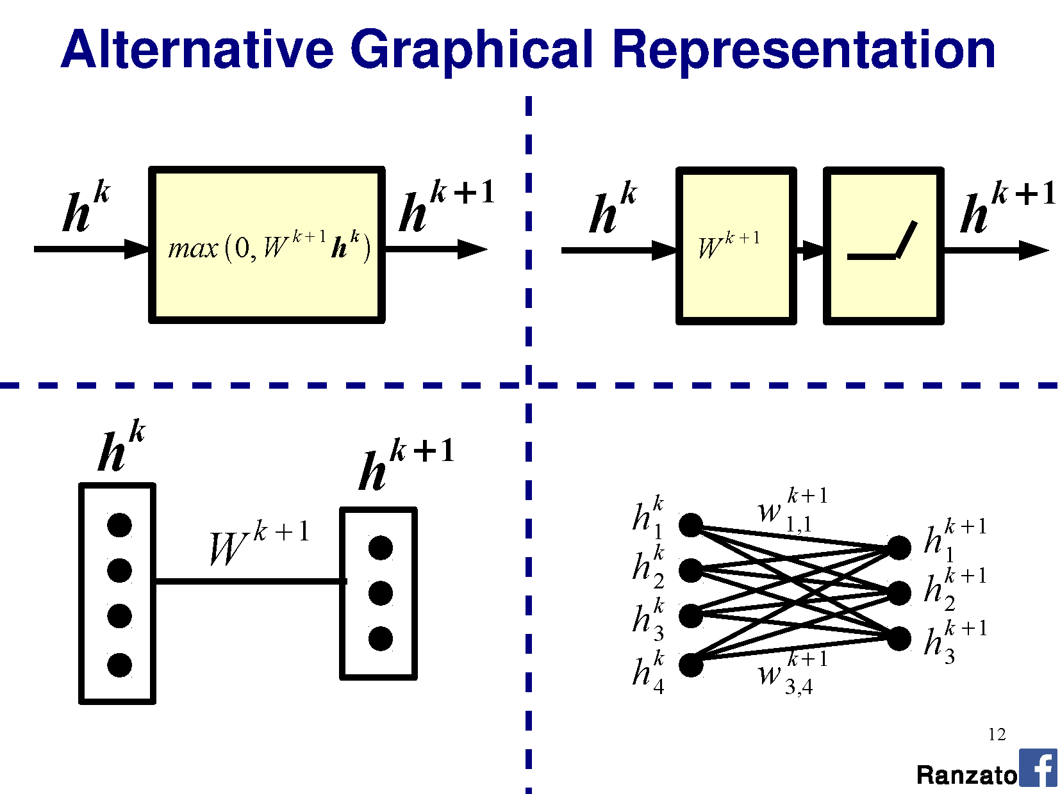

Slide 22
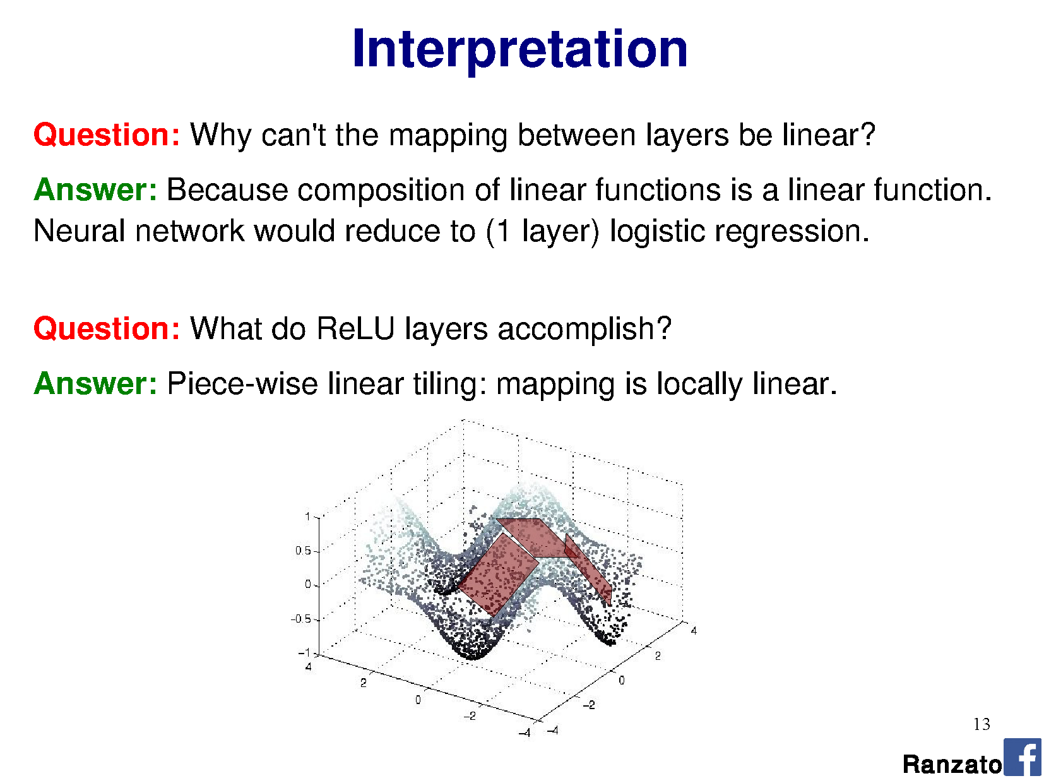

Slide 23
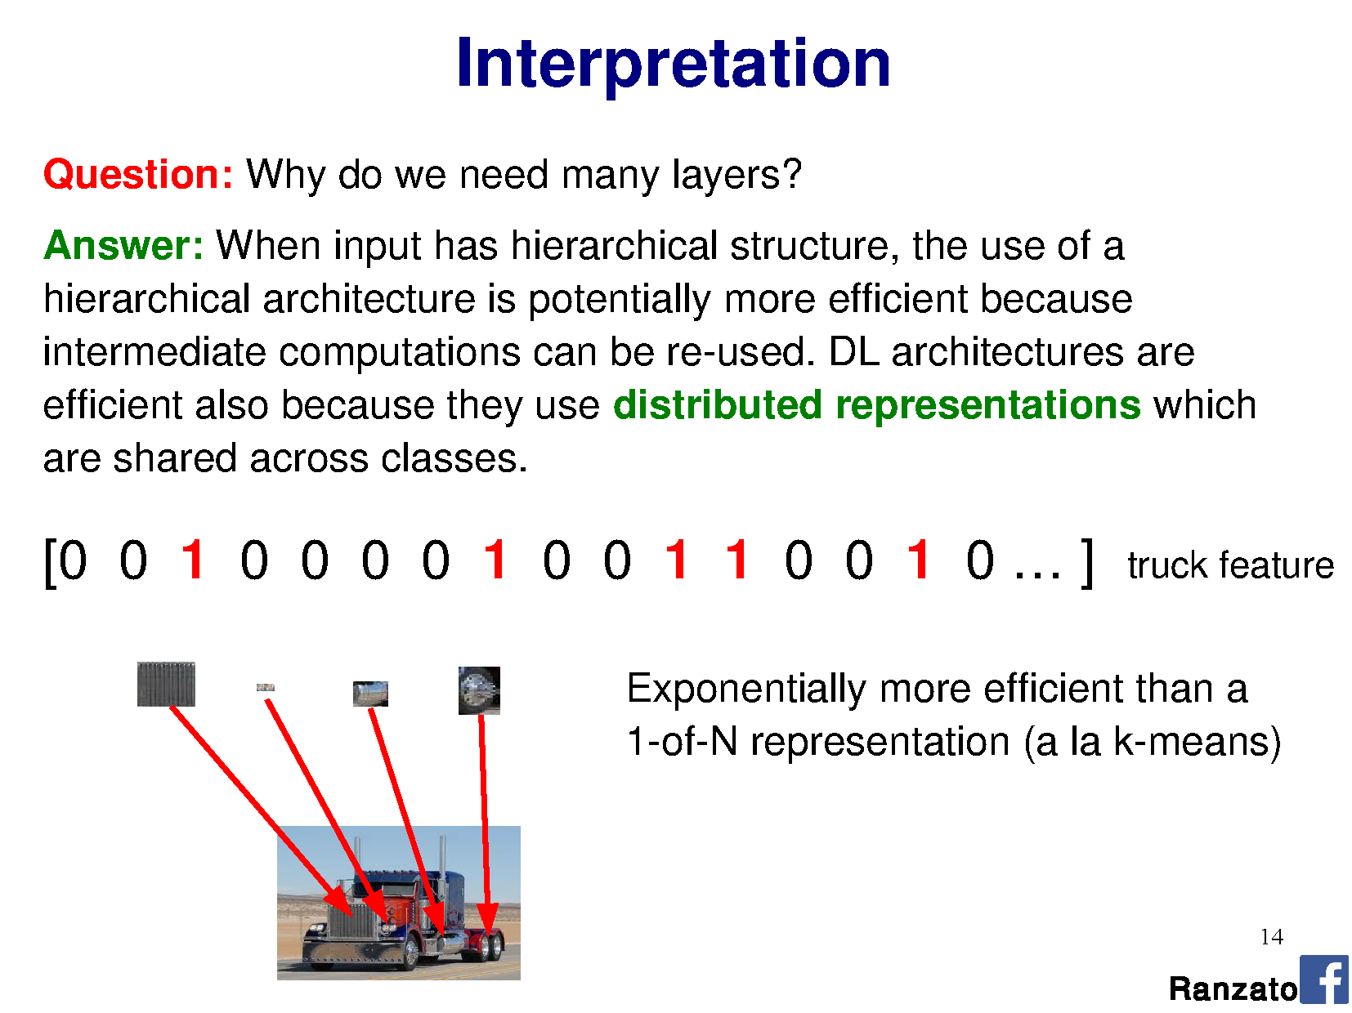

Slide 24
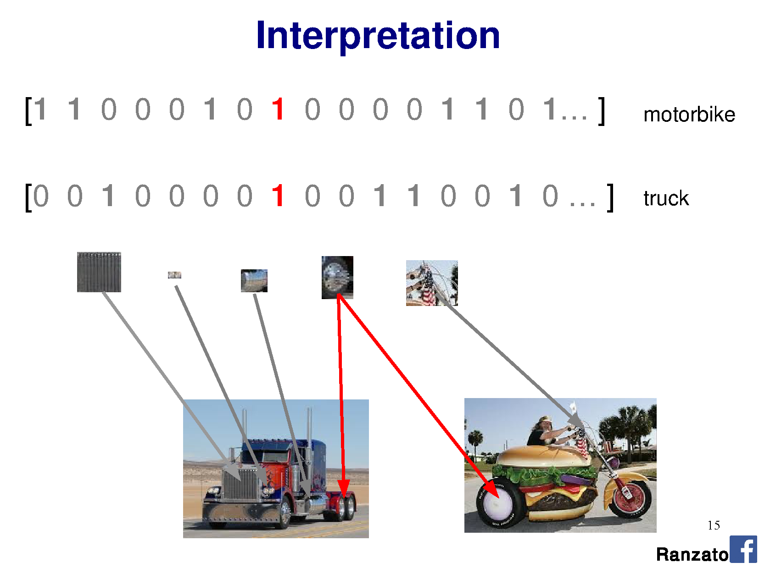

Slide 25
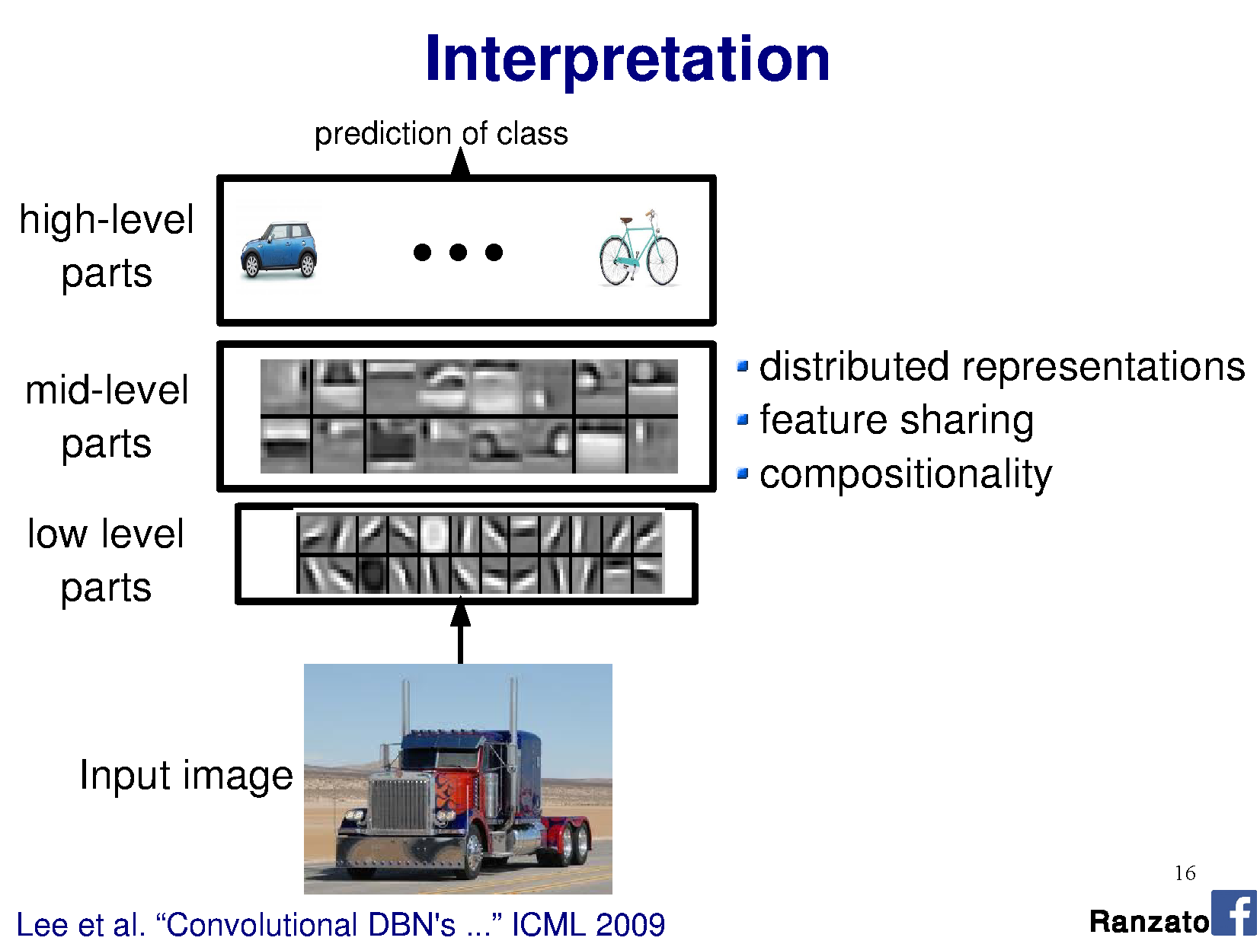

Slide 26
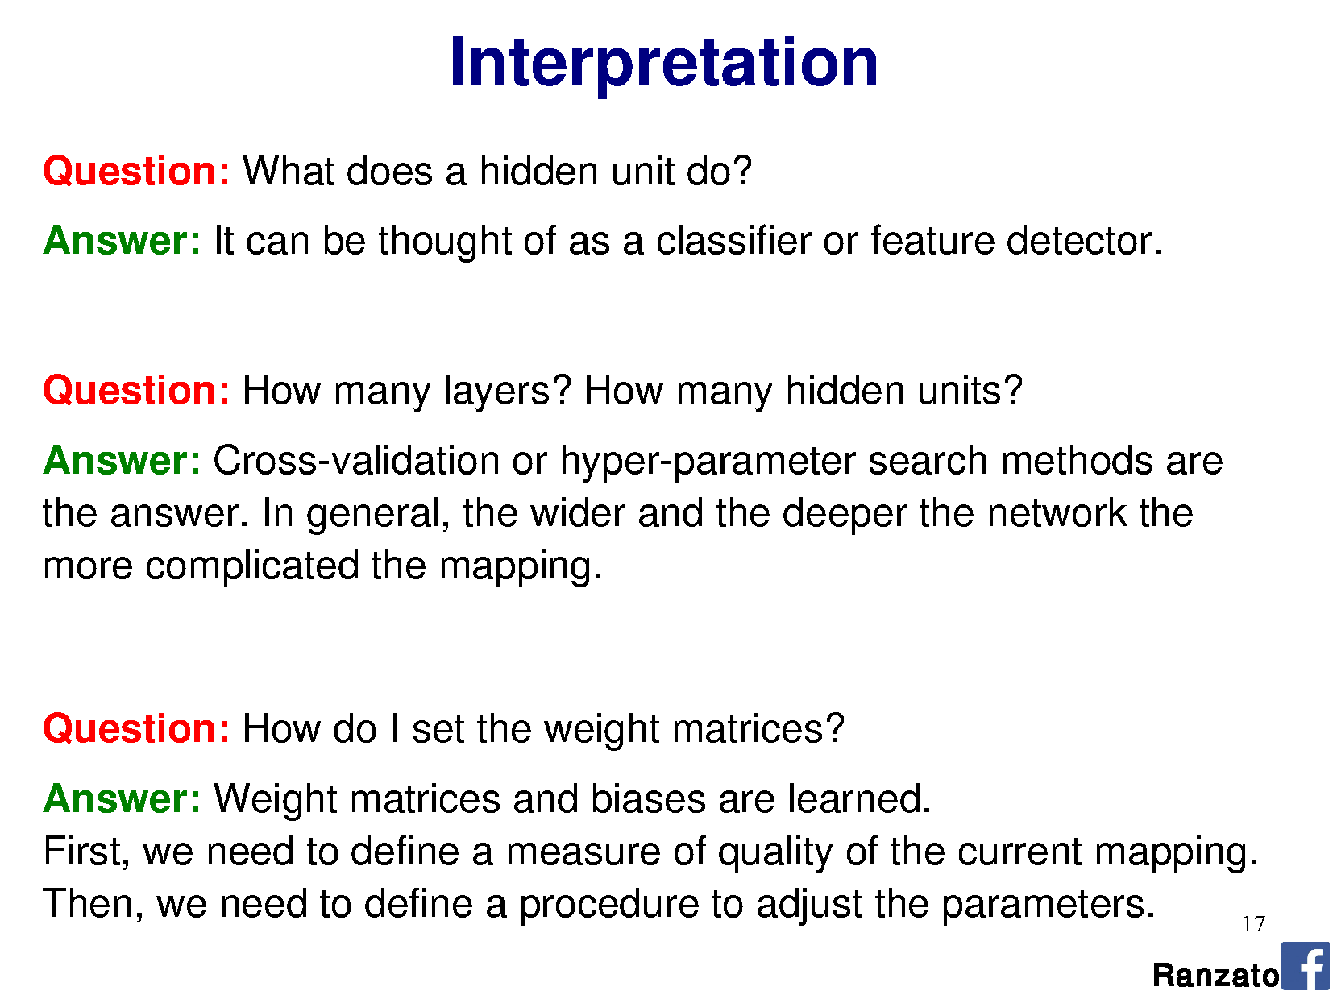

Slide 29
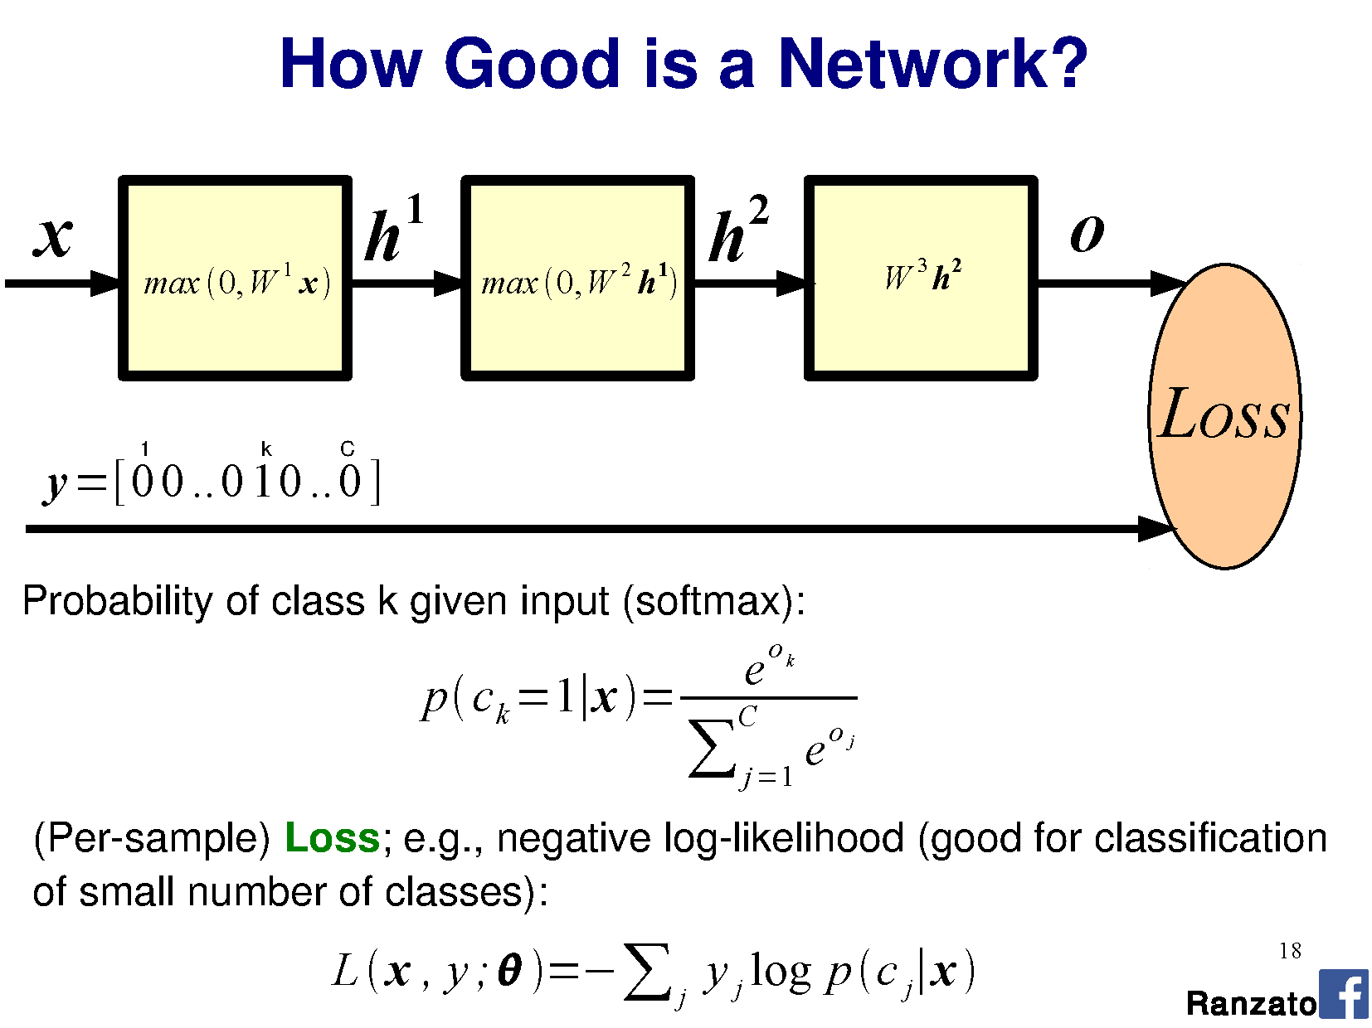

Slide 30
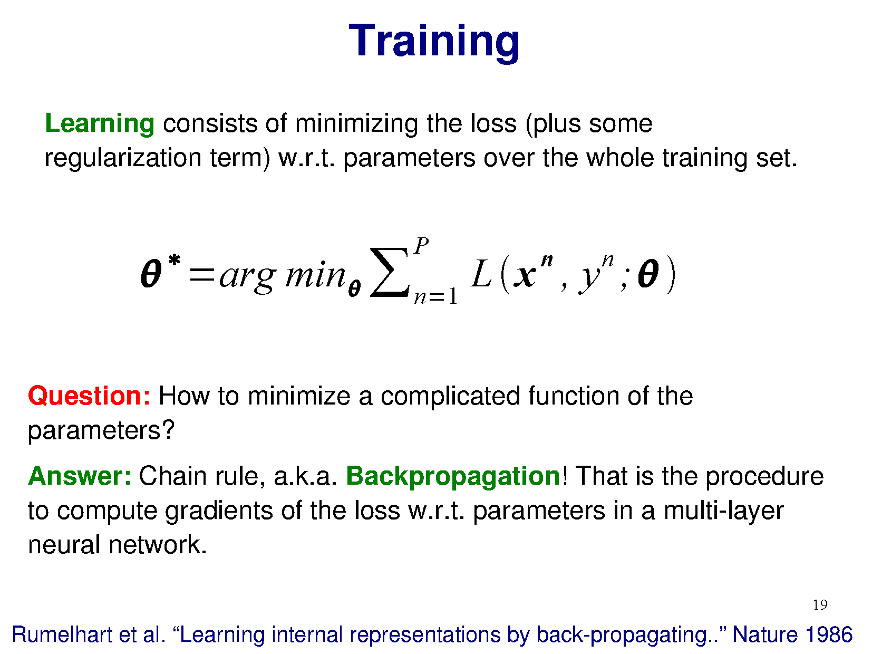

Slide 32
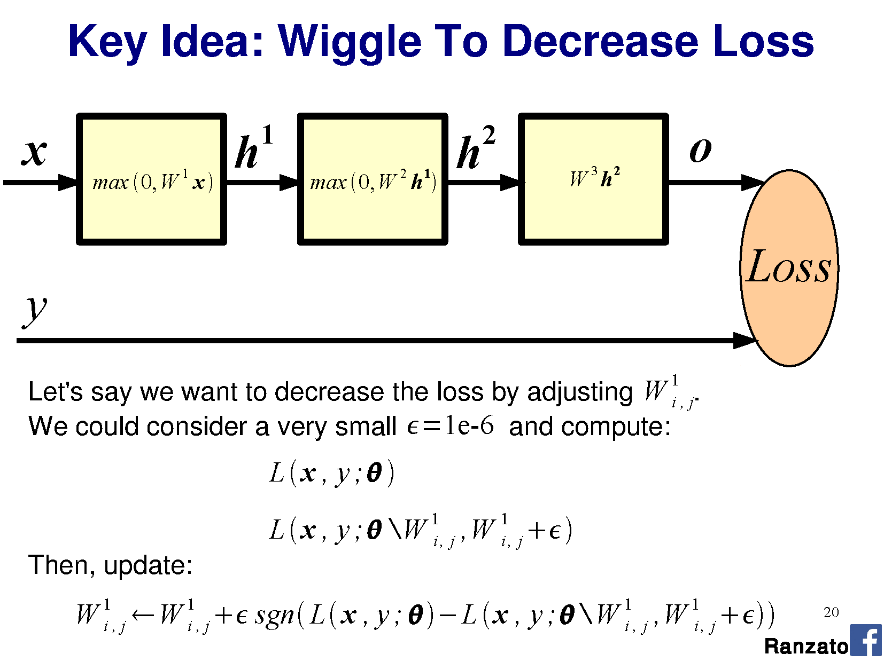

Slide 33
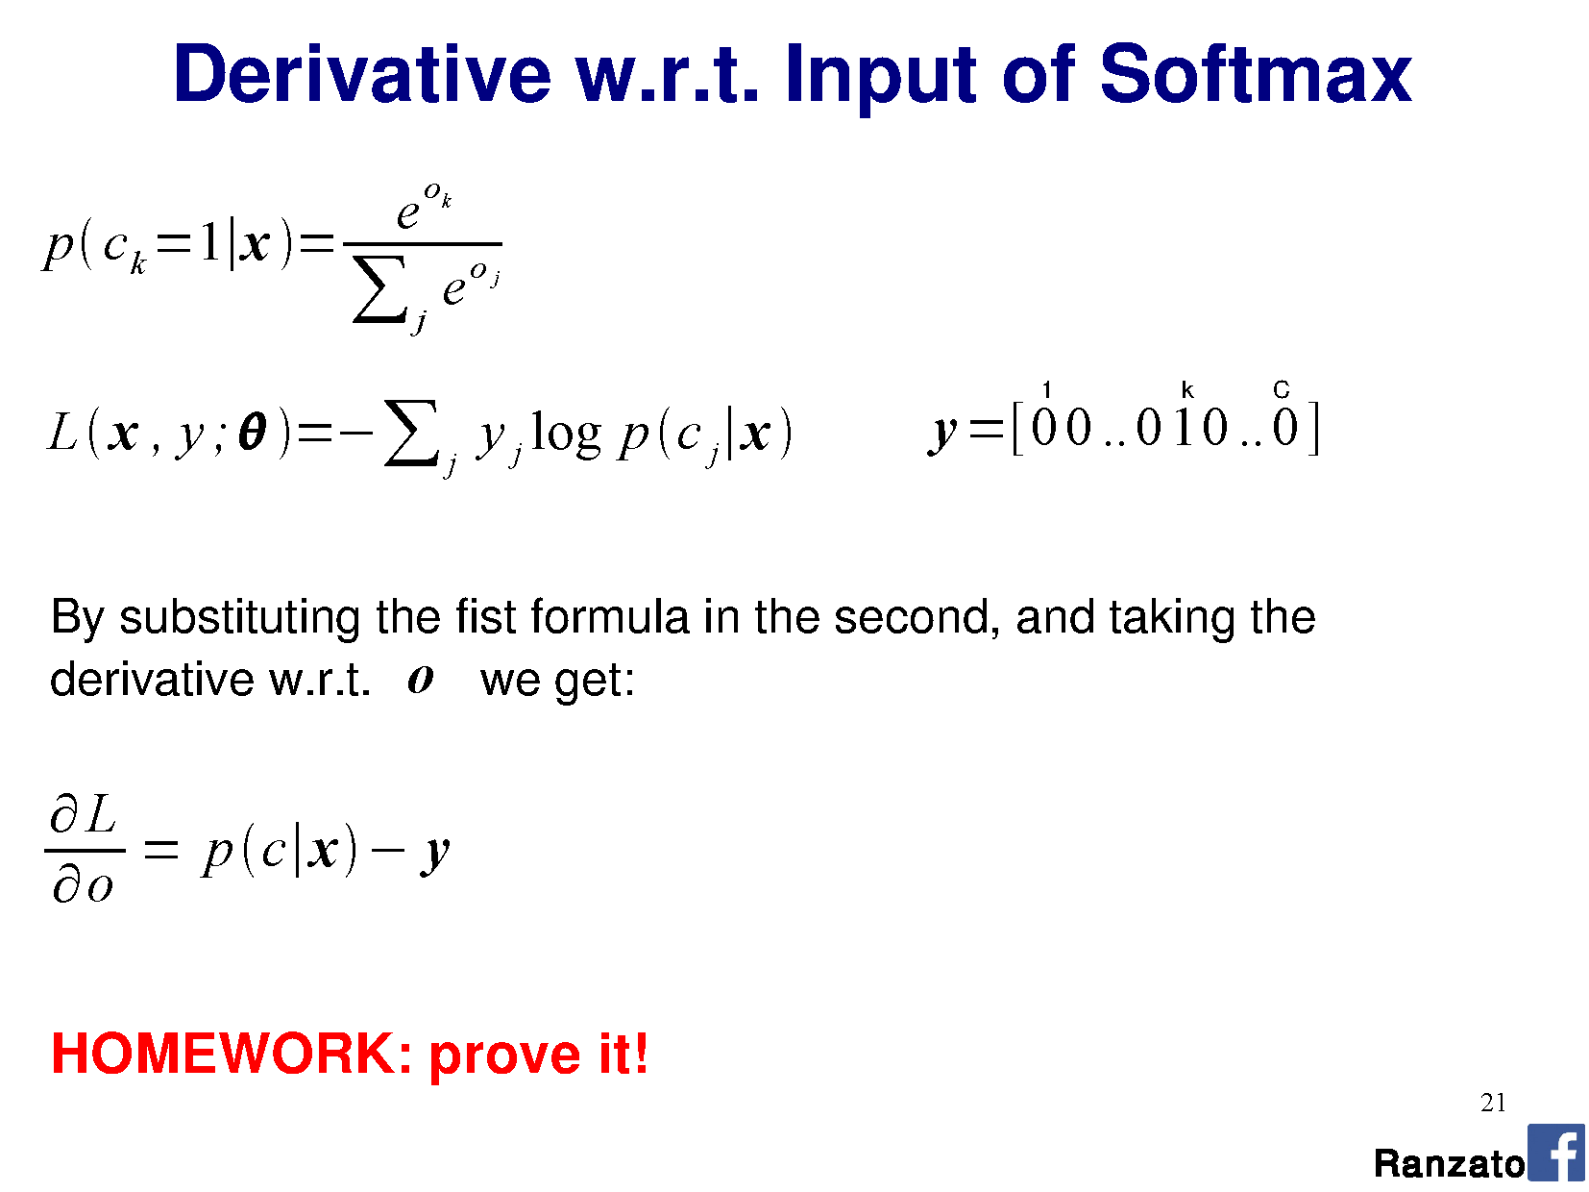

Slide 34
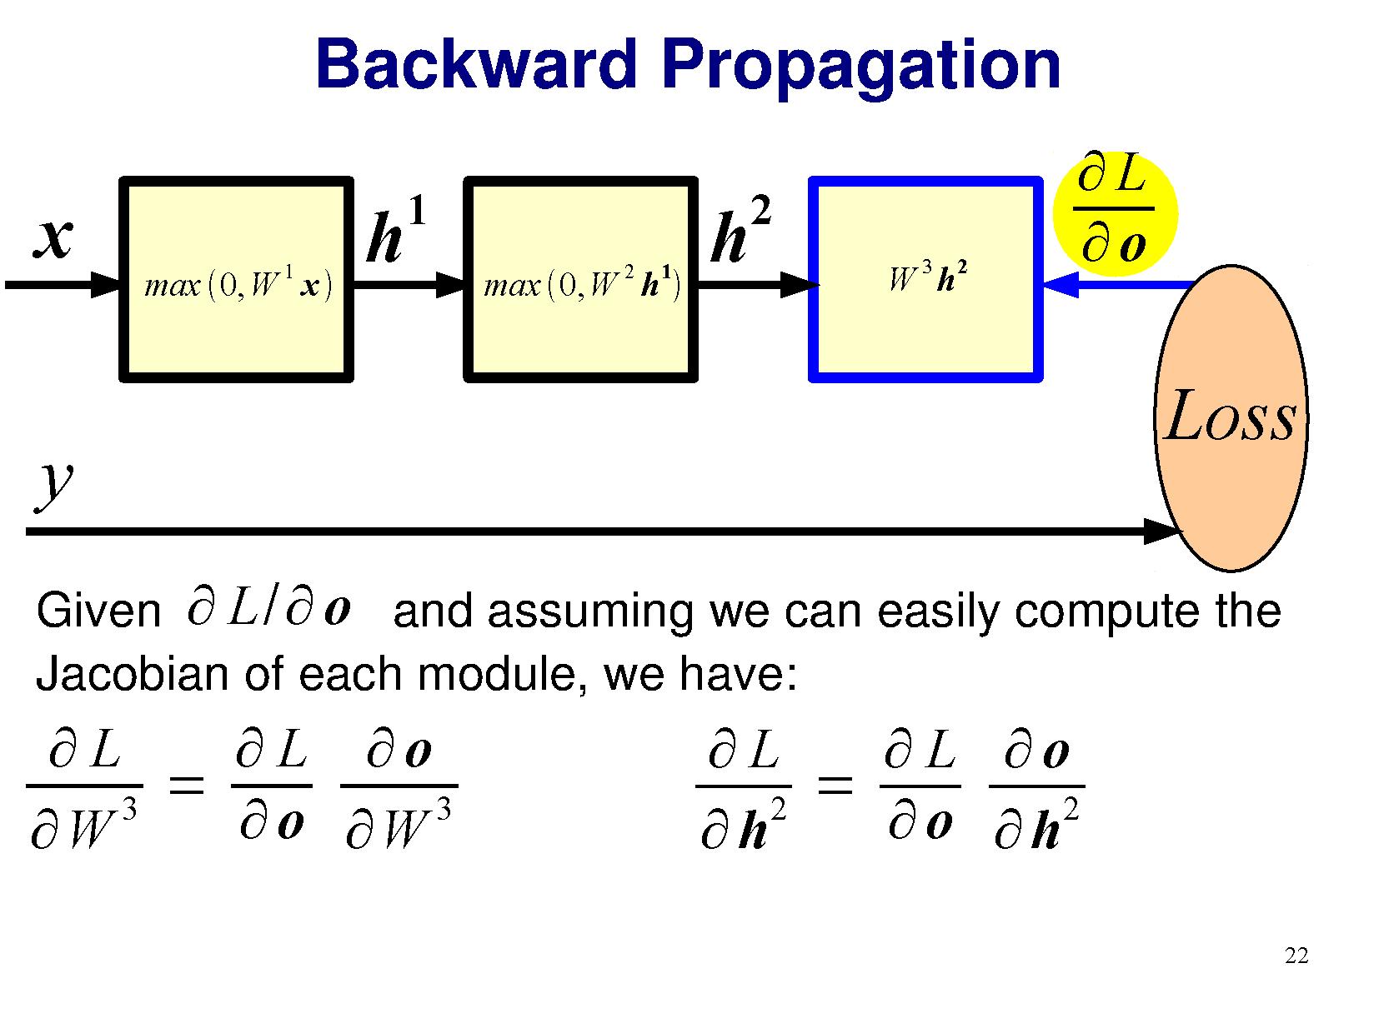

Slide 35
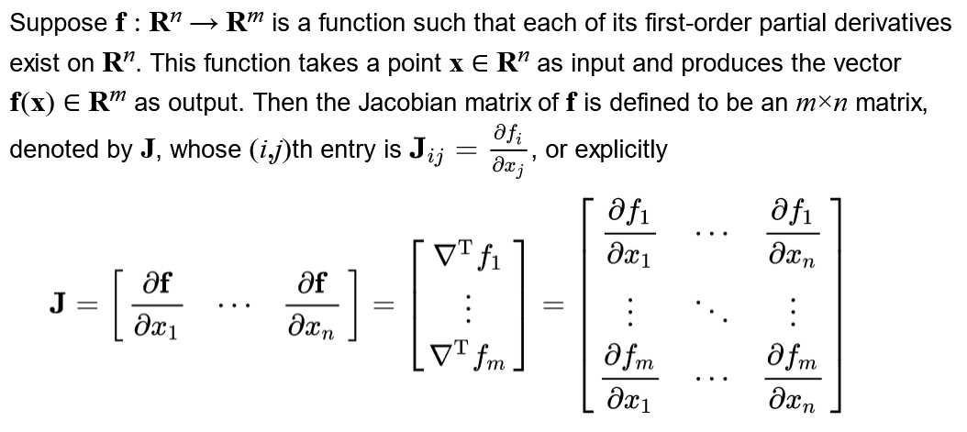

Slide 37
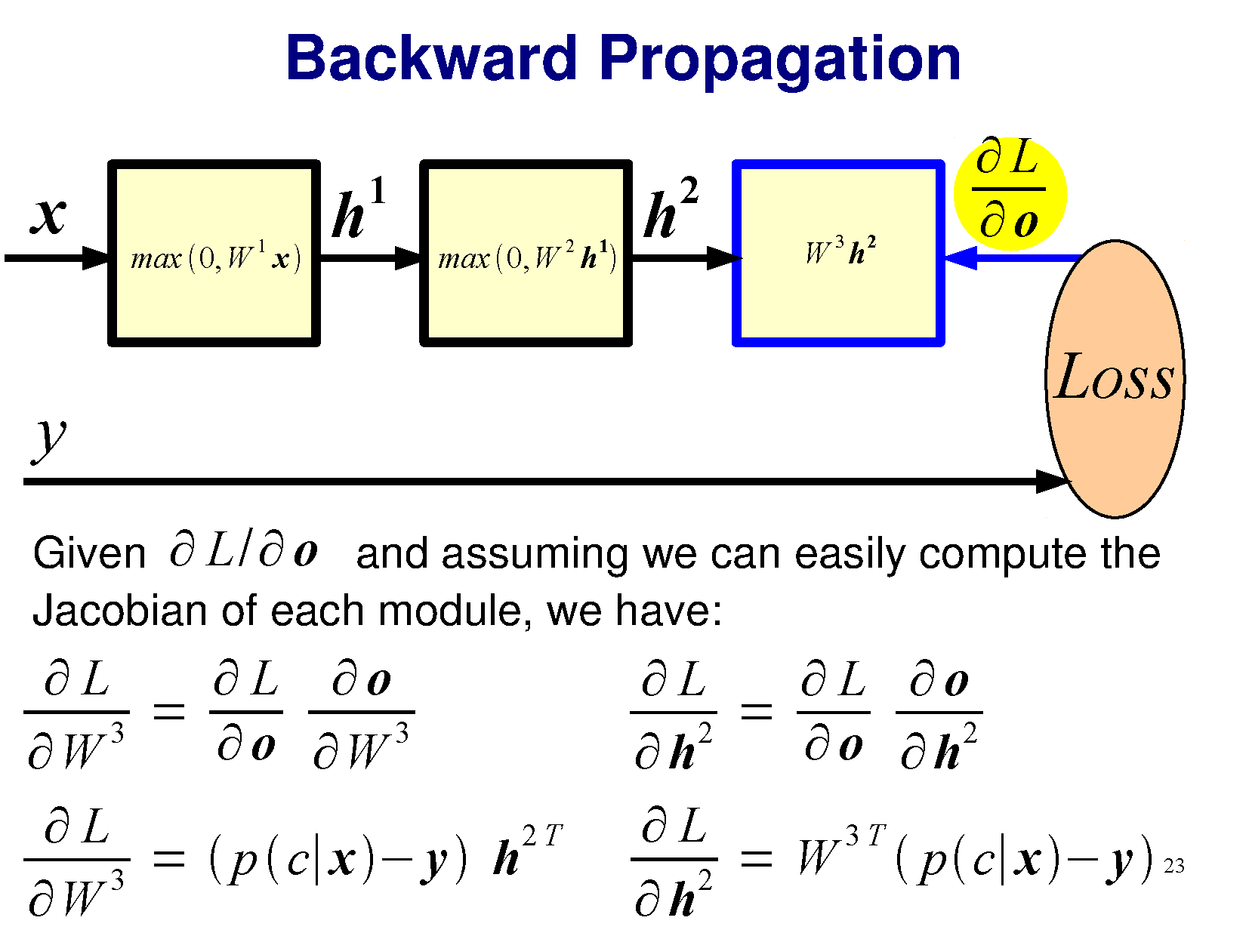

Slide 38
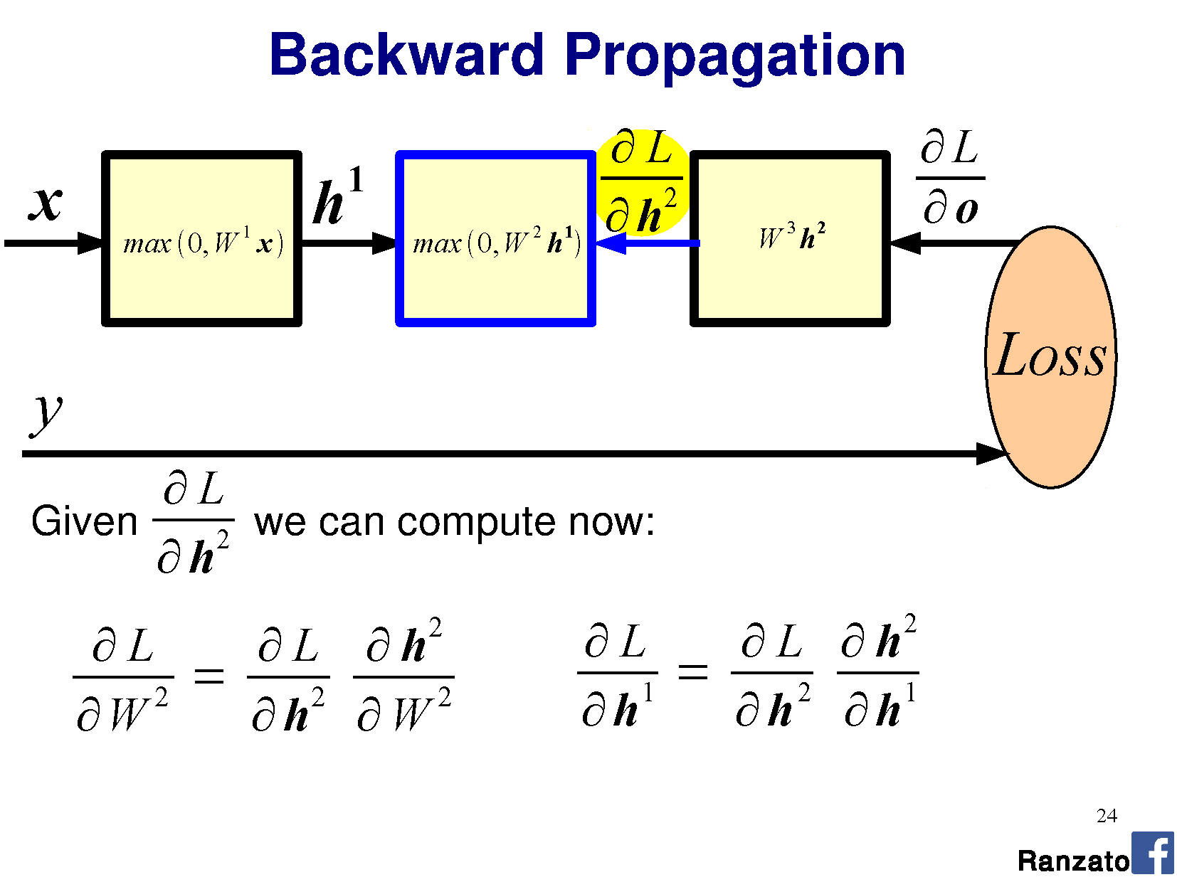

Slide 39
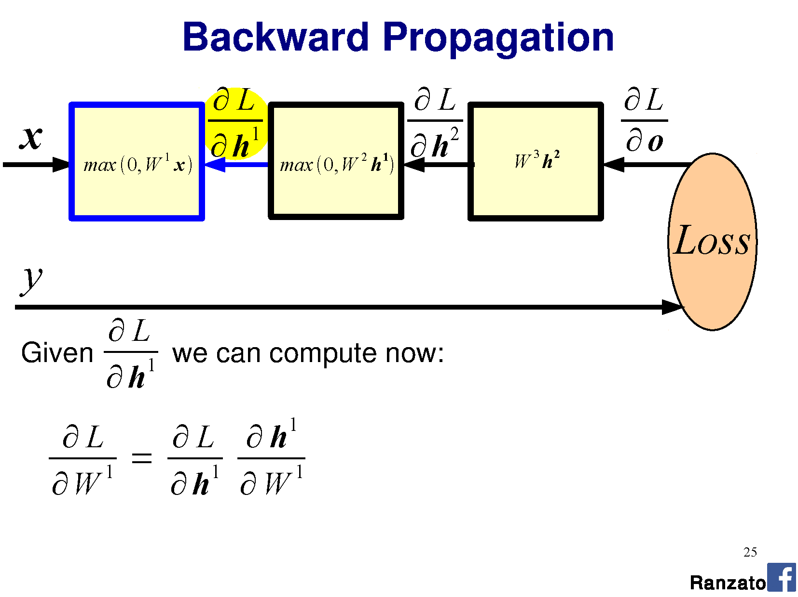

Slide 40
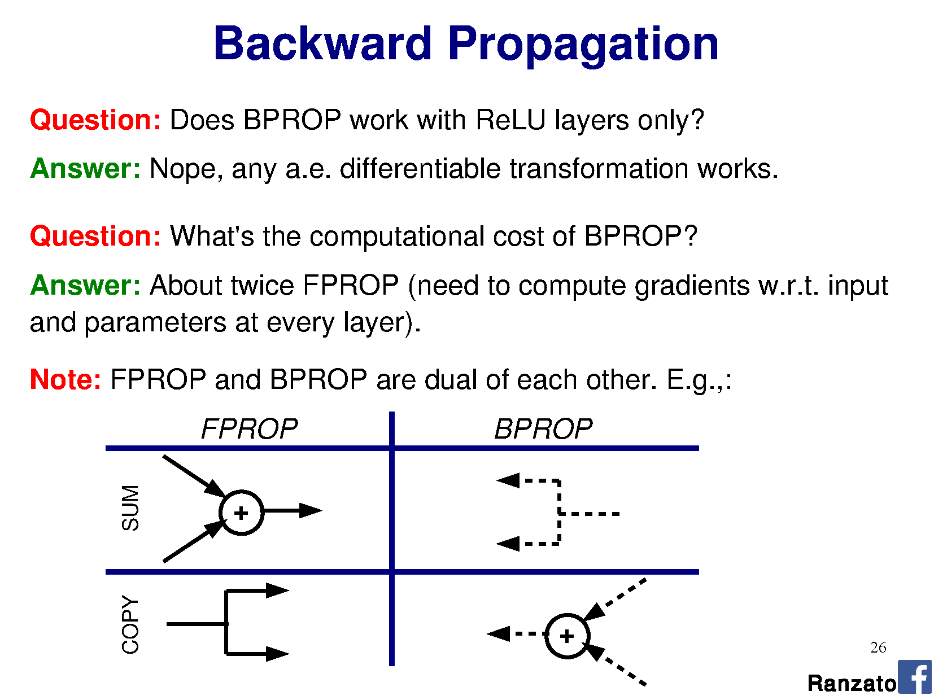

Slide 42
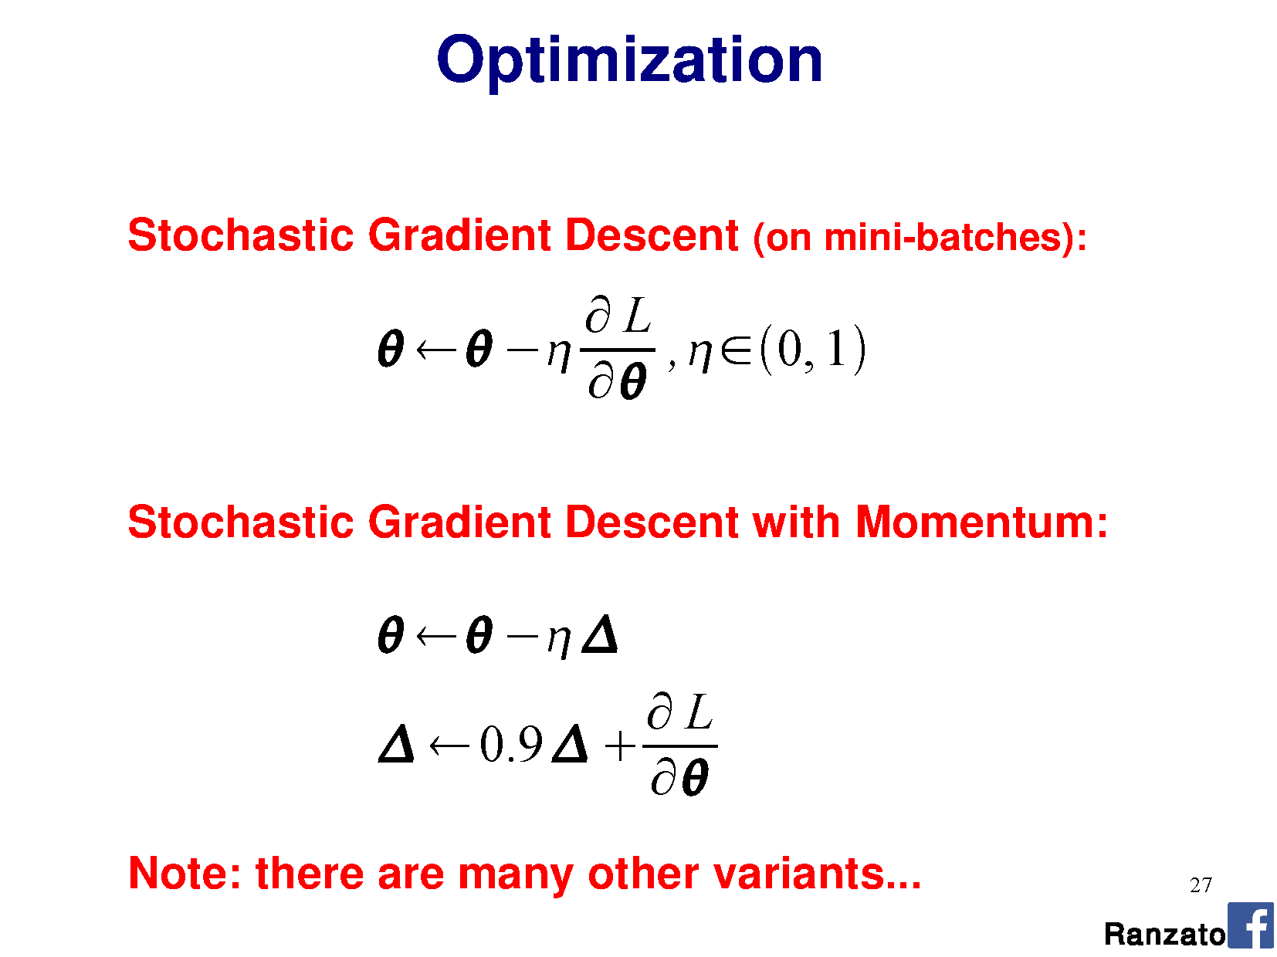

Slide 43
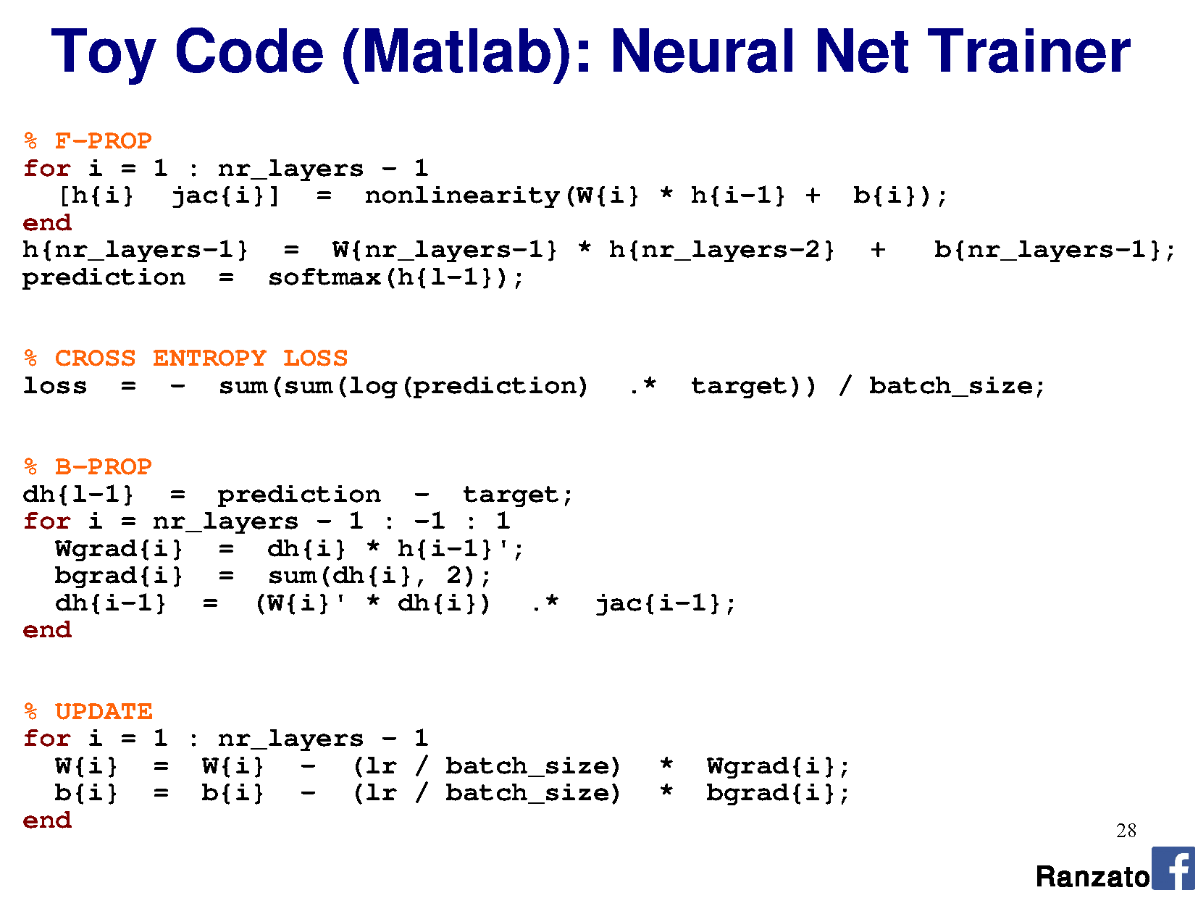

Slide 44
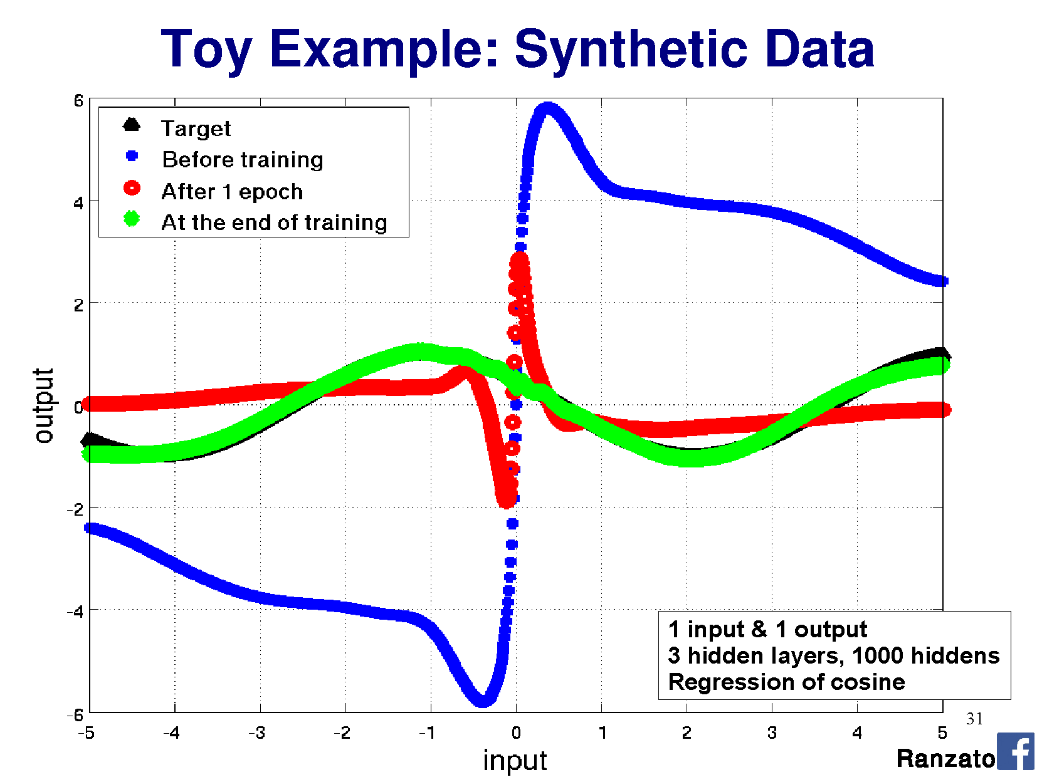

Slide 45
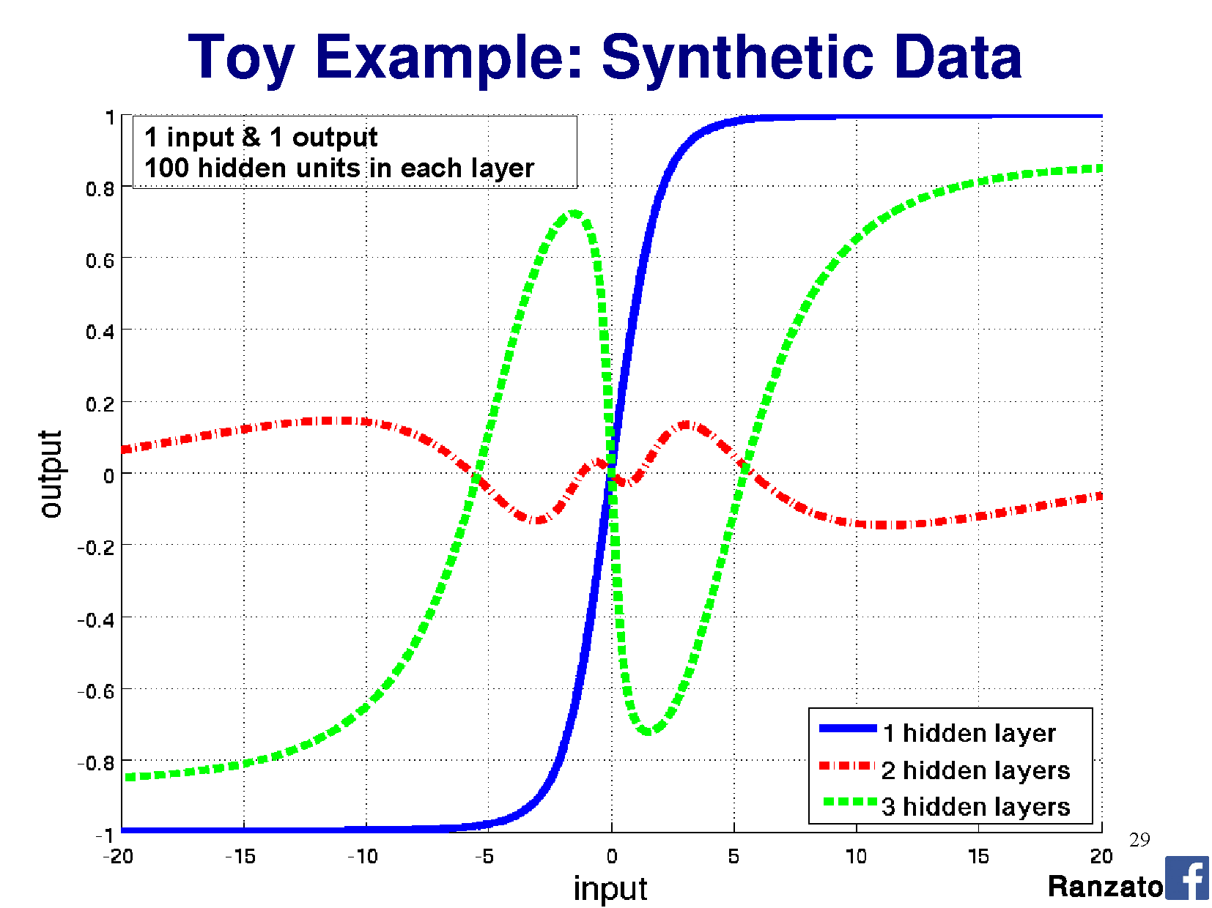

Slide 46
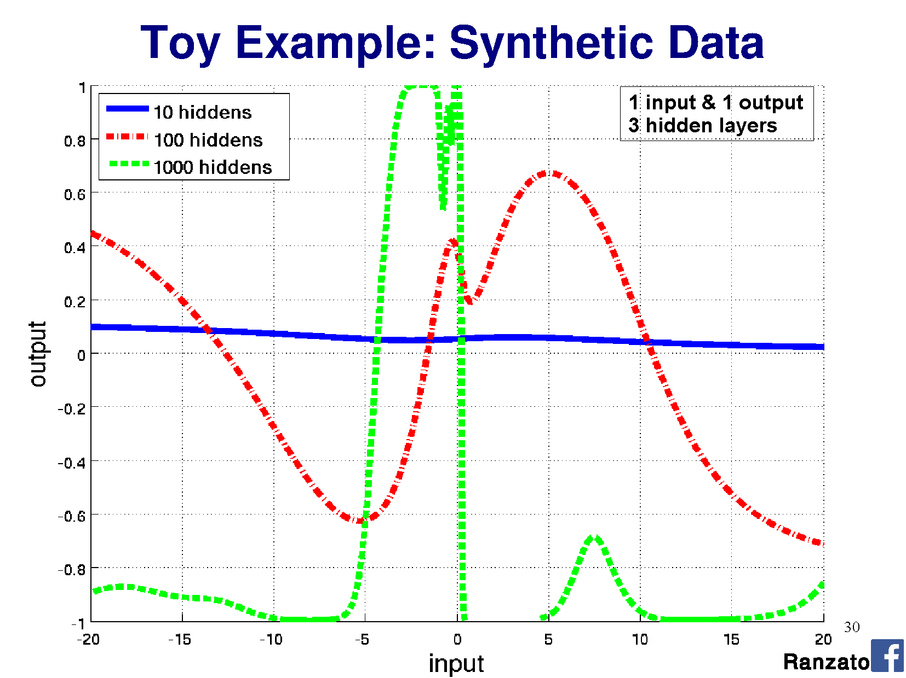

Slide 47
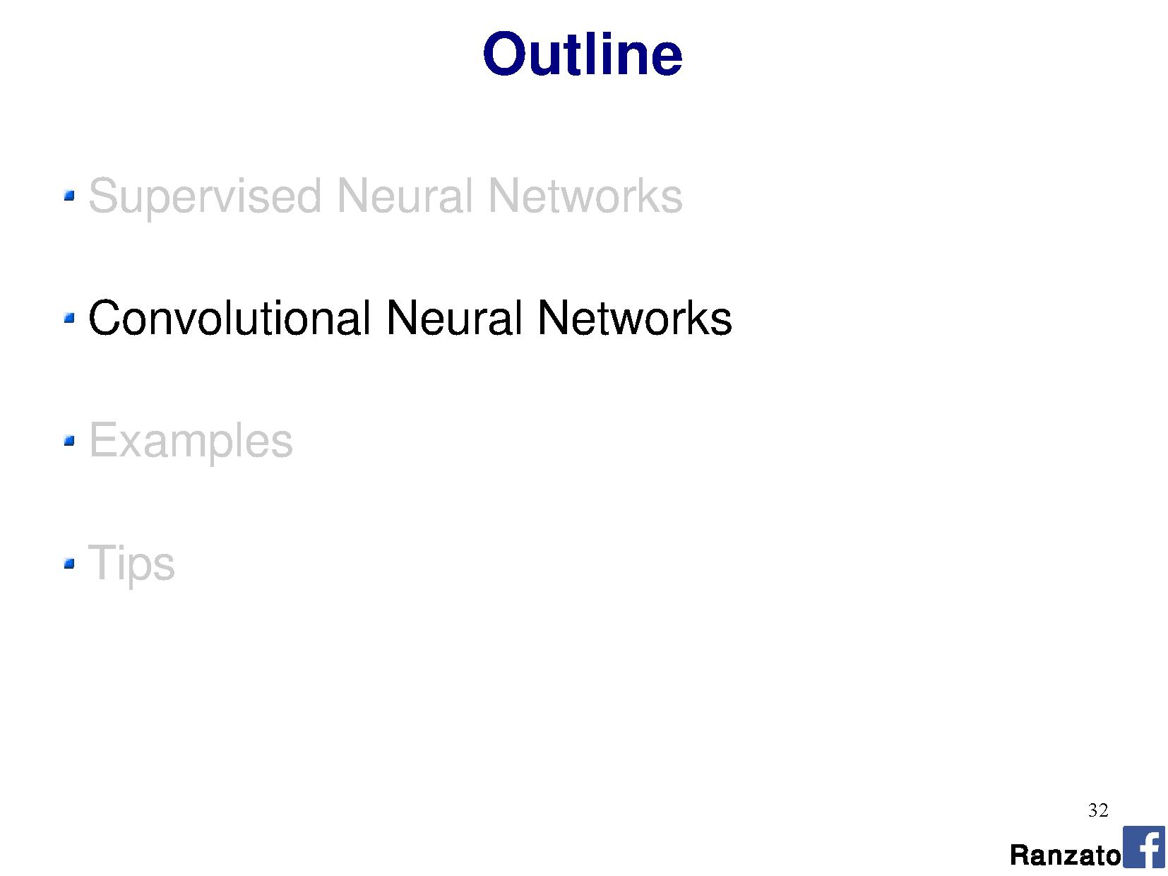

Slide 49
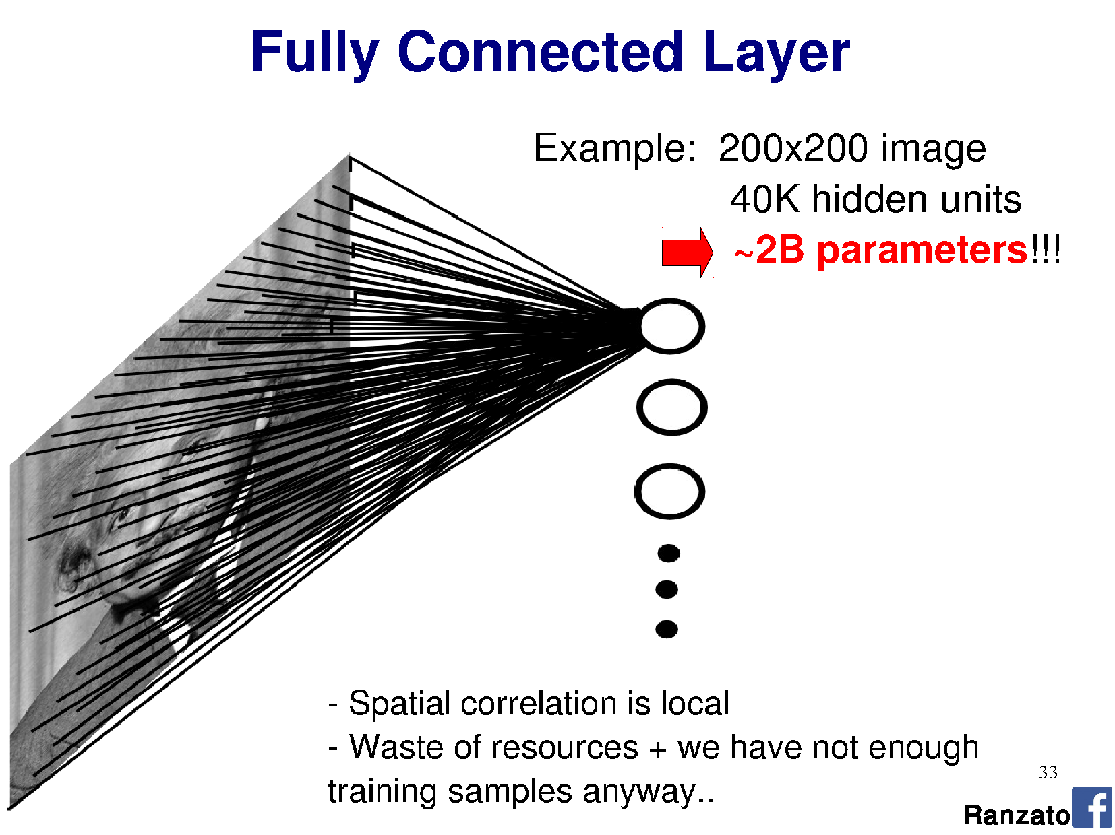

Slide 50
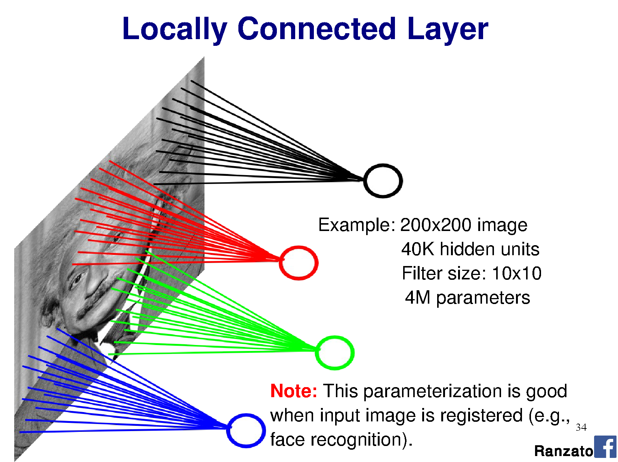

Slide 51
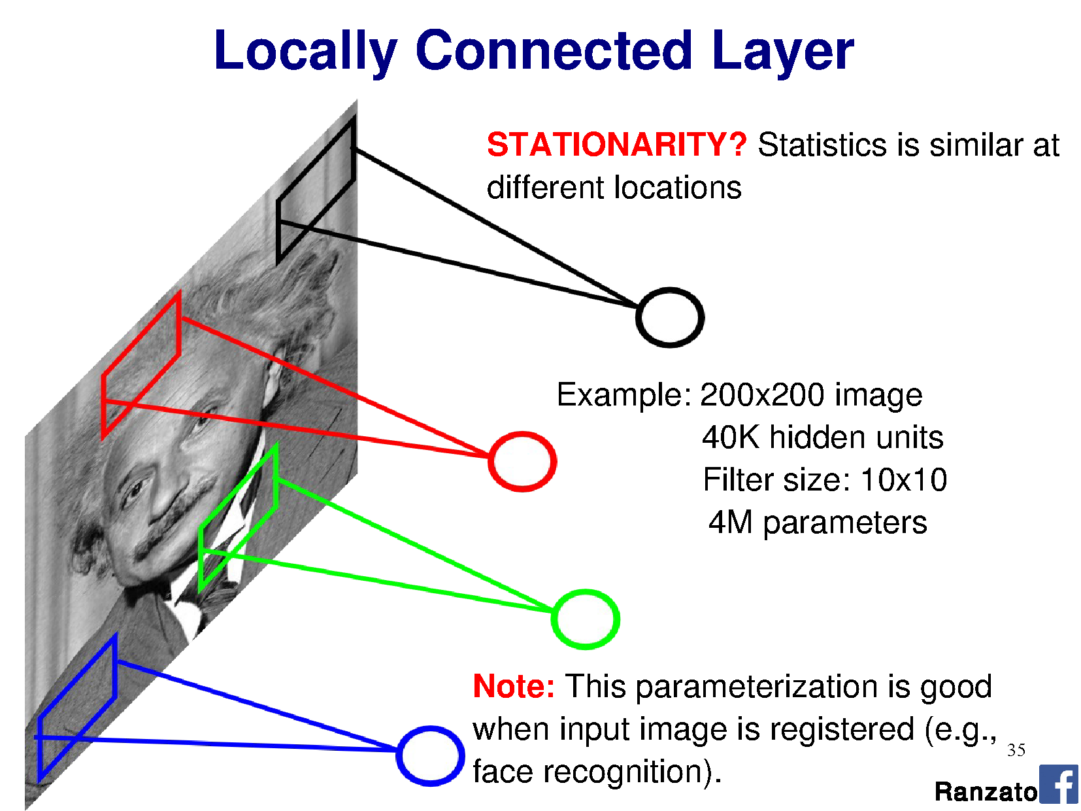

Slide 52
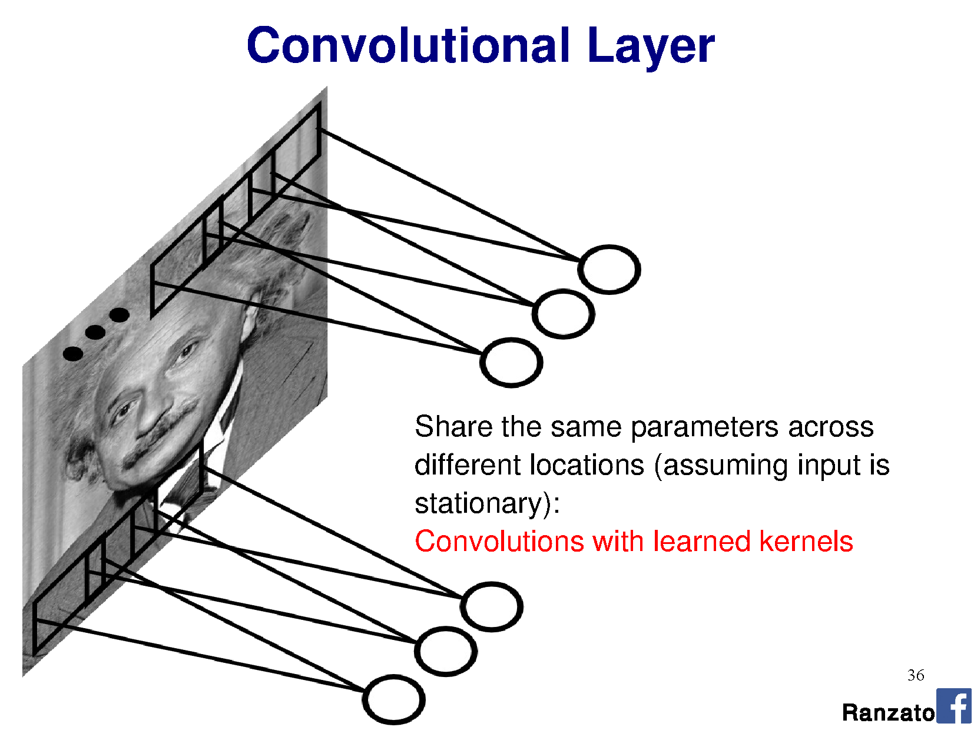

Slide 53
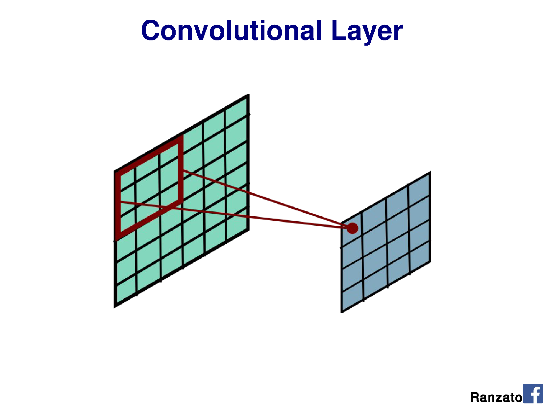

Slide 54
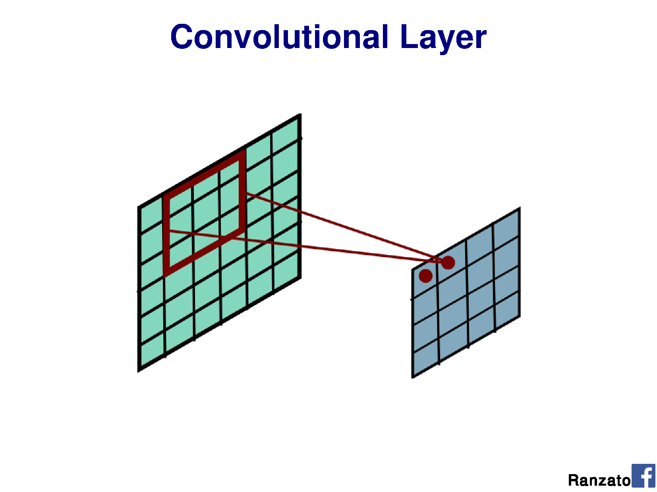

Slide 55
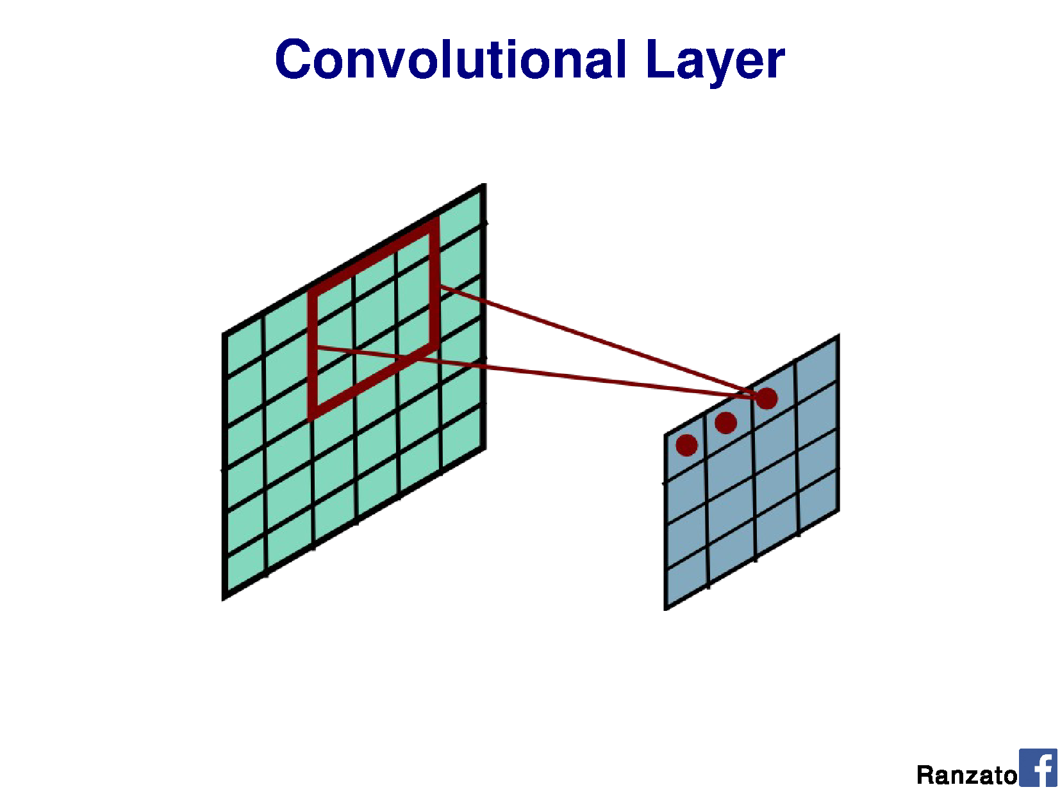

Slide 56
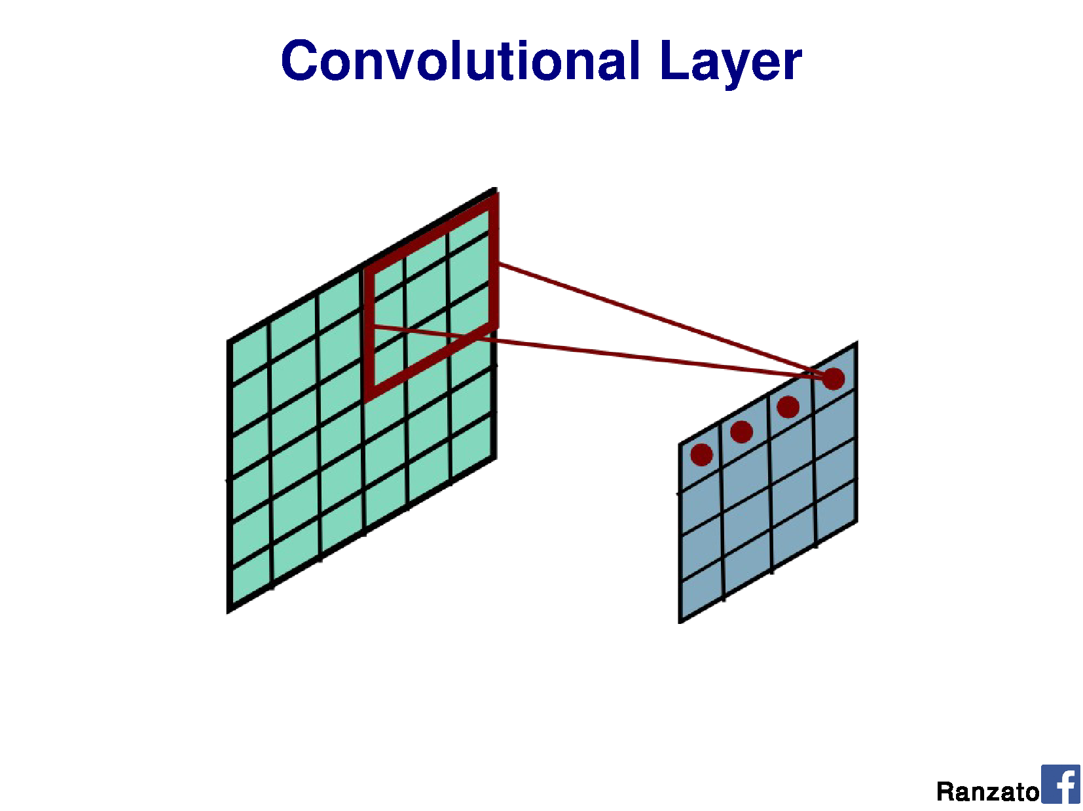

Slide 57
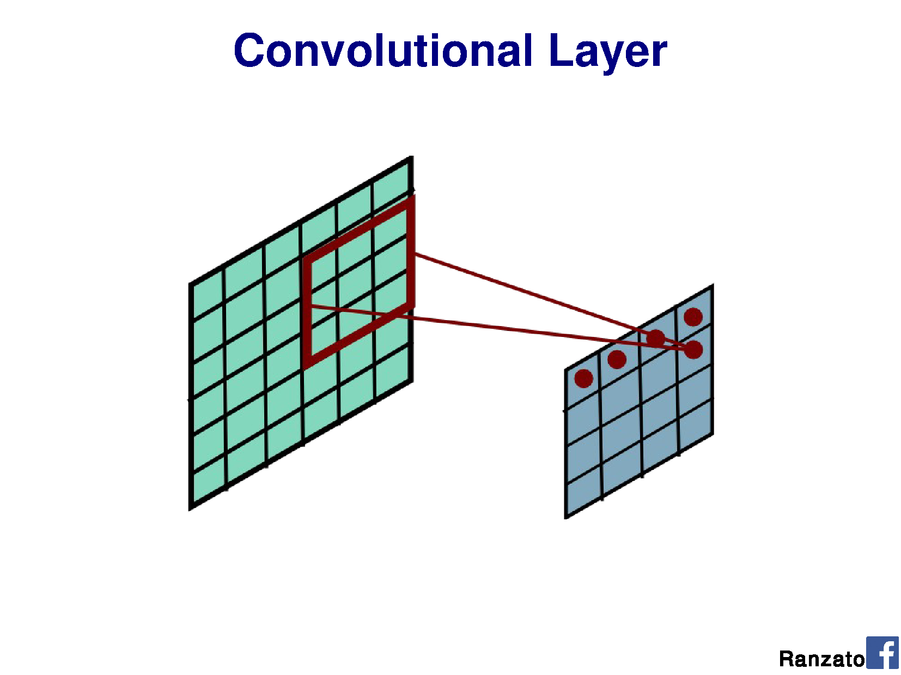

Slide 58
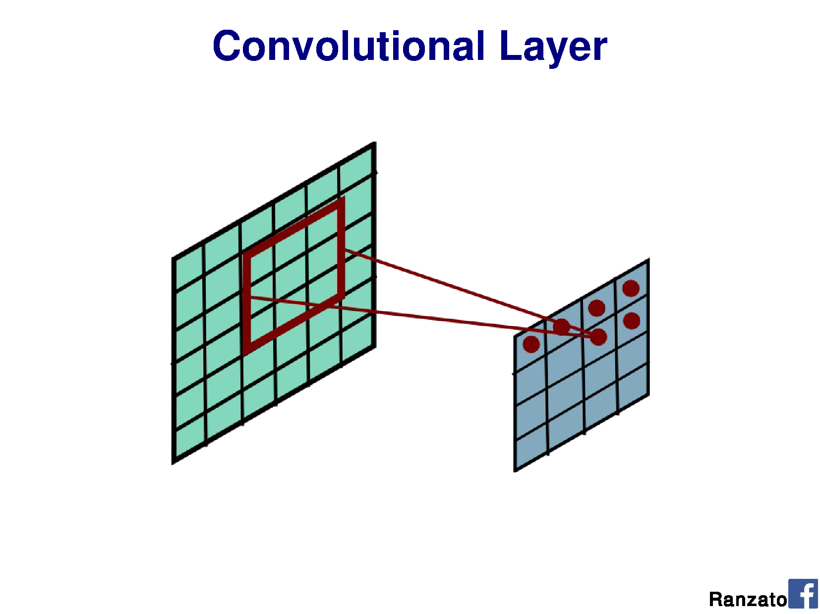

Slide 59
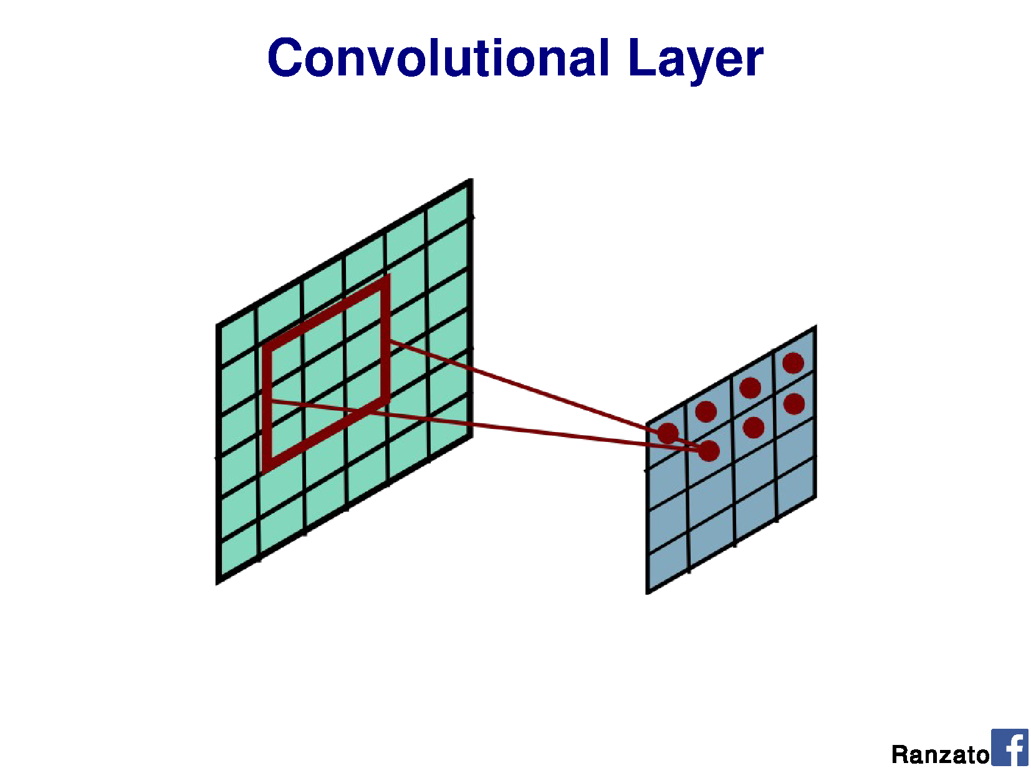

Slide 60
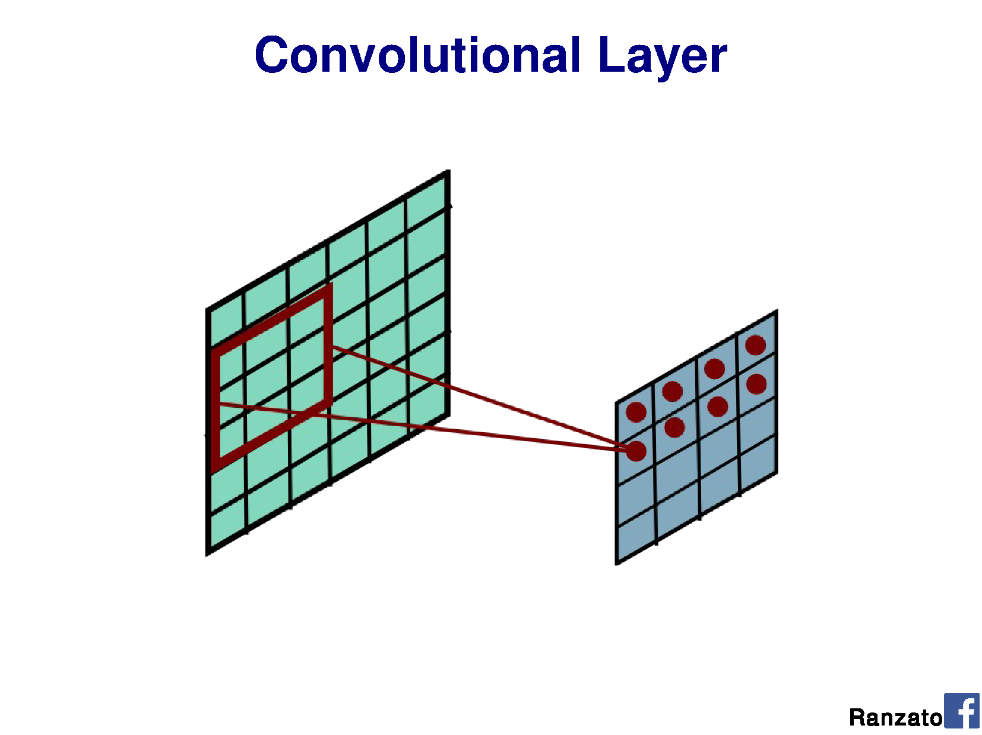

Slide 61
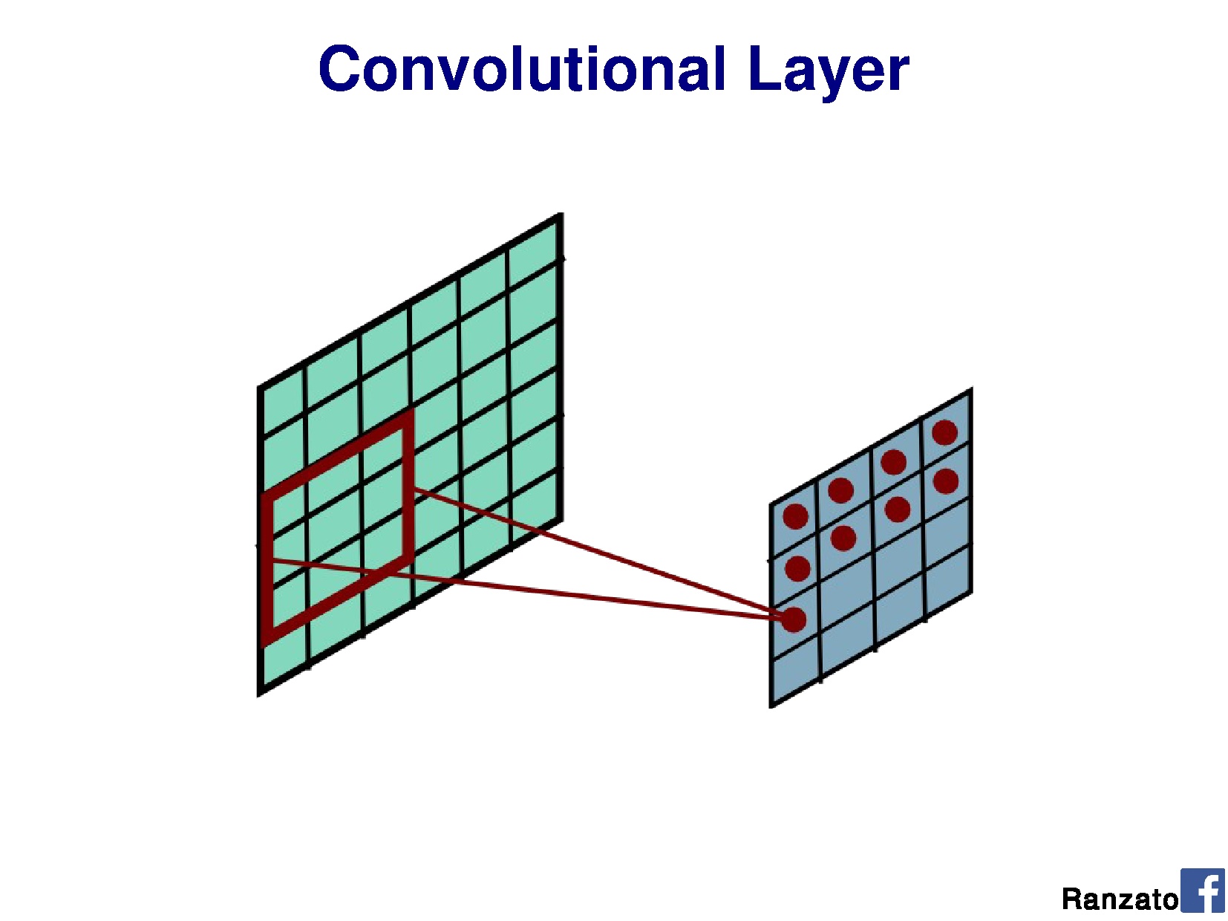

Slide 62
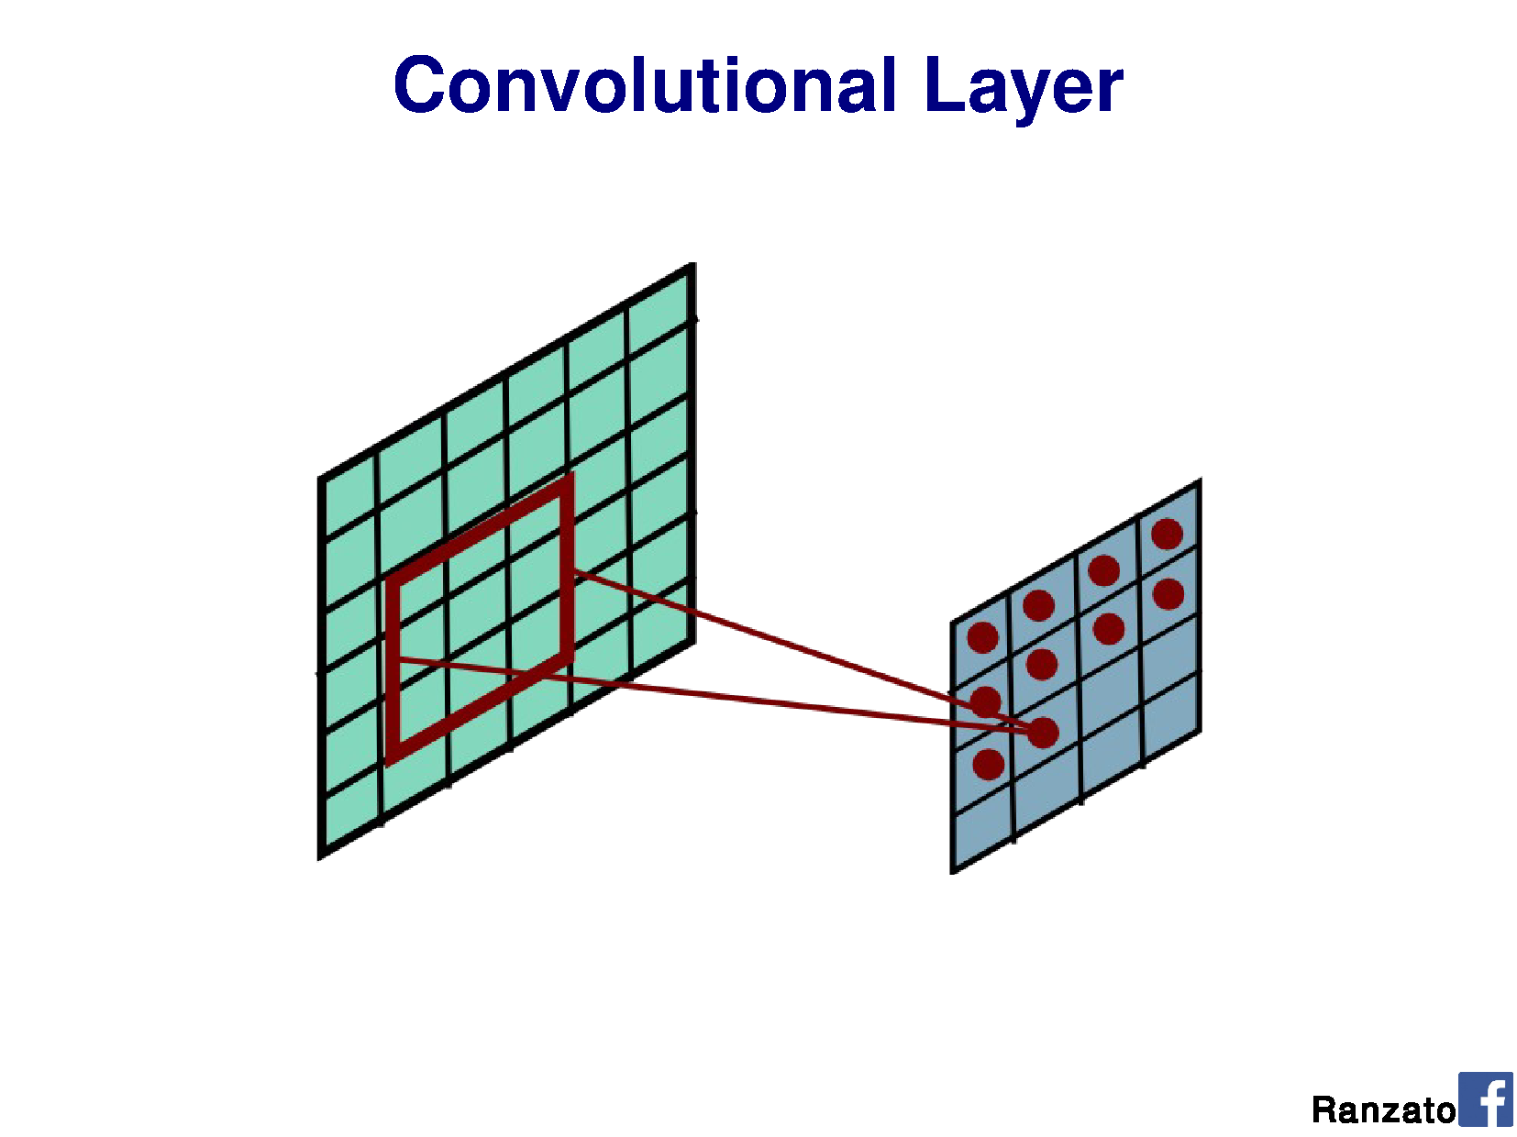

Slide 63
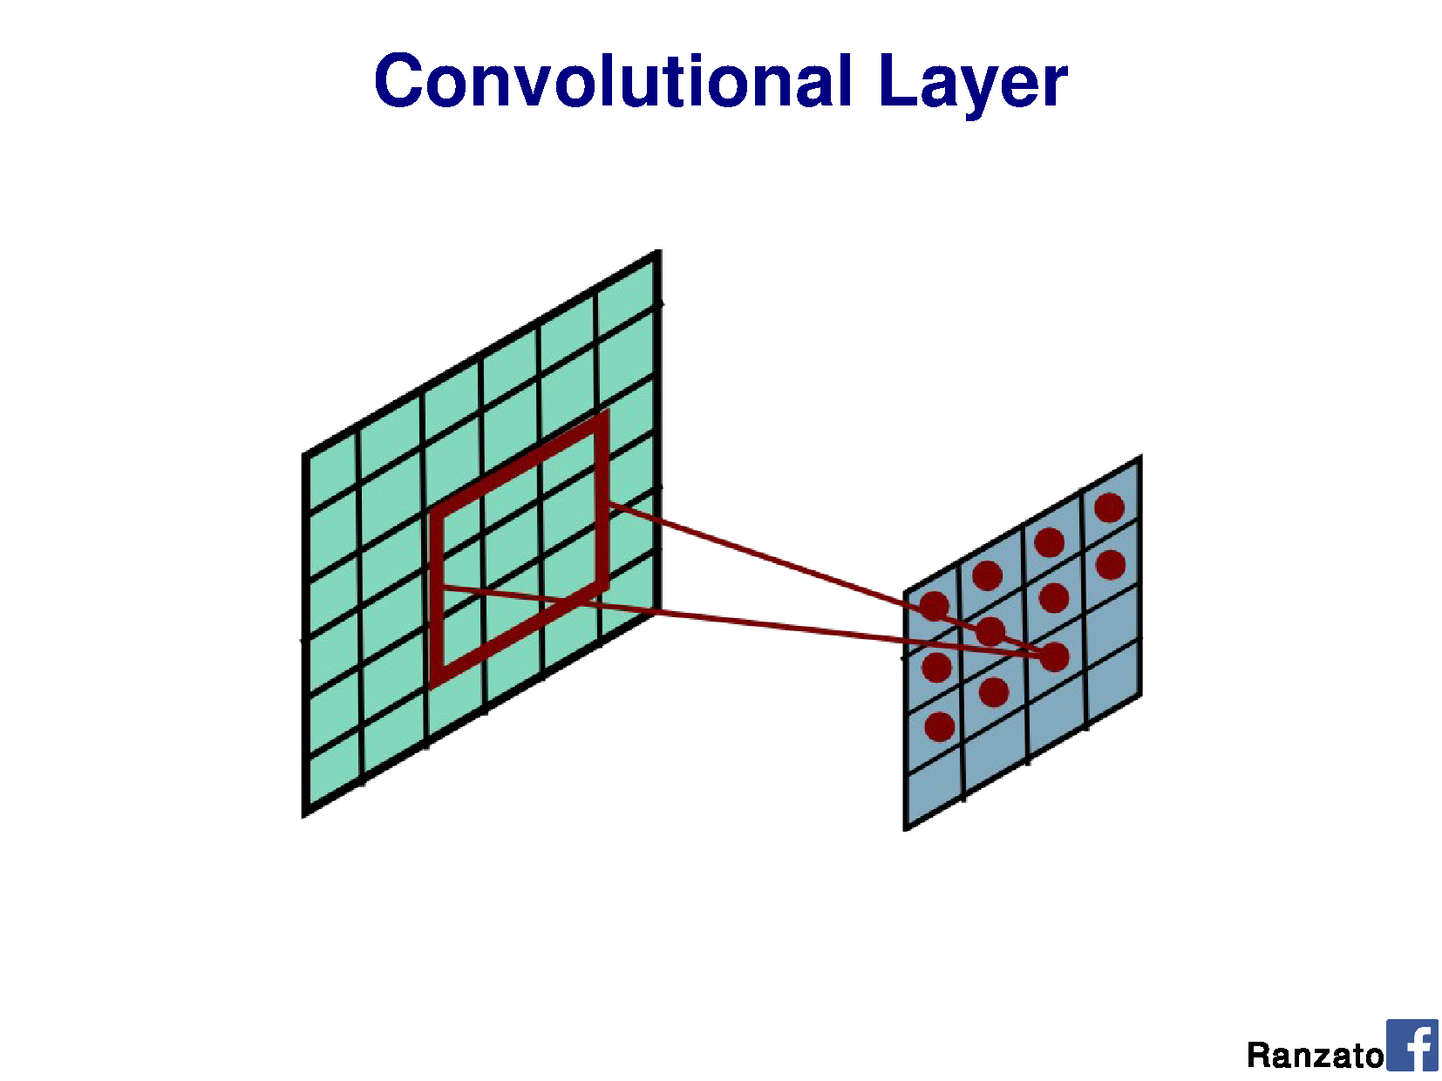

Slide 64
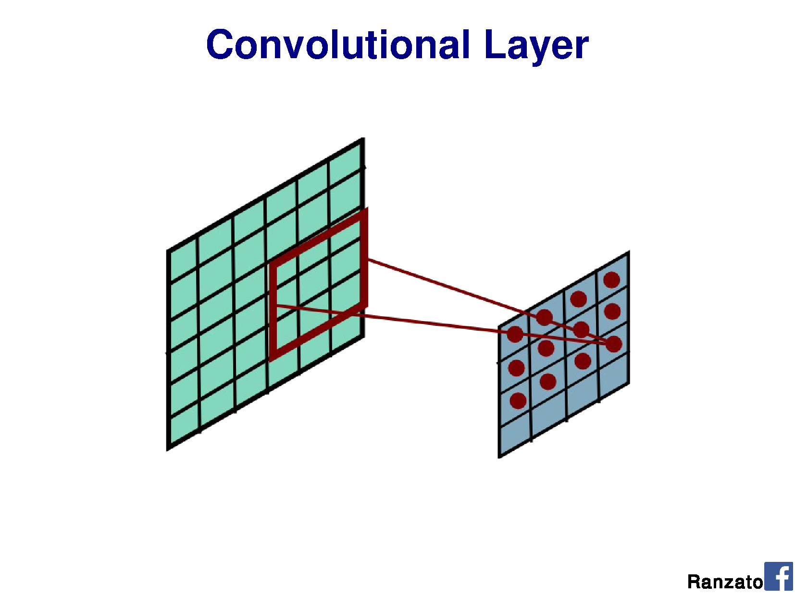

Slide 65


Slide 66


Slide 67


Slide 68


Slide 69


Slide 70


Slide 71


Slide 72


Slide 73


Slide 74


Slide 75


Slide 76


Slide 77


Slide 78


Slide 79


Slide 80


Slide 81


Slide 82


Slide 83


Slide 84


Slide 85


Slide 86


Slide 87

Batch Normalization: Accelerating Deep Network Training by Reducing Internal Covariate Shift
Sergey Ioffe, Christian Szegedy. 2015
Batch norm is what we will use for project 3
Gamma and Beta are learned parameters
The mean and variance are from the current mini-batch
At test time we use the average of those values since our batch size could be 1
This is global, per feature map, not local
Each channel in each layer learns a Gamma and Beta
Notes:
Batch norm is what we will use for project 3
Gamma and Beta are learned parameters
The mean and variance are from the current mini batch
At test time we use the average of those values since our batch size could be 1
This is global, per feature map, not local

Slide 88


Comparison of how BatchNorm, LayerNorm, and InstanceNorm compute statistics across dimensions of a 4D convolutional tensor $\left(N , C , H , W\right)$:
BatchNorm (left): normalizes per channel using statistics across Batch, Height, and Width.
LayerNorm (middle): normalizes per sample using statistics across Channels, Height, and Width.
InstanceNorm (right): normalizes per channel per sample using statistics across Height and Width only.

Slide 89


Slide 90


Slide 91


Slide 92


Slide 93


Slide 94


Slide 95


Slide 96


Slide 97


Slide 98


Slide 99


Slide 100


Slide 101


Slide 102


Slide 103


Slide 104

Notes:
This is top 5 error

Slide 105


Slide 107


Slide 108


Slide 109
This all seems pretty complicated. Why are we using Neural Networks? James’s rough assessment:
Learning method | Ease of configuration
Neural Network | 1
Nearest Neighbor | 10
Linear SVM | 10
Non-linear SVM | 5
Decision Tree or Random Forest | 4

Slide 110
This all seems pretty complicated. Why are we using Neural Networks? James’s rough assessment:
Learning method | Ease of configuration | Ease of interpretation
Neural Network | 1 | 1
Nearest Neighbor | 10 | 10
Linear SVM | 10 | 9
Non-linear SVM | 5 | 4
Decision Tree or Random Forest | 4 | 4

Slide 111
This all seems pretty complicated. Why are we using Neural Networks? James’s rough assessment:
Learning method | Ease of configuration | Ease of interpretation | Speed / memory when training
Neural Network | 1 | 1 | 1
Nearest Neighbor | 10 | 10 | 8
Linear SVM | 10 | 9 | 10
Non-linear SVM | 5 | 4 | 2
Decision Tree or Random Forest | 4 | 4 | 4

Slide 112
This all seems pretty complicated. Why are we using Neural Networks? James’s rough assessment:
Learning method | Ease of configuration | Ease of interpretation | Speed / memory when training | Speed / memory at test time
Neural Network | 1 | 1 | 1 | 6
Nearest Neighbor | 10 | 10 | 8 | 4
Linear SVM | 10 | 9 | 10 | 10
Non-linear SVM | 5 | 4 | 2 | 2
Decision Tree or Random Forest | 4 | 4 | 4 | 8

Slide 113
This all seems pretty complicated. Why are we using Neural Networks? James’s rough assessment:
Learning method | Ease of configuration | Ease of interpretation | Speed / memory when training | Speed / memory at test time | Accuracy w/ lots of data
Neural Network | 1 | 1 | 1 | 6 | 10
Nearest Neighbor | 10 | 10 | 8 | 4 | 7
Linear SVM | 10 | 9 | 10 | 10 | 5
Non-linear SVM | 5 | 4 | 2 | 2 | 8
Decision Tree or Random Forest | 4 | 4 | 4 | 8 | 7

Slide 114
This all seems pretty complicated. Why are we using Neural Networks? James’s rough assessment:
Learning method | Ease of configuration | Ease of interpretation | Speed / memory when training | Speed / memory at test time | Accuracy w/ lots of data
Neural Network | 1 | 1 | 1 | 6 | 10
Nearest Neighbor | 10 | 10 | 8 | 4 | 7
Linear SVM | 10 | 9 | 10 | 10 | 5
Non-linear SVM | 5 | 4 | 2 | 2 | 8
Decision Tree or Random Forest | 4 | 4 | 4 | 8 | 7
Representation design matters more for all of these

