Slide 1
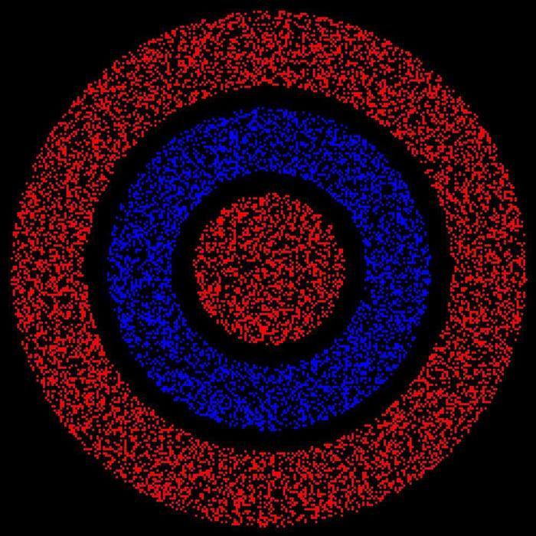

Slide 2
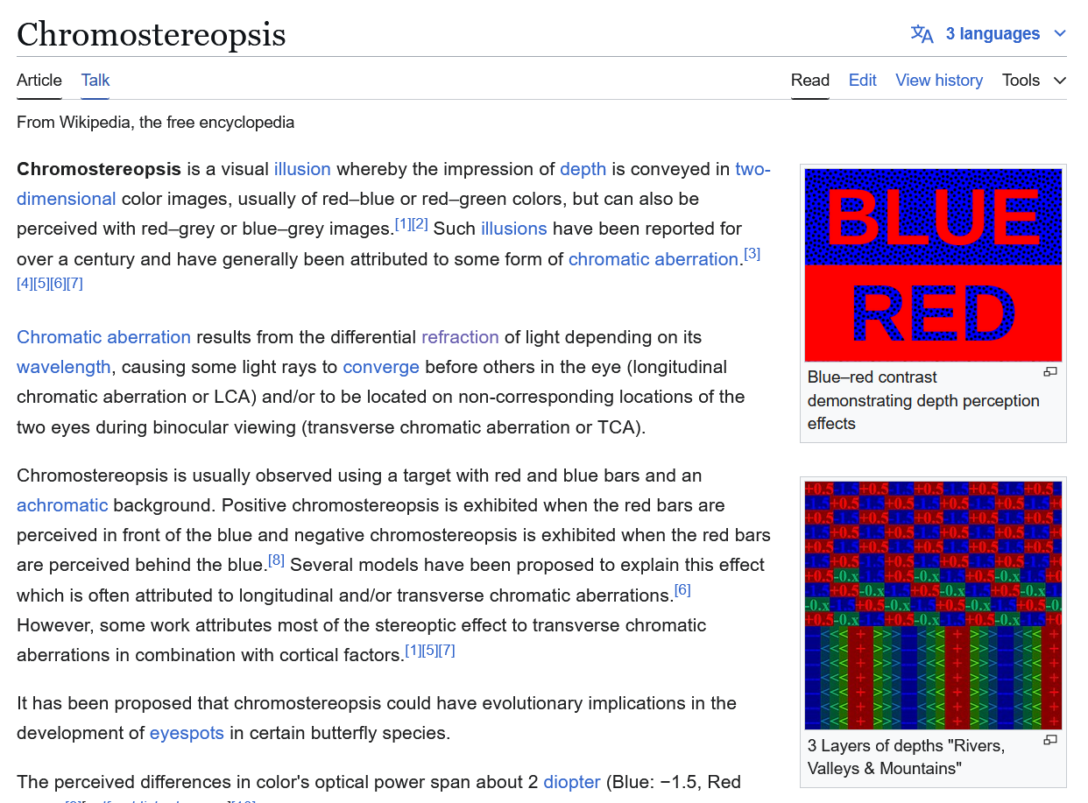

Slide 3
Object Detectors Emerge in Deep Scene CNNs
Bolei Zhou, Aditya Khosla, Agata Lapedriza, Aude Oliva, Antonio Torralba. 2014

Slide 4
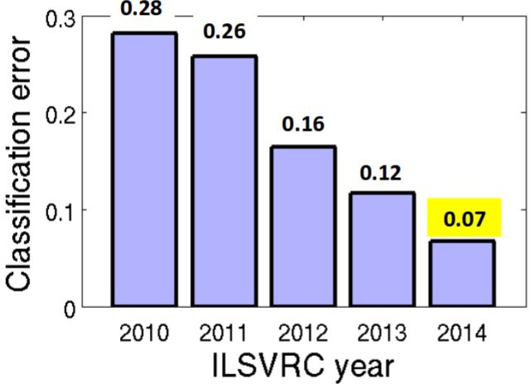
CNN for Object Recognition
Large-scale image classification result on ImageNet
CNN methods
Figure from Olga Russakovsky ECCV'14 workshop

Slide 5
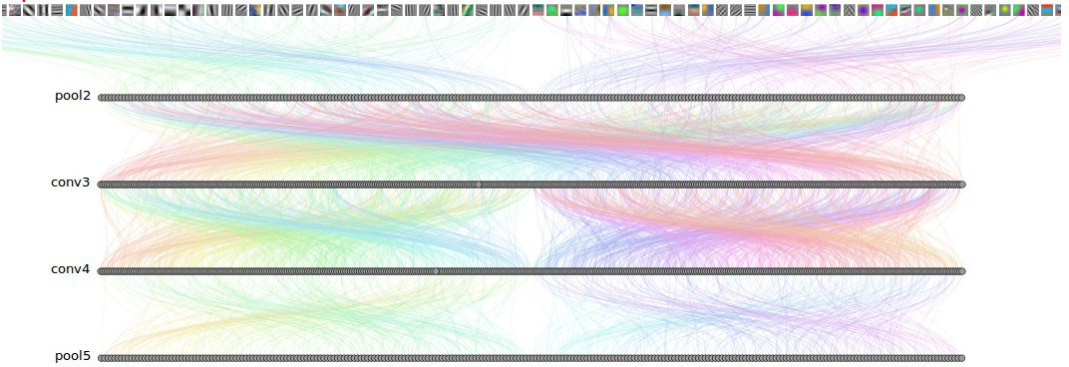
How Objects are Represented in CNN?
Conv1
Conv2
Conv3
Conv4 Pool5
DrawCNN: visualizing the units' connections

Slide 6
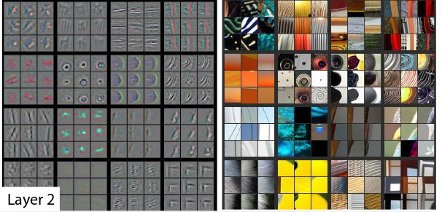
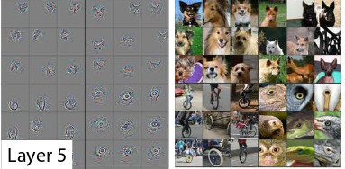
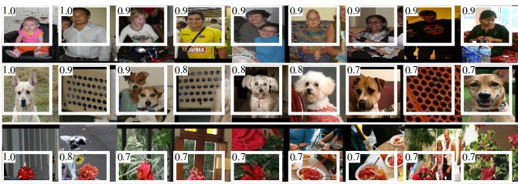
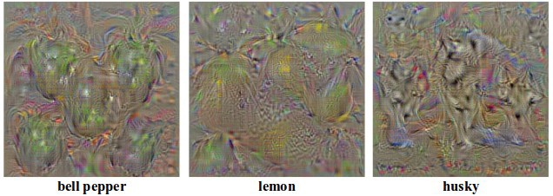
How Objects are Represented in CNN?
Deconvolution
Zeiler, M. et al. Visualizing and Understanding Convolutional Networks,ECCV 2014.
Strong activation image
Girshick, R., Donahue, J., Darrell, T., Malik, J.: Rich feature hierarchies for accu-rate object detection and semantic segmentation. CVPR 2014
Back-propagation
Simonyan, K. et al. Deep inside convolutional networks: Visualising image classification models and saliency maps. ICLR workshop, 2014

Slide 7
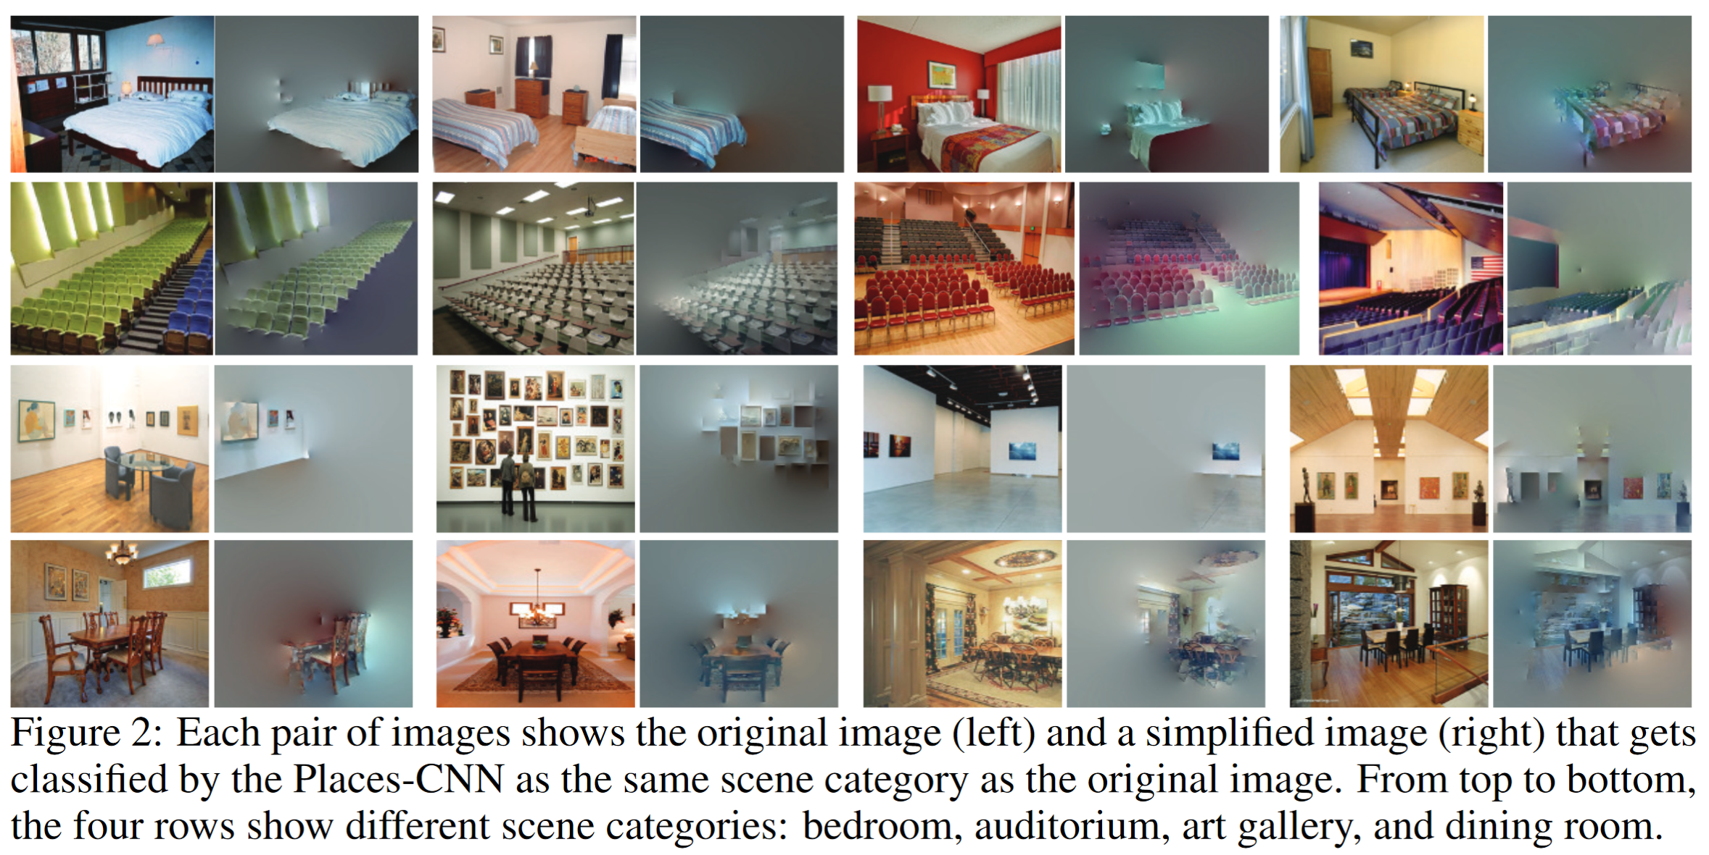
Another CNN interpretation method: Simplifying Scenes While Maintaining Classifier Decision

Slide 8
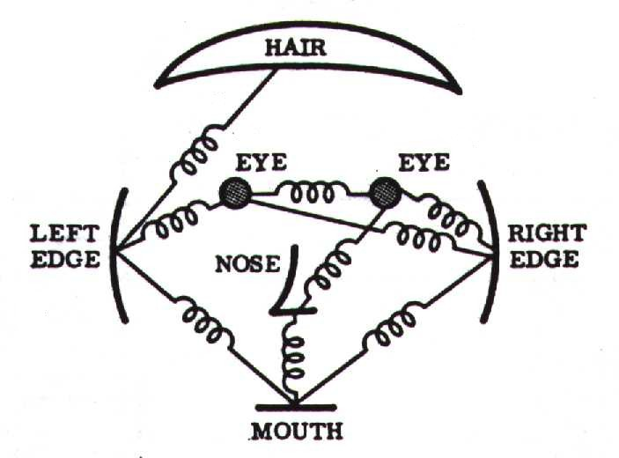
Object Representations in Computer Vision
Part-based models are used to represent objects and visual patterns.
-Object as a set of parts
-Relative locations between parts
Figure from Fischler & Elschlager (1973)

Slide 9
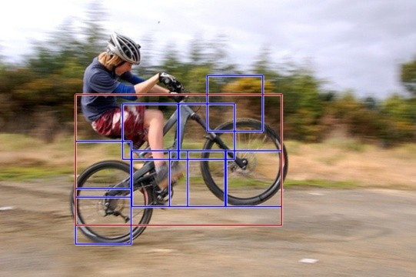
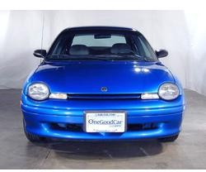

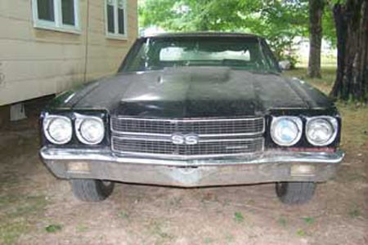
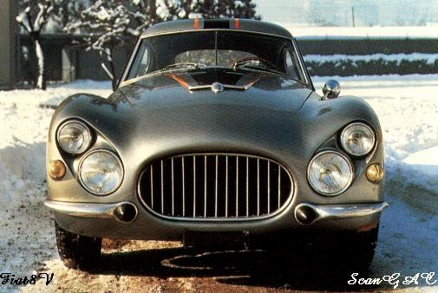
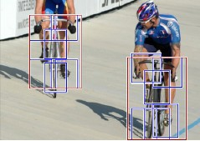

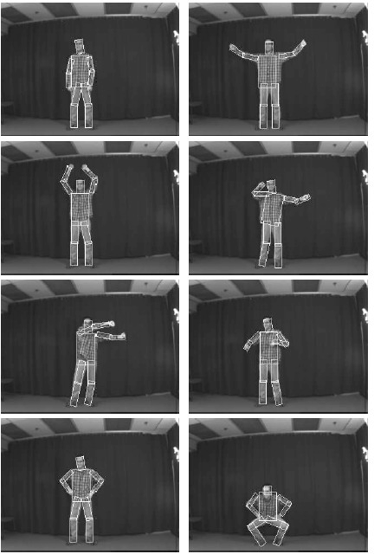
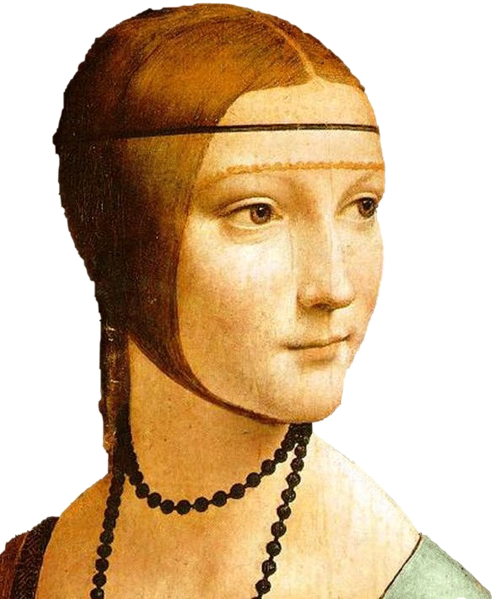


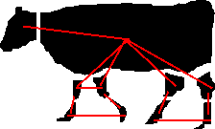








Object Representations in Computer Vision
Constellation model
Deformable Part model
Weber, Welling & Perona (2000), Fergus, Perona & Zisserman (2003)
P. Felzenszwalb, R. Girshick, D. McAllester, D. Ramanan (2010)
Bag-of-word model
Class-specific graph model
Lazebnik, Schmid & Ponce(2003), Fei-Fei Perona (2005)
Kumar, Torr and Zisserman (2005), Felzenszwalb & Huttenlocher (2005)

Slide 10

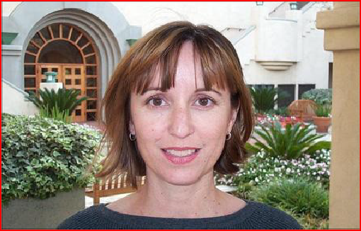
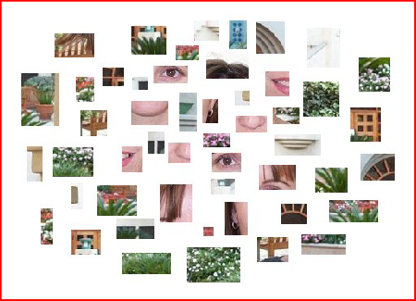
Learning to Recognize Objects
brambling
terrier
Possible internal representations:
Object parts
Textures
Attributes

Slide 11
How Objects are Represented in CNN?
CNN uses distributed code to represent objects.
Conv1
Conv2
Conv3
Conv4 Pool5
Agrawal, et al. Analyzing the performance of multilayer neural networks for object recognition. ECCV, 2014 Szegedy, et al. Intriguing properties of neural networks.arXiv preprint arXiv:1312.6199, 2013.
Zeiler, M. et al. Visualizing and Understanding Convolutional Networks, ECCV 2014.

Slide 12
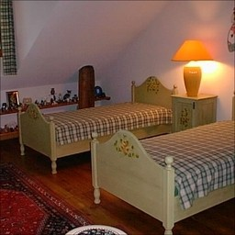

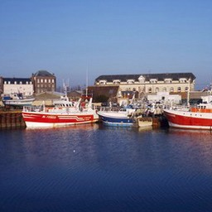
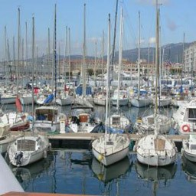
Scene Recognition
Given an image, predict which place we are in.
Bedroom
Harbor

Slide 13


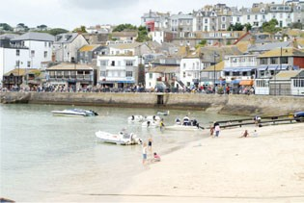
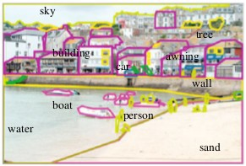
Learning to Recognize Scenes
bedroom
mountain
Possible internal representations:
Objects (scene parts?)
Scene attributes
Object parts
Textures

Slide 14
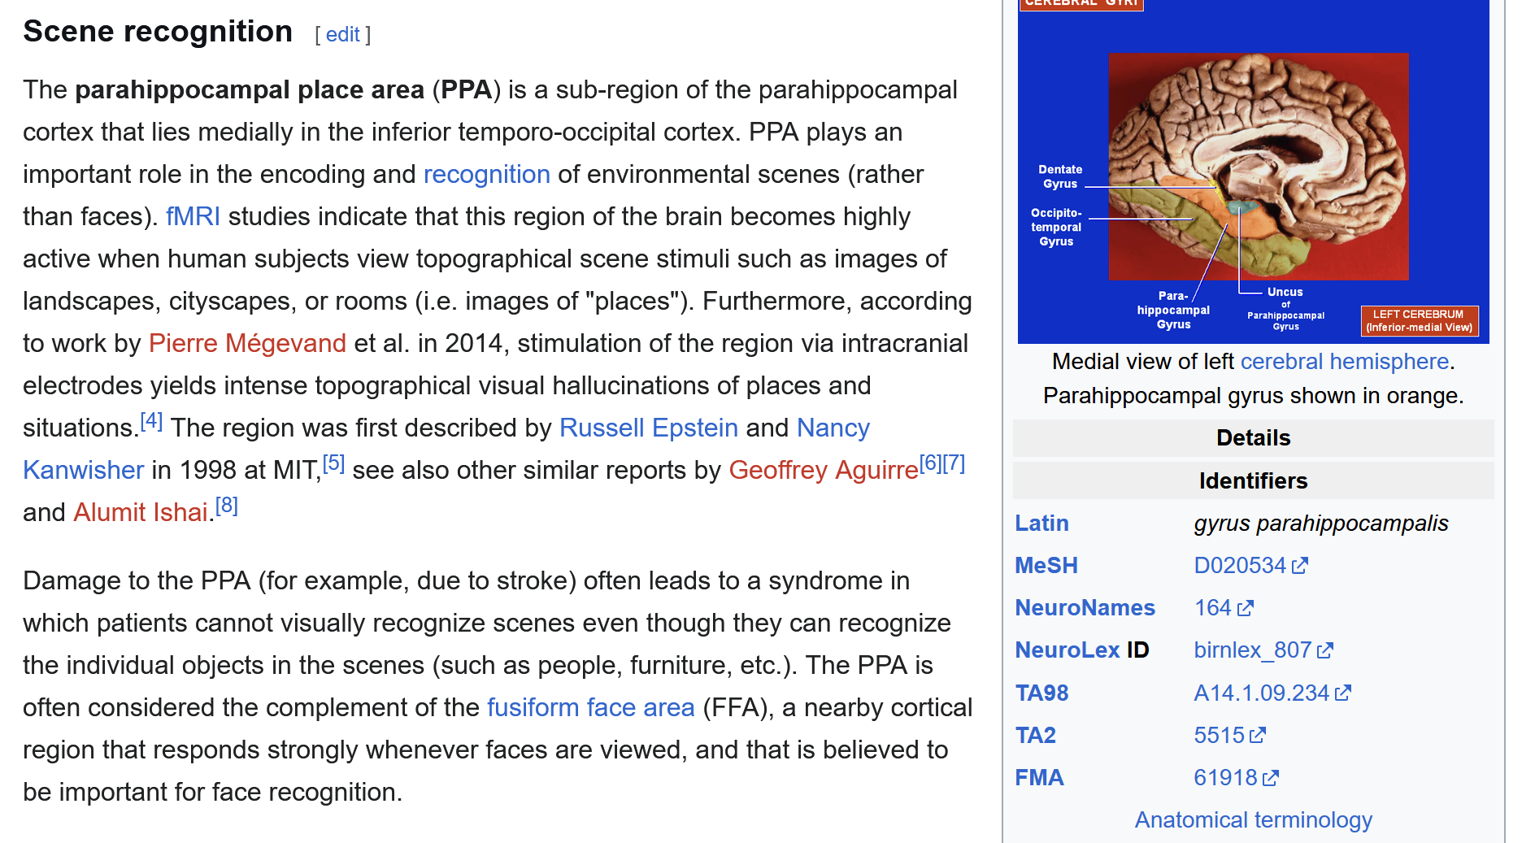

Slide 15

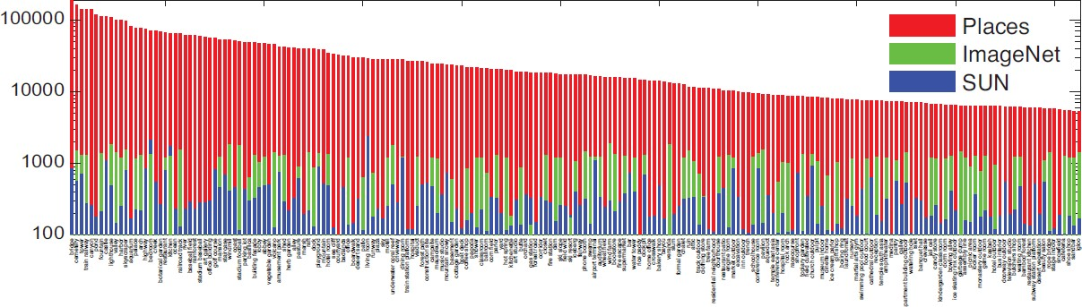

CNN for Scene Recognition
Places Database: 7 million images from 400 scene categories
scene category
Places-CNN: AlexNet CNN on 2.5 million images from 205 scene categories.
Zhou, et al. NIPS, 2014.

Slide 16
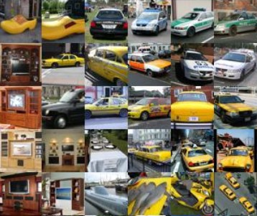
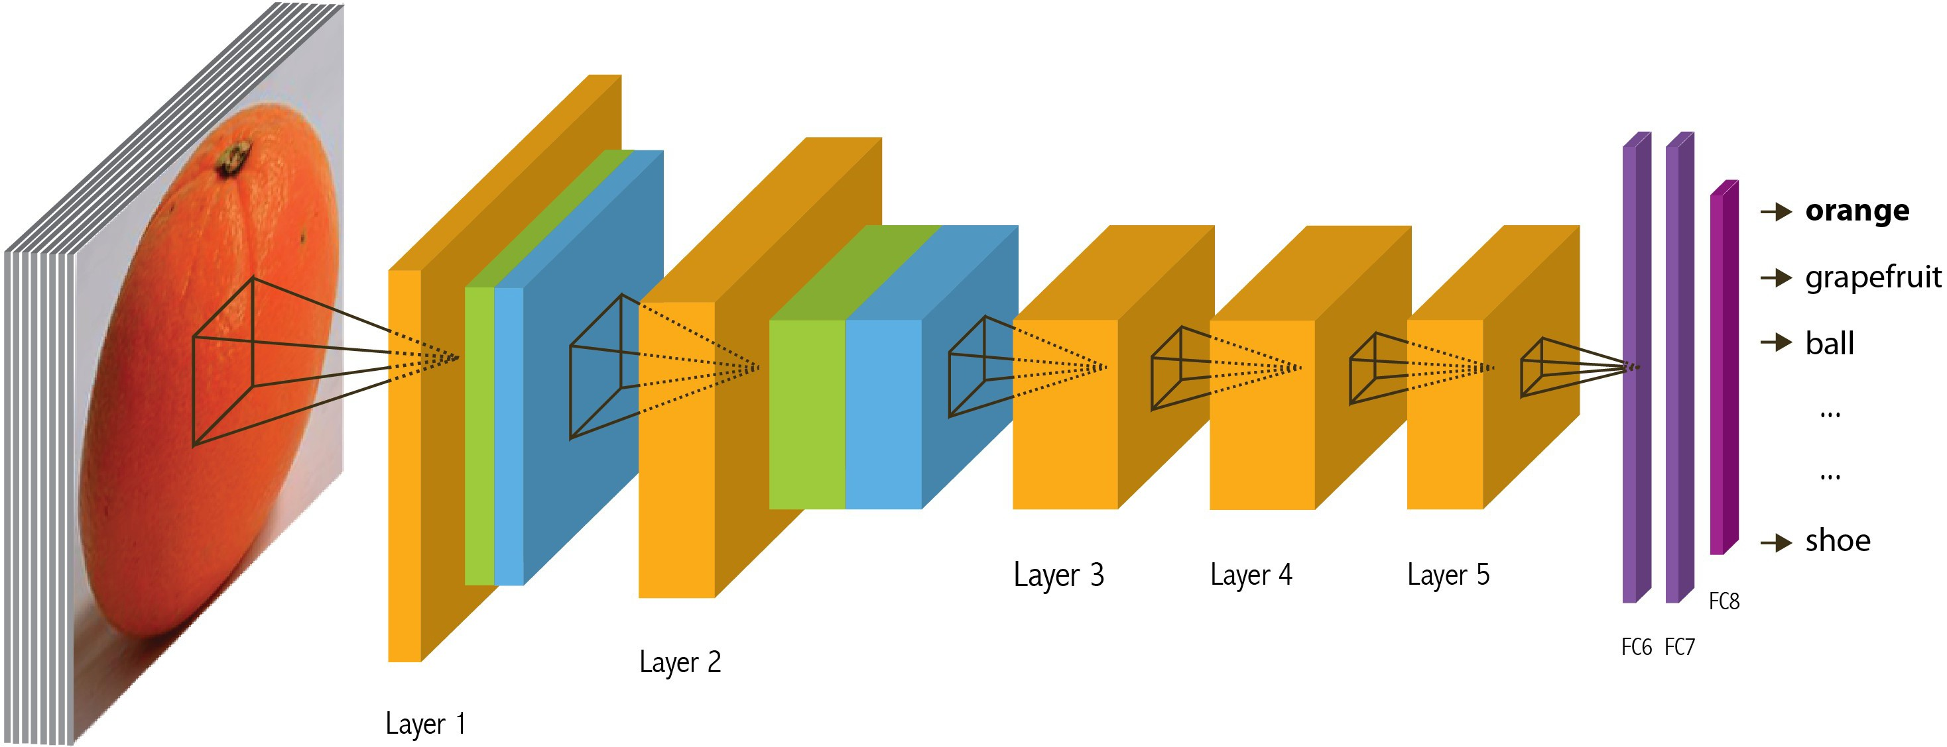
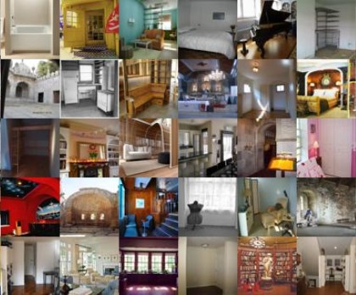
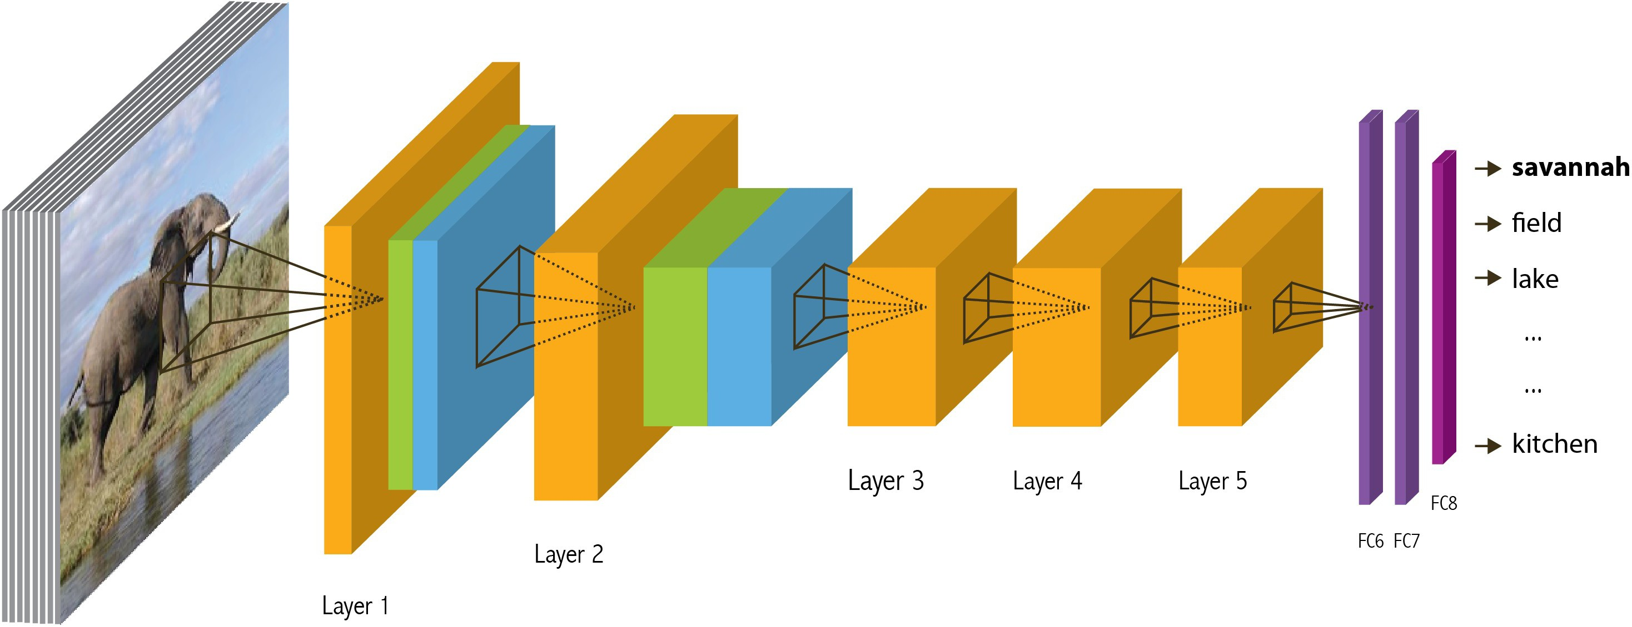

ImageNet CNN and Places CNN
ImageNet CNN for Object Classification
Same architecture: AlexNet
Places CNN for Scene Classification
Places

Slide 17
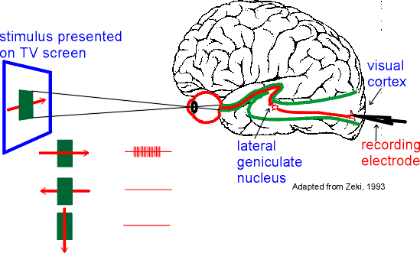
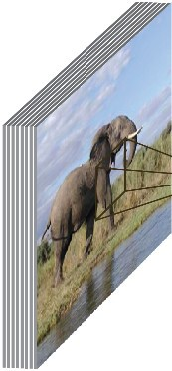

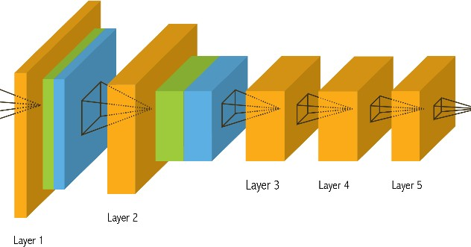



Data-Driven Approach to Study CNN
Neuroscientists study brain
ImageNet CNN Places CNN
200,000 image stimuli of objects and scene categories (ImageNet TestSet+SUN database)

Slide 18
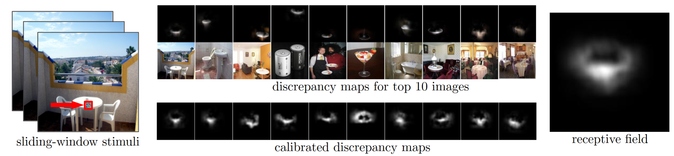
Estimating the Receptive Fields

Slide 19

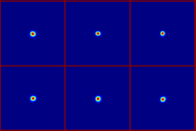
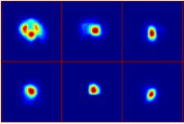
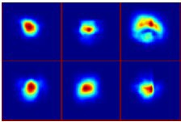
Estimating the Receptive Fields
Estimated receptive fields
pool1
Actual size of RF is much smaller than the theoretic size
conv3 pool5

Slide 20
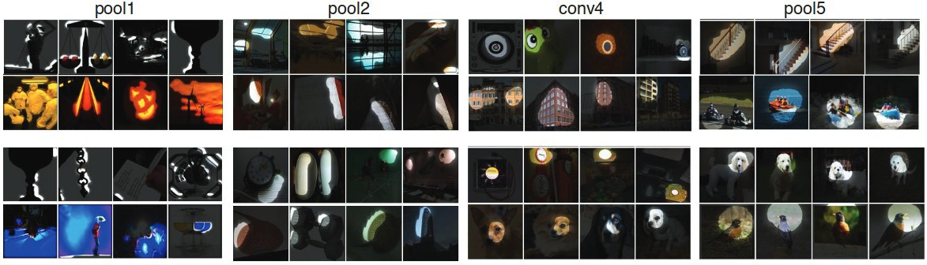
Estimating the Receptive Fields
Estimated receptive fields
pool1
Actual size of RF is much smaller than the theoretic size
conv3 pool5
Segmentation using the RF of Units
More semantically meaningful

Slide 21
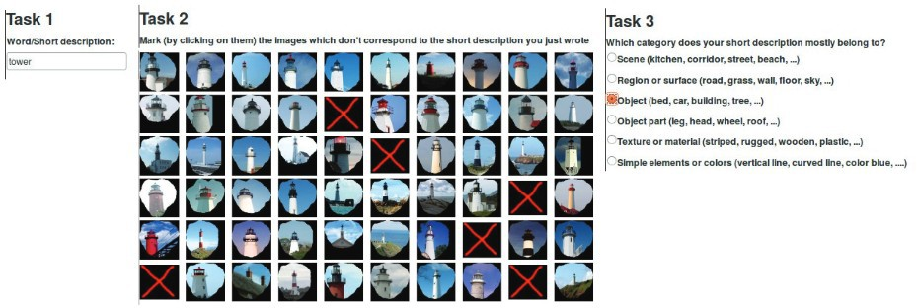
Annotating the Semantics of Units
Top ranked segmented images are cropped and sent to Amazon Turk for annotation.

Slide 22



Annotating the Semantics of Units
Pool5, unit 76; Label: ocean; Type: scene; Precision: 93%

Slide 23
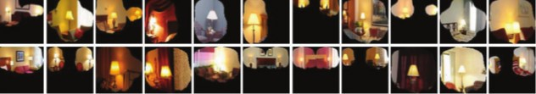
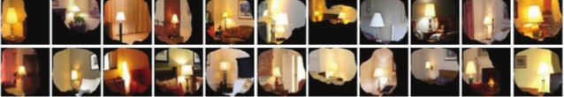
Annotating the Semantics of Units
Pool5, unit 13; Label: Lamps; Type: object; Precision: 84%

Slide 24
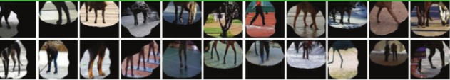
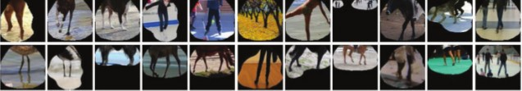

Annotating the Semantics of Units
Pool5, unit 77; Label:legs; Type: object part; Precision: 96%

Slide 25
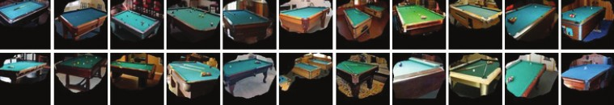
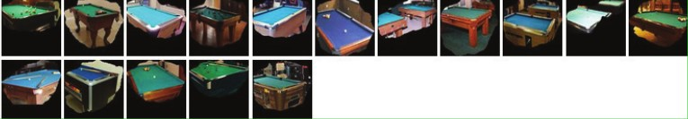

Annotating the Semantics of Units
Pool5, unit 112; Label: pool table; Type: object; Precision: 70%

Slide 26
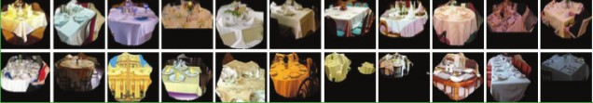
Annotating the Semantics of Units
Pool5, unit 22; Label: dinner table; Type: scene; Precision: 60%

Slide 27
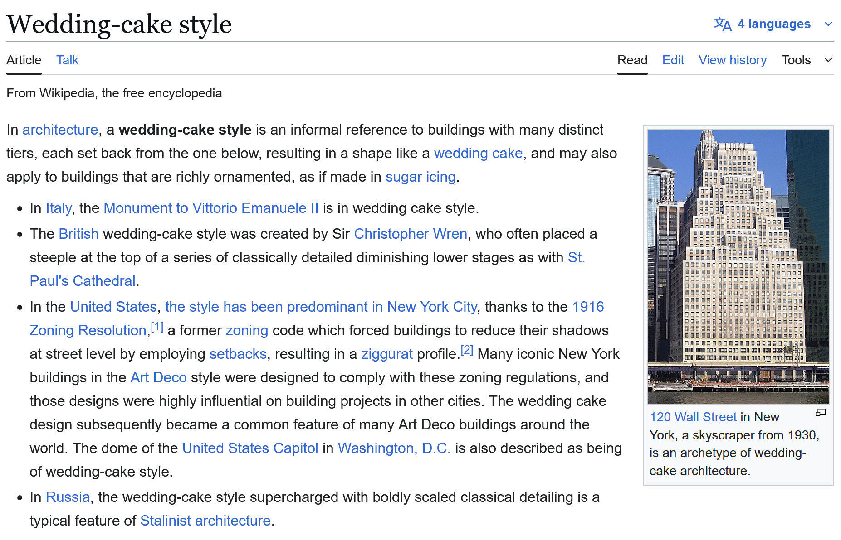

Slide 28




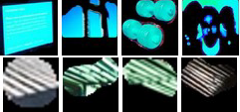
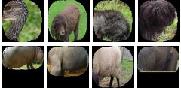







Distribution of Semantic Types at Each Layer
1
Object detectors emerge within CNN trained to classify scenes, without any object supervision!

Slide 29






Histogram of Emerged Objects in Pool5
ImageNet-CNN (59/256)

Slide 30






Histogram of Emerged Objects in Pool5
Places-CNN (151/256)

Slide 32


Evaluation on SUN Database
Evaluate the performance of the emerged object detectors

Slide 33



Evaluation on SUN Database
Correlation:0.53
Correlation:0.84

Slide 34
Wrap up
There are many ways to visualize what a neural network has learned
Networks learn smaller receptive fields than the “theoretical” receptive field.
As you go deeper in the network, the hidden activations correspond more to high-level semantic concepts
Object detectors emerge inside a CNN trained to classify scenes, without any object supervision.

