Slide 1
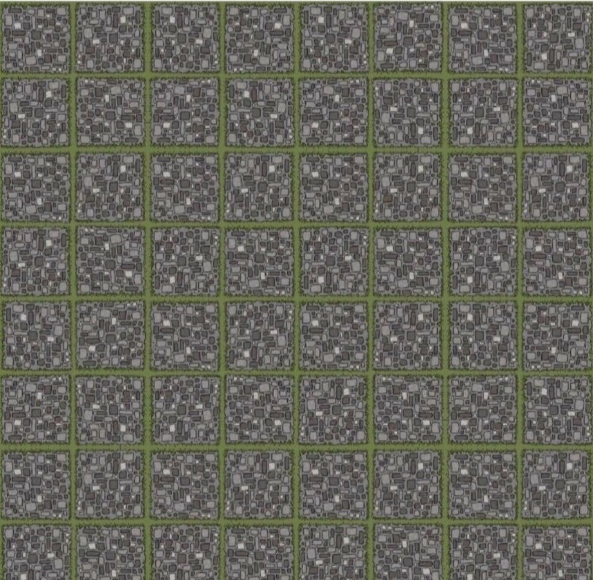
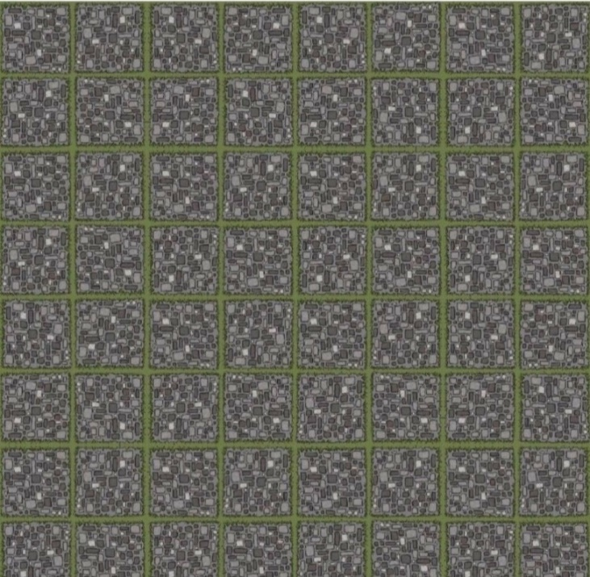
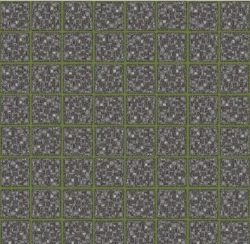

Slide 2
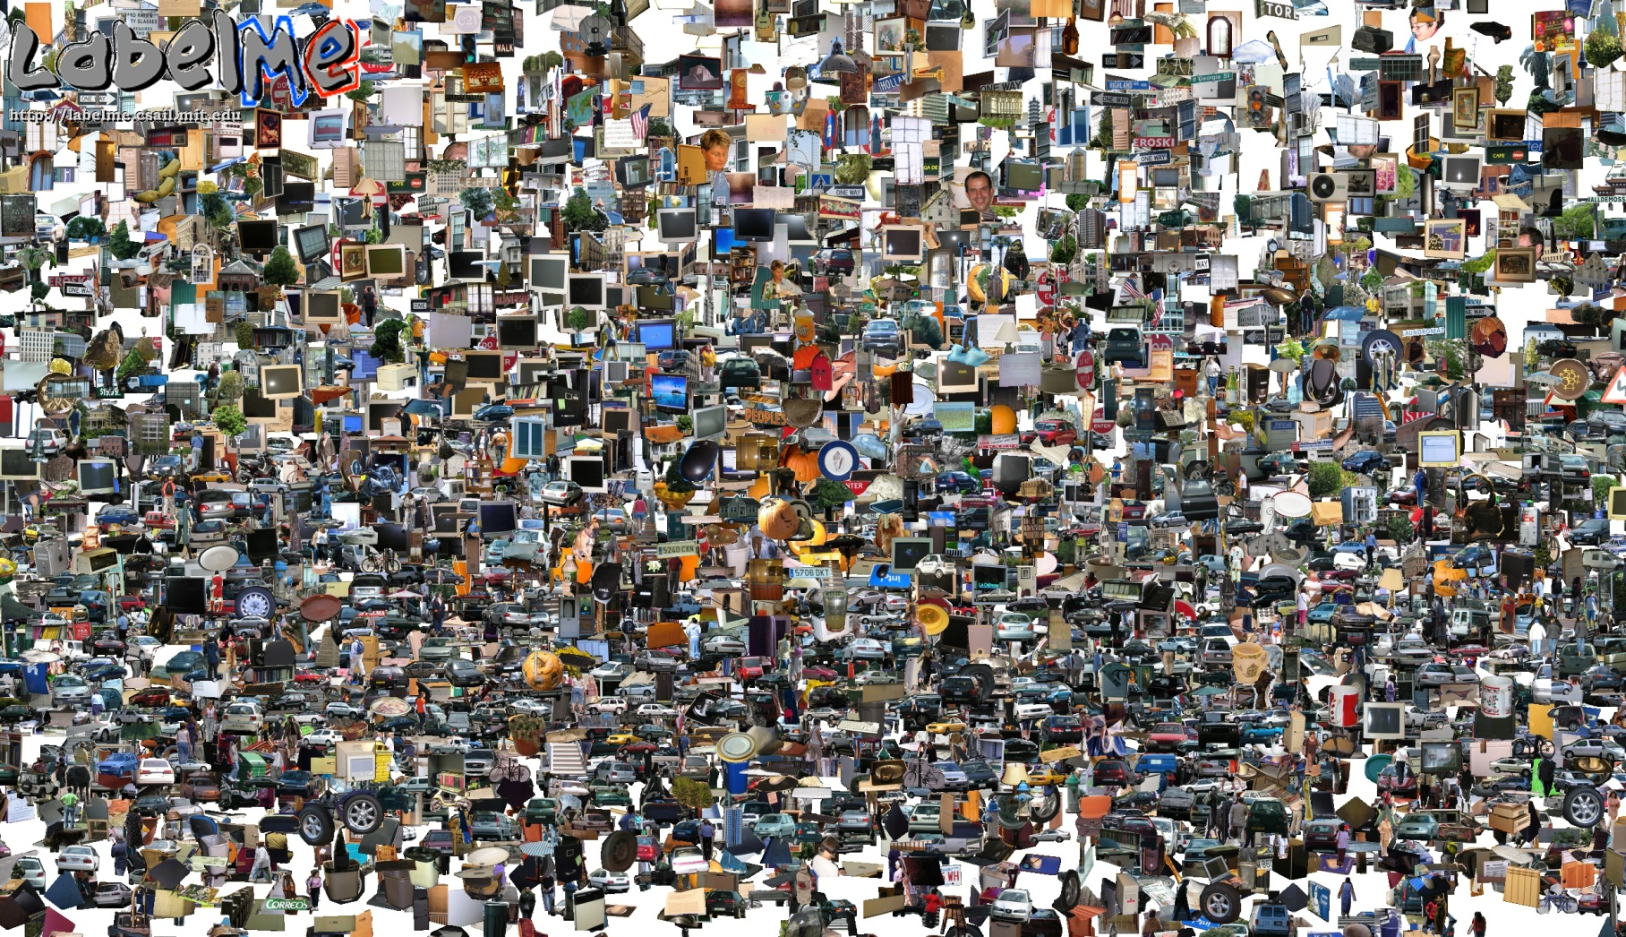
Big Data: Opportunities of Scale
Computer Vision
James Hays
Many slides from James Hays, Alyosha Efros, and Derek Hoiem
Graphic from Antonio Torralba

Slide 3
Outline
Opportunities of Scale: Data-driven methods
The Unreasonable Effectiveness of Data
Scene Completion
Image Geolocation

Slide 4
Computer Vision Class so far
The geometry of image formation
Ancient / Renaissance
Signal processing / Convolution
1800s, but really the 50’s and 60’s
Hand-designed Features for recognition, either instance-level or categorical
1999 (SIFT), 2003 (Video Google), 2005 (Dalal-Triggs), 2006 (spatial pyramid bag of words)
Learning from Data
1991 (EigenFaces) but late 90’s to now especially
Notes:
Omitting tracking / Multiview

Slide 5
What has changed in the last 20 years?
The Internet
Crowdsourcing
Learning representations from the data these sources provide (deep learning)
The inevitable Moore’s-law-esque increase in compute that allows large scale deep learning

Slide 6
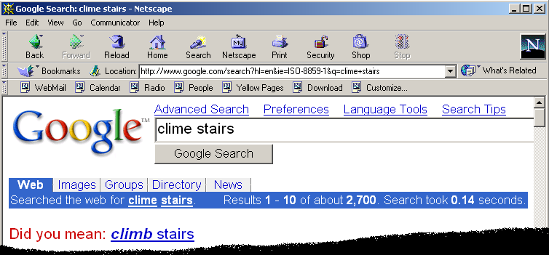
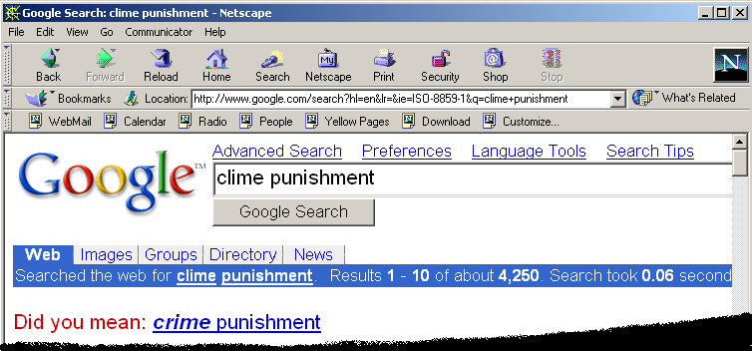
Google and massive data-driven algorithms
A.I. for the postmodern world:
all questions have already been answered…many times, in many ways
Google is dumb, the “intelligence” is in the data

Slide 7
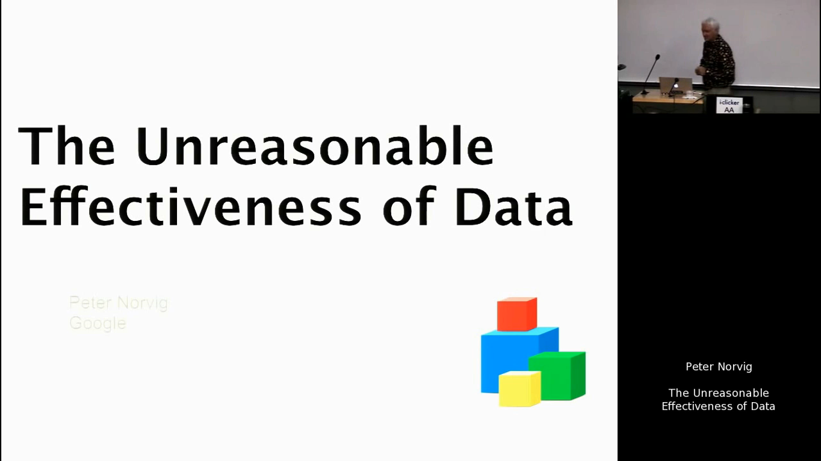
https://youtu.be/yvDCzhbjYWs?t=24
Watch until 9:42

Slide 8
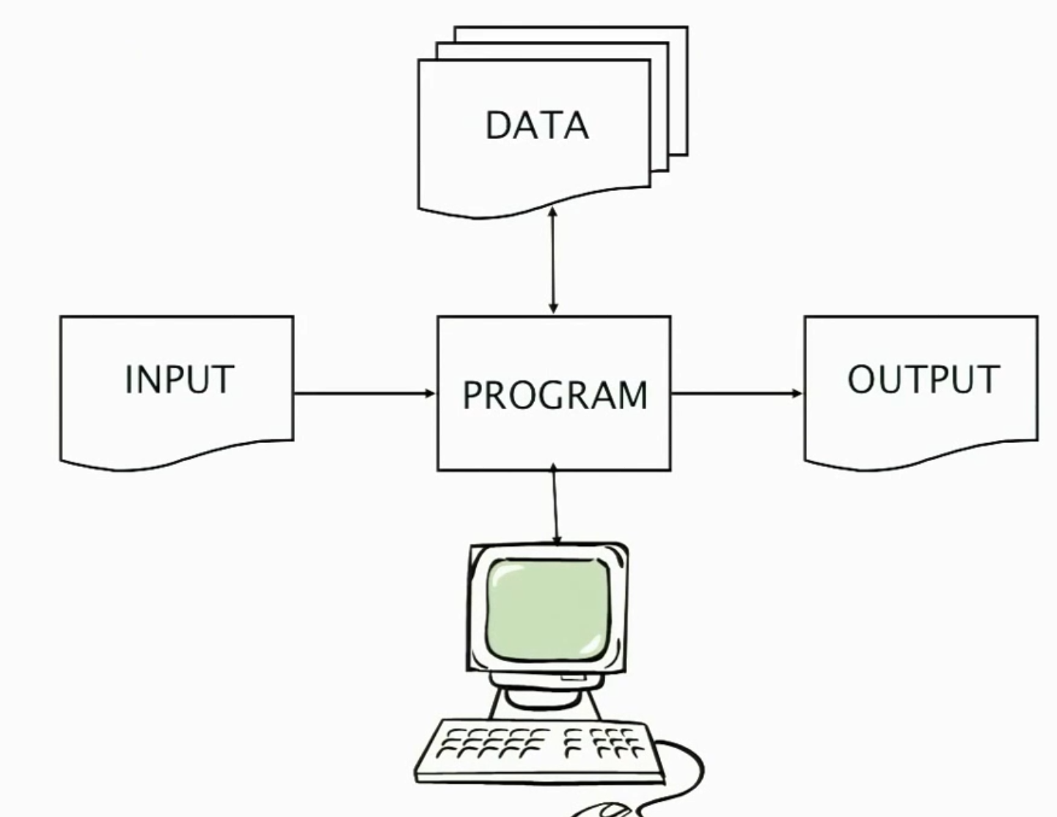

Slide 9
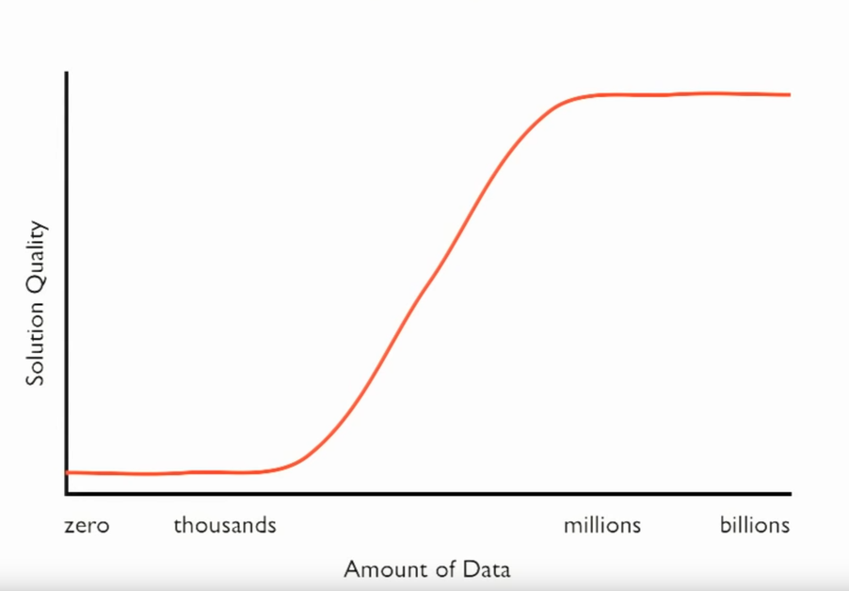

Slide 10
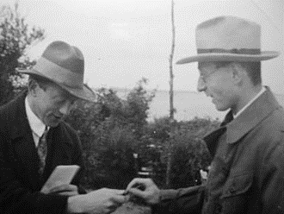
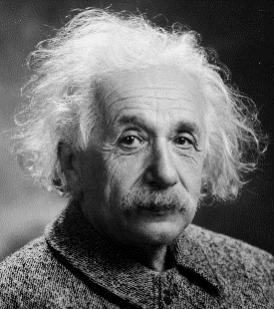
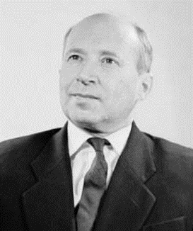
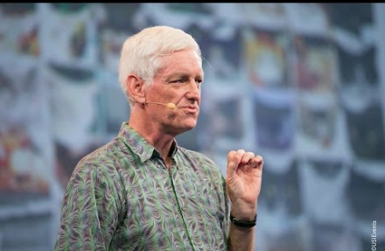
The Unreasonable Effectiveness of Math
“The miracle of the appropriateness of the language of mathematics…” Eugene Wigner
“The most incomprehensible thing about the universe is that it is comprehensible.” Albert Einstein
“There is only one thing which is more unreasonable than the unreasonable effectiveness of mathematics in physics, and this is the unreasonable ineffectiveness of mathematics in biology.” Israel Gelfand
“We should stop acting as if our goal is to author extremely elegant theories, and instead embrace complexity and make use of the best ally we have: the unreasonable effectiveness of data.” Peter Norvig

Slide 11
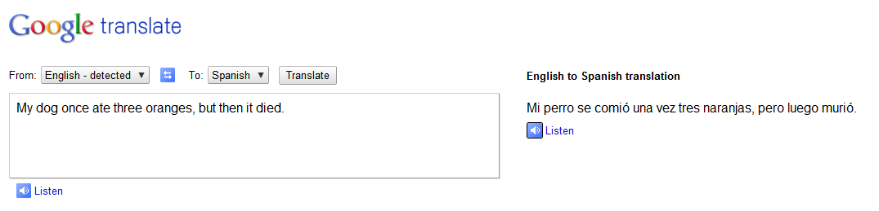
Google Translate
http://ackuna.com/badtranslator
Notes:
http://translationparty.com/#9988025
http://ackuna.com/badtranslator

Slide 12
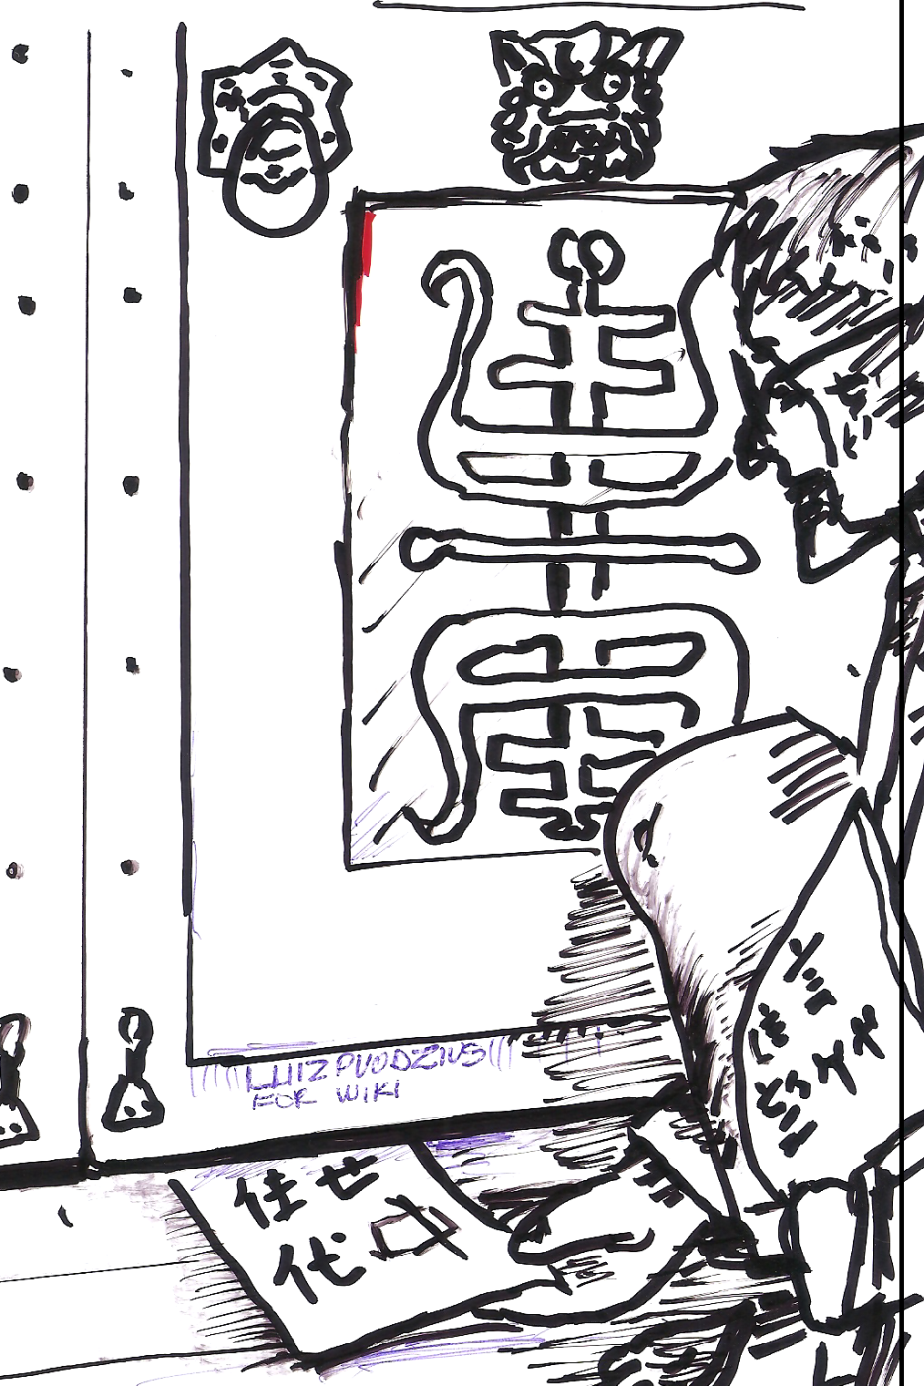
Chinese Room, John Searle (1980)
If a machine can convincingly simulate an intelligent conversation, does it necessarily understand? In the experiment, Searle imagines himself in a room, acting as a computer by manually executing a program that convincingly simulates the behavior of a native Chinese speaker.
Most of the discussion consists of attempts to refute it. "The overwhelming majority," notes BBS editor Stevan Harnad,“ still think that the Chinese Room Argument is dead wrong." The sheer volume of the literature that has grown up around it inspired Pat Hayes to quip that the field of cognitive science ought to be redefined as "the ongoing research program of showing Searle's Chinese Room Argument to be false.
Notes:
The experiment is the centerpiece of Searle's Chinese Room Argument which holds that a program cannot give a computer a "mind" or "understanding", regardless of how intelligently it may make it behave. He concludes that "programs are neither constitutive of nor sufficient for minds." "I can have any formal program you like, but I still understand nothing."
Searle “according to strong AI, . . . the appropriately programmed computer really is a mind, in the sense that computers given the right programs can be literally said to understand and have other cognitive states.”

Slide 13


Slide 14
Big Idea
Do we need computer vision systems to have strong AI-like reasoning about our world?
What if invariance / generalization isn’t actually the core difficulty of computer vision?
What if we can perform high level reasoning with brute-force, data-driven algorithms?

Slide 15
Scene Completion
[Hays and Efros. Scene Completion Using Millions of Photographs. SIGGRAPH 2007 and CACM October 2008.]
Selected as one of SIGGRAPH’s “Seminal papers” in 2023.
http://graphics.cs.cmu.edu/projects/scene-completion/

Slide 16
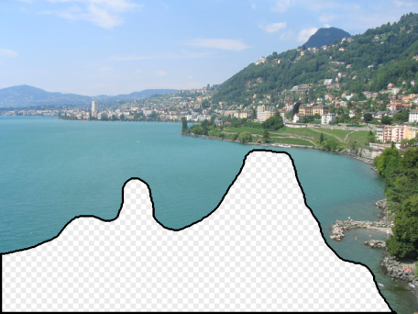
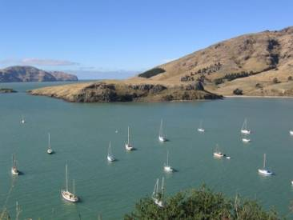
How it works
Find a similar image from a large dataset
Blend a region from that image into the hole
Dataset

Slide 17
General Principal
Huge Dataset
Images
image
matching
Info from Most Similar Images
Input Image
Associated Info
Hopefully, If you have enough images, the dataset will contain very similar images that you can find with simple matching methods.

Slide 18
How many images is enough?

Slide 19
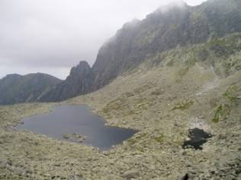
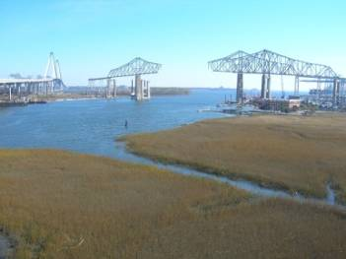
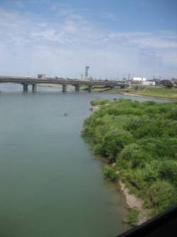

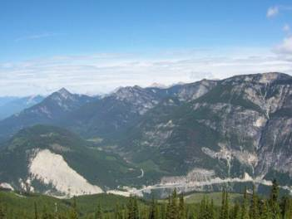
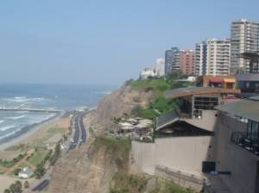
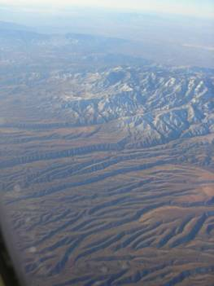
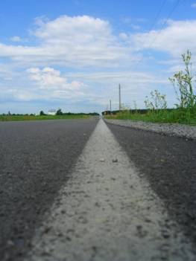


Nearest neighbors from a collection of 20 thousand images
Notes:
19

Slide 20
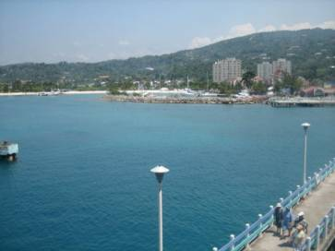
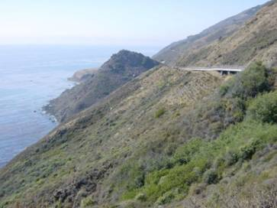
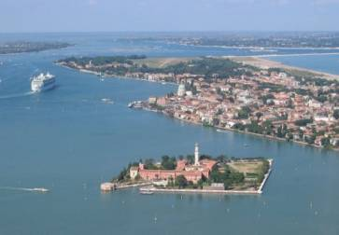
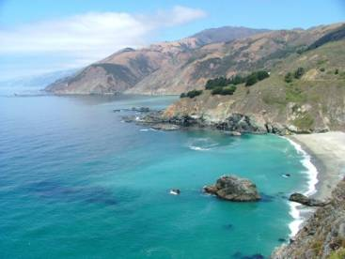

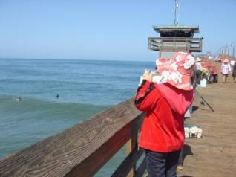
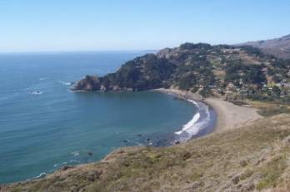
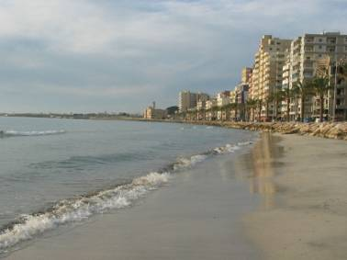
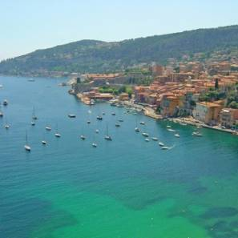
Nearest neighbors from a collection of 2 million images
Notes:
20

Slide 21
Image Data on the Internet
Flickr (as of Sept. 19th, 2010)
5 billion photographs
100+ million geotagged images
Facebook (as of 2009)
15 billion
http://royal.pingdom.com/2010/01/22/internet-2009-in-numbers/

Slide 22
Image Data on the Internet
Flickr (as of Nov 2013)
10 billion photographs
100+ million geotagged images
3.5 million a day
Facebook (as of Sept 2013)
250 billion+
300 million a day
Instagram
55 million a day

Slide 23
Image Data on the Internet
Instagram
100 million a day (as of 2017)
1 trillion photos taken per day.
Notes:
https://bernardmarr.com/how-much-data-do-we-create-every-day-the-mind-blowing-stats-everyone-should-read/

Slide 24
Scene Completion: how it works
[Hays and Efros. Scene Completion Using Millions of Photographs. SIGGRAPH 2007 and CACM October 2008.]

Slide 25
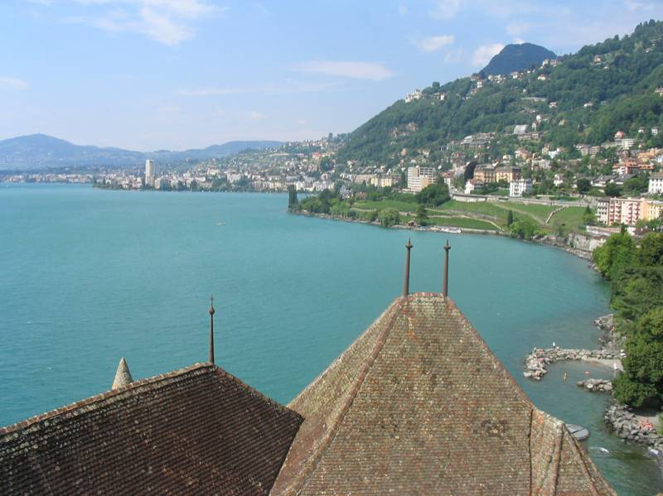
The Algorithm
Notes:
25
Introduce gist.

Slide 26
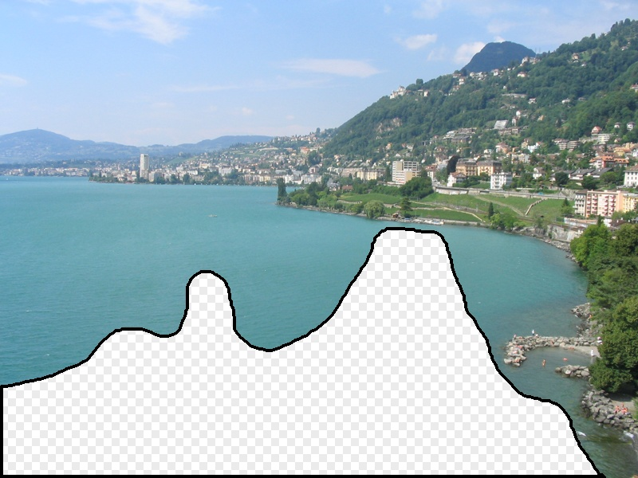
Scene Matching
Notes:
26
Introduce gist.

Slide 27
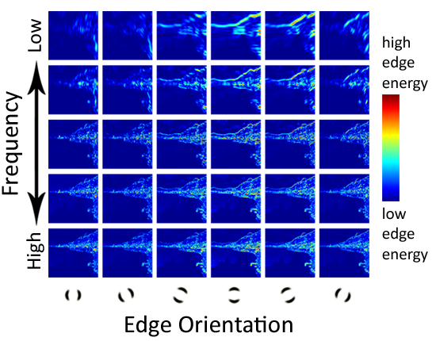
Scene Descriptor
Notes:
Edge energy is just the magnitude of directional derivatives of image intensity.
27

Slide 28
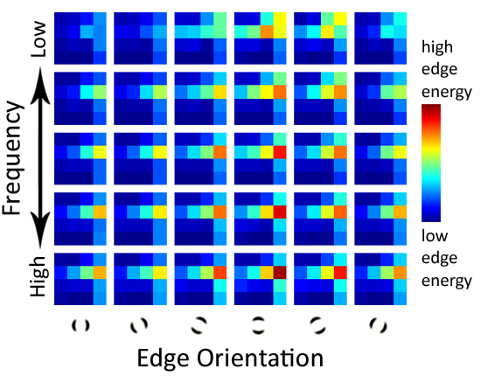
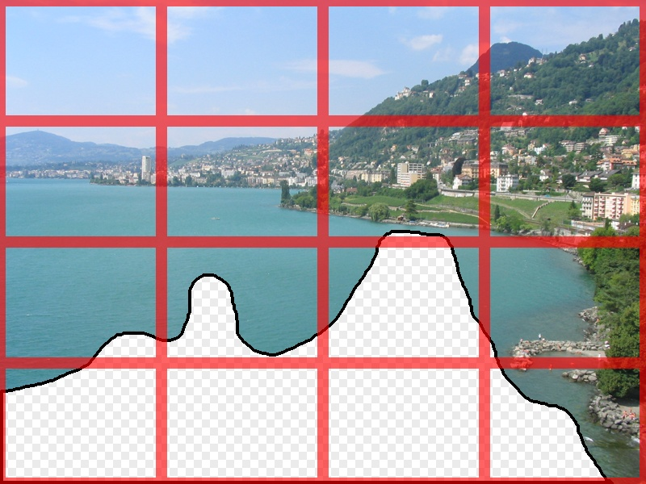
Scene Descriptor
Scene Gist Descriptor (Oliva and Torralba 2001)

Slide 29

Scene Descriptor
+
Scene Gist Descriptor (Oliva and Torralba 2001)

Slide 30

2 Million Flickr Images
22,500 thumbnails
Notes:
30
Now we take our gist (and mask and color image) and find it’s L2 nearest neighbors in the database of 2.3 million images, and here they are

Slide 31
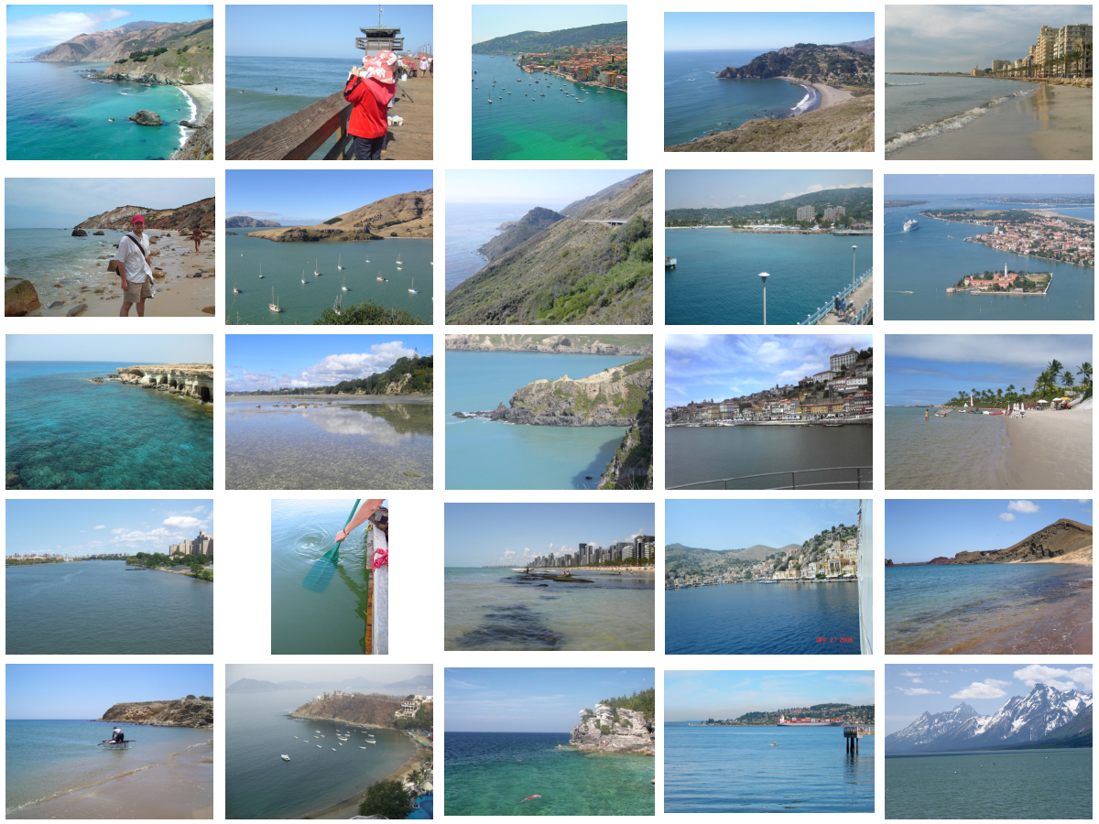
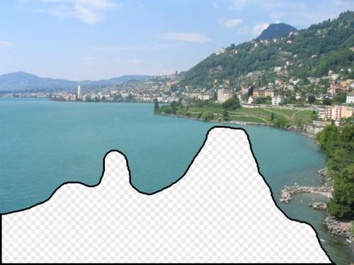
… 200 total
Notes:
31

Slide 32
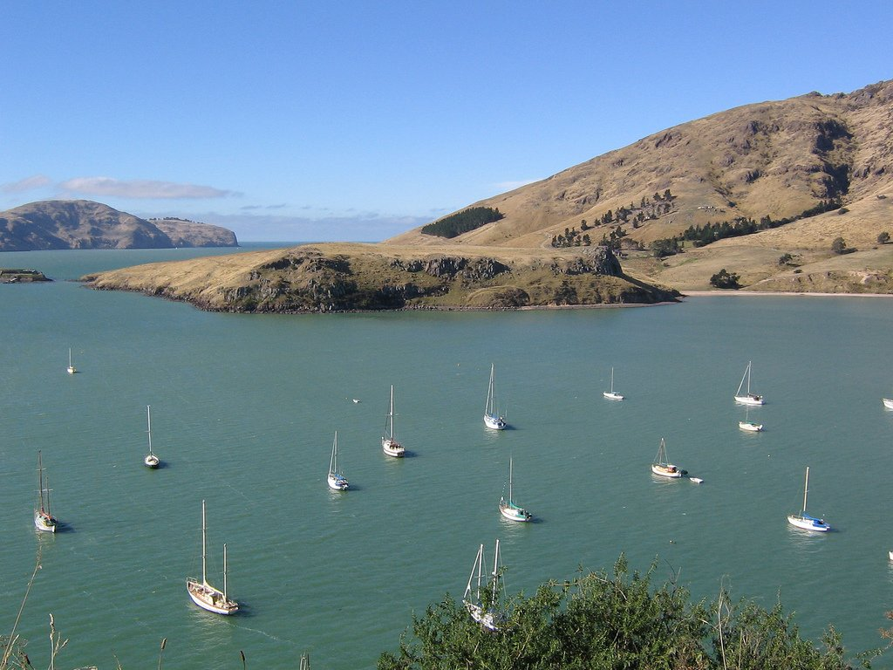
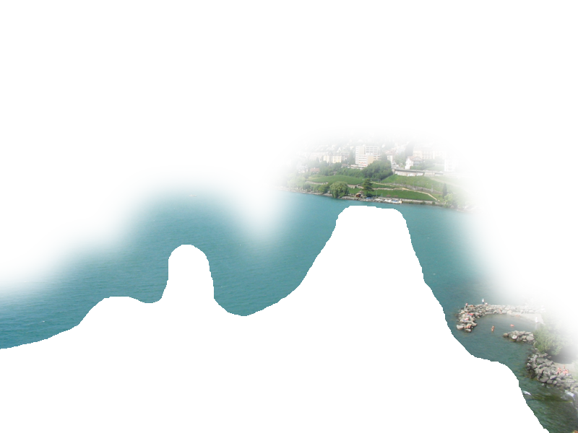
Context Matching

Slide 33
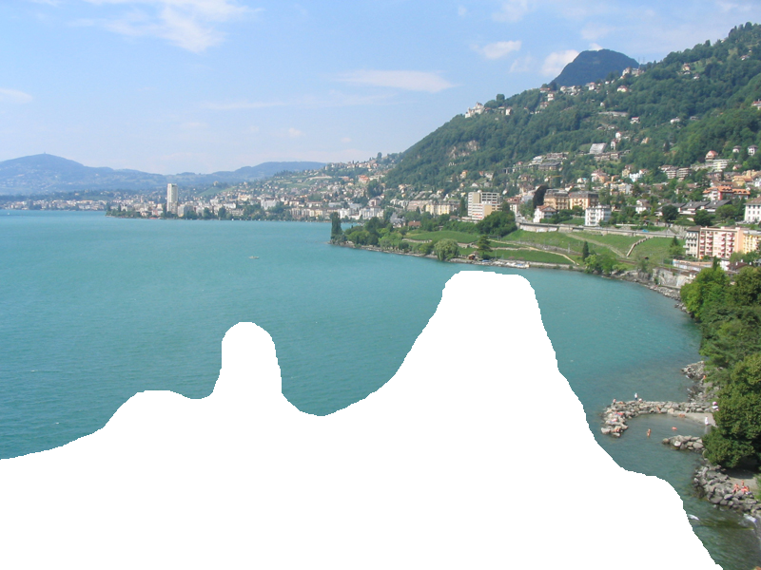
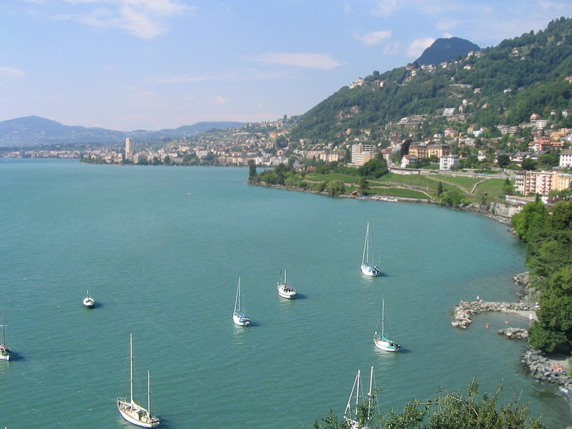
Graph cut + Poisson blending

Slide 34




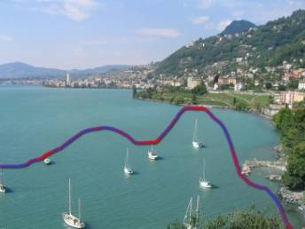
Result Ranking
We assign each of the 200 results a score which is the sum of:
The scene matching distance
The context matching distance (color + texture)
The graph cut cost
Notes:
34
Johnson et al. used the graph cut cost to sort results for users in Semantic Photo Synthesis

Slide 35
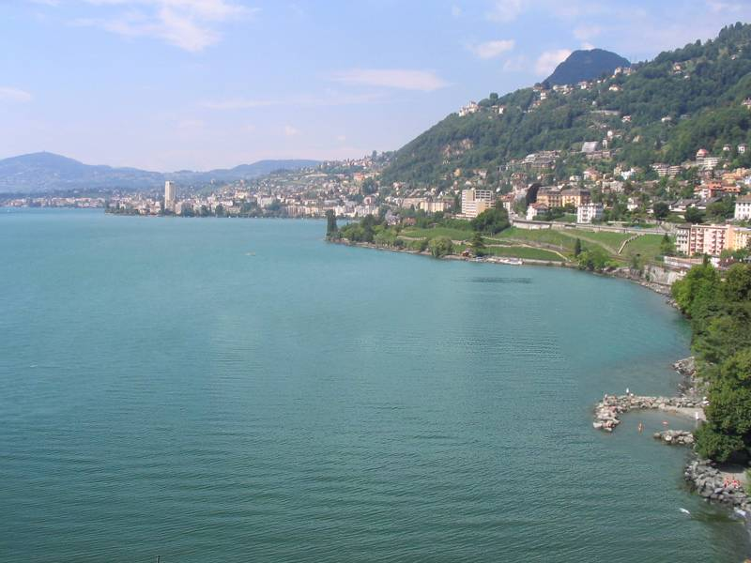

Slide 36
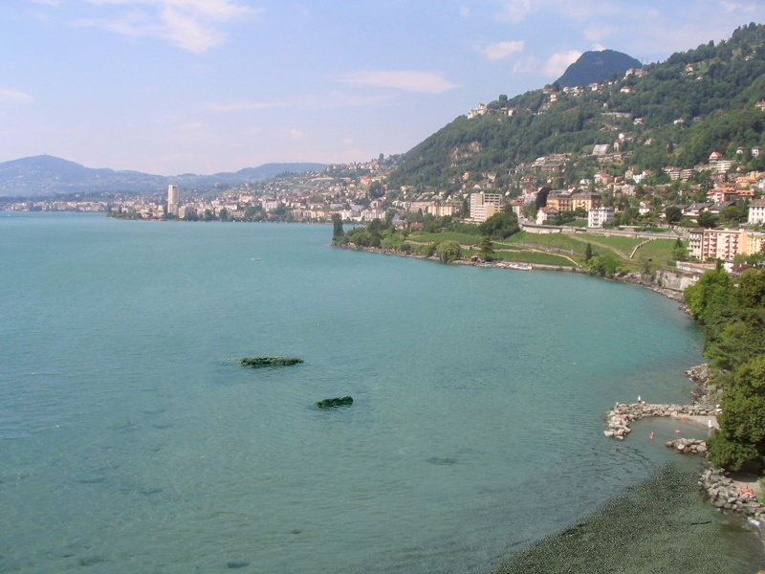

Slide 37
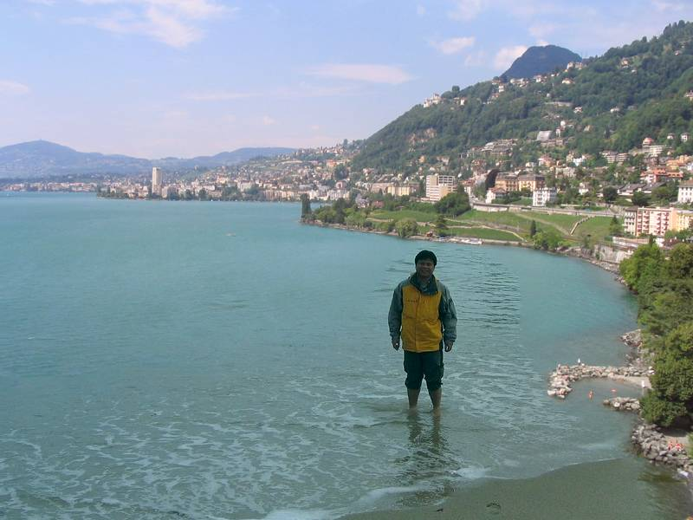

Slide 38


Slide 39
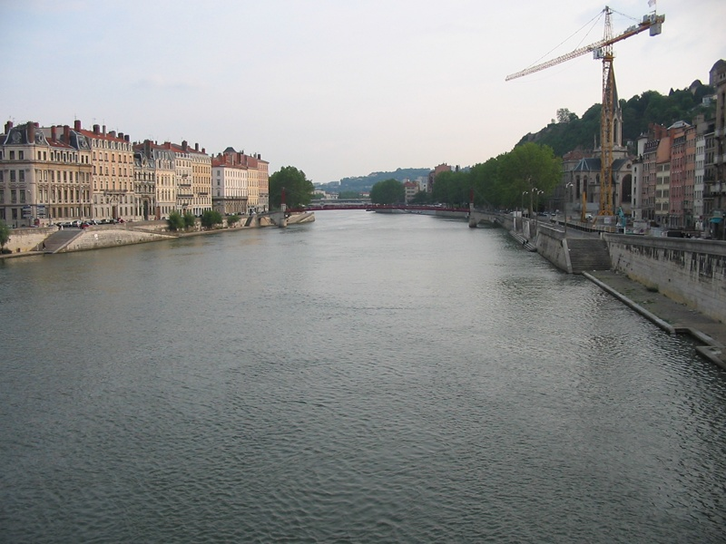
Notes:
39

Slide 40
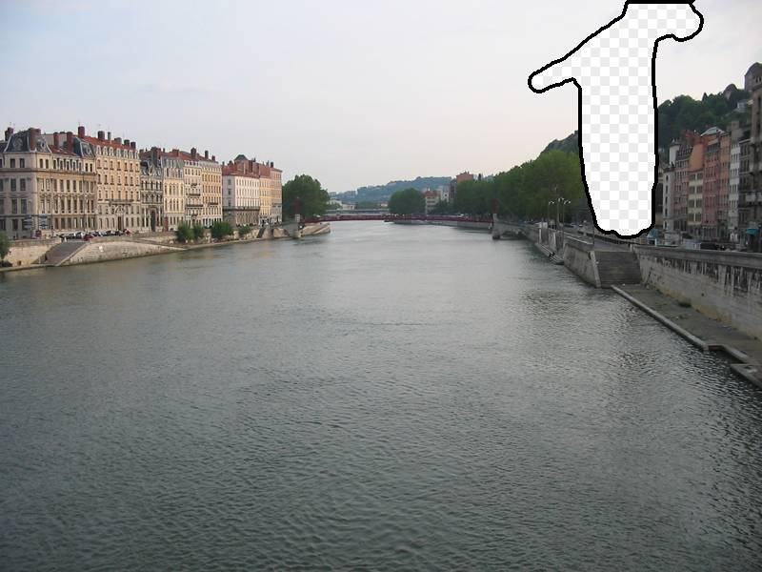
Notes:
40

Slide 41
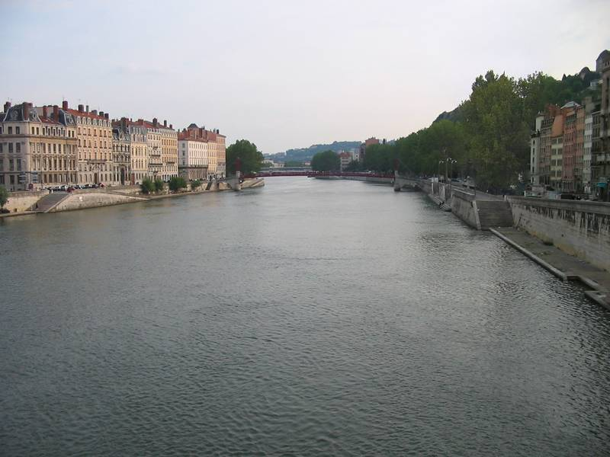
Notes:
41

Slide 42


… 200 scene matches
Notes:
42

Slide 43

Notes:
43
Not actually the same scene, even though they’re startlingly similar

Slide 45


Slide 46


Slide 47


Slide 48


Which is the original?

Slide 49


Slide 50

Notes:
50

Slide 51

Notes:
51
Can justify broader use of image completion here

Slide 52

Diffusion Result
Notes:
52

Slide 53

Efros and Leung result
Notes:
53
Efros and leung result

Slide 54

Scene Completion Result

Slide 55


Slide 56
Outline
Opportunities of Scale: Data-driven methods
The Unreasonable Effectiveness of Data
Scene Completion
Image Geolocation

Slide 57
General Principal
Huge Dataset
Images
image
matching
Info from Most Similar Images
Input Image
Associated Info
Hopefully, If you have enough images, the dataset will contain very similar images that you can find with simple matching methods.

Slide 58

https://www.geoguessr.com/
https://www.youtube.com/c/GeoWizard/videos

