Slide 1
Outline
Opportunities of Scale: Data-driven methods
  The Unreasonable Effectiveness of Data
  Scene Completion
  Image Geolocation

Slide 2
General Principal
Huge Dataset
Images
image
matching
Info from Most Similar Images
Input Image
Associated Info
Hopefully, If you have enough images, the dataset will contain very similar images that you can find with simple matching methods.

Slide 3
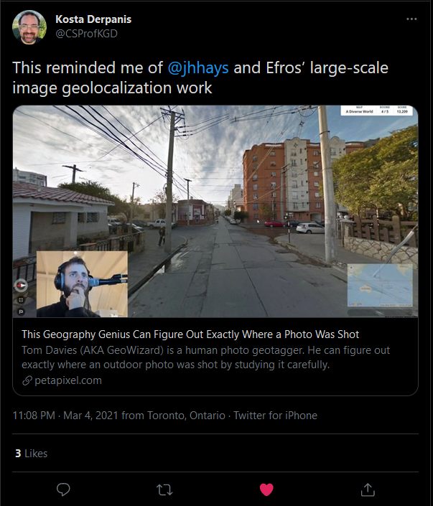
https://www.geoguessr.com/
https://www.youtube.com/c/GeoWizard/videos

Slide 4
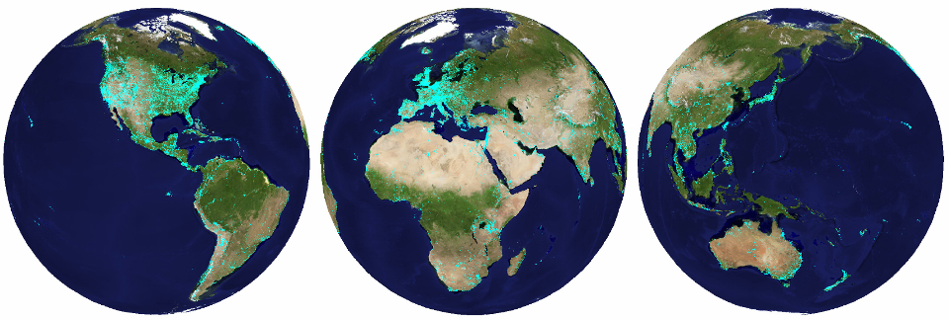
im2gps (Hays & Efros, CVPR 2008)
6 million geo-tagged Flickr images
http://graphics.cs.cmu.edu/projects/im2gps/

Slide 5
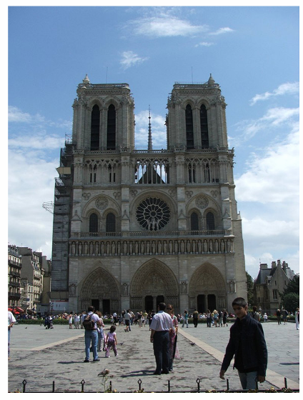
Where is this photo?

Slide 6
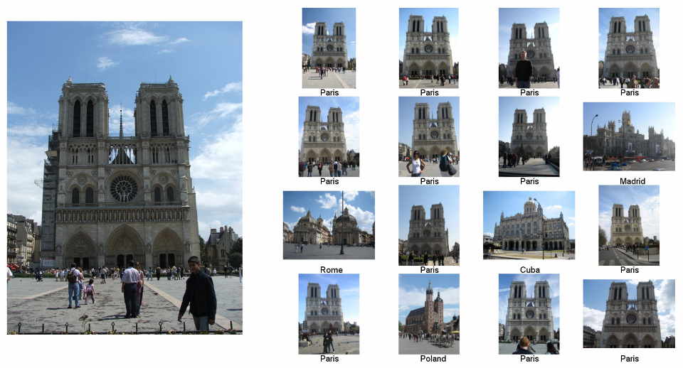
Nearest Neighbors according to gist + bag of SIFT + color histogram + a few others

Slide 7
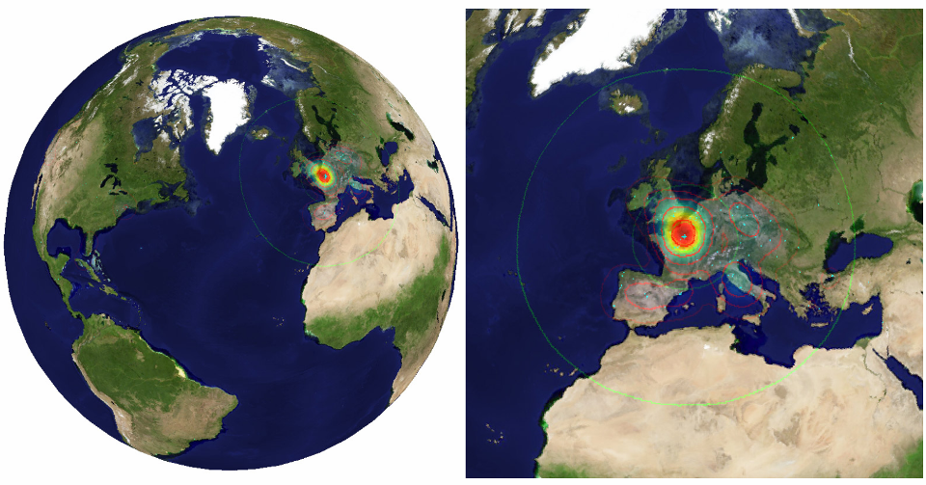

Slide 8
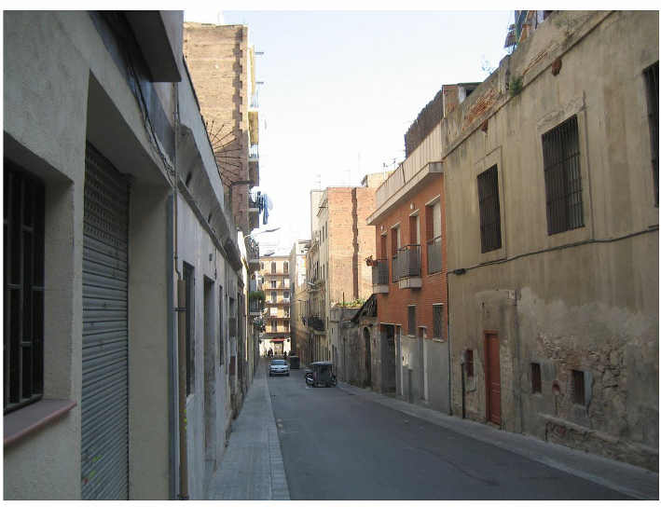
Where is this photo?

Slide 9
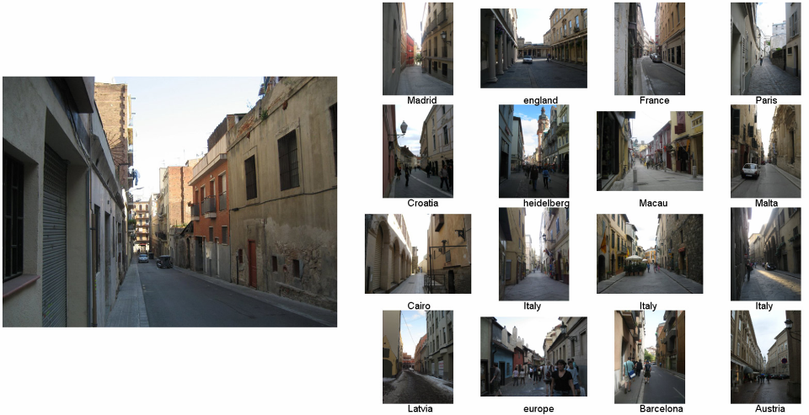
Nearest Neighbor Scenes

Slide 10
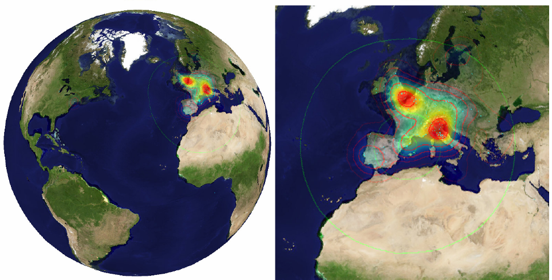
Notes:
Probability map for that same image
Explain the green circles and how they relate to evaluation
10

Slide 11
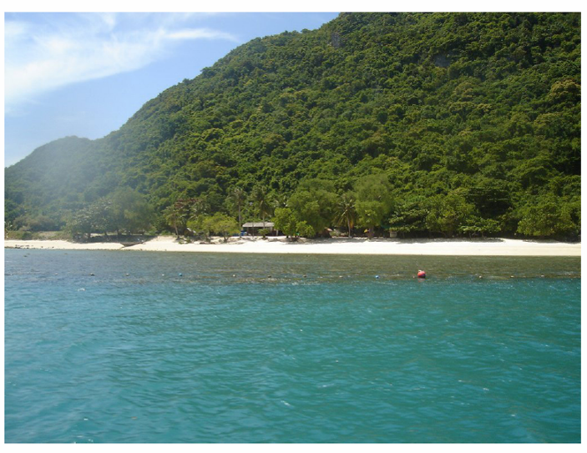
Where is this photo?

Slide 12
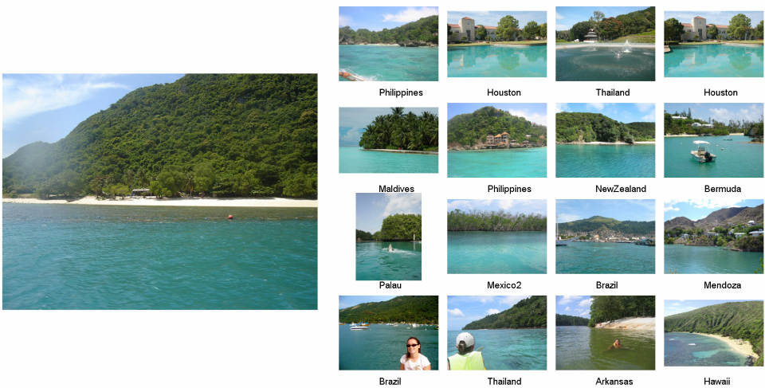

Slide 13
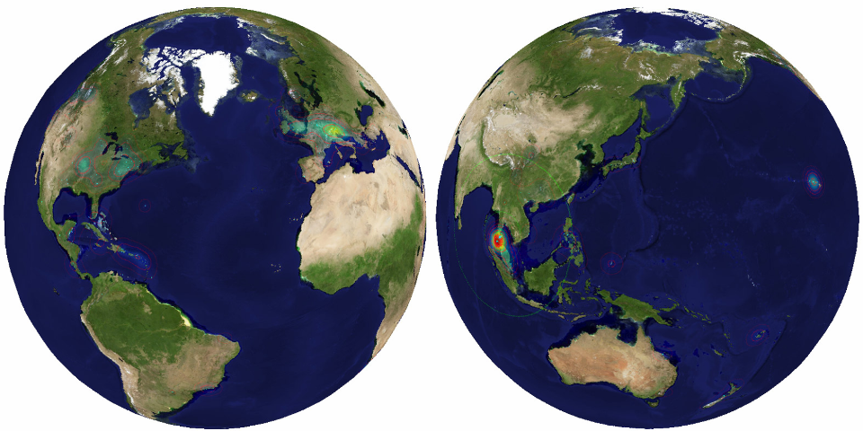

Slide 14
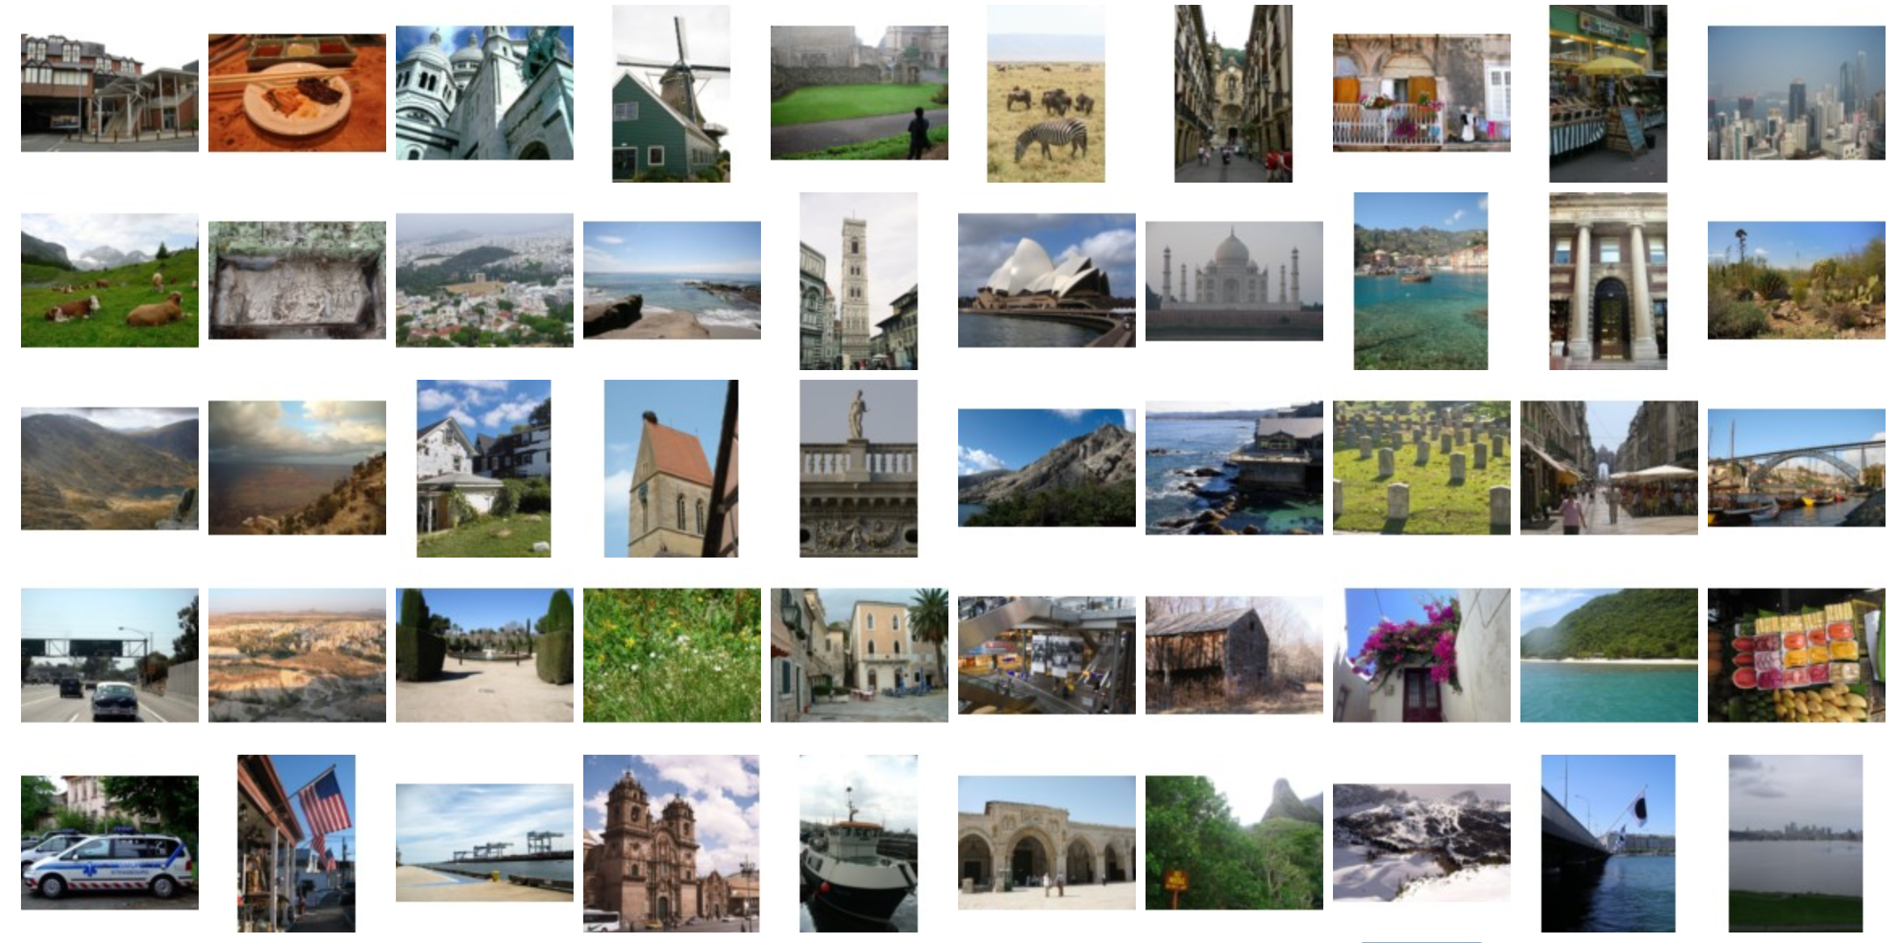
Test Set of 237 Touristy Photos

Slide 15
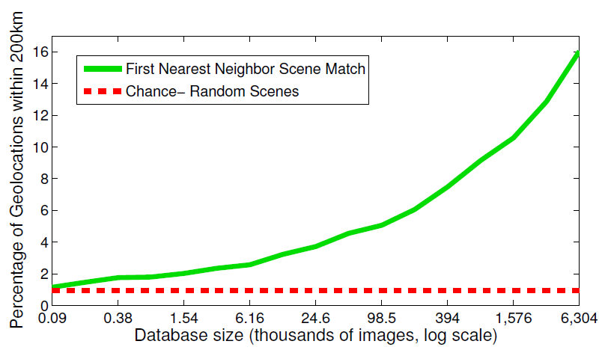
Effect of Dataset Size

Slide 16
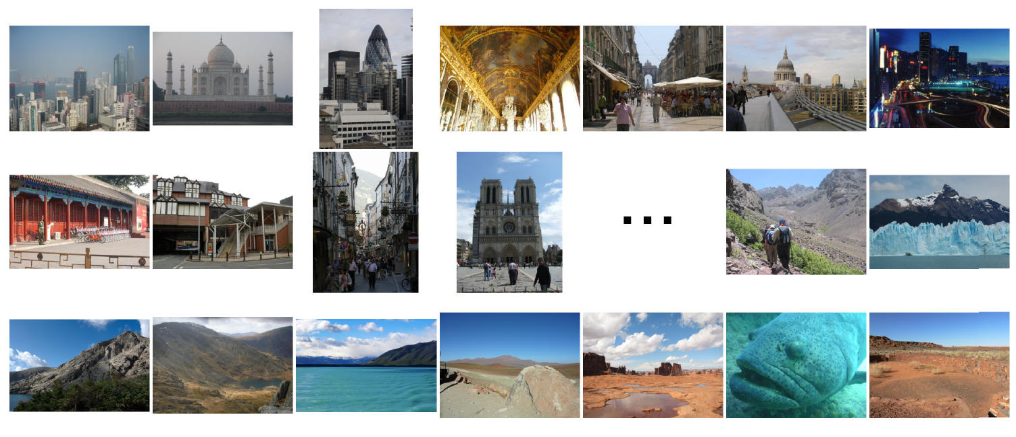
Population density ranking
High Predicted Density
Low Predicted Density

Slide 17
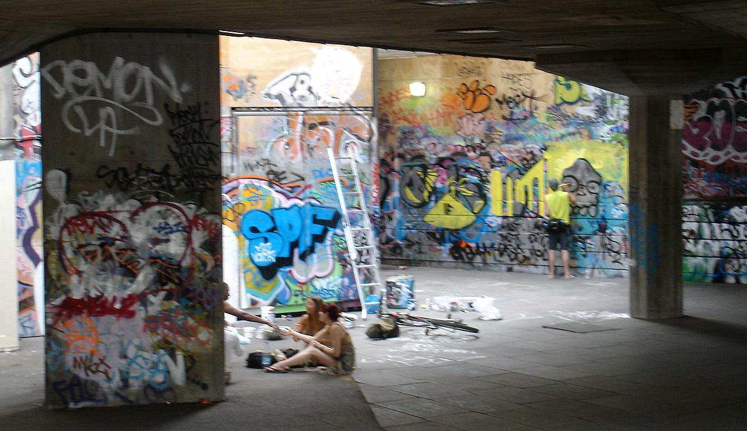
Where is This?
[Olga Vesselova, Vangelis Kalogerakis, Aaron Hertzmann, James Hays, Alexei A. Efros. Image Sequence Geolocation. ICCV’09]
Notes:
17

Slide 18
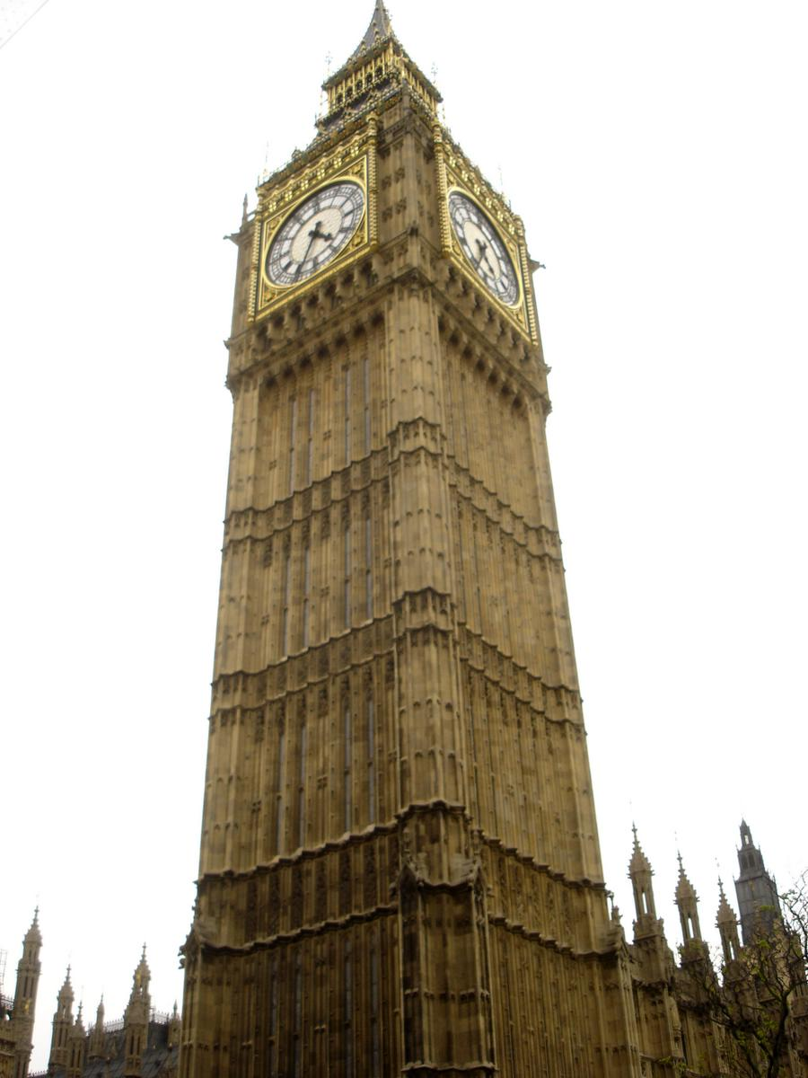
Where is This?

Slide 19


Where are These?
15:14,
June 18th, 2006
16:31,
June 18th, 2006
Notes:
Individually each photograph is 16%, but together they reinforce each other well
19

Slide 20
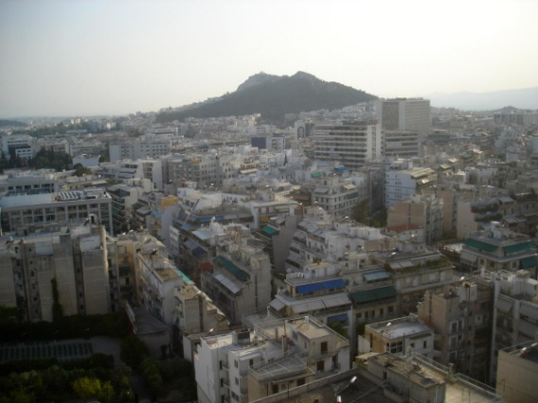
Where are These?
15:14,
June 18th, 2006
16:31,
June 18th, 2006
17:24,
June 19th, 2006
Notes:
If you know that brits love to vacation in greece…
20

Slide 21
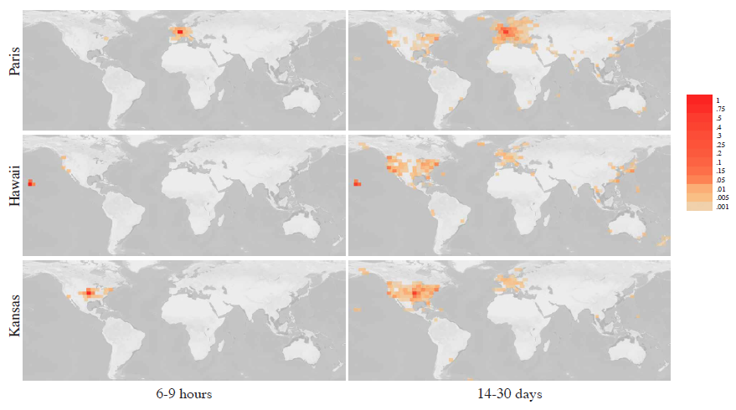
Results
im2gps – 10% (geo-loc within 400 km)
temporal im2gps – 56%

Slide 22
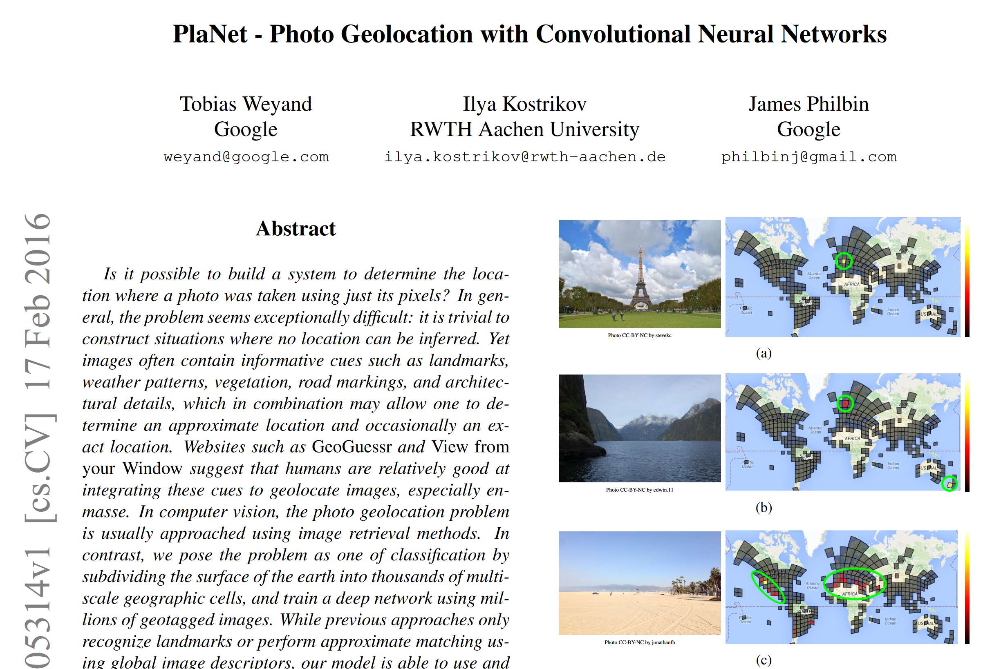

Slide 23
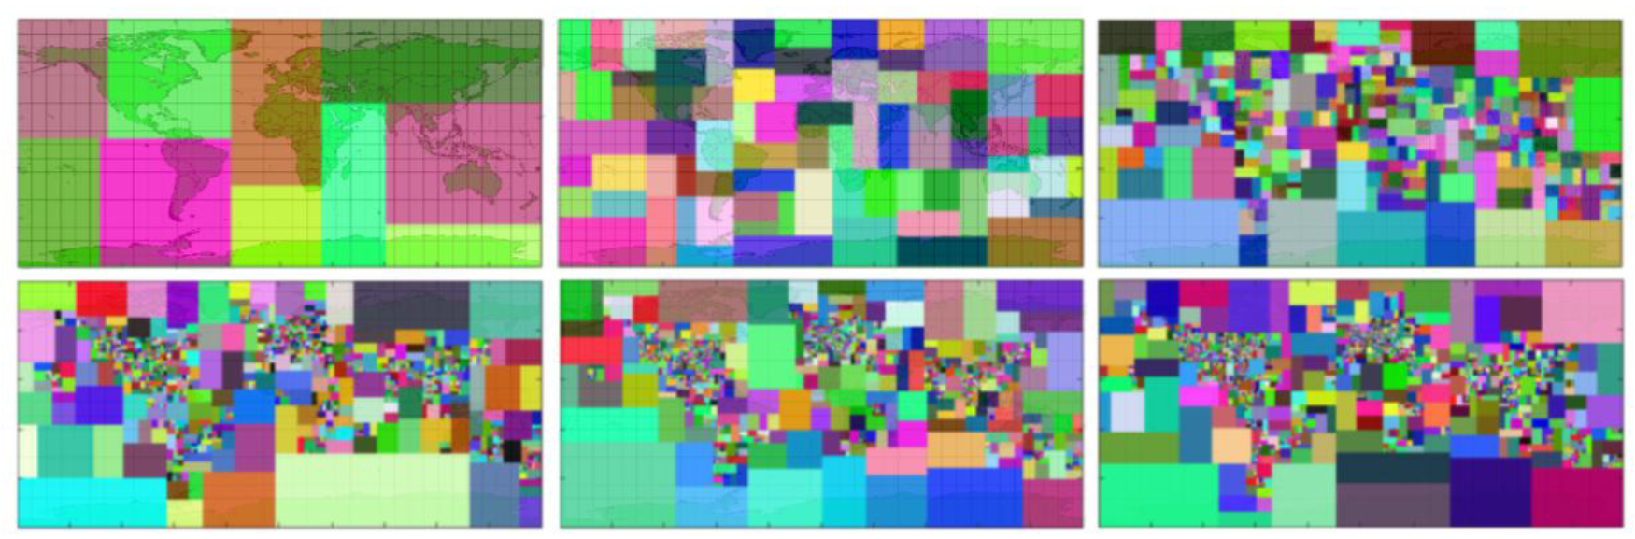
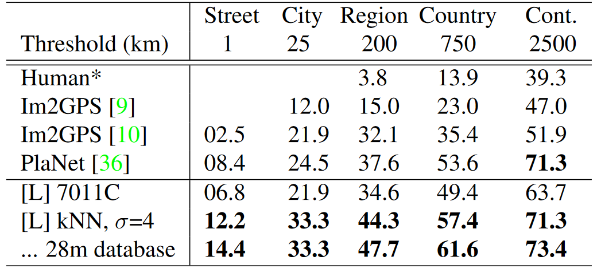
Revisiting IM2GPS in the Deep Learning Era.
Nam Vo, Nathan Jacobs, James Hays. ICCV 2017
2008
2009
2016
2017
2017
2017

Slide 24
Geolocation Overview
Bespoke Image Geolocation Approaches
  Im2gps (2008)
  PlaNet and im2gps revisited (2016 and 2017)
Can Large Vision-Language Models geolocate images?
  CLIP (2021)
  GeoGuessr
  Pigeon (2023)
Can Large Generative Vision-Language Models geolocate images?

Slide 25
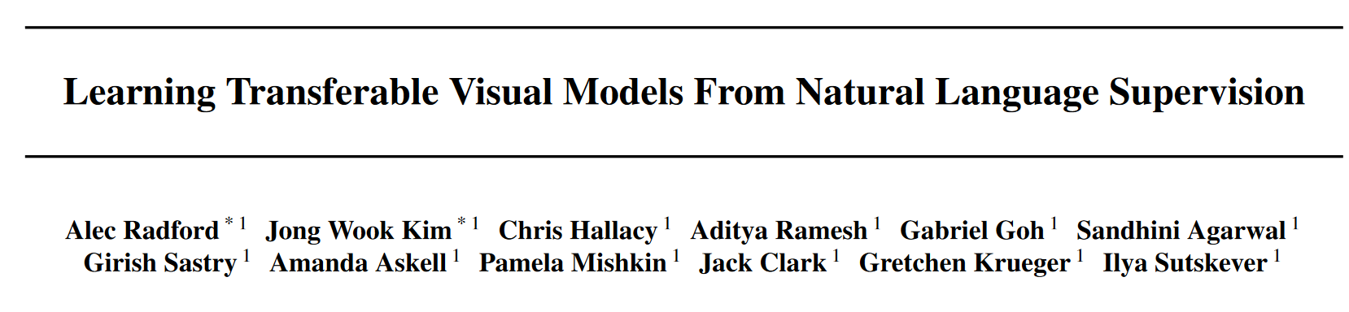
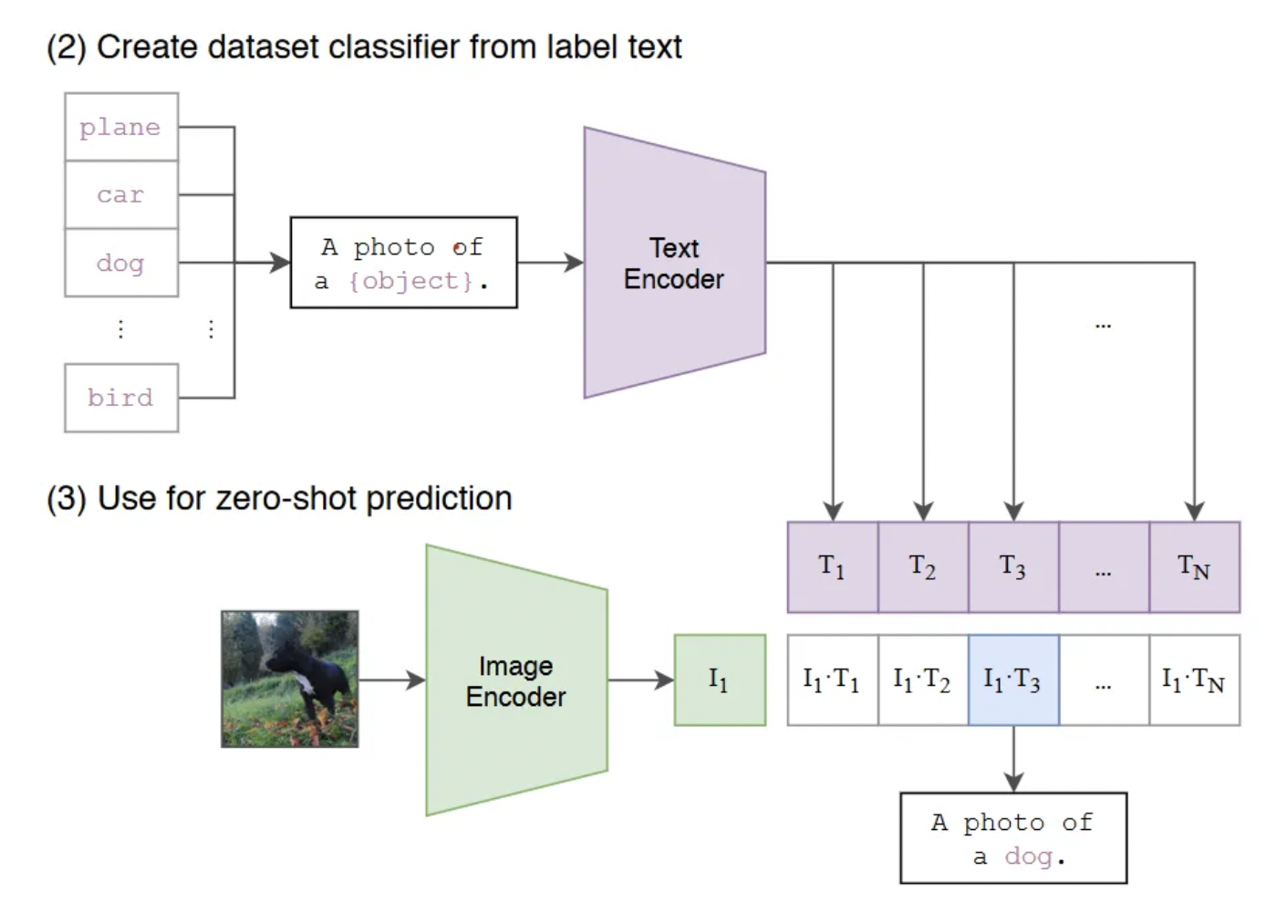
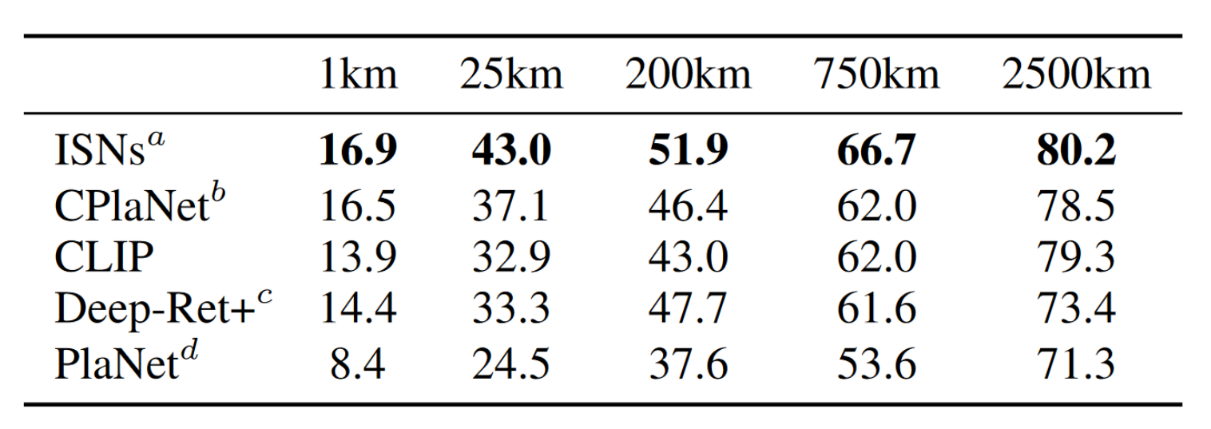
Are “Foundation” Models Good at Geolocation?
OpenAI’s CLIP (2021) is strong using only 1 million reference images

Slide 26
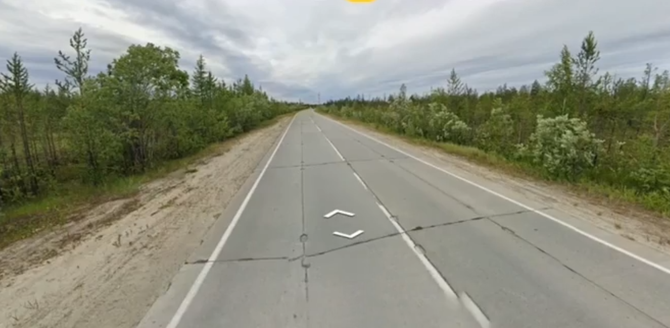
Notes:
Geoguessr has 40 million accounts as of July 2022

Slide 27
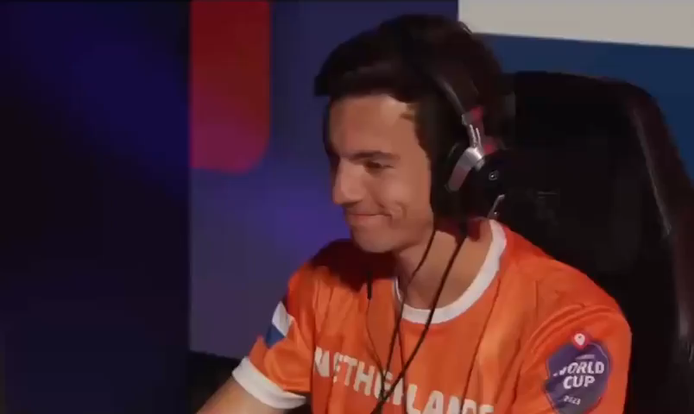

Slide 28
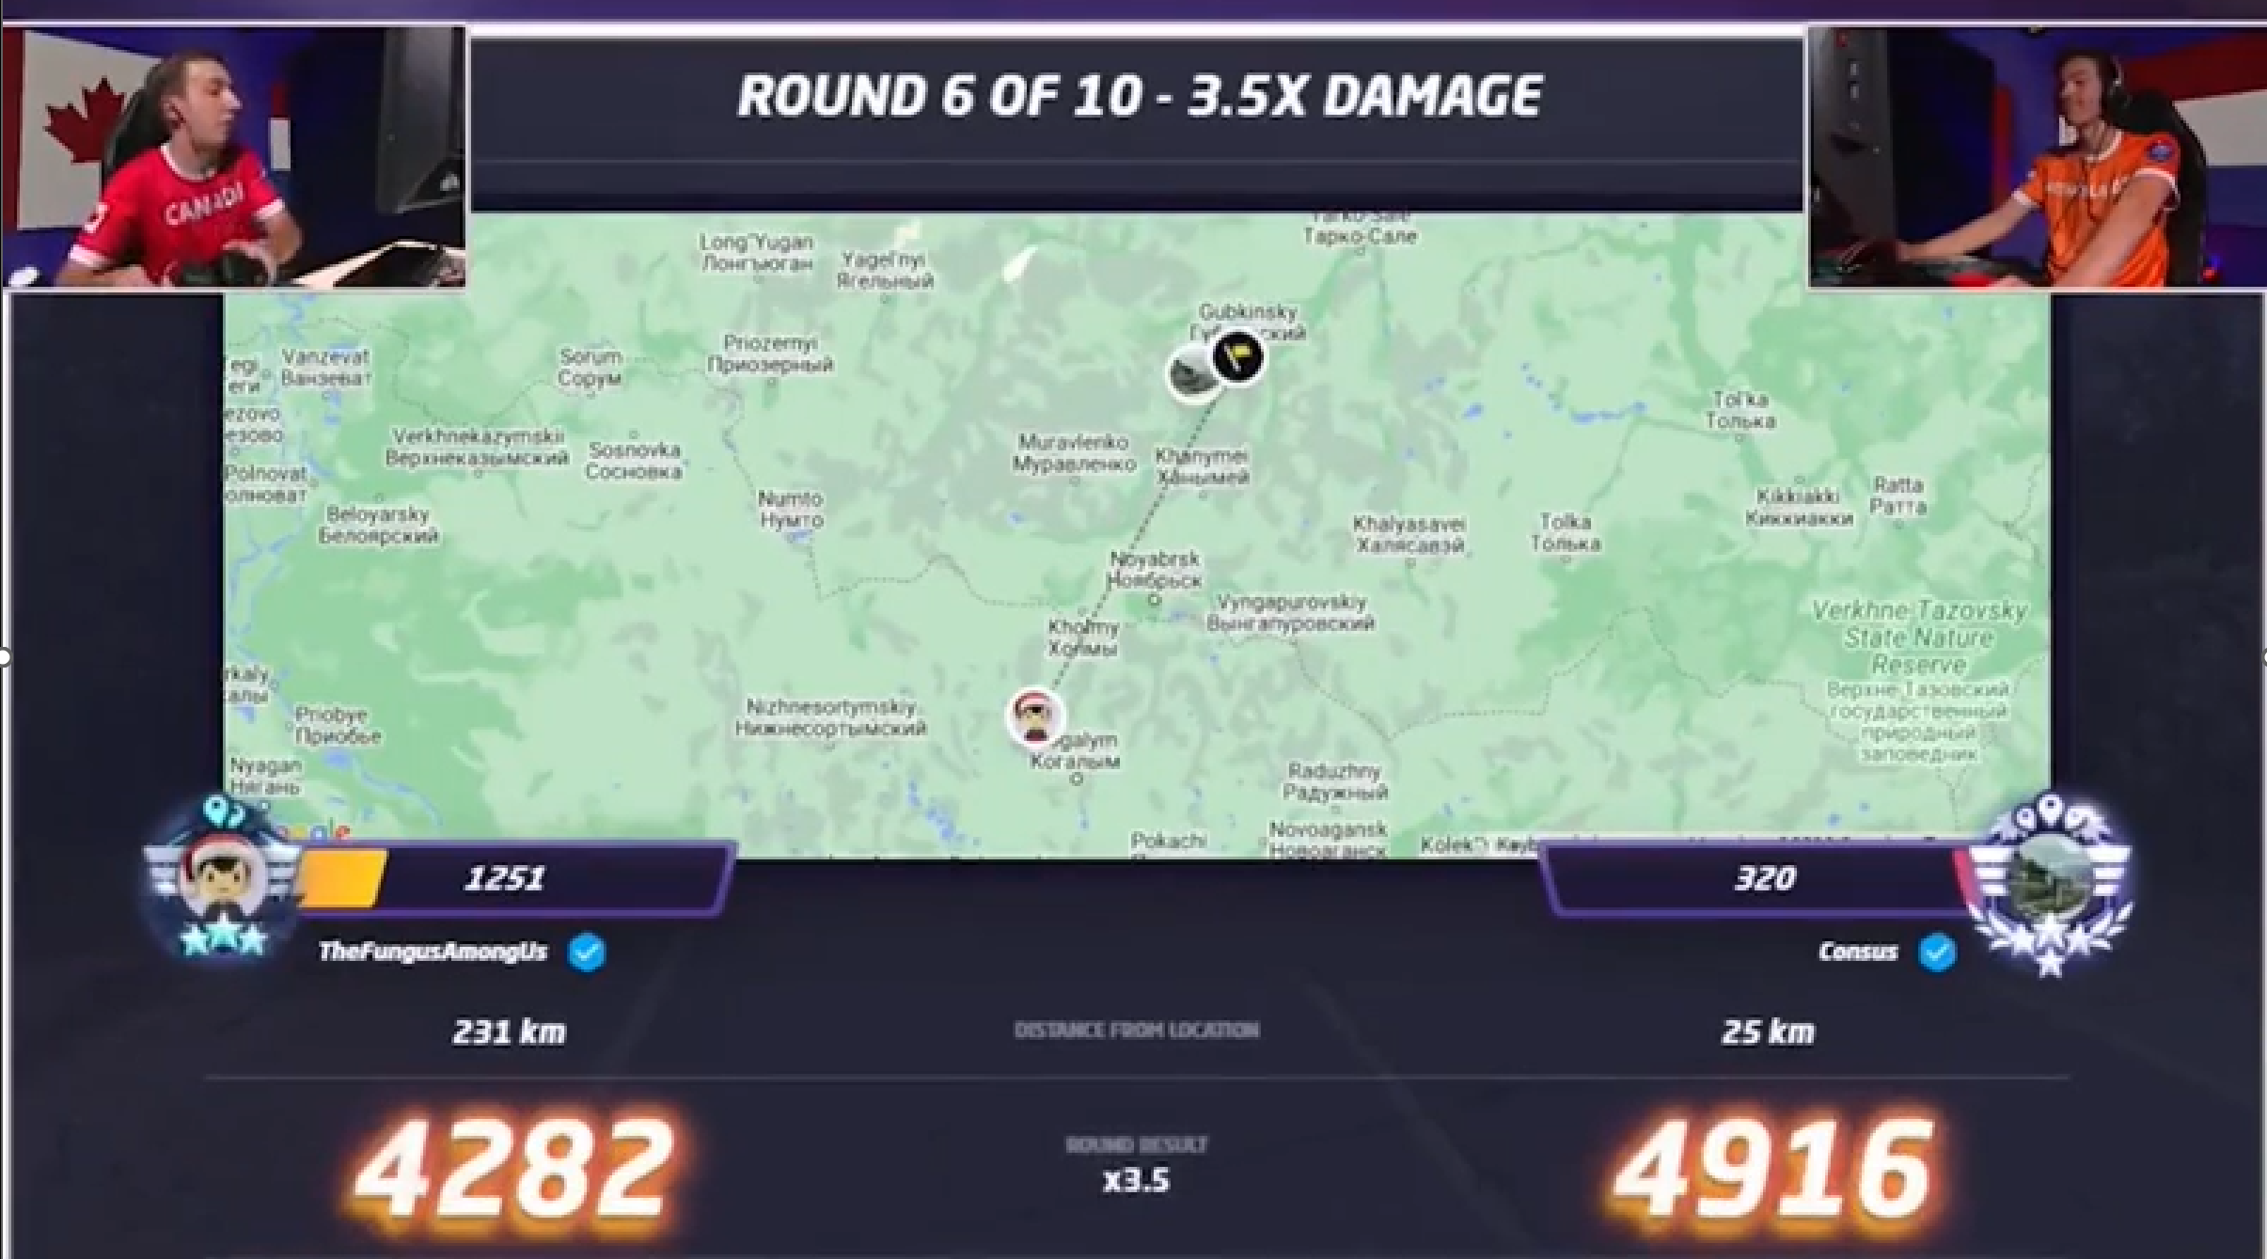

Slide 29
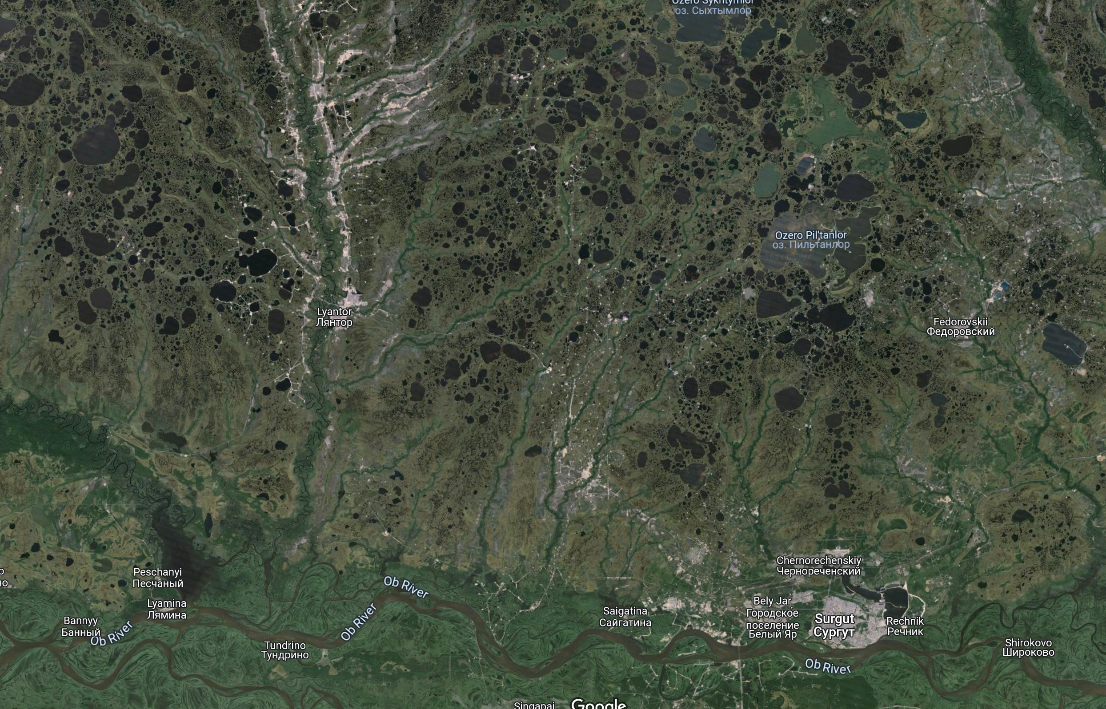

Slide 30
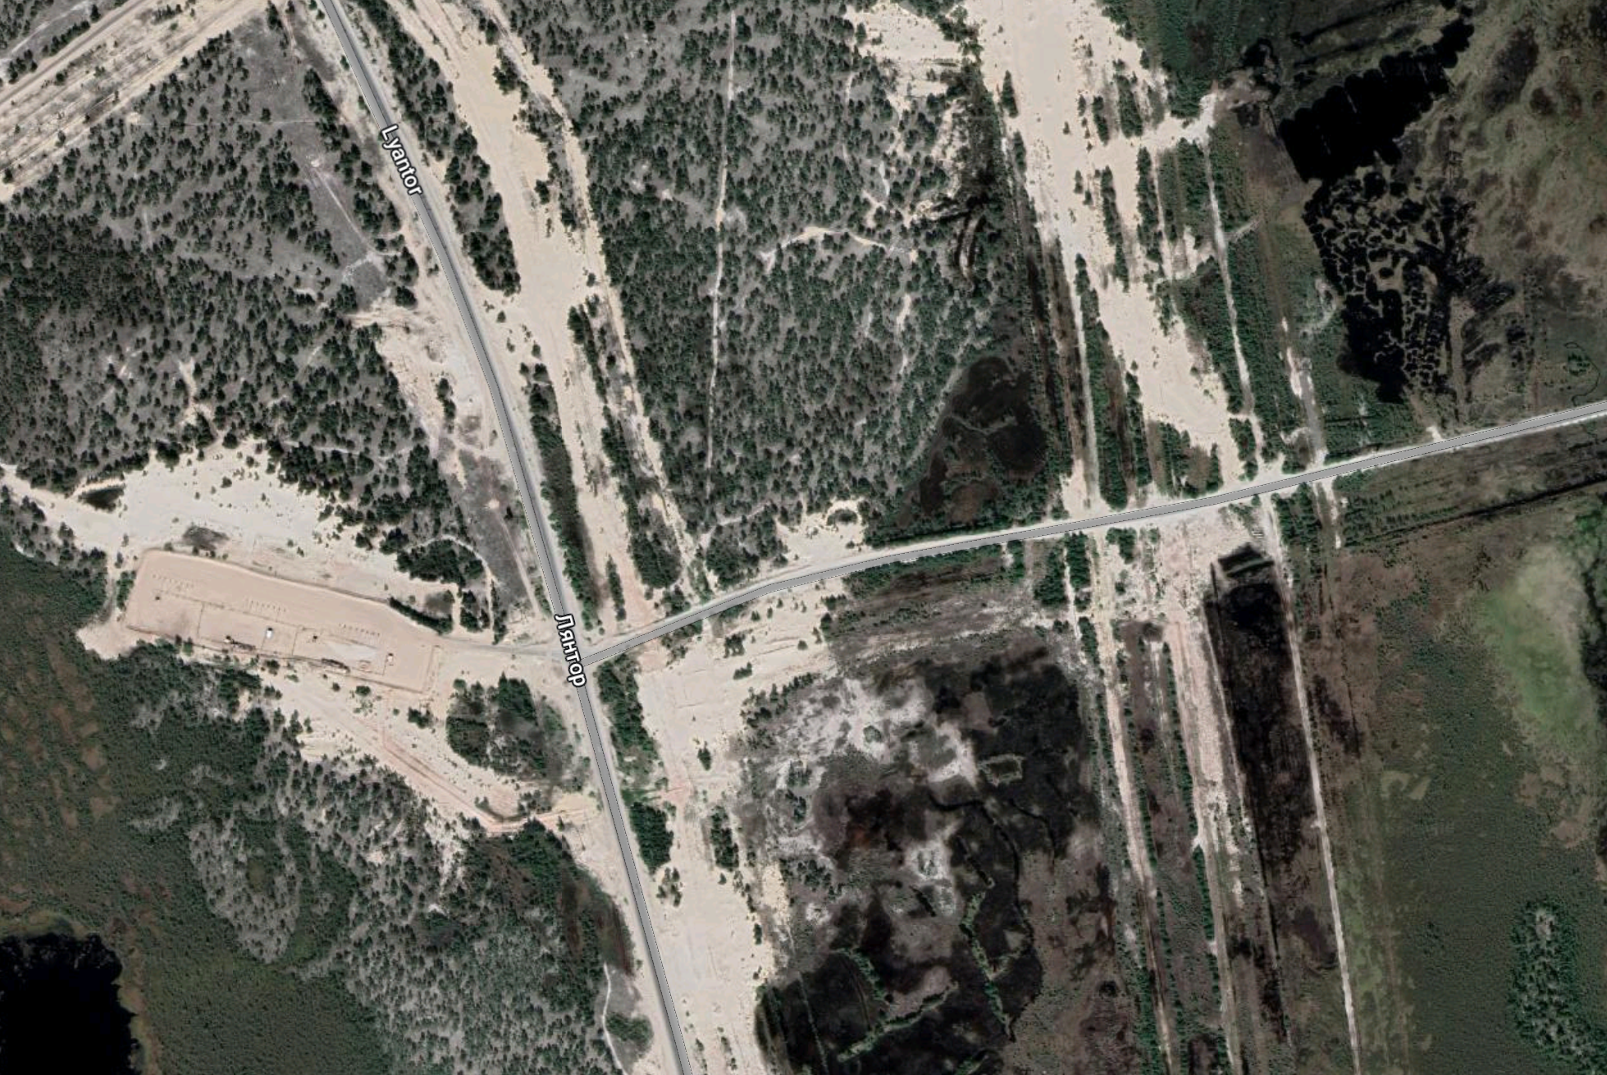

Slide 31
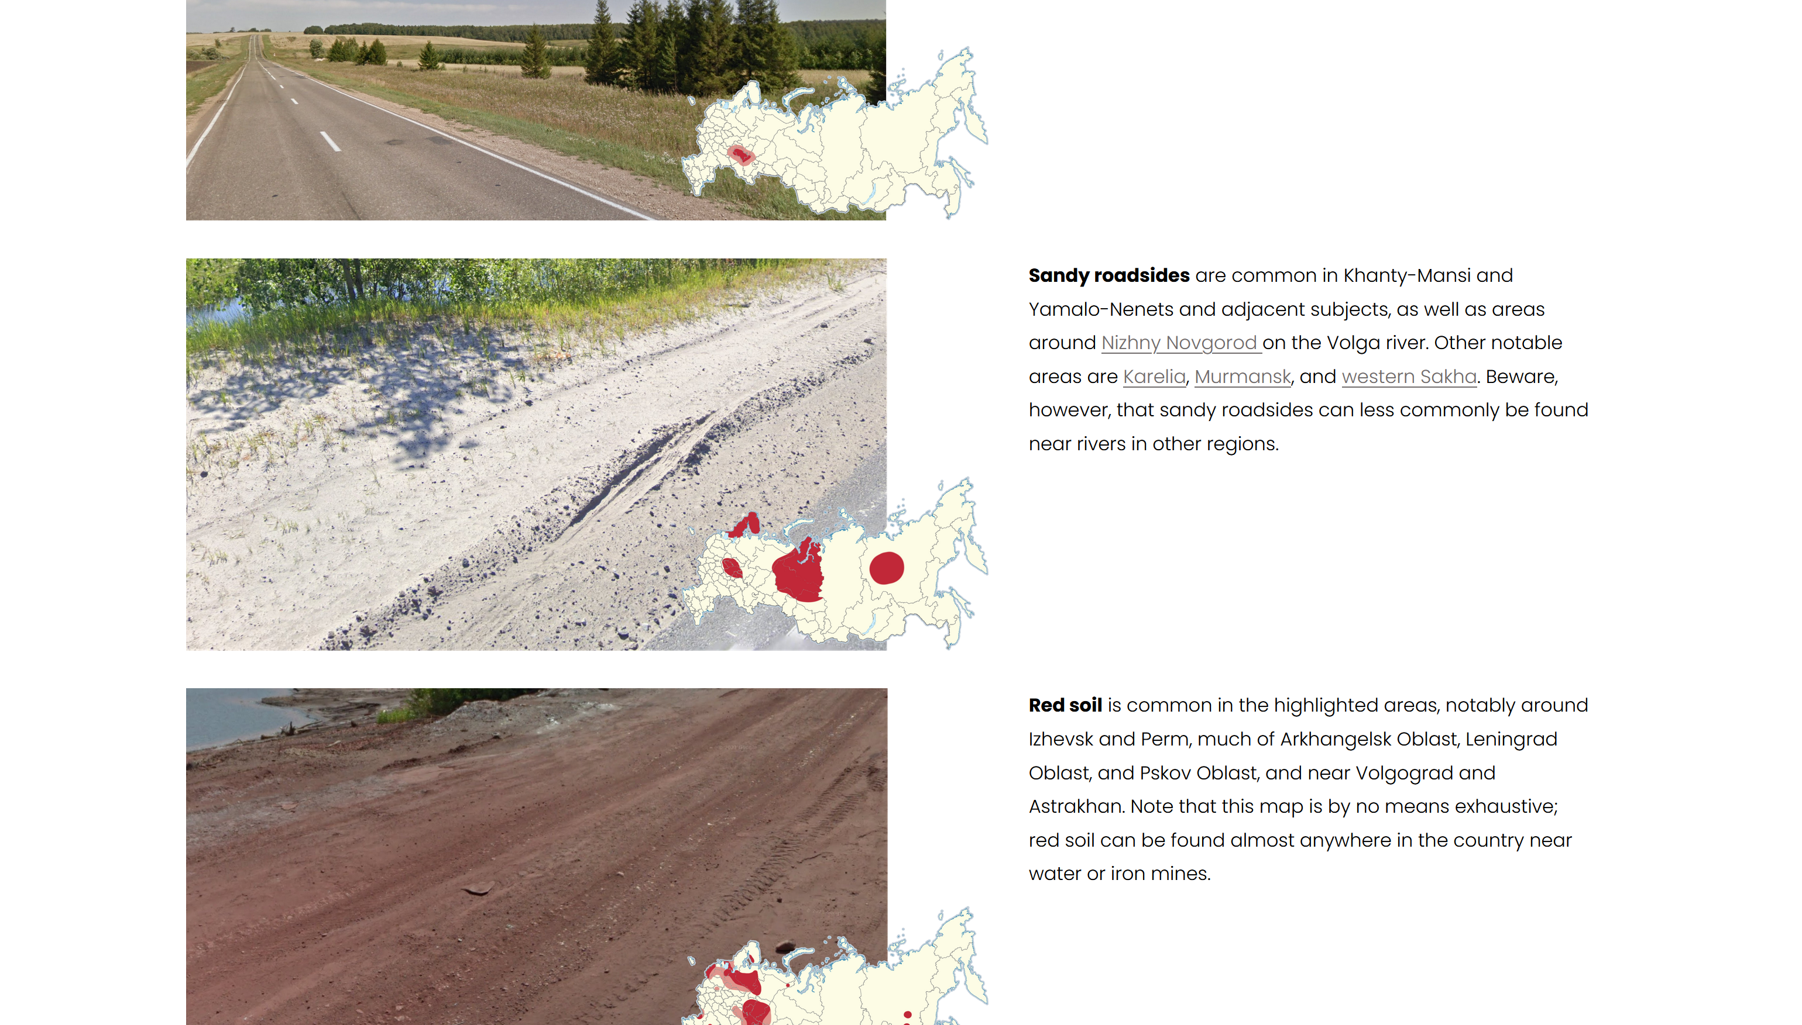
https://www.plonkit.net/russia
Notes:
https://www.plonkit.net/russia

Slide 32
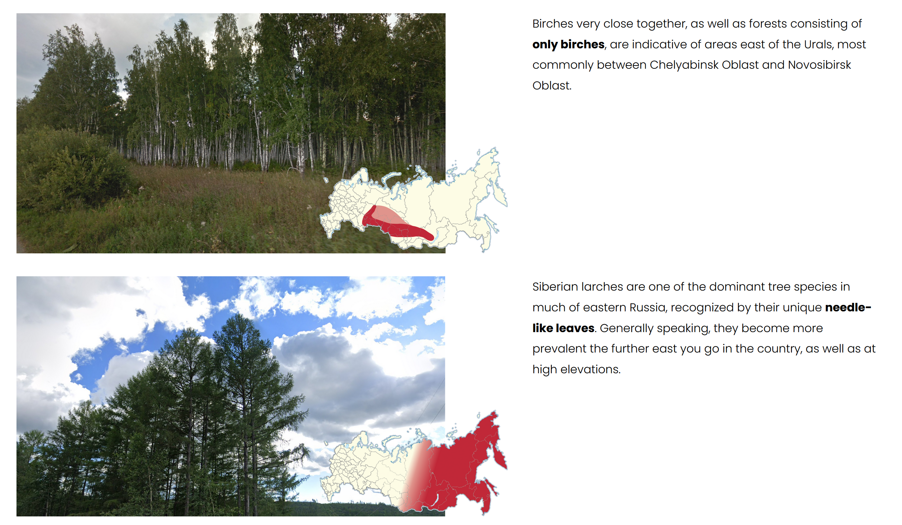

Slide 33
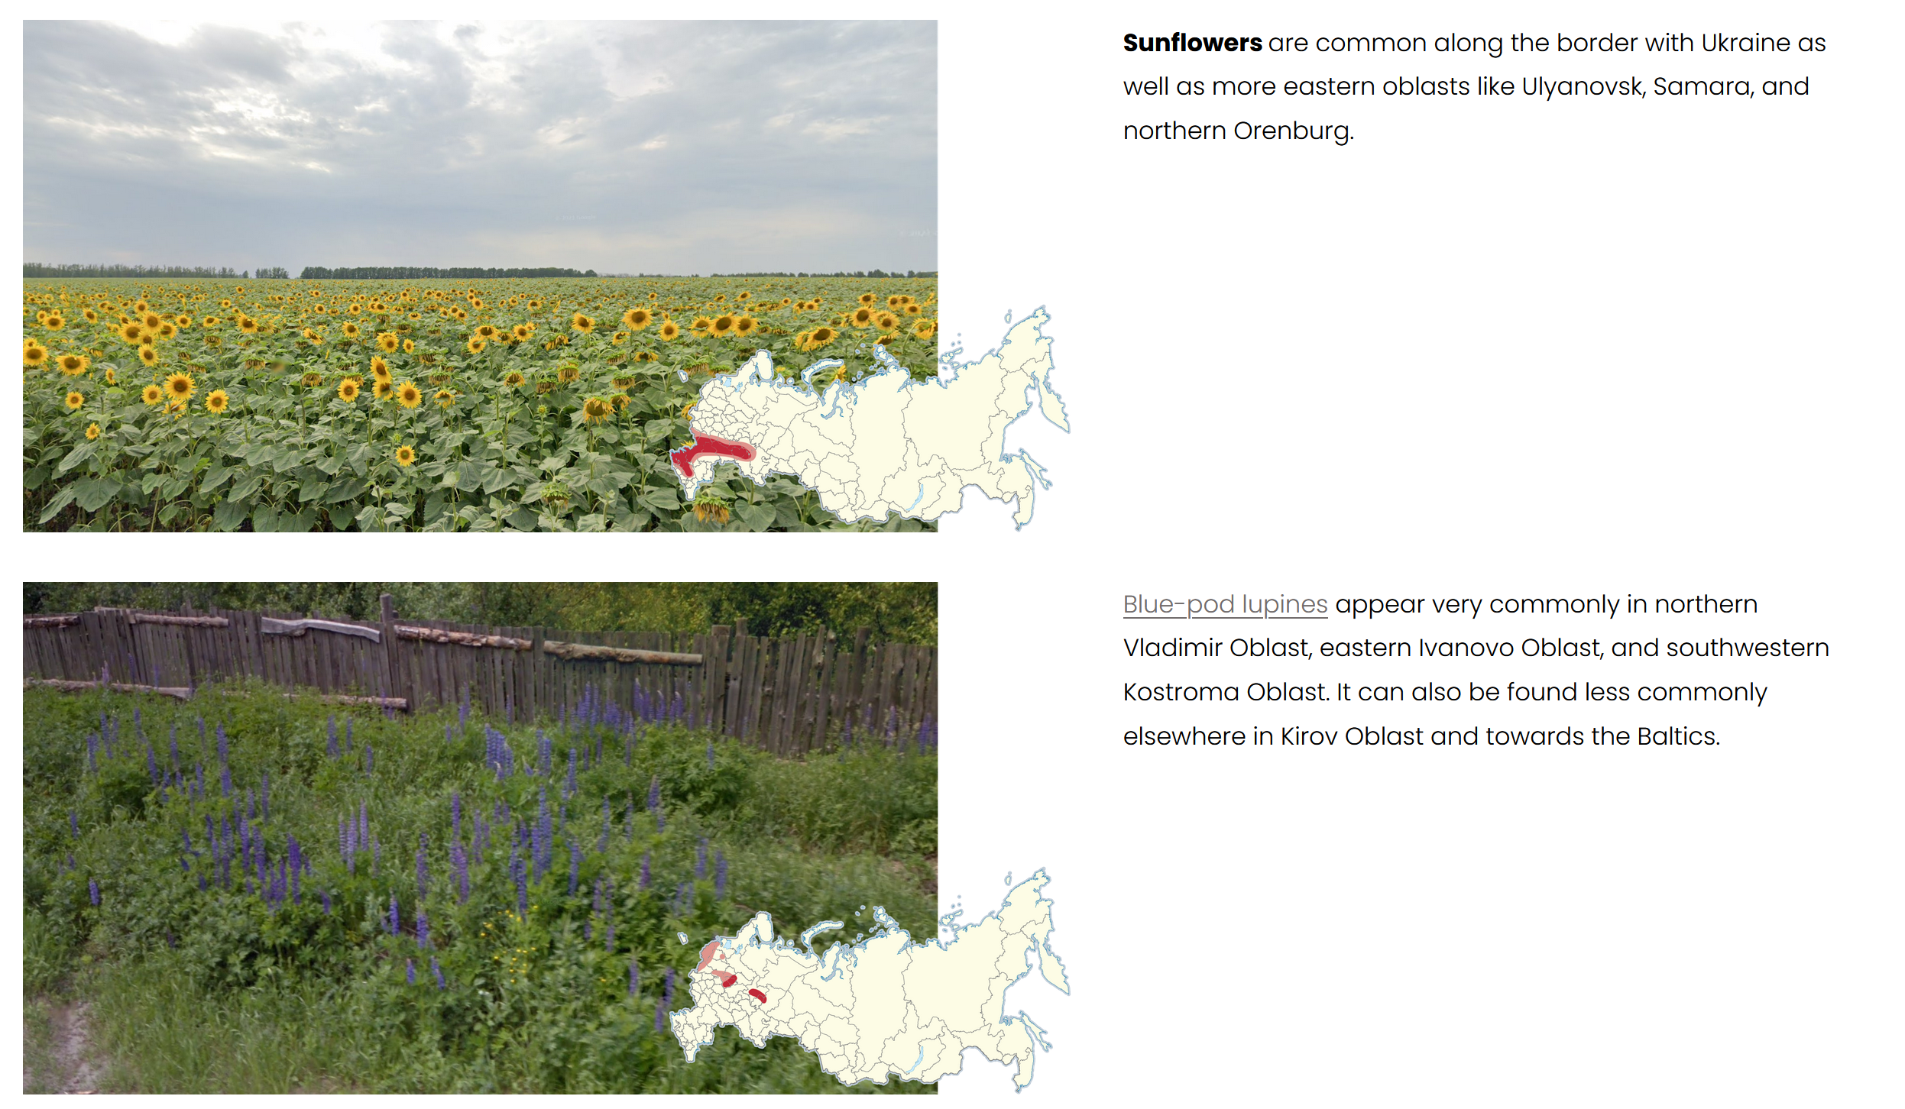

Slide 34
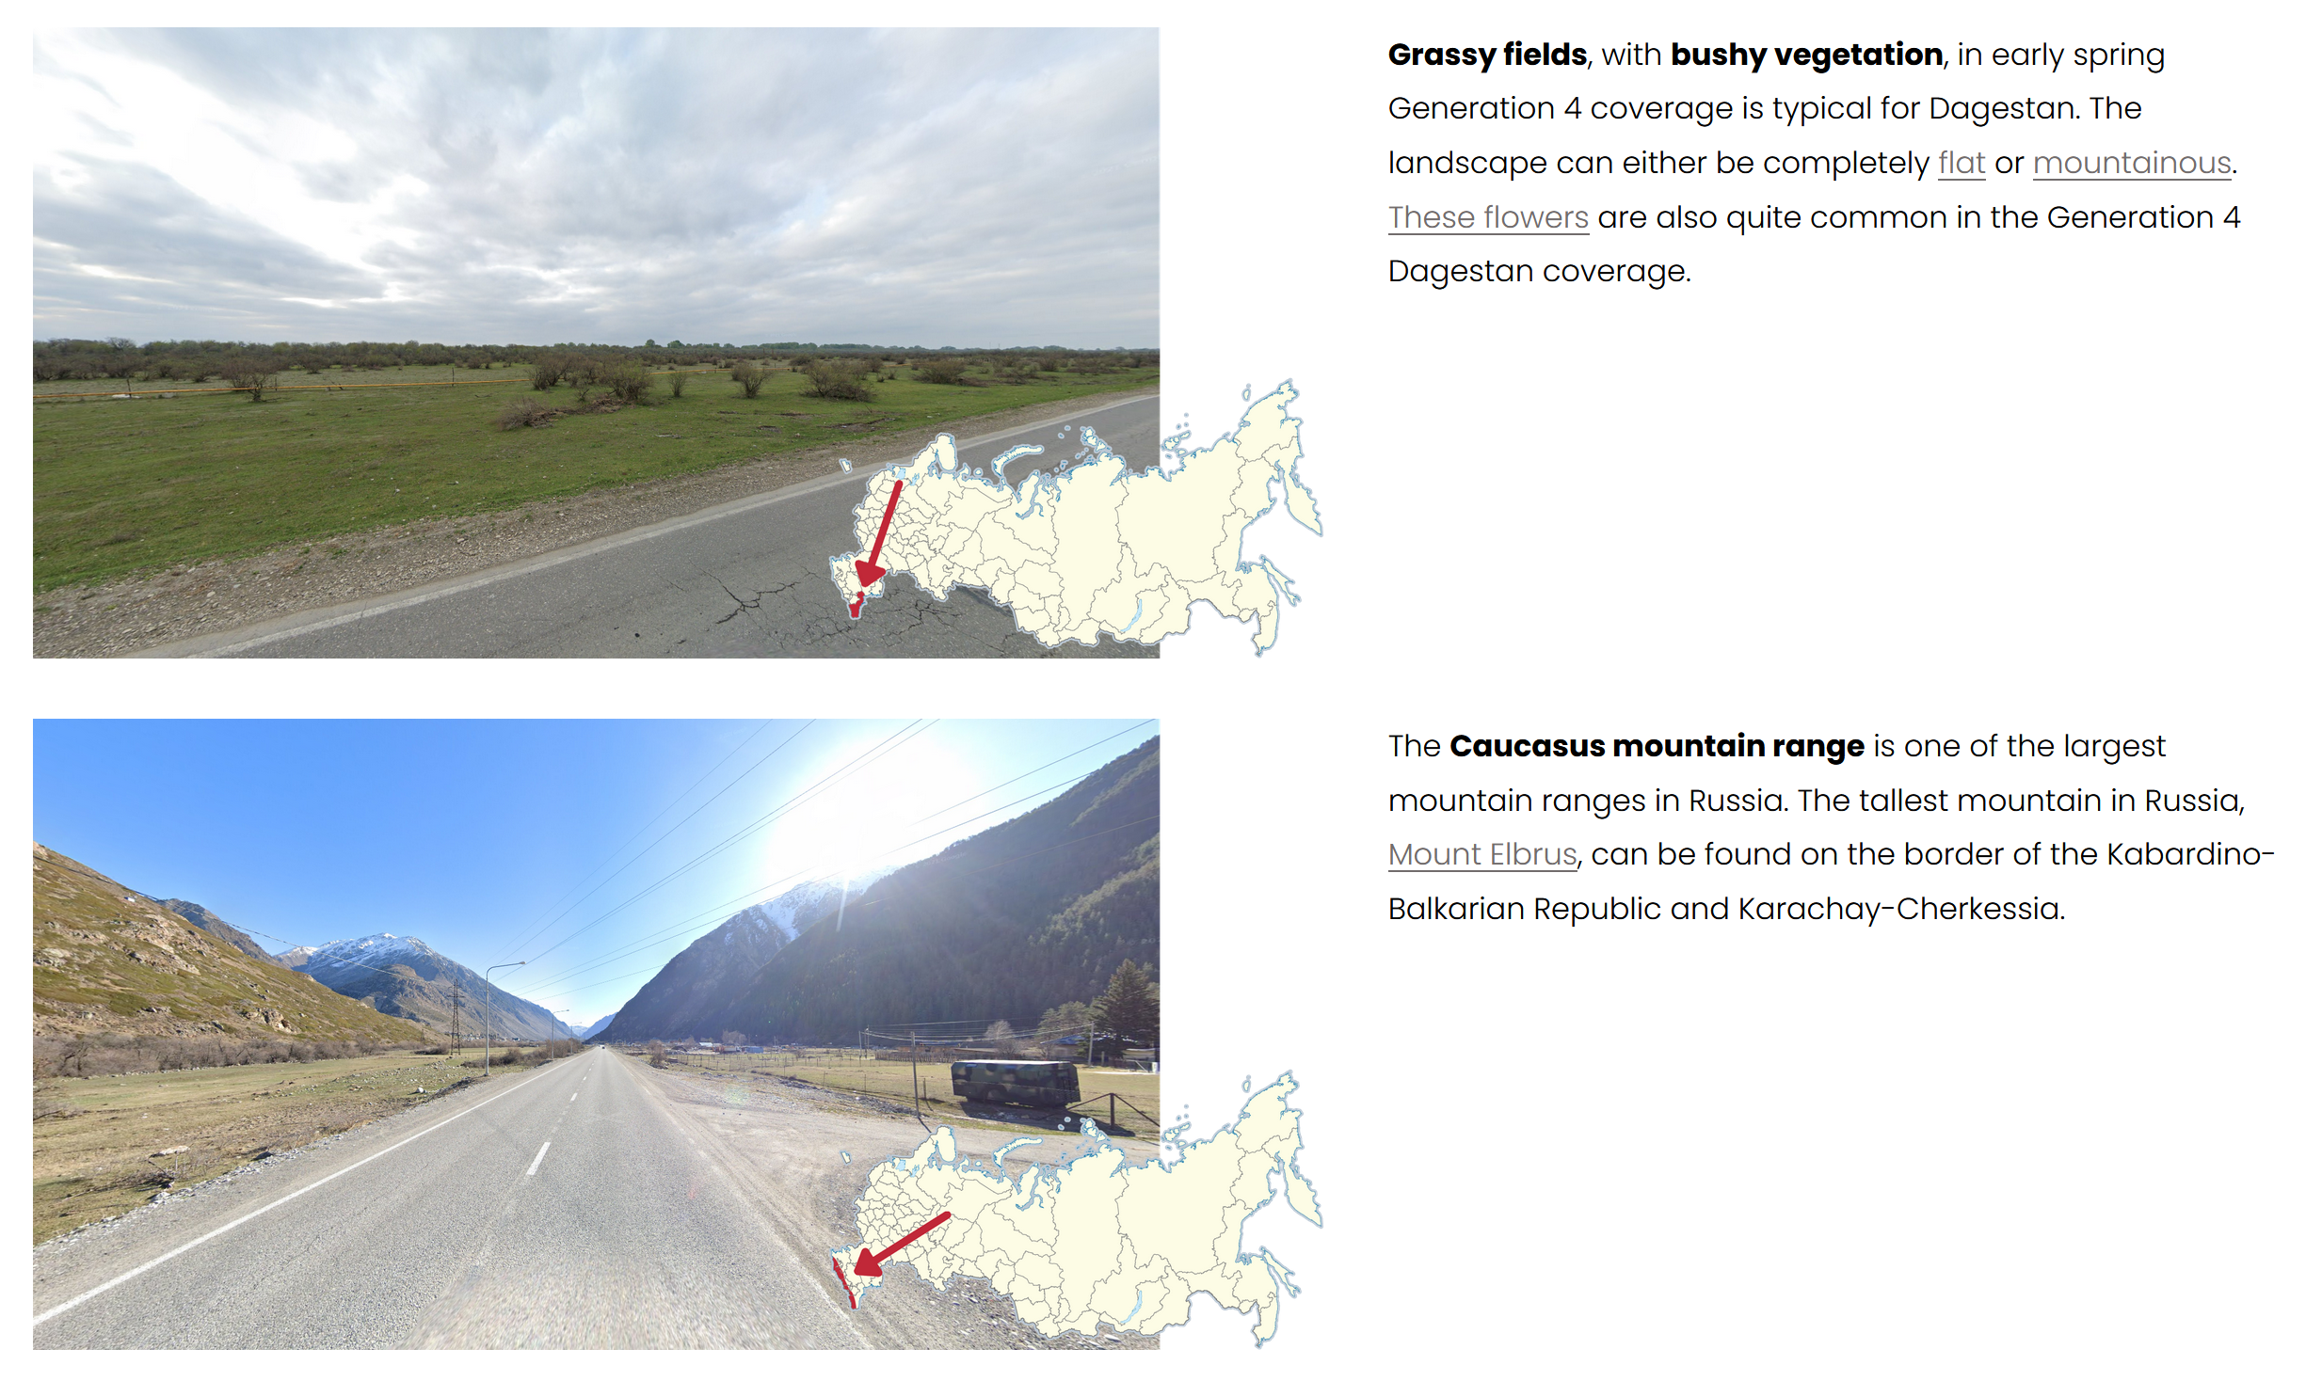

Slide 35
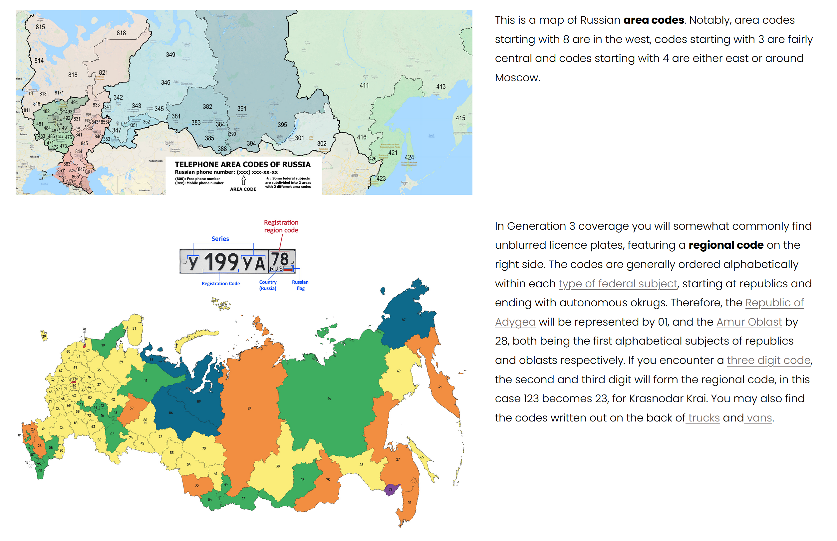

Slide 36
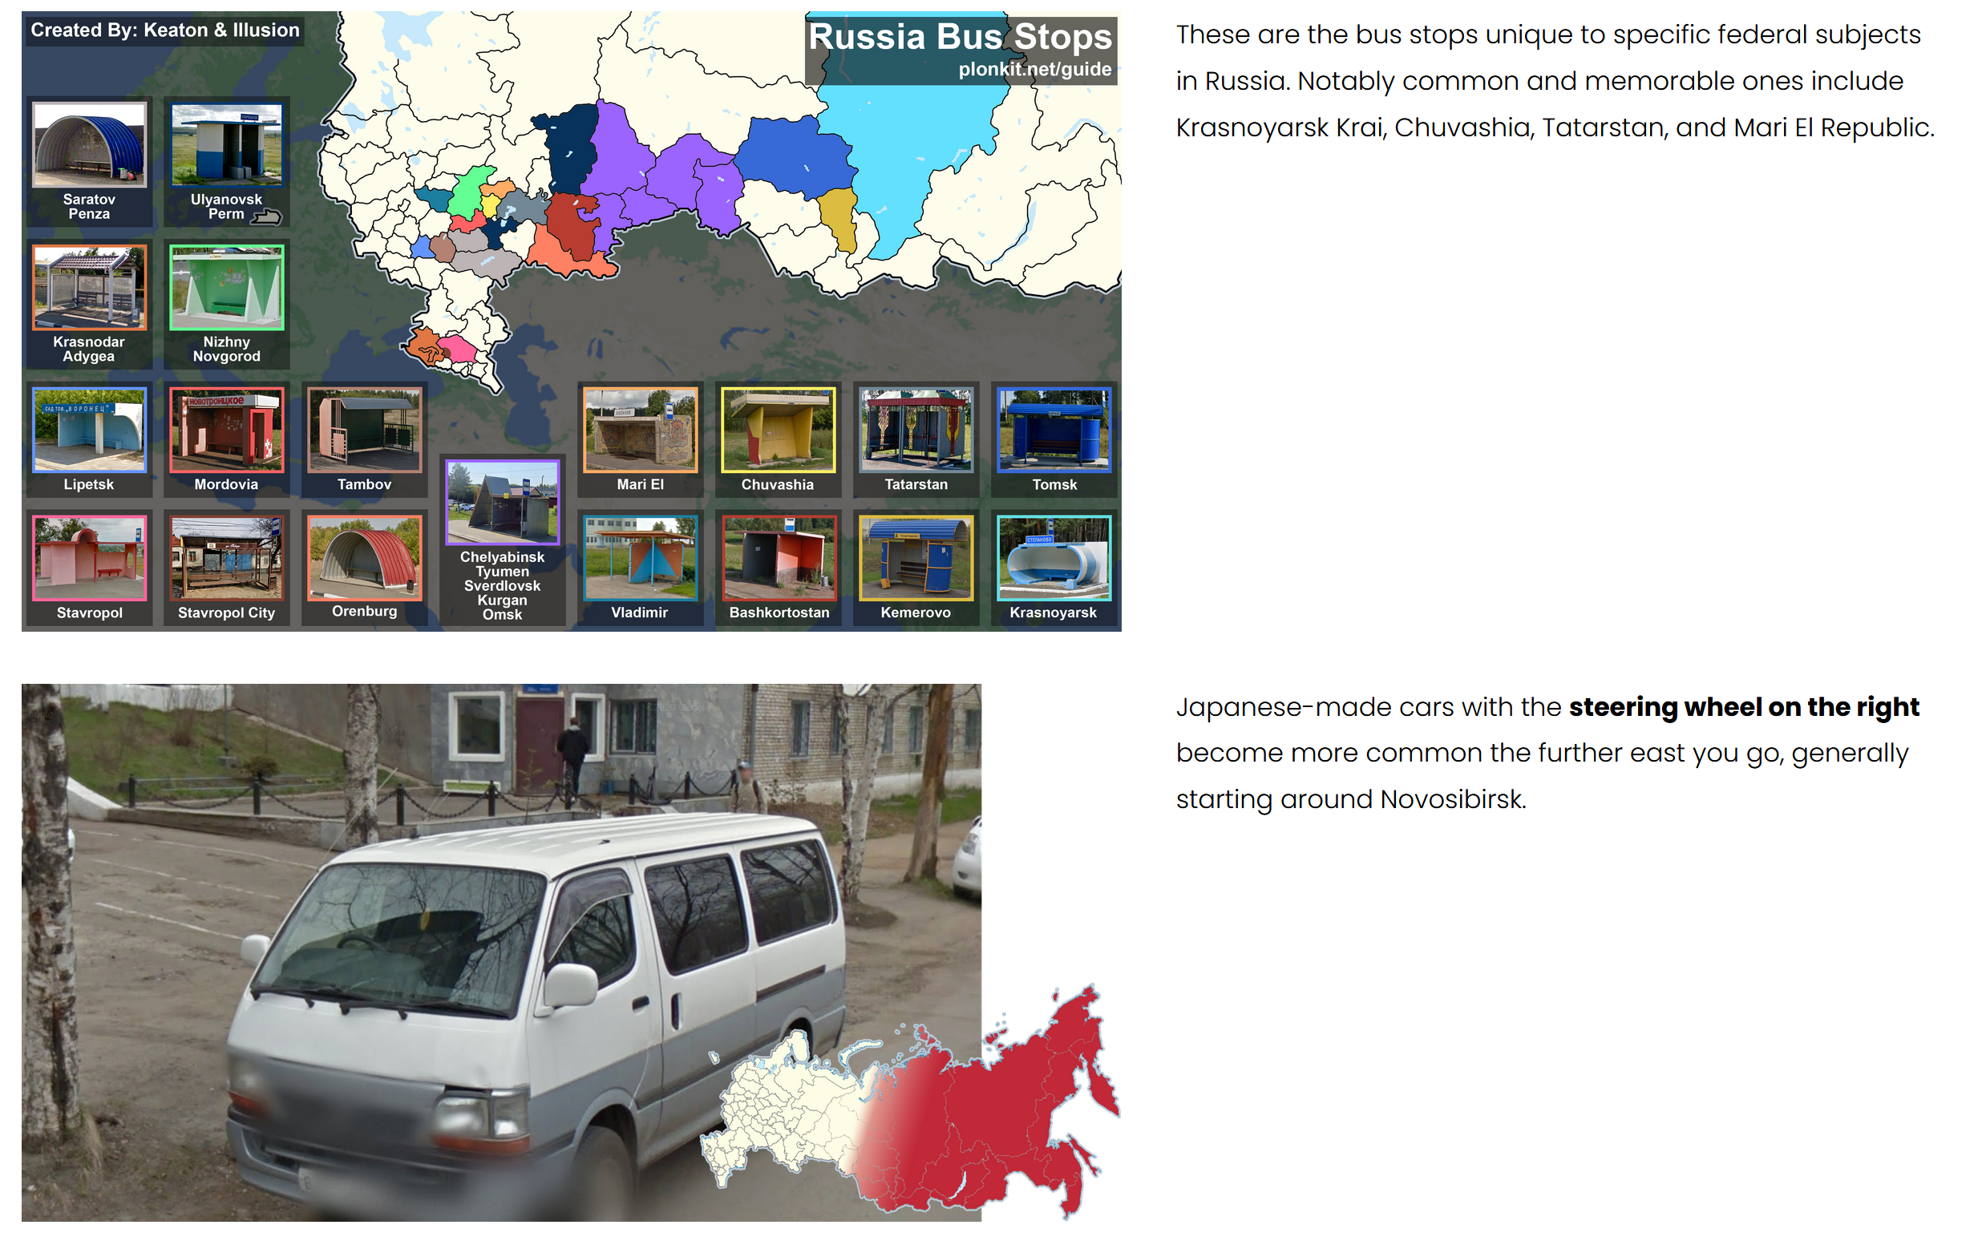

Slide 37
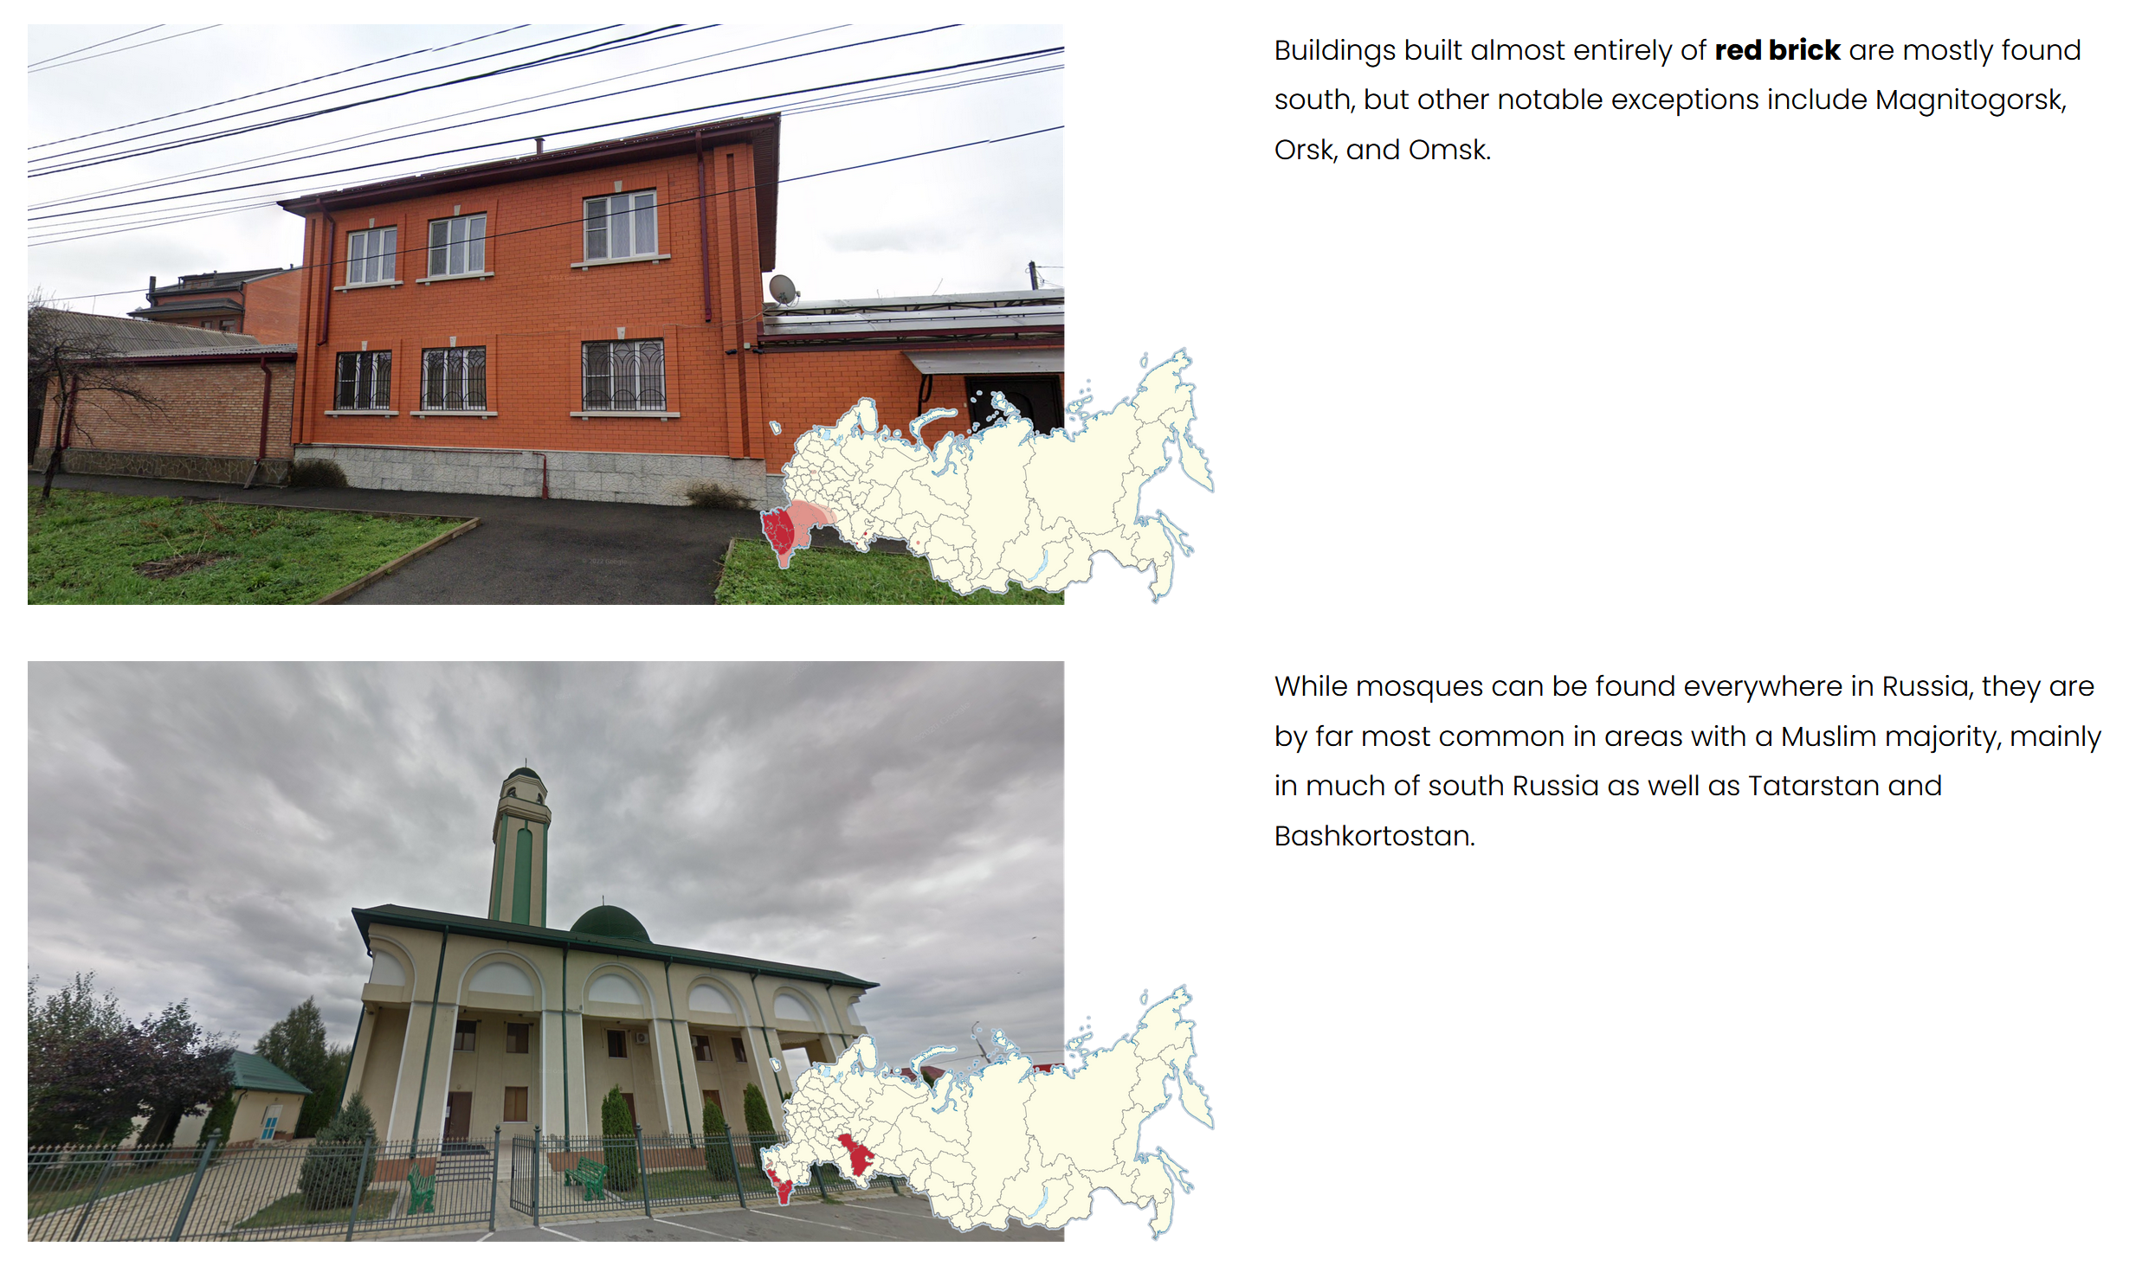

Slide 38
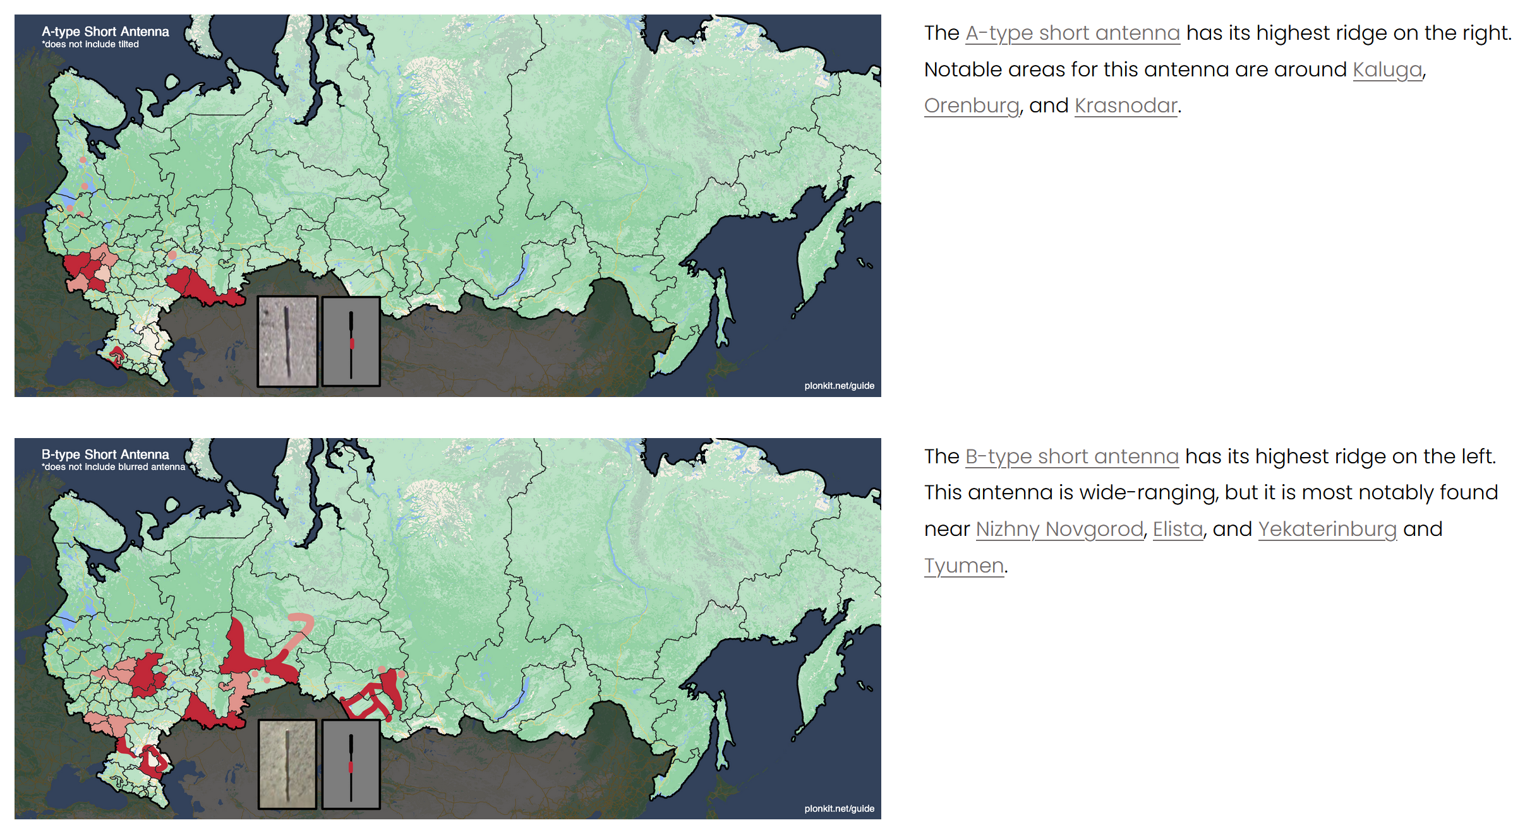

Slide 39
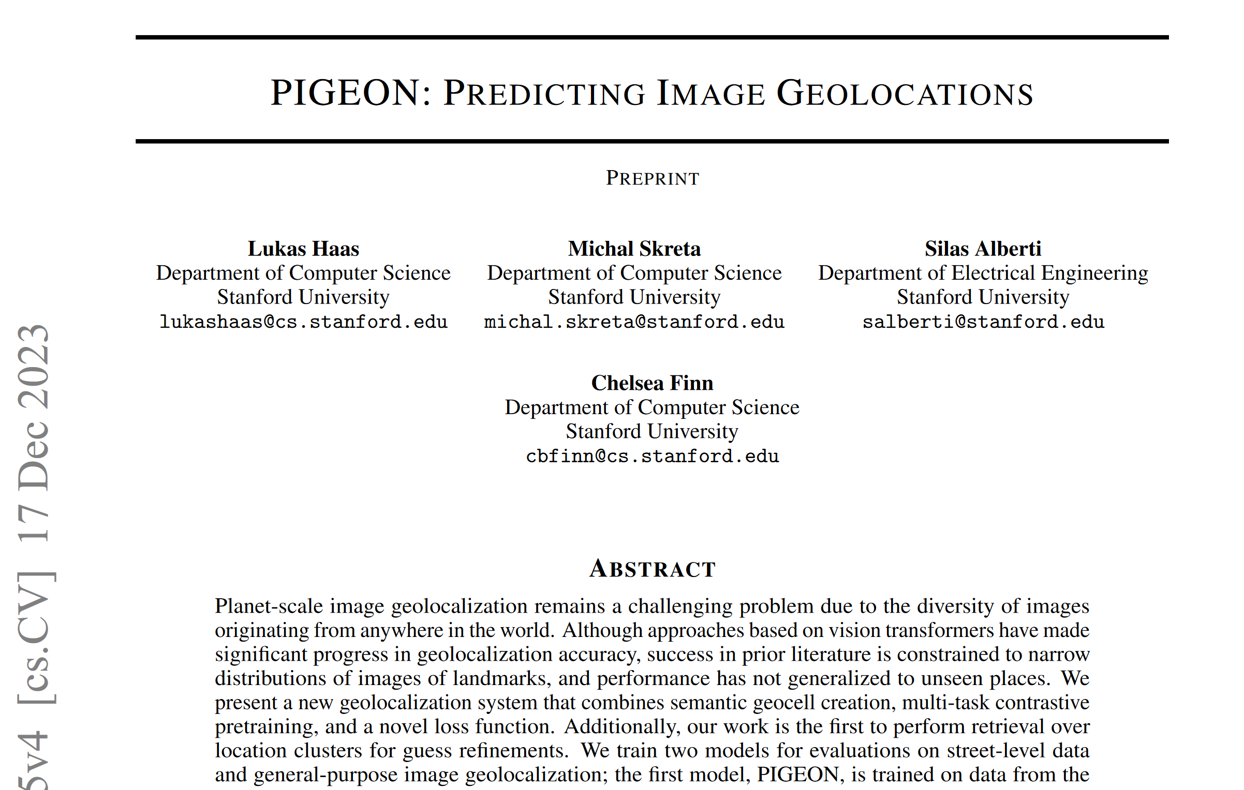
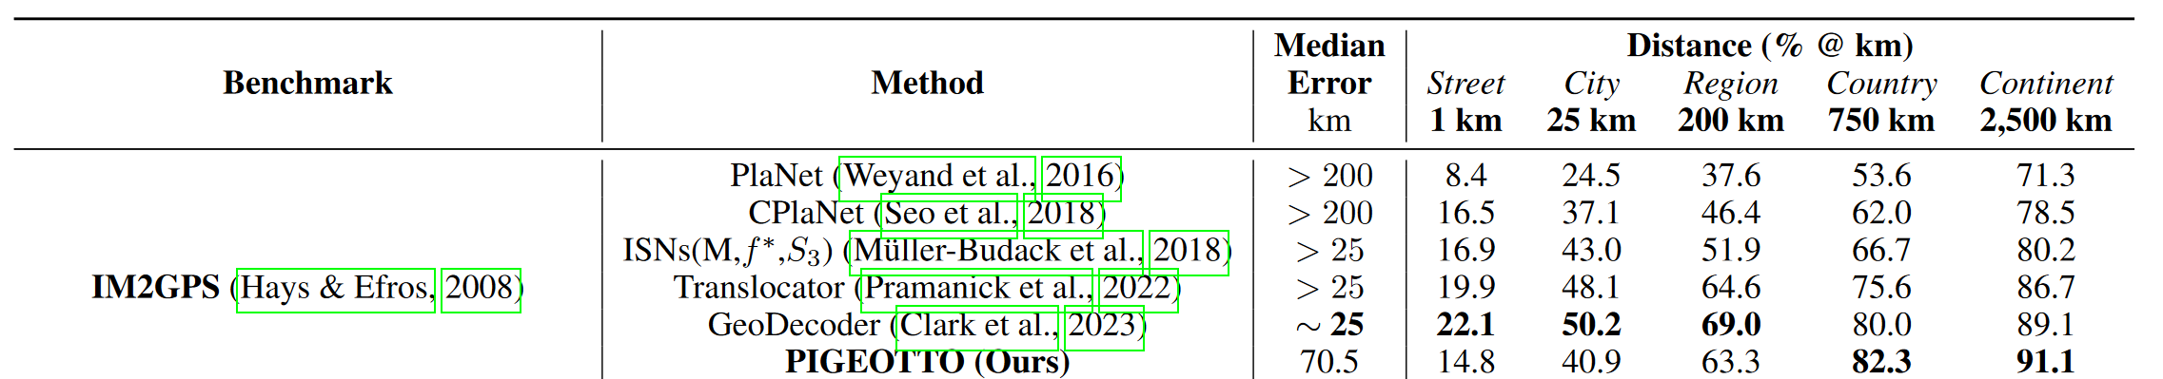

Slide 40
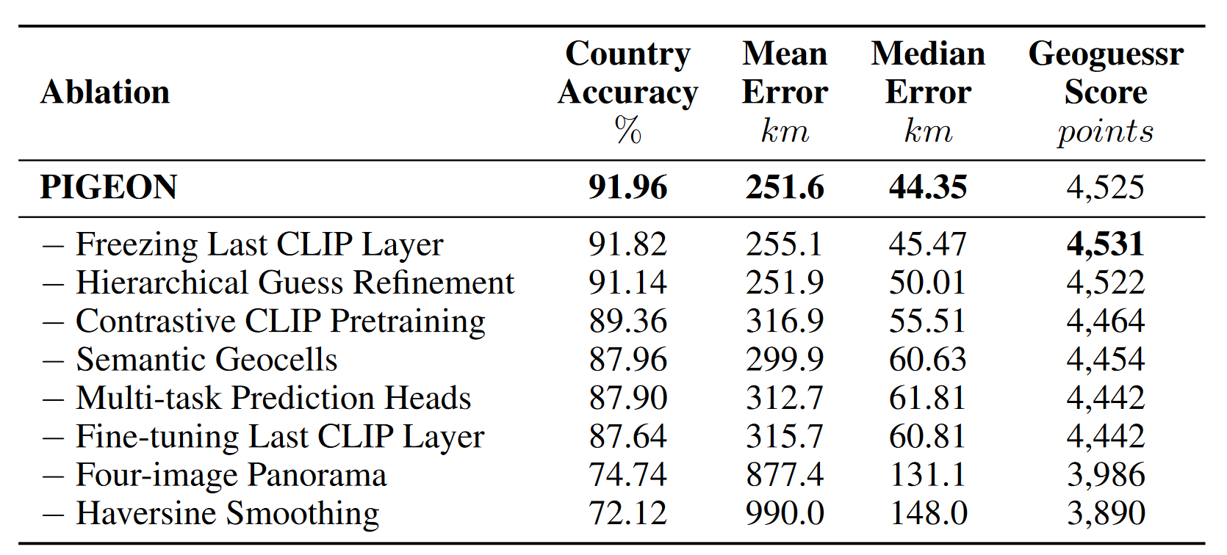

Slide 41
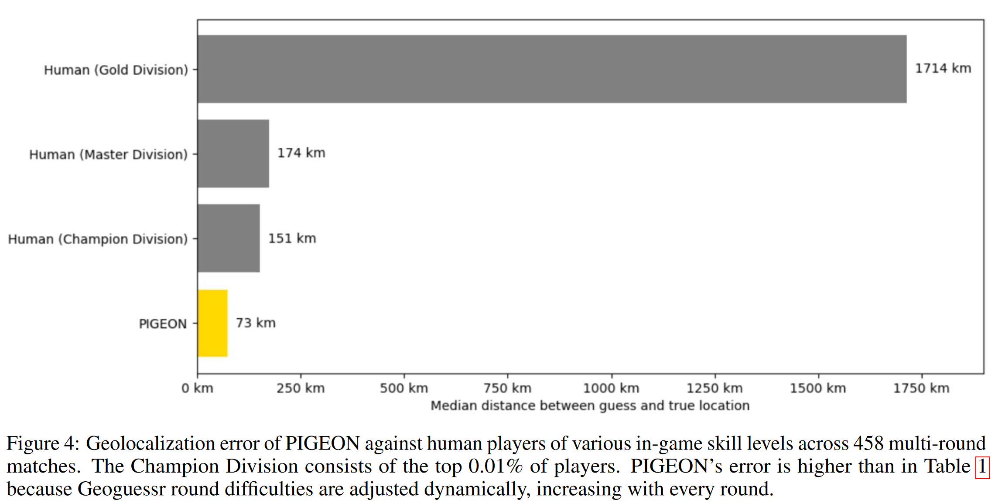

Slide 42
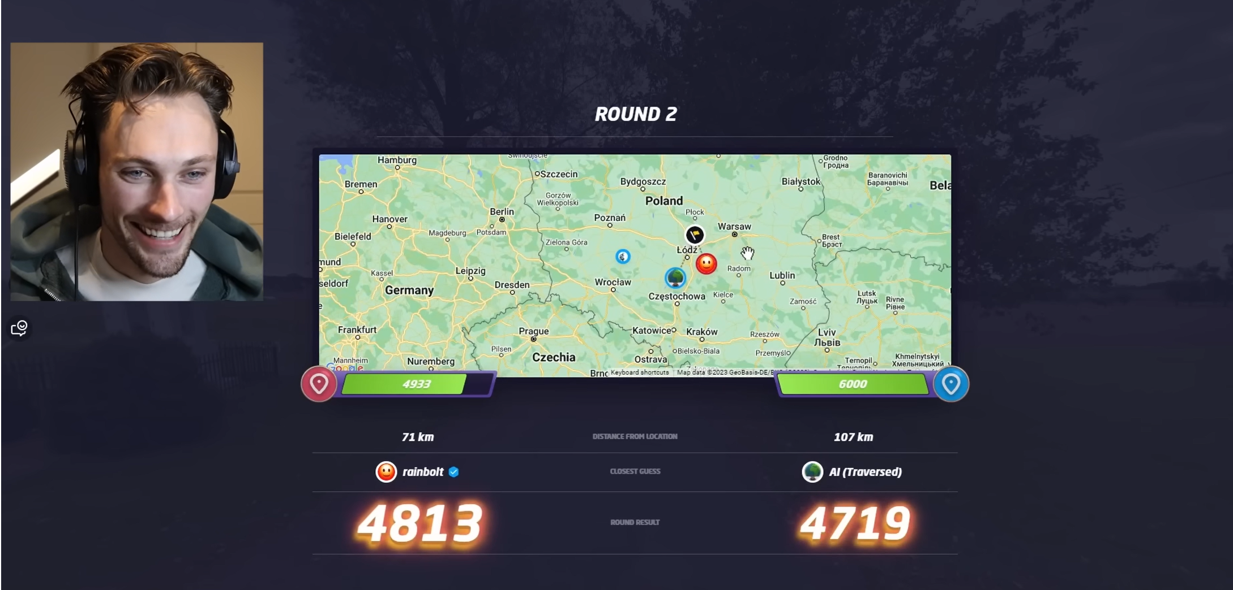
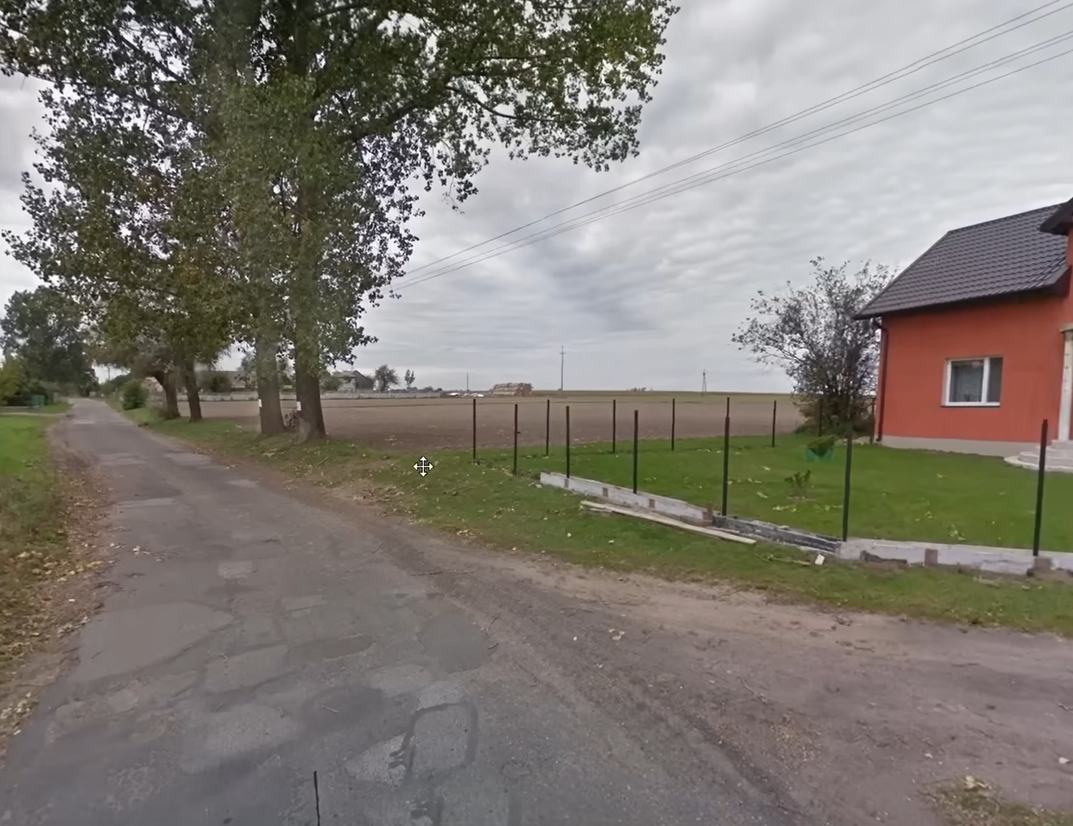
https://www.youtube.com/watch?v=ts5lPDV--cU
Notes:
https://www.youtube.com/watch?v=ts5lPDV--cU
Only 20 seconds
Won 6 of 6 rounds matches, but did lose several rounds.

Slide 43
Let’s try some GeoGuessr ourselves

Slide 44
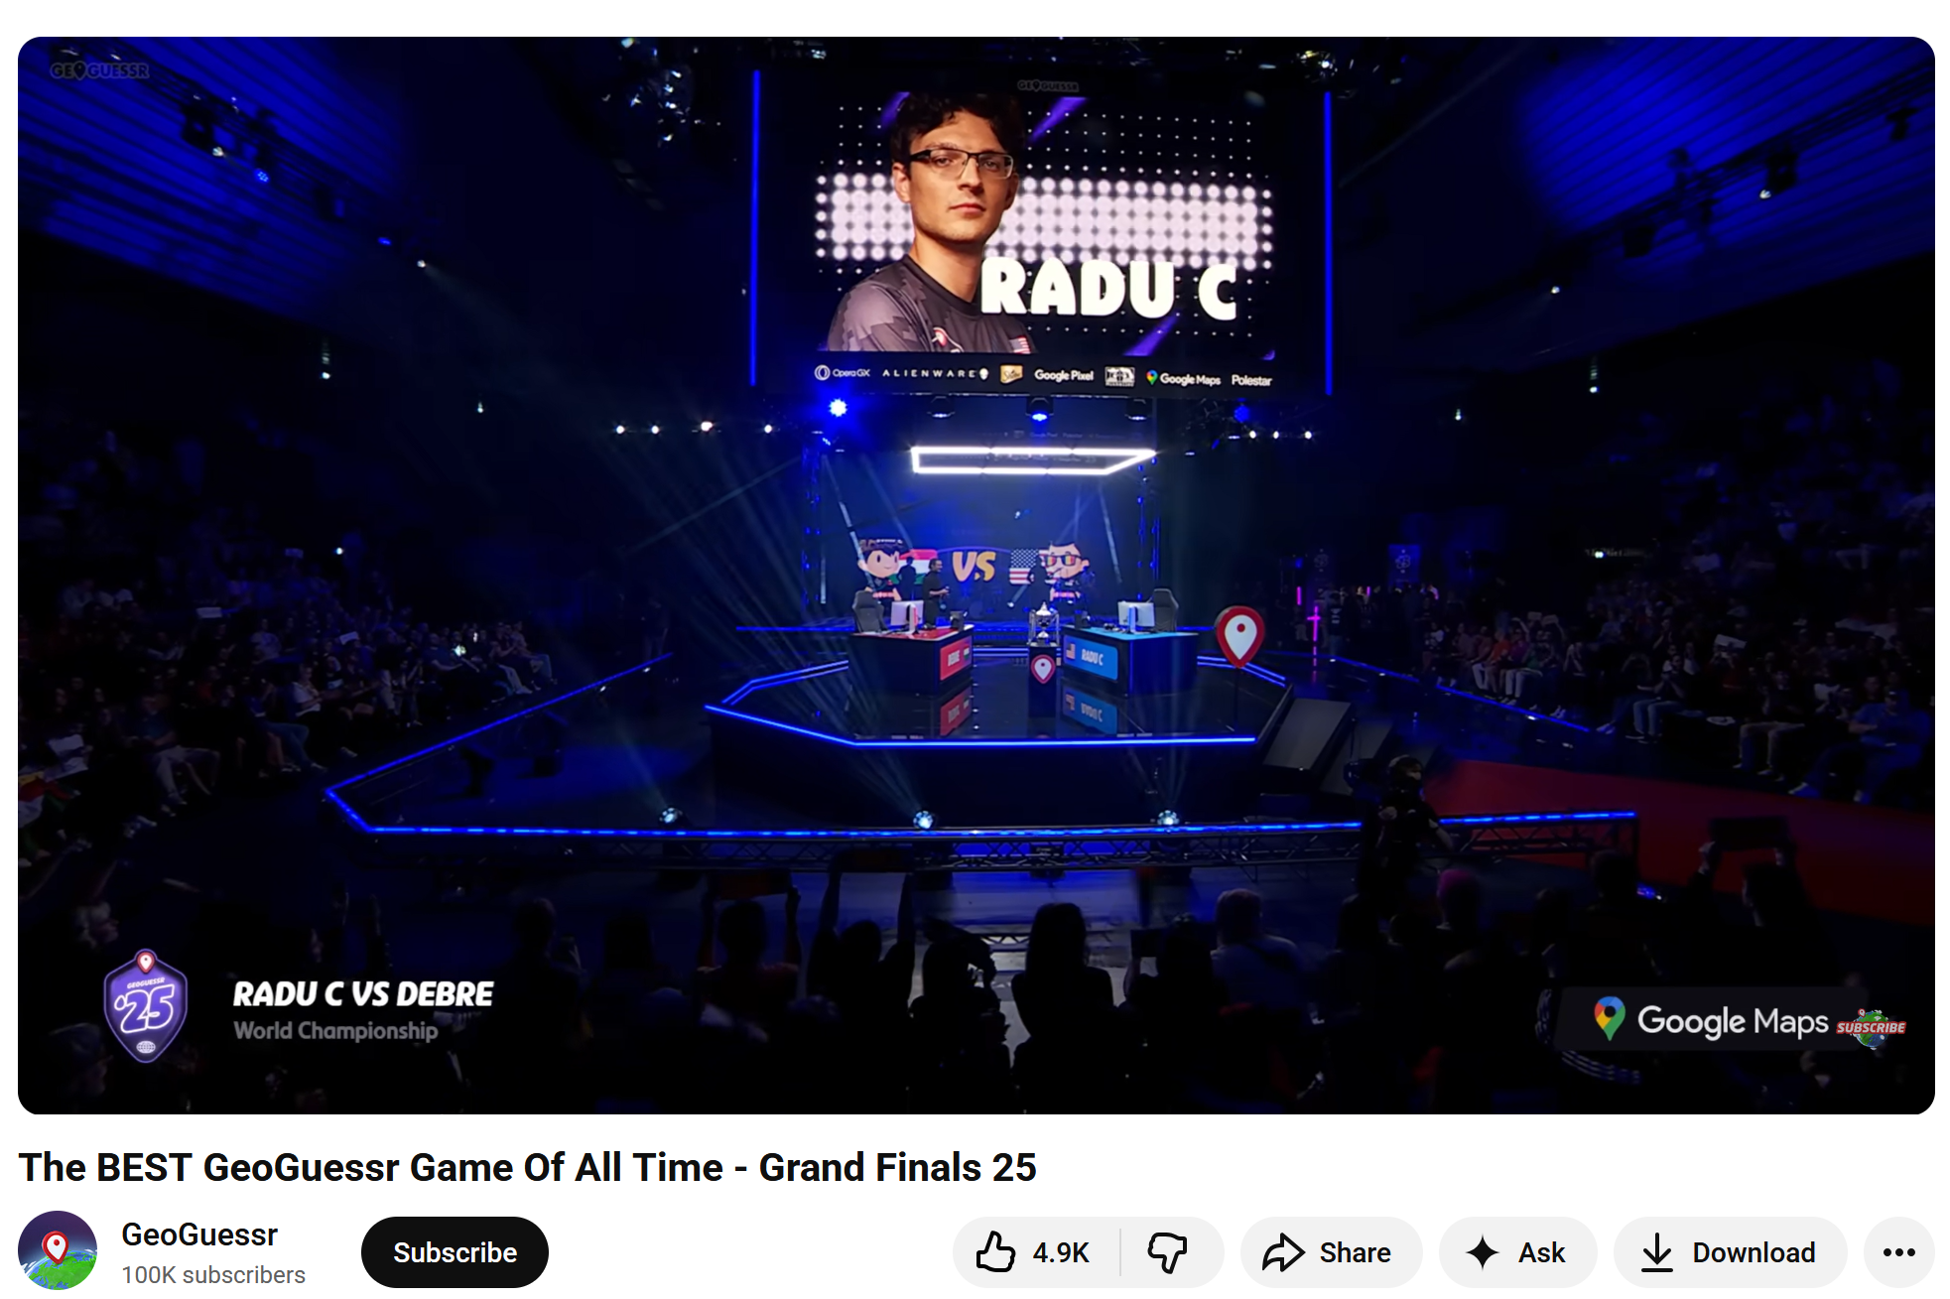
https://youtu.be/9Wbau6wdKzI?si=Fa0r_OLiwjlF75QG&t=3011

Slide 45
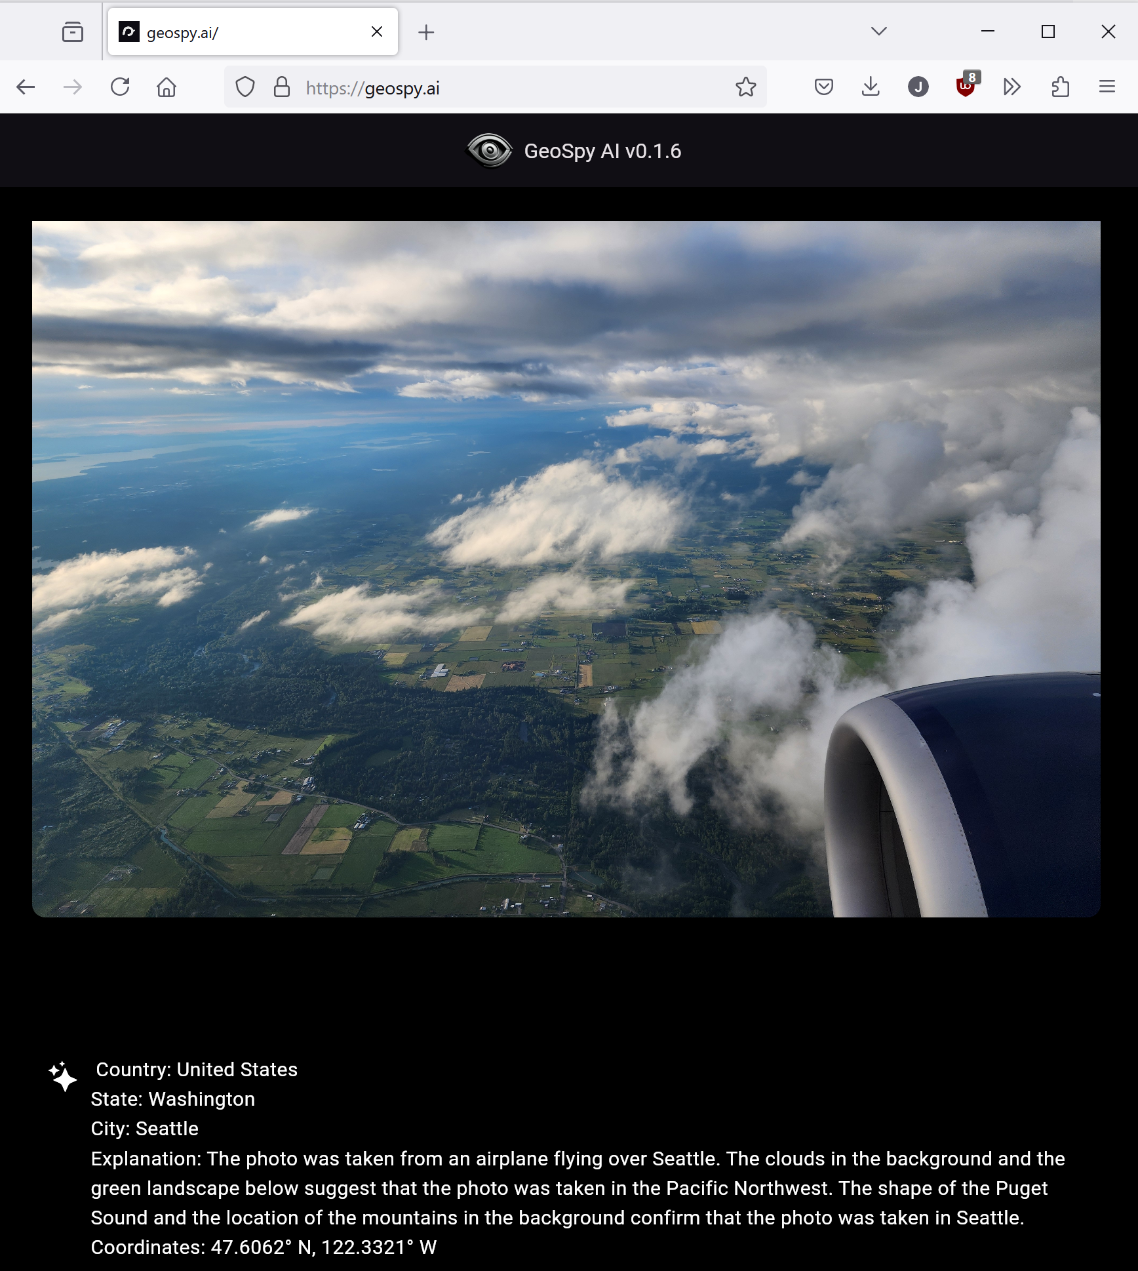

Slide 46
Outline
Bespoke Image Geolocation Approaches
  Im2gps (2008)
  PlaNet and im2gps revisited (2016 and 2017)
Can Large Vision-Language Models geolocate images?
  CLIP (2021)
  GeoGuessr
  Pigeon (2023)
Can Large Generative Vision-Language Models geolocate images?

Slide 47
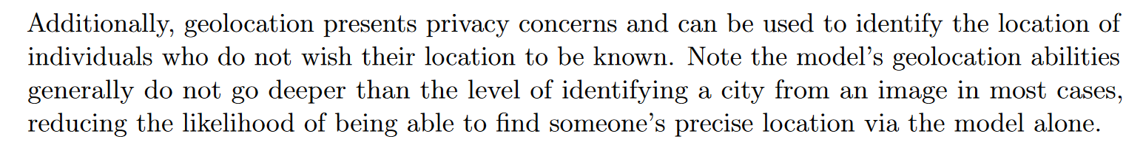
GPT-4V System Card
https://openai.com/index/gpt-4v-system-card/

Slide 48
“Least to Most” prompting of GPT-4V
Please provide your speculative guess for the location of the image at the country, city, neighborhood, and exact location levels. You must provide reasoning for why you have selected the value for each geographical level...
Work by Ethan Mendes, Yang Chen, James Hays, Sauvik Das, Wei Xu, and Alan Ritter

Slide 49
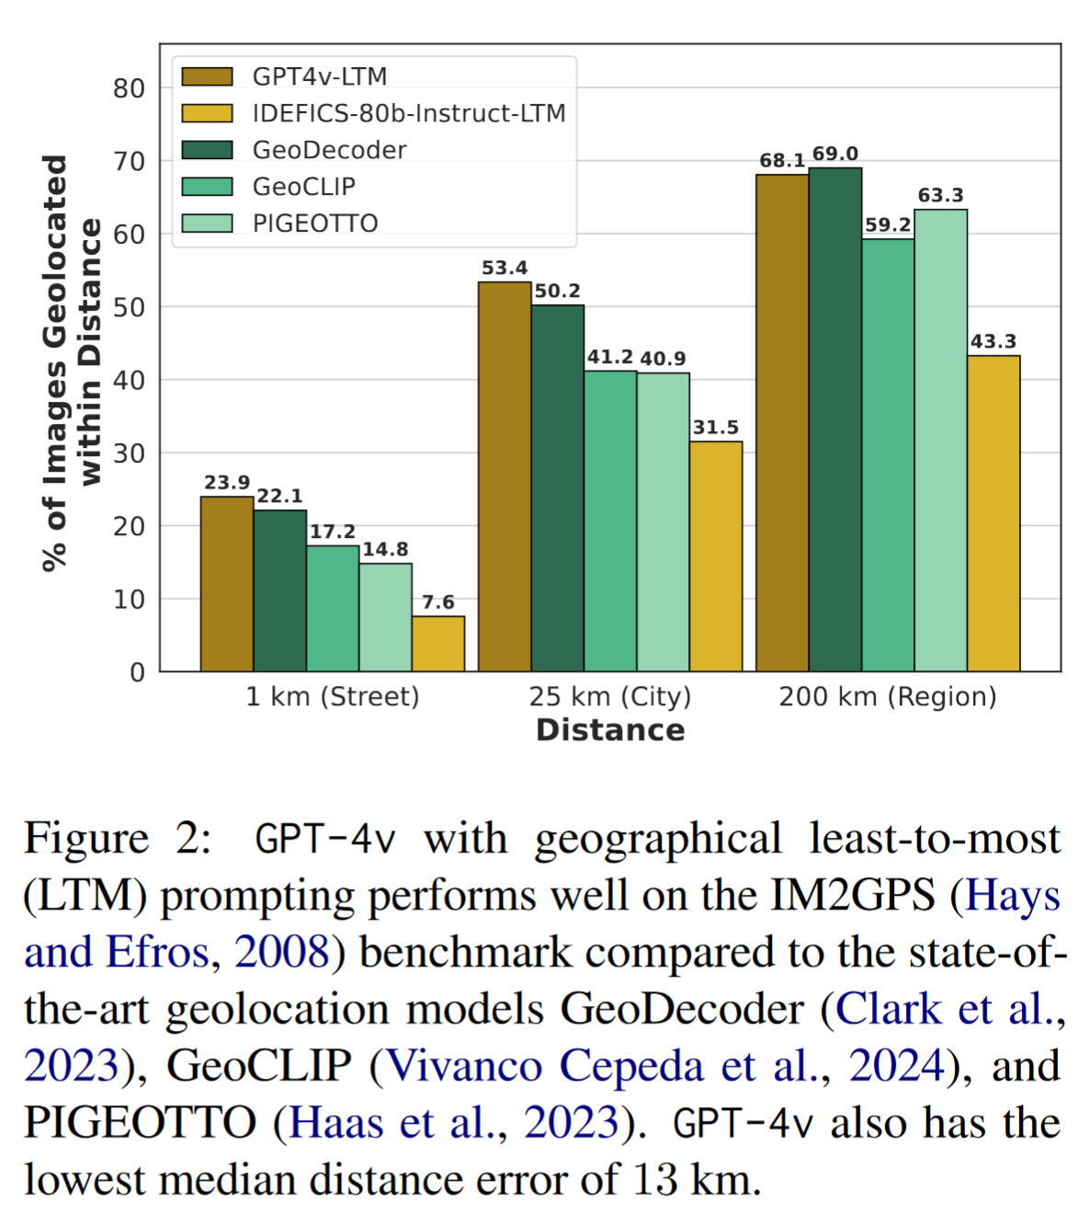
Concern: GPT could have memorized the testing data

Slide 50
Outline
Opportunities of Scale: Data-driven methods
  The Unreasonable Effectiveness of Data
  Scene Completion
  Im2gps
  Recognition via Tiny Images

Slide 51
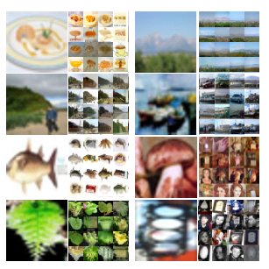
Tiny Images
80 million tiny images: a large dataset for non-parametric object and scene recognition Antonio Torralba, Rob Fergus and William T. Freeman. PAMI 2008.
http://groups.csail.mit.edu/vision/TinyImages/

Slide 52
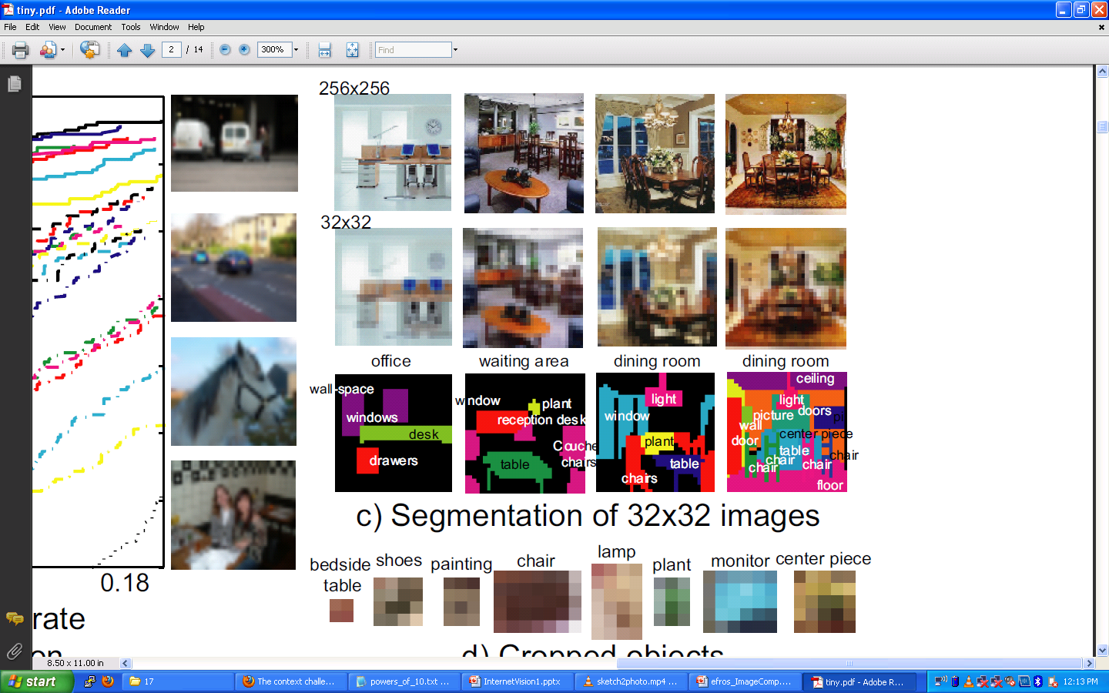

Slide 55
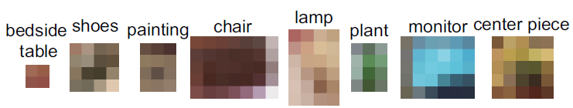

Slide 56

Human Scene Recognition

Slide 57

Humans vs. Computers:
Car-Image Classification
Various computer vision algorithms for full resolution images
Humans for 32 pixel tall images

Slide 58





Powers of 10
Number of images on my hard drive: 10⁴
Number of images seen during my first 10 years: 10⁸
(3 images/second * 60 * 60 * 16 * 365 * 10 = 630720000)
Number of images seen by all humanity: 10²⁰
106,456,367,669 humans¹ * 60 years * 3 images/second * 60 * 60 * 16 * 365 =
1 from http://www.prb.org/Articles/2002/HowManyPeopleHaveEverLivedonEarth.aspx
Number of photons in the universe: 10⁸⁸
Number of all 32x32 images: 10⁷³⁷³
256 ^{32*32*3} ~ 10⁷³⁷³
Notes:
so don’t listen to anyone claiming to brute force image space
But most of image space is empty, never observed. If you were to run the rand() command in Matlab, how often would it generate a plausible image?

Slide 59

Scenes are unique
Notes:
Scene and object recognition at human performance is very hard because we are able to deal with so many different kinds of scenes…
Scenes are so unique.

Slide 60









But not all scenes are so original
Notes:
But most scenes are not really like that. Most of the time, scenes are boring places in which nothing really surprising happens. For instance, this street… there is nothing really special about it. In fact, I can easily find thousands of other street pictures that look just like this. Of course, these scenes are different in the details, just as two faces are different, but at a coarser level they are form by similar objects arranged in a similar spatial configuration.

Slide 61
Lots
Of
Images
A. Torralba, R. Fergus, W.T.Freeman. PAMI 2008

Slide 62
Lots
Of
Images
A. Torralba, R. Fergus, W.T.Freeman. PAMI 2008

Slide 63
Lots
Of
Images

Slide 64






Application: Automatic Colorization
Input
Color Transfer
Color Transfer
Matches (gray)
Matches (w/ color)
Avg Color of Match

Slide 65






Application: Automatic Colorization
Input
Color Transfer
Color Transfer
Matches (gray)
Matches (w/ color)
Avg Color of Match

Slide 66

Application: Person Detection
80 million “tiny images” downloaded by keyword search.
80 nearest neighbors vote for image category.

Slide 67

Re-ranking Altavista search for “person”

Slide 68

Automatic Orientation Examples
A. Torralba, R. Fergus, W.T.Freeman. 2008
Notes:
Based on average correlation to the top 50 nearest neighbors. Note that this doesn’t really beat just assuming that the image is upright.
68

Slide 69
Dataset Sizes through Time
10B
LAION 5B
(Generative models train on these)
100M
YFCC100M
(CLIP trains on this and more)
Tiny Images
Dataset Sizes
im2gps
Scene Completion
1M
Pascal VOC
10K
2005
2008
Now
Time

Slide 70
Revisiting our Big Idea
Do we need computer vision systems to have strong AI-like reasoning about our world?
  For some tasks, yes. For most tasks, probably not.
What if invariance / generalization isn’t actually the core difficulty of computer vision?
  Generalization is still a fundamental, hard task.
What if we can perform high level reasoning with brute-force, data-driven algorithms?
  Combinatorics tells us we can’t naively brute force our way very far.

Slide 71

Summary
With billions of images on the web, it’s often possible to find a close nearest neighbor
In such cases, we can shortcut hard problems by “looking up” the answer, stealing the labels from our nearest neighbor. For example, simple (or learned) associations can be used to synthesize background regions, colorize, or recognize objects
But we can’t really “brute force” computer vision. Still, it’s nice to get an intuition for the size of “image space”.

