Slide 1
“Attention” and “Transformer” Architectures
James Hays

Slide 2
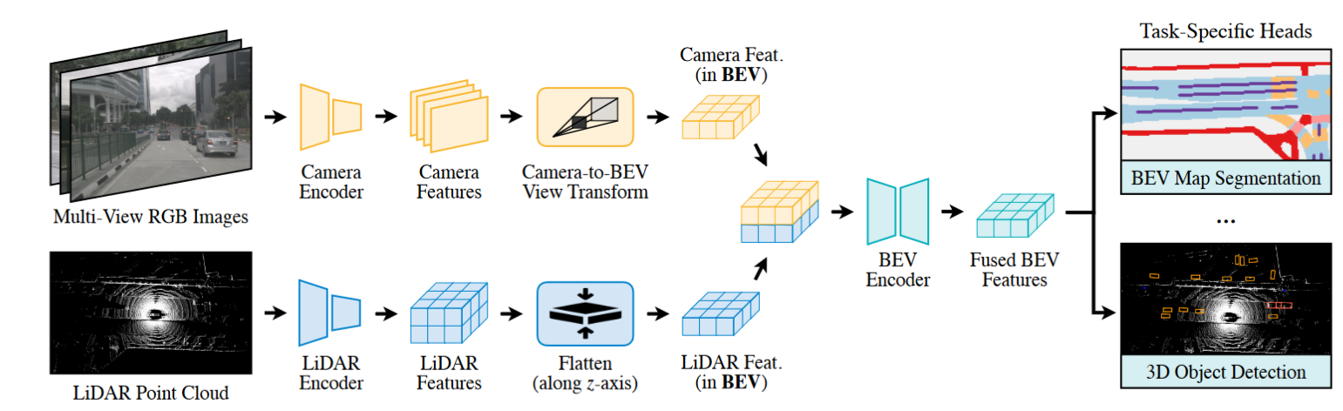
Recap – 3D point processing
Popular CNN backbones aren’t a direct fit for 3D point processing tasks.
It’s not clear how best to use deep learning on 3D data
Use a truly permutation invariant representation (PointNet)
Use a voxel representation (VoxelNet)
Use a bird’s a view representation (PointPillars)
Create a range image
With lidar, multi-modal approaches (adding images, radar) help surprisingly little compared to lidar-only approaches (~3 mAP).
BEVFusion: Multi-Task Multi-Sensor Fusion with Unified Bird’s-Eye View Representation.
Zhijian Liu, Haotian Tang, Alexander Amini, Xinyu Yang, Huizi Mao, Daniela L. Rus, Song Han

Slide 3
Outline
Context and Receptive Field
Going Beyond Convolutions in…
Text
Point Clouds
Images

Slide 4
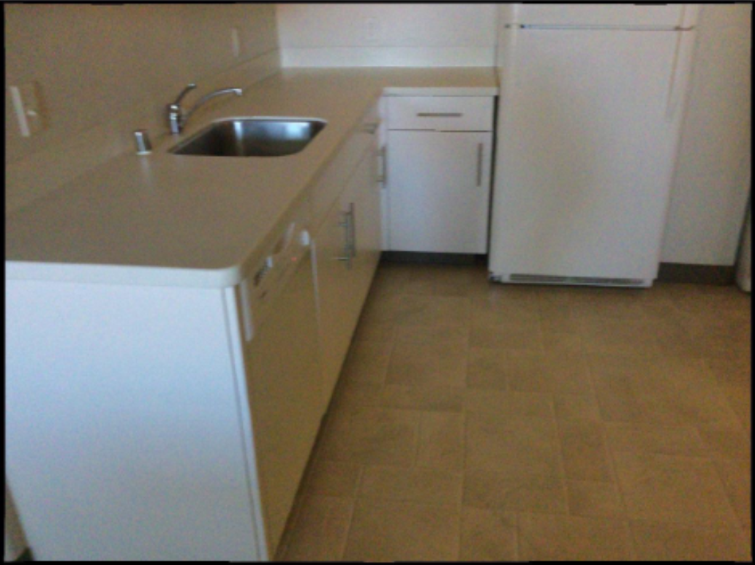

Slide 5
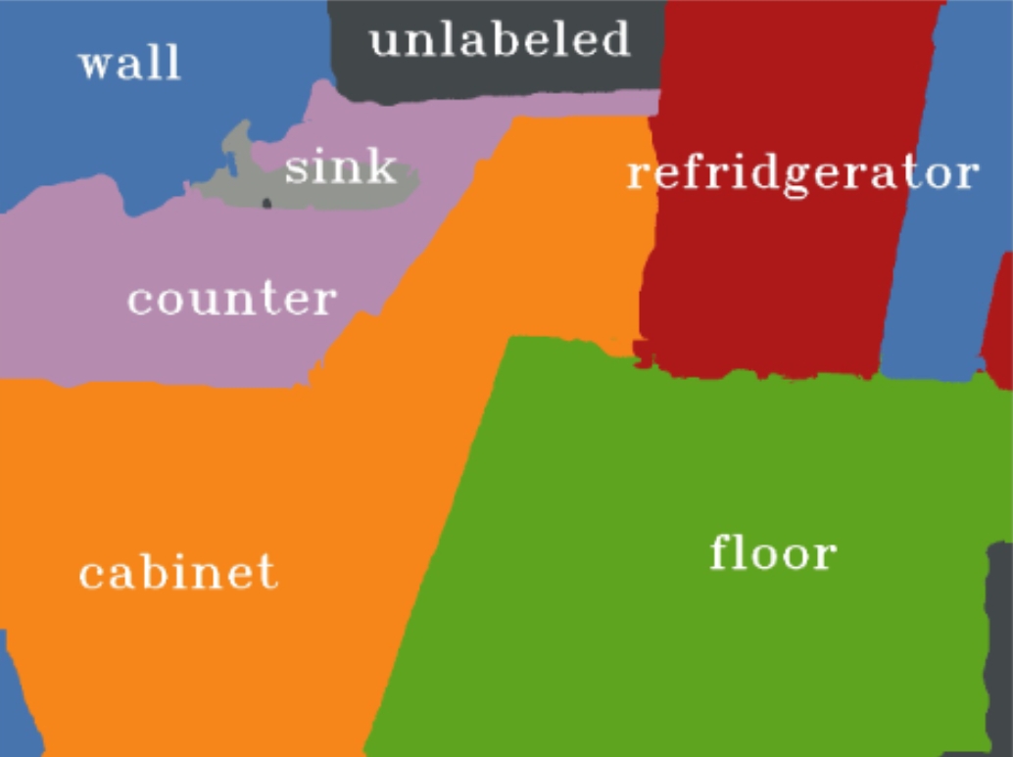
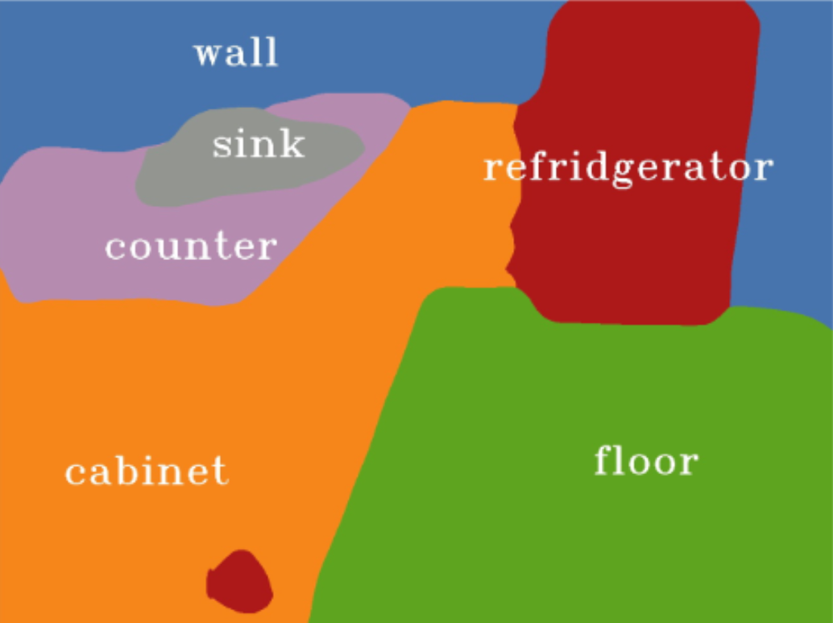
Ground truth
Prediction from Mseg
Notes:
Left – ground truth
Right – result from mseg http://vladlen.info/publications/mseg-composite-dataset-multi-domain-semantic-segmentation/

Slide 9
Language understanding
… serve …

Slide 10
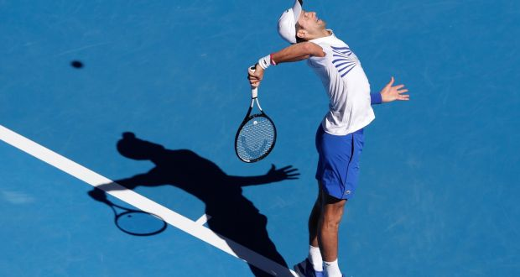
Language understanding
… great serve from Djokovic …

Slide 11

Language understanding
… be right back after I serve these salads …

Slide 12
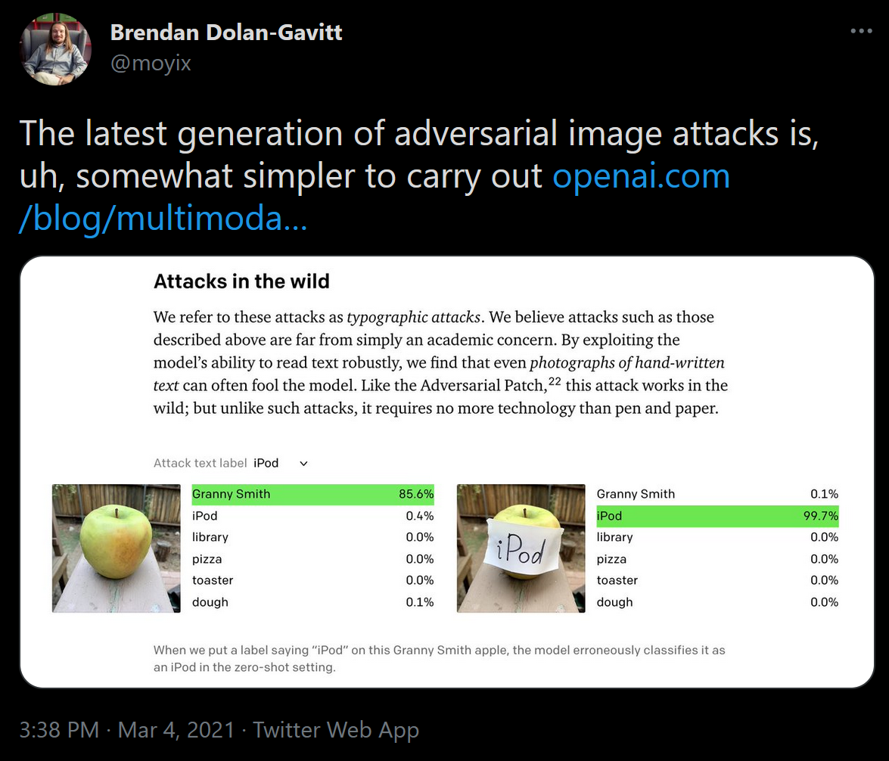

Slide 13
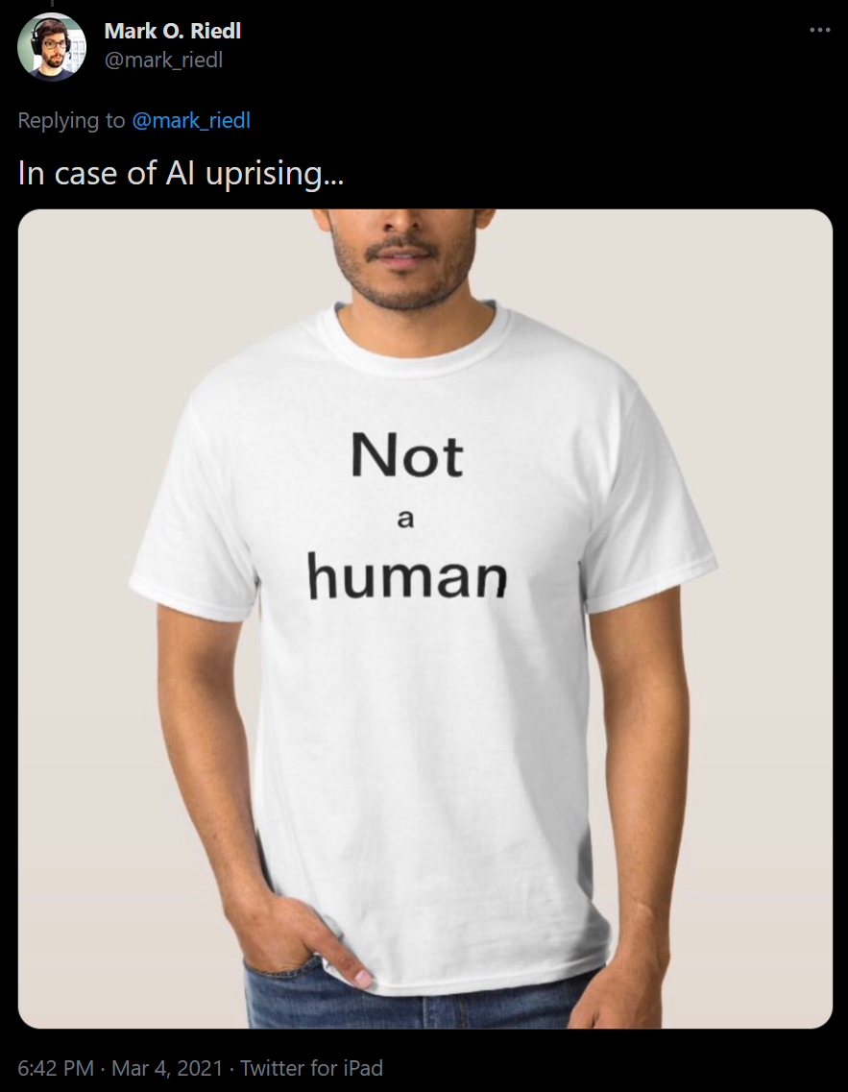
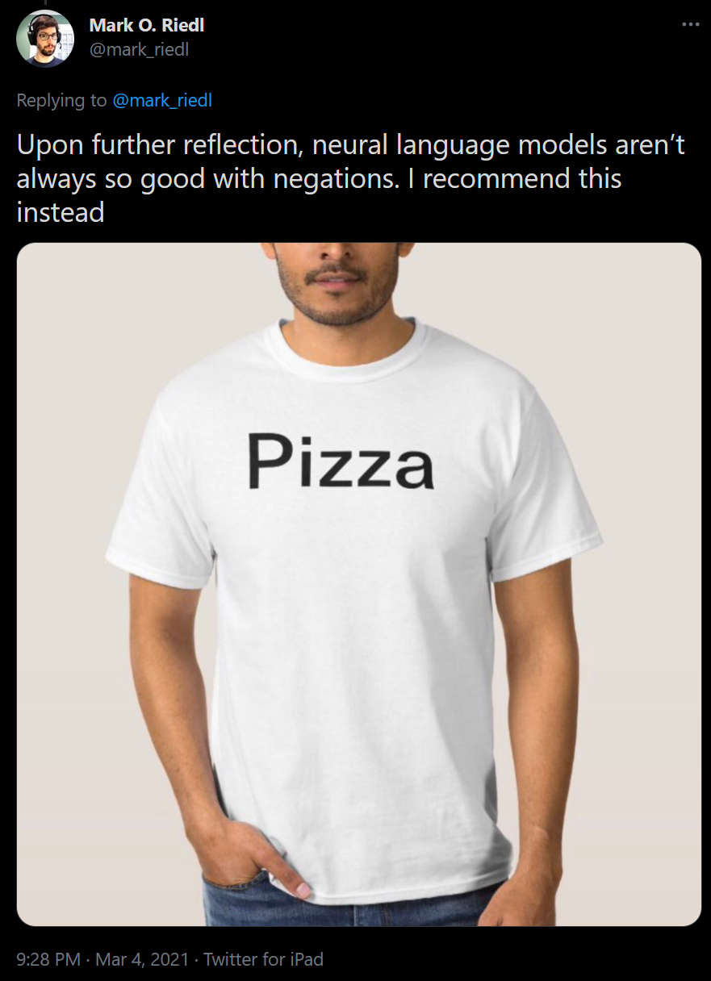

Slide 14
So how do we fix these problems?

Slide 15
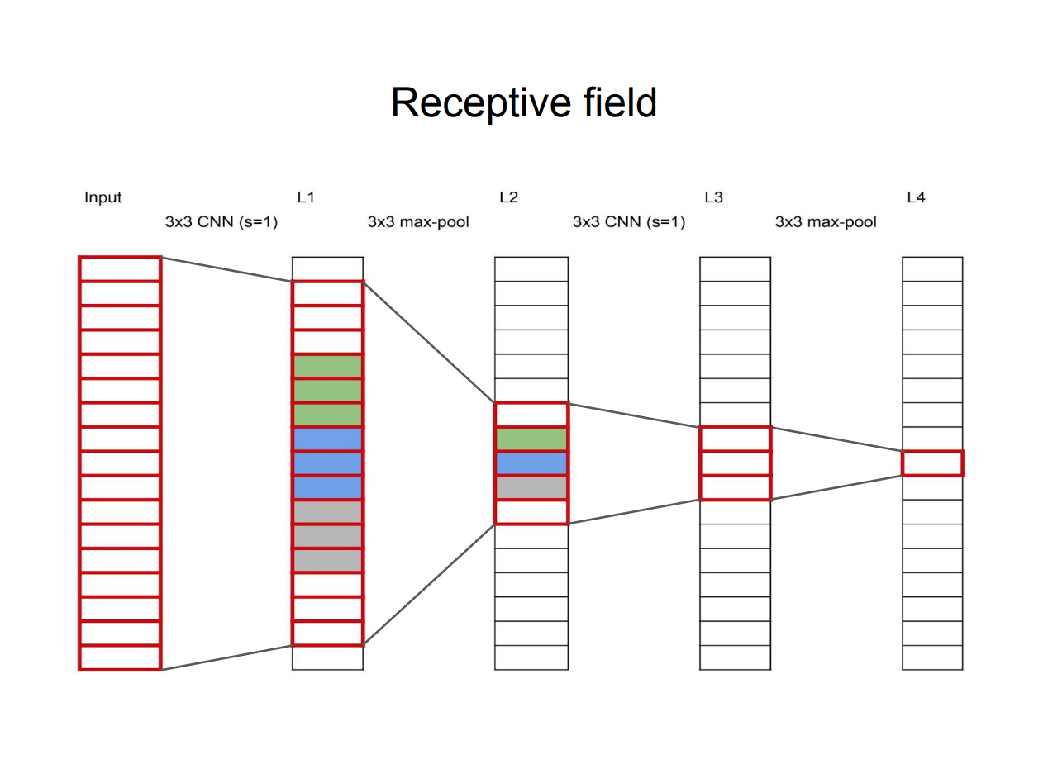
Slide Credit: Frank Dellaert https://dellaert.github.io/19F-4476/resources/receptiveField.pdf

Slide 16
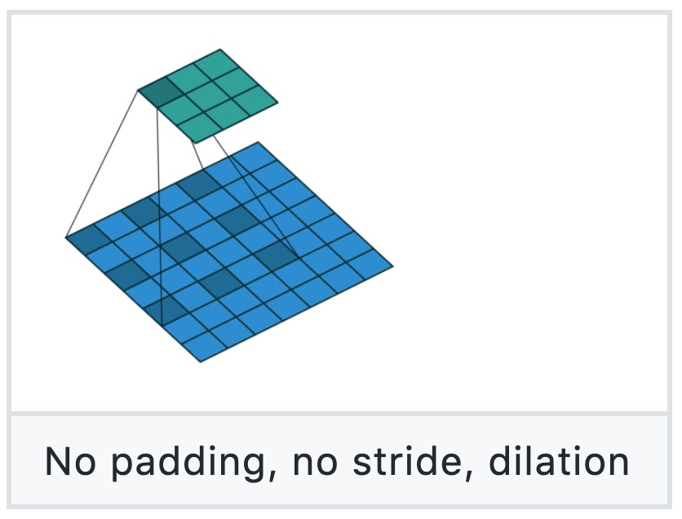
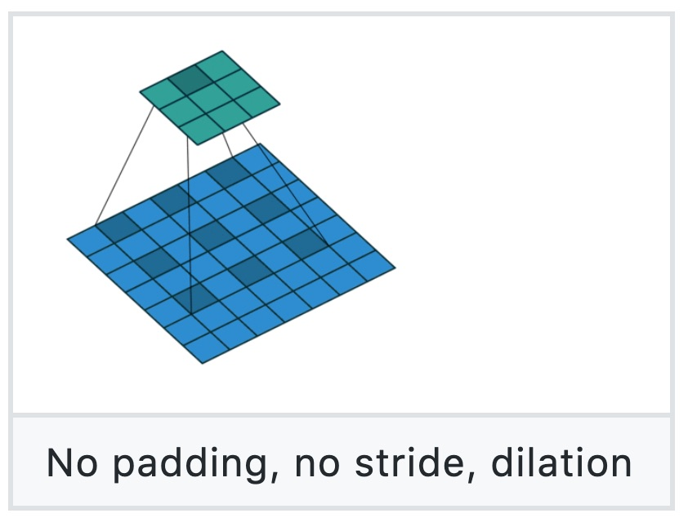
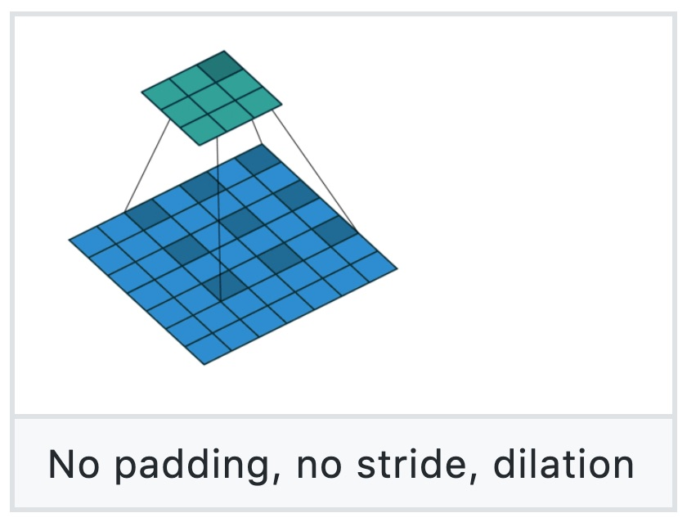
Dilated Convolution
Figure source: https://github.com/vdumoulin/conv_arithmetic

Slide 17
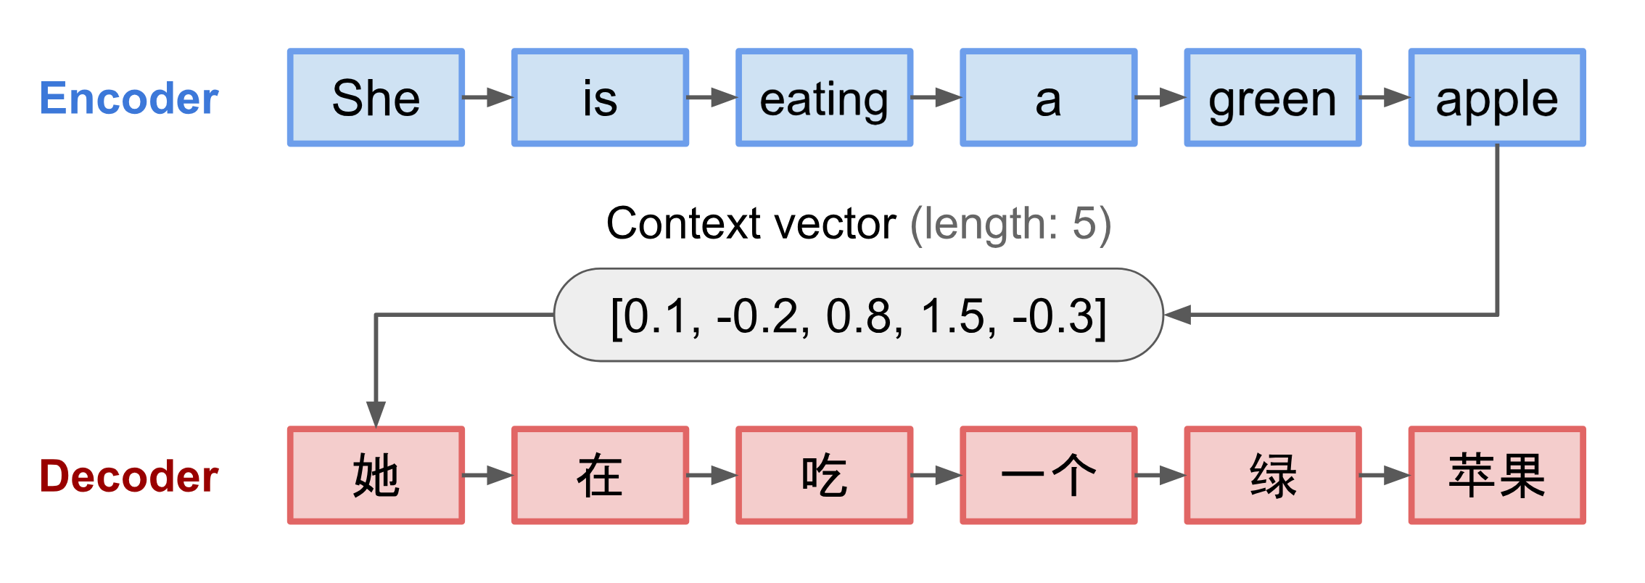
Sequence 2 Sequence models in language
Source: https://lilianweng.github.io/lil-log/2018/06/24/attention-attention.html

Slide 18
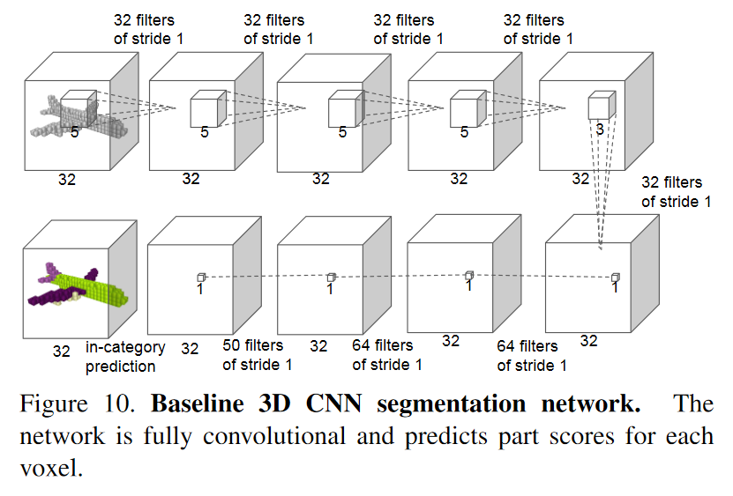
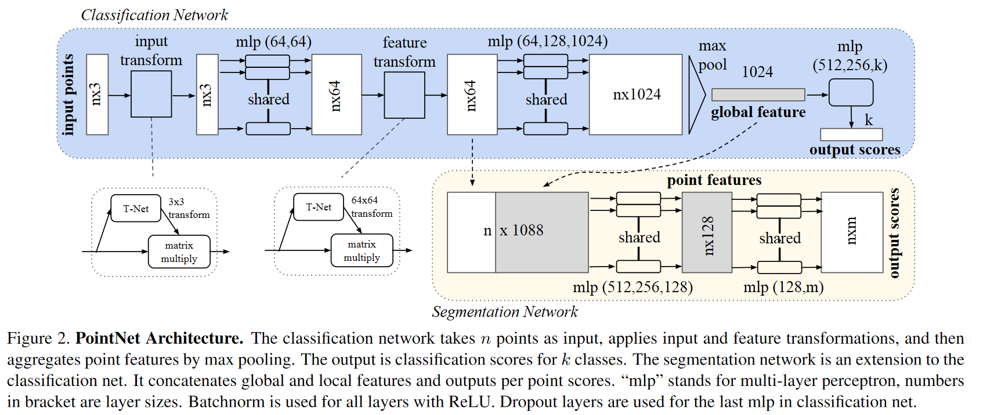
Receptive field could also be an issue in 3D

Slide 19
Outline
Context and Receptive Field
Going Beyond Convolutions in…
Text
Point Clouds
Images

Slide 20
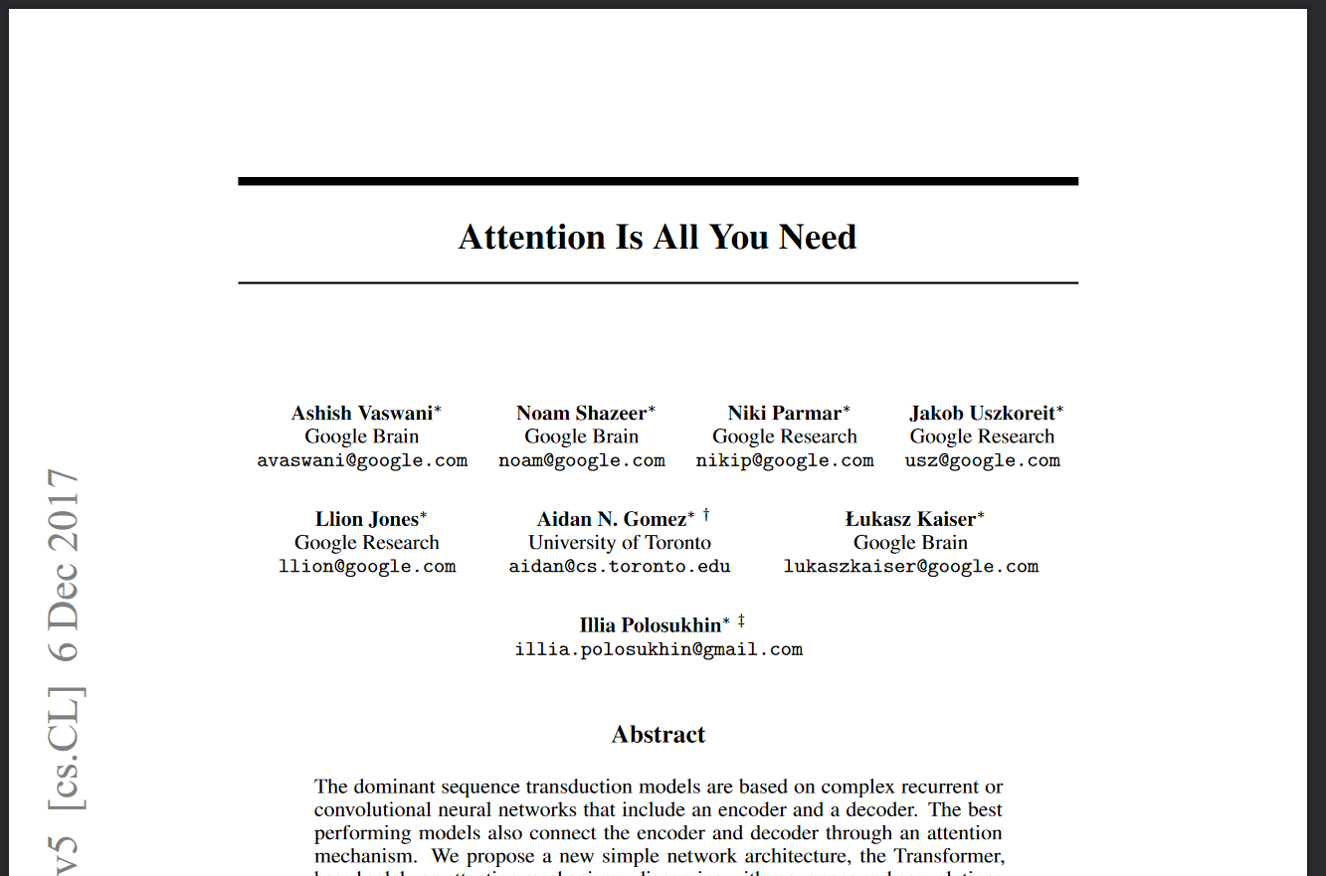
Notes:
*Bert*, GPT, etc build on this. Introduced “transformer”, as well
40 thousand citations in April 2022

Slide 21
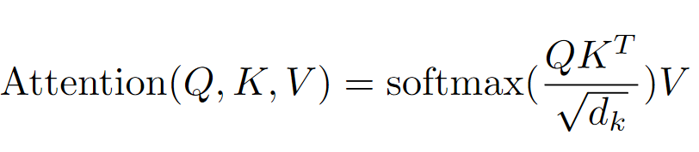
“Many readers will skim over formulas on their first reading of your exposition. Therefore, your sentences should flow smoothly when all but the simplest formulas are replaced by “blah” or some other grunting noise.” - Donald Knuth

Slide 22
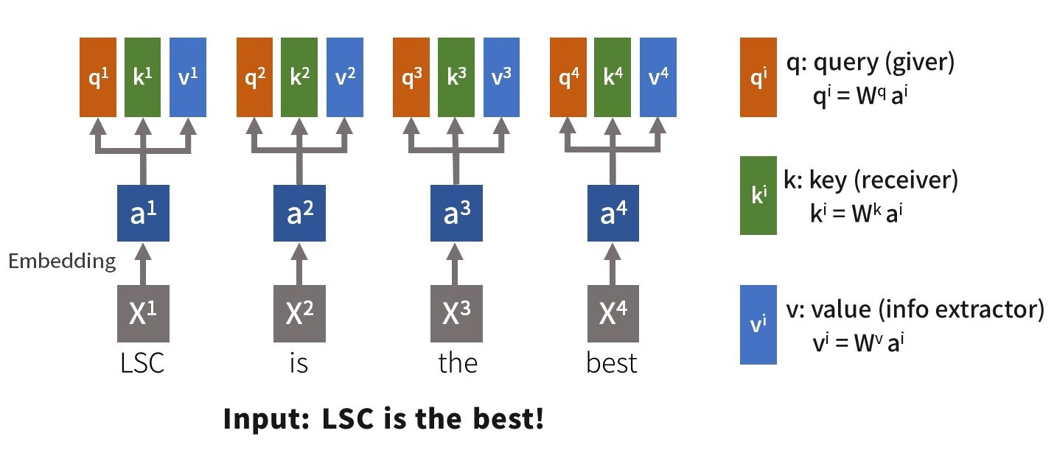
From https://medium.com/lsc-psd/introduction-of-self-attention-layer-in-transformer-fc7bff63f3bc

Slide 23
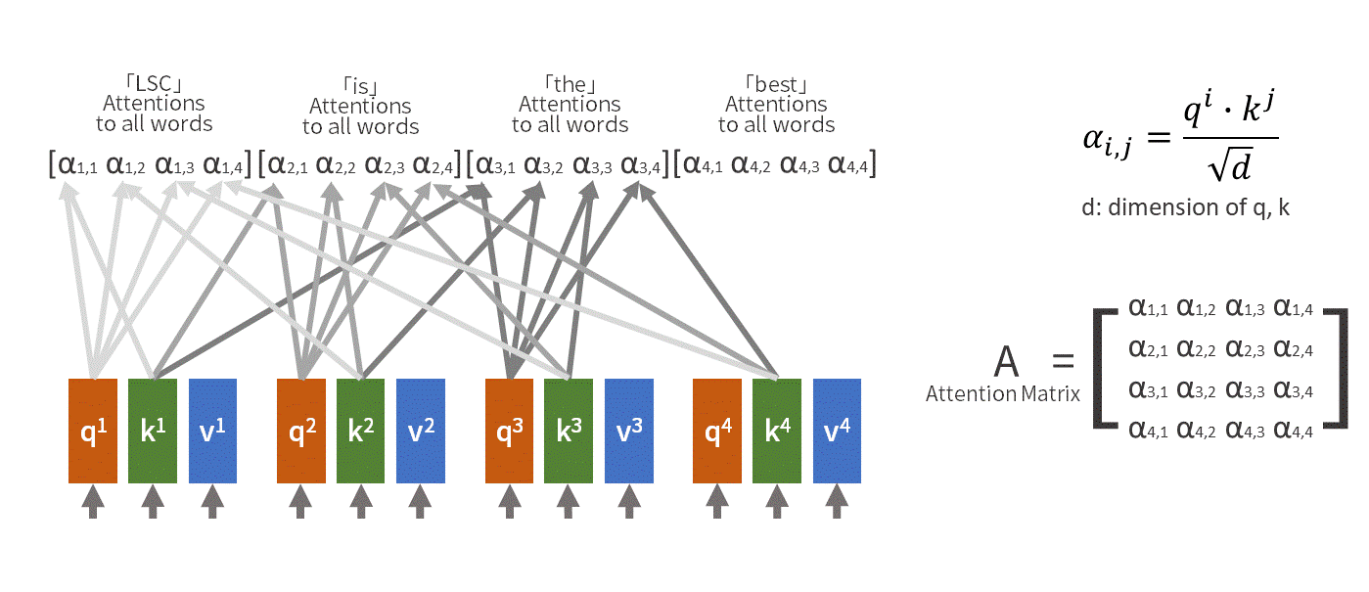
From https://medium.com/lsc-psd/introduction-of-self-attention-layer-in-transformer-fc7bff63f3bc

Slide 24
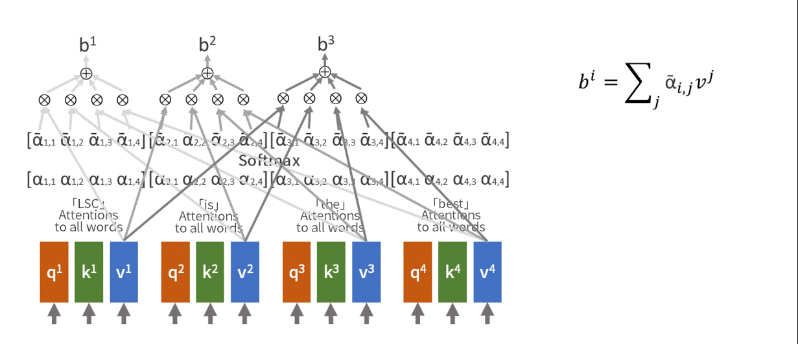

Slide 25
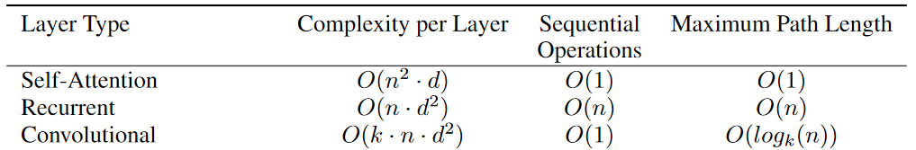
Complexity Comparison
Notes:
Table 1: Maximum path lengths, per-layer complexity and minimum number of sequential operations for different layer types. N is the sequence length, d is the representation dimension, k is the kernel size of convolutions and r the size of the neighborhood in restricted self-attention.

Slide 26
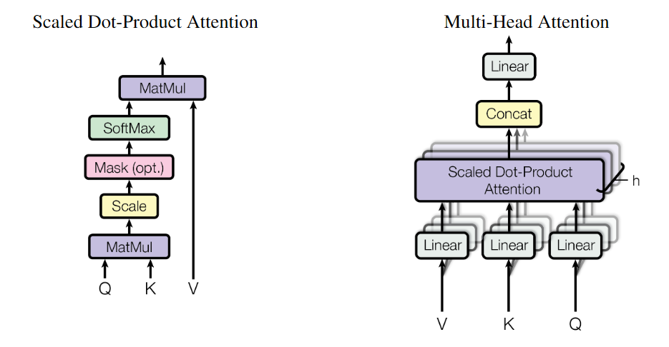

Slide 27
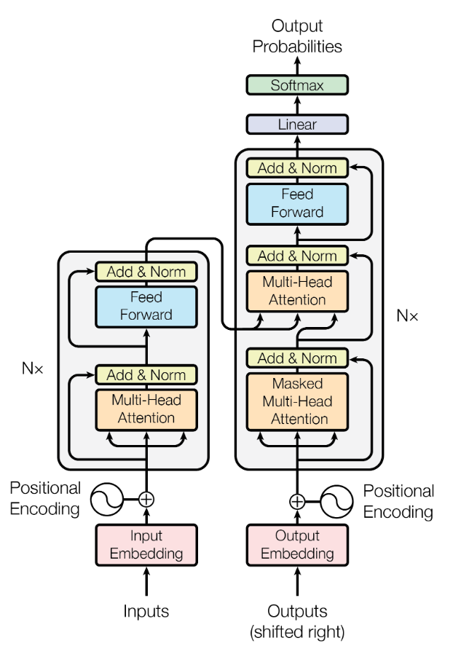
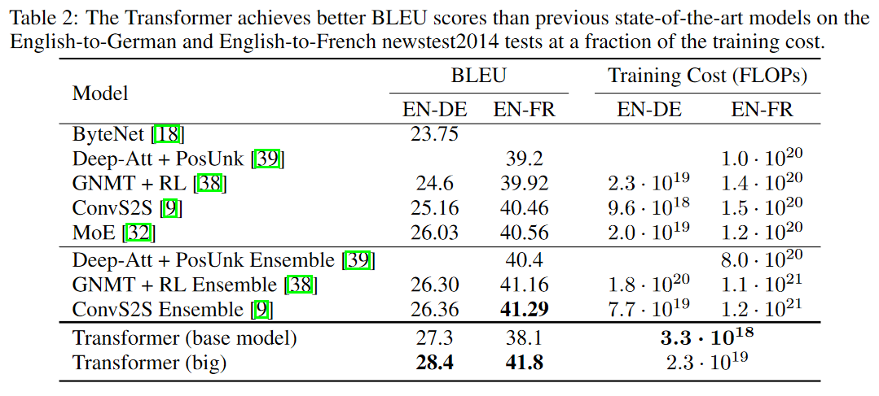
Transformer Architecture
Notes:
GPT and Bert build on these ideas

Slide 28
Outline
Context and Receptive Field
Going Beyond Convolutions in…
Text
Point Clouds
Images

Slide 29
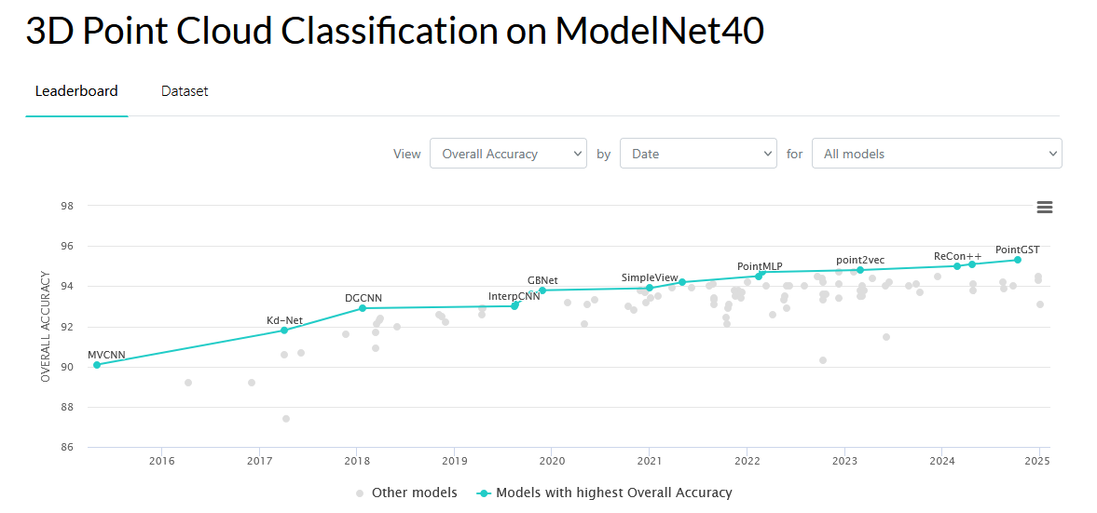

Slide 30
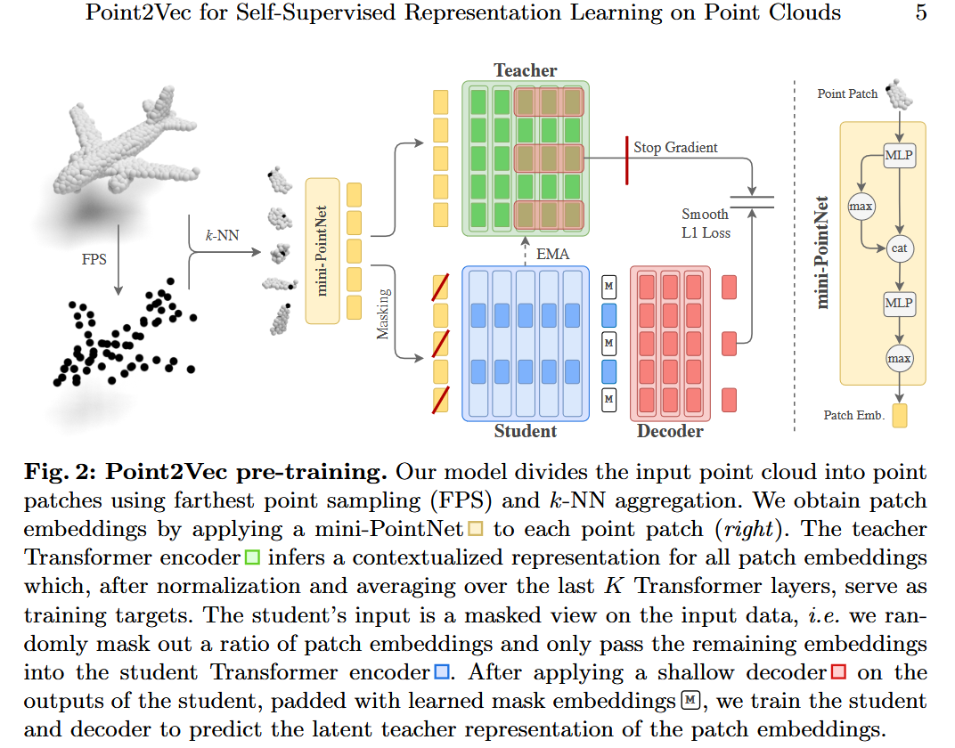

Slide 31
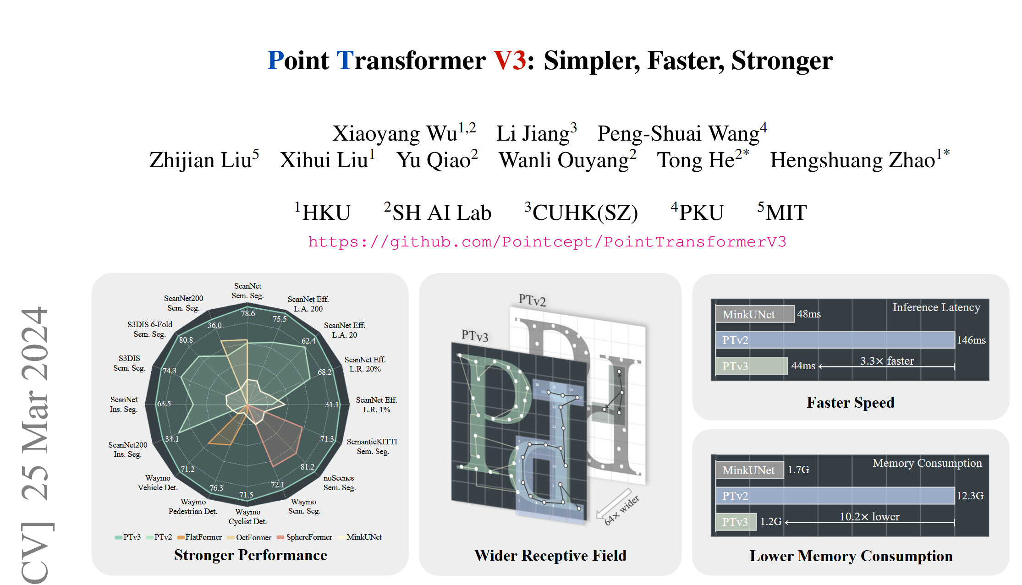

Slide 32
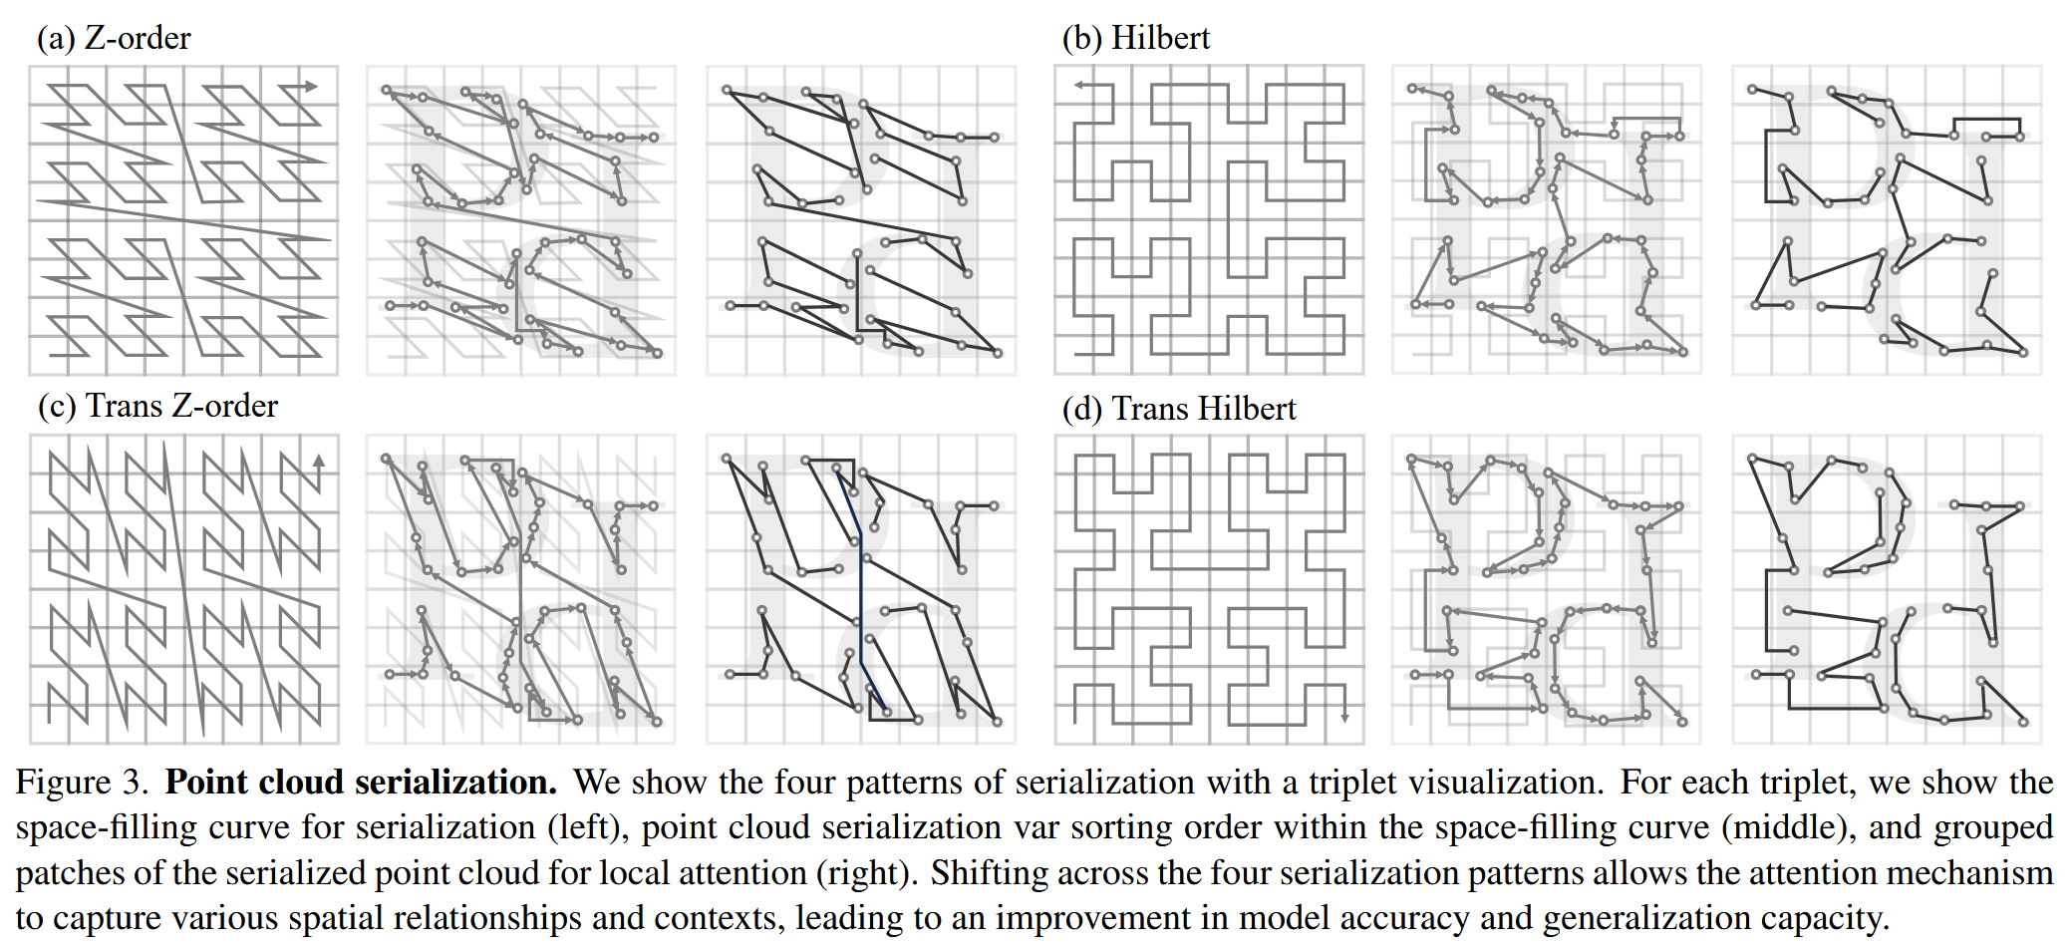

Slide 33
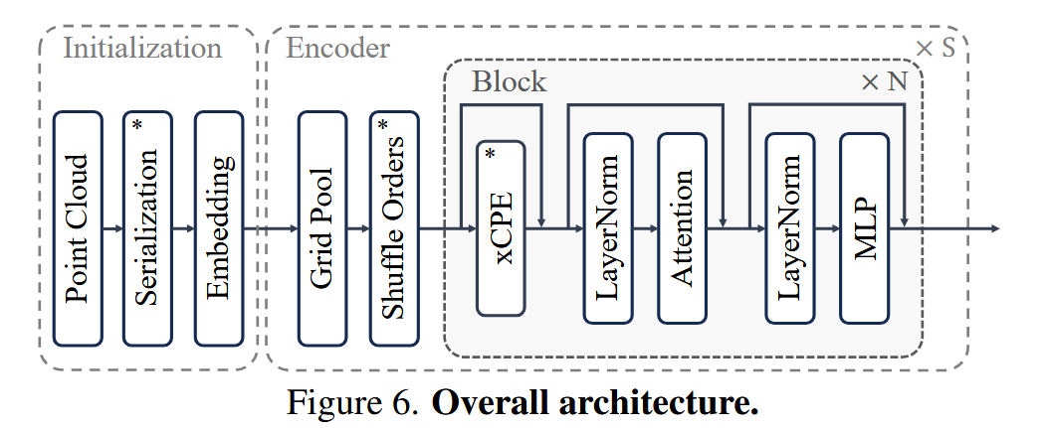

Slide 34
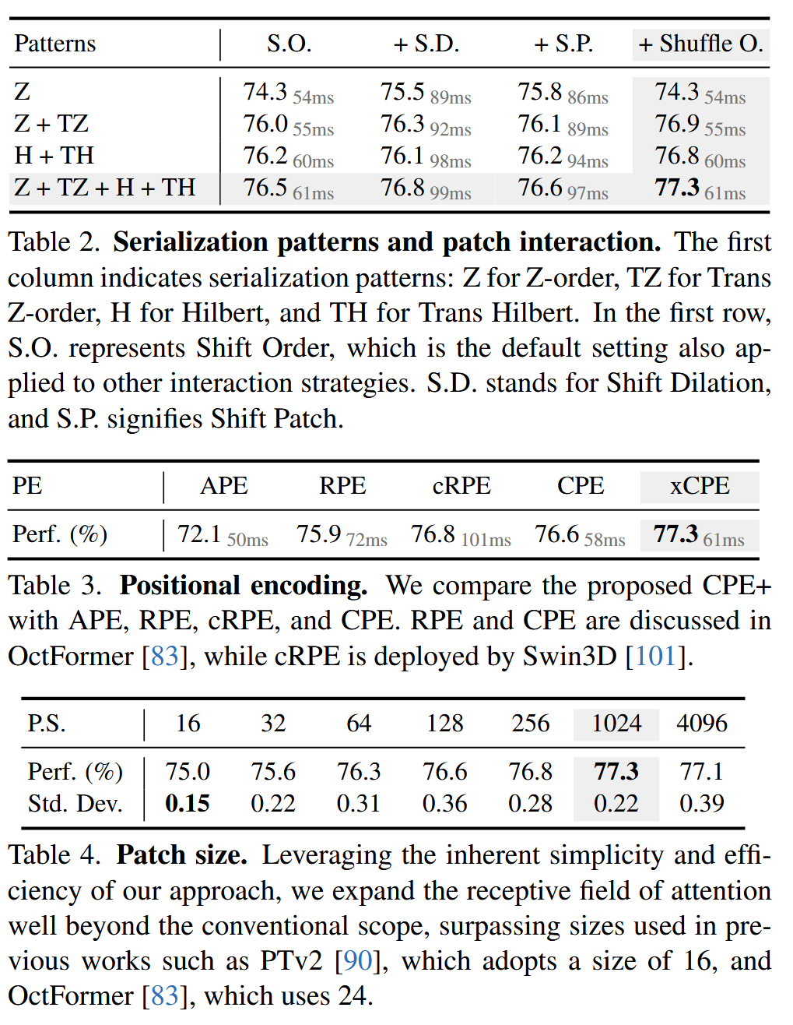

Slide 35
Outline
Context and Receptive Field
Going Beyond Convolutions in…
Text
Point Clouds
Images

Slide 36
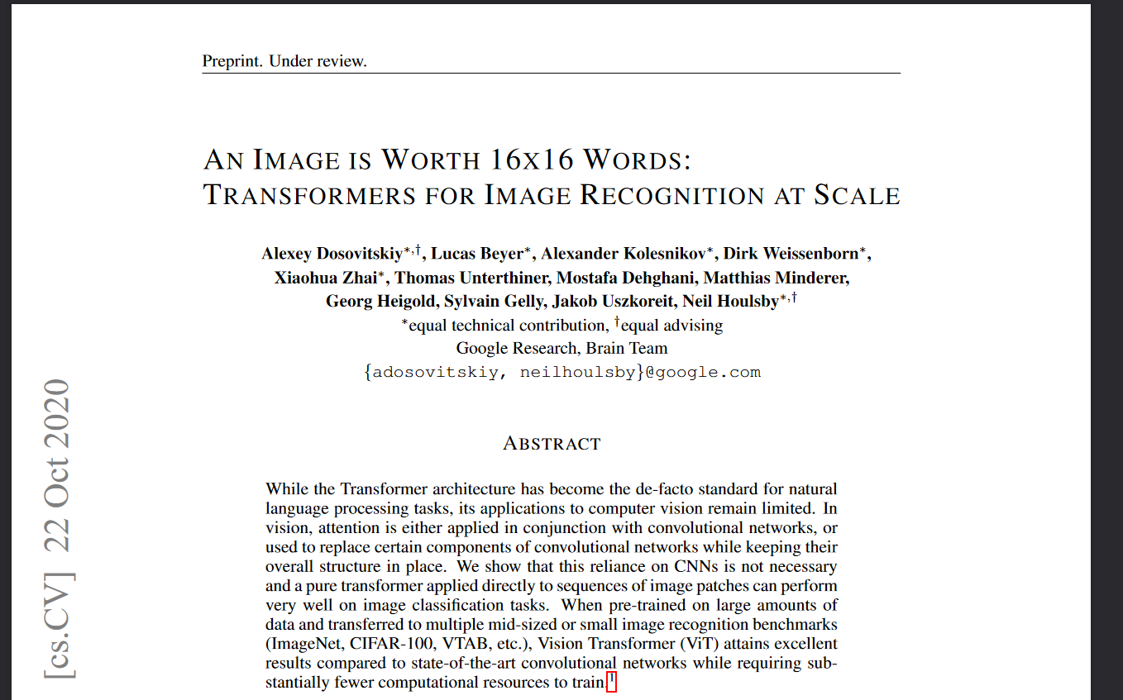
Notes:
3500 citations as of April 2022. Called “ViT” commonly.

Slide 37
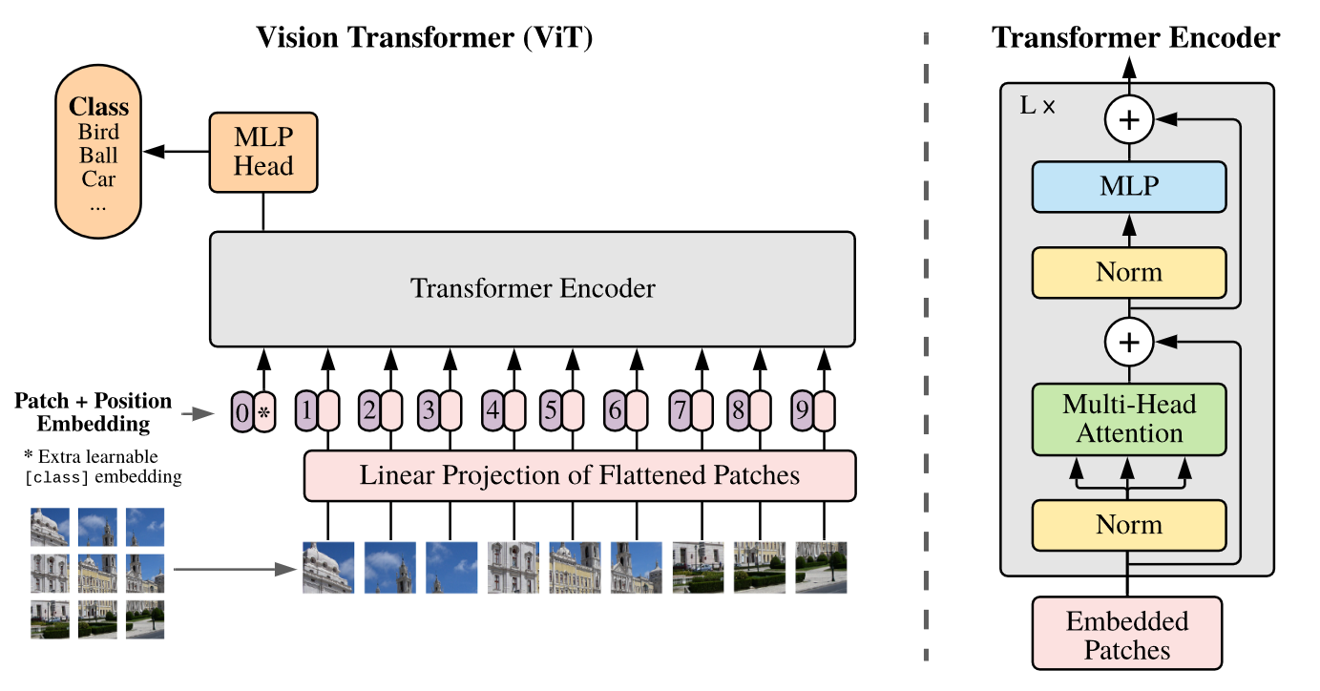
Supervised training on 300M labeled images
Notes:
Model overview. We split an image into fixed-size patches, linearly embed each of them, add position embeddings, and feed the resulting sequence of vectors to a standard Transformer encoder. In order to perform classification, we use the standard approach of adding an extra learnable “classification token” to the sequence. The illustration of the Transformer encoder was inspired by Vaswani et al. (2017)

Slide 38
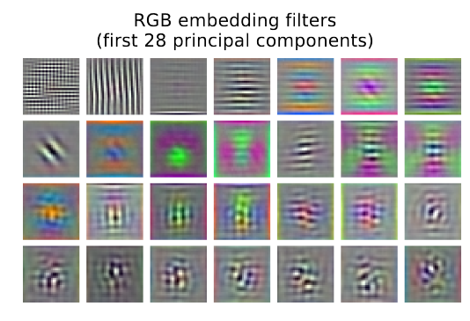
Notes:
Model overview. We split an image into fixed-size patches, linearly embed each of them, add position embeddings, and feed the resulting sequence of vectors to a standard Transformer encoder. In order to perform classification, we use the standard approach of adding an extra learnable “classification token” to the sequence. The illustration of the Transformer encoder was inspired by Vaswani et al. (2017)

Slide 39
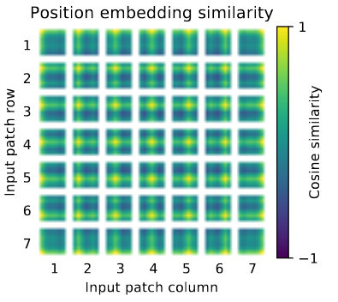
Notes:
Model overview. We split an image into fixed-size patches, linearly embed each of them, add position embeddings, and feed the resulting sequence of vectors to a standard Transformer encoder. In order to perform classification, we use the standard approach of adding an extra learnable “classification token” to the sequence. The illustration of the Transformer encoder was inspired by Vaswani et al. (2017)

Slide 40
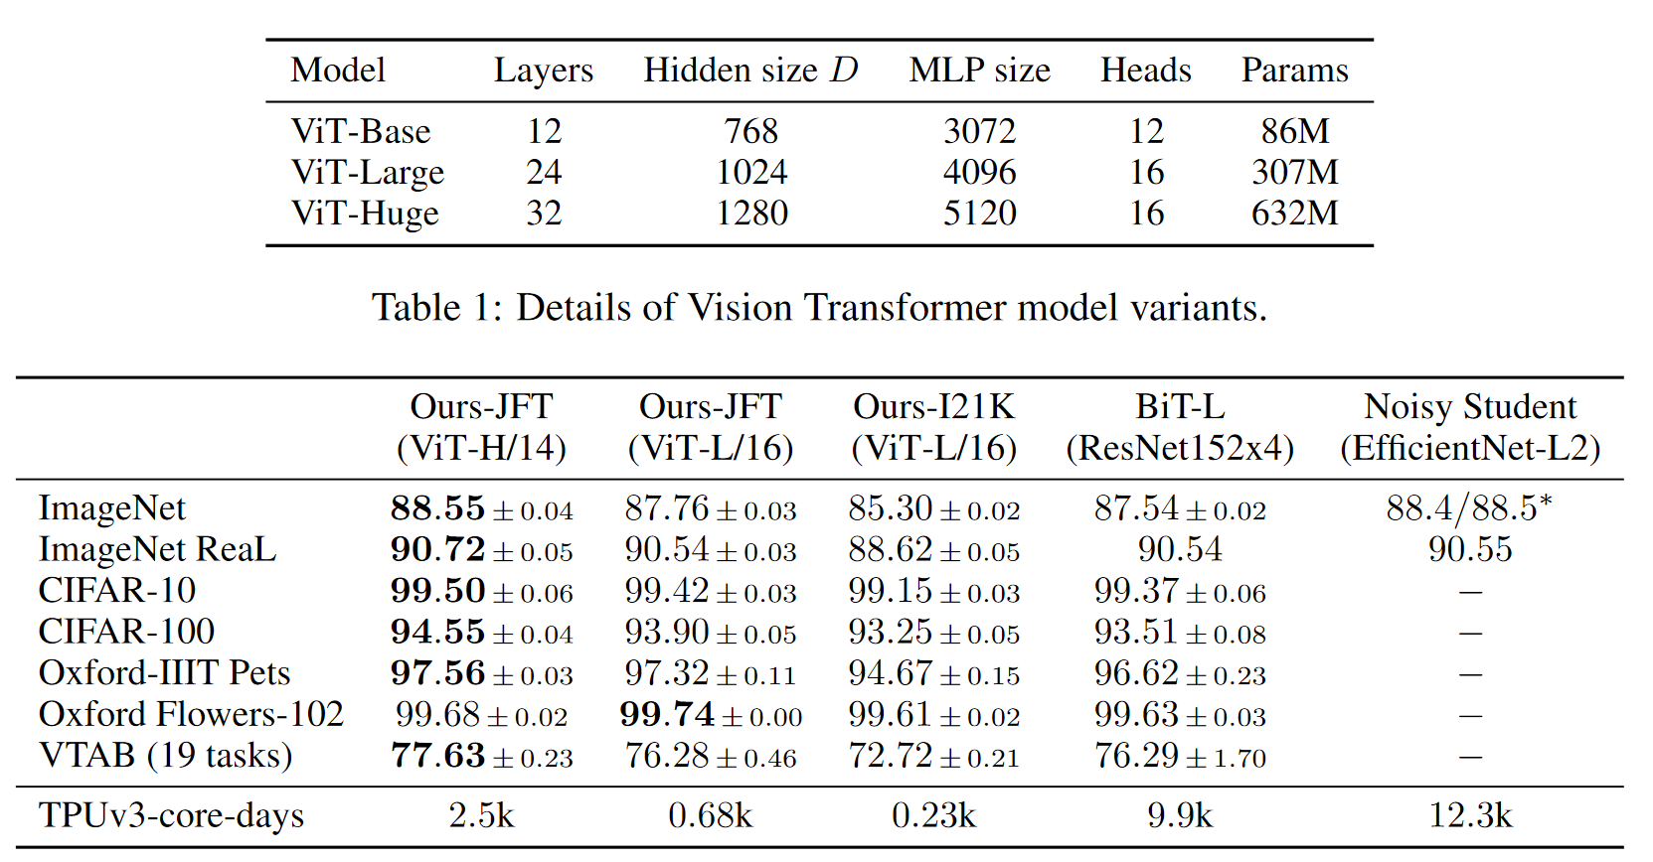
Notes:
Comparison with state of the art on popular image classification benchmarks. We re-
port mean and standard deviation of the accuracies, averaged over three fine-tuning runs. Vision
Transformer models pre-trained on the JFT-300M dataset outperform ResNet-based baselines on all
datasets, while taking substantially less computational resources to pre-train. ViT pre-trained on the
smaller public ImageNet-21k dataset performs well too. ∗Slightly improved 88.5% result reported
in Touvron et al. (2020).

Slide 41
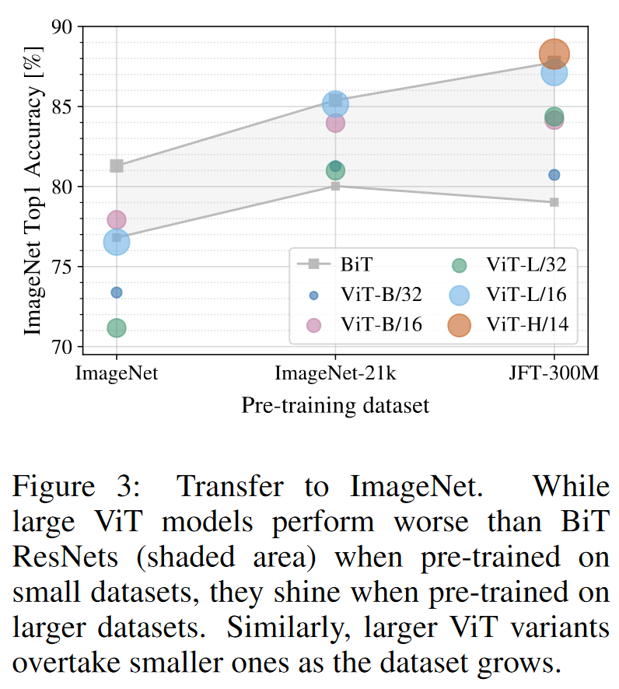
When trained on mid-sized datasets such as ImageNet, such models yield modest accuracies of a few percentage points below ResNets of comparable size. This seemingly discouraging outcome maybe expected: Transformers lack some of the inductive biases inherent to CNNs, such as translation equivariance and locality, and therefore do not generalize well when trained on insufficient amounts of data.
However, the picture changes if the models are trained on larger datasets (14M-300M images). We find that large scale training trumps inductive bias.
Dosovitskiy et al.
https://paperswithcode.com/sota/image-classification-on-imagenet

Slide 42
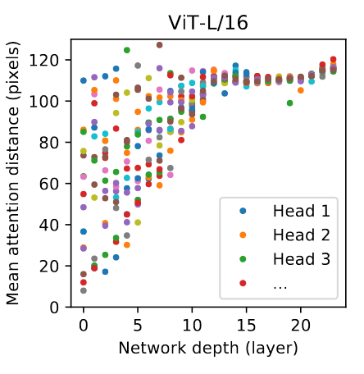

Slide 43
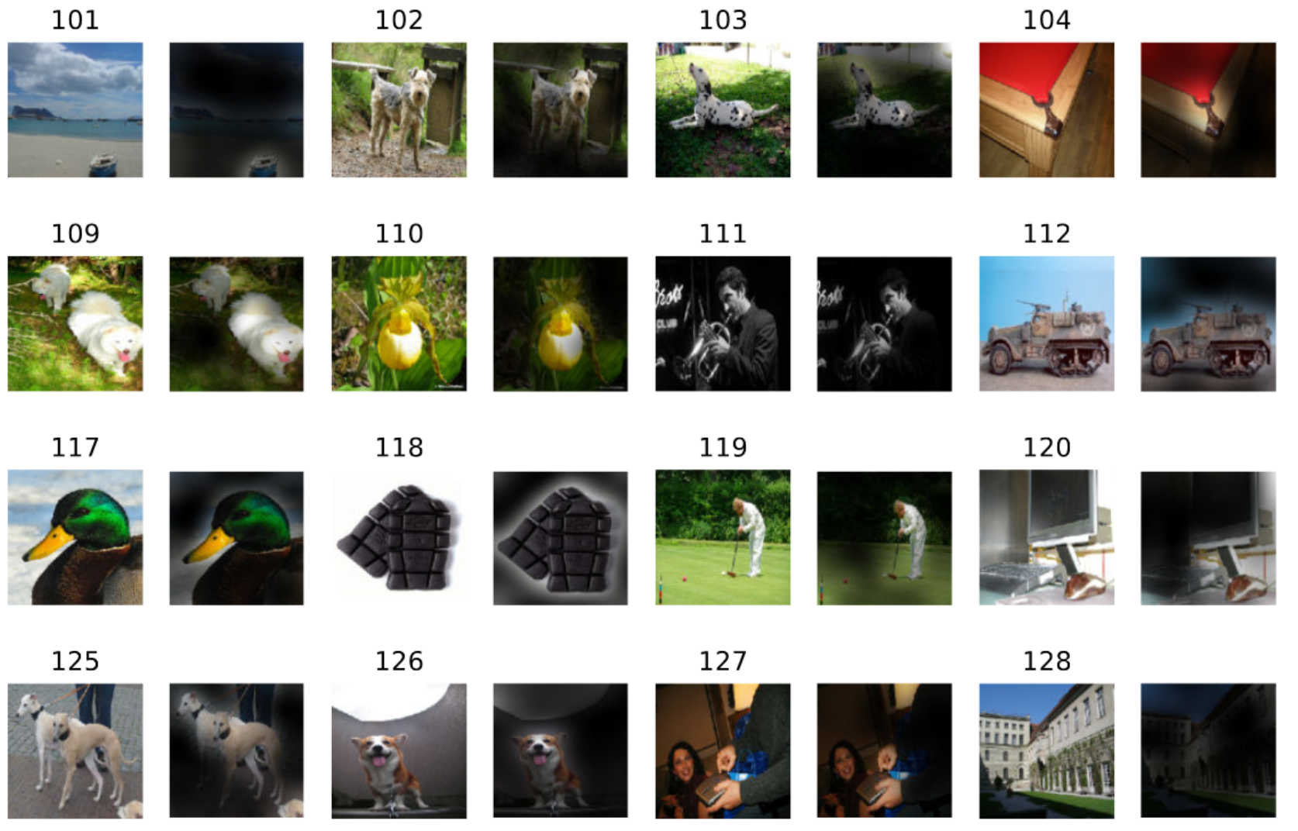

Slide 44
This can’t be ideal, right?

Slide 45
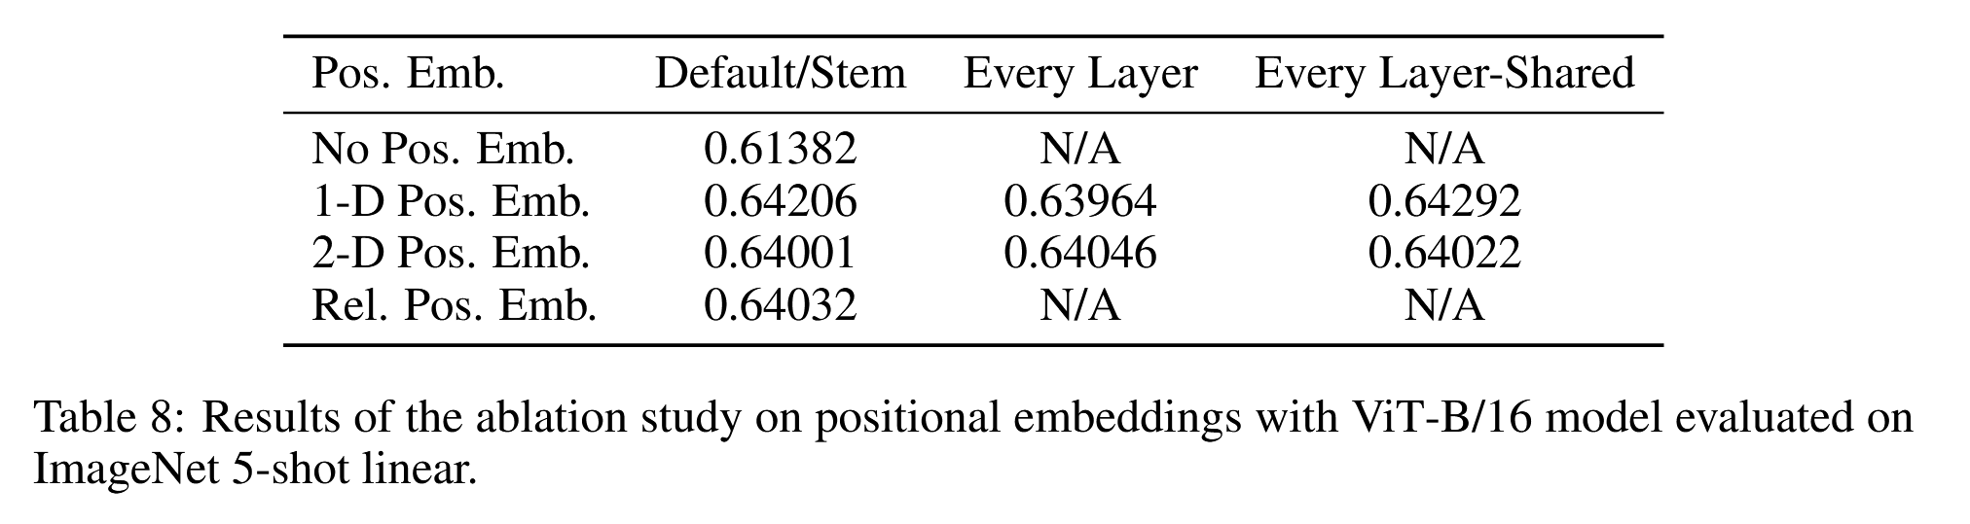

Slide 46
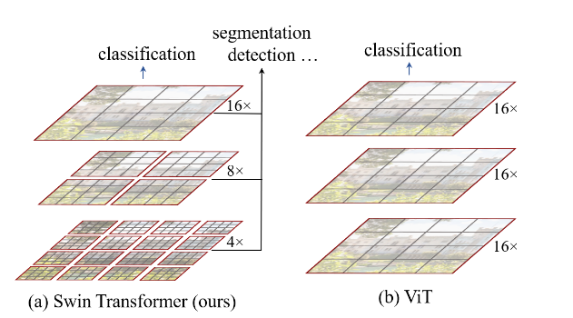
Swin Transformer: Hierarchical Vision Transformer using Shifted Windows
Ze Liu, Yutong Lin, Yue Cao, Han Hu, Yixuan Wei, Zheng Zhang, Stephen Lin, Baining Guo
Notes:
August 2021, 1163 citations

Slide 47
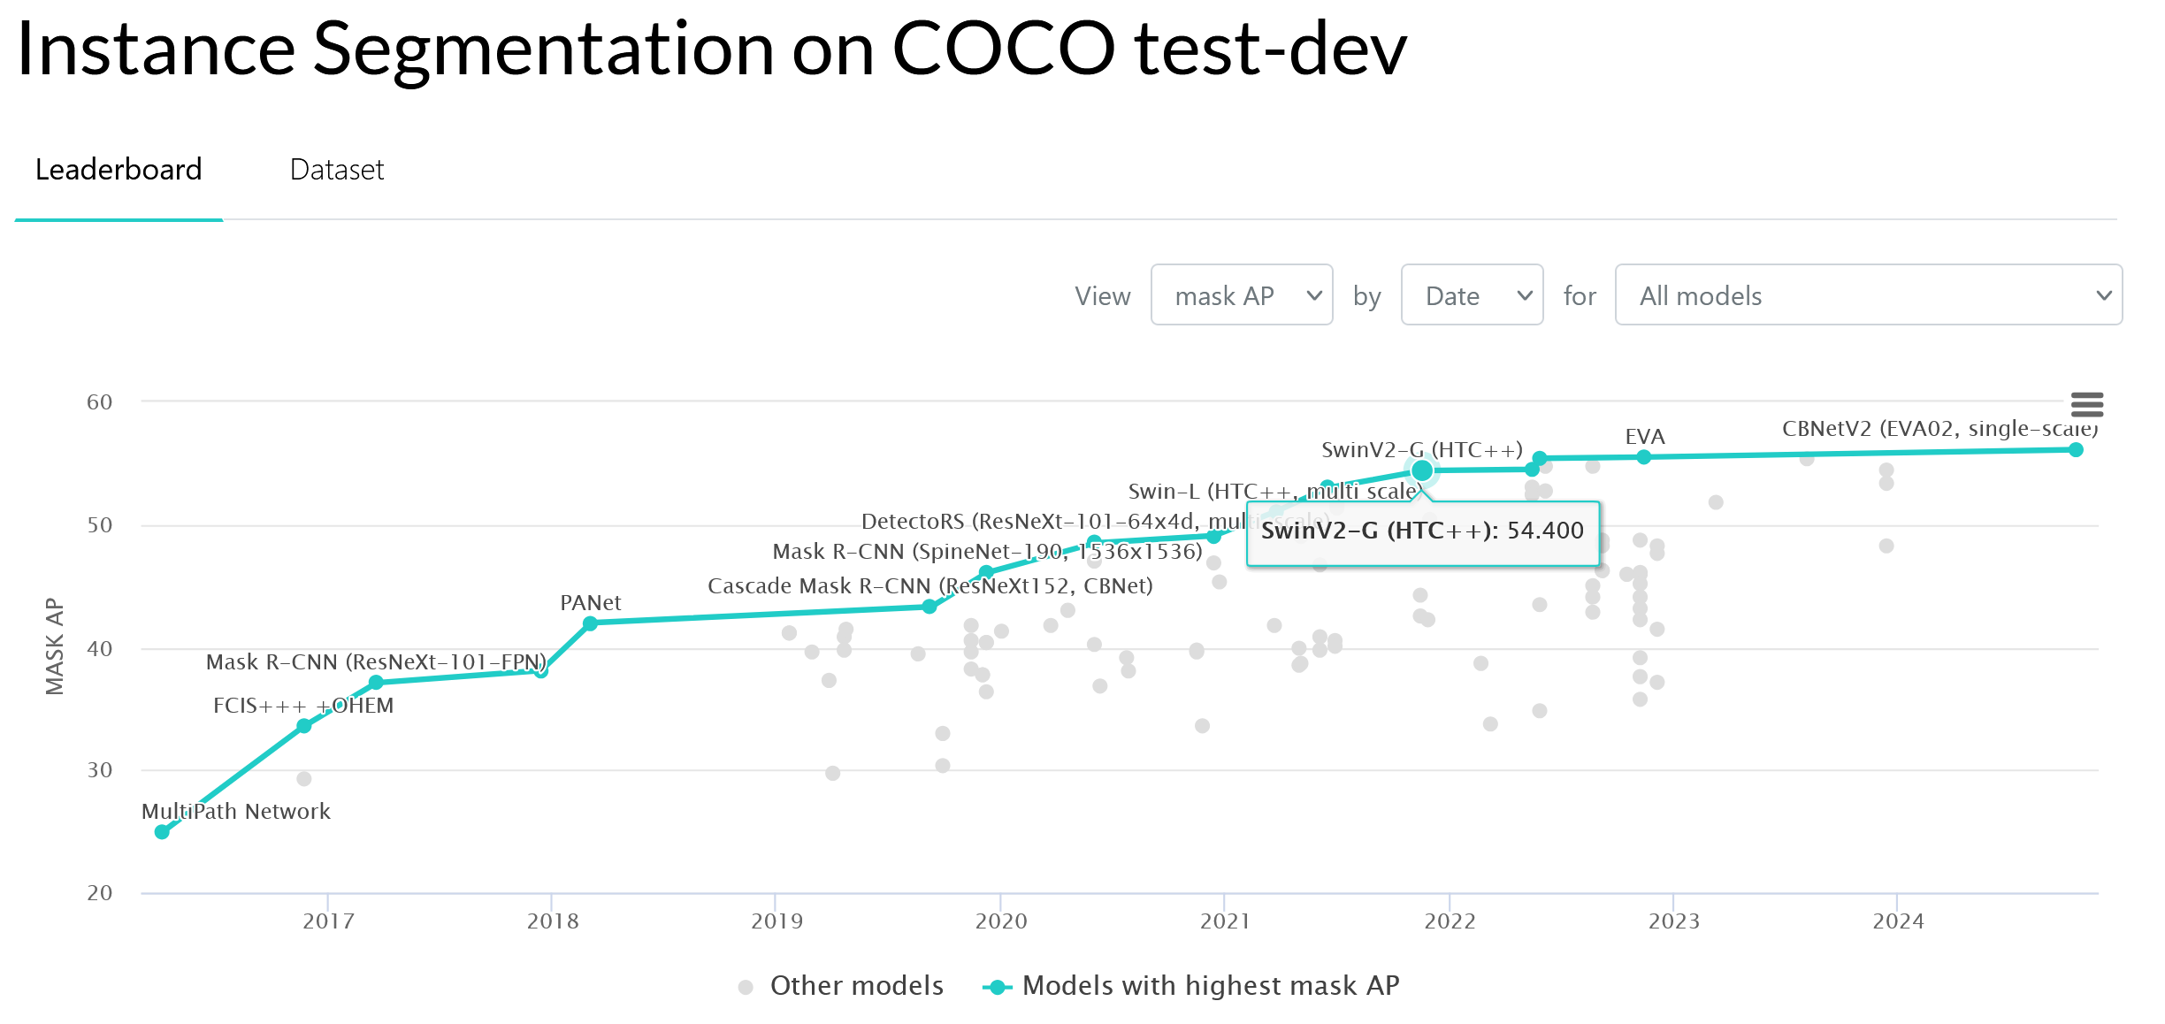

Slide 48
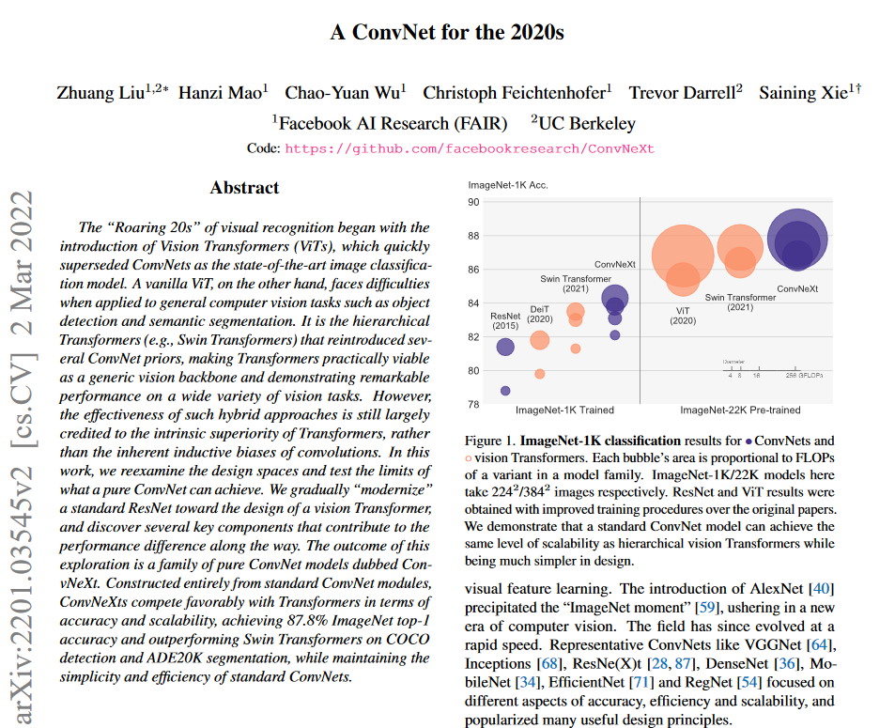

Slide 49
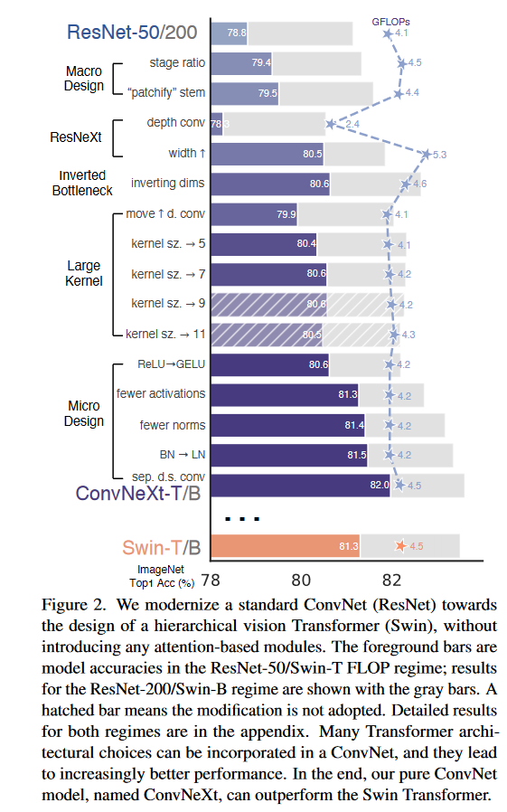
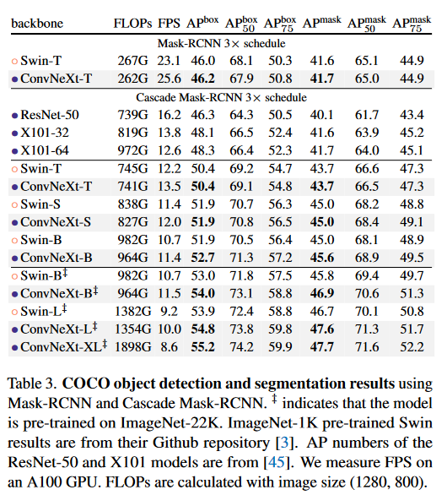

Slide 50
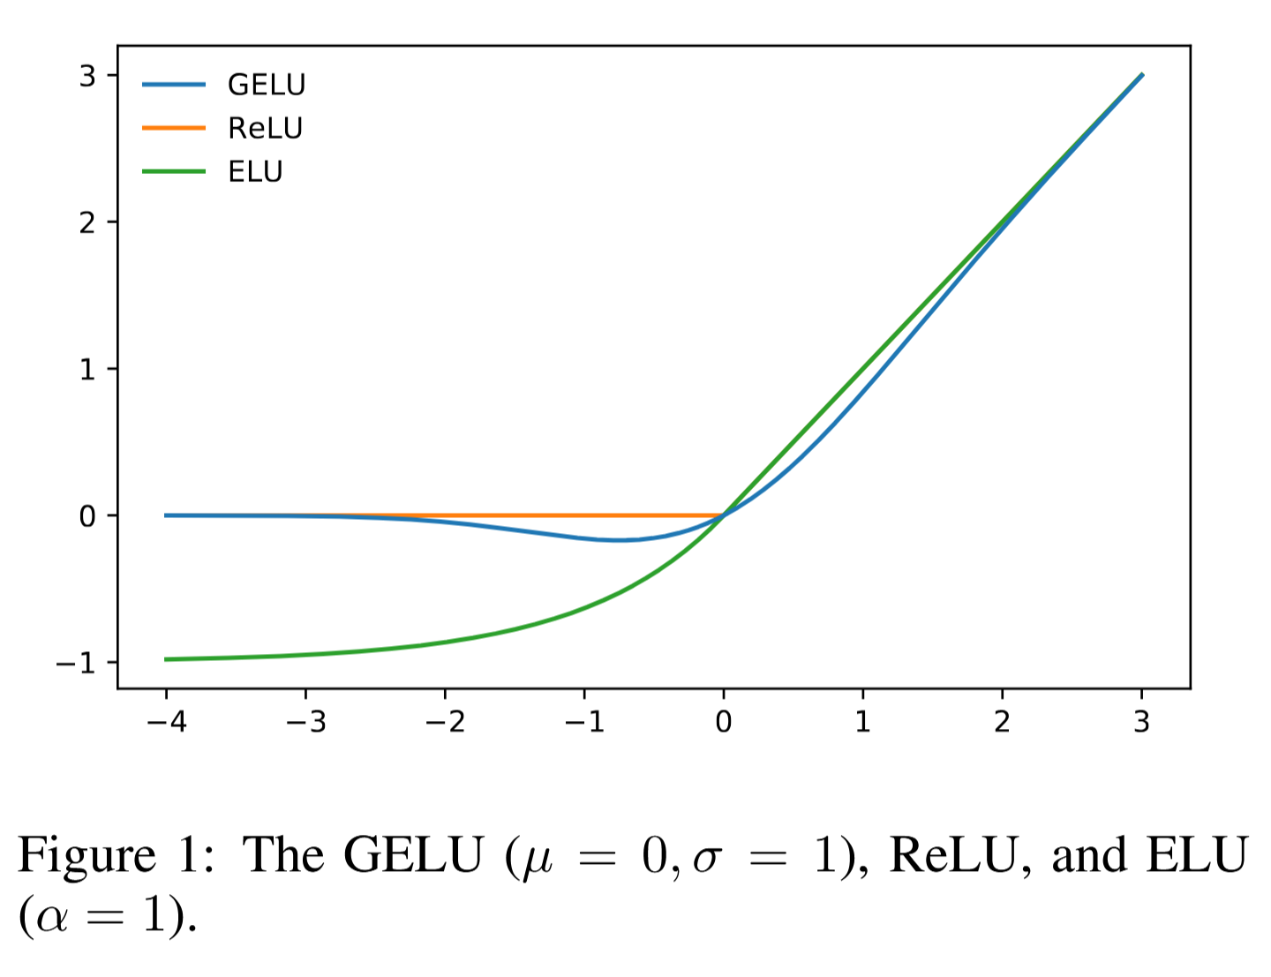

Slide 51
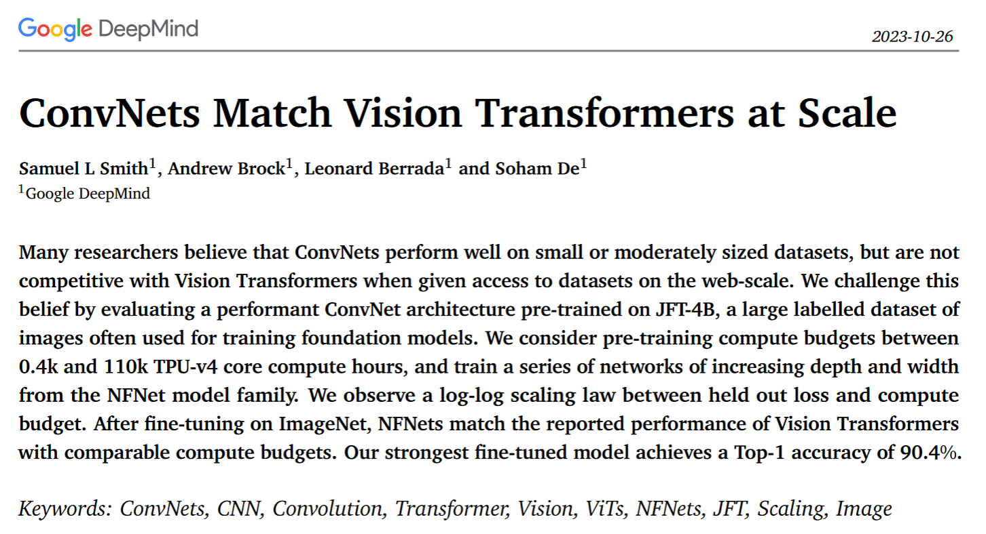
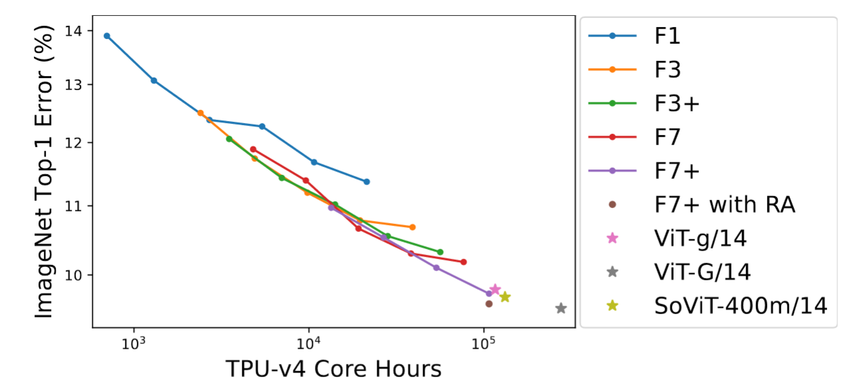

Slide 52
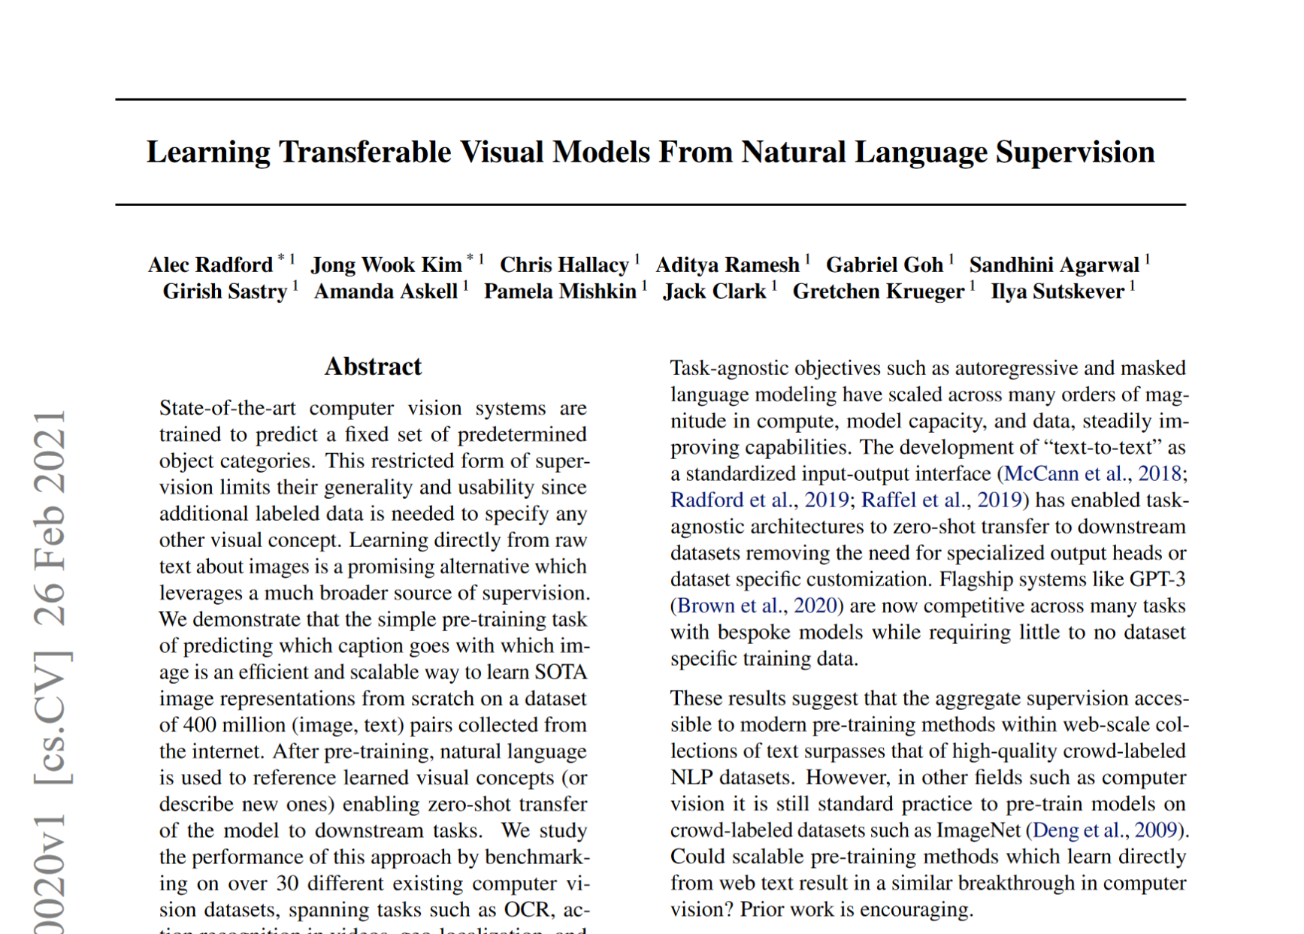
CLIP

Slide 53
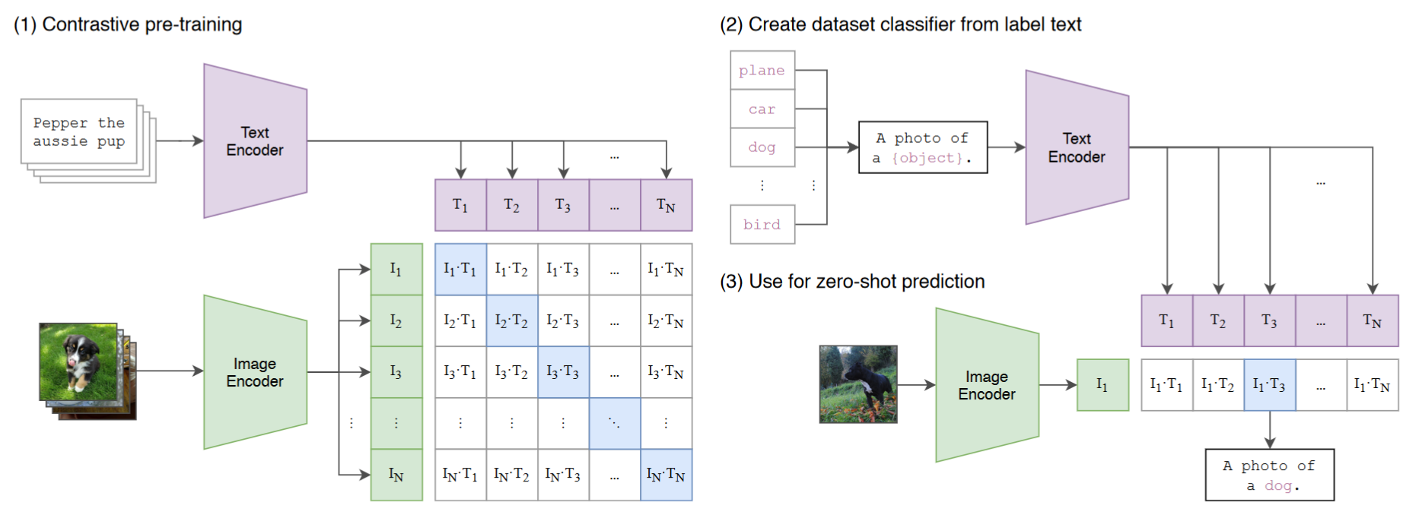
“weakly supervised” contrastive learning on 400M text / image pairs
ViT architecture trained from scratch

Slide 54
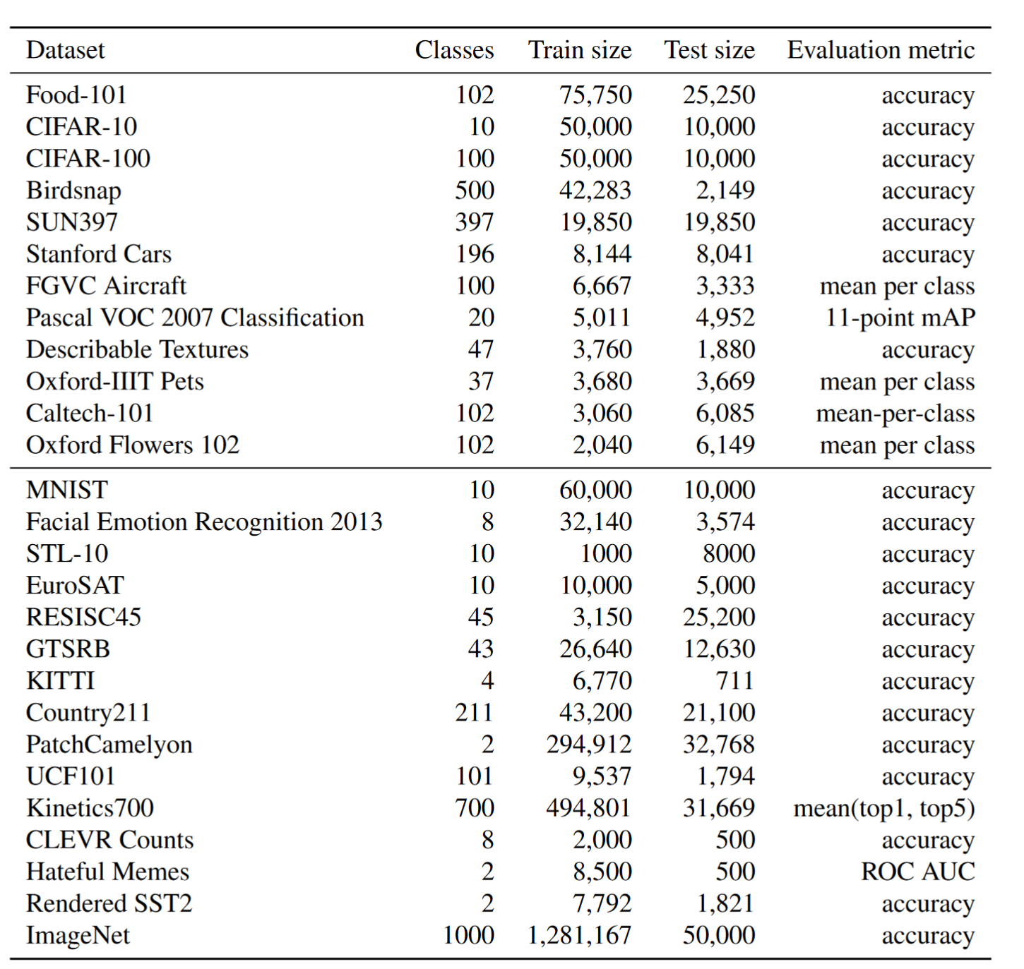

Slide 55


Notes:
Zero-shot CLIP is competitive with a fully super-
vised baseline. Across a 27 dataset eval suite, a zero-shot CLIP
classifier outperforms a fully supervised linear classifier fitted on
ResNet-50 features on 16 datasets, including ImageNet.

Slide 56


Slide 57

Notes:
CLIP’s features are more robust to task shift when compared to models pre-trained on ImageNet. For both dataset
splits, the transfer scores of linear probes trained on the representations of CLIP models are higher than other models with similar
ImageNet performance. This suggests that the representations of models trained on ImageNet are somewhat overfit to their task.

Slide 58


Slide 59

DinoV2 Datasets
140 M total images
No labels used
Self-supervised with image level strategies (like SimCLR) and patch level strategies (like MAE, masked auto-encoder)
Smaller models are distilled from the largest model

Slide 60


Slide 61

Notes:
Table 4: Linear evaluation on ImageNet-1k of frozen pretrained features. We report Top-1 accuracy
on the validation set for publicly available models trained on public or private data, and with or without
text supervision (text sup.). For reference, we also report the kNN performance on the validation set. We
compare across any possible architectures (Arch.), at resolution 224 × 224 unless stated otherwise. The
dataset used for training EVA-CLIP is a custom mixture, see paper for details (Fang et al., 2023).

Slide 62

Semantic Segmentation
Notes:
Semantic segmentation on ADE20K, CityScapes and Pascal VOC with frozen features
and a linear classifier (lin.) and with multiscale (+ms). The absolute state of the art – from Wang et al.
(2022), Liu et al. (2021) and Chen et al. (2018) respectively – are mentioned at the top of the Table. For
reference, using the Mask2Former pipeline (Steiner et al., 2021) with a ViT-Adapter (Chen et al., 2023b) on
top of our frozen ViT-g/14 backbone gives 60.2 mIoU on ADE-20k.

Slide 63


Slide 64


Slide 65


Slide 66


Slide 67


Slide 68


Slide 69
Summary
“Attention” models outperform recurrent models and convolutional models for sequence processing. They allow long range interactions.
These models do best with LOTS of training data
Naïve attention mechanisms have quadratic complexity with the number of input tokens, but there are often workarounds for this.
Tokenization seems harmful, so we have to fight back against its with positional embeddings or overlapping tokenizations.
Attentional models seem to succeed when they copy the inductive biases of convolutional models.
For “traditional” image processing, it is not clear if Transformers outperform convolutional networks.
You should start with one of these pre-trained models – CLIP if you want language support, Dino if you want spatial reasoning

