Slide 1
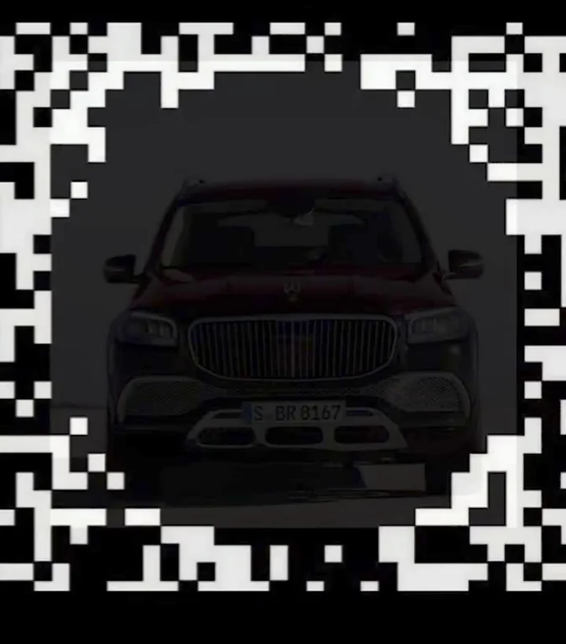

Slide 2


Slide 3
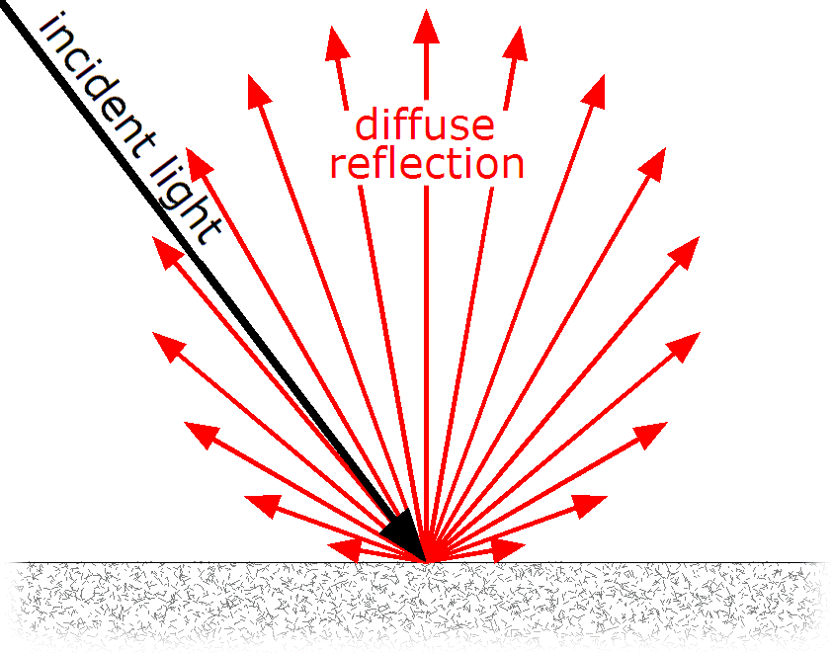
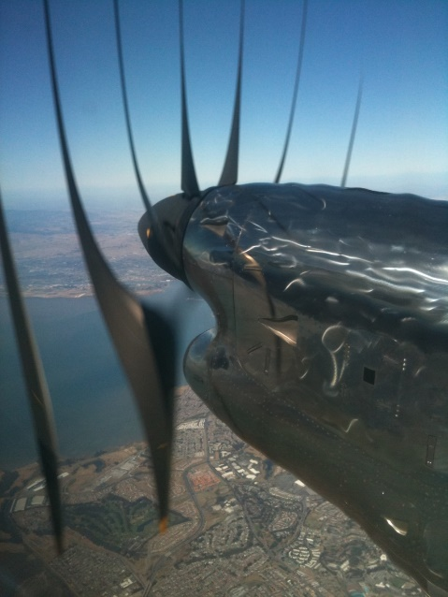
Recap of Light and Cameras
Light transport is complex, but in computer vision we often assume their interactions follow the Lambertian reflectance model.
Time, Intensity, and Space are all continuous, but they are all discretized when capturing images. Sometimes this leads to artifacts.

Slide 5
This lecture
Eyes (your cameras)
Light and Color
Next lecture: Interest Points

Slide 6
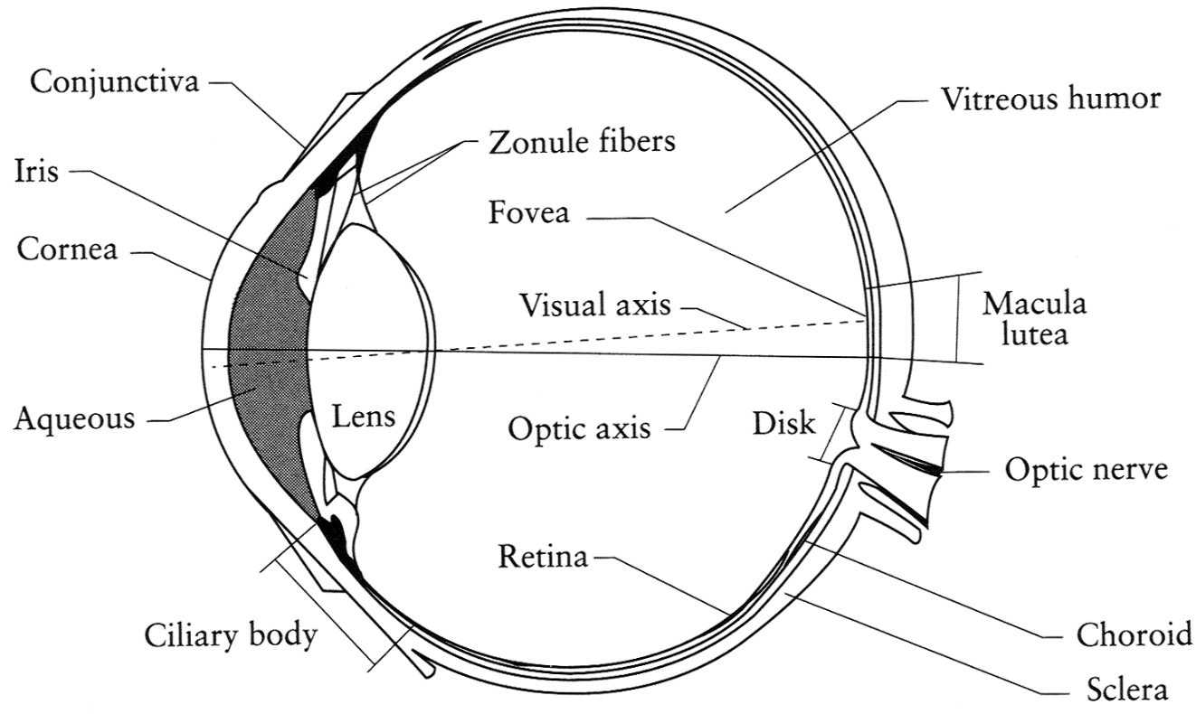
The Eye
The human eye is a camera!
  Iris - colored annulus with radial muscles
  Pupil - the hole (aperture) whose size is controlled by the iris
  What’s the “film”?
    photoreceptor cells (rods and cones) in the retina
Slide by Steve Seitz

Slide 7
Why do we care about human vision in this class?
We don’t, necessarily.

Slide 8
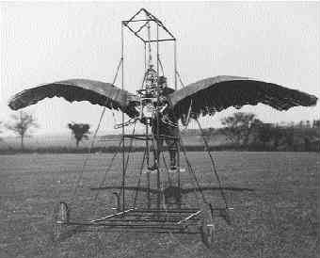
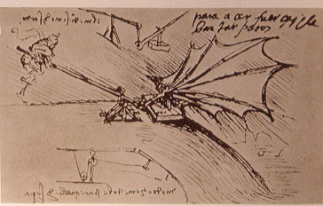
Ornithopters

Slide 9
Why do we care about human vision in this class?
We don’t, necessarily.
But cameras necessarily imitate the frequency response of the human eye, so we should know that much.
Also, computer vision probably wouldn’t get as much scrutiny if biological vision (especially human vision) hadn’t proved that it was possible to make important judgements from 2D images.

Slide 10
Does computer vision “understand” images?
"Can machines fly?" The answer is yes, because airplanes fly.
"Can machines swim?" The answer is no, because submarines don't swim.
"Can machines think?" Is this question like the first, or like the second?
Source: Norvig

Slide 11
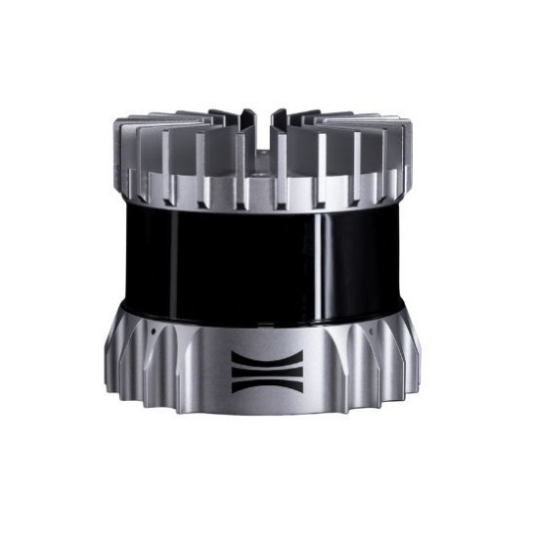
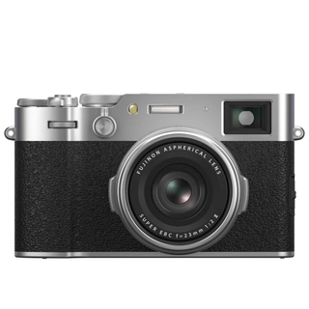
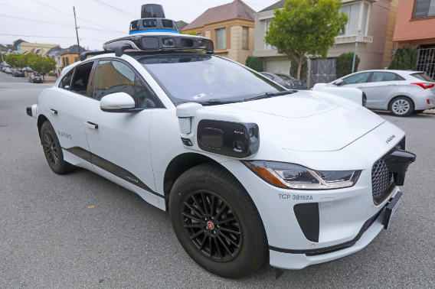
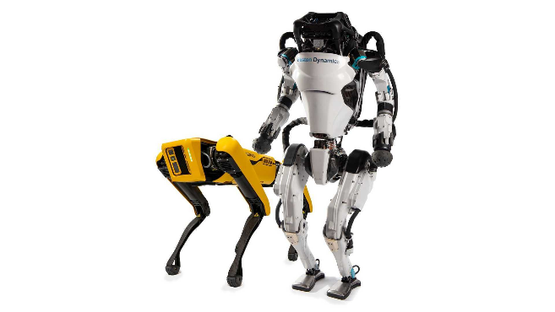
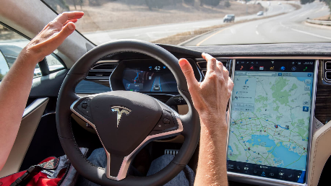
The Spectrum of Biological Inspiration
Radar
Lidar
Traditional cameras
Tesla autopilot
Humanoid and Quadruped robots
Less biologically inspired
More biologically inspired

Slide 12
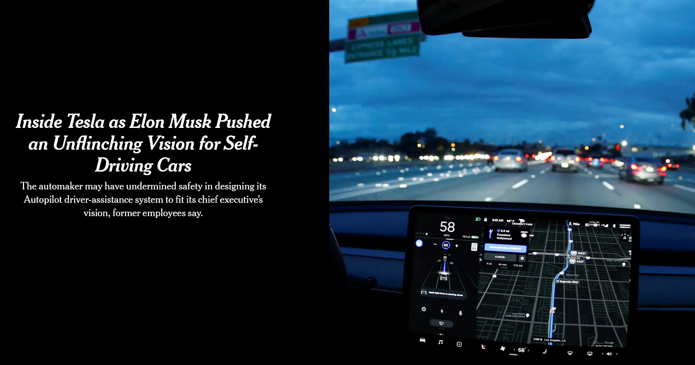
Notes:
December 6th, 2021 New York Times

Slide 13
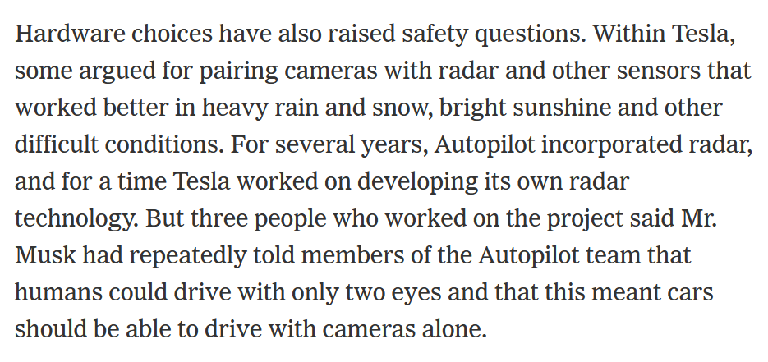

Slide 14
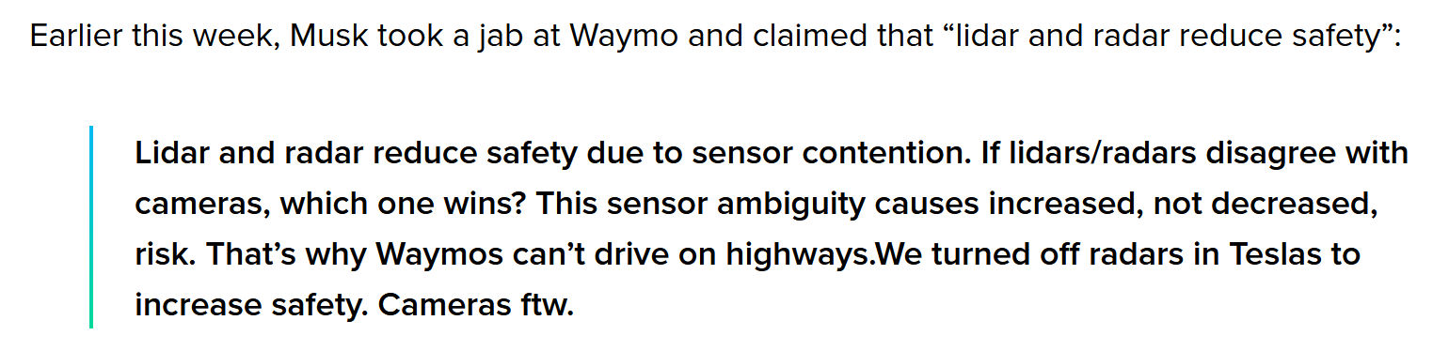
August 2025

Slide 15
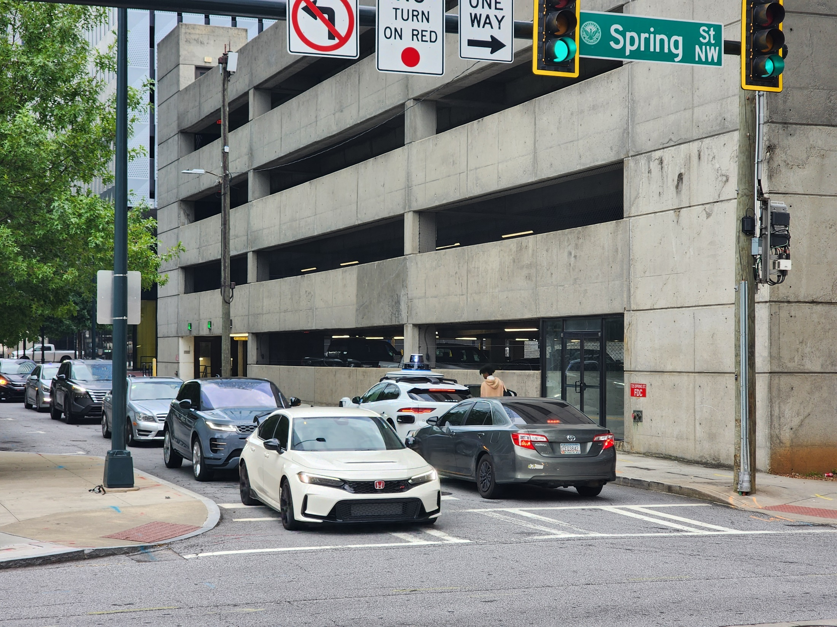

Slide 16
The Retina

Slide 17
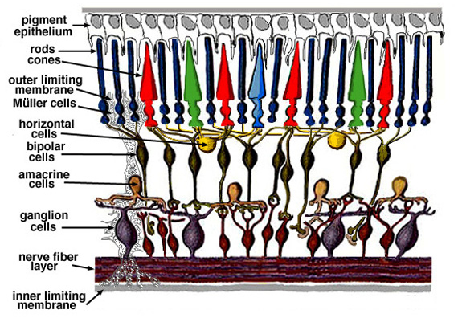
Retina up-close
Light
Notes:
Tapetum lucidum

Slide 18
Two types of light-sensitive receptors
Cones
cone-shaped
less sensitive
operate in high light
color vision
Rods
rod-shaped
highly sensitive
operate at night
gray-scale vision
© Stephen E. Palmer, 2002

Slide 19
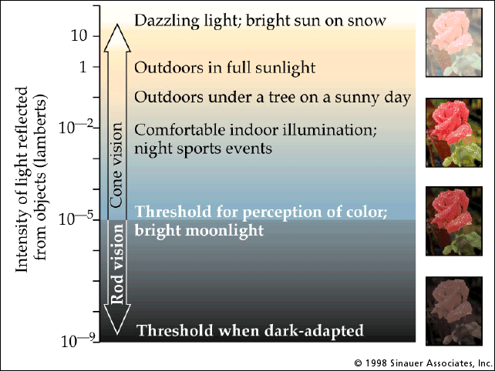
Rod / Cone sensitivity

Slide 20
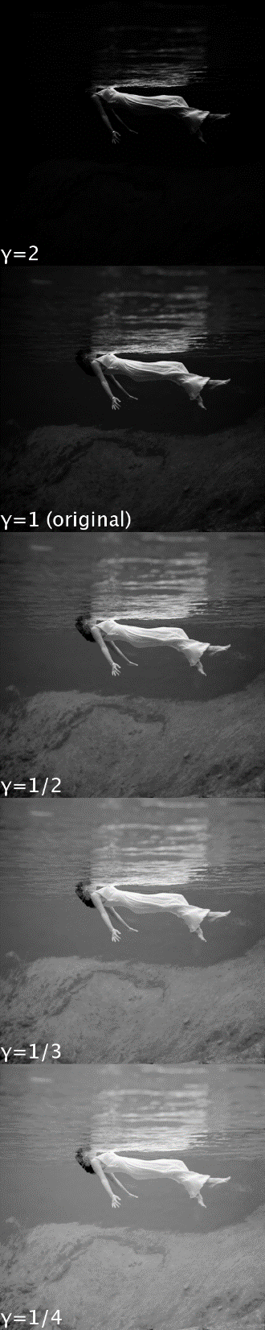
Camera Gamma Curve
$$encoded brightness={measured brightness}^{γ}$$
Typical encoding gamma value
In this class (e.g. for project 1), you are manipulating encoded brightness values. A pixel with value of “100” does not mean twice the light emissions as a pixel with value of “50”.
https://en.wikipedia.org/wiki/Gamma_correction

Slide 21
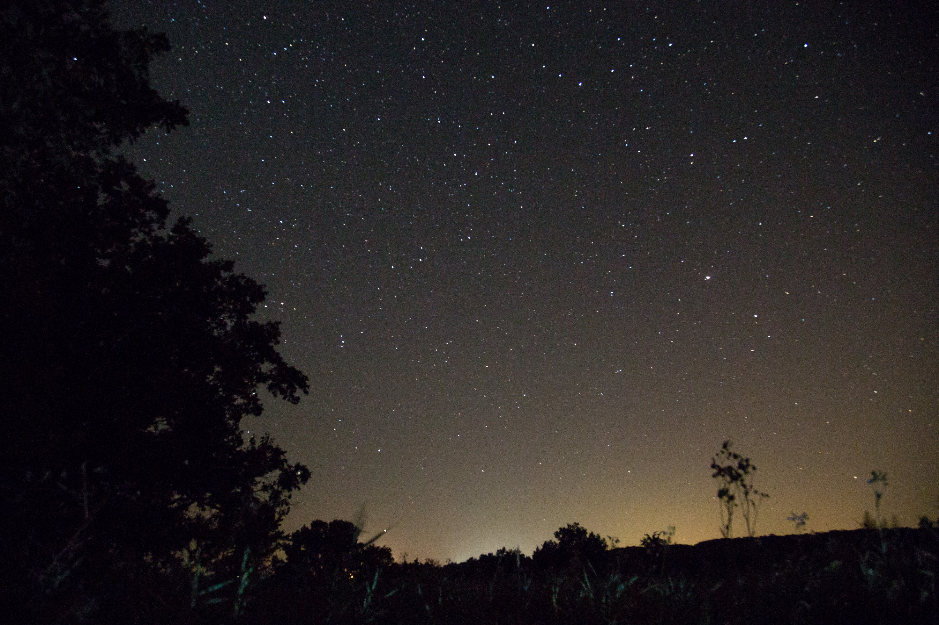
Night Sky: why are there more stars off-center?
Averted vision: http://en.wikipedia.org/wiki/Averted_vision
© Stephen E. Palmer, 2002

Slide 22
Distribution of Rods and Cones
Night Sky: why are there more stars off-center?
Averted vision: http://en.wikipedia.org/wiki/Averted_vision
© Stephen E. Palmer, 2002

Slide 23
Eye Movements
Saccades
Can be consciously controlled. Related to perceptual attention.
200ms to initiation, 20 to 200ms to carry out. Large amplitude.
Microsaccades
Involuntary. Smaller amplitude. Especially evident during prolonged fixation. Function debated.
Ocular microtremor (OMT)
Involuntary. high frequency (up to 80Hz), small amplitude.
Smooth pursuit – tracking an object

Slide 24
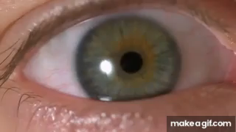
Slow mo guys – Saccades
https://youtu.be/Fmg9ZOHESgQ?t=21s

Slide 25
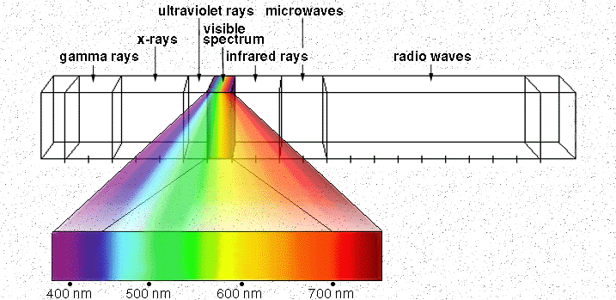
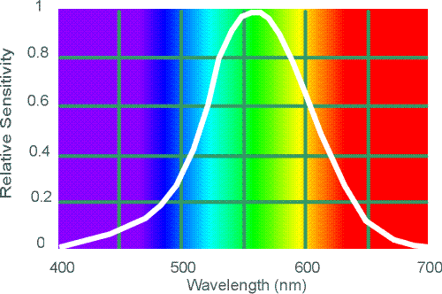
Electromagnetic Spectrum
Human Luminance Sensitivity Function
http://www.yorku.ca/eye/photopik.htm
Notes:
At least 3 spectral bands required (e.g. R,G,B)

Slide 26
Visible Light
Why do we see light of these wavelengths?
…because that’s where the
Sun radiates EM energy
© Stephen E. Palmer, 2002
Notes:
Because that’s where the Sun’s peak radiation was
Because the atmosphere is fairly transparent in that range
Because biology has many important markers in that range (but that’s because of the previous two reasons)

Slide 27
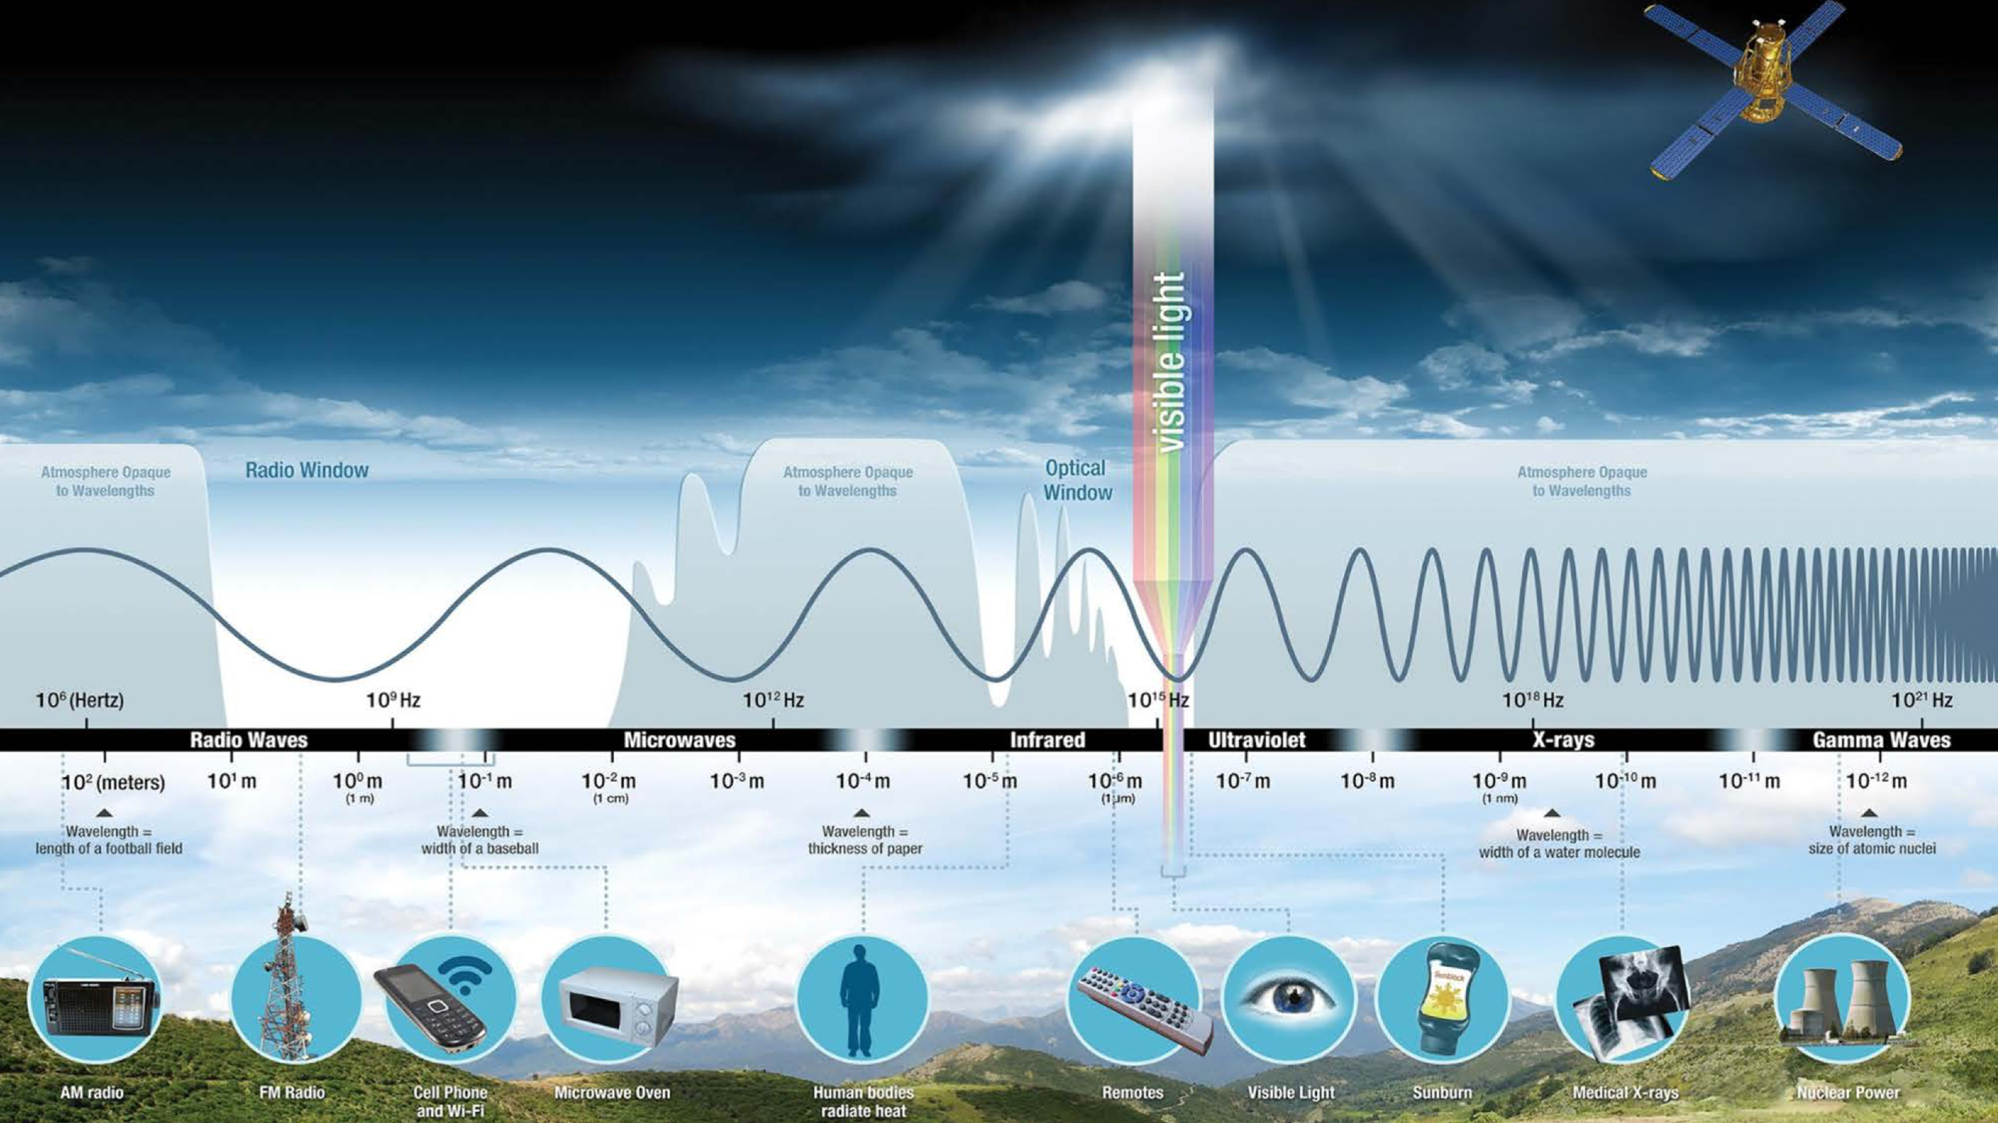
Notes:
Slide credit: NASA

Slide 28
The Physics of Light
Any patch of light can be completely described
physically by its spectrum: the number of photons
(per time unit) at each wavelength 400 - 700 nm.
© Stephen E. Palmer, 2002

Slide 29
The Physics of Light
Some examples of the spectra of light sources
© Stephen E. Palmer, 2002

Slide 30
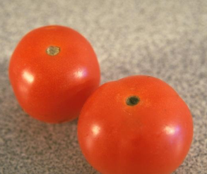
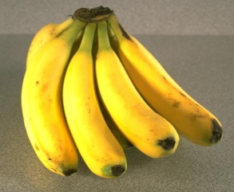
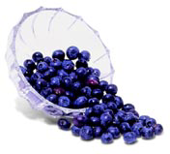
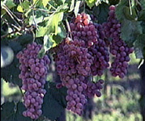
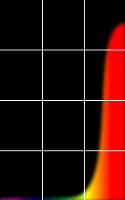
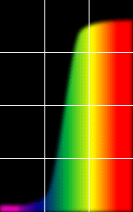
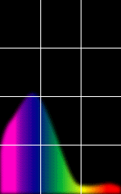
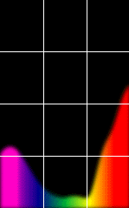
The Physics of Light
Some examples of the reflectance spectra of surfaces
Red
Yellow
Blue
Purple
% Photons Reflected
400 700
400 700
400 700
400 700
Wavelength (nm)
© Stephen E. Palmer, 2002

Slide 31
The Psychophysical Correspondence
There is no simple functional description for the perceived
color of all lights under all viewing conditions, but …...
A helpful constraint:
Consider only physical spectra with normal distributions
mean
area
variance
© Stephen E. Palmer, 2002

Slide 32
The Psychophysical Correspondence
Mean
Hue
# Photons
Wavelength
© Stephen E. Palmer, 2002

Slide 33
The Psychophysical Correspondence
Variance
Saturation
# Photons
Wavelength
© Stephen E. Palmer, 2002

Slide 34
The Psychophysical Correspondence
Area
Brightness
# Photons
Wavelength
© Stephen E. Palmer, 2002

Slide 35
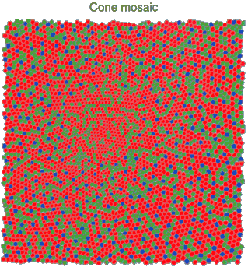
Physiology of Color Vision
Three kinds of cones:
Why are M and L cones so close?
Why are there 3?
© Stephen E. Palmer, 2002

Slide 36


Impossible Colors
Can you make the cones respond in ways that typical light spectra never would?
http://en.wikipedia.org/wiki/Impossible_colors

Slide 37
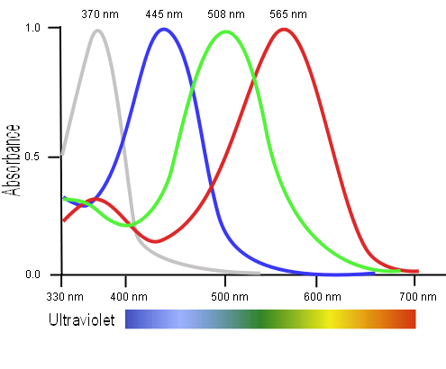
Tetrachromacy
Bird cone responses
Most birds, and many other animals, have cones for ultraviolet light.
Some humans, mostly female, seem to have slight tetrachromatism.

Slide 38
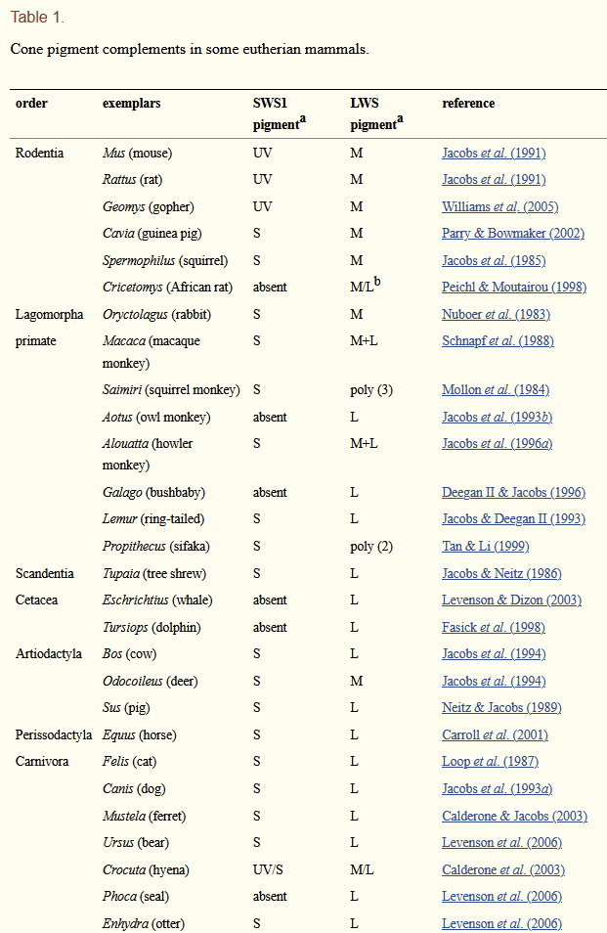
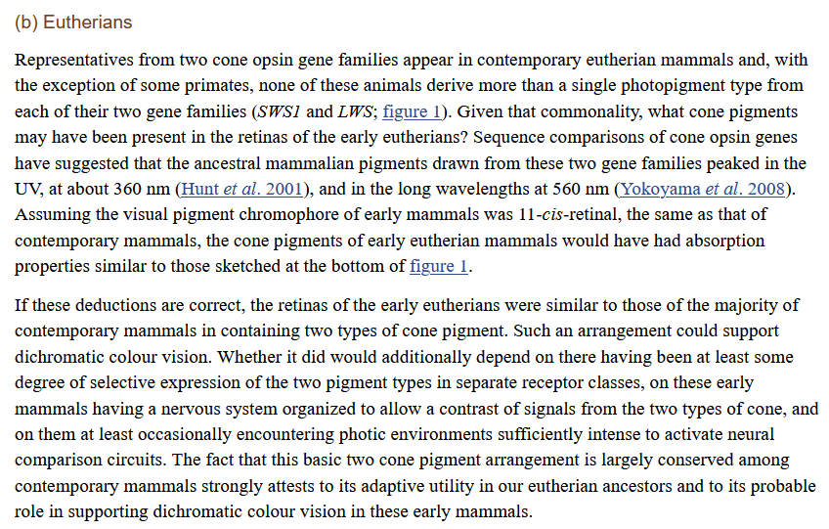
Jacobs GH. Evolution of colour vision in mammals. Philos Trans R Soc Lond B Biol Sci. 2009;364(1531):2957-2967. doi:10.1098/rstb.2009.0039

Slide 39
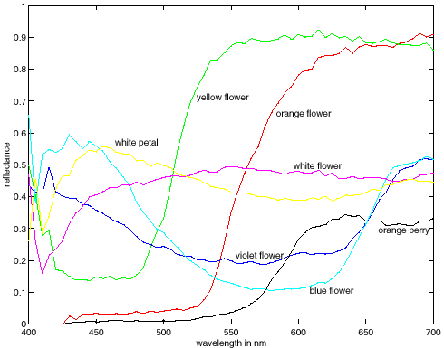
More Spectra
metamers
Notes:
Metamerism can be illuminant based or observer based. Color blindness produced well known instances of metamerism.

Slide 40
Multispectral / Hyperspectral Imaging
Astronomy / Earth Observation have long relied on multi-spectral imaging.

Slide 41
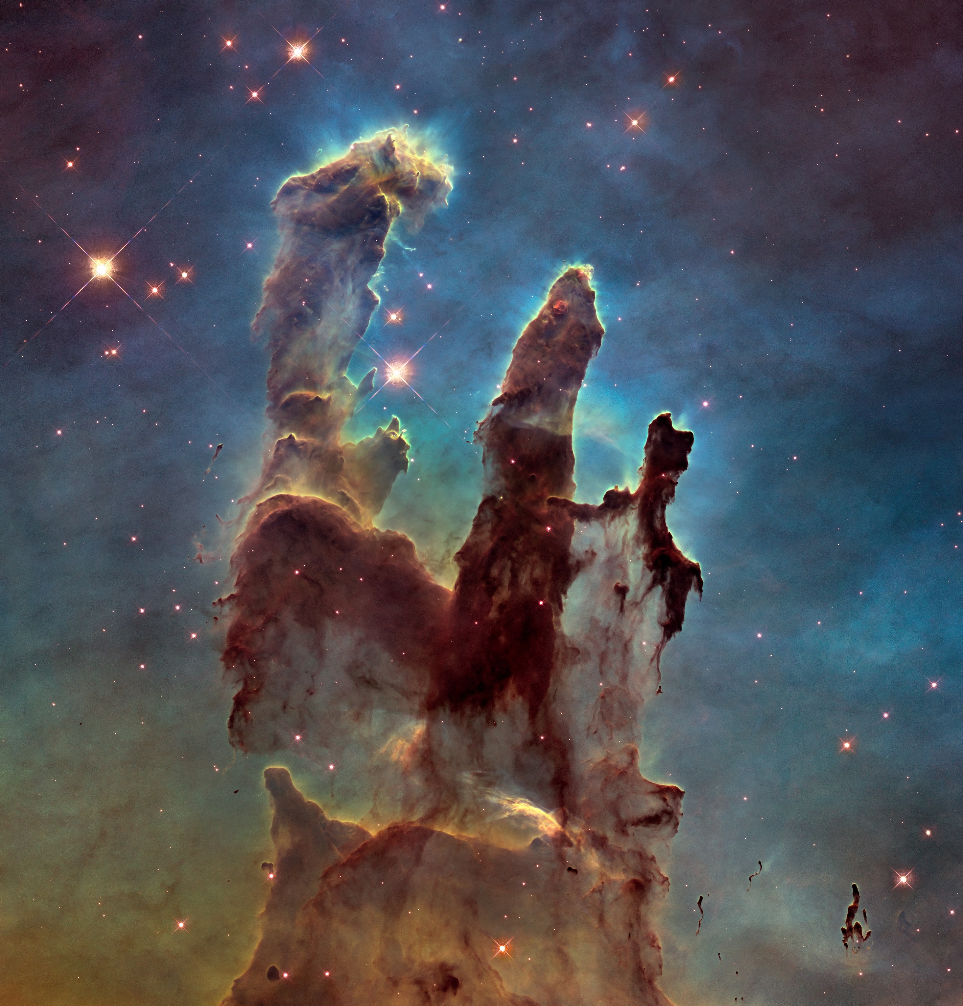
Hubble Space Telescope image of the Pillars of Creation, taken in 2014
Notes:
Hubble Space Telescope image of the Pillars of Creation, taken in 2014

Slide 42

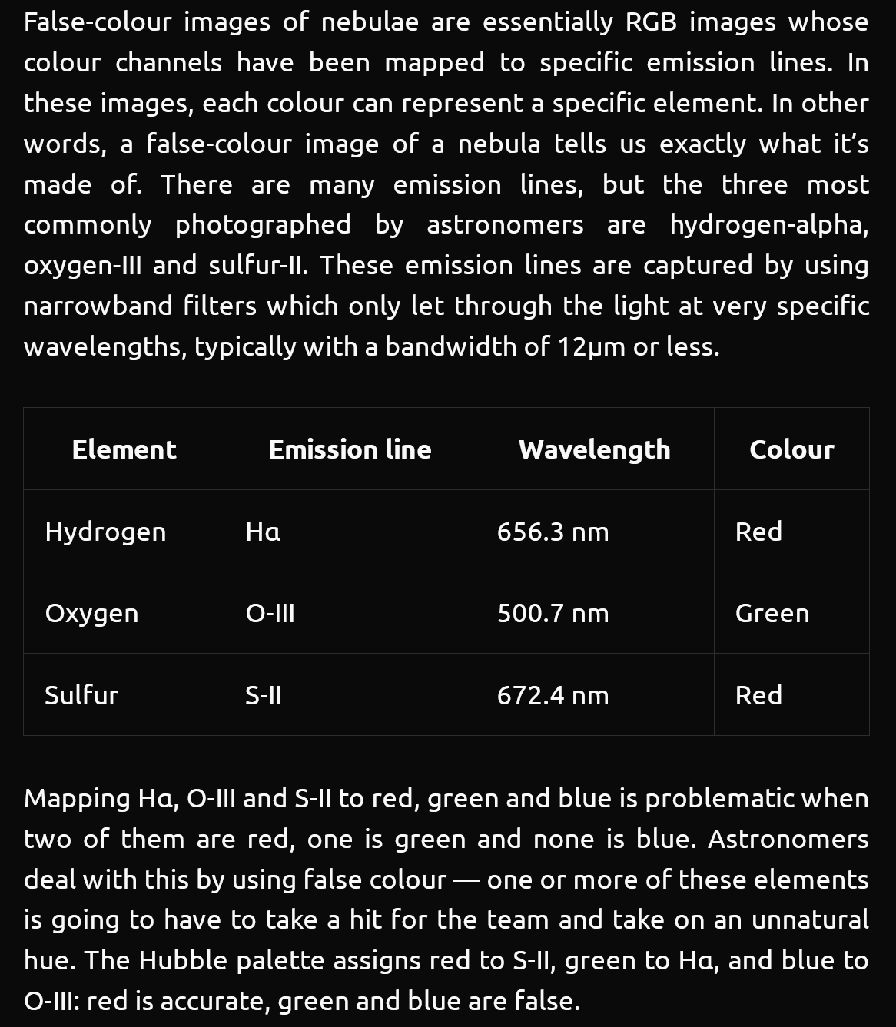
https://delsaert.com/deep-sky/nebulae/h-alpha/

Slide 43
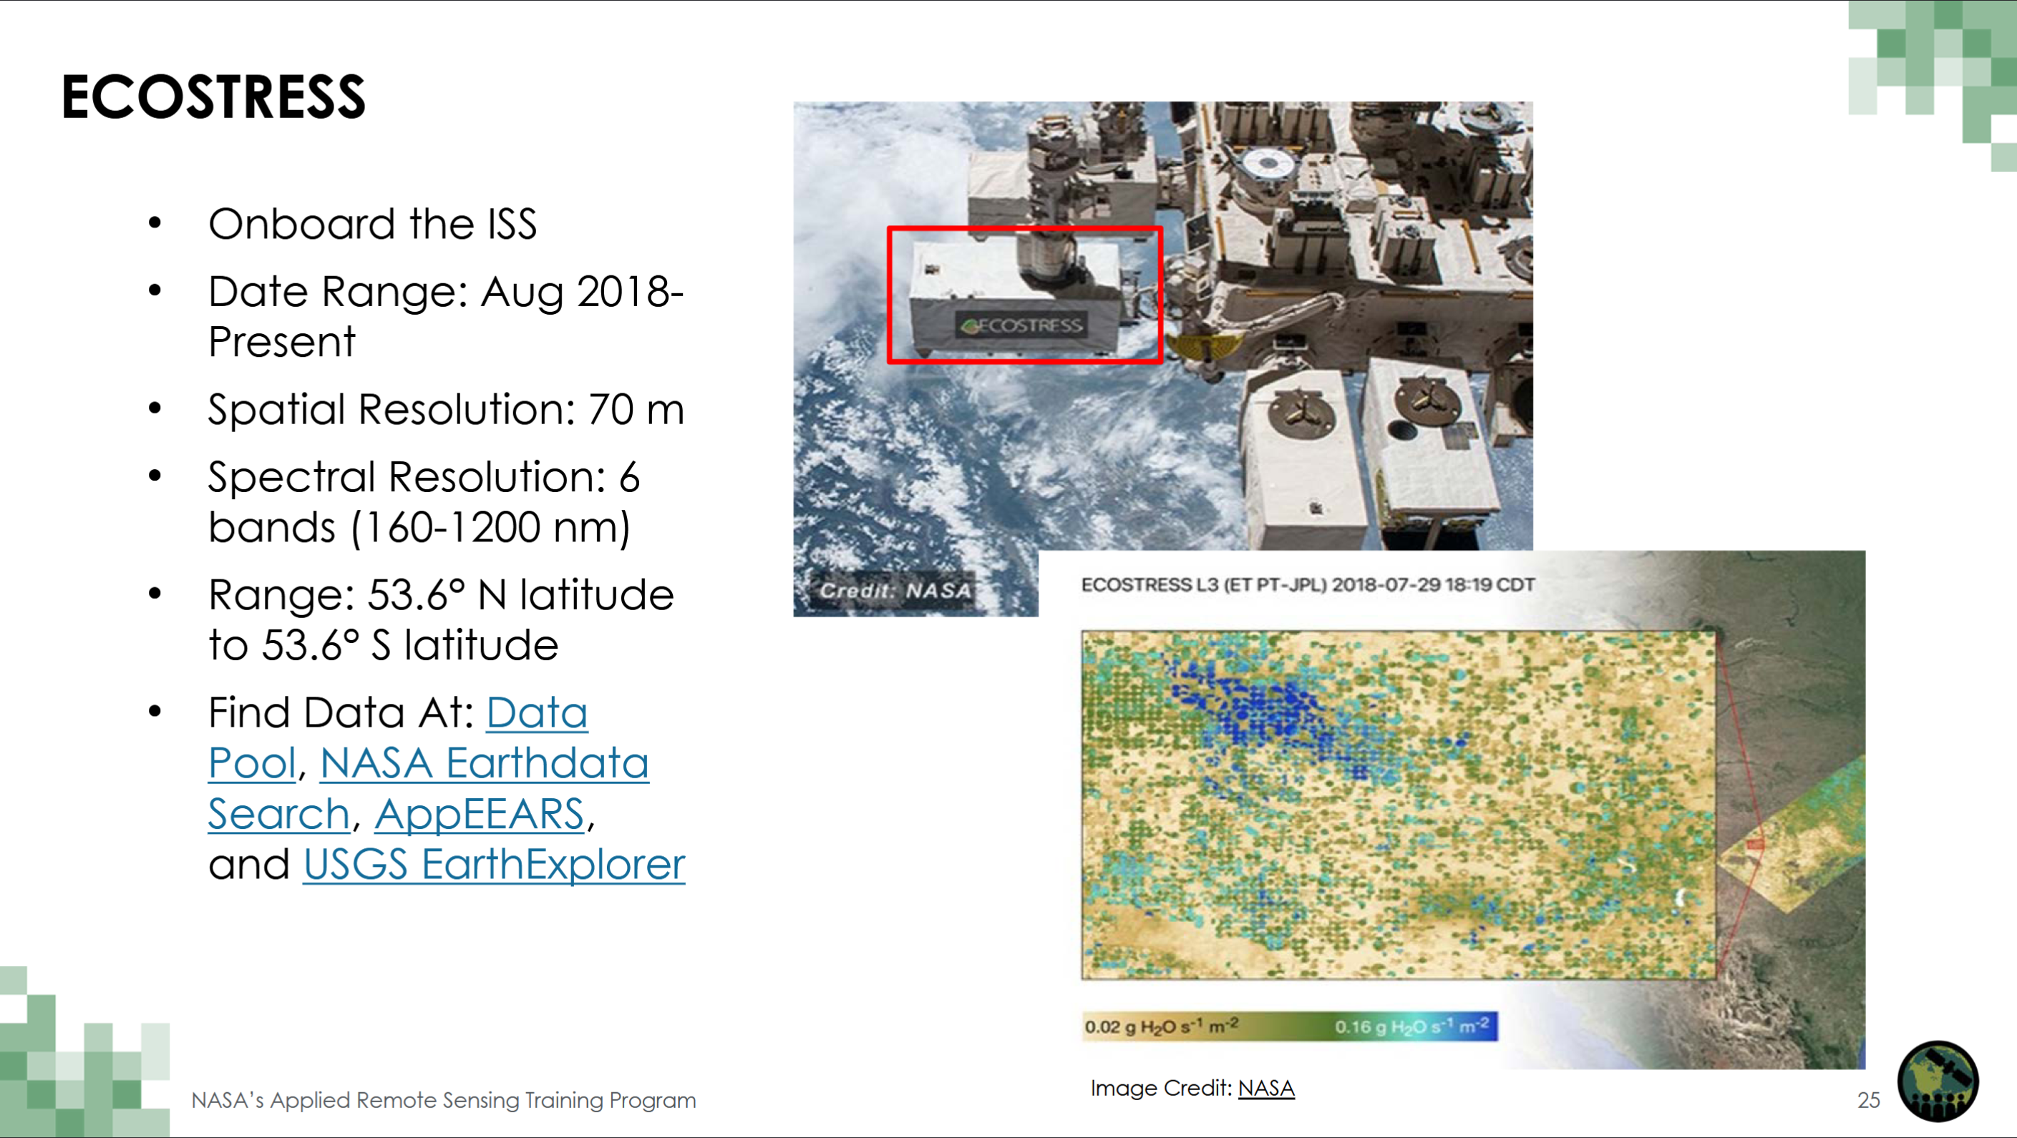

Slide 44
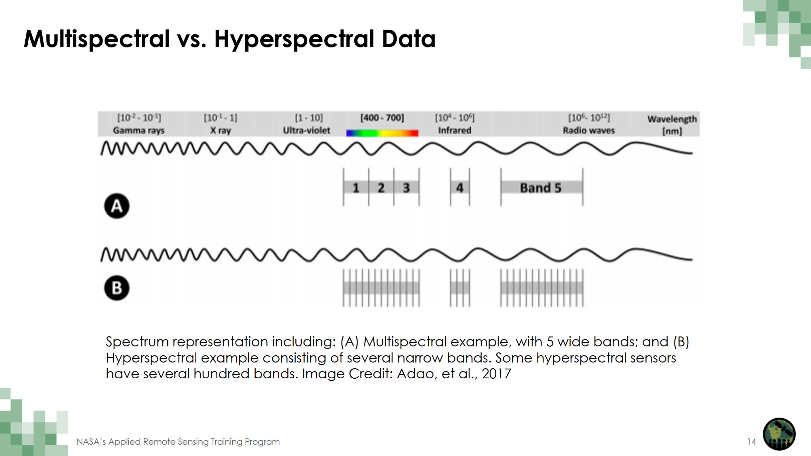

Slide 45
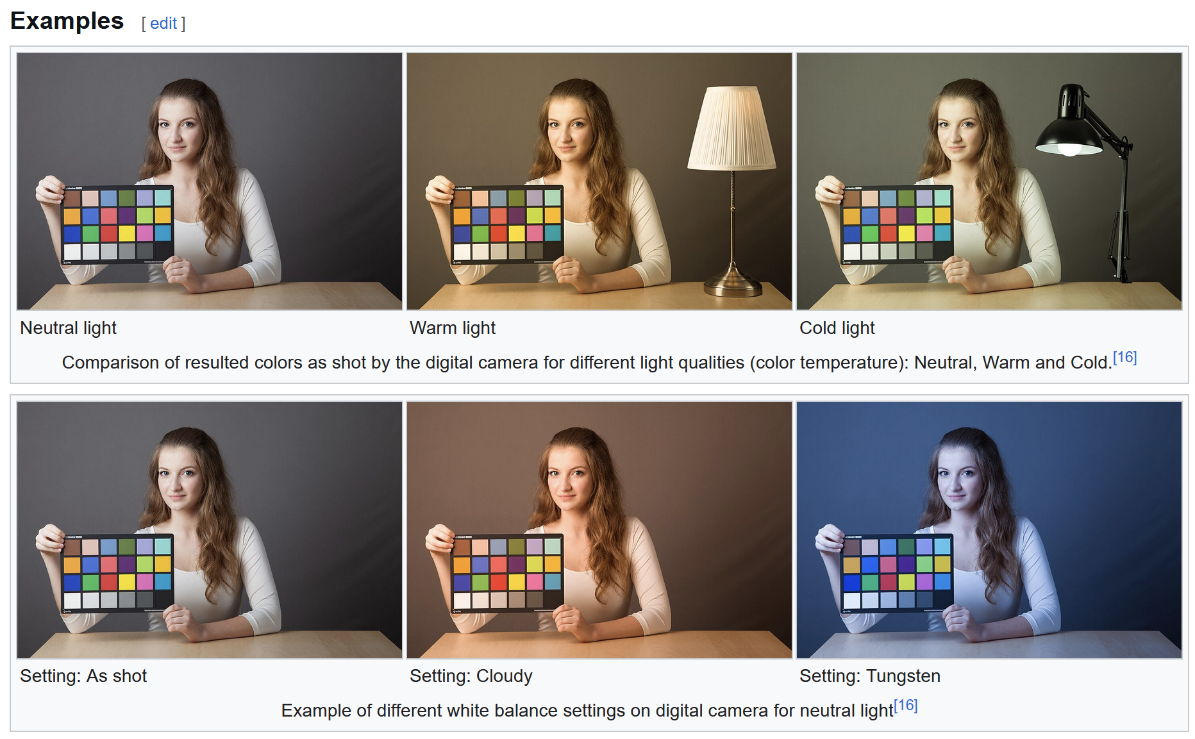
Cameras don’t faithfully capture color.
RGB don’t correspond to particular wavelengths.
Notes:
https://en.wikipedia.org/wiki/Color_balance

Slide 46
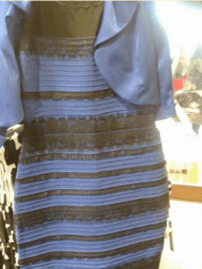
Color can be ambiguous

Slide 47
Color can be ambiguous

Slide 48
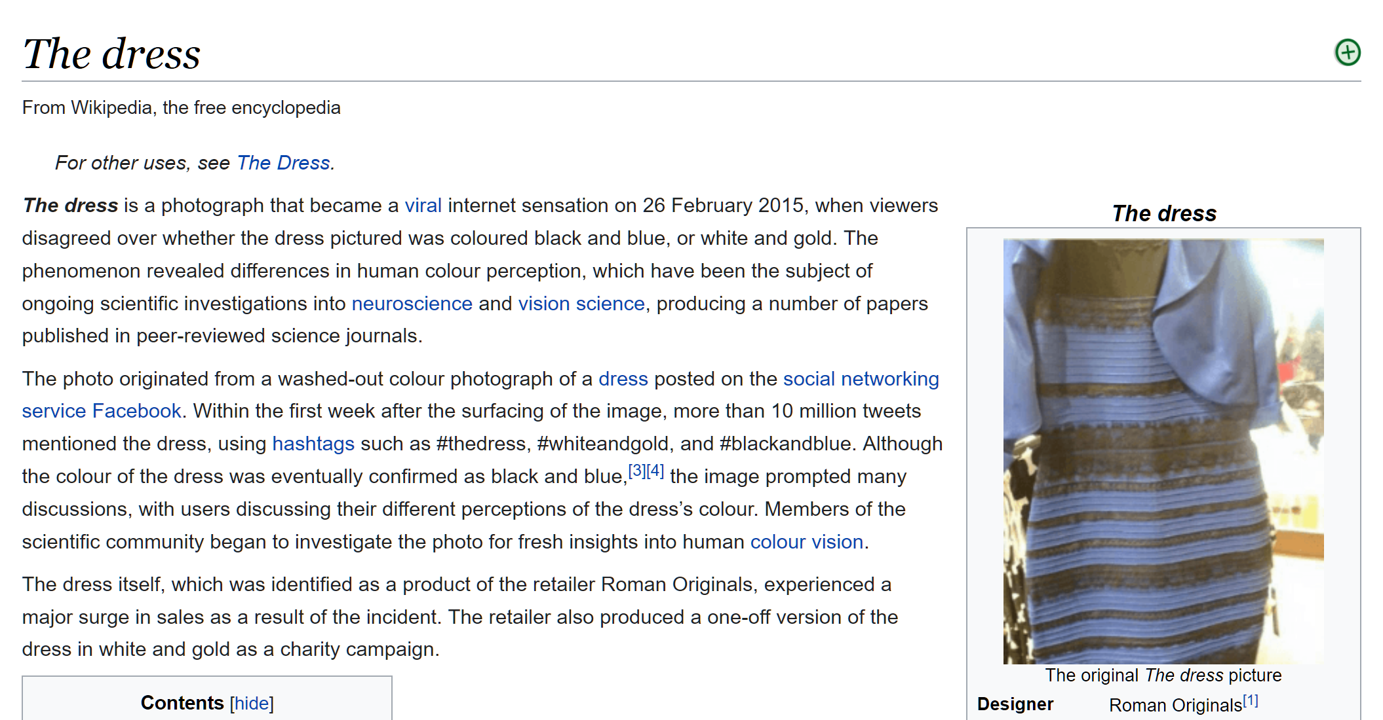
https://en.wikipedia.org/wiki/The_dress

Slide 49
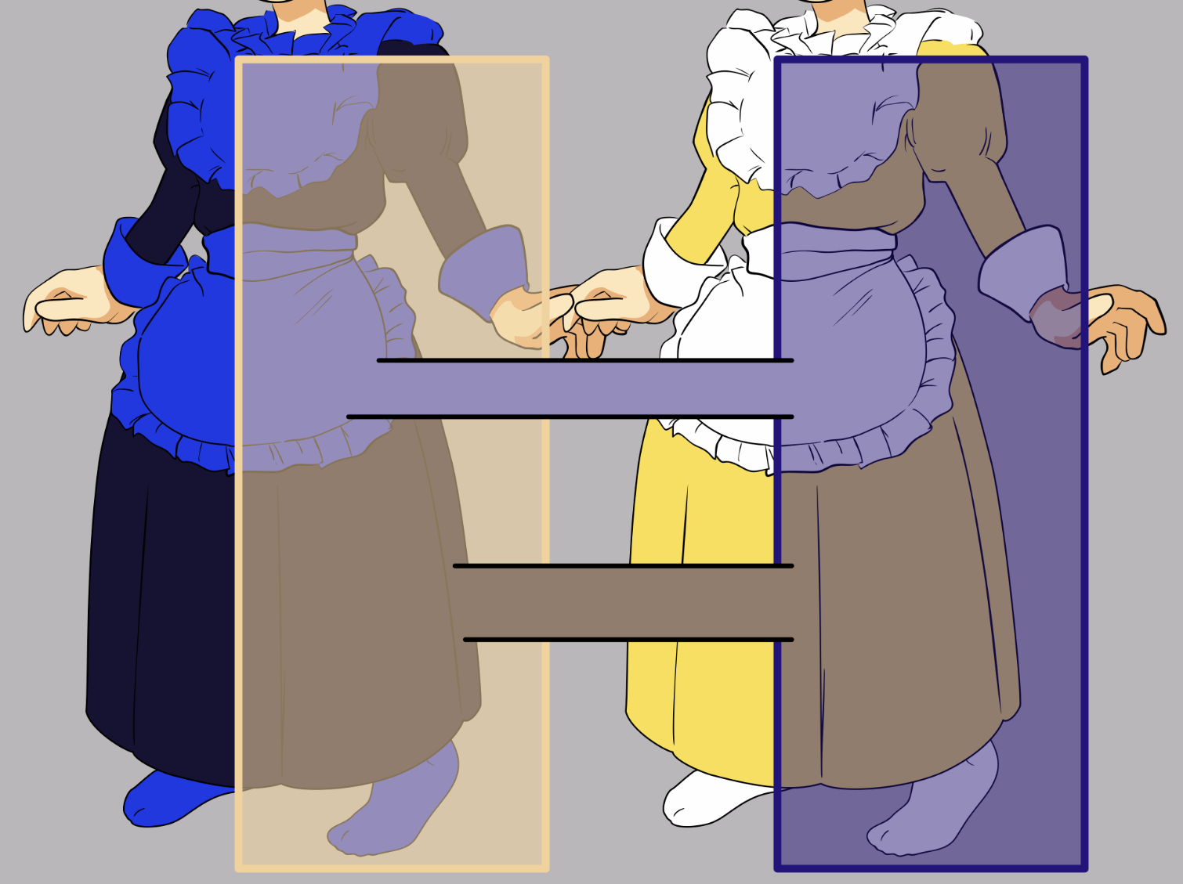
https://en.wikipedia.org/wiki/The_dress
Notes:
https://en.wikipedia.org/wiki/The_dress

Slide 50
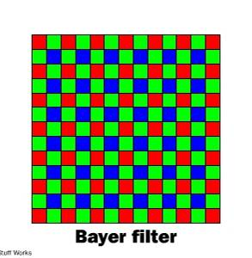
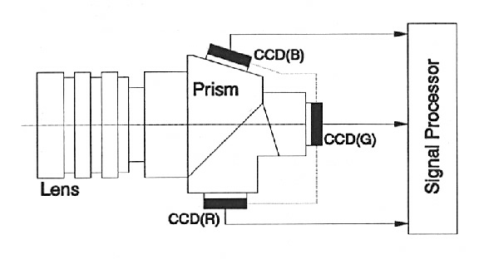
Color Sensing in Camera (RGB)
3-chip vs. 1-chip: quality vs. cost
Why more green?
Why 3 colors?
http://www.cooldictionary.com/words/Bayer-filter.wikipedia
Slide by Steve Seitz

Slide 51
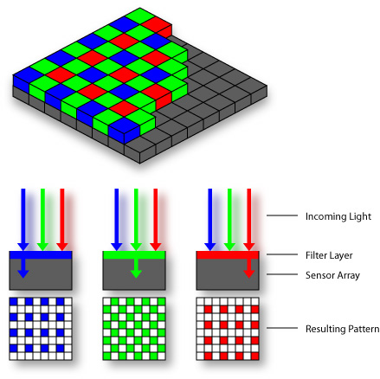

Practical Color Sensing: Bayer Grid
Estimate RGB
at ‘G’ cells from neighboring values
Slide by Steve Seitz

Slide 52
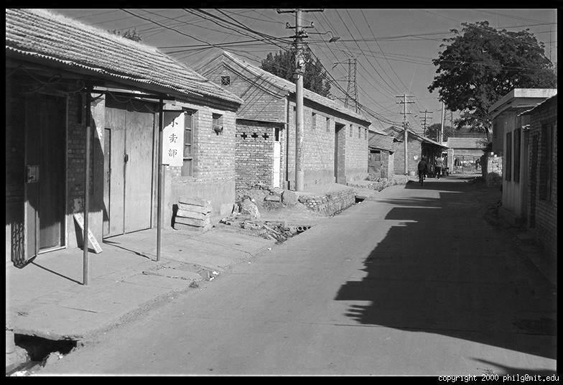
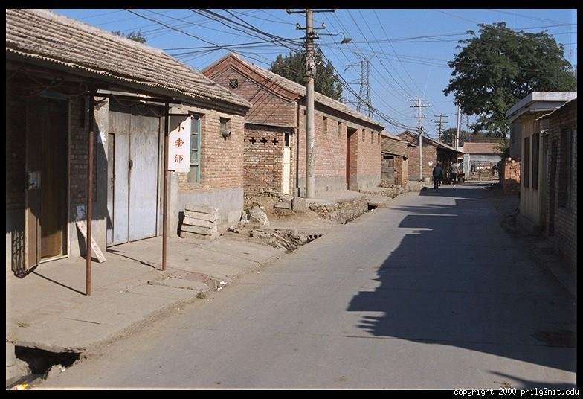
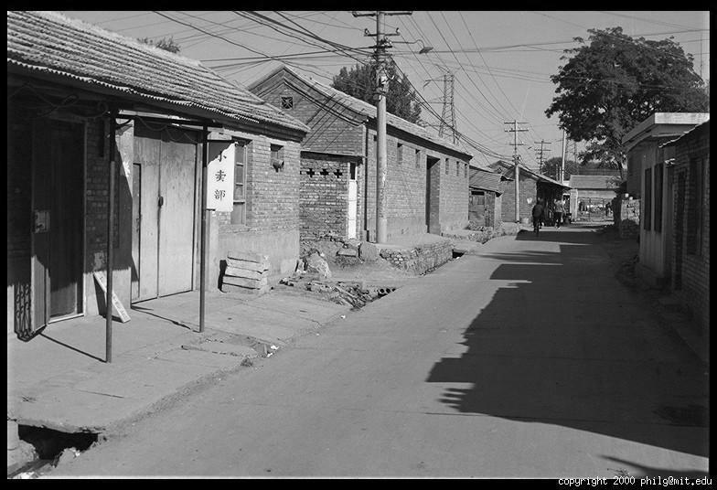

Color Image
R
G
B

Slide 53
Images in Python
Images represented as a matrix
Suppose we have a NxM RGB image called “im”
  im(0,0,0) = top-left pixel value in R-channel
  im(y, x, b) = y pixels down, x pixels to right in the b^{th} channel
  im(N-1, M-1, 2) = bottom-right pixel in B-channel
column
row
R
0.92 | 0.93 | 0.94 | 0.97 | 0.62 | 0.37 | 0.85 | 0.97 | 0.93 | 0.92 | 0.99
0.95 | 0.89 | 0.82 | 0.89 | 0.56 | 0.31 | 0.75 | 0.92 | 0.81 | 0.95 | 0.91
0.89 | 0.72 | 0.51 | 0.55 | 0.51 | 0.42 | 0.57 | 0.41 | 0.49 | 0.91 | 0.92
0.96 | 0.95 | 0.88 | 0.94 | 0.56 | 0.46 | 0.91 | 0.87 | 0.90 | 0.97 | 0.95
0.71 | 0.81 | 0.81 | 0.87 | 0.57 | 0.37 | 0.80 | 0.88 | 0.89 | 0.79 | 0.85
0.49 | 0.62 | 0.60 | 0.58 | 0.50 | 0.60 | 0.58 | 0.50 | 0.61 | 0.45 | 0.33
0.86 | 0.84 | 0.74 | 0.58 | 0.51 | 0.39 | 0.73 | 0.92 | 0.91 | 0.49 | 0.74
0.96 | 0.67 | 0.54 | 0.85 | 0.48 | 0.37 | 0.88 | 0.90 | 0.94 | 0.82 | 0.93
0.69 | 0.49 | 0.56 | 0.66 | 0.43 | 0.42 | 0.77 | 0.73 | 0.71 | 0.90 | 0.99
0.79 | 0.73 | 0.90 | 0.67 | 0.33 | 0.61 | 0.69 | 0.79 | 0.73 | 0.93 | 0.97
0.91 | 0.94 | 0.89 | 0.49 | 0.41 | 0.78 | 0.78 | 0.77 | 0.89 | 0.99 | 0.93
G
0.92 | 0.93 | 0.94 | 0.97 | 0.62 | 0.37 | 0.85 | 0.97 | 0.93 | 0.92 | 0.99
0.95 | 0.89 | 0.82 | 0.89 | 0.56 | 0.31 | 0.75 | 0.92 | 0.81 | 0.95 | 0.91
0.89 | 0.72 | 0.51 | 0.55 | 0.51 | 0.42 | 0.57 | 0.41 | 0.49 | 0.91 | 0.92
0.96 | 0.95 | 0.88 | 0.94 | 0.56 | 0.46 | 0.91 | 0.87 | 0.90 | 0.97 | 0.95
0.71 | 0.81 | 0.81 | 0.87 | 0.57 | 0.37 | 0.80 | 0.88 | 0.89 | 0.79 | 0.85
0.49 | 0.62 | 0.60 | 0.58 | 0.50 | 0.60 | 0.58 | 0.50 | 0.61 | 0.45 | 0.33
0.86 | 0.84 | 0.74 | 0.58 | 0.51 | 0.39 | 0.73 | 0.92 | 0.91 | 0.49 | 0.74
0.96 | 0.67 | 0.54 | 0.85 | 0.48 | 0.37 | 0.88 | 0.90 | 0.94 | 0.82 | 0.93
0.69 | 0.49 | 0.56 | 0.66 | 0.43 | 0.42 | 0.77 | 0.73 | 0.71 | 0.90 | 0.99
0.79 | 0.73 | 0.90 | 0.67 | 0.33 | 0.61 | 0.69 | 0.79 | 0.73 | 0.93 | 0.97
0.91 | 0.94 | 0.89 | 0.49 | 0.41 | 0.78 | 0.78 | 0.77 | 0.89 | 0.99 | 0.93
B
0.92 | 0.93 | 0.94 | 0.97 | 0.62 | 0.37 | 0.85 | 0.97 | 0.93 | 0.92 | 0.99
0.95 | 0.89 | 0.82 | 0.89 | 0.56 | 0.31 | 0.75 | 0.92 | 0.81 | 0.95 | 0.91
0.89 | 0.72 | 0.51 | 0.55 | 0.51 | 0.42 | 0.57 | 0.41 | 0.49 | 0.91 | 0.92
0.96 | 0.95 | 0.88 | 0.94 | 0.56 | 0.46 | 0.91 | 0.87 | 0.90 | 0.97 | 0.95
0.71 | 0.81 | 0.81 | 0.87 | 0.57 | 0.37 | 0.80 | 0.88 | 0.89 | 0.79 | 0.85
0.49 | 0.62 | 0.60 | 0.58 | 0.50 | 0.60 | 0.58 | 0.50 | 0.61 | 0.45 | 0.33
0.86 | 0.84 | 0.74 | 0.58 | 0.51 | 0.39 | 0.73 | 0.92 | 0.91 | 0.49 | 0.74
0.96 | 0.67 | 0.54 | 0.85 | 0.48 | 0.37 | 0.88 | 0.90 | 0.94 | 0.82 | 0.93
0.69 | 0.49 | 0.56 | 0.66 | 0.43 | 0.42 | 0.77 | 0.73 | 0.71 | 0.90 | 0.99
0.79 | 0.73 | 0.90 | 0.67 | 0.33 | 0.61 | 0.69 | 0.79 | 0.73 | 0.93 | 0.97
0.91 | 0.94 | 0.89 | 0.49 | 0.41 | 0.78 | 0.78 | 0.77 | 0.89 | 0.99 | 0.93

Slide 54

Color spaces
Are there other ways to encode color beyond R, G, B?
http://en.wikipedia.org/wiki/File:RGB_illumination.jpg

Slide 55





Color spaces: RGB
Default color space
0,1,0
R
(G=0,B=0)
1,0,0
G
(R=0,B=0)
0,0,1
B
(R=0,G=0)
Some drawbacks
Strongly correlated channels
Non-perceptual
Image from: http://en.wikipedia.org/wiki/File:RGB_color_solid_cube.png

Slide 56




Color spaces: HSV
Intuitive color space
H
(S=1,V=1)
S
(H=1,V=1)
V
(H=1,S=0)

Slide 57






Color spaces: YCbCr
Fast to compute, good for compression, used by TV
Y=0
Y=0.5
Y
(Cb=0.5,Cr=0.5)
Cr
Cb
(Y=0.5,Cr=0.5)
Cb
Y=1
Cr
(Y=0.5,Cb=05)

Slide 58




Color spaces: L*a*b*
“Perceptually uniform”* color space
L
(a=0,b=0)
a
(L=65,b=0)
b
(L=65,a=0)

Slide 59
If you had to choose, would you rather go without luminance or chrominance?

Slide 60
If you had to choose, would you rather go without luminance or chrominance?

Slide 61

Most information in intensity
Only color shown – constant intensity

Slide 62

Most information in intensity
Only intensity shown – constant color

Slide 63
Most information in intensity
Original image

Slide 64

Back to grayscale intensity
0.92 | 0.93 | 0.94 | 0.97 | 0.62 | 0.37 | 0.85 | 0.97 | 0.93 | 0.92 | 0.99
0.95 | 0.89 | 0.82 | 0.89 | 0.56 | 0.31 | 0.75 | 0.92 | 0.81 | 0.95 | 0.91
0.89 | 0.72 | 0.51 | 0.55 | 0.51 | 0.42 | 0.57 | 0.41 | 0.49 | 0.91 | 0.92
0.96 | 0.95 | 0.88 | 0.94 | 0.56 | 0.46 | 0.91 | 0.87 | 0.90 | 0.97 | 0.95
0.71 | 0.81 | 0.81 | 0.87 | 0.57 | 0.37 | 0.80 | 0.88 | 0.89 | 0.79 | 0.85
0.49 | 0.62 | 0.60 | 0.58 | 0.50 | 0.60 | 0.58 | 0.50 | 0.61 | 0.45 | 0.33
0.86 | 0.84 | 0.74 | 0.58 | 0.51 | 0.39 | 0.73 | 0.92 | 0.91 | 0.49 | 0.74
0.96 | 0.67 | 0.54 | 0.85 | 0.48 | 0.37 | 0.88 | 0.90 | 0.94 | 0.82 | 0.93
0.69 | 0.49 | 0.56 | 0.66 | 0.43 | 0.42 | 0.77 | 0.73 | 0.71 | 0.90 | 0.99
0.79 | 0.73 | 0.90 | 0.67 | 0.33 | 0.61 | 0.69 | 0.79 | 0.73 | 0.93 | 0.97
0.91 | 0.94 | 0.89 | 0.49 | 0.41 | 0.78 | 0.78 | 0.77 | 0.89 | 0.99 | 0.93

Slide 65
Wrap up: Why do we care about cameras vs eyes?
Notes:
December 6th, 2021 New York Times

Slide 66
Notes:
December 6th, 2021 New York Times

Slide 68


Slide 69

Another driving system with human level eyesight
https://www.youtube.com/watch?v=5fvsItXYgzk

Slide 70


Slide 71

https://twitter.com/JordanTeslaTech/status/1418413307862585344

Slide 72

https://www.reddit.com/r/teslamotors/comments/nrs8kf/you_think_ice_cream_truck_stop_signs_are_a_problem/

Slide 73
On the whole, cameras are a reasonable analogy for eyes. They do capture sufficient information for safe driving 99.9% of the time.

Slide 74

https://www.youtube.com/watch?v=s1eTBMYEs-Y
Notes:
But maybe some cameras don’t have enough dynamic range at the moment

Slide 75
On the whole, cameras are a reasonable analogy for eyes. They do capture sufficient information for safe driving 99.9% of the time.
  Imagine remote controlling a vehicle based on a camera feed.
But the computer vision and machine learning methods that interpret the camera images are not yet a reasonable analogy for the human brain.
And there are outlier cases where humans must do more than just passively perceive from a single fixed viewpoint.

Slide 76
Next: Interest points and corners
Slides: Hoiem, Efros, and others

